Slide 1

Creating and Developing a New Diamond Open Access Journal. The Example of CMC - Circular Materials and Chemistry
Open Access Belgium
International Open Access Week
J. Dumont
24-10-2025

Slide 2


Project FWB COARA
Diamond Open Access
CMC - Methodology – Choices – Realisations

Slide 3
1. Project FWB COARA

Slide 4

1. Project FWB COARA
COARA – Coalition for Advancing Research Assessment – EU initiative
FWB COARA – interuniversity project: reform research assessment – End 30 June 2025
5 Work Packages
WP1 – New rules of research assessment (UCL)
WP2 – Open Data and Open Access (ULiège)
WP3 – Scientific Ethics (ULB)
WP4 – Scientific Integrity – Authorship, Publish or Perish (UMons)
WP5 – Career development and formation of researchers (UNamur)

Slide 5
2. Diamond Open Access

Slide 6
2. Diamond Open Access – Model
Free for authors and readers – No APCs – No Subscriptions
Scientific publication model – Scientific Evaluation Criteria
Not-for-Profit Economy – No Dividends paid to Shareholders
Collaborative – Made by Researchers for Researchers
Online and Open
CC-BY Licences – Intellectual Property kept
Sustainable Business Model – Accessible to Everyone despite Economic Differences

Slide 7
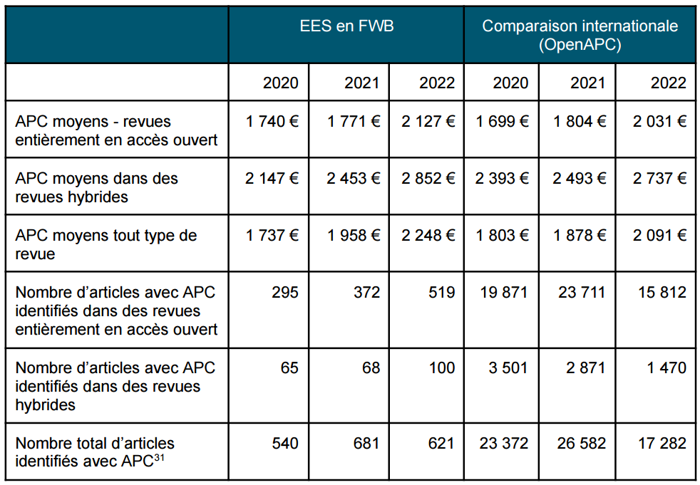
2. Diamond Open Access – APCs’ Costs
ARES, Rapport Open Access 2023 (data 2022), p. 21.

Slide 8
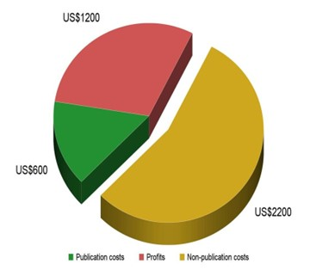
2. Diamond Open Access – APCs and dividends
A. Grossman, B. Brembs, Assessing the size of the affordability problem in scholarly publishing (2019). Copyright, Fair Use, Scholarly Communication, etc., 112, p. 493. URL : https://digitalcommons.unl.edu/scholcom/112.

Slide 9
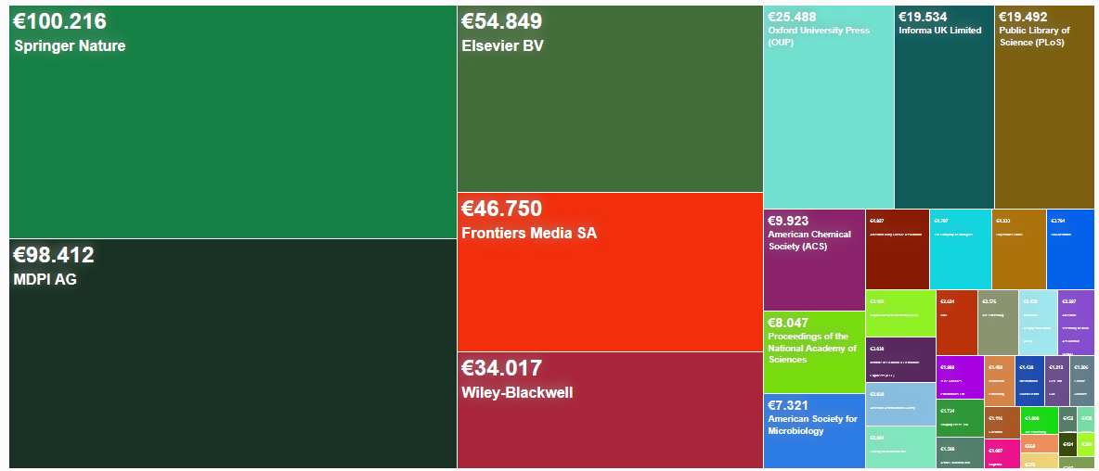
2. Diamond Open Access – APCs ULiège 2024
Total: 480 836 €
2020: 376 184 €
Open APC – U. Bielefeld

Slide 10
2. Diamond Open Access – Turning point
Diamond OA – The Future of Scientific Publishing
European Union – Council Resolution (23 May 2023) – DIAMAS Project
G7 – Sendai Summit Report (Japan, May 2023)
UNESCO – The Global Diamond OA Survey

Slide 11
3. CMC – Methodology – Choices – Realisations

Slide 12
3. CMC – Methodology
International – English
High Quality – Peer reviewed
High Level – International Research Community
Critical Mass – Importance of the Starting Size
Field – International / Filling a gap
Dissemination – High Impact Platform / Indexation Strategy
Sustainability – Journal viable beyond 15 months
Proof of Concept – Developing the Diamond Ecosystem

Slide 13
3. CMC – Choices
Circularity – How to create less impacting Materials?
Interdisciplinarity – Materials and Processes / Economy / Society
Difficulty to publish a Paper in this Field
No Important Diamond OA Journal
No Strong European Journal
Strong Starting Potential in FWB

Slide 14

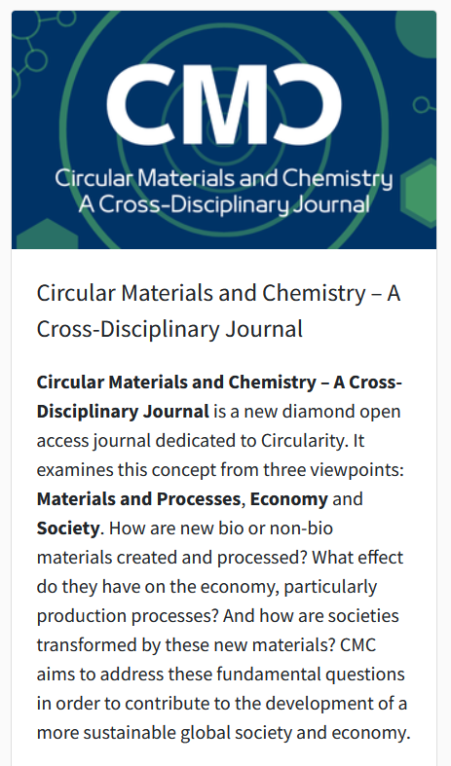

3. CMC – Realisations
https://popups.lib.uliege.be/cmc/

