Slide 1
Showcasing heritage collections and digitization projects
DONum, Alma, Primo, Archives, Cataloging
(Part II)
“Meet our Staff” Erasmus week 2025
Laurence Richelle
Systems & Data Unit
July 2025

Slide 2
Abstract
This session will present the strategies adopted by ULiège Library to enhance the visibility and distribution of our heritage collections using various tools. This includes the digitization project, the archives, manuscripts and rare books management in the LMS and the integration with the Discovery tool.

Slide 3
How to manage Heritage resources in the Library catalogue

Slide 4
Integrating DONum into the Library catalogue

Slide 5
Integrating DONum into the Library catalogue
Goals
  Provide seamless access to heritage resources
  Enhance discoverability and improve user experience
With Discovery tool considered the main access point to collections
ORBi
ULiège Library Collections
DONum
DSpace instances
MatheO

Slide 6
Integrating DONum into the Library catalogue
Public catalogue - Key milestones
  2013 – First local implementation of the Primo discovery tool
  2015 – Migration to the SaaS version with the Alma library management system
    New Primo project: hosted version
  2016 - Launch of DONum and integration into Primo via OAI-PMH harvesting
    DONum University of Liège
    DONum instances from other French-speaking universities in Belgium

Slide 7
Integrating DONum into the Library catalogue
35,000 old books records
570 incunabula
100 medieval manuscripts
=> Alma Marc21 records
Primo
Discovery tool
Not suited to the logic of archival and manuscript collections
No specific indexes or facets for heritage collections (printers, provenance…)
No matching by Primo features (no records deduplication; no frbrization)
  sometimes very confusing display
Print record and DONum record are not close together in the results display
DONum records are not included in the top-level facet “Heritage collections” created for printed resources
Publication
DONum: Several hundred digitised items
ORBi: some archive inventories (PDF documents)
=> DSpace DC records
OAI-PMH

Slide 8
Integrating DONum into the Library catalogue
Public catalogue - Key milestones
  2018-2019 Primo VE project
An opportunity to
    Rethink how DONum is harvested
    Analyse Alma Digital Component
    Analyse and implement the Collection Discovery feature
    Enhance the visibility of Heritage collections

Slide 9
Integrating DONum into the Library catalogue
Rethink how DONum is harvested
  What are the OAI-PMH export capabilities on the DONum side?
    Different sets by Institution
    Set for Liège University
      Subsets by type of document
Drawings
Letters
Fossils
Objects
Photographs
Paintings
Visual works
Broadsides
Incunabula
Journals
Printed Books
Manuscripts
Maps
Library’s materials
Primo VE harvesting => Discovery Import Profile
Add Digital inventory into Alma =>
Configuration of a Remote Digital Repository

Slide 10
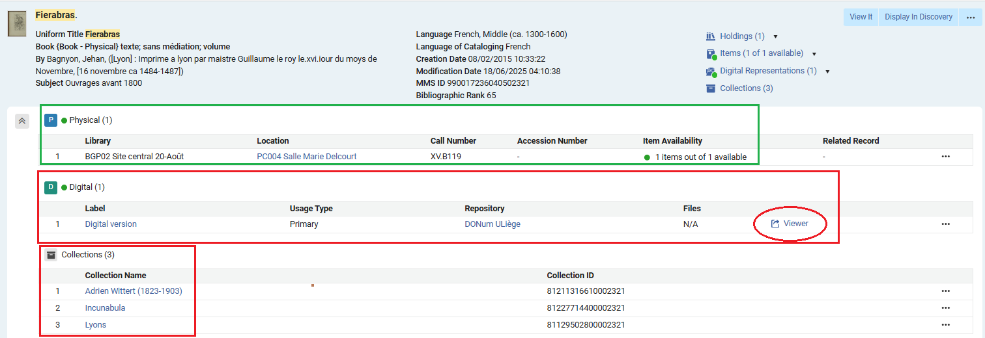
Integrating DONum into the Library catalogue
Alma Digital Component
  Digital inventory added to the ‘physical item’ bibliographic record (against RDA rules, but easily separable)
Associate with an Alma Collection
Operator just adds the original system ID
Opens DONum public interface in a new tab

Slide 11
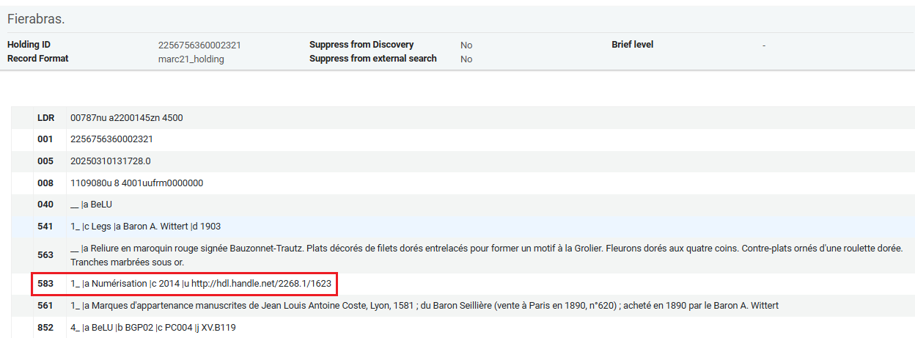
Integrating DONum into the Library catalogue
Record the preservation action in Holding of physical item
  No functional role - Action note Marc21 583 field:

Slide 12
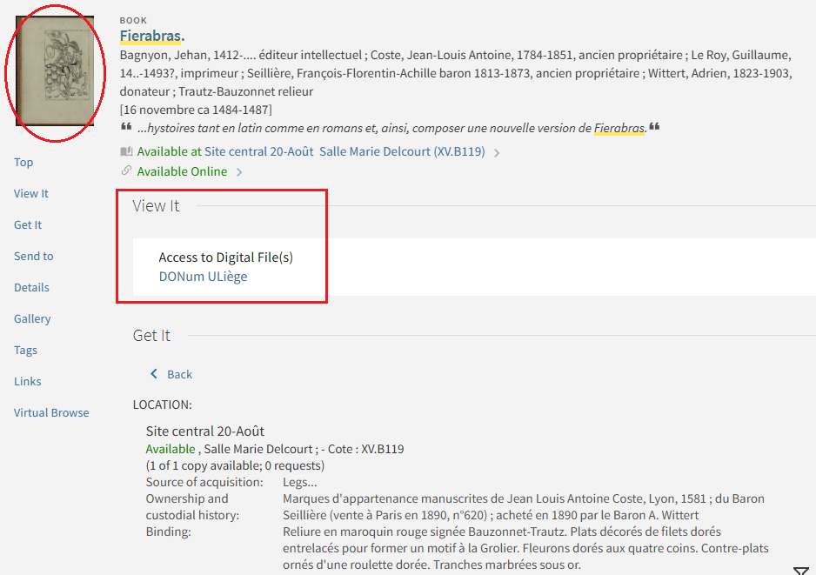
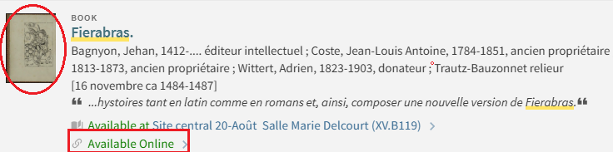
Integrating DONum into the Library catalogue
A single record for both physical and digital – improved user experience
Different linking parameter for the thumbnail and for the representation

Slide 13
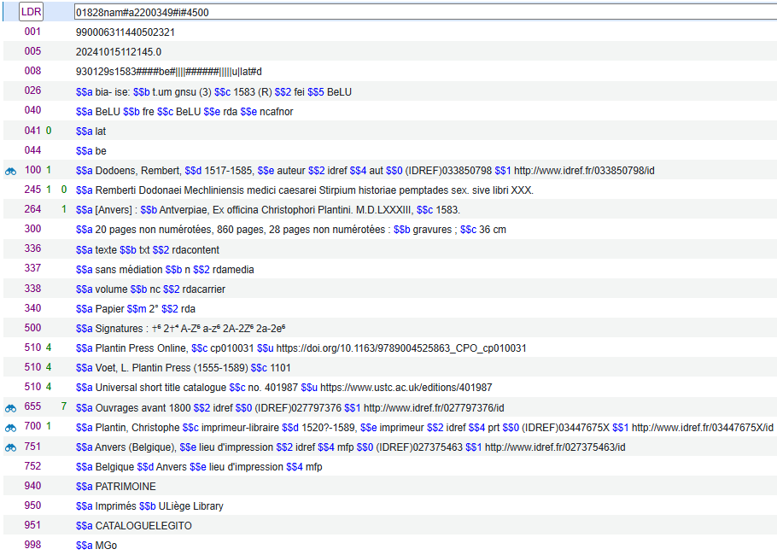
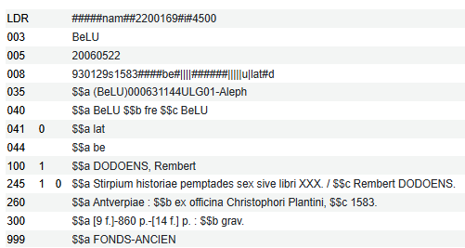
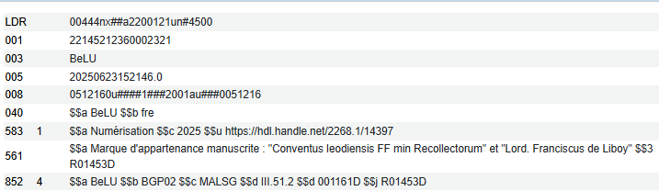
Integrating DONum into the Library catalogue
Quality of the metadata
  All digitised resources must have valid and enriched metadata in Alma
Controlled headings;
Printing information and physical description revised;
Fingerprint and Signatures;
References;
Binding, Action note, Provenance information…

Slide 14
Integrating DONum into the Library catalogue
But it’s not as perfect as it seems
DONum descriptive metadata
  Are mainly copied from Primo record display
  Time-consuming
  Lack of precision (e.g. relations for names that exist in Marc record not provided in DONum metadata schema…)
We have a better follow-up now for occasional corrections
But nothing is done for batch corrections or improvements that could be performed in Alma

Slide 15
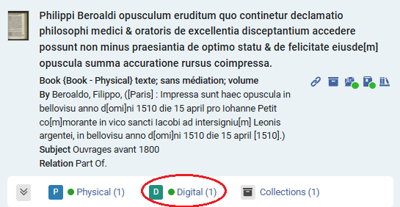
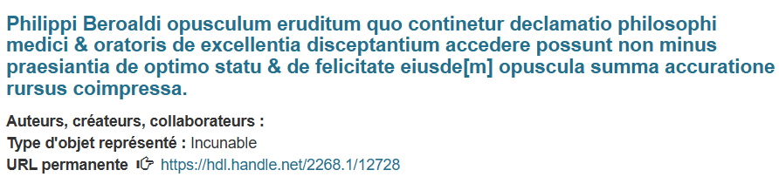
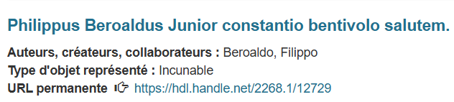
Integrating DONum into the Library catalogue
The only Alma identifier is the barcode
    No valid identifier in DONum when the digitised resource comes from a work in a bound-with volume
The Digital inventory in Alma is added manually
Bad linking for this record from a bound-with volume

Slide 16

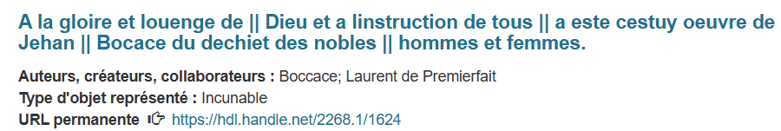

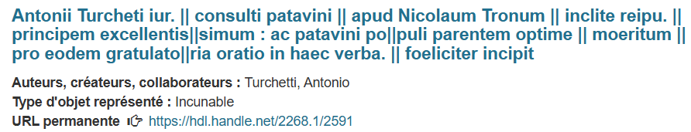
Integrating DONum into the Library catalogue
One-time action – no data update if the Alma record is modified
Cataloging tests on title proper field in Alma (in this case, not compliant with the guidelines);
Vertical bars were removed from Marc21 records during a tool change due to an indexing issue.

Slide 17
Integrating DONum into Alma - 2025-2026 Projects
  Enhance the integration of DONum with Alma and Primo VE
    Update DONum Metadata for library’s resources
=> Bulk export from Alma
Bibliographic record + Holding record + Item level
Create a publishing profile
Validate a metadata mapping
    Minimize manuel operations
      Regular import of Alma metadata into DSpace instance
=> Create a scheduled publishing profile in Alma
      Create digital inventory into Alma
Or just use Alma APIs for both operations?

Slide 18
Integrating DONum into Alma - 2025-2026 Projects
Use “Catalog” APIs allows retrieving BIB, HOL, and Item data, updating HOL records to add preservation actions, and creating or updating the digital inventory
But also other APIs as Requests, Collection update, Reminders… might be of interest

Slide 19
Archives, manuscripts & Incunabula

Slide 20
Archives, manuscripts & Incunabula
Traditionally, not described in Marc formats in libraries catalogs
  Some manuscripts are described in Marc21 format in our ILS because they needed description for a first digitisation project in 2013
  All incunabula are also described in Marc21 format in the ILS
2015-2016: A solution is needed to process this type of documents.
  The Library received an important archival collection from a family of printers
  The finding aid was to be completed and published for a conference in Liège, late 2017.
  A relatively simple encoding solution was chosen: the XML editor Oxygen made it possible to create EAD files and to set up a hierarchical tree structure appropriate for this type of resource.
  Encoding of the manuscripts also began within Oxygen at this time.

Slide 21
Archives, manuscripts & Incunabula
Main issue: How to expose this data?
  How to link this to the collections catalog?
    How to manage authority control or consider linked data integrations?
    How can the data be searched?
    How to search inside the materials?
=> Use Alma & Primo
as main access point to the different resources and tools

Slide 22
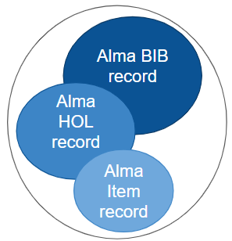
Archives, manuscripts & Incunabula
Oxygen EAD Archives
Marc21 BIB record: general description of the funds (title, extent, arrangement, archival creator, main headings linked…)
XSLT
Primo
Digital / E-Res
Marc21 HOL record: location, provenance information, etc. Action note…
Display the xml file in browser + create hierarchical tree structure
Alma Items for the physical unit that can be communicated to the user

Slide 23
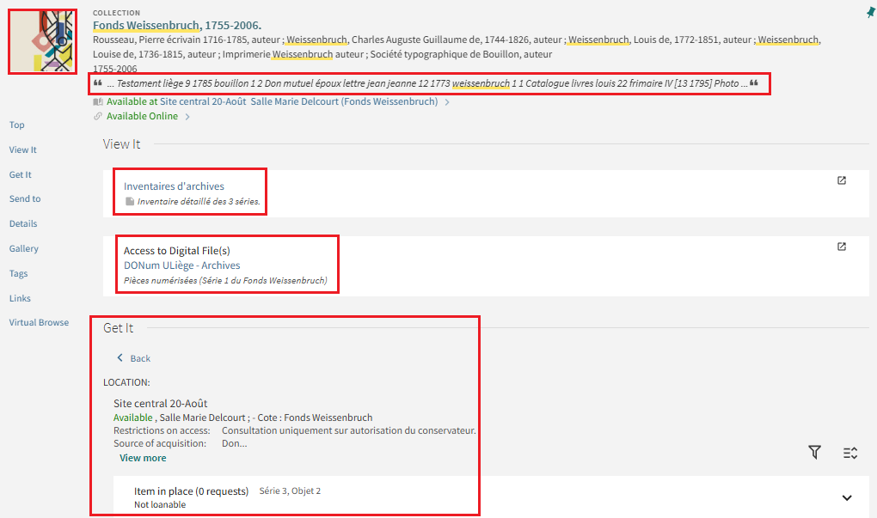
Archives, manuscripts & Incunabula
A local Marc21 field for Thumbnail
Snippet: A local Marc21 field for PrimoVE Full text indexing
Alma Electronic component to access the xml file
Alma Digital to access the digitised objects from DONum
Get It for physical Items management
Notes:
https://explore.lib.uliege.be/permalink/32ULG_INST/1iujq0/alma9919442985302321

Slide 24
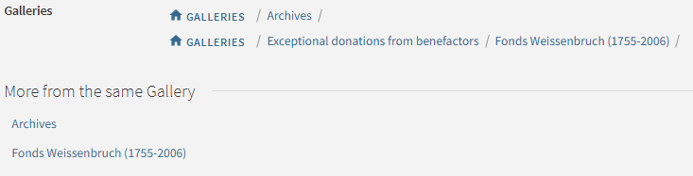
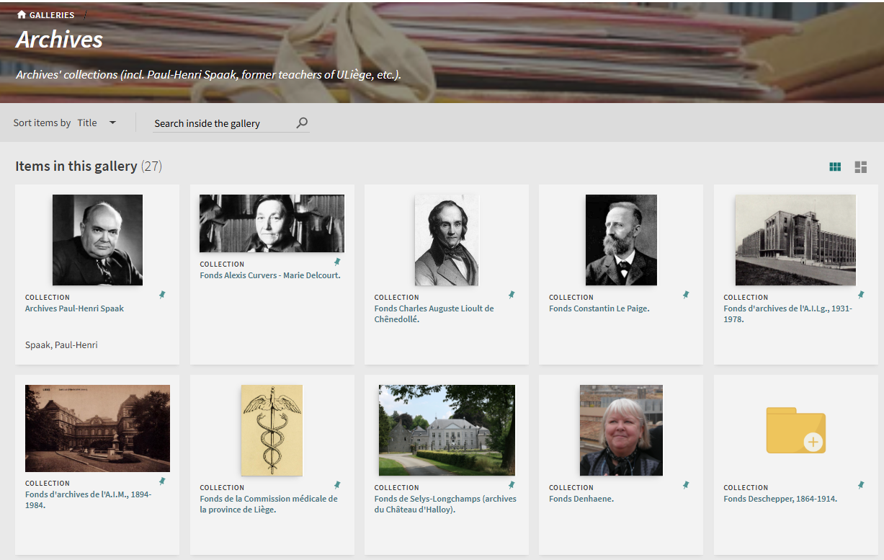
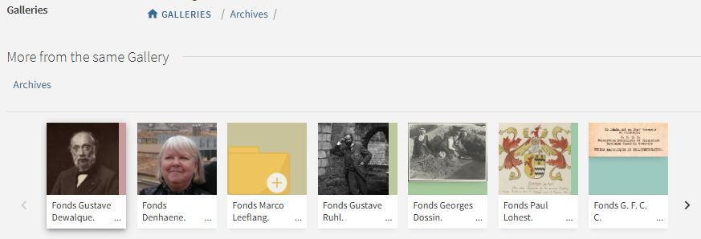
Archives, manuscripts & Incunabula
Primo full display of the record:

Slide 25
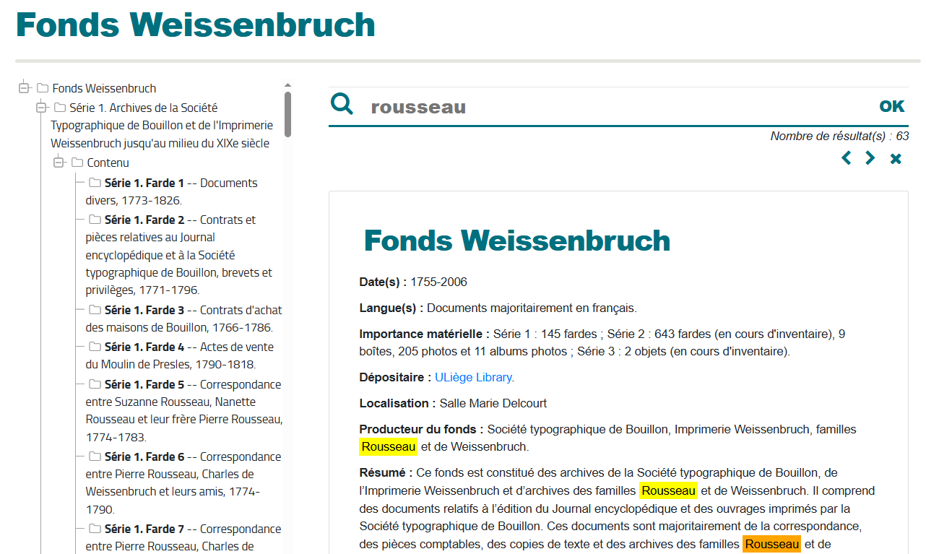
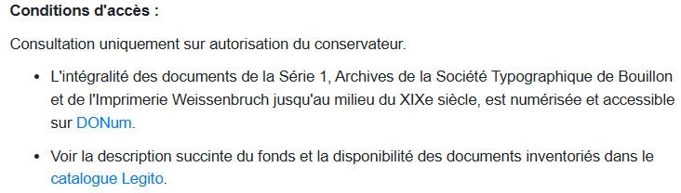
Archives, manuscripts & Incunabula
Web page with the EAD file transformed
Links to digitised materials and to Library catalog Heritage view (a separate Primo VE view)
https://app.lib.uliege.be/archives/fonds_weissenbruch.xml

Slide 26
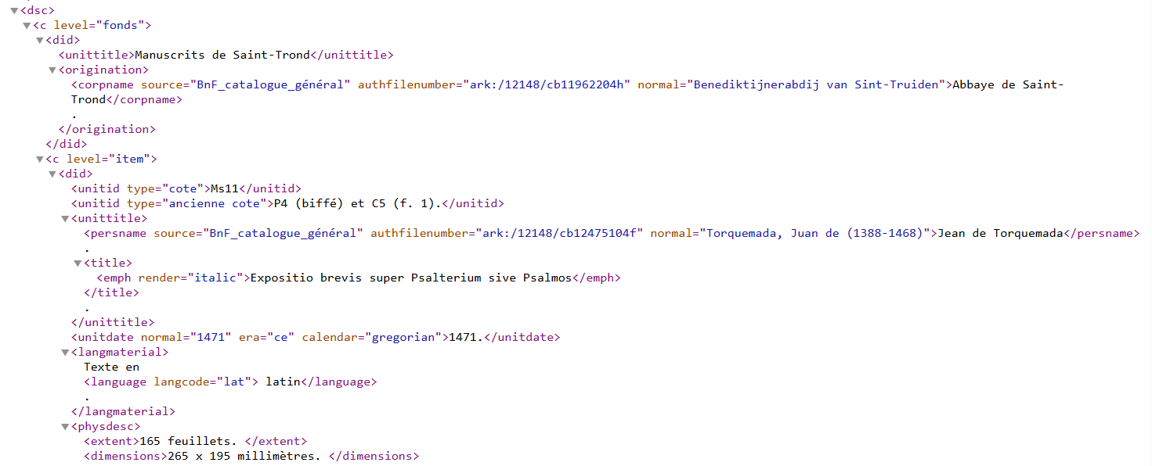
Archives, manuscripts & Incunabula
Oxygen EAD Manuscripts
Manual copying from one to the other
Precise guidelines for the mapping
Primo
No visibility

Slide 27
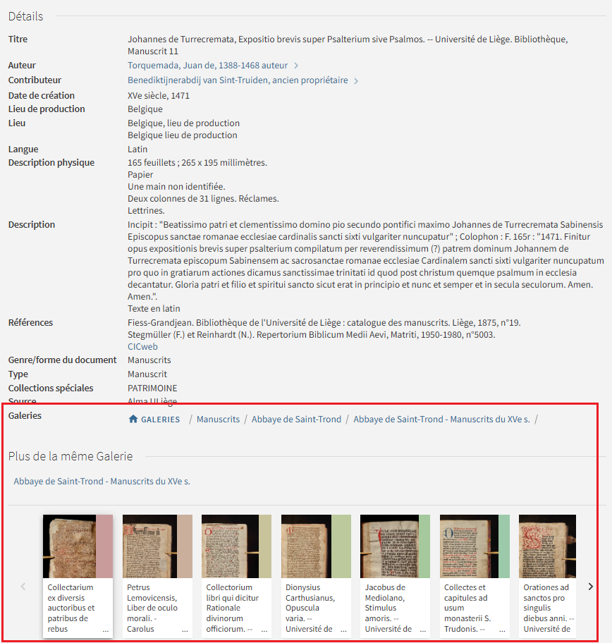
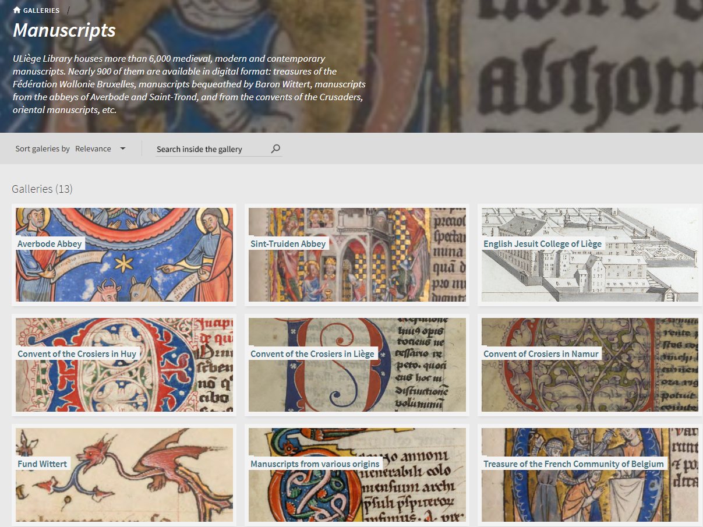
Archives, manuscripts & Incunabula
Collection Discovery with Primo VE
  Think about the structure before implementing

Slide 28
Collection Discovery (not only) for Heritage resources

Slide 29
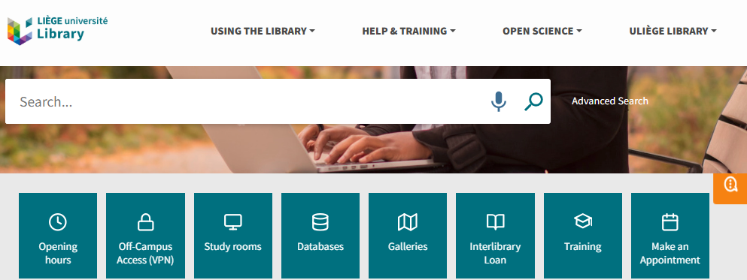
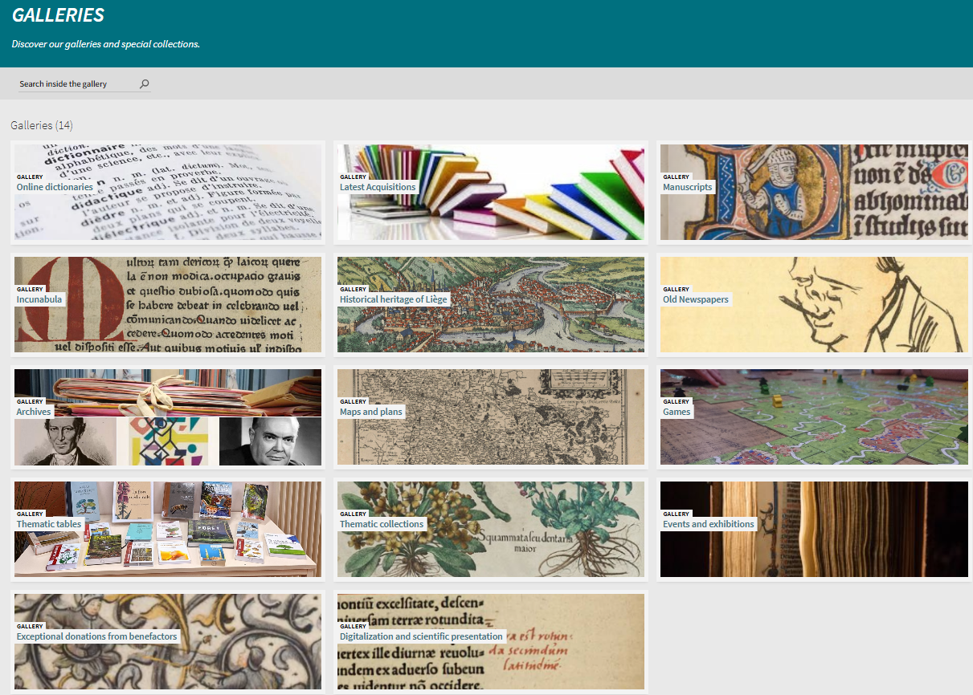
Collection Discovery (not only) for Heritage resources
A Primo feature we set up with Primo VE implementation (2019)
Heritage focus
But not only

Slide 30
Collection Discovery (not only) for Heritage resources
1st phase of analysis
  Systems administrators (2)
  Head of heritage collections
  Head of Digitisation
  Library Director
The request:
  “A formal manuscripts catalogue”
System administrators’ proposal:
  Alma/Primo Collections features
  Not limited to manuscripts
  Not limited to Heritage collections
Heritage knowledge;
Expertise in managing catalogue data;
Technical expertise;
Understanding of key challenges;
Global perspective
Cross-functional skills

Slide 31
Collection Discovery (not only) for Heritage resources
Establish a clear identity for the Collections Discovery component
  “GALLERIES - Discover our galleries and special collections”
Define the top-level collections from the start of the project
  Heritage collections: Manuscripts, Incunabula, Archives
  Thematic collections
  News (exhibitions, events)
  Basic references (online dictionaries…)
Identify collections to publish within the Collection Discovery
  and collections not to be published

Slide 32
Collection Discovery (not only) for Heritage resources
Define the hierarchical structure
  Take into account specific needs and search habits of certain user groups
    Without neglecting others (non-specialist users = Discovery-oriented vs. Manuscript Catalog-oriented)
  Consider the nature of the documents
    Manuscripts: highlight provenance or distinctive features
    Incunabula: highlight production locations
    Do not mix types: separate archival collections, cartographic documents, etc.
  Limit the hierarchy
    Avoid too many sub-collections with only one document
      But also avoid (sub-) collections with too many documents

Slide 33
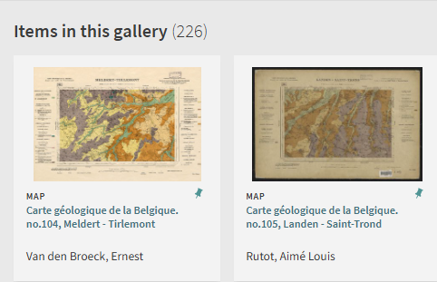
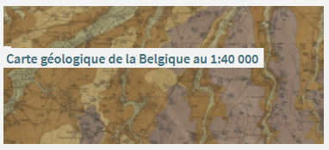
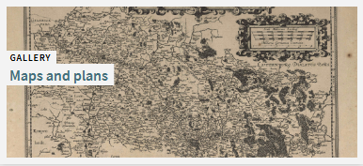
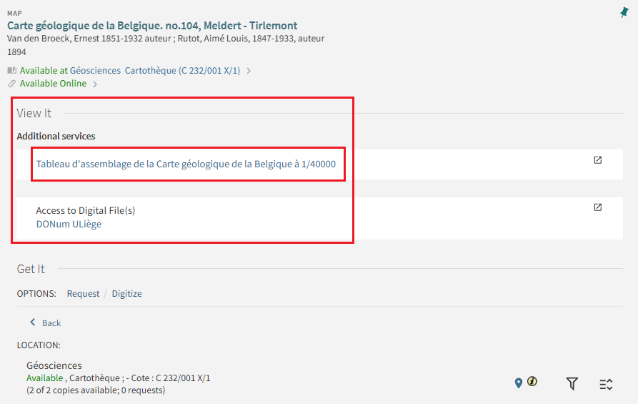
Collection Discovery (not only) for Heritage resources
Exploit the potential of Primo VE to provide useful information to specific users

Slide 34
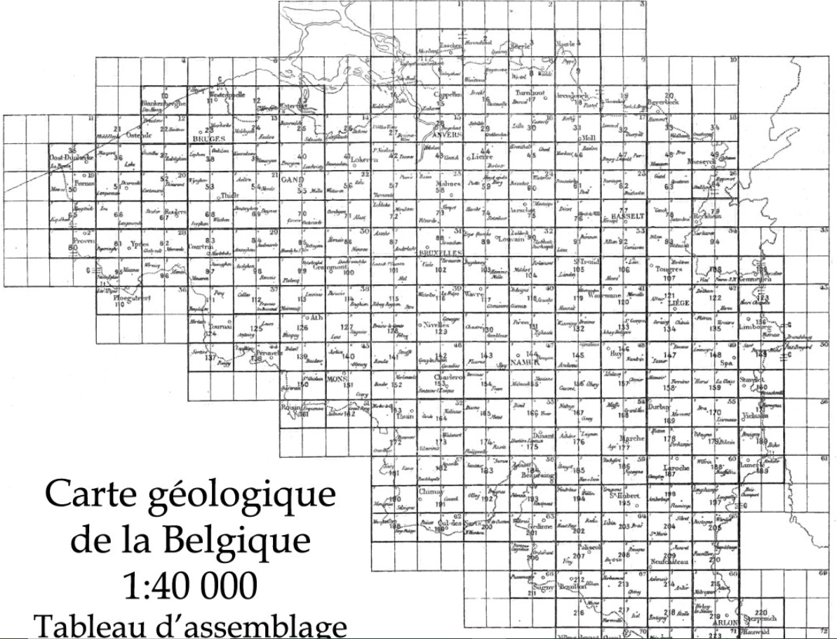
Collection Discovery (not only) for Heritage resources
Alma Holding record contains a specific Marc21 field
  This field can be displayed as a “View It” link using a Discovery setting in Primo VE configuration
Click on any square opens a new record in the catalog

Slide 35
Collection Discovery (not only) for Heritage resources
Alma Collections management
  Remember Alma search result display
A record can be linked to more than one collection

Slide 36
Collection Discovery (not only) for Heritage resources
Collection Discovery does not necessarily involve heritage digitisation
  e.g our ‘Latest Acquisitions” or “Thematic tables” Galleries
Digitisation does not necessarily involve Collection Discovery
  Many of the digitised resources are not highlighted within a Primo Gallery
    In order to create the Digital inventory in Alma, we have to link them to a non published Collection
      Around 2,500 books are part of such a collection

Slide 37
Legito: Heritage resources Primo VE View

Slide 38
Legito: Heritage resources Primo VE View
Remember: The request:
  “A formal manuscripts catalogue”
  “Archival collections should be accessible
  in the same way”
Collection Discovery just allows to set up structured display and to showcase resources
Partly met with Primo Collection Discovery feature

Slide 39
Legito: Heritage resources PrimoVE View
Solution proposed: A dedicated view for Heritage resources
Define the scope
  A subset of our printed resources catalogue
  Exclude electronic resources from Alma Community Zone (books and journals) and from the Central Discovery Index (articles)
Then, check features that don’t match the scope: Analyse Primo VE OTB configuration
  Suppress Autocomplete feature within simple search toolbar
  Suppress Virtual Browse
Is the “resource type” filter relevant to our set?
Is our main view choice of a “blended” simple search appropriate?
Which view elements (facets, links…) should be suppressed?
Can we add new search indexes and new filters?

Slide 40
Legito: Heritage resources PrimoVE View
(3) Analyse metadata
How many records have sufficient metadata?
Do we have enough in order to create specific facets or search index?
How is the quality of the descriptions?
How can we improve?
Some requests can’t be met: explain
  “Display manuscripts records based on their call numbers”
(4) Create the new configuration
Add local fields in Marc21 records
    for search scope and subsets: All, Printed materials, Manuscripts, Incunabula
Create new Primo rules for display, search and facets
  What’s the need?
    provenance information, printing places, printers, specific copy notes…
CSS changes

Slide 41
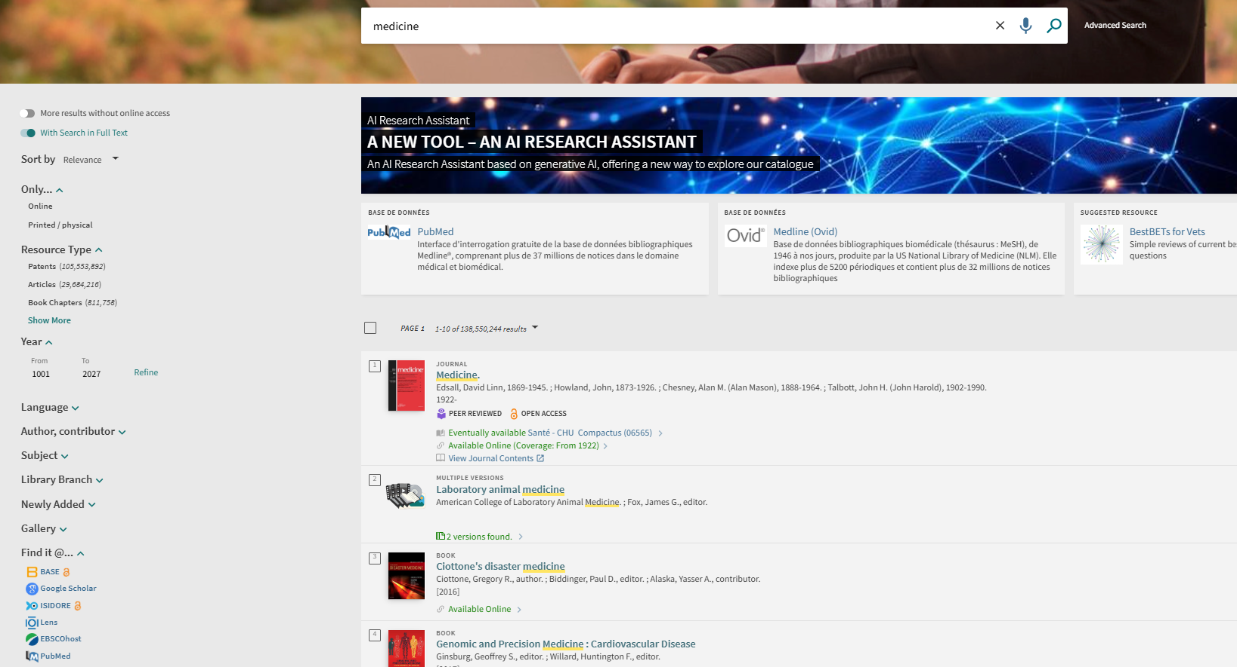
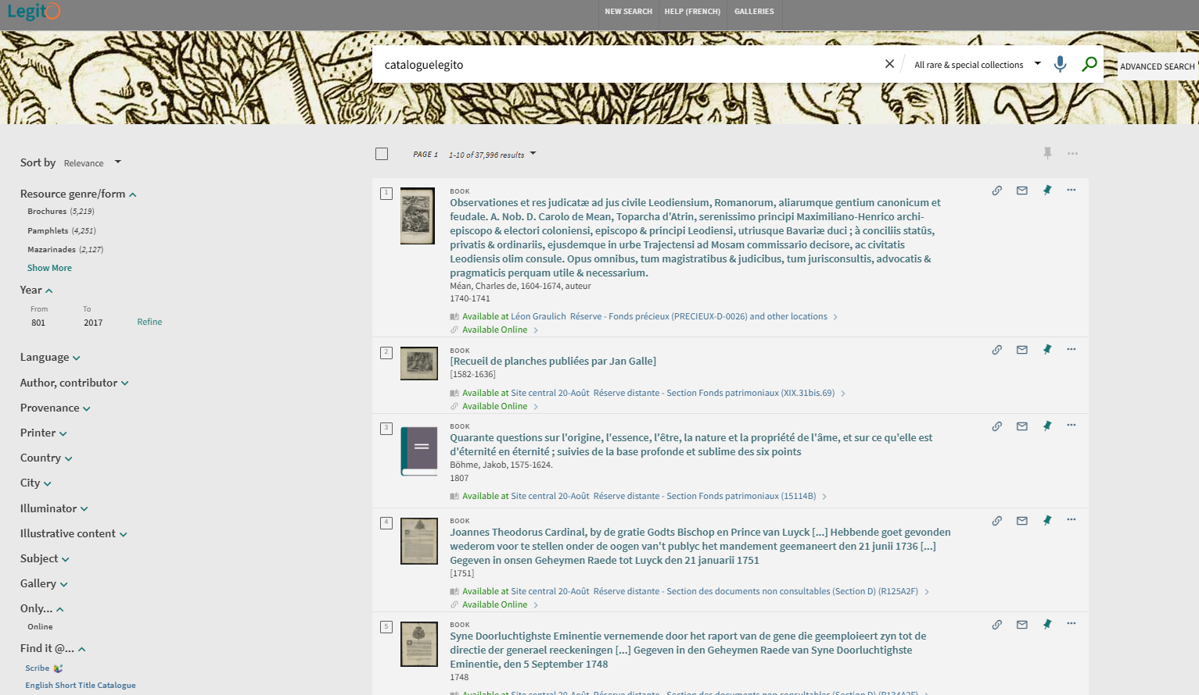
Legito: Heritage resources Primo VE View

Slide 42
Let’s think about it
Very restrictive scope: local printed resources + locally digitised
  No access to other digitised corpus (BSB, Gallica, or Gutenberg project…)
No link between the 2 Primo views
Difficult to maintain the scope
  automatically created based on publication date for monographs
  some records have to be added manually
Local search fields configuration prevents Primo capabilities with authority records
  non preferred forms can’t be searched with locally defined search indexes

Slide 43
Let’s think about it
At the time of the reflection, Primo VE configuration had some limits
  e.g. with resources types: now we can define secondary resource type
A new UX for Primo VE discovery has recently been launched by Ex Libris | Clarivate:
  We’ll probably switch to the new Primo NDE next year
  New choices are to be made: about search scopes, facets,
    Could the specific features from the Legito view be efficiently integrated into this new interface?
    We must not forget that the NDE will probably fully replace PrimoVE technology and that new features will be developed on NDE environments only.
We still have a lack for Archival collections
  Need to maintain the xml web page in order to search in the finding aid

Slide 44
Rare materials: Towards more complete metadata

Slide 45
Rare materials: Towards more complete metadata
Early 2010’s
  2 part-time catalogers dedicated to heritage collections
  1st project: cataloguing incunabula
    based on french standard for rare books
    not sufficient for a full level Marc21 record
=> Guidelines for cataloguing
  2nd project: cataloguing some medieval manuscripts
    based on printed catalogue of the Library manuscripts collection and a web site of manuscripts stored in belgian libraries
    map the description into a Marc21 record

Slide 46
Rare materials: Towards more complete metadata
2016-
  3d project
    “Weissenbruch collection” finding aid
    new tool (oxygen); learning about EAD and archival descriptions
Early 2020’s
  USTC project
    supply our pre-1700 printed books records to USTC
    around 14,000 records improved with semi-automatic procedures (Alma normalization rules, MarcEdit, OpenRefine)

Slide 47
Rare materials: Towards more complete metadata
Ongoing
  Rare printed books and serials cataloguing
  Full level descriptions
    Especially for “local” works (e.g. printed in Liège)
    Emphasis on identification (work, authors, places)
    Copy-specific informations
      but not exhaustive (e.g. no systematic description of bindings)
      provenance information recorded but not systematically identified
      …
  Retrieve catalog records with incorrect (author identification errors) or incomplete metadata (no date, or date in a inaccurate field)

Slide 48
Rare materials: Towards more complete metadata
Important to fix guidelines
  Cataloguing staff can change
  Specific uses or needs must be documented
    Can be technical for data publishing (e.g the fact we use a local Marc field to define the PrimoVE Heritage view)
    Can be intended for researchers (e.g structures in Collection Discovery)
    Always applying our own libraries standards

Slide 49


Thanks!

