Slide 2
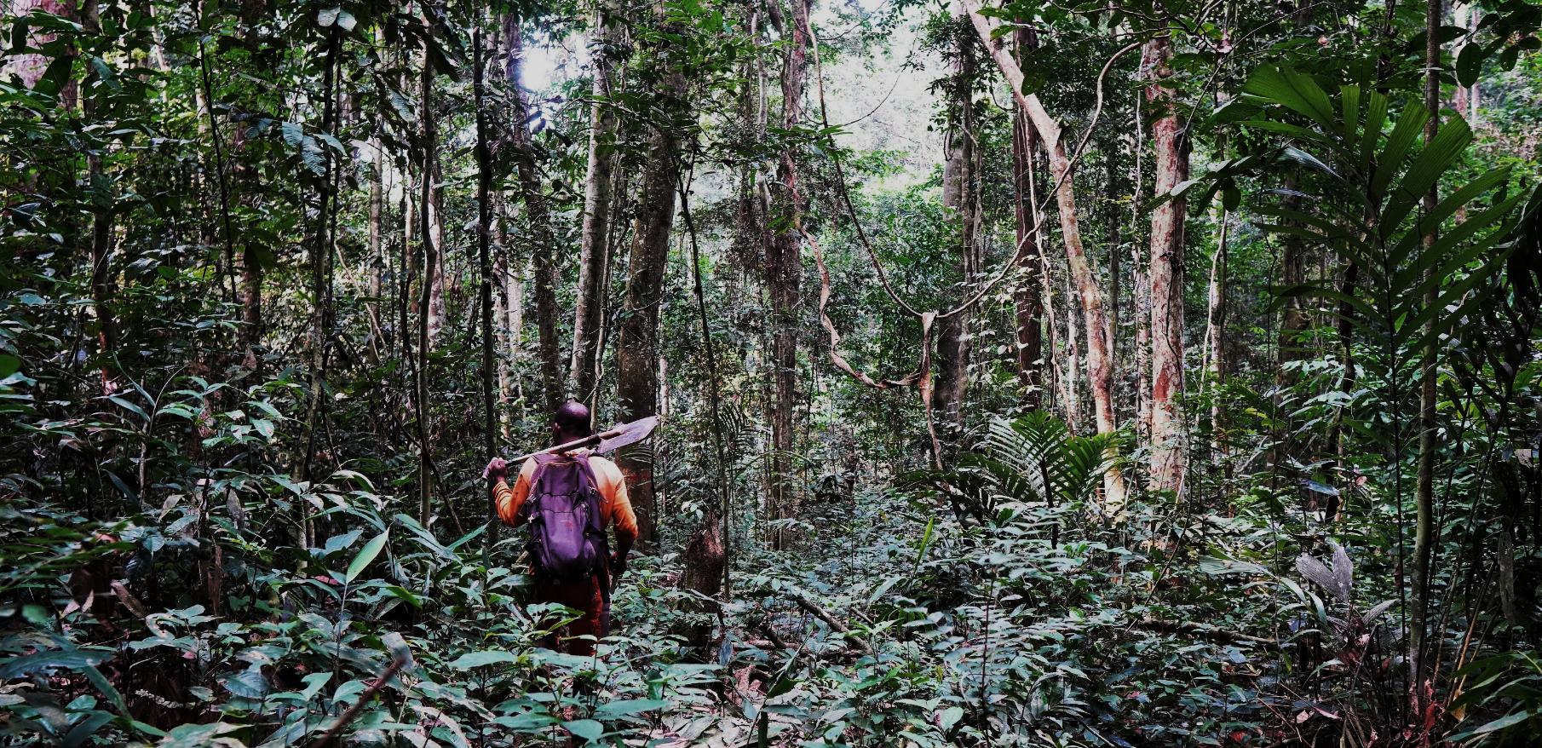
Tree species
Tropical forests are highly diverse ecosystems
Pantropical Zone
40.000 to >53.000
4.600 to 6.000
Tropical Africa
Temperate Europe
124
Tropical Africa : 50 – 150 tree species /ha
Slik et al, 2015
Gourlet-Fleury et al., 2013

Slide 3
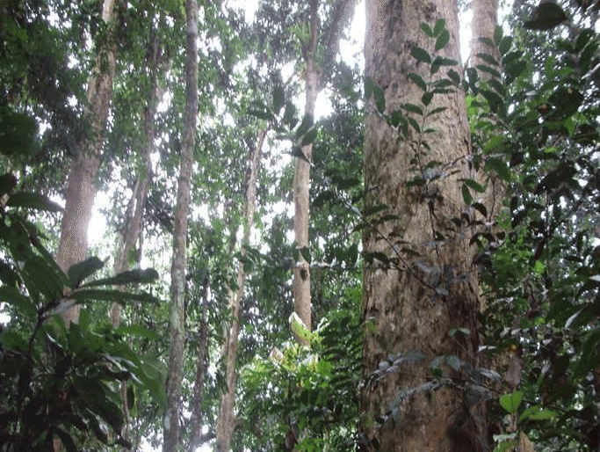
Monodominance
Paradoxically, some tropical forests are dominated by a single species, covering over 60% of the canopy
Gilbertiodendron dewevrei monodominant forest,
Democratic Republic of Congo
Botelanyele et al., 2016

Slide 4
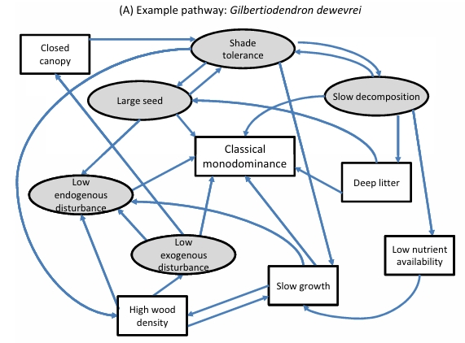
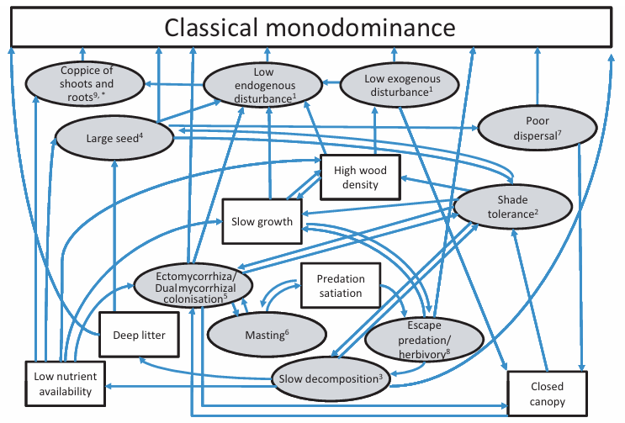
Monodominance
Gilbertiodendron dewevrei monodominant forest,
Democratic Republic of Congo
Peh et al., 2011
Botelanyele et al., 2016

Slide 5
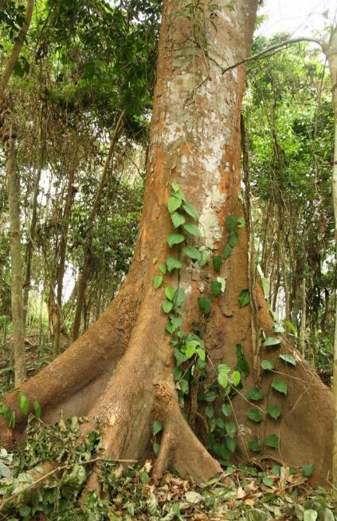
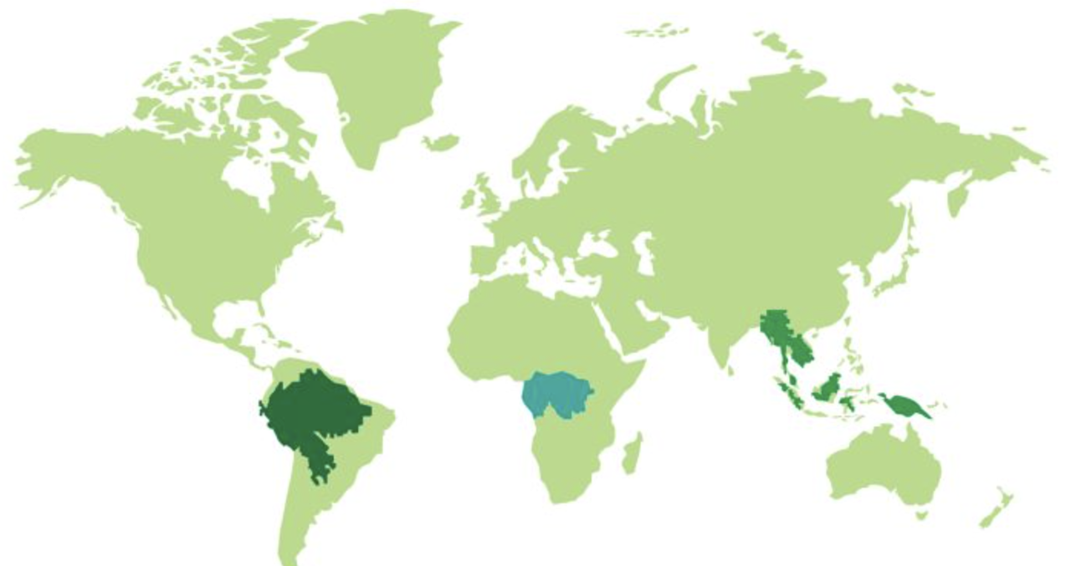
Okoumé
Gabon’s green gold
Aucoumea klaineana Pierre (Burseraceae)
Most harvested timber species in Central Africa
≈13%

Slide 6
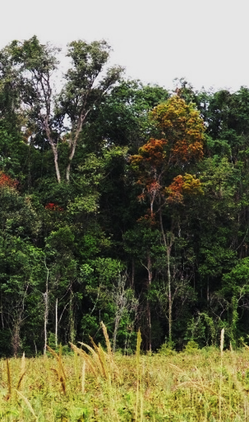
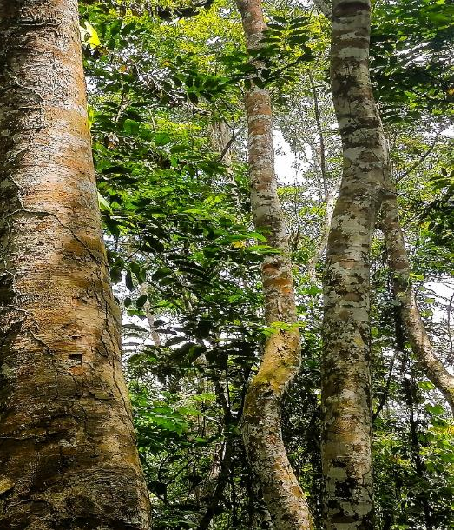
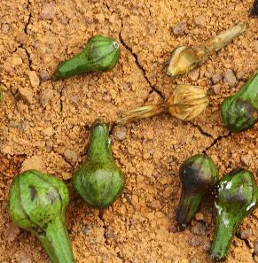
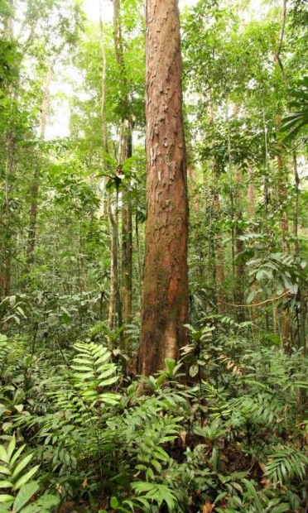
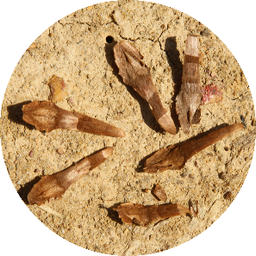
Forest Succession
From open environments to old-growth mixed forests
Winged seeds
Savannah colonisation
Monodominant stand
Old-growth mixed forest
Fruits
Seeds
Time
Lately

Slide 7
Research questions
1. How does this species persist as monodominant ?
1b. How do suppressed trees survive in such shaded environments ?
© André De Kesel
© Jean-Louis Doucet

Slide 8
Research questions
1. How does this species persist as monodominant ?
1b. How do suppressed trees survive in such shaded environments ?
8 interdependent mechanisms to explain classical monodominance:
Peh et al, 2011 ; 2024
© André De Kesel
© Jean-Louis Doucet

Slide 9
Research questions
1. How does this species persist as monodominant ?
1b. How do suppressed trees survive in such shaded environments ?
8 interdependent mechanisms to explain classical monodominance:
Peh et al, 2011 ; 2024
Low frequency of exogenous disturbances
Shade tolerance and seedling survival under closed canopy
Slow decomposition and low nutrient availability
Large seeds to overcome deep litter layers
Association with ectomycorrhizal (EcM) fungi
Mast fruiting and predator satiation
Limited seed dispersal and gregarious growth
Escape from herbivory
© André De Kesel
© Jean-Louis Doucet

Slide 10
Research questions
1. How does this species persist as monodominant ?
1b. How do suppressed trees survive in such shaded environments ?
8 interdependent mechanisms to explain classical monodominance:
Peh et al, 2011 ; 2024
Do not apply to A. klaineana
Low frequency of exogenous disturbances
Shade tolerance and seedling survival under closed canopy
Slow decomposition and low nutrient availability
Large seeds to overcome deep litter layers
Association with ectomycorrhizal (EcM) fungi
Mast fruiting and predator satiation
Limited seed dispersal and gregarious growth
Escape from herbivory
© André De Kesel
© Jean-Louis Doucet

Slide 11

Research questions
1. How does this species persist as monodominant ?
1b. How do suppressed trees survive in such shaded environments ?
8 interdependent mechanisms to explain classical monodominance:
Peh et al, 2011 ; 2024
Do not apply to A. klaineana
Low frequency of exogenous disturbances
Shade tolerance and seedling survival under closed canopy
Slow decomposition and low nutrient availability
Large seeds to overcome deep litter layers
Association with ectomycorrhizal (EcM) fungi
Mast fruiting and predator satiation
Limited seed dispersal and gregarious growth
Escape from herbivory
© André De Kesel
© Jean-Louis Doucet

Slide 12
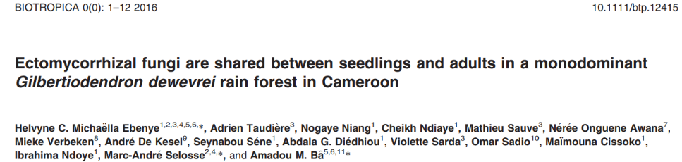
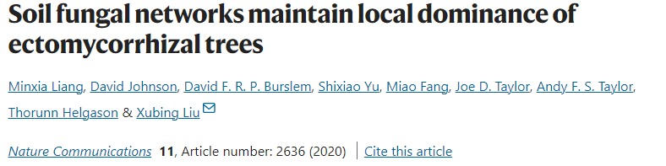
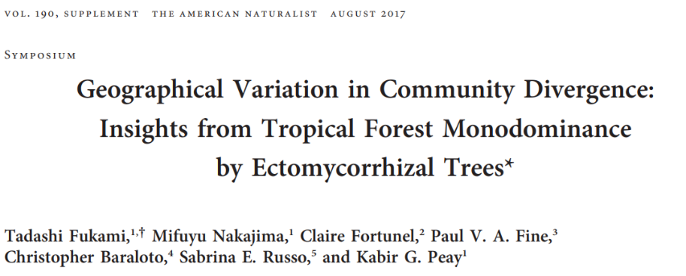
Research questions
1. How does this species persist as monodominant ?
1b. How do suppressed trees survive in such shaded environments ?
8 interdependent mechanisms to explain classical monodominance:
Peh et al, 2011 ; 2024
Low frequency of exogenous disturbances
Shade tolerance and seedling survival under closed canopy
Slow decomposition and low nutrient availability
Large seeds to overcome deep litter layers
Association with ectomycorrhizal (EcM) fungi
Mast fruiting and predator satiation
Limited seed dispersal and gregarious growth
Escape from herbivory
© André De Kesel
© Jean-Louis Doucet

Slide 13
Research questions
1. How does this species persist as monodominant ?
1b. How do suppressed trees survive in such shaded environments ?
8 interdependent mechanisms to explain classical monodominance:
Peh et al, 2011 ; 2024
Do not apply to A. klaineana
Low frequency of exogenous disturbances
Shade tolerance and seedling survival under closed canopy
Slow decomposition and low nutrient availability
Large seeds to overcome deep litter layers
Association with ectomycorrhizal (EcM) fungi
Mast fruiting and predator satiation
Limited seed dispersal and gregarious growth
Escape from herbivory
© André De Kesel
© Jean-Louis Doucet

Slide 14
Research questions
1. How does this species persist as monodominant ?
1b. How do suppressed trees survive in such shaded environments ?
Root-associated fungi diversity
Low frequency of exogenous disturbances
Shade tolerance and seedling survival under closed canopy
Slow decomposition and low nutrient availability
Large seeds to overcome deep litter layers
Association with ectomycorrhizal (EcM) fungi
Mast fruiting and predator satiation
Limited seed dispersal and gregarious growth
Escape from herbivory
© André De Kesel
© Jean-Louis Doucet

Slide 15
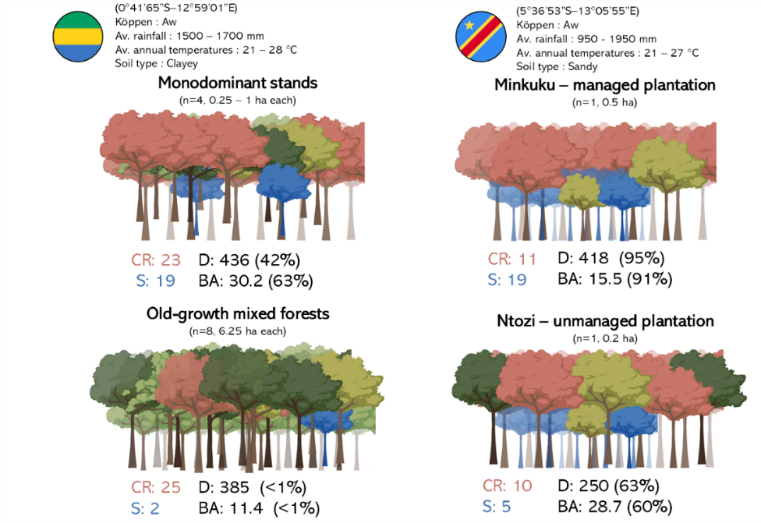
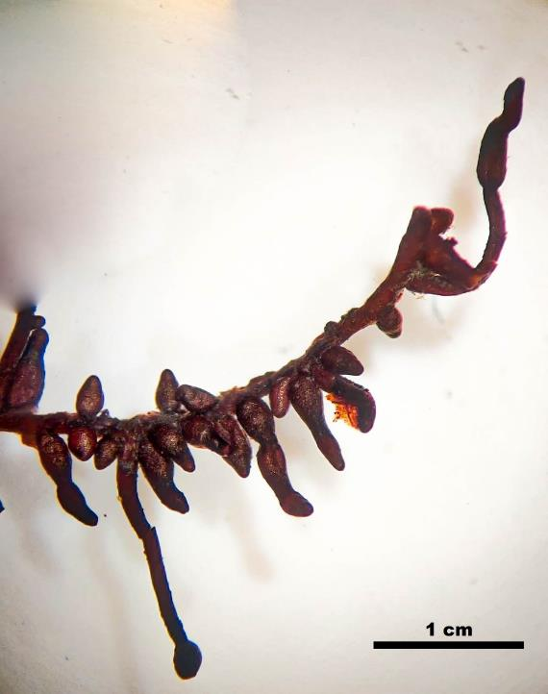
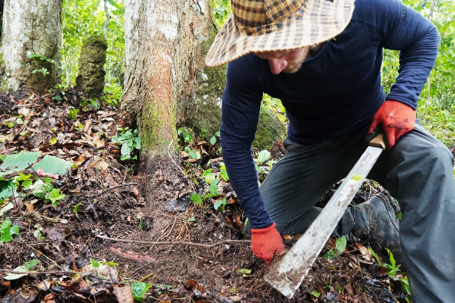
Material and Methods
Fine roots collected on :
69 trees in natural forests from Gabon
45 trees in plantations from the Democratic Republic of Congo
On canopy-reaching and suppressed A. klaineana trees
© Jean-Louis Doucet
2
2

Slide 16



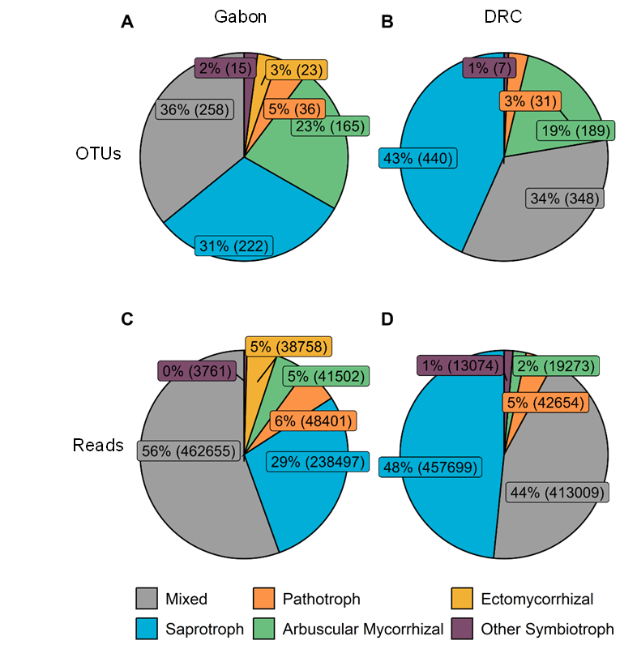
Results
* Methodological note
(Guidosse et al., 2022)
OTU : Operational Taxonomic Unit (cluster 97% similarity) obtained by DNA high-throughput sequencing*
Gabon: 1,694 OTUs
DRC: 2,003 OTUs
2
2

Slide 17
Results
* Methodological note
(Guidosse et al., 2022)
OTU : Operational Taxonomic Unit (cluster 97% similarity) obtained by DNA high-throughput sequencing*
Gabon: 1,694 OTUs
DRC: 2,003 OTUs
2
2

Slide 18
Results
* Methodological note
(Guidosse et al., 2022)
OTU : Operational Taxonomic Unit (cluster 97% similarity) obtained by DNA high-throughput sequencing*
2
2

Slide 19
Results
What we found :
Okoumé trees are not EcM-associated .
© Jean-Louis Doucet
2
2

Slide 20
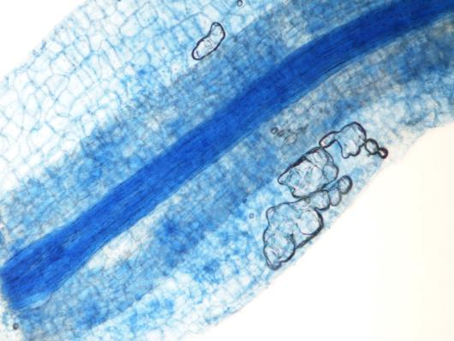
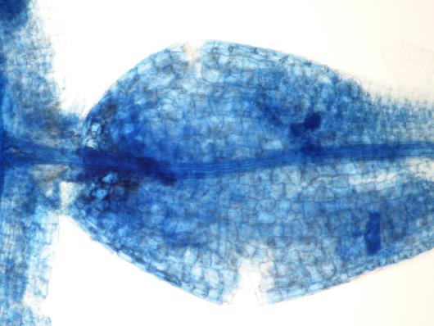
Results
What we found :
Okoumé trees are not EcM-associated .
They associate with arbuscular mycorrhizal fungi, but the relationship does not appear to be functionally critical.
© Jean-Louis Doucet
2
2

Slide 21
Results
What we found :
Okoumé trees are not EcM-associated .
They associate with arbuscular mycorrhizal fungi, but the relationship does not appear to be functionally critical.
Root-associated fungal communities alone does not explain:
how Okoumé form monodominant stand;
why suppressed trees survive in low-light conditions.
*
*
α-Diversity : Shannon, Simpson, Pielou indexes
β -Diversity : Bray-Curtis, Jaccard matrices
© Jean-Louis Doucet
2
2

Slide 22
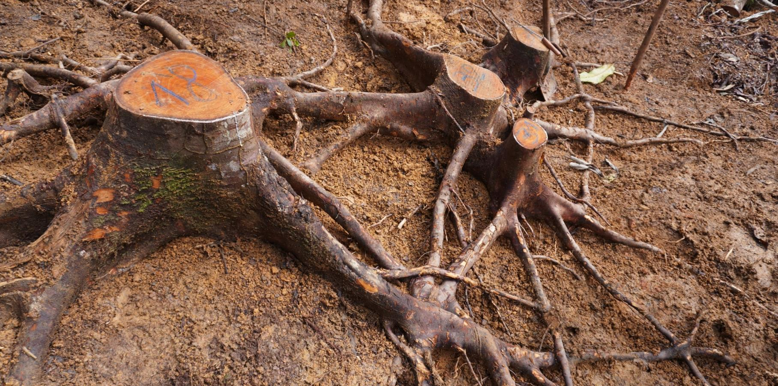
Natural root grafting in A. klaineana stands

Slide 23
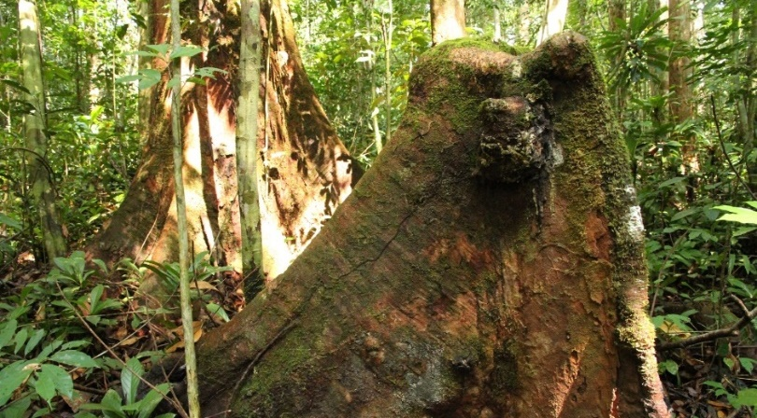
Living stumps
(through root grafts)
© Jean-Louis Doucet
© Jean-Louis Doucet
Discovery of living stump years after thinning operations

Slide 24
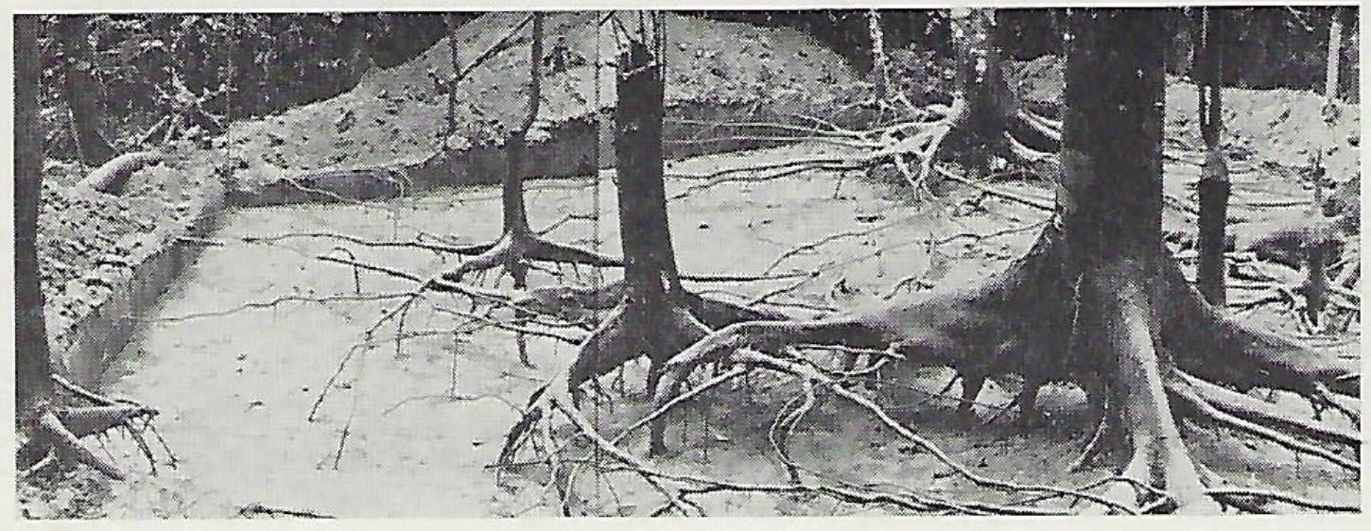
Root anastomoses
(Root grafts)
Leroy Deval, 1973
Mapping of okoumé root anastomoses

Slide 25
Root anastomoses
(Root grafts)
1) Do they enable sap redistribution between A. klaineana trees?
© Jean-Louis Doucet
2

Slide 26
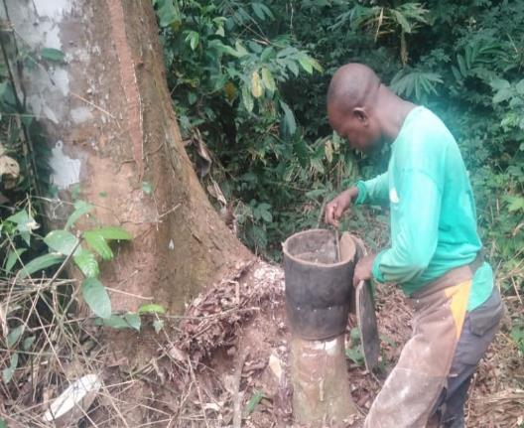
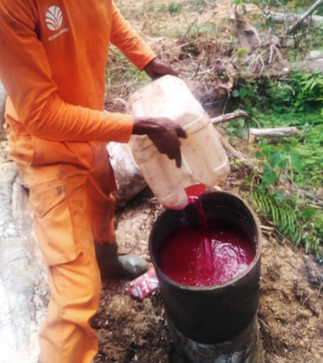
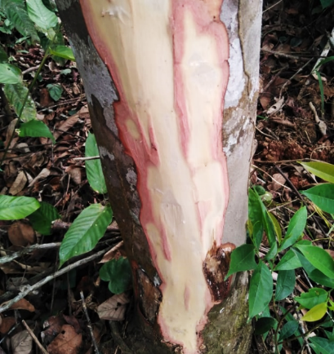
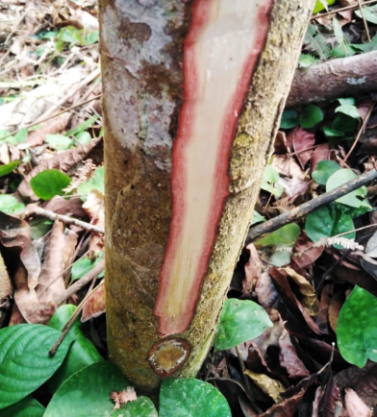
Root anastomoses
(Root grafts)
1) Do they enable sap redistribution between A. klaineana trees?
Donor stump preparation
Filling with fuschin acid
Slice in receptor trees after 3 weeks
© Jean-Louis Doucet
2

Slide 27
Root anastomoses
2) Do root grafts boost tree growth?
© Jean-Louis Doucet
2

Slide 28
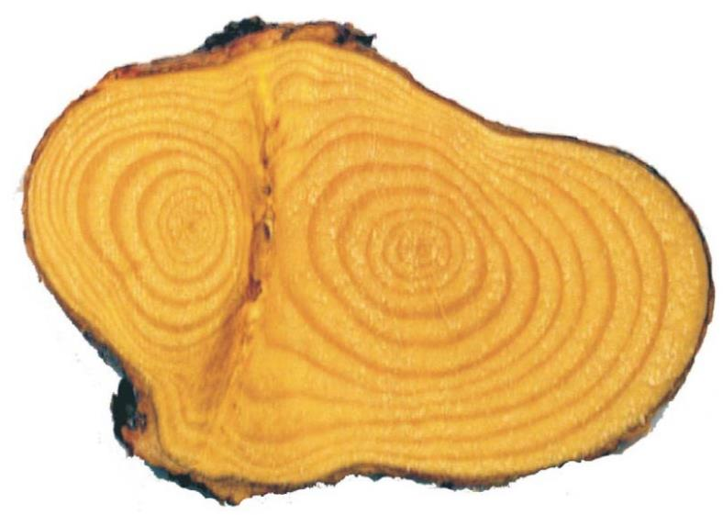
Root anastomoses
Do root anastomoses boost tree
Dendrochronological method in temperate regions :
2) Do root grafts boost tree growth?
5 Common rings
6 Individual rings
© Jean-Louis Doucet
Pinus contorta, Fraser et al., 2005
2

Slide 29
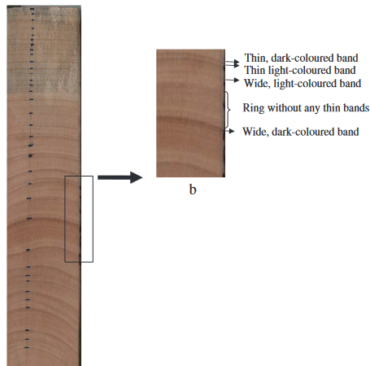
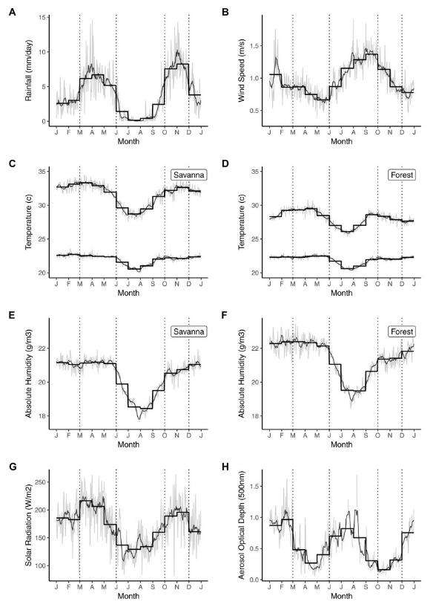
Root anastomoses
Dendrochronological method in tropical/equatorial regions :
Medzegue et al., 2017
Equatorial climate (La Lopé, Gabon)
According to previous authors, count only the broad dark bands as true annual rings, ignoring finer lines as false rings.
© Jean-Louis Doucet
2

Slide 30
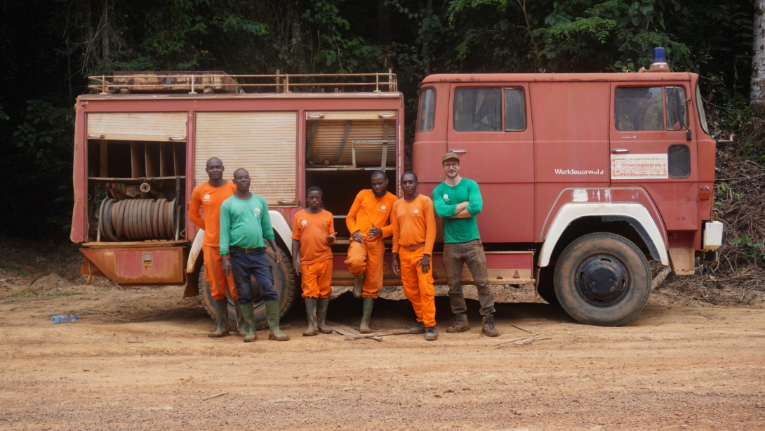
Material and Methods
Stand inventory (3)
Tree cutting
Root systems excavation
© Jean-Louis Doucet

Slide 31
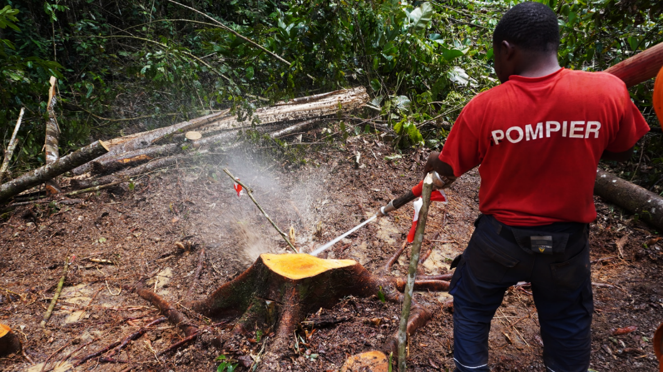
Material and Methods
Stand inventory (3)
Tree cutting
Root systems excavation
© Jean-Louis Doucet

Slide 32
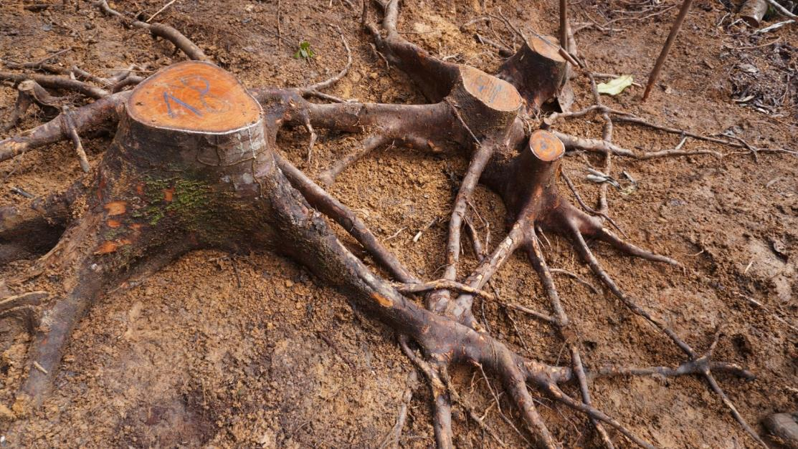
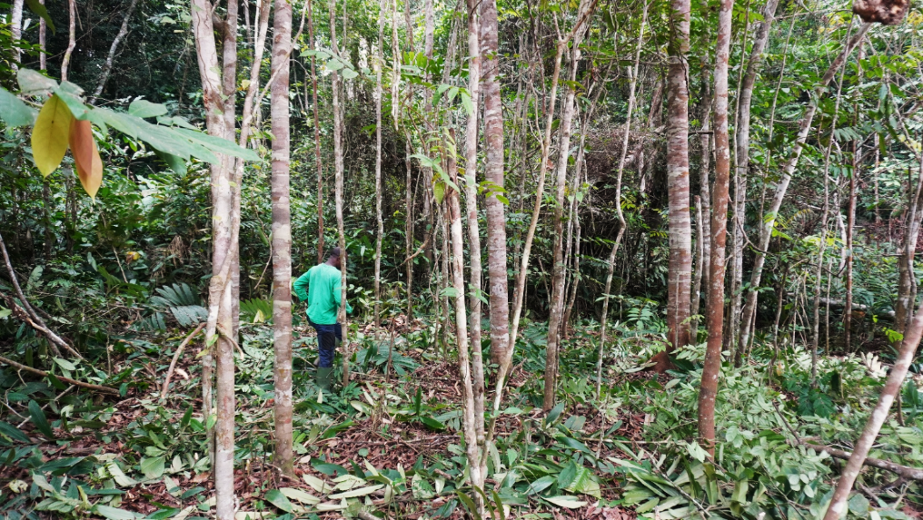
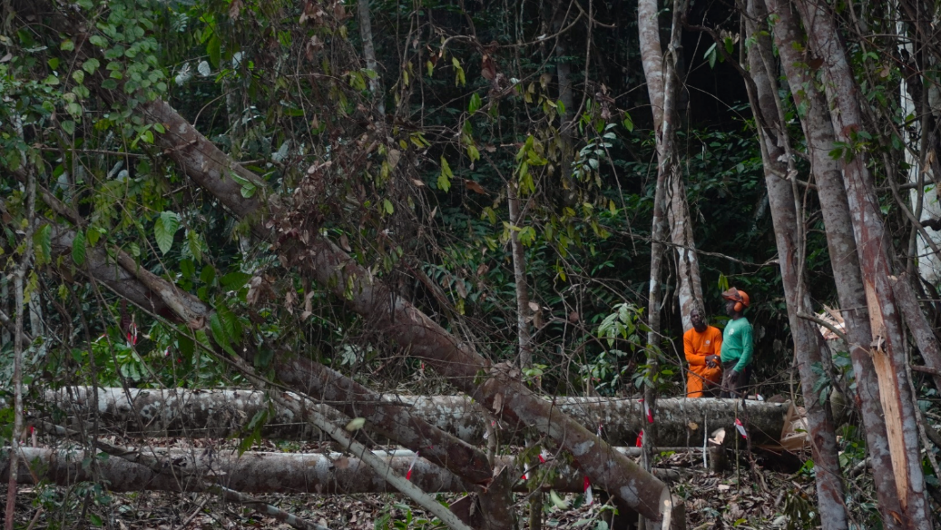
Material and Methods
Stand inventory (3)
Tree cutting
Root systems excavation
© Jean-Louis Doucet

Slide 33
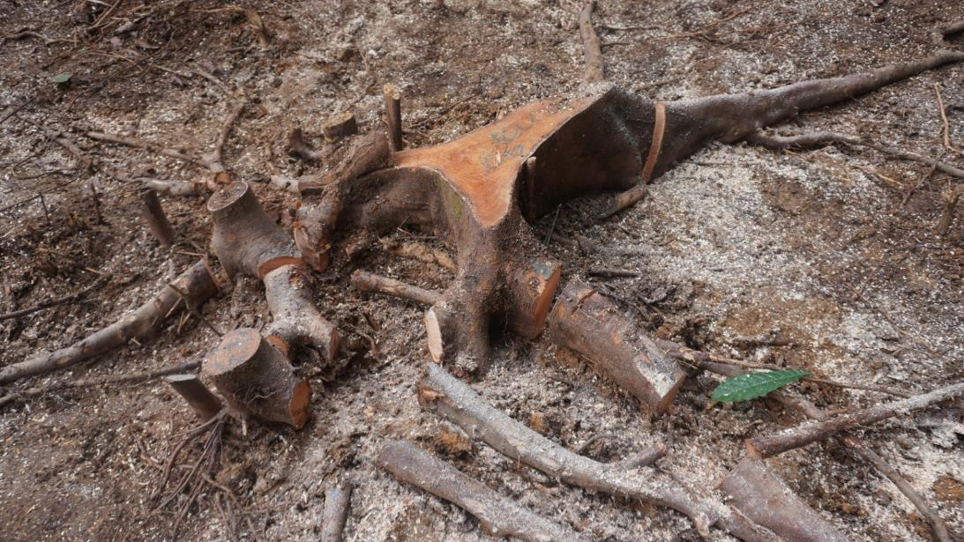
Material and Methods
Stand inventory (3)
Tree cutting
Root systems excavation
Samples collection
85 trunk sections
212 root sections
55 root grafts
© Jean-Louis Doucet

Slide 34
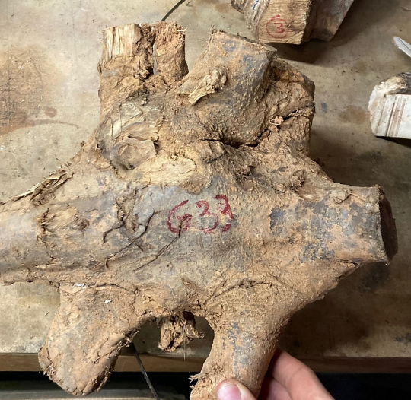
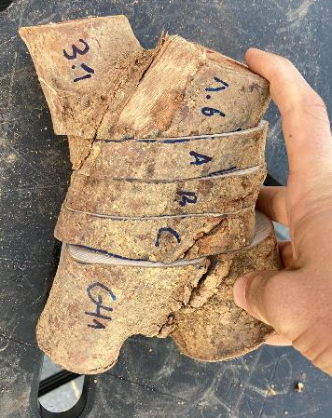
Material and Methods
Stand inventory (3)
Tree cutting
Root systems excavation
Samples collection
85 trunk sections
212 root sections
55 root grafts
© Jean-Louis Doucet

Slide 35
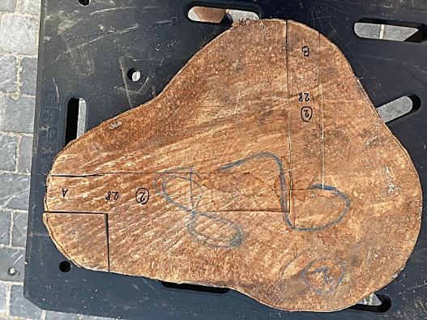
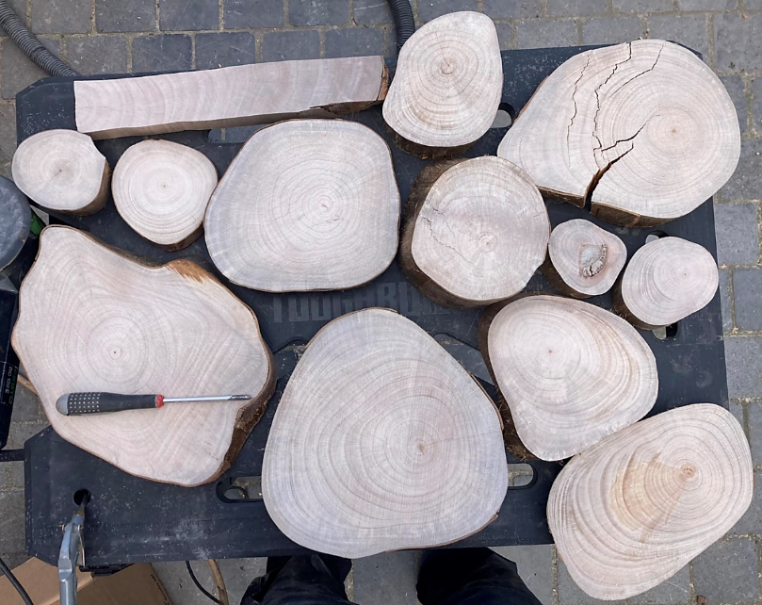
Material and Methods
Stand inventory (3)
Tree cutting
Root systems excavation
Samples collection
85 trunk sections
212 root sections
55 root grafts
Sanding and Ring analyses
© Jean-Louis Doucet

Slide 36
Radiocarbon dating
Measure carbon-14 decay to estimate the age of organic material
© Jean-Louis Doucet
2

Slide 37
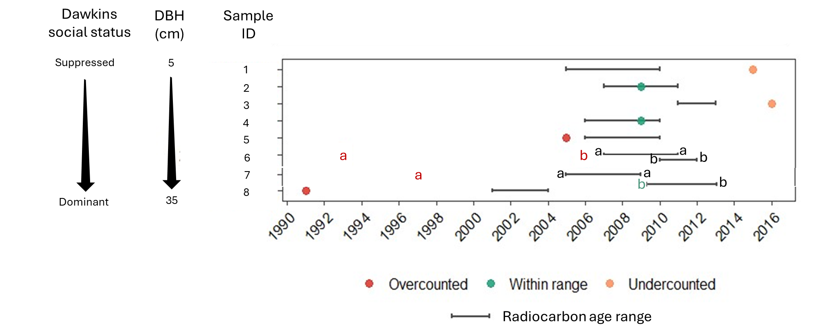
Radiocarbon dating
Measure carbon-14 decay to estimate the age of organic material
Missing rings
False rings
© Jean-Louis Doucet
2

Slide 38
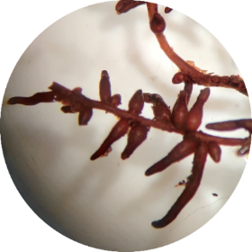
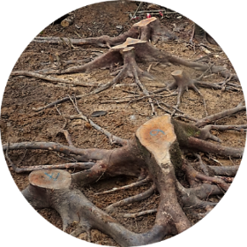
Take home message
Fungi
Fungal community structure has no consistent effect on A. klaineana monodominance or suppressed tree survival
Grafts
Root grafts enable sap transfer, likely supporting monodominance and survival of shaded trees. To assess their impact on growth, alternatives to dendrochronology are needed
By embracing the hidden solidarity of root grafts in okoumé stands, silviculture can align with the forest’s own strategies not to control, but to collaborate with nature for enduring balance and resilience but also productivity on the long term
© Jean-Louis Doucet
2
2

Slide 39
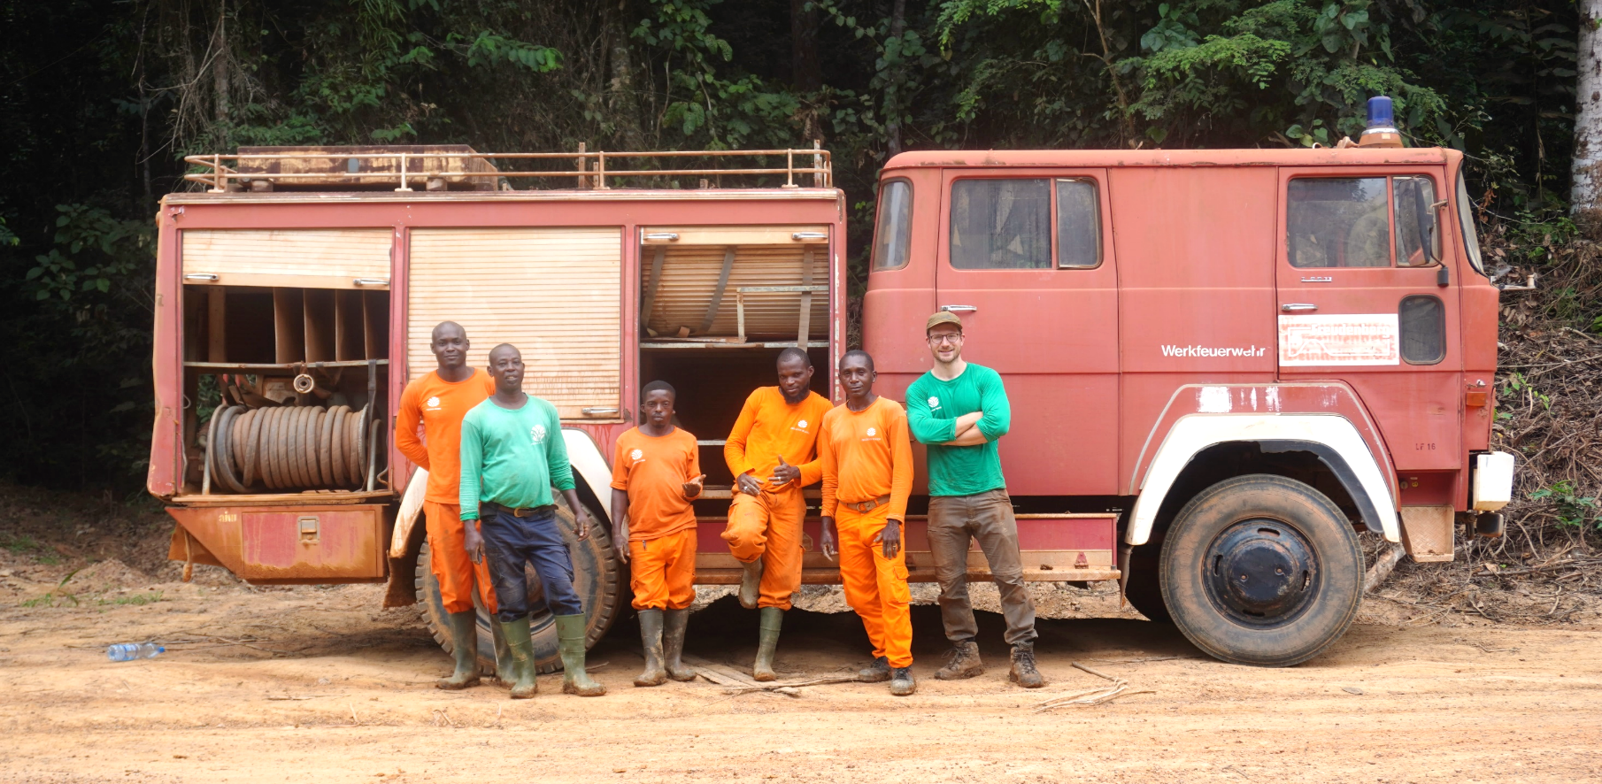

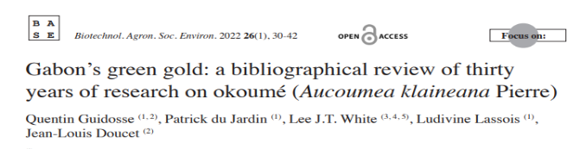

Thank you
Learn more about okoumé:
Quentin Guidosse
University of Liège,
Belgium
qguidosse@uliege.be
© Jean-Louis Doucet
2
2

