Slide 1
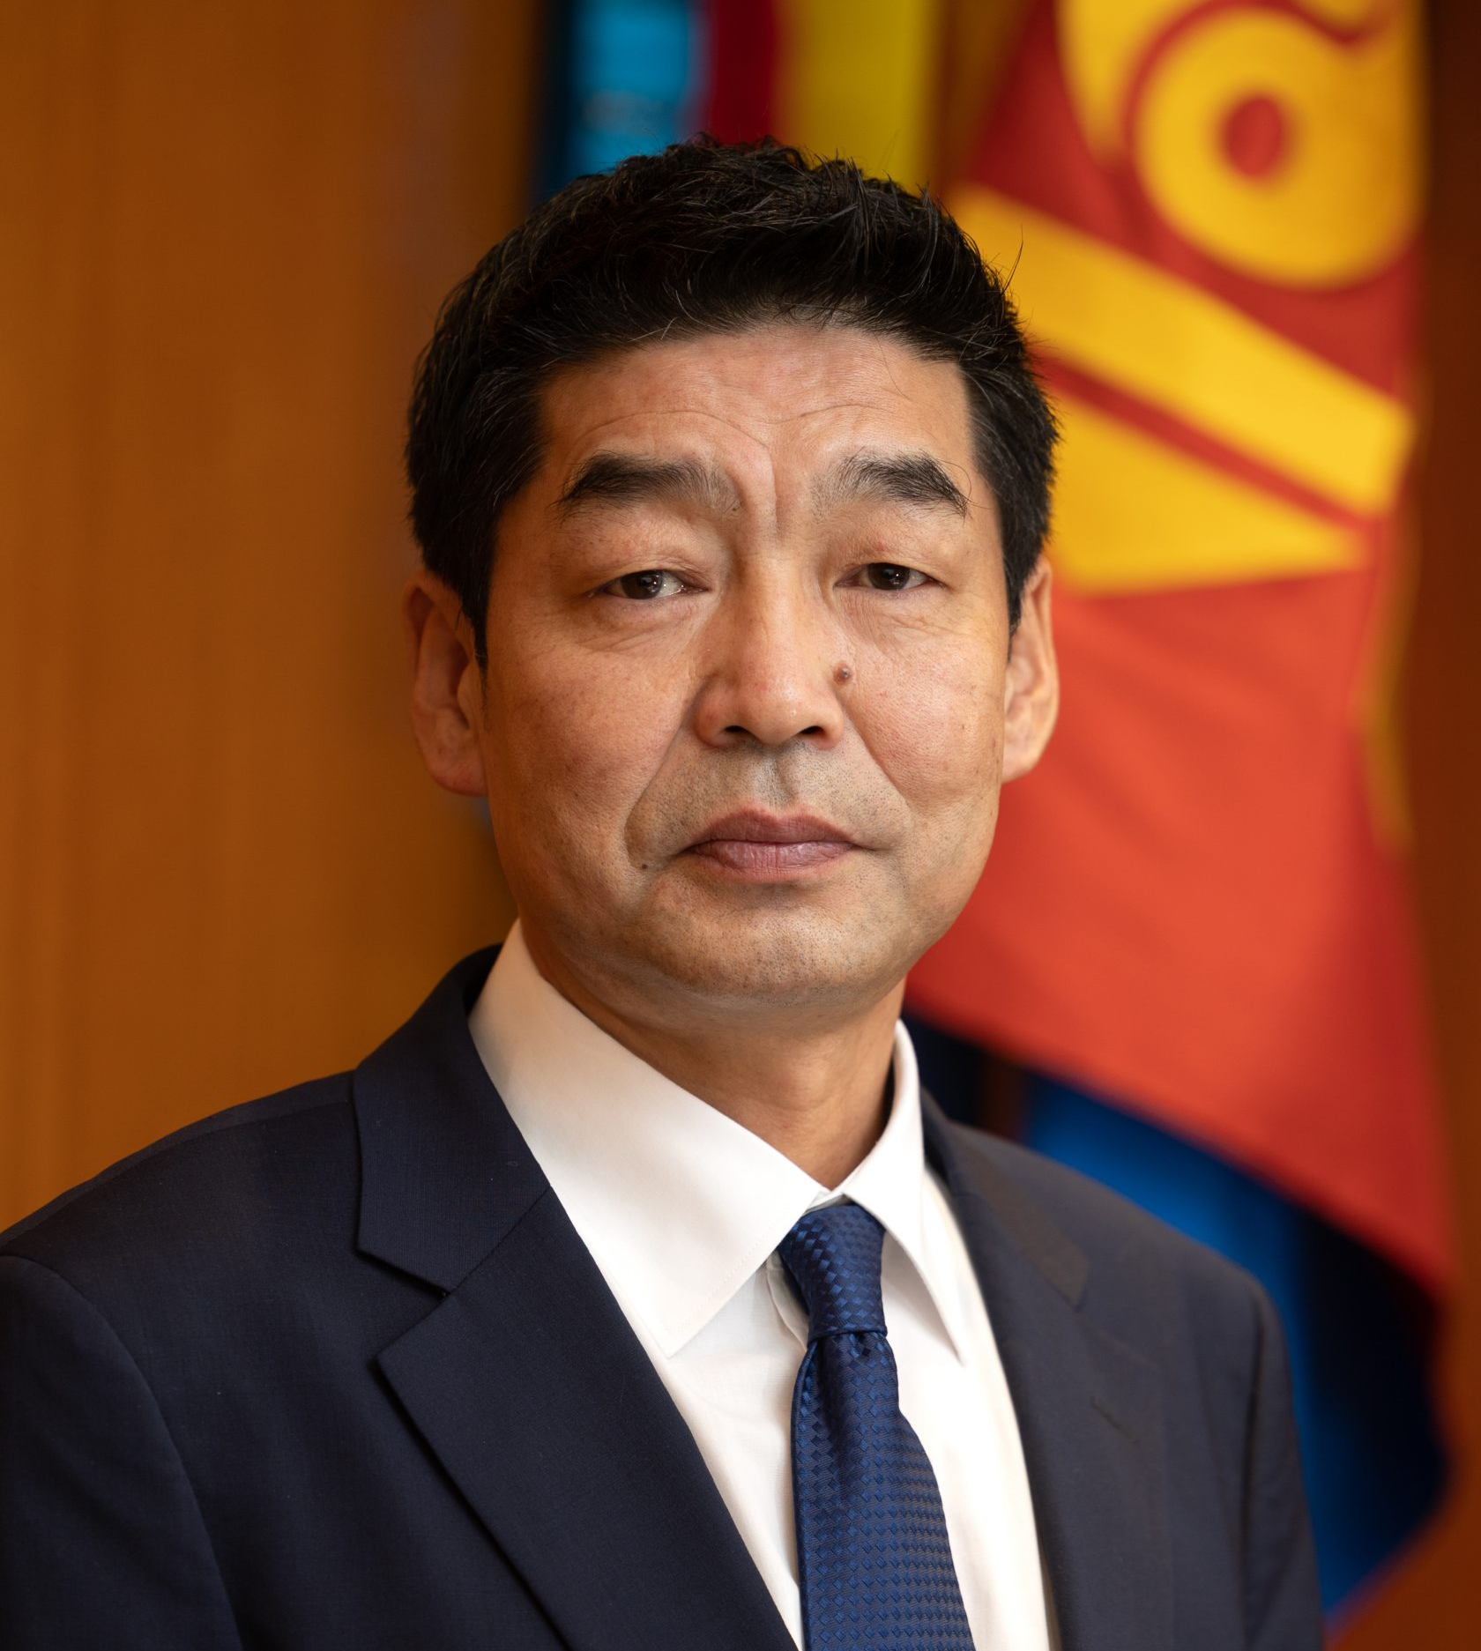

Opening & Welcome
Prof. Batkhuu Nyam-Osor
Advisor to the President of Mongolia
October 16, 2025

Slide 2
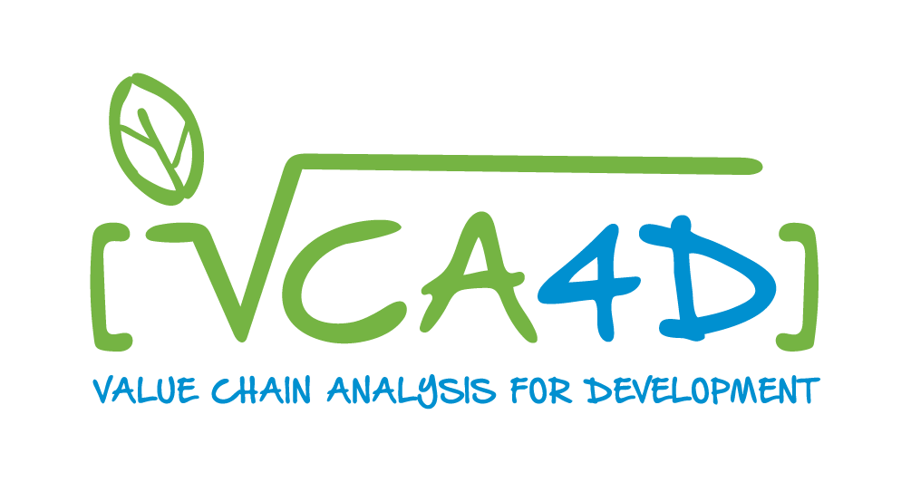
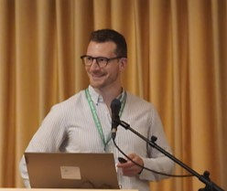

Value Chain Thinking in Agriculture (and Forestry)
Quentin Guidosse
Member of Gembloux Agro-Bio Tech,
University of Liège, Belgium
October 16, 2025

Slide 3
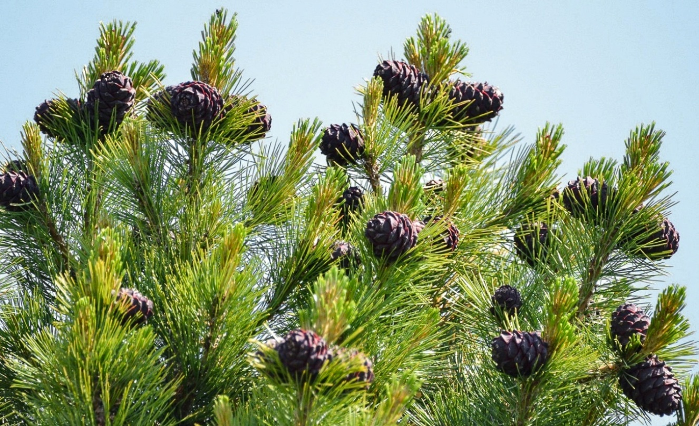
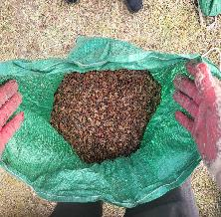
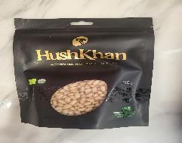
The Pine Nut Value Chain in Mongolia => Potential for economic diversification
John Morton, Quentin Guidosse, Erdenetsolmon Ganbaatar, Petri Lehtonen
Purpose: Assess the current state of the value chain and pinpoint constraints to sustainable, inclusive growth and value addition
Challenges : limited value addition, regulatory framework misaligned with reality, data gaps (e.g., inventories, harvested volumes), …
Need : Evidence to guide responsible investment and inclusive growth → VCA4D methodology

Slide 4
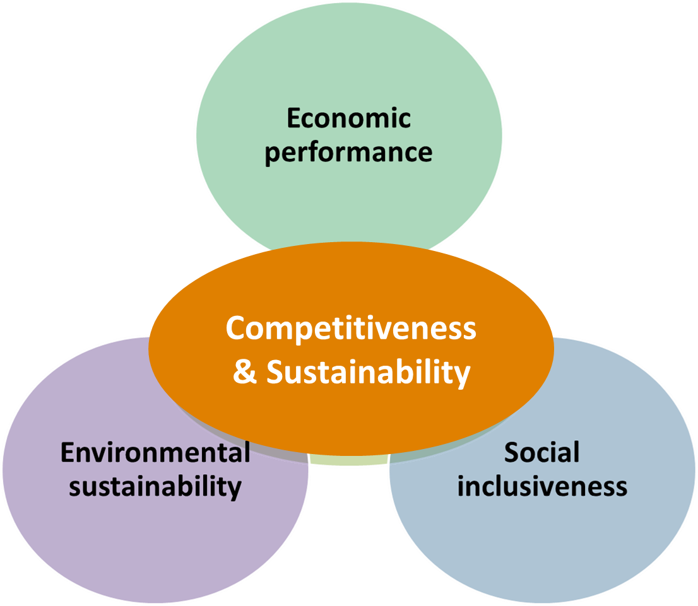
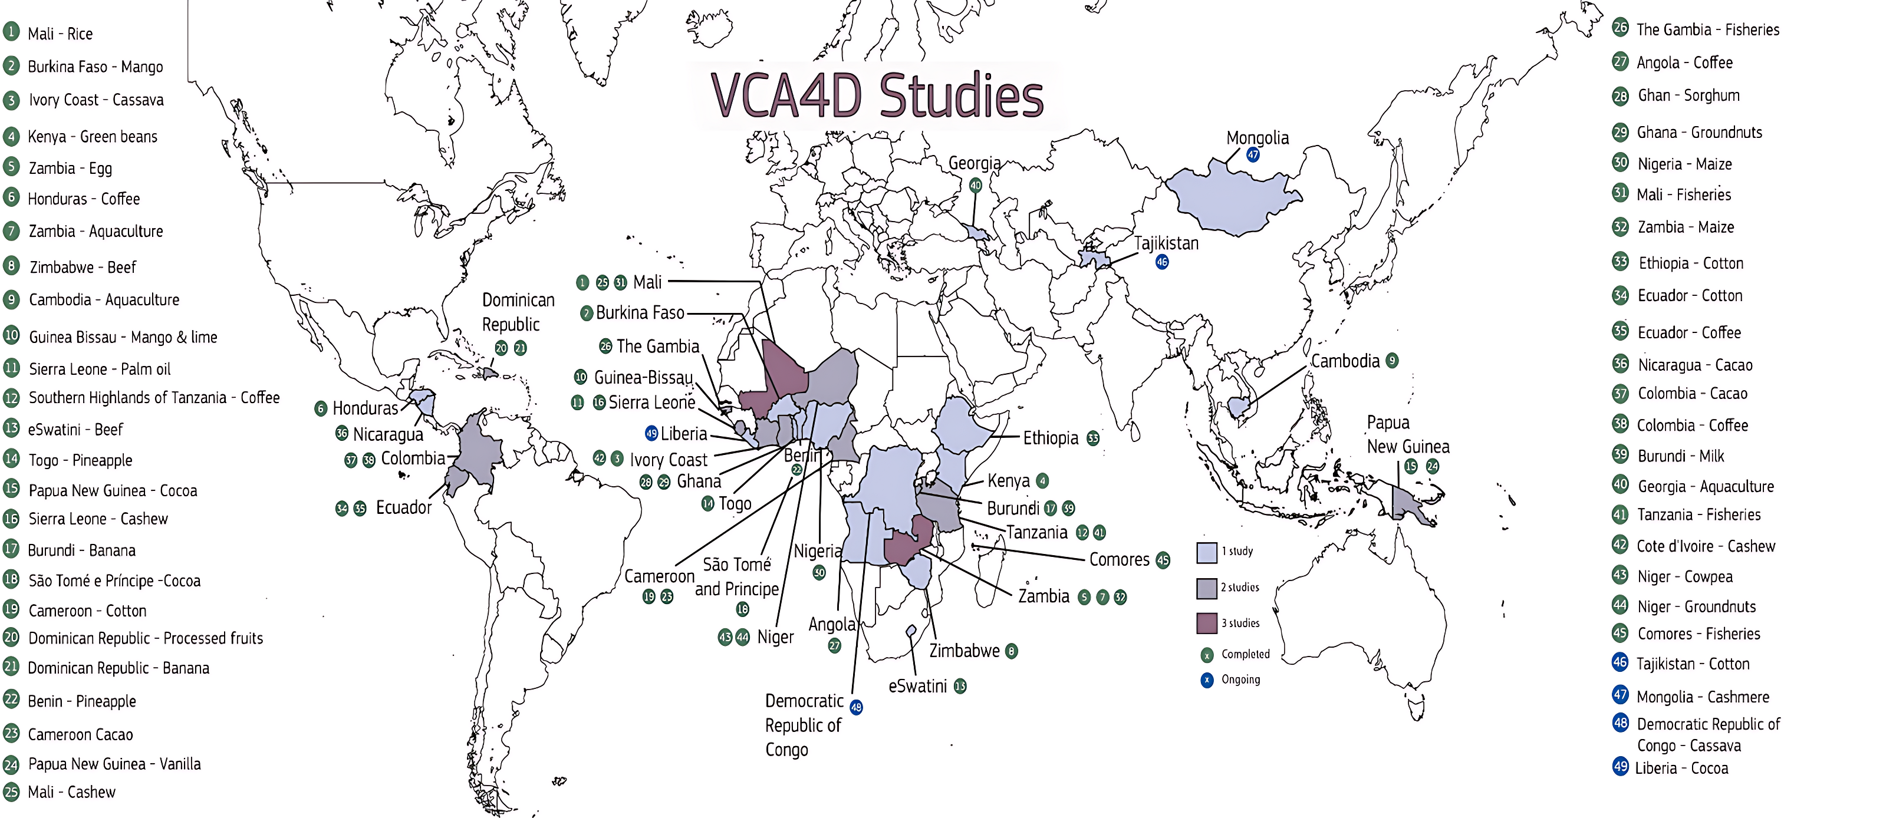
What is (Value Chain Analysis for Development)
EU-funded program implemented by Agrinatura
Applied in >30 countries including Mongolia
Evidence for better investments decisions and policy dialogue
Cashmere (reporting)
Pine nut (collecting data)

Slide 5
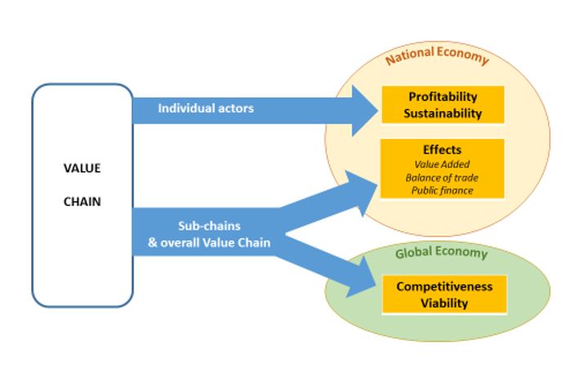
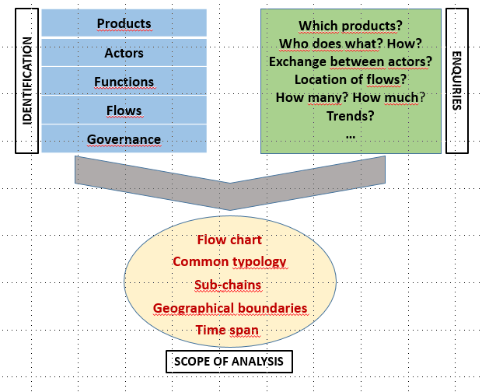
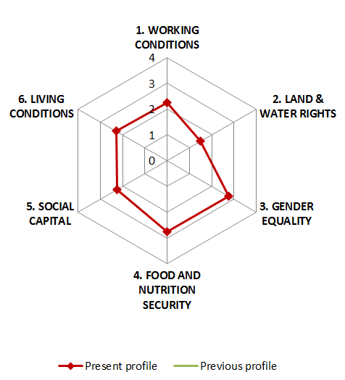
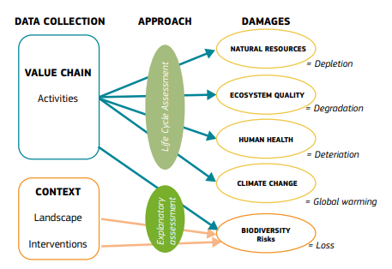
How VCA4D works - A structured, transparent approach
2. Economic analysis
1. Mapping the value chain
3. Social analysis
4. Environmental analysis
Quantitative indicators and expert assessments based on field interviews, local data, and participatory workshops

Slide 6
Why this matters for EU–Mongolia cooperation
Markets exist and global demand is strong for forest and agricultural value chains (e.g., pine nuts, other NTFPs, …). However, barriers limit value creation:
Finance
quality control
sustainability certification
production variability
regulatory gaps
data scarcity
…
Value chain analysis can guide responsible investment and policy choices while strengthening EU–Mongolia green partnerships in:
Investing in value addition and processing
Supporting traceability & sustainable forest/crop management
Building export partnerships and certification
Mobilising finance for local companies & cooperatives
Ensuring benefits reach local communities
Value chains are not just about products.
They’re about people, policies and partnerships

Slide 7
THANK YOU FOR YOUR ATTENTION

Slide 8
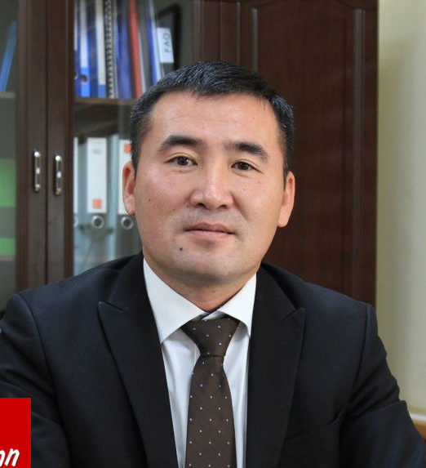
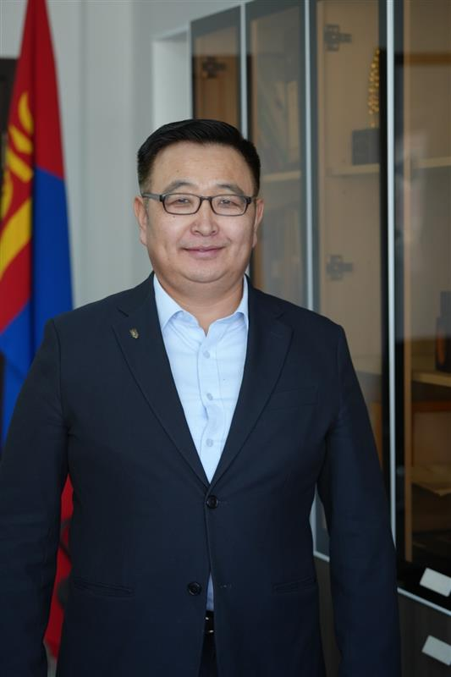
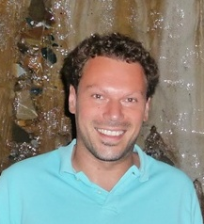
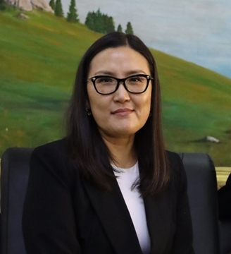

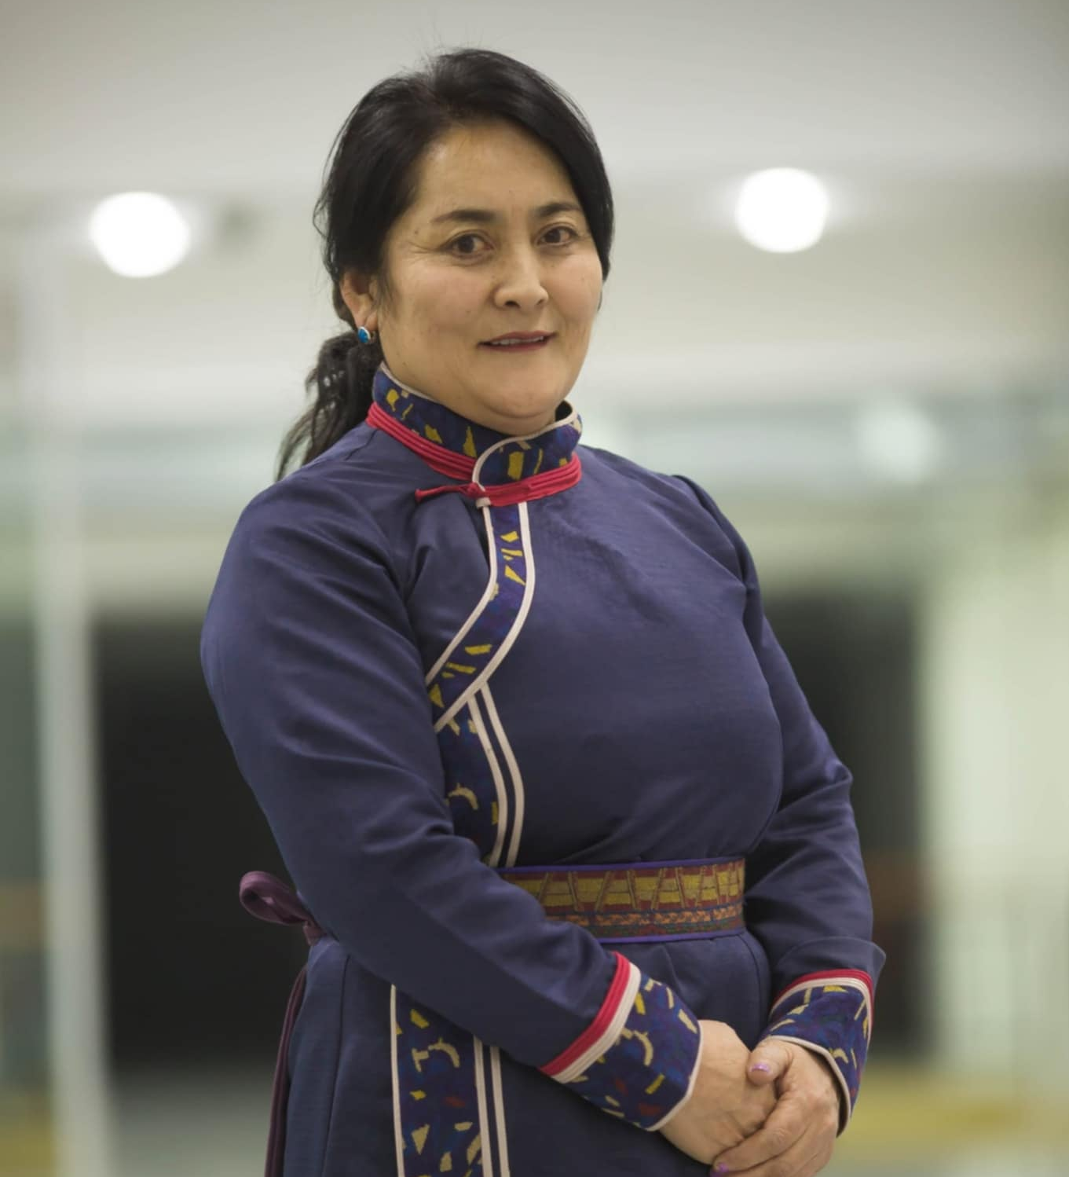
Panel Discussion
SECTORAL SESSION – AGRIBUSINESS & FORESTRY
Panelists
Moderator
Mr. Prof. Batkhuu Nyam-Osor,
Advisor to the President of Mongolia
Mr. Dr. Oyunsanaa Byambasuren,
Director General of the National Forest Agency, the Government Implementing Agency
Mr. Yesun-Erdene Davaasuren,
Director General of Crop Policy Implementation and Coordination Department, MOFALI
Mr. Tobias Goedde,
Senior Forest Sector Development Advisor, GIZ
Mr. Quentin Guidosse,
Member of Gembloux Agro-Bio Tech, University of Liège
Mrs. Altantuya Tseden Ish,
President, National Association of Mongolian Agricultural Cooperatives
Mr. Tsogoo Tsedenpuntsag
Board member, National Association of Mongolian Forest Professionals NGO
Mrs. Purevdash Dudlii,
Head of Forest User Groups Association in Khuvsgul Province
October 16, 2025

