Slide 1


Generation of anticoherent states from a pulse-based protocol

Slide 2
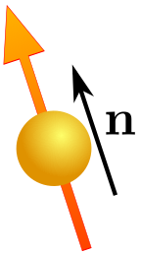
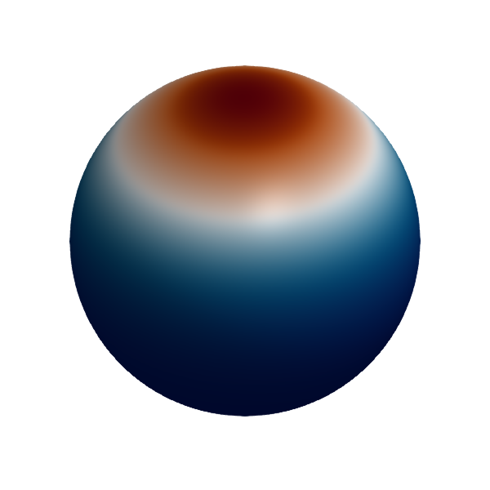
AC States

Slide 3
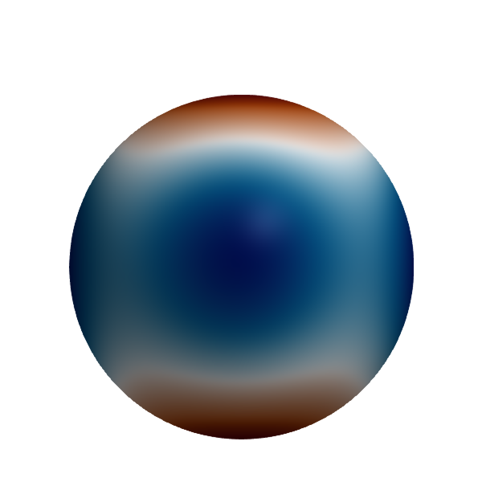

AC States

Slide 4
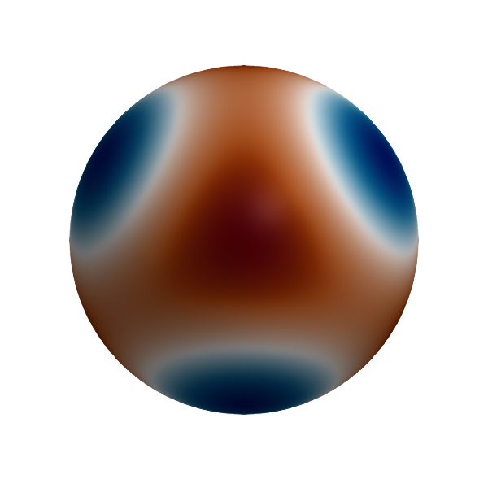




AC States

Slide 5

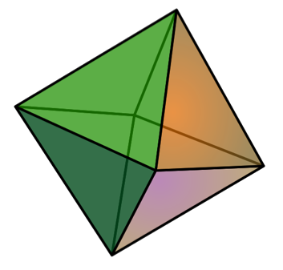


AC States
maximally mixed state
state multipoles
multipole operators

Slide 6


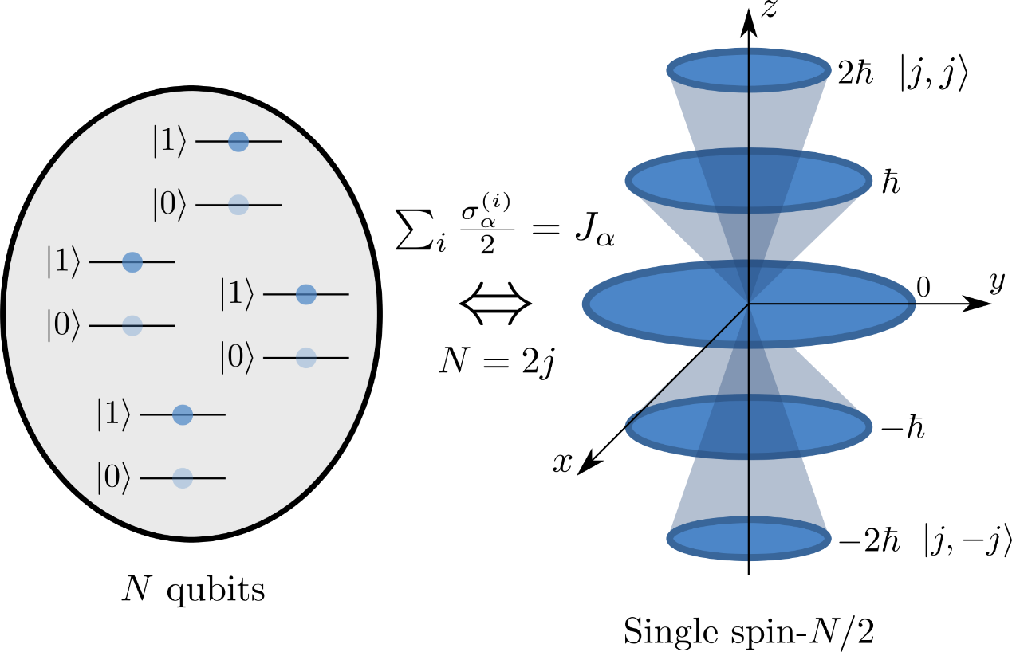





Anticoherent states

Slide 7
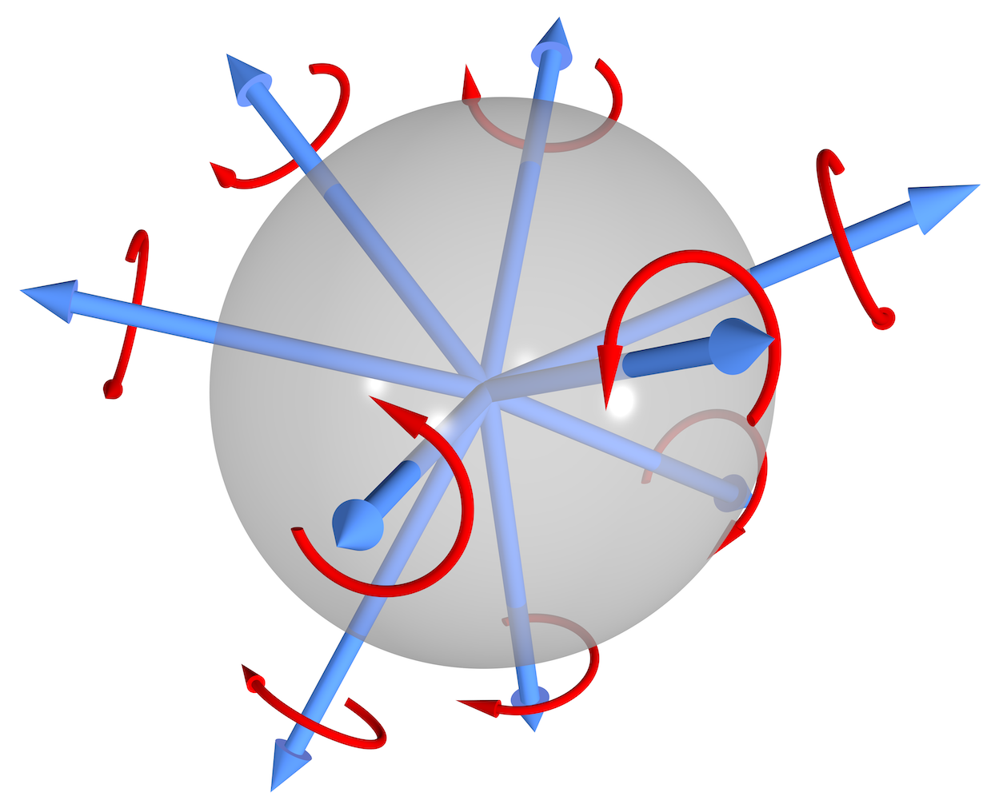





Properties

Slide 8
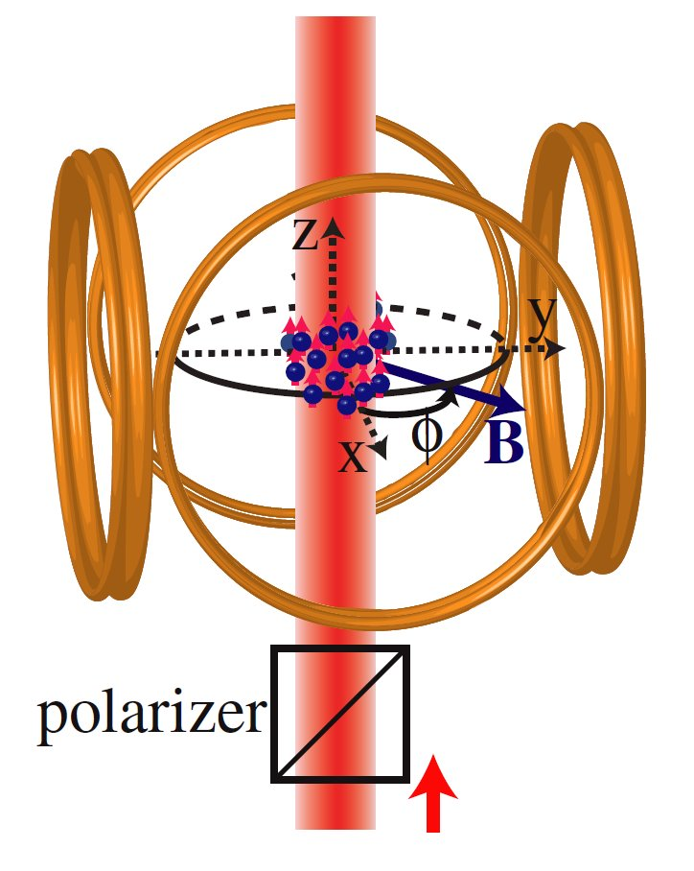


Quantum optimal control

Slide 9

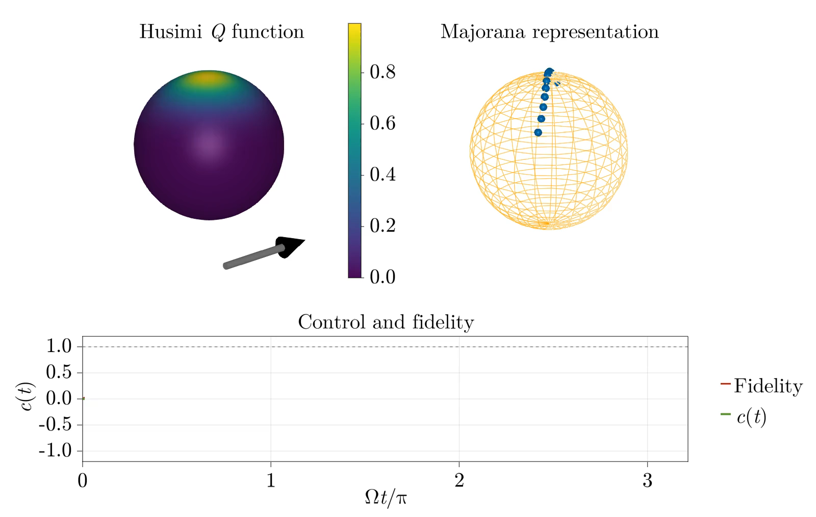


Slide 10

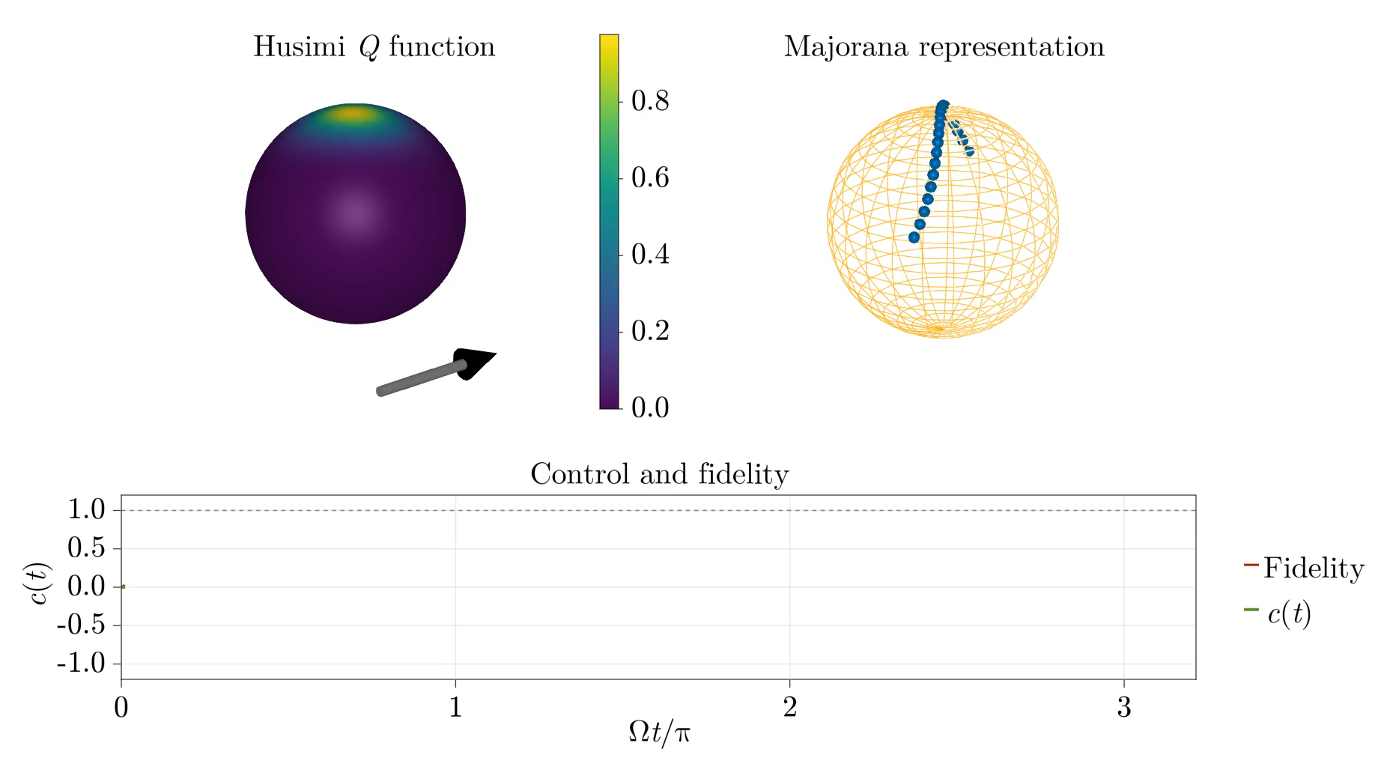

Slide 11

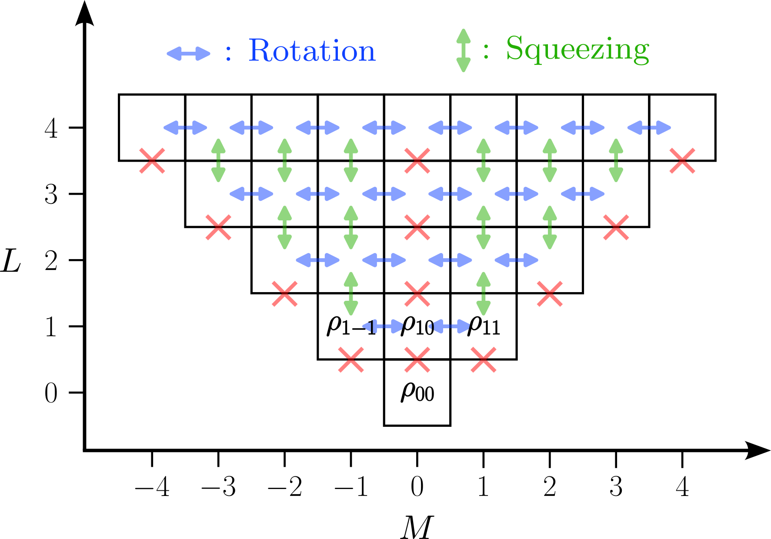



Pulse dynamics

Slide 12




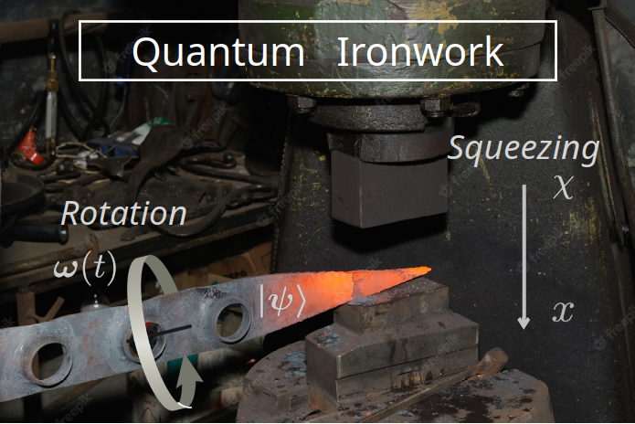





Turn-and-squeeze

Slide 13


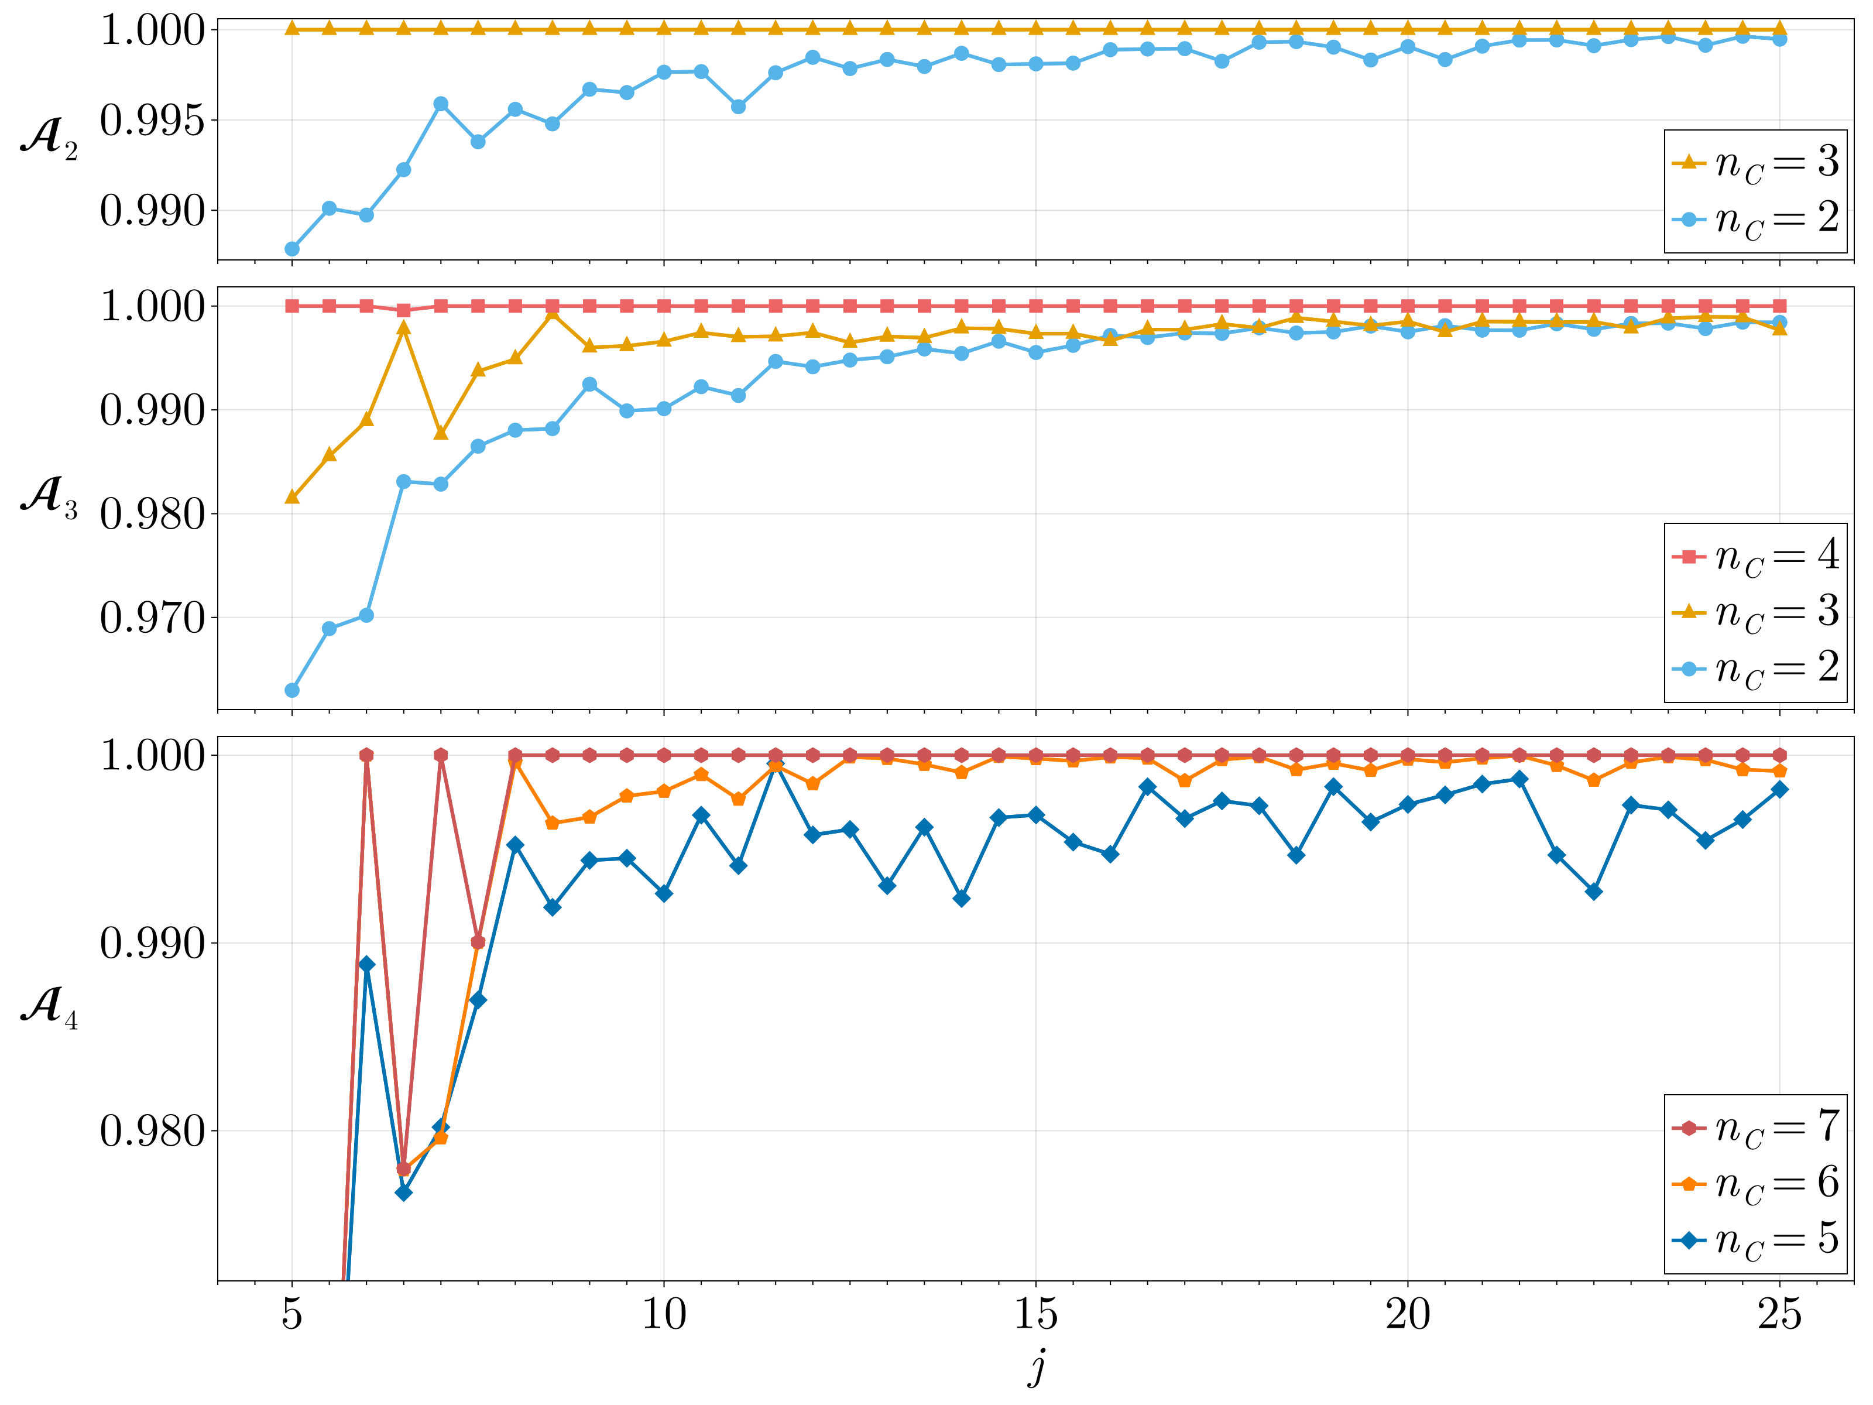
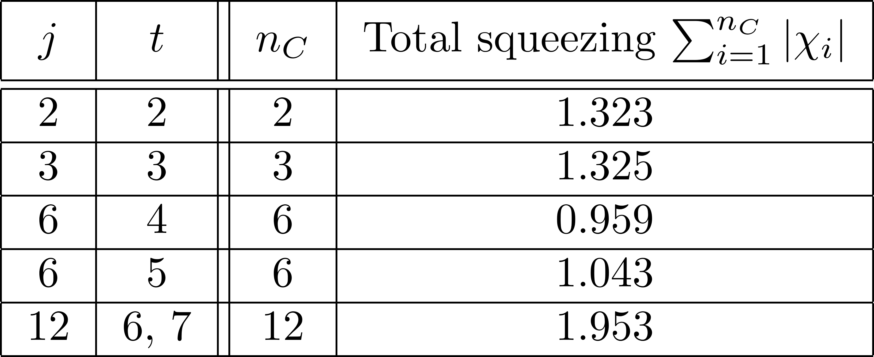

Numerical optimisation

Slide 14
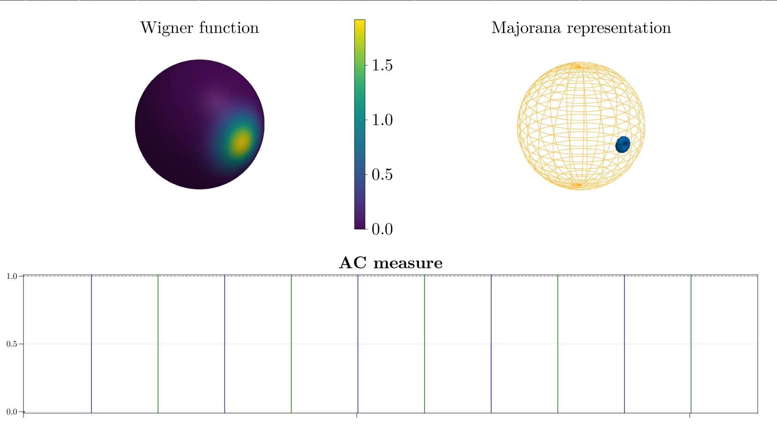



Slide 15
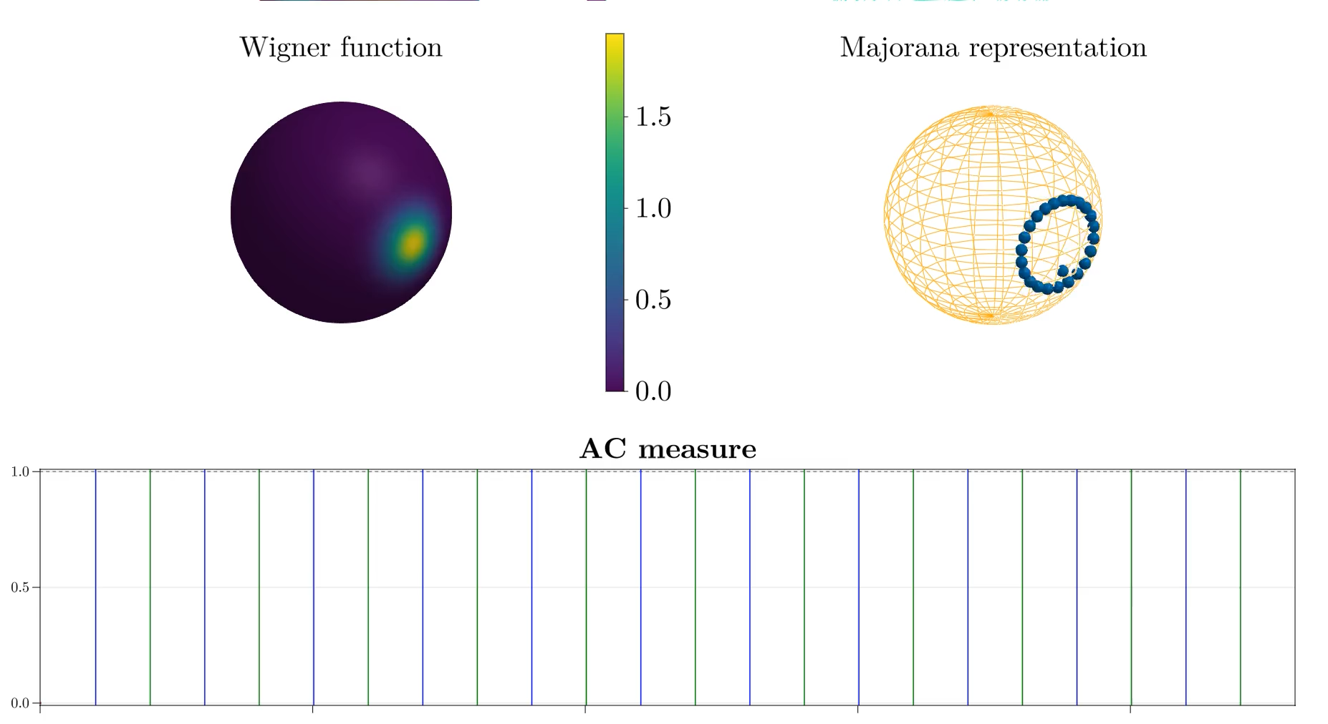

Slide 16
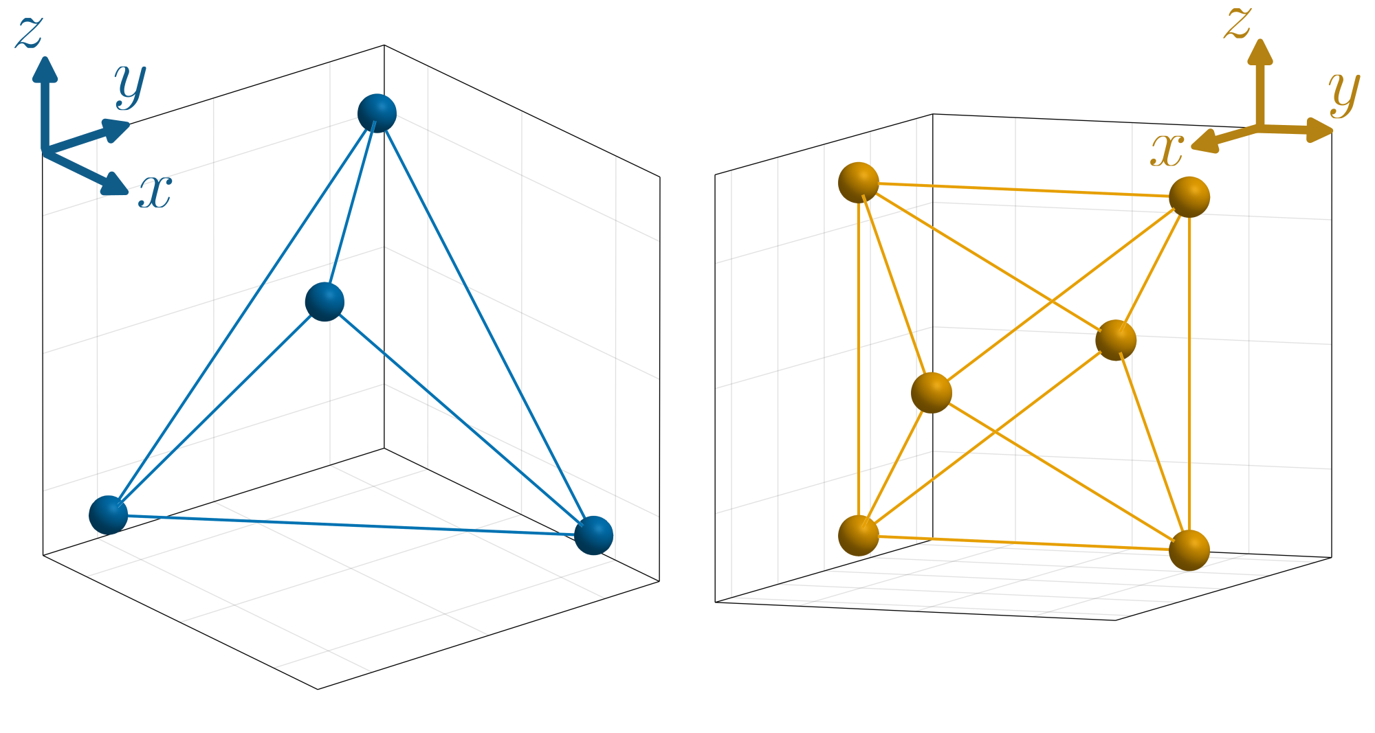




Analytical AC states

Slide 17
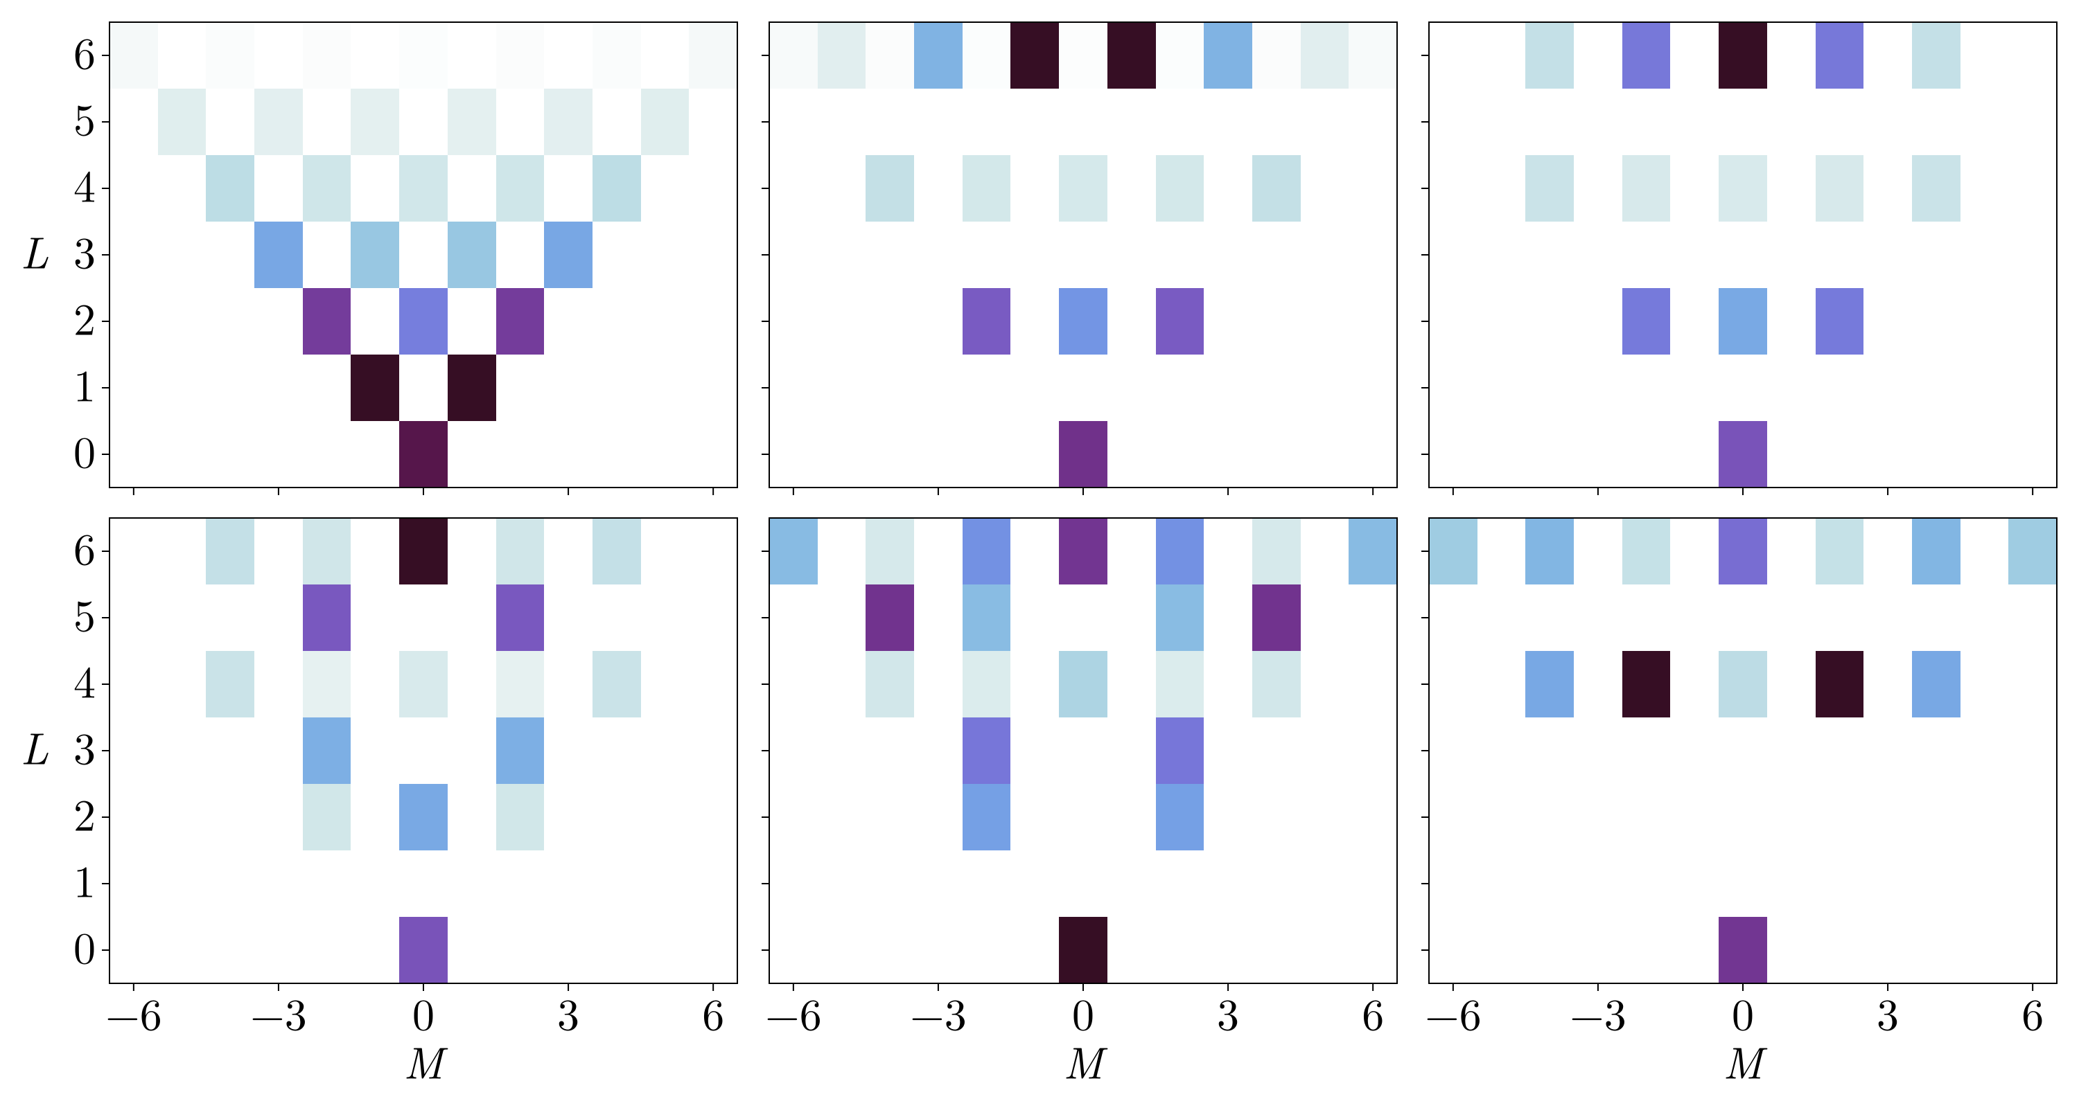
Analytical AC states

Slide 18
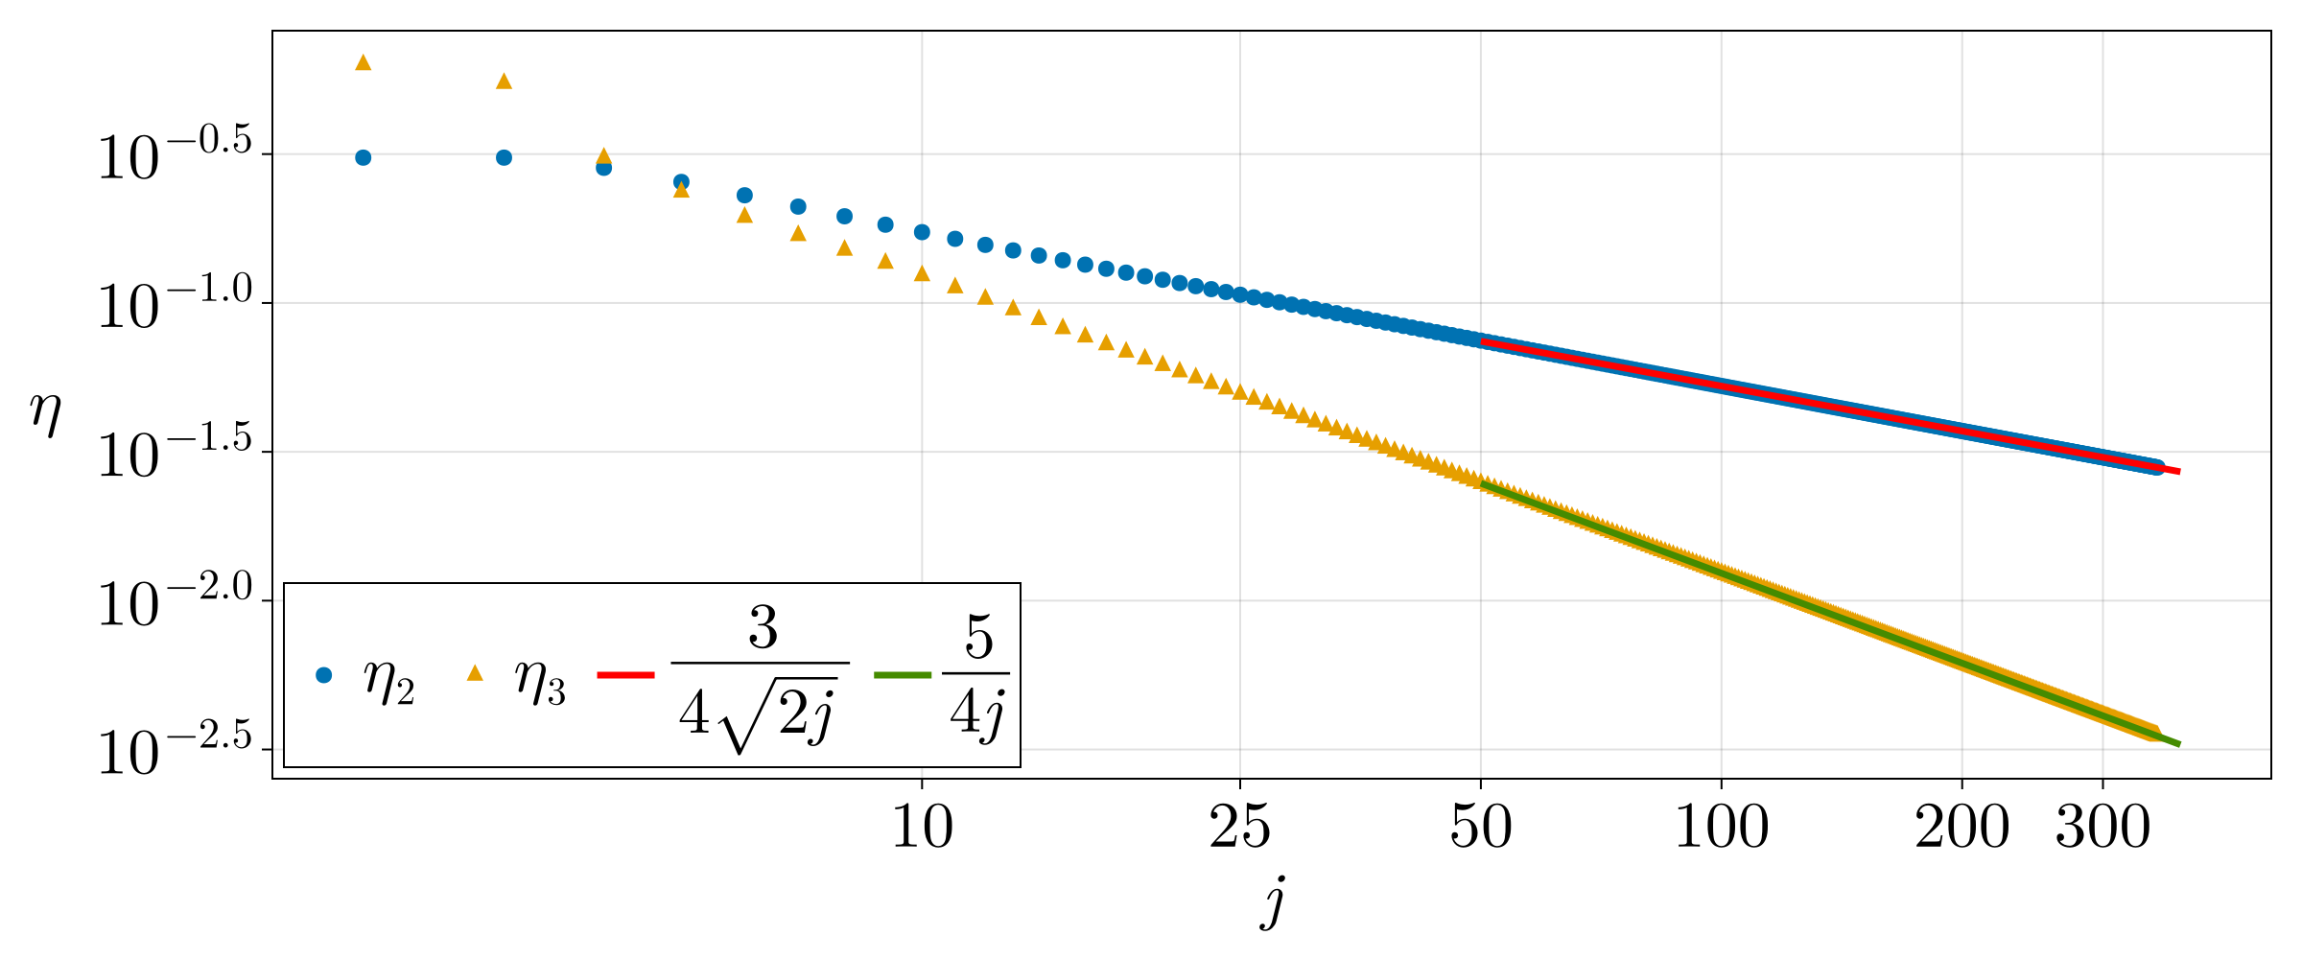
High spin values

Slide 19
Conclusion and outlook
The protocol is able to generate AC states with high degree of
Anticoherence, even analytically exact
Possibility to use dynamical decoupling to protect AC states
from decoherence (cf. the paper)
Experimental generation of AC states from spin or Bose-Einstein
Condensate systems
Other kind of Hamiltonian or evolutions to speed-up the generation
of anticoherent states

