Slide 1

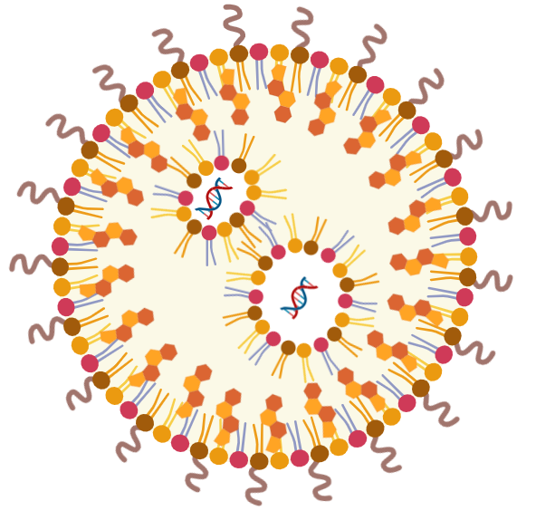

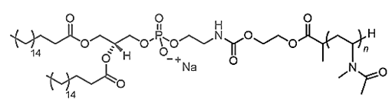

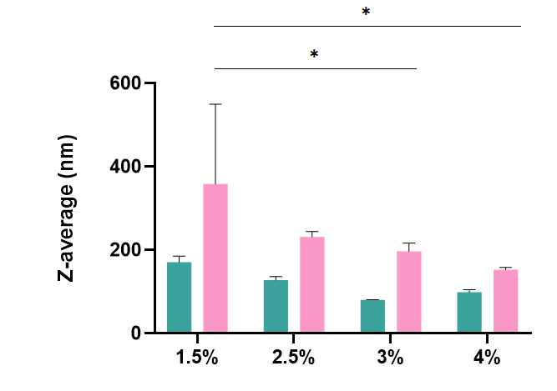
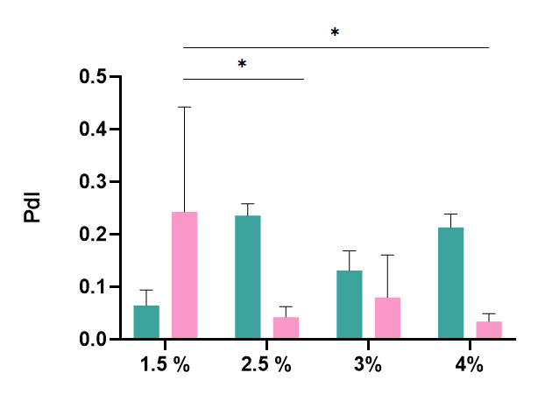
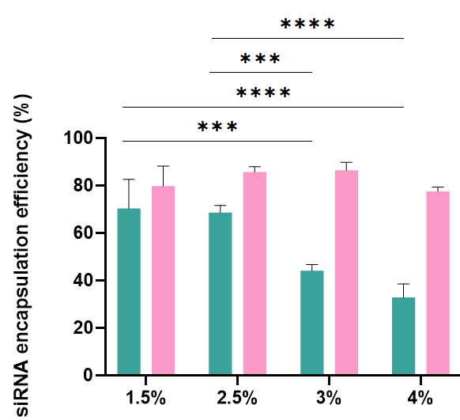
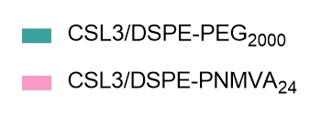
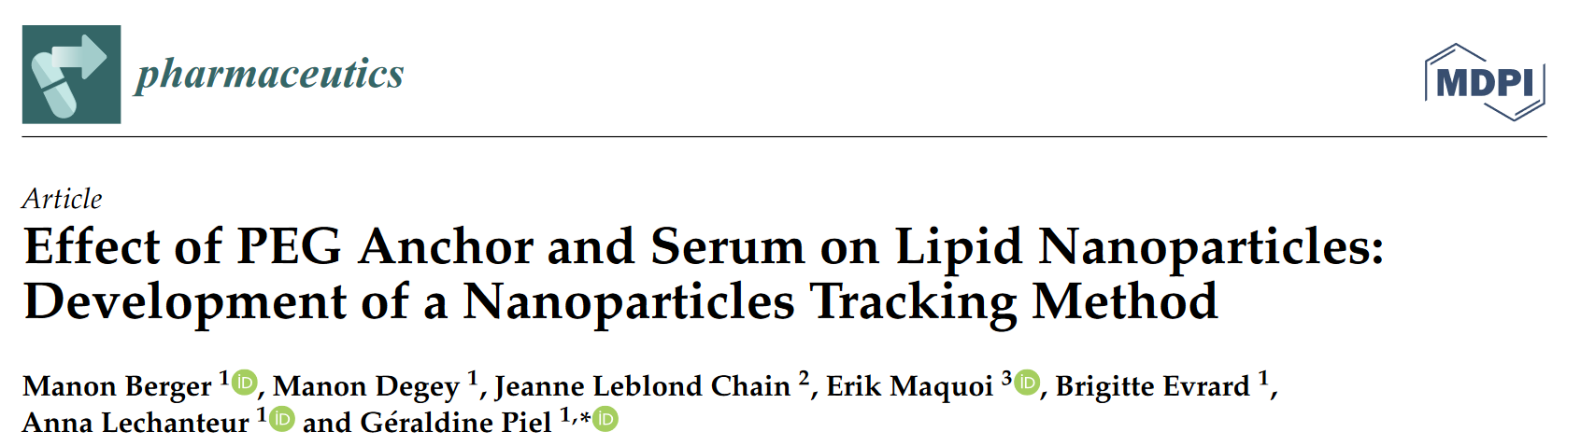
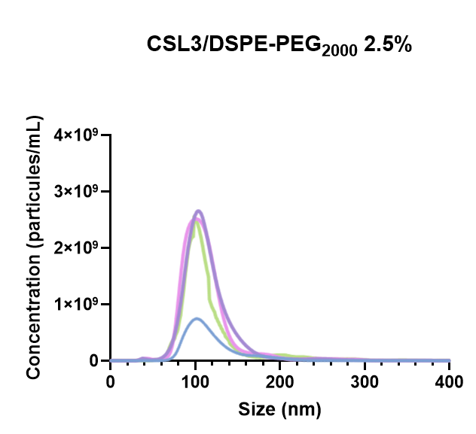
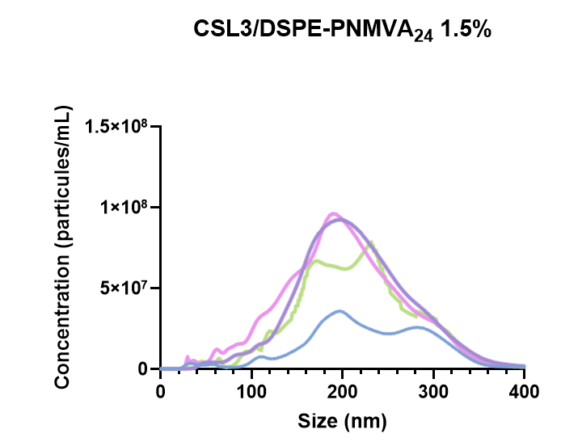
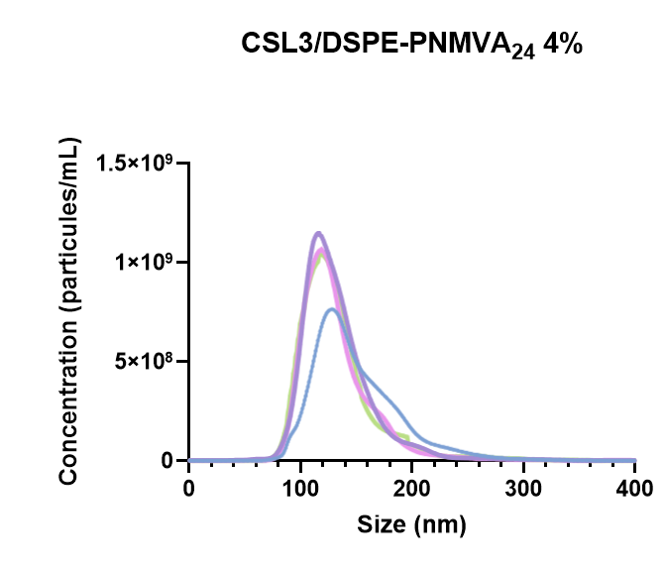
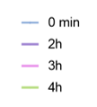
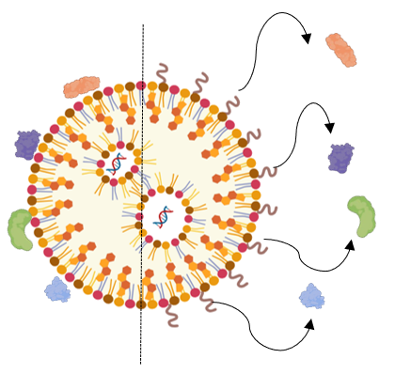
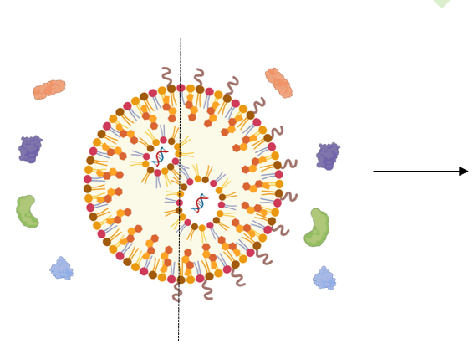
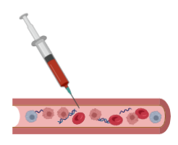
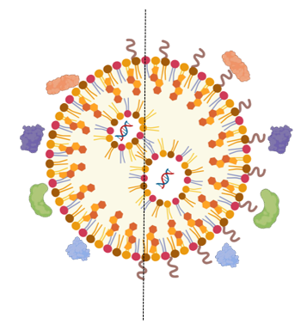
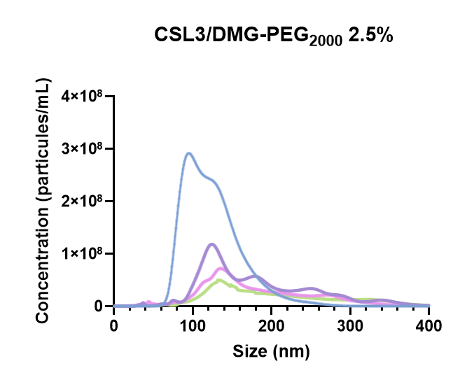
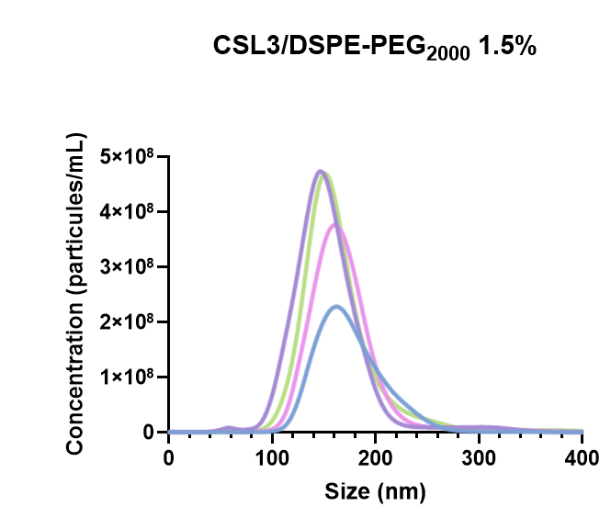
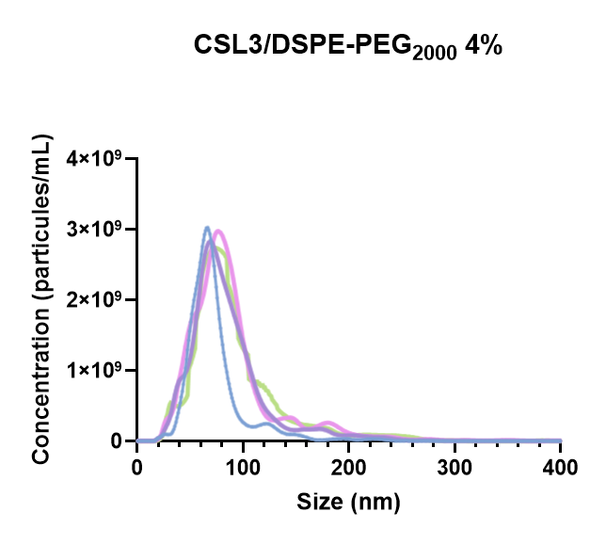
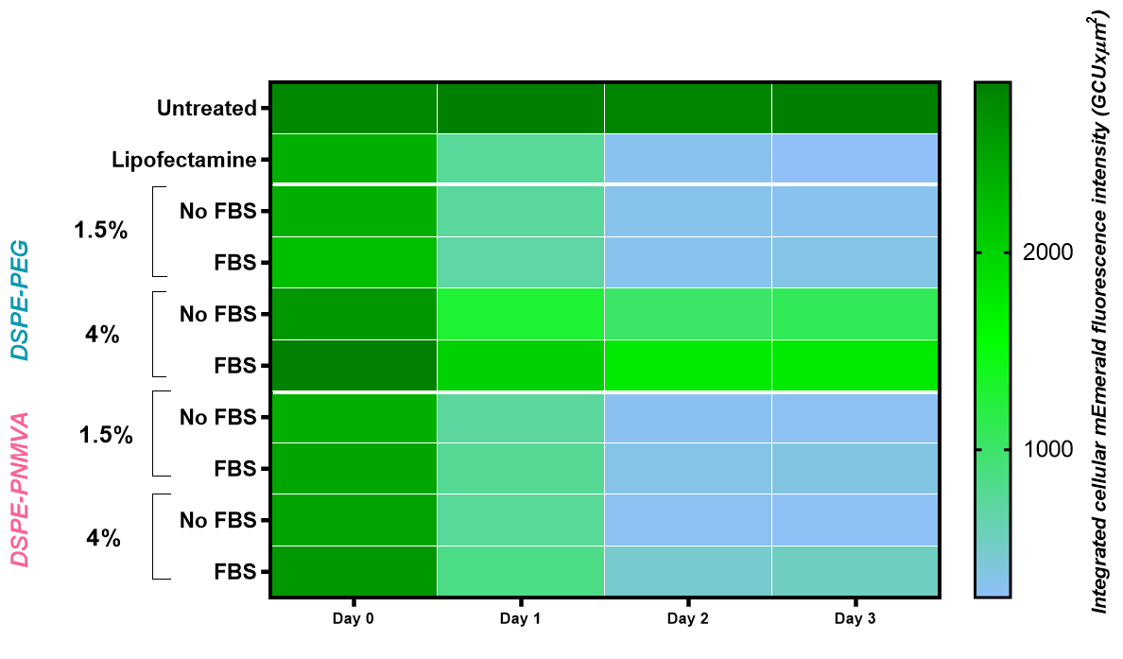
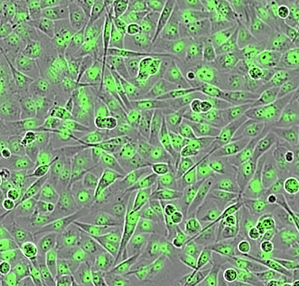
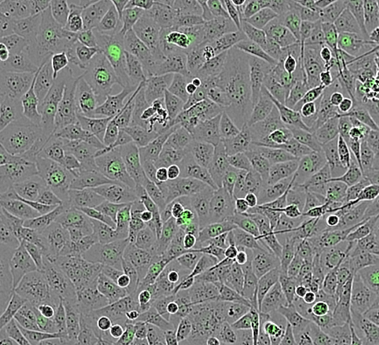
Redesigning lipid nanoparticles for enhanced intravenous delivery for cancer treatment: PNMVA as a promising PEG substitute
Degey Manon¹, Berger Manon¹, Meloni Laura¹, Pedergnana Stefano², Debuigne Antoine², Jérôme Christine², Evrard Brigitte¹, Maquoi Erik³, Leblond Chain Jeanne⁴, Piel Géraldine¹
¹Laboratory of Pharmaceutical Technology and Biopharmacy, University of Liege, CIRM, 15 Avenue Hippocrate, 4000 Liege, Belgium
²Center for Education and Research on Macromolecules CERM, CESAM Research Unit, University of Liege, 13 Allée du Six Août, 4000 Liege, Belgium
³Laboratory of Tumor and Development Biology, GIGA-Cancer, University of Liege, 4000 Liège, Belgium
⁴CNRS, INSERM, ARNA, University of Bordeaux, UMR 5320, U1212, F-33000 Bordeaux, France
Introduction
Objectives
Since COVID-19 pandemic, Lipid Nanoparticles (LNPs) encapsulating mRNA have emerged as a new class of therapeutic agent as well as Onpattro®, the first FDA-approved drug based on LNPs and siRNA for a hepatic disease [1]. Indeed, siRNA and mRNA need vectors to reach the target undamaged. This is the reason why LNPs have garnered attention in this context. To target beyond the liver, notably for cancer treatment, LNPs need to be protected from blood biomolecules because of the formation of a protein corona, affecting their efficacy. In this context, polyethylene glycol (PEG) is used to prevent this phenomenon, but its issues initiate the search for alternatives. Recently, alternatives to PEG such as Poly(N-methyl-N-vinylacetamide) (PNMVA) have been studied with LNPs and seem to be promising [2]. However, improvements need to be done to optimize LNP properties and protein corona formation ability.
1.5% 2.5% 3% 4%
DSPE-PNMVA (DP=24)
Materials and methods
Figure 1 : DSPE-PNMVA₂₄ structure.
v
Production
The LNPs, produced by rapid-mixing, are composed of CSL3 (switchable lipid), DSPC, cholesterol and different types of C₁₈ lipid-polymers (DSPE-PEG₂₀₀₀ and DSPE-PNMVA₂₄) and DMG-PEG₂₀₀₀ as C₁₄ control at a molar ratio respectively of 50:10:37.5:2.5. The lipid-polymer content was decreased to 1.5% for all the formulations and increased to 3 to 4% by varying the cholesterol content only for DSPE-PEG₂₀₀₀ and DSPE-PNMVA₂₄ formulations.
II. Physicochemical characterization
Key properties such as size, PdI and surface charge were analyzed by DLS and NTA while siRNA encapsulation efficiency was evaluated by Ribogreen® assay. The goal was to meet intravenous administration standards: size < 150 nm, PdI < 0.2 and maximum encapsulation efficiency.
III. Protein corona formation
Protein corona formation was evaluated using NTA method after incubation in 33.33% of FBS at 37°C.
To explore the impact of different contents of a new type of lipid-polymer (DSPE-PNMVA₂₄) on LNP physicochemical properties (Figure 1) and protein corona formation to then compare it to PEG (DSPE-PEG₂₀₀₀).
Development of safer and efficient LNP formulations for a future antitumoral application.
Results and discussion
I. Impact of DSPE-PNMVA₂₄ and DSPE-PEG₂₀₀₀ content on LNP properties
The impact of DSPE-PNMVA₂₄ and DSPE-PEG₂₀₀₀ content (1.5–4%) on LNP physicochemical properties was studied. Increasing the lipid-polymer content reduces Z-average for both LNP types. However, increasing lipid-PEG content increases PdI, while increasing lipid-PNMVA content decreases it. Encapsulation efficiency of siRNA is also changing as increasing lipid-PEG content reduces it, whereas increasing lipid-PNMVA content has no impact. So on, a higher DSPE-PNMVA₂₄ content (4%) is needed to form and stabilize LNPs compared to DSPE-PEG₂₀₀₀. While 1.5% lipid-polymer is used in the COVID-19 vaccines, 4% of DSPE-PNMVA₂₄ ensures LNPs with a size <150 nm, PdI <0.2, and ~80% siRNA encapsulation efficiency (Figure 2).
II. Impact of DSPE-PNMVA₂₄ and DSPE-PEG₂₀₀₀ content on protein corona formation
Figure 2 : Physicochemical properties of different LNP formulations.
C18-PEG
A previously developed NTA method was used to assess the impact of the nature and lipid-polymer ratio on their ability to protect LNPs from protein corona formation. According to this study, long lipid chains as C₁₈ lipid-PEG protect against protein corona. Indeed, in the presence of 33% of FBS, LNPs covered with 2.5% of this type of lipid-PEG showed no significant variation in size and concentration (Figure 3) at the opposite of LNPs composed of C₁₄ lipid-PEG.
C14-PEG
A concentration of 1.5% of DSPE-PEG₂₀₀₀ is sufficient to stabilize LNPs in FBS, maintaining consistent size and concentration over time. In contrast, DSPE-PNMVA₂₄ requires 3–4% to ensure stability, as lower concentrations (<3%) result in irregular size and concentration profiles over time. This indicates that 4% DSPE-PNMVA₂₄ is necessary to enhance shielding capacities (Figure 4).
Figure 3 : Illustration of protein corona formation on LNP surface composed of long lipid-PEG (C₁₈) and short lipid-PEG (C₁₄).
Figure 4 : NTA profiles (FBS 33.33%) of different LNP formulations.
III. Preliminary in vitro results : gene knockdownn efficiency (triple negative breast carcinoma MDA-MB-231cells expressing nuclear mEmerald)
Untreated cells
CSL3/DSPE-PNMVA₂₄ 4% siGFP
The developed formulations were prepared with siGFP a small interfering RNA targeting GFP expression, and incubated with MDA-MB-231 cells expressing mEmerald (mutated form of GFP) for 4 hours in serum-free conditions (100 nM siGFP). Live-cell imaging was performed using the Incucyte Sx5 over 72 hours and showed a decrease of GFP expression with PNMVA formulations inserted at higher contents (Figure 5). Composite images combining phase contrast and green fluorescence are shown. After 72 hours, cells were analyzed by flow cytometry (CytoFLEX) to measure mean fluorescence intensity (MFI) of GFP.
Formulations with 4% DSPE-PNMVA₂₄ allowed the 90% of GFP fluorescence extinction
Figure 5 : Live cell imaging of MDA-MB-231 cells expressing mEmerald after 72 hours of incubation with indicated formulations of LNPs
Conclusion
References
In conclusion, the promising potential of DSPE-PNMVA₂₄ at 4% as an alternative to PEG in LNPs has been confirmed, with findings indicating the need for a higher concentration than previously used.
[1] L. Schoenmaker et al., ‘mRNA-lipid nanoparticle COVID-19 vaccines: Structure and stability’, Int. J. Pharm., vol. 601, p. 120586, May 2021, doi: 10.1016/j.ijpharm.2021.120586.
[2] M. Berger et al., ‘Poly( N ‐methyl‐ N ‐vinylacetamide): A Strong Alternative to PEG for Lipid‐Based Nanocarriers Delivering siRNA’, Adv. Healthc. Mater., p. 2302712, Nov. 2023, doi: 10.1002/adhm.202302712.
Notes:
Revoir les interprétations des résultats
Revoir les cadres

