Slide 1

Videogames and Cultural Democracy: Alternative Practices, Archives, and Discourses
Liège Game Lab
Notes:
HELLO + THANKS TO THE ORGANIZERS

Slide 2

https://www.liegegamelab.uliege.be
Notes:
THIS PANEL IF ORGANIZED BY THE LIEGE GAME LAB, a collective group that was born in 2016 in Liège
10th birthday next year
we work on a big variety of themes but are gathered by the notion of video games as a culture

Slide 3
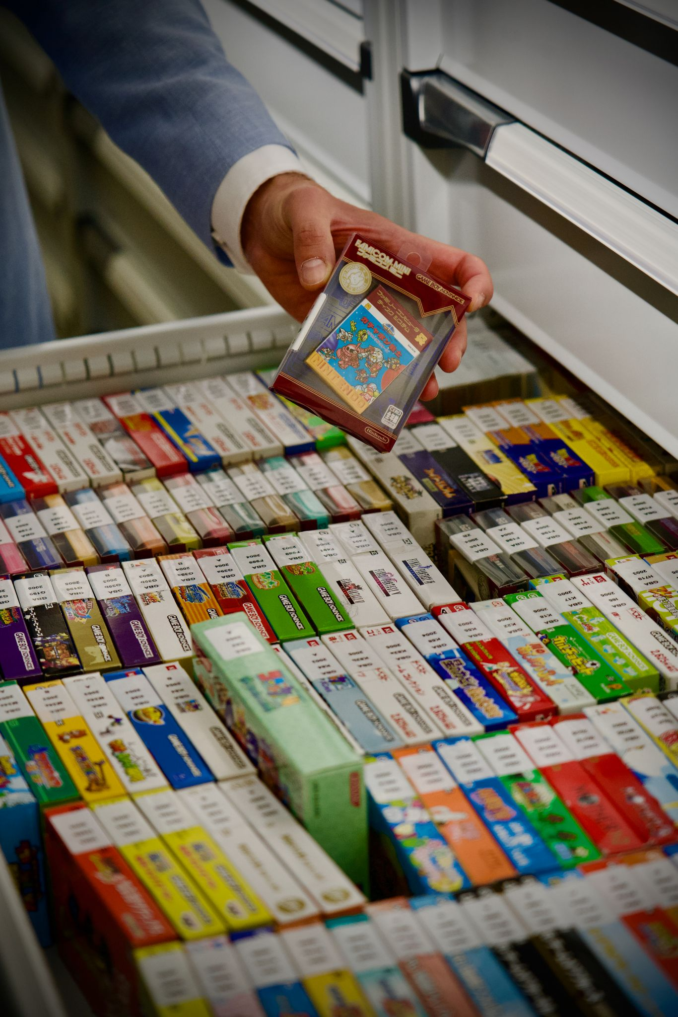
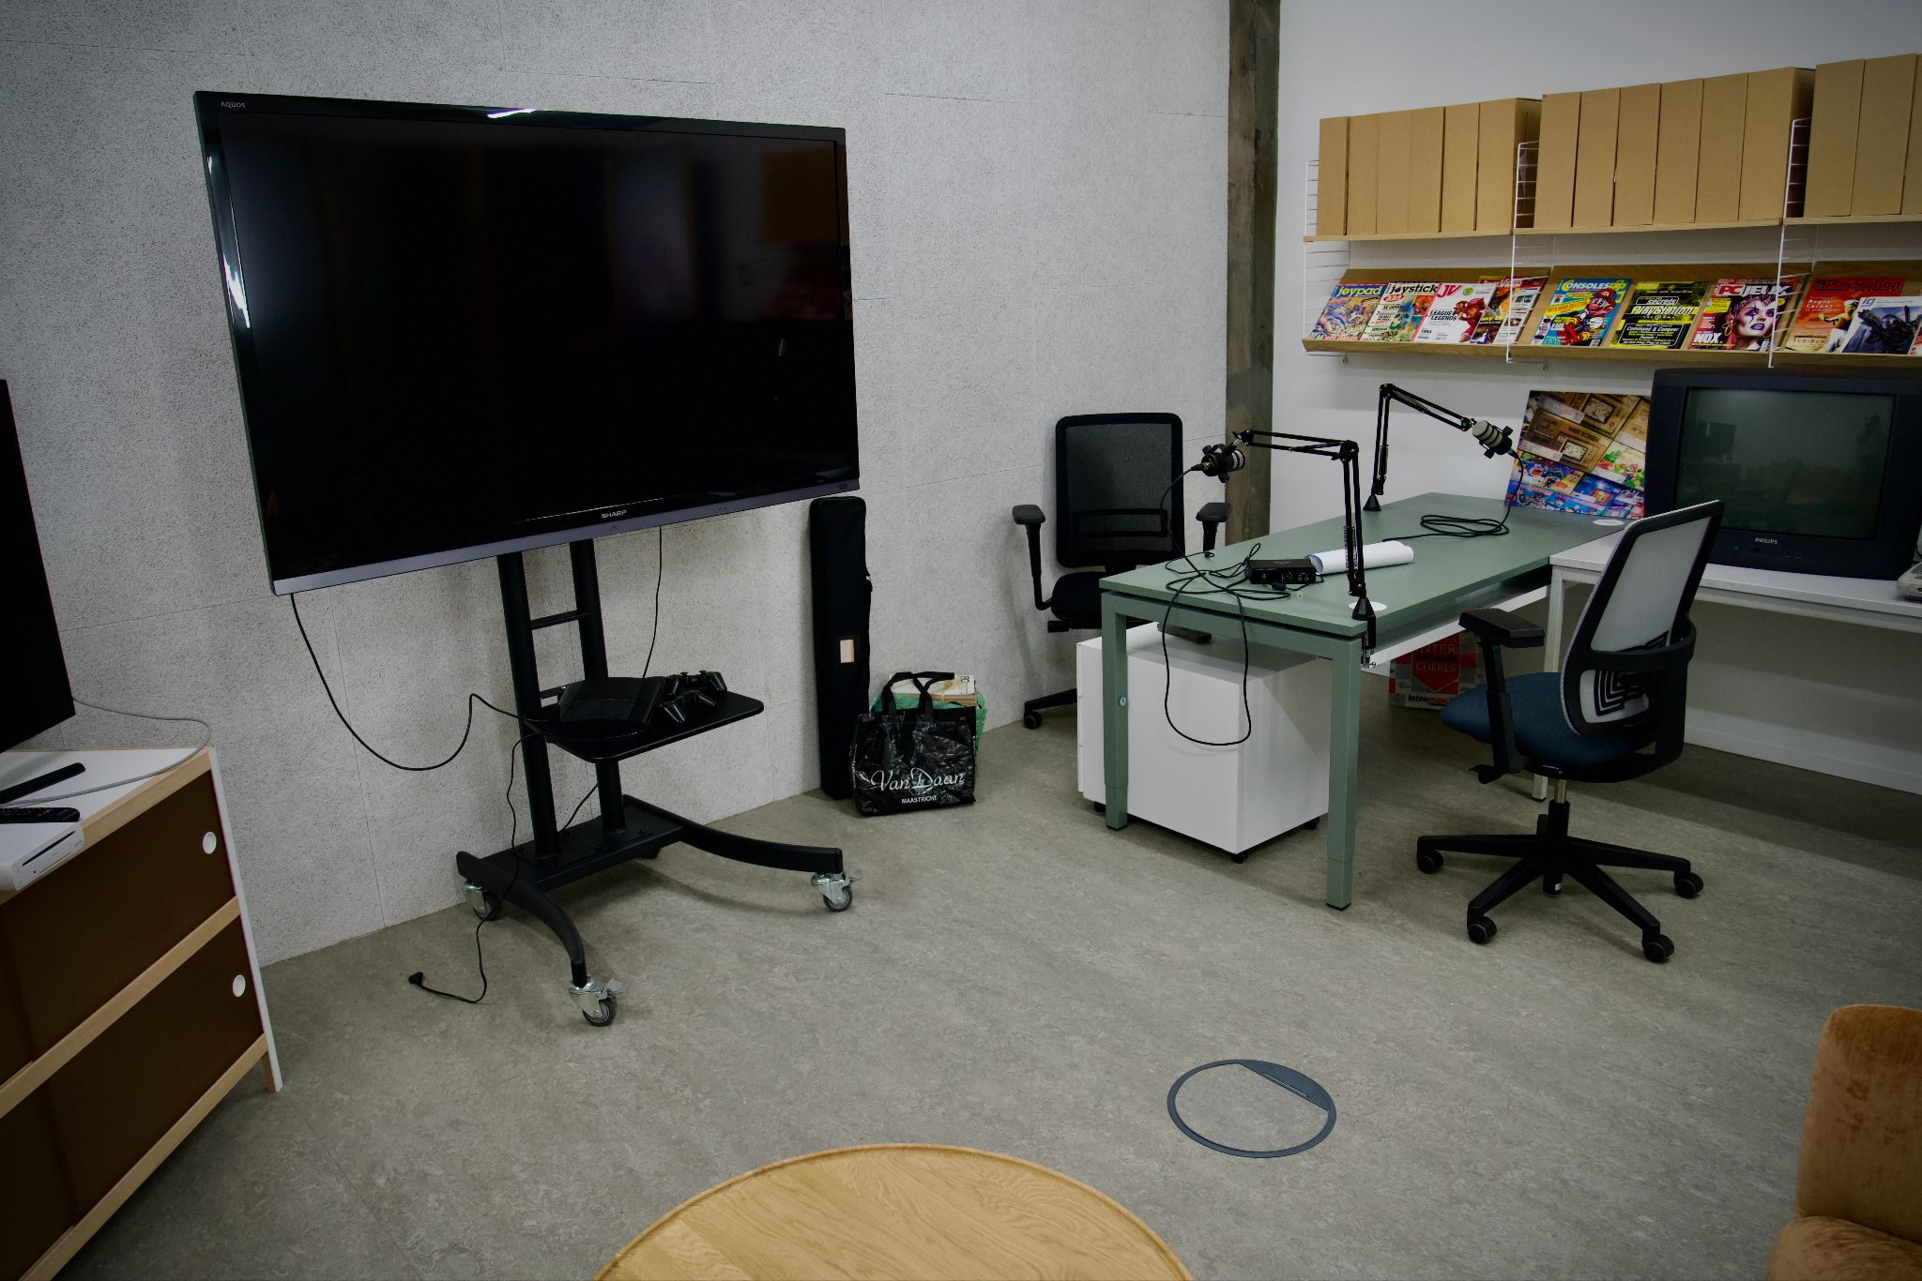
A brand new space!
Notes:
THIS PANEL IF ORGANIZED BY THE LIEGE GAME LAB
From the end of 2024 onwards, two new rooms have been occupied by us in the new Campus of ValBenoit at the University of Liège. The first is an office where we have a workspace, several spaces where we can test the games from the collection.
The most important thing is our archive room where we store several collections of video games:
almost 5000 Japanese video games that we received on long-term loan from the Ritsumeikan Center for Game Studies,
a sizeable collection of video game magazines, and a collection of video games in French.
We have the ambition to develop a video game archive center that will be accessible to students and researchers.
and if you have any question please ask to anna maria she's just here

Slide 4
Study the margins
Understanding a culture
Notes:
OUR TAKE TODAY IS THAT : PROMOTING INCLUSIVITY IN VIDEO GAMES CULTURE IMPLY TO STUDY ITS MARGINS, AND UNDERSTAND HOW WORK THIS FIELD AS A CULTURE (AND NOT ONLY AS AN INDUSTRY OR A TOOL, for example)
BECAUSE WE’RE GOING THROUGH THE DARKNESS, WITH FASCISATION RISING IN DIFFERENT PART OF THE WORLD, WE’D LIKE TO COORDINATE AND MAKE THESE INITIATIVES MORE VISIBLE IN THE COMING TIMES

Slide 5
Summary
Around 12 minutes by light talk 1 question after each one
Discussion at the end
Amateurism and videogame democracy
Pierre-Yves Hurel, University of Lausanne, Switzerland
Game design workshops as ludoliteracy : Giving young people the means to create
Maxime Verbesselt, University of Namur, Belgium
The alternative video game archive : (re)naming video game creators
Anna-Maria Tefois, University of Liège, Belgium
Who decides what kind of video game to play? The place of audience discussion
François-Xavier Surinx, University of Liège, Belgium
Public space in the era of platformization: the case of Twitch
Fanny Barnabé, University of Namur, Belgium
Notes:
So we will have 5 parts, you can expect "light talks" around twelve minutes. We will try to do not do too much into the details but invite you to get in touch to continue exchanges if you're instesresting.
We'll take only one question after each talk and hopefully have time for cross discussion at the end of the panel
One last thing English is not our mother tongue, so don’t hesitate to express non verbal sign of interest and understanding, so the situation is less stressful for each of us

Slide 6
AMATEURISM AND
VIDEO GAME DEMOCRACY
Pierre-Yves Hurel – FNS Postdoctoral Researcher, University of Lausanne, pierre-yves.hurel@unil.ch UNIL-EPFL Game Lab – Liège Game Lab – Confoederatio Ludens project
Notes:
I come to my part, about amateurism and video game democracy

Slide 7
Legitimizing video games
Economics
Education
Art
=> Amateurism
Notes:
In order to legitimate video games, scholars, institutions or general audience are used to refer to three main strategies :
1. ECONOMICAL That’s the most important cultural industry of the world
2. EDUCATIONAL It is useful : look at serious games or serious gaming
3. ARTISTIC : look how these games are beautiful, it has to be of great cultural value.
And those strategies can be used with good intentions, of course.
But there are not exactly the more interesting when it comes to draw an inclusive field
1. We don’t want to limit ourselves to economical success, nor recognize the best successes
2. We don’t want to devaluate non-serious games
3. We don’t want to judge witch games are the ones with cultural value, not judge which practice is légitimité
I would like to invite you to think about a fourth strategies today, which is starting for the very specific moment of contact betxween games and players - in line with my phd thesis finished in 2020 and regional histories I’m working on since then.

Slide 8
I was looking for amateurs making games (there are really a lot of them)
I found amateurs of video games
"Why are you making games ? Because I like games"
Notes:
(THESE RESEARCH ARE BASED ON INTERVIEWS, GTM AND INDUCTIVITY - WE CAN TALK OF METHODOLOGY IF YOU WANT)
Why players are playing games ?
=> feelings

Slide 9
TASTING (GOÛTER / DÉGUSTER)
Taste as a situated activity is not so pre-established: it points toward the contact, a situation of ‘between-the-two’, the place and the moment of the uncertain upsurge of sensation. In the act of tasting, (…) in the tiny ongoing adjustments that lay it out and favour its felicity and reproducibility – it is on the basis of all these responses that objects return to those who take an interest in them. (Hennion 2007)
https://journals.sagepub.com/doi/epdf/10.1177/1749975507073923
Tastes / Tasting => Focus on the activity
Notes:
WHAT DOES IT MEAN TO LIKE GAMES?
I FOUND HELP IN THE PRAGMATIC SOCIOLOGY AND THE CONCEPT OF TASTING
=> tasting
Tasting wine, music, video games

Slide 10

TASTING VIDEO GAMES
“For example, by setting up equipment statistics, by hiding chests in the scenery, I feel a pleasure very similar to that of discovering equipment and hidden chests in an RPG […].” (Lucien)
Playing and making as a continuum, two ways to taste video games
https://books.openedition.org/enseditions/45920?lang=fr
Notes:
playing and making as a continuum

Slide 11
What is there to taste in video games?
Narratives, graphics, musics gameplay… => focus on the management of uncertainty (Henriot)
Interviewees expressed their attachment to small video games units (chests, blocks, a grappling hook), and I analyzed it as ways for them taste uncertainty.
Ludèmes : the minimal units of a video game, composed of graphics, sounds, and characteristics. (Not a minimal interaction or gameplay loop as in previous works). Can be grasped from both making and playing.
Notes:
What is there to taste in video games ?
Many things ? What's specific to games ? the management of uncertainty
=> one key way to grasp this is based on small units, that I called ludèmes. One quick exemple : pushable blocks in zelda like games

Slide 12
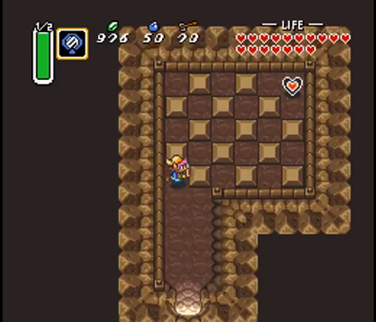
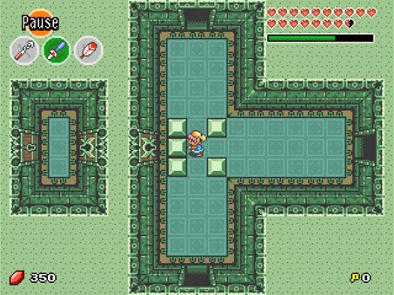

A Link to the Past
Zelda Solarus
Linked to certain kind of uncertainty
Identification
Activation
Reveal
Access to
Situations (or motifs, or even genres)
Subdivision of
Ludème : a pushable block (not the act of pushing the block)
To divide in
Representation
Characteristics
Graphics
Sounds
Can be pushed (0 or 1 time)
Push distance = X pixels
Can fall into a hole
…
Amateurism generates video game cultures.
Notes:
Ludèmes are combining graphics, sounds, code
MY POINT IS THAT IS IS ON THIS SPECIFIC TASTING ACTIVITY THAT WE CAN BUILD VIDEO GAMES CULTURES :
WE PLAY, WE TASTE, WE THEN WANT TO CREATE A DIFFERENT VERSION, DEVELOP AN OPINION
HERE IT'S ONLY ON SPECIFIC UNITS, BUT IT SHOWS HOW IT WORK MORE BROADLY
Amateurism generates video game cultures.

Slide 13


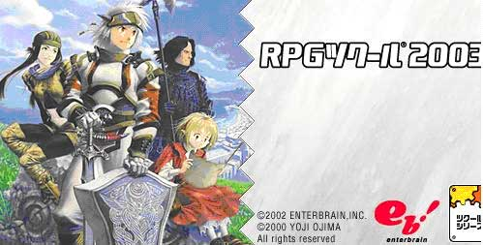

RPG MAKER IN FRANCE
RPG Dimension (2000-2001)
Okius (2001-2002)
Manka-Dream (2002-2004)
Imagie-Nation (2004)
La Ligue des Makers Extraordinaires (2003-2006)
Oniromancie (2006-2025)
rpgmakervx-fr.com
Notes:
MONGST OTHER THINGS, URGE TO
- MAKE THE HISTORIES OF THESES COMMUNITIES AND REINTGRATE THIS IN THE CANONICAL WAY TO MAKE THE HISTORY OF VIDEO GAMES

Slide 14

The invisibilization of amateurs
French-speaking amateurs in 1980s & in 2000s
Hobbyists and local authors were known in the late 1980s but disappeared from specialized press in the 2000s
and wee deleted while the videogames became mainstream
Krywicki, Boris, et al. « Le jeu vidéo amateur dans Tilt et Consoles + de 1982 à 2000 : généalogie d’une invisibilisation ». Lire les magazines de jeux vidéo, édité par Sélim Ammouche et al., Presses universitaires de Liège, 2022, https://doi.org/10.4000/books.pulg.25892
Notes:
- FIGHT AGAINST THEIR INVISIBILIZATION

Slide 15
MANIFESTO FOR THE AMATEURIFICATION
OF VIDEO GAMES – VERSION 0.2
Attention to affects, whether ordinary or not, constitutes an aesthetic experience: tasting.
Receptive and creative tasting belong to the same continuum: amateurism.
Amateurism generates video game cultures.
The amateur, when creating, is a dead author: creating without pretension, from within a situation.
There are as many “best games” as there are games, for there are as many forms of “good” taste as there are amateurs.
To recognize, defend, preserve, and promote receptive and creative tasting is the foundation of amateurification.
The establishment of a cultural democracy of video games requires the amateurification of video games.
Notes:
MANIFESTO
=> LET’S FOCUS ON THE AFFECTS TO BUILD A NEW REGIME OF LEGITIMIZATION

Slide 16


Game design workshops as videogame literacy Giving young people the means to create
Inclusive Digital Society 2025 Maxime Verbesselt
Notes:
Following the theme of the conference, I will focus on the role that learning game design can play in building a more inclusive society, and its potential as an expressive tool to support cultural democracy and citizenship.

Slide 17
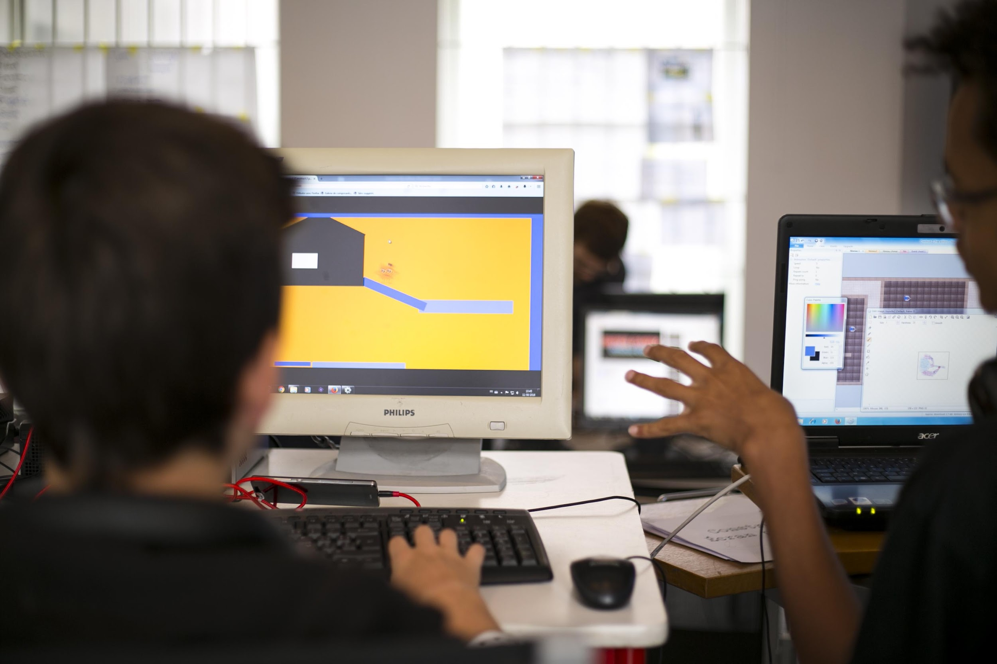
Some context
Videogame creation workshops
Media education
Notes:
I am about to start a doctoral thesis at the University of Namur in the “information and communication” department. I come from the field of media education, and I worked for ten years in a youth media education organization based in Wallonia. In this context, I had the opportunity to organize video game creation workshops from a perspective of videogame literacy. Two of these workshops have already been presented in previous communications, and I will briefly present them to contextualize my doctoral research project.

Slide 18

« Rives d’Europe » (« Shores of Europe »)
Cultural mediation
Cultural democracy
Critical discourse on Clash of civilizations (huttington, 1996)
Notes:
First, the project “Rives d’Europe” was presented jointly with Pierre Yves Hurel in Lausanne in 2017 at the conference “Thinking with videogame culture.” It was a cultural mediation project within a perspective of cultural democracy. We proposed the idea of videogame-based civic expression by offering participants, all of whom were newcomers in video game creation, the opportunity to express critical discourse on the theory of the clash of civilizations and to promote intercultural dialogue, both through videogame creation. Here are four of the seven games that came out the workshops.

Slide 19
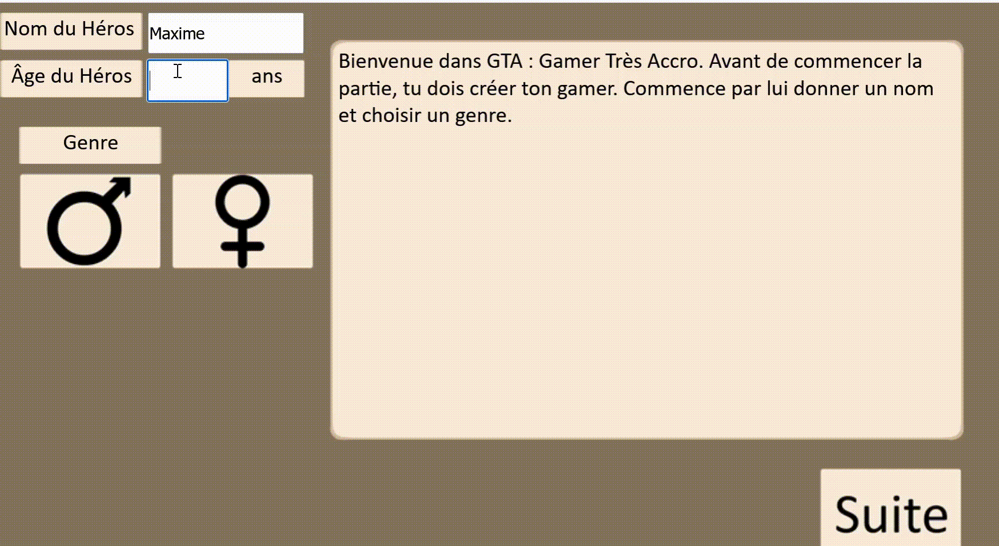
« Game Très Accro» (« Very Addicted Gamer»)
Stereotypes about gamers
Opinions translated in game mechanics
Notes:
Secondly, the project “Very Addicted Gamer” (in French, it’s “Gamer très accro”, so the acronym is: GTA) was presented in 2018 in Liège and published in the conference proceedings in 2023. It was a video game creation workshop for adolescents. The objective was to use video games as a means of expression and reflection on stereotypes associated with gamers. The participants were encouraged to translate their opinions into game mechanics. For example, by turning the stereotype of video game violence into a temporary gameplay effect, or by caricaturing the exclusion of girls through a “female character” button that could not be selected.

Slide 20
Tensions
Game Design | Free-form design | Tool-centered approach
Gameplay | Engineering process | Experimental way
Notes:
W hen evaluating these projects, several tensions emerged, in particular regarding how game design is initiated during the workshops (game design being the process of constructing mechanics and rules). The organizers oscillated between an approach focused on an free form design approach; for instance, allowing participants to freely imagine mechanics on paper, without necessarily implementing them in a digital game, and an approach focus on the technical game creation tools, emphasizing the learning of these tools during workshops. The first approach, based on free and creative imagination of mechanics in the abstract, has the benefit of encouraging the development of reflective skills among participants, linked to a more developed understanding of expressive potential of video games. However, this approach faces the practical challenges of video game development. It is indeed very difficult to gather the conditions necessary to create sophisticated video games in this type of workshop - given that participants have relatively little technical expertise beforehand. On the other hand, the techno-centered approach, which anchors learning in the technical use of the game engine, ensures greater participant autonomy and therefore prioritizes the concrete finalization of the game project. However, it tends to limit the range of possible outcomes by restricting creativity to what the tool immediately allows.
The design of gameplay can thus follow two main approaches. In the first case, one starts from a more or less detailed analysis of existing video games: they are observed, their principles are extracted, and these principles are then reused or adapted in one’s own creation. This approach is more structured: it resembles an engineering process in which the logic is planned in advance. By contrast, one can proceed in a more experimental way, by directly exploring the game engine and progressing through trial and error. Here, the goal is not to set up a precise plan intended to deliver a predefined experience “on paper,” as one might with a design brief. This method, more intuitive, leaves ample room for unpredictability and for play with the tools themselves. From this perspective, creating a game in an amateur and iterative way often amounts to extending the act of play into the very process of making. As Pierre-Yves Hurel has shown, this practice can be understood as a form of play in itself, where designing and experimenting are part of the same playful activity.
Tous les commentaires ou modifications dans ce paragraphe sont liés au fait qu’il contient beaucoup d’implicite et que j’ai peur que le public ait du mal à te suivre
A l’oral, la phrase ne sera pas facile à suivre s’il y a une incise au milieu

Slide 21
Research problem
Can civic videogame expression be taught through game design in video game creation workshops ?
Notes:
So, the question I am currently asking is: “Can civic videogame expression be taught through game design in video game creation workshops?” This question can be broken down into two perspectives.
(5’)

Slide 22
Procedural rhetoric
Game design leads the player to make choices, which can prompt an ethical evaluation of the game system (BOGOST, 2007) (FRASCA, 2003)
Rules are an intermediary between production and reception (SALEN & ZIMMERMAN, 2003) (DJAOUTI & ALVAREZ 2008)
Ludèmes are minimal signifying units of video game language (HANSEN, 2023)
Notes:
The first perspective is the idea that one can participate in civic life through video game creation. In other words, that a video game carries a message through its game design. This relates to the concept of procedural rhetoric, which posits that video games can make arguments through their game systems and thus communicate ideas in ways unique to their media-specific properties. Game design leads the player to make choices, which can prompt an ethical evaluation of the game system. It is therefore important to consider not only the intentions of the creators but also the player’s experience: what real freedom does the player have, and do their actions have meaningful consequences on the progression of the game? Game rules act as an intermediary between production and reception through the arrangement of ludic components whose interactions form the grammar of the game. However, this idea is criticized, because bare mechanics hardly exist in video games. Mechanics are combined with representations to form what Damien Hansen calls “ludèmes” as you heard from Pierre Yves before. It is the configurations of these “ludèmes” that can carry the message of a video game.

Slide 23
Videogame literacy
Ability
To read and write media
To master social and cultural practices specific to these media (GEE, 2003)
To understand, analyze, appreciate, and create games critically
To interpret their mechanics and meanings (ZAGAL, 2010)
Notes:
The second perspective is that there exists a way to “teach video games.” This refers to Videogame Literacy. Literacy is the ability to read and write media, but also the mastery of social and cultural practices specific to these media. Videogame literacy can therefore be defined as the ability to understand, analyze, appreciate, and create games critically, as well as to interpret their mechanics and meanings.

Slide 24
Videogame literacy
Situate a videogame
In a broad cultural context
In relation to other games
According to the technologies used
Through the deconstruction of their components (ZAGAL, 2010)
Notes:
One must be able to situate a video game in a broad cultural context, but also in relation to other games, according to the technologies used, and through the deconstruction of their components. It is also important to recognize the role of communities of practice in the construction and sharing of knowledge about games. This allows the development of one’s ludic capital. Videogame literacy views games as entangled languages and requires understanding the system rules, their significance in relation to others, the messages about the world they construct, and how players respond to these representations. Teaching video games requires analyzing gameplay and reflecting on the meaning of the consequences of our actions in the game. This can involve various formalized teaching activities of critical play and analysis, but also production activities.

Slide 25
Literacy through videogame creation
Computational Thinking (ZIMMERMAN, 2009)
Systems building and understanding
Play = free movement in a designed structure
Rules > generate interactions
Mobilization of social skills (YASMIN et QUINN, 2016)
Notes:
This last point is precisely what interests us: videogame literacy can be developed through videogame creation, or game design-based learning. The main specificity of of this method of developing videogame literacy is computational thinking—that is, the ability to build and understand systems. Games are systems whose elements only gain meaning in relation to each other through dynamic interactions. The game is experienced as an activity; it only takes shape when the system is activated. Play should therefore be viewed as free movement within the created structure, where rules designed by participants are intended to generate interactions between humans or between humans and computers. Game design thus consists of creating a context to be encountered by a player, a space where meaning emerges from interaction. It involves designing a set of possibilities rather than producing a fixed object. Furthermore, the fundamentally collective nature of game design based literacy, through the mobilization of social and communicative skills, has been highlighted in several studies.
8 ou 9 minutes

Slide 26
The place of game design in videogame creation workshops
Confusion about game design
Methodological and pedagogical challenges (VIGNEAU, 2019)
Difficulty to move from a playful mode to a critical mode (Zagal, 2010)
Notes:
In theory, then, teaching game design through videogame creation workshops can provide critical tools for questioning society. But, in practice, we must ask about the real place of game design in video game creation workshops. In this regard, the workshops I have been able to study so far raise questions which can be grouped into three categories.
First, there is often confusion about the concept of game design. This confusion can be found both in the way workshops are designed by organizers and in participants’ representations of what it means to design a video game. Indeed, game design is often mistaken for other tasks involved in video game creation, such as narrative design, level design, programming or even the creation of assets (graphic, sound, or textual.) Although all of these operations depend on one another, we observe that very few activities are actually dedicated to defining the game mechanics.
Secondly, we can observe significant methodological and pedagogical in implementing game design activities in this type of workshop. Game design mechanics stem from both theoretical research and the practical work of professional game designers. They are complex concepts that are difficult to understand for newcomers.
Finally, we can observe a gap between the facilitators' objectives for understanding the concept of game design and the experiences of the participants. We found that workshop facilitators expect participants to understand the game design choices made in the video games they play. However, participants find it difficult to move beyond their appreciation of their experience to adopt a more analytical perspective and formalize how the games they play actually work. This is what Zagal calls “the difficulty of moving from a playful attitude to an analytical attitude.”

Slide 27
Research project
Videogame creation workshops analyzing
Game design pedagogical tools experiments
Interviews with facilitators and participants
Study of productions from the workshops
Notes:
Here is where I currently stand in defining my research problem. The main goal of this research is to build tools for critical video game education focused on game design, with the aim of evaluating and objectifying the impact of activities conducted from a perspective of civic expression. I plan to implement a protocol for analyzing creation workshops. I will base this on observations of activities conducted using different game design pedagogical tools. These observations will be combined with interviews and the study of productions generated during the workshops.
I have already begun conducting exploratory observations this summer during a week of video game creation activities held at Quai 10 in Charleroi. I have also planned several additional observations in the coming months, and I look forward to being able to share some results.

Slide 28


Slide 29
Bibliography
ANTHROPY, A. (2012). Rise of the Videogame Zinesters: How Freaks, Normals, Amateurs, Artists, Dreamers, Drop-outs, Queers, Housewives, and People Like You Are Taking Back an Art Form. Seven Stories Press
BOGOST, I. (2007). Persuasive games. The expressive power of videogames. MIT Press.
GEE J-P. (2003). What video games have to teach us about learning and literacy. Palgrave Macmillan
GENVO, S. (2005). L’expression vidéoludique. Dans GENVO, S. (Ed), Le game design de jeux vidéo. Approches de l’expression vidéoludique. L’Harmattan.
HUREL,P-Y. (2020). L’expérience de création de jeux vidéo en amateur : travailler son goût pour l’incertitude. Université de Liège.
HUREL, P-Y & VERBESSELT, M (2017), « Ateliers de (dé)construction de jeux vidéo : une question de démocratie culturelle », in Penser (avec) la culture vidéoludique, Lausanne, Université de Lausanne.
HUNTINGTON, S. (1996). The clash of civilizations and the remaking of world order. New York: Simon & Schuster
SALEN , K. et ZIMMERMAN, E. (2003). Rules of play : Game design fundamentals. MIT Press
VERBESSELT, M. (2023). « Le jeu vidéo comme espace de réflexivité et de construction discursive : retour sur Gamer Très Accro, un atelier d’expression vidéoludique. »In Liège Game Lab (Éd.), Entre le jeu et le joueur : écarts et médiations (pp. 267-285). Liège : Presses Universitaires de Liège.
VIGNEAU, C. (2024). « Apprendre par la création de jeu vidéo : propositions pour la conception et la production de templates à visée pédagogique » CNAM / Université HESAM, France.
YASMIN B. K. et QUINN B. (2016) Connected Gaming: What Making Video Games Can Teach Us about Learning and Literacy. MIT.
ZAGAL, J.P. (2010) Ludoliteracy : Defining, Understanding, and Supporting Games Education. ETC Press.
ZIMMERMAN, E. 2009, « Gaming Literacy. Game Design as a Model of Literacy in the Twenty-First Century », in Bernard Perron, Mark J.P. Wolf (éd.), The Video Game Theory Reader 2, (pp. 23-31) New York, Routledge

Slide 30







THE ALTERNATIVE VIDEO GAME ARCHIVE : (RE)NAMING VIDEO GAME CREATORS
ANNA-MARIA TREFOIS

Slide 31


Main concept
CREATIVE CONSTELLATION
created by
Les Jaseuses

Slide 32

“CONSTELLATION CRÉATRICE”
It consists of establishing links between different female, or gender minorities, creators from work to work, while including those who are usually excluded from the recognition circles.

Slide 33

« Construire un matrimoine de la bande dessinée : creations, mobilisations et transmissions des femmes dans le neuvième art, en Europe et en Amérique. » directed by Marys Renné Hertiman and Camille de Singly.
3 different versions of “creative constellations” in comic books history :
the graphic constellations (the creators who oversee drawing)
the scriptural constellations (the creators who take charge of the written narrative framework or their direction)
the constellation of female collaborators (the practitioners or professionals who have a decision-making role in the final design of the work).

Slide 34
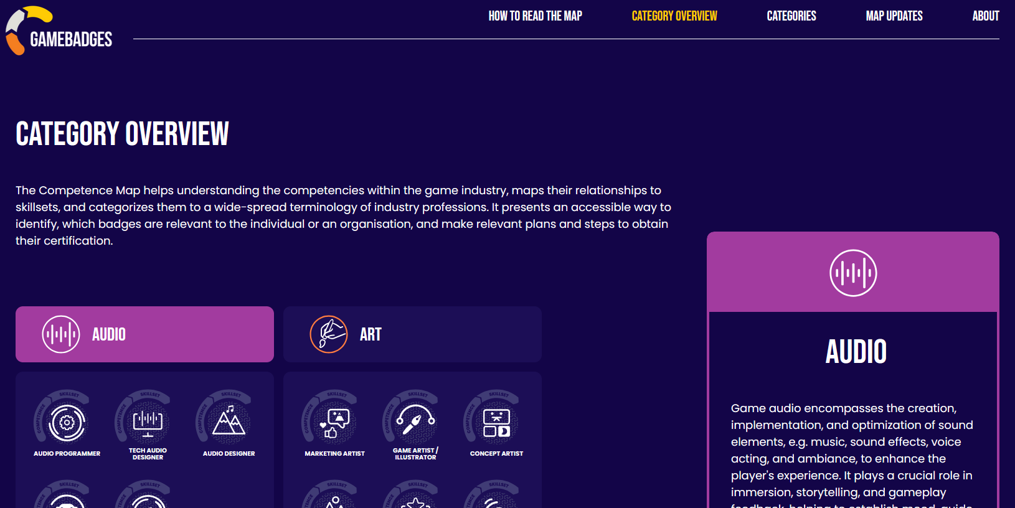
AND ON VIDEOGAMES HISTORY ?
The Competence Map on the Gamebadges website

Slide 35

ESTABLISHING CREATIVE CONSTELLATION ON VIDEO GAME INDUSTRY
Audio constellation
Artistic constellation
Business constellation

Slide 36

Design constellation
Marketing constellation
Production constellation

Slide 37

Programming constellation
Quality assurance constellation
Industry-wide constellation

Slide 38
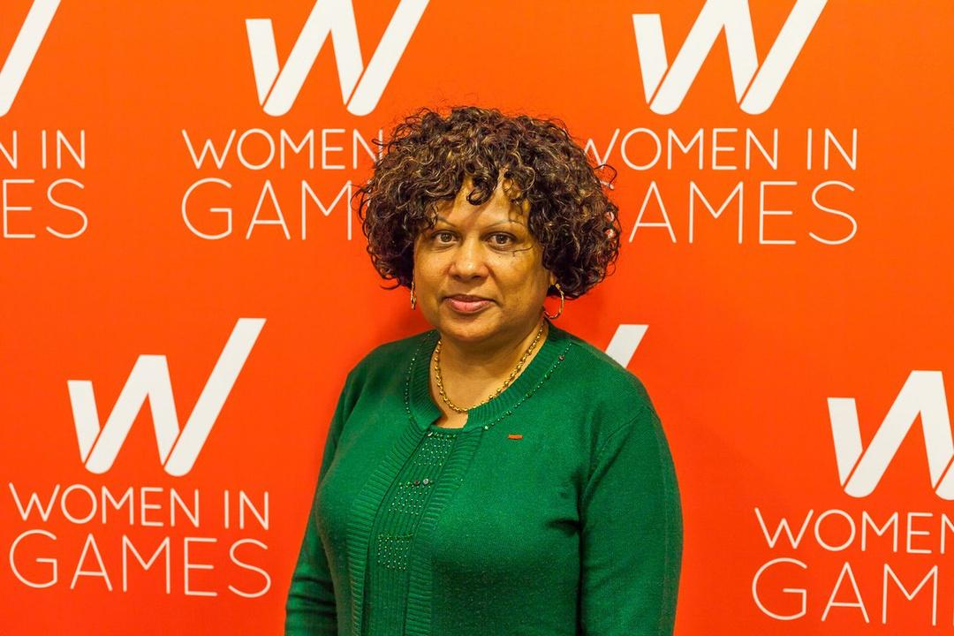

AN ATTEMPT ON MURIEL TRAMIS

Slide 39
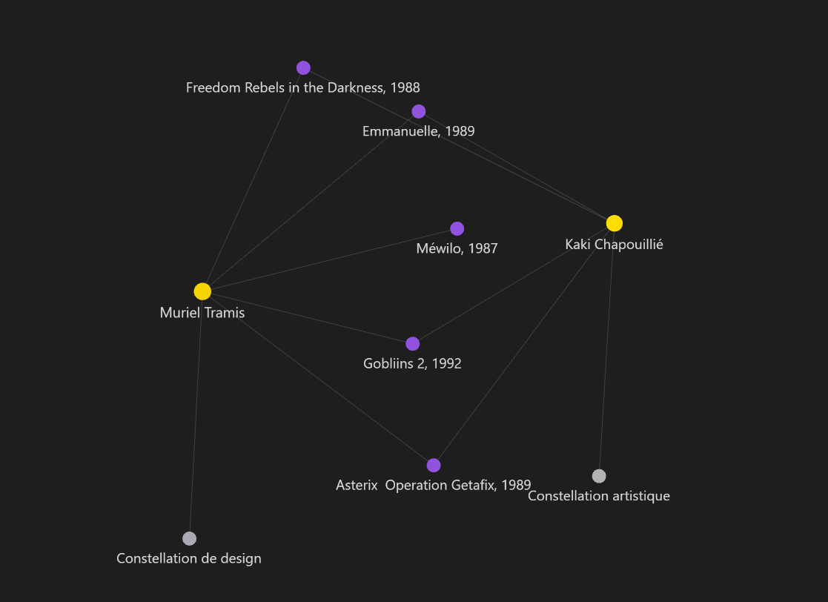
MURIEL TRAMIS AND KAKI CHAPOUILLIÉ

Slide 40
WITH WHO KAKI CHAPOUILLIÉ WORKED ?
On Playtoons 1 : Fearturing Uncle Archibald (1995):
Valérie Courtial (Project manager) - Production constellation
Anne-Sophie Bailly (Marketing and Publishing) - Marketing constellation
Anne-Lise Prodel (Marketing and Publishing) - Marketing constellation
Helene Pokidine (Programming) - Progamming constellation
Karen Strassman (Voice actress) - Audio and artistic constellation ?
Cécile Turet (Editing) - Audio constellation

Slide 41
WHAT ARE MY ASPIRATIONS ?
Highlighting women and gender minorities in the global historical narrative.
BUT
A possible non-rigorous credit policy, like Capcom in the 70s and 80s.
→ For example, Yoko Shimomura appeared under several names, such as Oimonoyouchan, Pii, ShimoPii, Shimo-P., P-Chan or even Pi-Bomb Shimomura, and sometimes was not even credited. (Fritsch, 2022)
Shift the focus from the geniuses, the creators with a success story like Yoko Shimomura or Hideo Kojima.

Slide 42




WHAT IS MY CORPUS ?
Japanese video game from the 2000s
Productions classified CERO A, accessible to all ages.
→ Equivalent to PEGI in Europe, ESRB in North America, ACB in Australia
タッチ!カービィ(2005), Kirby : Le Pinceau du pouvoir [titre français], Nintendo DS, HAL Laboratory, Nintendo.
星のカービィ 参上! ドロッチェ団(2006), Kirby : Les souris attaquent [titre français], Nintendo DS, Flagship Natsume, Nintendo.
星のカービィ 鏡の大迷宮(2004), Kirby et le Labyrinthe des Miroirs [titre français], GameBoy Advance, Flagship, Nintendo, HAL Laboratory.
カービィのエアライド(2003), Kirby Air Ride [titre français],GameCube, HAL Laboratory, Nintendo.
シナモンボール くるくるスイーツパラダイス(2007), Cinnamoroll Shinamon bōru Kurukuru suītsu paradaisu [Translittération], Nintendo DS, Delta Arts, Imagineer, Rocket Company.
ハローキティのご当地コレクション 恋のどきどきトラベル(2007), Harō kiti no gotōchi korekushon Koi no dokidoki toraberu [Translittération], Nintendo DS, Imagineer, Rocket Company.
リラックマ なかよしコレクション(2014), Rirakkuma nakayoshi korekushon [Translittération], Nintendo 3DS.
and more.

Slide 43
WHY DID I CHOOSE CERO A VIDEOGAMES ?
Using the essentialization of women to find them:
Kaori Ikeda, an employee at the promotion of the company Asmik observed that, in the 80s and 90s, women were seen by companies as people who could attract a young audience thanks to their sensitivity. (McCorkle Okazaki, 2024, p. 206)
One of the reasons for this invisibility is because the female creators of comics were at the production of stories intended for little girls. Thus, the history of comics was built around periodicals that could appeal to an adult audience. (Hertiman, et al., 2024, p.40)

Slide 44
EXEMPLE
Muriel Tramis worked on child video games but also on NSFW productions like Emmanuelle (1989), Geisha (1990), Fascination (1991).
→ She also worked on Méwilo (1987), a 'point and click' game taking place in Martinique and which deals with themes related to colonization and slavery.

Slide 45

WHAT’S NEXT ?
Sort out all CERO A Japanese video game (2000-2010) we have and add it to my corpus.
Also, focus on one video game licence for excavating its credits.
Testing my methodology on this.
Exploring more on “Creative constellations” and its application on other media like comics.
Other initiative like WIJA (Women in Japanese Animation)

Slide 46
BIBLIOGRAPHY
Hertiman, M. R. et de Singly, C. (2024). Construire un Matrimoine de la Bande Dessinée : Créations, mobilisations et transmissions des femmes dans le neuvième art, en Europe et en Amérique. Les presses du réel.
Turbiau, A., Leïchlé, M., Islert, C., Hertiman, M. R. et Gauthier, V. (2022). Introduction. GLAD!. Revue sur le langage, le genre, les sexualités, (12).
Fritsch, M. (2022). Heroines Unsung The (Mostly) Untold Story of Female Japanese Game Music Composers. Dans F. Wilcox (dir.), Women’s Music for the screen. Diverse Narratives in sound (p. 177‑191). Routledge.
McCorkle Okazaki, B. (2024). Onna no Jidai: Women and Video Game Sound in 1980s Japan. Dans W. Gibbons et M. Grimshaw-Aagaard (dir.), The Oxford Handbook of Video Game Music and Sound. Oxford University Press.
Lemon, A. et Rietveld, H. C. (2018). The Street Fighter Lady: Invisibility and Gender in Game Composition. Dans Women, LGBTQI & Allies: Videogiochi e identità di genere

Slide 47

THANK YOU
contact : amtrefois@uliege.be

Slide 48
Who decides what kind of video game to play? The place of audience discussion
What kind of video games do you play ?
Some categorisations of Wolfenstein 3D from the perspectives of gaming communities
François-Xavier Surinx (FNRS-FRESH fellow)

Slide 49
A bit of context
2020, master’s thesis: how can text in video games scare the player?
⇒ But… What is a “scary” video game, or even “survival horror”?
Lots of more or less formal descriptions among the researchers (e.g. Arsenault, 2011; Perron, 2018) ⇒ No consensus nor clear definition of the genre, and no list of works…
In 2023, I started a PhD about video games’ genres

Slide 50
From genres to categories
What is a genre for a scientist?
⇒ Answer: Nobody really have a definitive answer.
Lots of theories, but no consensus and they rarely take in account the pragmatic nature of the concept
What is a genre for a standard regular player?
⇒ Answer : Nobody really knows… and that’s ok!

Slide 51
From genres to categories
Importance to adopt a larger scale to think about the problem
⇒ Category: any collection of video games (at least two) that appears in a discourse, with or without a label and with or without a clear definition

Slide 52
From genres to categories
Purposes:
To break away from an essentialist question
To observe other ways to classify games

Slide 53
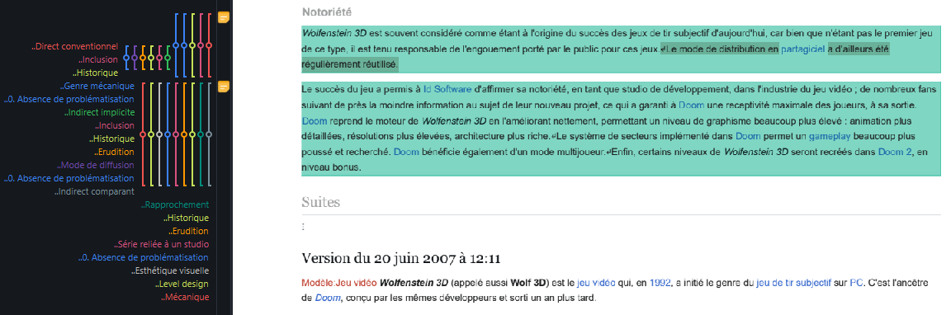
Methodology
Qualitative analysis of the players’ online discourses, with a semiorhetorical grid

Slide 54

Today’s quick demonstration
Game: Wolfenstein 3D (id Software, 1992)
Who: French-speaking players
Where: test section on JV
Objective:
Show (a fraction of) the variety of existing categorisations
Describe their functions

Slide 55
Wolfenstein 3D
What kind of video games is Wolfenstein 3D?
Think about it a second…

Slide 56
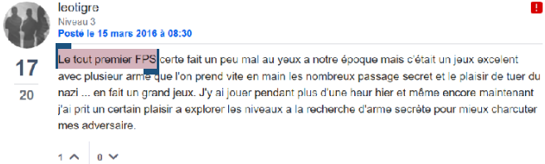
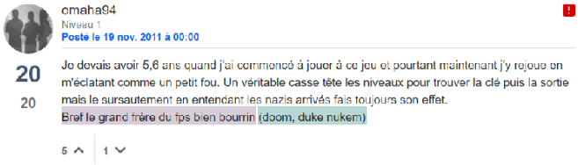
The most frequent (and expected): “mechanical genres”

Slide 57
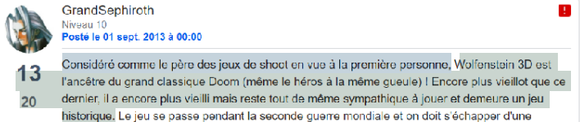
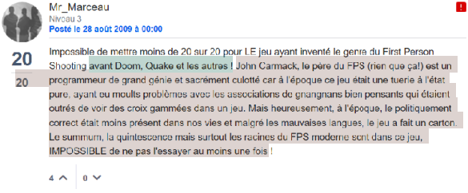
But with some alternatives

Slide 58
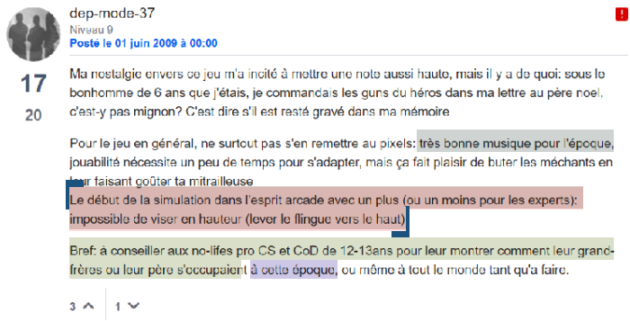
But with some alternatives

Slide 59
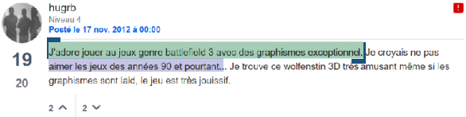
Again, what is a genre?

Slide 60
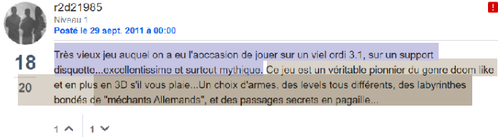
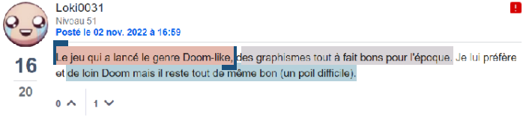
Anachronistic label: Doom-like

Slide 61
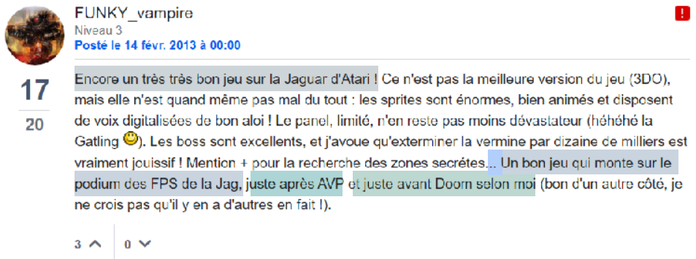
And also some specifications…

Slide 62
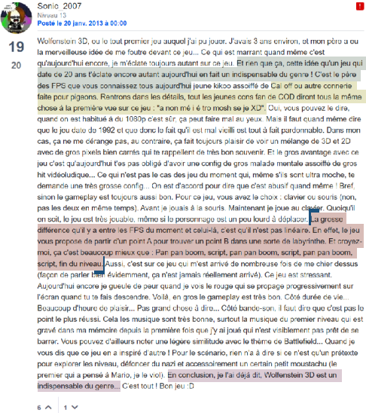
And also some specifications…

Slide 63
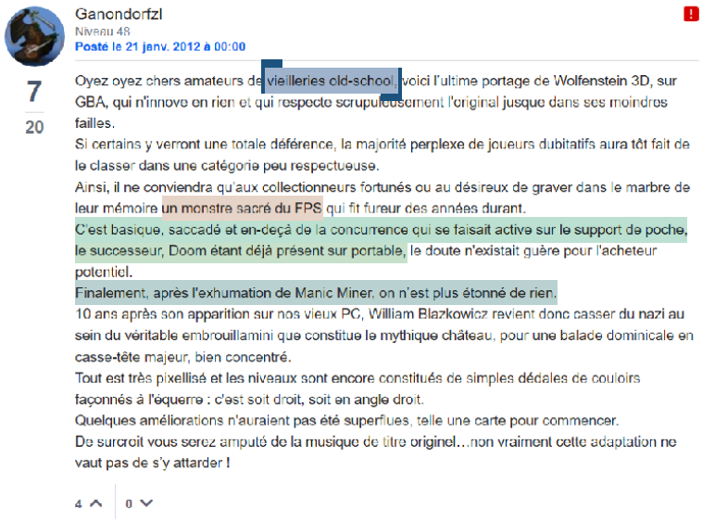
An old game after all…

Slide 64
Several missing categories
Themes (lots of description, but no categorization)
Sequels in the same serie (different developers)
Target audience
Creators (John Carmack and John Romero)

Slide 65
Functions
Categories are not primarily used to classify games.
More often, the functions associated are :
evaluation: to compare games on a certain basis
historical/of erudition: to understand a game depending on its place in a category
recommendation: to give advice to other players by judging a game’s adequation with a certain category

Slide 66
Conclusion and extensions
It is important to look away from industrial and scientific categorizations
Communities of players have developed skills to talk about games
⇒ Study other formats on other websites to see other kinds of categorizations

Slide 67
Thank you for your attention!!
Contact: fxsurinx@uliege.be

Slide 68
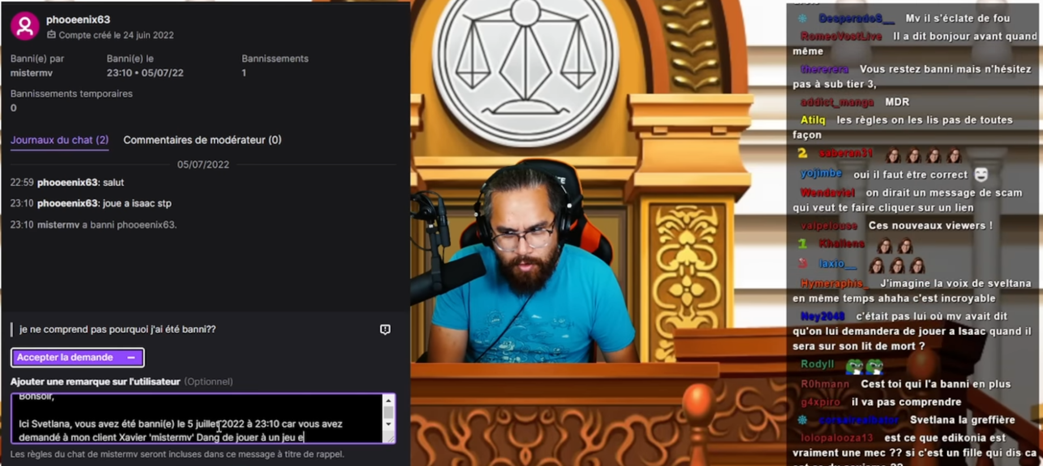

Public Space in the Era of Platformization:
The Case of Twitch
Fanny Barnabé – CRIDS/NADI
University of Namur – fanny.barnabe@unamur.be

Slide 69
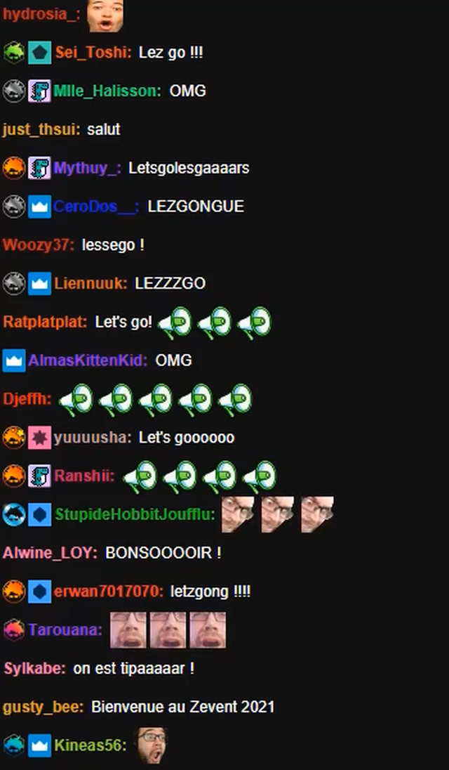

1. Introduction: Twitch, Toxicity and the “Court of the Banned”
Twitch = fertile ground for toxic discourses: insults, threats, verbal harassment, aggressive and discriminatory comments (Poyane, 2019 ; Mihailova, 2020 ; Seering et al., 2017 ; Pellicone et Ahn, 2017 ; Karhulahti, 2016)

Slide 70

1. Introduction: Twitch, Toxicity and the “Court of the Banned”
• A mixed moderation system:
Automatic detection and moderation of strictly prohibited content, behavior, and speech (harassment, hate speech, nudity, etc.)
Within this framework: “channel owners and moderators are free to ban anyone from their channel, for any reason. Twitch will not assist in reversing channel-specific bans” (https://safety.twitch.tv/s/article/appeals?language=en_US)
Possibility of tolerating violent content when it is presented as satire, irony, parody, or in a friendly context (ex.: hateful insults with obvious “affectionate intent” are allowed)

Slide 71

1. Introduction: Twitch, Toxicity and the “Court of the Banned”
Corpus :
- Étoiles
- Gotaga
- Deujna
- Squeezie
- MisterMV
- Kameto
- Domingo
- Sardoche
- BagheraJones

Slide 72
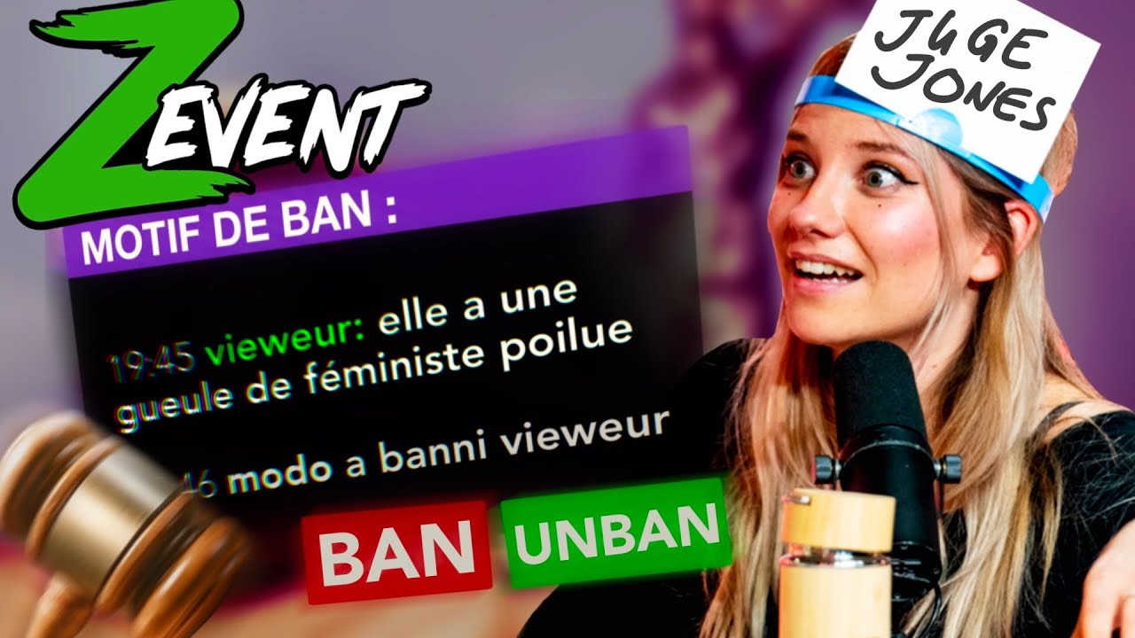
2. Toxicity on Twitch: A Source of Entertainment, Spectacle, and Value
• What is perceived as violent in a normative context will not necessarily be so on Twitch => importance of local standards (Gauducheau et Marcoccia, 2023)
• Embedding experience frames (Goffman, 1991):
play = second-degree activity (Henriot, 1989; Brougère, 2002; Bateson, 1977)
contents broadcast on Twitch are themselves put on display
Where are the boundaries between true and false, literal and figurative meaning, playful and serious?

Slide 73

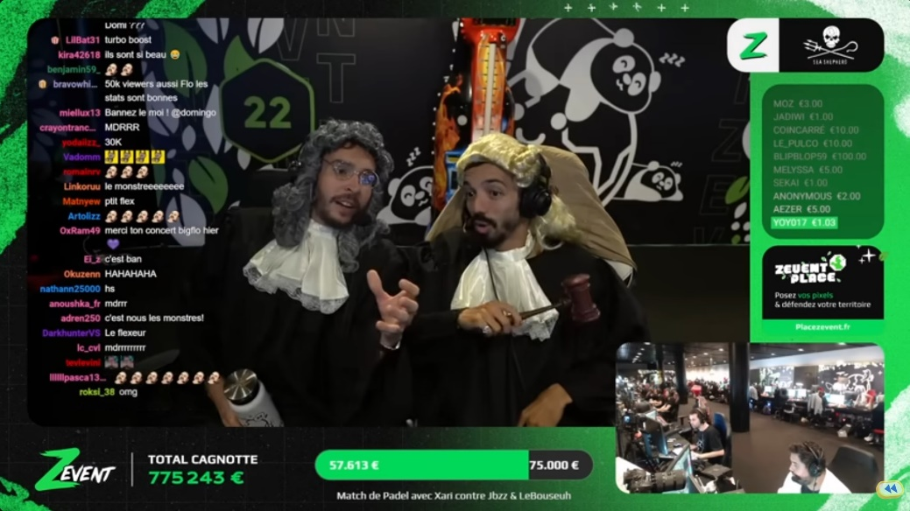
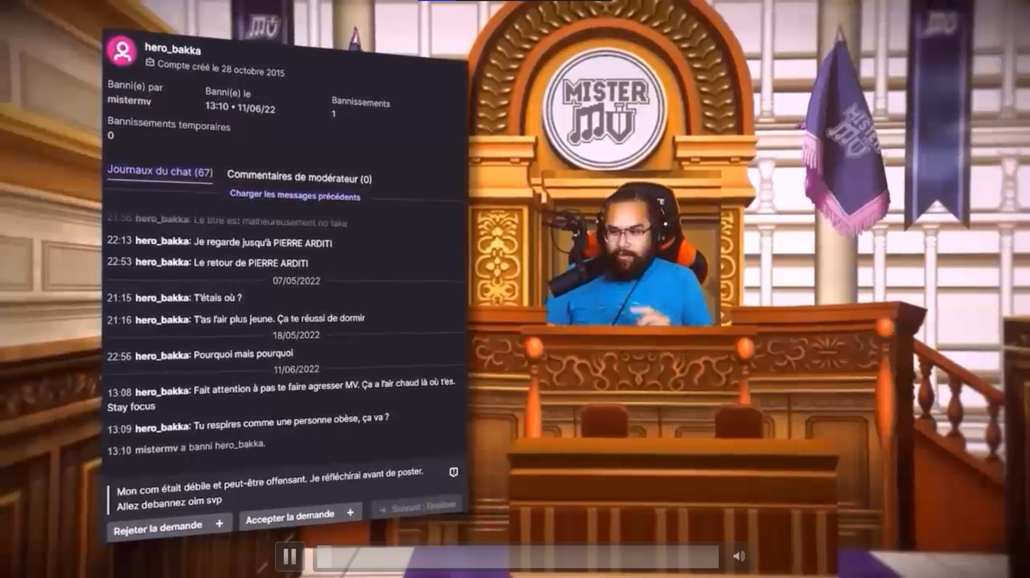
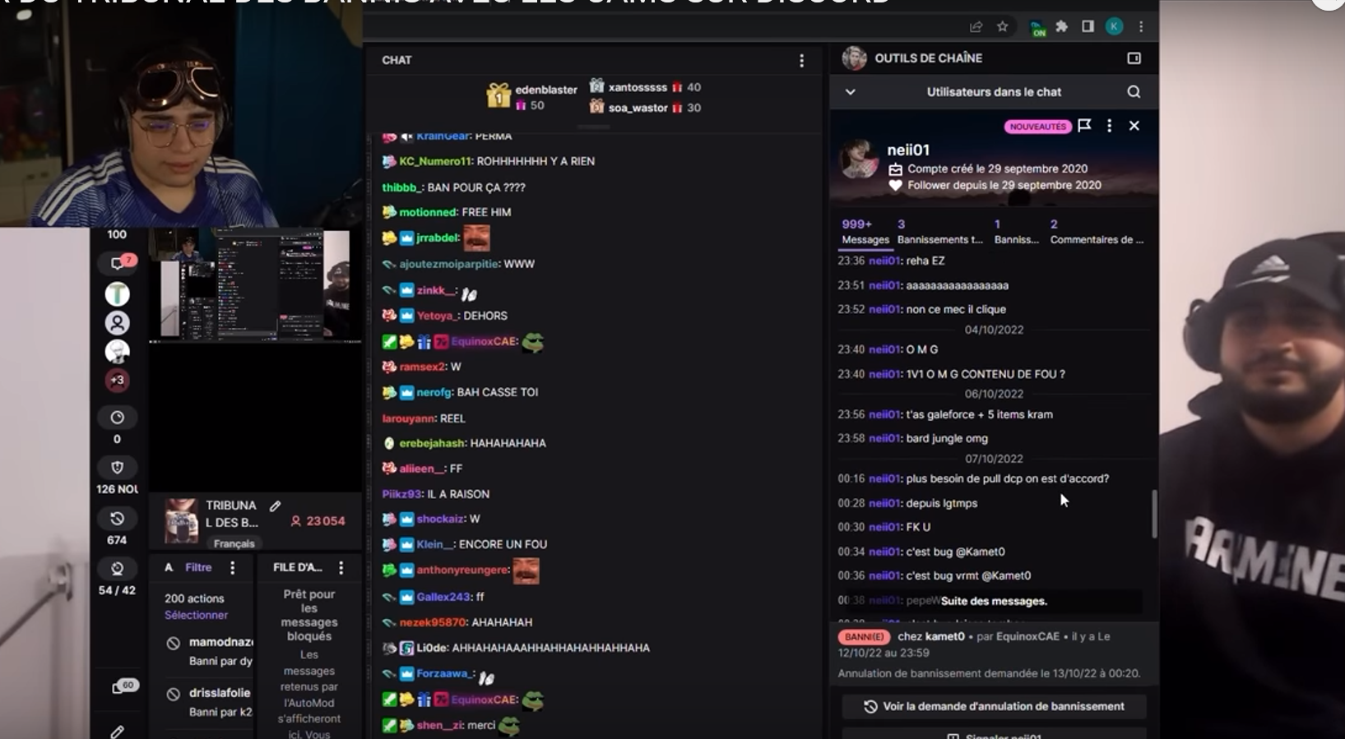

Slide 74
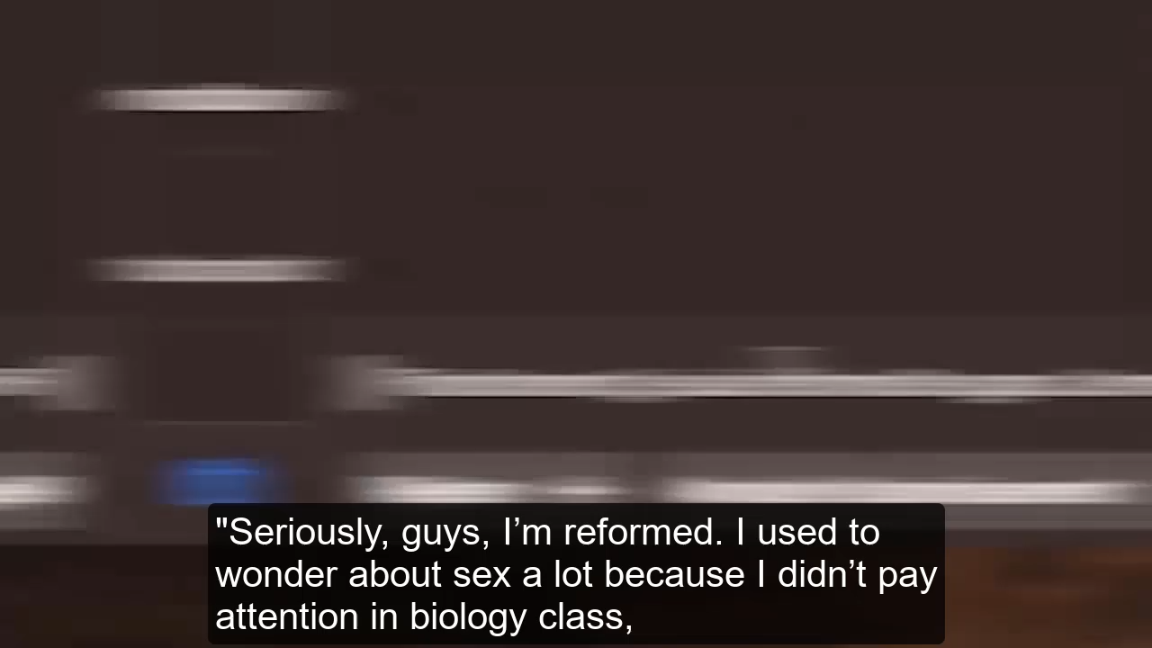
2. Toxicity on Twitch: A Source of Entertainment, Spectacle, and Value
« Hyperflat world » (Azuma, 2008 : 165-168) or metamodernism : several frames of experience and value systems are simultaneously activated in the performance

Slide 75
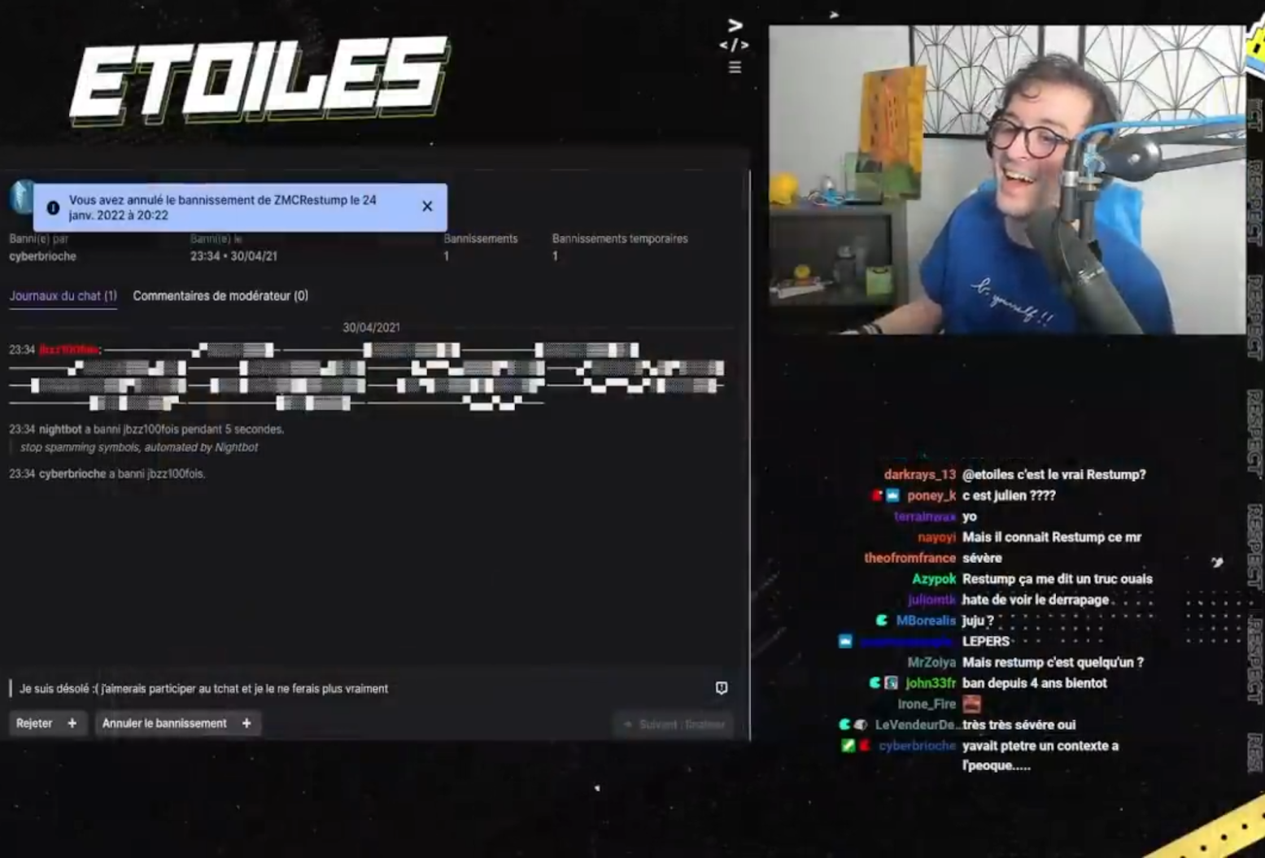
3. Scenographic Framework: Viewers’ Contribution to the Show
An evaluation criterion: the message’s contribution to the scenography (Maingueneau, 2015)
Vs
Being funny
Being useless
= Principle of originality, uniqueness, incongruity (Vaillant, 2021 : 294)
“he adds nothing” | Etoiles
“he’s really not very useful”, “not a great loss” | Squeezie
“that guy, when you bring him to a party, […] he’s not the kind of guy who’s there to liven things up. He’s more the kind of guy who sits there looking a bit glum, drinking his Coke with a sad look on his face. […] We don’t need him” | Domingo
that viewer doesn’t have “any extraordinary additional value for the chat” | MisterMV

Slide 76
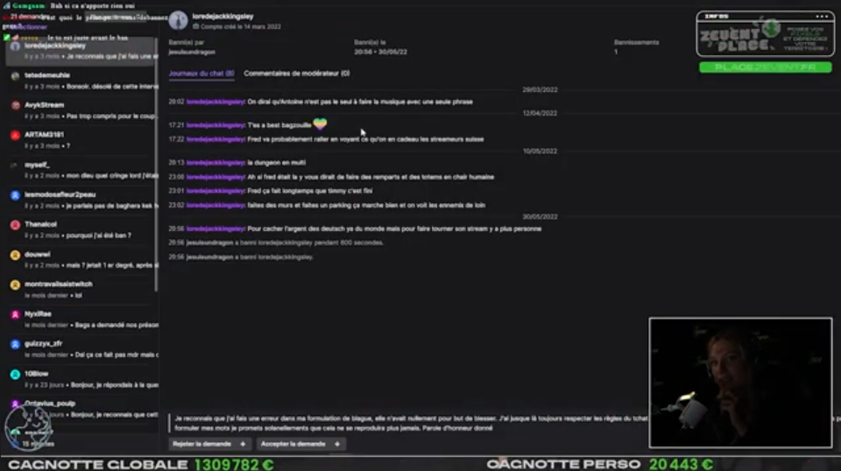
4. Social Framework: Toxicity is Other People
The problem = differences between the viewer’s ethos and that of the streamer
Discursive mimetism:
“that guy, he’s family” (Domingo)
“ok, he’s a fan of JDG… It’s not starting well...” (BagheraJones)
“he sounds like a bot” (Domingo)
Vs
The chat primarily functions as an echo chamber for the streamer’s words
Deviating from community standards means taking the risk of being seen as an outsider

Slide 77
5. Legal Framework: Complying with Rules and Regulating Behaviors
Systematic removal of racist, transphobic, sexist, homophobic, and fatphobic messages, in the form of reminders of the rules or in a tone of exasperation:
“Guys, the rules are clear in the chat! […] And you know that this is a clear permaban!” | Kameto
No axiological commentary: hate speech is removed, but rarely described as bad, harmful, prejudicial, or dangerous
The most strictly hateful discourses are not considered good material for the Court of the banned
“Bro, that’s an insult that’s... impossible to defend [...], you can’t take that stuff to the Court [...]. Even in trolling, whatever, we can’t” | Kameto

Slide 78

Conclusion: show must go on
“The concept of hate speech is fundamentally axiological; it is not neutral: it is a pejorative term. […] What is labeled as hate speech is what we, as researchers, research funding bodies, and institutions, consider to be ideologically wrong” (Longhi & Vernet, 2023: 18)
On Twitch:
calls to order are not so much guided by moral concerns as by community, spectacular, and playful considerations

Slide 79
References
Azuma Hiroki (2008), Génération Otaku. Les enfants de la postmodernité, Paris, Hachette Littératures
Bateson Gregory (1977), « Une théorie du jeu et du fantasme », in Vers une écologie de l’esprit, tome 1, Paris, Seuil, pp. 209-224
Brougère Gilles (2002), « Jeu et loisir comme espaces d'apprentissages informels », Éducation et sociétés, vol. 2, n° 10, pp. 5-20
Gauducheau N. & Marcoccia M. (2023), « La violence verbale dans un forum de discussion pour les 18-25 ans: Comment les jeunes jugent-ils les messages? », Réseaux, n° 241, pp, 79-122
Henriot J. (1969), Le jeu, Paris, Presses Universitaires de France
Karhulahti V.-M., 2022, Esport play: Anticipation, attachment, and addiction in psycho-ludic development, Londres, Bloomsbury
Longhi J. & Vernet S. (2023), « Quelle place pour les réseaux sociaux numériques dans la production et la circulation des discours de haine ? », Réseaux, n° 241, pp. 11-35
Maingueneau D. (2015), « Argumentation et scénographie », in C. Pineira-Tresmontant (ed.), Discours et effets de sens : Argumenter, manipuler, traduire, Arras, Artois Presses Université
Mihailova T. (2020), « Navigating ambiguous negativity: A case study of Twitch.tv live chats », New Media & Society, 24(8)
Pellicone A. J. & Ahn J. (2017), “The Game of Performing Play: Understanding Streaming as Cultural Production”, in Proceedings of the 2017 CHI Conference on Human Factors in Computing Systems (CHI'17), New York, ACM Publications, pp. 4863–487
Poyane R. (2019), “Toxic Communication on Twitch.tv. Effect of a Streamer”, in D. A. Alexandrov, A. V. Boukhanovsky, A. V. Chugunov, Y. Kabanov, O. Koltsova, I. Musabirov & S. Pashakhin (eds.), Digital Transformation and Global Society, Cham, Springer, pp. 414-421
Seering J., Kraut R. & Dabbish L. (2017), “Shaping Pro and Anti-Social Behavior on Twitch Through Moderation and Example-Setting”, in Proceedings of the 2017 ACM Conference, New York, ACM Publications, pp. 111-125
Vaillant A.(2021), « L’imagination », in M. Letourneux & A. Vaillant (eds.), L’empire du rire XIXe – XXIe siècle, Paris, CNRS Éditions, pp. 290-317

Slide 80
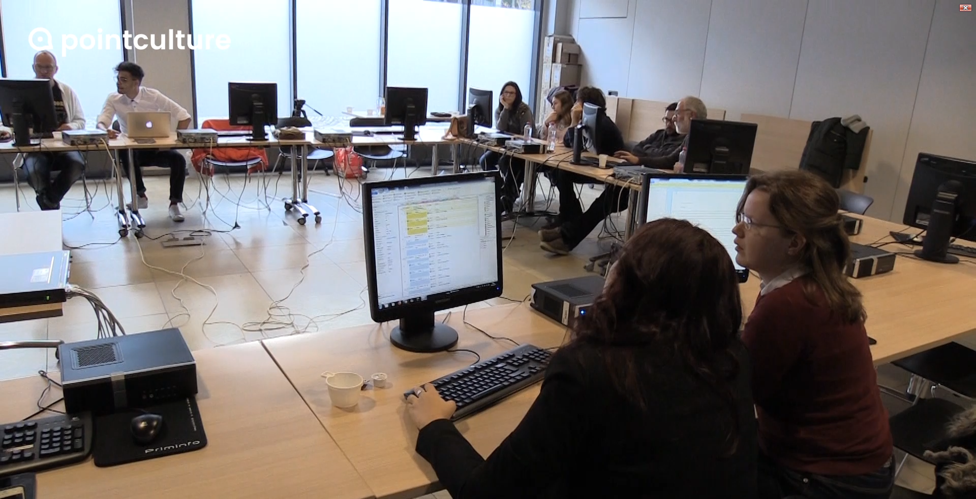


Slide 81
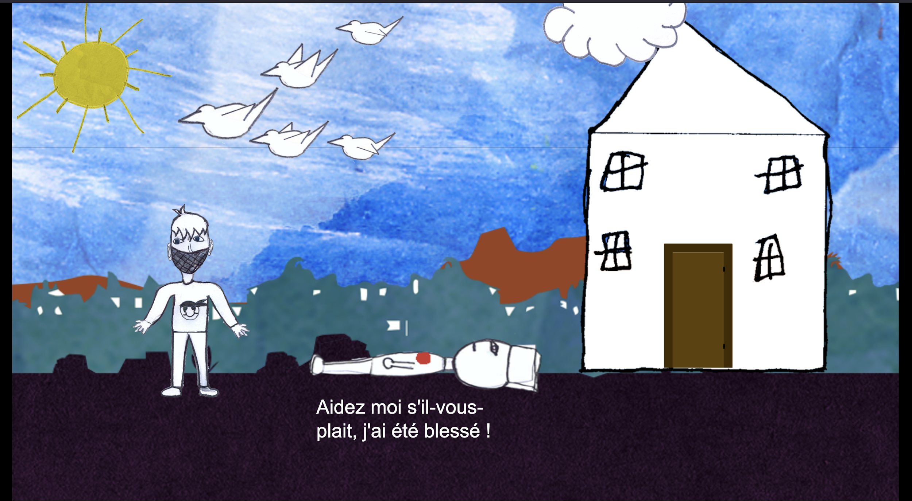
Miogrations, 2017

