Slide 1





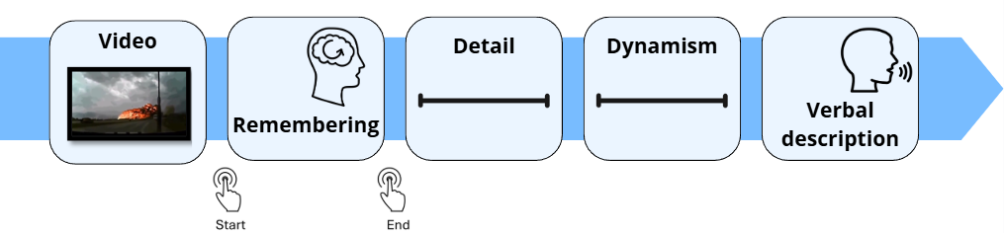







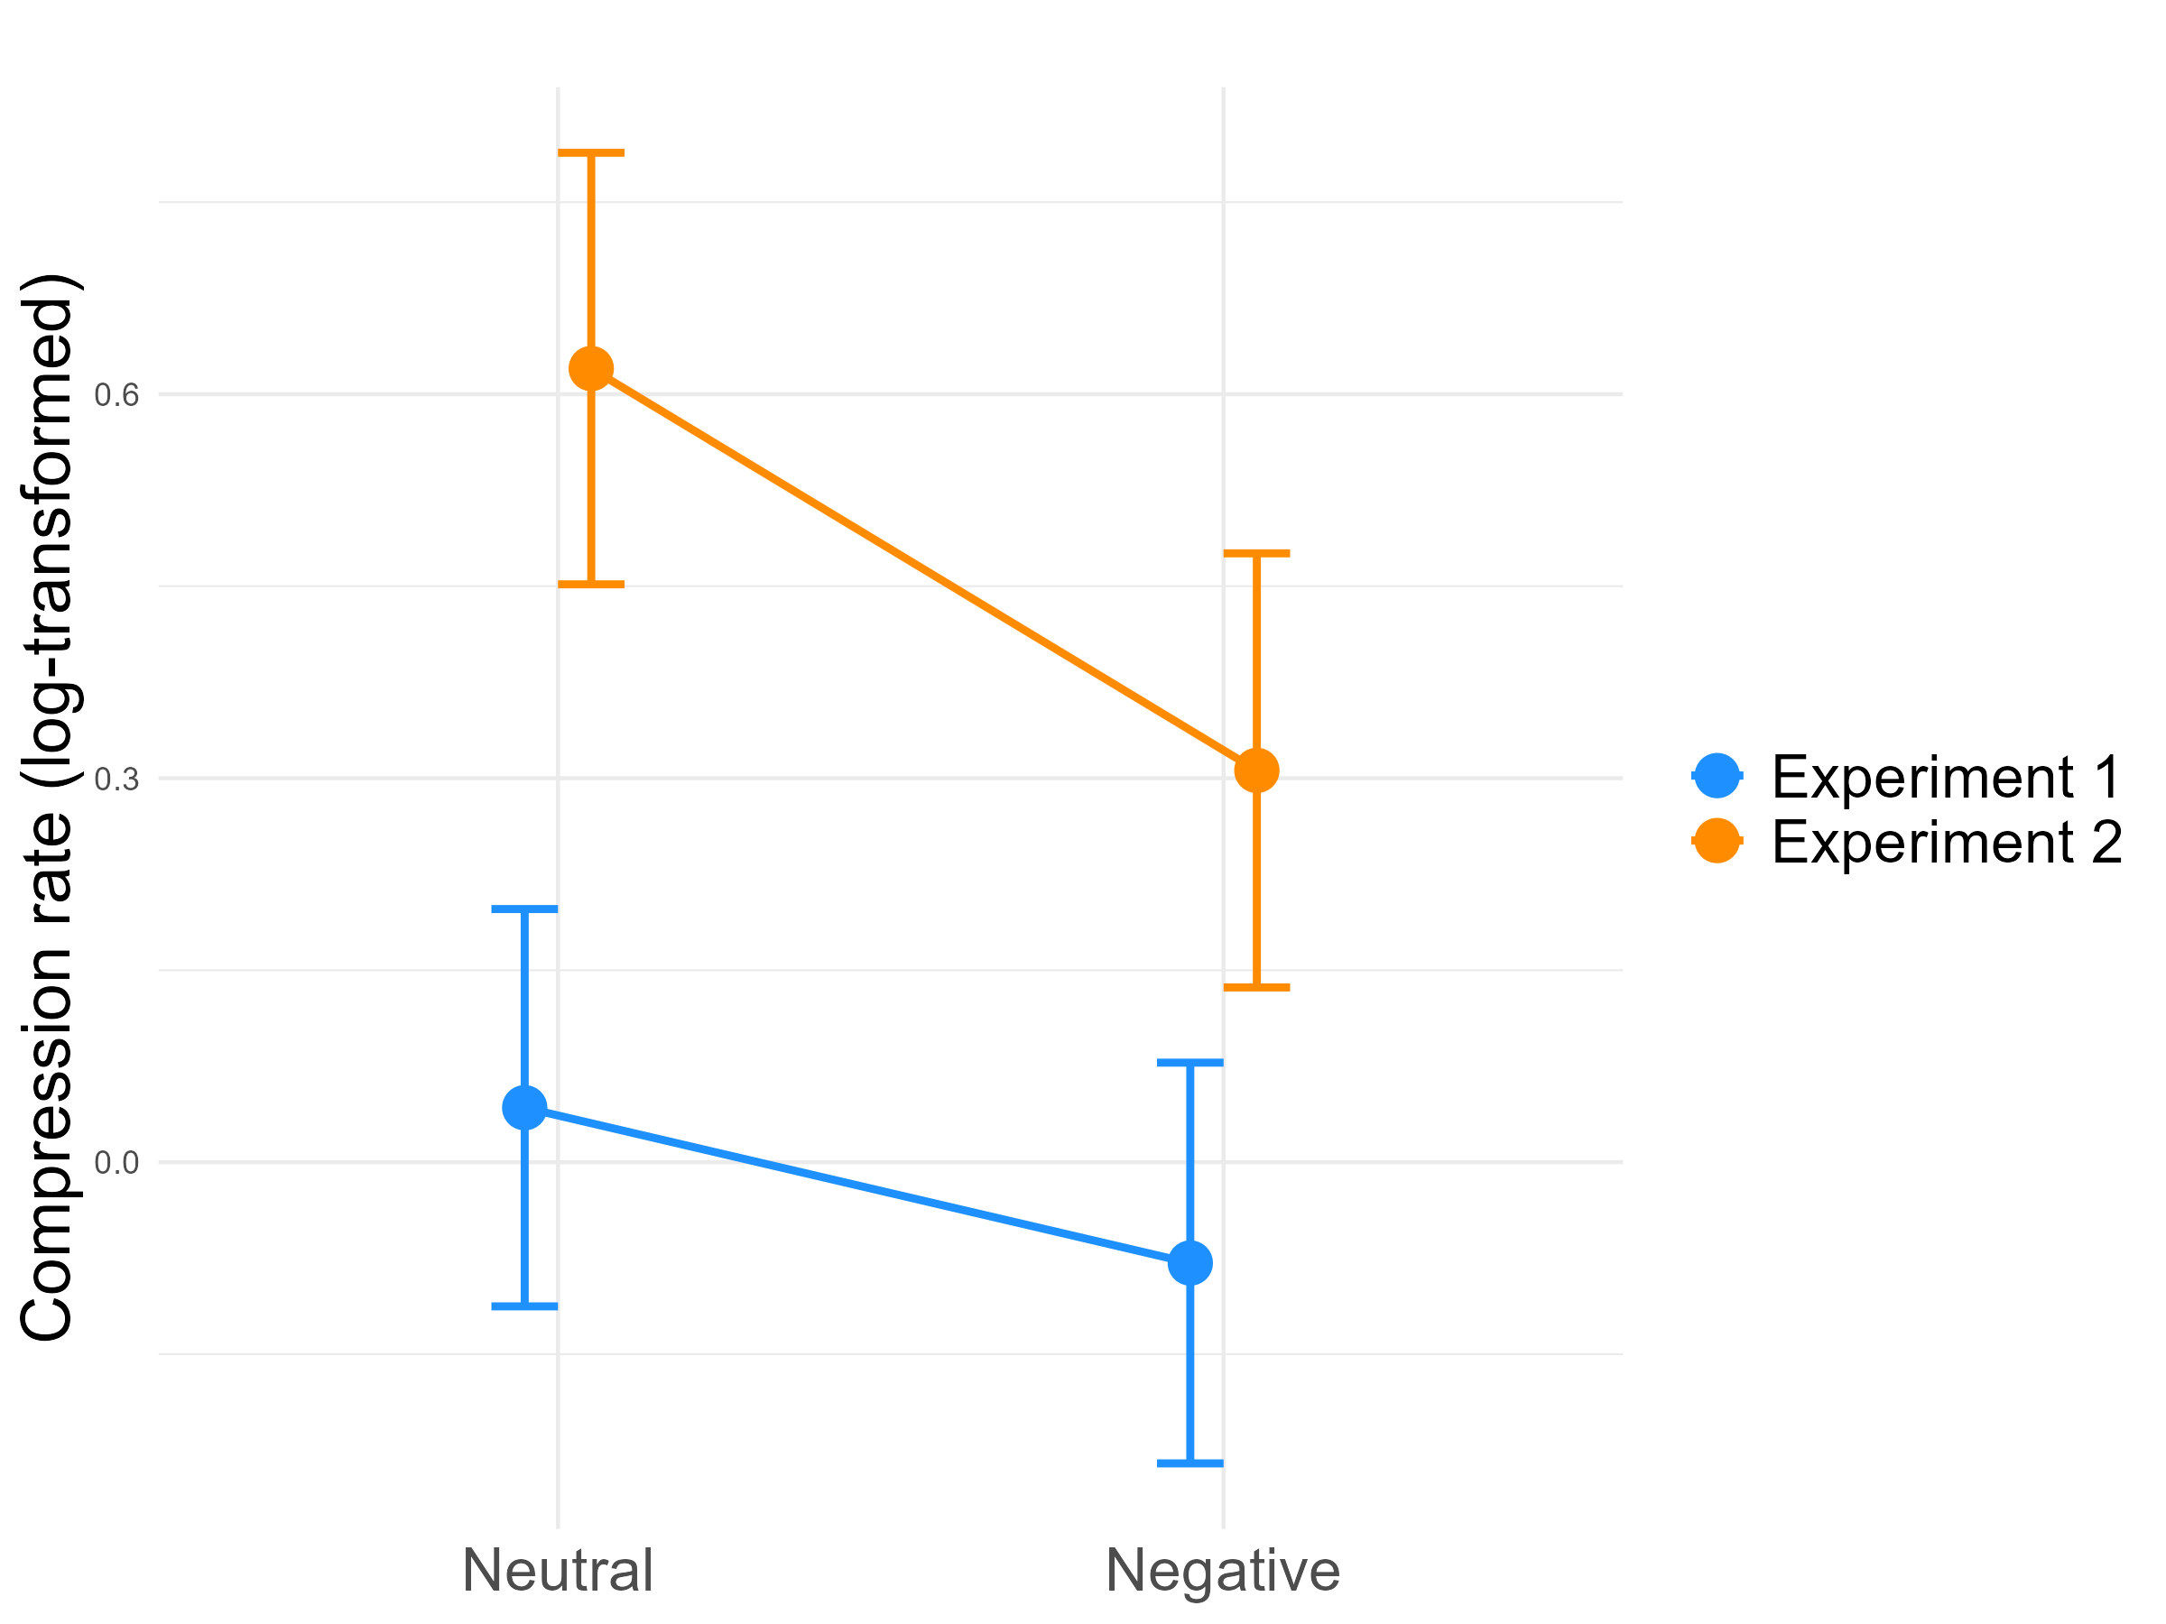
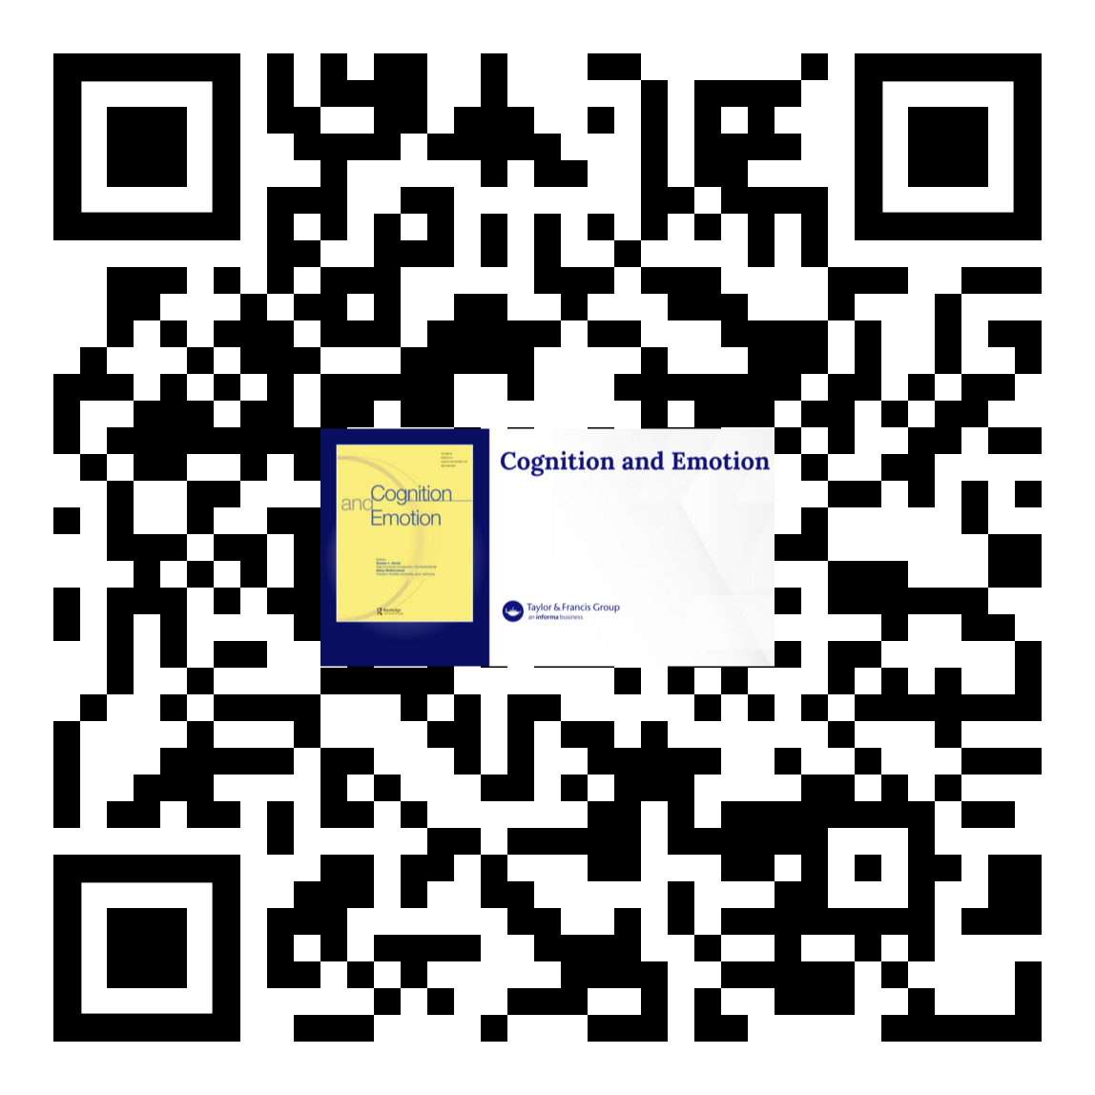


The influence of negative emotion on the temporal compression of events in episodic memory
Charline COLSON ª, Gaëlle PANNEELS ª & Arnaud D’ARGEMBEAU ^{a,b}
a University of Liège, Psychology and Neuroscience of Cognition Unit - PsyNCog
b Fund for Scientific Research (FNRS)
Introduction
Remembering past events typically takes less time than the actual duration of prior experience (Jeunehomme & D’Argembeau, 2019) ➔ Temporal compression of events in episodic memory
What event characteristics determine temporal compression rates in memory?
Emotion enhances memory (Holland & Kensinger, 2010), including memory for temporal information: enhancement of temporal-order memory and dilatation of remembered duration for negative events (Petrucci & Palombo, 2021)
Hypothesis:
Memories
We predicted that the course of negative events would be less summarized in memory, resulting in a lower compression rate compared to neutral events
To what extent does negative emotion affect the temporal structure and compression of episodic memories?
Method
Experiment 1
Experiment 2
Same method but presentation of the stimuli in a mixed list that includes both emotional and neutral stimuli:
The entire set of 16 videos is shown
Memory task: remembering, subjective evaluations and verbal description
Actual duration
Compression rate:
Remembering duration
Compared to Experiment 1:
Stimuli in mixed list
Short delay between encoding and retrieval
Incidental encoding
Stimuli: 8 negative and 8 neutral videos matched in duration (range: 12-35 sec)
Videos recalled individually and immediately
34 healthy young adults
34 healthy young adults
Results
Discussion
Robust Linear Mixed-effects Models (Koller, 2016)
Negative events are less compressed in memory than neutral events
Memories of negative events contain a greater density of information per unit of time when the unfolding of the event is represented
Higher emotional effect observed in Experiment 2, compared with Experiment 1
Rmodel <- rlmer(log(CompressionRate) ~ Emotion + Video_duration + (Emotion | ID) + (1 | Videos)
Experiment 1
Experiment 2
b = -0.13, SE = 0.06, t = -2.28, p = 0.023
b = -0.32, SE = 0.08, t = -3.97, p < .001
Cognitive mechanisms?
During initial encoding:
- Attention
- Segmentation processes
Post-encoding:
- Consolidation
Comparison between Experiments 1 and 2
Interaction:
Manuscript
b = -0.19, SE = 0.06, t = -3.35, p < .001
Colson, C., Panneels, G., & D’Argembeau, A. (2025). Negative emotion reduces the temporal compression of events in episodic memory. Cognition and Emotion, 1-16.
References:
Contact: Charline.colson@uliege.be
Holland, A. C., & Kensinger, E. A. (2010). Emotion and autobiographical memory. Physics of Life Reviews, 7(1), 88–131. https://doi.org/10.1016/j.plrev.2010.01.006
Jeunehomme, O., & D’Argembeau, A. (2019). The time to remember: Temporal compression and duration judgements in memory for real-life events. Quarterly Journal of Experimental Psychology, 72(4), 930–942. https://doi.org/10.1177/1747021818773082
Koller, M. (2016). robustlmm: An R Package for Robust Estimation of Linear Mixed-Effects Models. Journal of Statistical Software, 75(6). https://doi.org/10.18637/jss.v075.i06
Petrucci, A. S., & Palombo, D. J. (2021). A matter of time: How does emotion influence temporal aspects of remembering? Cognition and Emotion, 35(8), 1499–1515. https://doi.org/10.1080/02699931.2021.1976733

