Slide 1
Deindustrialization, really?*
Lionel Artige University of Liège
ENTRENOVA 2025 Opatija, Croatia
* Joint paper with Hubert Escaith, University of Liège.

Slide 2
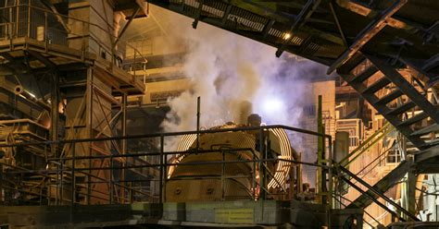
Quote
“The United States ignores the manufacturing sector at the expense of its innovation system and working class communities. The political ramifications could be enormous.”
William B. Bonvillian (2016)
In “Donald Trump's voters and the decline of American manufacturing”

Slide 3
Outline
1. What is deindustrialization?
2. How to measure deindustrialization?
3. Why doubt the reality of deindustrialization?
4. Accounting statistics
5. Conclusions

Slide 4
1. What is deindustrialization?

Slide 5
Deindustrialization: definition
Deindustrialization is a special case of a broader economic phenomenon known as structural change or structural transformation.
Herrendorf et al. (2014) define structural transformation as “the reallocation of economic activity across three broad sectors (agriculture, manufacturing, and services) that accompanies the process of modern economic growth”.
Deindustrialization can be defined as the result of manufacturing production growing at a lower rate than services, leading to a reallocation of economic activity from manufacturing to services over time.

Slide 6
2. Three accounting perspectives on deindustrialization

Slide 7
Deindustrialization: three accounting perspectives
A value-added perspective.
An employment perspective.
An expenditure perspective.

Slide 8
Value-added perspective
This is the supply perspective of deindustrialization.
A country’s manufacturing value added is either sold to domestic buyers or foreign buyers (exports).
It is this perspective that leads to different conclusions about deindustrialization in the literature.

Slide 9
Employment perspective
This is the perspective most commonly used by researchers because employment data is readily available and easy to use.
This is also the perspective that has the greatest media impact because it concerns people's jobs.
This perspective provides only a partial view of the dynamics within the manufacturing sector.

Slide 10
Expenditure perspective
This is the demand perspective of deindustrialization.
This perspective is rarely addressed in scientific literature because it requires a large amount of data that is not easily accessible.
This perspective allows us to address the issue of the offshoring of manufacturing activities.

Slide 11
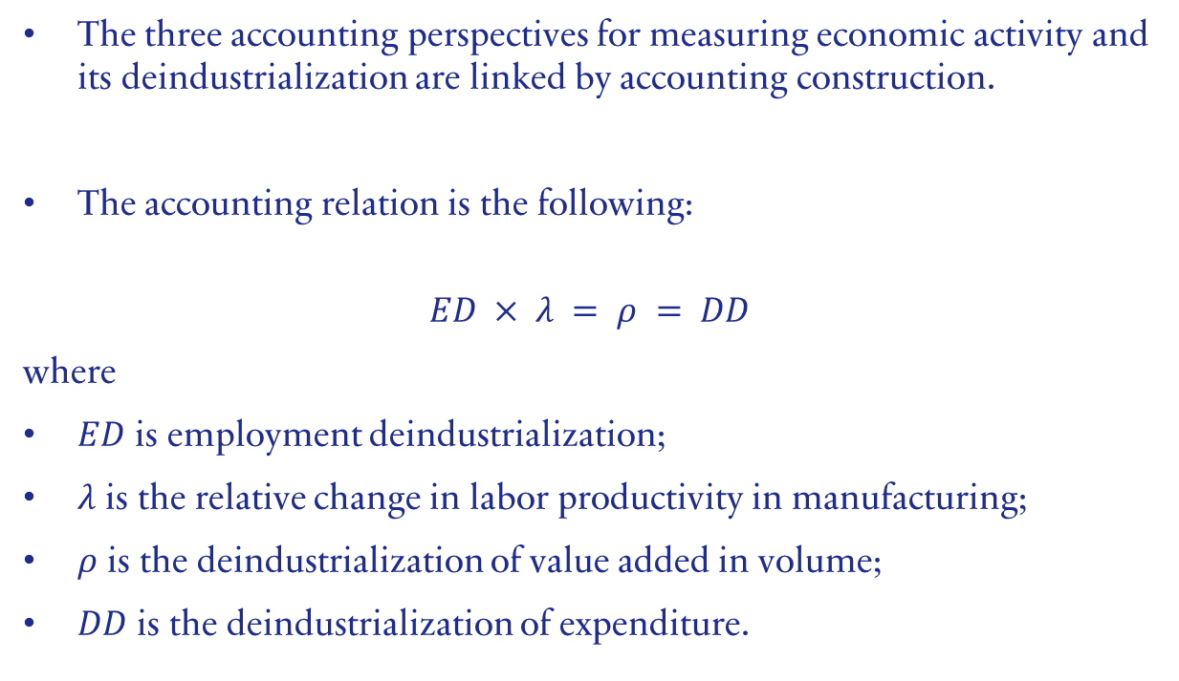
Relation between the three accounting perspectives
The three accounting perspectives for measuring economic activity and its deindustrialization are linked by accounting construction.
The accounting relation is the following:
$$ED × λ = ρ = DD$$
where
$ED$ is employment deindustrialization;
$λ$ is the relative change in labor productivity in manufacturing;
$ρ$ is the deindustrialization of value added in volume;
$DD$ is the deindustrialization of expenditure.

Slide 12
3. Why doubt the reality of deindustrialization?

Slide 13
Contradicting results in the literature
In the literature, deindustrialization studies cover
Developed countries/developing countries
Employment/value added
Current prices/constant prices
US dollar/national currency

Slide 14
Measurement issues
Current prices
Constant prices
US dollar / National currency

Slide 15
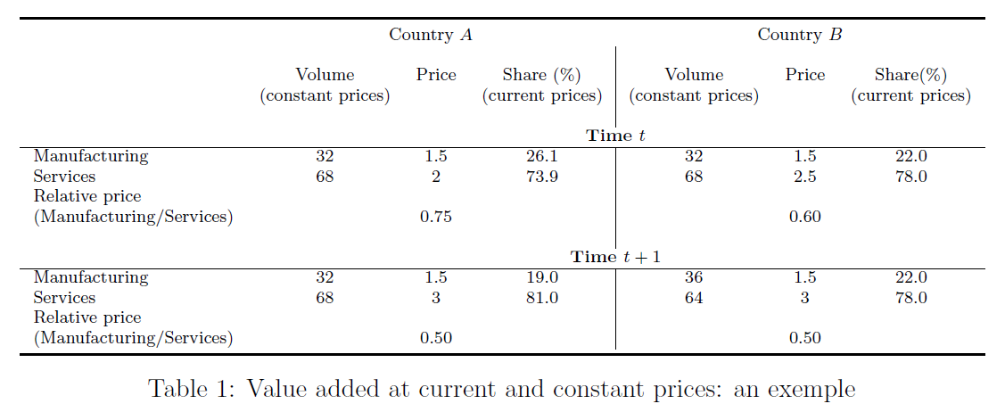
Current and constant Prices: an example

Slide 16
“Accounting illusion”
The “accounting illusion” is the result of outsourcing.
Manufacturing companies engage in both manufacturing and service activities. When the latter are outsourced, they are no longer included in manufacturing value added and are instead included in services and as intermediate consumption.
If outsourcing is significant, then the share of intermediate consumption in gross output must increase.

Slide 17
4. Accounting statistics

Slide 18
Value added

Slide 19
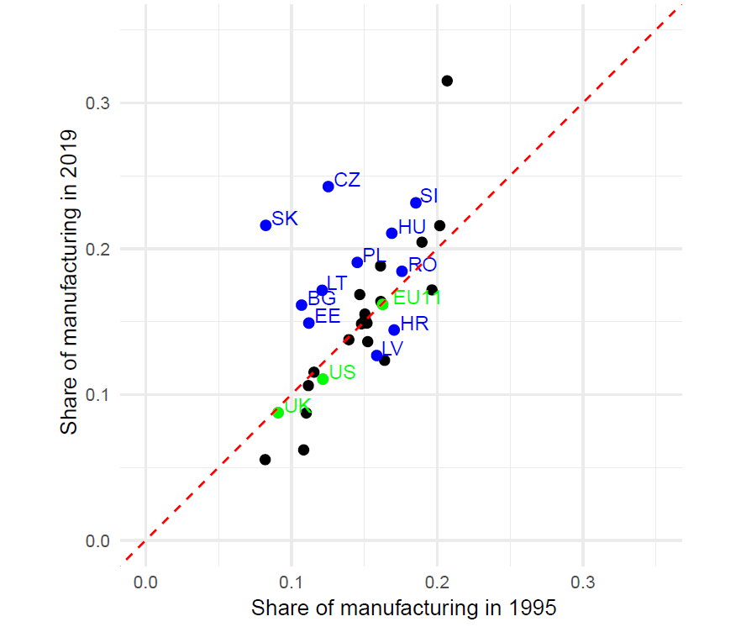
Share of manufacturing in total value added in volume 1995 vs 2019
The red dotted line is the 45° line.
Deindustrialization over time: below this line.
Industrialization over time: above this line.
No change: on the line.
Source of data: EU KLEMS
Calculus: authors

Slide 20
Employment

Slide 21
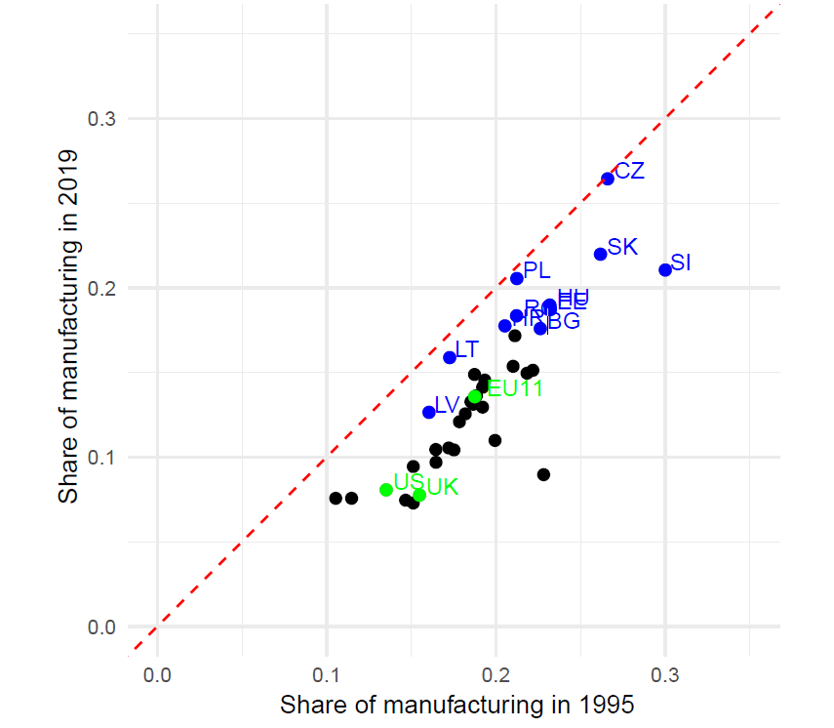
Share of manufacturing in employment 1995 vs 2019
The red dotted line is the 45° line.
Deindustrialization over time: below this line.
Industrialization over time: above this line.
No change: on the line.
Source of data: EU KLEMS
Calculus: authors

Slide 22
Labor productivity

Slide 23
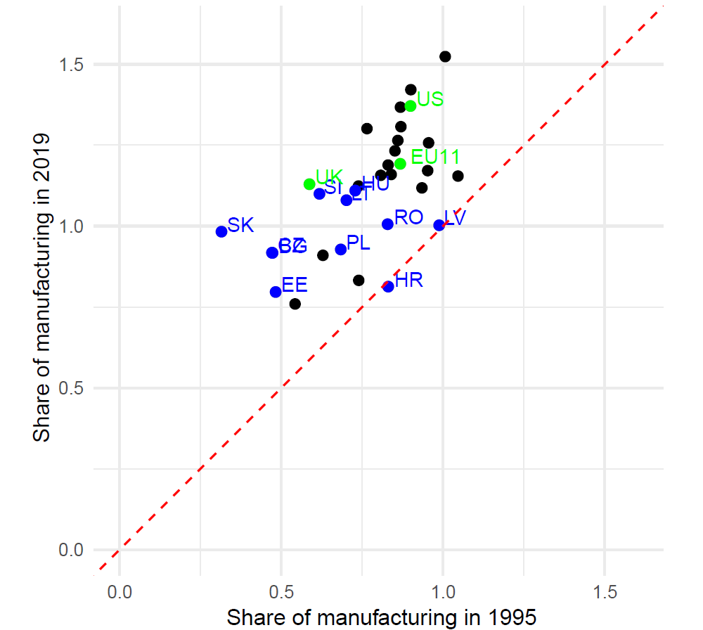
Manufacturing and total labor productivity 1995 vs 2019
The red dotted line is the 45° line.
Labor productivity is the same in manufacturing and the whole economy when the point lies on the dotted line 1.0.
Source of data: EU KLEMS
Calculus: authors

Slide 24
“Accounting deindustrialization”

Slide 25
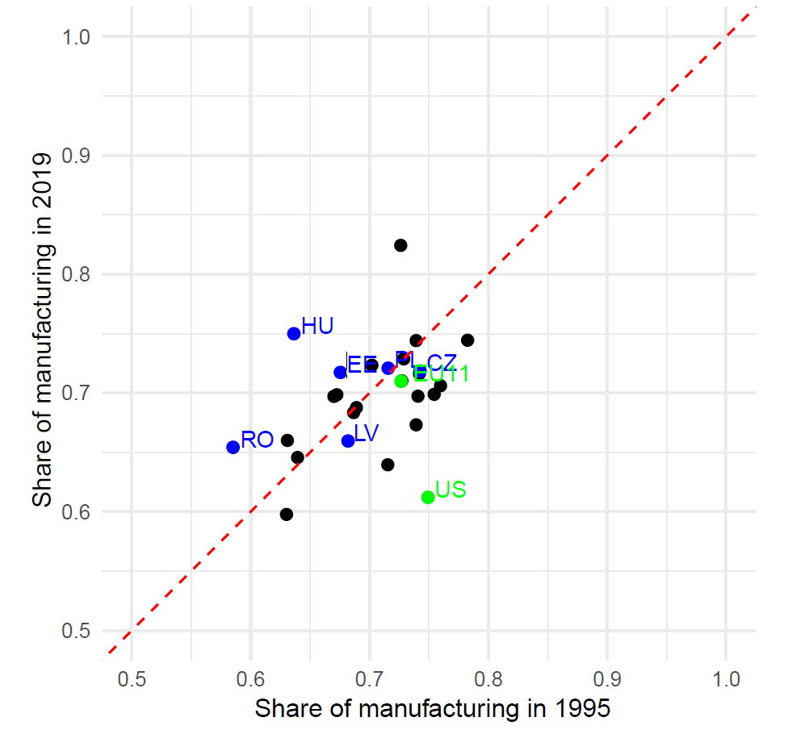
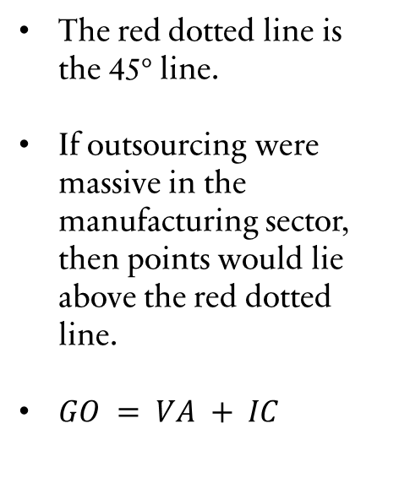
Share of intermediate consumption in manufacturing gross output in volume 1995 vs 2019
The red dotted line is the 45° line.
If outsourcing were massive in the manufacturing sector, then points would lie above the red dotted line.
$GO = VA + IC$
Source of data: EU KLEMS
Calculus: authors

Slide 26

5. Conclusions
Gross output, intermediate consumption and employment: deindustrialization over the last 30 years
Value added in volume in manufacturing: stable over the last 30 years.
Labor productivity in manufacturing: sharp increase over the last 30 years.
Deindustrialization of low-paid jobs? The real issue?

Slide 27
References
Bonvillian, W. B. (2016). Donald Trump's voters and the decline of American manufacturing. Issues in Science and Technology, 32(4), 27.
Herrendorf, B., Rogerson, R., and Valentinyi, A. (2014). Growth and structural transformation. In Aghion, P. and Durlauf, S. N., editors, Handbook of Economic Growth, volume 2, chapter 6, pages 855–941. Elsevier.

Slide 28
Thank you for your attention

