Slide 1
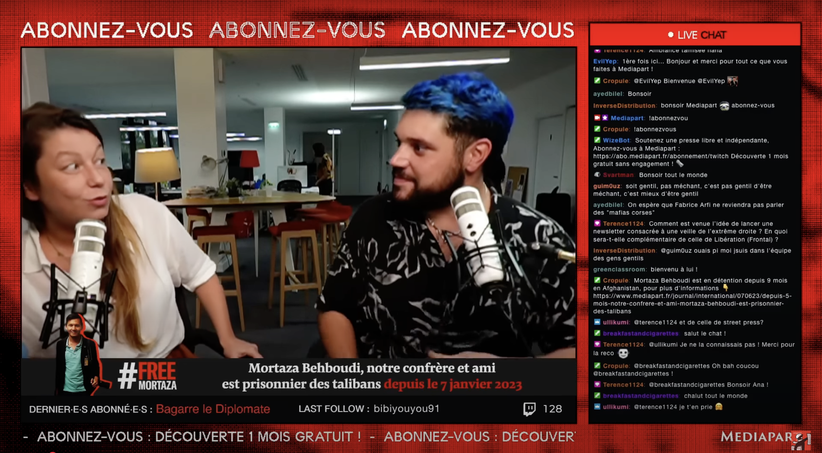

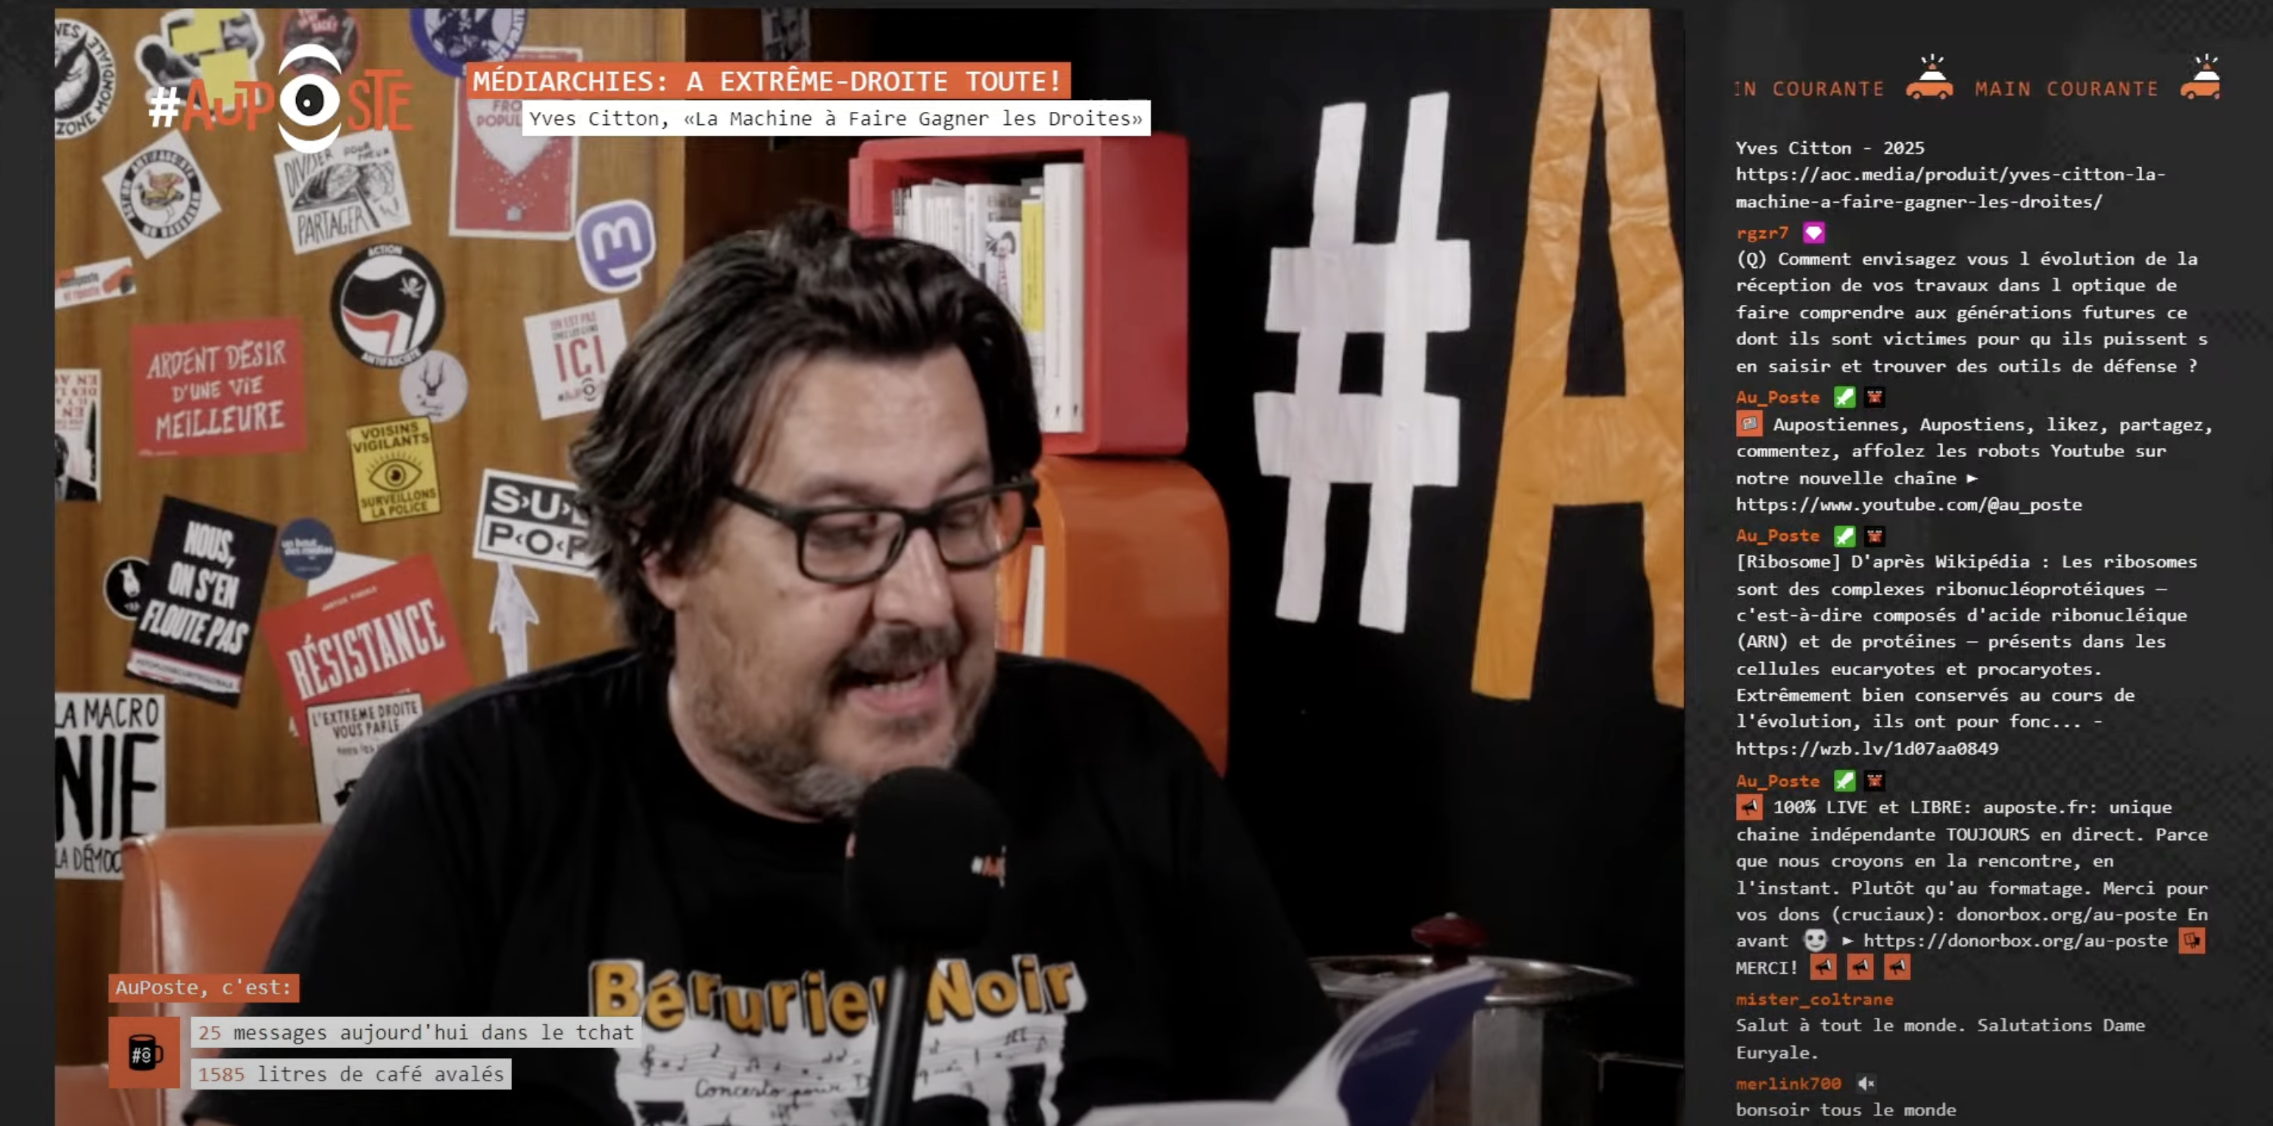
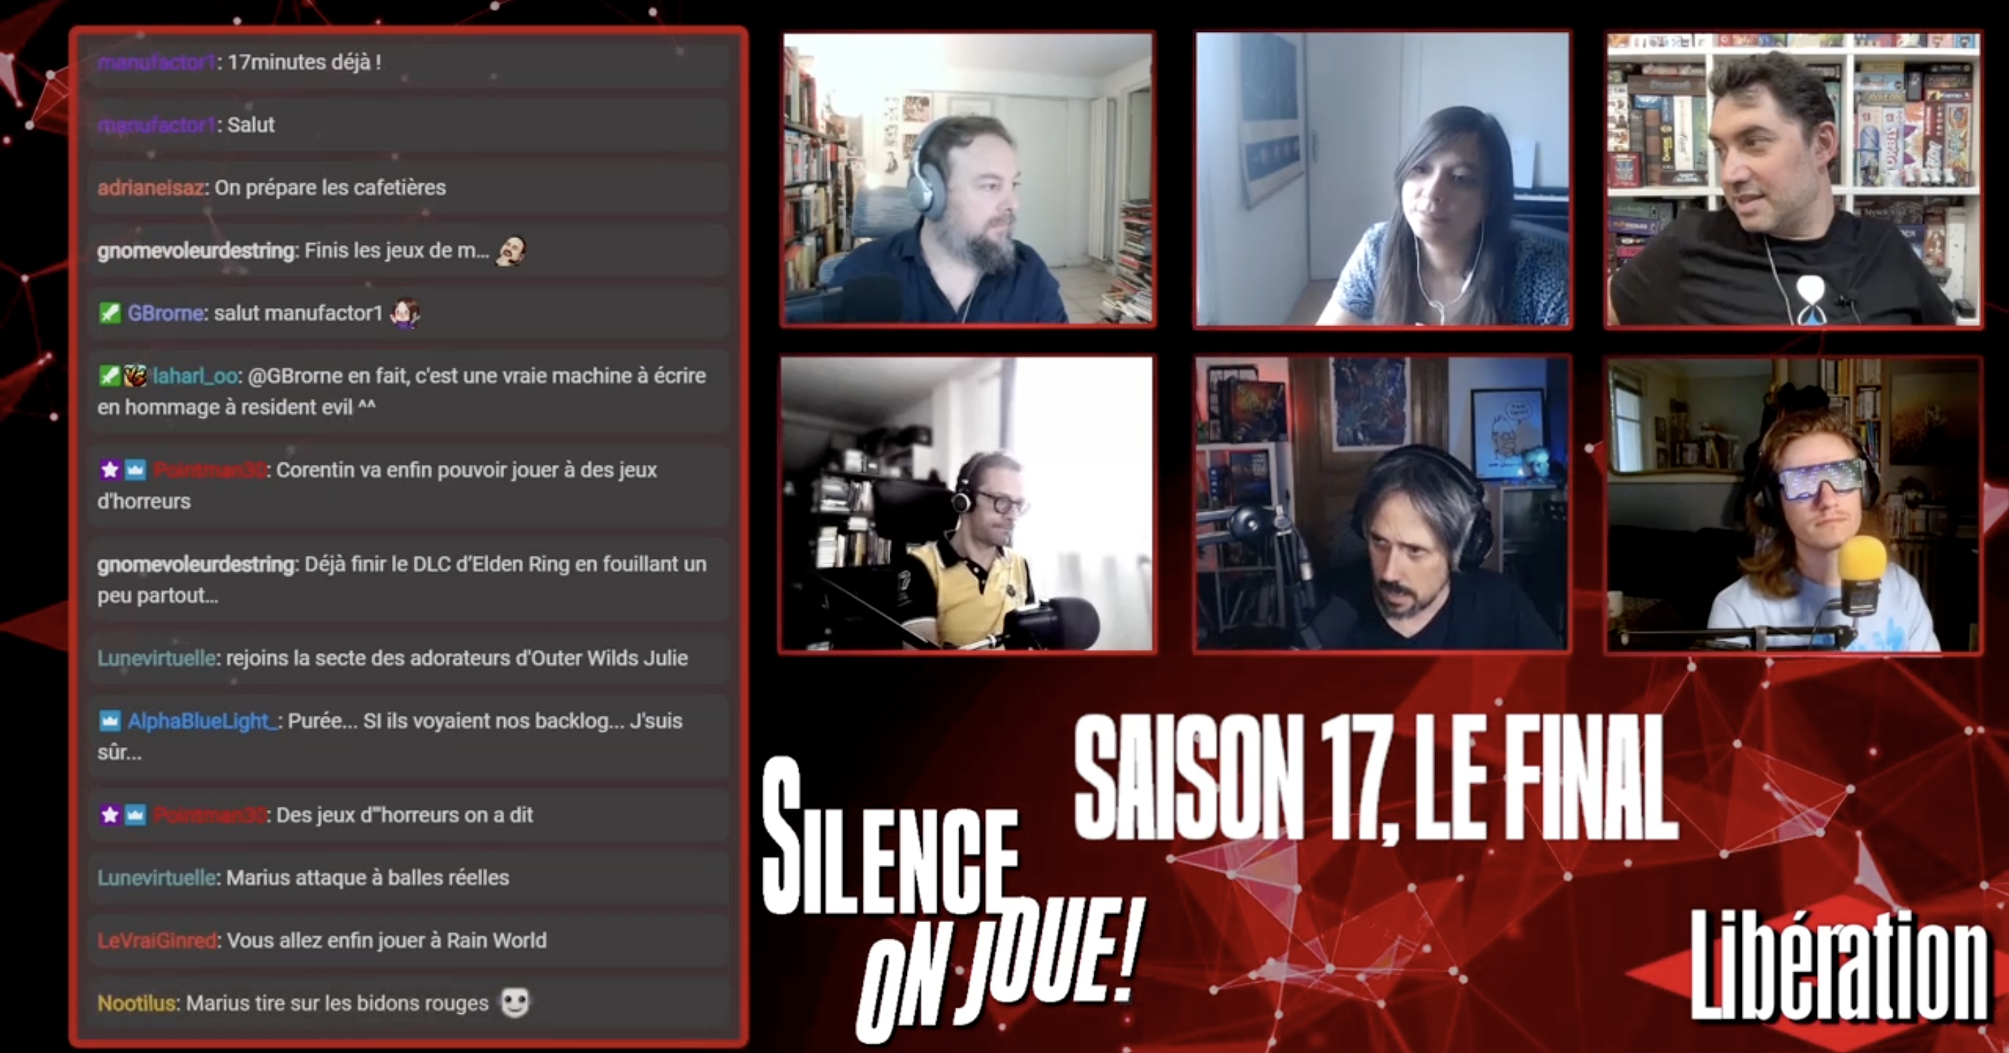
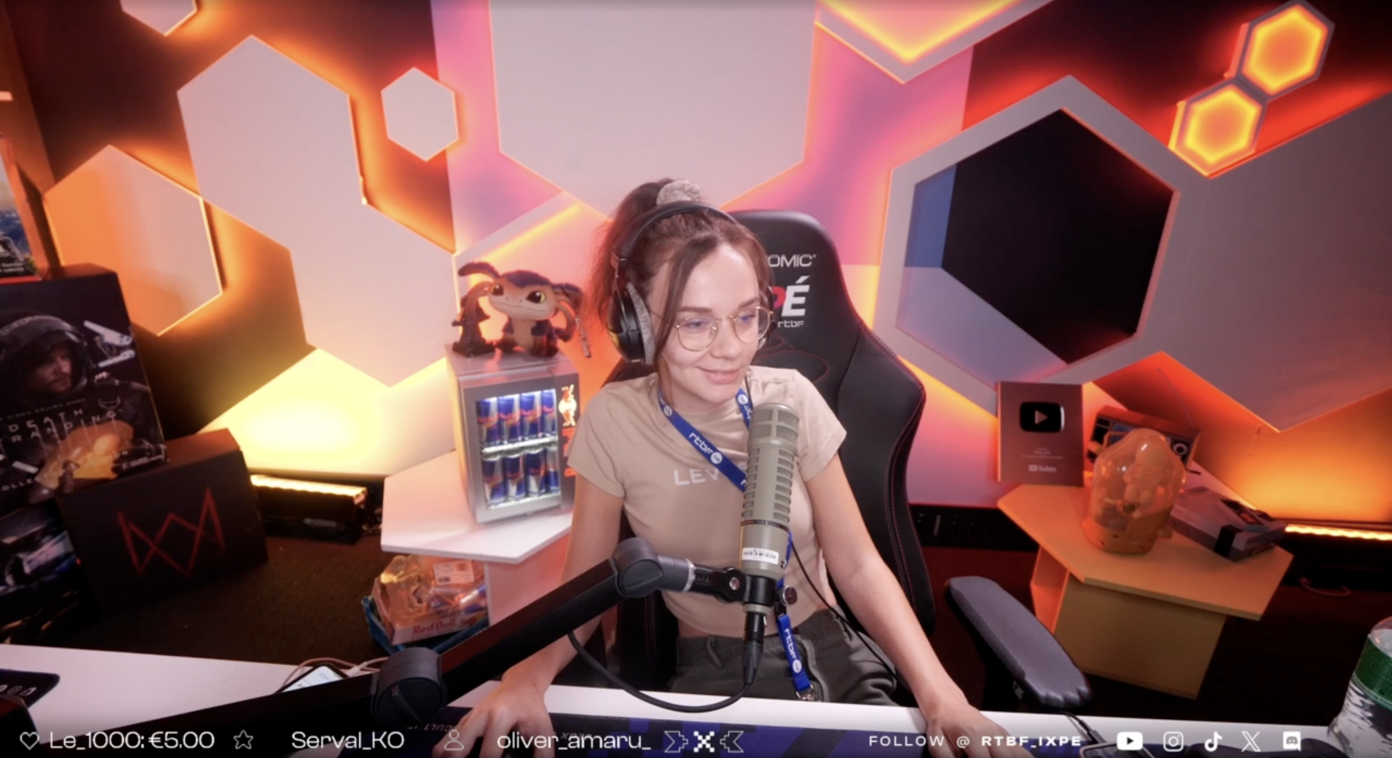
Streaming journalism: balancing information and entertainment
Boris Krywicki Université de Liège – LEMME, MagNet
Notes:
Hello, thank you for your presence. Today, I’ll be giving a talk named « Streaming journalism: balancing information and entertainment”, about stream practices of French-speaking journalists, mainly on the platform Twitch.

Slide 2
Twitch as a platform for journalism
Origins and Growth: Launched in 2011 as a spin-off of Justin.TV, Twitch focused on live-streaming games and esports, quickly becoming popular among younger audiences.
Amazon Era: After its 2014 acquisition, Twitch began diversifying content beyond gaming, though it remained closely linked to gaming culture and outside mainstream media attention.
Pandemic Shift: COVID-19 lockdowns in 2020 marked a turning point, as journalists and communicators started using Twitch as a new medium for engagement.
Impact on Journalism: The rise of streaming in news challenges traditional practices, blurring information and entertainment and raising questions about journalistic identity and integrity.
Notes:
2 Initially launched in 2011 as a spin-off of Justin.TV, Twitch was conceived as a live-streaming platform primarily dedicated to video game content and esports. While Justin.TV featured a variety of content, growing interest in gaming led to the creation of Twitch.TV, which quickly gained popularity among younger audiences. In 2014, Twitch was acquired by Amazon, marking a strategic pivot: while maintaining its dominance in esports, the platform began to diversify its content and encourage the development of communities beyond gaming. For several years, Twitch remained largely associated with gaming culture and was relatively unnoticed by the broader public and mainstream media. However, in mid-2020, during the COVID-19 lockdowns, journalists and communicators began exploring Twitch as a new medium. As news organizations increasingly adopt live streaming on platforms like Twitch, they enter a media ecosystem shaped by entertainment-driven engagement strategies. While journalism has traditionally focused on investigation and reporting, the integration of streaming challenges established norms, blurring the boundaries between information and entertainment. This shift raises critical questions about journalism’s future: How do journalists navigate the performative demands of live platforms while maintaining professional integrity? Does this transition redefine journalistic “occupational identity”, prioritizing audience engagement over investigative depth?

Slide 3
Research question and methodology
Research Question: The study examines how adopting Twitch as a live-streaming platform influences journalists’ professional identity and practices, especially in balancing traditional reporting norms with the performative and interactive demands of streaming.
Approach: A qualitative, multi-method design is used, combining close reading of audiovisual material (Burke, 2014) with comprehensive interviews (Kaufmann, 1999).
Corpus: The empirical material includes (1) close readings of Twitch broadcasts from five media organizations—Mediapart, Au Poste, RTBF, Libération, and Origami—and (2) five semi-structured comprehensive interviews with journalists actively engaged in streaming for these outlets.
Analytical Focus: The analysis attends to discursive strategies, performative gestures, audience interaction, and narrative framing, in order to capture how journalists negotiate Twitch’s entertainment affordances while conveying news.
Notes:
I am working on the following research question : How does the adoption of Twitch as a live-streaming platform influence the professional identity and practices of journalists, particularly in balancing traditional norms of reporting with the performative and interactive demands of the platform? To investigate this potential transformation, this study adopts a qualitative, multi-method approach. The empirical corpus consists of two primary components: (1) a close reading of Twitch broadcasts from five media organizations—Mediapart, Au Poste, RTBF, Libération, and Origami—and (2) five semi-structured “comprehensive interviews” conducted with journalists actively engaged in streaming for the five medias quoted above. The close reading methodology allows for a detailed examination of audiovisual content, focusing on discursive strategies, performative gestures, audience interaction, and narrative framing. By attending to both form and content, this analysis seeks to understand how journalists negotiate the entertainment affordances of Twitch while conveying news.

Slide 4
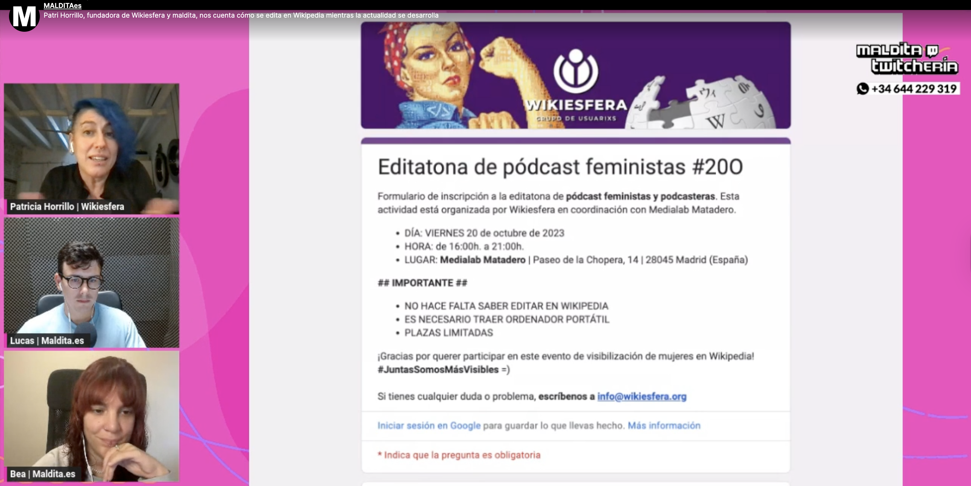
State of the art
Generalist media are increasingly leveraging Twitch as an extension of their existing editorial offerings, driven by the platform's significant growth since 2020, its predominantly young audience, and its strong interactive potential (Rodríguez, 2019 ; Vasquez Herrero et. al, 2022).
For generalist medias, Twitch offers an opportunity to delve deeper into certain subjects and provide real-time updates on developing news. For instance, MALDITA.es used Twitch to elaborate on topics and update information, though not necessarily to diversify content or introduce new journalistic perspectives (Martínez Valerio and Espada Ipiña, 2024).
Notes:
Generalist media are increasingly leveraging Twitch as an extension of their existing editorial offerings, driven by the platform's significant growth since 2020, its predominantly young audience, and its strong interactive potential. For generalist medias, Twitch offers an opportunity to delve deeper into certain subjects and provide real-time updates on developing news. For instance, MALDITA.es used Twitch to elaborate on topics and update information, though not necessarily to diversify content or introduce new journalistic perspectives.

Slide 5
Following Olivares-García and Méndez Majuelos’ typology…
Hybridity of Uses: According to Olivares-García and Méndez Majuelos (2022), Twitch occupies a space between information and entertainment, with journalists adopting its visual and narrative codes to reach younger audiences through formats that mix news, culture, and engagement.
Dominant Formats: The most common model is interactive discussion or Just Chatting, structured as semi-scripted monologues enriched by live comments. This conversational approach is complemented by interviews with cultural figures, reinforcing the journalistic character of the streams.
Programmed and Hybrid Content: Some creators propose structured programs with editorial agendas (e.g., Buenos días, La Cafetera), blending radio, television, and livestreaming. Other frequent formats include live commentary or reactions to videos, as well as political debate and real-time analysis of current events.
Role of Video Games: Games are often used as a backdrop for discussion rather than the main focus, serving as a setting for dialogue (e.g., Red Dead Redemption 2, Total War: Rome II). Most communicators integrate games into their streams, with the notable exception of Facu Díaz, who favors structured talk formats.
Notes:
According to Olivares-García and Méndez Majuelos, Twitch occupies a space between information and entertainment, with journalists adopting its visual and narrative codes to reach younger audiences through formats that mix news, culture, and engagement. The most common model is interactive discussion or Just Chatting, structured as semi-scripted monologues enriched by live comments. This conversational approach is complemented by interviews with cultural figures, reinforcing the journalistic character of the streams. Some creators propose structured programs with editorial agendas, blending radio, television, and livestreaming. Other frequent formats include live commentary or reactions to videos, as well as political debate and real-time analysis of current events. Games are often used as a backdrop for discussion rather than the main focus, serving as a setting for dialogue.

Slide 6


1) Twitch as an Expansion of Editorial Strategy (RTBF, Mediapart)
Notes:
Now let’s move on to our two first case studies to see how they fit to this typology.

Slide 7

Strategic Role: Launched in october 2021, iXPé complements RTBF’s editorial strategy by targeting gaming, esports, and geek communities, broadening its audience reach in a fragmented digital media landscape.
Origins and Audience Focus: Emerging from an internal initiative rather than top-down direction, iXPé was designed to engage the underserved 18–35 demographic, identified through research as strongly interested in video games and music, while also challenging outdated gamer stereotypes.
Dual Function: Beyond being a content platform, iXPé acts as both a direct engagement tool (B2C) and a partner in developing Belgium’s gaming and esports ecosystem (B2B), collaborating with industry stakeholders and fostering new expertise.
Notes:
iXPé is a digital label of RTBF (Belgium’s public broadcaster) dedicated to gaming, esports, and geek culture. Launched in october 2021, iXPé complements RTBF’s editorial strategy by targeting gaming, esports, and geek communities, broadening its audience reach in a fragmented digital media landscape. Emerging from an internal initiative rather than top-down direction, iXPé was designed to engage the underserved 18–35 demographic, identified through research as strongly interested in video games and music, while also challenging outdated gamer stereotypes. Beyond being a content platform, iXPé acts as both a direct engagement tool (B2C) and a partner in developing Belgium’s gaming and esports ecosystem (B2B), collaborating with industry stakeholders and fostering new expertise.

Slide 8


Ixpé : Navigating the tension between specialization and inclusivity
“We're a specialized video game unit, but we're still part of a public service broadcaster. So we have to find a balance: we’re focused, we only do video games, and we’re speaking to people who actually play video games—not just people who only play FIFA and Call of Duty. But since we’re a public service, we can’t start talking about, I don’t know, Granblue Fantasy Versus or super niche Japanese games that maybe a thousand people in the whole country care about. That’s part of the public service mission too—to reach a broader audience. We can’t afford to go too niche, because we’re still RTBF’s video game channel. But that doesn’t mean we’re not specialized—we only talk video games, and we talk to gamers” (Interview with Bastien Mertens, journalist for Ixpé RTBF).
“What we decided to do is let go of the idea of covering all of esports—all the games, all the competitions, all the transfers and news in every title. Instead, we chose a Belgian angle. That means we cover everything that involves one or more Belgian players in esports. […] Basically, our focus is working with Belgian talent. When there are Belgian tournaments, we try to get involved—whether that’s casting, broadcasting, or supporting in other ways. And when we see promising Belgian players trying to break through, we try to highlight them—maybe bring them on for a stream, do an interview, that kind of thing. We really try to stick to that angle, because it’s our own, and there’s not a lot of competition in that space” (Interview with Christopher Pierre, journalist for Ixpé RTBF).
Notes:
Within RTBF, iXPé functions as a specialized hub for gaming content, balancing public service obligations with domain-specific expertise. Its editorial approach aims to maintain high credibility among gamers while remaining accessible to a broader audience, navigating the tension between specialization and inclusivity. On platforms such as Twitch, iXPé distinguishes itself through expert-led content and a strong emphasis on esports coverage with a distinctly Belgian perspective, thereby occupying a niche with limited competition. Working with independent Belgian streamers and specialized journalists, iXPé has become a reference point within RTBF for all matters related to gaming.

Slide 9

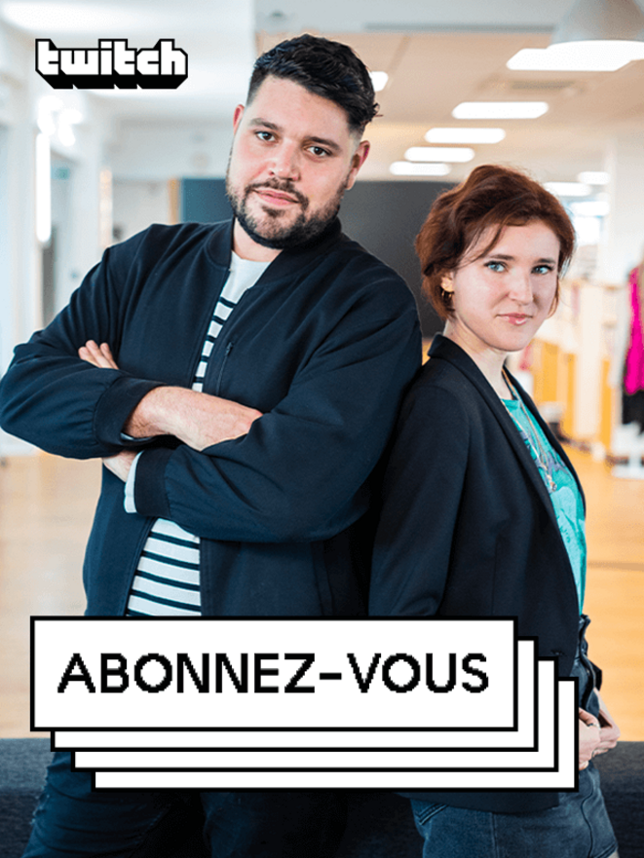
Mediapart, “À l’air libre“ and “Abonnez-vous”
À l’air libre was Mediapart’s first step onto Twitch, launched during the COVID-19 lockdowns as a daily live show designed to sustain a direct connection with its readers and to open a new space for debate. From this foundation, Mediapart expanded its Twitch presence into a showcase for its investigative work while deliberately refusing Twitch’s built-in monetization tools, such as ads or paid subscriptions. Instead, the channel serves as a promotional gateway to Mediapart’s independent business model, where financial autonomy rests entirely on reader contributions. This strategy is embodied in the program’s title (Abonnez-vous, meaning “Please Subscribe”). In this way, the outlet leverages Twitch’s interactivity and youth-oriented reach without compromising its editorial independence or aligning with Amazon’s commercial ecosystem.
Notes:
À l’air libre marked Mediapart’s initial foray into Twitch, emerging during the COVID-19 lockdown as a daily live show that served as a virtual meeting point with its audience. Building on this foundation, Mediapart gradually expanded its Twitch presence into a broader platform for showcasing its journalistic work, while maintaining a clear boundary with Twitch’s embedded monetization features—eschewing subscriptions and advertisements in favor of promoting its own paywalled model.

Slide 10
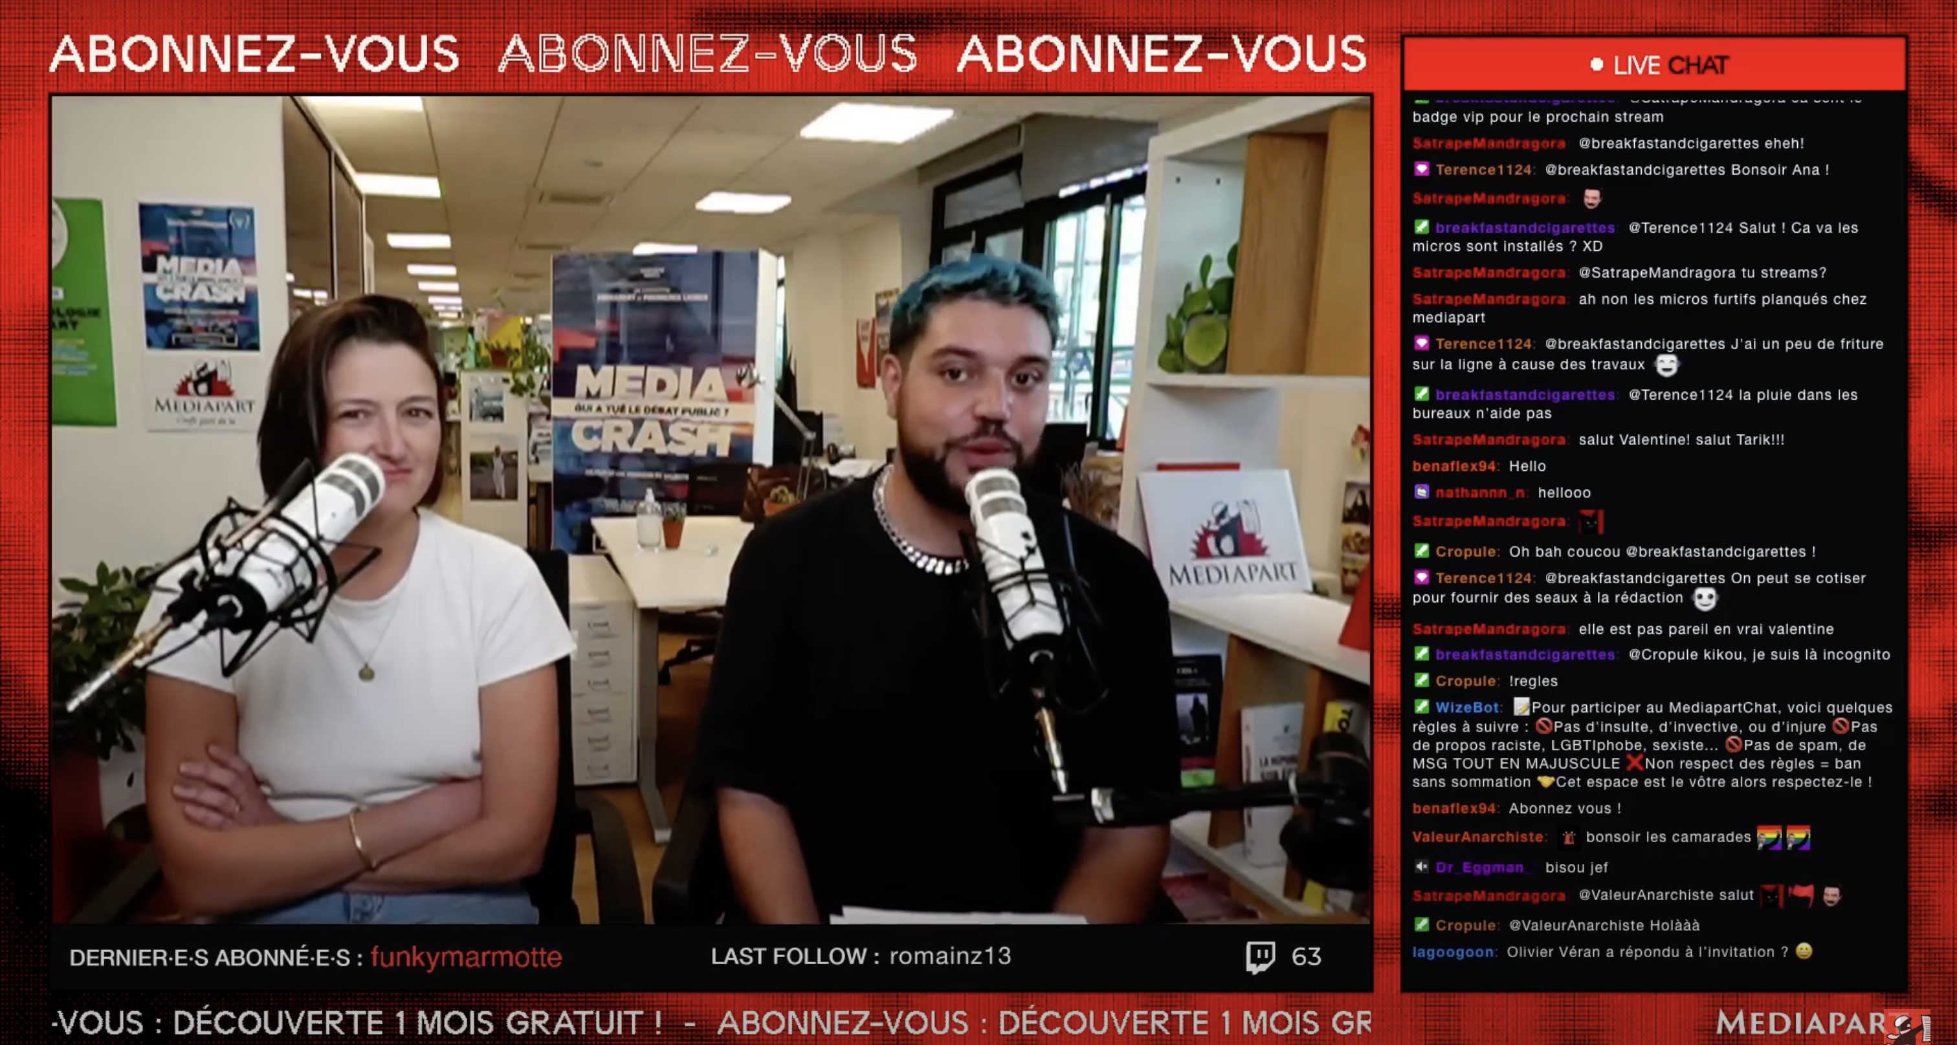
“As you know, we’re on Twitch — and Twitch is owned by Amazon, so by Jeff Bezos. That’s why we’ve decided, since Mediapart is an independent media outlet — or at least tries to be, in everything it produces — to remain as autonomous as possible. So we don’t accept subs, which are basically Amazon tips, and we’re not monetized. So don’t bother trying — it won’t work.That said, we’re going to talk a lot about Mediapart’s content, and if you want to support us, the best way is to subscribe to Mediapart. The regular subscription already helps a lot — but if you’ve never subscribed before, we’re being extra nice: we’ve set up a free one-month trial so you can give Mediapart a try.” Tarik Safraoui, Mediapart
Notes:
The Twitch channel thus functions as a strategic extension of its independent journalistic mission: it operates as a promotional gateway to Mediapart’s subscription service, reinforcing the outlet’s financial autonomy. This stance is showed by the program’s title, Abonnez-vous (“Please Subscribe”), which functions as an injunction to take out a subscription in order to support the media outlet’s financial independence. The title echoes one of Mediapart’s core slogans: “only our readers can buy us.”

Slide 11

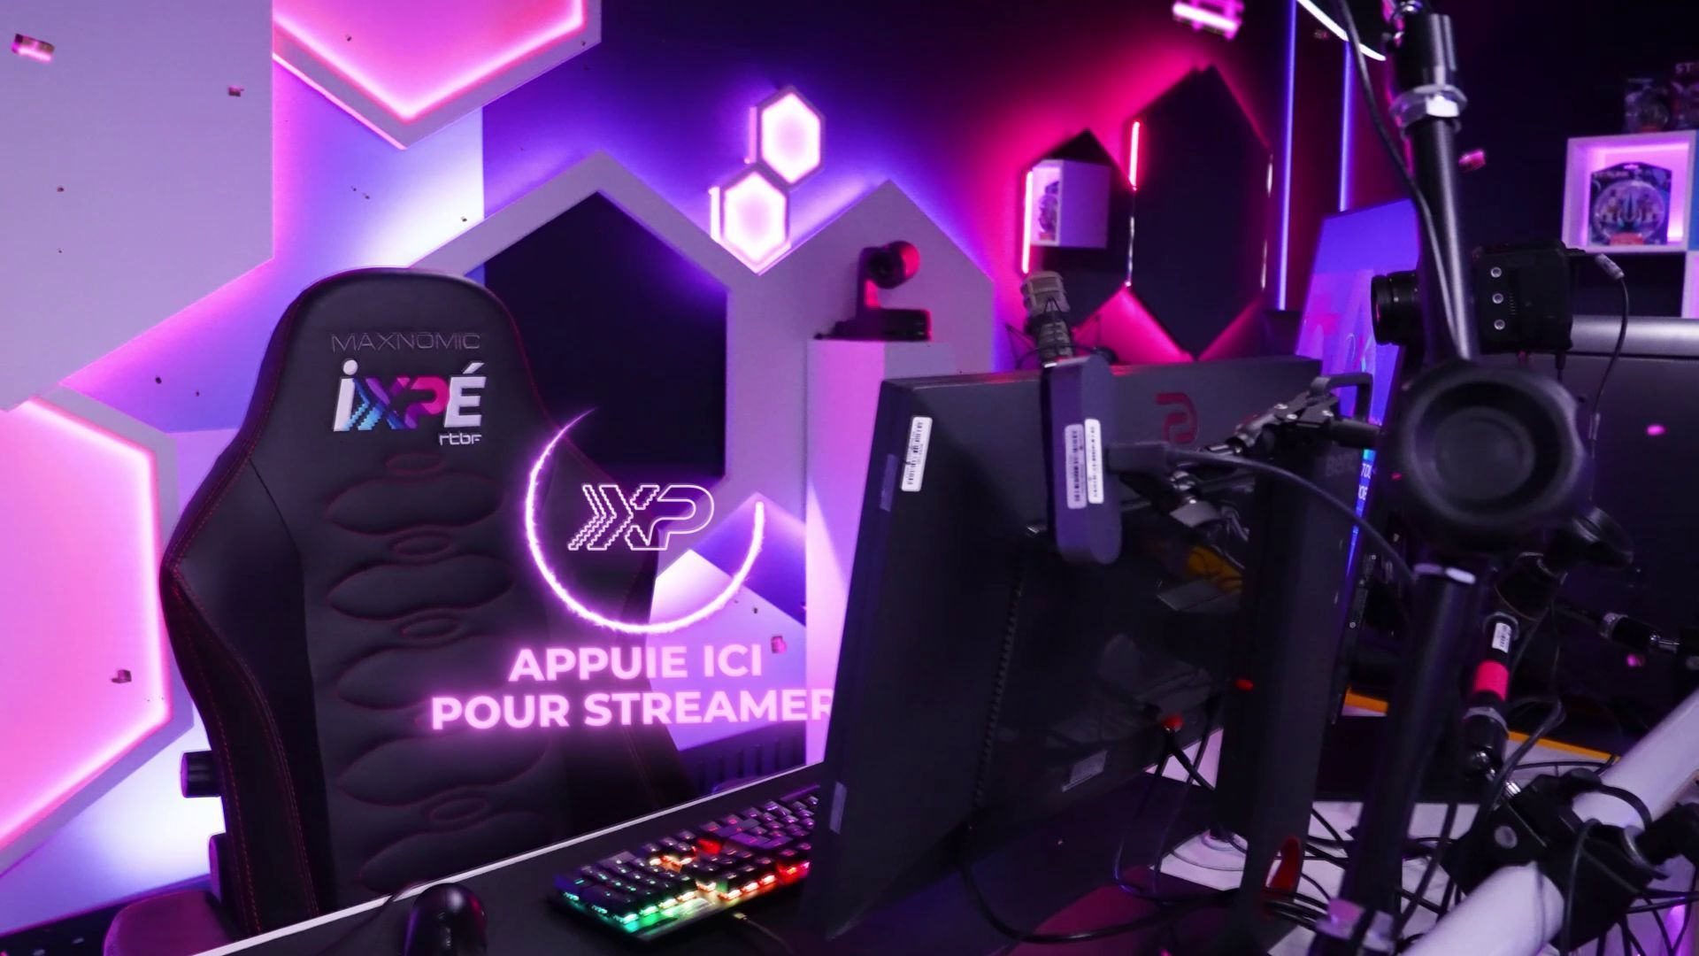
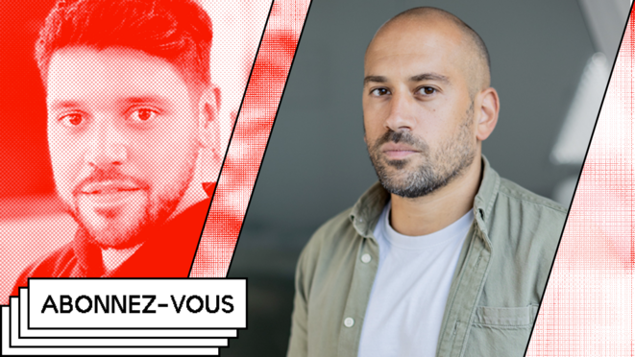
Comparing RTBF and Mediapart’s stream practices
Both RTBF and Mediapart leverage Twitch’s interactive features to align with their distinct institutional missions, adapting to evolving media consumption habits.
RTBF’s iXPé initiative engages gaming communities and promotes Belgian esports talent, focusing on cultural interests of younger audiences rather than traditional news coverage whereas Mediapart uses Twitch to enhance transparency, showcase investigative journalism, and foster viewer engagement, prioritizing subscription-based sustainability over platform monetization.
The two approaches highlight broader trends of hybridization between legacy journalism and platform-native practices, with Twitch serving as both a distribution channel and a space for editorial experimentation.
Notes:
In this way, Mediapart seeks to leverage the interactive affordances of Twitch without submitting to Amazon’s monetization systems, despite the latter's ownership of the platform. Mediapart’s Twitch channel showcases a wide range of editorial content, including investigative reports, thematic documentaries, and political and social debates. It also engages audiences through interactive shows, extending accountability journalism beyond traditional articles. RTBF and Mediapart both approaches highlight broader trends of hybridization between legacy journalism and platform-native practices, with Twitch serving as both a distribution channel and a space for editorial experimentation.

Slide 12
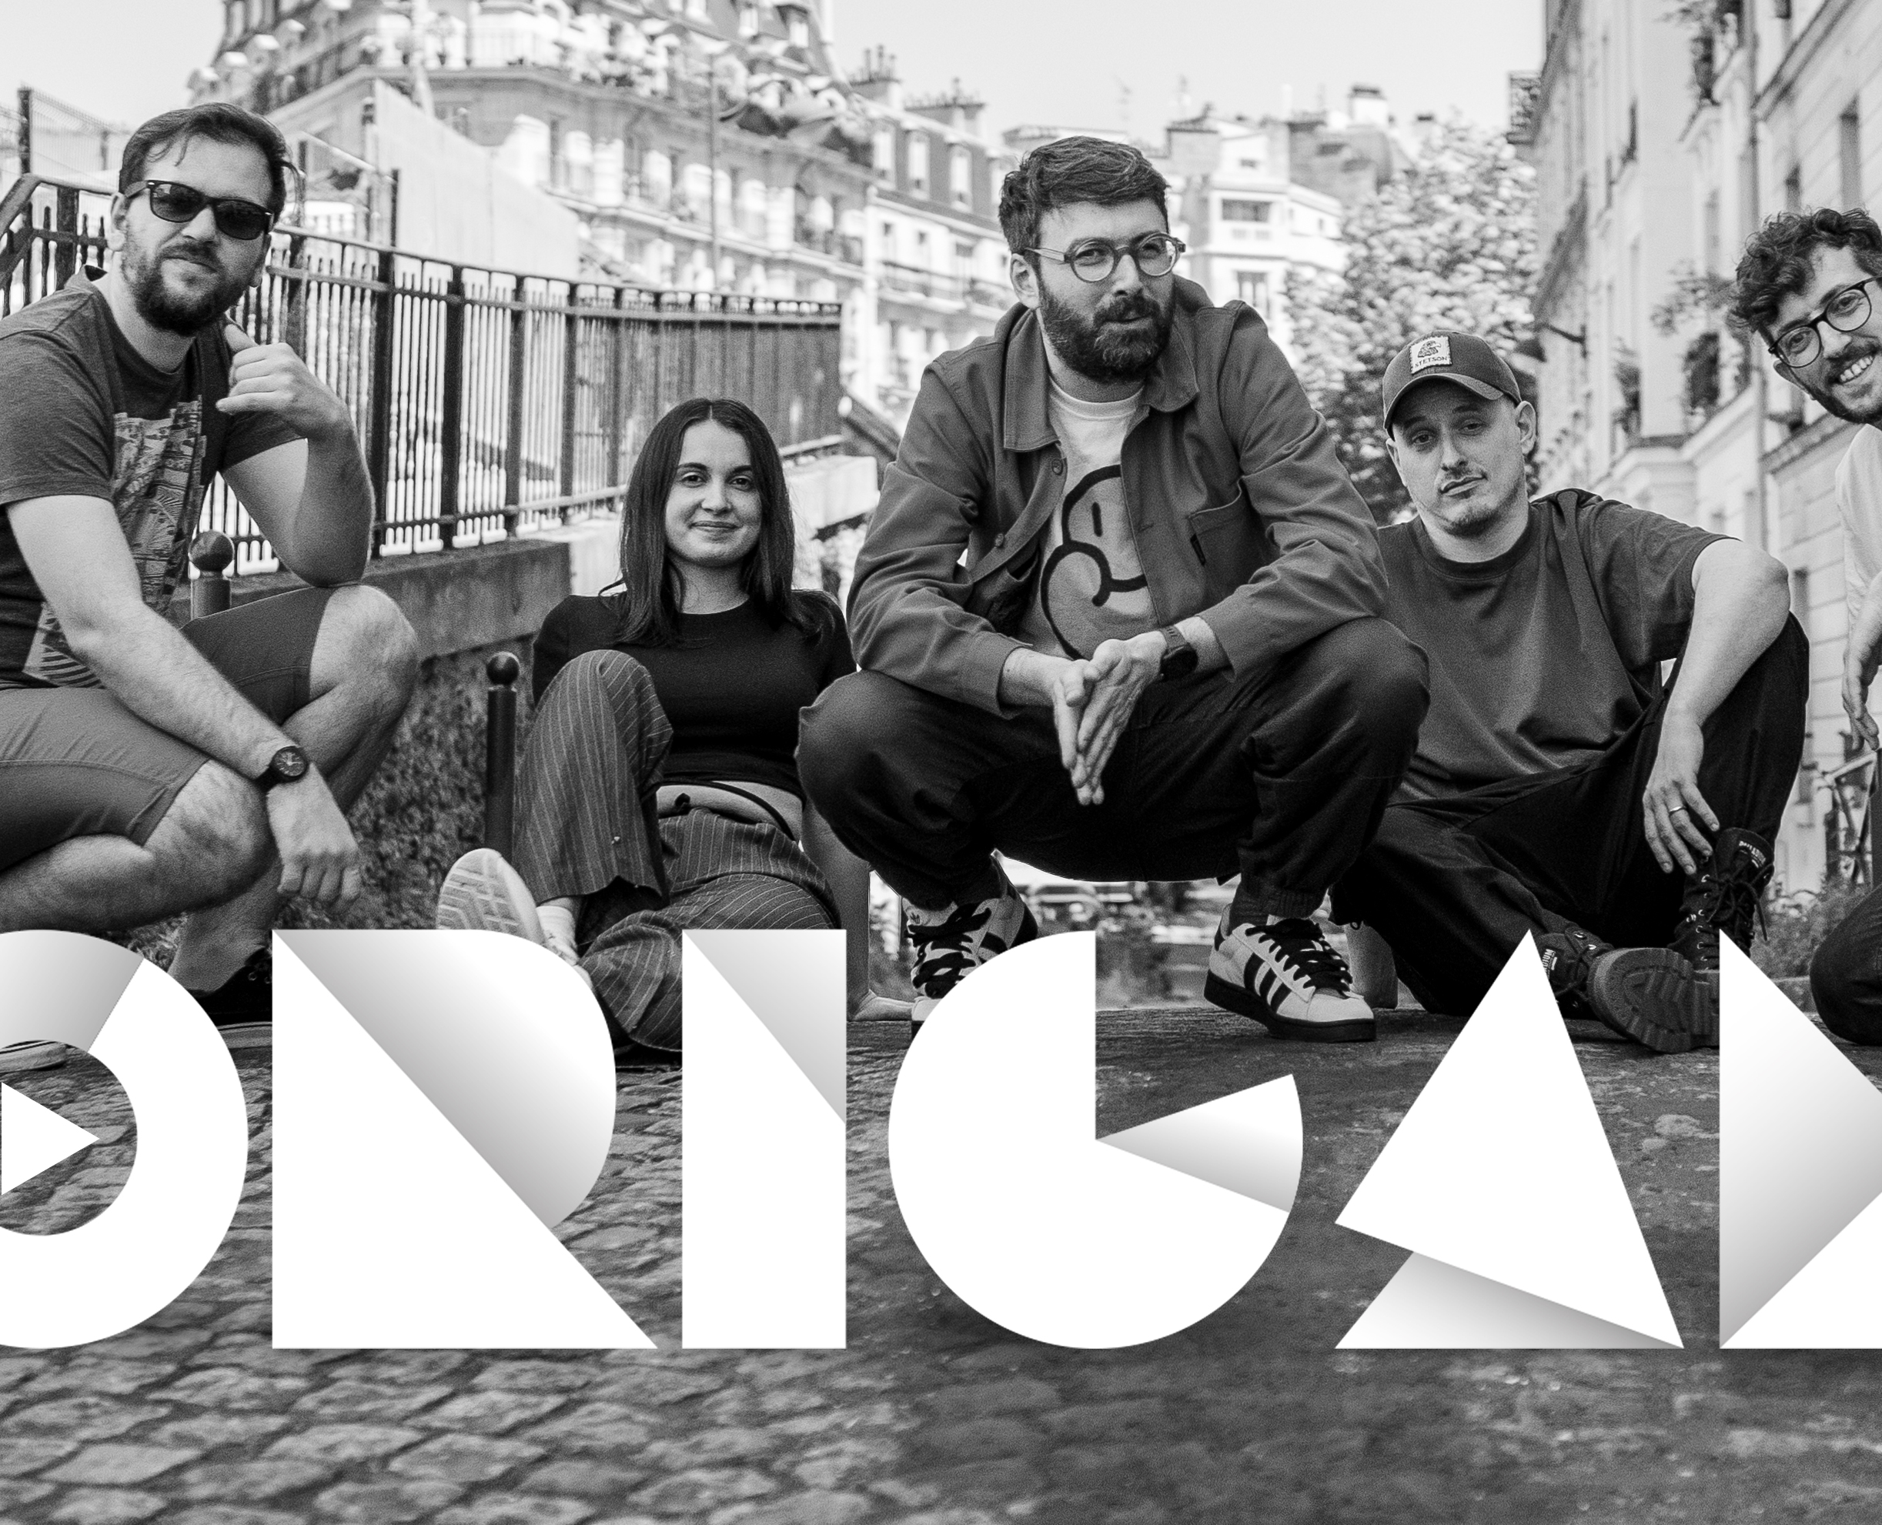
2) Twitch as a foundational basis of the editorial approach (Au Poste, Origami)
Notes:
Unlike Mediapart and RTBF, which incorporate Twitch as an ancillary component developed progressively over time, media outlets such as Au Poste and Origami originated primarily on Twitch, positioning the platform as the foundational basis of their editorial approach. In these cases, Twitch redefines the traditional “émission regime” as theorized by Dagiral and Parasie (2010) by decentralizing journalistic authority, embracing participatory interaction, and reshaping aesthetic and linguistic conventions. Twitch enables a more informal and flexible production style that values authenticity and proximity. Journalists who stream often operate from personal spaces with minimal technical resources, fostering a sense of intimacy and spontaneity.

Slide 13
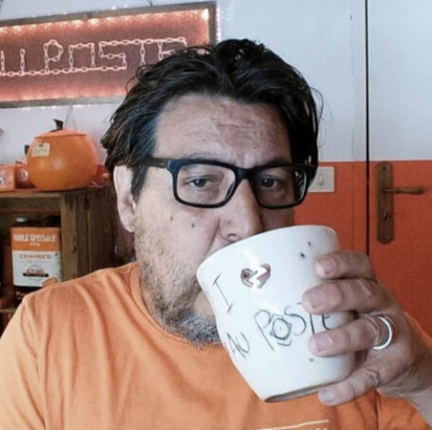
Redifining the traditionnal “émission’s regime” (Dagiral and Parasie, 2010)
"The amazing thing about Twitch, from my point of view, is that it really feels like a space where speech is freed—kind of like the free radio movement in the 1980s, or even the early web in the mid-1990s, especially with the interactive side of it, like the chat. That part is hugely important to me: there’s a real back-and-forth between the host, the guests if there are any, and the chat—people asking questions, reacting, sharing thoughts. When it works well, it creates a kind of collective intelligence. A show watched by 1,000 or 2,000 people—that’s more than a lecture hall, sometimes even more than a political rally. And it's an audience that’s super focused and engaged. You’re speaking to people who are totally able to watch a one or two-hour stream, who interact, bring in their own experience, their know-how." David Dufresne, Au poste
Notes:
This reconfiguration also shifts interpretative authority from journalists to a more collective dynamic that includes the audience. Twitch's live chat facilitates real-time feedback, discussion, and co-construction of meaning, positioning viewers not just as passive recipients but as active participants in the editorial process. Additionally, Twitch’s extended and adaptable broadcast durations allow for both in-depth exploration and background listening, similar to radio – A commonly invoked metaphor among interviewees

Slide 14
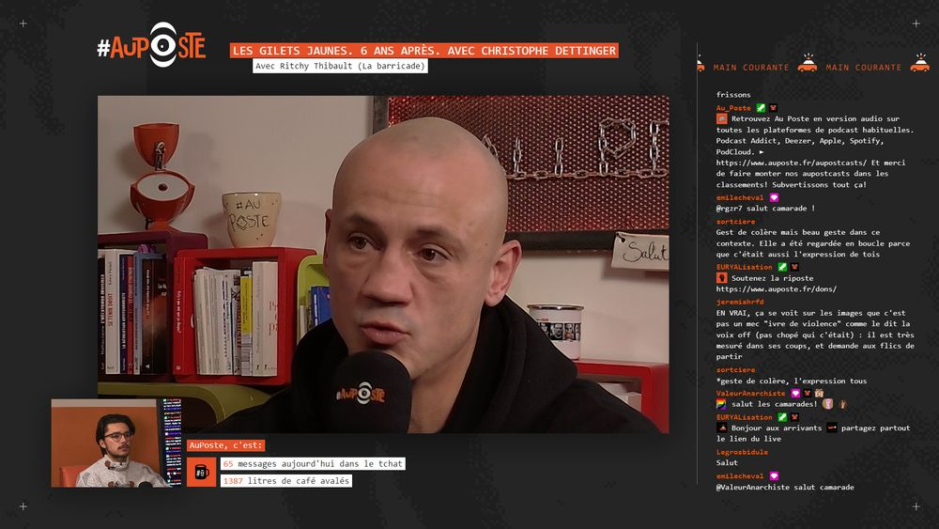
Au Poste : journalism as a collective dynamic
Began as a solo Twitch initiative by David Dufresne in 2021 before becoming a fully-fledged media outlet in 2022.
Funded through donations and subscriptions.
In 4 years : 3,500 hours of content with 784 invited guests.
Notes:
Auposte.fr, while hosting replay archives and written articles, began as a solo Twitch initiative by David Dufresne in 2021 before becoming a fully-fledged media outlet in 2022. The site is funded through donations and subscriptions, following a patronage-based economic model prevalent on Twitch. In four years of activity, the channel has broadcast over 3,500 hours of content with 784 invited guests (as of June 2025).

Slide 15
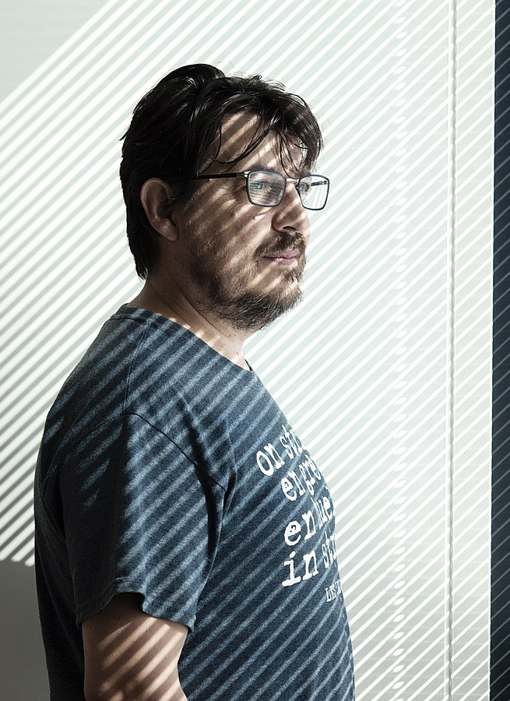
A paradoxical space for counter-power
"What Twitch, YouTube, and more broadly the web have solved is the question of the broadcaster. You can now be broadcast, be distributed. Whereas back in the 1980s, it was impossible to start your own radio — it was illegal. The frequencies were already assigned. So we've seen an incredible liberalization of how people can broadcast — in the sense of being the sender. […] The thing is, it’s kind of dumb to only make cat videos or to think being a YouTuber just means being funny. It’s great that some people do that, sure. But we don’t have to only do that, you know? And that’s what’s frustrating — there’s this standardization happening, even though the whole point at the start was freedom." (Interview of David Dufresne).
Notes:
Its visual identity plays with and subverts police imagery: Despite Twitch’s ownership by Amazon, Dufresne views the platform not as an extension of centralized power but as a space for counter-power, aligning it with the legacy of “free” or “pirate” radio stations.

Slide 16
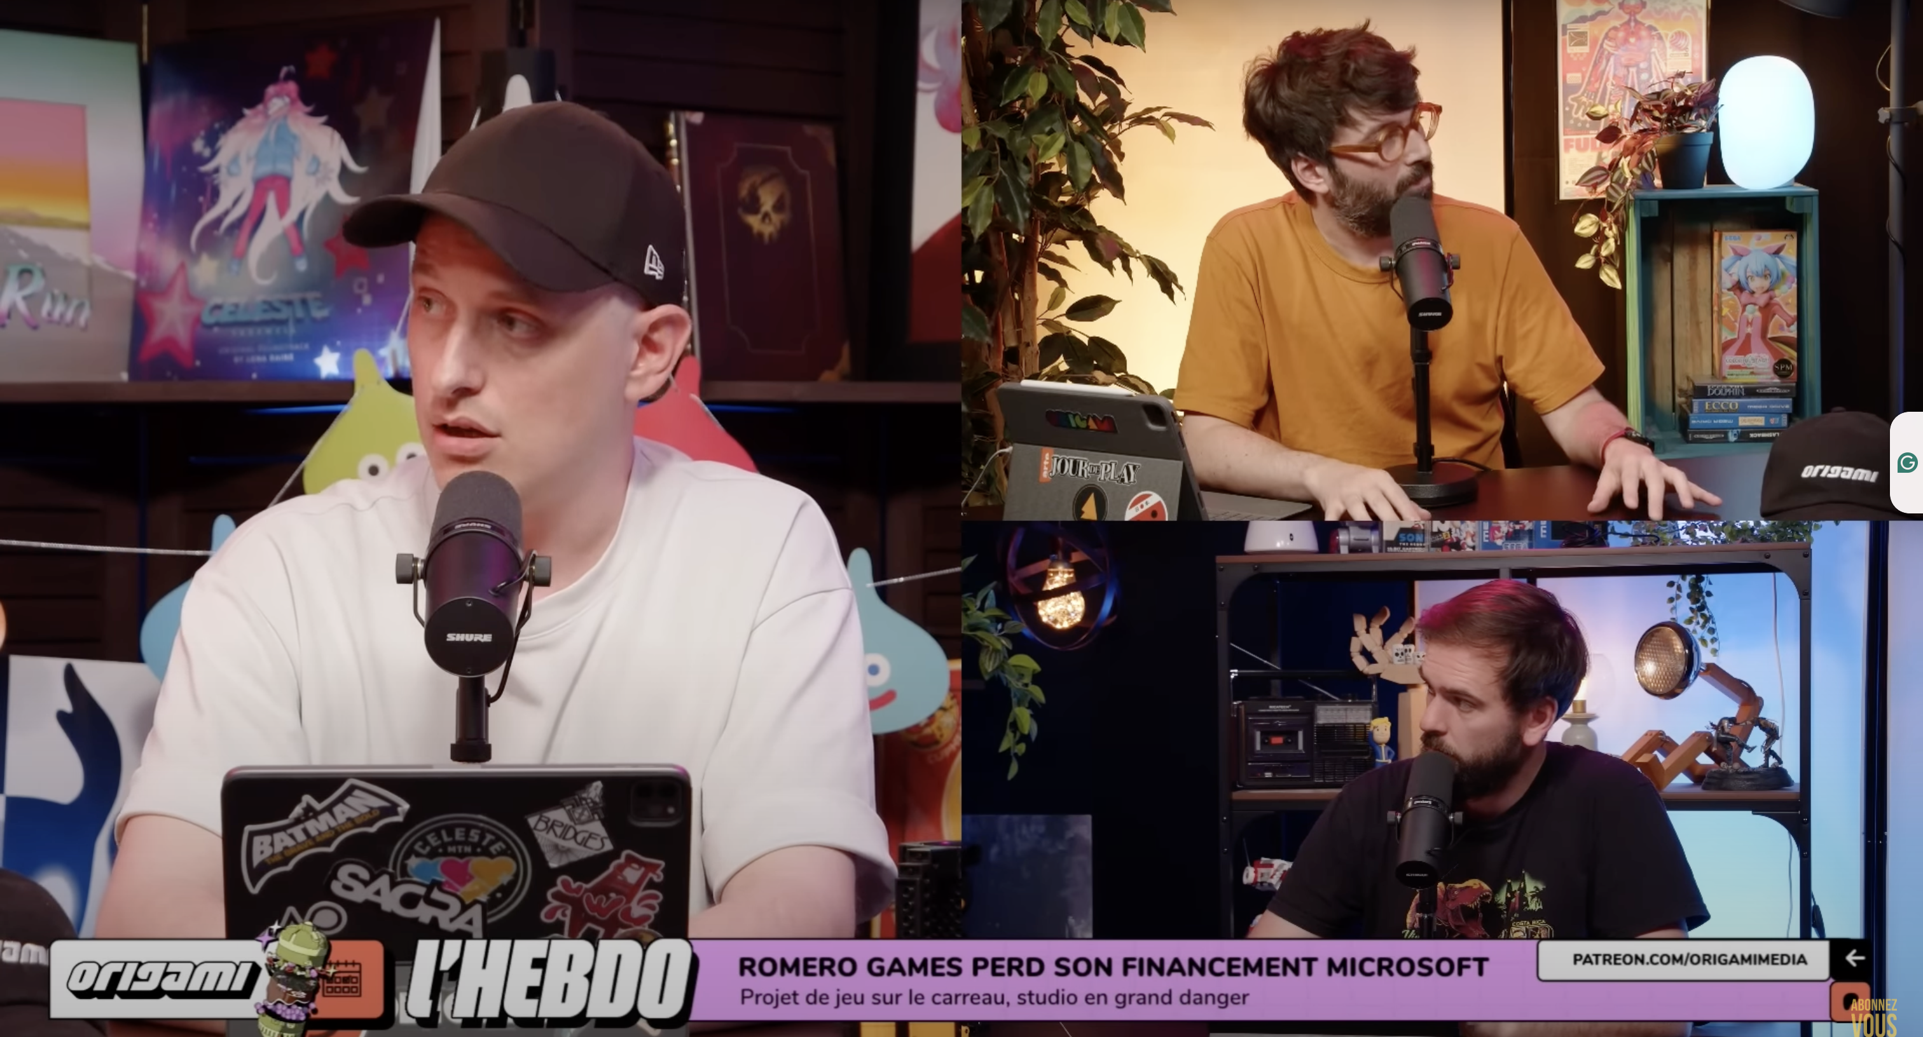
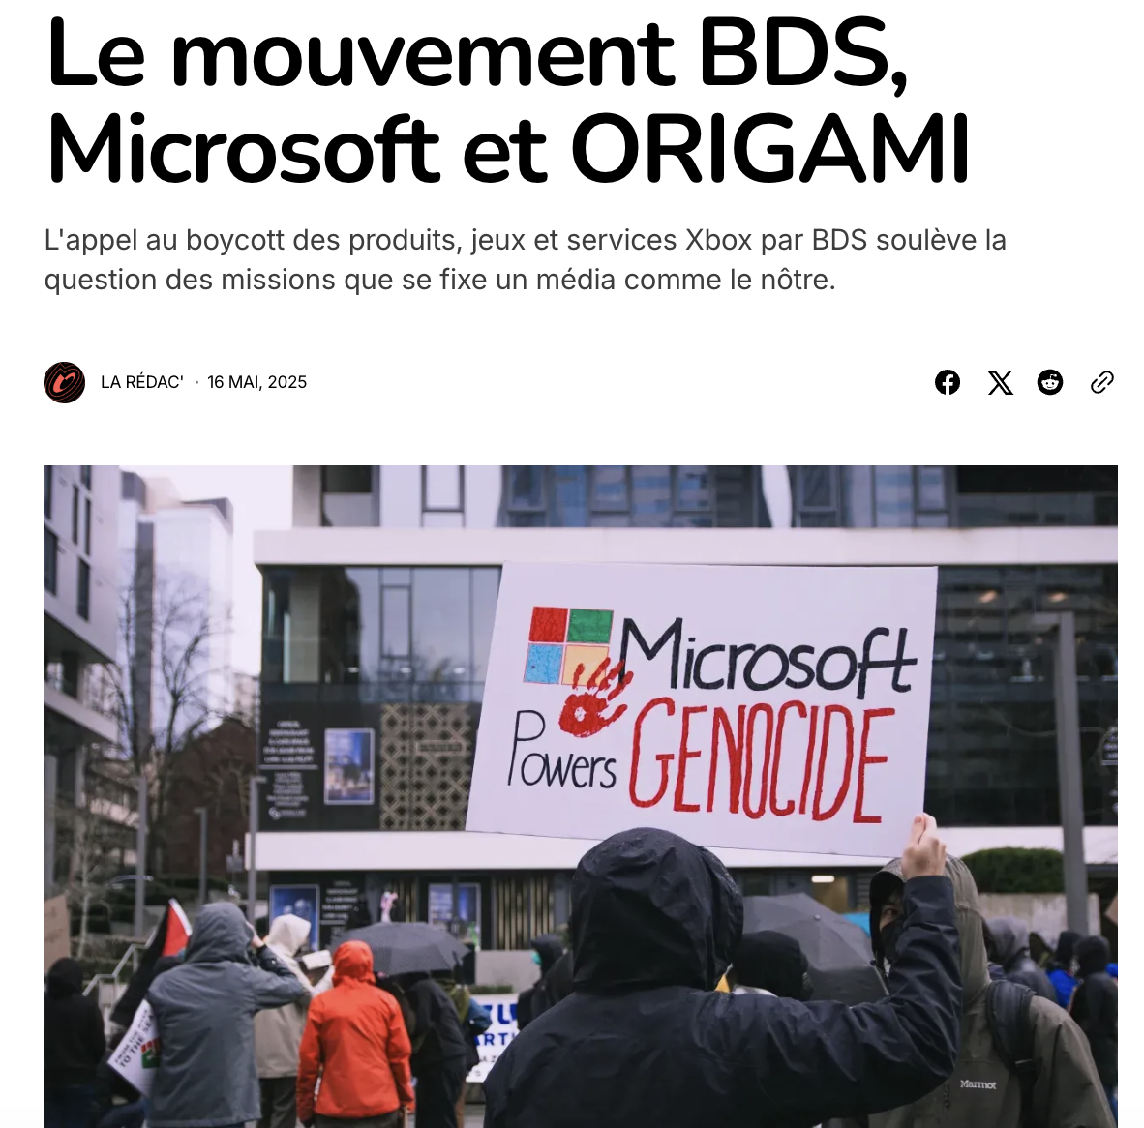
Notes:
The media outlet Origami, launched in 2023 by five video game journalists from former outlets, exemplifies a decentralized media model. Without a dedicated website, it operates solely through video platforms, blogs, and social media. It reimagines traditional video game journalism by offering oral, audiovisual, and live criticism, supported through participatory funding via Patreon. While Origami initially conforms to a classic “émission regime” (Dagiral & Parasie, 2010)—comprising short news roundups, thematic segments by individual commentators, and embodied, subjective reviews—it regularly disrupts this format to affirm its editorial ideology and cooperative structure. These disruptions include editorial stances against Microsoft’s ties with the Israeli military (as documented by the BDS movement), coverage supporting Ubisoft strikers, and transforming press reviews into exclusive investigations, such as on the harsh layoff plans at the French publisher Microids.

Slide 17
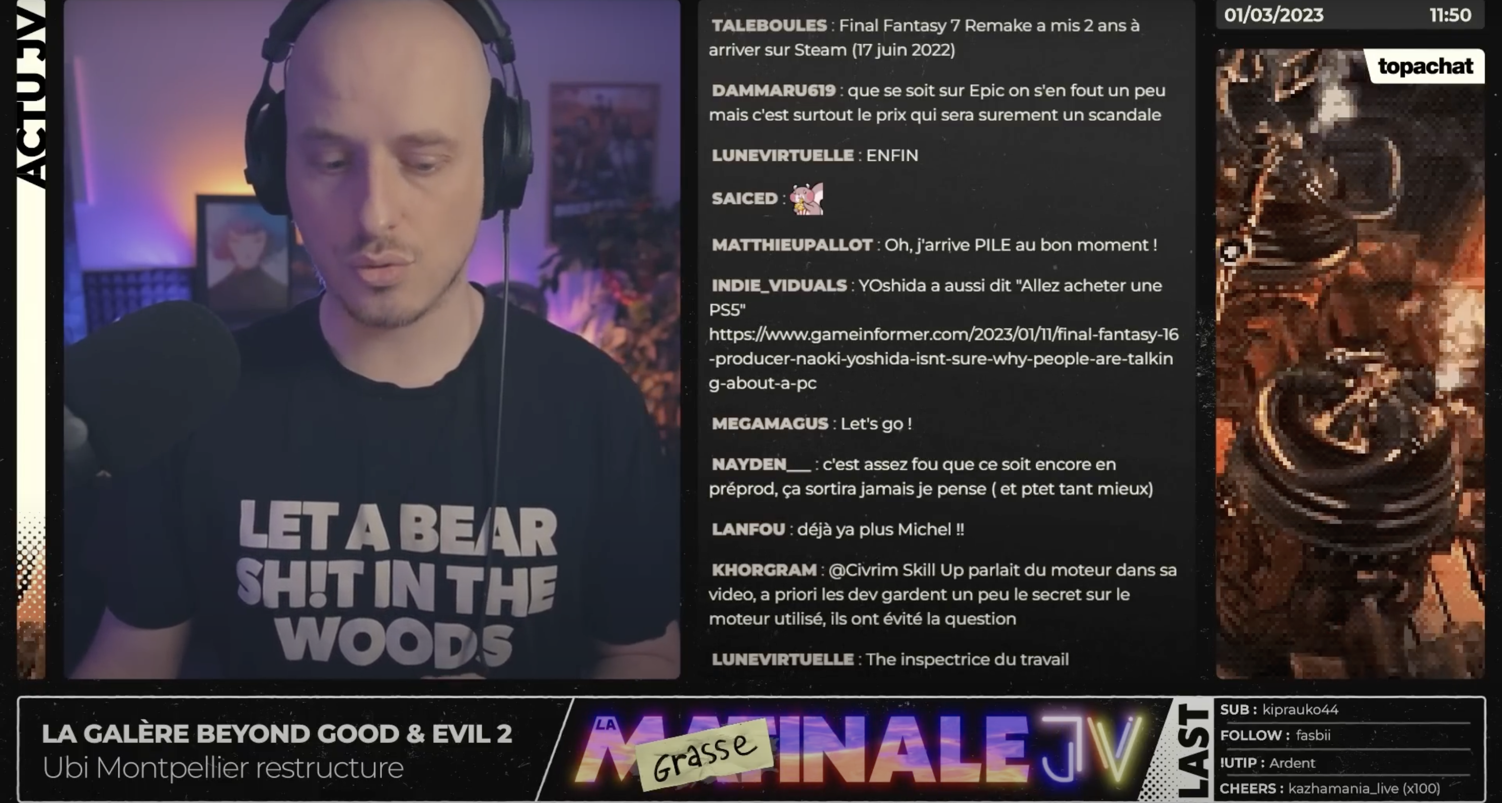
"We're going to talk about [the video game in development] Beyond Good and Evil 2, which was the subject of a little investigative article by Kotaku, which motivated me, for my part, to dig into the subject too. We're going to talk about an investigation by the labor inspectorate at Ubisoft Montpellier, as well as the departure of the creative director. [...] This Beyond Good and Evil 2 project, although it's extremely ambitious and motivates a lot of people, is a machine for breaking up, discouraging [workers], and then rehiring new people, not necessarily more experienced, but who still be motivated, to the point of demotivating them, and so on and so forth..."
“We come from a paper press where we were just signatures at the bottom of articles, and nowadays we carry projects in terms of image. There's a shift happening here. In the magazines of the 1990s, there were already trombinoscopes, the equivalent of Youtube before Youtube. That's what you're going to build a community around. There's a very cold side to magazine writing, and video can make you more human” (Interview with Sylvain Tastet, Origami)
Notes:
Through its various formats Origami uses video as a means to personalize its media identity and promote values of independent game development, worker solidarity, and labor rights. Beyond covering video game news through a societal lens, the journalists at Origami occasionally conduct their own investigations, notably to document the perspectives of workers involved in labor disputes

Slide 18
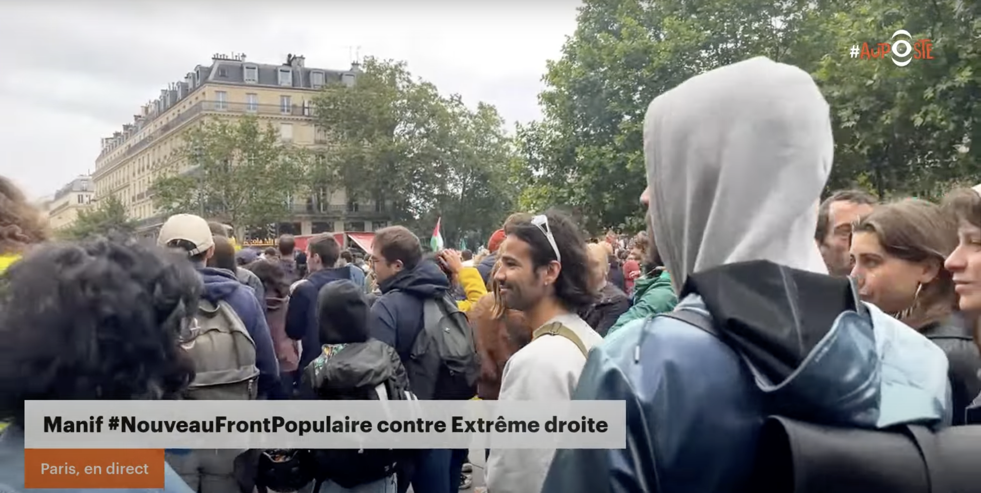
Twitch as an alternative media space
Authenticity and radical expression (e.g., six hours from an antifascist protest)
Editorial independence through funding models
By asserting the presence of investigative journalism in a space traditionally affiliated with entertainment, these journalists are defending a transversal occupational ideology (Deuze, 2005), which can be exercised everywhere with the same deontology and rigor, whatever the medium.
Notes:
For outlets like Au Poste and Origami, Twitch offers greater freedom from traditional media structures, prioritizing live video over websites and enabling small editorial teams to build familiarity with audiences. Au Poste exemplifies long-form “slow journalism” with extended streams (e.g., six hours from an antifascist protest), resisting click-driven news cycles and fostering organic discussion. Reliance on donations, subscriptions, and Patreon creates what David Dufresne calls a “temporary autonomous zone,” granting greater independence than institutionalized media. By asserting the presence of investigative journalism in a space traditionally affiliated with entertainment, these journalists are defending a transversal occupational ideology, which can be exercised everywhere with the same deontology and rigor, whatever the medium.

Slide 19
3) Silence, on joue : A Satellite ecosystem within the generalist media Libération
Notes:
The live-streamed podcast Silence, on joue!, hosted by Erwan Cario and produced under the umbrella of the journal Libération, exemplifies the emergence of specialized journalistic ecosystems within generalist media institutions. Although still formally attached to the newspaper, the show operates as an editorially autonomous entity with its own Twitch channel, distribution networks, and audience—many of whom are unaware of its affiliation with Libération.

Slide 20
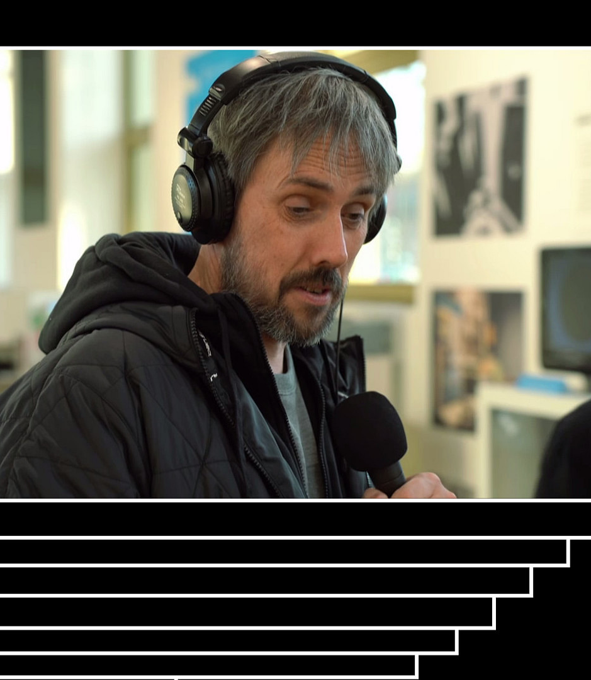
"When the lockdown started, I didn’t want to stop Silence, on joue, so I did everything I could to keep it going. We switched to remote recording on Discord. […] I was recording from home, and I actually learned to enjoy working remotely—so now I’m basically working from home full-time. In the end, it kind of mechanically isolates us from the rest of the newsroom. That said, I’m still in regular contact with the deputy editor-in-chief, who’s my supervisor now. Silence, on joue is known and appreciated within the newsroom—I’ve only had positive feedback. I feel physically apart, but totally integrated." (Interview with Erwan Cario, lead editor of Silence, on joue!)
Notes:
The COVID-19 pandemic accelerated remote work, enabling Silence, on joue! to function independently from the rest of Libération while still anchored in journalistic norms. Each episode devotes a substantial segment to news, collectively discussed by contributors and framed within the paper’s progressive ethos on labor, gender, and ethics

Slide 21

"People don’t really see us as just a specialized section within a general newspaper anymore—we’ve become a proper specialized media outlet for a lot of our listeners. Silence, on joue! is right there alongside other dedicated gaming media. Quite a few people who listen to us don’t even realize we’re produced by Libération. I still see myself as a generalist journalist, even though now my focus is Silence, on joue! and video games. But I do think Silence, on joue! is now almost a fully-fledged specialized outlet. We’re a specialized media produced by a generalist one—we’re no longer just a niche section within it."(Interview with Erwan Cario)
Notes:
This critical stance is reinforced by the spin-off Gâchette Gauche, which gathers editors-in-chief for broader debates, often more irreverent than traditional press formats, and illustrates the podcast’s ability to deliver reflective analysis even on reactive platforms like Twitch and YouTube. Produced by a team of five journalists—mostly freelancers—the show makes audience engagement possible without any connection to Libération. As of 2024, with Erwan Cario now dedicated full-time, the podcast exemplifies how digital audio can establish a semi-autonomous form of specialist journalism within, yet distinct from, legacy media.

Slide 22
Conclusions
The use of Twitch in journalism remains largely anchored in the platform’s original video game DNA. This is evident in initiatives such as RTBF’s Ixpé or Libération’s Silence, on joue!, as well as in broader trends identified by Olivares-García and Méndez Majuelos (2022), in which journalists either stream gameplay directly or employ video games as a visual and thematic support for discussion. In such contexts, the ludic heritage of Twitch serves as both a resource—enabling entry points to younger, digitally native audiences—and a frame that shapes production choices and editorial positioning.
Across the sample, journalists adapted their formats to align with the platform’s aesthetics and interactional norms. These adaptations include the systematic use of webcams, high-quality audio setups, and active engagement with the live chat as an integral part of the broadcast. While some adopted the “Just Chatting” model as a form of interactive monologue, others blended interviews, panel discussions, and reaction videos, thereby hybridizing traditional journalistic genres with Twitch’s hallmark interactivity. In certain cases, video games persisted within the frame—either as the primary subject or as a background device to sustain engagement on political, social, or cultural issues.
Notes:
The analysis of the five case studies highlights that, despite growing diversification, the use of Twitch in journalism remains largely anchored in the platform’s original video game DNA. This is evident in initiatives such as RTBF’s Ixpé or Libération’s Silence, on joue!, as well as in broader trends identified by Olivares-García and Méndez Majuelos, in which journalists either stream gameplay directly or employ video games as a visual and thematic support for discussion. In such contexts, the ludic heritage of Twitch serves as both a resource—enabling entry points to younger, digitally native audiences—and a frame that shapes production choices and editorial positioning.
Across the sample, journalists adapted their formats to align with the platform’s aesthetics and interactional norms. These adaptations include the systematic use of webcams, high-quality audio setups, and active engagement with the live chat as an integral part of the broadcast. While some adopted the “Just Chatting” model as a form of interactive monologue, others blended interviews, panel discussions, and reaction videos, thereby hybridizing traditional journalistic genres with Twitch’s hallmark interactivity. In certain cases, video games persisted within the frame—either as the primary subject or as a background device to sustain engagement on political, social, or cultural issues.

Slide 23
Conclusions
One notable affordance of Twitch is its capacity to host a plurality of voices within a single temporal and spatial frame. This multi-voiced dynamic, facilitated by live conversation and real-time audience input, contrasts with the logistical constraints of co-authoring a written article involving multiple contributors. Such live polyphony allows for the co-construction of meaning in ways that would be difficult to replicate in print, offering opportunities for richer, more dialogic journalism.
Taken together, these findings suggest that Twitch operates as more than a simple distribution channel: it is a socio-technical environment that encourages experimentation with new editorial rhythms, interactional models, and visual languages. While the platform’s commercial ownership and algorithmic priorities inevitably impose constraints, journalists across institutional and independent contexts are appropriating its affordances to reinforce core professional values—accuracy, independence, and critical inquiry—while simultaneously embracing new modes of proximity, informality, and participatory engagement. This results in a hybridized form of journalism, situated between information and entertainment, legacy norms and emergent platform cultures, singular authorship and collective performance.
Notes:
One notable affordance of Twitch is its capacity to host a plurality of voices within a single temporal and spatial frame. This multi-voiced dynamic, facilitated by live conversation and real-time audience input, contrasts with the logistical constraints of co-authoring a written article involving multiple contributors. Such live polyphony allows for the co-construction of meaning in ways that would be difficult to replicate in print, offering opportunities for richer, more dialogic journalism.
Taken together, these findings suggest that Twitch operates as more than a simple distribution channel: it is a socio-technical environment that encourages experimentation with new editorial rhythms, interactional models, and visual languages. While the platform’s commercial ownership and algorithmic priorities inevitably impose constraints, journalists across institutional and independent contexts are appropriating its affordances to reinforce core professional values—accuracy, independence, and critical inquiry—while simultaneously embracing new modes of proximity, informality, and participatory engagement. This results in a hybridized form of journalism, situated between information and entertainment, legacy norms and emergent platform cultures, singular authorship and collective performance. Thank you for your attention.

Slide 24
Bibliography
Barnabé, F. (2017). Réthorique du détournement vidéoludique : Le cas de Pokémon (Doctoral dissertation, Université de Liège). Université de Liège.
Borger, M., Van Hoof, A., Costera Meijer, I., & Sanders, J. (2012). Constructing participatory journalism as a scholarly object. Digital Journalism, 1(1), 117–134.
Borrell, A., Wojcik, S., & Berthet, É. (2024, October 21). Une interview participative ? (Re)définir le rôle et les pratiques journalistiques dans « 20h22, la suite sur Twitch ». Les enjeux de l’information et de la communication. Les reconfigurations de l’information télévisée, dossier 2024 B.
Deuze, M. (2005). What is journalism? Professional identity and ideology of journalists reconsidered. Journalism, 6(4), 442–464.
Dagiral, E., & Parasie, S. (2010). Vidéo à la une ! L’innovation dans les formats de la presse en ligne. Réseaux, 160–161, 101–132.
Foxman, M. (2022, June 9). Lessons for journalists from virtual worlds. Columbia Journalism Review. https://www.cjr.org/tow_center_reports/lessons-for-journalists-from-virtual-worlds.php
Foxman, M., Harris, B. C., & Partin, W. (2024). Recasting Twitch: Livestreaming, platforms, and new frontiers in digital journalism. Digital Journalism.
García-Avilés, J. A., Arias-Robles, F., de Lara-González, A., Carvajal, M., Valero-Pastor, J. M., & Mondéjar, D. (2024). How COVID-19 is revamping journalism: Newsroom practices and innovations in a crisis context. Journalism Practice, 18(1), 181–199.
Kaufmann, J.-C. (1999). L’entretien compréhensif. Armand Colin.
Martínez Valerio, L., & Espada Ipiña, A. (2024). Nuevos horizontes informativos: ¿Es profesional el periodismo en Twitch?, European Public & Social Innovation Review, 9, 1–17.
Olivares-García, F. J., & Méndez Majuelos, I. (2022). Periodistas y comunicadores en Twitch: Medios más allá de las redes sociales [Journalists and communicators on Twitch: Media beyond social networks]. Anàlisi: Quaderns de Comunicació i Cultura, 66, 45–61.
Rodríguez Hernández, L. M. (2019). Los medios de comunicación en las plataformas digitales. Un acercamiento al futuro inmediato de las exigencias a los profesionales de la radio (Trabajo de Fin de Grado). Corporación Universitaria Minuto de Dios, Bogotá.
Vázquez-Herrero, J., Negreira-Rey, M.-C., & Zago, G. (2022). “Young audience wanted! Journalism looks to the future”, In S. Splendore (Ed.), Emerging practices in the age of automated digital journalism (1st ed., p. 11). Routledge

