Slide 1
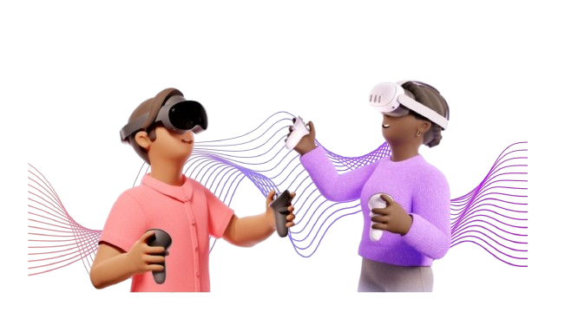
Virtual Reality in Support of Trans-Affirmative Vocal Care and Mental Health: Toward a Scientific-Clinical Ecology
EPATH conference 2025 « Cutting Through the Noise: Evidence-driven Transgender Care »
Antoine Henrotin (he/they),
Dominique Morsomme (she/her),
Aurélie Wagener (she/her)
Notes:
Trans-affirmative vocal care is a booming field that blends medical, paramedical, psychological, and social aspects.
In this study, we combine speech therapy and psychological approaches to support vocal harmonization.
We know that for trans people, the voice plays a fundamental role in the perception of their femininity or masculinity and in their gender affirmation.
Consequently, supporting the development of this harmonized voice in the most appropriate way possible is essential.

Slide 2

STATE of ART
HOW TO FEMINIZE VOICE ?
HOW TO TRANSFERT AND MAINTAIN ?
(Leyns et al, 2021)
Notes:
If the answer to the question "how to harmonize a voice?" is relatively consensual in the literature and meets the demands of trans individuals,
it must be noted that little is known about "how to automate and maintain" the new vocal motor behavior in their daily life.

Slide 3


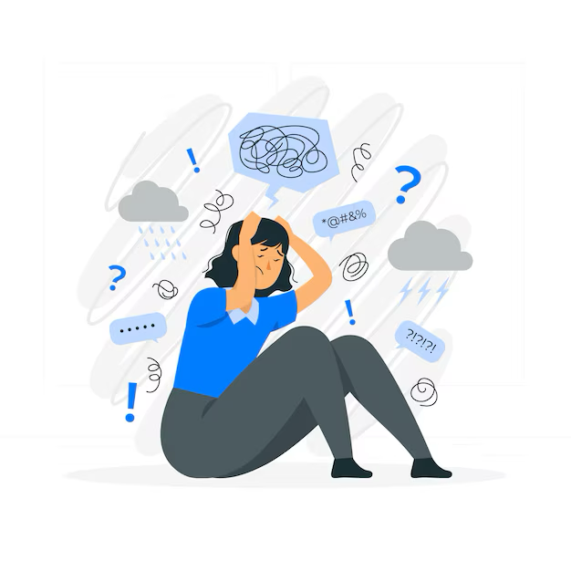

STATE of ART
(Alessandrin, 2018)
Int
f_{o}
(Budge et al, 2013)
Notes:
We know that the effectiveness of care is hindered by social fears and the low sense of self-efficacy that trans people may experience.
This feeling increases their level of anxiety and affects their quality of life.
The voice, heavily affected by anxiety, can be improved through direct techniques , modifying for example frequency and intensity

Slide 4
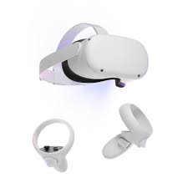
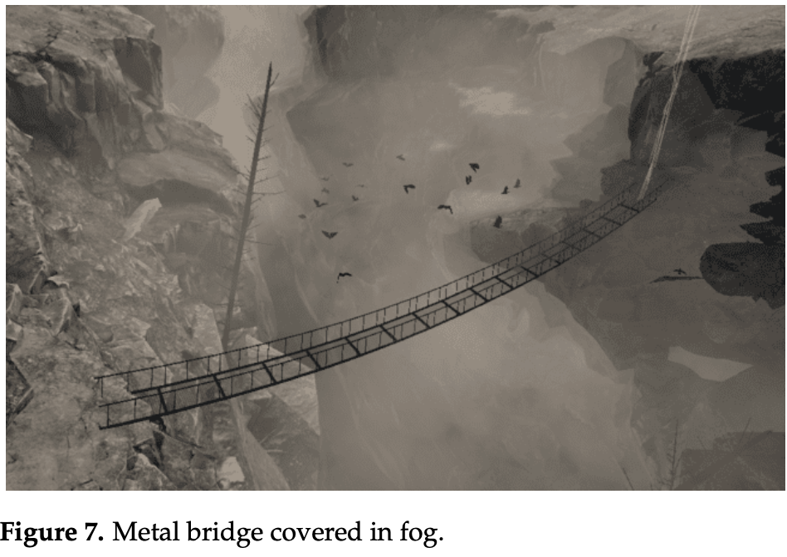
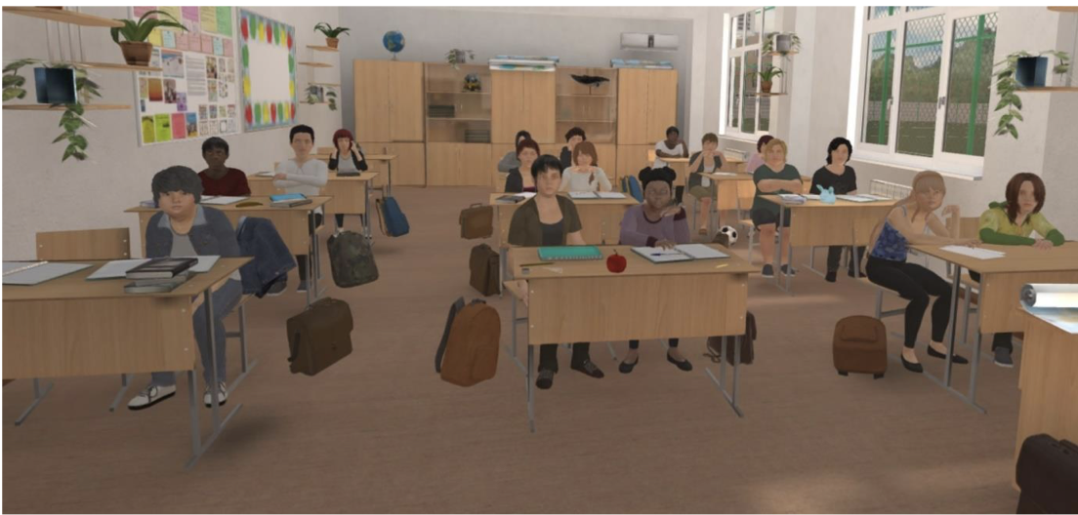
STATE of ART
Moldoveanu & al. (2023). Immersive Phobia Therapy through Adaptive Virtual Reality and Biofeedback. Applied Sciences, 13(18), 10365-.
Remacle, A., Bouchard, S., & Morsomme, D. (2023). Can teaching simulations in a virtual classroom help trainee teachers to develop oral communication skills and self-efficacy? A randomized controlled trial. Computers and Education, 200, 104808-.
Notes:
and indirect techniques, for example exposure therapy aimed at reducing stress and its effects on the voice.
We know that Immersive environments are effective in treating phobias and fluency disorders, and among teachers, according to Remacle et al., they promote lasting vocal changes.

Slide 5
Can virtual reality help a trans woman use her feminized vocal motor behavior in her daily life?
INTRODUCTION
METHOD
Notes:
So, based on these results, immersive environments could help reduce social fears and strengthen self-efficacy by offering ecologically valid and repetitive training, which is essential for automating a vocal motor behavior.
Our research question was therefore formulated as follows:
Can virtual reality help a trans woman use her feminine vocal motor behavior in her daily life?

Slide 6

PSYCHO FACTORS
VIRTUAL REALITY
Virtual Reality
ECOLOGIZE
TAVC
MINORITY STRESS
SELF-EFFICACY
Int
f_{o}
VOCAL MOTOR BEHAVIOUR/PARAMETERS
Notes:
This study case aims to //
Firstly, Evaluate the influence of psychological factors and virtual reality on vocal parameters,
Secondly, // how could virtual reality enhance self-efficacy ?
Thirdly, //explore the psychological and social benefits of trans-affirmative voice care combined with virtual reality.

Slide 7

INTRODUCTION
METHOD
25-year-old trans woman
In the early stages of transition.
A student
Hobbies: drawing and video games.
Minimal daily voice use .
No hormonal therapy
No surgery
Notes:
To test this research question, we opted for a single-case experimental design. The participant is 25 years old, is studying at University college in Belgium and has been transitioning for less than a year. She speaks little, around 2 hours per day.

Slide 8
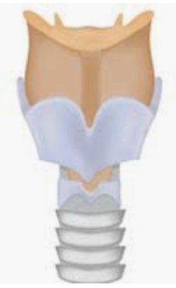
INTRODUCTION
METHOD
RV immersion
Environment
Target Interview +
Environment transfert 1
Environment transfert 2 lift
Environment
Target
Interview
Environment
Amphi
Environment
Amphi
Environment
Amphi
T0
1
2
3
4
T1
5
T2
1
2
3
4
5
6
7
8
9
10
No sessions
Vocal profile
Vocal profile
Vocal profile
Voice therapy
Notes:
The study was conducted over 13 weeks.
Ten vocal therapy sessions were conducted at a rate of one session per week.
Three voice evaluations took place before the sessions, immediately after the sessions, and three weeks after the voice care.
Note that between T1 and T2, no voice sessions were delivered.
Five virtual reality sessions were conducted, with one session every 15 days. Pre- and post-immersion evaluations were also carried out.

Slide 9

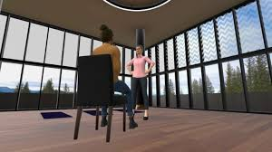
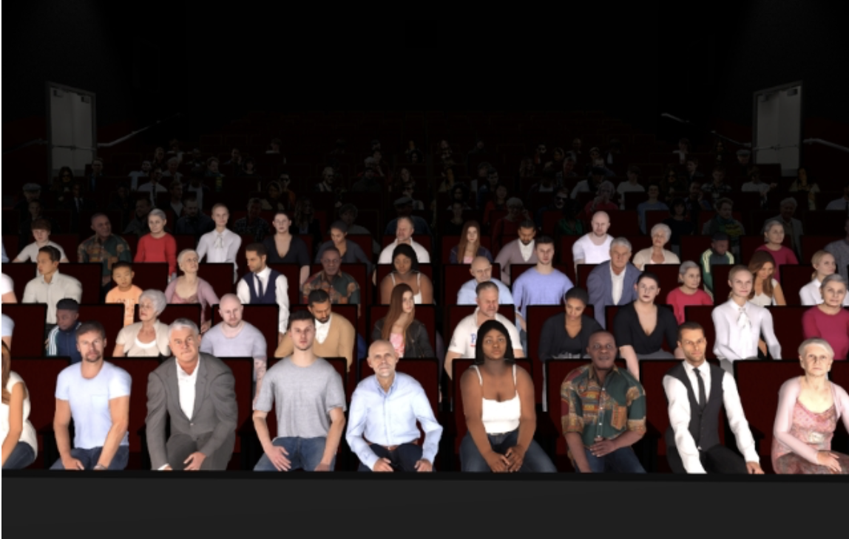
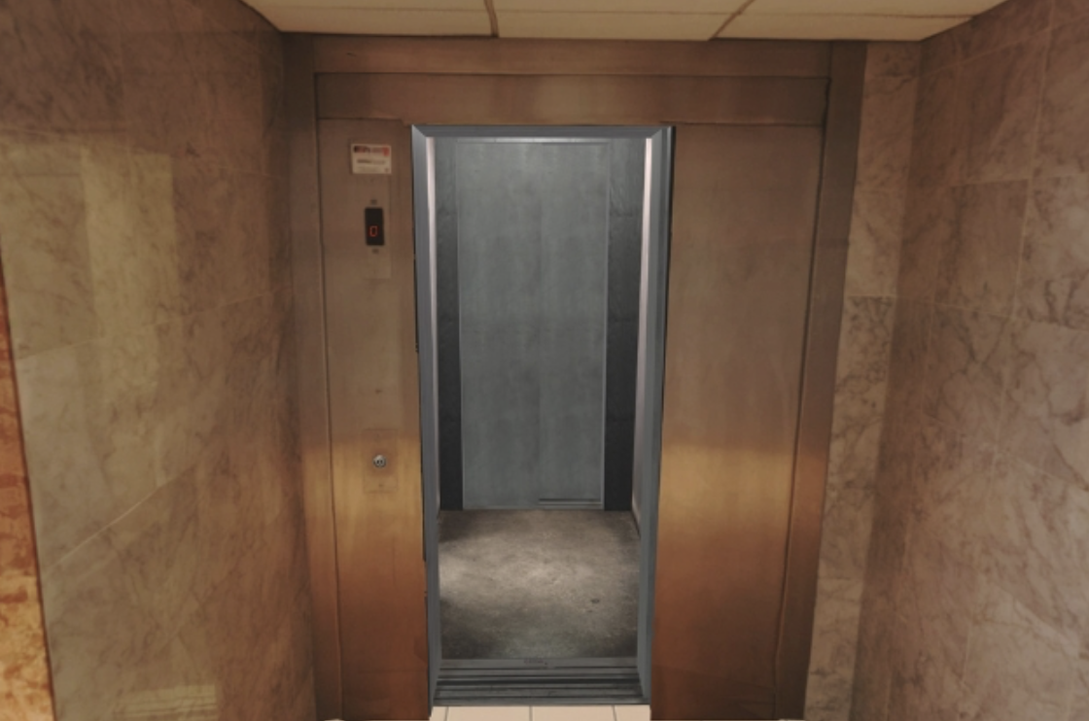
INTRODUCTION
METHOD
Interview
Amphitheater
Elevator
Notes:
The environments in which the participant was immersed were chosen by the clinician to mimic her everyday social interactions.
She praticed her voice in 2 environments called respectively "Interview" and «Amphitheater" .
The selected environments, often used for patients suffering from social anxiety, include interactions with avatars.
To assess the transfer of the acquired vocal motor behavior, the experimenter collected measurements in two settings: a familiar interview environment and an unfamiliar elevator environment.

Slide 10

Depression
(CES-D)
Presence questionnaire
(Meyer, 2015)
(Solhdju, 2015)
Minority stress
Clinical ecology
PSYCHO FACTORS
Virtual Reality
VIRTUAL REALITY
Anxiety (OASIS)
Sense of Self-efficacy (SGSES)
SFF
Simulator Sickness Questionnaire (SSQ)
(Iwarsson, 2015)
TWVQ
+ Visual Analog Scales (VAS)
Motor learning
VOCAL MOTOR
BEHAVIOUR
f_{o}
sd_f_{o}
f_{R1-4}
Notes:
As illustrated by the diagram, a wide variety of measurements was collected across voice sessions and Virtual Reality one.
This includes acoustic measurements tracking the evolution of acquiring feminine vocal motor behavior, VR-related questionnaire scores (assessing, for example, the potential presence of cyber sickness or the ability to immerse oneself in another reality), as well as monitoring the speaking fundamental frequency during VR sessions. Various scales were also used to measure psychological aspects such as depression, self-efficacy, and anxiety.

Slide 11
INTRODUCTION
METHOD
RESULTS
Evaluation time T0
VR Time
Evaluation time T1
Follow up
VISUAL ANALOG SCALES
Notes:
This graph illustrates the changes in scores on visual analog scales at each measurment time including Virtual Reality sessions.
The red curve, representing vocal changes, indicates increasingly significant positive modifications at each session.

Slide 12
INTRODUCTION
METHOD
RESULTS
Evaluation time T0
VR Time
Evaluation time T1
Follow up
VISUAL ANALOG SCALES
Notes:
The orange curve, reflecting self-efficacy, starts high, then drops sharply during VR sessions 2 and 3 before rebounding in sessions 4 and 5 while keeping a high value during T1 and T2.

Slide 13
INTRODUCTION
METHOD
RESULTS
Evaluation time T0
VR Time
Evaluation time T1
Follow up
VISUAL ANALOG SCALES
Notes:
The green curve, indicating the feminized voice use, steadily increases throughout the VR sessions.

Slide 14
INTRODUCTION
METHOD
RESULTS
Evaluation time T0
VR Time
Evaluation time T1
Follow up
VISUAL ANALOG SCALES
Notes:
The light blue curve, representing the feeling of isolation drops at the VR4 time and keep on being low.

Slide 15
INTRODUCTION
METHOD
RESULTS
Evaluation time T0
VR Time
Evaluation time T1
Follow up
VISUAL ANALOG SCALES
Notes:
Meanwhile, the violet curve, which measures anxiety, begins at a relatively high level before dropping drastically and maintaining a low score.

Slide 16
INTRODUCTION
METHOD
RESULTS
Speaking Fundamental Frequency in VR5
Neutral voice frequency range
Unfamiliar
Notes:
1. During the fifth virtual reality session, the participant was exposed to one target environment and two transfer environments.
The objective was to observe how the participant transitioned from one environment to another, one of which was completely unfamiliar.
2. In each virtual environment, the participant encountered several avatars. She primarily interacted with women in all three environments.
3. A speech sample was recorded and then segmented into four parts to allow for a chronological analysis within the same environment.
The results show that, on one hand, the speaking fundamental frequency gradually increases with the introduction of each new environment, and, on the other hand, it continuously decreases over time in each of the three observed environments.

Slide 17


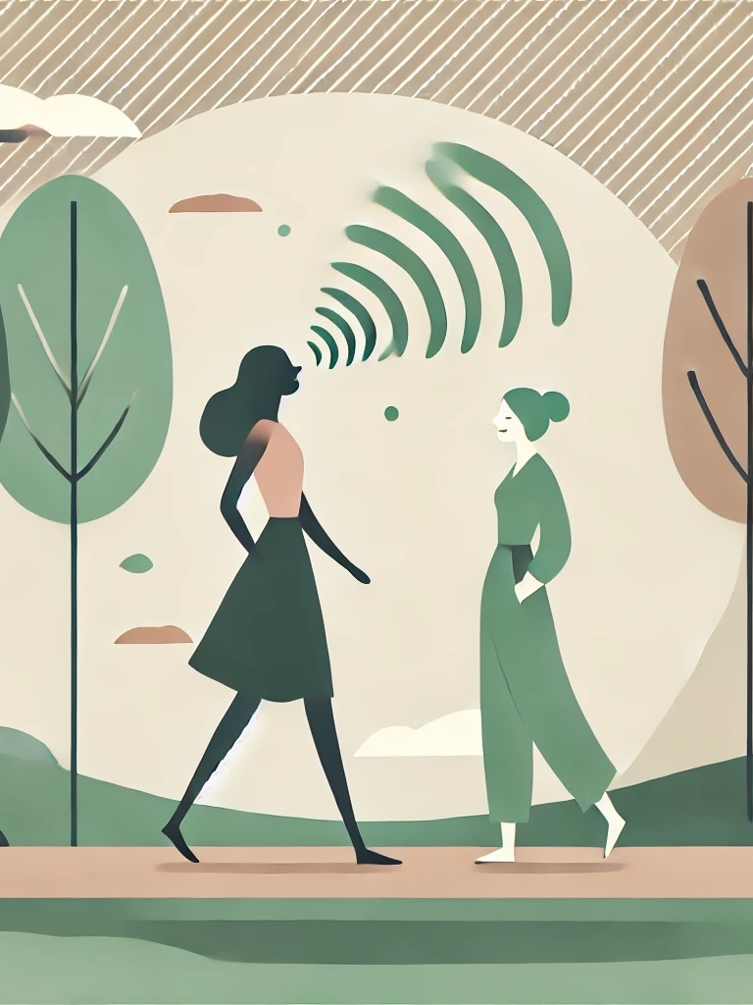
INTRODUCTION
METHOD
RESULTS
DISCUSSION
Notes:
The participant demonstrated her ability to maintain and transfer her female vocal motor behavior—evidenced by the T2 and RVs evaluation times—thanks to the study design.
Her daily commitment to vocal therapy exercises facilitated the automation of this behavior,
… a process further reinforced by immersion, which also improved her treatment adherence.
Moreover, the reduction in anxiety and depression, along with the increase in self-efficacy, illustrates the positive interaction between vocal care and overall well-being.
So, the study demonstrates that in order to fully understand the effects of Trans affirmative vocal care, it is essential to broaden our analysis to include the psychological repercussions of our interventions. Furthermore, immersion therapy is identified as an effective means of integrating clinical ecology into sessions.
What does "ecologizing trans-affirmative vocal care" precisely mean? It involves moving beyond an individualistic approach to consider the interaction between the person and their collective environment. Ecology refers to relationships with the surrounding context, to what emerges through interaction. To ecologize therapy is therefore to situate the person within their context, linking their care journey to their actual living conditions. In other words, it is about contextualizing care.

Slide 18
INTRODUCTION
METHOD
RESULTS
DISCUSSION
Vocal feminization :
Higher f_{o} and variation of f_{o} in continued speech
Differences in VR between T0 and T1
Parameters | T0 (04-10-2023) | T1 (06-12-2023) | T2 (07-04-2023)
f_{o} | 129,48 (27,64) | 208,04 (37,69) | 194,35 (34,02)
sd_f_{o} | 25,22 (9,82) | 42,40 (15,90) | 35,07 (12,78)
Virtual Reality mesures | VR1 | VR2 | VR3 | VR4 | VR5
SFF | 109,26 (4,87) | 128,26 (10,93) | 138,65 (17,16) | 176,64 (9,91) | 164,51 (17,13)
sd_SFF | 17,38 (5,27) | 31,74 (4,96 | 28,52 (10,58) | 40,33 (6,11) | 32,82 (6,52)
f_{R4} is the only significantly increased resonance frequency (χ² = 20.724, df = 11, p = 0.036).
TWVQ : 64/120 → 45/120.
“I feel like my voice does not reflect who I really am” : « always » → « never »
Satisfying vocal evolution
Notes:
The participant demonstrated her ability to maintain and transfer her female vocal motor behavior—evidenced by the T2 and RVs evaluation times—thanks to the study design.
Her daily commitment to vocal therapy exercises facilitated the automation of this behavior,
… a process further reinforced by immersion, which also improved her treatment adherence.
Moreover, the reduction in anxiety and depression, along with the increase in self-efficacy, illustrates the positive interaction between vocal care and overall well-being.
So, the study demonstrates that in order to fully understand the effects of Trans affirmative vocal care, it is essential to broaden our analysis to include the psychological repercussions of our interventions. Furthermore, immersion therapy is identified as an effective means of integrating clinical ecology into sessions.
What does "ecologizing trans-affirmative vocal care" precisely mean? It involves moving beyond an individualistic approach to consider the interaction between the person and their collective environment. Ecology refers to relationships with the surrounding context, to what emerges through interaction. To ecologize therapy is therefore to situate the person within their context, linking their care journey to their actual living conditions. In other words, it is about contextualizing care.

Slide 19
INTRODUCTION
METHOD
RESULTS
DISCUSSION
Psychological and VR parameters :
Different reactions to different VR environnements
Questionnaires | T0 (04-10-2023) | T1 (06-12-2023) | T2 (07-04-2023)
SGSES (general) | 38/68 | 49/68 | 46/68
SGSES (social) | 15/24 | 13/24 | 12/24
OASIS | 8/20 | 4/20 | 1/20
CES-D | 23/60 | 12/60 | 8/60
TWVQ | 64/120 | 45/120 | 46/120
Would prefer less formal VR environments
How does the diversification of the speaking contexts align with the necessity to standardise measure ?
Good immersive quality and overall sense of presence remained relatively low.
Notes:
The participant demonstrated her ability to maintain and transfer her female vocal motor behavior—evidenced by the T2 and RVs evaluation times—thanks to the study design.
Her daily commitment to vocal therapy exercises facilitated the automation of this behavior,
… a process further reinforced by immersion, which also improved her treatment adherence.
Moreover, the reduction in anxiety and depression, along with the increase in self-efficacy, illustrates the positive interaction between vocal care and overall well-being.
So, the study demonstrates that in order to fully understand the effects of Trans affirmative vocal care, it is essential to broaden our analysis to include the psychological repercussions of our interventions. Furthermore, immersion therapy is identified as an effective means of integrating clinical ecology into sessions.
What does "ecologizing trans-affirmative vocal care" precisely mean? It involves moving beyond an individualistic approach to consider the interaction between the person and their collective environment. Ecology refers to relationships with the surrounding context, to what emerges through interaction. To ecologize therapy is therefore to situate the person within their context, linking their care journey to their actual living conditions. In other words, it is about contextualizing care.

Slide 20
INTRODUCTION
METHOD
RESULTS
DISCUSSION
To ecologize trans-affirmative vocal care
(Solhdju, 2015)
Moving beyond an individualistic approach to consider the interaction between the person and their collective environment.
Ecology refers to relationships with the surrounding context, to what emerges through interaction. To ecologize therapy is therefore to situate the person within their context, linking their care journey to their actual living conditions.
Contextualize
Automatize
Operationalize
“Naturalize”
Interactionism
Research by living conditions
Automatize voice in living conditions and in interaction with natural biodiversity
Operationnalize communication and coping strategies to minority stress in context
Notes:
The participant demonstrated her ability to maintain and transfer her female vocal motor behavior—evidenced by the T2 and RVs evaluation times—thanks to the study design.
Her daily commitment to vocal therapy exercises facilitated the automation of this behavior,
… a process further reinforced by immersion, which also improved her treatment adherence.
Moreover, the reduction in anxiety and depression, along with the increase in self-efficacy, illustrates the positive interaction between vocal care and overall well-being.
So, the study demonstrates that in order to fully understand the effects of Trans affirmative vocal care, it is essential to broaden our analysis to include the psychological repercussions of our interventions. Furthermore, immersion therapy is identified as an effective means of integrating clinical ecology into sessions.
What does "ecologizing trans-affirmative vocal care" precisely mean? It involves moving beyond an individualistic approach to consider the interaction between the person and their collective environment. Ecology refers to relationships with the surrounding context, to what emerges through interaction. To ecologize therapy is therefore to situate the person within their context, linking their care journey to their actual living conditions. In other words, it is about contextualizing care.

Slide 21

Take home message
Notes:
The results indicate that the combination of trans-affirmative vocal care and virtual reality promotes the generalization of acquired vocal motor behaviour while reducing psychological and social barriers, thereby enhancing psychological well-being and the transfer of vocal skills to daily life.

Slide 22






In 2022, at the Parole & Ecriture Workshop
In 2024, at the PRIDE in Liège
In 2024, at the 1st congress of RUCHE
Thanks to Mathilde Marchal and Isaure Renaville for their efficient contribution
Notes:
In these uncertain times, we need to support minorities more than ever. How society perceives them depends on our actions and commitments.
Thanks for you attention.

