Slide 1
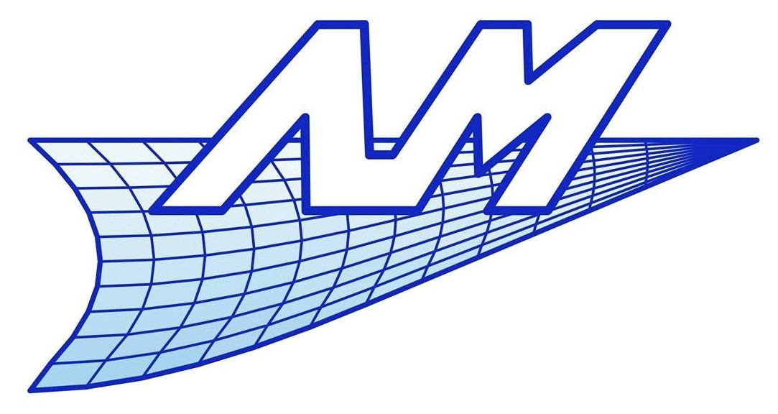

Cable-actuated soft finger modeling using an ALE approach
11th European Solid Mechanics Conference
4 - 8 July 2022, Galway, Ireland
Olivier Devigne, Alejandro Cosimo, Olivier Brüls
Department of Aerospace and Mechanical Engineering
University of Liège

Slide 2
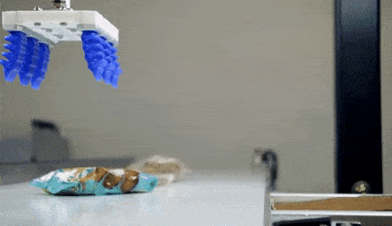
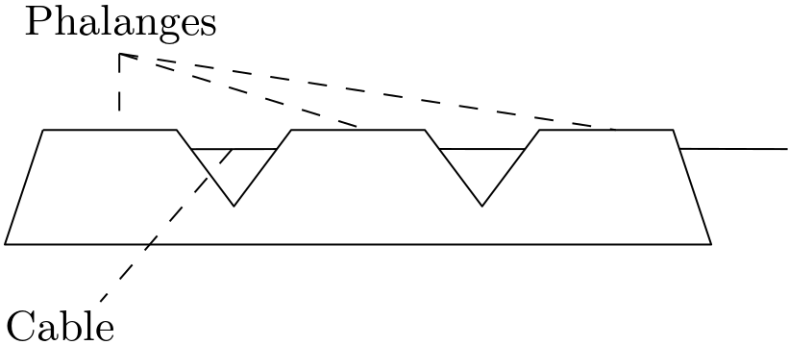
Context: soft robots
Soft robots exhibit several advantages:
Possibility of grasping by adapting its shape and contact force
Easily replaceable (often 3D printed)
Low cost
Safer for human-robot interaction
…
Aim: develop a multibody-oriented simulator for a cable-actuated soft finger
https://thumbs.gfycat.com/ElementaryShadowyBrant-small.gif

Slide 3
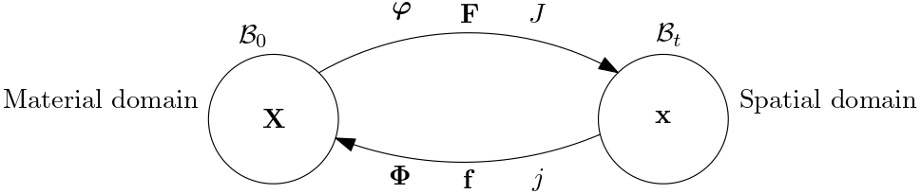
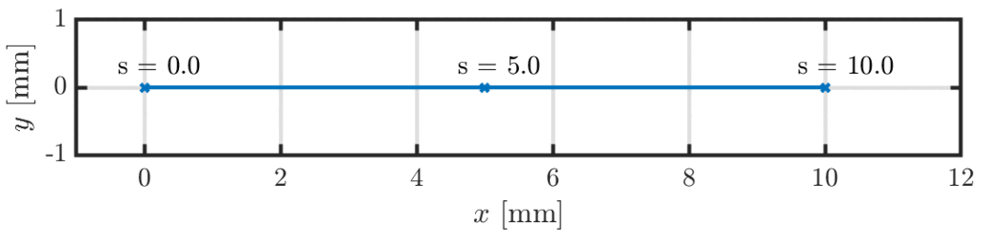
Arbitrary Lagrangian-Eulerian concept
Lagrangian approach | Eulerian approach
Track the motion of a material particle in space => Solve for a map going from the material to the spatial domain | Observe the flow of material at fixed spatial locations => The inverse map is involved (popular in fluid dynamics)

Slide 4
Arbitrary Lagrangian-Eulerian concept
ALE approach
Hybrid formulation => Both maps must be solved for simultaneously

Slide 5
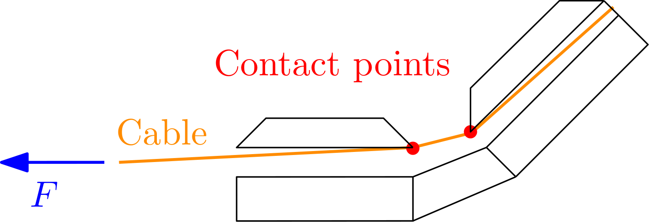
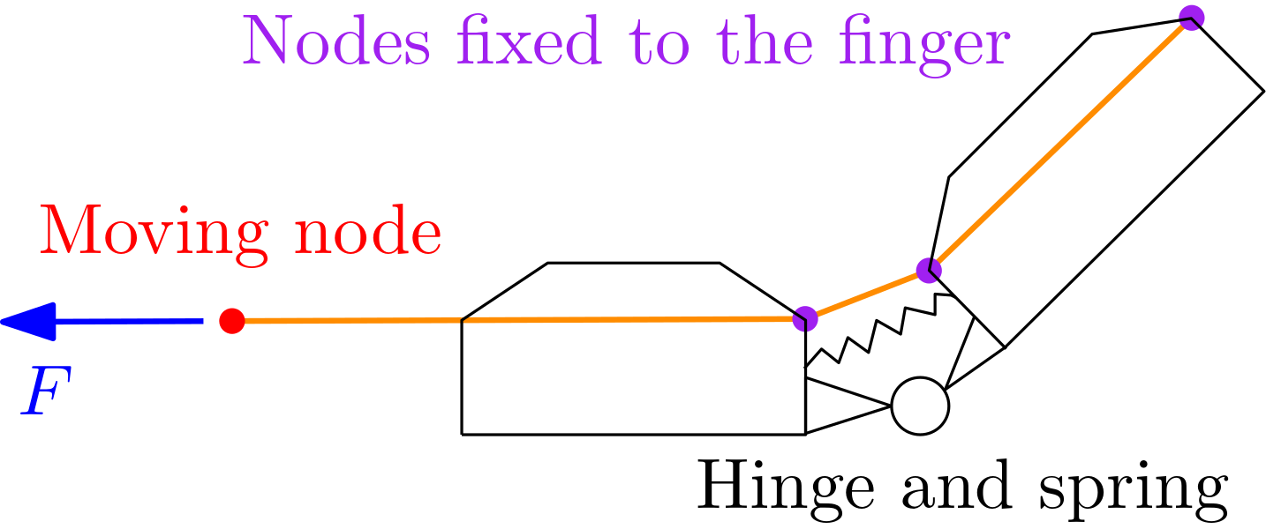
Cable model
Pulling on the cable creates contact and friction between the cable and the inside of the finger
These contact locations are known a priori
In order to avoid a fine discretization of the cable, the position of some nodes of the mesh should remain fixed w.r.t. to the finger
Arbitrary Lagrangian-Eulerian (ALE) representation of the cable

Slide 6

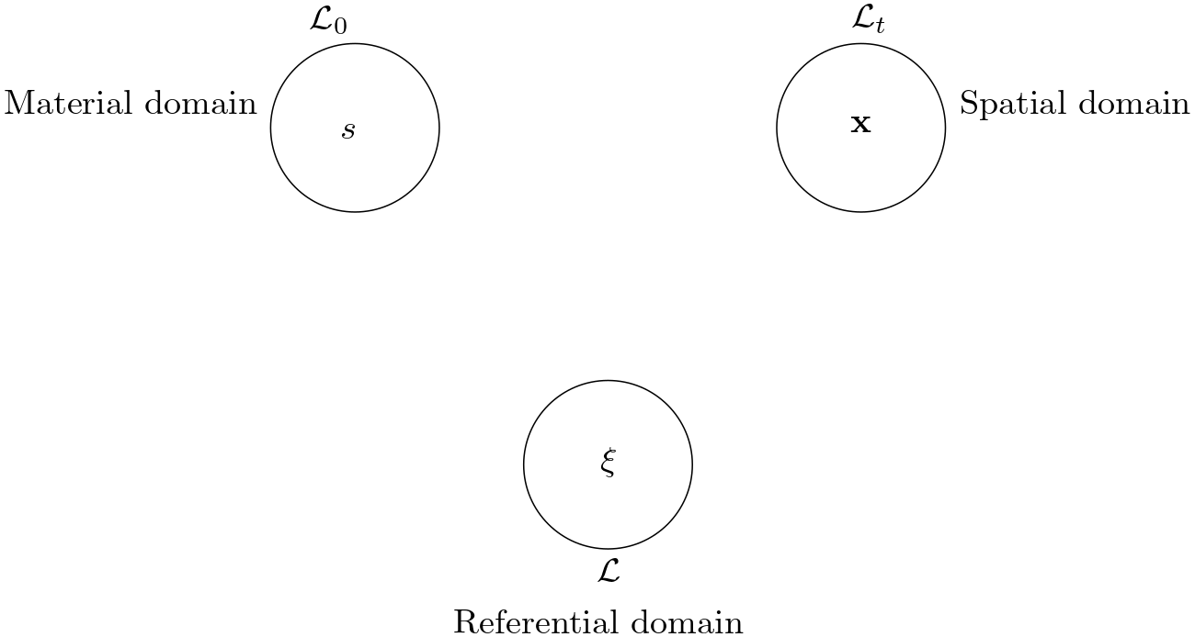


Arbitrary Lagrangian-Eulerian cable
represents the material
coordinate on the centerline
is the vector of spatial
coordinates
Use of a third “referential
domain”
represents the points of
interest (e.g., grid points, mesh,…)

Slide 7
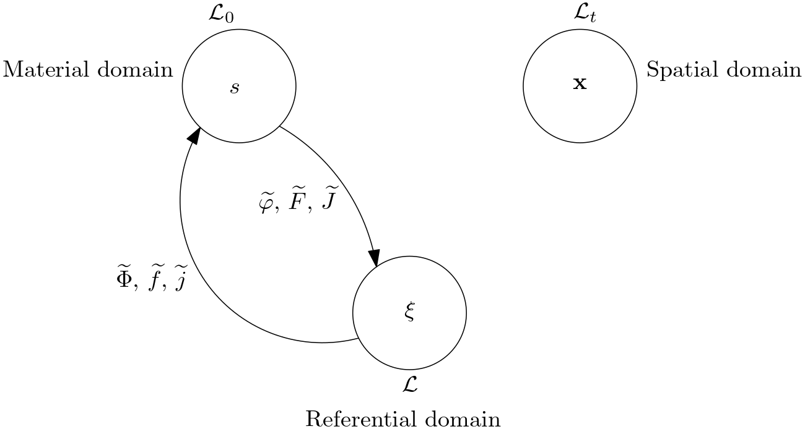
Arbitrary Lagrangian-Eulerian cable
One contribution to the motion is the Eulerian contribution, called material motion
In a discretized setting, it represents the flow of material through the mesh

Slide 8
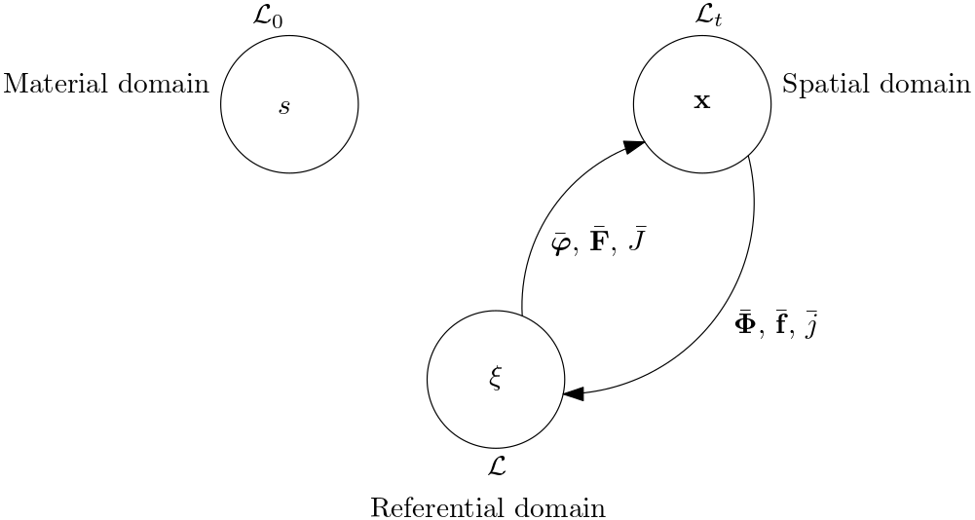
Arbitrary Lagrangian-Eulerian cable
Another contribution to the motion is the Lagrangian contribution, called spatial motion
In a discretized setting, it represents the motion of the mesh

Slide 9
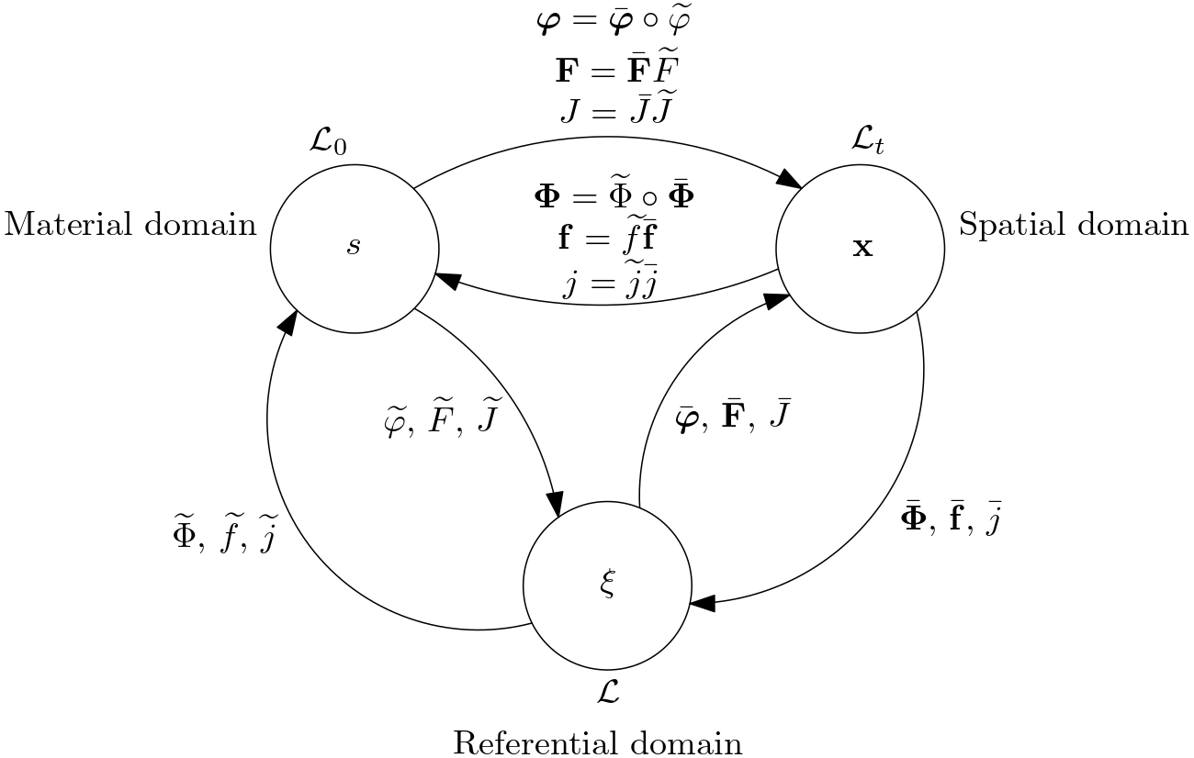
Arbitrary Lagrangian-Eulerian cable
The total motion is the composition of the two contributions
No direct information on
the map from the material to
the spatial domain
The unknowns are the maps going from the referential domain

Slide 10
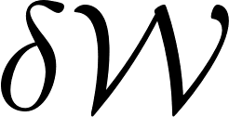
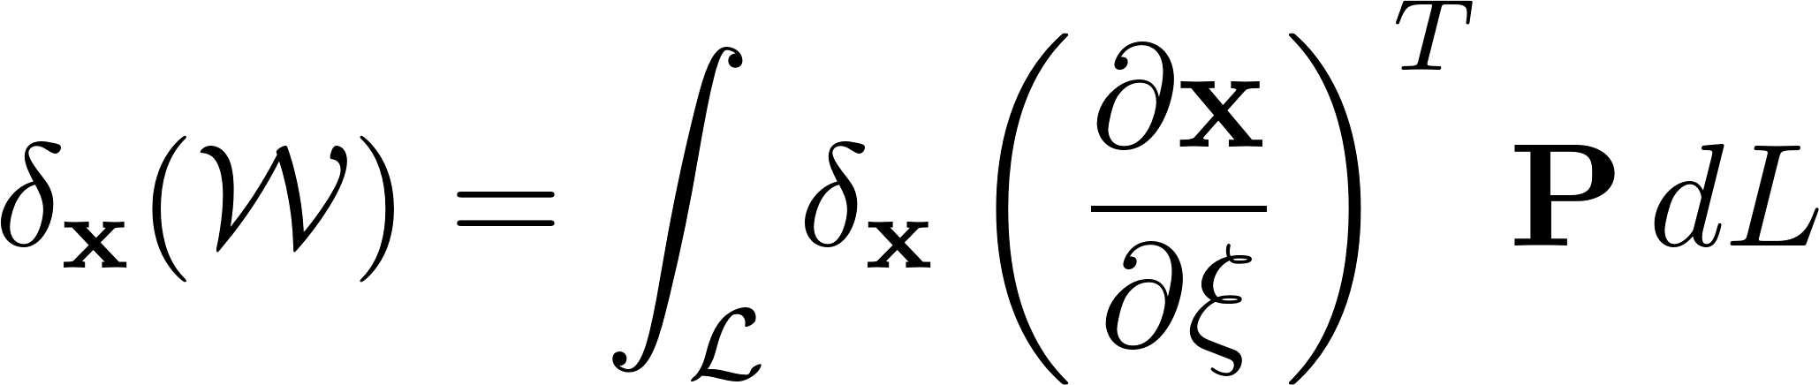
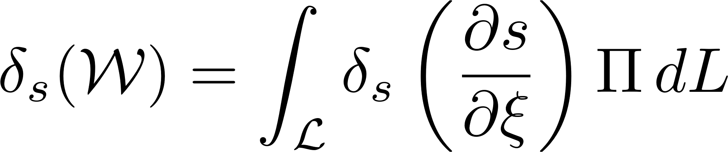
Equations of motion: variation of the energy
Variation of the total potential energy
Two unknown maps => two contributions (Kuhl et al., 2004)
First term: variation keeping fixed
Second term: variation keeping fixed
Equations of motion for an ALE cable element (valid in quasi-static)

Slide 11

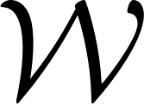
Equations of motion: meaning
Virtual change of the spatial coordinate with respect to the reference => spatial motion
has the dimensions of a force
If is the internal energy, is the vector of elastic forces in the cable

Slide 12

Equations of motion: meaning
Virtual change of the material coordinate with respect to the reference => flow of material
has the dimensions of a force
It is known as a configurational or Eshelby force

Slide 13
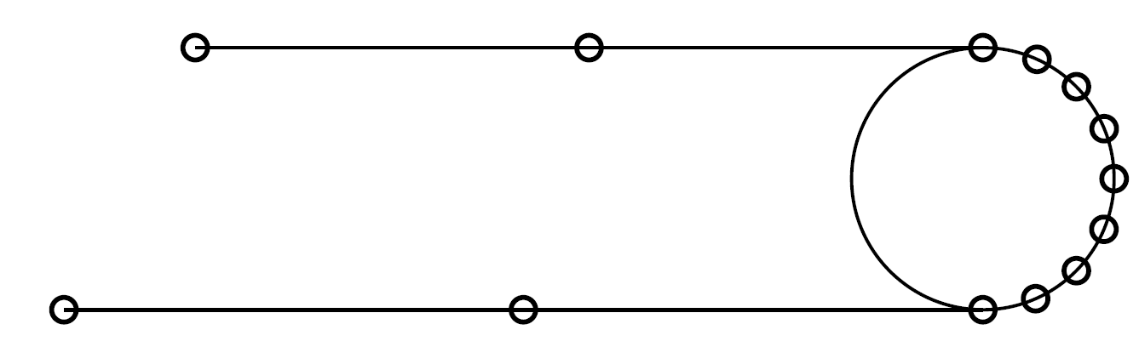
Model: pulley simulation with ALE cable
Imposed force at the end node of the cable
Nodes on the pulley are constrained to stay on the pulley
There is friction between the cable and the pulley
F

Slide 14
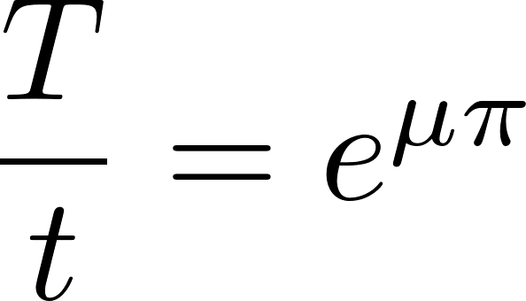
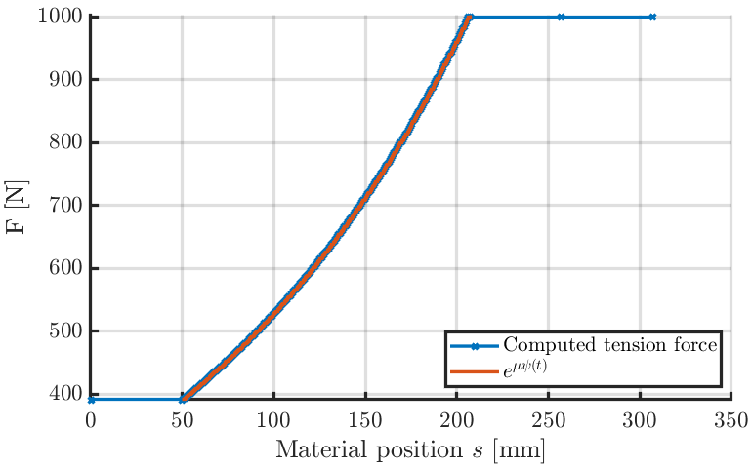
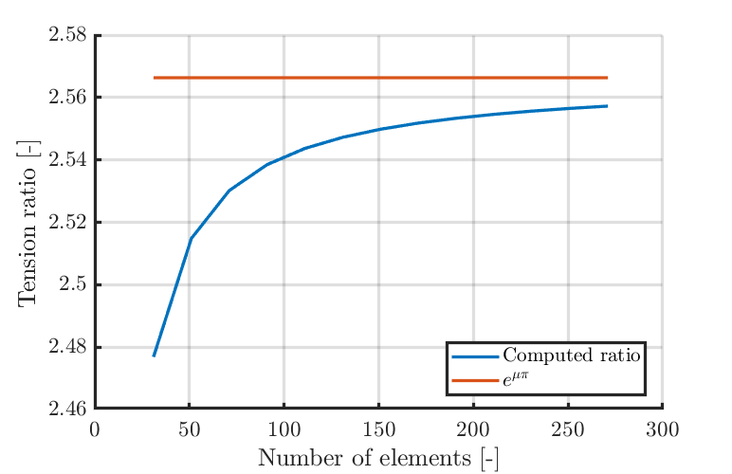
Model: pulley simulation with ALE cable
Friction (slip) is applied
Analytical result for the tension ratio is verified:

Slide 15
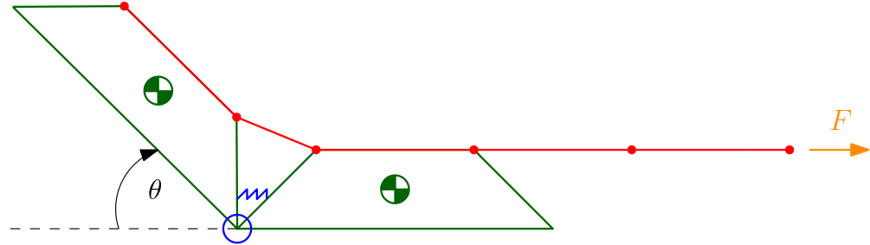
Model: finger simulation with ALE cable
Force pulling the end node of the cable
Some nodes are constrained to the finger
Phalanges are considered rigid bodies

Slide 16
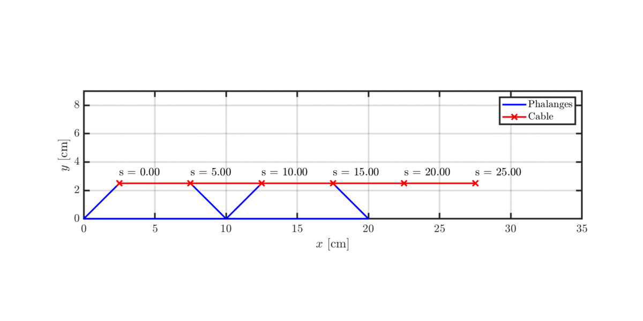
Result: finger simulation with ALE cable
Flow of material at the nodes of interest
Unconstrained nodes follow the same material particle during the simulation

Slide 17
Conclusions and perspectives
Conclusions
3D ALE cable model applicable to multibody systems in general
Friction (slip) can be applied
Perspectives
Change bar element to beam element to model bending stiffness

Slide 18
Distinctions with other formulations
In the multibody dynamics community, equations generally derived from an already discretized form (Escalona, 2017 ; Liu, 2018 ; Peng, 2017)
Kuhl, 2004, starts from a continuous form but was initially derived for mesh optimization or for fracture mechanics
In the proposed formulation:
Addition of constraints to work in a multibody framework
Consistency of the spatial and material equilibria

Slide 19
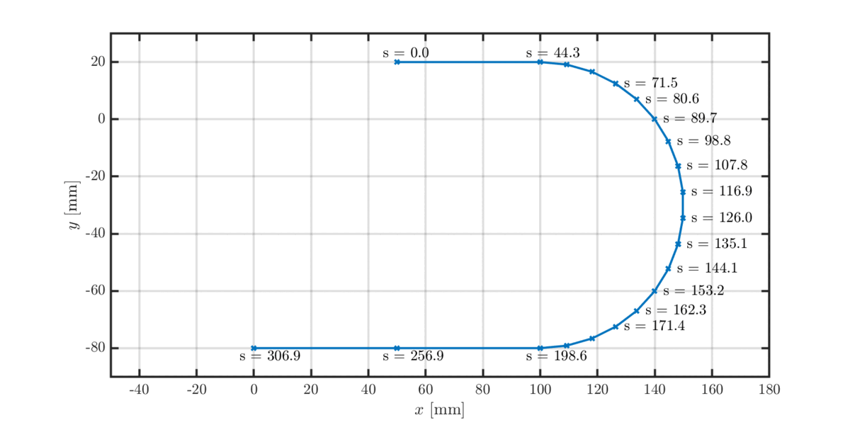
Result: pulley simulation with ALE cable
Flow of material for nodes which are constrained to the pulley
Other nodes always follow the same material particles

Slide 20
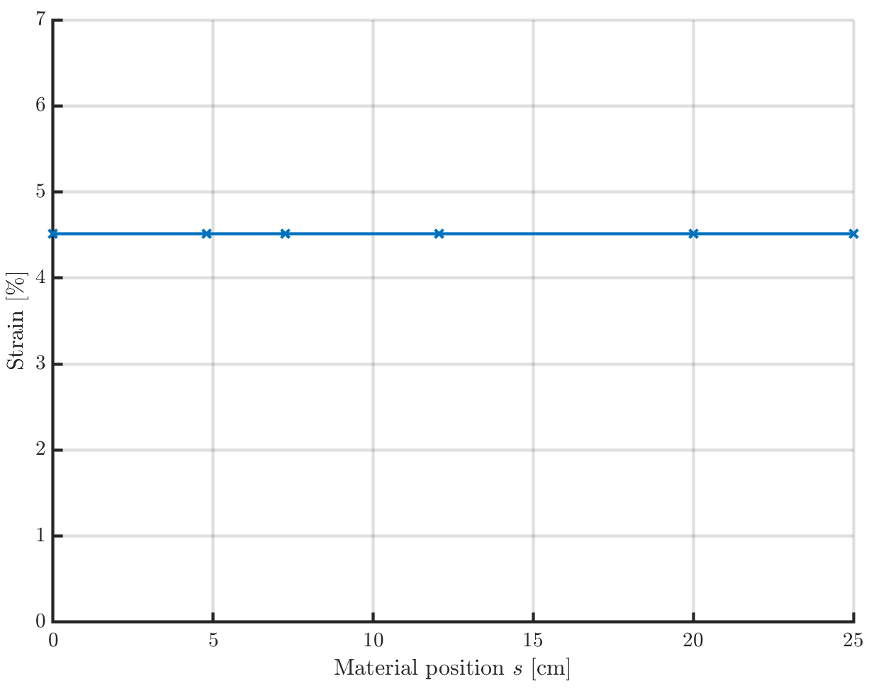
Remark: unicity of the solution
For unconstrained nodes, the optimal (minimum-energy) solution should be given
The solution is not always unique because the problem is not always convex
Constant strain in the elements
Redundant equations because of unidimensional cable assumption
A regularization of the problem is then used (Mosler and Ortiz, 2006)

Slide 21
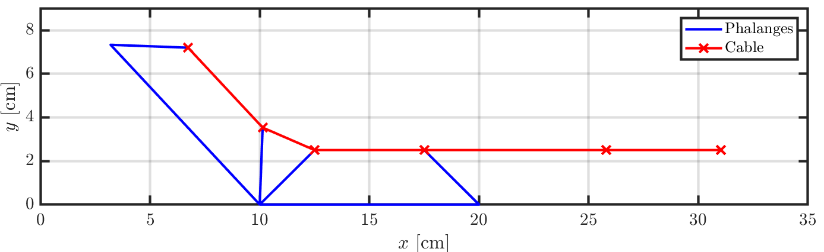
What about friction?
Because of the contact between the cable and the finger, there is an inherent friction force
This force is proportional to the normal component of the contact force
This component is given by the bilateral constraints!
N₂
N₁
F

Slide 22

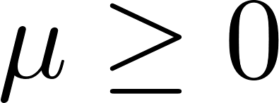
What about friction?
Consider slip-only friction (should be valid in practice because the applied force F is much greater than the normal contact force N)
Amplitude of the friction force:
_{with}
Friction is taken into account
N₂
N₁
T₂
F
T₁

Slide 23
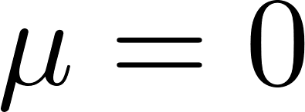
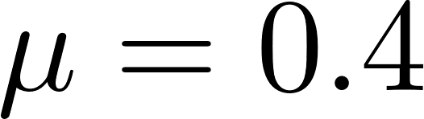
What about friction?
Two observable effects of friction
Resistance to elongation
Shortest range of motion
No friction ( ) With friction ( )

