Slide 1


Title Here
Subtitle Here
Author¹, Author²
Affiliation of Author¹, Affiliation of Author²

Slide 2
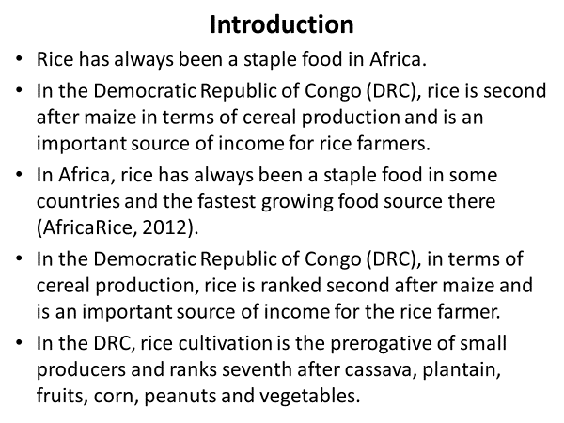
Text here. Text here. Text here.

Slide 3
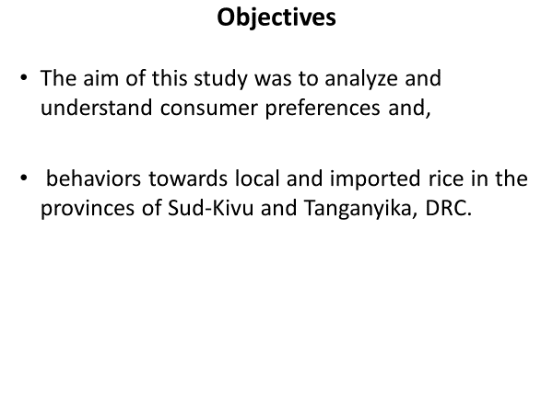



Title Here.
Text here.
Text here.
Text here.
Caption here.
Caption here.
Caption here.

Slide 4
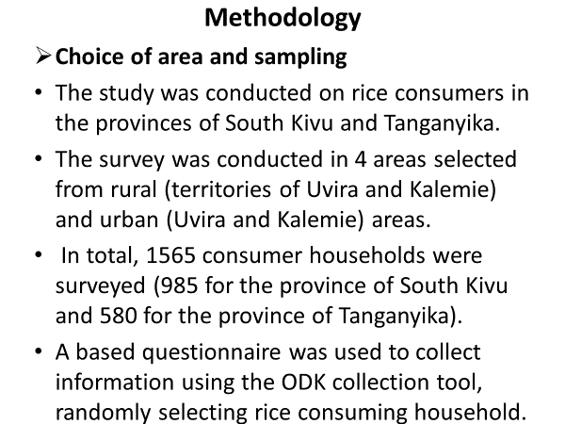
Title here.
Text here.
Text here
Text here

Slide 5
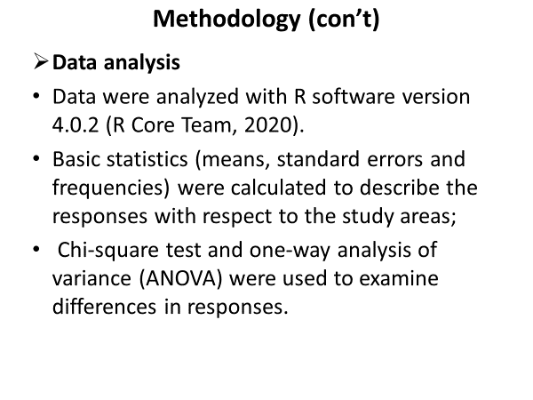
Title here.
Text here.

Slide 6
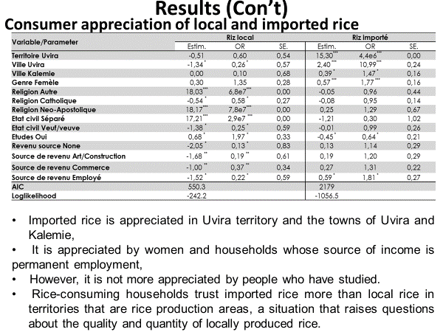
Title here.
Text here.

Slide 7
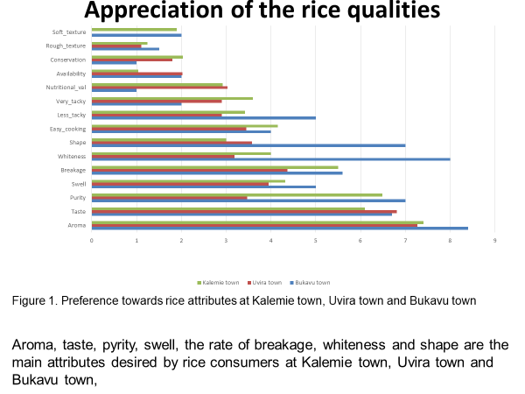



Title here.
Text here.
Text here.
Text here.

Slide 8
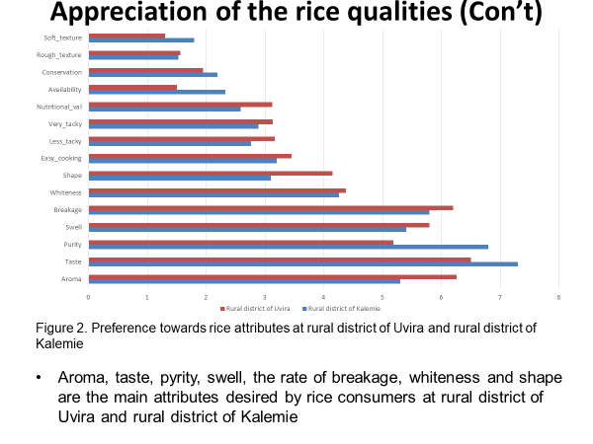
Title here.
Text here.

Slide 9


Slide 10




Thank you!

