Slide 1



Contributions of radiative transfer modelling to a stochastic biogeochemical forecasting system in the Black Sea
Loïc Macé¹², Luc Vandenbulcke¹, Jean-Michel Brankart², Pierre Brasseur², Marilaure Grégoire¹
1: FOCUS-MAST group, University of Liège, Belgium
2: IGE, Univ. Grenoble Alpes/CNRS/INRAE/IRD/Grenoble INP, France
19th November 2024

Slide 2
Ocean radiative transfer
Physical framework of ocean colour remote sensing
Description of the radiance field in the ocean based on the Inherent Optical Properties (IOPs) of sea water
We use a 1D 3-stream model coupled to a physical-BGC model to solve water columns individually. The aims are:
  To simulate radiometric variables that are comparable to observations
  To assess the influence of uncertainties in their simulation
2/13

Slide 3
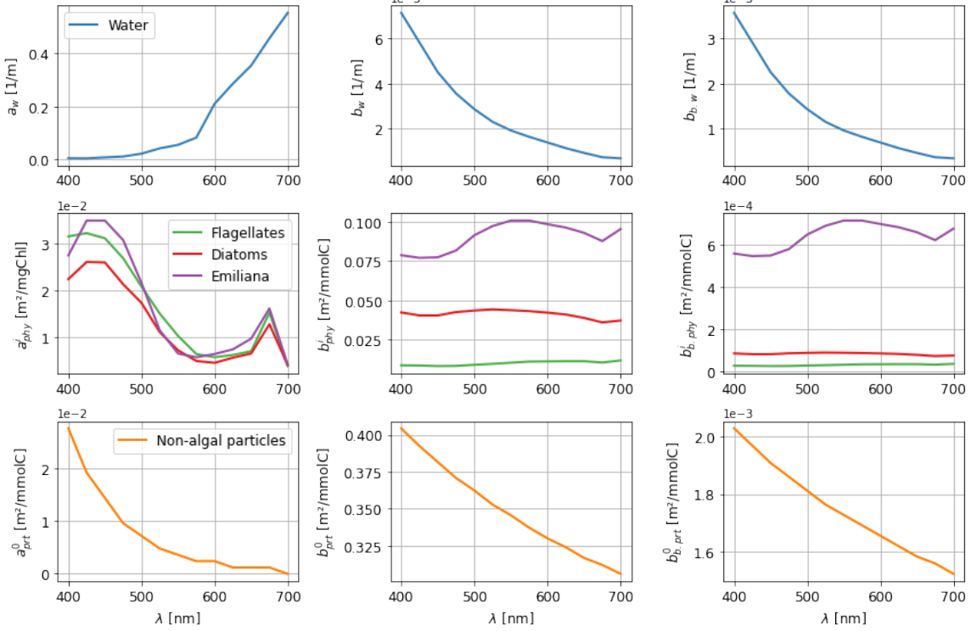
Inputs
Direct and scattered (downward) surface irradiance
IOPs (absorption and scattering)
We solve 4 major constituents:
Pure water
Phytoplankton
Non-algal particles
CDOM
Direct
Optically active component
3/13

Slide 4

Outputs
In-water irradiance streams:
Direct (downward)
Scattered (downward)
Backscattered (upward) -> Leaving-water irradiance
Sea surface
reflectance
Direct
Backscattered
Sea surface reflectance (R_{RS})
Ratio between upward and downward surface irradiance
Model reflectance is transformed to remote-sensed reflectance by accounting for BRDF and the air-sea interface
Optically active component
Direct
Scattered
4/13

Slide 5
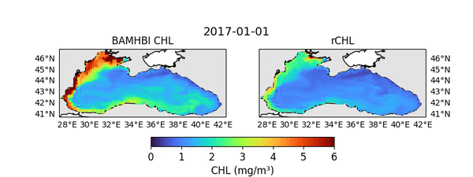
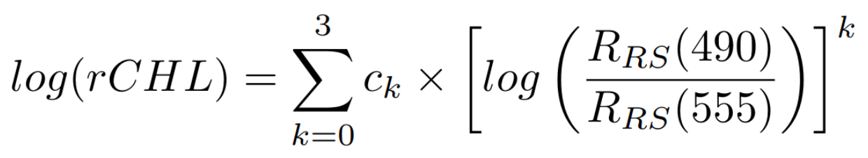
Reflectance-derived chlorophyll
We use a blue/green band ratio algorithm to derive reflectance-derived chlorophyll (rCHL), a proxy for surface chlorophyll.
with c_{k} coefficients as used in the CMEMS product for the Western Black Sea
5/13

Slide 6
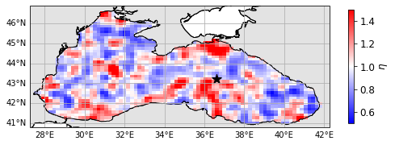
Uncertainties
Here we consider uncertainties in the IOPs only, arising from:
  Uncertainty on phytoplankton, non-algal particles and CDOM concentrations
  Uncertainty on the absorption and scattering spectra
We use 1st order autoregressive processes following a log-normal distribution to perturb IOPs.
  Time correlation: 30 days
  Space correlation: 75 km
  Standard deviation: 50%
  20 members
Example of perturbation field
6/13

Slide 7
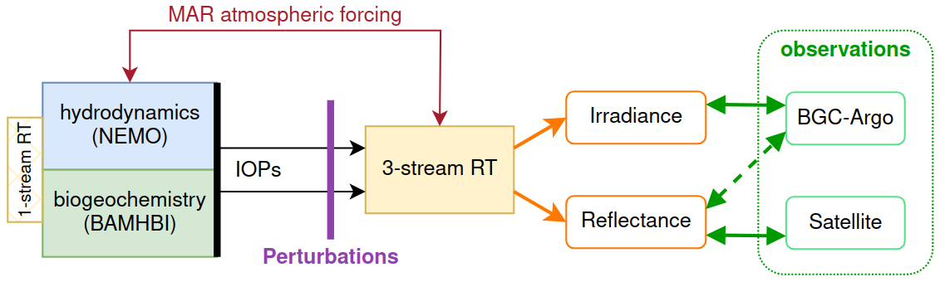
Coupled modelling framework
1-way coupling:
No feedback from the 3-stream RT model towards NEMO and the BGC
RT model is used as an observation operator, projecting model variables into the space of observations
7/13

Slide 8
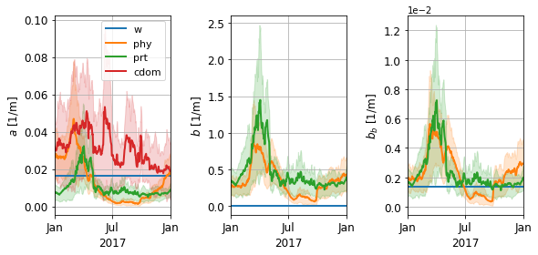
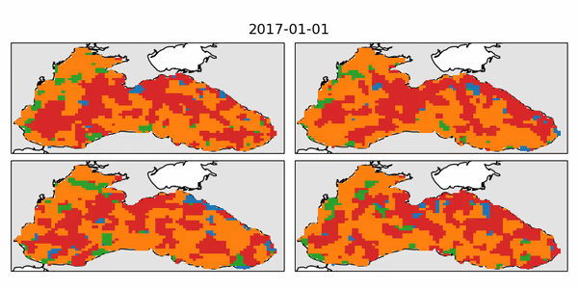
Optical contributions
Absorption domination in 4 members:
water, phytoplankton, non-algal particles, CDOM
IOPs. 2017, eastern gyre
CDOM tends to dominate absorption outside of blooms,
Phytoplankton and non-algal particles have IOPs of similar magnitude.
8/13

Slide 9
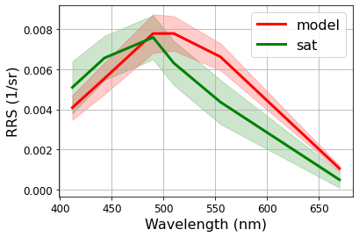
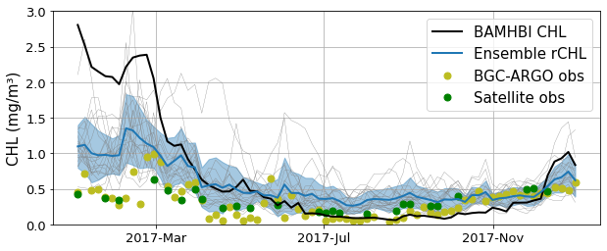
Sea surface reflectance fields
2017 basin-wide average
Along BGC-Argo 6901866 track, 2017
Overestimation of reflectance in longer wavelengths.
rCHL is closer to measured chlorophyll during winter/spring blooms, but does not capture all observations.
9/13

Slide 10
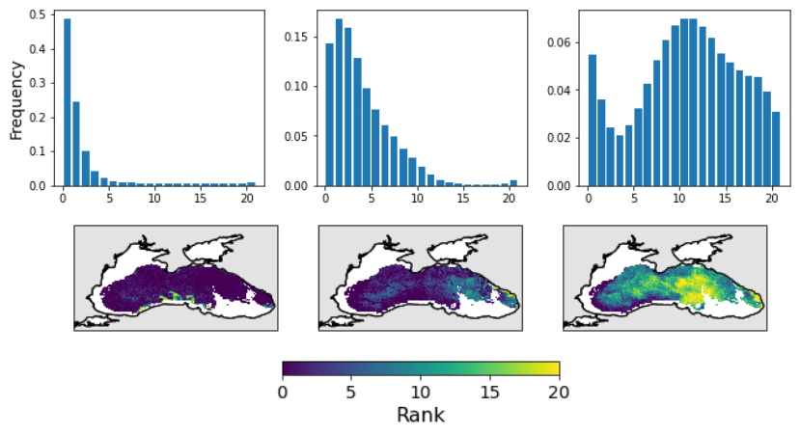
rCHL distributions
05-03-17
08-06-17
13-09-17
Initial bias in the deterministic solution of rCHL.
In some conditions, distributions of rCHL are consistent with observations:
  In the deep basin
  In summer/autumn
Observations are not properly captured in winter/spring. Reasons can be:
  The deterministic solution is not good enough
  Other sources of uncertainty should be considered
10/13

Slide 11
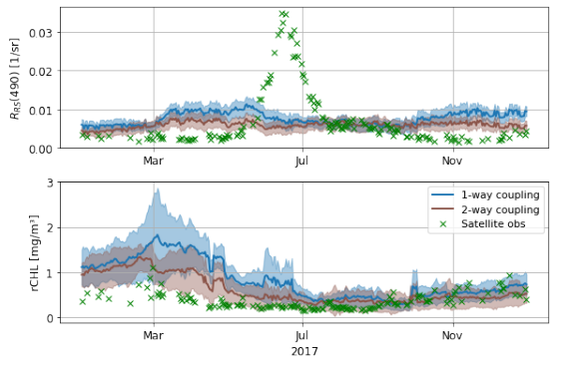
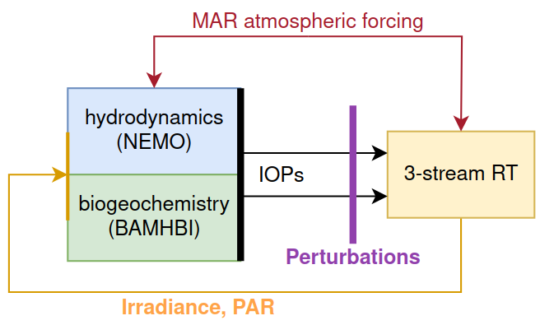
2-way coupling ?
RT feedback to physics and BGC may improve the computation of R_{RS} and rCHL.
The influence on the physics and BGC has to be further assessed too.
11/13

Slide 12

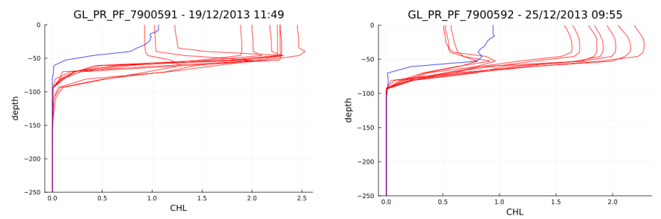
Consequences of light perturbation
ODESSA
L. Vandenbulcke
Perturbation of surface irradiance - BGC-ARGO profile / Ensemble members
Perturbation of light (both directly and indirectly) can have major consequences on ocean biogeochemistry.
12/13

Slide 13
Conclusions
The use of RT model shows the importance of modelling irradiance and IOPs (esp. CDOM) correctly.
With rCHL, we obtain estimates of surface chlorophyll that are closer to observations that BAMHBI chlorophyll.
Distributions of rCHL do not always capture observations, further calibration will be required for bloom periods.
RT models allow to make a better use of reflectance products.
  Model calibration and validation
  Data assimilation (poster by P. Verezemskaya, Monday)
ODESSA
13/13

