Slide 1

Artificial forest plot generation from individual tree point clouds
6TH VOD4Forest Workshop
Cadwal Borremans, Benjamin Lecart , Romain Neuville and François Jonard

Slide 2
Introduction
VOD : macro evaluation of a combination of water content and biomass over large areas
Tree detection : finer evaluation of the biomass at lower scale, from 2D or 3D structural information (e.g., LiDAR point clouds, CHM)
Complementarity:
Cross-comparison of biomass or structural metrics extracted from both sources
Extraction of detailed data (e.g., individual tree height, crown volume) to calibrate and refine VOD-based models
Potential to improve multi-scale monitoring of forest dynamics (e.g., deforestation, degradation, regrowth)

Slide 3
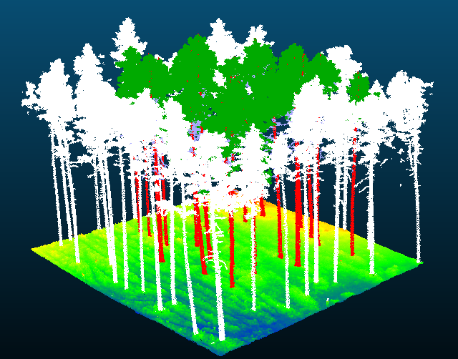
Tree detection
Goal: Detect and extract trees from forest point clouds
Rule-based techniques widely explored (local maxima, watershed segmentation, clustering, voxel density,…)
Drawbacks :
Strong parameter dependence
Difficulties in complex/dense forest context
Current research: Deep learning approach (instance segmentation / object detection)
Limitations:
Lack of labelled datasets
Existing labelled datasets: clear areas where trees are easily identifiable
=> Lack of labelled complex forest datasets

Slide 4

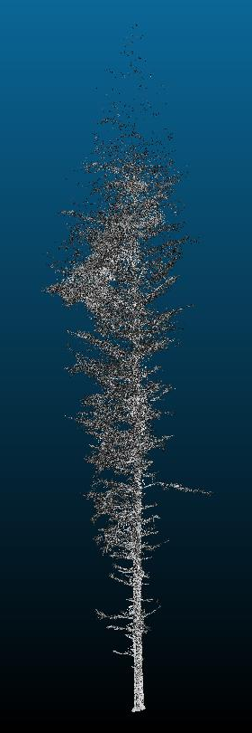
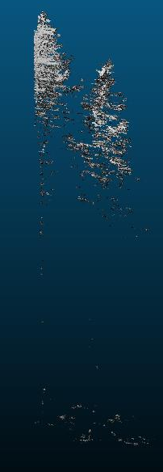
PyTreeDB
Individual tree point clouds dataset
1951 trees
24 species
3 acquisition mode ALS, ULS and TLS
Quality score
Multiple point cloud for each tree

Slide 5


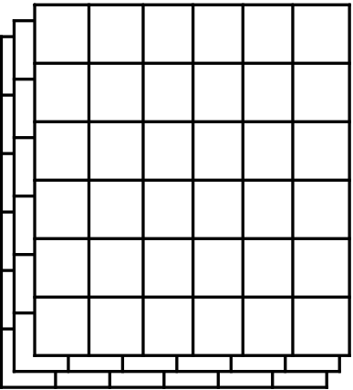
Algorithm
< overlap threshold
Tree selection
-random species
-given sensor type
Σcells / nbr cells
≥ overlap threshold
Update occupancy grid
Generate low vegetation and add to pc
PyTreeDb
ALS + TLS + ULS
(individual trees)
Height class
Random rotation
Add to output pc
Write output pc
Add random noise
Overlap buffer
- Applied to each tree already in the scene
XY plane buffer
- Keep xy overlap with the new tree below 40% and away from stem
- Takes into account height class of added and already present trees
=0
Random cell selection
Tree translation to cell
Σcells
>0
Binary occupation grid
Height class grid
Binary stem occupation grid

Slide 6
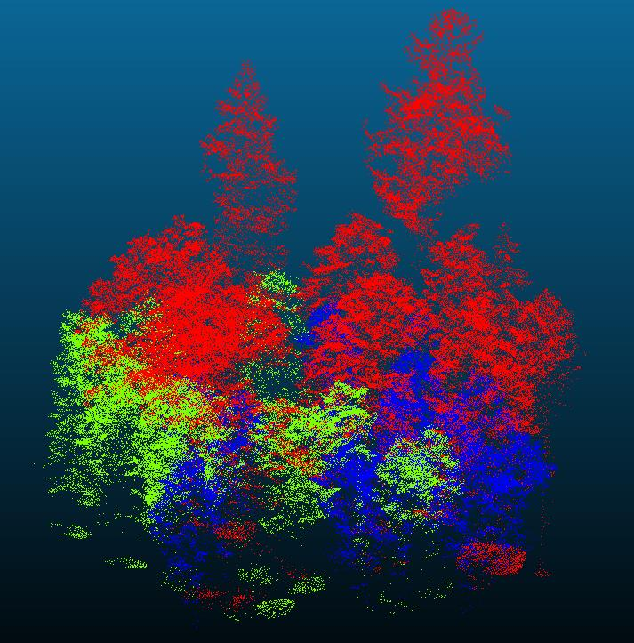
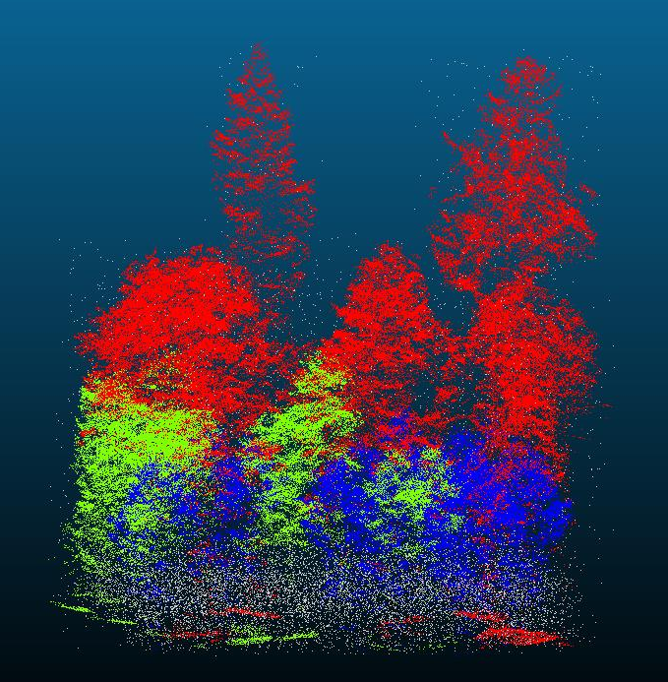
Current results

Slide 7

Algorithm setup
Height class :
1: h <15m
2: 15m > h < 25m
3: h > 25m
Grid size : 30m x 30m, 0.5m resolution
Overlap : 40%
Occupation threshold : 90% - 100%
Noise density : 0,05 – 0,2 points / $m^{3}$
Low vegetation noise density : 1-2 points / $m^{3}$

Slide 8
Next steps
Train detection model on this new dataset
Does it fit efficiently on it?
Does it improve results on ground truth dataset?
Try another parametrization
Different height classes
Other way of simulating low vegetation

Slide 9

Thank you for your attention

