Slide 1





THE MECHANICAL INTERPLAY BETWEEN BONE AND SCAFFOLD MICROSTRUCTURES – A COMPUTATIONAL ANALYSIS
H. Souhail¹, E. Zamengo², L. D’Andrea³, S. Blouin², M.A. Hartmann², P. Vena³, D. Ruffoni¹
University of Liège, Belgium
Ludwig Boltzmann Institute of Osteology, Austria
Politecnico di Milano, Italy
Bone Biomechanics: Microscale

Slide 2


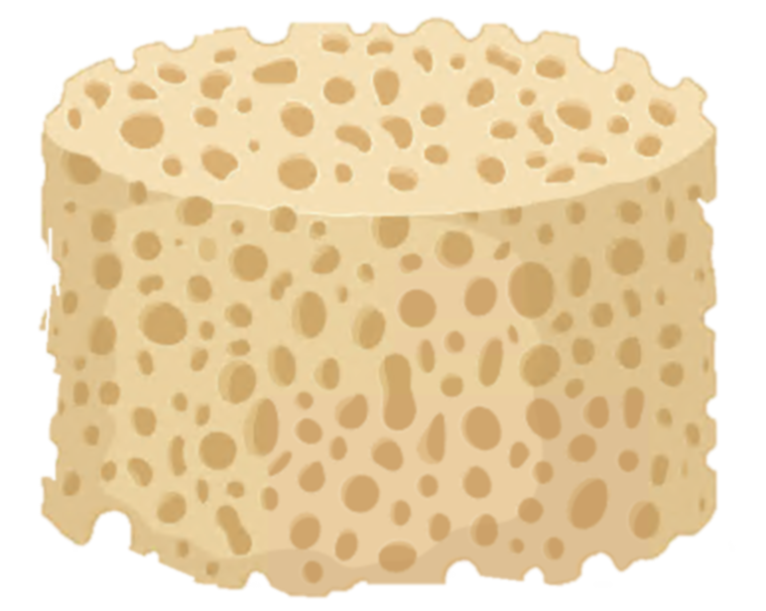
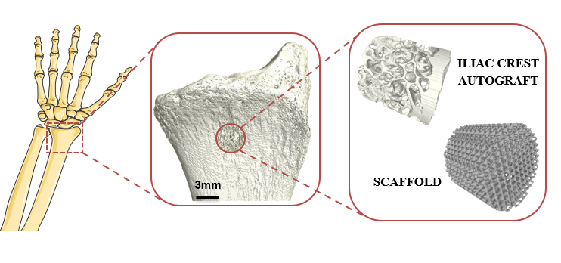


INTRODUCTION METHODS RESULTS CONCLUSIONS
Research Question
How does the insertion of a bone scaffold impact the mechanical loading on the surrounding bone?
Clinical Context
Computational Study
Virtual defect
Virtual implant insertion
Mechanical interaction in vivo
Bone scaffolds:
Autografts
3D printed
Servier Medical Art
Toosi et al., 2023, J. Mater. Sci.: Mater. Med.
Rubin et al., 2002, JBMR.
2
Servier Medical Art

Slide 3
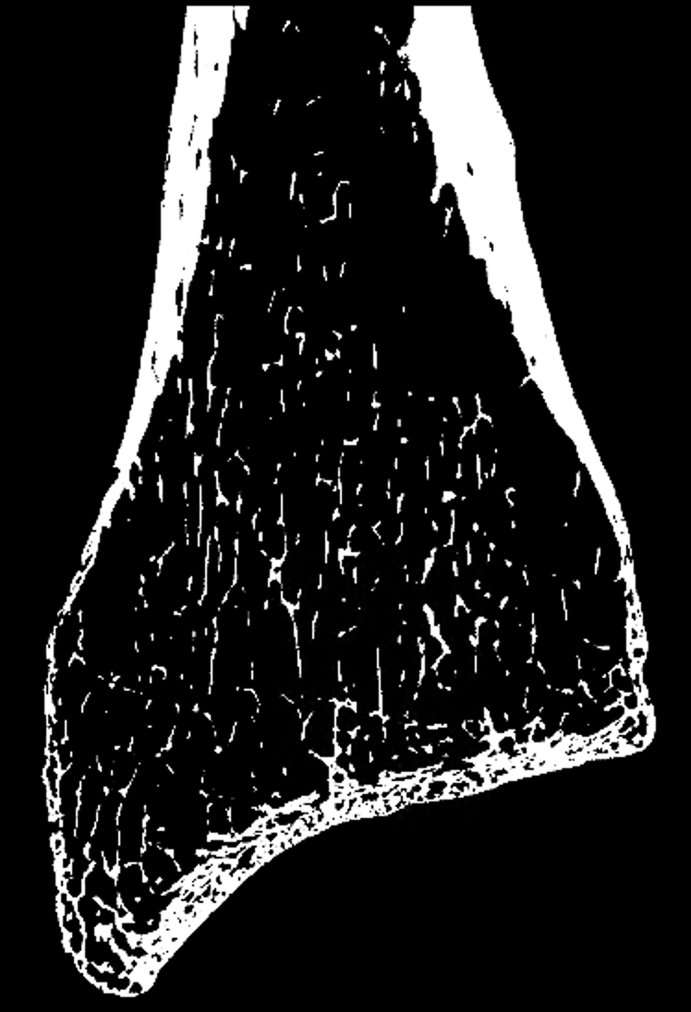
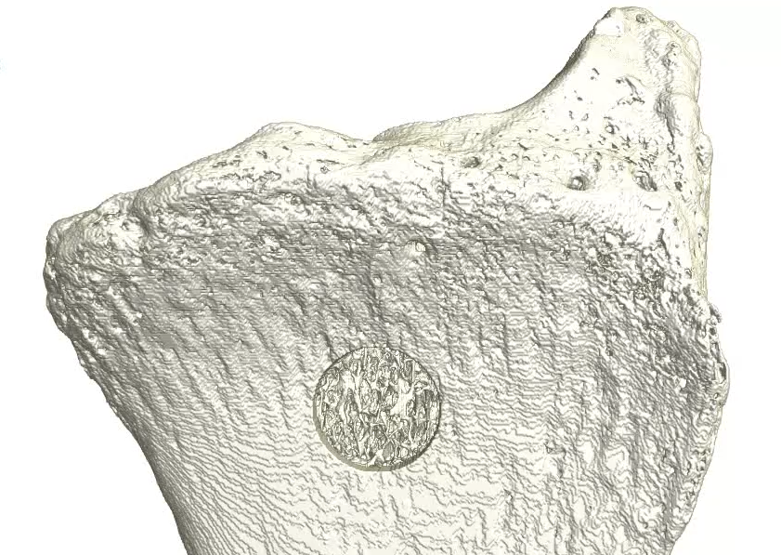
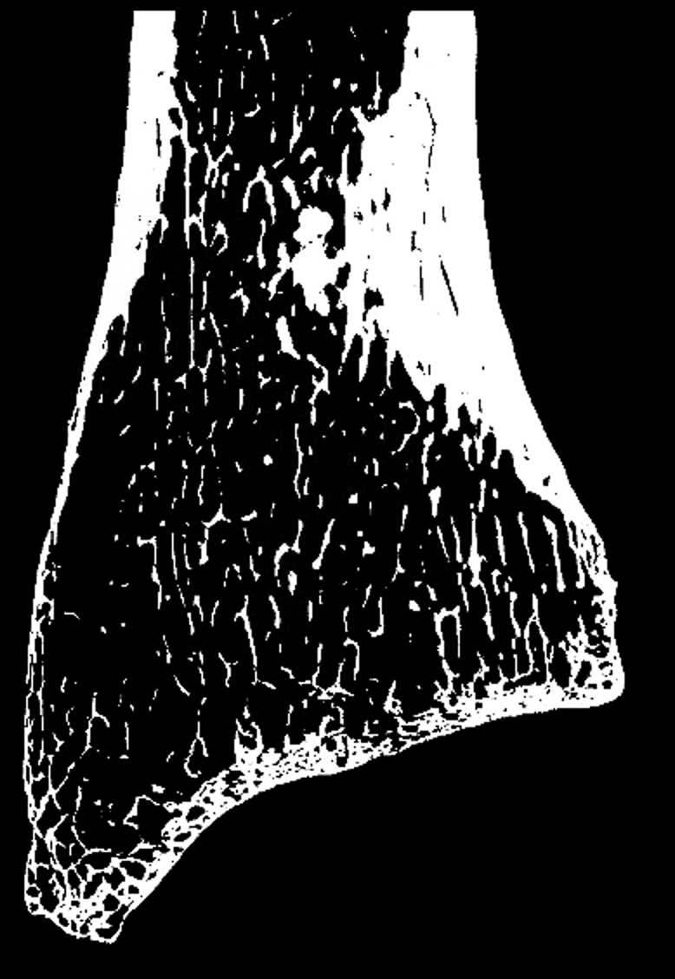
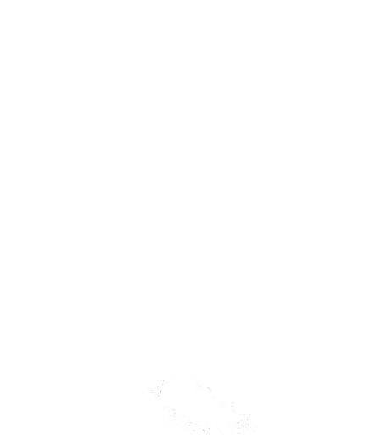

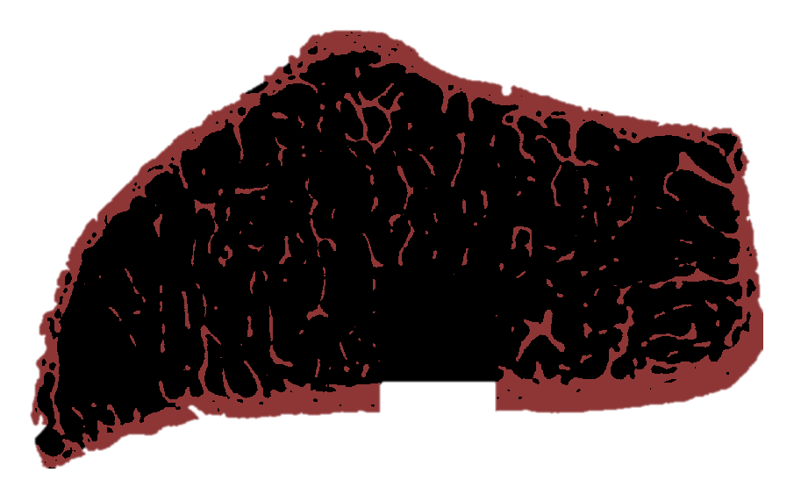
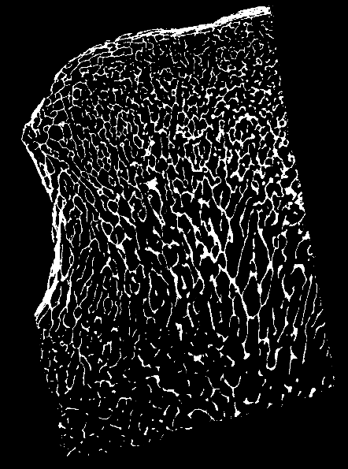
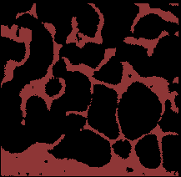
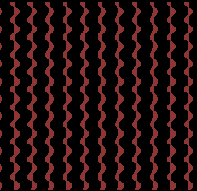



INTRODUCTION METHODS RESULTS CONCLUSIONS
µ-CT
Images
Radius Model
Defect Model
Computational Cases
INTACT
Radius
ILIAC CREST
Iliac Crest
6mm
SCAFFOLD
Voxel size: 24 µm
3

Slide 4
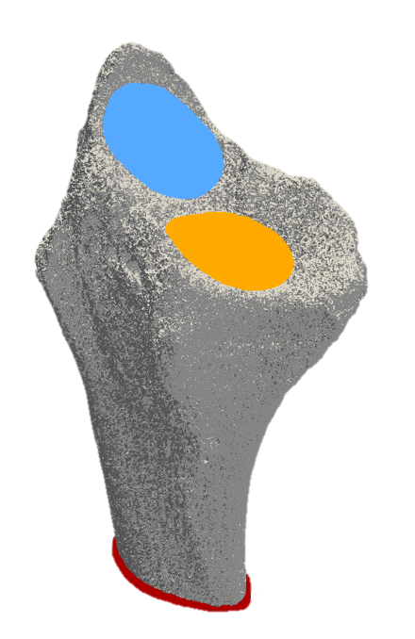
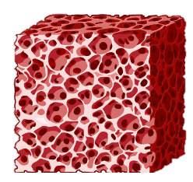
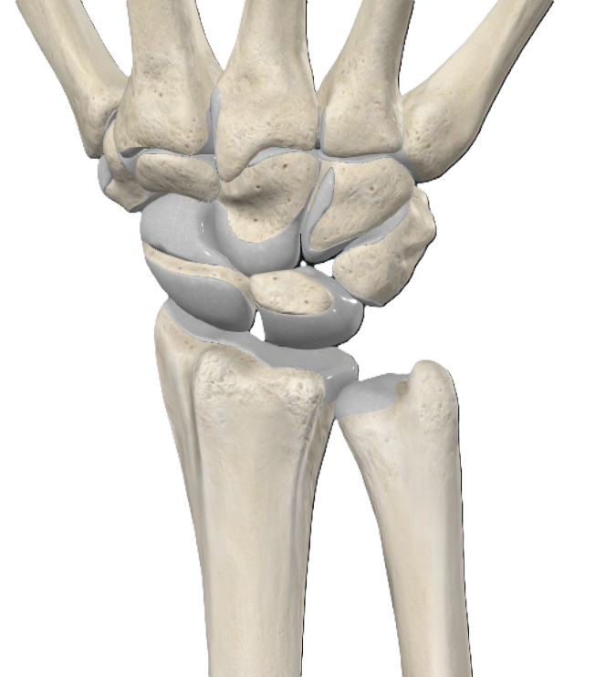
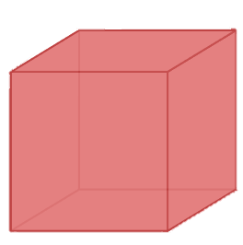

INTRODUCTION METHODS RESULTS
INTRODUCTION METHODS RESULTS CONCLUSIONS
Simulations
ParOSol: Voxel-based parallel micro-FE solver
Parameters
F_{z, scaphoid} = 60%
1. MICROSTRUCTURE
EFFECT
F_{z, lunate} = 40%
E _{autograft} , E _{scaffold} = 16 GPa
Lunate
Scaphoid
Radius
2. MATERIAL EFFECT
62 cores on NIC5 SuperComputer ~ 24h
Z
Y
E _{scaffold} = 16 GPa VS 100 GPa
U _{x, y ,z} = 0
X
Flaig C. et al., Parallel Comput, 37: 846-854; 2011
4
Pistoia et al., 2002, J Biomech

Slide 5
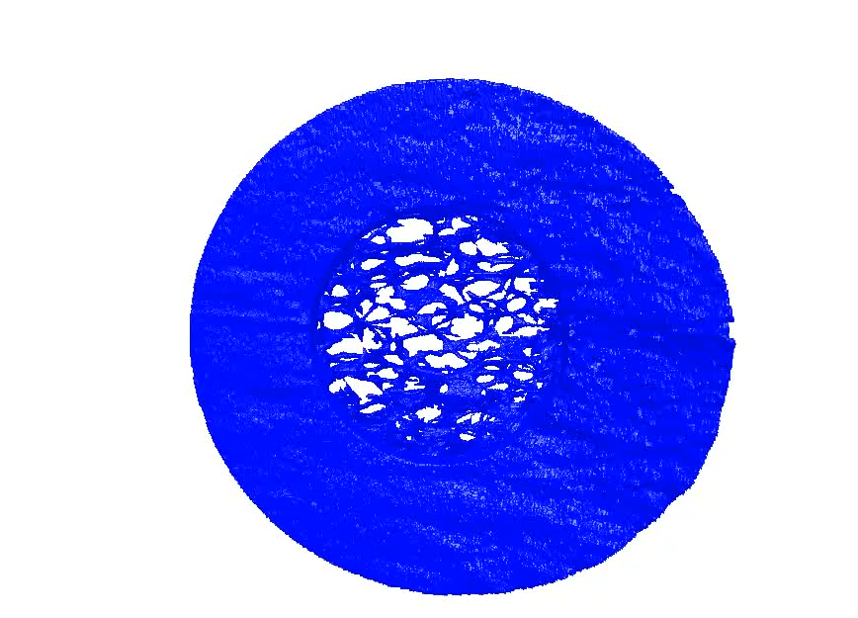
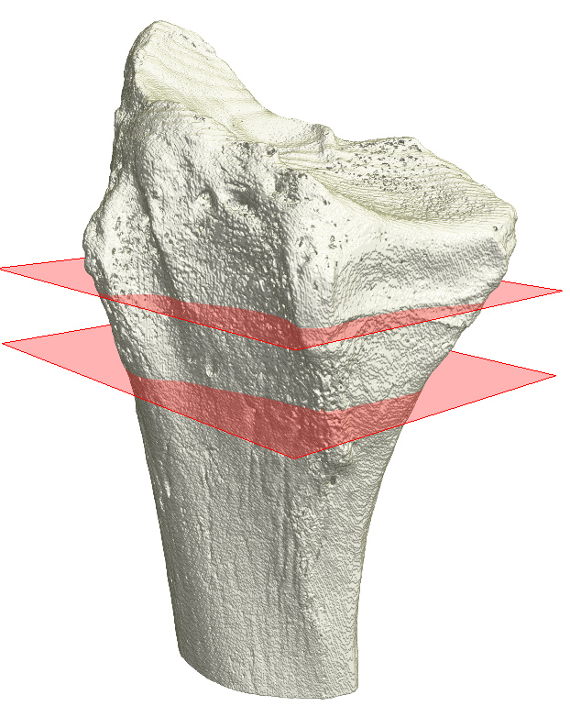
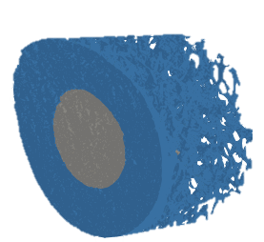
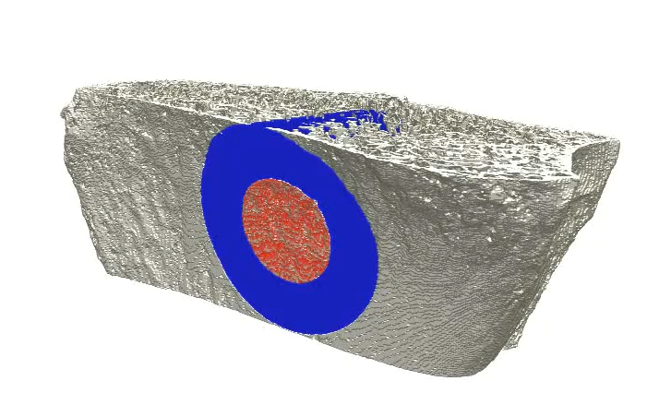

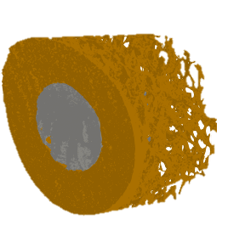
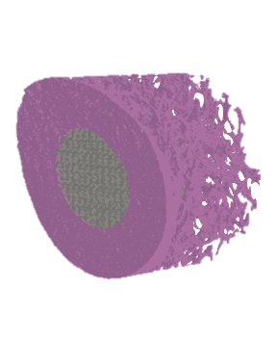
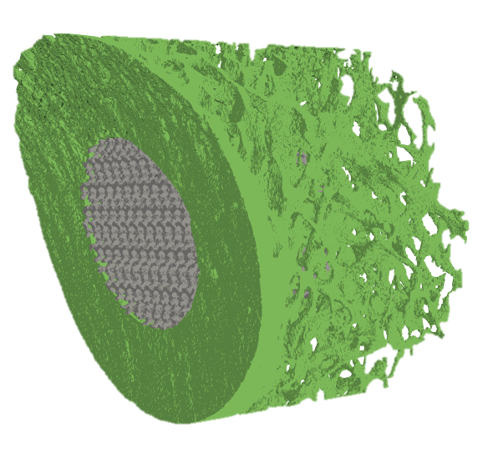


INTRODUCTION METHODS RESULTS
INTRODUCTION METHODS RESULTS CONCLUSIONS
Post-Processing
$$Strain Distribution Ratio= \frac{{EFF}_{i}}{{EFF}_{PERI−BONE}}$$
PERI-BONE
Peri-Implant Bone
PERI-
AUTOGRAFT
PERI-DEFECT
PERI-
SCAFFOLD16
PERI-
SCAFFOLD100
Z
Y
X
Mancuso et al., 2020, JBMR
5

Slide 6
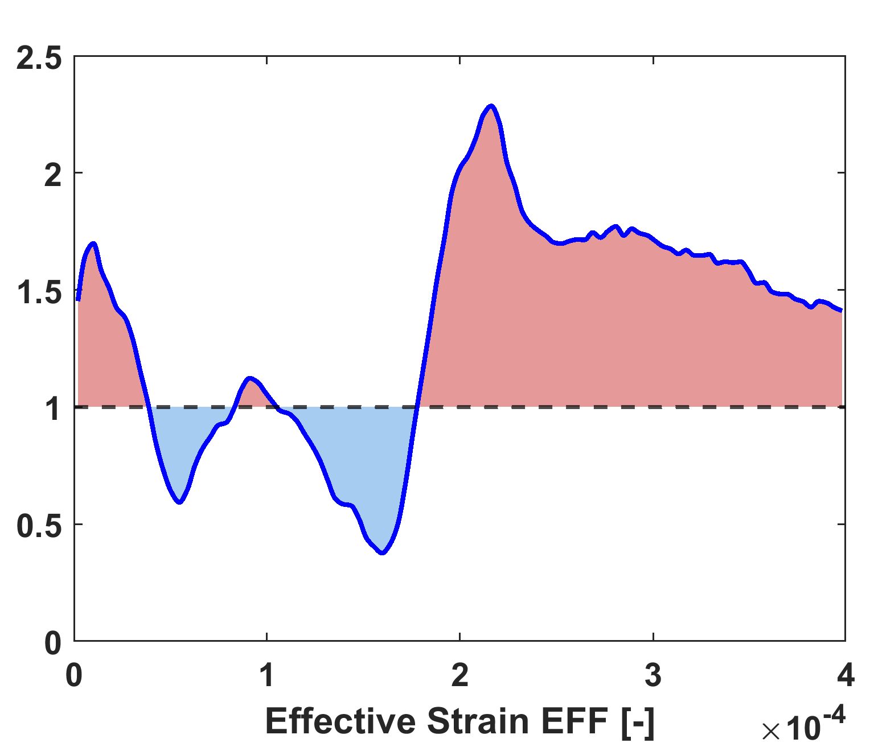
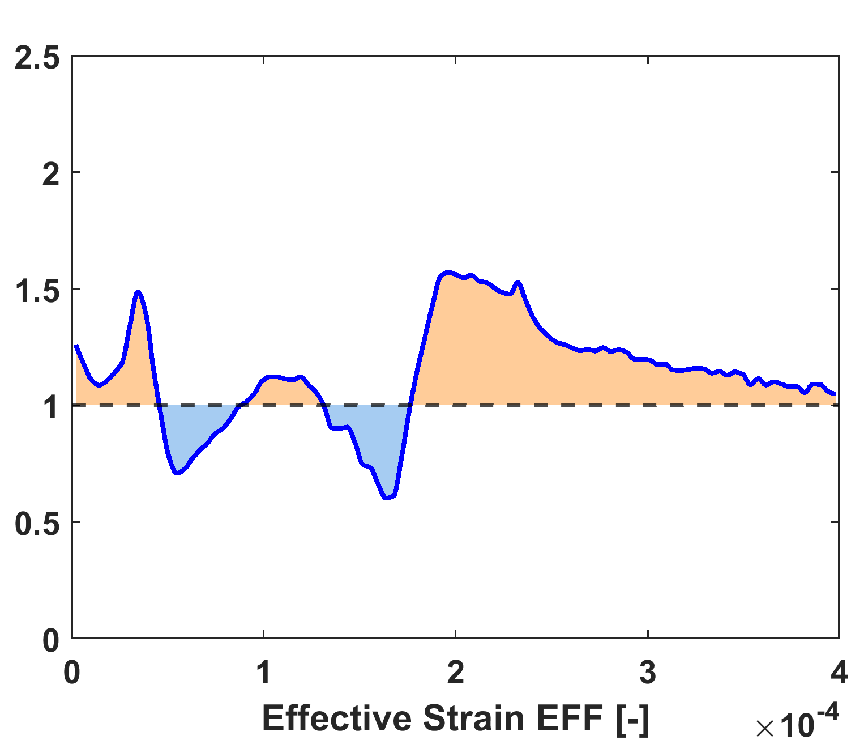
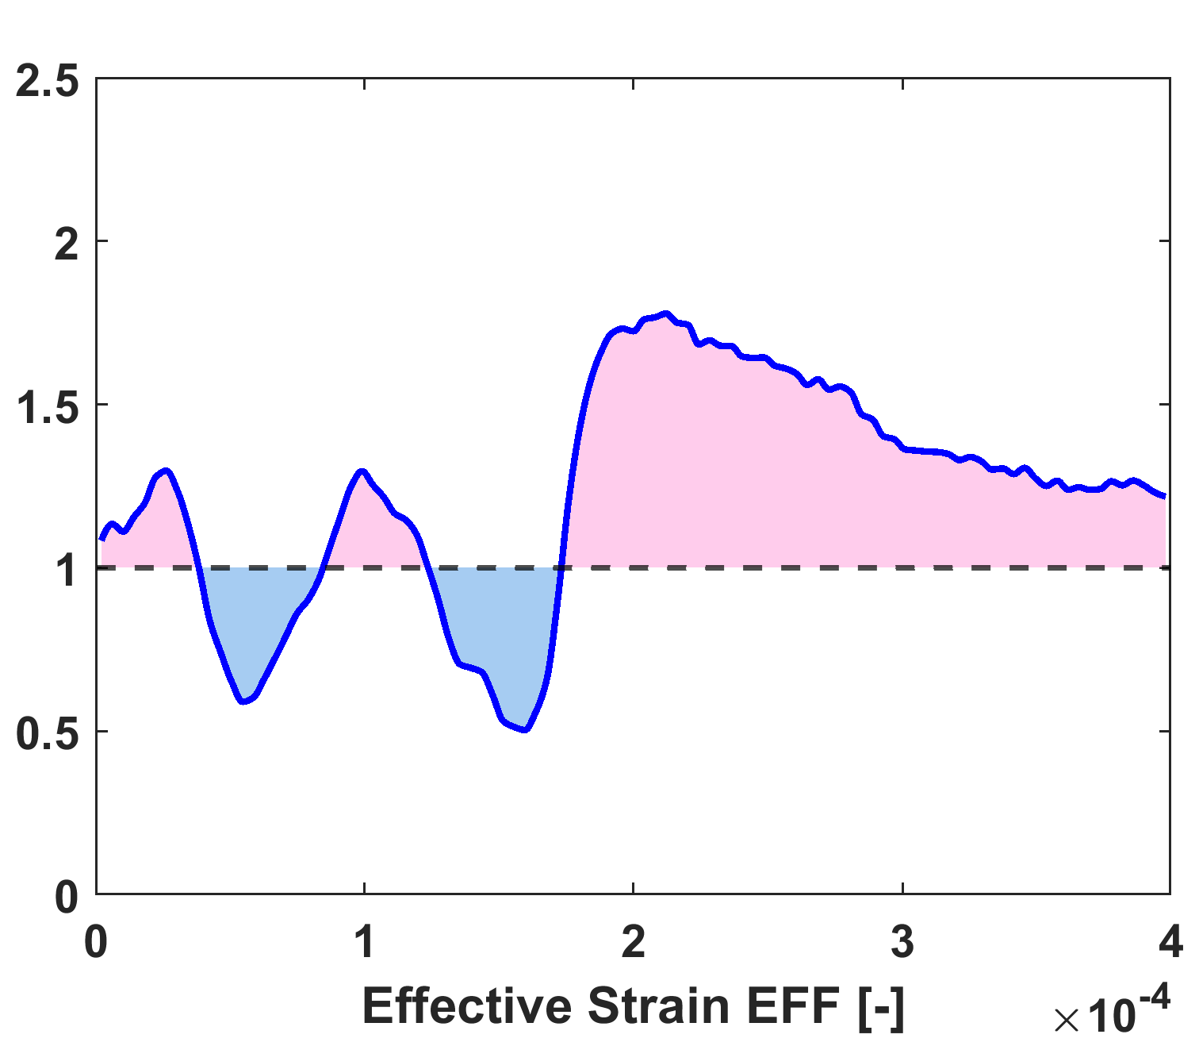
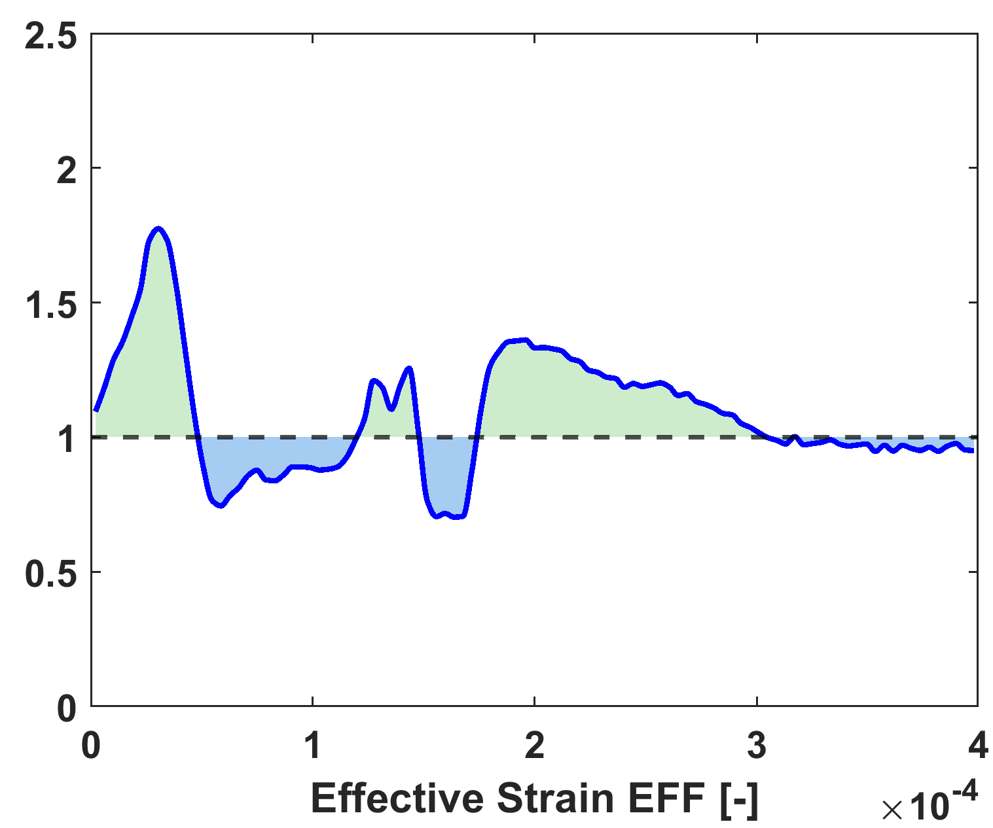
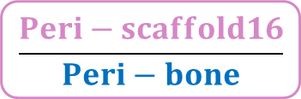
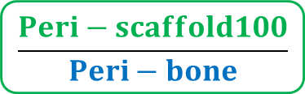
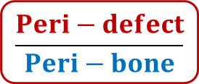
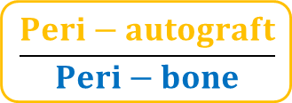
INTRODUCTION METHODS RESULTS CONCLUSIONS
$$\frac{Peri−defect}{Peri−bone}$$
$$\frac{Peri−autograft}{Peri−bone}$$
$$\frac{Peri−scaffold16}{Peri−bone}$$
$$\frac{Peri−scaffold100}{Peri−bone}$$
6

Slide 7
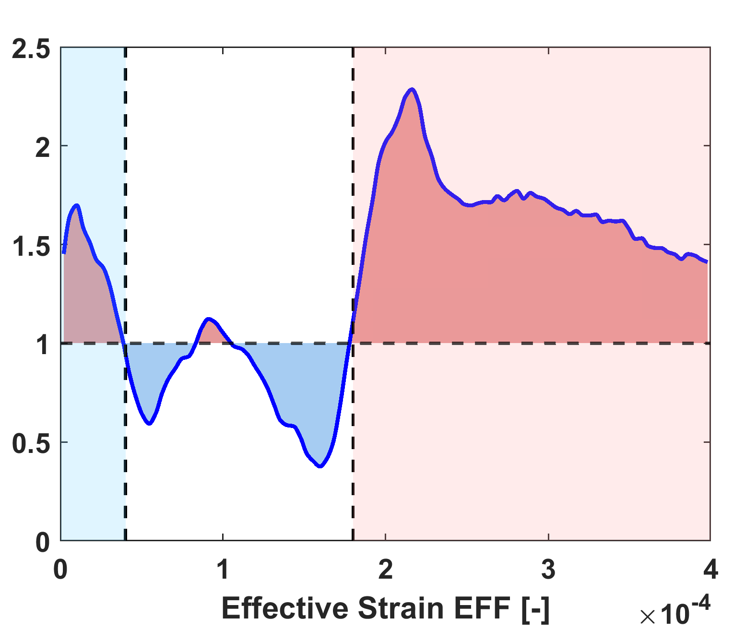
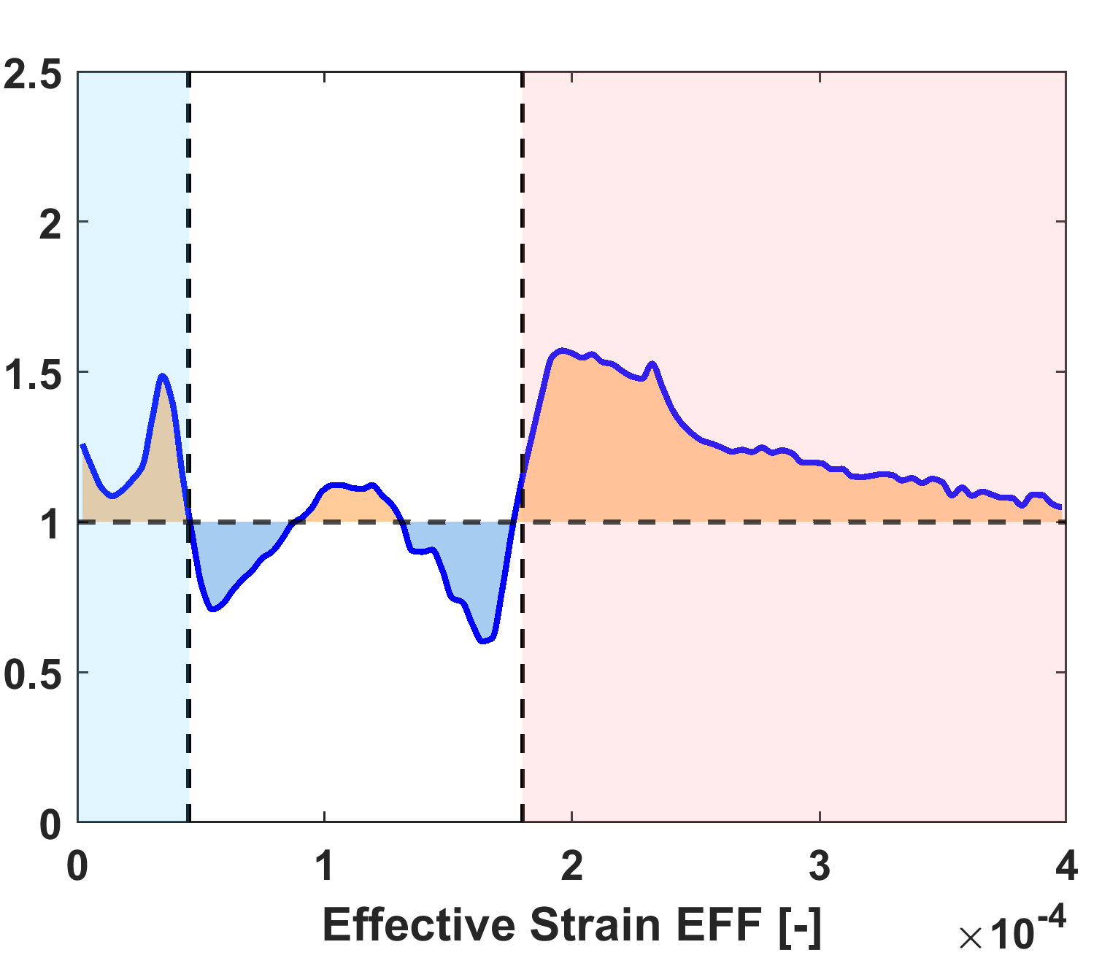
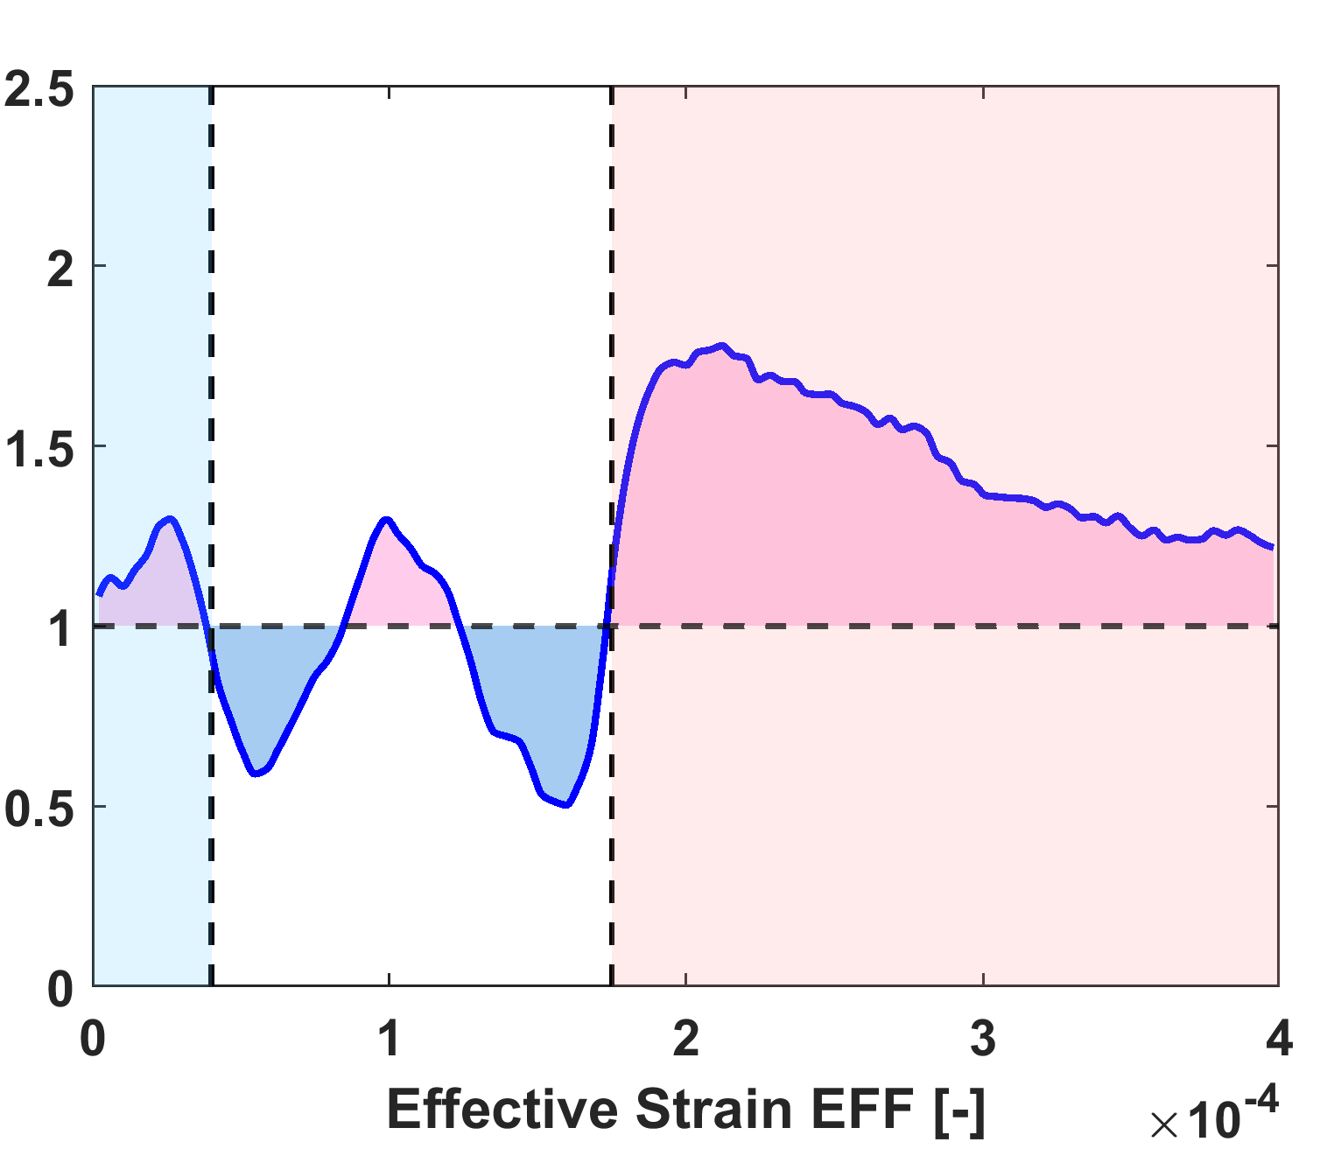
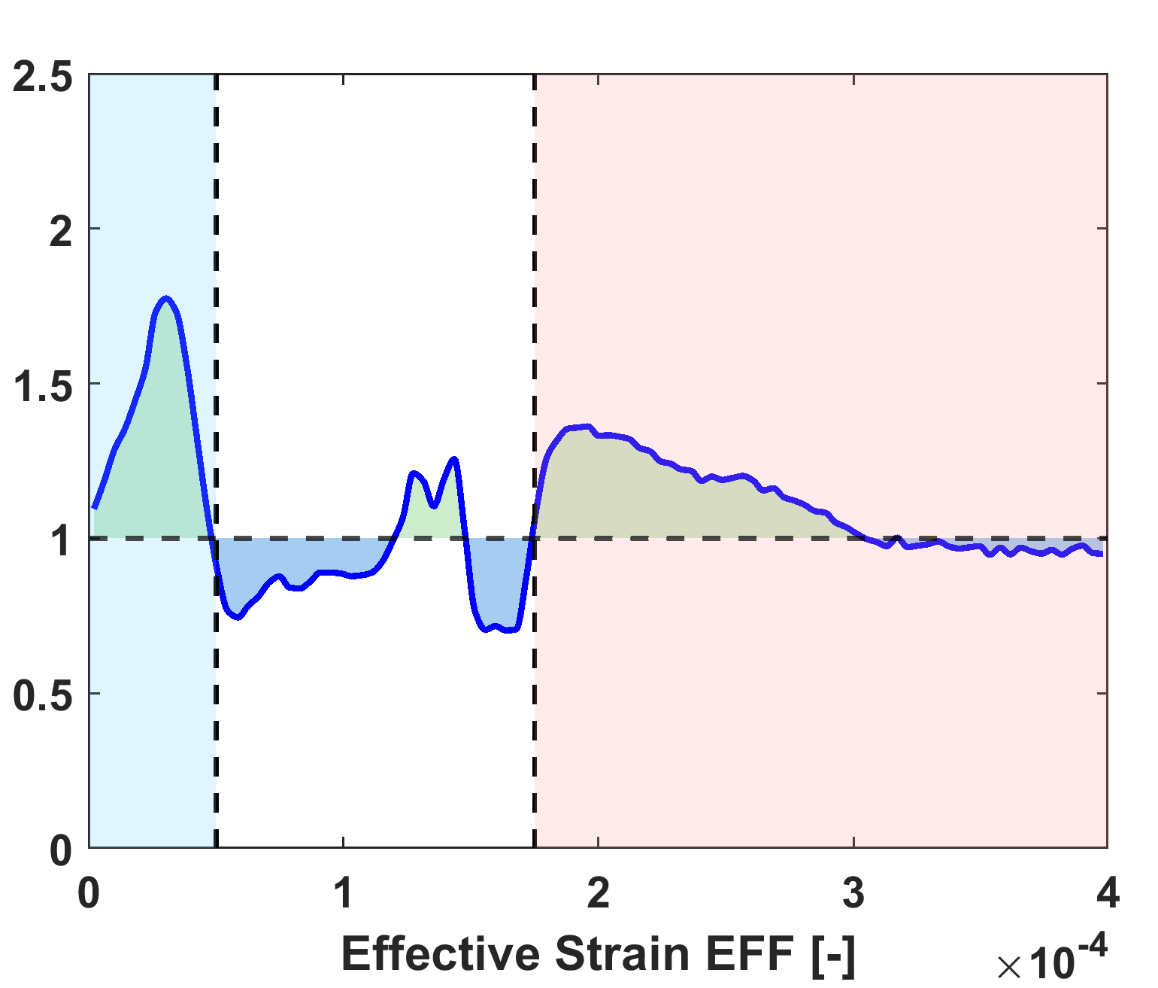
INTRODUCTION METHODS RESULTS CONCLUSIONS
$$\frac{Peri−defect}{Peri−bone}$$
$$\frac{Peri−autograft}{Peri−bone}$$
$$\frac{Peri−scaffold16}{Peri−bone}$$
$$\frac{Peri−scaffold100}{Peri−bone}$$
HIGH STRAIN
LOW STRAIN
7

Slide 8
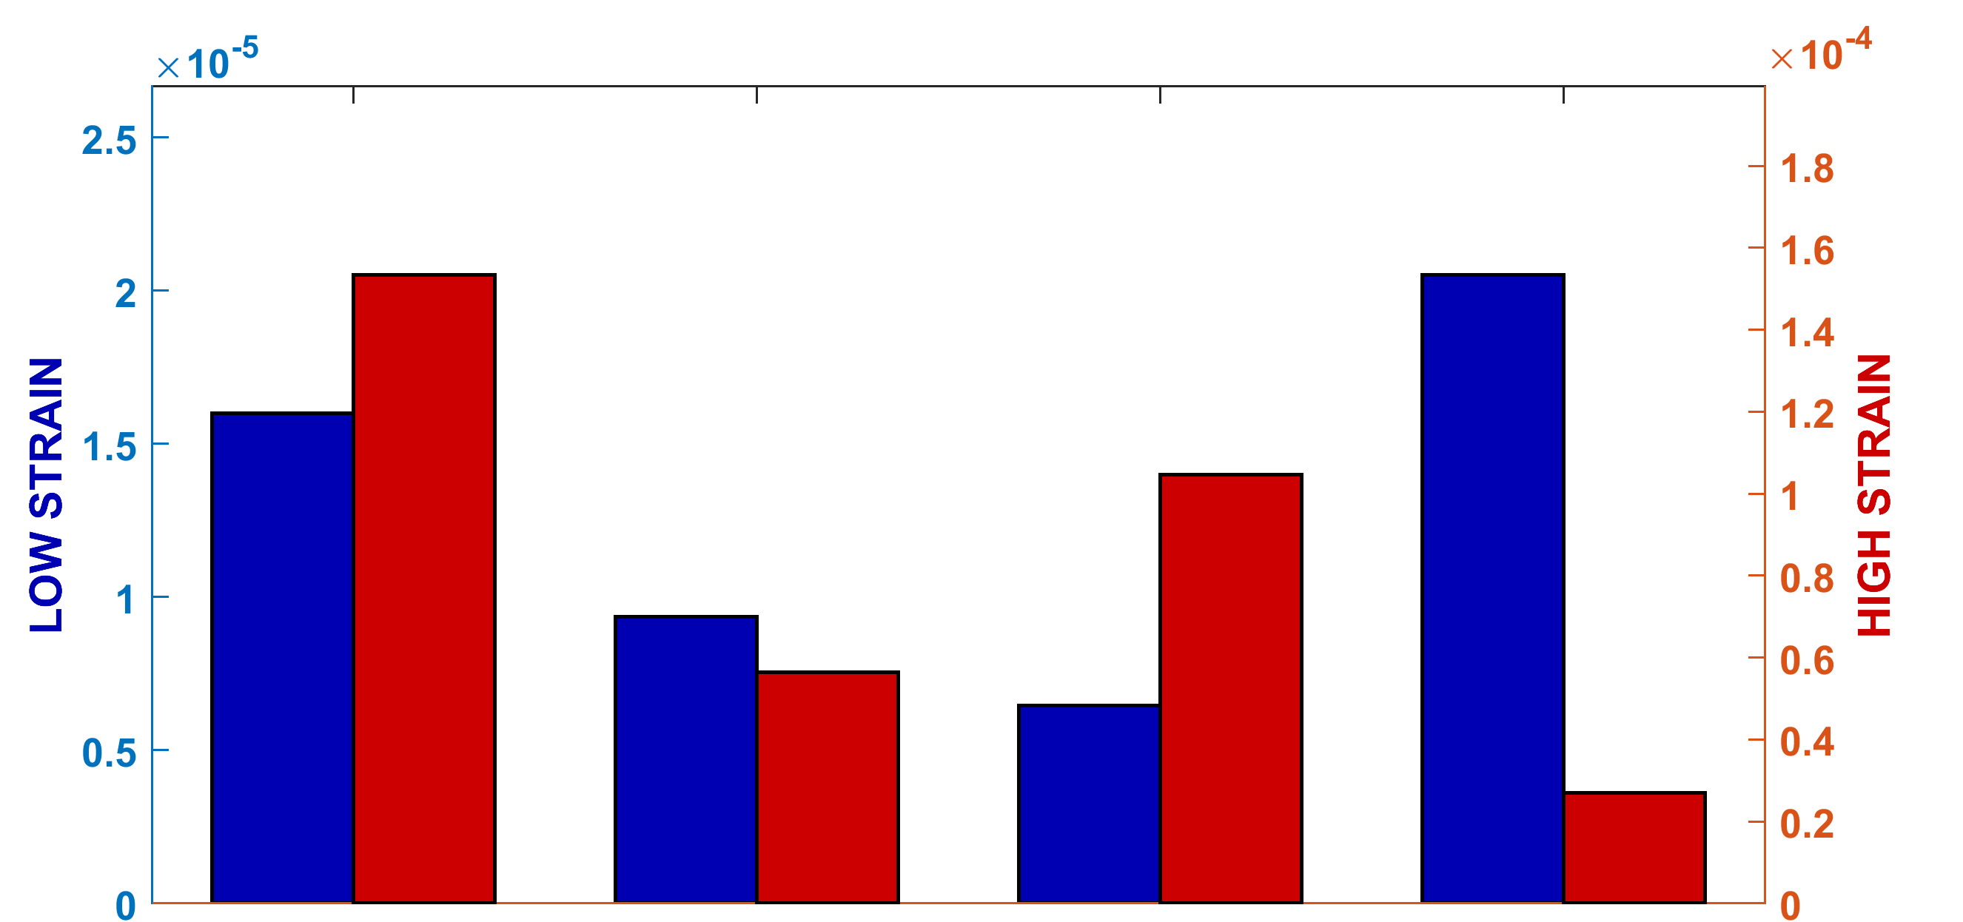
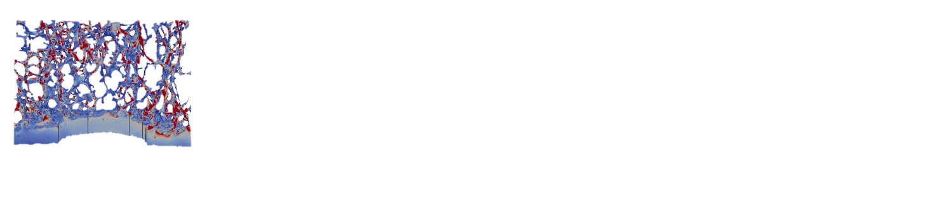
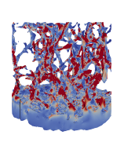
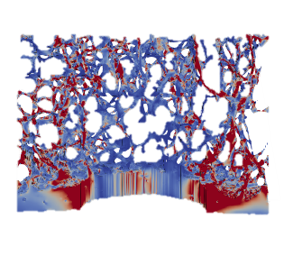
INTRODUCTION METHODS RESULTS CONCLUSIONS
DEFECT
EFFECT
PERI-BONE
HIGH STRAIN
LOW STRAIN
LOW
HIGH
PERI-DEFECT
EFF
PERI-
DEFECT
PERI-
AUTOGRAFT
PERI-
SCAFFOLD
16
PERI-
SCAFFOLD
100
8

Slide 9
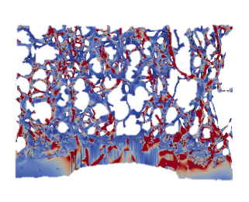
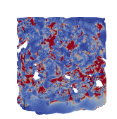
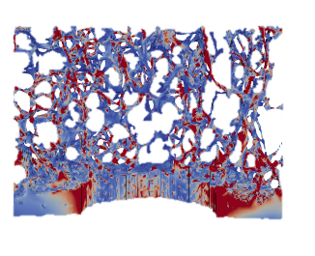
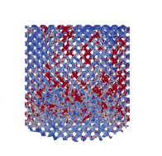
INTRODUCTION METHODS RESULTS CONCLUSIONS
MICROSTRUCTURE EFFECT
AUTOGRAFT
PERI-AUTOGRAFT
HIGH STRAIN
LOW STRAIN
SAME ELASTIC MODULUS!
LOW
PERI-SCAFFOLD16
HIGH
EFF
PERI-
DEFECT
PERI-
AUTOGRAFT
PERI-
SCAFFOLD
16
PERI-
SCAFFOLD
100
SCAFFOLD 16GPa
9

Slide 10
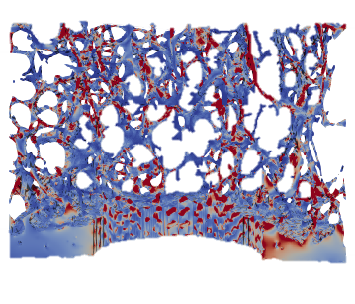
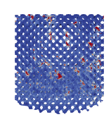
INTRODUCTION METHODS RESULTS CONCLUSIONS
MATERIAL
EFFECT
PERI- SCAFFOLD100
HIGH STRAIN
LOW STRAIN
SCAFFOLD 100 GPa
SAME POROSITY!
LOW
HIGH
PERI-SCAFFOLD16
EFF
PERI-
DEFECT
PERI-
AUTOGRAFT
PERI-
SCAFFOLD
16
PERI-
SCAFFOLD
16
PERI-
SCAFFOLD
100
SCAFFOLD 16 GPa
10

Slide 11
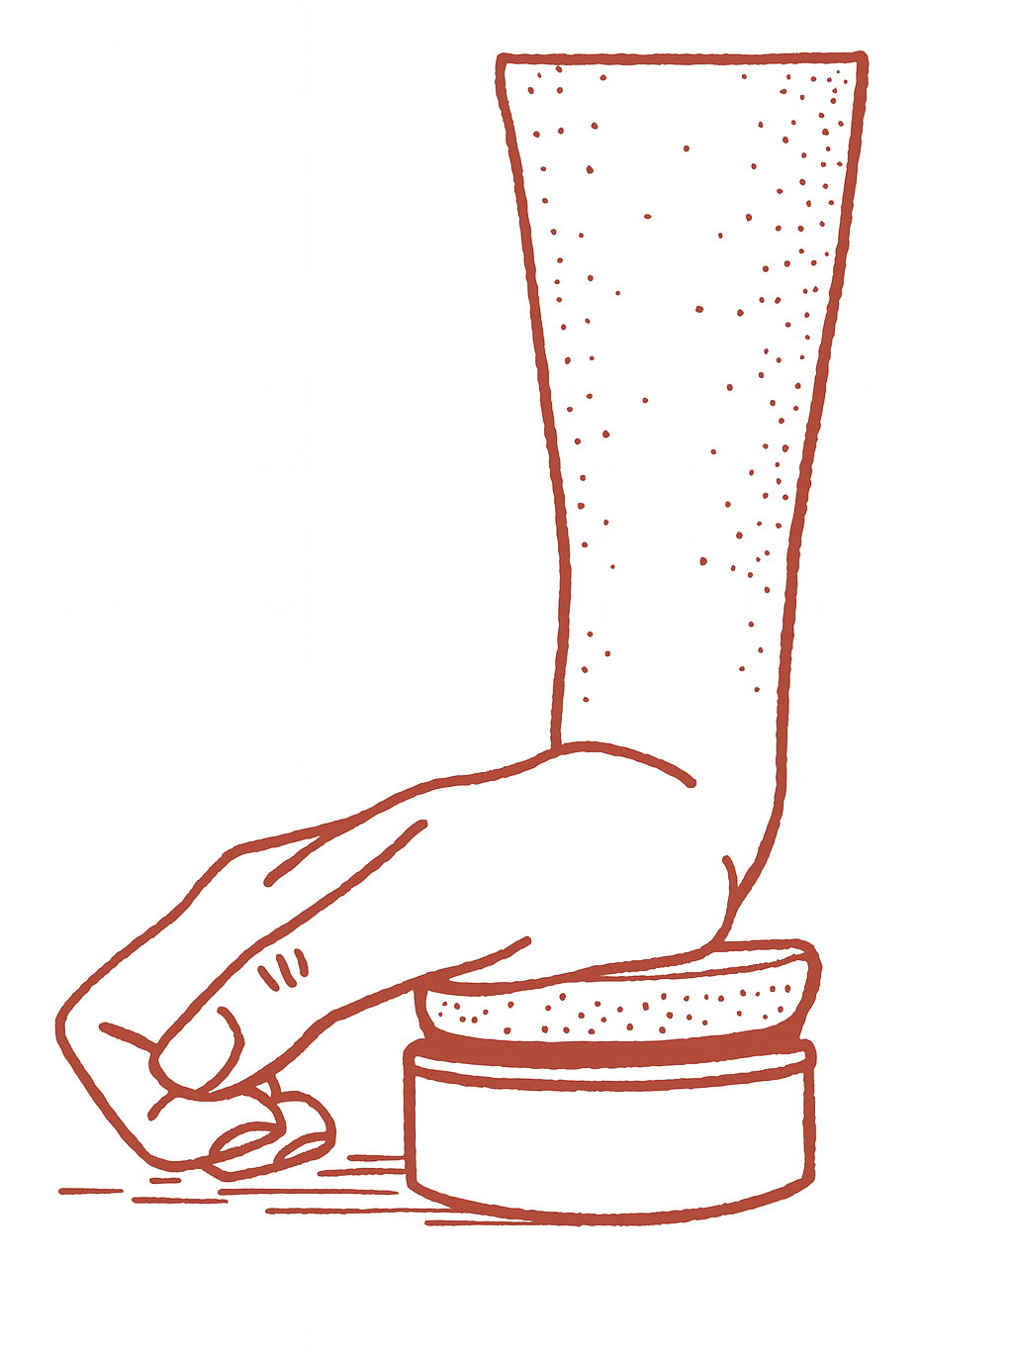

INTRODUCTION METHODS RESULTS CONCLUSIONS
How does the insertion of a bone scaffold impact the mechanical loading on the surrounding bone?
MECHANICAL ENVIRONMENT
SCAFFOLD DESIGN
In vivo loading
Microarchitecture
Material
BONE SCAFFOLD
STRAIN
SHIELDING
STRAIN
INTENSIFICATION
11

Slide 12


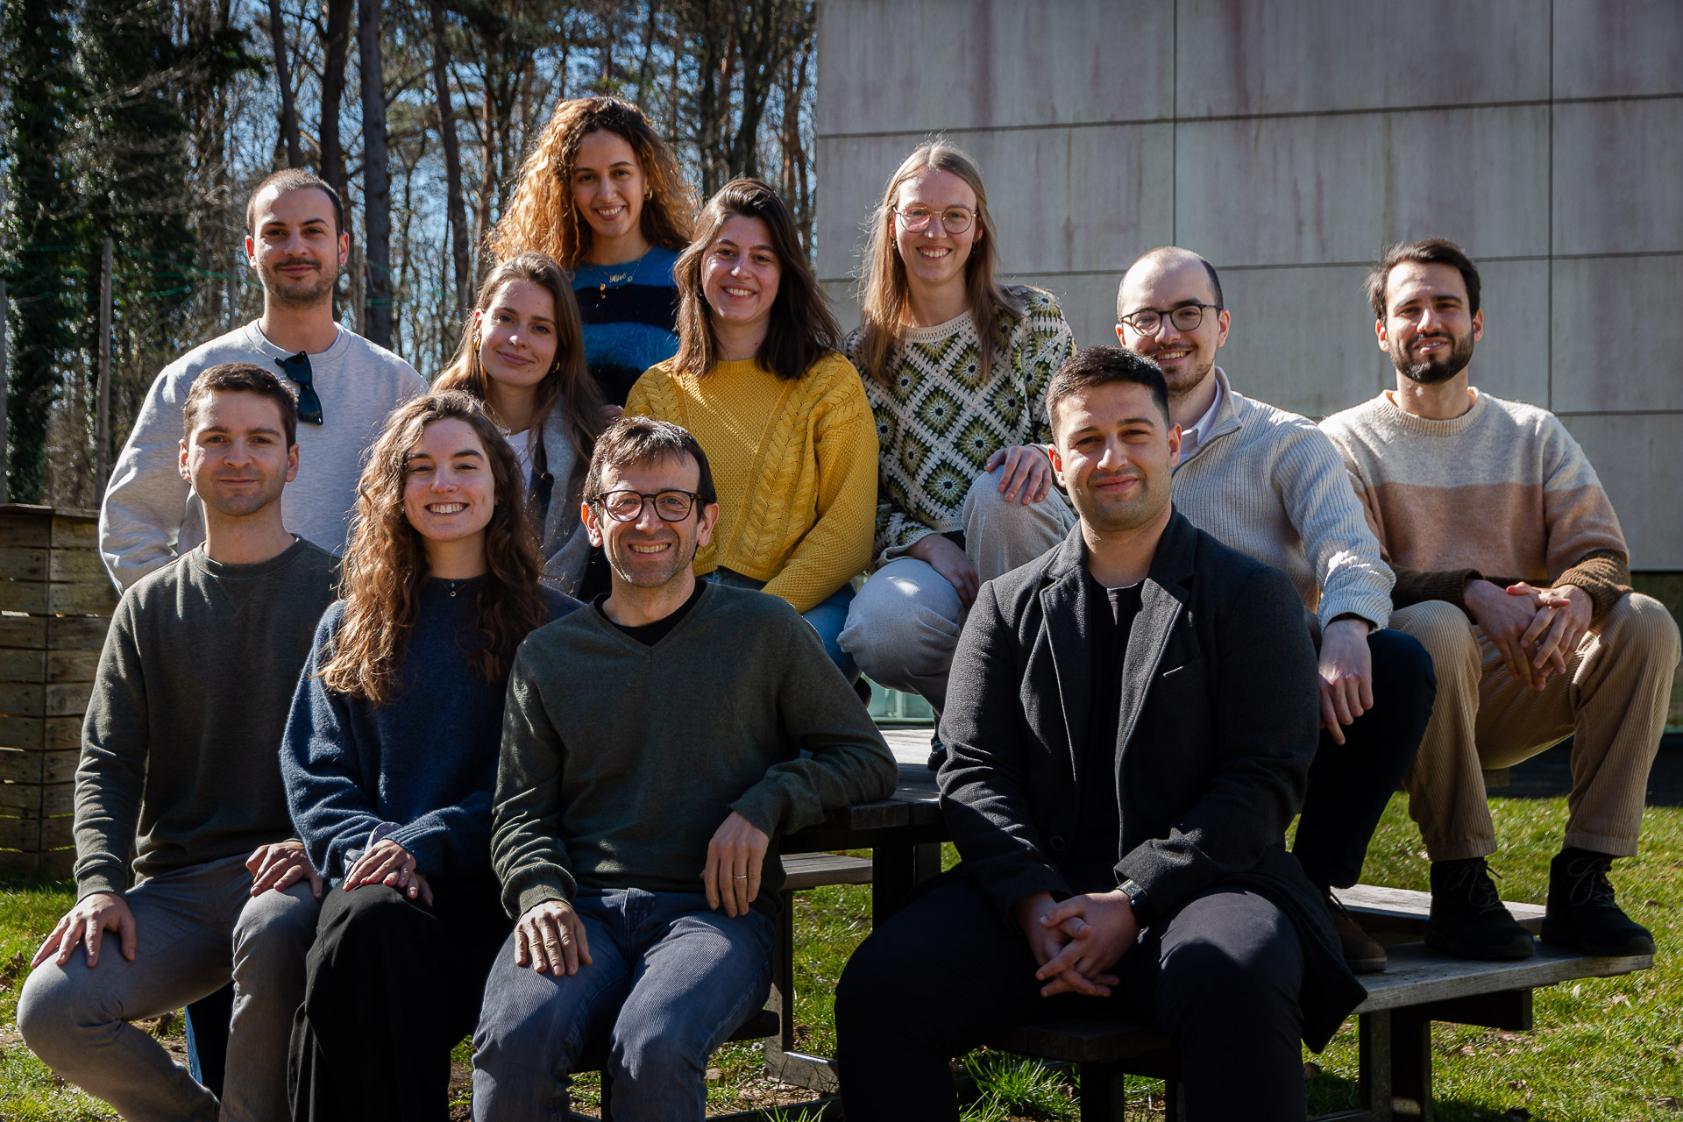



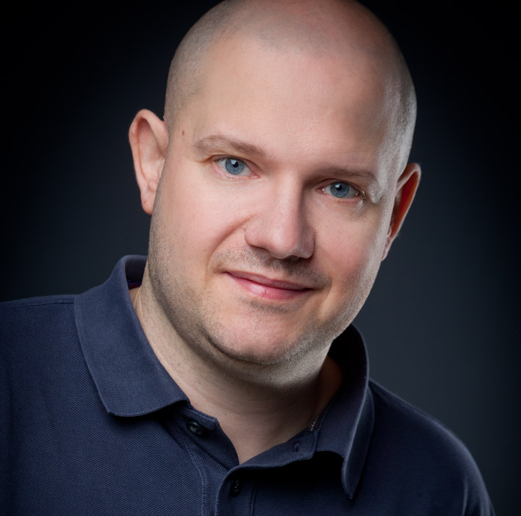






ACKNOWLEDGMENTS
Prof. P. Vena
L. D’Andrea
PhD
Prof. G. H. van Lenthe
Prof. D. Ruffoni
M.A. Hartmann
Priv. Doz. Dr.
E. Zamengo
PhD Candidate
S.Blouin
Senior Researcher
Hajar Souhail
This work was funded by the European Union’s Horizon Europe (grant agreement no. 101119884).
hsouhail@uliege.be

