Slide 1


Assessing Temperature Sensitivity and Blocker Efficacy in hNa_{v}1.4 Mutations
Nurcan Inci Kavum
Supervisor: Prof. Vincent Seutin
Laboratory of Neurophysiology, GIGA Neurosciences, University of Liège, Belgium
Notes:
Hello, my name is Nurcan. I will present my project which is offering precision therapies for muscle channelopathies , focusing on two key ion channels—Nav1.4 and ClC-1

Slide 2
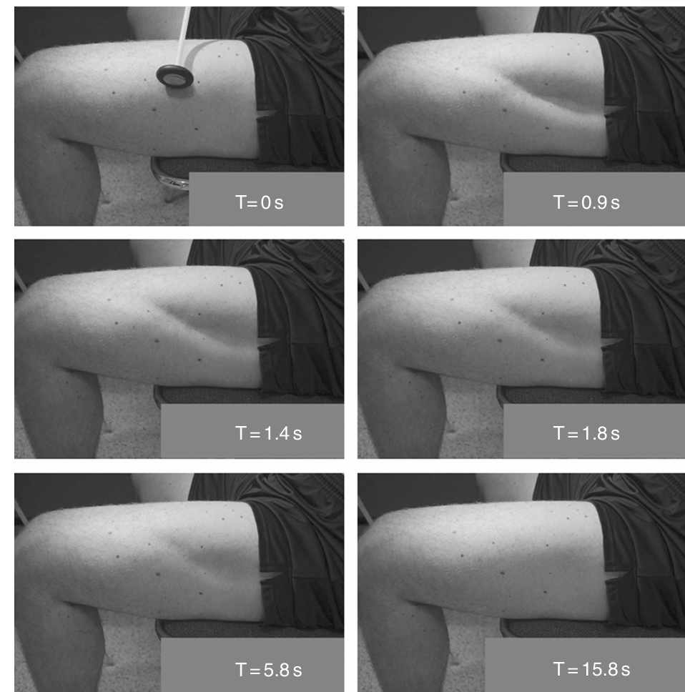
Muscle Channelopathies
Skeletal muscle channelopathies are rare neuromuscular diseases (1:100000).
Muscle channelopathies cause disrupted ion flow which leads to muscle dysfunction.
PMC (Paramyotonia Congenita) is the result of mutations affecting the Na_{v}1.4 sodium channel.
It disrupts muscle relaxation after contraction, causing stiffness (myotonia) that is notably exacerbated by cold temperatures.
Current treatment is unsatisfactory for the patients.
(Lossing and George 2008)
Notes:
Now, let’s begin by understanding what muscle channelopathies are.
These patients can feel difficulty in relaxing muscles which might results in falling and injuries. Sometimes even handshaking is hard for these patients due to delayed relaxation. For example their hands tends to stay like this. In fact, these patients can classified as disabled person.
Here is a picture of a patient to show the symptom for you. When we apply a pressure to the muscle. As you can see the muscle stays contracted almost15 sec. and for this reason even climbing the stairs is hard for these patients
“
Unfortunately, the current treatment options are unsatisfactory for these patients.

Slide 3
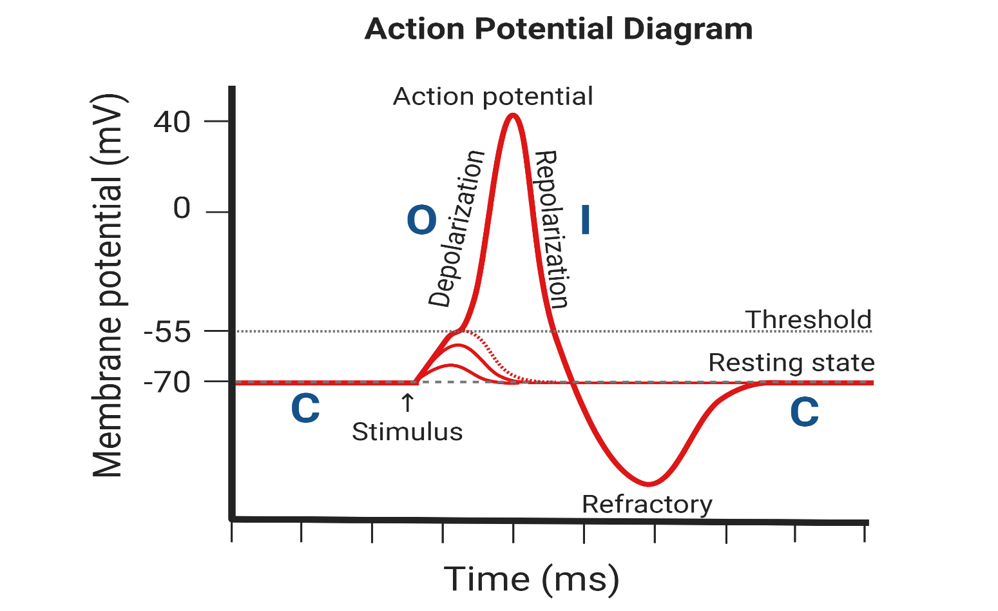
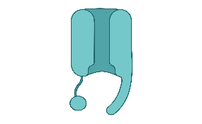
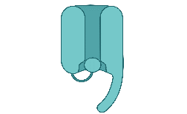
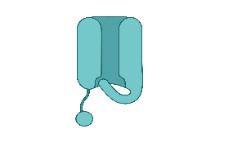
States of The Nav1.4 During Action Potential
3 States of Nav1.4 Channels
(Morales et al., 2023)
Notes:
As we discuss muscle channelopathies, it’s essential to understand how two key ion channels—Nav1.4 and ClC-1—work together to regulate muscle function. Nav1.4 initiates muscle contractions by allowing sodium ions to enter muscle cells, generating action potentials. This channel exists in three states:
Resting State: The channel is closed, preventing sodium entry.**
Open State: Upon stimulation, the channel opens, allowing sodium ions to rush in and trigger contraction.**
Inactivated State: After opening, the channel quickly closes again, stopping sodium flow until the cell resets.
Understanding these states is crucial because many treatments for muscle disorders target Nav1.4, particularly its inactivated state. If a mutation keeps the channel open, medications may not work effectively.**
. Together, Nav1.4 and ClC-1 ensure that muscles contract and relax properly. Any dysfunction in these channels can lead to significant muscle problems.
Extra info:
The CLCN1 gene provides instructions for making a chloride channel called ClC-1. These channels are found only in muscles used for movement (skeletal muscles). For the body to move normally, skeletal muscles must tense (contract) and relax in a coordinated way. Muscle contraction and relaxation are controlled by the flow of certain ions into and out of muscle cells. ClC-1 channels, which span the cell membrane, control the flow of chloride ions into these cells. This influx stabilizes the cells' electrical charge, which prevents muscles from contracting abnormally.
ClC-1 channels are made of two identical protein subunits, each produced from the CLCN1 gene. Although each subunit forms a separate opening (pore) that allows chloride ions to pass through, the two proteins work together to regulate the flow of chloride ions into skeletal muscle cells.
www.mdpi.com/2227-9059/11/10/2622s (mdpi.com)

Slide 4
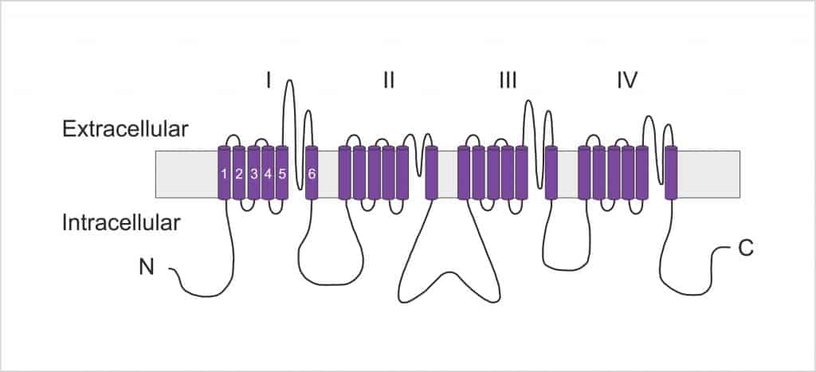
Nav1.4 Channel Structure and Mutations
hNav1.4
L1436P
R1448H
PMC Mutations
Notes:
Highlight the mutations that we are interested in
Mutations clinically found
JCI - Muscle channelopathies and critical points in functional and genetic studies
D136N
F337c
R105c
F167L

Slide 5
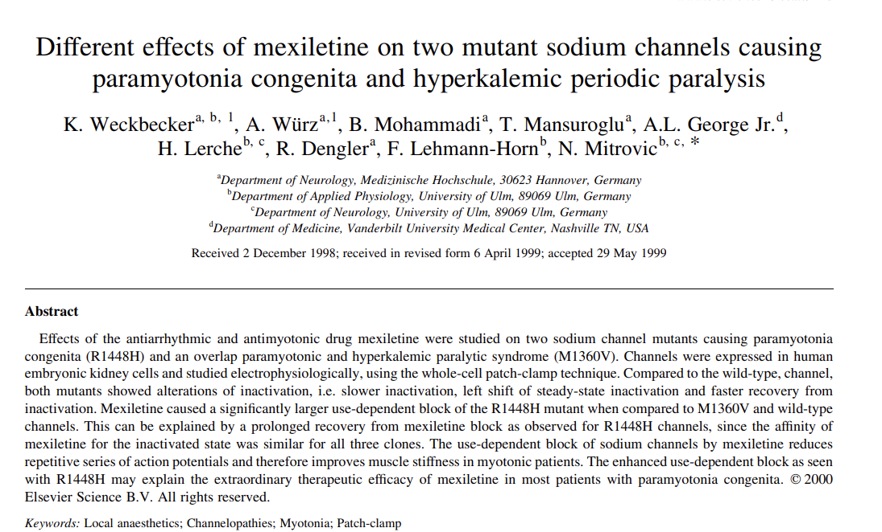
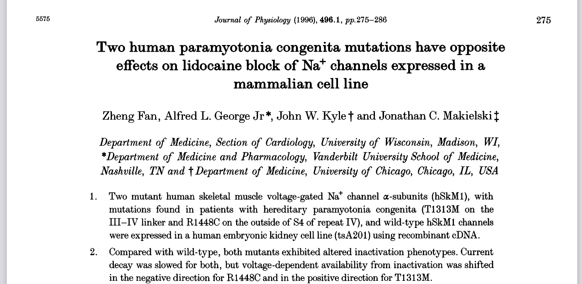
Research Question
Would any classical any Nav blockers be more effective on mutant channels than on the wild-type channels?

Slide 6
Research Question
Would any classical any Nav blockers be more effective on mutant channels than on the wild-type channels?
Personalized mutation-specific treatment is needed for myotonic patients through drug repurposing studies.

Slide 7
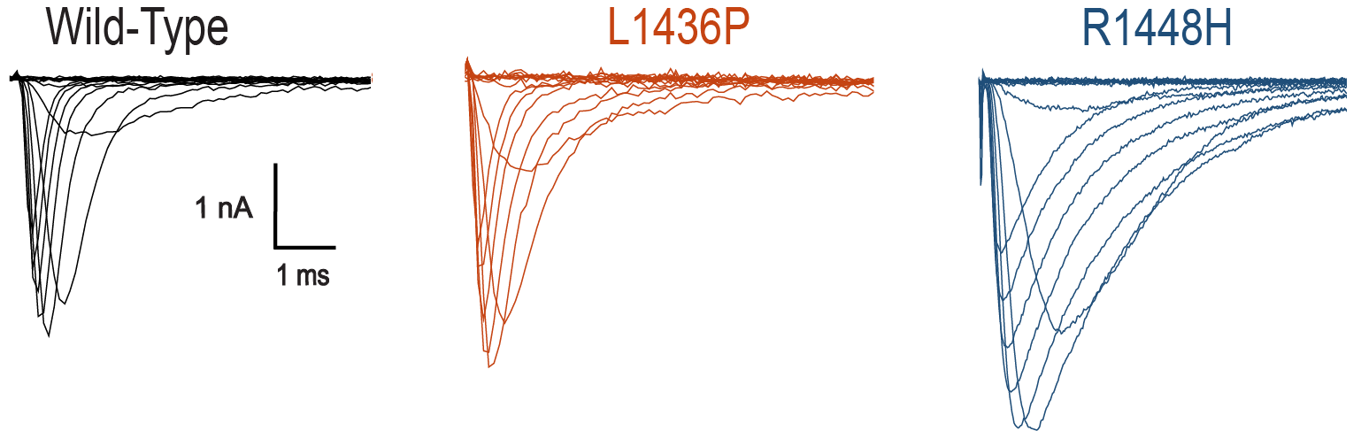
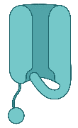
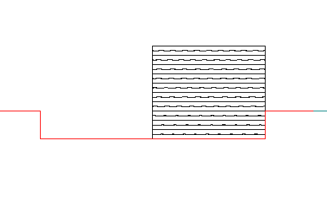
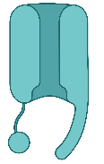
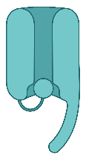
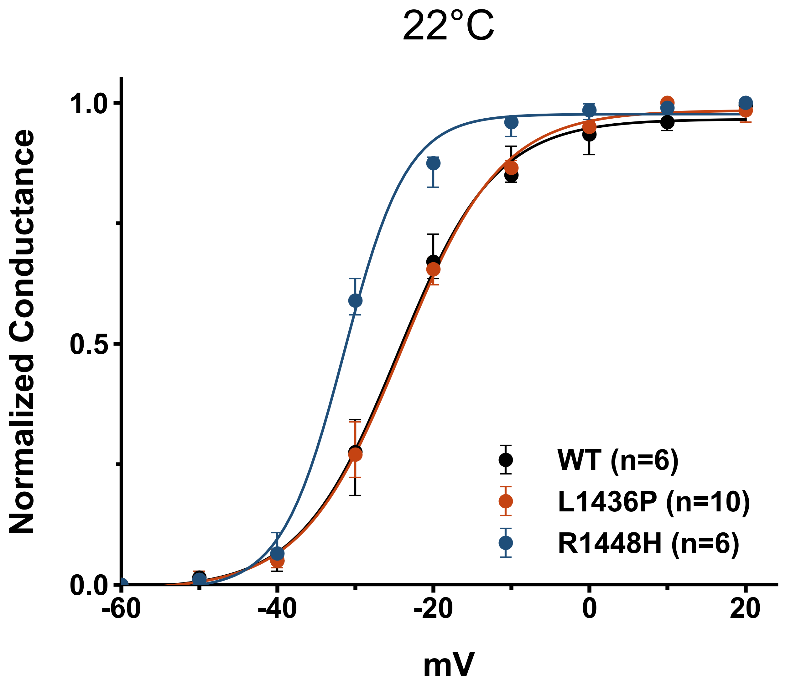
Different mutations have different effects on the channels.
Fast Inactivation
30ms
-60 mV
-120 mV
100ms
G _{Na} = I _{Na} /(V − E _{rev})
Notes:
Panel A you see the current resulting from -10 mV act
The area of the curves
The decreased rate of inactivation and an increased rate of recovery from inactivation would increase excitability during and following action potentials.

Slide 8
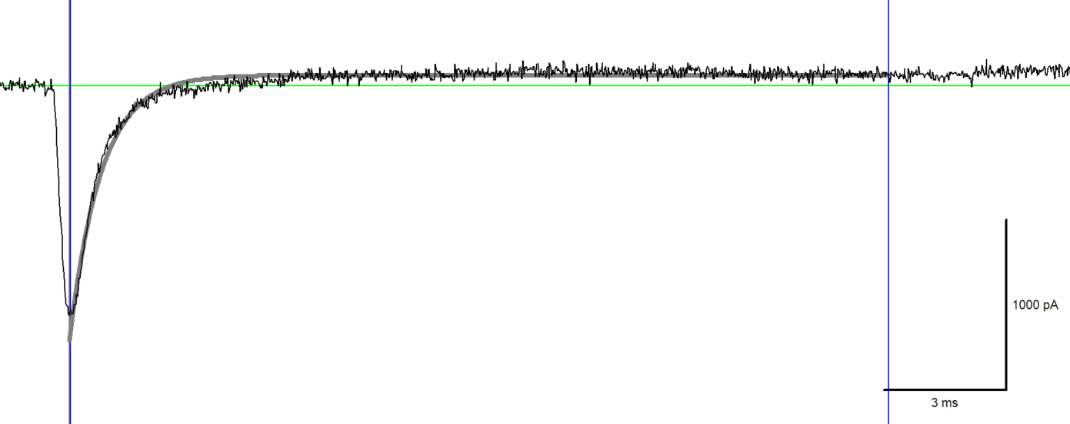
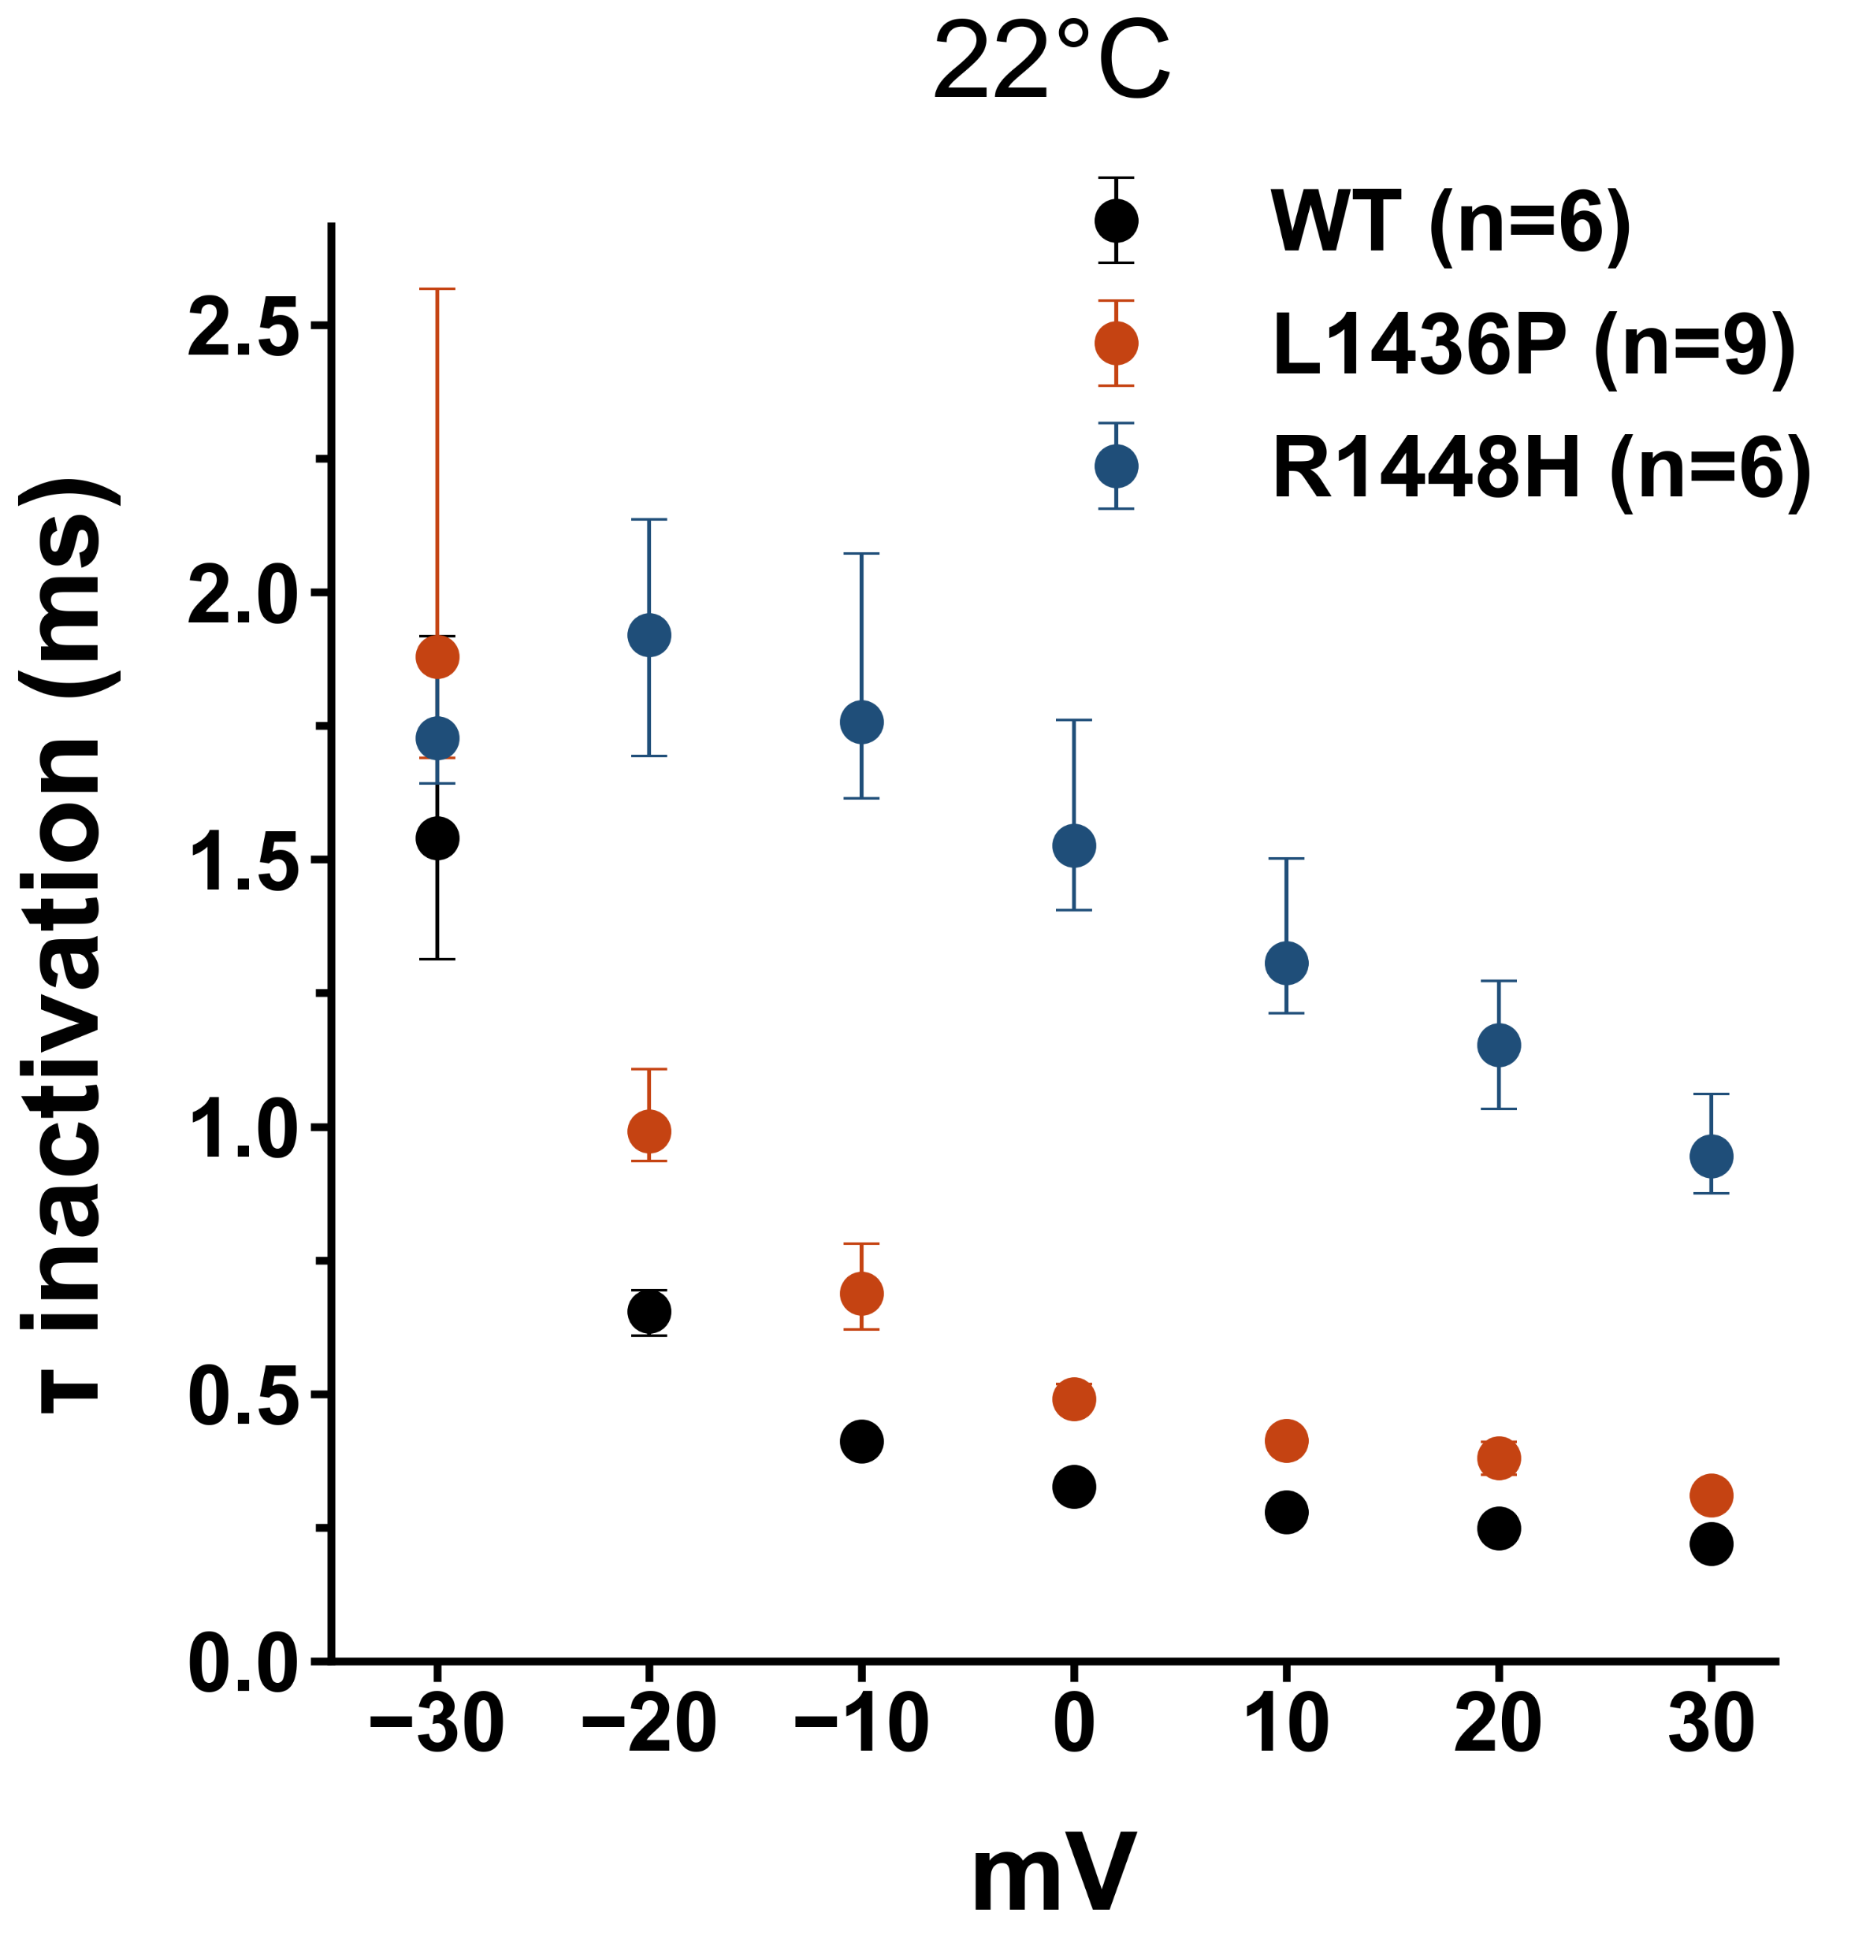
Different mutations have different effects on the channels.
Fast Inactivation
30ms
-60 mV
-120 mV
100ms
G _{Na} = I _{Na} /(V − E _{rev})
Notes:
Panel A you see the current resulting from -10 mV act
The area of the curves
The decreased rate of inactivation and an increased rate of recovery from inactivation would increase excitability during and following action potentials.

Slide 9
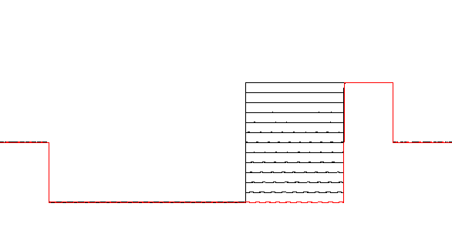
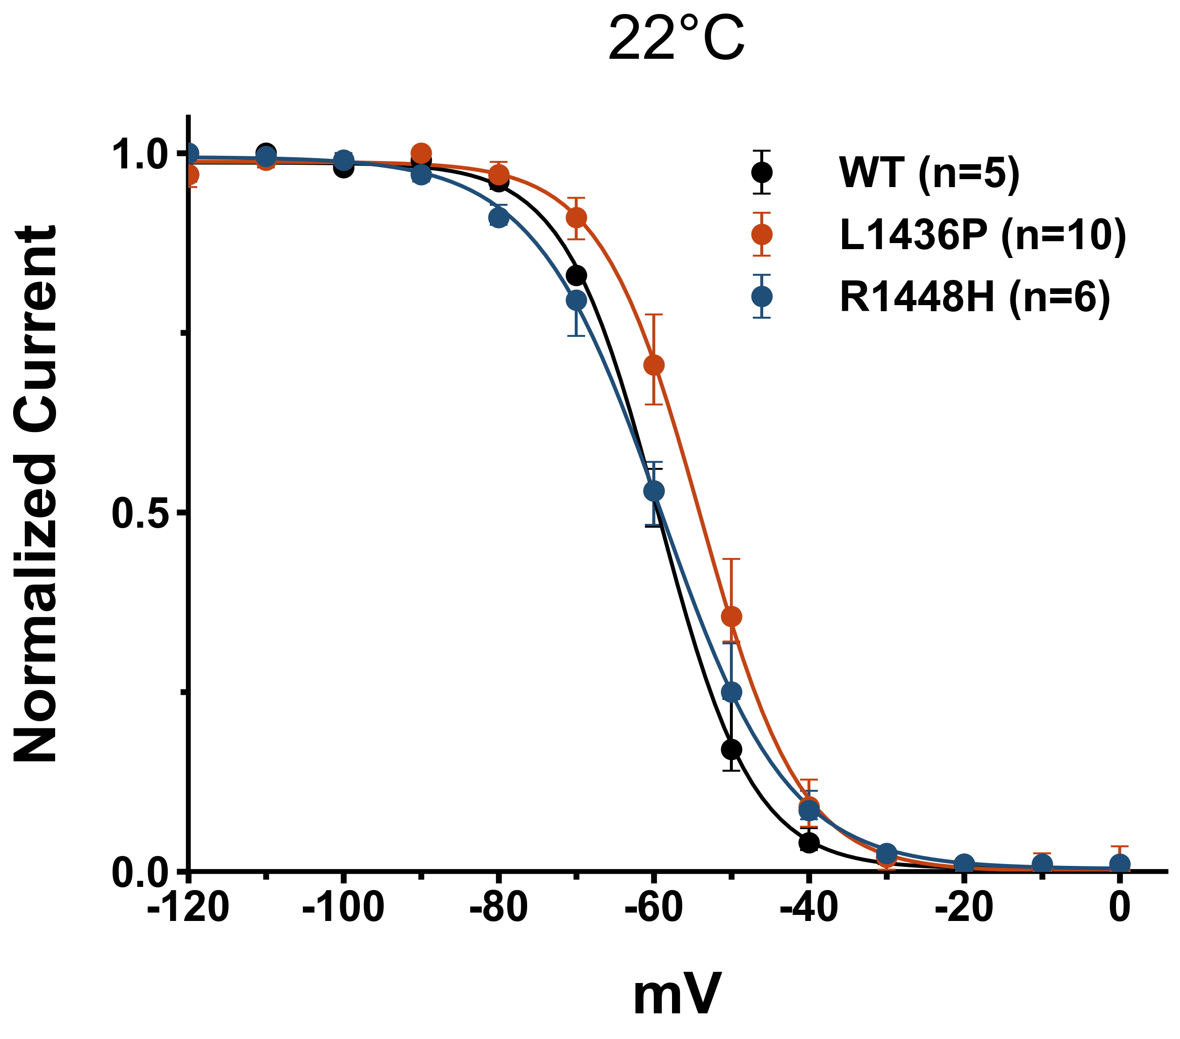
Different mutations have different effects on the channels.
Steady State Inactivation
100 ms
0 mV
-60 mV
-120 mV
100ms
Notes:
Panel A you see the current resulting from -10 mV act
The area of the curves
The decreased rate of inactivation and an increased rate of recovery from inactivation would increase excitability during and following action potentials.

Slide 10
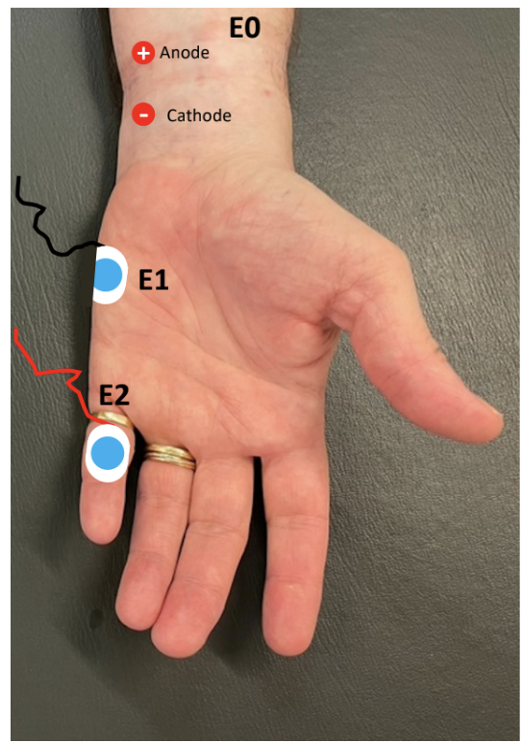
Effect of the Cold on the Mutations
Figure : Clinical CMAP figure of a patient with L1436P mutation (Wang et al., unpublished).
Notes:
, Compound muscle action potential (CMAP) amplitudes reflect the actual number of motor fibers activated upon stimulation.
With this understanding of Nav1.4 and ClC-1, we can now look at how mutations in these channels lead to the specific conditions we are focusing on: paramyotonia congenita and myotonia congenita.
Mostly loss of function for Clc1 Mostly Gain of function
Why nav blocker for CLC1?
Inhibition of sodium channels reduces the abnormal firing of action potentials responsible for sarcolemmaover-excitability andmusclestiffness

Slide 11
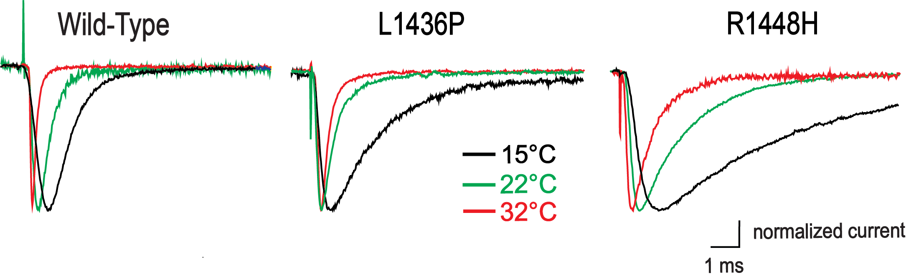
Effect of the Cold on the Mutations
Wild Type
L1436P
R1448H
15 °C
22 °C
32 °C
Notes:
With this understanding, we can now explore how mutations in these channels contribute to specific muscle disorders, such as paramyotonia congenita and myotonia congenita.”
With this understanding of Nav1.4 and ClC-1, we can now look at how mutations in these channels lead to the specific conditions we are focusing on: paramyotonia congenita and myotonia congenita.
Mostly loss of function for Clc1 Mostly Gain of function
Why nav blocker for CLC1?
Inhibition of sodium channels reduces the abnormal firing of action potentials responsible for sarcolemmaover-excitability andmusclestiffness

Slide 12
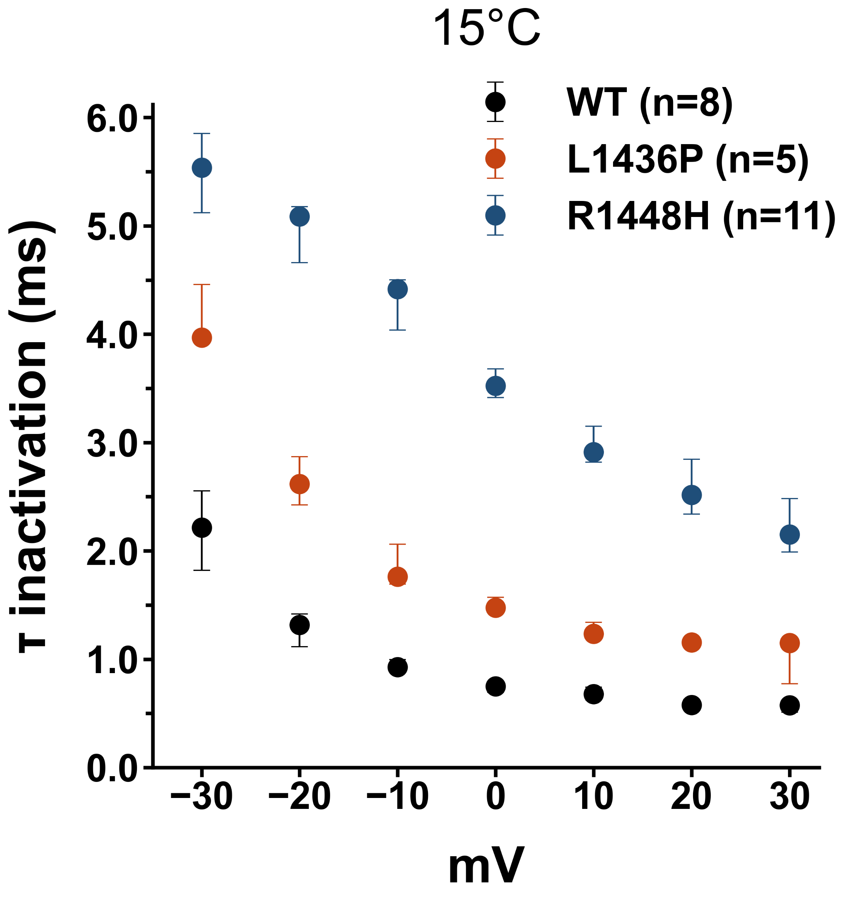
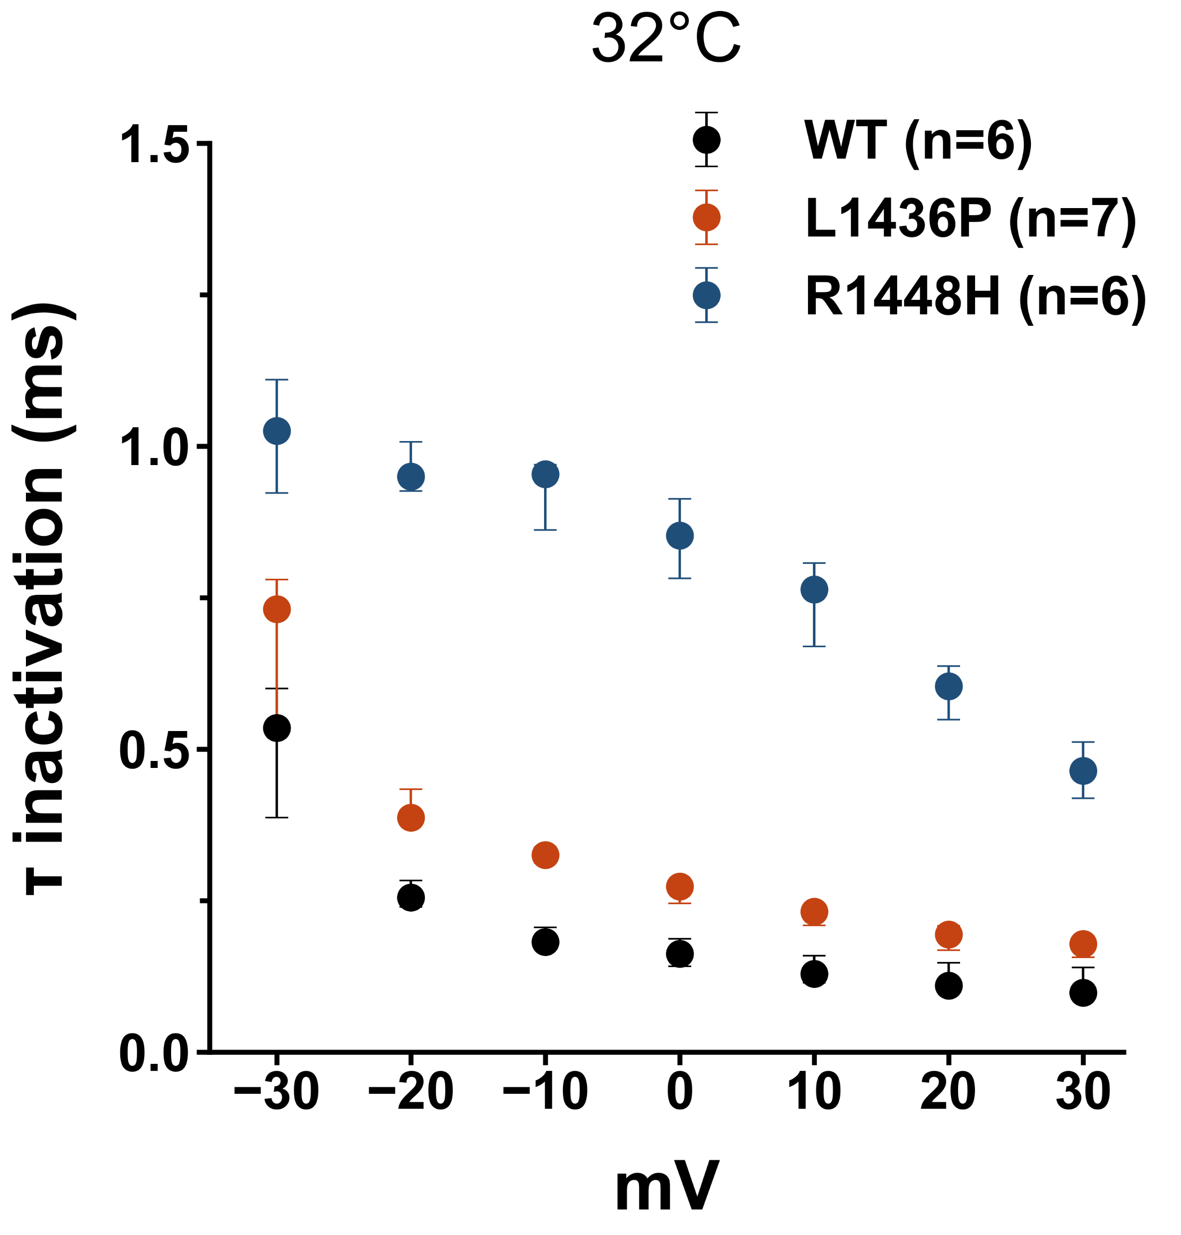
Effect of the Cold on the Mutations
Wild Type
L1436P
R1448H
15 °C
22 °C
32 °C
15 °C
22 °C
32 °C
Notes:
With this understanding, we can now explore how mutations in these channels contribute to specific muscle disorders, such as paramyotonia congenita and myotonia congenita.”
With this understanding of Nav1.4 and ClC-1, we can now look at how mutations in these channels lead to the specific conditions we are focusing on: paramyotonia congenita and myotonia congenita.
Mostly loss of function for Clc1 Mostly Gain of function
Why nav blocker for CLC1?
Inhibition of sodium channels reduces the abnormal firing of action potentials responsible for sarcolemmaover-excitability andmusclestiffness

Slide 13
Different Na_{v} blockers have different binding mechanisms.
Feature | Lidocaine | Lamotrigine
Primary Clinical Use | Antiarrhythmic and Local Anasthetic | Anticonvulsant
Use-Dependency | Strong Use-Dependent Block | Little/No Significant Use-Dependent Block
Inactivated State Affinity | High affinity | High affinity
Resting State Affinity | Appreciable affinity (lower than inactivated) | Lower affinity / Primarily state-dependent
Access Pathway | Cytoplasmic (Hydrophilic) | Lipid Membrane (Hydrophobic) / Probably
Ionization | More ionized at physiological pH | Less ionized at physiological pH
Notes:
With this understanding, we can now explore how mutations in these channels contribute to specific muscle disorders, such as paramyotonia congenita and myotonia congenita.”
With this understanding of Nav1.4 and ClC-1, we can now look at how mutations in these channels lead to the specific conditions we are focusing on: paramyotonia congenita and myotonia congenita.
Mostly loss of function for Clc1 Mostly Gain of function
Why nav blocker for CLC1?
Inhibition of sodium channels reduces the abnormal firing of action potentials responsible for sarcolemmaover-excitability andmusclestiffness

Slide 14

Different drugs have different effects on the mutation.
L1436P Control
Lidocaine 100 uM
Lamotrigine 100 uM
0.5 nA
2 ms
0 mV
-60 mV
100 ms
-120 mV
Notes:
https://ascpt.onlinelibrary.wiley.com/doi/full/10.1111/cts.13311 https://www.sciencedirect.com/science/article/pii/S1347861319302725

Slide 15
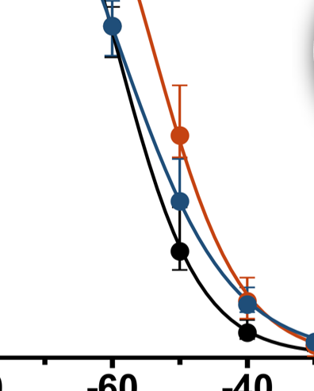
Different drugs have different effects on the mutation.
Lamotrigine and Lidocaine enhance steady-state inactivation,
shifting the voltage dependence to more negative potentials.

Slide 16
Recovery from inactivation
1000 ms
50 ms
0 mV
-60 mV
-120 mV
100 ms
Δ t
Notes:
https://www.ncbi.nlm.nih.gov/pmc/articles/PMC2683958/ --- cold we dont know why

Slide 17
Fast recovery from fast inactivation
Notes:
https://www.ncbi.nlm.nih.gov/pmc/articles/PMC2683958/ --- cold we dont know why

Slide 18
Conclusion
Mutant Phenotype: L1436P exhibits biophysical changes consistent with a PMC phenotype.
Biophysical effects: L1436P mutation is less severe than R1448H both in RT and cold temperatures.
Blocker Efficacy: Both Lamotrigine and Lidocaine are effective in blocking both Wild Type (WT) and the L1436P mutant channels.
Future Directions: Work is ongoing to screen additional Na_{v} channel blockers to identify mutant-specific interactions.

Slide 19
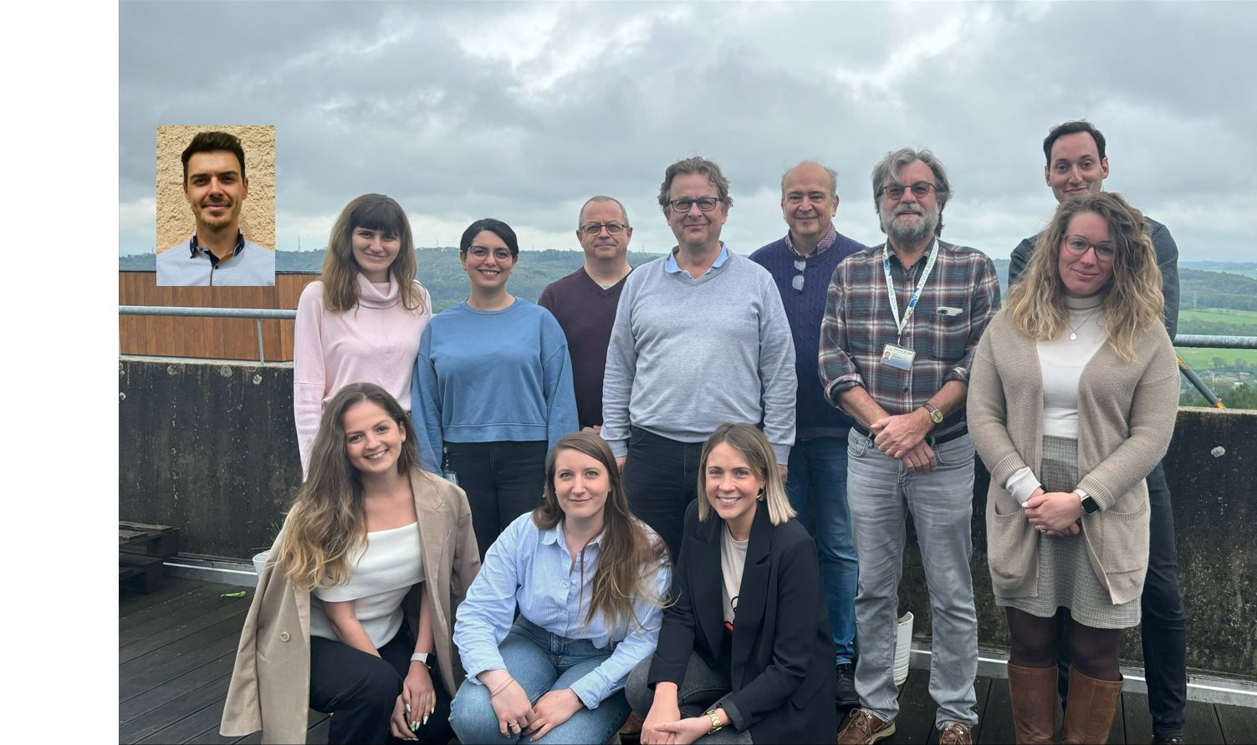
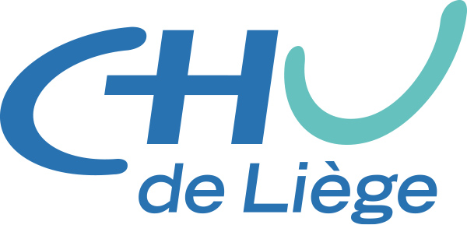
Acknowledgements
Notes:
https://www.ncbi.nlm.nih.gov/pmc/articles/PMC2683958/ --- cold we dont know why

Slide 20

THANK YOU FOR YOUR ATTENTION!
Notes:
Thank you for listening me and I can take questions .
For the PC causing R1448H mutant, a positively charged arginine in the S4 segment of domain IV of the skeletal muscle sodium channel α-subunit is substituted by a histidine which is predominantly neutral at pH 7.4

Slide 21
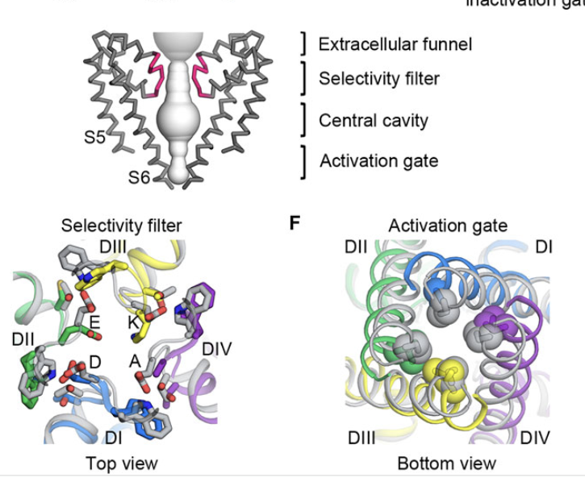
Different Na_{v} blockers have different binding mechanisms.
Notes:
With this understanding, we can now explore how mutations in these channels contribute to specific muscle disorders, such as paramyotonia congenita and myotonia congenita.”
With this understanding of Nav1.4 and ClC-1, we can now look at how mutations in these channels lead to the specific conditions we are focusing on: paramyotonia congenita and myotonia congenita.
Mostly loss of function for Clc1 Mostly Gain of function
Why nav blocker for CLC1?
Inhibition of sodium channels reduces the abnormal firing of action potentials responsible for sarcolemmaover-excitability andmusclestiffness

Slide 22
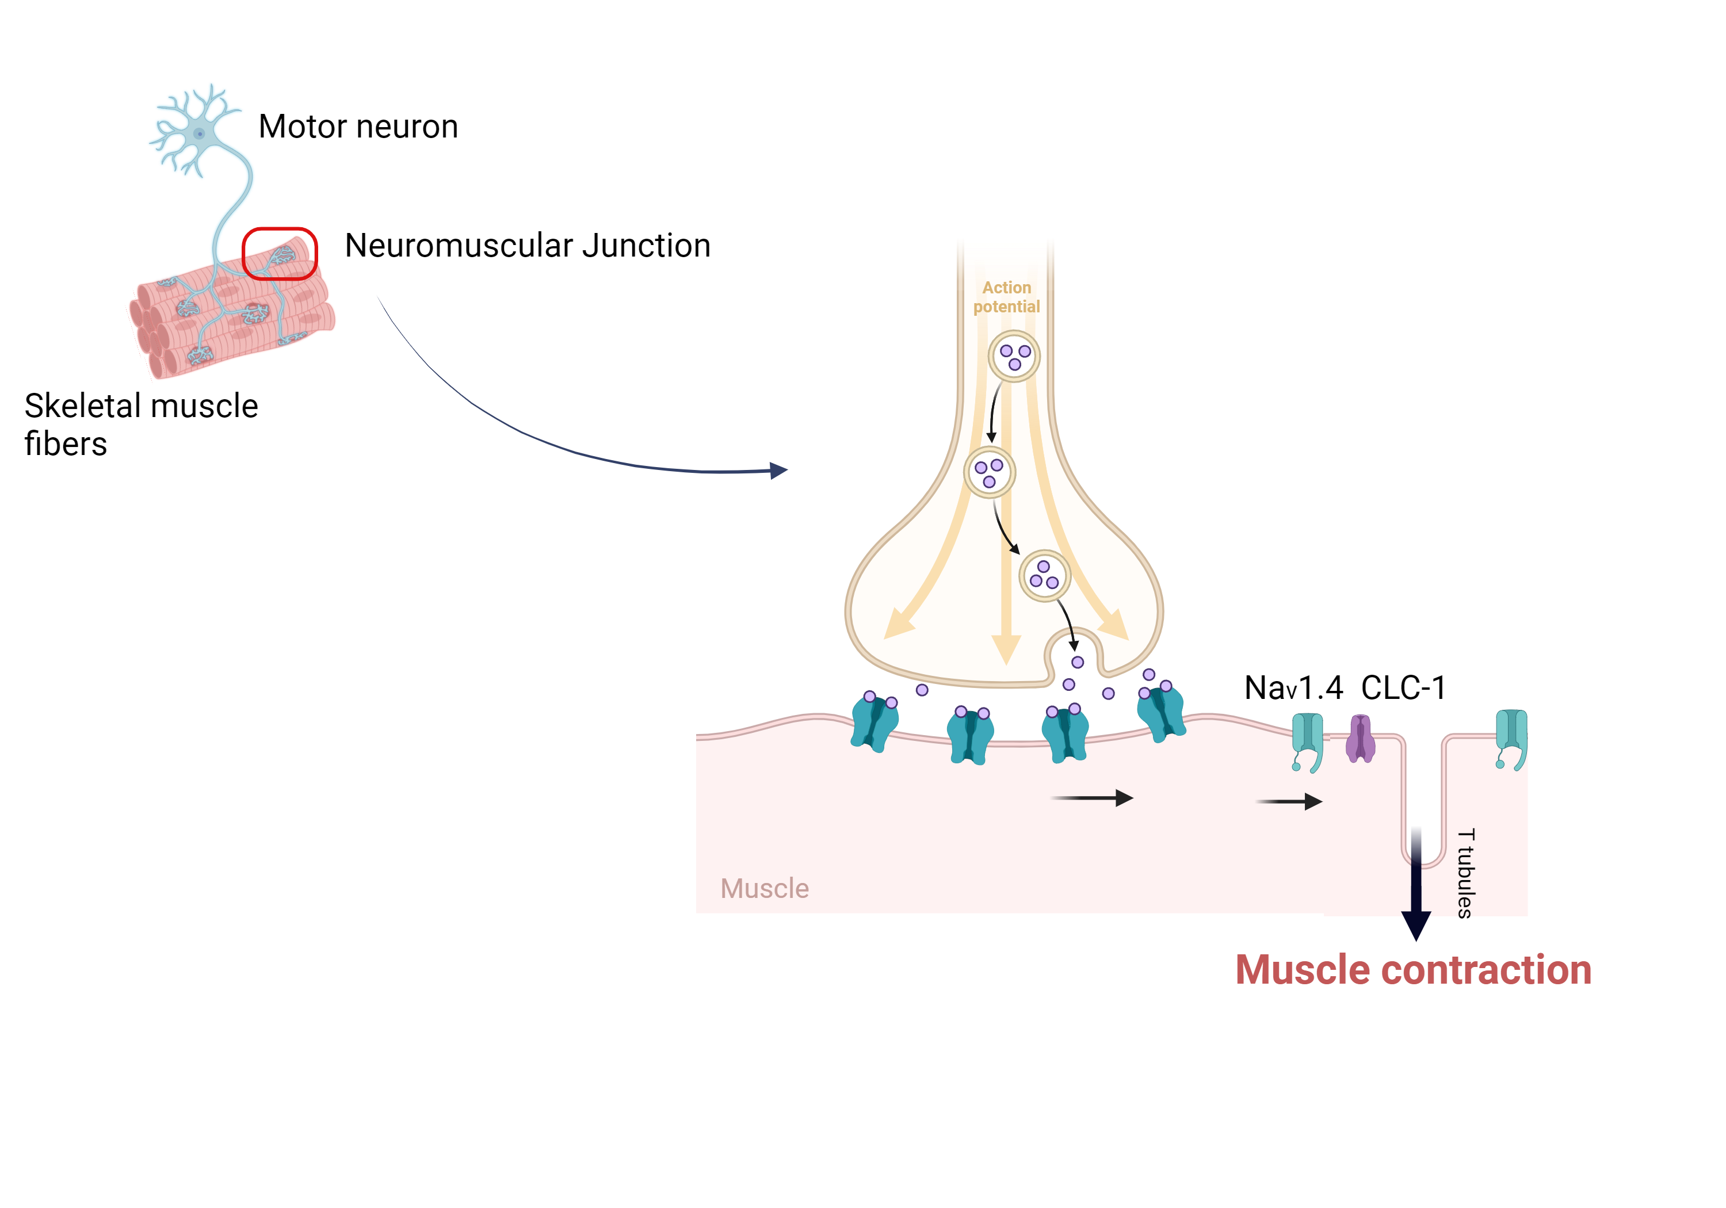
Muscle Contraction Through Channels
Notes:
it’s crucial to understand the underlying mechanisms driving these diseases, which are largely due to dysfunctional ion channels during muscle contraction.
When we look in detail to the neuromuscular junction; for a muscle to contract, it needs an action potential from motor neurons. The arrival of the AP leads to the release of acetylcholines. They bind to their receptors and this initiates membrane depolarization. Voltage gated ion channels are now activated. The AP moves along the t tubules to initate the contraction. You can see that our channel of interests are involved in this part
K and Na flow through
Muscle Fiber Contraction and Relaxation | Anatomy and Physiology I (lumenlearning.com) https://link.springer.com/article/10.1007/s00424-020-02376-3
Ion channel genes and human neurological disease: recent progress, prospects, and challenges. - Abstract - Europe PMC

Slide 23
Na⁺ CHANNEL BLOCK
DRUG τ recovery¹, seconds State- dependence Purpose of the drug
Lidocaine 0.1 I > O Local anasthesy
Mexiletine 0.3 Anti-arrythmic
Flecaïnide* 11 O arrhythmias
Riluzole I ALS
Ranolazine I Epilepsy
Cabamazepine I Epilepsy
Lamotrigine O/I Epilepsy
GS967
Notes:
https://www.ncbi.nlm.nih.gov/pmc/articles/PMC2683958/ --- cold we dont know why

Slide 24
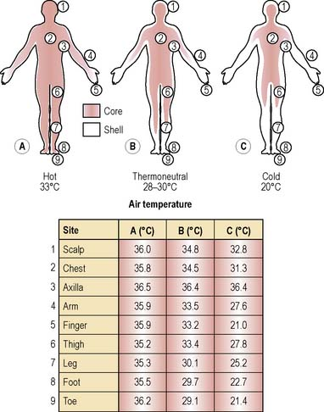
Based on an original figure by Aschoff & Wever, cited in Stainer et al 1984, with additional data from Childs C.
Notes:
This happens because paramyotonia causes the muscles to get easily tired and stiff. Sodium channels in the muscle don’t close properly, making it harder for the muscle to generate new signals.
A CMAP (Compound Muscle Action Potential) figure from a patient with paramyotonia congenita
If the CMAP drops to, say, 60-70% of the original value, it means the muscle’s ability to respond has decreased after exercise.This reflects a reduction in sodium channel availability or the onset of depolarization block.

