Slide 1

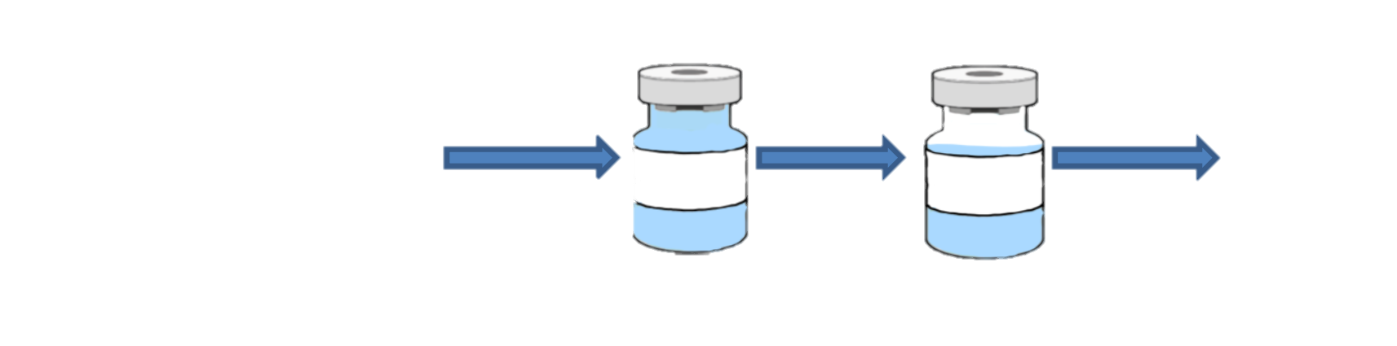
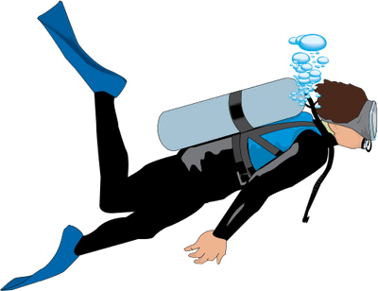
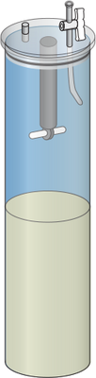
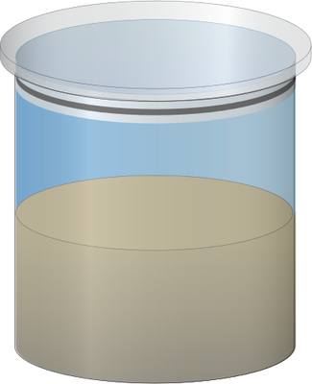
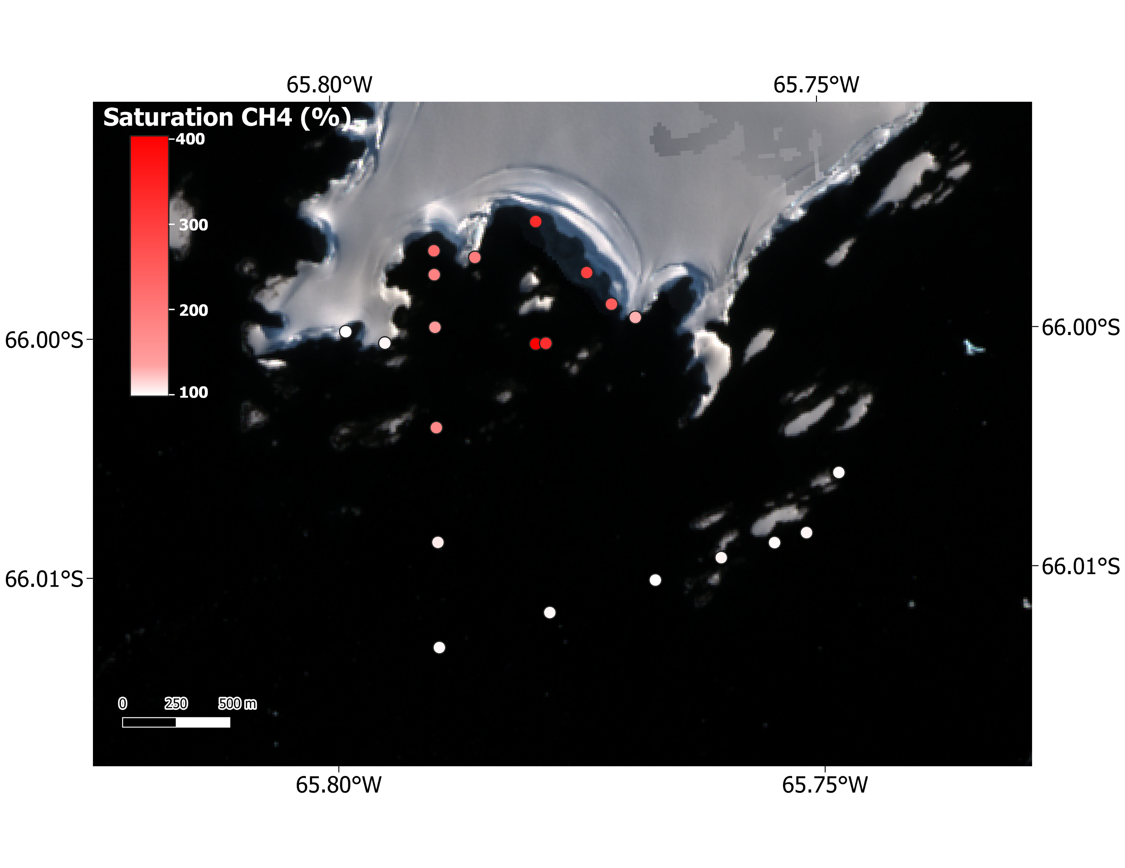

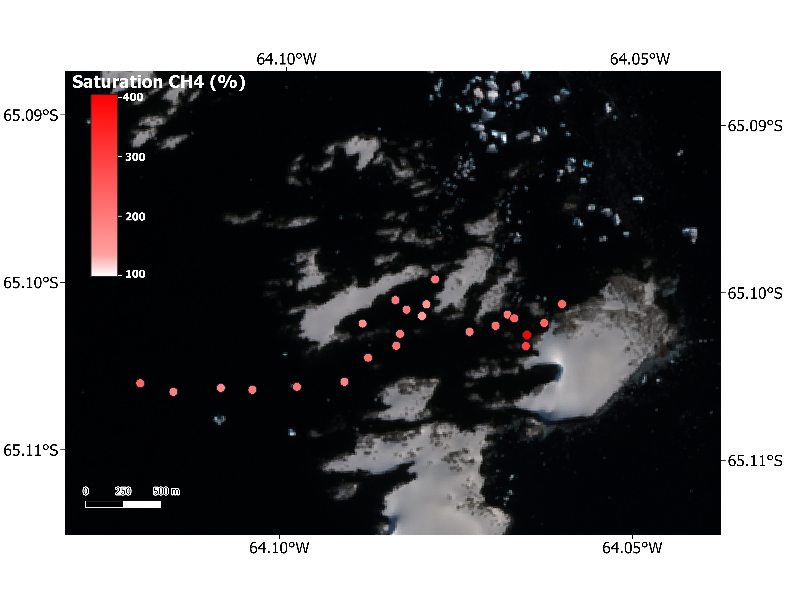
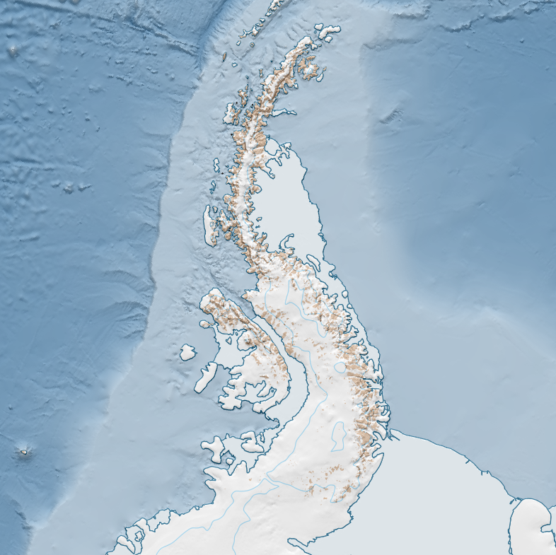
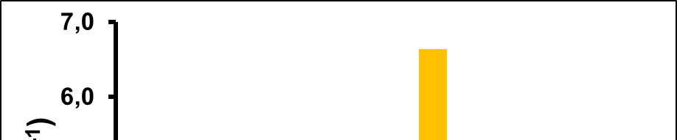
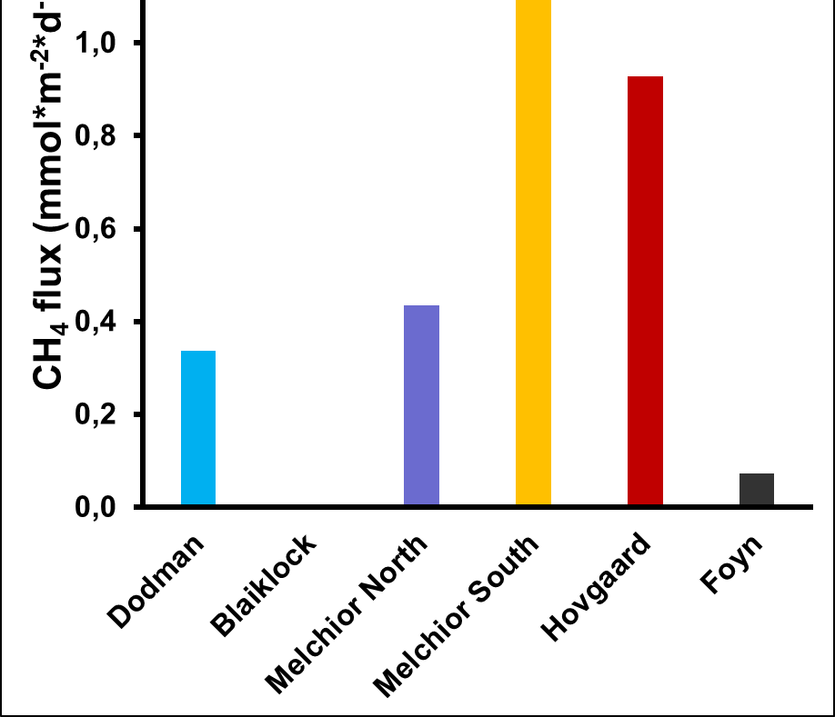

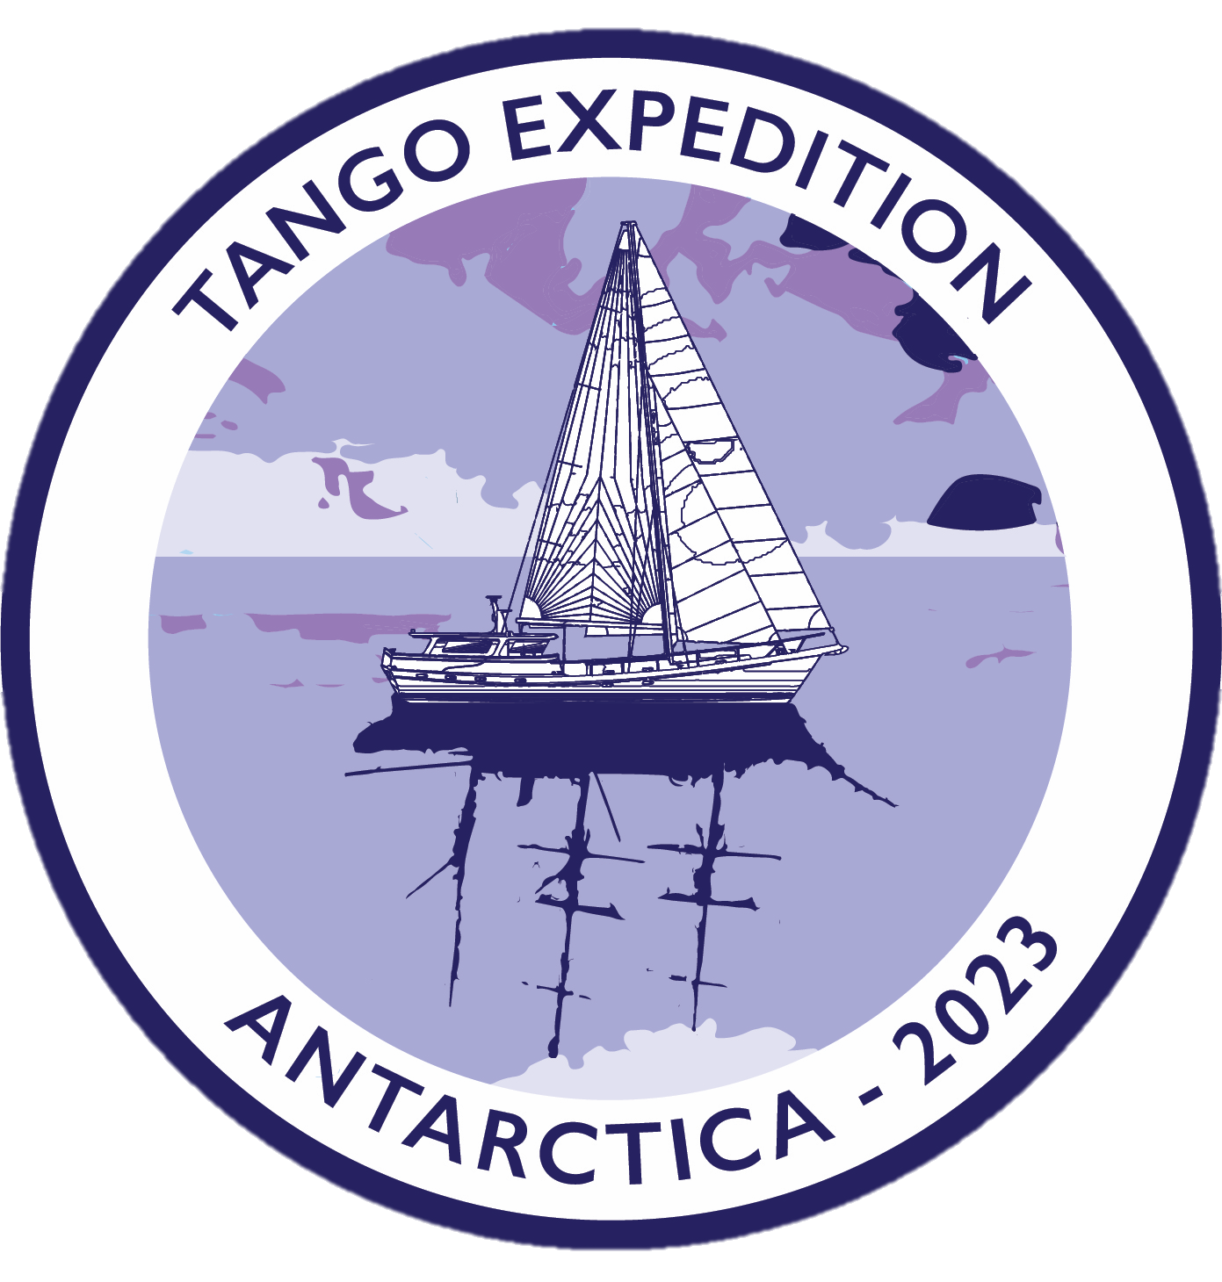





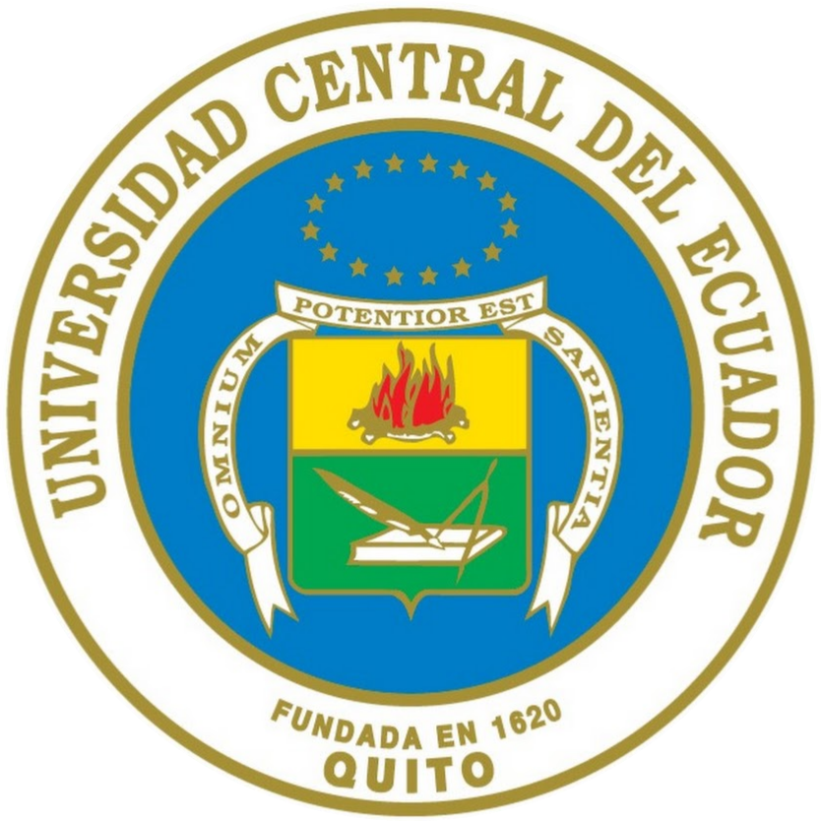
Methane: sources and variability in the West Antarctic Peninsula
A. Brusselman^{1,2}, O. Crabeck^{1,2}, S. Muller^{1,2}, P.A. Araujo³, E. De Borger⁴, B. Danis⁵, M. Dall’Osto⁶, F. Fripiat², B. Delille¹
1 Chemical Oceanography Unit, University of Liège, 2 Glaciology laboratory, Université Libre de Bruxelles, 3 Chemical engineering faculty, Central University of Ecuador, 4 Marine Biology (MarBiol), University of Gent, 5 Marine Biology Lab (BIOMAR), Université Libre de Bruxelles, 6 Institut de Ciences del Mar ICM, Spanish National Research Council (CSIC)
Methane
Question
Surveys
CH₄ is the second most important greenhouse gas after CO₂. If the CH₄ dynamics in the Arctic Ocean has received attention, contrastingly, the Southern Ocean has garnered far less interest. For instance, no data are available between 0° and 90°W, i.e., more than half of the SO, or south of 70°S (1).
What is the current status of the West Antarctic Peninsula coastal waters as a source or sink of atmospheric CH₄ in summer and the relevant processes that control this status?
Surveys took place in the West Antarctic Peninsula in February and March 2023 and 2024 aboard Australis sailing boat. This boat allowed us to be more agile, to reach really shallow area (+- 10m), to adapt swiftly our sampling strategy and to reduce our carbon footprint.
Water column
Methods
Water column
60 mL
+ HgCl₂
+ 20 mL
24h equilibration
GC
Sediments
N₂
10 mL
12h incubation
Sea surface
Marine terminating glacier
Oversaturated in CH₄ inside the bay
Close to saturation outside the bay
→ Impact of the glacier meltwater ?
Homogenous concentration
Three stations (Blaiklock, Melchior North and Hovgaard)
→ No specific sources or good mixing ?
Higher concentration at the top
Two stations (Dodman and Melchior South)
Drop in salinity
Source from subglacial meltwater ?
Land terminating glacier
Oversaturated everywhere
No gradient
Other sources
of CH₄
Highest concentration at the bottom
Two stations (Føyn and Melchior South)
Source from the sediment ?
Melchior North
Melchior South
Føyn
Hovgaard
Dodman
What’s next ?
Blaiklock
CH₄ isotopes → origin of CH₄
Fluxes at water-atmosphere interface → impact on global CH₄ budget
Correlations with environmental parameters → constrain sources and sink
Sediment fluxes
Blaiklock
No flux
Concentration at the equilibrium
Dodman and Melchior North
Low fluxes
No change in concentration
Hovgaard
Average flow
Homogenous high concentration
→ Mixing ?
Conclusion
Global over saturation in the surface water in coastal area in the West Antarctic Peninsula.
Formation of CH₄ below Antarctic icelandsis.
Multiple sources possible → glacier, sediment, in situ production…
High heterogeneity in the sediment fluxes
Melchior South
High flux
Increase of concentration at the bottom of the water column
Føyn
Low flux
Increase at the bottom
→ Heterogeneity in the sediment?
References
1 Weber, T., Wiseman, N. A., & Kock, A. (2019). Global ocean methane emissions dominated by shallow coastal waters. Nature Communications, 10(1), 4584. https://doi.org/10.1038/s41467-019-12541-7
email: axelle.brusselman@uliege.be

