Slide 1
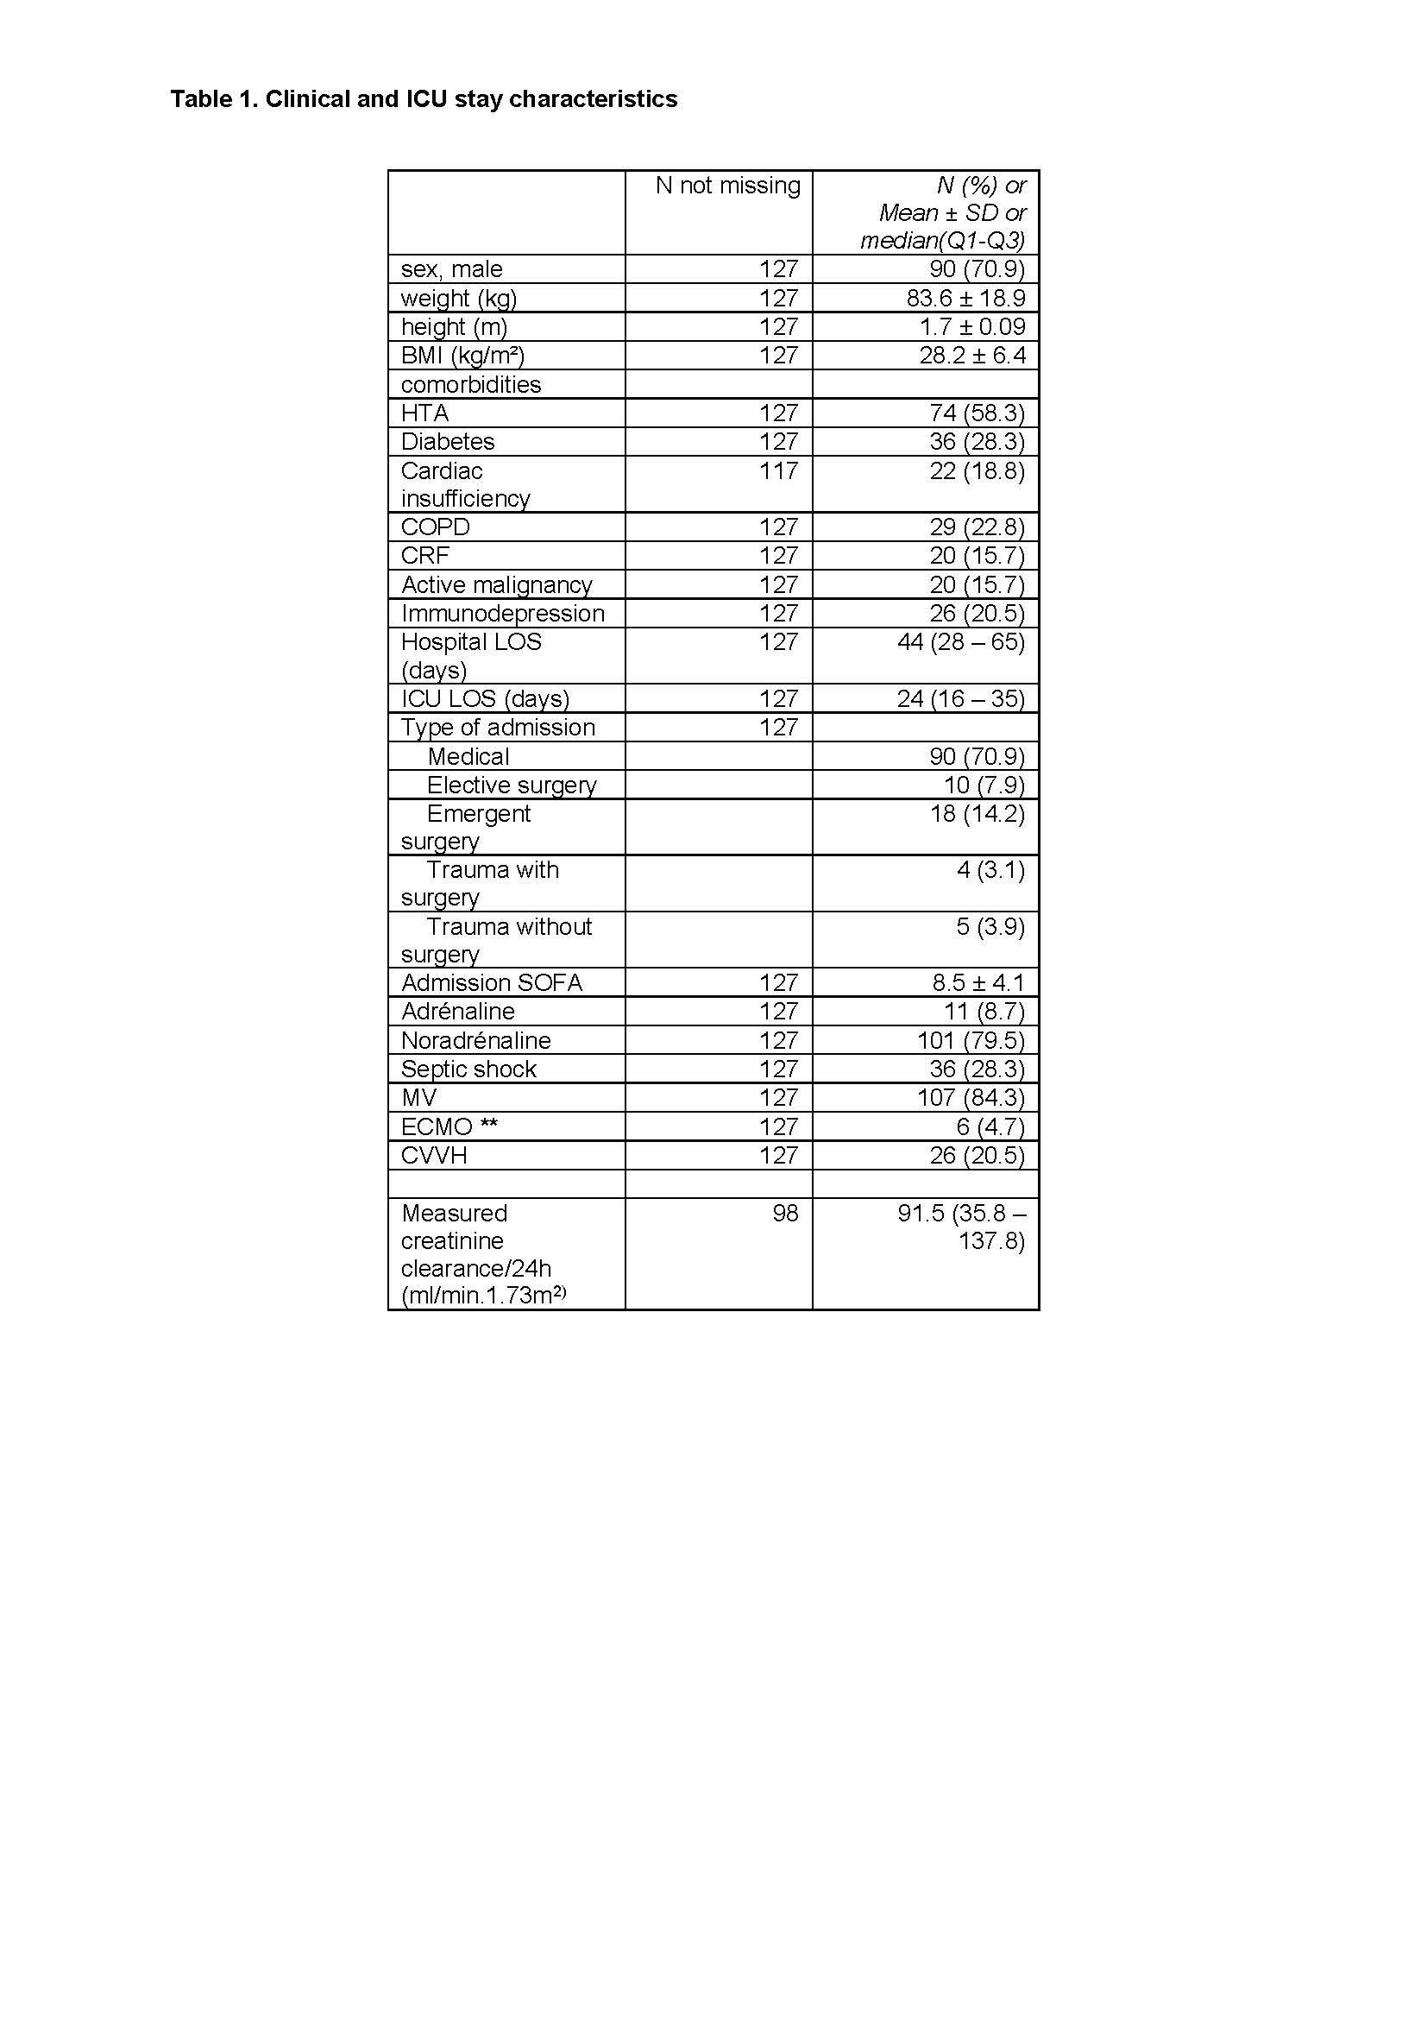
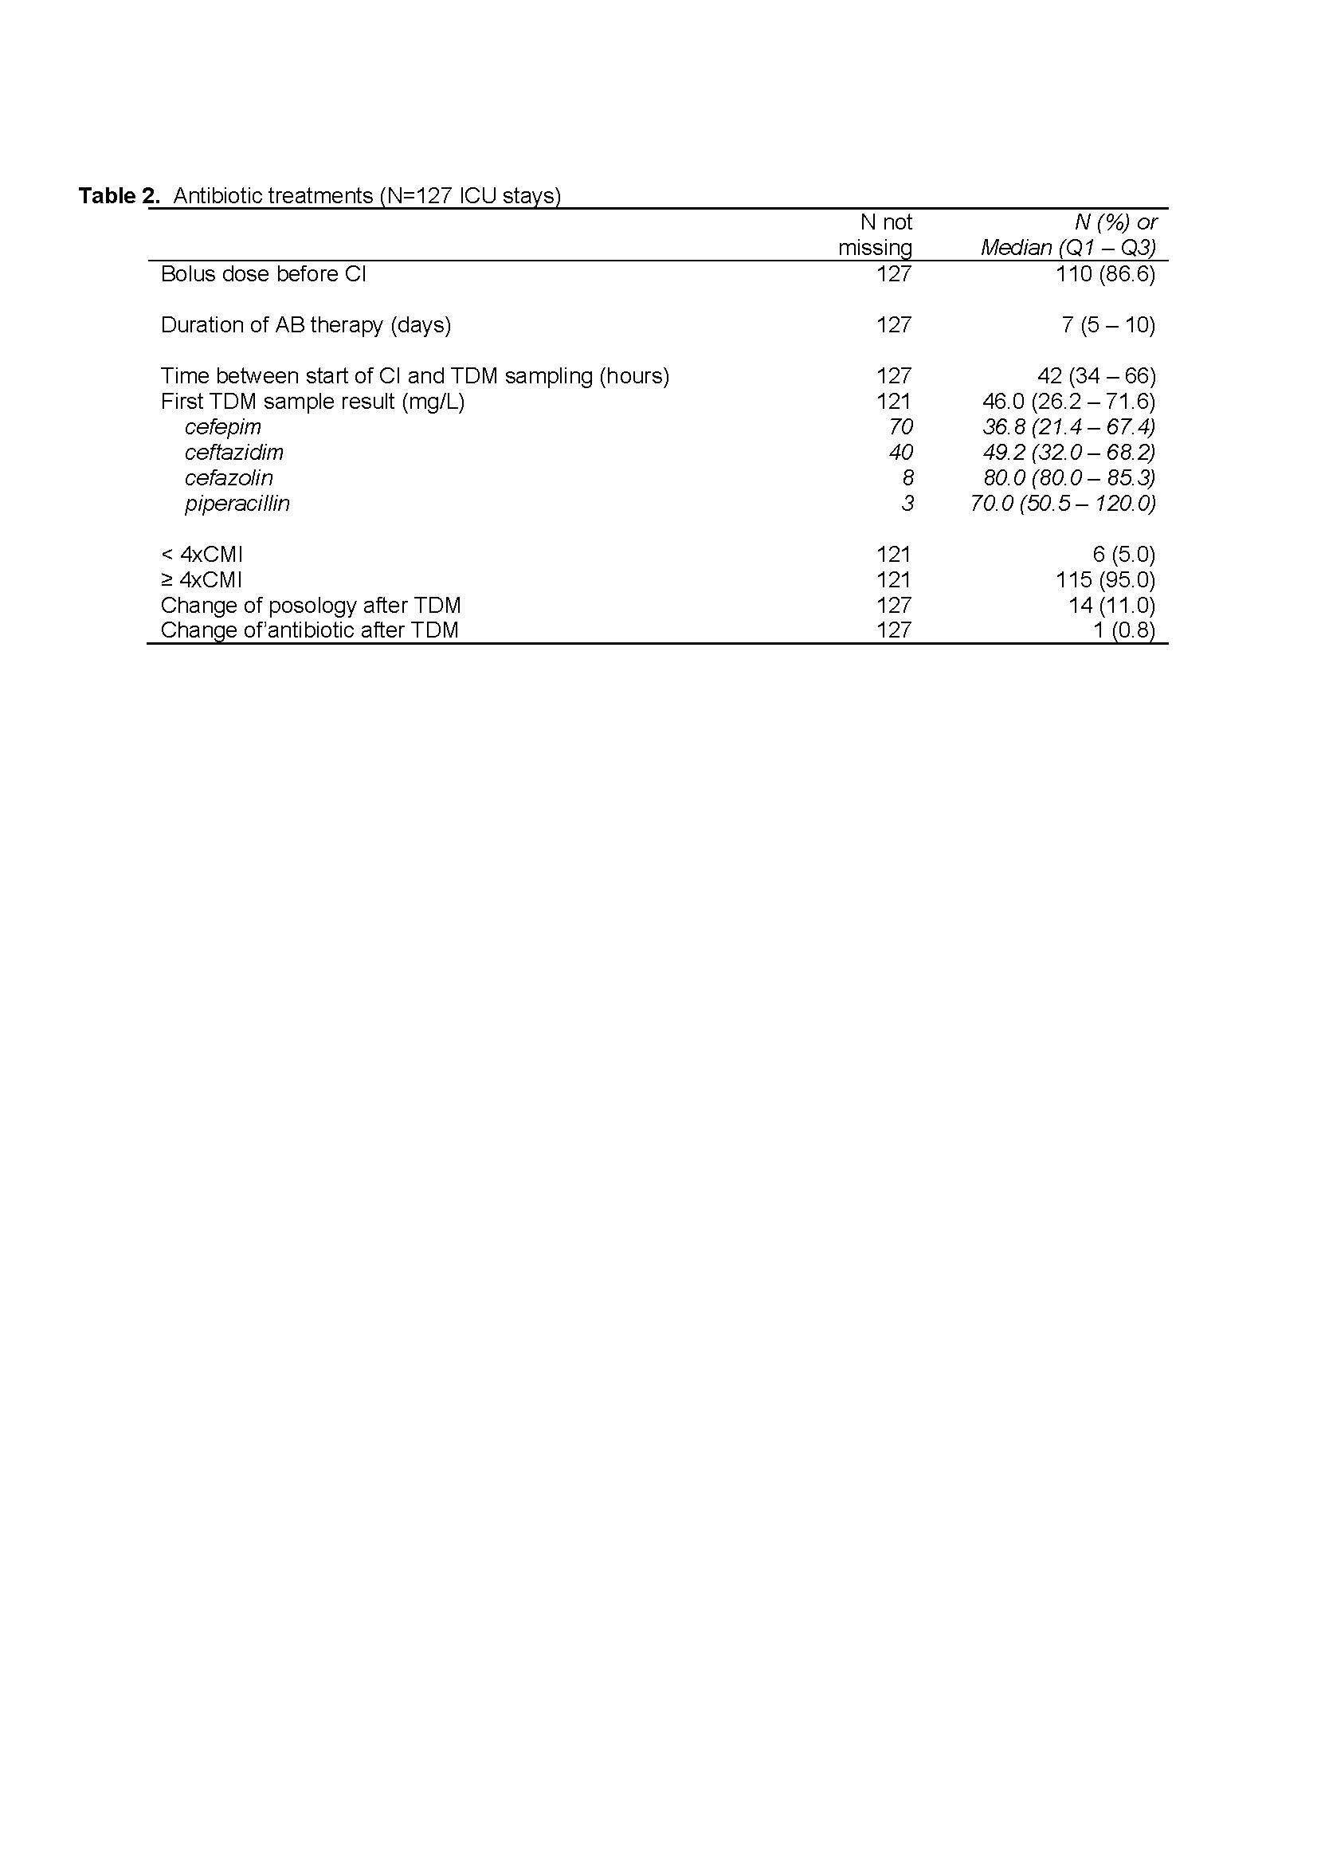
Early beta-lactam target attainment in critically ill patients P02455
a 3-year retrospective cohort study using therapeutic drug monitoring
              N. Layios¹, A. Pochon¹, M. Thys², N. Maes³, C. Meex⁴
        ¹Department of Intensive Care, Data Analyst, ²Data exploitation department, ³Biostatistics and Research Methods Center (B-STAT), ⁴Department of Clinical Microbiology, University Hospital of Liege, Liege, Belgium
Background
Infected critically ill patients exhibit unpredictable beta-lactam (BL) levels which have been associated with worse outcomes. Experts recommend obtaining routine therapeutic drug monitoring (TDM) despite ongoing controversy about amelioration of target attainment or outcome with this approach. This retrospective study assessed target attainment and potential modifications of treatment with the currently used posologies of BL in our center with the aim of streamlining TDM usage.
Methods
Patient selection: retrospective (EHR) ICUadmissions 1/2020-1/2023
TDM
Treatment with CI after a loading dose (2g IVD)
1st episode of infection only
Data collection
- Demographics admission+ ICU stay
- First TDM timing and result
- Posology of BL, site of infection
cefazolin/cefepim/ceftazidim/piperacillin
Measurement
BL total plasma conc (mg/l) via HPLC-UV
Primary outcome
Target attainment
100%fT_{≥4xMIC}
Secondary outcomes
% of changed trt
clinical and microbiological cure
Results
Demographic and clinical characteristics of ICU stay are shown in Table 1 for the 127 included patients.
Lower respiratory tract infections were predominant (88.2%). Severity of illness was high as shown by median SOFA score 8.5, mechanical ventilation (84.3%) and septic shock (28.3%), respectively.
As shown in Table 2, cefepim was the most prescribed BL (59.1%)
with a median plasma level of 36.8mg/l. Median duration of antibiotic therapy and of first TDM sampling was 7 days and 42h, respectively. Early target attainment was observed in the majority (95%) of patients with the currently used posologies of BL. Only 11% of treatment posologies were changed. At day 28, clinical and microbiological cure was obtained in 43% and 61% of patients, respectively.
Conclusions
Currently used posologies of BL enable early target attainment in a majority of critically ill patients without augmented renal clearance. TDM streamlining is feasible but more importantly, further insight into higher-than-expected plasma levels is warranted in view of potential side effects (costs, toxicity).
References: Taccone, Crit Care 2010; Roberts, CID 2014; Abdul-Aziz ICM 2020

