Slide 1

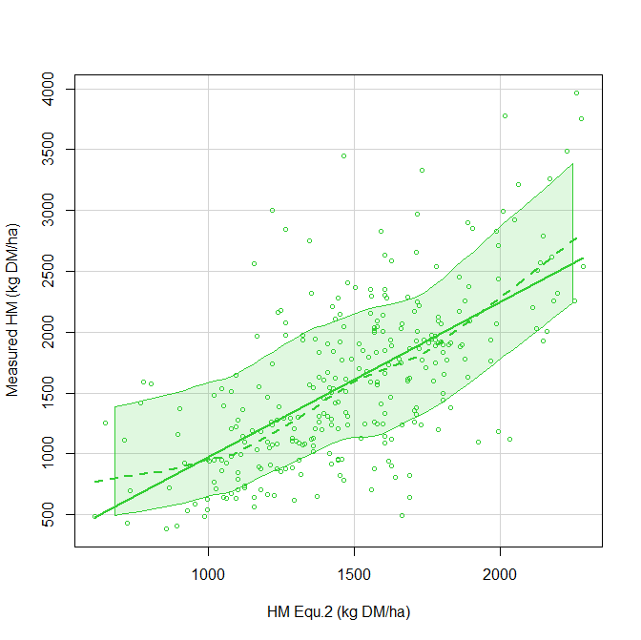
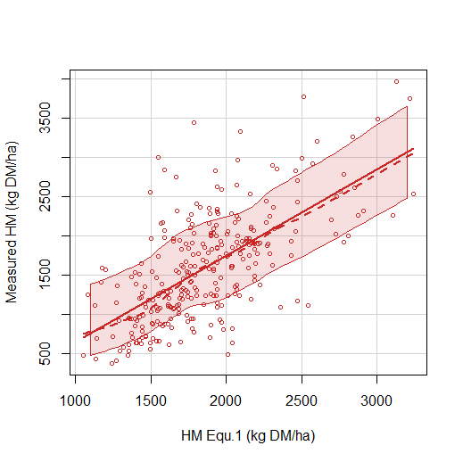
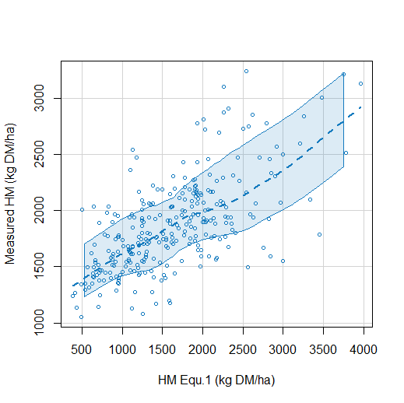
Climate Farm Demo project
Living labs aim to develop mitigation and adaptation Climate Smart Solutions for a carbon neutral Europe
Lessire F., Dufrasne I.
Faculty of Veterinary Medicine, FARAH, Avenue de Cureghem, 6 B43, 4000 Liège, Belgium; flessire@uliege.be
Introduction
Grazing practice is decreasing in Wallonia (Southern Belgium).
Main invoked reasons: difficult management & lack of confidence in available grass stocks.
Desirable grass stocks are calculated on basis of herb mass (HM-kg DM/ha) measured by rising plate maters (RPM).
An equation converting sward height (H-cm) into HM is thus necessary.
Aim of the study
Different equations developed by RPM manufacters are available.
The aim of this study was to compare the HM values obtained using 3 different equations (NZ; F and Irl) with field values from mowing of quadrats used as gold values of HM.
Material and methods
299 data collected from 2013-2015 – 6 Walloon farms.
Determination of HM (kg DM/ha)
Quadrats were mowed on a 5 to 10 meter length over 38 cm width on the pre-and post grazed paddocks. The mower was calibrated to leave a residual H of 4 cm. However, the H after mowing was verified.
The pre-cut grass H was determined by performing 10 measurements on the grass strip using a RPM (Jenquip®, Feilding, New Zealand). Attention was paid to select a representative sample of the pasture.
Collected grass cut was weighted.
The DM content (g/kg wet weight) was determined by taking a sample from the total homogenised harvest. It was thus weighted before and after oven drying (65°C – 72h) to determine the dry matter content (DM).
Herbage mass in the quadrat (kg DM/ha) per cm of grass height was calculated by dividing the weight of the cut grass (kg DM) by the mowed area (ha) and by sample height (cm).
The HM (kgDM/ha) was calculated by multiplying this value by the average height measured on the paddock.
Challenged equations
The challenged equations are presented on Table 1
Figure 1 RPM used to measure CSH.
Abbreviations RPM: rising plate meter.
CSH (cm): compressed sward height
Table 1 Studied equations. Abbreviations: CSH: compressed sward height (cm). HM: herb mass: kg DM/ha
 |  | Origin | Used Device | Study/reference
HM = (CSH*140) +500 | (equ-1) | New Zealand | Jenquip EC20®: | Earle et al., 1997
HM = -227.6+233*CSH +(-5.35*CSH²) | (equ-2) | Ireland | GrassHopper® | McSweeney et al., 2022
HM = 238 *CSH | (equ-3) | France |  | Defrance et al., 2004
Statistics
Determination coefficients (R²)
Mean square error (MSE) & relative prediction error (RPE -%).
Calculation HM by using field CSH values (cm)
Over- and under-evaluated values
With regards to HM field values (kg DM/ha)
Results and discussion
Table 2 HM calculated using the different equations and statistic analysis. Abbreviations: HM: Herb mass (kg DM/ha)
CSH: compressed sward height (cm)
 | CSH | HM | R² | RMSE | RPE (%)
Field data | 9.73 ± 2.86 cm | 1599 ± 674 kg DM/ha
equ-1 | 9.73 ± 2.86 cm | 1862 ± 400 kg DM/ha | 0.42 | 576.9 | 36.1
equ-2 | 9.73 ± 2.86 cm | 1489 ± 339 kg DM/ha | 0.41 | 537.5 | 33.6
equ-3 | 9.73 ± 2.86 cm | 2315 ± 680 kg DM/ha | 0.42 | 913.2 | 49
The equ.1 and 3 led to a recurrent over-evaluation of grass stocks (74% and 90% in Equ1 and 3 respectively). This over-estimation reached 503 kg DM/ha.
Conversely, the RPE of equ. 2 was the lowest (33.6%) and the errors were more equally balanced (55% under vs 45% over-estimation).
Figure 2 Relationship between HM calculated using of the challenged equations and the HM field values .
Abbreviations: HM: Herb mass (kg DM/ha)
Conclusions
Despite the fact that all the challenged equations demonstrated evaluation errors, the Irish one seems the most accurate as under-estimation of grass stocks could help the farmers to adjust grazing management, so that milk yield could be preserved. Better estimation of grass stocks could be obtained by using an equation developed specially for Walloon conditions, in terms of grass species and weather conditions.
References
Earle, D..; MCGowan, A.. Evaluation and Calibration of an Automated Rising Plate Meter for Estimating Dry Matter Yield on Pasture. Aust. J. Exp. Agric. Anim. Husb. 1979, 337–343.
McSweeney, D.; Delaby, L.; O’Brien, B.; Ferard, A.; Byrne, N.; McDonagh, J.; Ivanov, S.; Coughlan, N.E. Dynamic Algorithmic Conversion of Compressed Sward Height to Dry Matter Yield by a Rising Plate Meter. Comput. Electron. Agric. 2022, 196, 106919, doi:10.1016/j.compag.2022.106919
Defrance, P.; Delaby, L.; Seuret, J.M. Mieux Connaître La Densité de l ’ Herbe Pour Calculer La Croissance , La Biomasse d ’ Une Parcelle et Le Stock d ’ Herbe Disponible d ’ Une Exploitation Contribution to a Better Knowledge of Sward Density , a Parameter Useful to Calculate Grass Growth , P. 2004, 291–294.

