Slide 1



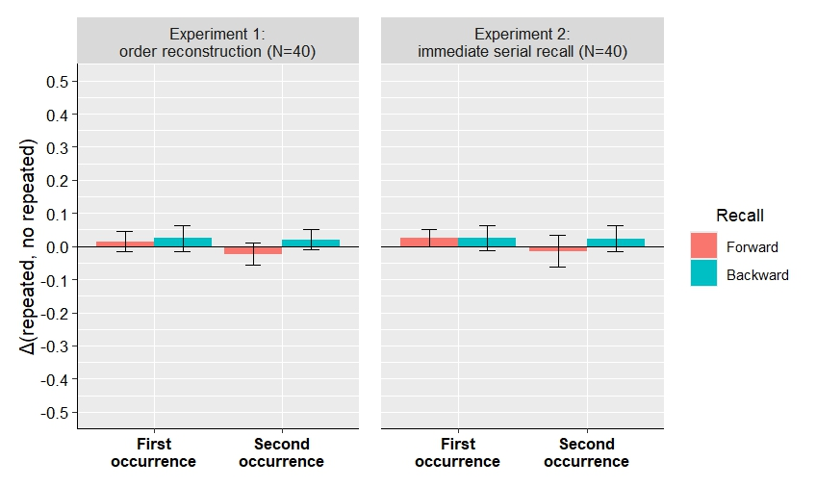
Ranschburg unrepeated: A failure to replicate
R. REMOUCHAMPS ^{a, b}, S. MAJERUS ^{a,b,c} , B. KOWIALIEWSKI ^{a,b,c}
ª ULiège, Belgium
^{b} Psychology and Neuroscience of Cognition Research Unit (PsyNCog) , Belgium
^{c} Fund for Scientific Research - FNRS, Belgium
Introduction
Retrieval
The Ranschburg effect is a classic working memory effect characterized by impaired recall of the second occurrence of repeated items. This phenomenon is typically explained by response suppression, a mechanism by which an item is removed from memory once recalled (Henson, 1998a; Lewandowsky, 1999). To test this hypothesis, we manipulated the direction of recall.
Experiment 1:
order reconstruction
Experiment 2:
immediate serial recall
Forward
condition
D H L N Q X
V S P K G B
C F J M T R
x7
Hypotheses
Backward
condition
D H L N Q X
V S P K G B
C F J M T R
If the Ranschburg effect is explained by response suppression, it should depend on recall rather than encoding. Specifically, in backward recall, the first occurrence of the repeated item (which is recalled second) should be impaired, reversing the typical pattern observed in forward recall.
Example:
-Encoded sequence: “BRKRXNT”
-Forward recall: “BRKRXNT”
-Backward recall: “TNXRKRB”
x7
Participants reproduced the sequence by clicking on each letter in the original or reversed order.
Participants recalled the letters from memory by typing them one at a time on the keyboard, in either the original or reversed sequence.
Results
Experiment 1 and 2
Methods
BF01:
3.938
BF01:
2.436
BF01:
1.046
BF01:
4.897
Encoding
BF01:
2.797
BF01:
2.457
BF01:
2.689
BF01:
3.042
Experiment 1 and 2
b
Sequential presentation
(1s/item)
r
…
t
Note. Each Bayes factor results from a Bayesian one-sample t-test conducted for each condition.
N items = 7
Discussion
Repeated
Non-repeated
Across two experiments, we failed to replicate the Ranschburg effect. These results question the importance of the Ranschburg effect as a reference effect for working memory models, its role in the response suppression mechanism, and consequently the very existence of this mechanism.
b r k r x n t
b r k s x n t
All conditions (repetition and recall direction) were randomly presented.
References
Henson, R. N. (1998). Item repetition in short-term memory: Ranschburg repeated. Journal of Experimental Psychology: Learning, Memory, and Cognition, 24(5), 1162.
Lewandowsky, S. (1999). Redintegration and response suppression in serial recall: A dynamic network model. International Journal of Psychology, 34(5-6), 434-446.

