Slide 1



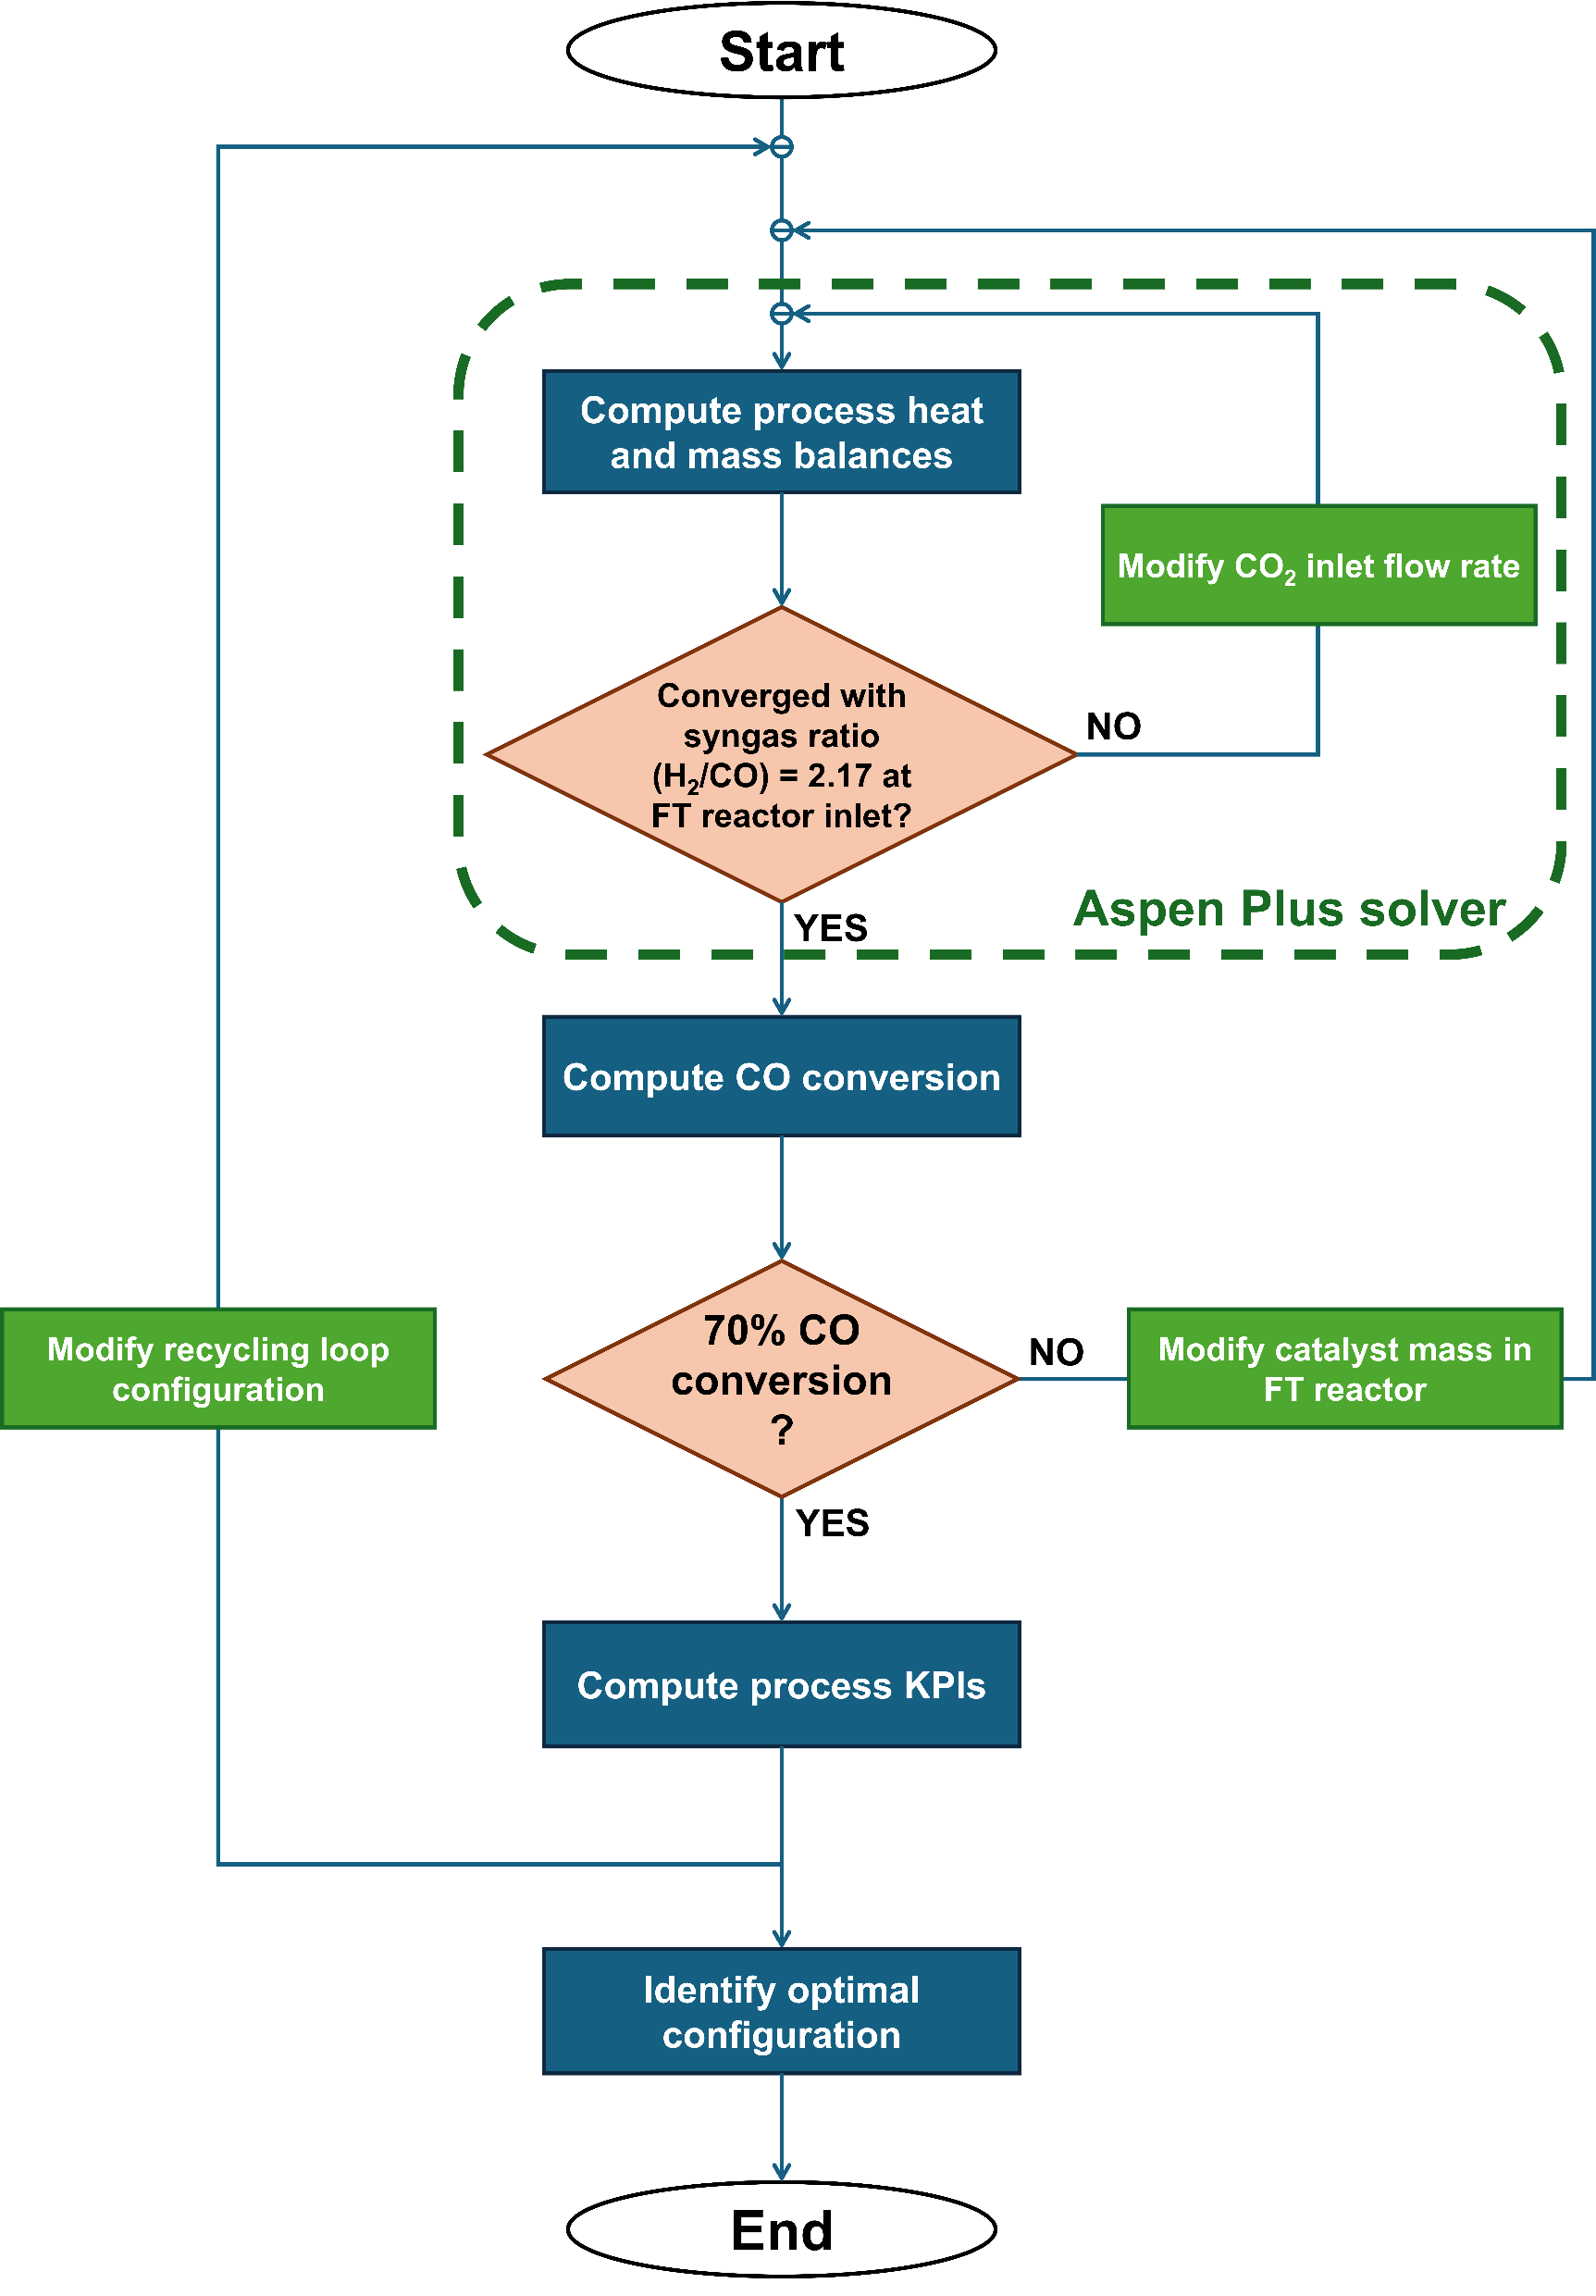
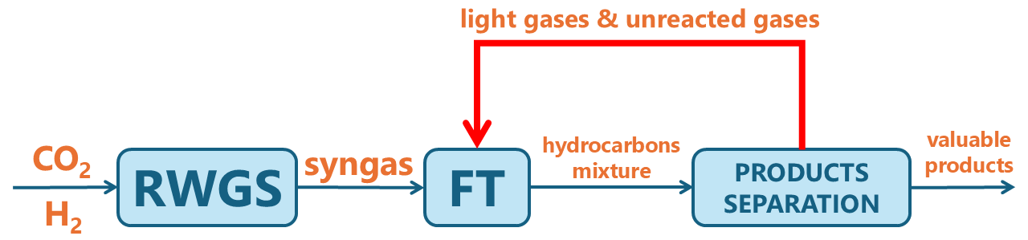
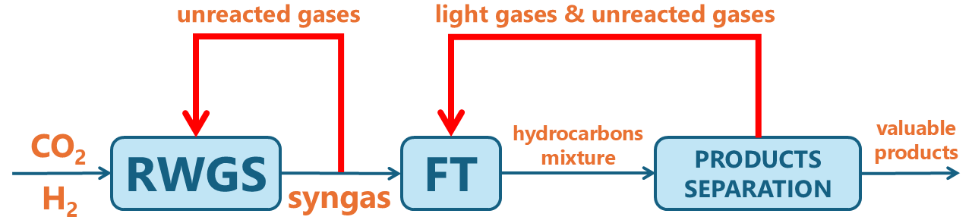
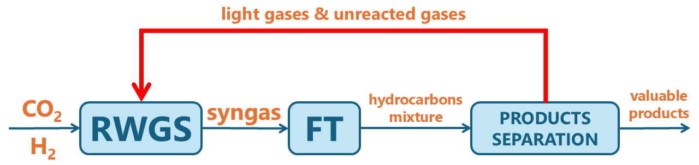
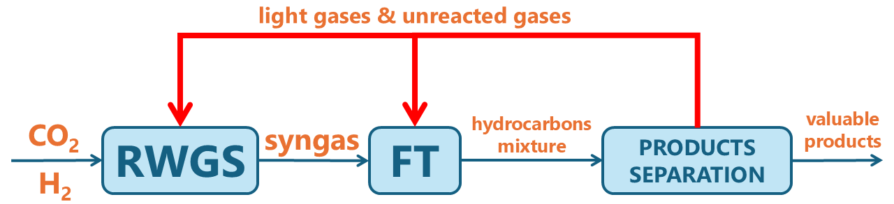
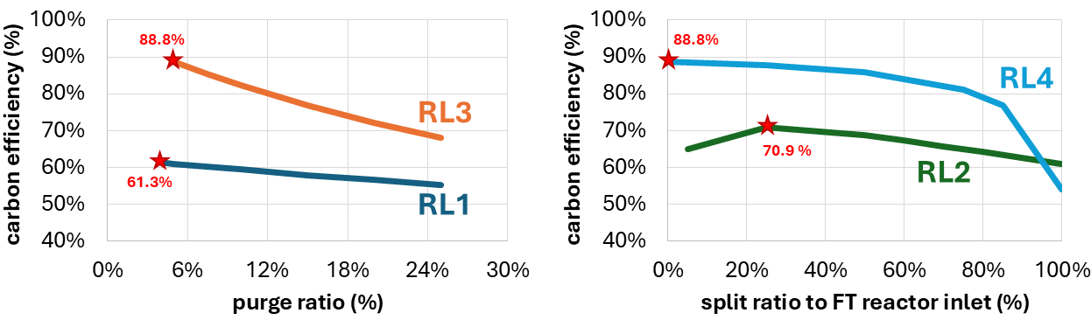
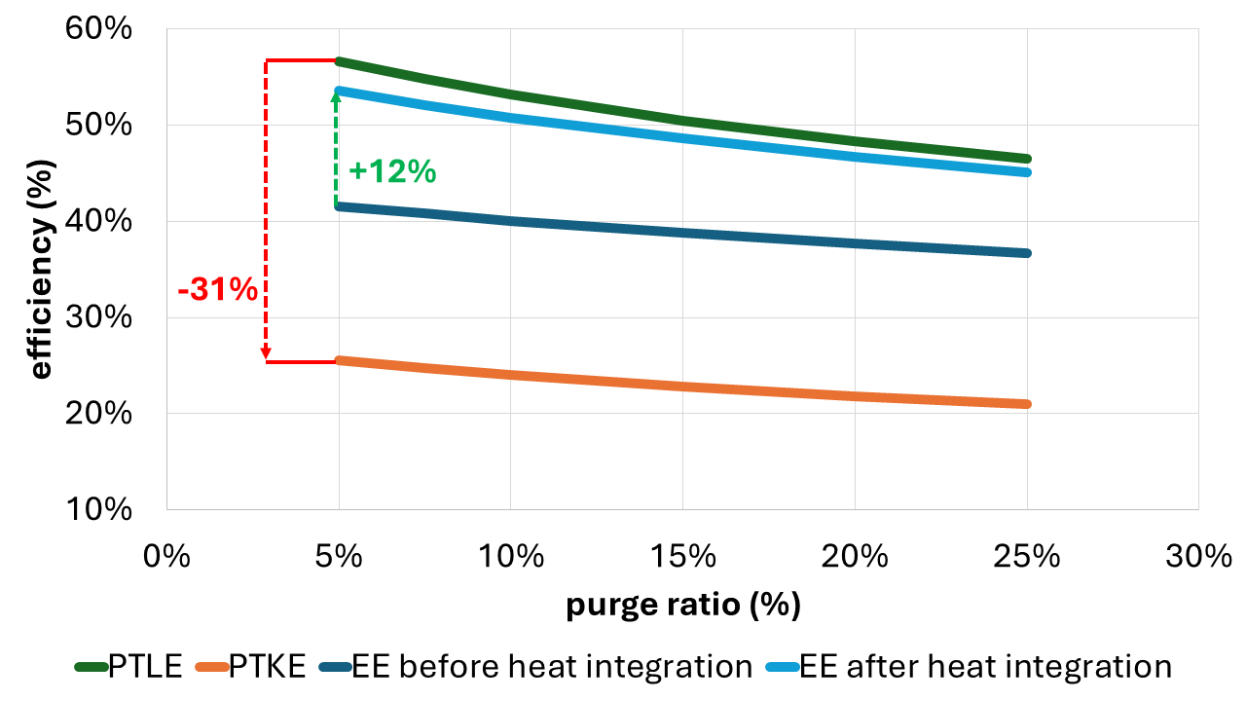
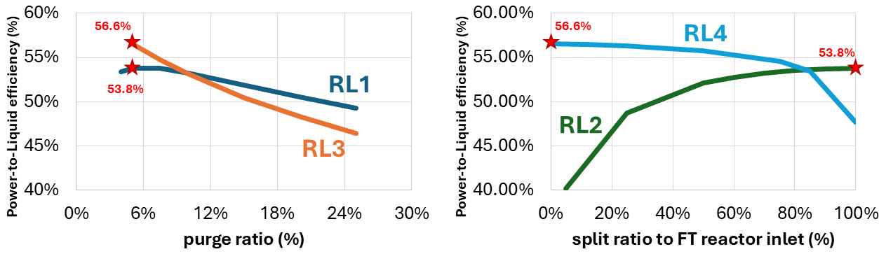
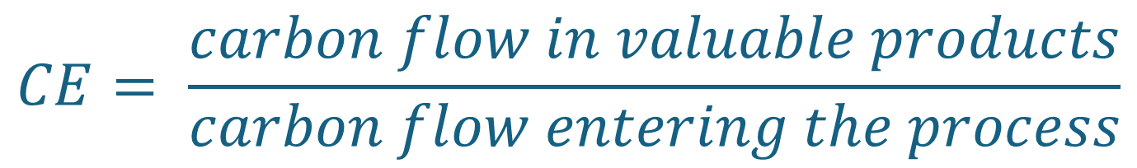
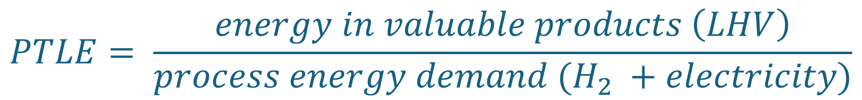
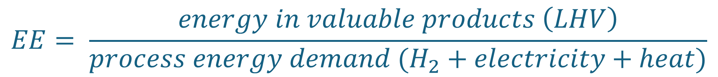
Comparative Analysis of Recycling Loops for Sustainable Aviation Fuel Synthesis from CO₂
Antoine Rouxhet*, Alejandro Morales, and Grégoire Léonard
Department of Chemical Engineering, University of Liège, Belgium
*antoine.rouxhet@uliege.be
Context and Objectives
The Fischer-Tropsch (FT) process stands out as a promising solution for synthesizing carbon-based fuels independently of fossil resources by replacing conventional coal or natural gas used for syngas production with captured CO₂ and low-carbon H₂. This is particularly relevant for sectors with hard-to-abate emissions, such as aviation. At ULiège, a detailed Aspen Plus (AP) model was developed to simulate aviation fuel production using a combination of reverse water-gas shift (RWGS) and low-temperature cobalt-based FT reactions. The model incorporates advanced RWGS and FT kinetics and stoichiometry through Aspen Custom Modeler (ACM) blocks. This process model is used in a comparative analysis to identify the optimal recycling loop configuration for this application.
Comparative analysis methodology
RL1. Single recycling loop back to FT reactor
 | RWGS | FT | Products separation
Temperature | 850 °C | 220 °C | 5 – 150 °C
Pressure | 20 bar | 20 bar | 2 – 20 bar
Modeling | Detailed kinetics incl. secondary reactions (ACM model inserted in AP process model)¹ | Detailed kinetics² and stoichiometry³ incl. secondary reactions and deviations from ideal ASF distribution (ACM model inserted in AP process model) | Succession of flash separations (AP process model)
RL2. Two independent recycling loops
RL3. Single recycling loop back to RWGS reactor
$$CE= \frac{carbon flow in valuable products}{carbon flow entering the process}$$
RL4. Two interlinked recycling loops
$$PTLE= \frac{energy in valuable products \left(LHV\right)}{process energy demand (H_{2} +electricity)}$$
Variation of split ratio in each configuration
$$EE= \frac{energy in valuable products \left(LHV\right)}{process energy demand (H_{2}+electricity+heat)}$$
Location where the split ratio is varied in the considered configuration
Results
Further analysis of the optimal configuration (RL3) energy efficiency
PTLE = Power-to-Liquid efficiency : all FT products (except C1 and C2) are considered valuable (as they can be further transformed into kerosene)
PTKE = Power-to-Kerosene efficiency : only products in the kerosene-like fraction are considered valuable
Restricting valorization to kerosene-like products decreases the power efficiency by 31% (absolute)
Integrating process heat increases the energy efficiency by 12% (absolute)
Power-to-Liquid efficiency and energy efficiency after heat integration are almost equivalent, suggesting a strong impact of H₂ production and electricity demand on these metrics
RL3 configuration with the lowest possible purge ratio is the optimal recycling loop option in terms of carbon and energy efficiencies
Conclusion
References
This study shows that recycling unreacted gases and light hydrocarbons back to the RWGS reactor inlet is the best configuration to maximise both Power-to-Liquid and carbon efficiencies. In this configuration, the purge ratio should be as low as possible to ensure sufficient recycling. Further analysis highlights the importance of valorizing all possible products (and not only kerosene-like ones), and of utilizing waste heat directly within the process. Further work will explore the upgrading of the optimal recycling loop, for instance, by transforming recycled light hydrocarbons into CO₂ and CO.
¹ Vidal Vázquez F, Pfeifer P, Lehtonen J, Piermartini P, Simell P, and Alopaeus V, 2017, ‘Catalyst Screening and Kinetic Modeling for CO Production by High Pressure and Temperature Reverse Water Gas Shift for Fischer–Tropsch Applications’, Industrial & Engineering Chemistry Research, 56 (45): 13262–72.
² Pandey U, Runningen A, Gavrilović L, Jørgensen EA, Putta KR, Rout KR, Rytter E, Blekkan EA, and Hillestad M. 2021. ‘Modeling Fischer–Tropsch Kinetics and Product Distribution over a Cobalt Catalyst’. AIChE Journal 67 (7): e17234
³ Hillestad M. 2015. ‘Modeling the Fischer–Tropsch Product Distribution and Model Implementation’. Chemical Product and Process Modeling 10 (3): 147–59.
This poster is supported by the Walloon Region as part of a FRIA grant (F.R.S.-FNRS).
ESCAPE35 Conference, Gent, 6-9 July 2025

