Slide 1
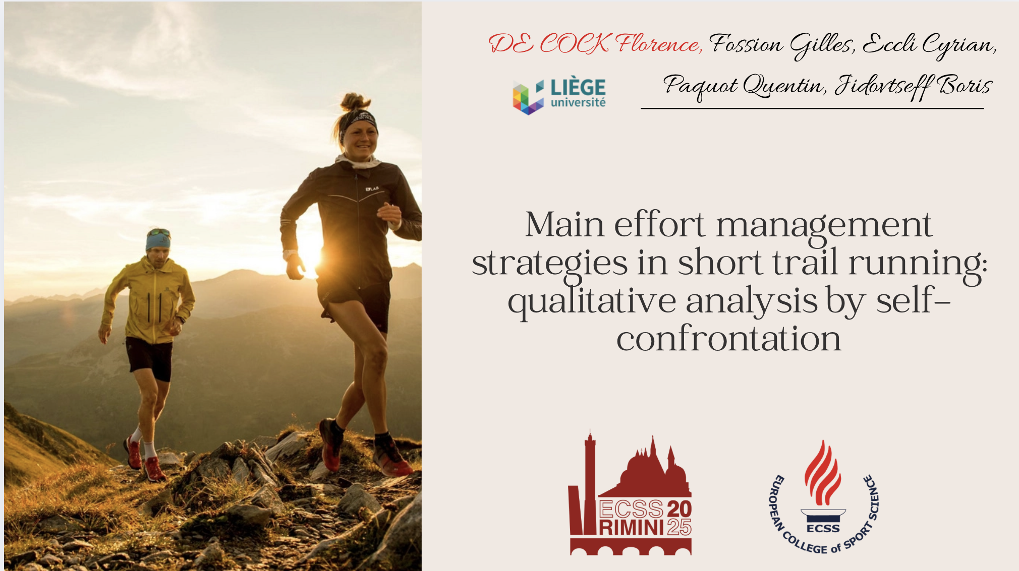

Slide 2
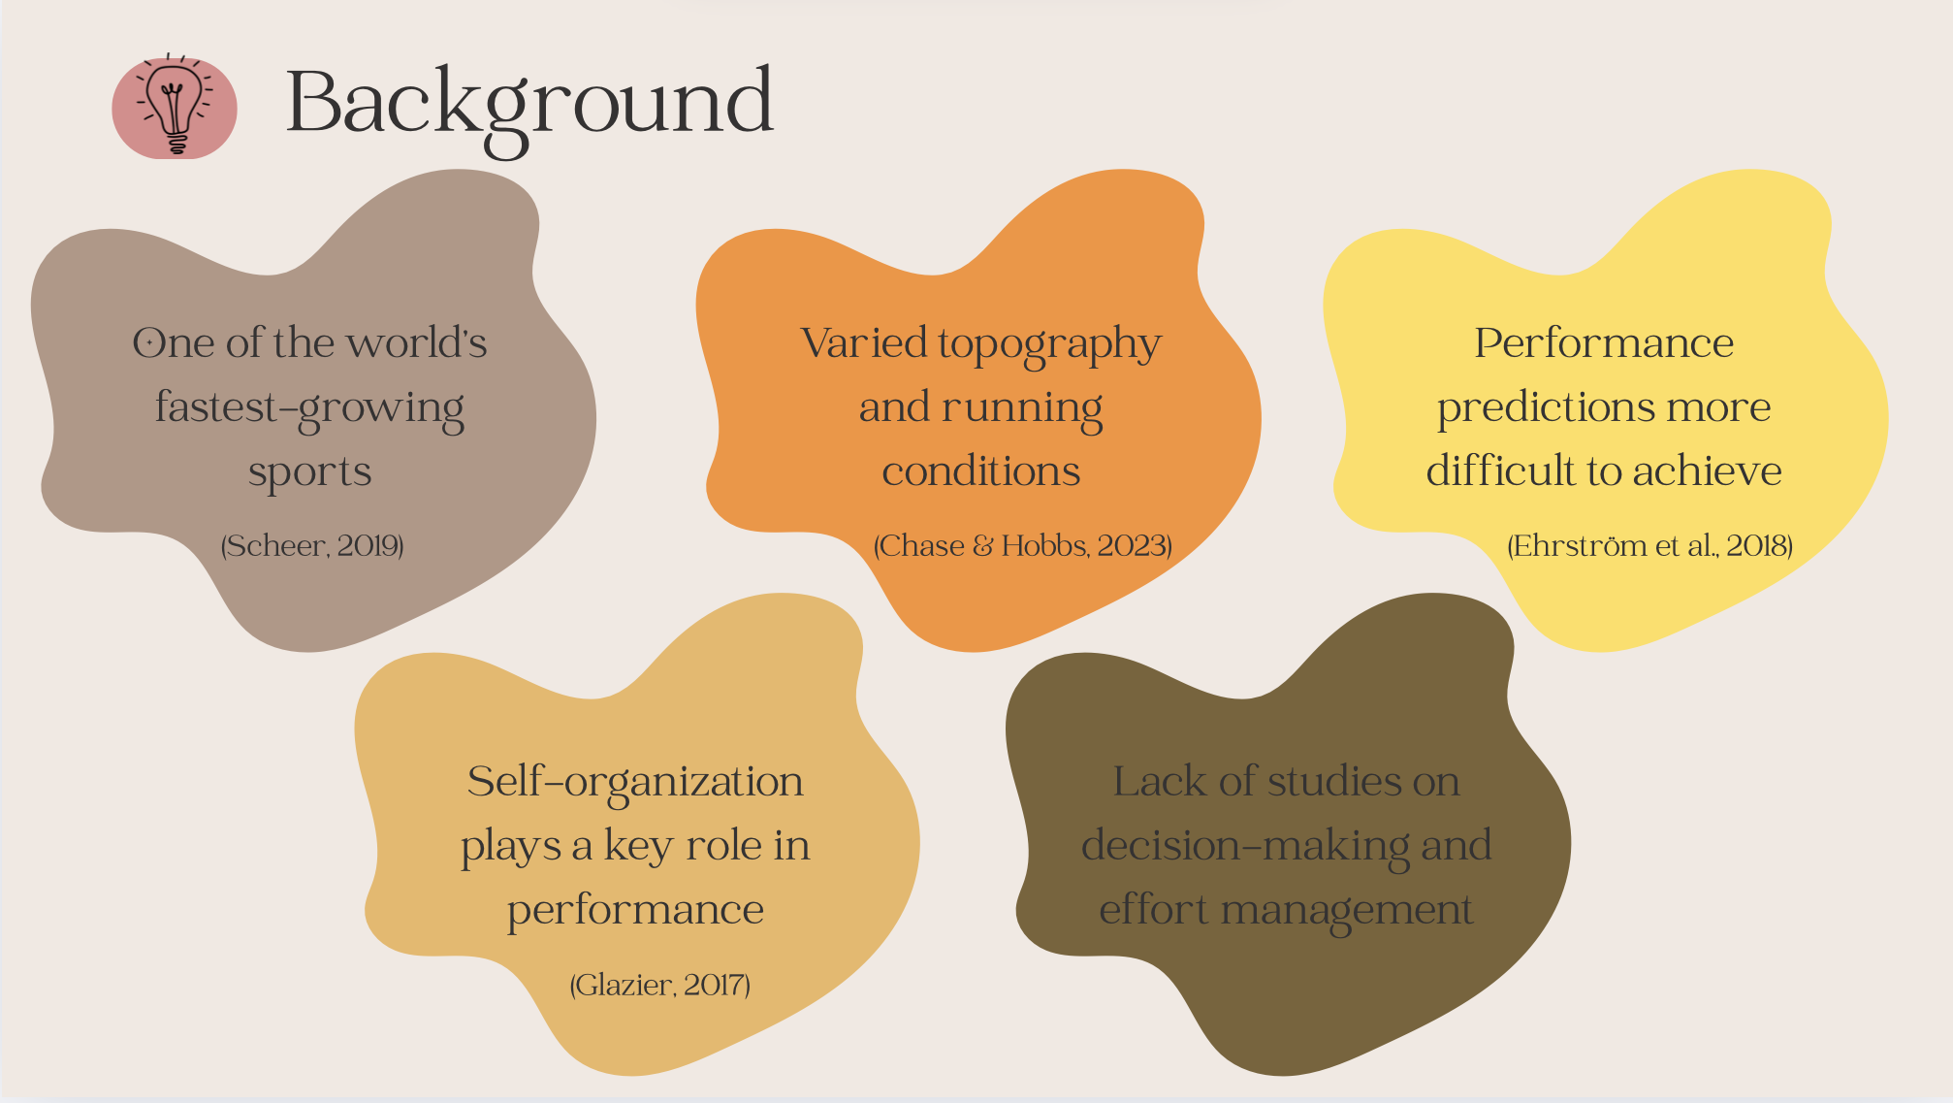
Notes:
The popularity of endurance sports has grown considerably over recent years and trail running in particular has become one of the world's fastest-growing sports.
Trail running imposes unique constraints due to surface variations, changing weather conditions and significant altitude differences, making its races more technical and tactical.
Each trail event is totally different, which makes performance predictions even more difficult to achieve.
During trail running, participants are often confronted with a variety of decision-making challenges and self-organization plays a key role in performance.
Surprisingly, there is a lack of studies on decision-making and effort management and few qualitative trail studies in the literature.

Slide 3
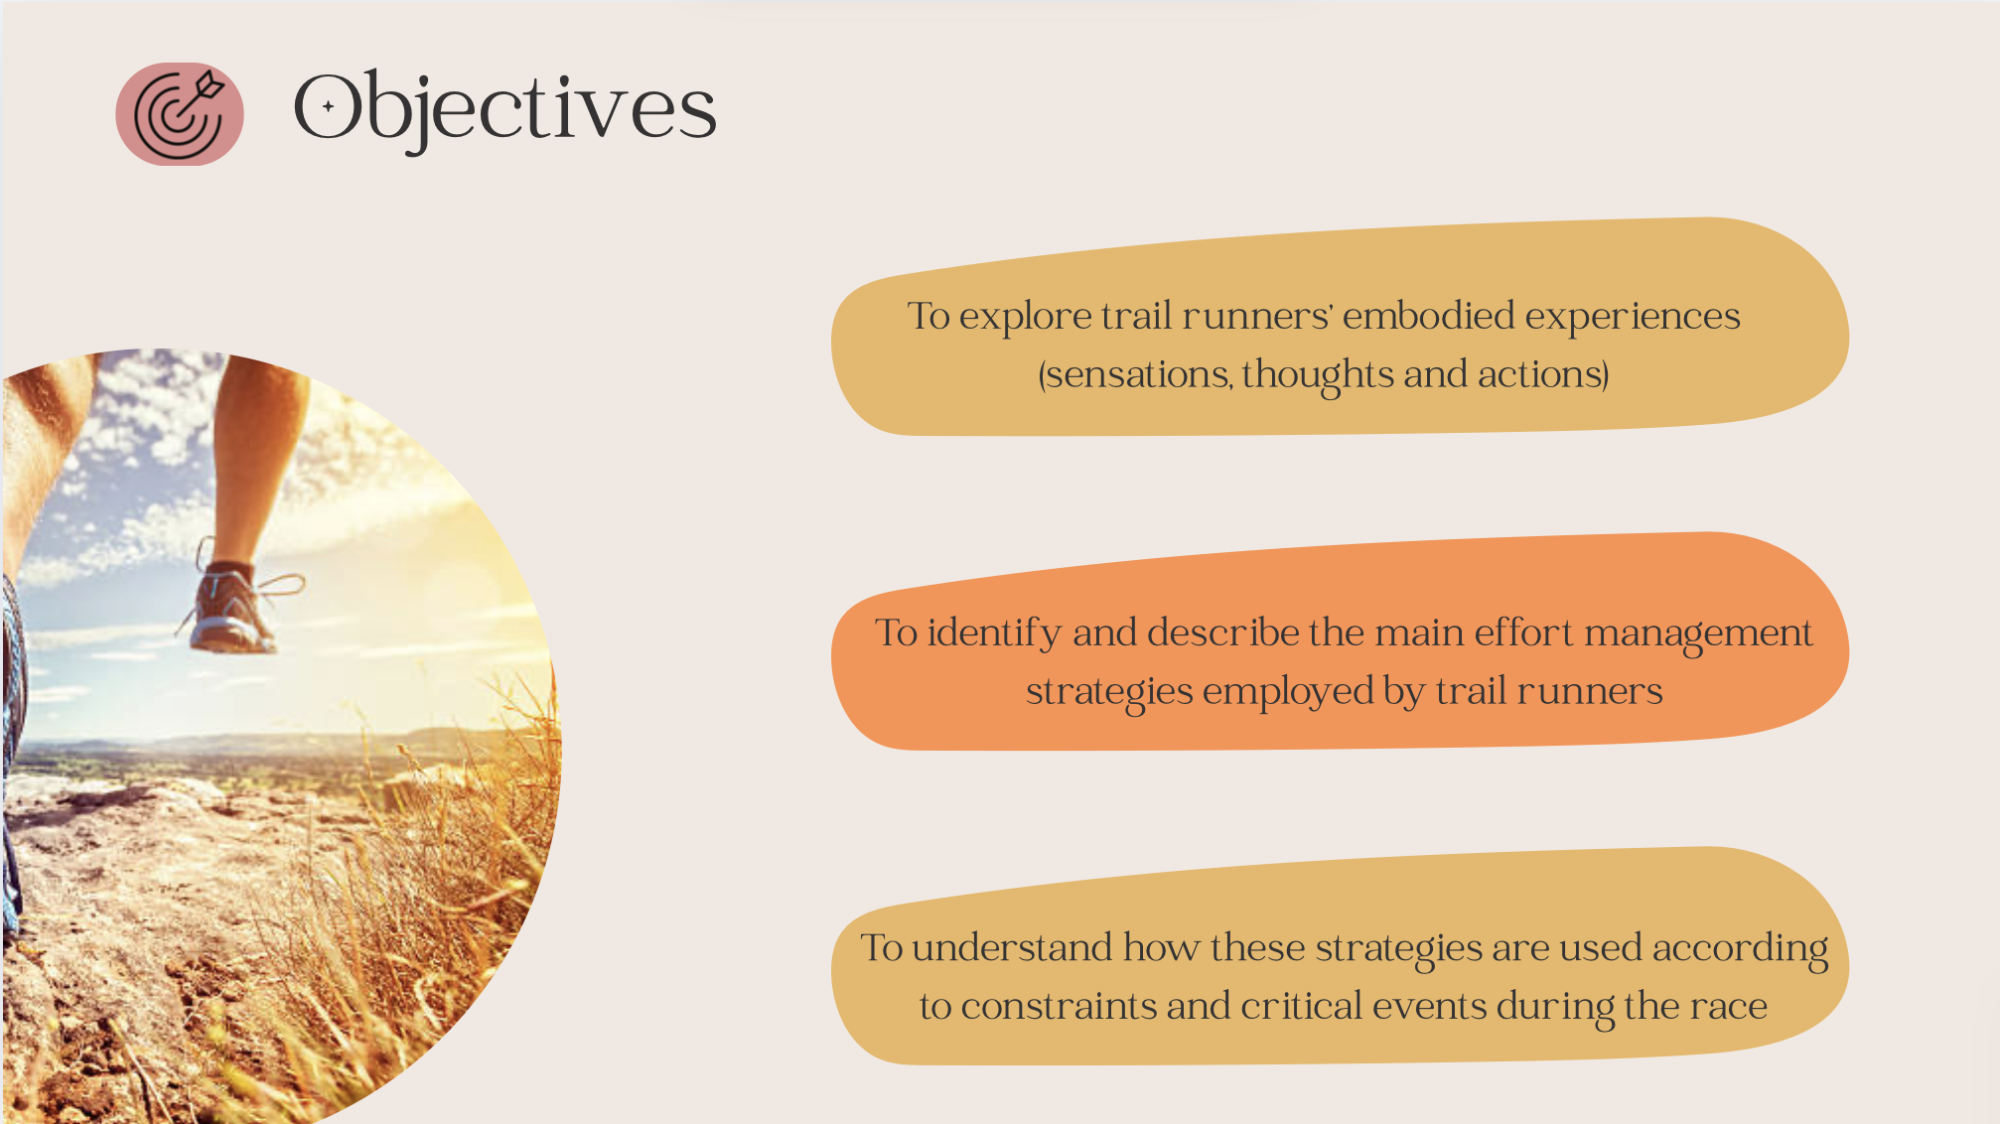
Notes:
The objectives of this study are to identify and describe the main effort management strategies employed by trail runners and, to understand how these strategies are used according to constraints and critical events encountered during the race.

Slide 4
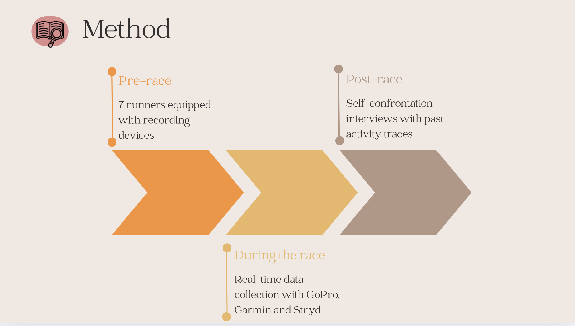
Notes:
Participants were recruited on a voluntary basis and were selected with the aim to have a variety of profiles in terms of gender, age, level and goals.
Seven runners (3 women and 4 men) aged between 25 and 45 with different levels ranging from beginner to advanced participated in this study
participating in a short trail race (10 to 30km) were equipped with a GoPro, a Garmin watch and a Stryd accelerometer to record traces of their activity
Within the 5 days following the race, each subject participated in a self-confrontation interview.
The past activity traces were shown to the runner to help to relive their meaningful experiences in its various facets. Participants were asked to describe for each relevant event what they feel, think and the decisions they make according to race chronology.

Slide 5
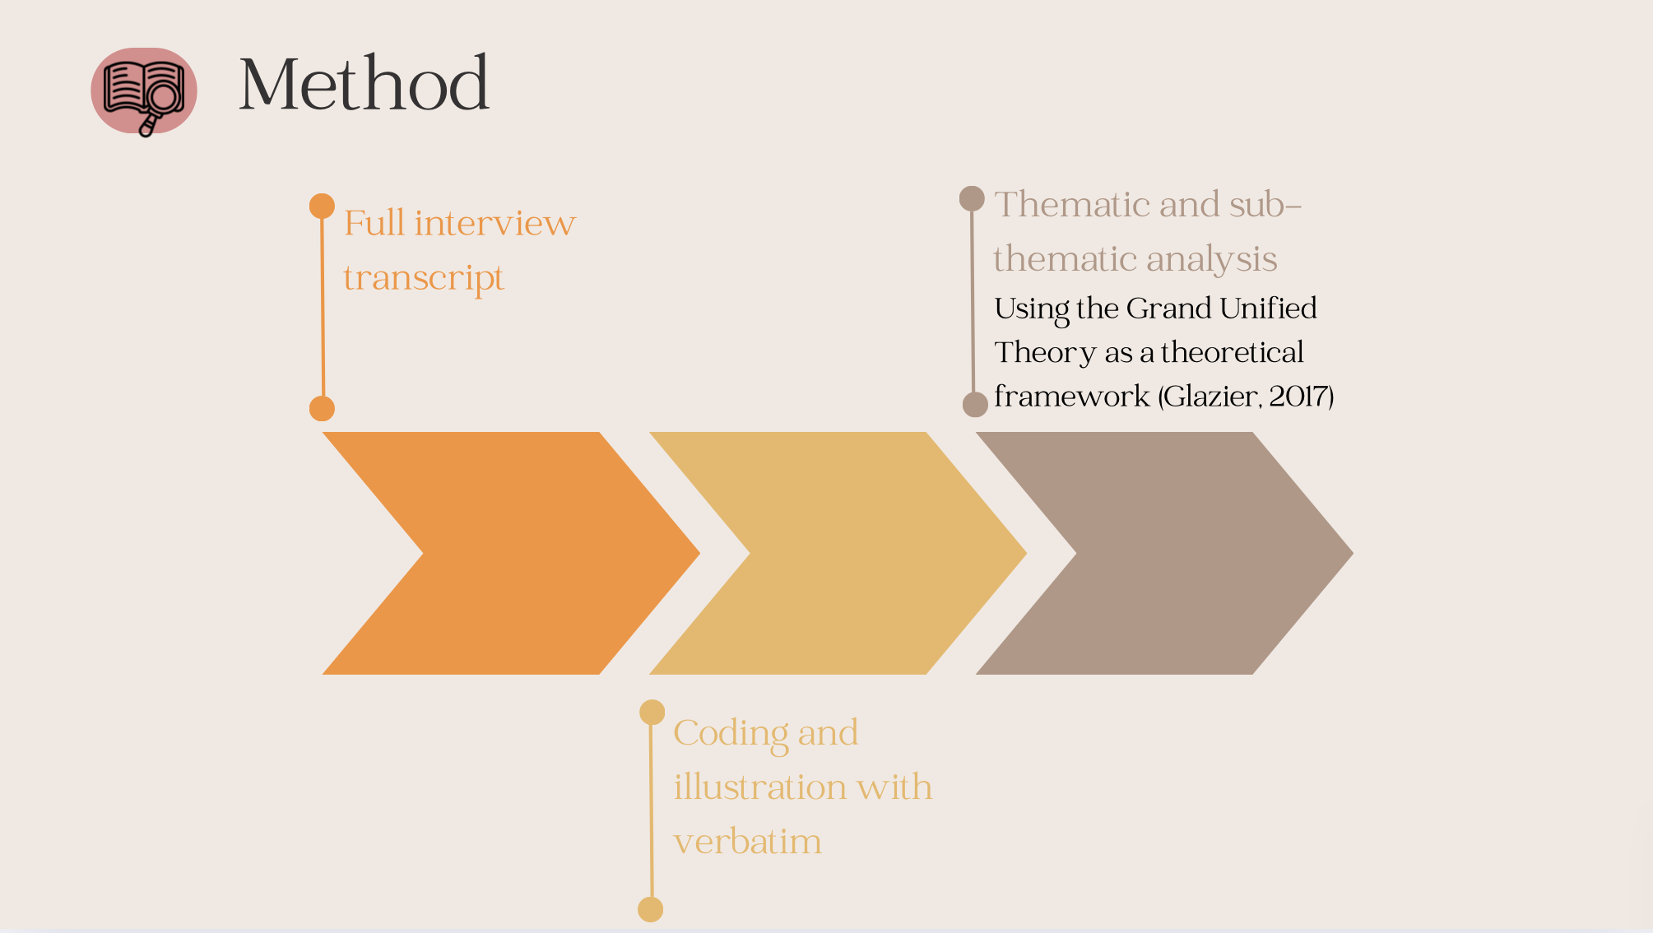
Notes:
The interviews were fully transcribed and coded
Triangulation procedure and thematic analysis were used to determine main effort management strategies during short trail race, using the Grand Unified Theory (GUT) as a theoretical framework (Glazier, 2017). This model proposes a holistic vision of sports performance.
Indeed, the performance outcome emerge from the confluence of interacting organismic (e.g. body mass and composition, anthropometric characteristics, development of resilience, motivation), environmental (e.g. weather, societal expectations, peer support), and task (specific to the task being performed and are related to the goal of the task and the rules governing the task) constraints via the formation and self-organization of coordinative structures.
We agreed that any strategy is characterized by the implementation of an action plan to get over the various constraints encountered throughout the race to achieve the objectives. These strategies are often associated with decisions leading to action or changes in behavior. Certain less visible strategies can also correspond to the maintenance of a behavior.

Slide 6
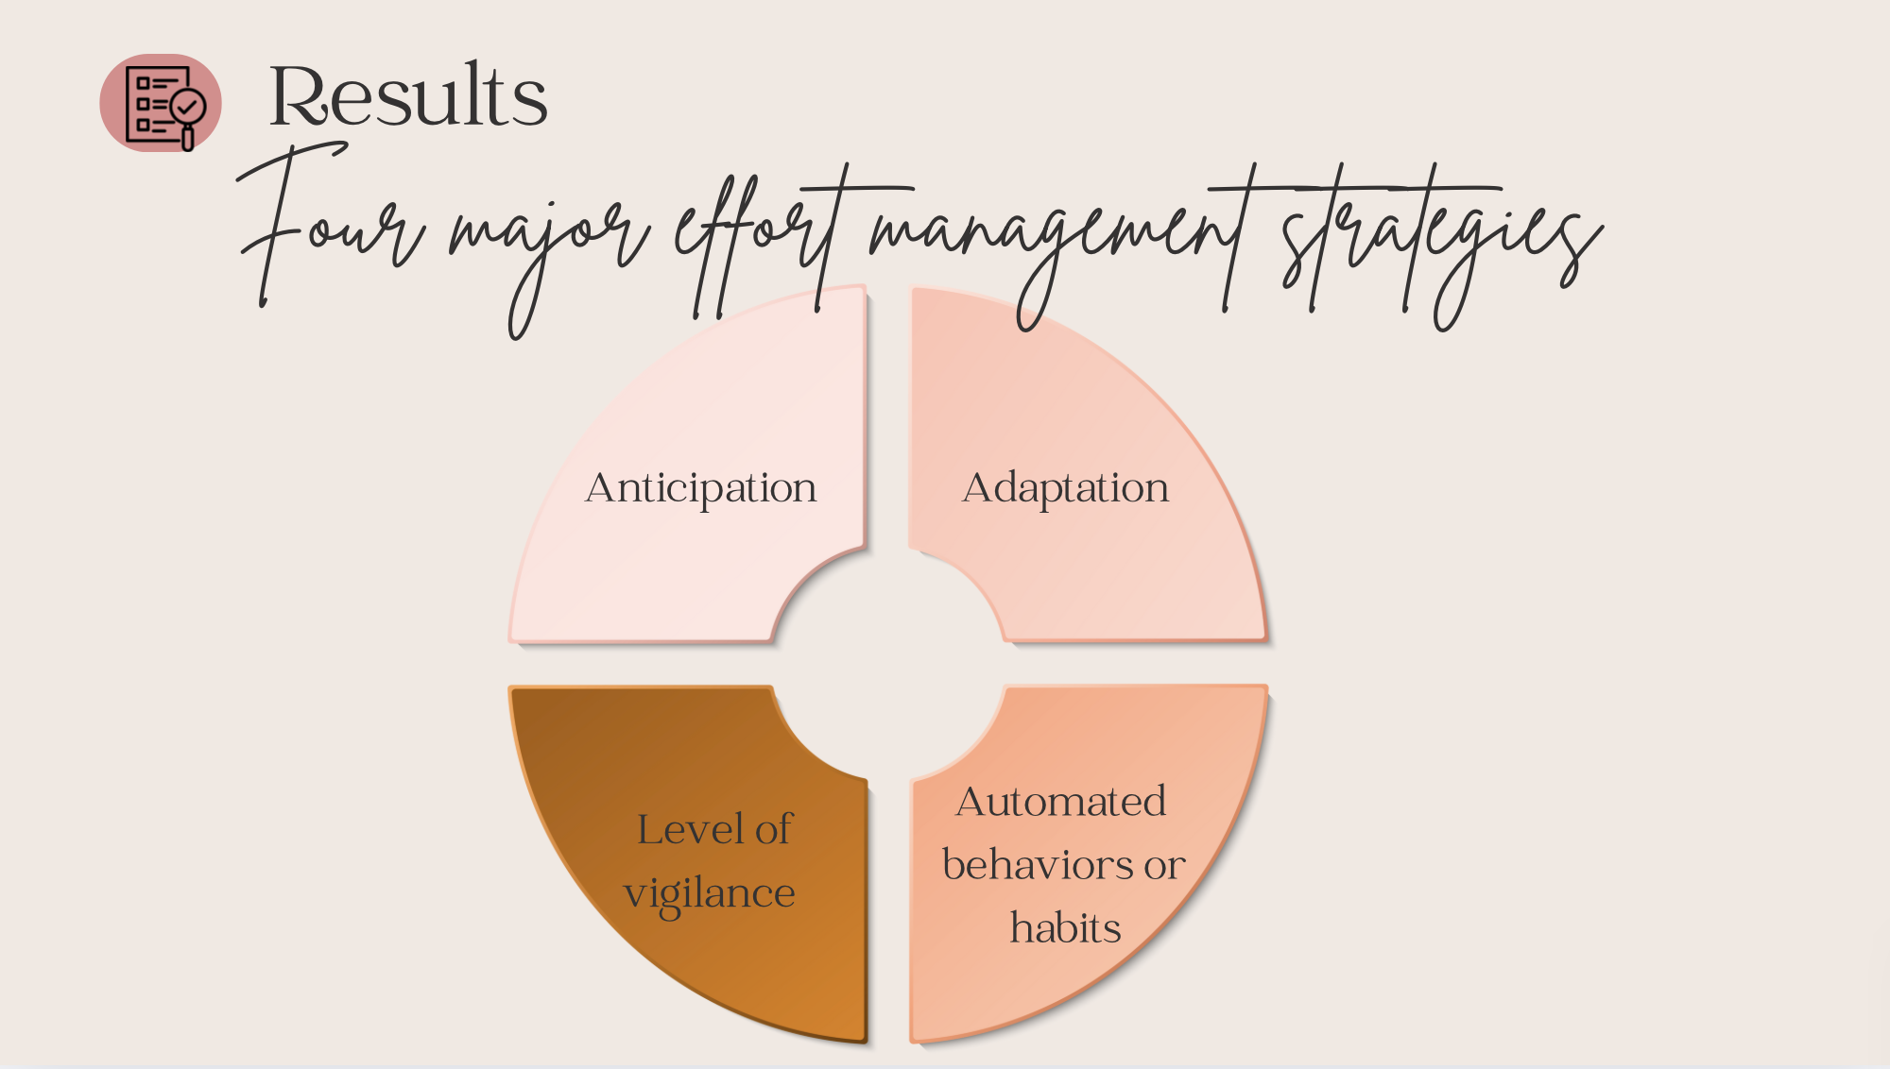
Notes:
Four major effort management strategies emerge from our results, three of which relate directly to the choices made by the runner (adaptation strategies; anticipation strategies; and automated behaviors or habits) and one of which concerns his/her level of vigilance (focused to unfocused).

Slide 7
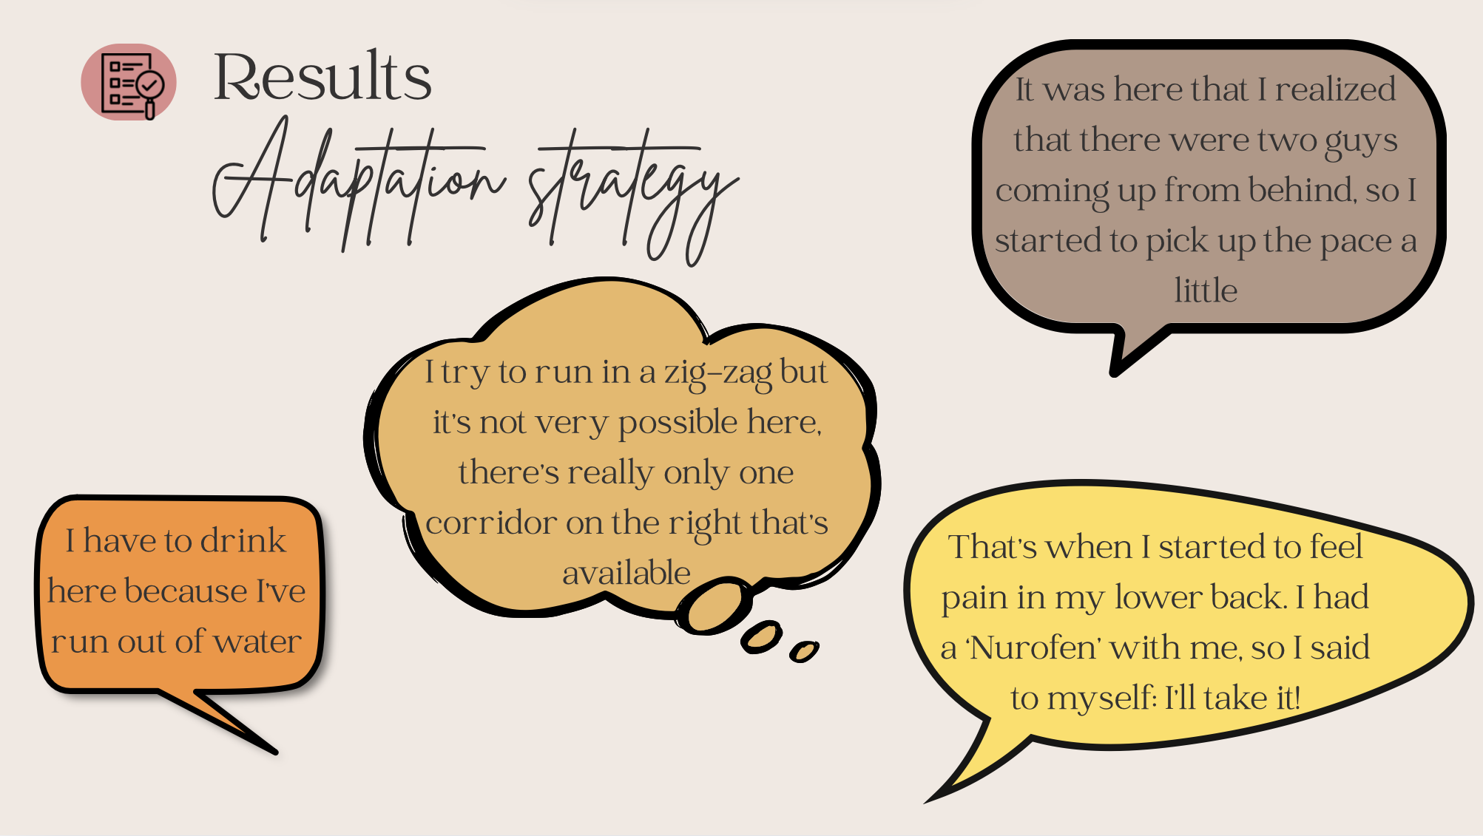
Notes:
Adaptation strategy refers to a reactive approach adopted by an individual to adjust his/her actions and processes in response to changes and unforeseen or evolving external/internal conditions. These ADS can be linked to the particularities of the trail (Participant 4 or P4), to an unexpected event (P3), to opponents (P6), or even to how the runner sensations and feelings are at a particular moment during the race (P2):
- “I try to run in a zig-zag but it's not very possible here, there's really only one corridor on the right that's available” (P4).
- “I have to drink here too because I've run out of water” (P3).
- “It was here that I realized that there were two guys coming up from behind, so I started to pick up the pace a little” (P6).
- “That's when I started to feel pain in my lower back. I had a ‘Nurofen’ with me, so I said to myself: I'll take it!” (P2).

Slide 8
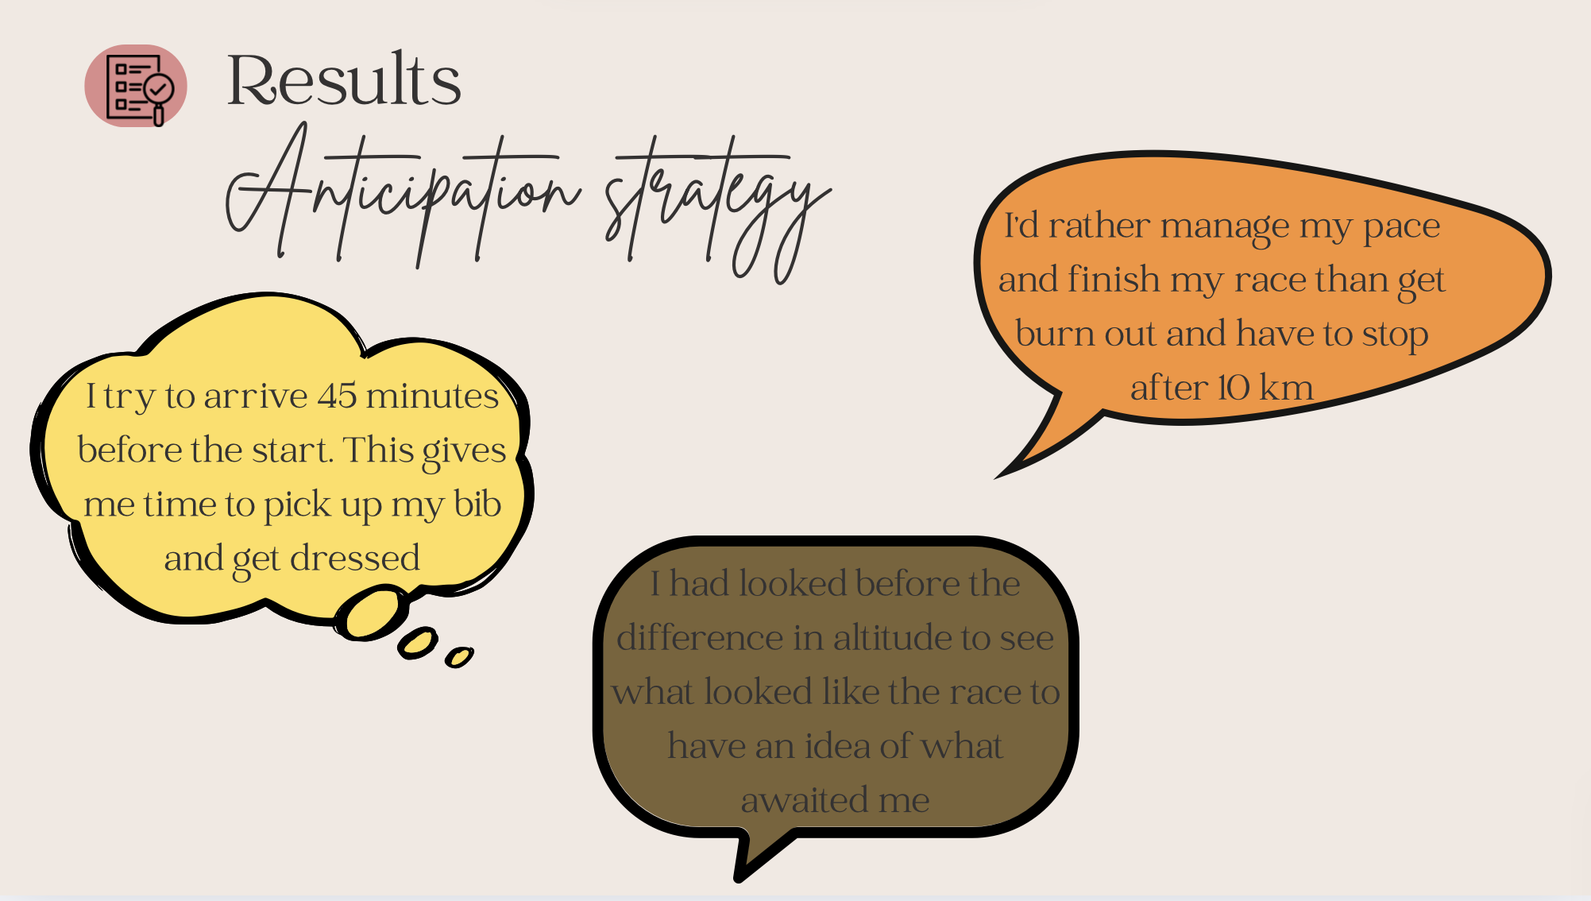
Notes:
Anticipation strategy refers to a proactive approach adopted by an individual to prepare the race and anticipate for expected events, trends, changes and usual challenges met during trail running (P2):
- “I try to arrive 45 minutes before the start. This gives me time to pick up my bib and get dressed” (P2).
These ATS are used by runners to adopt an appropriate behavior to the characteristics of the race. They concern key elements such as the running pace (P1), or key moments such as the start of the race which has been previously recognized (P6):
- “I'd rather manage my pace and finish my race than get burn out and have to stop after 10 km” (P1).
Most ATS are generally linked to predicted events and are based on prior reconnaissance of the route and/or the runner’s accumulated experience (P1),
- “I had looked before the difference in altitude (…) to see what looked like the race to have an idea of what awaited me” (P1).

Slide 9
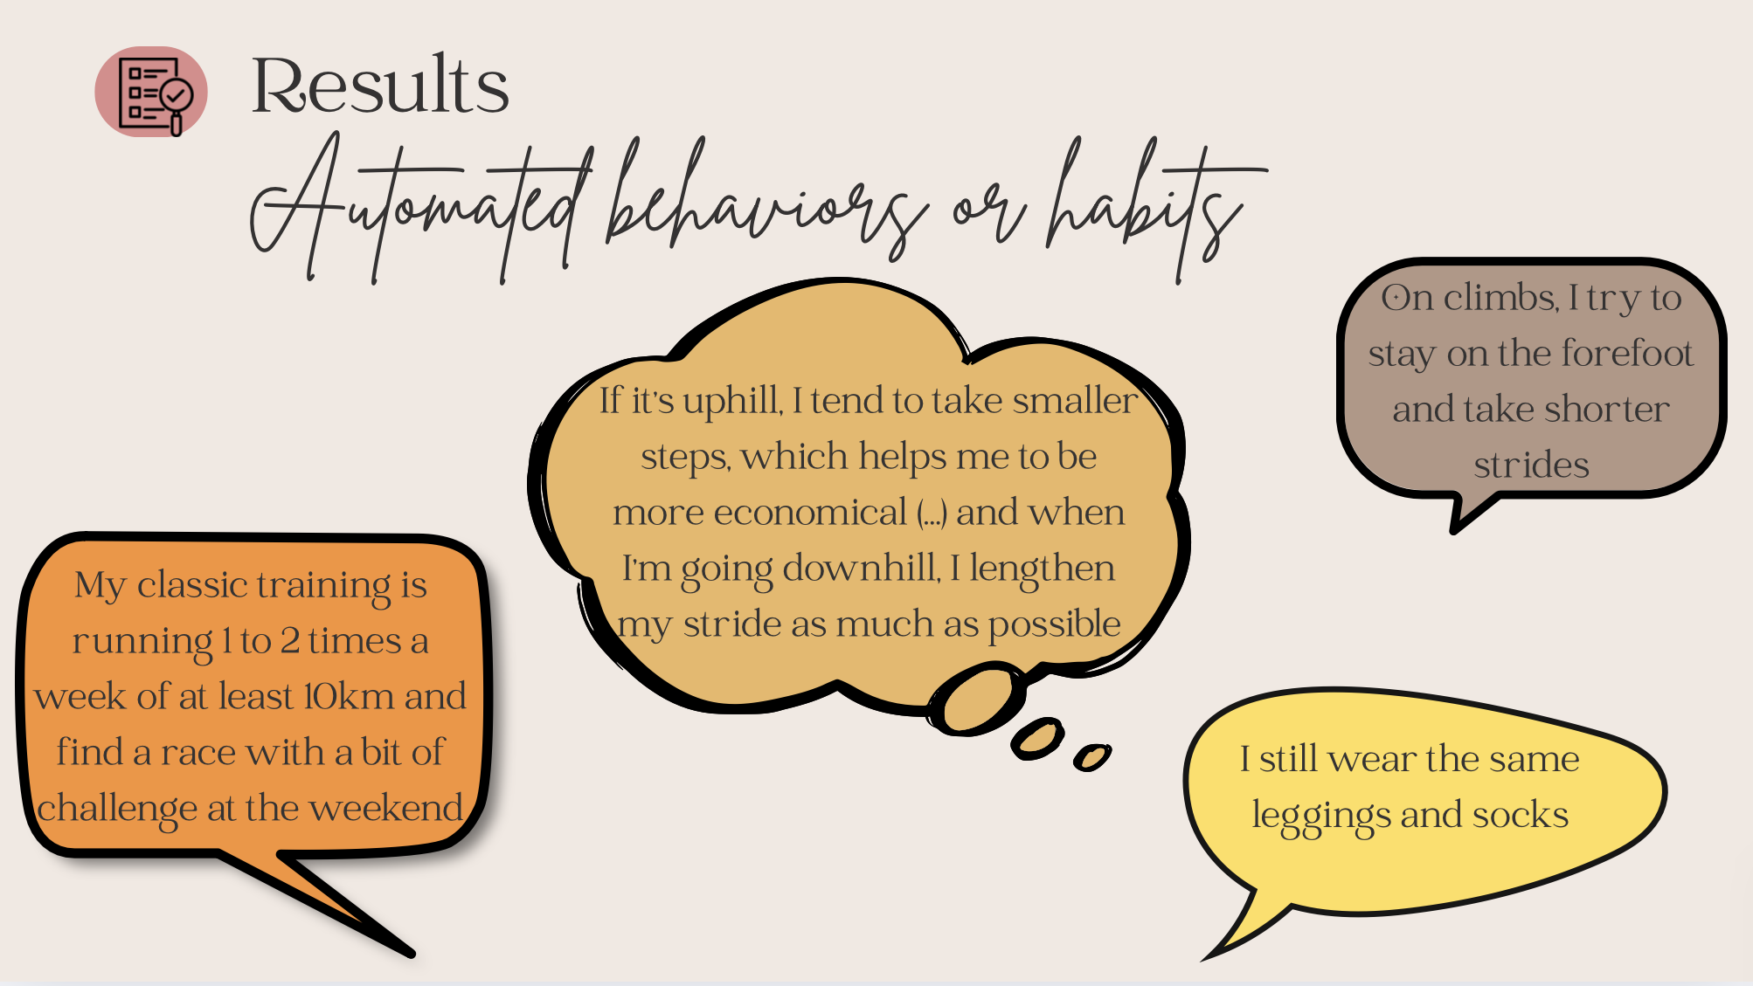
Notes:
the automated behaviors or habits refer to the circumstances in which actions and behaviors are systematized or routinized, and can also be induced by familiar trail context. These automated behaviors seem to be based on runner’s preferences and experiences. These habits are found in the pre-race preparation (P3),
- “My classic training is running 1 to 2 times a week of at least 10km and find a race with a bit of challenge at the weekend” (P3).
Habits can also involve ways of acting or adapting to trail conditions that runners are regularly encounter. For example, adjusting your stride to suit the gradient is an adaptation strategy that can be automated (P6):
- “If it's uphill, I tend to take smaller steps, which helps me to be more economical (…) and when I'm going downhill, I lengthen my stride as much as possible” (P6).
These automated behaviors can concern both ADS and ATS during the race. We also observed that some habits were “relevant” and derived from the experience of good runners (P2), while other habits are not necessarily as relevant and were mainly found in beginners (P7):
- “On climbs, I try to stay on the forefoot and take shorter strides” (P2).
- “I still wear the same leggings and socks” (P7).

Slide 10
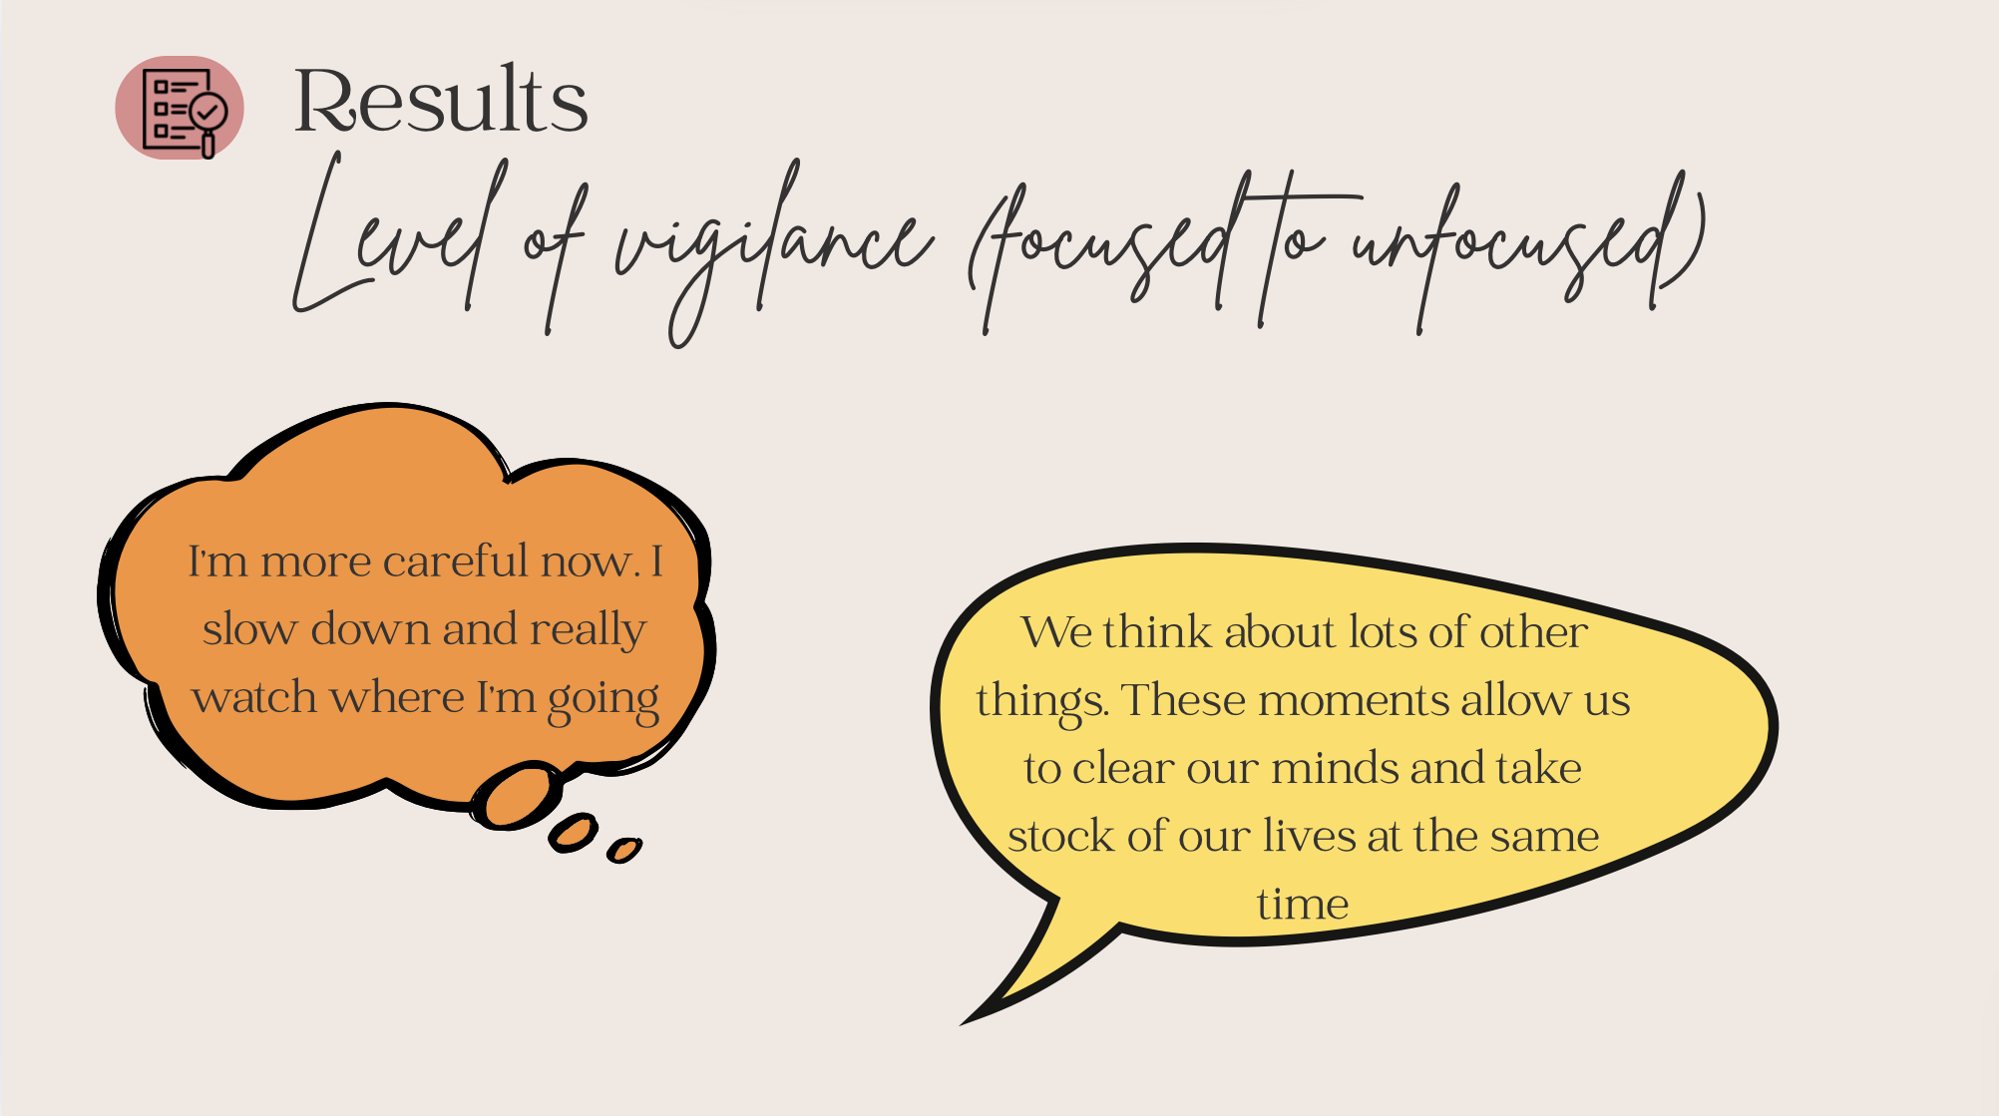
Notes:
The fourth strategy concerns the “level of vigilance” which has an impact on the other three effort management strategies. LOV can vary according to the moment of the race, with moments when attention and vigilance are high (focused), especially in very technical segments (P1), and with other moments when runners seem detached with floating thoughts that are not necessarily linked to the objectives of the race (unfocused). For example, runners may express moments of “disconnection” with a “non-decision making”, when they forget daily stress and clear their minds (P4):
- “I'm more careful now. I slow down and really watch where I'm going” (P1).
- “We think about lots of other things. These moments allow us to clear our minds and take stock of our lives at the same time” (P4).

Slide 11
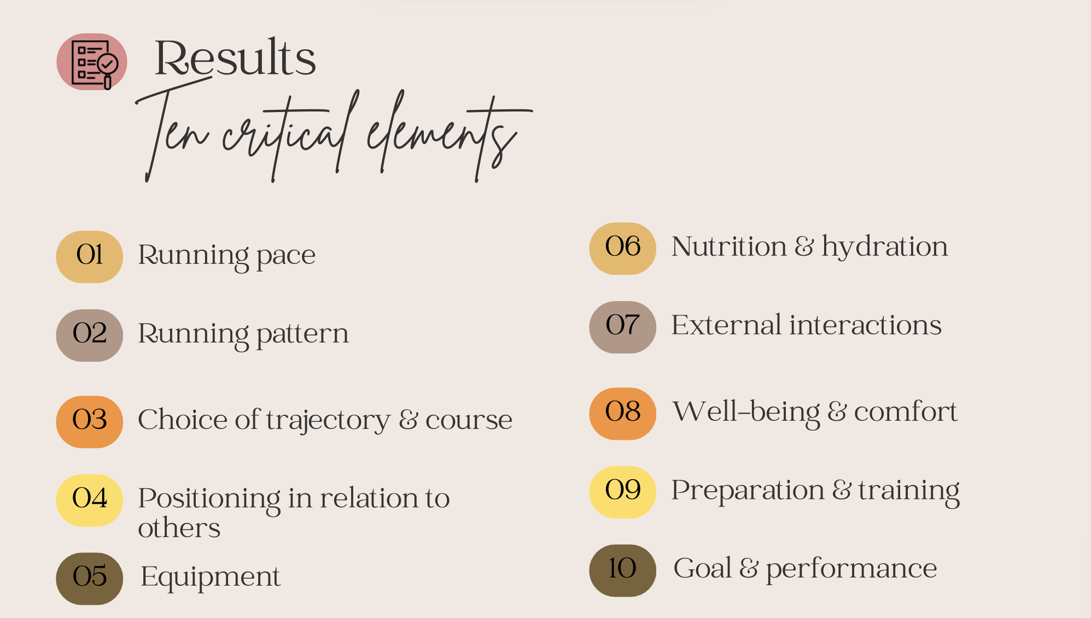
Notes:
we also identified 10 critical elements that were directly concerned by the strategies: (a) running pace, (b) running pattern, (c) choice of trajectory and course, (d) positioning in relation to others, (e) equipment, (f) nutrition and hydration, (g) external interactions, (h) well-being and comfort, (i) preparation and training, and (j) goal and performance. All these various critical elements may be affected by one or more strategies at the same time.

Slide 12
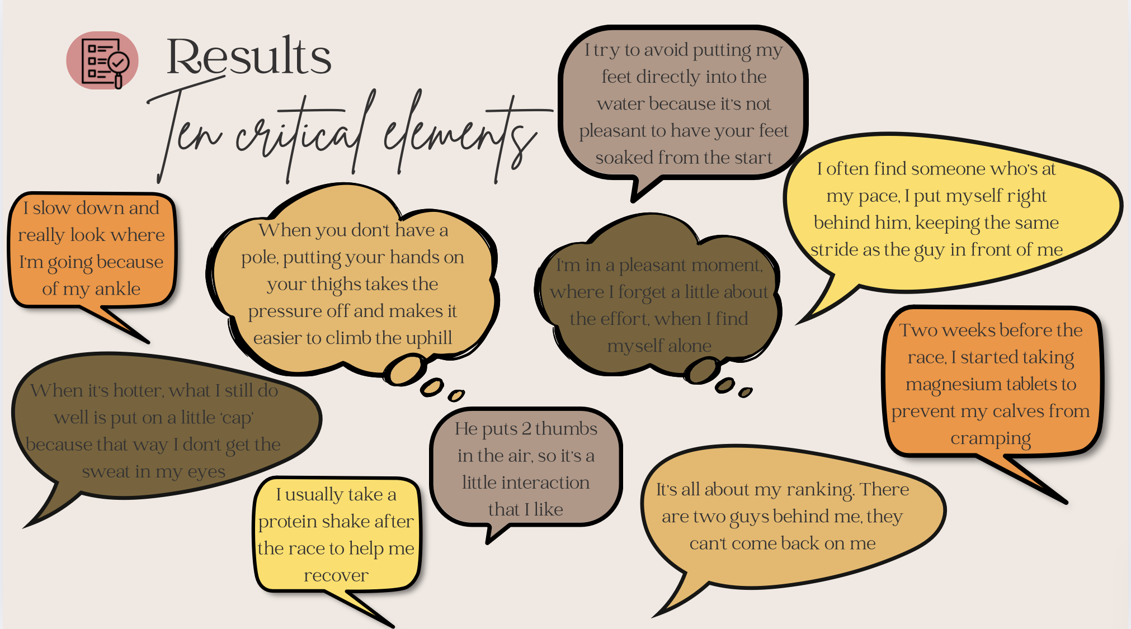

Slide 13
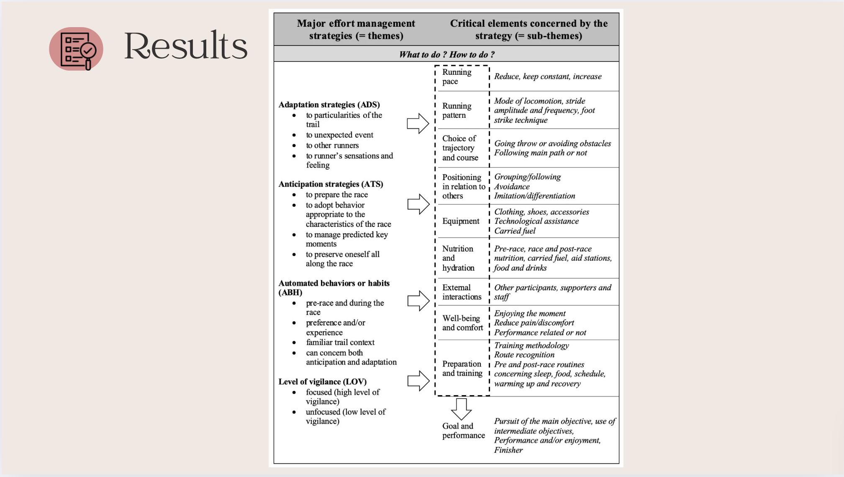

Slide 14
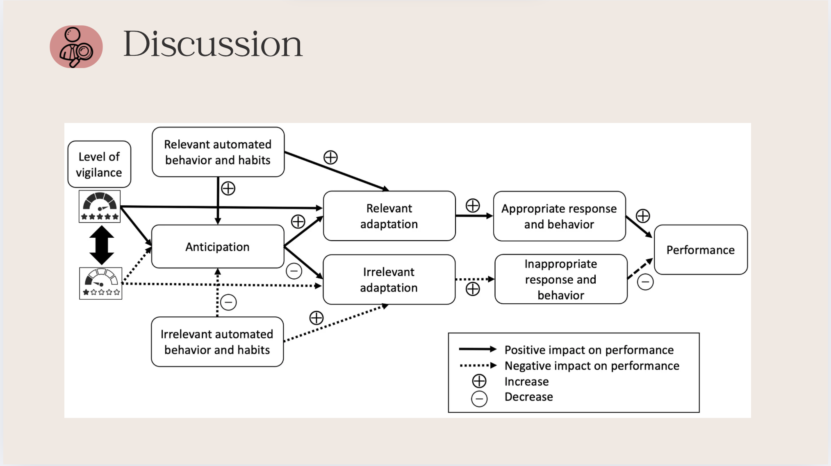
Notes:
The results of this study reveal complex interactions between the four main effort management strategies identified. It seems that there is a hierarchy, and that above it, we find automated behaviors and habits that can affect the ability to anticipate and the relevance of adaptations. The runner's training, accumulated experience and possibly good dispositions from birth enable the emergence of good habits and relevant, automated adaptive behaviors. When they are automated, they enable cognitive discharge and reduce need for hazardous adaptations.

Slide 15
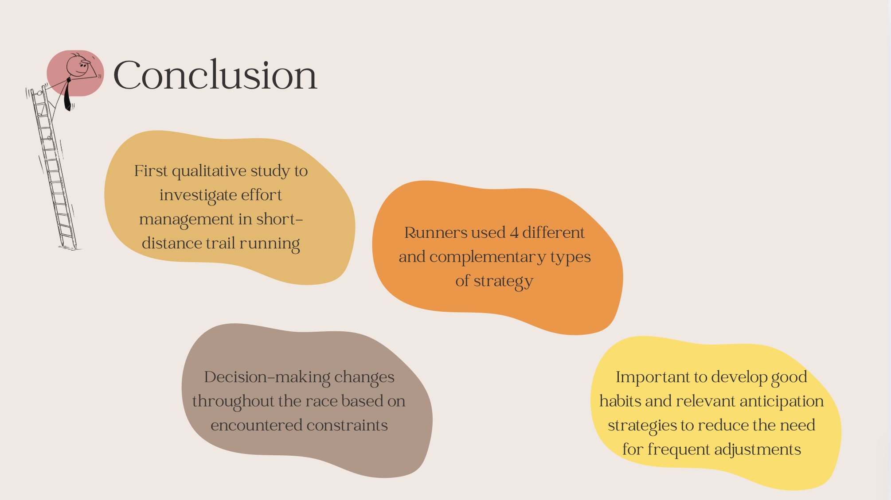
Notes:
To our knowledge, this is the first qualitative study to investigate effort management in short-distance trails.
This study provides insights into how runners manage their effort during races. Decision-making changes throughout the event based on encountered constraints.
Our results suggest that developing good habits and relevant anticipation strategies by education and training can reduce the need for frequent adjustments, manage energy consumption, and to avoid premature exhaustion or injury. enabling athletes to focus on their strategy and maximize performance. Better anticipation enables better adaptation by minimizing surprises and increasing appropriate responses. The data can help runners, coaches, and psychologists better understand and prepare for short-distance trail running.

Slide 16
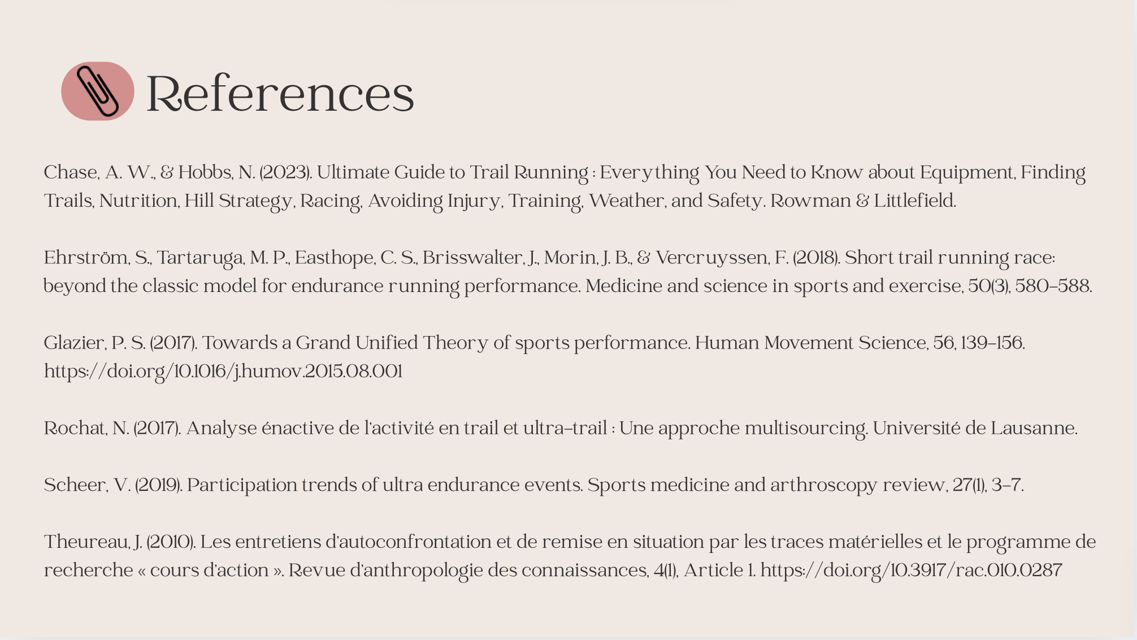

Slide 17


