Slide 1
Testing Independence from Within
The perceptions of national
civil servants of independent administrative authorities regarding
their enforcement of EU law

Slide 2
The focus : EU-generated national Independent Public Authorities
EU secondary law increasingly includes procedural and institutional obligations
  No longer only substantial harmonization
Rise of independent public authorities (IPAs) under EU law at national level

Slide 3
Main points: changes of national constitutionalism without formal constitutional change
National administrative setups and processes changed by EU law
Rise of IPAs with monitoring, enforcing and sanctioning power, with little oversight from other branches of government
Impossibility to change the status of IPAs via formal constitutional amendments
Democratic concerns ? Independence, accountability …
Illustrations: railways, electricity, prudential supervision

Slide 4
In the GDPR: Art. 52 “Independence”
“Each supervisory authority shall act with complete independence in performing its tasks and exercising its powers in accordance with this Regulation.
The member or members of each supervisory authority shall, in the performance of their tasks and exercise of their powers in accordance with this Regulation, remain free from external influence, whether direct or indirect, and shall neither seek nor take instructions from anybody.
Member or members of each supervisory authority shall refrain from any action incompatible with their duties and shall not, during their term of office, engage in any incompatible occupation, whether gainful or not.
Each Member State shall ensure that each supervisory authority is provided with the human, technical and financial resources, premises and infrastructure necessary for the effective performance of its tasks and exercise of its powers, including those to be carried out in the context of mutual assistance, cooperation and participation in the Board.
Each Member State shall ensure that each supervisory authority chooses and has its own staff which shall be subject to the exclusive direction of the member or members of the supervisory authority concerned.
Each Member State shall ensure that each supervisory authority is subject to financial control which does not affect its independence and that it has separate, public annual budgets, which may be part of the overall state or national budget.”

Slide 5
ECN+ Directive: Art. 4 Independence
To guarantee the independence of national administrative competition authorities when applying Articles 101 and 102 TFEU, Member States shall ensure that such authorities perform their duties and exercise their powers impartially and in the interests of the effective and uniform application of those provisions, subject to proportionate accountability requirements and without prejudice to close cooperation between competition authorities in the European Competition Network.
2. In particular, Member States shall at a minimum ensure that the staff and persons who take decisions exercising the powers in Articles 10 to 13 and Article 16 of this Directive in national administrative competition authorities are able to perform their duties and to exercise their powers for the application of Articles 101 and 102 TFEU independently from political and other external influence; neither seek nor take any instructions from government or any other public or private entity when carrying out their duties and exercising their powers for the application of Articles 101 and 102 TFEU, without prejudice to the right of a government of a Member State, where applicable, to issue general policy rules that are not related to sector inquiries or specific enforcement proceedings; and refrain from taking any action which is incompatible with the performance of their duties and/or with the exercise of their powers for the application of Articles 101 and 102 TFEU and are subject to procedures that ensure that, for a reasonable period after leaving office, they refrain from dealing with enforcement proceedings that could give rise to conflicts of interest.
3. The persons who take decisions exercising the powers in Articles 10 to 13 and Article 16 of this Directive in national administrative competition authorities shall not be dismissed from such authorities for reasons related to the proper performance of their duties or to the proper exercise of their powers for the application of Articles 101 and 102 TFEU, as referred to in Article 5(2) of this Directive. They may be dismissed only if they no longer fulfil the conditions required for the performance of their duties or if they have been found guilty of serious misconduct under national law. The conditions required for the performance of their duties, and what constitutes serious misconduct, shall be laid down in advance in national law, taking into account the need to ensure effective enforcement.
4. Member States shall ensure that the members of the decision-making body of national administrative competition authorities are selected, recruited or appointed according to clear and transparent procedures laid down in advance in national law.
5. National administrative competition authorities shall have the power to set their priorities for carrying out the tasks for the application of Articles 101 and 102 TFEU as referred to in Article 5(2) of this Directive. To the extent that national administrative competition authorities are obliged to consider formal complaints, those authorities shall have the power to reject such complaints on the grounds that they do not consider such complaints to be an enforcement priority. This is without prejudice to the power of national administrative competition authorities to reject complaints on other grounds defined by national law.

Slide 6
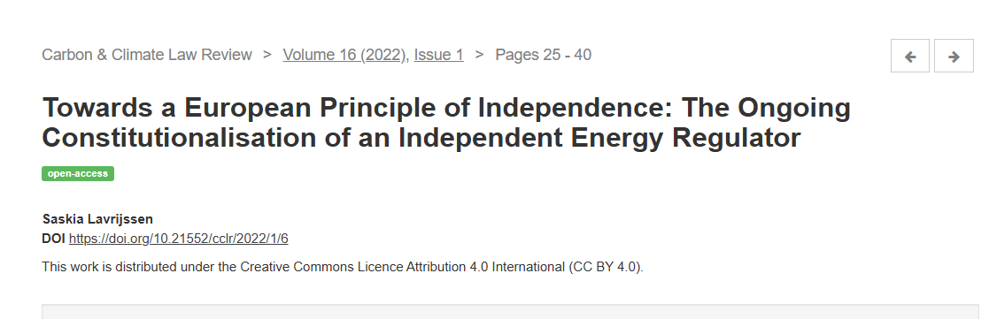

Slide 7
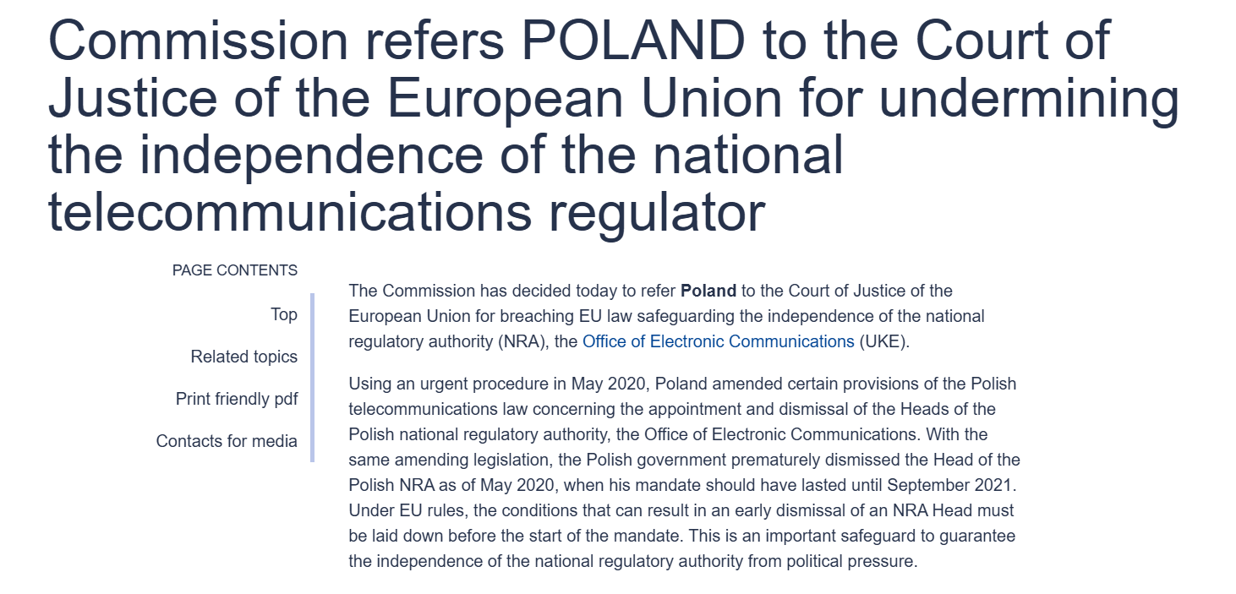

Slide 8
Independence in the literature
“Autonomous public bodies” (De Somer 2017) or “semi-independent” bodies (Trondal 2025) ?
P-A Theory (Thatcher 2002) no longer capturing the contemporary reality
  Vibert 2024: experts as a 4th branch of government
Independence: no complete insulation
  Double-hatted bodies (Egeberg and Trondal 2011)
  Cooperation with EU bodies, especially the Commission (EANs: Martinsen and al. 2022)

Slide 9
Independence in the literature
Legitimacy concerns: not much of a concern (Majone 2005; but see 2014)
Scholarship stressing the need for further independence (Gilardi 2008)
Focus on institutional design and normative concerns: independence from outside
Less is said about perceptions of agents: independence from within
How do civil servants perceive the independence of their IPAs?
  Absolute perceptions: YES/NO
  Content: what is independence for them?

Slide 10
How do we test independence from within?
Mixed-methods approach
Qualitative part: semi-structured interviews (ca. 50, 13 cited)
  4 Member States: France, Portugal, Poland, Romania
  Several policy sectors: utilities, competition, financial supervision
Quantitative part: survey

Slide 11
Survey
Survey sent out to 1709 civil servants from IPAs
All Member States: translation in 22 languages
6 sectors: Telecoms, Prudential financial supervision, rail, data protection, competition, energy
195 responses (11,4% response rate)

Slide 12
Expectations
Variations across Member States
  Different administrative cultures vis-à-vis IPAs
Variations across policy areas
  Different regulatory regimes, different institutional setups, different relationships vis-à-vis the executive and the Commmission, different implementation results

Slide 13
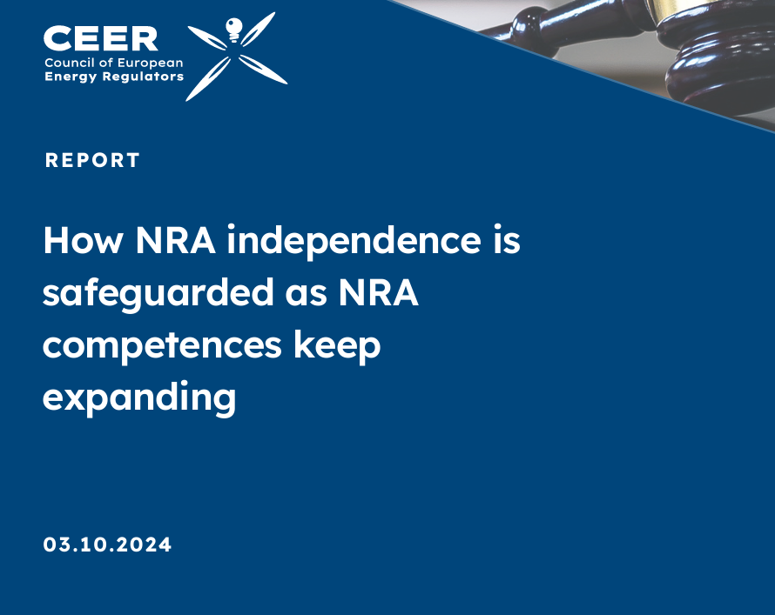
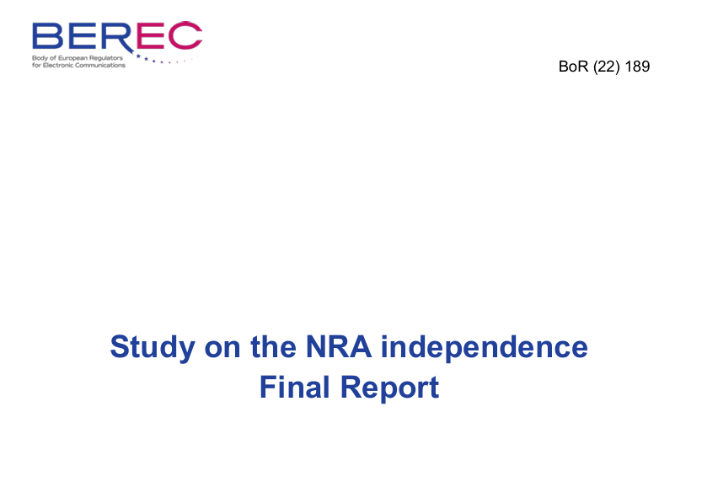
Conflicting views

Slide 14
Main results
Feeling of sufficient independence widely shared among respondents
  Isolated contestation in some states (RoL)
Independence does not mean insulation
No significant
Clear pro-EU stance
Main point of contention: finances

Slide 15
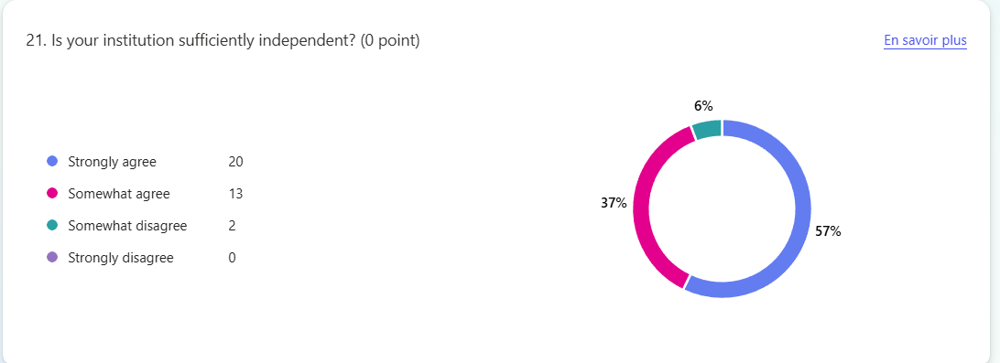

Slide 16
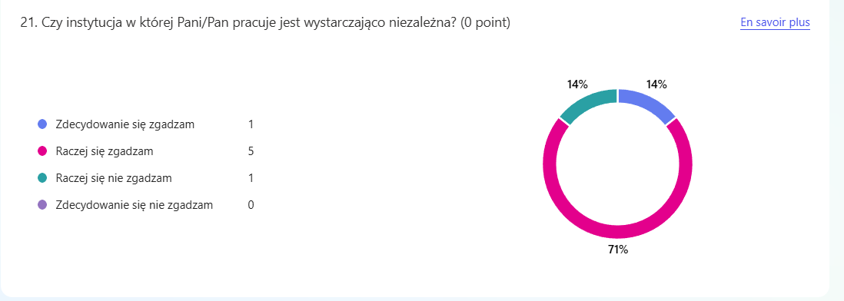

Slide 17
Strong independence, but not always complete
“The Hungarian political system does not allow for complete independence in reality. We are independent in some matters that are not important for politics, but there are actors against whom we do not initiate cases, do not carry out pro-competitive activities, while in other cases we act "toughly", even if this is less justified. So there is a “double standard.” (Comment from Hungarian official)

Slide 18
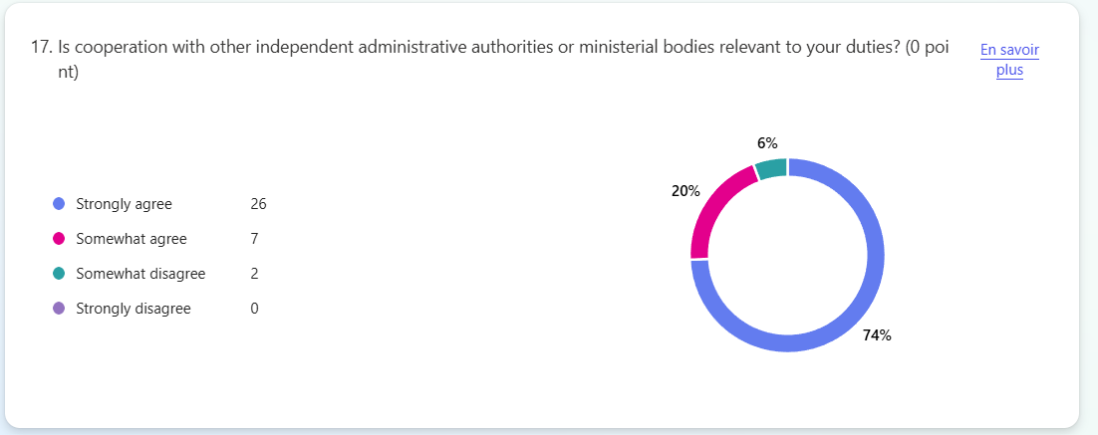

Slide 19
Cooperation
“This is critical to our work, and in many cases the EU framework provides for such cooperation through institutional EU bodies (e.g. BEREC in the case of electronic communications, ERGP in the case of postal, the Board of Digital Service Coordinators in the case of the DSA)”
“Very frequent and relevant”

Slide 20
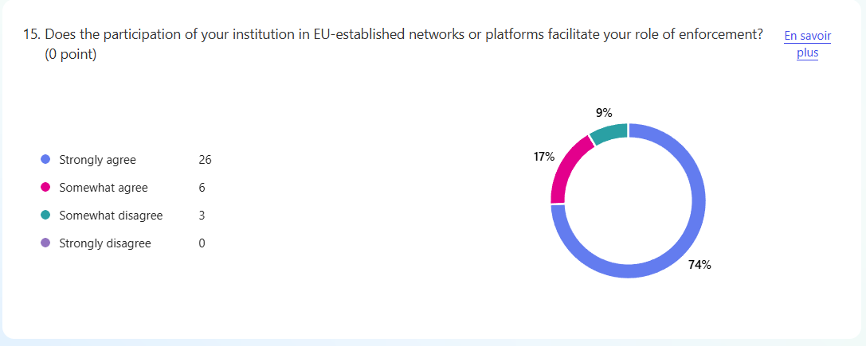

Slide 21
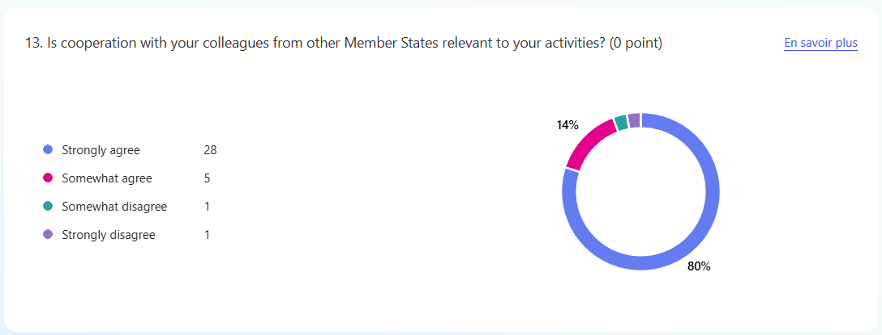

Slide 22
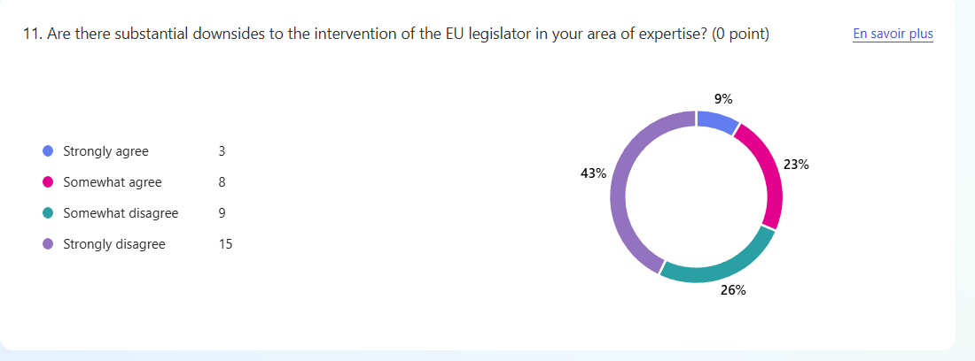

Slide 23
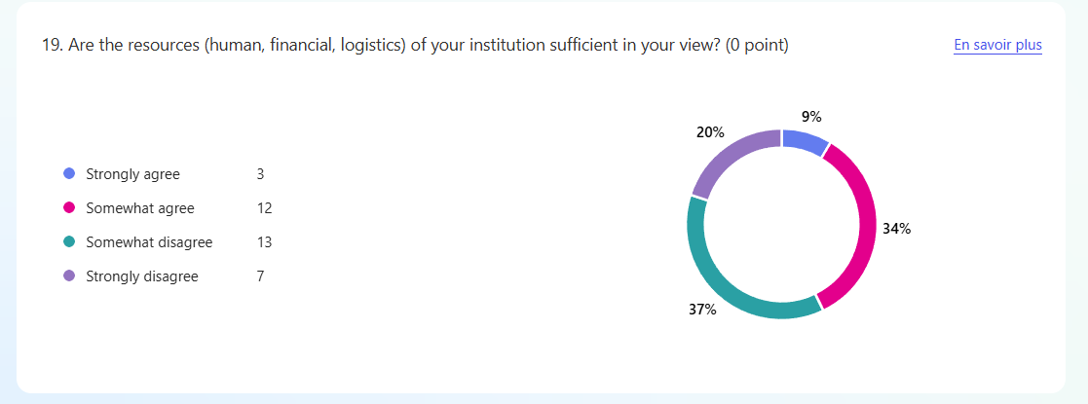

Slide 24
Takeaways
Staff of IPAs mostly perceive that their institution is independent
Cooperation with other bodies (national/EU) is key
Concerns on logistics, not on substance

