Slide 1
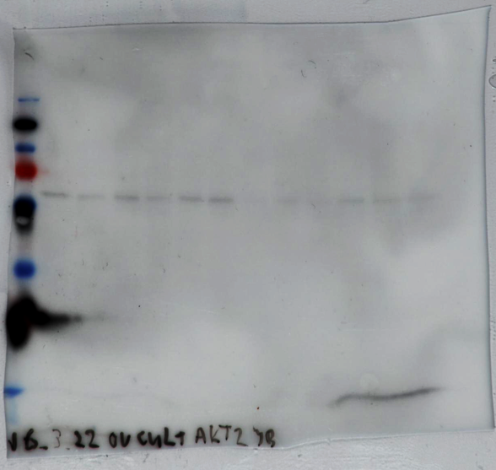
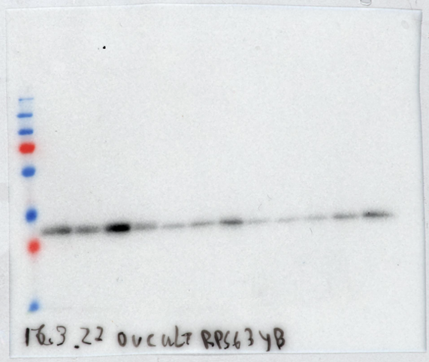
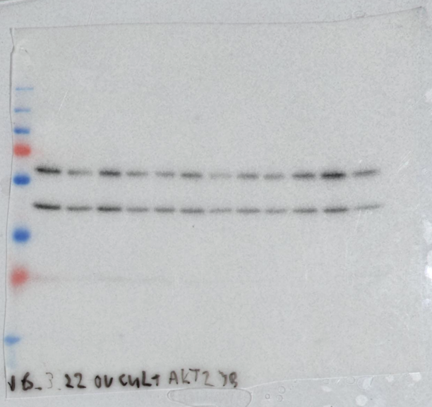
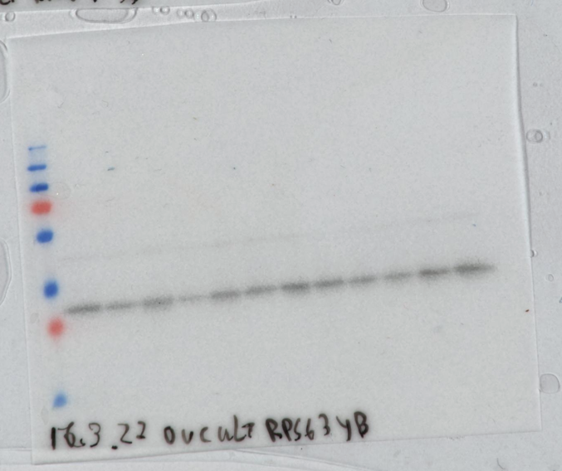
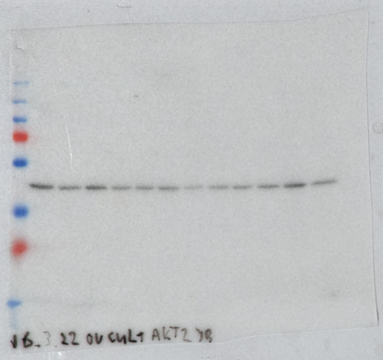
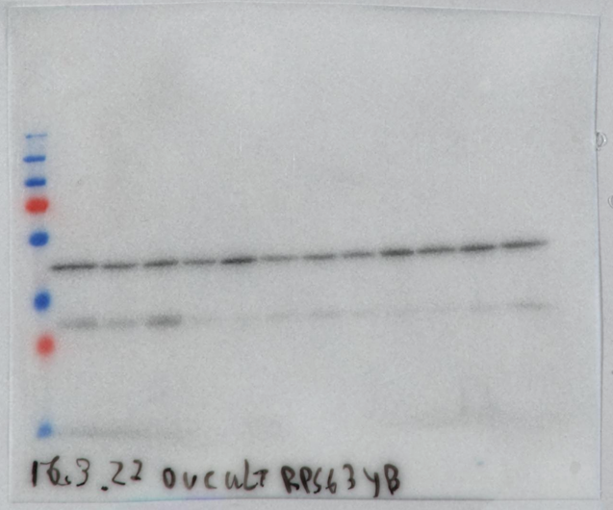
Figure 1 Full uncropped blots
4-HC
+
RAPA
4-HC
+
LY
4-HC
+
BEZ
4-HC
+
RAPA
4-HC
+
LY
4-HC
+
BEZ
A
B
CT
4-HC
CT
4-HC
Observed molecular weight
pAkt
(60 kDa)
(32 kDa)
pRps6
Akt
(60 kDa)
*
(32 kDa)
Rps6
Actin
(42 kDa)
(42 kDa)
Actin
* Stripping was not performed after Actin revelation.
Therefore, we observe Actin during Akt revelation.

Slide 2
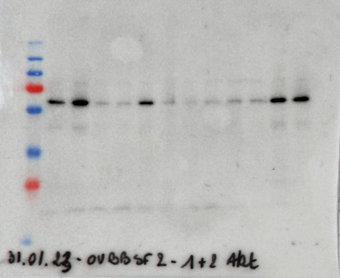
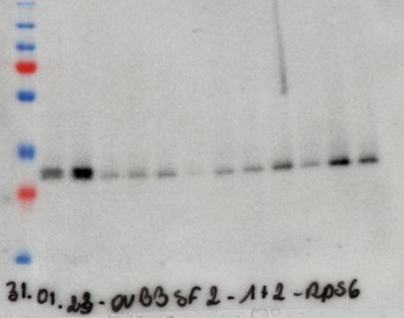
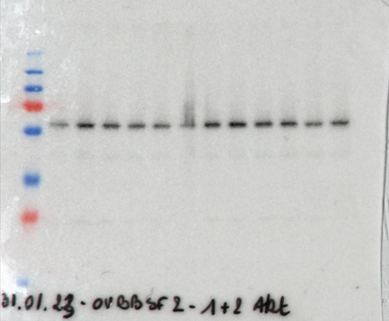
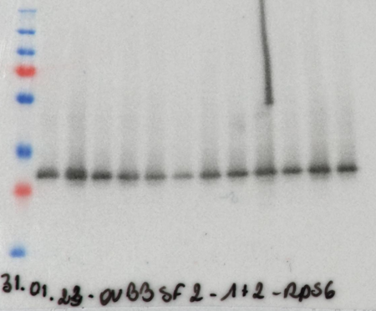
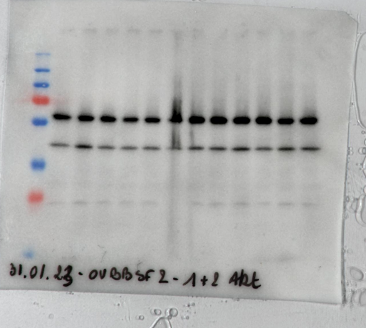
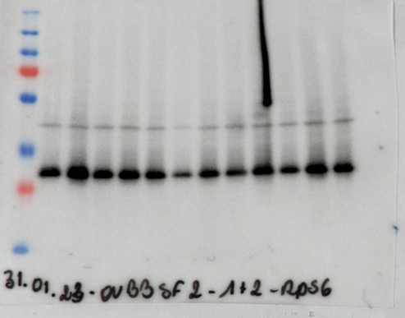
Figure 2 Full uncropped blots
A
B
RAPA
BEZ
CT
RAPA
BEZ
CT
LY
LY
Observed molecular weight
pAkt
(60 kDa)
(32 kDa)
pRps6
Akt
(60 kDa)
(32 kDa)
Rps6
*
(42 kDa)
(42 kDa)
Actin
Actin
**
* Stripping was not performed after Akt revelation.
Therefore, we observe Akt during Actin revelation.
** Stripping was not performed after Rps6 revelation.
Therefore, we observe Rps6 during Actin revelation.

Slide 3
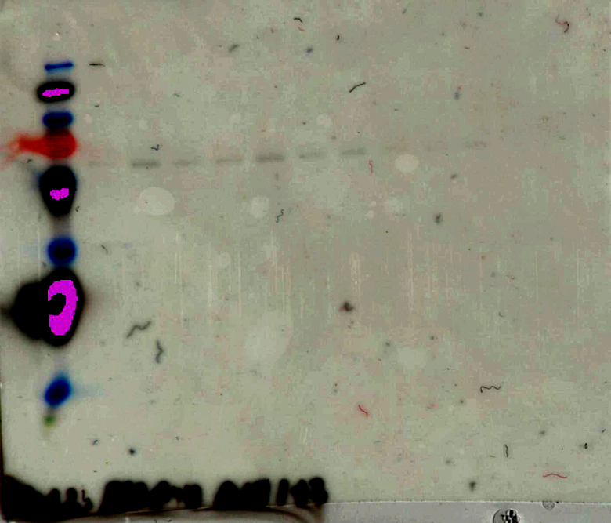
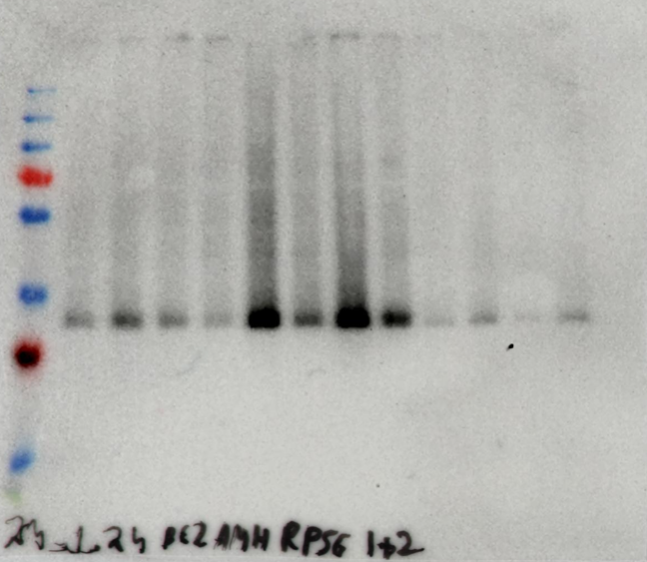
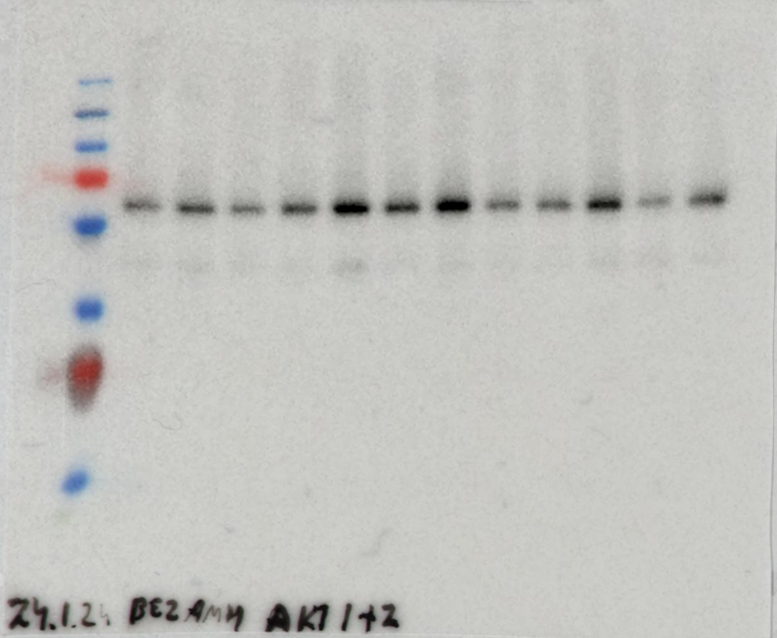
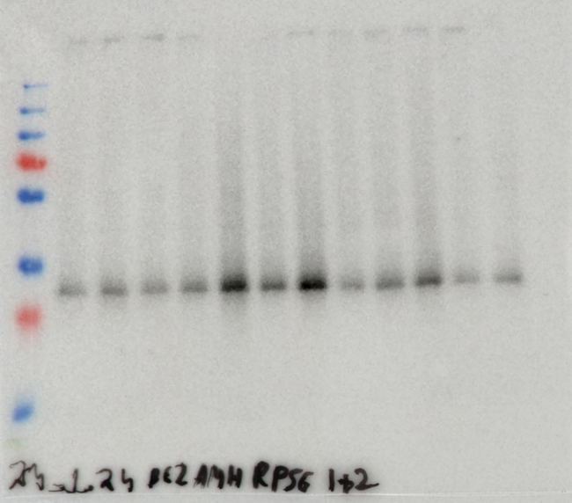
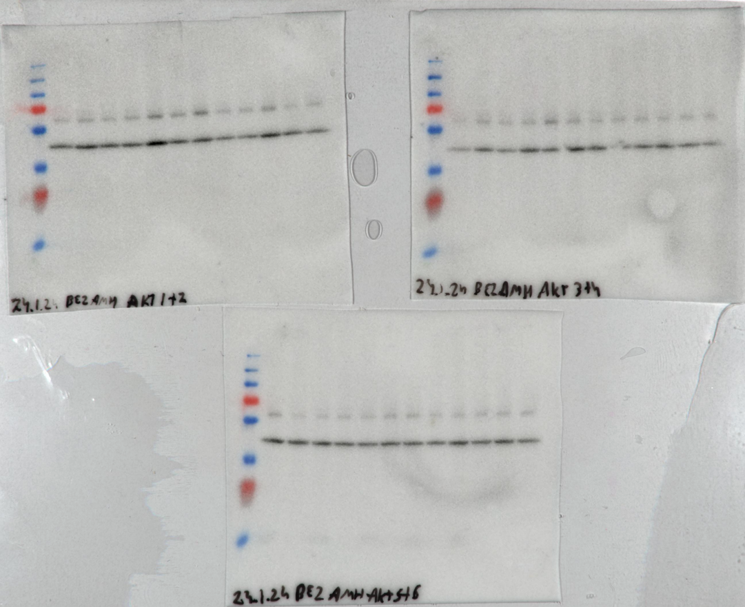
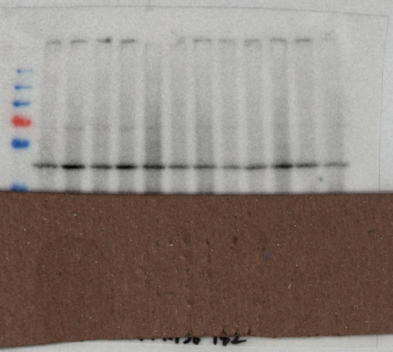
Figure 3 Full uncropped blots
A
B
4-HC
AMH
BEZ
+
-
-
4-HC
AMH
BEZ
+
-
-
+
+
-
-
-
-
+
+
-
+
-
+
+
+
+
-
-
-
+
-
+
+
+
+
Observed molecular weight
pAkt
(60 kDa)
(32 kDa)
pRps6
Akt
(60 kDa)
(32 kDa)
Rps6
Actin
(42 kDa)
(42 kDa)
Actin

