Slide 1


Changes in Mineral Content and Mechanical Properties of Calcified Cartilage in the Knee during Aging
Laura Müller ¹, Stéphane Blouin², Pierre Drion ¹, Markus A. Hartmann², Davide Ruffoni ¹
¹ University of Liege, Liege, Belgium ;
² Ludwig Boltzmann Institute of Osteology, Vienna, Austria
Musculoskeletal biomechanics VII: Soft tissues and interfaces
📅 03/07/2024
✉ laura.muller@uliege.be
🌐 www.biomat.uliege.be

Slide 2
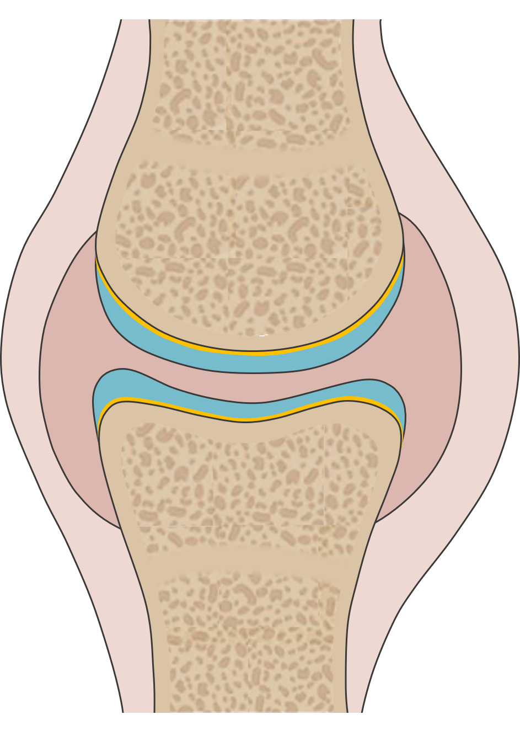
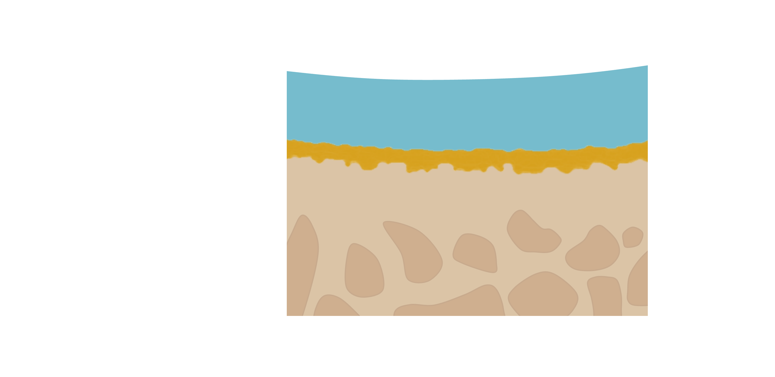
The Impact of Aging on the Proximal Tibia
Femur
Clinical relevance:
Aging is the main risk factor of joint diseases
Materials engineering:
Attachment of dissimilar materials on a very small area
Osteochondral junction
Uncalcified cartilage (UC)
20 MPa
Calcified cartilage (CC)
~80 µm
Subchondral bone (SB)
20 GPa
Tibia
1/10

Slide 3
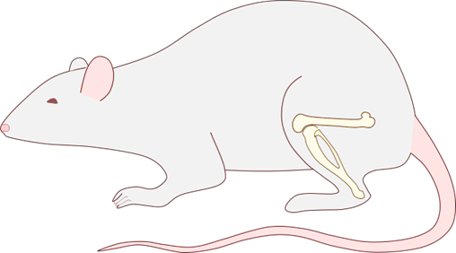
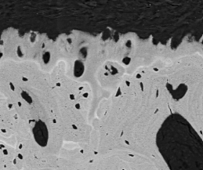
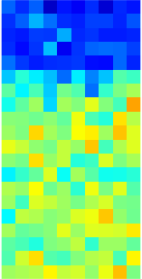
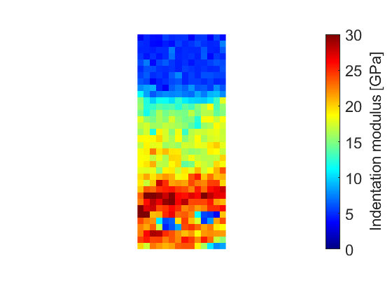
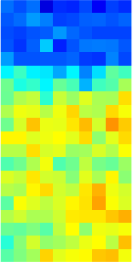
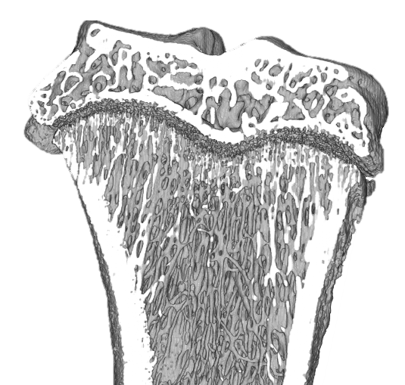
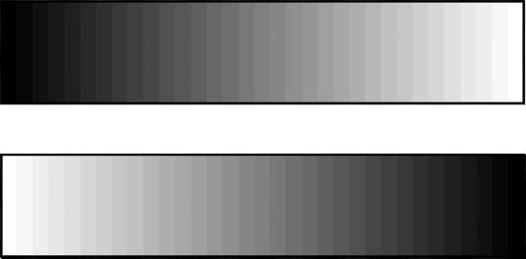

A Multimodal Analysis of Proximal Tibia
Animal model: Wistar Rats
Adult 3 months (n=6)
Old 13 months (n=6)
Microstructure
Mineral content
Mechanical properties
µCT – 10 µm
Quantitative backscattered electron microscopy
qBEI – 0.88 µm
Nanoindentation
Lateral spacing : 1.5 µm
Loss of trabecular BV/TV
Increase of thickness subchondral plate
CC
Ca [wt%]
CC
H [GPa]
E [GPa]
SB
3 mm
Ludwig Boltzmann Institute of Osteology
250 µm
30 µm
2/10

Slide 4
Qualitative Analysis of Mineral Content
Adult
Old
Uncalcified Cartilage
Calcified Cartilage
Cement Line
Subchondral Bone
100 µm
100 µm
Aging:
Thickening of calcified cartilage
Mineralization of chondrocytes lacunae
Reduced roughness at the tidemark due to less chondrocytes
4/10

Slide 5
Qualitative Analysis of Mineral Content
Adult
Old
Mineralized lacunae
Uncalcified Cartilage
Calcified Cartilage
Cement Line
Subchondral Bone
100 µm
100 µm
Aging:
Thickening of calcified cartilage
Mineralization of chondrocytes lacunae
Reduced roughness at the tidemark due to less chondrocytes
4/10

Slide 6
Qualitative Analysis of Mineral Content
Adult
Old
Mineralized lacunae
Uncalcified Cartilage
Calcified Cartilage
Cement Line
Subchondral Bone
100 µm
100 µm
Aging:
Thickening of calcified cartilage
Mineralization of chondrocytes lacunae
Reduced roughness at the tidemark due to less chondrocytes
4/10

Slide 7
Qualitative Analysis of Mineral Content
Adult
Old
Mineralized lacunae
Uncalcified Cartilage
Calcified Cartilage
Cement Line
Subchondral Bone
100 µm
100 µm
Aging:
Thickening of calcified cartilage
Mineralization of chondrocytes lacunae
Reduced roughness at the tidemark due to less chondrocytes
4/10

Slide 8
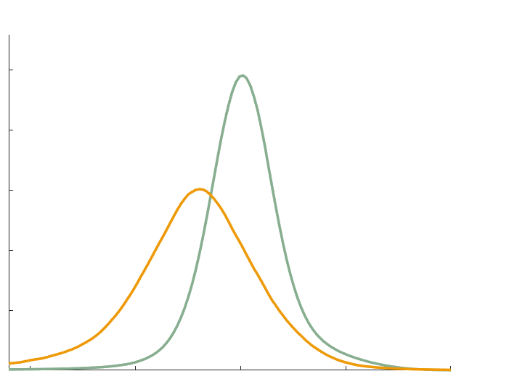
Frequency Distribution of Mineral Content
0.25
0.2
Adult Bone
0.15
Frequency [%]
0.1
0.05
Adult Cartilage
0
15
20
25
30
35
Ca [wt%]
5/10

Slide 9
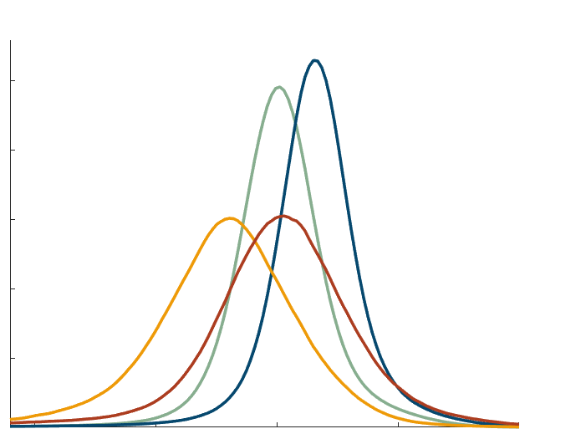

Frequency Distribution of Mineral Content
0.25
Adult Bone
Old Bone
0.2
0.15
Frequency [%]
0.1
Adult Cartilage
Old Cartilage
0.05
0
15
20
25
30
35
Ca [wt%]
5/10

Slide 10
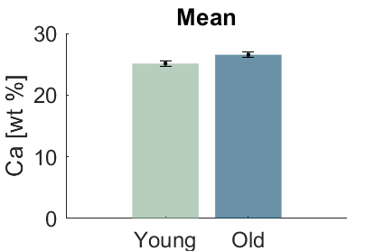
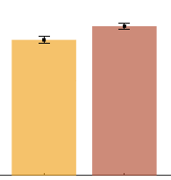
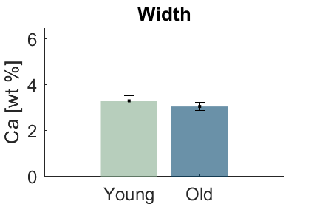
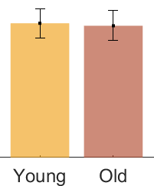
Frequency Distribution of Mineral Content
Bone
Cartilage
+6%*
+10%*
30
0.25
20
Adult Bone
Old Bone
Ca Mean [wt%]
0.2
10
0.15
0
Frequency [%]
Adult
Old
Adult
Old
0.1
-2%
6
Adult Cartilage
Old Cartilage
-7%*
0.05
4
Ca Width [wt%]
2
0
0
15
20
25
30
35
Ca [wt%]
Adult
Old
Adult
Old
*p-value: 0.05
5/10

Slide 11
Frequency Distribution of Mineral Content
Bone
Cartilage
+6%*
+10%*
30
0.25
20
Adult Bone
Old Bone
Ca Mean [wt%]
0.2
10
0.15
0
Frequency [%]
Adult
Old
Adult
Old
0.1
-2%
6
Adult Cartilage
Old Cartilage
-7%*
0.05
4
Ca Width [wt%]
2
0
0
15
20
25
30
35
Ca [wt%]
Adult
Old
Adult
Old
*p-value: 0.05
5/10

Slide 12
Frequency Distribution of Mineral Content
Bone
Cartilage
+6%*
+10%*
30
0.25
20
Adult Bone
Old Bone
Ca Mean [wt%]
0.2
10
0.15
0
Frequency [%]
Adult
Old
Adult
Old
0.1
-2%
6
Adult Cartilage
Old Cartilage
-7%*
0.05
4
Ca Width [wt%]
2
0
0
15
20
25
30
35
Ca [wt%]
Adult
Old
Adult
Old
*p-value: 0.05
5/10

Slide 13
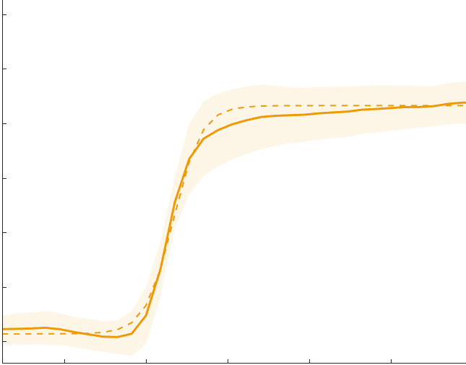
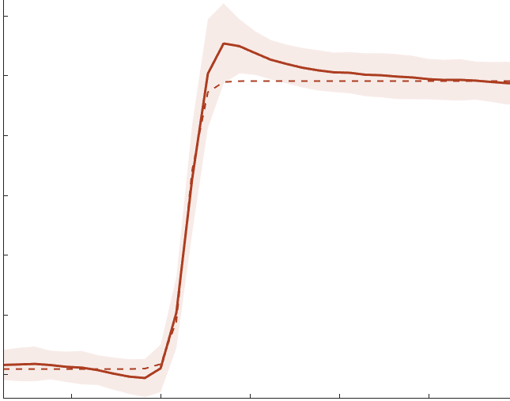
Mineral Gradients across Cartilage Interface
Adult
Old
30
Uncalcified
Calcified
30
Uncalcified
15 µm
Calcified
22 µm
20
Average
Sigmoid fit
20
Average
Sigmoid fit
Ca Content [wt%]
Ca Content [wt%]
UC
UC
10
CC
10
CC
SB
SB
0
0
-5
0
5
10
15
-5
0
5
10
15
Distance [µm]
Distance [µm]
6/10

Slide 14
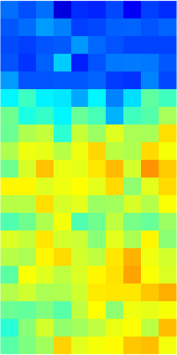
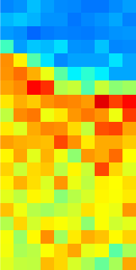
Indentation Modulus Maps in Mineralized Cartilage
Adult
Old
UC
UC
UC
UC
CC
CC
CC
CC
50 µm
30 µm
30 µm
0
15
30
45
0
15
30
0
15
30
45
0
15
30
Ca Content [wt%]
Indentation
Modulus [GPa]
Ca Content [wt%]
Indentation
Modulus [GPa]
7/10

Slide 15
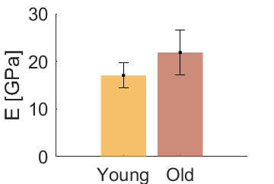
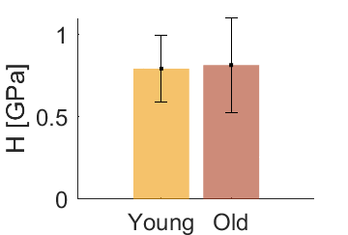
Quantitative Analysis in Mineralized Cartilage
Stiffness
Hardness
+2%
30
+28%*
1
20
0.7
E [GPa]
H [GPa]
10
0.3
0
0
Adult
Old
Adult
Old
*p-value: 0.05
8/10

Slide 16
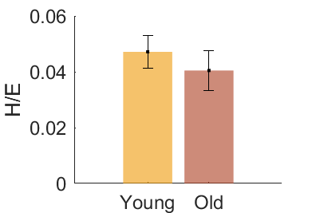
Quantitative Analysis in Mineralized Cartilage
Stiffness
Hardness
Ratio Hardness/Stiffness
+2%
30
+28%*
0.06
-14%*
1
20
0.04
0.7
H/E [-]
E [GPa]
H [GPa]
10
0.3
0.02
0
0
0
Adult
Old
Adult
Old
Adult
Old
*p-value: 0.05
8/10

Slide 17
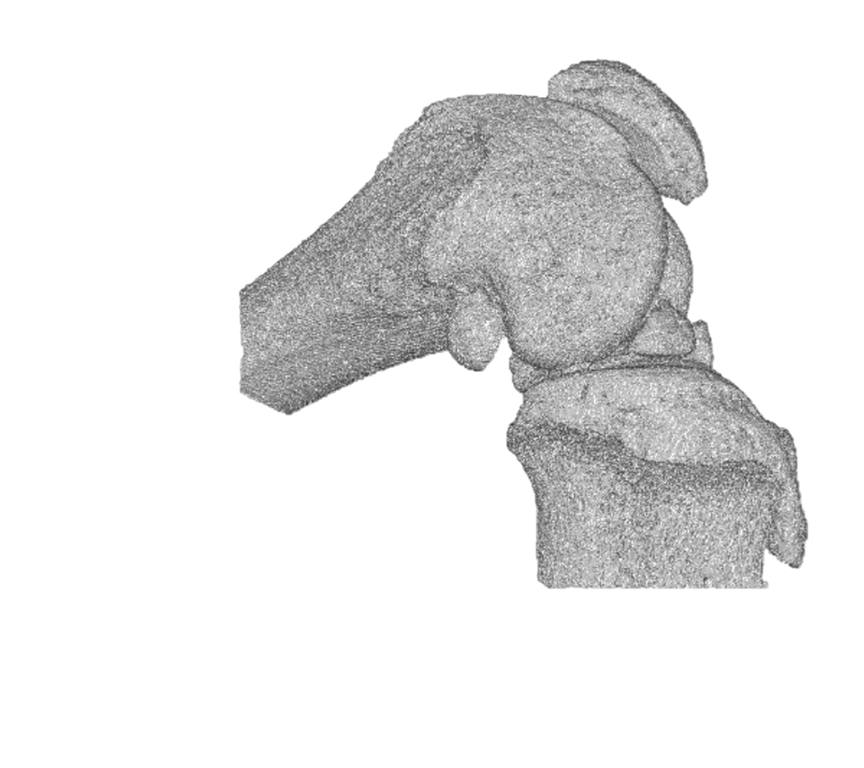
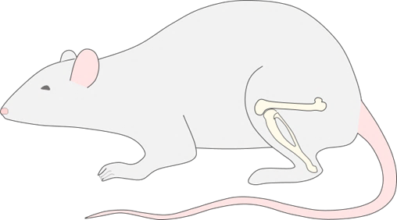


Conclusion
Analyses show significative changes in the proximal tibia's microstructure, mineral content, and stiffness with age
Strains & Displacements distribution
µCT & Digital volume correlation
Enrico Dall’Ara
Sriram Kunnoth
Supported by mobility grant ESB
9/10

Slide 18




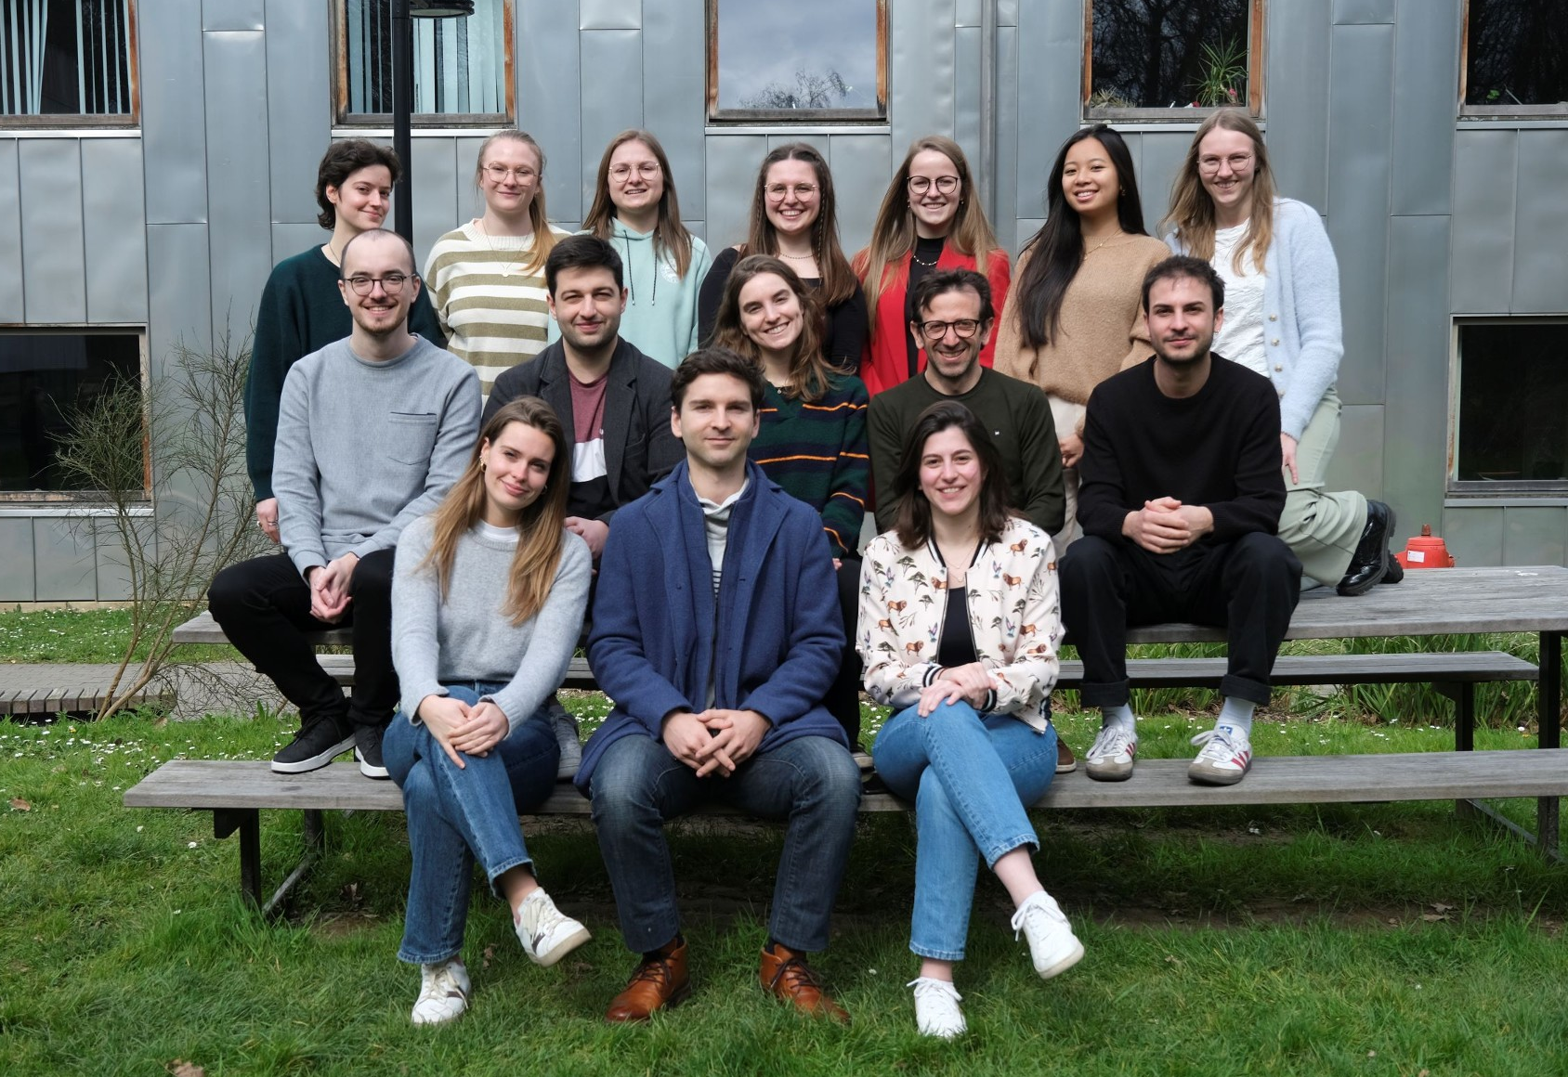




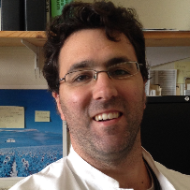

Thanks to all co-authors!
University of Liège, Belgium
University of Liege, Belgium
Pierre
DRION
Davide
RUFFONI
Ludwig Boltzmann Institute of Osteology, Austria
Markus
HARTMANN
Stéphane
BLOUIN
10/10

Slide 19


Thank you for your attention!
Any questions?
@Mllr_Laura
Laura Müller

Slide 20
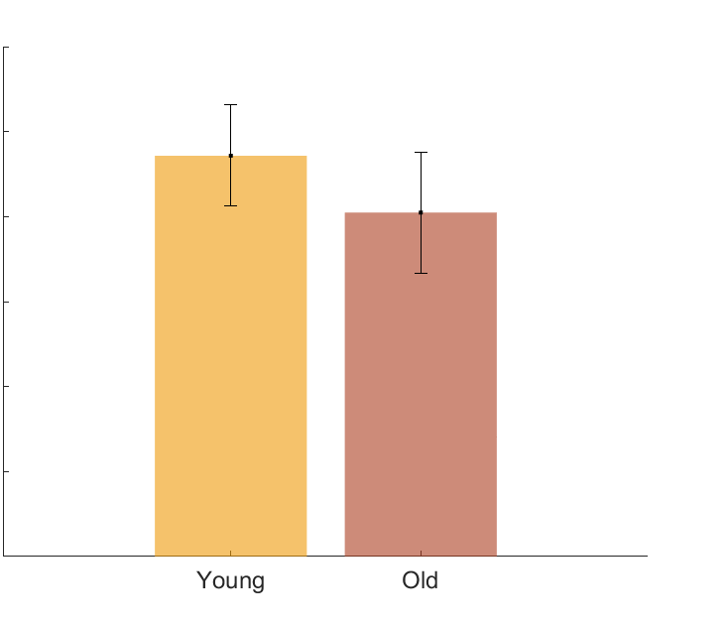
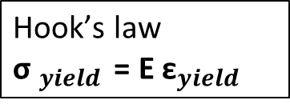
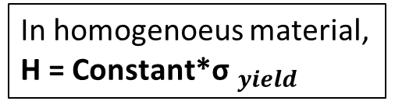
Quantitative Analysis in Mineralized Cartilage
30
+28%*
In homogenoeus material, H = Constant*${\text{σ} }_{yield }$
$$\text{Hook}\text{’}\text{s} \text{law}$$
${\text{σ} }_{yield }$ = E ${\text{ε}}_{yield }$
20
E [Gpa]
10
0.06
0.05
0
+2%
0.04
H/E [-]
1
0.03
0.02
0.7
H [Gpa]
0.01
0.3
0
0
Adult
Old
Adult
Old

Slide 21
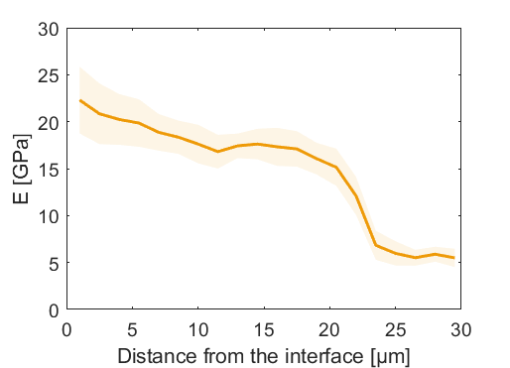
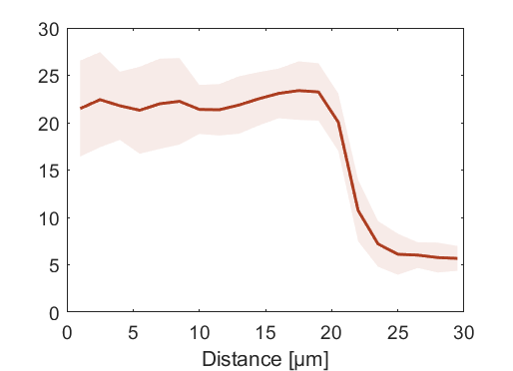
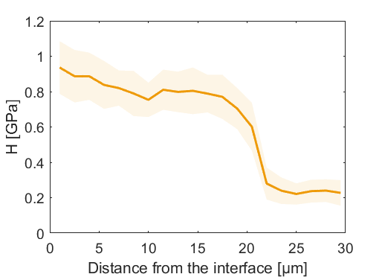
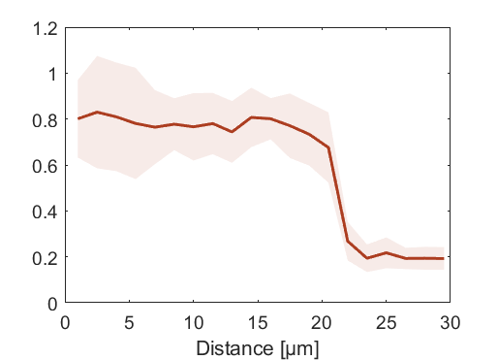
Quantitative Analysis in Mineralized Cartilage
Adult
Old
30
+28%*
30
30
20
20
20
E [Gpa]
E [GPa]
E [GPa]
10
10
10
0
0
0
-5
0
5
10
20
-5
0
5
10
20
+2%
Distance [µm]
Distance [µm]
1
1
1
0.7
0.7
0.7
H [Gpa]
H [GPa]
H [GPa]
0.3
0.3
0.3
0
0
0
-5
0
5
10
20
Adult
Old
-5
0
5
10
20
Distance [µm]
Distance [µm]

Slide 22
Nanoindentation
  Berkovitch tip (50 nm tip radius)
  Displacement controlled trapezoidal load function
  10s loading, 15s holding, 10s unloading
  Penetration depth of ~150 nm
  Lateral spacing of 1.5 µm

Slide 23
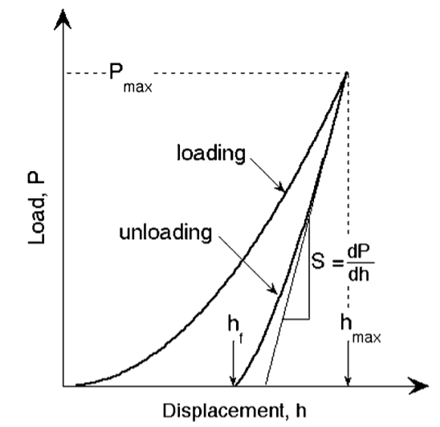
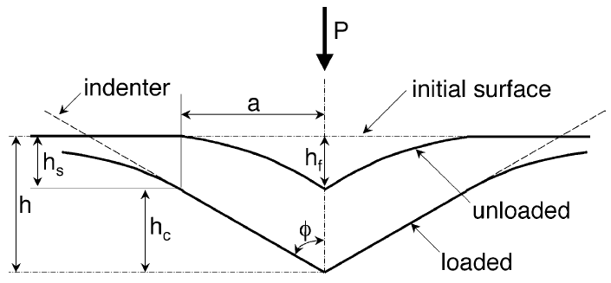

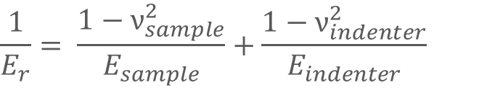


Nanoindentation
Based on Oliver Pharr model which assumes that elastic and plastic deformations during loading and only elastic displacements recovered during unloading
Berkovitch tip → β
From P-h curves: max load, max displacement and elastic unloading stiffness
From calibration in FQ (reference material): contact area →
Hardness estimation:
Elastic modulus measurements (derived from eastic contact theory):
E_{r} accounts for elastic displacement in both sample and tip
$$A=F\left(h_{c}\right)$$
$$H= \frac{P_{max}}{A}$$
$$E_{r}= \frac{1}{β}\frac{S}{2}\sqrt{\frac{π}{A(h_{c})}}$$
$$\frac{1}{E_{r}}= \frac{1−ν_{sample}^{2}}{E_{sample}}+\frac{1−ν_{indenter}^{2}}{E_{indenter}}$$

Slide 24
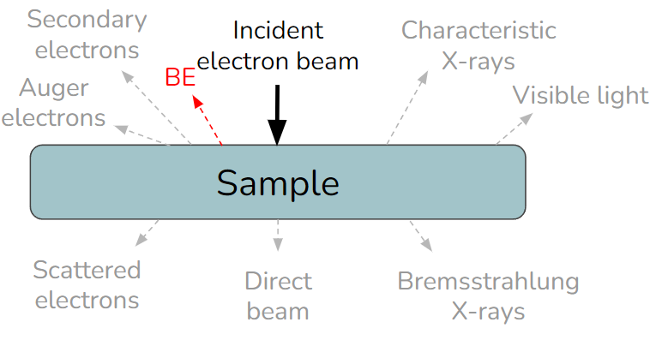
qBEI Calibration
When sending a beam of electrons over a sample, electrons interact with atoms, producing various signals (including BE)
BE are electrons from the beam that are reflected back because they are deviated by atom nuclei
Therefore, BE signal is highly sensitive to the local atomic number (Z): the higher the atomic number of the atoms hit by the beam, the higher the BE signal
Bone is a heterogeneous material, composed of varying proportion of:
  Organic matrix: Z ~ 6
  Hydroxylapatite Ca₅(PO₄)₃OH: Z ~ 14.06
The constituent with the highest atomic number dominantly influences the BEs intensity (Ca, Z = 20)

Slide 25
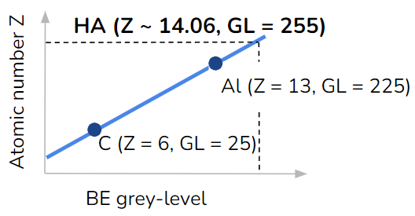
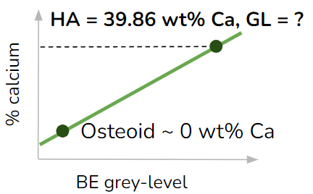
qBEI Calibration
How can we connect grey level (GL) to local Ca concentration ?
Adjust machine parameters to get GL of 2 reference materials:
- GL(C) = 25
GL(Al) = 225
Define calibration line with those points
Measure experimentally osteoid GL and fix it as 0 wt% Ca standard
Pure HA is 39.86 wt% Ca, and measure its GL from calibration line (known Zmean = 14.06)
Define standardization line from those points
Ca wt% = -4.332 + 0.1733 × GL
Depth resolution : 2 µm

Slide 26
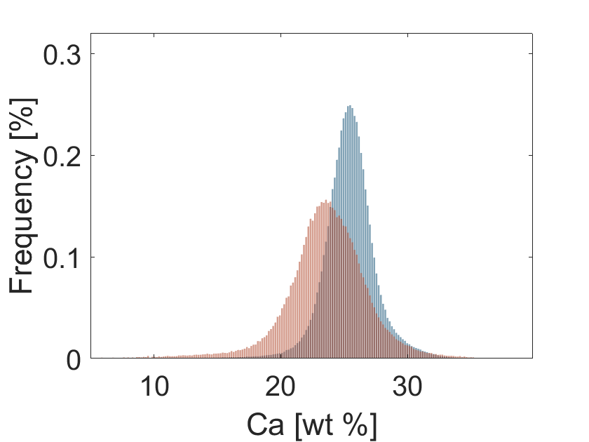
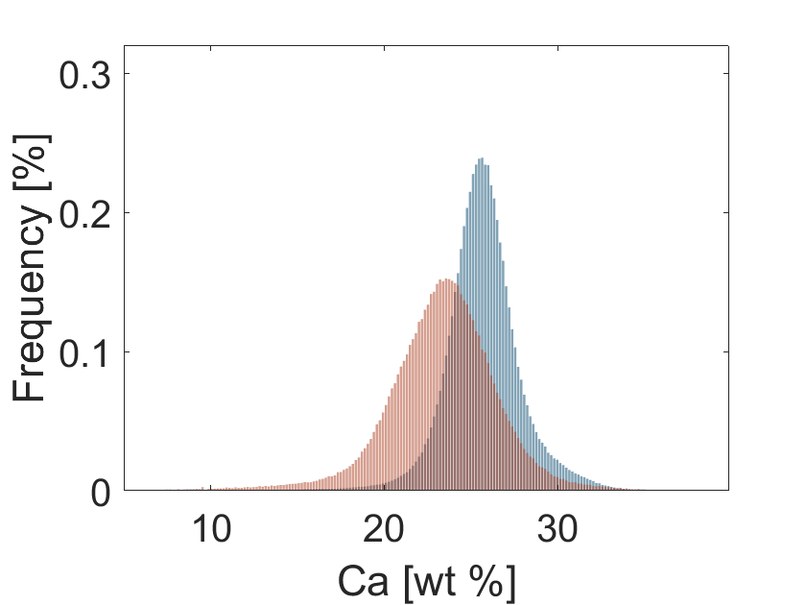
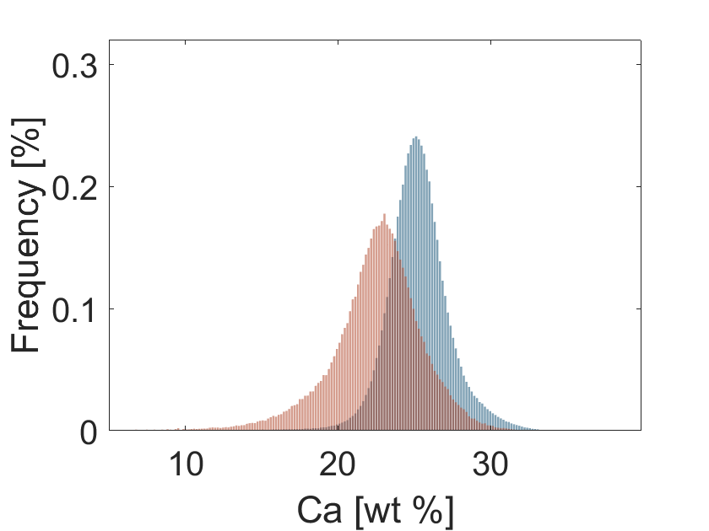
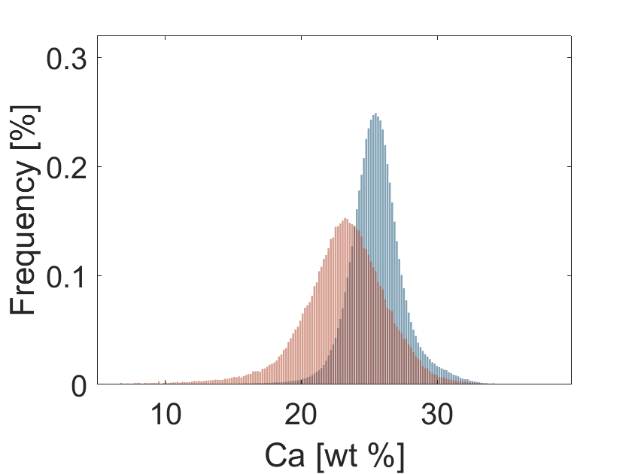
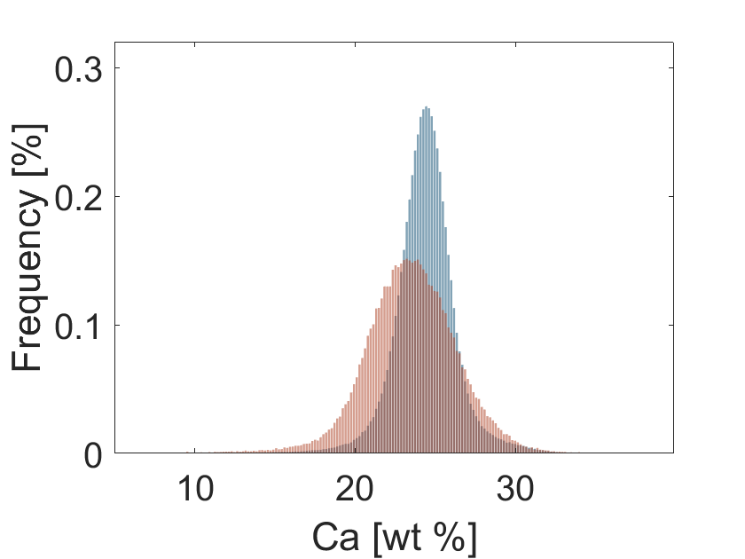
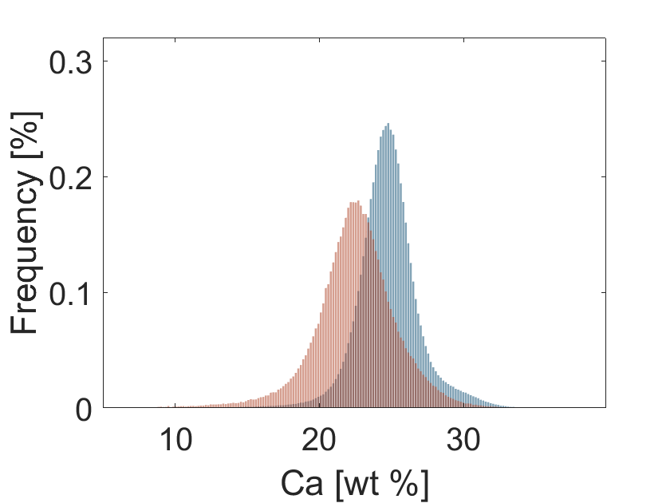
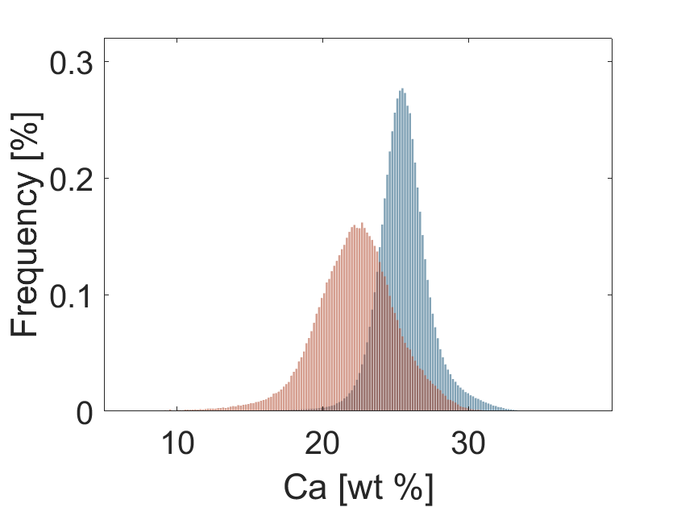
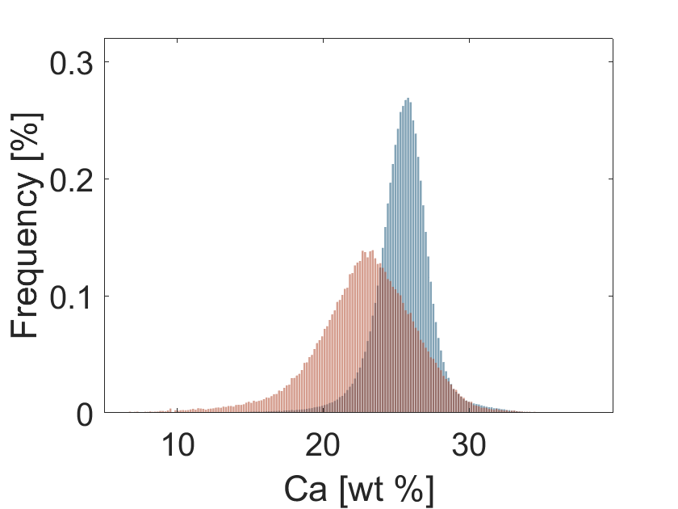
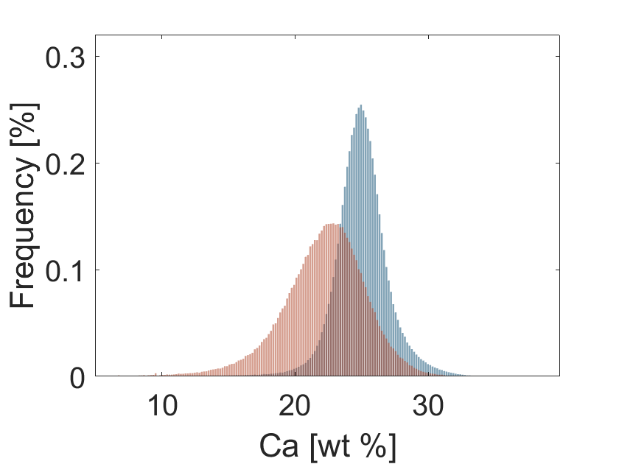
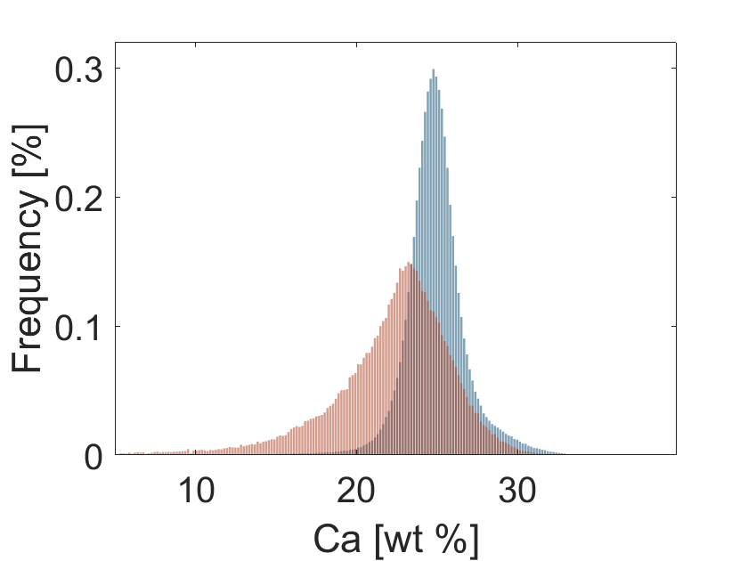


Distributions (Adults)
LM2
Pl1
LM2
Pl2
LM5
Pl1
LM5
Pl2
LM3
Pl1
LM3
Pl2
LM6
Pl1
LM6
Pl2
LM4
Pl1
LM4
Pl2
LM7
Pl1
LM7
Pl2

Slide 27










Distributions (Olds)
LM1
Pl1
LM1
Pl2
LM5
Pl1
LM5
Pl2
LM3
Pl1
LM3
Pl2
LM6
Pl1
LM6
Pl2
LM4
Pl1
LM4
Pl2

