Slide 1
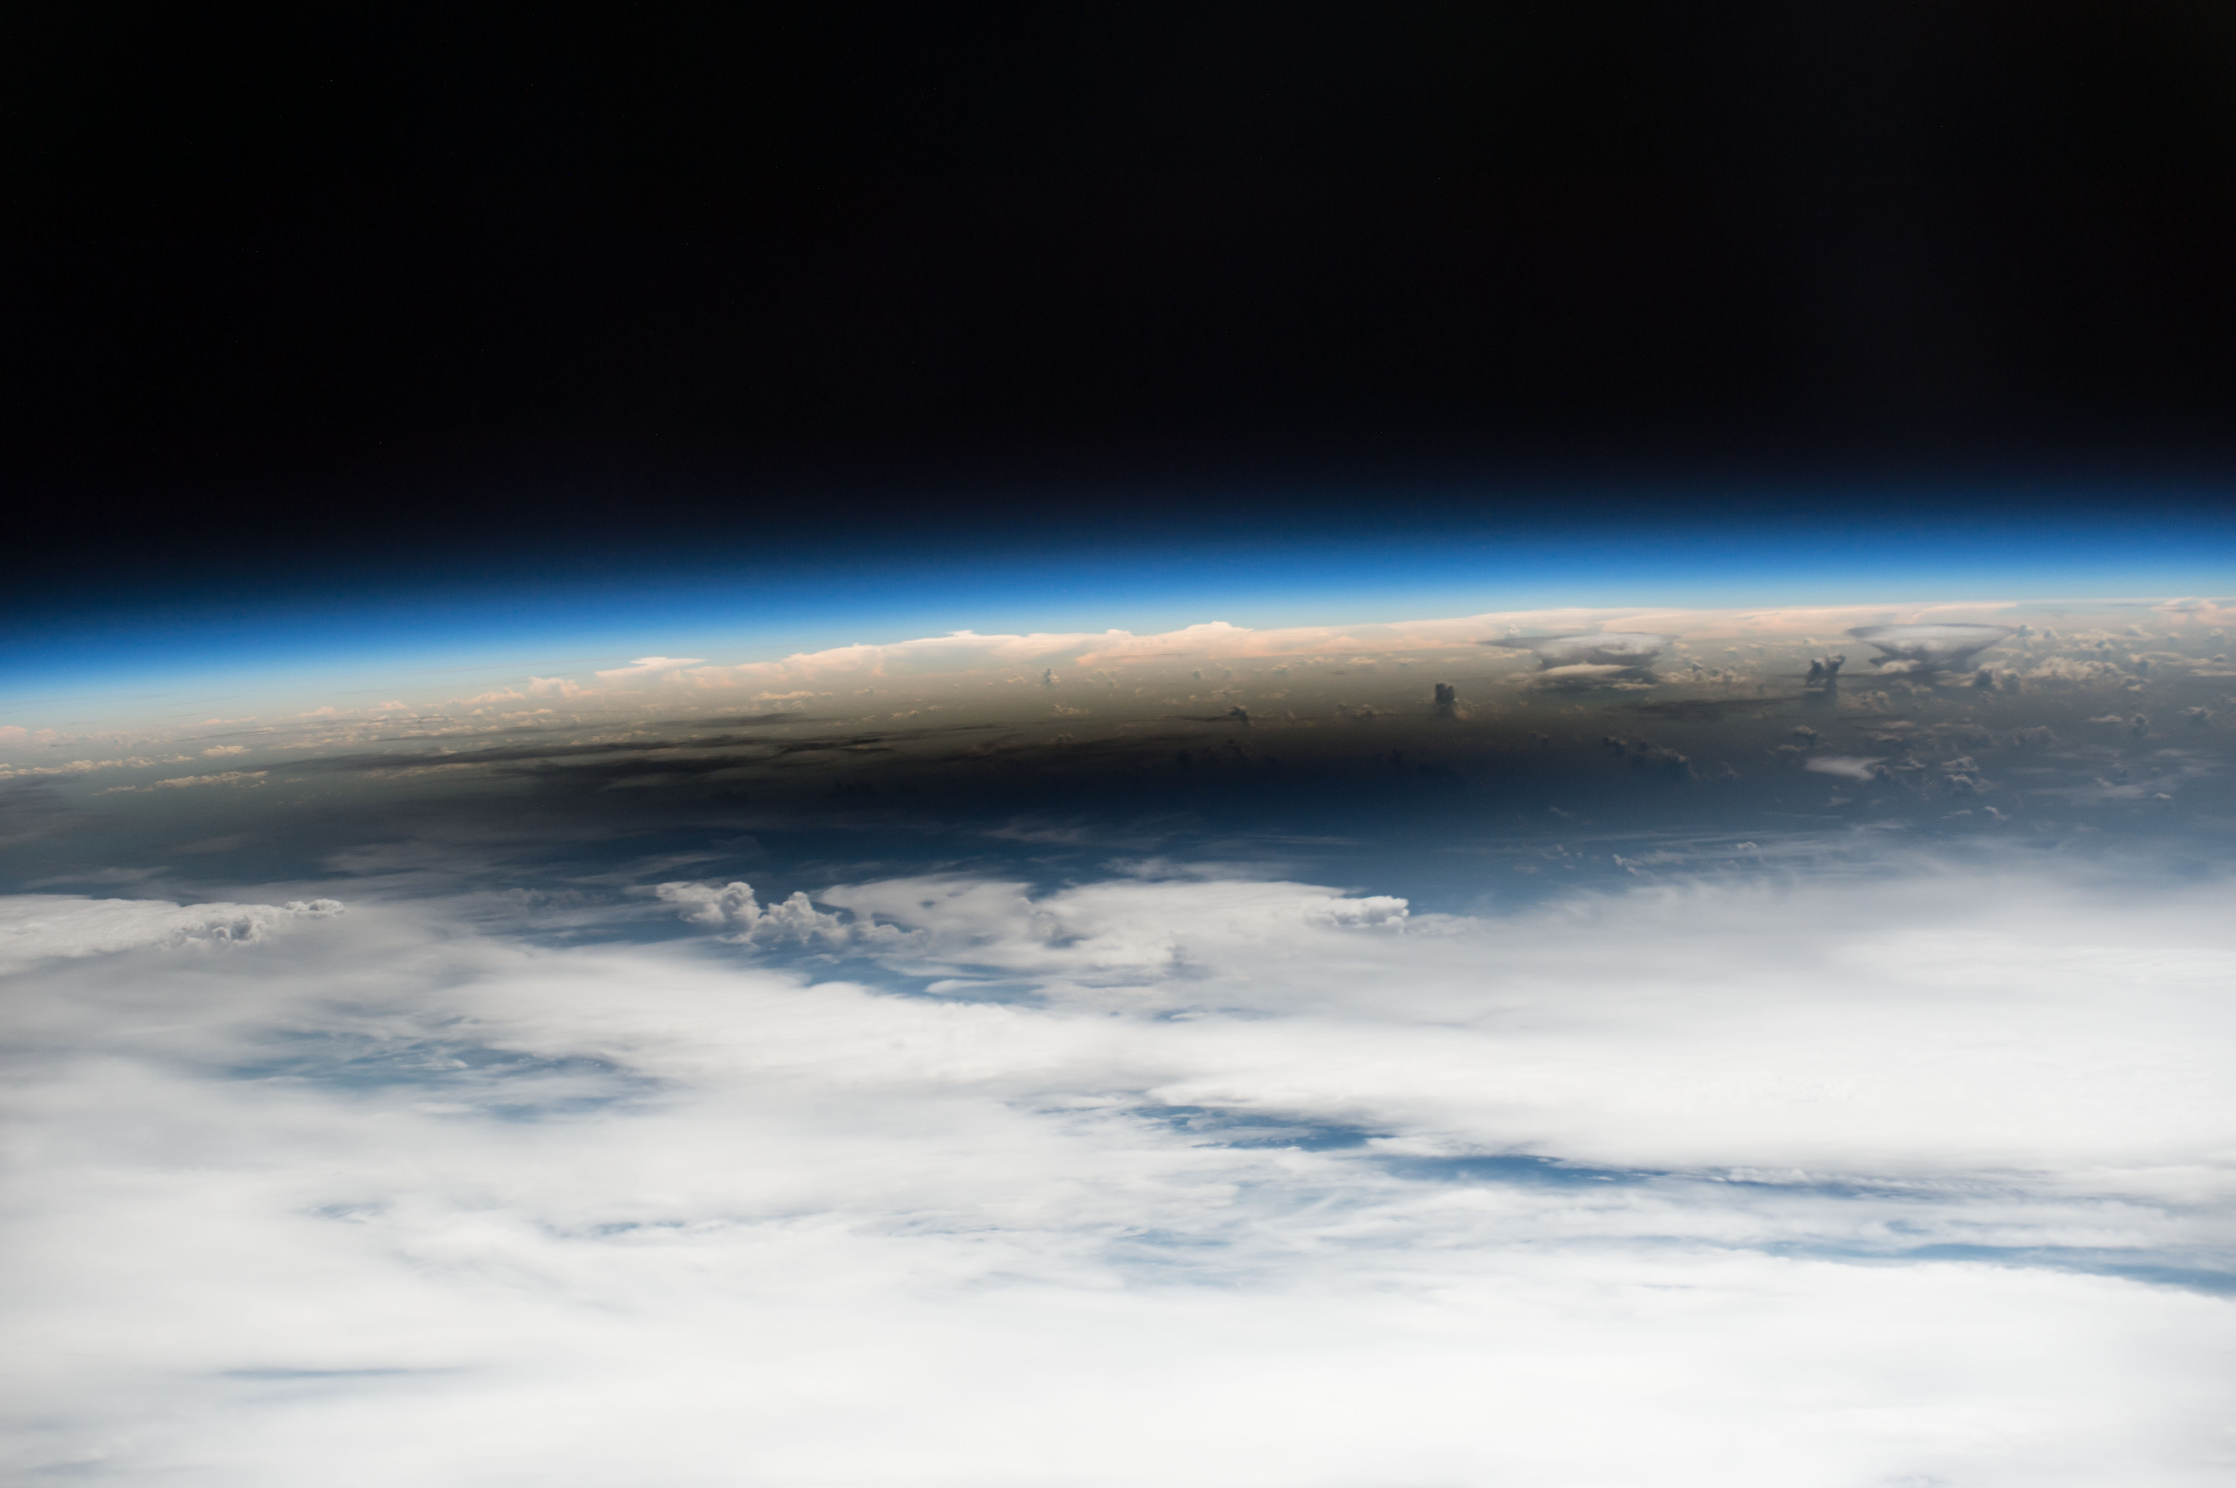
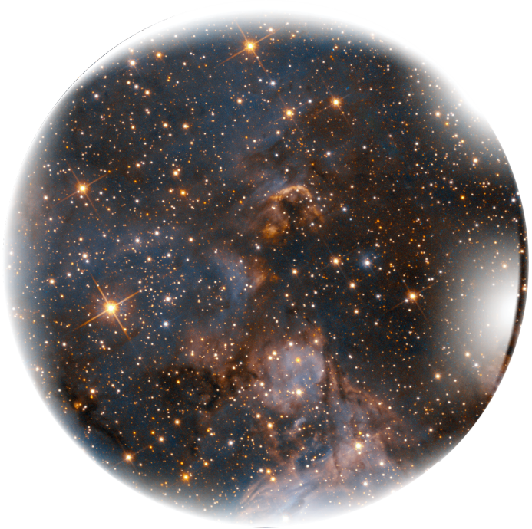
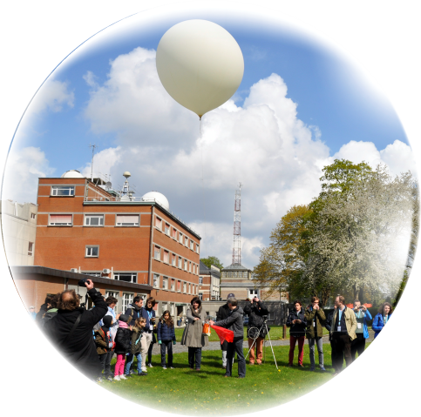



PhD Day

Slide 2



Slide 3
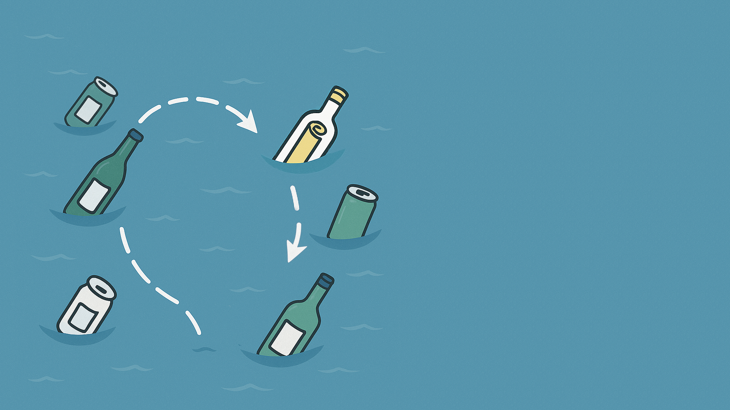
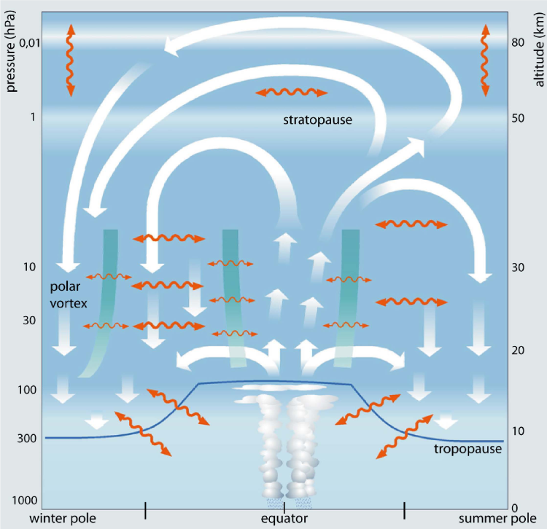
Brewer-Dobson circulation (BDC)
mesospheric overturning
deep branch
deep branch
mixing
mixing
shallow branch
Bönisch et al. (2011), Atmos. Chem. Phys.

Slide 4
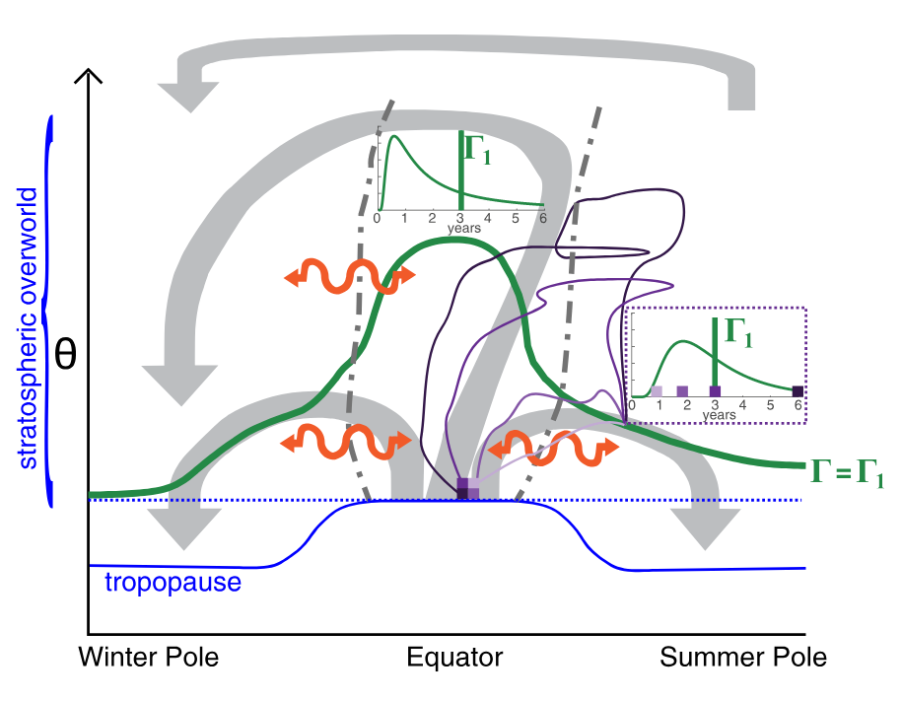
Age of air (AoA) as a proxy for circulation speed
Definition: A measure of the transport time of an air parcel travelling from the tropopause to a certain location in the stratosphere (Stiller, 2008, ACP; Waugh & Hall, 2002, Rev. Geo.)
mesospheric overturning
deep branch
deep branch
mixing
mixing
shallow branch
Garny et al. (2024), Rev. Geophys.

Slide 5

A perfect tracer for stratospheric age of air
Trace gas
Tropospheric source
Linear increase in the troposphere
Chemically inert (long-lived)
Two options:
Idealized “clock” tracers in models: can’t compare to observations
Real tracers: never perfect

Slide 6
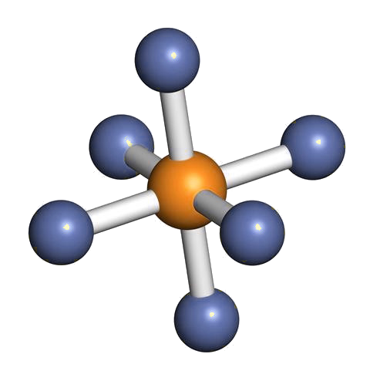
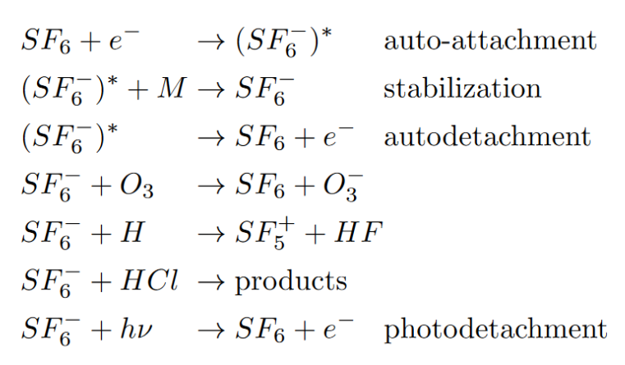
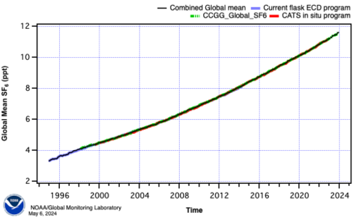
Sulfur hexafluoride
SF₆
Produced by humans at the surface of the Earth.
Nearly linear increase in the troposphere.
Destroyed in the mesosphere.
Strong greenhouse gas.
Notes:
End of introduction

Slide 7
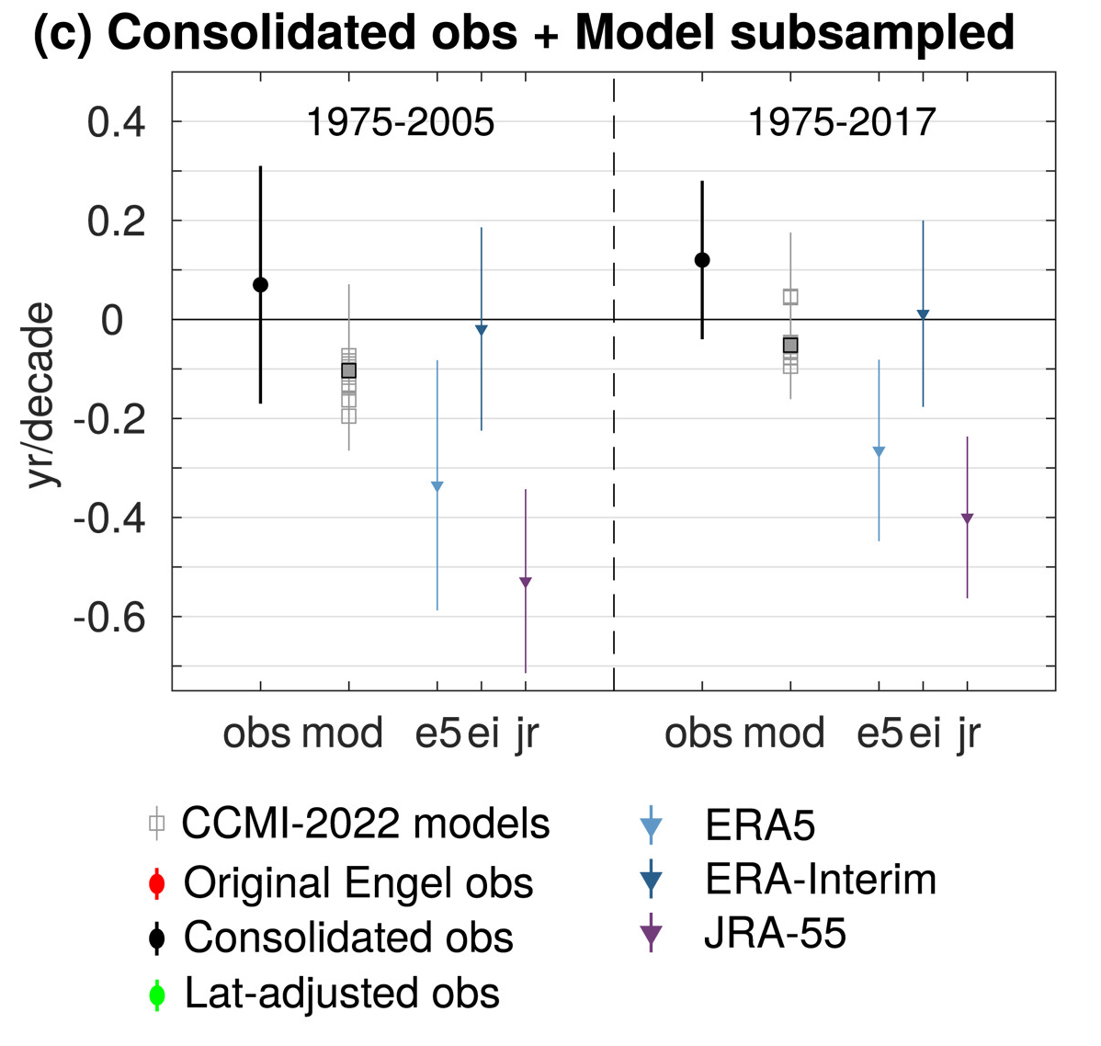
Disagreement between AoA trends from models, observations and reanalyses
Consolidated obs = AoA computed using non-linearity correction by Stiller et al., 2012, an inverse Gaussian shape for the age spectrum and a climatological mean for the ratio of the moments from CLaMS simulations driven by ERA-Interim
Garny et al. (2024), Rev. Geophys.

Slide 8



The Belgian Assimilation System for Chemical ObsErvations (BASCOE)
Winds and temperature (e.g. reanalyses)
Based on a chemistry transport model (Errera et al., 2019, Atmos. Chem. Phys.)
More than 200 chemical equations and around 60 species
Initial conditions
Boundary conditions
kinetic preprocessor (KPP)

Slide 9




BASCOE simulations
Definition: A reanalysis data set is a model simulation combined with observations (via data assimilation) to provide a globally complete picture of the atmosphere that contains real world information.
ERA5, Hersbach et al. 2020, Q.J.Roy.
MERRA2, Gelaro et al. 2017, J.Clim.
JRA-3Q, Kosaka et al. 2023, JMSJ
Input for 3 different BASCOE simulations! CTM-E5, CTM-M2 and CTM-J3Q

Slide 10
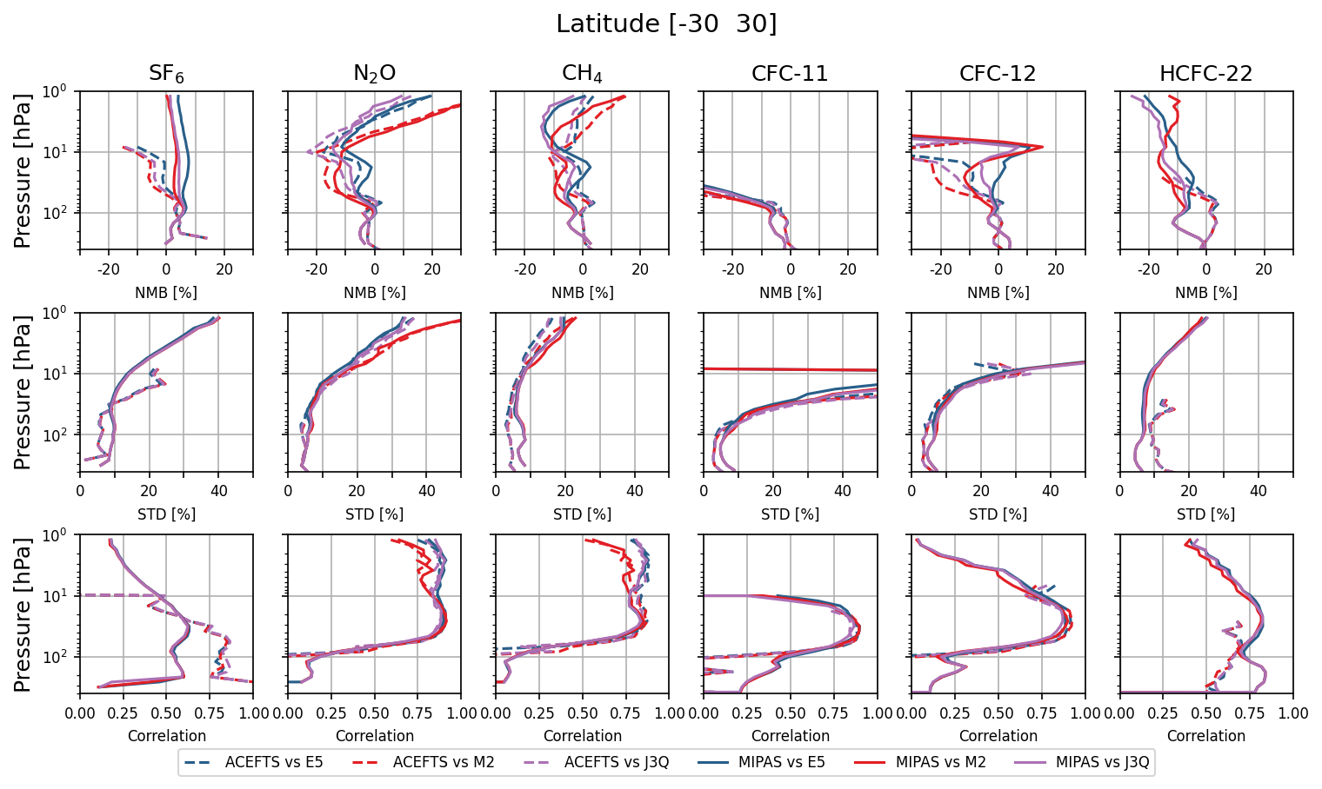
Good agreement with MIPAS and ACE-FTS

Slide 11
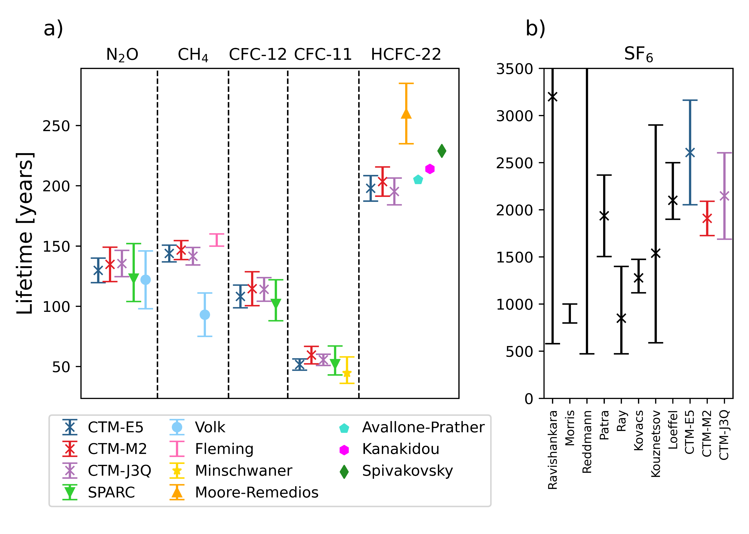
Lifetime averages 2002-2012 agree well with the literature

Slide 12
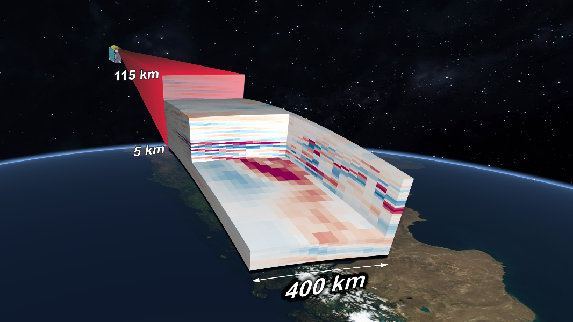

The Changing Atmosphere Infrared Tomography (CAIRT) Explorer
Limb instrument!
50 km
25 km

Slide 13
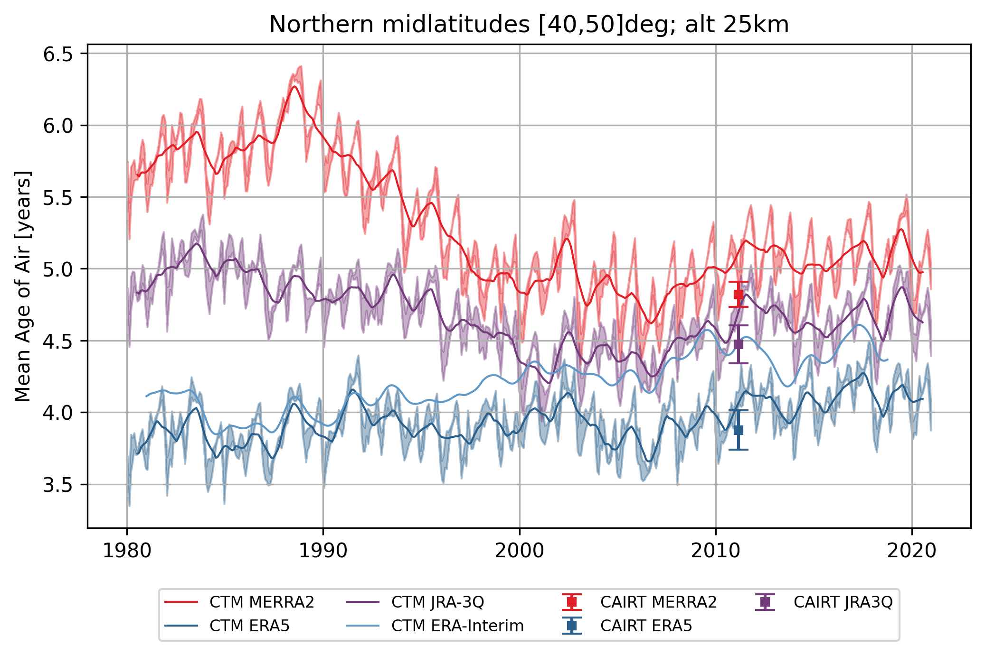
Age of air simulations for CAIRT
Notes:
This is not the correct figure! Update!!!

Slide 14
Assessing changes in the middle atmosphere using stratospheric observations, chemical transport models and data assimilation
To be continued…

Slide 15



Image credits
Please don’t throw trash in the oceans
CAIRT picture retrieved from
https://www.cairt.eu/technology
on 19.05.2025
The images of the bottles on the ocean current and the globe were created by Chat GPT
This slide:
https://www.freepik.com/free-vector/hand-drawn-ocean-plastic-pollution-illustration_41775423.htm#fromView=keyword&page=1&position=25&uuid=e60ed217-d06d-437c-9ea3-fd88704128a7&query=Ocean+Plastic
sarah.vervalcke@aeronomie.be

Slide 16

Back-up slides

Slide 17
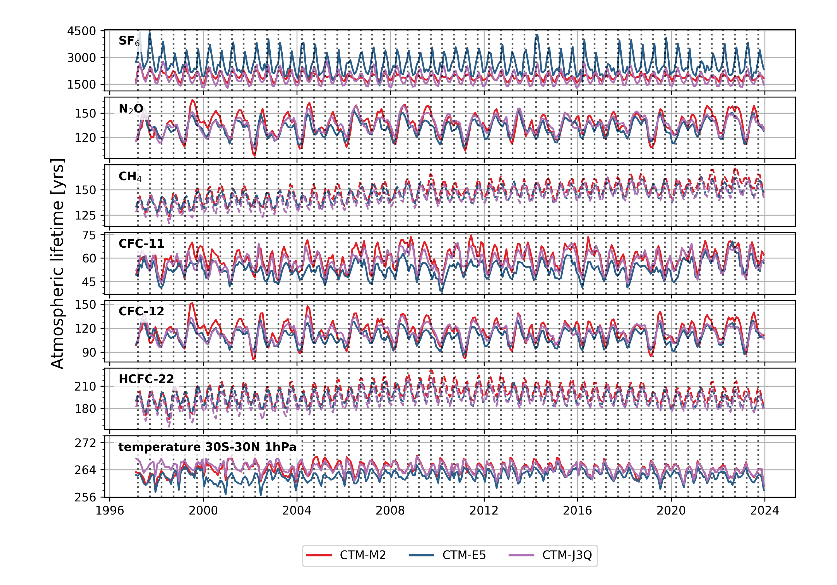
Lifetime timeseries show a semi-annual oscillation

Slide 18
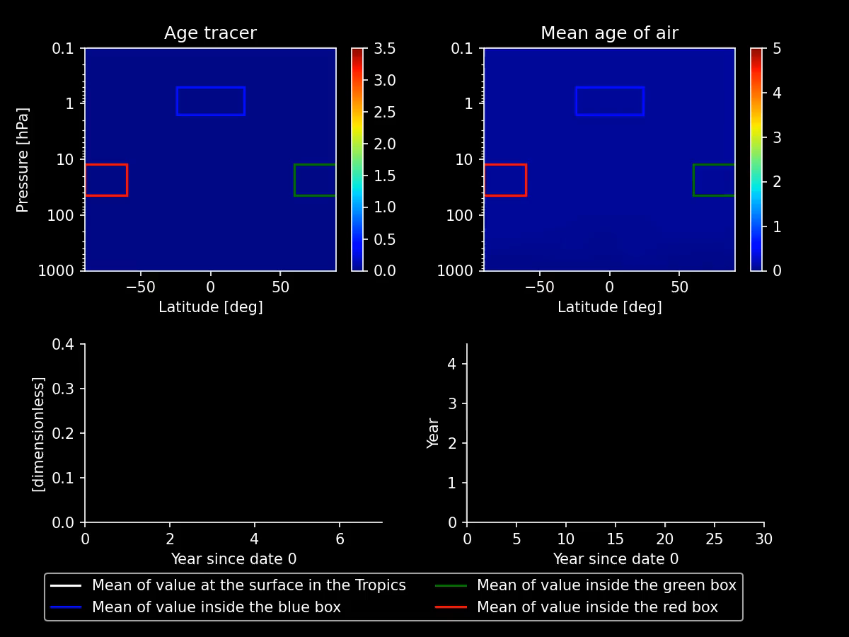
Age of air (AoA) as a proxy for circulation speed

Slide 19
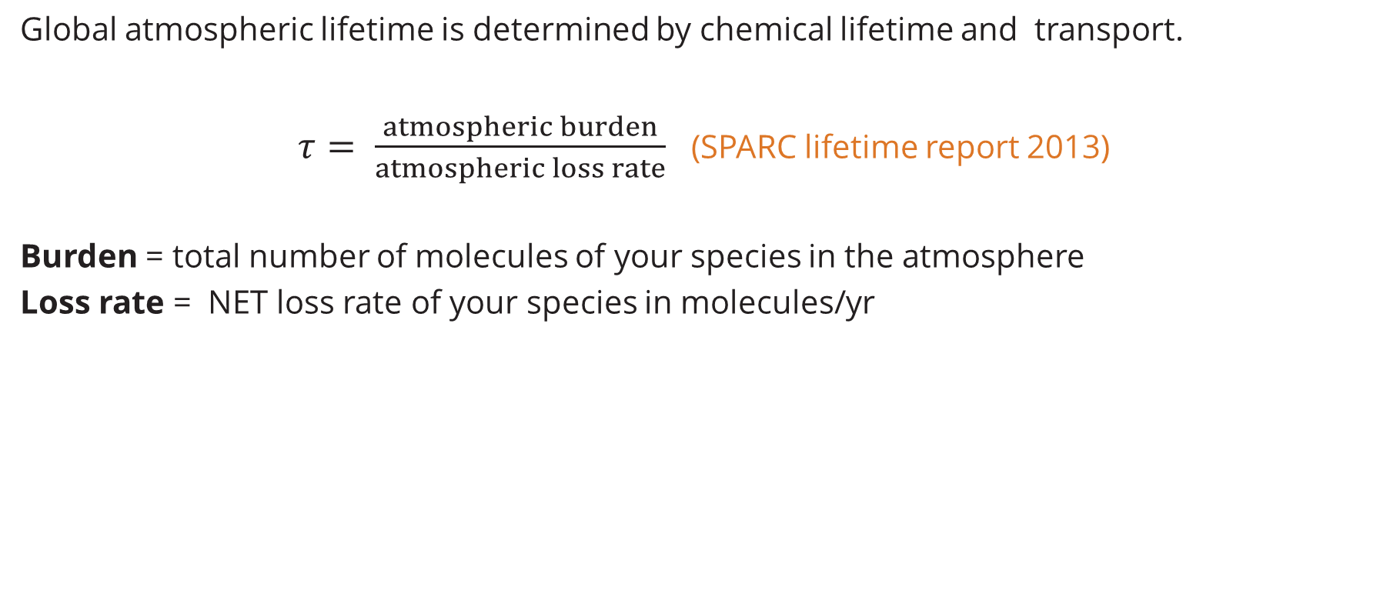
Global atmospheric lifetime
Global atmospheric lifetime is determined by chemical lifetime and transport.
$τ= \frac{atmospheric burden}{atmospheric loss rate}$ (SPARC lifetime report 2013)
Burden = total number of molecules of your species in the atmosphere
Loss rate = NET loss rate of your species in molecules/yr

Slide 20
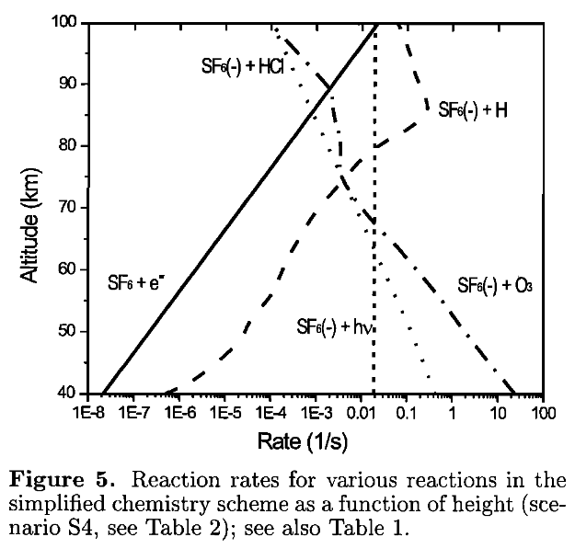
Reaction rates
Notes:
This is not the correct figure! Update!!!

Slide 21
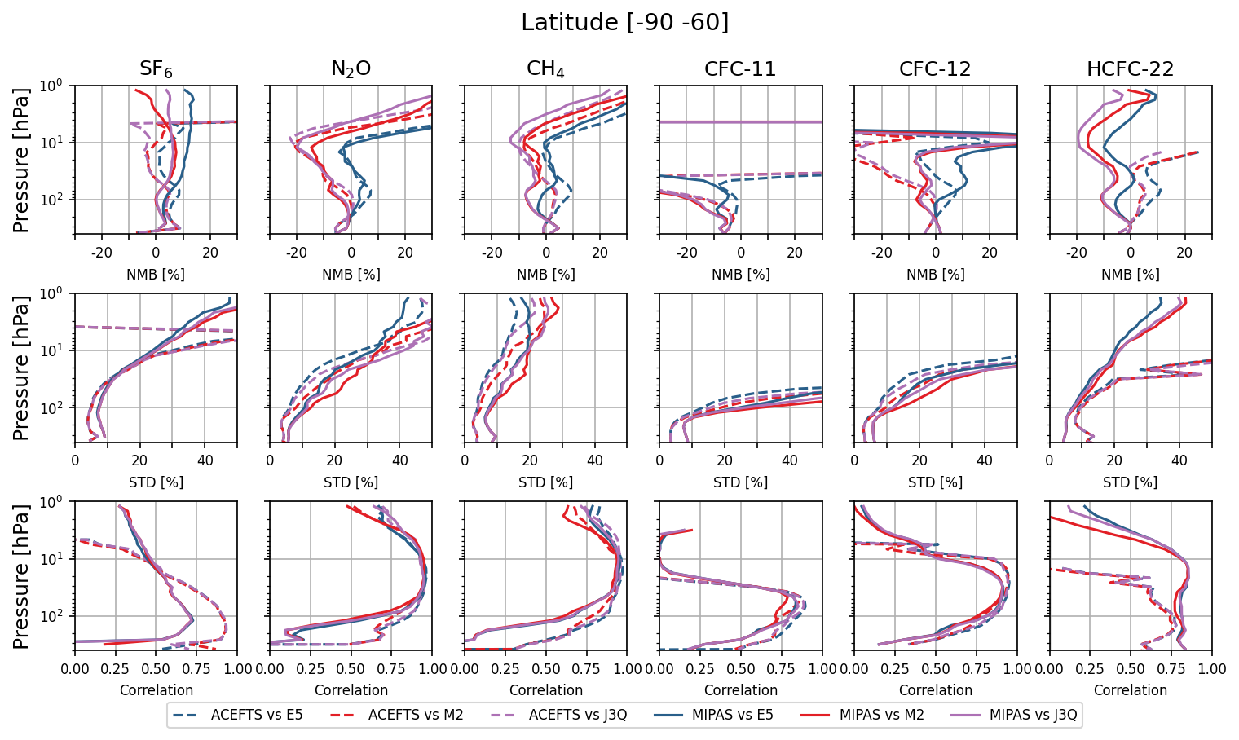
Notes:
This is not the correct figure! Update!!!

Slide 22
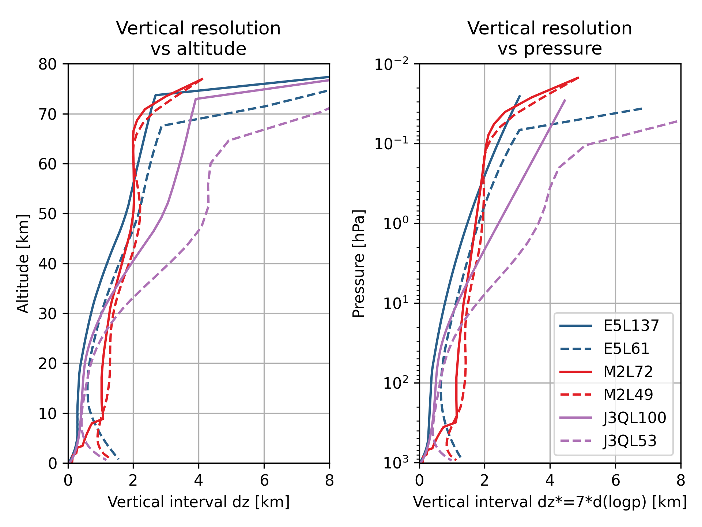
Reanlysis preprocessing: reducing vertical resolution
Notes:
This is not the correct figure! Update!!!

Slide 23
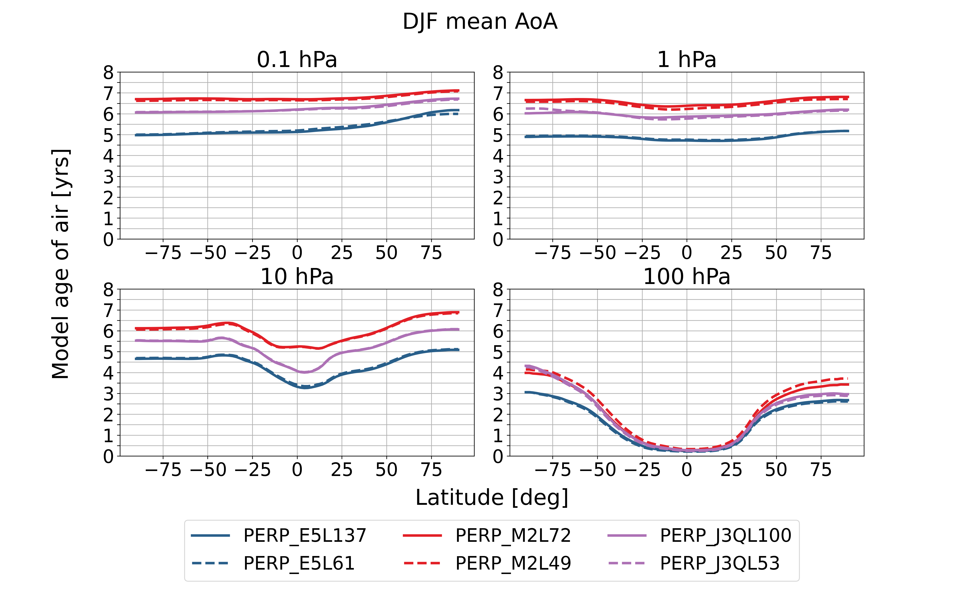
Perpetual QBO runs: December-January-February

Slide 24
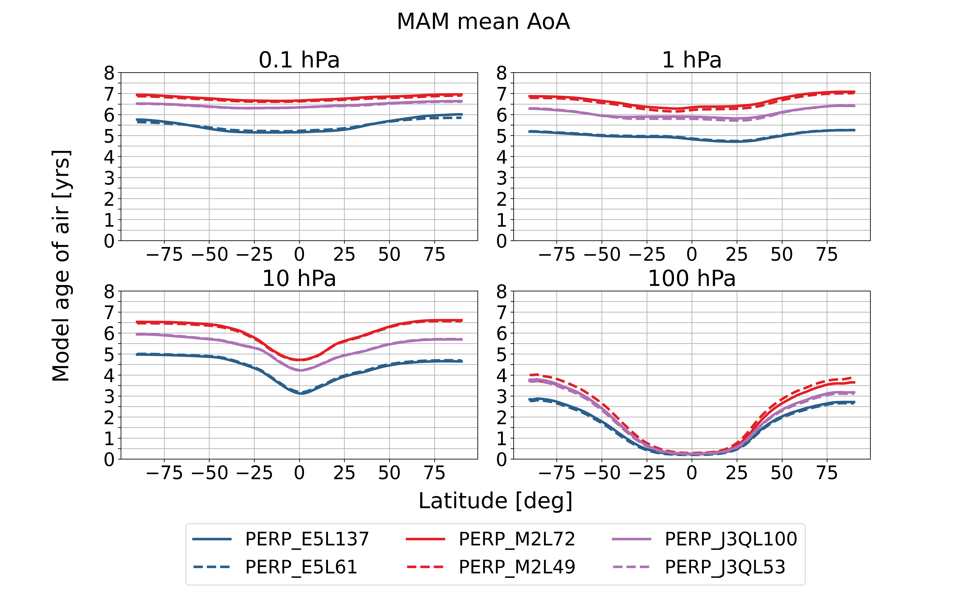
Perpetual QBO runs: March-April-May

Slide 25
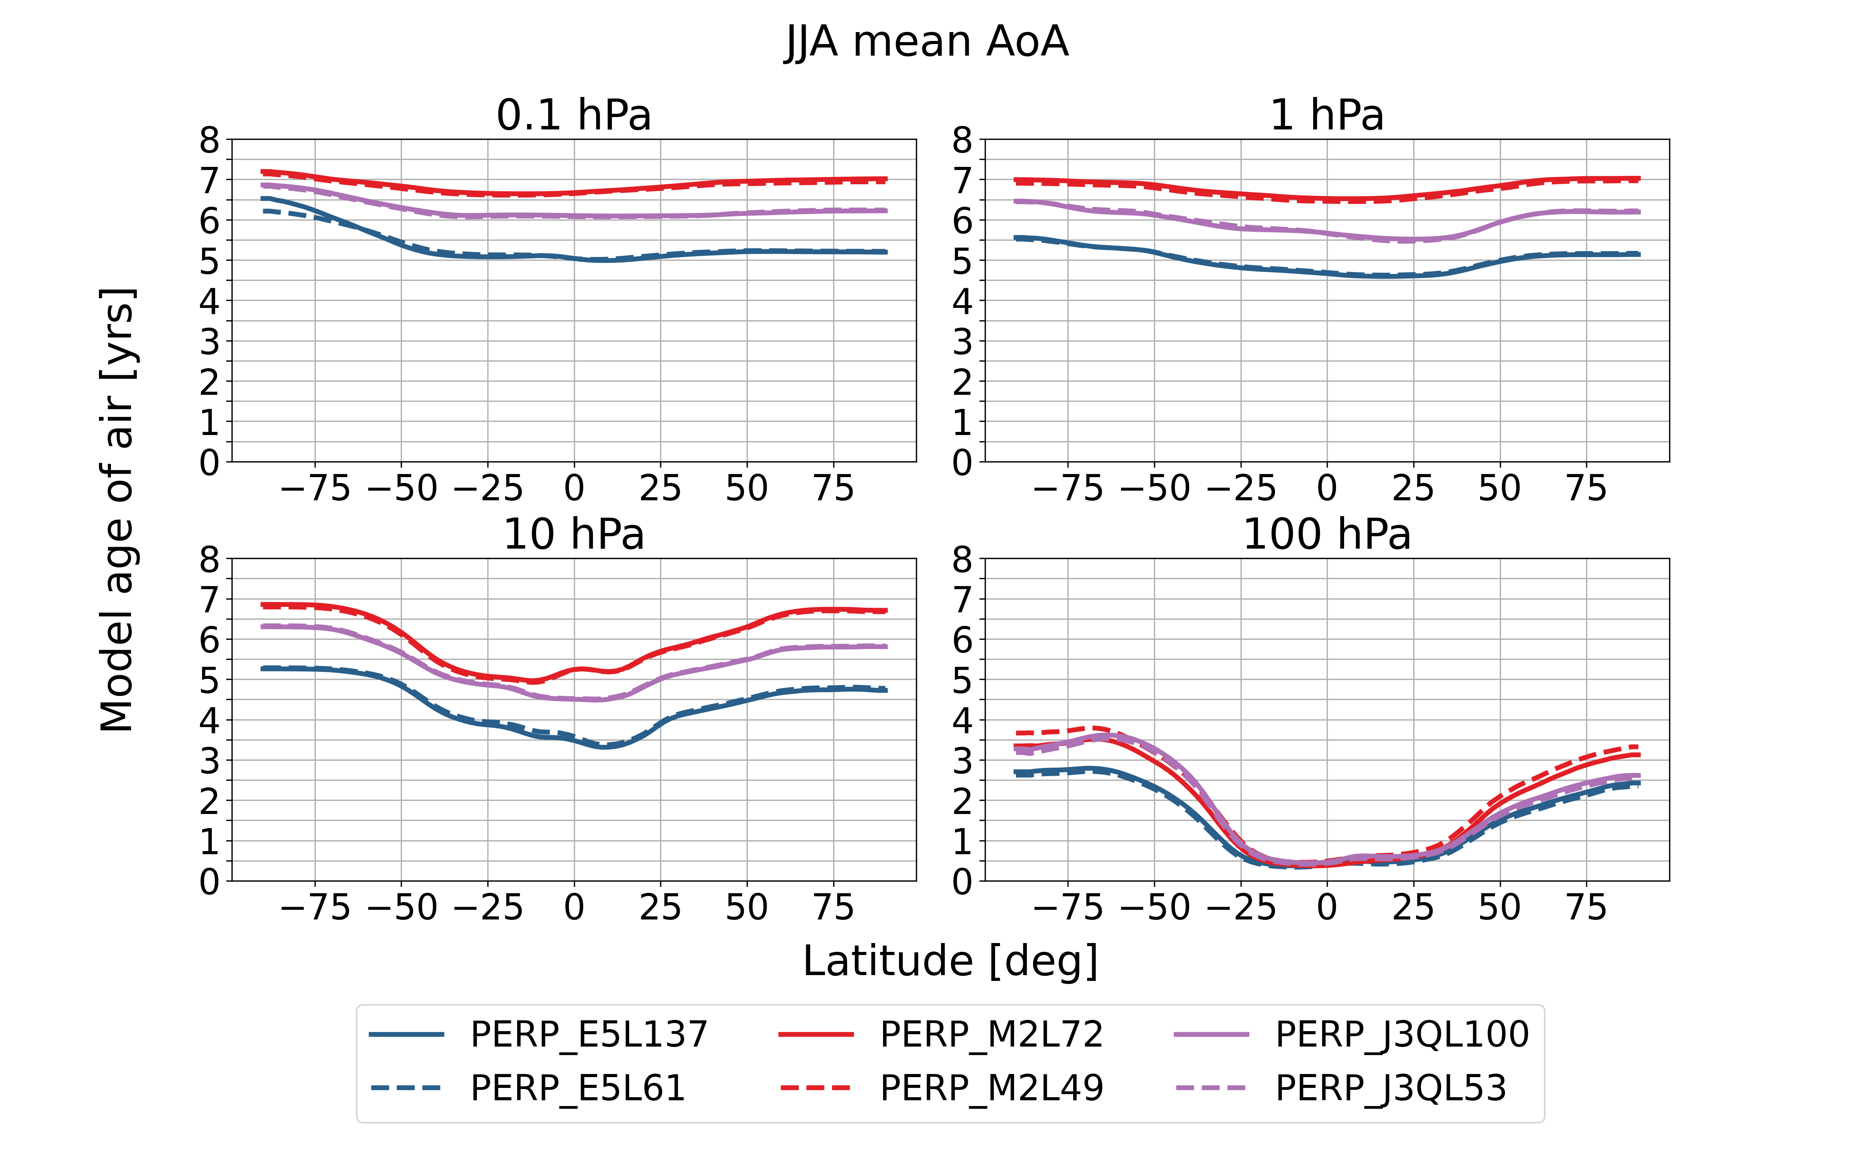
Perpetual QBO runs: June-July-August

Slide 26
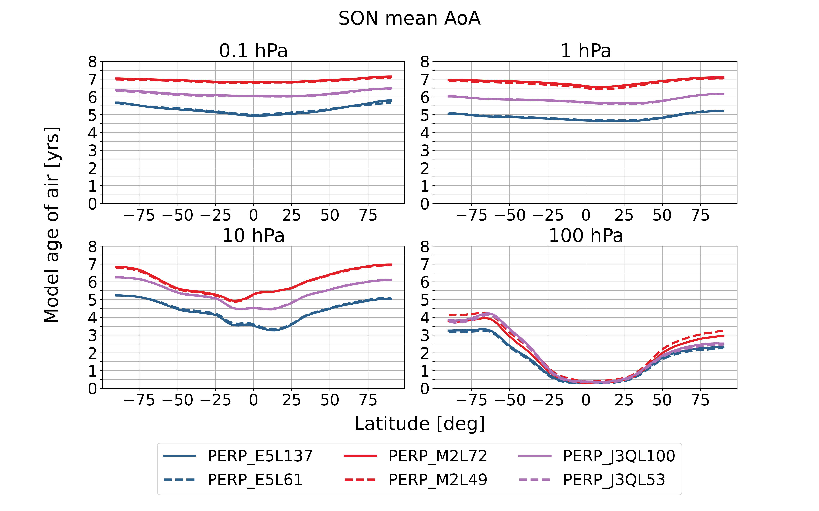
Perpetual QBO runs: September-October-November

