Slide 1
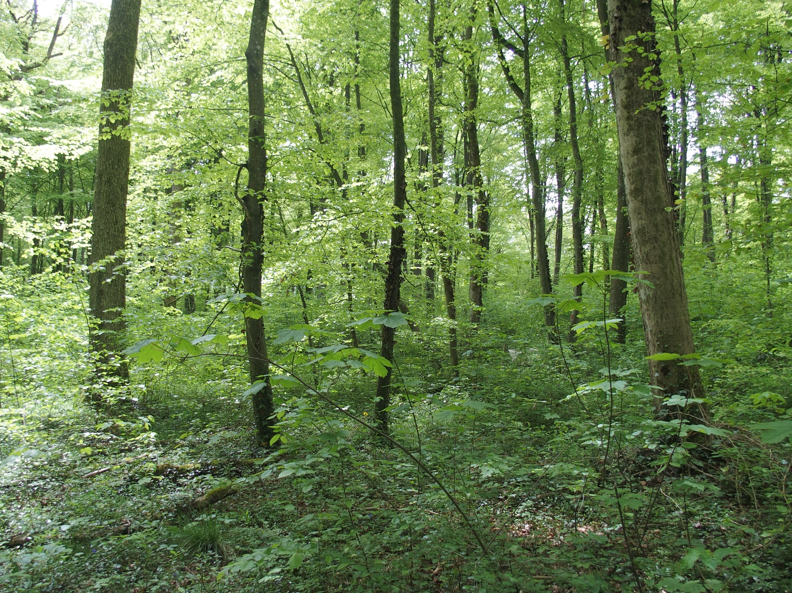



Climate change, ungulate pressure and forest diversification: exploring trade-offs through simulation
Mathilde PAU, Mathieu JONARD, Frédéric ANDRÉ et Gauthier LIGOT
Adapting temperate forest management to climate change: from assessment to solutions – 11 June 2025

Slide 2
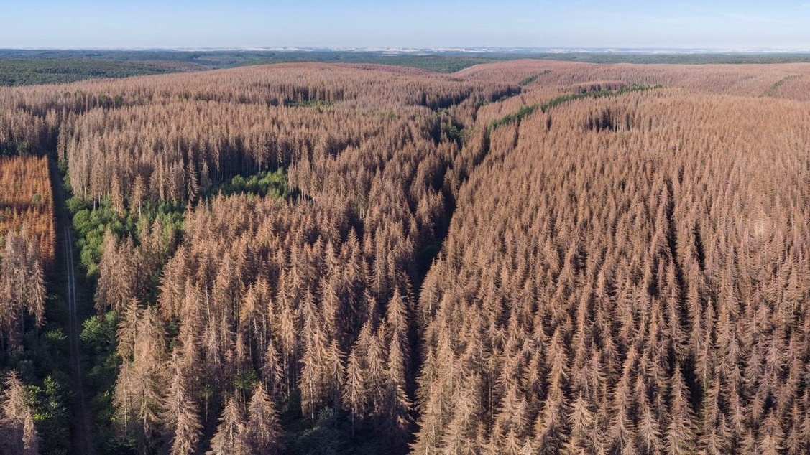
Sylvain Gaudin © CNPF
Notes:
= the context of this study
Climate change and global changes
Increased temperature, more frequent and intense droughts and heatwaves
Affecting forest ecosystem functionning
Affecting forest ecosystem services. Timber production but not only
There is no silver bullet to adapt forest to climate change. There are rather substantial uncertainty about how forest will be affected by changling climatic and how these changes could be mitigated.

Slide 3
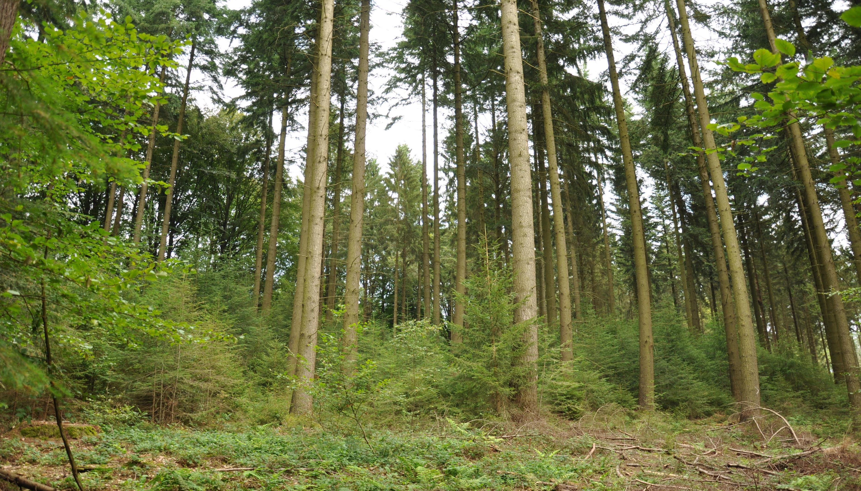
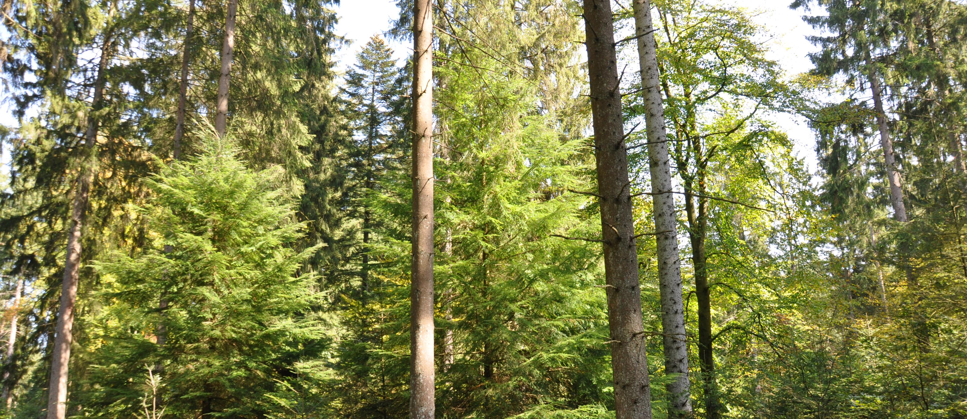
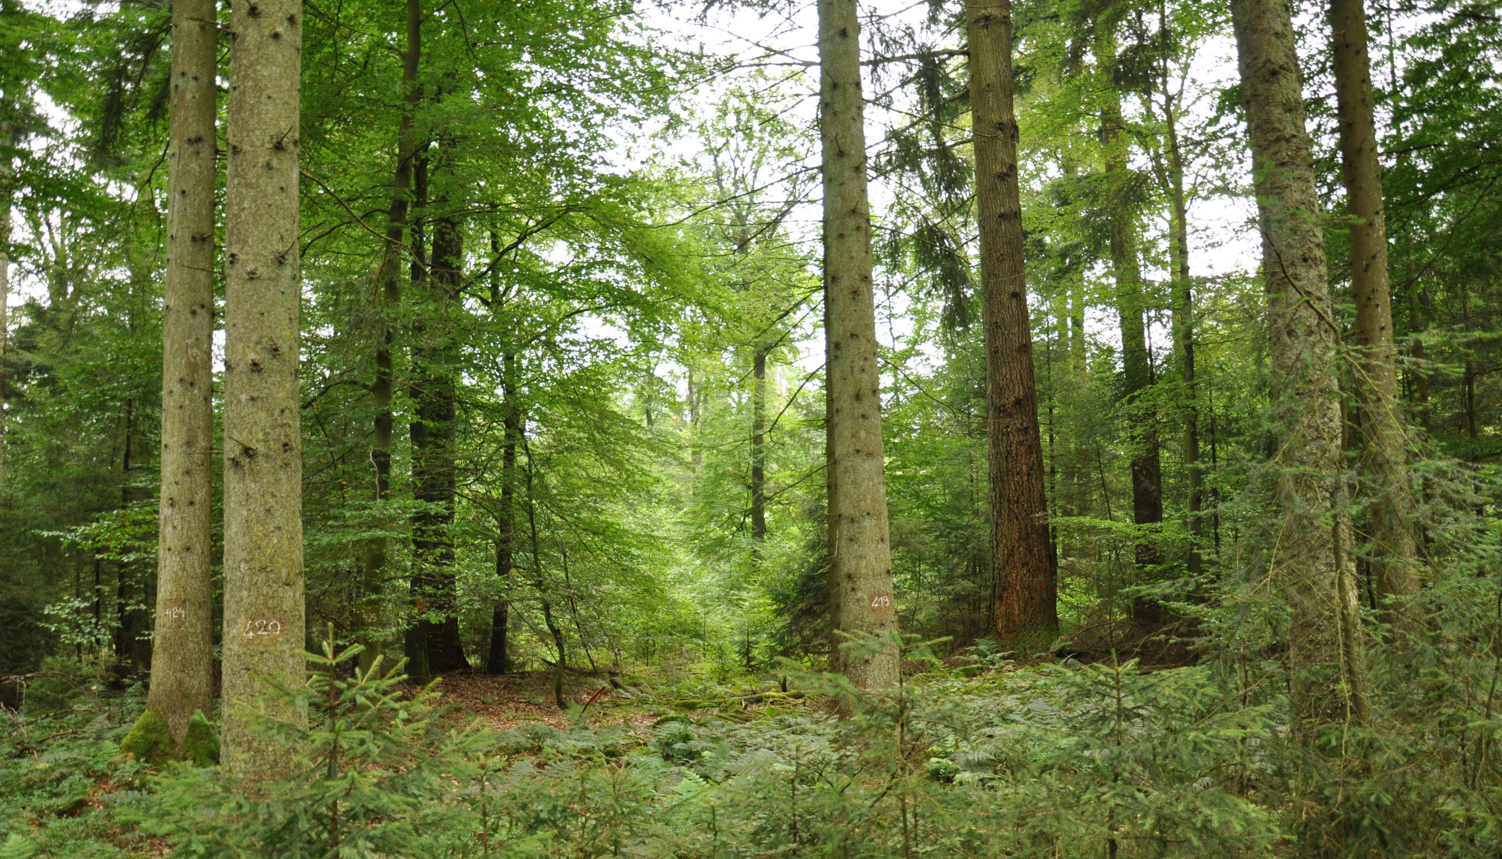
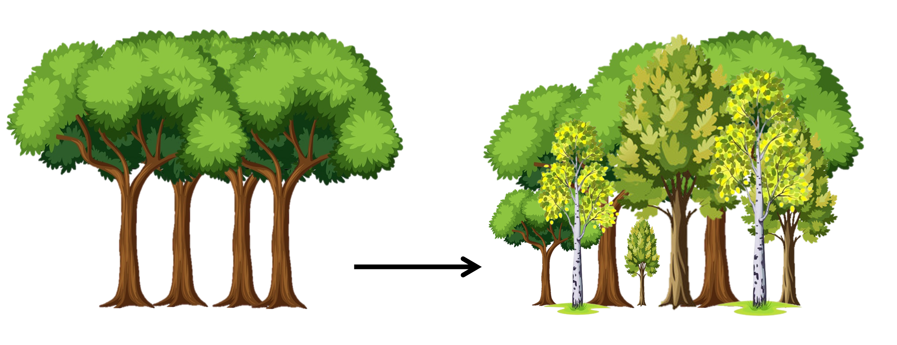
species and structural diversity

Slide 4
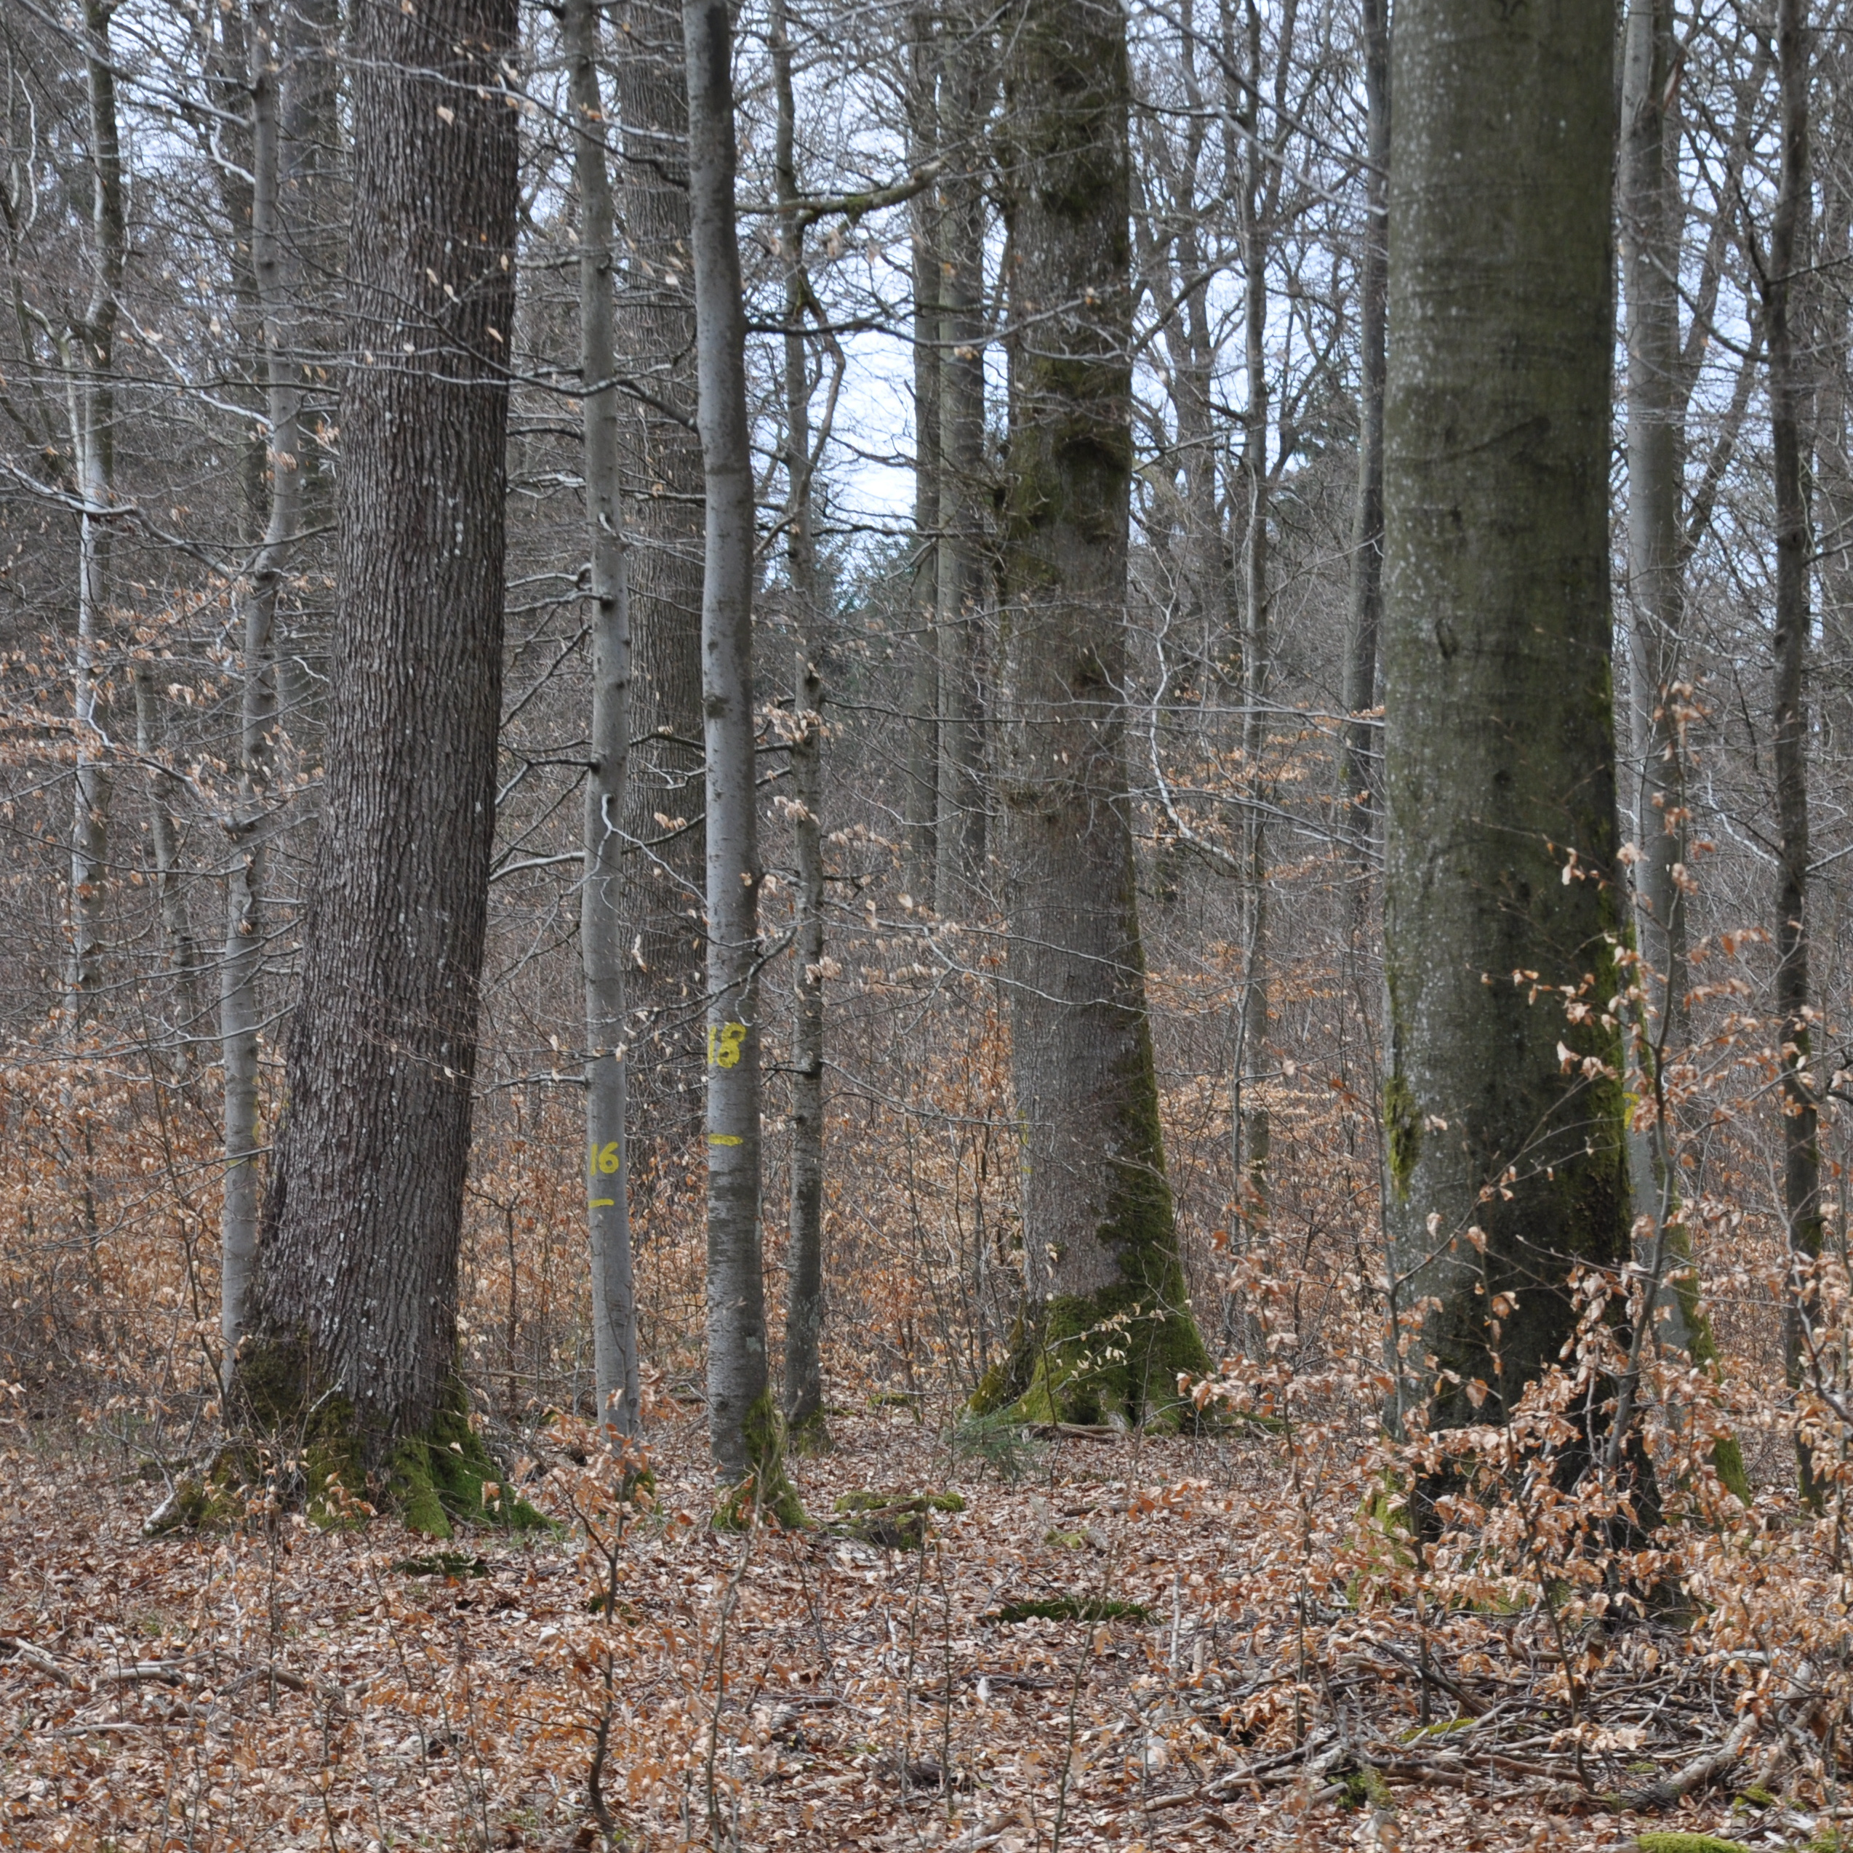
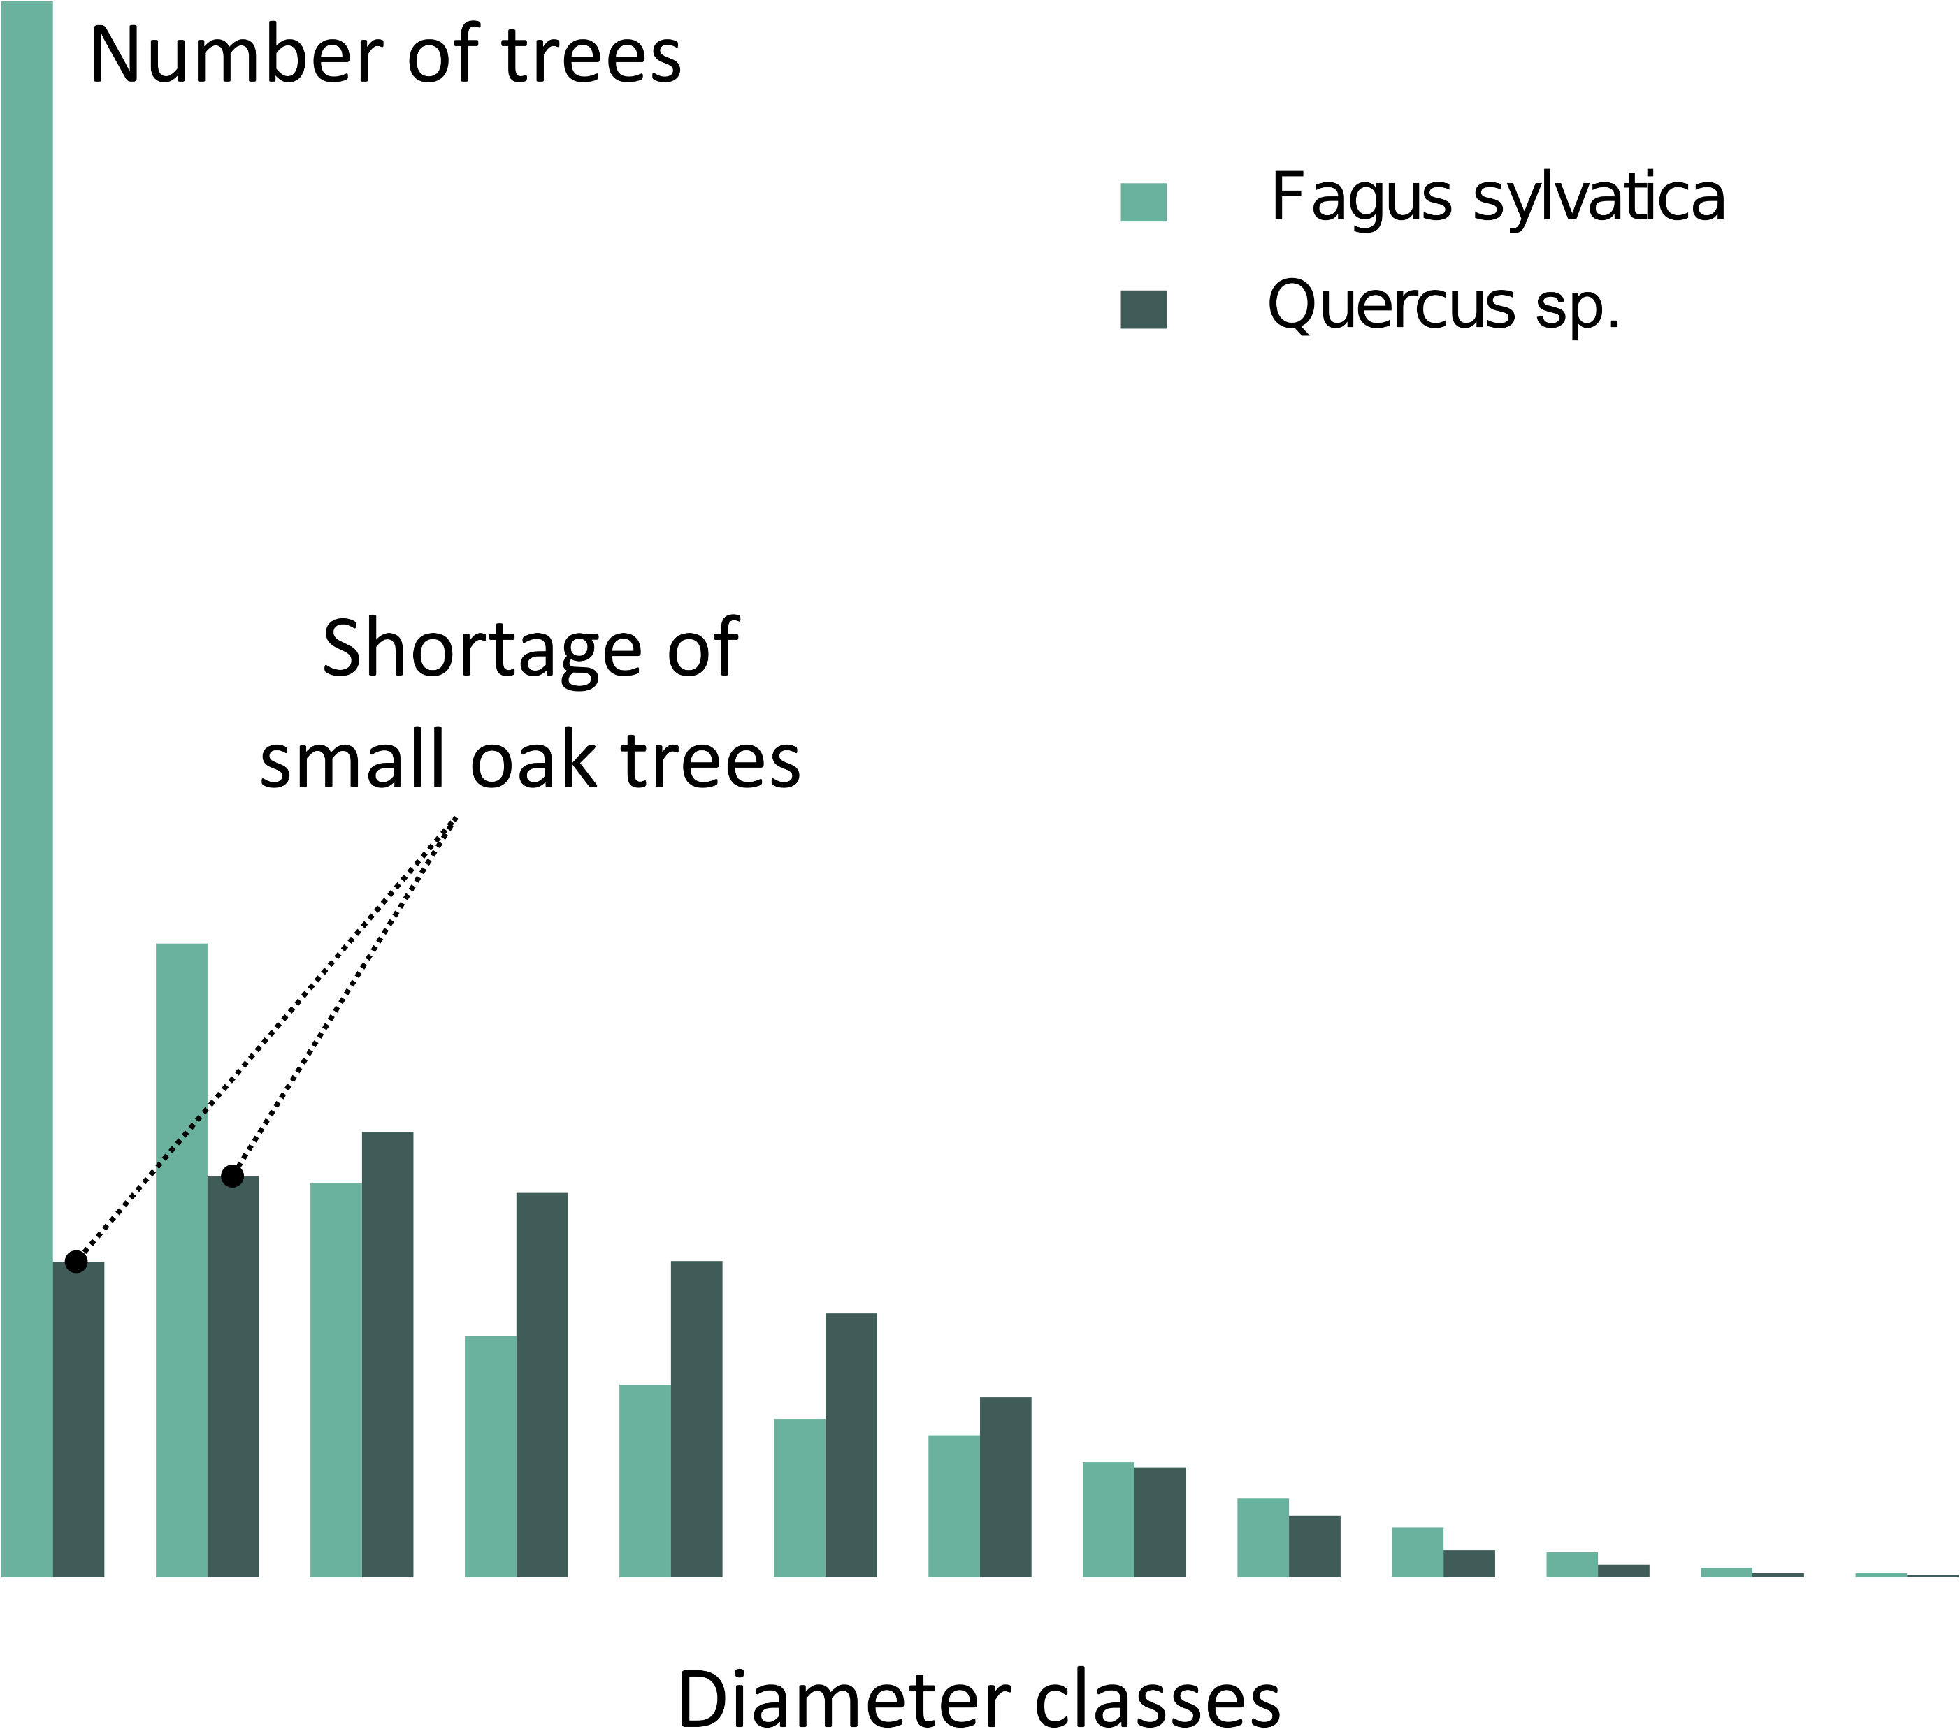
Sessile oak
Quercus petraea (Matt) Liebl.
Less shade-tolerant
Scarce in natural regeneration
Density of oak and beech by size class in southern Belgium (550 000 ha)
European beech
Fagus sylvatica L.
Shade-tolerant
Invade the understory
Notes:
Managed mostly with continuous cover forestry

Slide 5
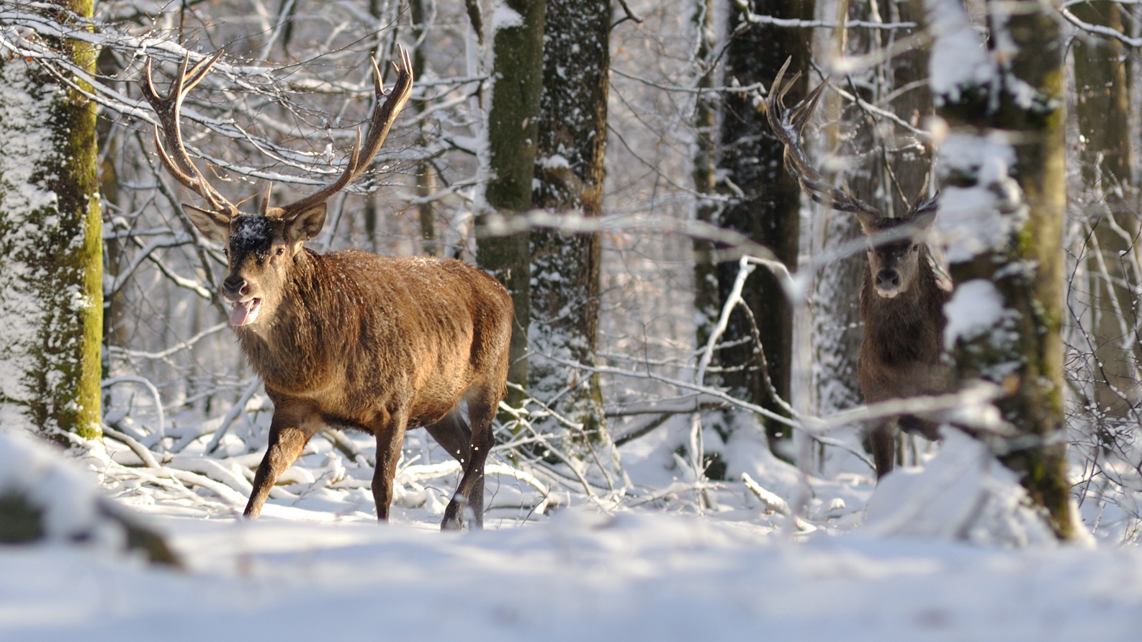
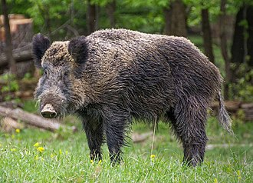
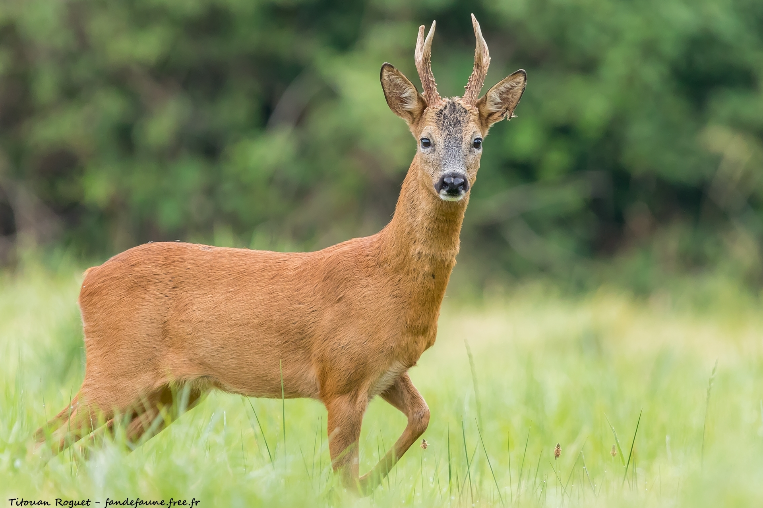
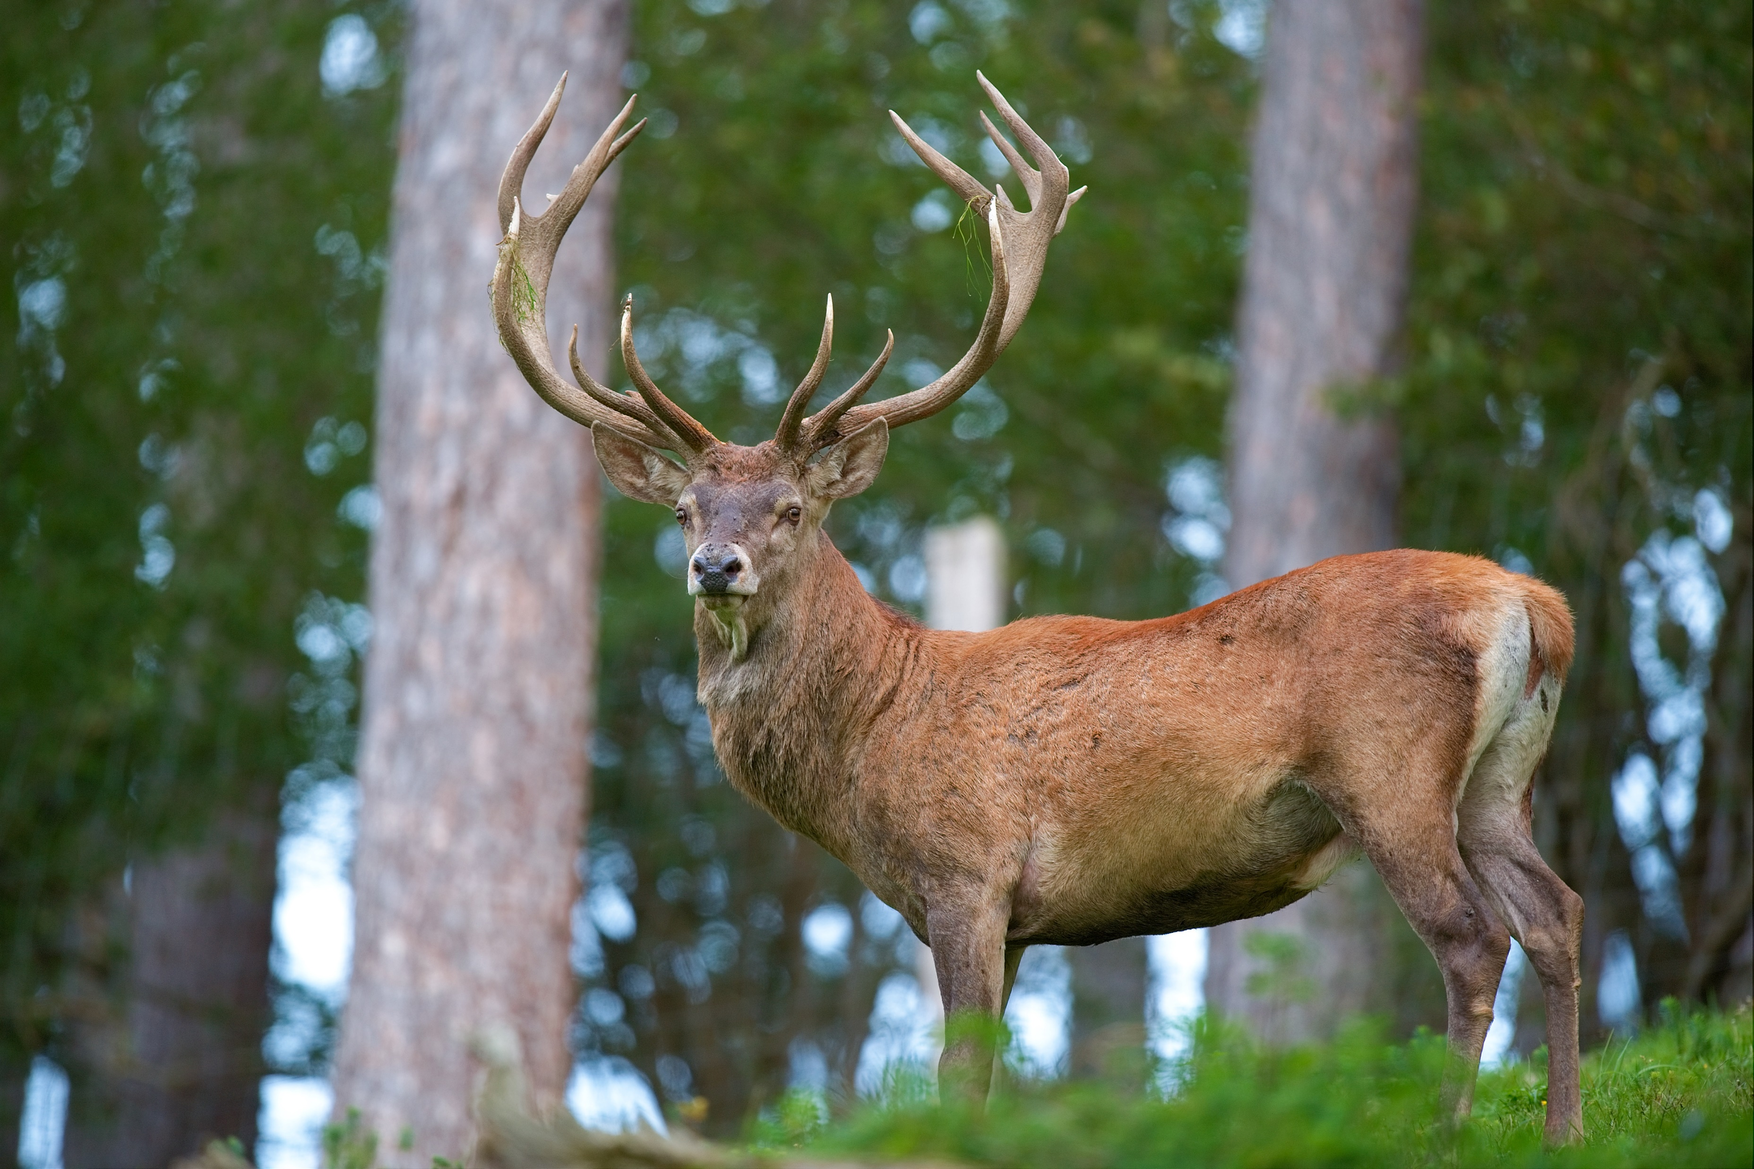
Ungulate population have increased since the 80s threatening the development of natural regeneration.
Notes:
Les populations d'ongulés ont augmenté dans toute l'Europe et l'Amérique du Nord
Répertoriée comme l'une des principales perturbations forestières en Europe
Pourrait entraver la résistance et la résilience des forêts futures

Slide 6
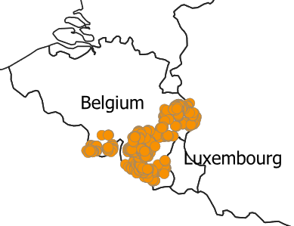
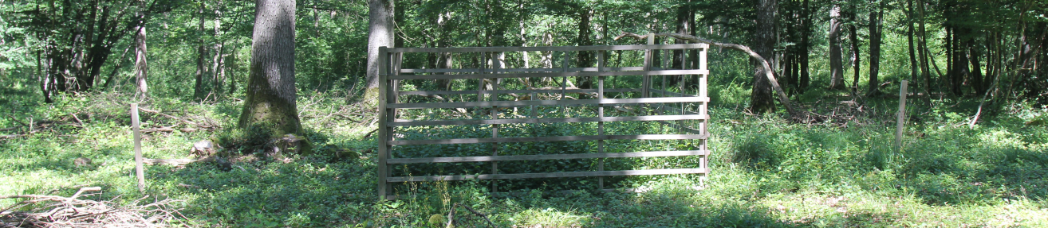


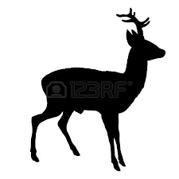
Monitoring natural regeneration in pairs of fenced-unfenced plots
726 plot pairs (Systematic sampling) established where regeneration is not advanced but expected to be in good conditions (e.g. understory light) to thrive.
Annual monitoring (2016-2021) : Species identity and height of the 5 tallest seedlings ; Cover of woody/non-woody species.
6 m²
6 m²
6 m²
Unfenced 1
Fenced
Unfenced 2
1 m
1 m
6
  1 control plots with wooden lattice
  (In case the 1st plot get damaged)

Slide 7
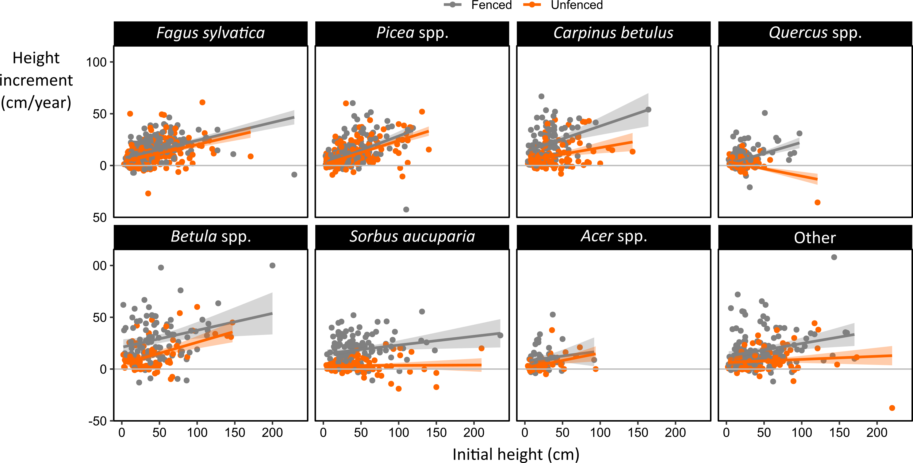
Considering only the tallest saplings, the height increment of all species but beech and spruce was significantly reduced by browsing.
Candaele et al. 2023, Forest 14 (7)

Slide 8
Species ranking in height increment was altered by browsing but oak was the slowest growing species in fenced and unfenced plots.
In fenced plots
Species | iH (cm/yr)
Birch (Betula sp.) | 25
Rowan (Sorbus aucuparia) | 18
Hornbeam (Carpinus betulus) | 17
Beech (Fagus sylvatica) | 13
Maple (Acer pseudoplatanus) | 11
Norway spruce (Picea abies) | 10
Oak (Quercus sp.) | 7
Unfenced plots
Species | iH (cm/yr) | ∆ (cm/yr) | ∆ (%)
Birch | 10 | 15 | 60
Spruce | 10 | n.s. | n.s.
Beech | 9 | 4 | 30
Hornbeam | 6 | 11 | 65
Maple | 5 | 6 | 54
Rowan | 3 | 15 | 83
Oak | 3 | 4 | 57
strongly suppressed species
Candaele et al. 2023, Forest 14 (7)

Slide 9
Research questions
What are the potential benefits and limitations of different diversification strategies in a context of climate change and increasing ungulate density.
Does the increase in ungulate densities limit the adaptive potential of forest diversification?

Slide 10

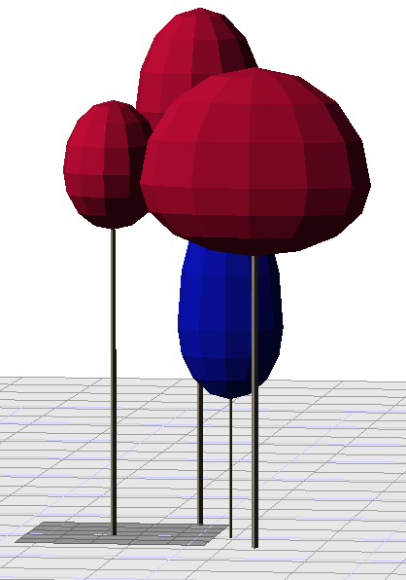
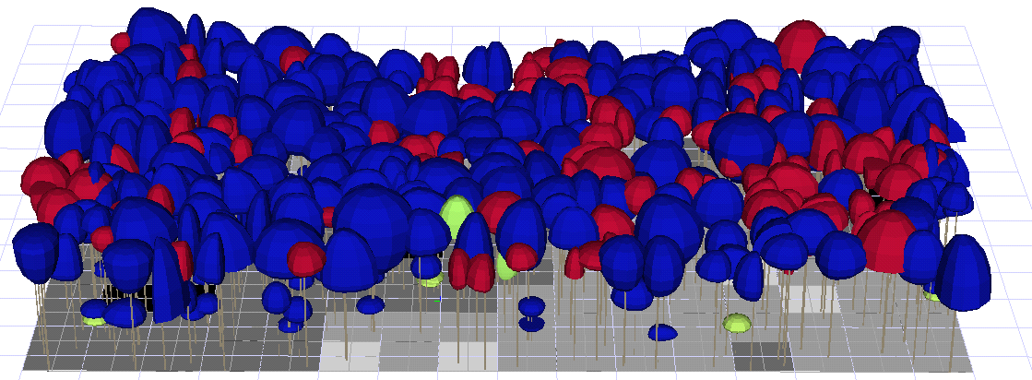
HETEROFOR
Evapo
PAR
-
Rainfall
transpiration
Phenology
Soil water content
Light interception
(SAMSARALIGHT)
aPAR
aPAR
aPAR
Runoff
tree_1
tree_2
tree_i
Photosynthesis
(CASTANEA)
GPP
Leaves
∆DBH
Stems &
Branches
NPP
Roots
Fine roots
Fruits
Jonard, M., André, F., Guignabert, A., & de Wergifosse, L., 2022, HETEROFOR 1.1 User Manual

Slide 11
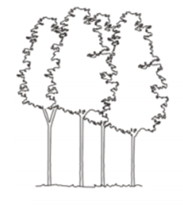
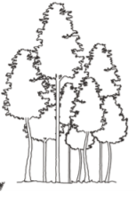
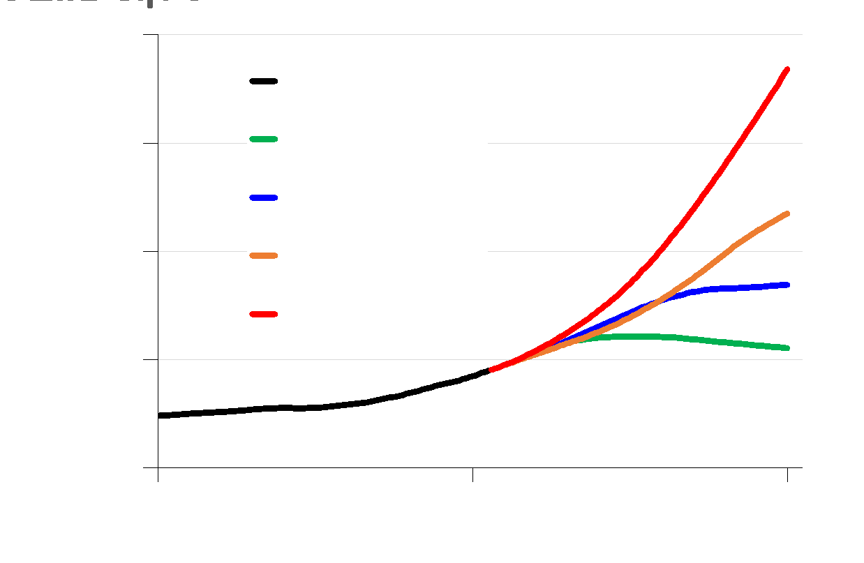
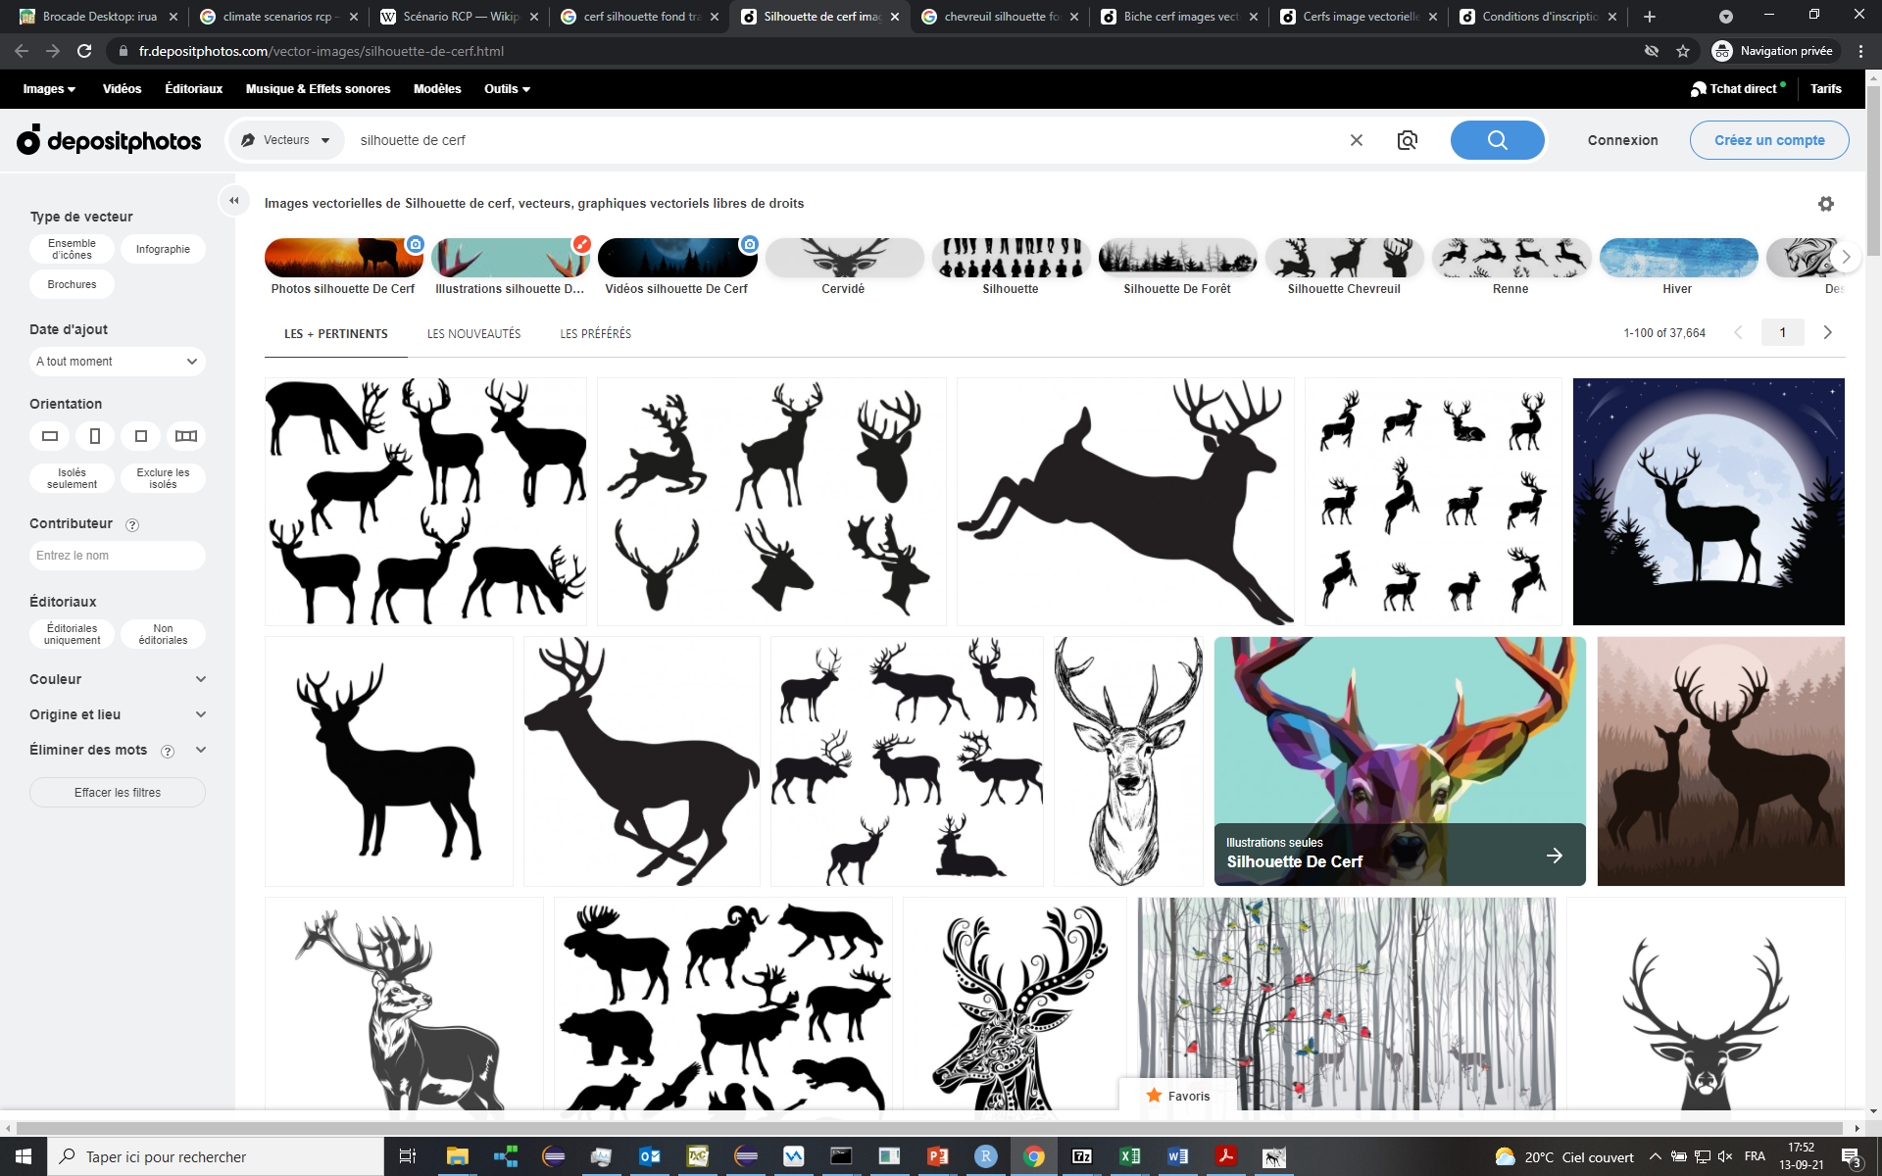
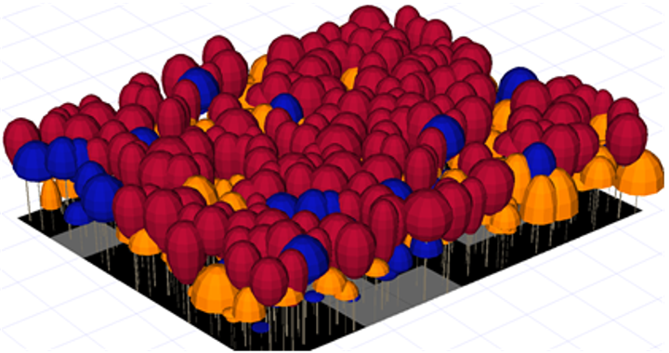
HETEROFOR – A simulation experiment
Forest managements
Climatic scenarios
Ungulate pressures
CO₂ Concentration
(ppm)
HETEROFOR
Year
Forest evolution : timber production, profitability, carbon sequestration, …

Slide 12
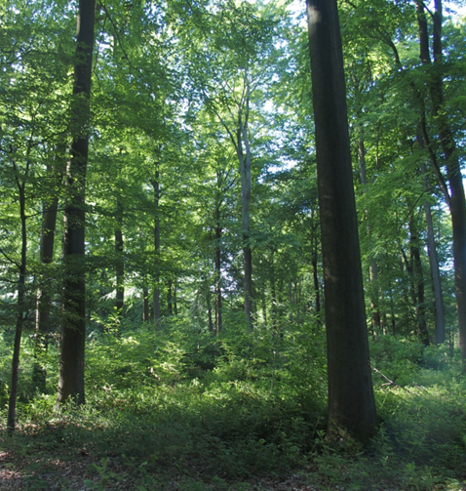
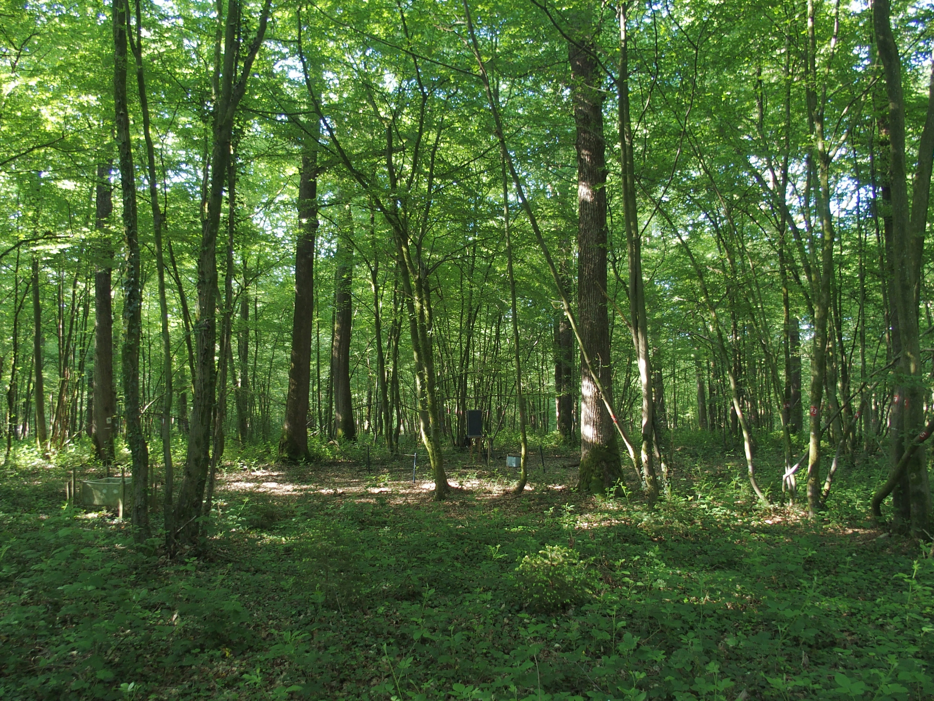
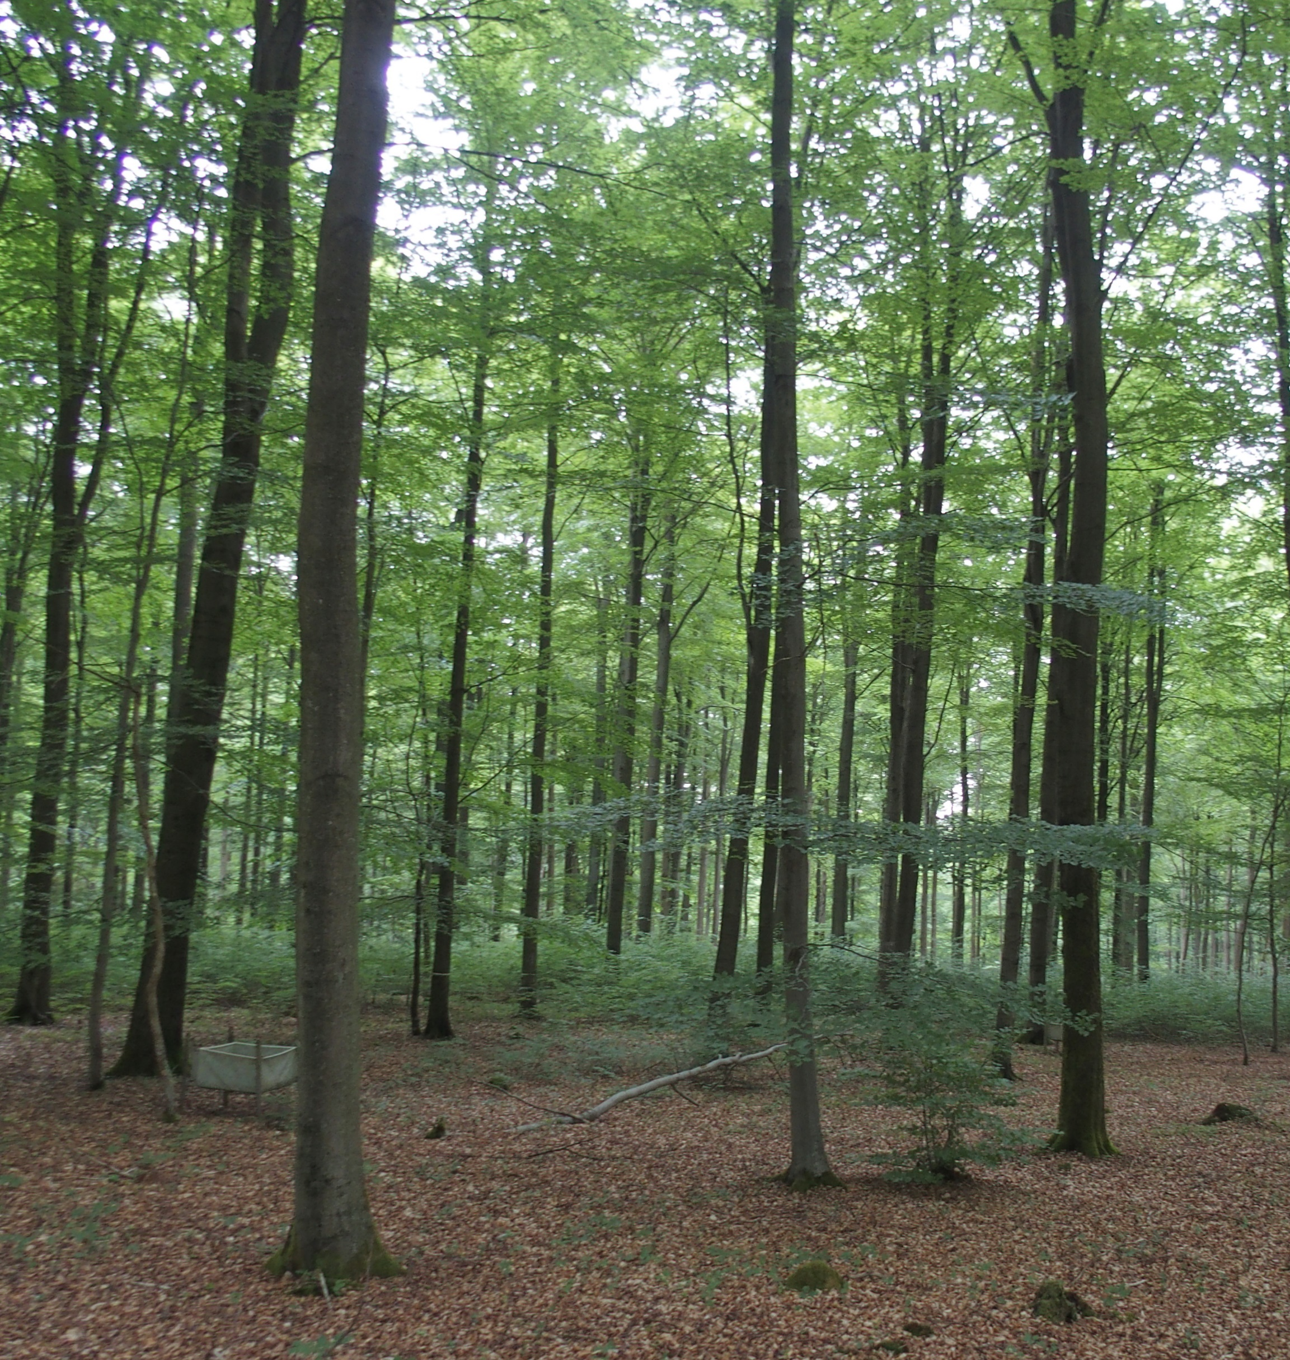
Study cases
Site | Species | Structure
Chimay | Quercus petraea Carpinus betulus | Even-aged
Stoumont C111 | Quercus petraea Fagus sylvatica Betula pendula | Even-aged in conversion to uneven-aged
Stoumont C114 | Fagus sylvatica Quercus petraea | Even-aged
Baileux | Quercus petraea Fagus sylvatica | Even-aged
Eupen | Fagus sylvatica | Even-aged
Louvain-la-Neuve | Fagus sylvatica Quercus petraea | Even-aged
6 broadleaved stands
To be regenerated within 20-40 years
Mostly even-aged stand with different species composition

Slide 13
Scenarios of forest management
Business As Usual (BAU)
Even-aged stand
Diversification (DIV)
Increase species and structural stand diversity
Promote oak natural regeneration
Even-aged stand
Oak regeneration (OAK)
Limiting silvicultural interventions
Maintain at least one commercial species
Uneven-aged stand

Slide 14
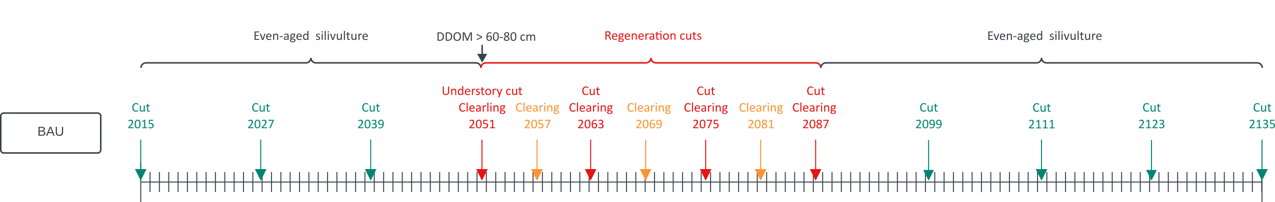
Scenarios of forest management
Business As Usual (BAU)
Step 1 : maintaining an even-aged stand
As long as Ddom < 60-80 cm (site productivity)
Thinning from below every 12 years, basal area : 24 m²/ha
Step 2 : regenerate the stand
Shelterwood cutting
6 clearing of the herbaceous vegetation
3 clearing of the woody vegetation
Step 3 : maintaining an even-aged stand
Thinning from below every 12 years

Slide 15
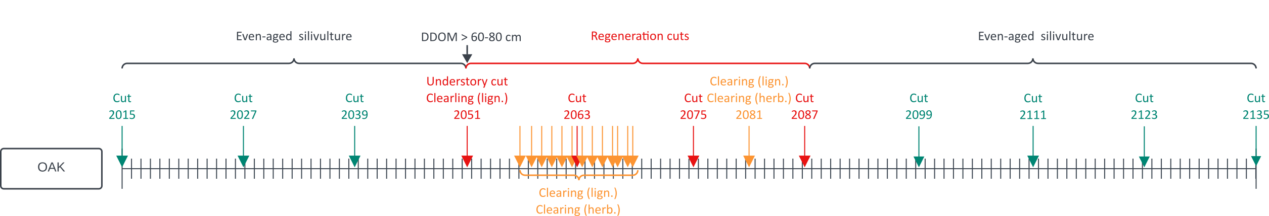
Scenarios of forest management
Oak regeneration (OAK)
Step 1 : maintaining an even-aged stand
As long as Ddom < 60-80 cm (site productivity)
Thinning from below every 12 years, basal area : 24 m²/ha
Step 2 : regenerate the stand
Shelterwood cutting
12 clearing of the herbaceous vegetation
13 clearing of the woody vegetation
Step 3 : maintaining an even-aged stand
Thinning from below every 12 years

Slide 16
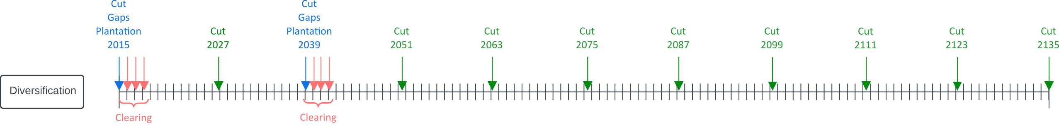
Scenarios of forest management
Diversification (DIV)
Step 1 : Enrichment plantations (48 years)
Mixed thinning every 12 years, basal area : 16 m²/ha
Opening 6 canopy gaps (400 m² - 1200 m² for birch)
Plantation of 2500/ha = 100 trees per gap (Betula, Quercus, Tilia)
3 clearing of the herbaceous vegetation
3 clearing of the woody vegetation
Step 2 : Continuous cover forestry
Thinning from above every 12 years

Slide 17
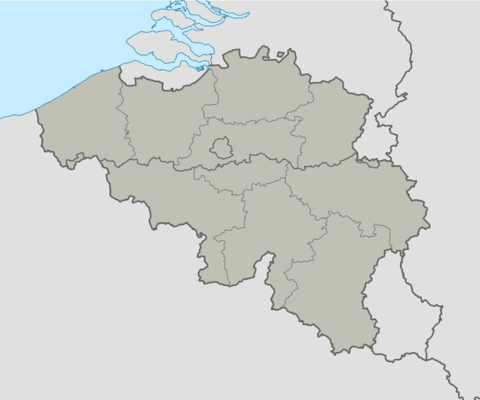
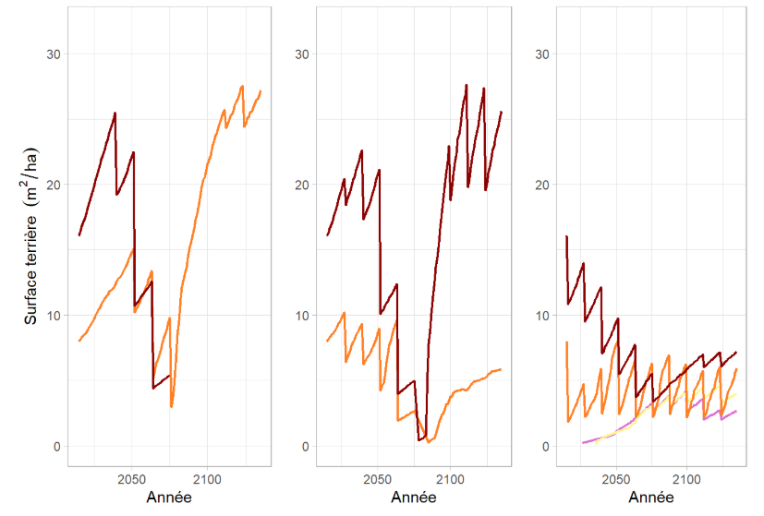
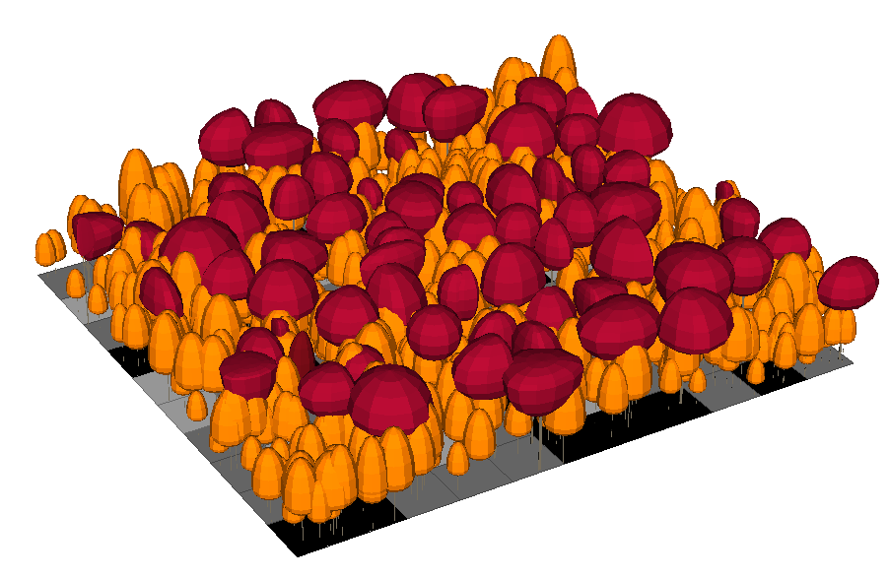
Scenarios of forest management
Chimay
Rainfall : 940 mm
T° : 9.7°C
BAU OAK DIV
Hornbeam
Oak
Basal area (m²/ha)
Linden
Birch
Year
Year
Year

Slide 18
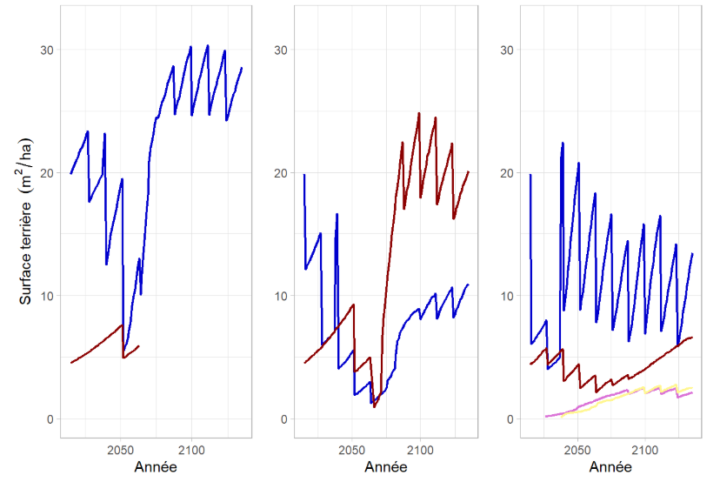
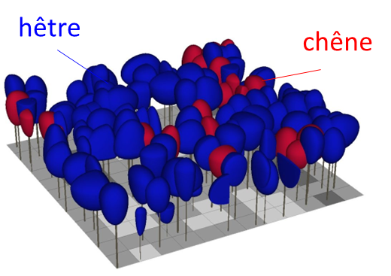
Scenarios of forest management
Louvain-la-Neuve
Rainfall : 820 mm
T° : 11°C
BAU OAK DIV
Beech
Basal area (m²/ha)
beech
oak
Oak
Birch
Linden
Year
Year
Year

Slide 19
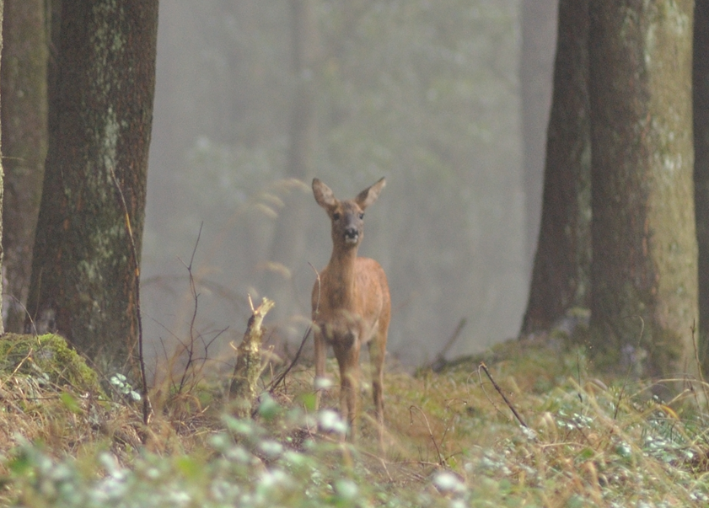
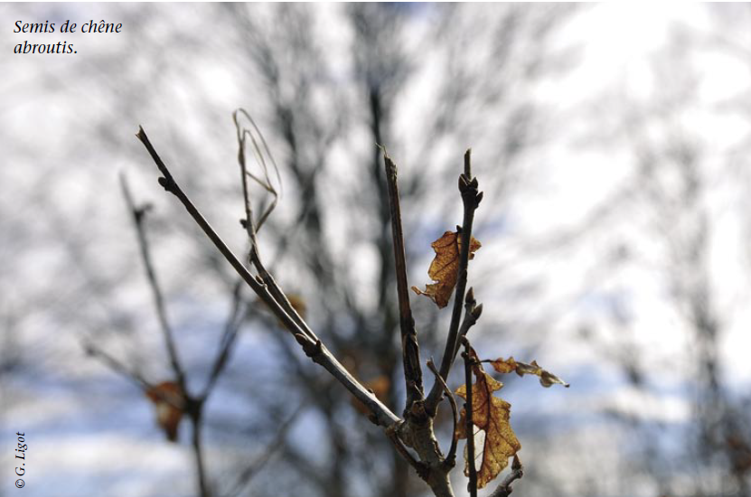
Levels of ungulate pressure
None → Protected regeneration
Low → Local recommandations
Mid → Average conditions in southern Belgium
High → Highest observed browsing rate
Empirichal approach : Relative reduction in sapling height increment (%)
Level | Oak | Beech | Birch | Hornbeam
None | 0 | 0 | 0 | 0
Low | 39 | 18 | 35 | 25
Mid | 90 | 40 | 80 | 60
High | 100 | 80 | 90 | 85
(Willecomme, 2022 ; Candaele, 2023 ; Fichant, 1977 ; Licoppe, 2017)

Slide 20
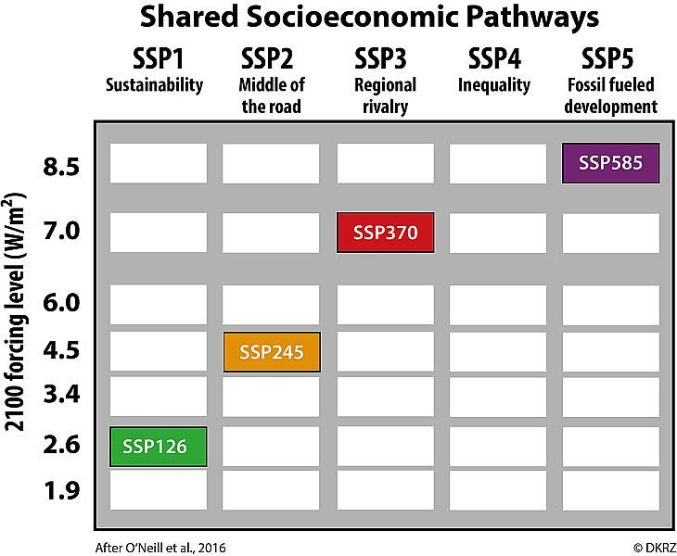
Climatic scenarios
3 scenarios among those defined by the IPCC
SSP1-2.6
SSP2-4.5
Middle of the road
SSP3-7
Regional rivalry
Sustaina-bility
RCP 2.6 (1.8°C)
RCP 4.5 (2.7°C)
RCP 7.0 (3.6°C)
Notes:
Warmin in 2081 - 2100

Slide 21
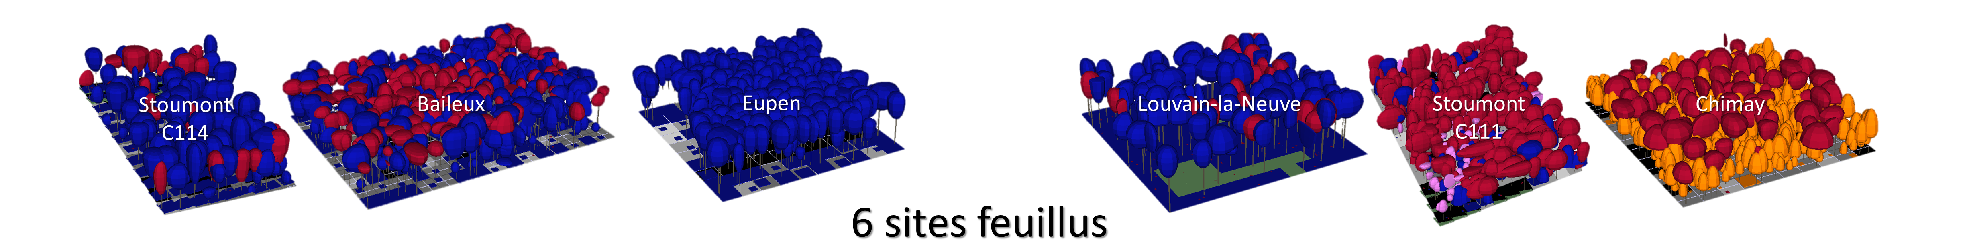

Simulation experiment
6 broadleaved stands
3 management scenarios
→ BAU
→ OAK
→ DIV
4 ungulate pressure levels
→ none
→ low
→ Mid
→ High
3 climatic scenarios
→ SSP1-2.6
→ SSP2-4.5
→ SSP3-7
HETEROFOR
216 simulations de 120 ans
(durée : 4/5 jours)
Notes:
Warmin in 2081 - 2100

Slide 22
Scoring simulations
44 indicators grouped into 6 categories → PCA → PC1 -> 6 scores
SCORE | INDICATORS
PRODUCTIVITY | Gross primary production of trees (kg C/ha), Gross primary production of seedlings (kg C/ha), Net primary production of trees (kg C/ha), Net primary production of seedlings (kg C/ha), Harvested volume per hectare per year (m³/ha/year), Volume production (m³/ha), Basal area production (m²/ha)
SHORT-TERM PROFITABILITY | Annual income (€), Annual net income (€), Net present value at a 3% discount rate (€/ha)
SUSTAINABILITY | Final market value of the stand (€), Final commercial timber volume (m³/ha), Change in commercial volume over the simulation period (€), Change in stand market value over the simulation period (€), Basal area of trees (m²/ha), Basal area of seedlings (m²/ha)
CARBON | Aboveground living woody biomass (Mg C/ha), Belowground living woody biomass (Mg C/ha), Dead woody biomass (Mg C/ha), Carbon stored in wood products in use (Mg C/ha), Cumulative carbon emissions (Mg C/ha), Cumulative substitution effect (Mg C/ha), Change in current aboveground living biomass (Mg C/ha), Change in current belowground living biomass (Mg C/ha), Change in current dead biomass (Mg C/ha)
SPECIES DIVERSITY | Simpson diversity index, Shannon diversity index, Species richness, Species mixture proportion
STRUCTURAL DIVERSITY | Spatial aggregation index, Circumference differentiation index, Height differentiation index, Density of new seedlings (n/ha)
Notes:
Warmin in 2081 - 2100

Slide 23
Scoring simulations
44 indicators grouped into 6 categories → PCA → PC1 -> 6 scores
🌳
PRODUCTIVITY
Timber production, NPP, …
💰
SHORT-TERM PROFITABILITY
NPV
♻️
SUSTAINABILITY
Final stand value, basal area
🌍
CARBON
Sequestration
🌿
SPECIES DIVERSITY
Specific richness, mixture
🌱
STRUCTURAL DIVERSITY
Spatial aggregation, Gini index
Notes:
Warmin in 2081 - 2100

Slide 24
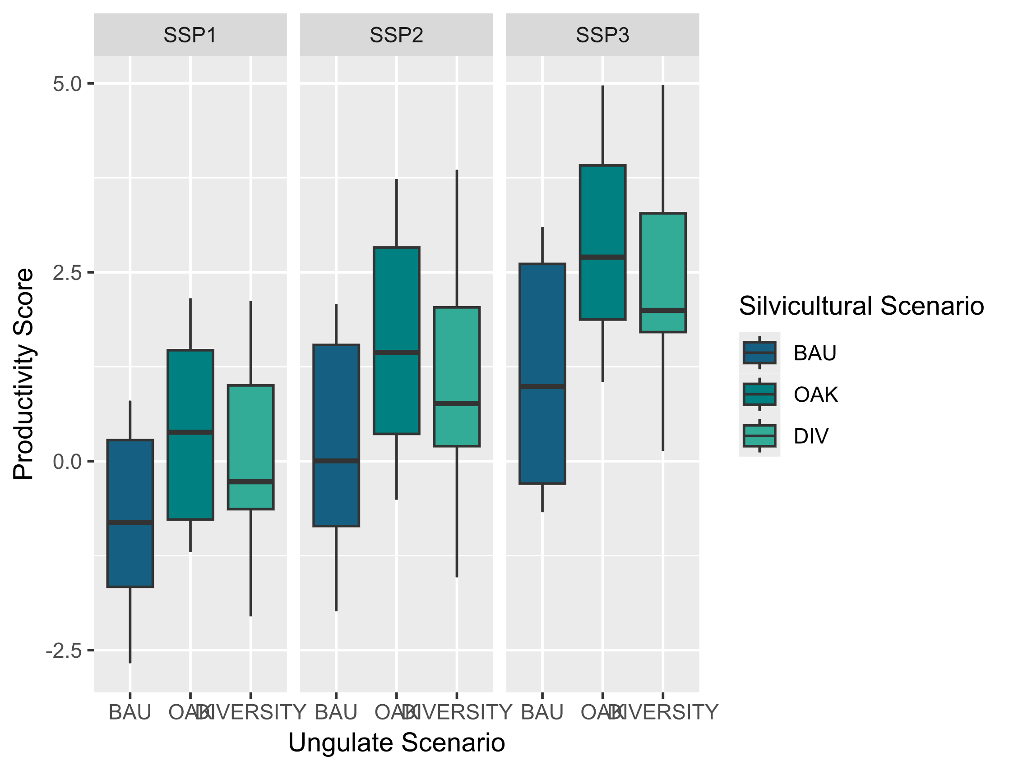

Positive effects of climate change
BAU
OAK
DIV
The increase in temperature and CO₂ concentration has led to an increase in forest productivity and an increase in each of the 6 scores.
Consistent with previous study
But, HETEROFOR likely underestimate climate change impacts.
No implementation yet of :
Embolism
Defoliation
…
Notes:
Warmin in 2081 - 2100

Slide 25
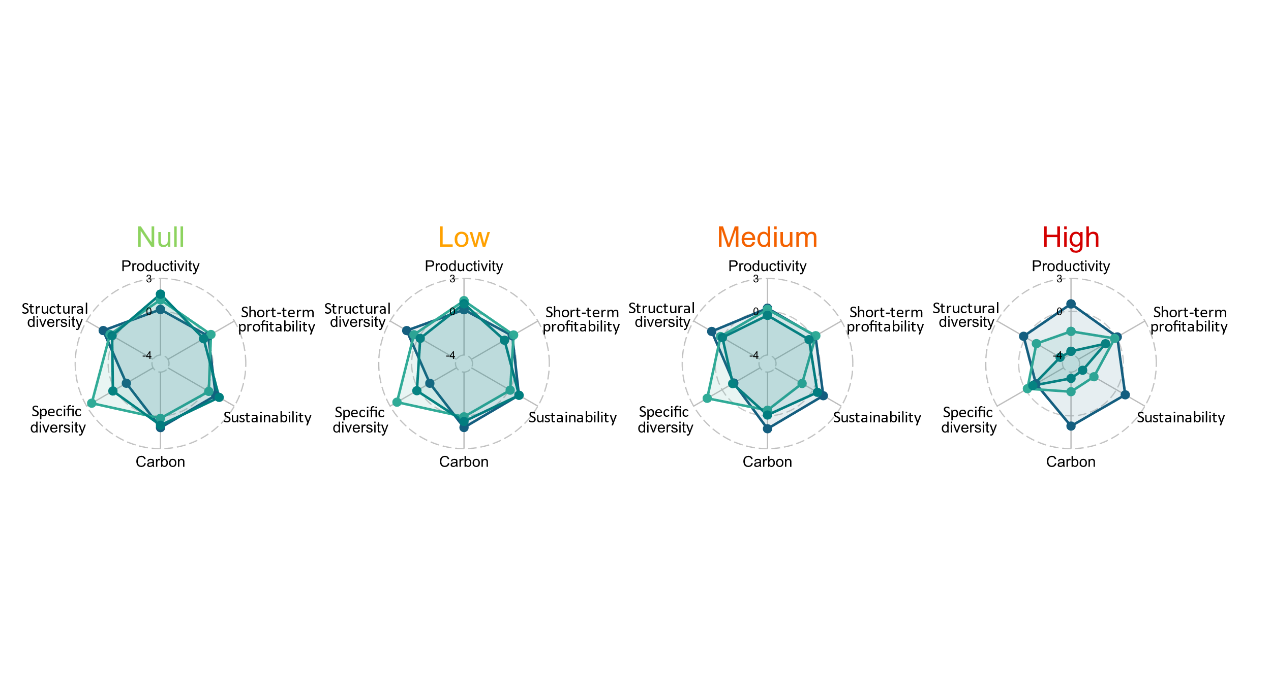
With no ungulate pressure, efforts to maintain oak and to increase diversity can pay off
BAU
OAK
DIV

Slide 26
The higher the ungulate pressure, the less interesting OAK and DIV are in comparison to BAU.
Notes:
Warmin in 2081 - 2100

Slide 27
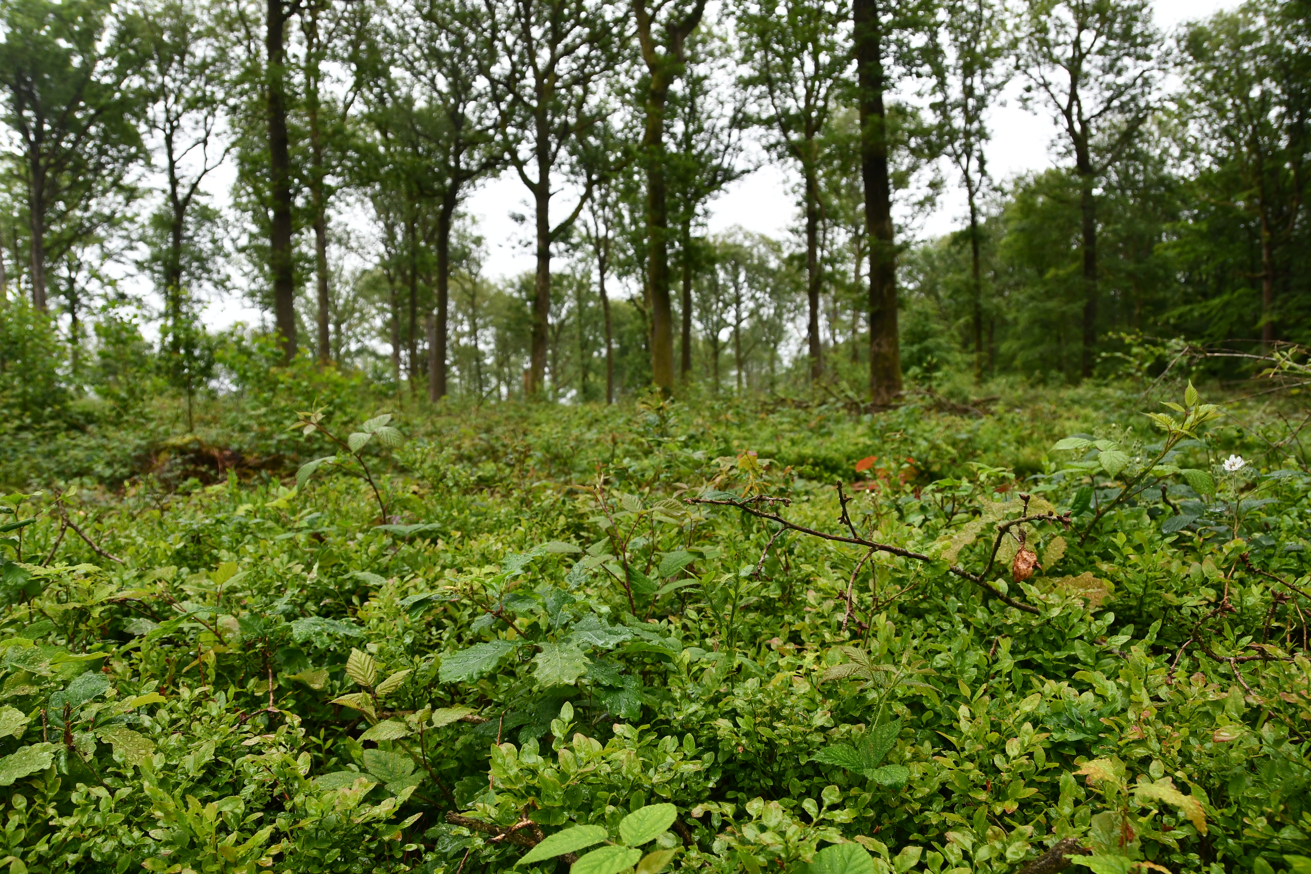
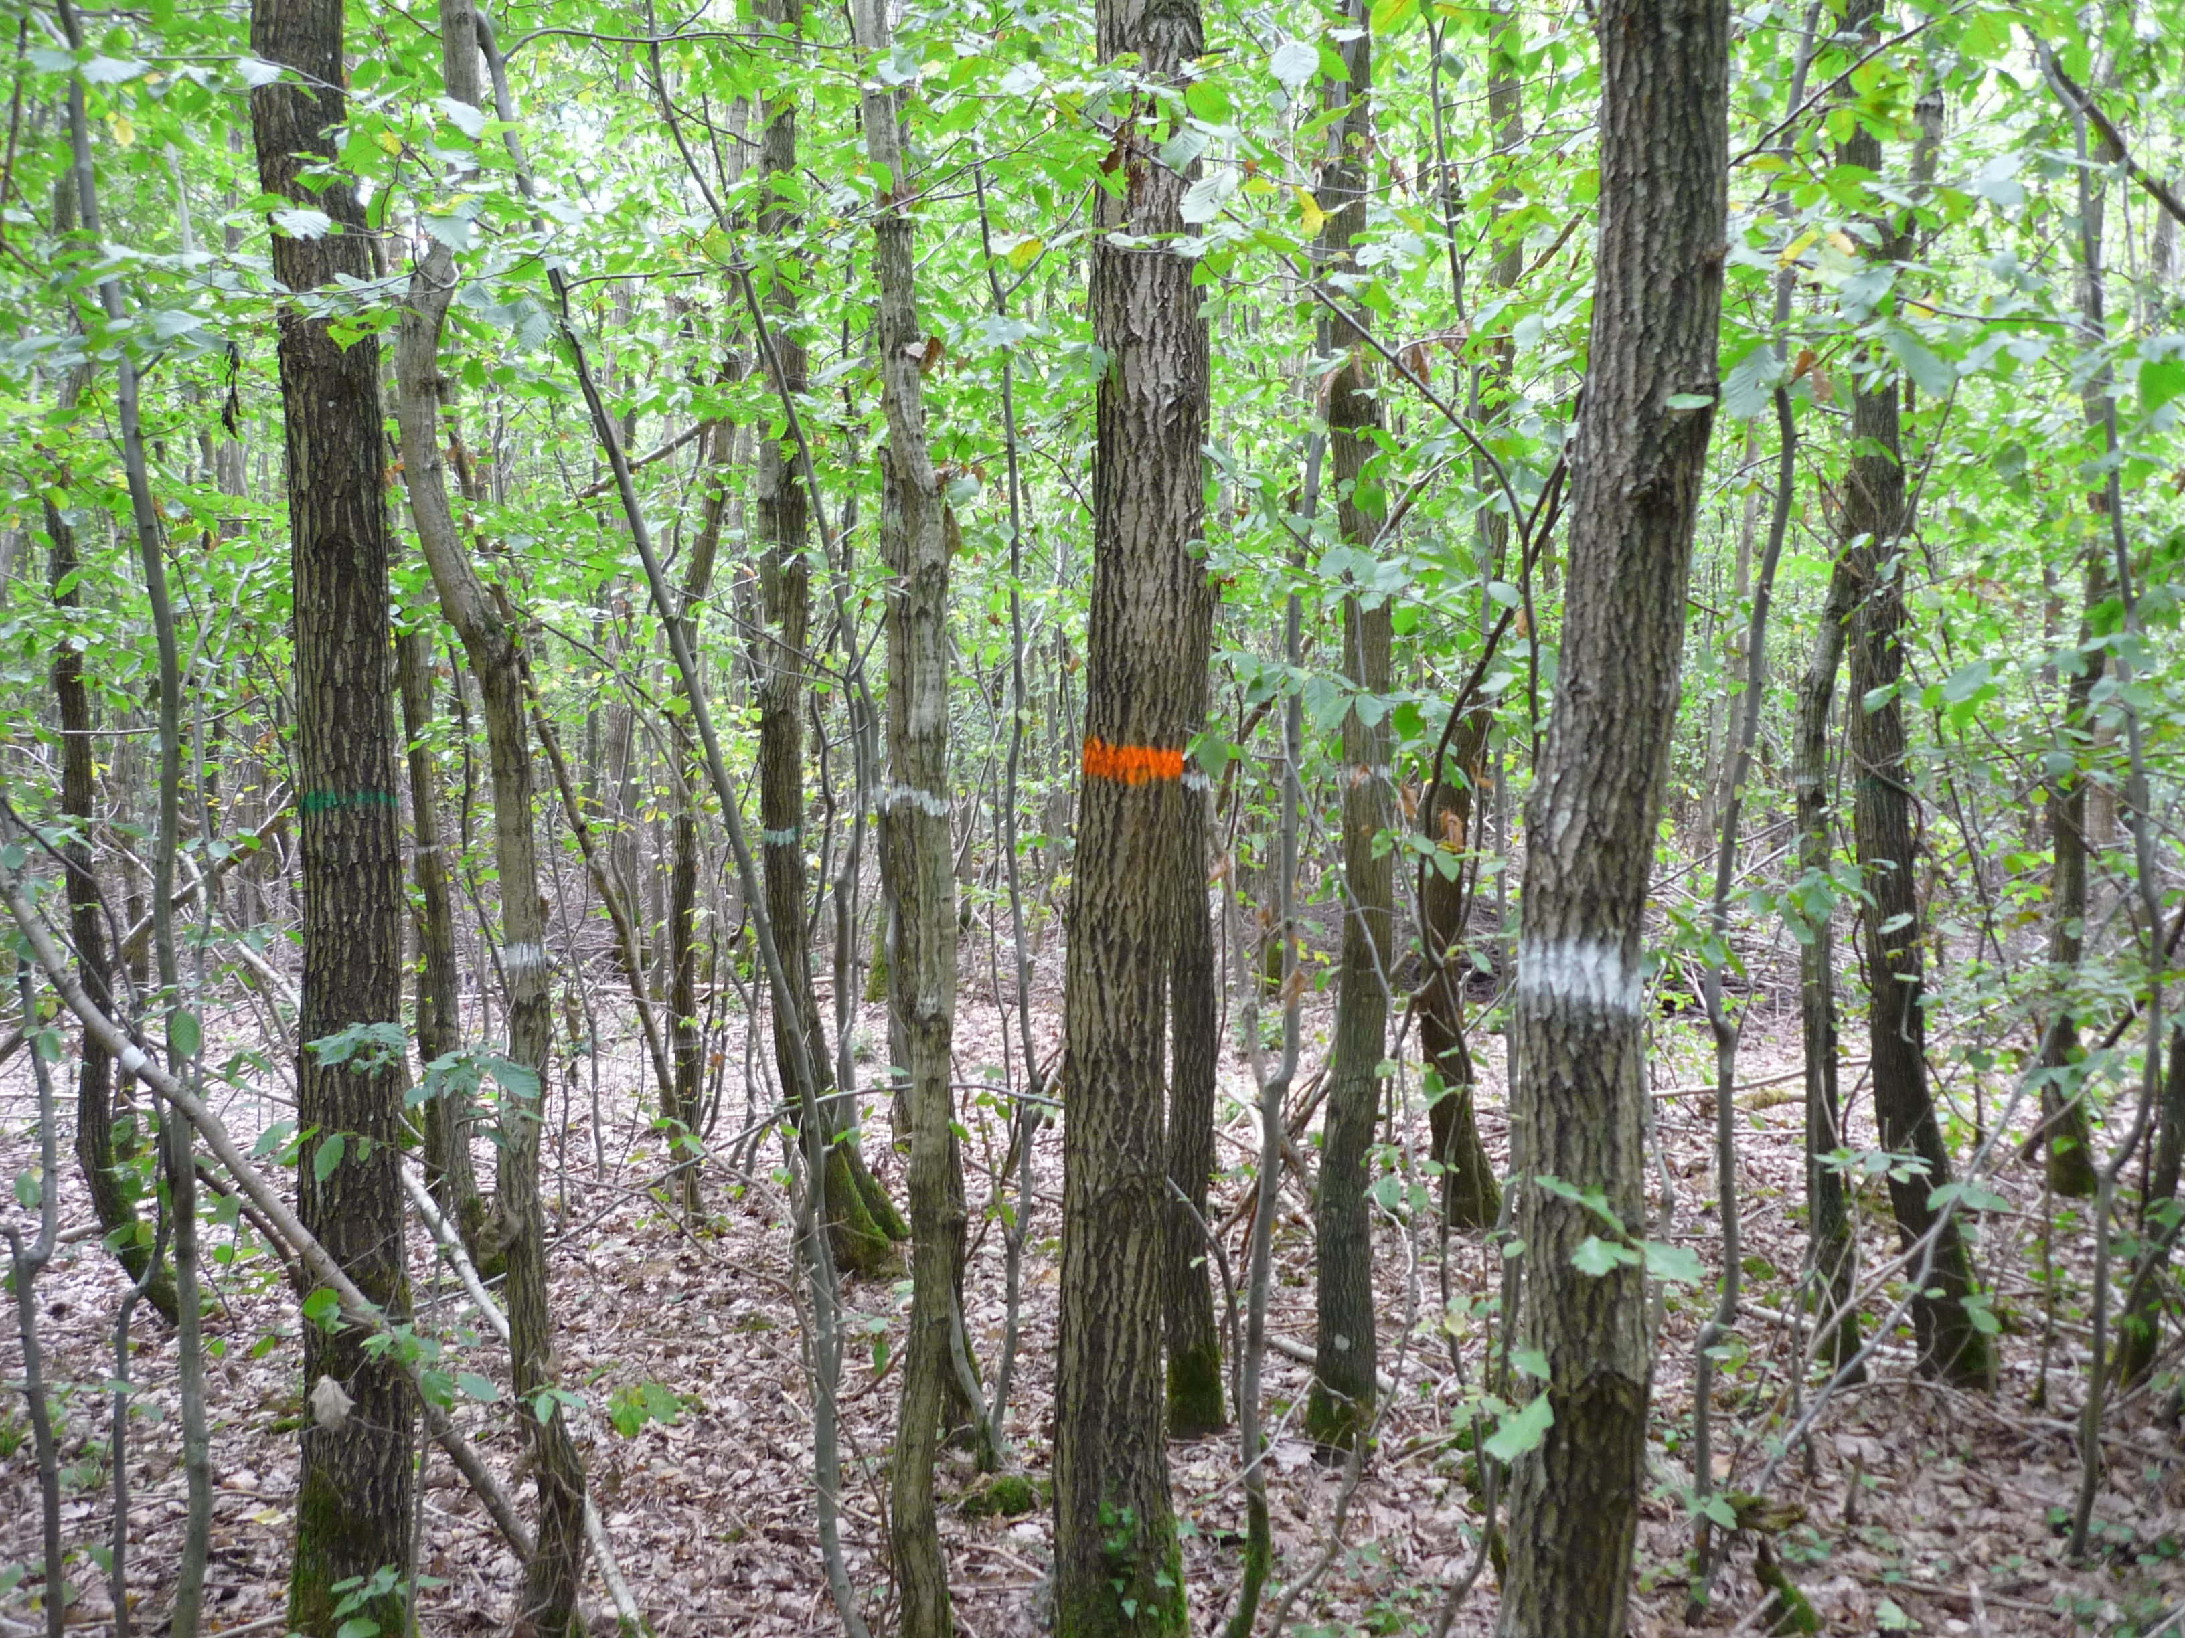
Study limitations
6 study cases
Few management scenarios investigated among numerous possibilities (Ddom, cutting cycle length, enrichment plantations)
Numerous hypotheses to evaluate management profitability (intervention costs, timber prices)
Notes:
Warmin in 2081 - 2100

Slide 28
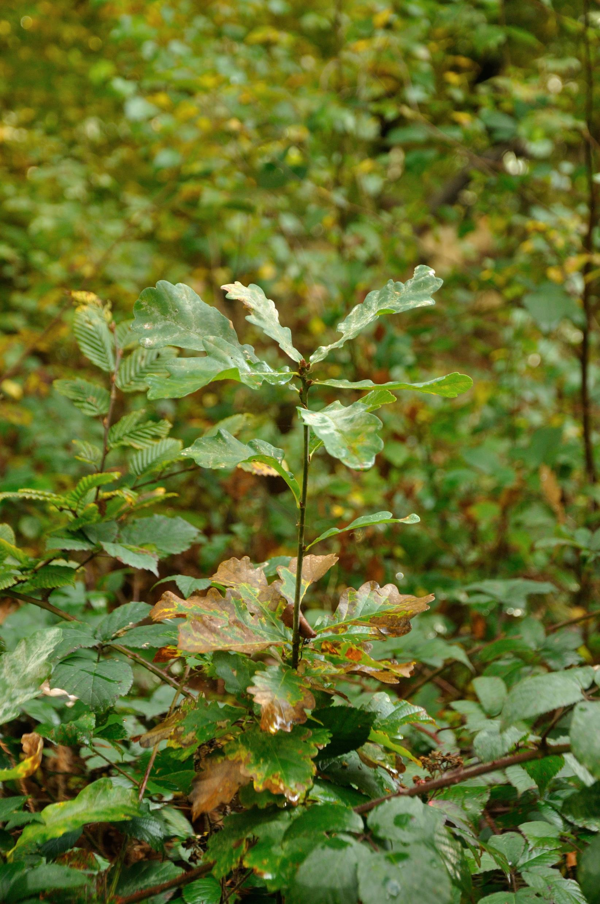
Conclusions and perspectives
Development of a framework to compare different managing strategies under different climate change scenario and ungulate pressure.
In mature broadleaved stands, silvicultural efforts to maintain oak and/or increase diversity can be competitive in comparison to BAU scenario if ungulate pressure is limited.
Under moderate to high ungulate pressure, the advantages of these efforts might be pointless and BAU strategies might rightly so be preferred…
Notes:
Warmin in 2081 - 2100

Slide 29
Thank you

