Slide 1
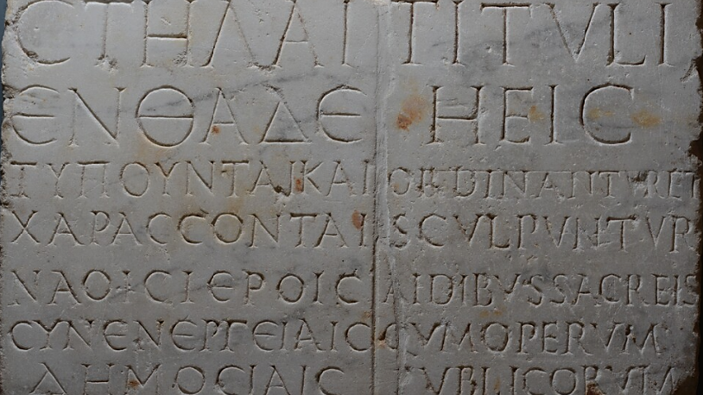

Litteras Graecas Athenis, non Lilybaei, Latinas Romae, non in Sicilia (Cic., div. in Caec. 39)
The attitude of Latin-speaking authors towards Sicilian Greek-Latin bilingualism
Penn-Leiden Colloquium on Ancient Values XIII
The Values of Language(s) in the Ancient World
June 12-14, 2025 — Leiden
Hugo Simons — Assistant-PhD candidate, University of Liège
hugo.simons@uliege.be

Slide 2
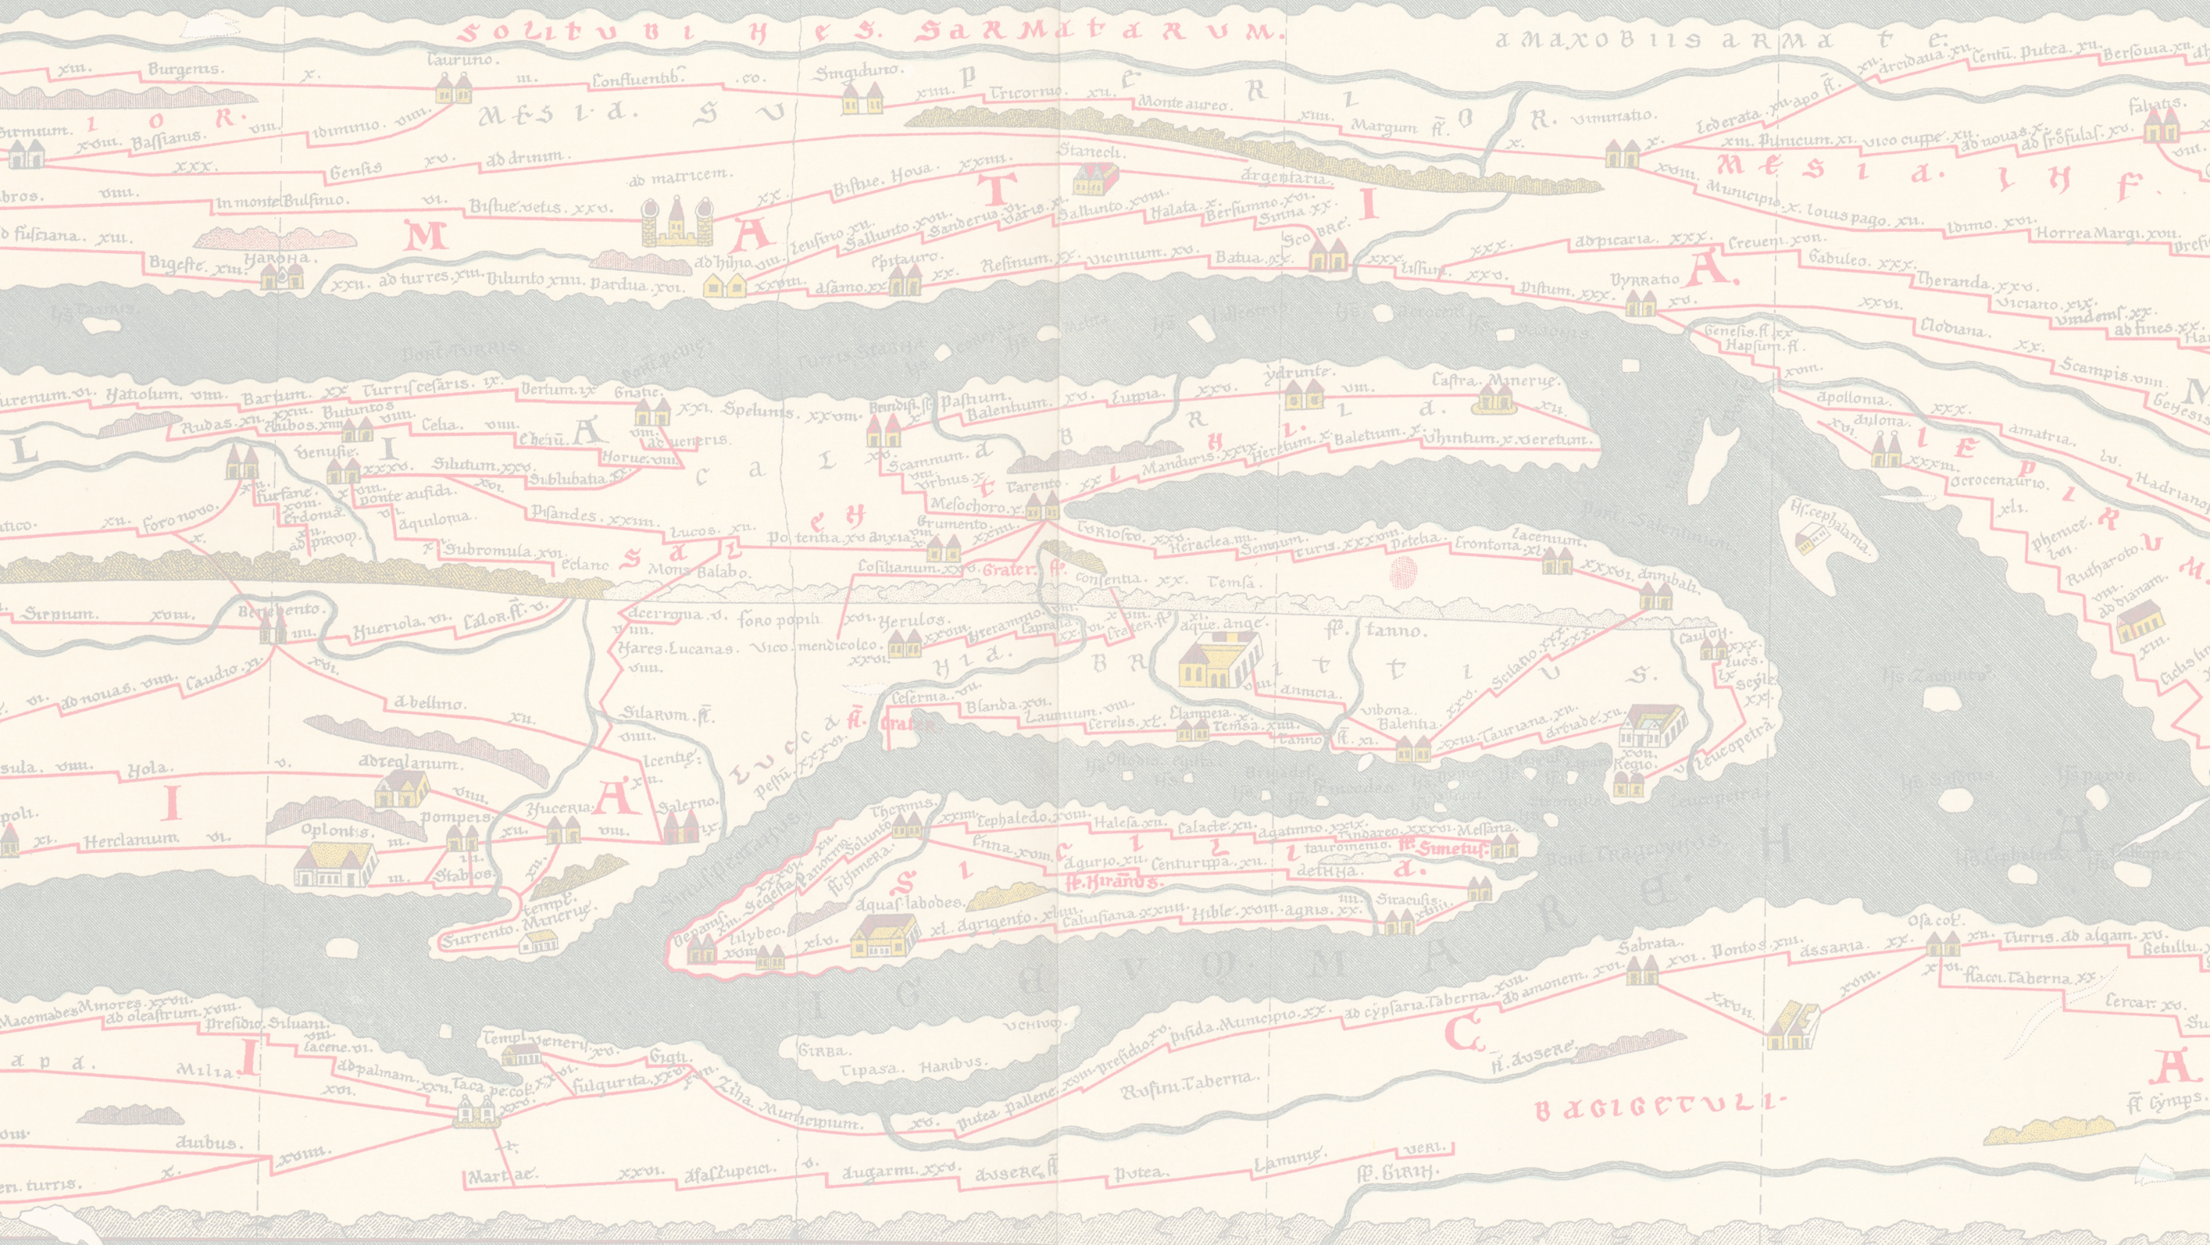
Cicero’s Divinatio in Caecilium
as a guiding thread
The Roman attitude to Greek language is marked by ambivalence.
Major focus on the reception and representation of the Greek and Latin languages spoken in Sicily.
Cicero’s testimony
Cicero, div. in Caec. 39: In quo si te multum natura adiuuaret, si optimis a pueritia disciplinis atque artibus studuisses et in his elaborasses, si litteras Graecas Athenis, non Lilybaei, Latinas Romae, non in Sicilia didicisses, tamen esset magnum tantam causam, tam expectatam et diligentia consequi et memoria complecti et oratione expromere et uoce ac uiribus sustinere.
Even if you were assisted greatly in this matter by natural gifts, even if from boyhood you had given yourself over to the best disciplines and technical skills and had exerted yourself in these accomplishments, even if you had learnt Greek letters at Athens rather than at Lilybaeum and Latin letters at Rome and not in Sicily: even so, with a case of such magnitude, a case that has aroused such wide public interest, it would be hard to find the industry to master it, the memory to remember it, the eloquence to set it forth, and the strength of voice and strength to sustain it.
Learning the litterae utriusque linguae
Greek litterae: Athens vs Lilybaeum (nowadays Marsala)
Latin litterae: Rome vs whole Sicily
Two cities that act as cultural centres for those seeking the most prestigious education.
An assault on Q. Caecilius Niger’s capabilities
Even with the best intellectual training, Caecilius would be unfit to prosecute Verres (unlike Cicero).
Societal bilingualism
“Societal bilingualism refers to the use of two or more languages within a community (strictly speaking multilingualism should be employed for more than two languages, but the term bilingualism tends to be extended). Various factors may affect the levels and patterns of bilingualism in a community.”
Mullen (2011), p. 528.

Slide 3
Si litteras Graecas Athenis,
non Lilybaei…
Plautus’ testimonies:
Men. 9-10: Atque adeo hoc argumentum graecissat: tamen
Non atticissat, uerum sicilicissitat.
And besides, this plot summary has a Greek air; nevertheless, it doesn’t have an Attic air, but a Sicilian one.
Trans. Wolfgang de Melo, 2011, LCL.
Persa 394-395: Dabuntur dotis tibi inde sescenti logi,
Atque Attici omnes; nullum Siculum acceperis.
You’ll get six hundred witty words from there, and all of them Attic ones; you needn’t take a single Sicilian word.
Trans. Wolfgang de Melo, 2011, LCL.
Atticisso vs siciliciss(it)o / Atticus vs Siculus
Inside a more global ‘Greek identity’, two subdivisions:
An Attic identity;
A Sicilian identity.
Paul. Fest., p. 26 Lindsay 7-8: Plautus: “Non atticissat, sed sicilicissat”, id est Sicule loquitur.
Being Greek, talking Greek:
“[L]e fait de parler grec se confond avec celui d’être grec, dans son comportement, en particulier dans son habillement et sa nourriture.”
Biville (1993), p. 138.
Suetonius, Aug. 98.2-4: Forte Puteolanum sinum praeteruehenti vectores nautaeque de navi Alexandrina, quae tantum quod appulerat, candidati coronatique et tura libantes fausta omina et eximias laudes congesserant… Sed et ceteros continuos dies inter varia munuscula togas insuper ac pallia distribuit, lege proposita ut Romani Graeco, Graeci Romano habitu et sermone uterentur.
As he sailed by the gulf of Puteoli, it happened that from an Alexandrian ship which had just arrived there, the passengers and crew, clad in white, crowned with garlands, and burning incense, lavished upon him good wishes and the highest praise… More than that, for the several remaining days of his stay, among little presents of various kinds, he distributed togas and cloaks as well, stipulating that the Romans should use the Greek dress and language and the Greeks the Roman.
Trans. J.C. Rolfe, 1914, LCL.

Slide 4
Si litteras Graecas Athenis,
non Lilybaei…
Sicilian Greeks vs other Greeks: a moral distinction
Cicero, Verr. II.2.7: Iam vero hominum ipsorum, iudices, ea patientia virtus frugalitasque est ut proxime ad nostram disciplinam illam veterem, non ad hanc quae nunc increbruit, videantur accedere. Nihil ceterorum simile Graecorum; nulla desidia, nulla luxuries; contra summus labor in publicis privatisque rebus, summa parsimonia, summa diligentia. Sic porro nostros homines diligunt.
And then again, the character of the inhabitants is such, so hardy and upright and honest, that it really reminds us of the stern old Roman manners, rather than of those which have come to prevail among us to-day. They have none of the failings found elsewhere among Greeks; they are neither slothful nor self-indulgent; on the contrary, they are highly industrious, for their own and for the public good; plain-living and conscientious folk. Such, moreover, is their attachment to our own people that among them.
Trans. L.H.G. Greenwood, 1928, LCL.
Attic Greek as a norma loquendi
Cicero, de orat. III.43: … quae quidem ut apud Graecos Atticorum, sic in Latino sermone, huius est urbis maxime propria.
… a merit which as among the Greeks it is peculiar to Attica so in Latin speech is specially the attribute of this city.
Trans. H. Rackham, 1942, LCL.
“[P]arler grec implique immédiatement un rattachement symbolique à la ville d’Athènes. En effet, de même que, pour un Romain, le latin est la langue de Rome, le grec ne peut être que le grec d’Athènes. […] Pour un Romain, il semble tout aussi inconcevable et peu reluisant de parler le grec de Sicile que le latin de la provincia. Il y a donc des différences qualitatives entre divers types de grec tout comme il existe différentes façons de s’exprimer en latin. Et si la norme de référence pour le latin est évidemment Rome (la latinitas est en réalité une romanitas), pour le grec, c’est la langue d’Athènes qui est toujours la norme implicite.”
Valette-Cagnac (2003).

Slide 5
... Latinas Romae,
non in Sicilia didicisses
Caecilius’s natural abilities
Cicero, div. in Caec. 39: … Latinas Romae, non in Sicilia didicisses, tamen esset magnum tantam causam, tam expectatam et diligentia consequi et memoria complecti et oratione expromere et uoce ac uiribus sustinere.
… and Latin letters at Rome and not in Sicily: even so, with a case of such magnitude, a case that has aroused such wide public interest, it would be hard to find the industry to master it, the memory to remember it, the eloquence to set it forth, and the strength of voice and strength to sustain it.
Lucilius’ remark
Cicero, fin. I.7: Nec uero ut noster Lucilius recusabo quominus omnes mea legant. Vtinam esset ille Persius. Scipio uero et Rutilius multo etiam magis: quorum ille iudicium reformidans Tarentinis ait se et Consentinis et Siculis scribere.
Nor yet shall I object, like our Lucilius, to all the world’s reading what I write. I only wish his Persius were alive to day! and still more Scipio and Rutilius, in fear of whose criticism Lucilius protests that he writes for the public of Tarentum, Consentia and Sicily.
Trans. H. Rackham, 1914, LCL.
“Lucilius is not stating that he is writing for the likes of the inhabitants of the Latin colony Suessa Aurunca, but for Greeks who would scarcely know Latin, if at all. […] Lucilius’ statement is an exaggeration with humorous intent: he will avoid criticism by addressing (in Latin) those who do not know Latin. The passage on this interpretation is not relevant to regional Latin because the opposition implied is between Latin and Greek rather than city Latin and regional Latin. It is however of interest as presenting Rome as a cultural centre inhabited by urbane critics.”
Adams (2007), p. 142.
Presence of the interpretes
Cicero, Verr. II.3.84: A. Valentius est in Sicilia interpres, quo iste interprete non ad linguam Graecam, sed ad furta et flagitia uti solebat.
There is, for instance, an interpreter in Sicily called Aulus Valentius, whom Verres employed to help him not with the Greek language but with his thefts and debaucheries.
Trans. L.H.G. Greenwood, 1928, LCL.

Slide 6
In ea insula quae neutra
bene utatur
Symmachus, or. 1.2: “Si litteras,” inquit Tullius, “Graecas Athenis non Lilybaei, Latinas Romae non in Sicilia didicisses,” videlicet ex locorum ingeniis adprobans ea nescire Caecilium, quae eum dicit ubi innata non errant adsecutum. Sola est enim disciplinarum magistra natura regionum.
“If,” said Cicero, “you had learnt Greek literature at Athens, not at Lilybaeum, and Latin at Rome, not in Sicily,” he was demonstrating, obviously, from the natures of the localities that Caecilius did not know the things which he says he studied where they were not inborn; for the only teacher of knowledge is the nature of places.
Jerome, epist. 46.9: Certe, si etiam praeclarus orator reprehendendum nescio quem putat, quod litteras Graecas non Athenis, sed Lilybaei, Latinas non Romae, sed in Sicilia didicerit, quod uidelicet unaquaeque prouincia habeat aliquid proprium, quod alia aeque habere non possit, cur nos putamus absque Athenis nostris quemquam ad studiorum fastigium peruenisse?
If a famous orator blames a man for having learned Greek at Lilybaeum instead of at Athens, and Latin in Sicily instead of at Rome—since each province evidently has something unique that another cannot equally possess—, why do we assume that no one has reached the heights of learning without the Christian Athens?
Ps. Asconius, div. in Caec., p. 197 Stangl, 24: “Athenis, non Lilybaei, Romae, non in Sicilia”. Dicit illum Graecas litteras, simul Latinas in Sicilia didicisse, in ea insula quae neutra bene utatur. Ita et Plautus in Persa:
Dabuntur <dotis> tibi <inde> sexcenti logi,
Atque Attici <omnes>: nullum Siculum acceperis.
“At Athens, not at Lilybaeum; at Rome, not in Sicily”. He says that the man learned both Greek and Latin literature in Sicily, on this island where poor use is made of either. Thus, as Plautus also states in Persa: “You’ll get six hundred witty words from there, and all of them Attic ones; you needn’t take a single Sicilian word.”
Sicilian lexicon
Cicero, Att. V.11.5: Sed ego hanc, ut Siculi dicunt, ἀνέξιαν in unum annum meditatus sum; proinde pugna ne, si quid prorogatum sit, turpis inveniar.
Cicero, Verr. II.4.50: Catinam cum venisset, oppidum locuples honestum copiosum, Dionysiarchum ad se proagorum, hoc est summum magistratum, vocari iubet.

Slide 7
In ea insula quae neutra
bene utatur
Sicilian lexicon
Varro, ling. V.20.101: Lepus, quod Siculi, ut Aeolis quidam Graeci, dicunt λέποριν: a Roma quod orti Siculi, ut annales veteres nostri dicunt, fortasse hinc illuc tulerunt et hic reliquerunt id nomen.
Lepus ‘hare,’ because the Sicilians, like certain Aeolian Greeks, say λέπορις. Inasmuch as the Sicilians originated from Rome, as our old Annals say, perhaps they carried the word from here to Sicily, but also left it here behind them.
Trans. Roland G. Kent, 1938, LCL.
  Varro, rust. III.12.6: Aelius putabat ab eo dictum leporem a celeritudine, quod levipes esset. Ego arbitror a Graeco vocabulo antico, quod eum Aeolis λέποριν appellabant.
  Lucius Aelius thought that the hare received its name lepus because of its swiftness, being levipes, nimble-foot. My own opinion is that it comes from an old Greek word, as the Aeolians called it λέπορις.
  Trans. Harrison Boyd Ash, 1934, LCL.
Varro, ling. V.25.120: Vasa in mensa escaria: ubi pultem aut iurulenti quid ponebant, a capiendo catinum nominarunt, nisi quod Siculi dicunt κάτινον ubi assa ponebant.
Varro, ling. V.36.173: In argento nummi, id ab Siculis.
Varro, ling. V.36.175: Dos, si nuptiarum causa data; haec graece δωτίνη: ita enim hoc Siculi.
Varro, ling. V.39.179: Si datum quod reddatur, mutuum, quod Siculi μοῖτον: itaque scribit Sophron μοῖτον ἀνθύμῳ.
Varro, ling. VII.5.6: Epityrum vocabulum est cibi, quo frequentius Sicilia quam Italia usa.
Varro: 1) A Roma quod orti Siculi.
2) Connection between the Siculi and the Greeks.
Cicero: Clarification of the (cultural) context.

Slide 8
In ea insula quae neutra
bene utatur
Apuleius’ Siculi trilingues
Apuleius, met. XI.5.2: Inde primigenii Phryges Pessinuntiam deum matrem, hinc autocthones Attici Cecropeiam Mineruam, illinc fluctuantes Cyprii Paphiam Venerem, Cretes sagittiferi Dictynnam Dianam, Siculi trilingues Stygiam Proserpinam…
In one place the Phrygians, first-born of men, call me Pessinuntine Mother of the Gods, in another the autochthonous people of Attica call me Cecropian Minerva, in another the sea-washed Cyprians call me Paphian Venus; to the arrow-bearing Cretans I am Dictynna Diana, to the trilingual Sicilians Ortygian Proserpina…
Trans. J. Arthur Hanson, 1989, LCL.
A geographical reference? – Rochette (2018), p. 209.
Ovid, met. 13.722-724:
  Inde futurorum certi, quae cuncta fideli
  Priamides Helenus monitu praedixerat, intrant
  Sicaniam: tribus haec excurrit in aequora linguis.
There having learned all that awaited them from the friendly prophecies of Helenus, Priam’s son, they came to Sicily. This land runs out into the sea in three capes.
Trans. Frank Justus Miller, revised by G.P. Goold, 1916, LCL.
The viri divites et eruditi of Sicily
Expositio totius mundi et gentium 65: Post quas insulas omnes optima et maxima Sicilia insula… Habet autem et viros divites et eruditos omni doctrina, Graeca quoque et Latina.
After all these islands comes the finest and largest of them all: the island of Sicily… It also has men who are wealthy and learned in every branch of knowledge, both Greek and Latin.
Descriptio totius mundi et gentium 65: Post has optima sequitur et maxima Siciliae insula… Habet autem eruditos et divites viros graeco latinoque sermone.
After these islands, the finest and largest of all follows—the island of Sicily… It has, moreover, learned and wealthy men, fluent in both Greek and Latin language.

Slide 9
In ea insula quae neutra
bene utatur
Sextus Clodius
Suetonius, rhet. 29: Sextus Clodius e Sicilia, Latinae simul Graecaeque eloquentiae professor, male oculatus et dicax par oculorum in amicitia M. Antoni triumviri extrisse se aiebat.
Sextus Clodius of Sicily, a teacher of both Greek and Latin oratory and a man with poor sight and a sharp tongue, used to say that he had worn out a pair of eyes during his friendship with Mark Antony, the triumvir.
Trans. J.C. Rolfe, 1914, LCL.
Cicero, Phil. 2.42: At vero adhibes ioci causa magistrum suffragio tuo et compotorum tuorum rhetorem, cui concessisti ut in te quae vellet diceret, salsum omnino hominem, sed materia facilis in te et in tuos dicta dicere.
Ah, but then for sport, you and your drinking companions voted to set up as the master of ceremonies a professional rhetorician, and you gave him permission to say whatever he liked against you—a witty fellow, no doubt, but you and your crowd make easy targets for satire.
Trans. D.R. Shackleton Bailey, revised by John T. Ramsey and Gesine Manuwald, 2010, LCL.
Citharius
Ausonius, prof. Burd. 13.1-8:
Et, Citari dilecte, mihi memorabere, dignus
grammaticos inter qui celebrere bonos.
esset Aristarchi tibi gloria Zenodotique
Graiorum, antiquus si sequeretur honos.
5 carminibus, quae prima tuis sunt condita in annis,
concedit Cei musa Simonidei.
urbe satus Sicula nostram peregrinus adisti
excultam studiis quam propere edideras.
You also shall be recalled by me, beloved Citarius, for you deserve to be praised amongst good grammarians. If the custom of past ages still obtained, you would have the renown of Aristarchus and Zenodotus among the Greeks. Even the Muse of Simonides of Ceos yields place to the odes which you composed in your early years. Born in a Sicilian town, you came a stranger to our city, but quickly made it the home of culture with your learning.
Trans. Hugh G. Evelyn-White, 1919, LCL.

Slide 10
Sicily as a space of interaction, circulation, and transformation
Cicero’s Divinatio in Caecilium contributes to the construction of a normative discourse on language and culture.
An idealized form of Greek (Attic Greek), playing a structuring function:
  in a “Roman world vs Hellenized world” opposition.
  in an “elite vs subjugated population” opposition.
The Latin authors’ point of view bears witness to the island’s linguistic and cultural vitality.
A deeply rooted Greek-Latin bilingualism, forming a core component of Sicilian identity.
Overall, the analysis remains, because of the nature of the selected sources, predominantly Roman-centred. Integrating Greek authors’ testimonies would provide a more nuanced and contrastive view.

Slide 11
Selected bibliography
J.N. Adams, “‘Romanitas’ and the Latin Language”, CQ 53.1 (2003), p. 184-205.
J.N. Adams, The Regional Diversification of Latin 200 BC - AD 600, Cambridge, 2007.
F. Biville, “Grec des Romains, ou latin des Grecs ? Ambiguïté de quelques processus néologiques dans la koiné”, in C. Brixhe (ed.), La koiné grecque antique, I. Une langue introuvable ?, Nancy, 1993 (Études Anciennes, 10), p. 129-140.
G. Bonfante, “Siculi trilingues”, RAL 37 (1982), p. 187-188.
M. Dubuisson, “Remarques sur la terminologie antique du bilinguisme”, RPh 57 (1981), p. 203-225.
M. Dubuisson, “Le grec à Rome à l’époque de Cicéron, extension et qualité du bilinguisme”, Annales : économies, sociétés, civilisations 47 (1992), p. 187-206.
K. Korhonen, “Language and Identity in the Roman Colonies of Sicily”, in R.J. Sweetman (ed.), Roman Colonies in the First Century of their Foundation, Oxford – Oakville (Conn.), 2011, p. 7-31.
K. Korhonen, “Sicily in the Roman Imperial Period: Language and Society”, in O. Tribulato (ed.), Language and Linguistic Contact in Ancient Sicily, Cambridge, 2012, p. 326-369.
K. Lomas, “Between Greece and Italy: an external perspective on culture in Roman Sicily”, in C.J. Smith, J. Serrati (ed.), Sicily from Aeneas to Augustus: New Approaches in Archaeology and History, Edinburgh, 2000 (New Perspectives on the Ancient World), p. 161-173.
A. Mullen, “Latin and Other Languages: Societal and Individual Bilingualism”, in J. Clackson (ed.), A Companion to the Latin Language, Chichester, 2011, p. 527-548.
P. Poccetti, “Language Relations in Sicily: Evidence for the Speech of the Σικανοί, the Σικελοί and Others”, in O. Tribulato (ed.), Language and Linguistic Contact in Ancient Sicily, Cambridge, 2012, p. 49-94.
P. Poccetti, “Plurilinguismo a Lilybaeum nella prima età romana”, in M.L. Aliffi et alii (ed.), Perspectives on Language and Linguistics. Essays in Honour of Lucio Melazzo, Palermo, 2021, p. 395-422.
J. Prag, “Identità siciliana in età romano-repubblicana”, in C. Ampolo (ed.), Immagine e immagini della Sicilia e di altre isole nel Mediterraneo antico. Atti delle Seste Giornate internazionali di studi sull’area elima e la Sicilia occidentale nel contesto mediterraneo (Erice, 12-16 ottobre 2006), Pisa, 2009, p. 87-99.
B. Rochette, “La terminologie grecque et latine du plurilinguisme”, Lingue antiche e moderne 7 (2018), p. 191-219.
E. Valette-Cagnac, “« Plus grec que le grec des Athéniens. » Quelques aspects du bilinguisme gréco‑latin”, in P. Borgeaud et alii (ed.), Dossier : Alexandre le Grand, religion et tradition, Paris, 2003 (Mètis, N.S. 1), p. 149-179.
A. Várvaro, Lingua e storia in Sicilia. Dalle guerre puniche alla conquista normanna, Palermo, 1981.
R.J.A. Wilson, Sicily under the Roman Empire: The Archaeology of a Roman Province, 36 B.C. - A.D. 535, Warminster, 1990 (Archaeologists’ guides to the Roman Empire).

