Slide 2
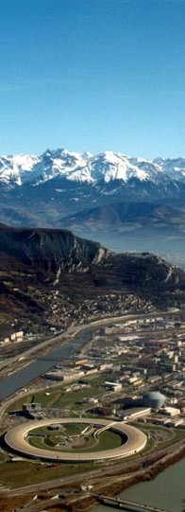
Fixed-Exit Double Crystal Monochromator
developments at the ESRF
3-Way Meeting – Optics Workshop
Thomas DEHAEZE and Olivier MATHON

Slide 3
Introduction – The ESRF Double Crystal Monochromator
What is a Double Crystal Monochromator?
DCM
“White” beam
Crystal
Source
Monochromatic beam
Crystal
Sample
Main Requirements:
Energy Stability
(Over Time)
Beam Stability
(During Scans)
Fast Scanning
(e.g. 1x EXAFS/s)
DCM Installations on Beamlines:
Today
ESRF DCM
Workshop
ID21 (prototype)
ID24
BM23
ID26,ID16b
2014
2019
2020
2021
2022
2023
2024
2025
Page 3
Optics Workshop l March 7, 2024 l T. Dehaeze & O. Mathon

Slide 4
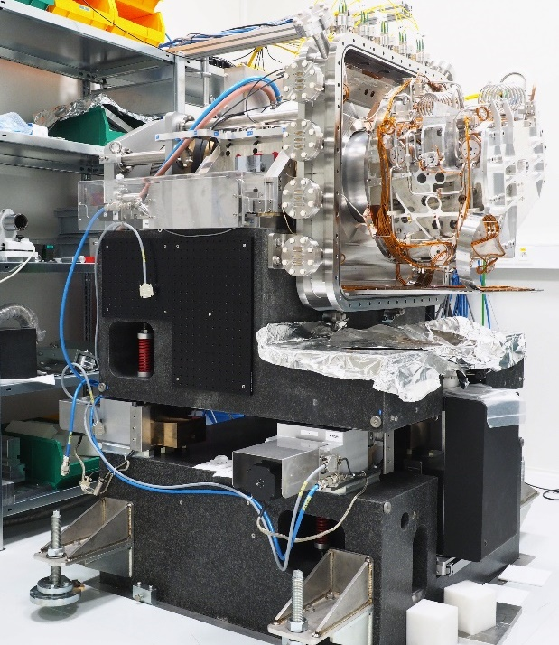
Outline
DCM overview
Working principle
Mechanical architecture
Real time control architecture
Positioning performances
Calibration Strategy
Tools and procedure
Commissioning results (ID24 and BM23)
Energy Stability, Position and angular stability
Conclusion and Further Work
Page 4
Optics Workshop l March 7, 2024 l T. Dehaeze & O. Mathon

Slide 5
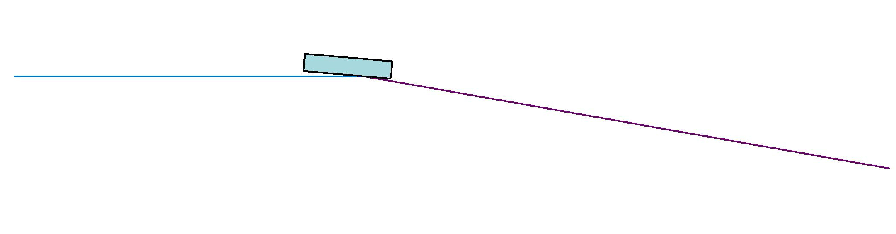
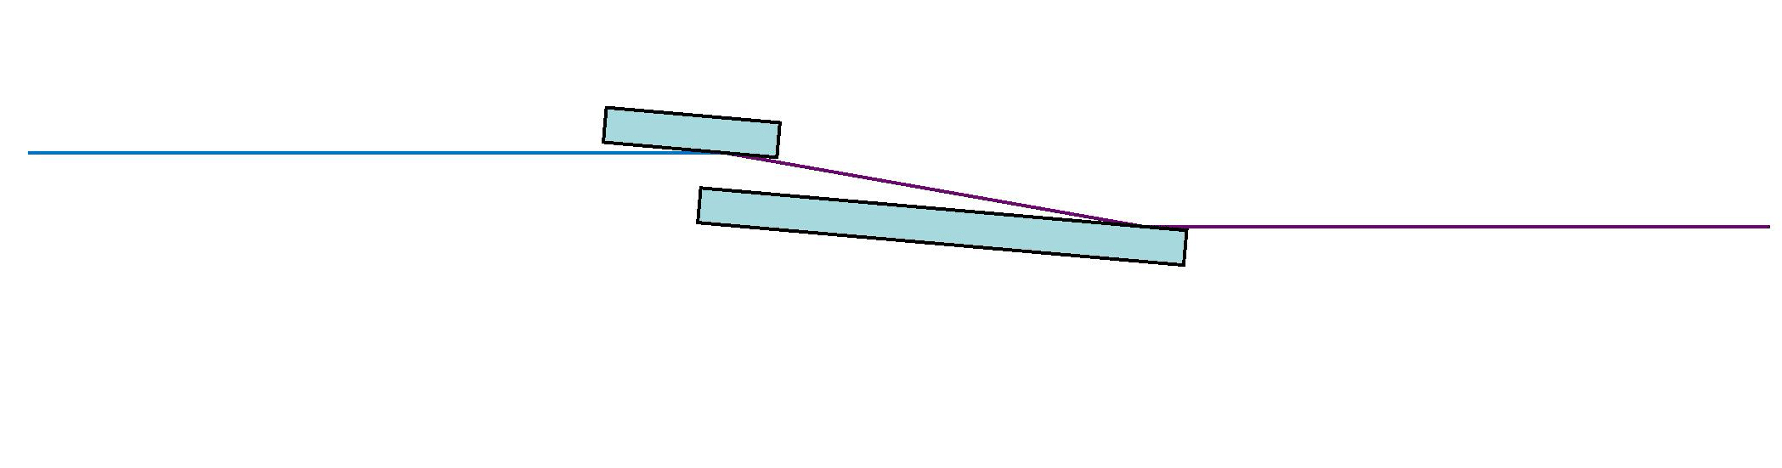
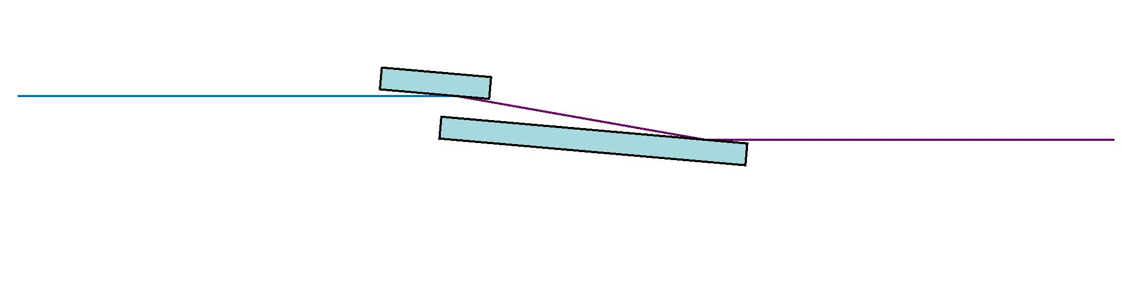

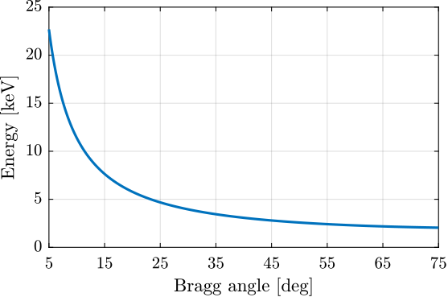
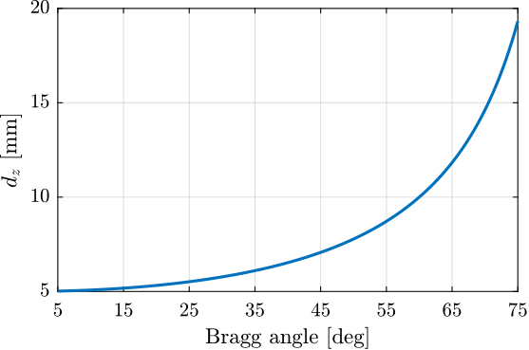
DCM – Working Principle
Bragg Diffraction
Fix Exit
Effect of Crystal Positioning Errors on the beam
$$E=\frac{hc}{2d(T)\sin{θ}}$$
$$d_{z}= \frac{d_{FE}}{2 \cos{θ}}$$
Beam
Crystal
$$ε_{z} = 2 ε_{d_{z}} \cos{θ}$$
$$ε_{R_{z}} =−2 ε_{r_{x}} \sin{θ}$$
$$ε_{R_{y}} =−2 ε_{r_{y}}$$
Page 5
Optics Workshop l March 7, 2024 l T. Dehaeze & O. Mathon

Slide 6
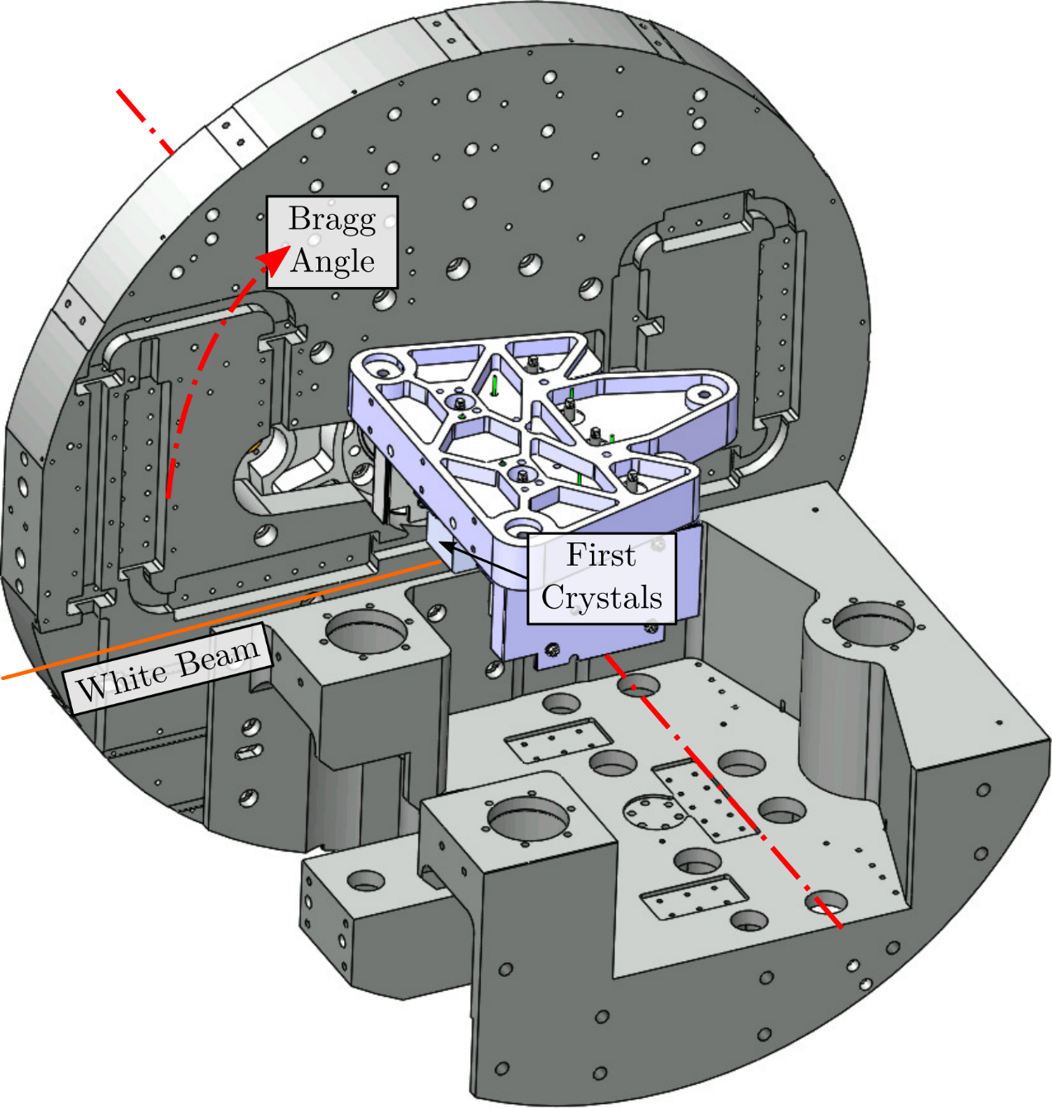
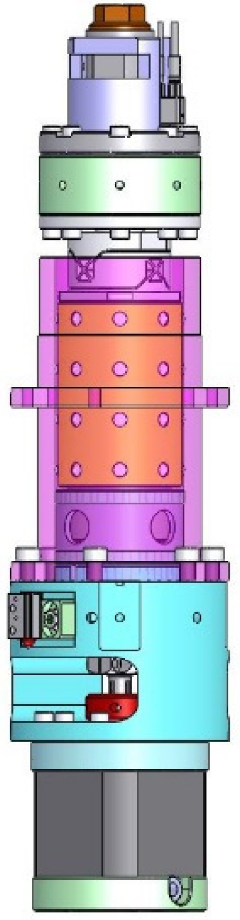
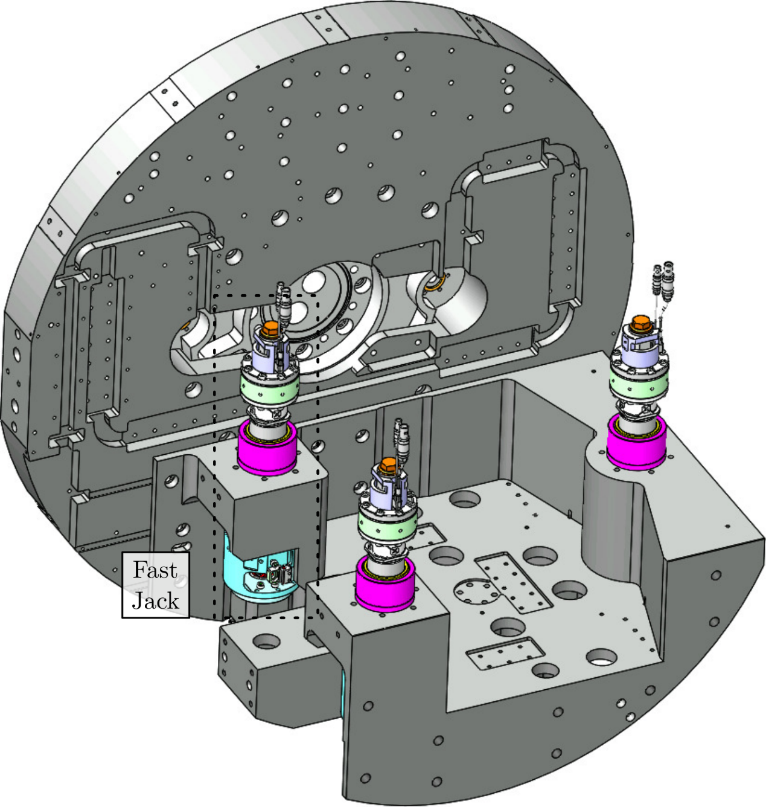
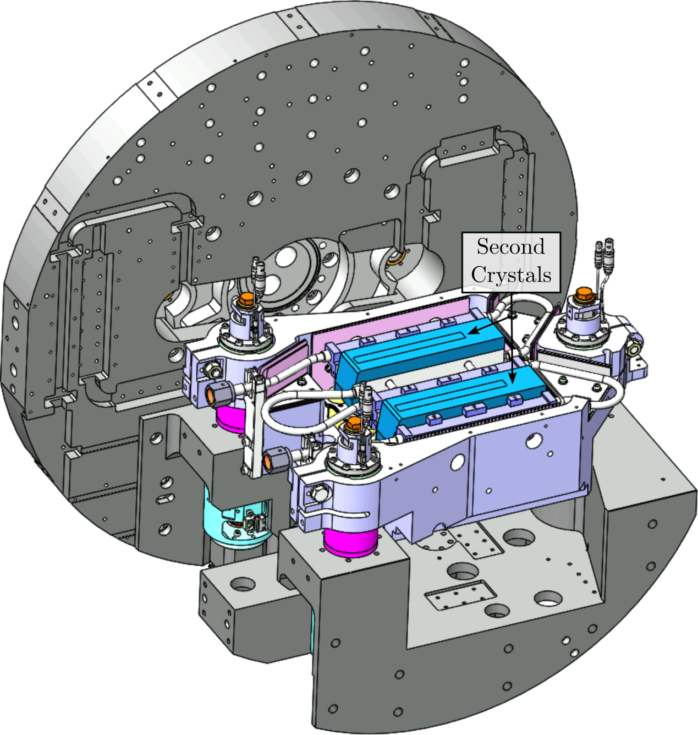
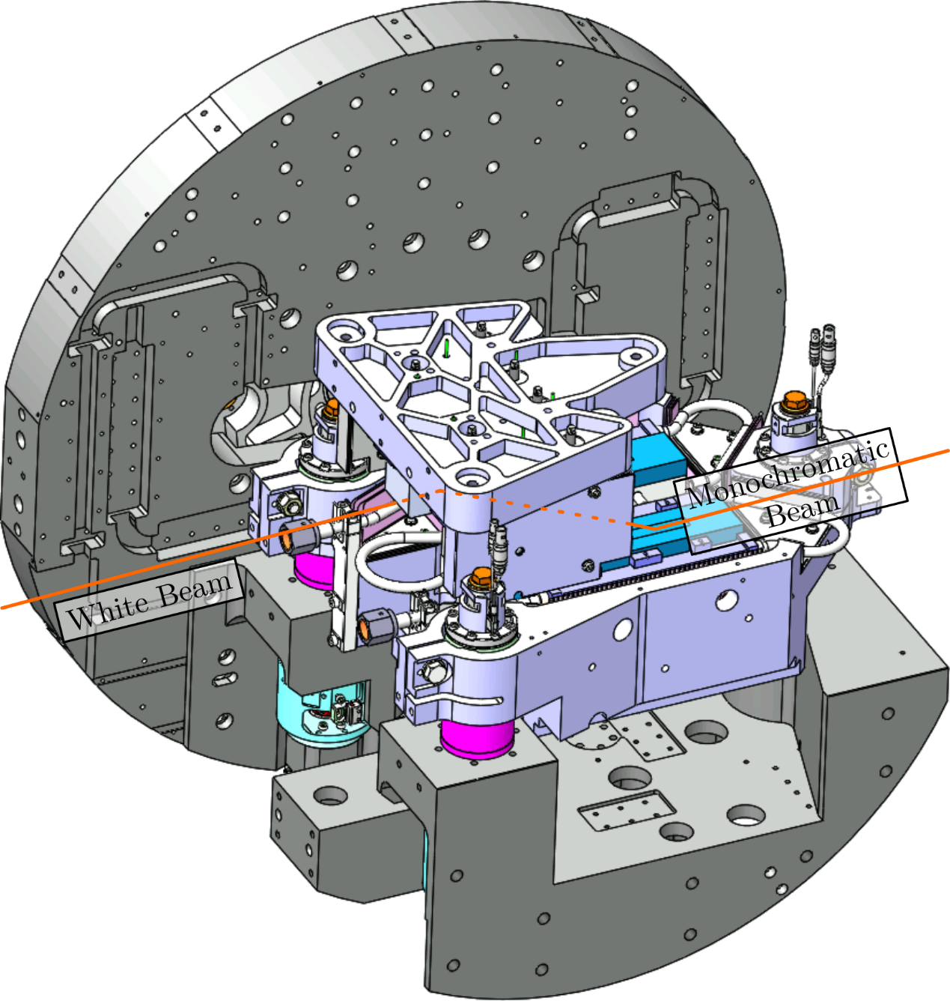
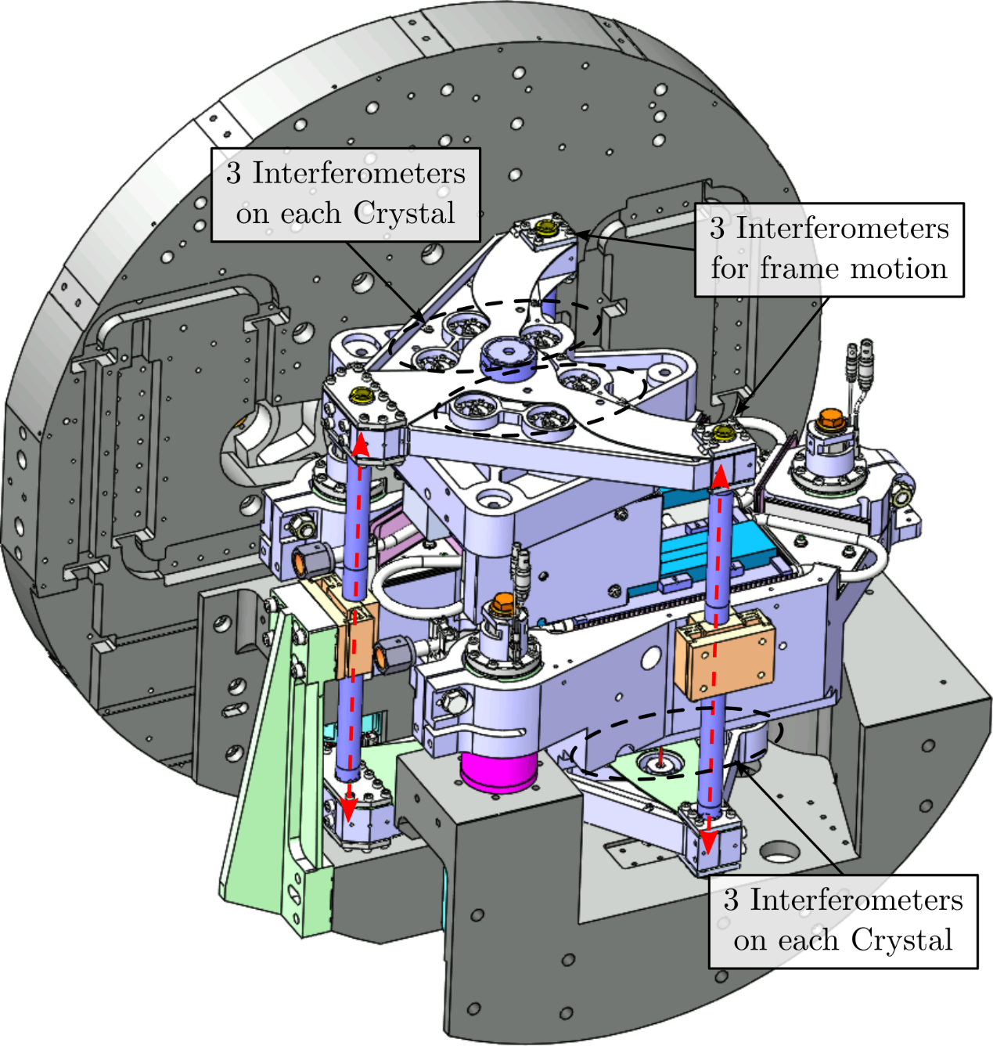
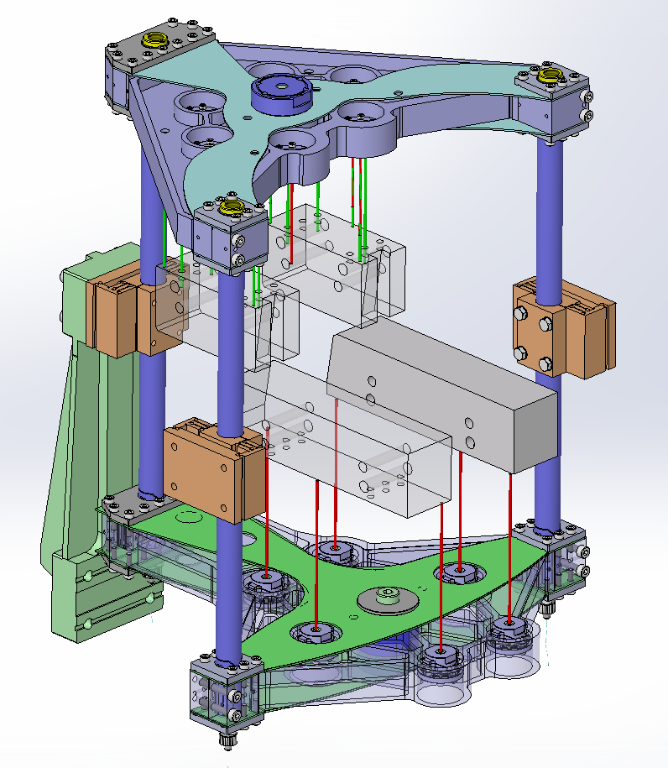
DCM – Mechanical Design
Crystal Cage / Bragg Axis
4 in Vaccum Encoders
Direct Drive Torque Motor
Piezoelectric Stack
(15μm stroke)
Flexible Joint
Fast Jacks
“Hybrid” Actuator
Piezo for real time error correction
Satellite roller screw
(1mm pitch)
Ball bearing guide
Tripod Architecture
Positioning along $$D_{z}R_{x}R_{y}$$
High rigidity compared to stack stages
Stepper Motor
(200 steps/turn)
Mechanically too complex
to keep a parallelism
<100 nrad
Separate Metrology frame
$$D_{z}R_{x}R_{y}$$ Indirect measurement
9 interferometers per crystal
Page 6
Optics Workshop l March 7, 2024 l T. Dehaeze & O. Mathon

Slide 7
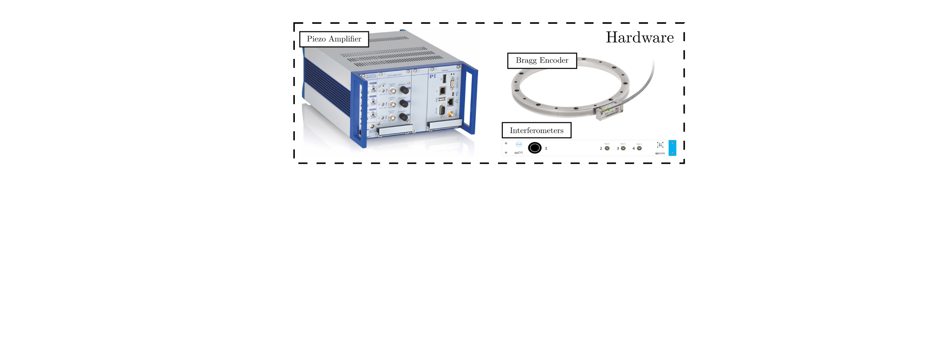
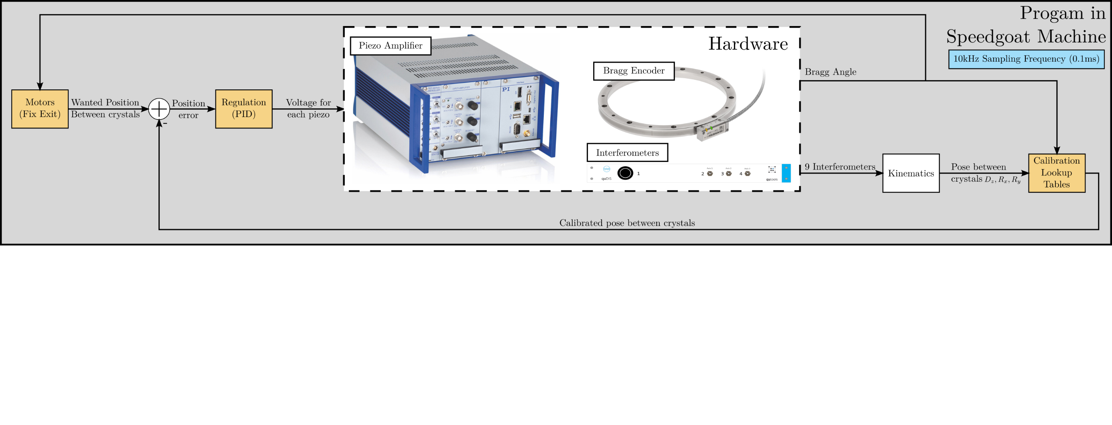
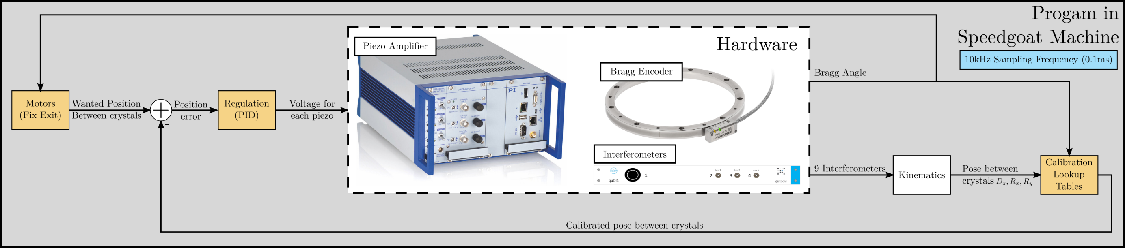
Real Time Control Architecture
Page 7
Optics Workshop l March 7, 2024 l T. Dehaeze & O. Mathon

Slide 8
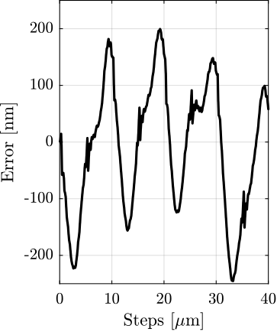
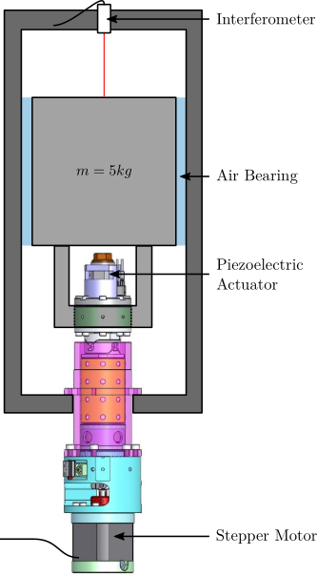
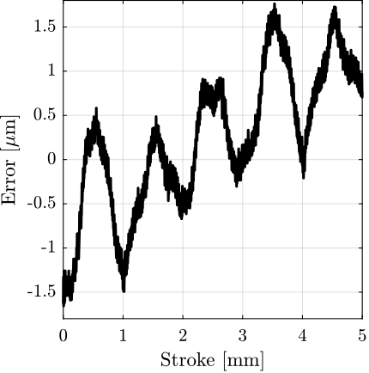
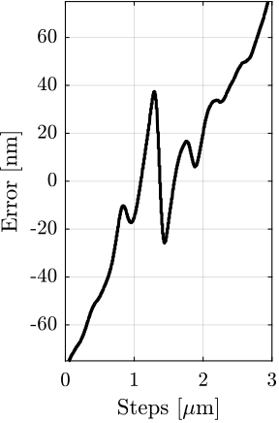
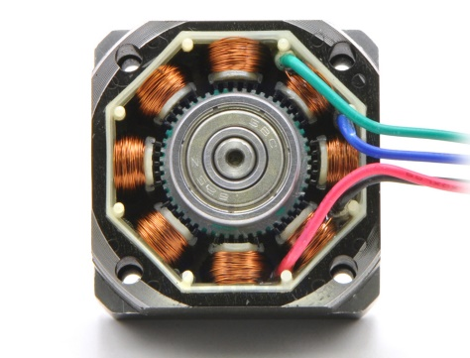
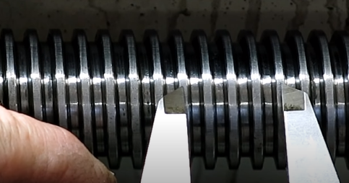
FastJack – Open Loop Errors
Lead Screw Errors
Microstepping Errors
Cogging
Page 8
Optics Workshop l March 7, 2024 l T. Dehaeze & O. Mathon

Slide 9
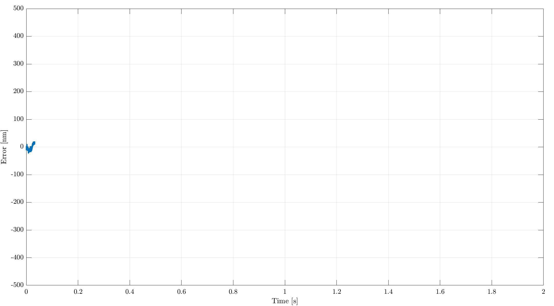
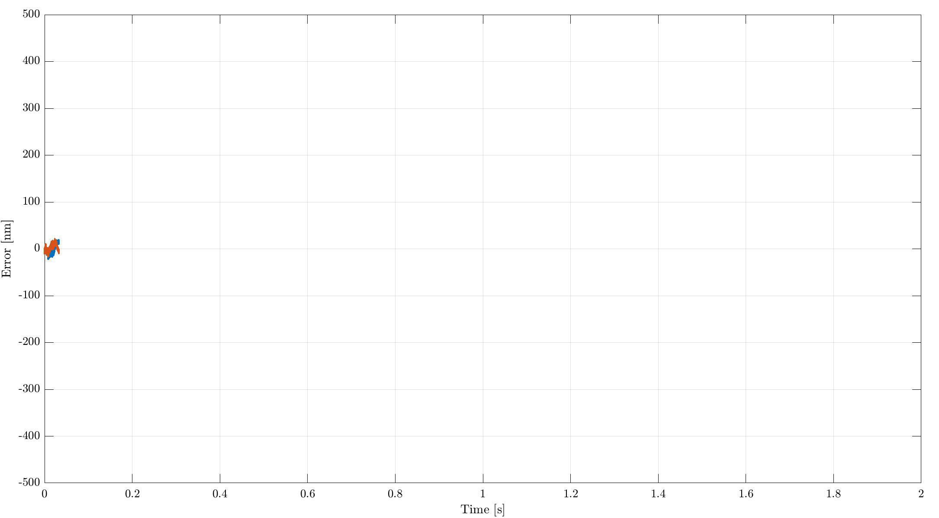
Fast Jack – Scanning Performances
$$10μm/s$$
Open Loop
Open Loop
Closed Loop

Slide 10
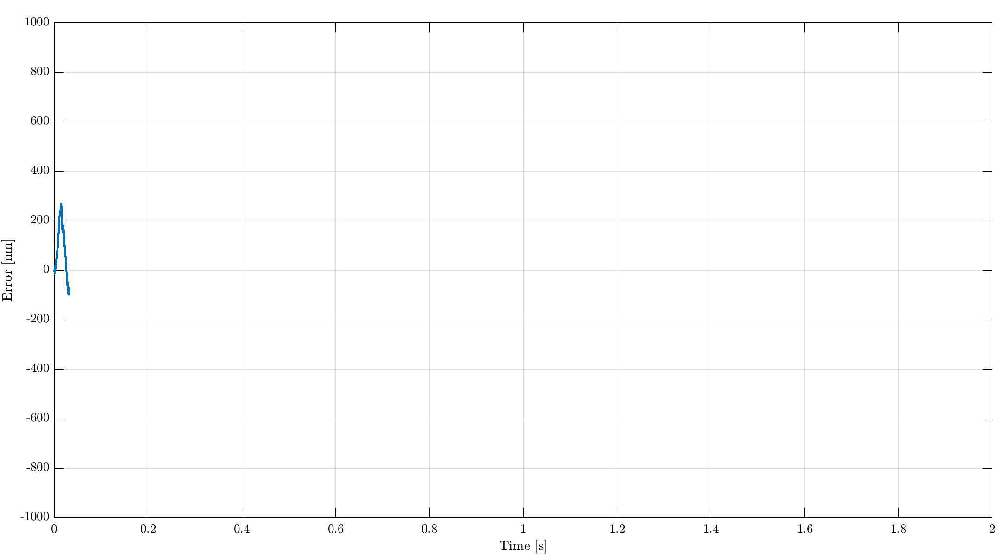
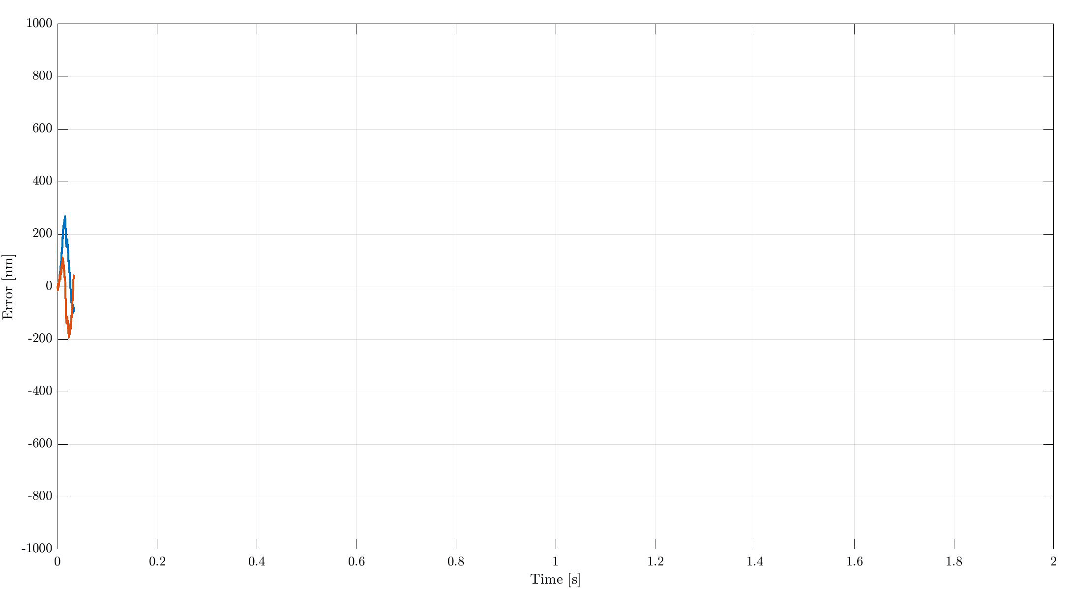
Fast Jack – Scanning Performances
$$200μm/s$$
Open Loop
Closed Loop
Open Loop
Stepper motors: Not suited for accurate and fast continuous scans
Degraded performances when the velocity is increased
Feedback (piezo) decreases the errors only below a certain frequency (i.e. the bandwidth)

Slide 11
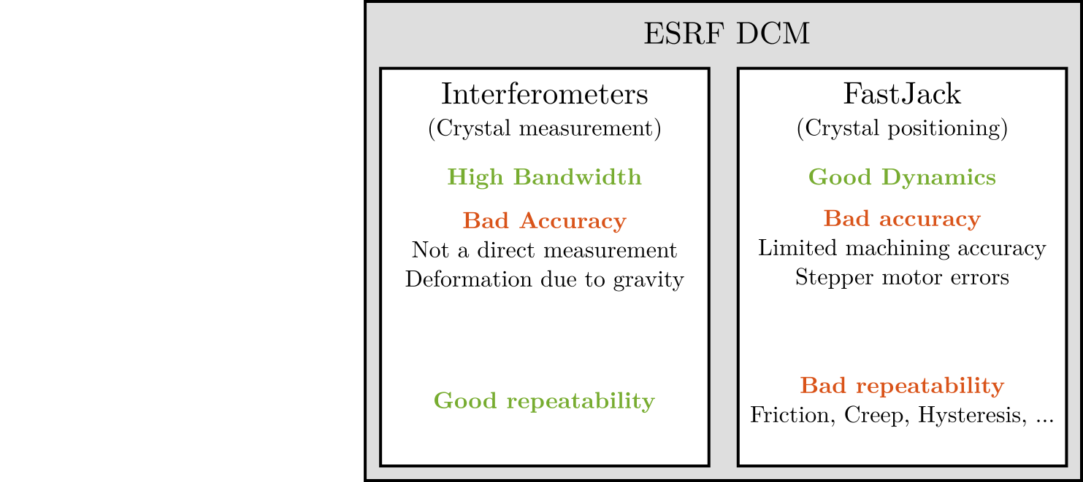
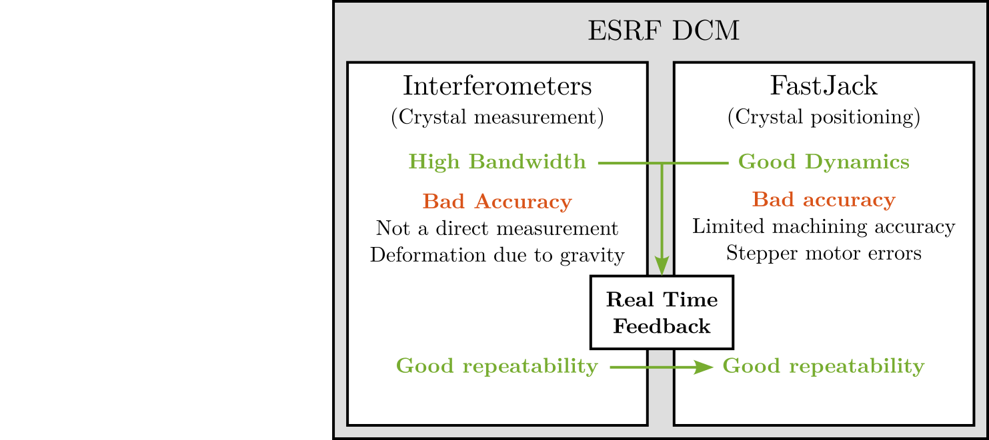
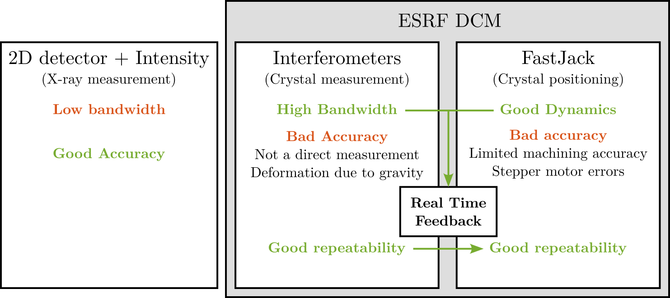
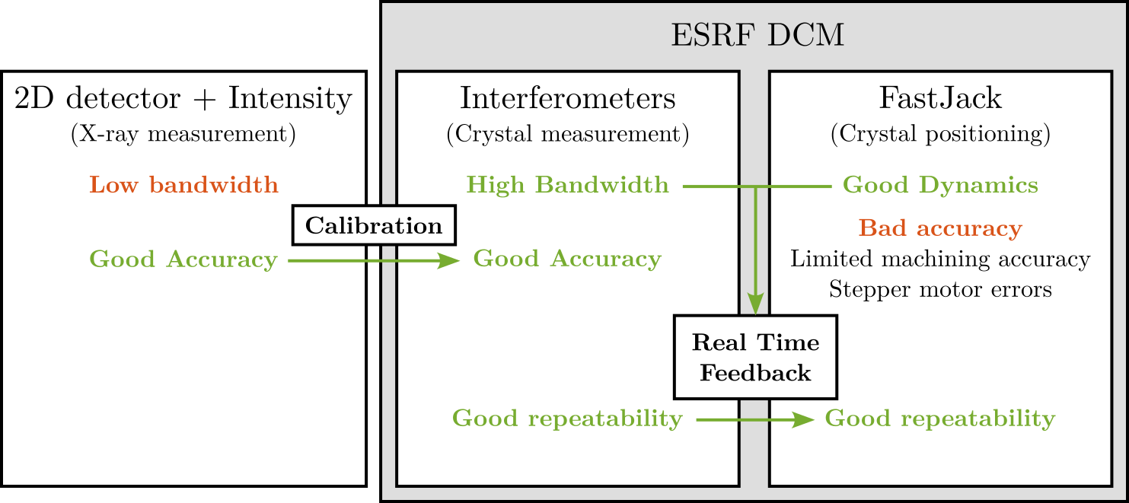
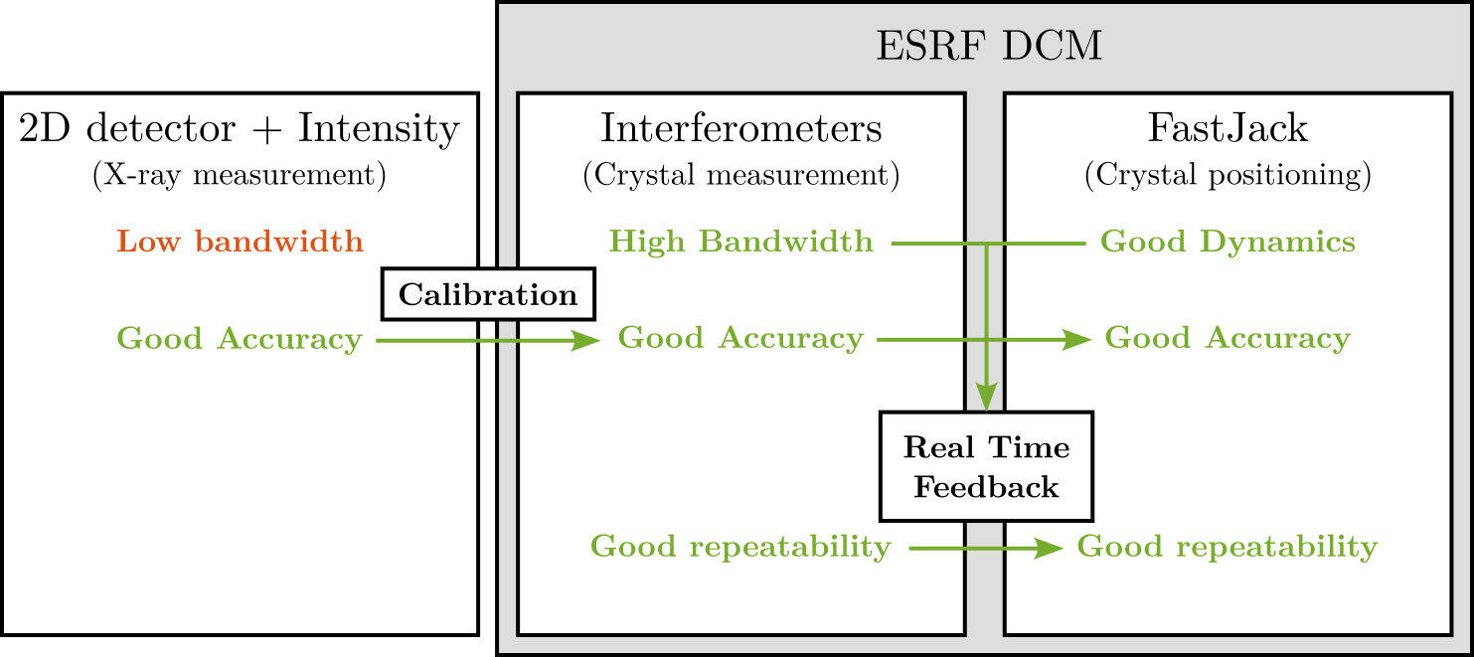
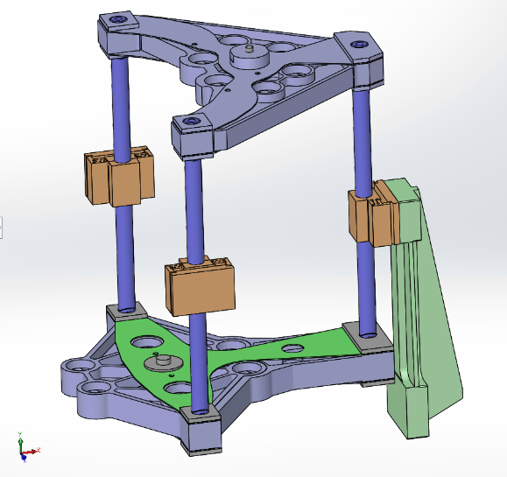
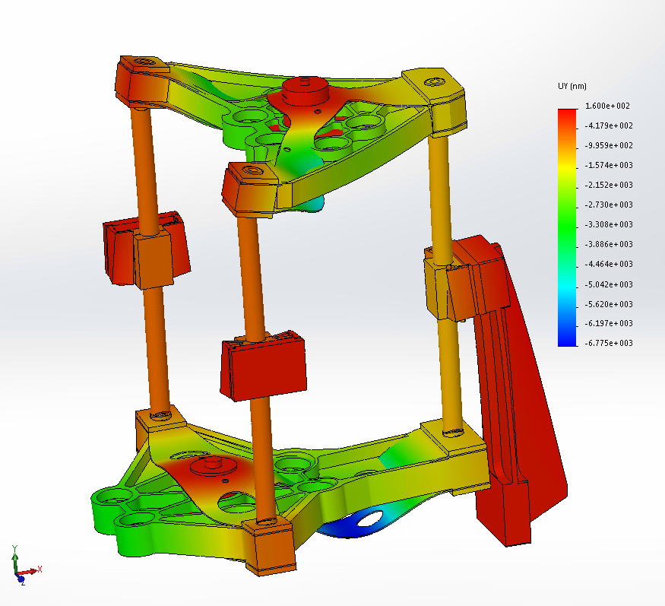
How to get an Accurate DCM? Calibration !
Calibration Procedure:
1/ $$R_{y}$$ calibration: rocking curves
2/ $$R_{x},D_{z}$$ calibration using BPM
3/ (optional): $$R_{x}$$ and $$R_{y}$$ calibration using focusing optics
Page 11
Optics Workshop l March 7, 2024 l T. Dehaeze & O. Mathon

Slide 12

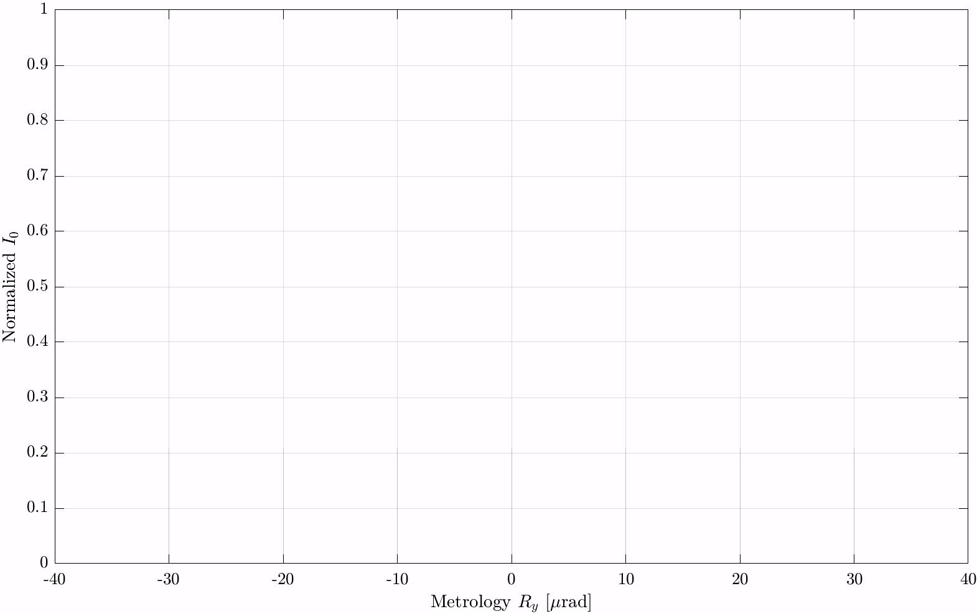
1 - Ry Calibration: Finding the top of the Rocking Curve…
$$I_{0}$$ Photodiode
Metrology Ry offset
At this energy
Page 12
Optics Workshop l March 7, 2024 l T. Dehaeze & O. Mathon

Slide 13
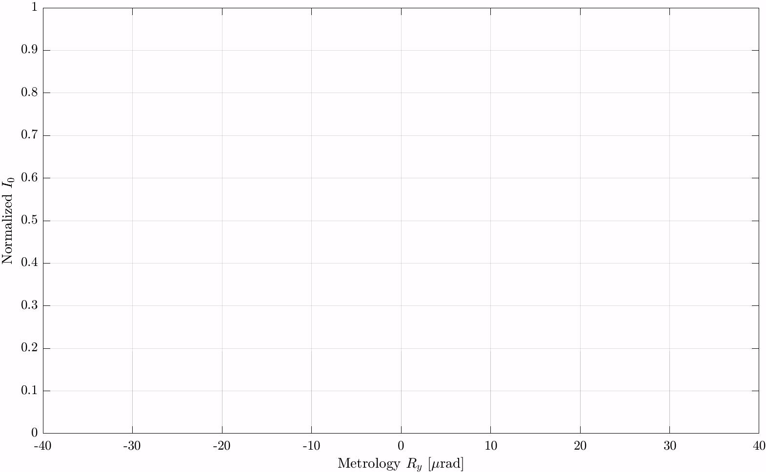
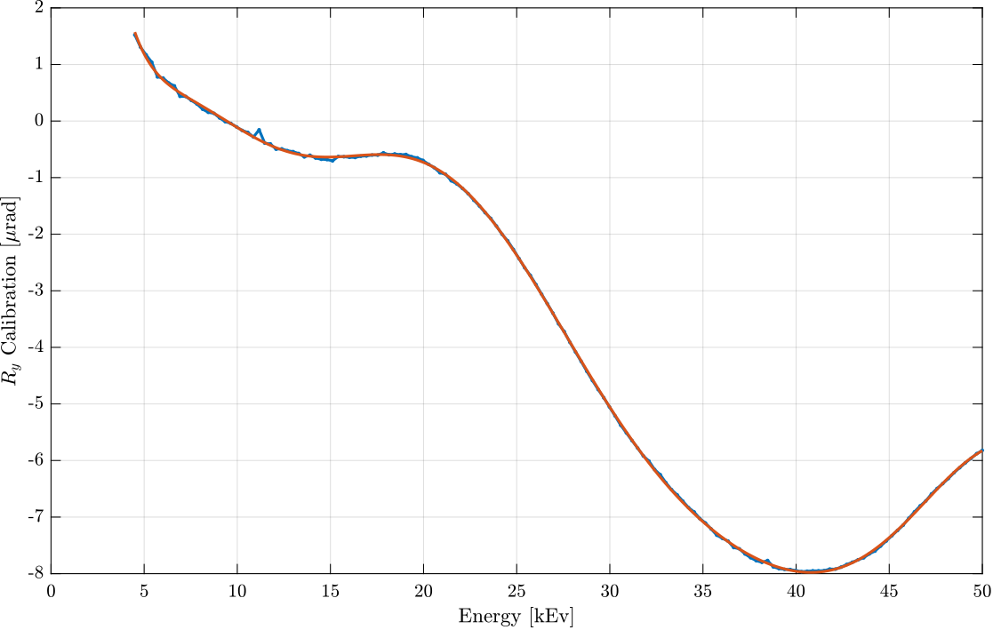
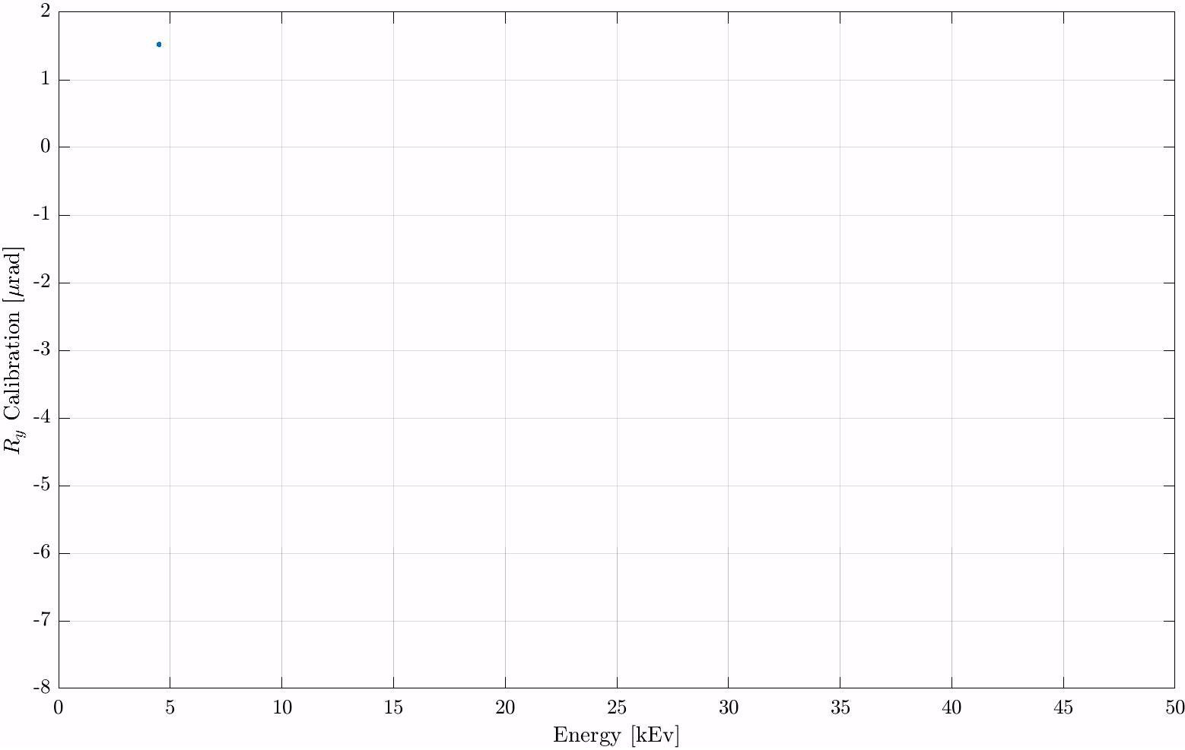
1 - Ry Calibration: … At several energies
Page 13
Optics Workshop l March 7, 2024 l T. Dehaeze & O. Mathon

Slide 14
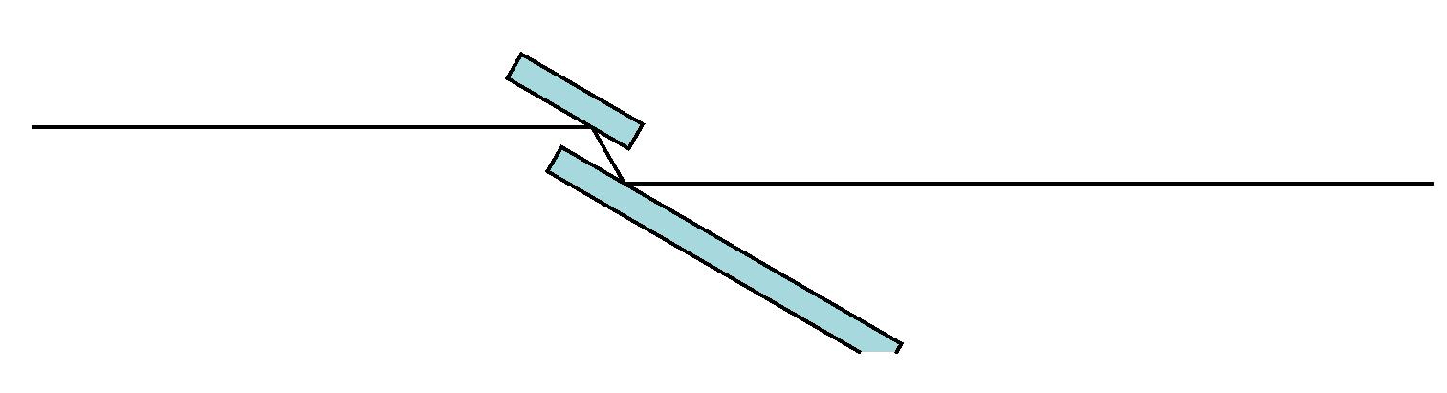
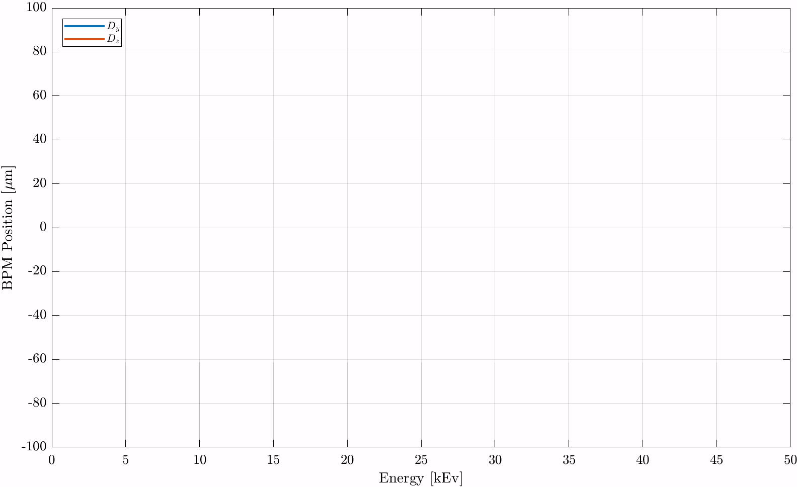
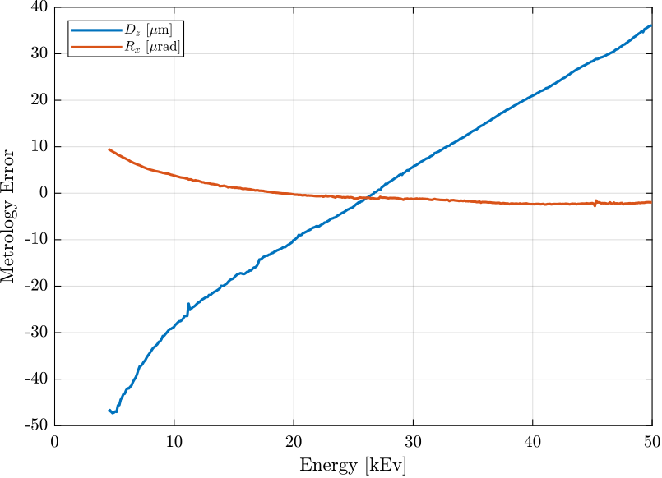
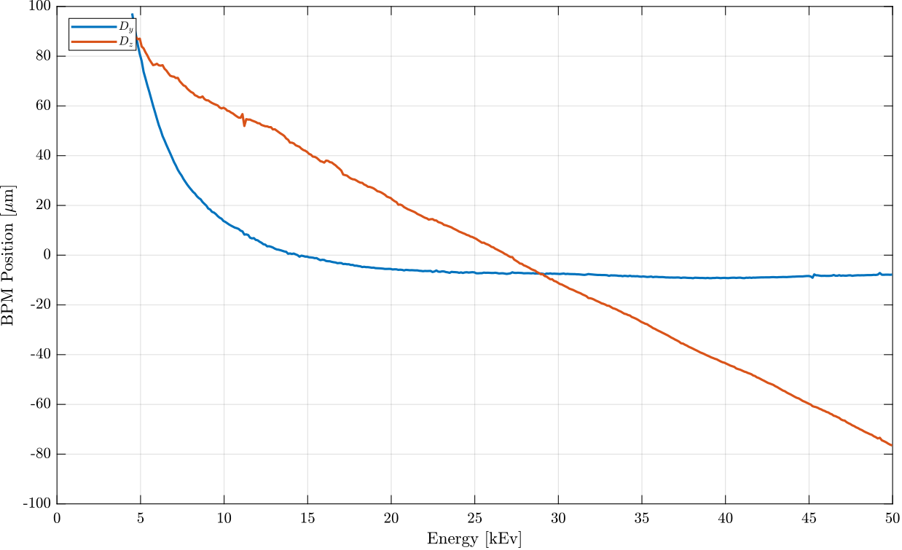
2 - $$D_{z}$$ And $$R_{x}$$ Calibration: Unfocused Scan
Fluorescence screen
CCD camera
Beam
Crystal
$$ε_{z} = 2 ε_{d_{z}} \cos{θ}$$
$$ε_{y} =−2D ε_{r_{x}} \sin{θ}$$
Page 14
Optics Workshop l March 7, 2024 l T. Dehaeze & O. Mathon

Slide 15

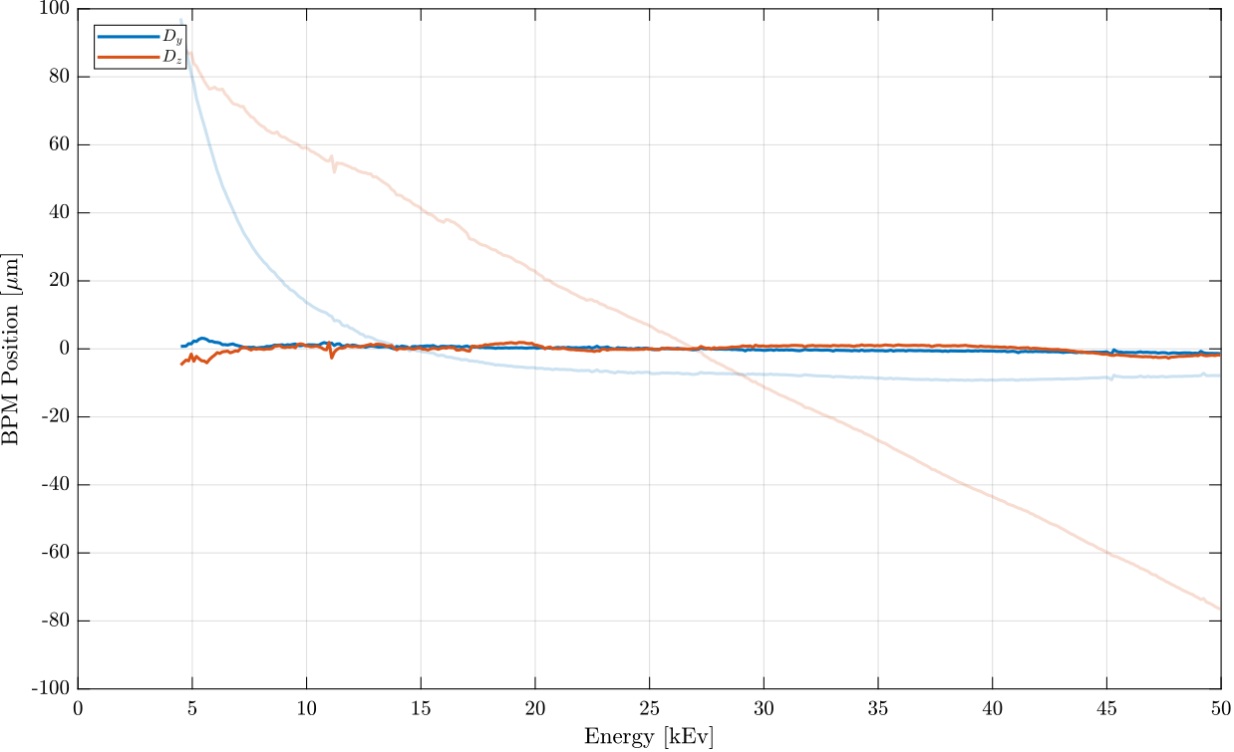
2 - $$D_{z}$$ And $$R_{x}$$ Calibration: Verification Scan
Page 15
Optics Workshop l March 7, 2024 l T. Dehaeze & O. Mathon

Slide 16
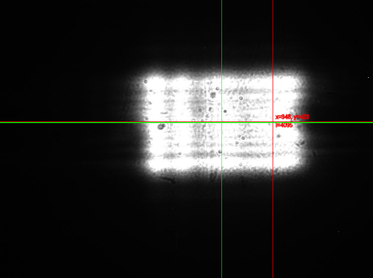
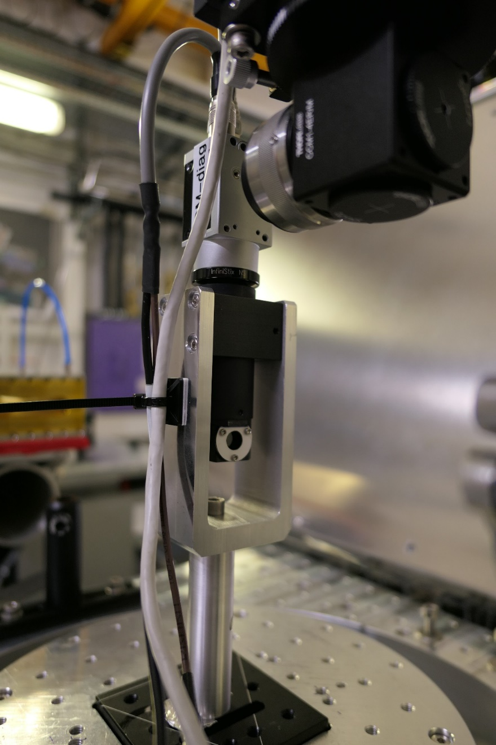
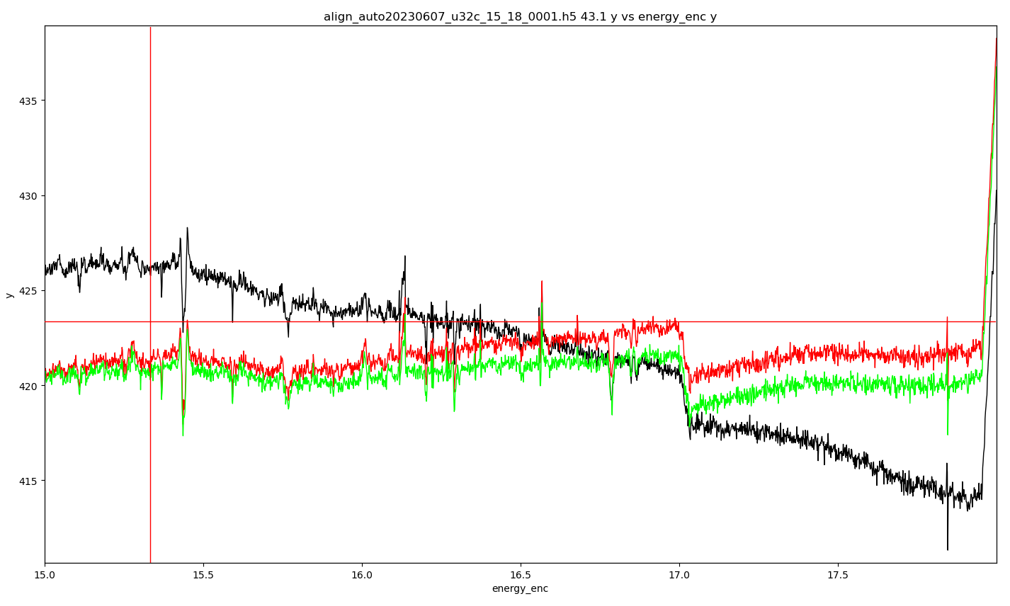
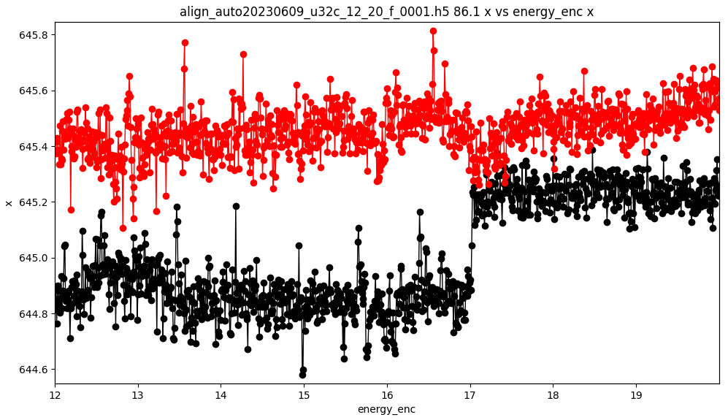
DCM Calibration - diagnostic tool
Fluorescence screen at 45 deg + CCD camera
Measured position of the beam is sensitive to:
Vibration and drift of the diagnostic tool itself
Beam imperfections
Cameras misalignment, screen absorption edges
Multiple Bragg diffraction
“glitch”
Saturation
Y K edge of the fluorescence screen
(saturation)
Crystal defects
Beam inhomogeneity
The diagnostic tool remains a weak point of the calibration procedure
Y K edge: diagtool
misalignment: R_{z} 0.8 deg off
Page 16
Optics Workshop l March 7, 2024 l T. Dehaeze & O. Mathon

Slide 17
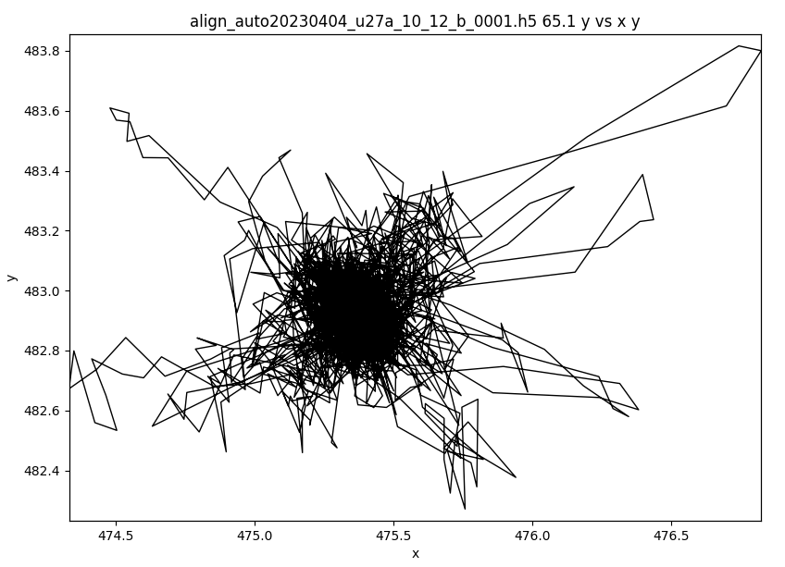
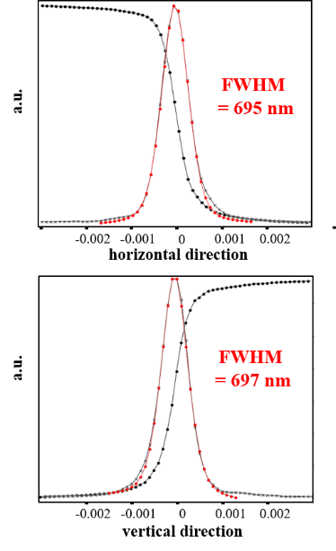
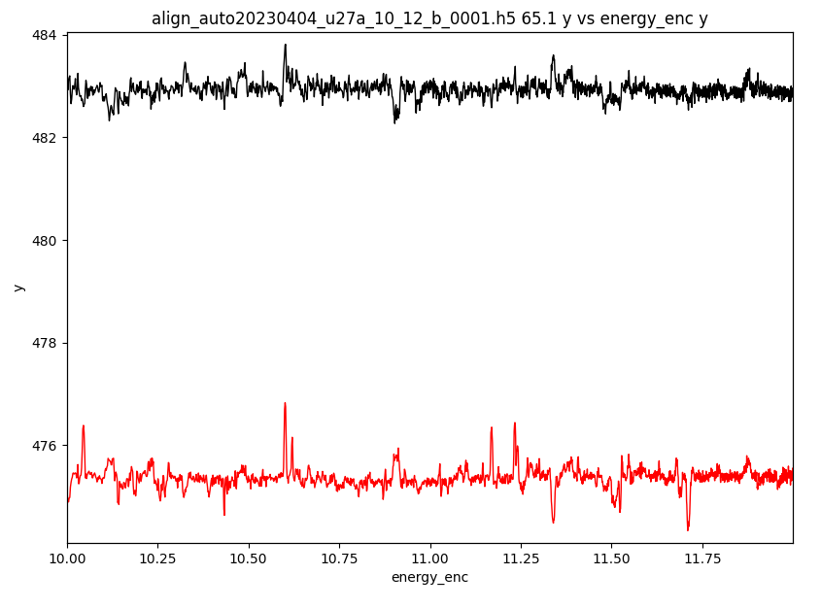


DCM commissioning – beam position stability
Si(111) – 10 to 12 keV – Focused beam
2000 pts - 40 ms/pt
Focal spot trajectory
Focal spot
Not a real beam displacement
Vertical beam centroid
1 μm
Multiple Bragg Diffraction on DCM deforms the focal spot - not a real beam displacement
Horizontal beam centroid
Beam stability : 500 nm FWHM
→ DCM is not the main source of beam motion
Page 17
Optics Workshop l March 7, 2024 l T. Dehaeze & O. Mathon

Slide 18


DCM commissioning – angular stability (indirect measurement using beam intensity)
Beam intensity is recorded during two (continuous) scans :
Regulation around the top of the rocking curve (zero slope)
Regulation with a 1 μrad offset (high slope)
The intensity difference between the two scans is interpreted as a pitch error between the crystals.
1
2
Result for energy range : 38.6 - 39.5 keV
$$R_{y}=10 nrad RMS$$ (50 nrad p-p)
Page 18
Optics Workshop l March 7, 2024 l T. Dehaeze & O. Mathon

Slide 19




DCM commissioning – energy stability
Cobalt K edge for 48 hours
One spectrum every 5 minutes
continuous scan, 800 eV, 1600 pts, 100 ms/pt
Edge drift between consecutive spectra
Raw data
First scan and last scan
Average drift: 0.017 meV/spectrum
$$ΔE=1.5meV RMS (\sim 50nrad)$$
Edge shift position referred to the first spectrum
A drift is still present, but difficult to conclude where it comes from:
DCM, X-ray beam, day/night, air conditioning?
$$ΔE_{max}=20meV (\sim 0.7μrad)$$
Page 19
Optics Workshop l March 7, 2024 l T. Dehaeze & O. Mathon

Slide 20
Main DCM Requirements – Conclusion and further work
Energy Stability
(Over Time)
Beam Stability
(During Scans)
Fast Scanning
(e.g. 1x EXAFS/s)
Good Bragg Stability
Stable mechanics thanks to thermal control
Cooling with Liquid Nitrogen on both crystals
Metrology has repeatable errors
Allows calibration using the X-ray (RC + CCD camera)
Complex Mechatronics Architecture
Real time control with high bandwidth metrology and FastJack
Estimated Energy Stability
$$ΔE≈1.5 meV RMS$$
Better temperature control in the hutch?
Drifts of the incoming beam?
Improvements of the beam position measurement ?
Pattern recognition?
Improve Crystal stability at high velocity
Replacement of stepper motors
With 3-phase torque motors
Page 20
Optics Workshop l March 7, 2024 l T. Dehaeze & O. Mathon

Slide 21



FastJAck: Test with 3-phase torque motors
Velocity | Stepper Motor | Torque Motor
$$1 μm/s$$ | 3nm RMS | 3nm RMS
$$10 μm/s$$ | 5nm RMS | 4nm RMS
$$100 μm/s$$ | 50nm RMS | 6nm RMS
$$1000 μm/s$$ | 670nm RMS | 40nm RMS
$$÷10$$
$$÷15$$
Open Loop ($$100μm/s$$)
Stepper
3-Phase
Closed Loop ($$100μm/s$$)
Stepper
3-Phase
Page 21
Optics Workshop l March 7, 2024 l T. Dehaeze & O. Mathon

Slide 22

Thanks to the DCM team and the ID21/ID24/BM23 beamline teams, especially :
Robert BAKER, Ray BARRETT, Philipp BRUMUND, Gilles BERRUYER, Julien BONNEFOY, Marine COTTE, Ludovic DUCOTTE, Hervé GONZALEZ, Cyril GUILLOUD, Ricardo HINO, Marc LESOURD, Kirill LOMACHENKO, Alban MOYNE, Manuel PEREZ, Thomas ROTH, Murielle SALOMÉ, Philippe TARDIEU, Hans-Peter VAN DER KLEIJ,…
Thank You
ご清聴ありがとうございました
Page 22
Optics Workshop l March 7, 2024 l T. Dehaeze & O. Mathon

