Slide 1



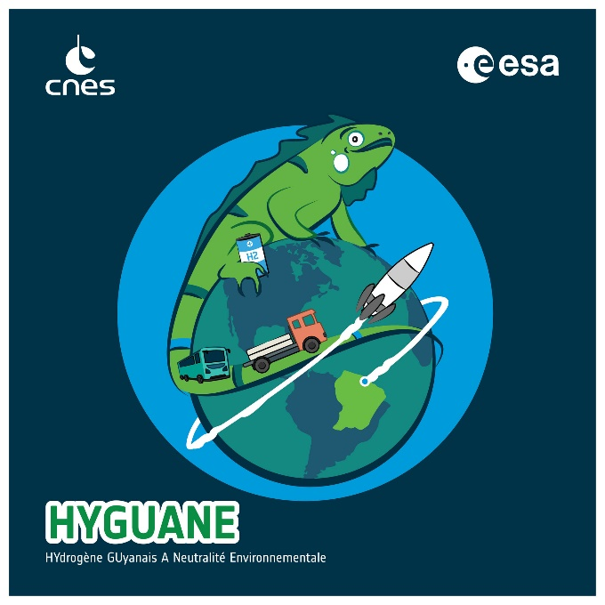


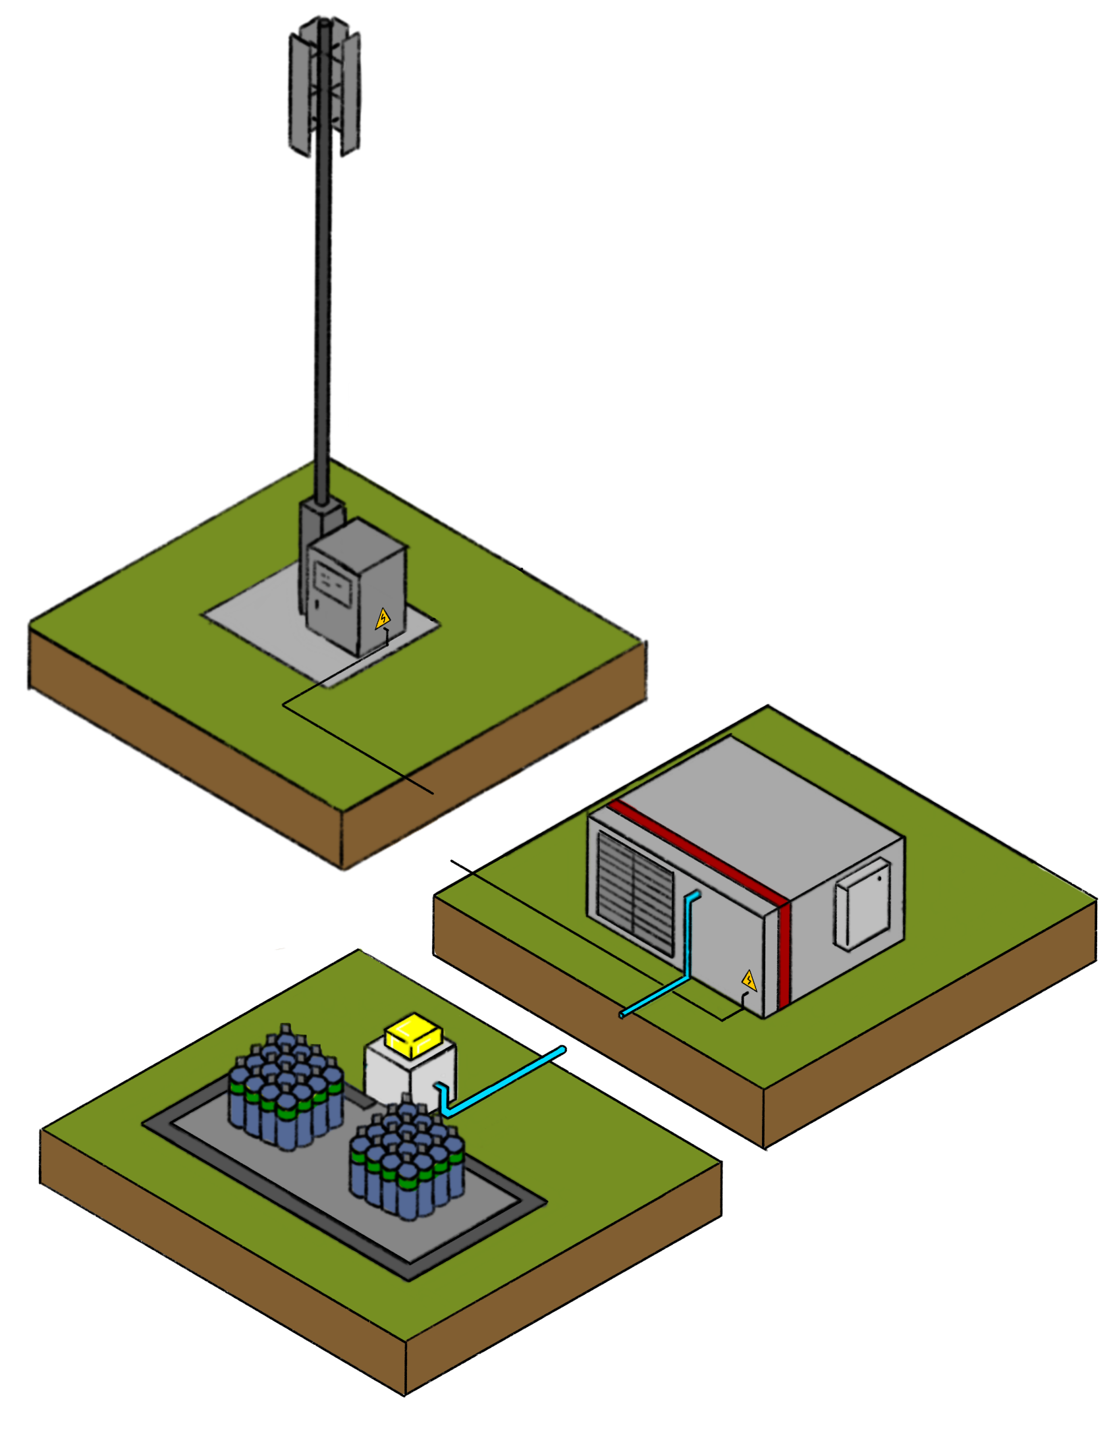








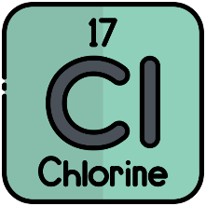
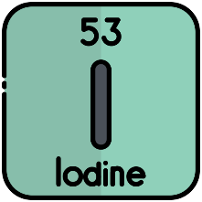
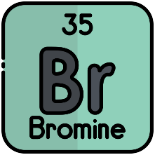

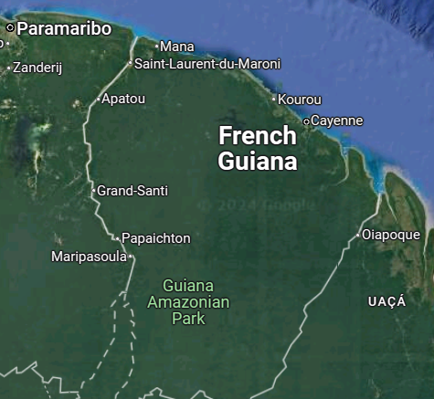
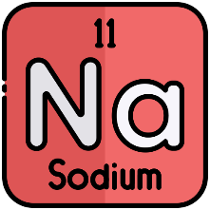
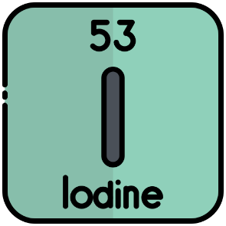
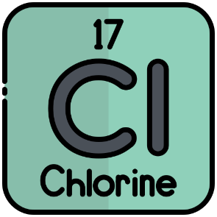
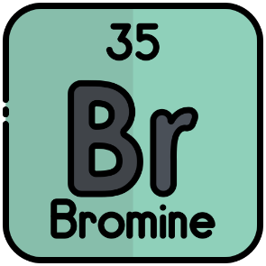

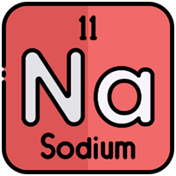

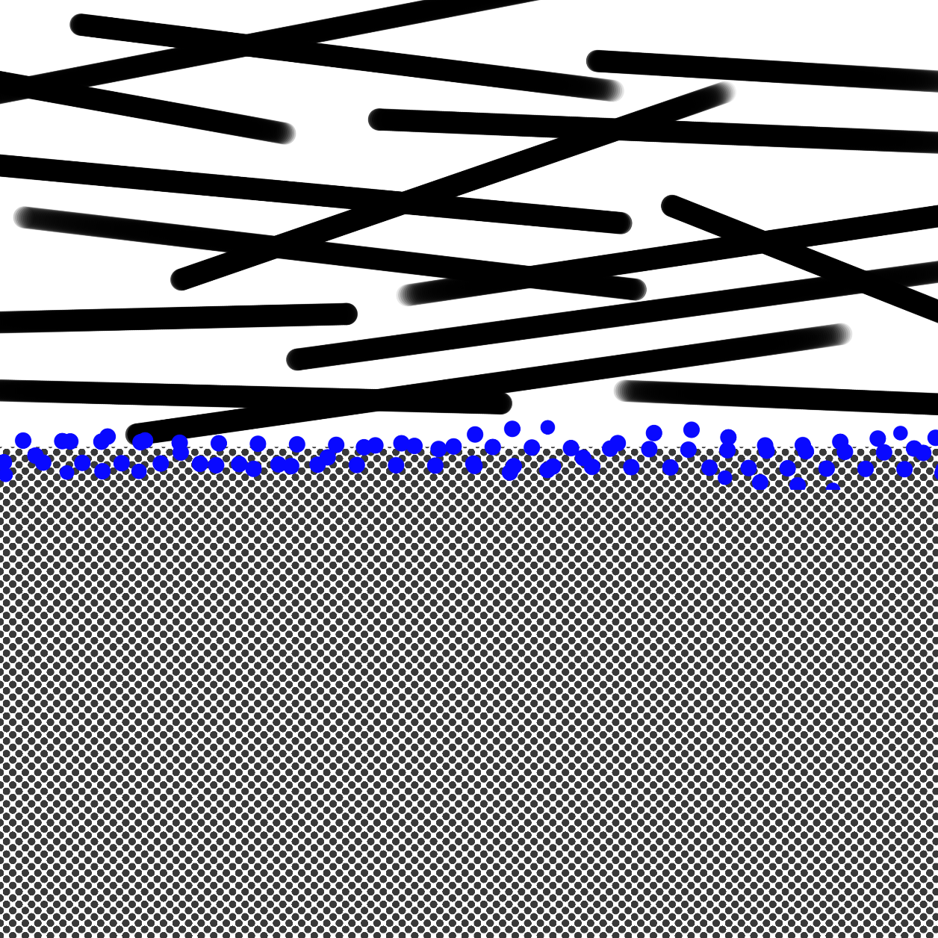
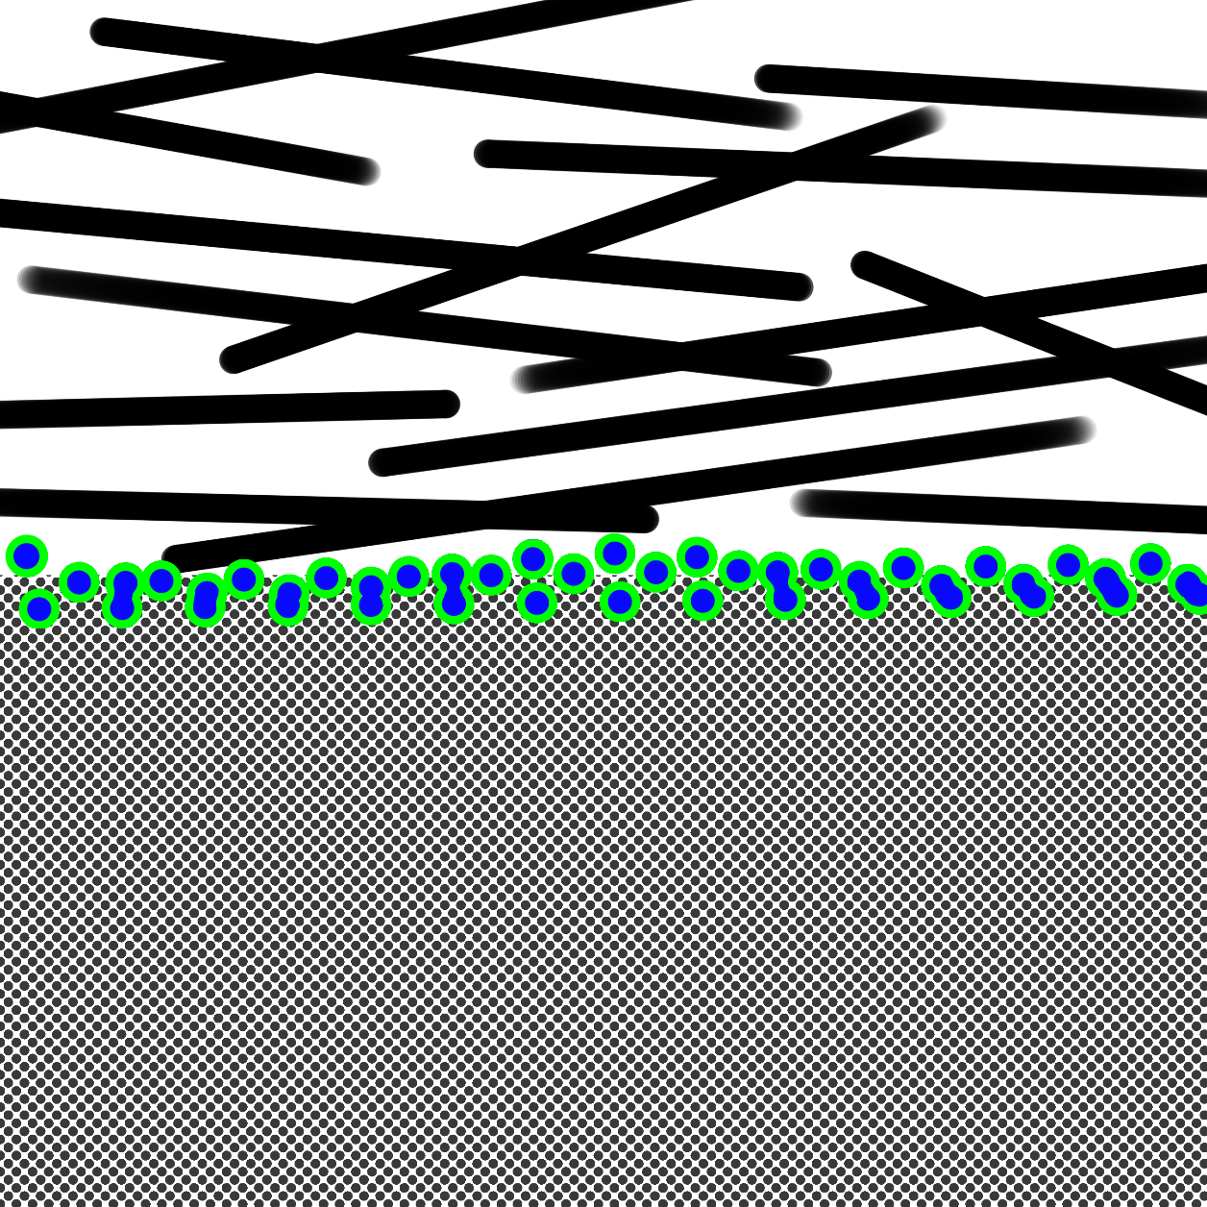
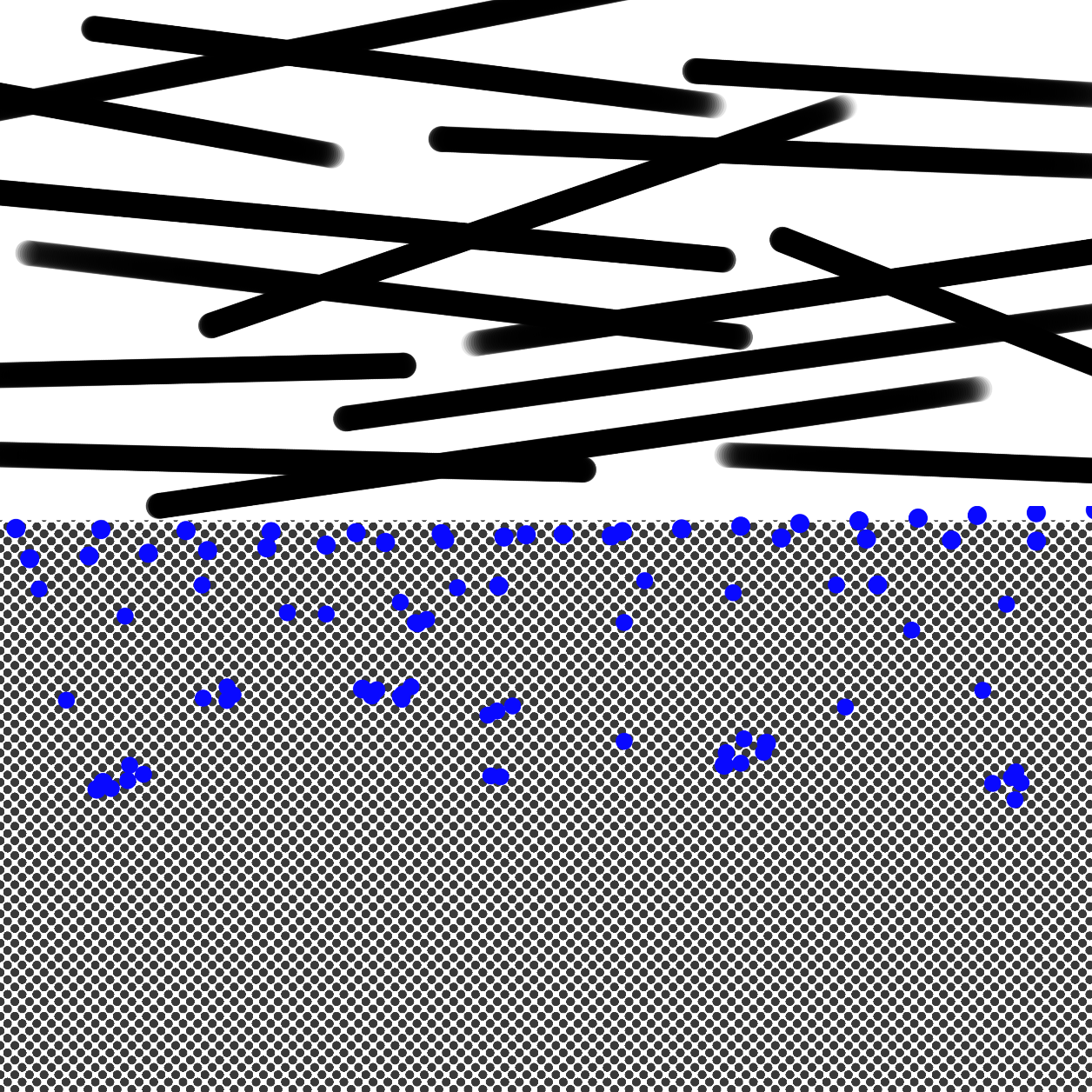
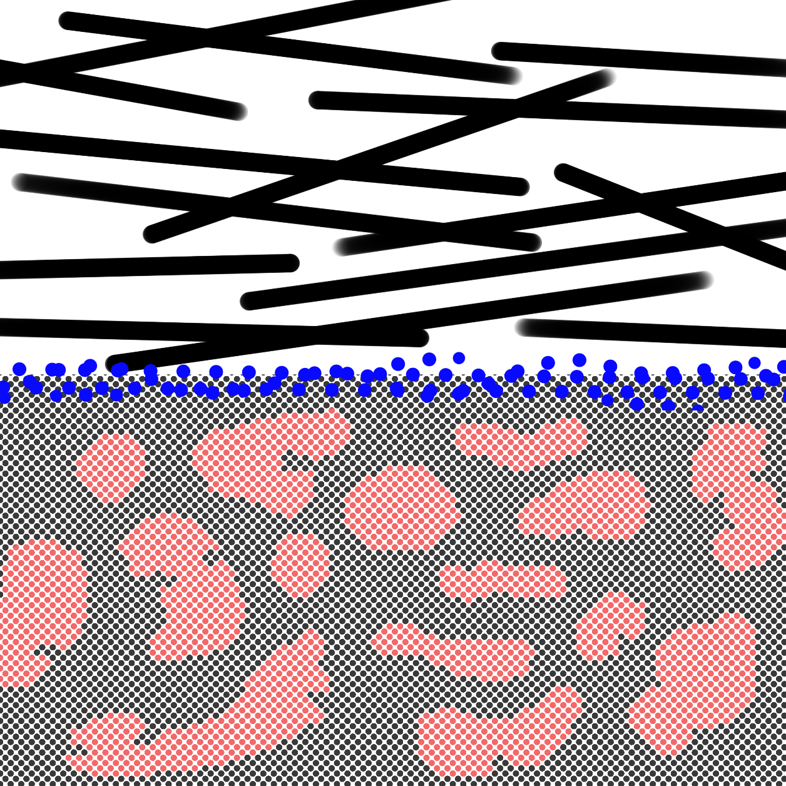
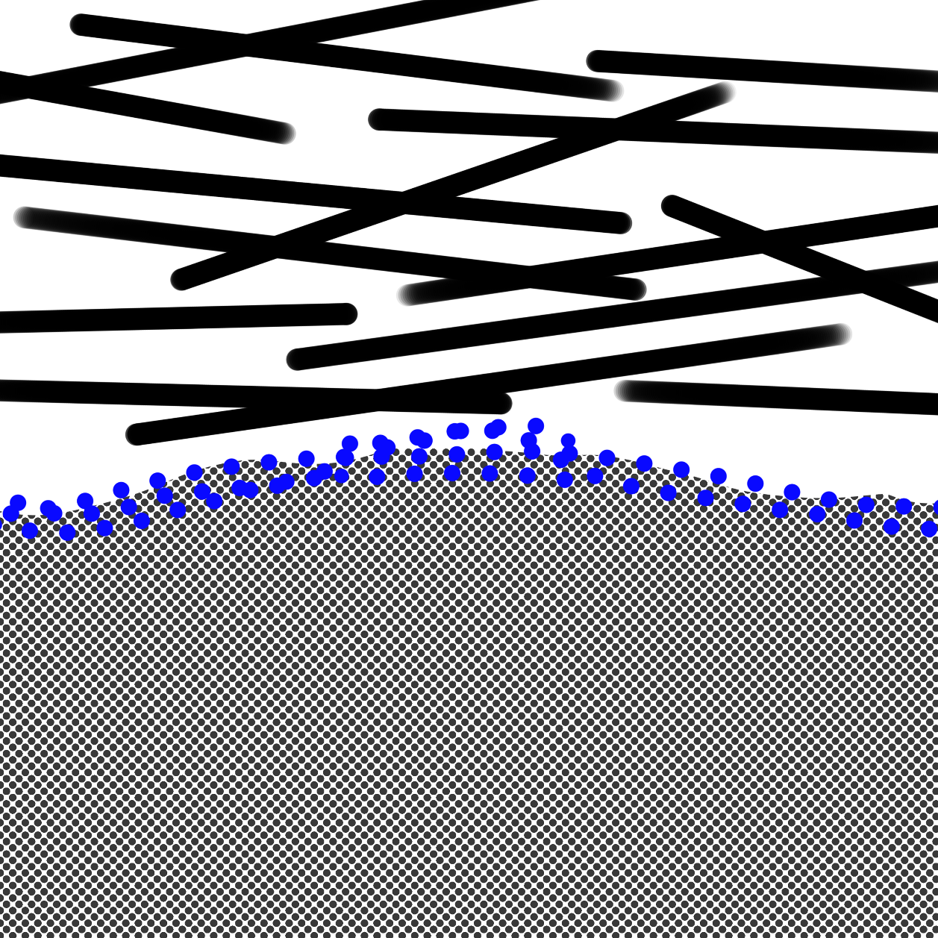
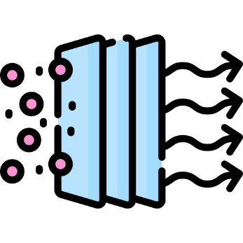





Use of PEM Fuel Cell Stack as power supply in French Guiana:
mitigation of poisoning from coastal tropical environments
Claessens Lucas*¹, Stergiopoulos Vaios², Job Nathalie¹
¹University of Liège, Department of Chemical Engineering – Nanomaterials, Catalysis, Electrochemistry,
Building B6a, 4000, Liège, Belgium
²BEBLUE CRYOTECH S.A. Grande Traverse 3, 4000, Liège, Belgium
L.Claessens@uliege.be
Project motivations
Scope of the study
Base Transceiver Station
Decarbonation
Expose PEMFC Stack to a contaminated atmosphere similar to real conditions,
that provoke degradation mechanisms and poisoning
and estimate lifespan for such conditions
Fuel Cell
stack
Network coverage expansion
Electrical islanding
Hydrogen
storage
Degradation mechanisms
The main degradation mechanisms for these contaminants are:
(i) Proton replacement in membrane, (ii) catalyst coverage, dissolution and redeposition and (iii) gas diffusion layer delamination.
Contaminated atmosphere
Implantation site is within few kilometers of the coast in French Guiana. The climate is tropical and typical coastal contaminants are present. Namely halogens, ozone and aerosols of salt, nitrates, ammonium and sulfates. These contaminants can be found in the air supply, at the cathode.
Halogens adsorb on platinum catalysts, leaving few/no active sites left for oxygen reduction. This impedes fuel cell operation.
Chlorine and ozone can oxidize Pt catalysts. The metal becomes soluble and migrates into the membrane. Agglomerates form, decreasing the active area of the catalyst. This phenomenon (Ostwald ripening) is accelerated in the presence of these gases
When Na is introduced via the cathode, it replaces H⁺ in the membrane, in the form of Na⁺.
This, in turn, contributes to membrane polymer unzipping and contact resistance increases.
Furthermore, replacement of H⁺ by Na⁺ leads to mass transfer resistance increase.
Each of these effects has a negative impact on cell performance.
Chlorine has been observed to cause delamination between the membrane coated with catalyst and the gas diffusion layer. In other words, the layers separate and lose contact surface. This causes contact resistance increase and uneven gas distribution.
Gas diffusion layer
Fresh MEA
Catalyst coverage
Catalyst migration
Membrane poisoning
GDL Delamination
Catalyst
Reaction
Membrane
Halogens adsorb on the catalyst,
reaction sites are occupied
Pt atoms solubilize and migrate in the membrane, H⁺ conduction is poor, and catalyst electroactive surface area is decreased
Na⁺ accumulates in the membrane, H⁺ conduction is very poor
Contact between the membrane and cathode is very poor and decreases electrical conduction
Fuel cell lifespan depends on operating conditions, water management and material stability. Degradation mechanisms like previously described are directly linked to these factors. In this study, mitigation techniques and optimization of operating conditions are essential to extending fuel cell lifespan in contaminated conditions. The overall target is to determine how ageing can be prevented in order to implement the stack cells in the best possible working configuration in a tropical environment.
Lifespan
Most common mitigation methods :
Air filtering
Nitrogen flushing
High humidity operation
Desorption via cyclic voltammetry
bearicons – Flaticon
nangicon – Flaticon
Adriansyah – Flaticon
Freepik – Flaticon
Copyrights
J. W. Adams and R. A. Cox, “Halogen chemistry of the marine boundary layer,” J. Phys. IV France, 12 (2002), 105–124.
M. L. Gobinddass et al., “Coastal Sea Salt Chlorine Deposition Linked to Intertropical Convergence Zone (ITCZ) Oscillation in French Guiana,” J. Atmos. Sci., 77 (2020).
K.-M. Wai and P. A. Tanner, “Wind-dependent sea salt aerosol in a Western Pacific coastal area,” Atmospheric Environment, 38 (2004), 1167–1171.
L. J. Carpenter et al., “Atmospheric iodine levels influenced by sea surface emissions of inorganic iodine,” Nature Geoscience, 6 (2013), 108–111.
B. D. Finley and E. S. Saltzman, “Observations of Cl₂, Br₂, and I₂ in coastal marine air,” Journal of Geophysical Research: Atmospheres, 113 (2008).
N. Job et al., “Efficient Pt/carbon electrocatalysts for proton exchange membrane fuel cells: Avoid chloride-based Pt salts!,” Journal of Power Sources, 240 (2013), 294–305.
C. Sun et al., “Origin of Pt Site Poisoning by Impurities for Oxygen Reduction Reaction Catalysis: Tailored Intrinsic Activity of Pt Sites,” ACS Applied Energy Materials, 6 (2023), 5700–5709.
D. Madhav et al., “The Effect of Salty Environments on the Degradation Behavior and Mechanical Properties of Nafion Membranes,” Energies, 16 (2023).
N. Bussayajarn, S. Therdthianwong, and A. Therdthianwong, “Improvement of cathodic reaction of proton exchange membrane fuel cell by ozone,” International Journal of Hydrogen Energy, 32 (2007), 392–399.
L. Franck-Lacaze et al., “Effects of Ozone on the Performance of a Polymer Electrolyte Membrane Fuel Cell,” Fuel Cells, 9 (2009), 562–569.
Bibliography

