Slide 1




USER-CLIENT INVOLVEMENT &
PARTICIPATION IN PRIVATE HOUSING:
BELGIAN ARCHITECTS' PERSPECTIVE
Audrey Mertens*, Çiğdem Yönder*, Yaprak Hamarat, Catherine Elsen
*first authors
Notes:
Good morning/afternoon, everyone. My name Audrey, and today I’m here to present a study titled 'User-Client Involvement & Participation in Private Housing: Belgian Architects' Perspective.' This work was done in collaboration with my colleagues Çiğdem Yönder, Yaprak Hamarat, and Catherine Elsen from the Inter'Act Research Lab at the University of Liège. Let’s dive in.

Slide 2
INTRODUCTION
Context:
Private housing is the largest sector for architectural practices in Belgium (89% of firms involved in residential design) (ACE 2022).
Main Issue:
Architects in Belgium face challenges balancing user-client involvement with maintaining control over the design process in private housing projects. (Defays & Elsen 2018)
Objective:
This study explores Belgian architects' perceptions of user-client involvement in private housing design.
Notes:
To begin, let’s set the context. Private housing is the dominant sector for architectural practices in Belgium, with 89% of architectural firms engaged in residential design. Given this dominance, architects play a crucial role in shaping the housing landscape. However, they face a constant challenge: how to balance meaningful user-client involvement with maintaining control over the design process. This study explores how Belgian architects perceive and manage user-client involvement in private housing design.

Slide 3
THEORETICAL FRAMEWORK
User-Centered Design (Sanders, 2002):
  Passive role for clients
  Focus on data collection to meet user needs
Participatory Design (Damodaran, 1996):
  Active user engagement in the design process
  Enhanced satisfaction through collaborative decision-making
Challenge:
  Finding balance between collaboration and maintaining project integrity.
Notes:
Let’s talk briefly about the theoretical framework guiding this study. We distinguish between two approaches to user involvement.
User-centered design, as defined by Sanders in 2002, positions clients in a more passive role, where their needs are met through data collection. Participatory design, on the other hand, as described by Damodaran in 1996, calls for active user engagement in the design process. Participatory design fosters collaboration and decision-making but can challenge the integrity of the architectural project. Our study seeks to understand how Belgian architects navigate these different models of user involvement.

Slide 4

RESEARCH QUESTIONS
How are user-clients involved in the design process of private housing?
What roles do architects expect user-clients to play?
What are architects’ views on participatory practices in private housing design?
Notes:
The key questions guiding our research are:
How are user-clients currently involved in the design process of private housing in Belgium?
What roles do architects expect their user-clients to play in the process?
What are architects' views on participatory practices in private housing design?
With these questions in mind, we conducted a series of interviews to gather insights directly from practicing architects.

Slide 5
METHODS
Approach:
  15 semi-structured interviews with architects in Wallonia and Brussels.
Participant Profiles:
  Variety in firm sizes (e.g., from sole practitioners to medium-sized firms).
  Mixed focus on renovation and new construction house projects.
Analysis:
  Thematic analysis (Lejeune, 2019) focusing on user-client involvement, roles, and participatory views.
Notes:
We conducted 15 semi-structured interviews with practicing architects from the Wallonia and Brussels regions. The participants ranged from sole practitioners to architects in medium-sized firms, providing a diverse perspective on the role of user-client involvement. The interviews were analyzed thematically to uncover key trends related to user-client engagement, roles, and architects' attitudes toward participatory practices.

Slide 6

FINDINGS
CURRENT INVOLVEMENT PRACTICES
Communication Tools Used:
  Conversation-based interactions
  Site visits, mood boards, sketches
Notable Method:
  "Blank Page Method" (Kevin): Client writes all ideas on a blank sheet.
Client Proactivity:
  Example of Florence’s clients who created detailed PDFs for each room.
Emerging Technology:
  Virtual reality for design walkthroughs (limited by cost and time constraints).
Notes:
Now, let’s look at what we found regarding current involvement practices.
Most architects rely heavily on traditional communication tools, such as conversation, site visits, and sketches. However, there are some interesting innovations. For instance, Kevin uses what he calls the 'Blank Page Method,' where clients are encouraged to write down all their thoughts about the project on a blank sheet left in their home. Florence, on the other hand, had clients who provided her with detailed PDFs for each room in their home, complete with design preferences.
Some architects are also beginning to experiment with virtual reality. Though not yet widespread due to cost and time constraints, VR allows clients to experience their future spaces more tangibly. This is promising but still a fringe practice.

Slide 7

FINDINGS
ROLES AND EXPECTATIONS
Key Roles of User-Clients:
  Decision-making on design, budget, and contractors.
  Often struggle with indecision and unrealistic budgets.
Architects' Responsibilities:
  Managing user-client expectations
  Often exceeding legal responsibilities to ensure project success (e.g., submitting permits, managing contractors).
Notes:
We also looked at what roles architects expect their clients to play. The primary expectation is that clients make decisions about design, budget, and contractors. However, there are frequent challenges.
For example, many clients struggle with indecision or have unrealistic expectations regarding the budget. Architects often find themselves having to step in and take on responsibilities that technically belong to the client, such as handling permits or managing contractors, just to keep the project on track.

Slide 8
FINDINGS
Table 1: Architects Pro Participation and uninformed
Architect (pseudo) | Summary of Reason | Practicing Participation
Geraldine | Sees participation as a positive exchange involving multiple perspectives. | No
Valerie | Understands participation as consulting clients, though her understanding is limited to decorative decisions. | No
Lionnel | Supports participation in public projects, especially in youth centers, though finds private participation challenging. | Yes
Cynthia | Uncertain about participatory approaches, though occasionally engages in home upgrade consultations. | No/Not Sure
Michele | Confused about the concept and associates it with self-built projects and co-housing. | No
Kevin | Does not understand the term "participative" and questions its meaning. | No
Coralie | Unfamiliar with participatory approaches and relates it to a vague "holistic" concept she doesn’t fully understand. | No
Notes:
Now, let’s look at what we found regarding current involvement practices.
Most architects rely heavily on traditional communication tools, such as conversation, site visits, and sketches. However, there are some interesting innovations. For instance, Kevin uses what he calls the 'Blank Page Method,' where clients are encouraged to write down all their thoughts about the project on a blank sheet left in their home. Florence, on the other hand, had clients who provided her with detailed PDFs for each room in their home, complete with design preferences.
Some architects are also beginning to experiment with virtual reality. Though not yet widespread due to cost and time constraints, VR allows clients to experience their future spaces more tangibly. This is promising but still a fringe practice.

Slide 9
FINDINGS
Table 2: Architects Con/Unclear/Mitigated on Participation
Architect (pseudo) | Summary of Reason | Practicing Participation
Dimitri | Participation must be well-structured and not just a collection of ideas; it is project-dependent. | Yes
Violette | Dislikes the institutionalization of participation, favoring a more authoritative design process. | No
Beatrice | Stresses interaction among designers but notes that clients don't fully understand technical aspects. | Yes
Gerard | Highlights the challenge of clients not mastering technical aspects, despite explaining choices to them. | Yes
Henri | Argues that understanding architecture is a specialized skill, and roles should remain distinct. | No
Baptiste | Concerned that participation can lead to disappointment if ideas are not followed through. | Yes
Florence | Believes participation is context-specific, but is wary of involving large associations or extreme views. | Yes
Dorian | Does not understand participatory approaches and prefers minimal client interaction. | No
Notes:
Now, let’s look at what we found regarding current involvement practices.
Most architects rely heavily on traditional communication tools, such as conversation, site visits, and sketches. However, there are some interesting innovations. For instance, Kevin uses what he calls the 'Blank Page Method,' where clients are encouraged to write down all their thoughts about the project on a blank sheet left in their home. Florence, on the other hand, had clients who provided her with detailed PDFs for each room in their home, complete with design preferences.
Some architects are also beginning to experiment with virtual reality. Though not yet widespread due to cost and time constraints, VR allows clients to experience their future spaces more tangibly. This is promising but still a fringe practice.

Slide 10
FINDINGS
ARCHITECT PERSPECTIVES ON PARTICIPATION
Mixed Views:
  Pro: Participation allows for richer design inputs (e.g., Geraldine).
  Con: It can lead to disappointment if clients’ ideas are not fully implemented (e.g., Baptiste).
  Some architects find participatory processes more relevant for public projects, not private housing.
Common Concern:
  User-clients' lack of technical knowledge limits meaningful participation.
Notes:
When it comes to participatory practices, architects’ views are mixed.
Some, like Geraldine, see participation as a way to bring multiple perspectives into the design process, enriching the final product. Others, like Baptiste, are more skeptical, worrying that participation raises client expectations to unrealistic levels and could lead to disappointment if their ideas are not fully implemented.
A common concern is the clients’ lack of technical knowledge, which makes meaningful participation difficult. As a result, participation in private housing tends to be more consultative than truly collaborative.

Slide 11
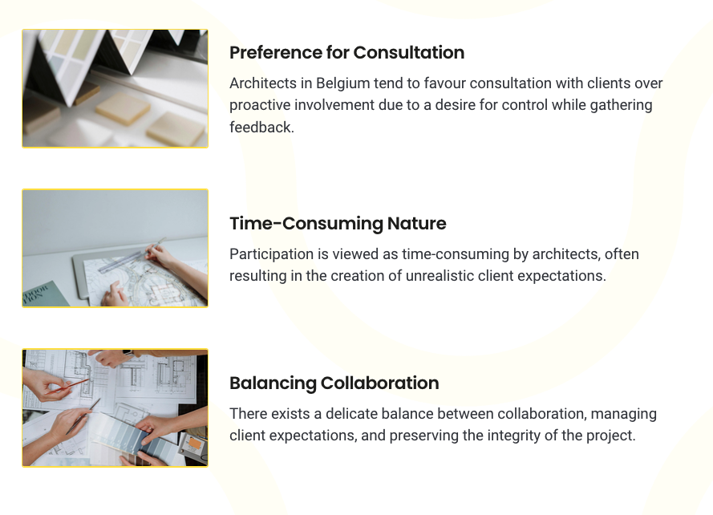
DISCUSSION
Preference for Consultation:
  Architects tend to favor consultation with user-clients over proactive involvement
Time-Consuming Nature:
  Participation is viewed as time-consuming, often resulting in the creation of unrealistic client expectations
Balancing Collaboration:
  Further research could study the delicate balance between user-client involvement, managing expectations, and preserving the integrity of the project

Slide 12
BARRIERS TO PARTICIPATION
Lack of Client Knowledge:
  Clients often lack the technical understanding necessary for effective participation.
Cultural & Aesthetic Differences:
  Architects sometimes clash with clients' personal tastes, complicating design coherence.
Interpersonal Skills:
  Architects are often not trained in managing client relationships, leading to communication difficulties and added stress.
Notes:
We identified several barriers to effective participation.
First, clients often lack the technical knowledge needed to engage meaningfully in the design process. This creates a gap between the architect’s vision and the client’s ability to contribute constructively.
Second, cultural and aesthetic differences can create tension. Architects may struggle to reconcile their professional standards with clients' personal tastes, which sometimes clash with broader design principles.
Finally, many architects feel unprepared to manage the relational dynamics that come with involving clients deeply in the process. While they recognize the importance of these skills, few have been formally trained in the interpersonal aspects of participation, which can lead to stress and communication breakdowns.

Slide 13

CONCLUSION
Key Findings:
  Belgian architects might favor consultation over deeper client participation.
  Some innovative tools (VR, mood boards) are used but not widely adopted.
  Lack of client knowledge, aesthetic differences, and limited interpersonal skills are key barriers to effective participation.
Future Directions:
  Further exploration of participatory tools and how they can be systematically integrated into small architectural practices.
  Client learning (Siva and London, 2011) in architecture could be systematically addressed in architectural training
Notes:
In conclusion, our findings suggest that most Belgian architects lean towards consultative rather than fully participatory practices in private housing design. While there is interest in tools like virtual reality and mood boards to enhance client engagement, these innovations remain underutilized.
The biggest barriers to participation include clients’ lack of knowledge, aesthetic differences, and architects' limited interpersonal training. To address these challenges, we believe there is a need for architectural training programs to include more focus on participatory methods and relational skills.
Further research could explore how to systematically integrate participatory tools into small architectural practices and whether this could lead to improved client satisfaction and project outcomes.

Slide 14
THANK YOU
Contact Information:
Audrey Mertens: audrey.mertens@uliege.be
Çiğdem Yönder: cyonder@uliege.be
Notes:
Thank you for your attention. If you have any questions or would like to discuss this research further, feel free to contact us at the emails listed on the screen. I’m happy to take any questions now.

Slide 15
Bibliography
Architects’ Council of Europe (ACE). European Architects Council Observatory. Accessed 2022. https://aceobservatory.com/Home.aspx?Y=2022&c=Belgium&l=EN.
Damodaran, L. "User Involvement in the Systems Design Process: A Practical Guide for Users." Behaviour & Information Technology 15, no. 6 (1996): 363–77.
Defays, A., and C. Elsen. "Architecte et Maître d’Ouvrage: Main dans la Main, ou Dos à Dos?" Archinews 18 (2018): 14–21.
Lejeune, C. Manuel d’analyse qualitative. Brussels: De Boeck Supérieur, 2019.
Sanders, E. B. N. "From User-Centered to Participatory Design Approaches." In Design and the Social Sciences: Making Connections, 1–8.
Siva, J. P. S., and K. London. "Investigating the Role of Client Learning for Successful Architect–Client Relationships on Private Single Dwelling Projects." Architectural Engineering and Design Management 7, no. 3 (2011): 177–89.

