Slide 1

“I’m not sure what I was thinking about” How mind blanking informs spontaneous thinking
BAPS 2025
HOW UNCERTAINTY IN VARIANT DESIGNS
CAN INFORM NEURO-COGNITIVE FUNCTION​
May 26 2025
Brussels
Athena Demertzi, PhD
FNRS Chercheuse Qualifiée
Director, Physiology of Cognition Lab
GIGA Institute
GIGA CRC-Human Imaging
University of Liège
BELGIUM

Slide 2
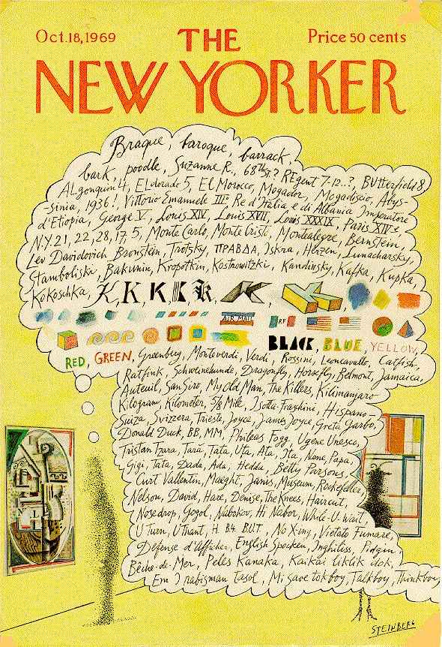
Spontaneous brain
Spontaneous mind
Demertzi, Kucyi, Ponce-Alvarez, Keliris, Whitfield-Gabrieli, Deco. Network Neurosci 2022
Demertzi & Whitfield-Gabrieli: Neurology of Consciousness 2nd ed. 2015 Fox et al, PNAS 2005
Notes:
Saul Steinberg's marvelous New Yorker cover from October 8, 1969 (see Figure 1), provides the best picture of human consciousness I have encountered. Not just words, but colors and shapes succeed each other in delicious association. Even the genius of Steinberg can't quite render aromas, tickles and sounds on the cover of a magazine, but at least he suggests the likelihood of their inclusion. And the whole rendering is made possible by his exploitation of a familiar cartoonists' convention, the thought balloon or thought bubble. Calling this a convention underplays its naturalness; I doubt that children ever need to have the convention explained to them--it's quite wonderfully obvious what it depicts, metaphorically: the stream of consciouscontents in the mind of the man looking at the painting in the museum. This powerful and natural metaphor provides a nice setting of the problem of consciousness: If this picture gives us the metaphorical truth, what is the literal truth? How can an account of what happens in the man's brain ever do justice to the familiar--indeed intimate--facts we recognize in this metaphorical rendering?
W. James (1980): five characters in thought
Every thought tends to be part of a personal consciousness
Within each personal consciousness, thought is always changing
Within each personal consciousness, thought is sensibly continuous
It always appears to deal with objects independent of itself
It is interested in some parts of these objects to the exclusion of others, and welcomes or rejects or chooses from among them, all the while it thinks

Slide 3
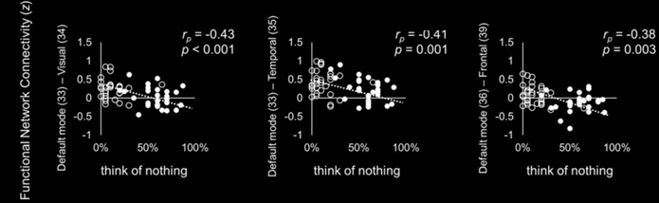
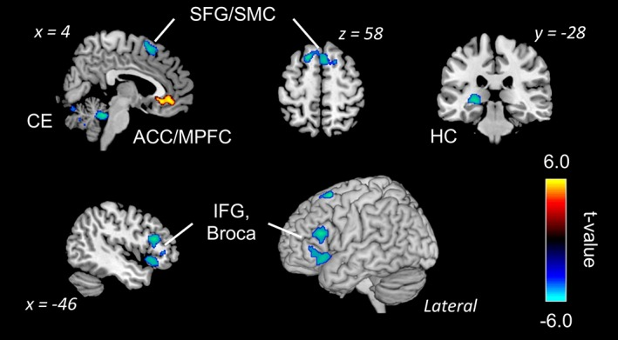
Mind Blanking has its own neural correlates
Default mode network
Kawagoe et al , Eur J Neurosci 2018
“When you realize that you are thinking about something, disengage your attention and again try to think of nothing during the scans”
Deliberate MB?
Kawagoe et al, Hum. Brain Mapp 2019
Notes:
Decreased activation:
Broca's area → reduced “inner speech”
Hippocampus → less impressionable “content”
Increased activation:
ACC → stream of consciousness continuity is retained
Decreased connectivity:
DMN - sensory cortices → less available content from sensory avenues to drive internally, self-oriented thought

Slide 4
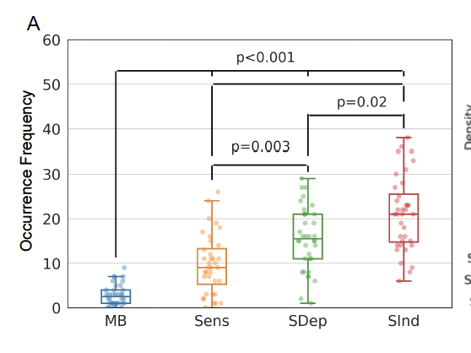
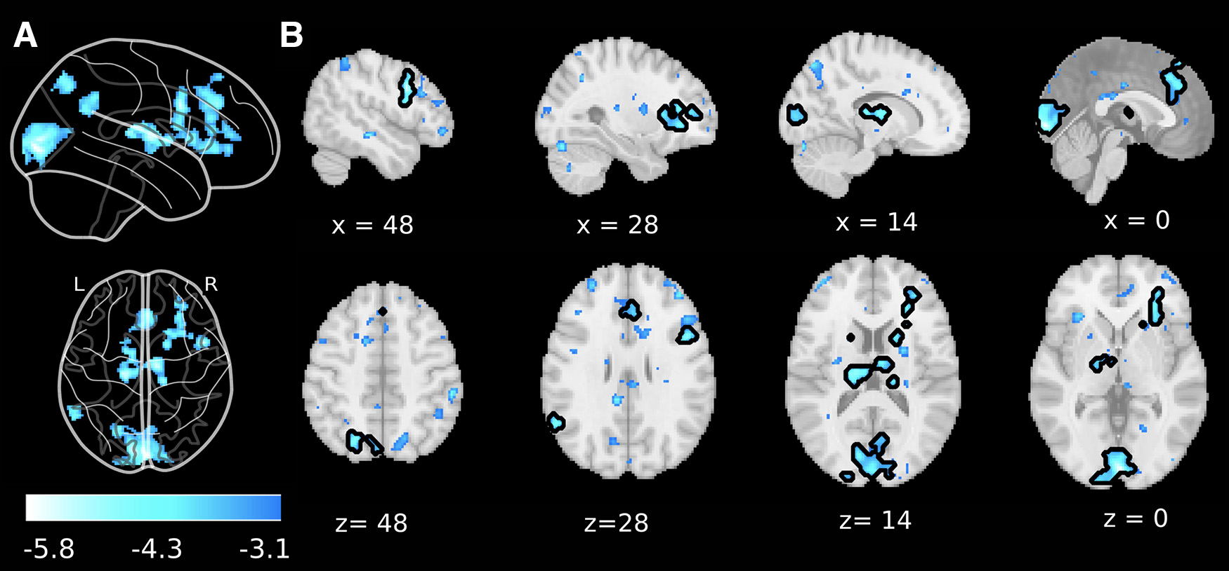
Mind Blanking happens “by default”
Less frequent Equally probable across time Whole-brain deactivations
36 participants; 50 probes
voxel-level p_{uncorrected} <0.001
cluster level p_{FDR} <0.05
MB Senses Stimulus Stimulus
Boulakis, Mortaheb, Van Calster,
Majerus, Demertzi. J Neurosci 2023
Dependent Independent
Mortaheb, Van Calster, Raimondo, Klados, Boulakis, Georgoulaa, Majerus, Van De Ville*, Demertzi*. PNAS 2022
Van Calster, D’Argembeau, Salmon, Peters, Majerus. J Cogn Neurosci 2017

Slide 5
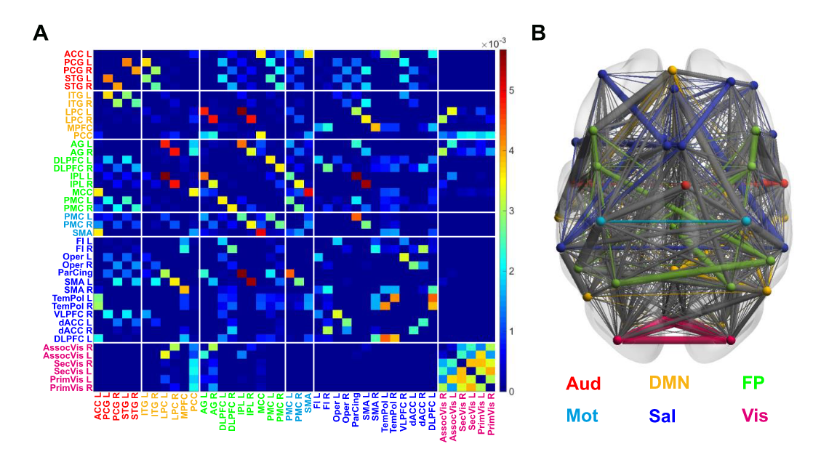
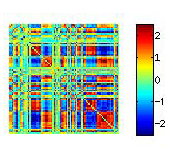
The brain as a network
100 billion neurons, ~100 trillion synaptic connections
The Connectome
Fornito, Zalesky, Bullmore. Ch 1: An Introduction to Brain Networks. Fundamentals of Brain Network Analysis, Academic Press 2016
Sporns, Tononi, & Koetter. PLoS Comput Biol 2005
I
mage from: Demertzi & Tagliazucchi, Dehaene, Deco, Barttfeld, Raimondo […] Sitt. Science Advances 2019
Notes:
This approach emphasises the fundamental roles of the interactions between regions, thereby finding solid grounding in the complex systems approach to the brain – and providing plentiful insights about brain function and dysfunction

Slide 6
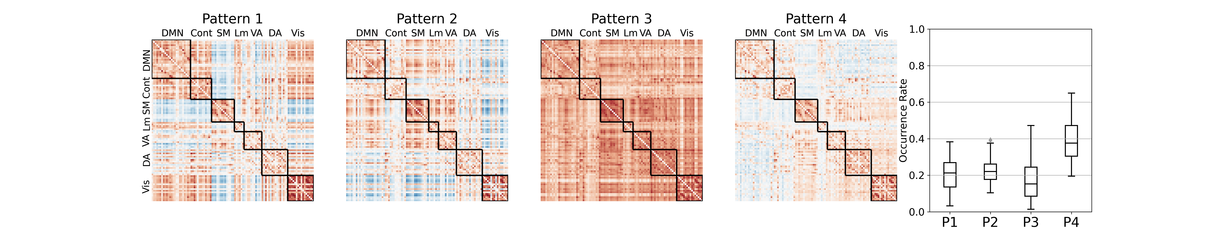
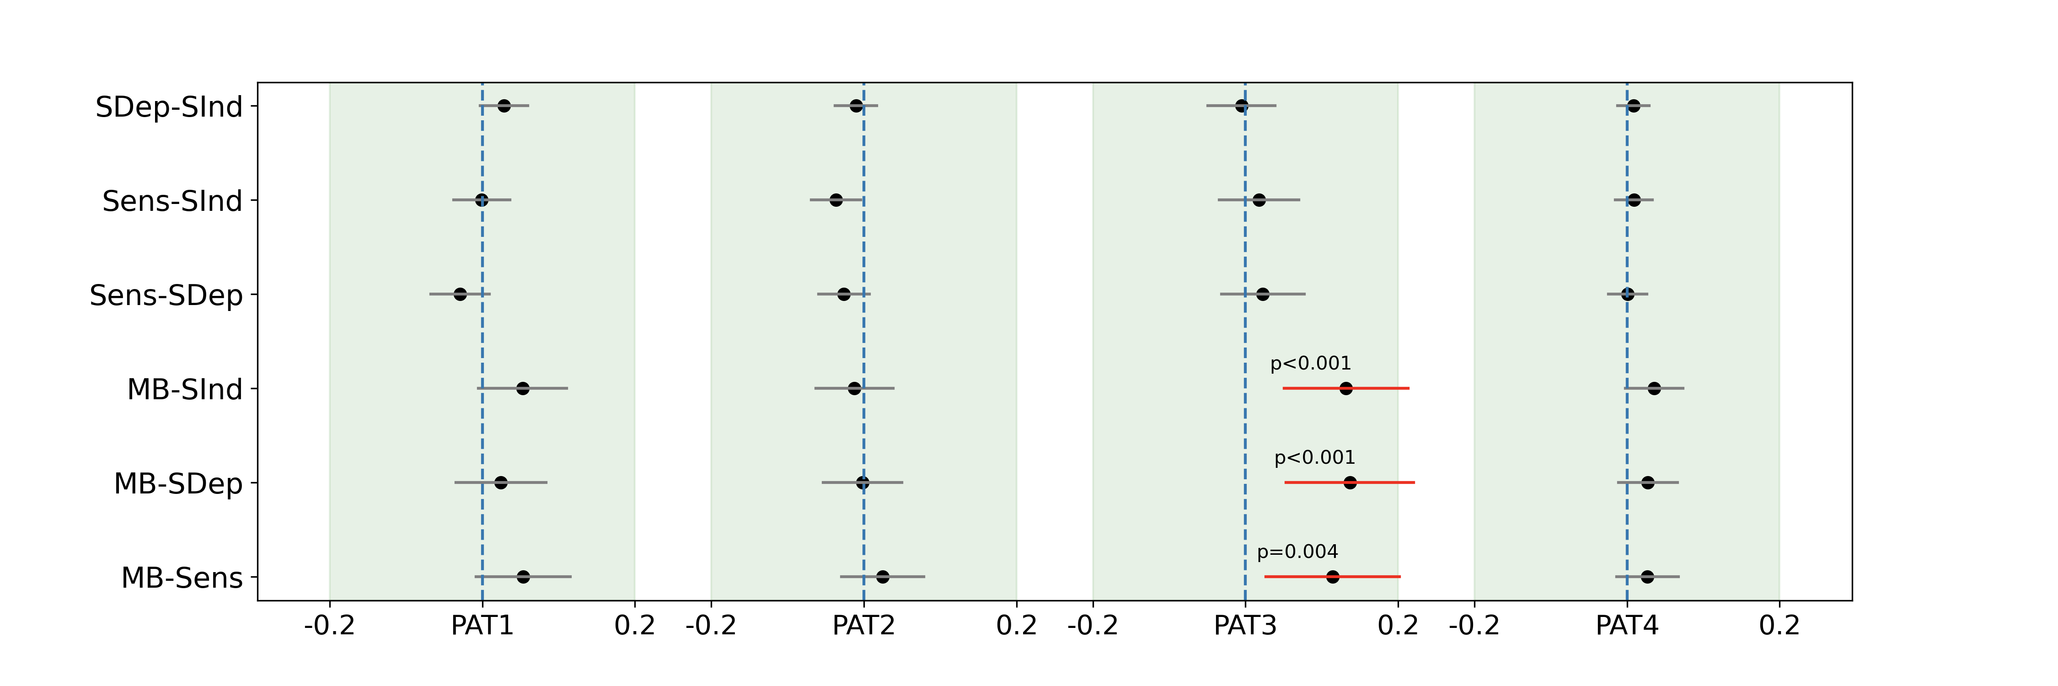
MB is linked to a hyper-connected pattern
Sparsely reported Reduced perceptions Equiprobable
Mortaheb, Van Calster, Raimondo, Klados, Boulakis, Georgoulaa, Majerus, Van De Ville*, Demertzi*. PNAS 2022
Notes:
Cosine similarity determines how similar two matrices/vectors are irrespective of their norm. It can be considered as the normalized version of the Euclidean distance (i.e., projecting the vectors onto the unit sphere and calculating Euclidean distance, which is then effectively the cosine of the angle between those vectors). Subsequently, for each mental state the distribution of distances to all four centroids was created.
A generalized linear mixed effect model with gamma distribution and log link function was applied to test the relationship between the distances to each pattern and the mental states.
Tukey post hoc test was applied to compare

Slide 7
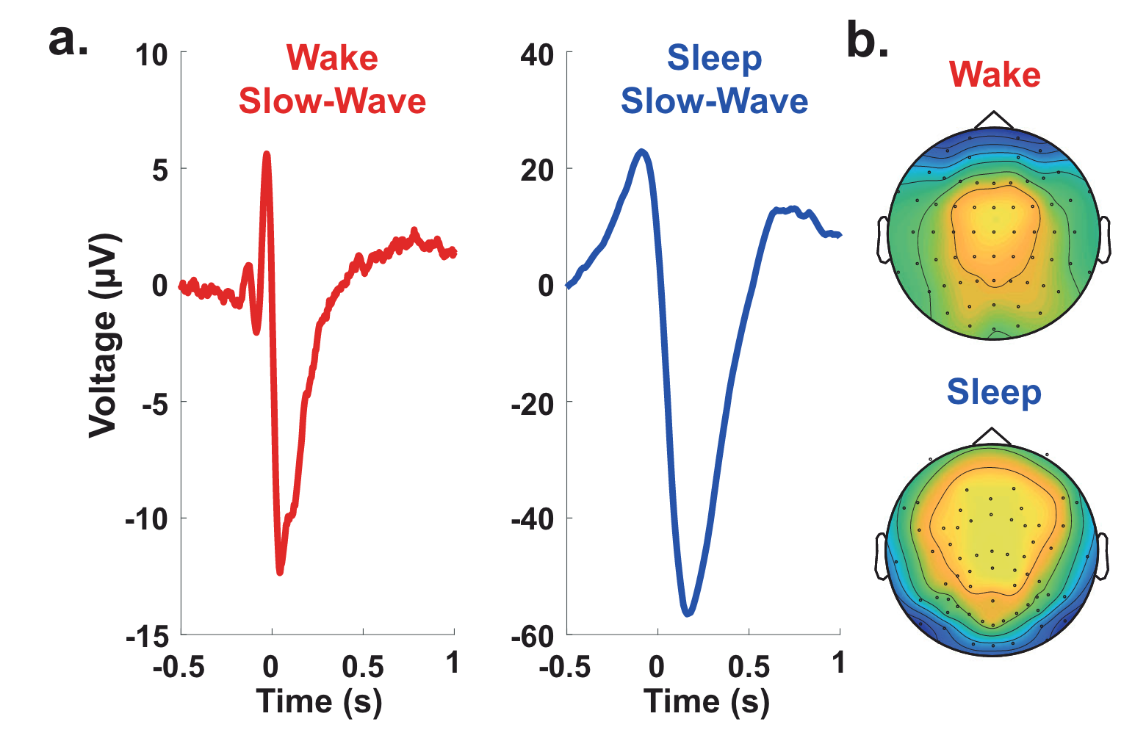
MB linked to slow wave-like activity
Properties of slow waves
Predictive of mental states
Andrillon et al, Nat Communications 2021
Notes:
Slow waves in the back of the brain were associated with misses (Fig. 5c), which is consistent with the involvement of parietal cortices in sensorimotor integration
MB > MW: reduction of slow-wave amplitude over frontal electrodes but an increase in their upward slope over parietal electrodes were predictive of MB: a perturbation of frontal cortices leads to unconstrained thoughts (MW) rather than the loss of awareness, but that awareness decreases when posterior regions momentarily go offline, a pattern similar to the neural correlates of dreaming during sleep or spontaneous thoughts during wakeful rest57,75.
Slow wave parameters such as
Amplitude
slope and
number of negative peaks
are thought to depend on the number of recruited neurons and the speed of synchronization across neuronal populations (Esser et al., 2007; Riedner et al., 2007; Vyazovskiy et al., 2007). In particular, steep, high-amplitude slow waves with few negative peaks are generated when an efficient neuronal synchronization allows for a fast recruitment of a large number of neurons at the cortical level.
https://www.ncbi.nlm.nih.gov/pmc/articles/PMC3900623/#:~:text=Slow%20wave%20activity%20(SWA%2C%200.5,slope%20of%20sleep%20slow%20waves.:
It has been proposed that the slope of slow waves, measured in the EEG, may represent a marker of this neuronal synchronization.^{16–18} Thus, the faster neuronal populations of a network are able to synchronize their activity, the steeper the slopes of the slow waves are. Consequently, the slope of slow waves at the beginning of the night when sleep pressure is high is much steeper compared to the slope of slow waves with the same amplitude towards the end of the sleep period when sleep pressure has dissipated.¹⁷

Slide 8
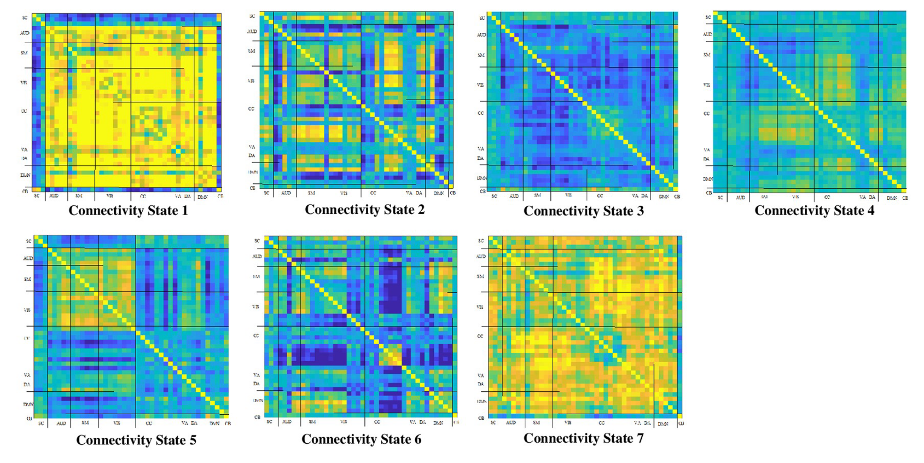
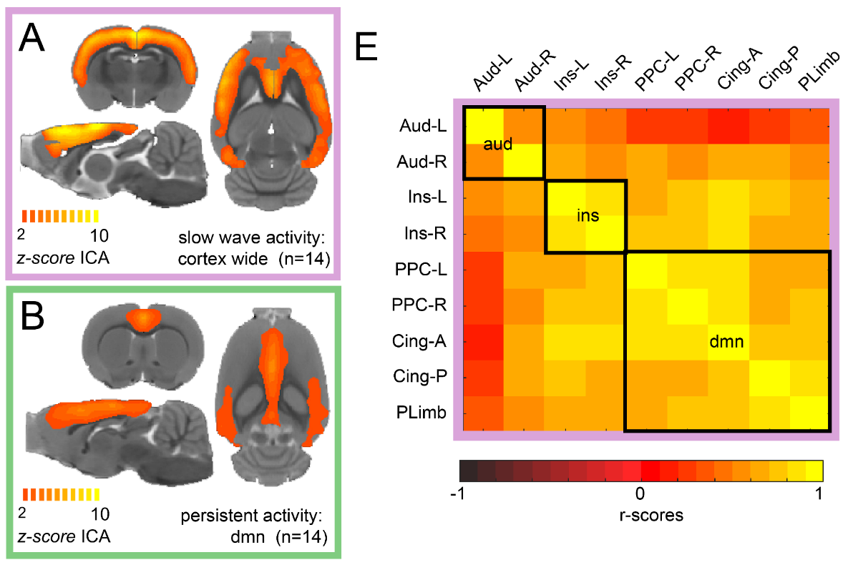
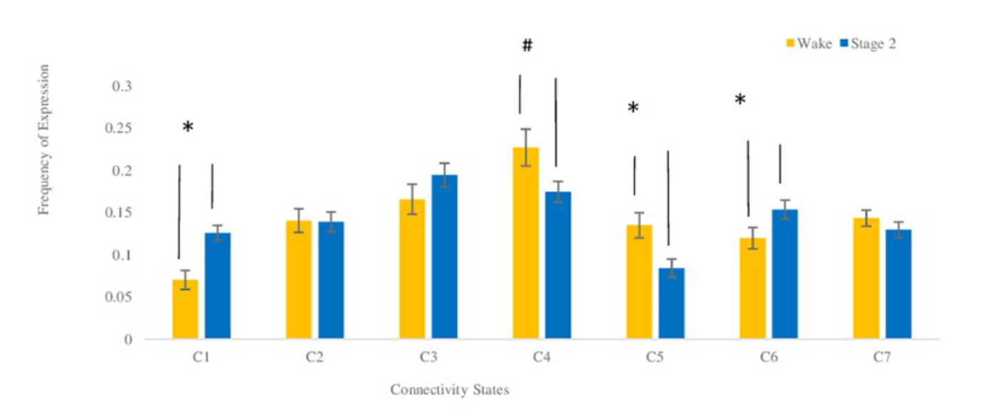
Higher connectivity in unconscious states
NREM sleep
Humans
Isoflurane anesthesia
Rats
Wake
Stage 2
Frequency
El-Baba et al, PLOS One 2019
Aedo-Jury et al, eLife 2019

Slide 9
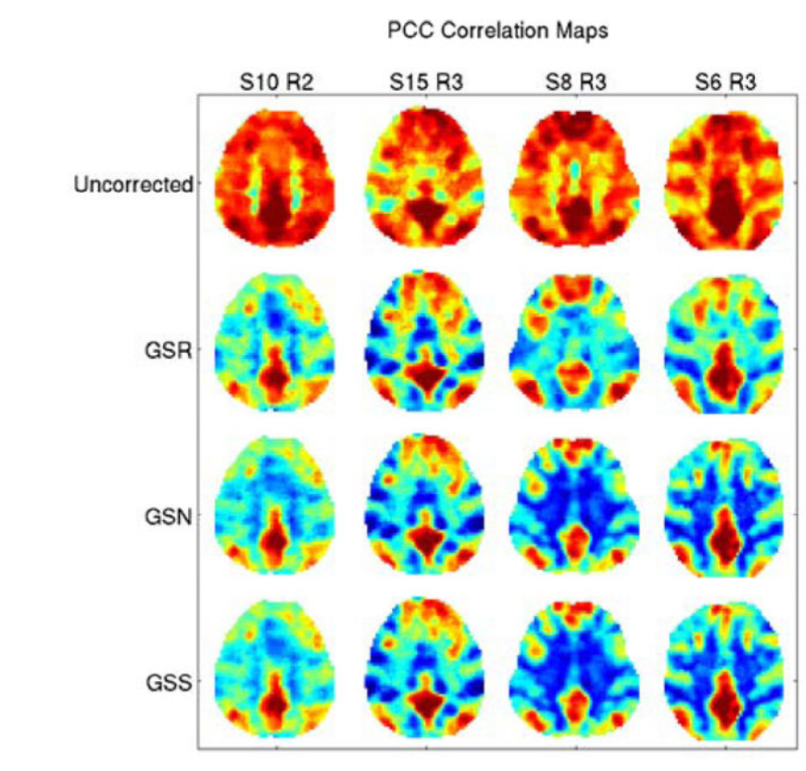
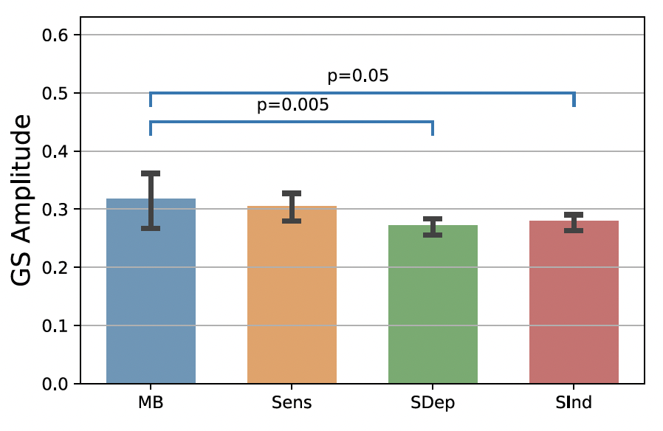
Higher connectivity & the BOLD Global signal
The Global Signal
Higher Global Signal Amplitude around MB reports
Liu et al, NeuroImage 2017
Mortaheb et al, PNAS 2022
Notes:
‘‘Global flow’’ in PET (Friston et al., 1990), which is the average measured blood flow for the entire volume.
In fMRI there is at least a superficial analogue which we will refer to as the ‘‘global signal’’ and which we define as the average brain voxel time series (the global signal is thus a time signal)
The global signal for each subject was calculated after applying the atlas and time series extraction, by averaging time series of all the ROIs
The global signal amplitude was defined as the sum of the absolute value of the GS time points related to the functional repertoire of each mental state (extracted at the ROI level, after preprocessing)

Slide 10
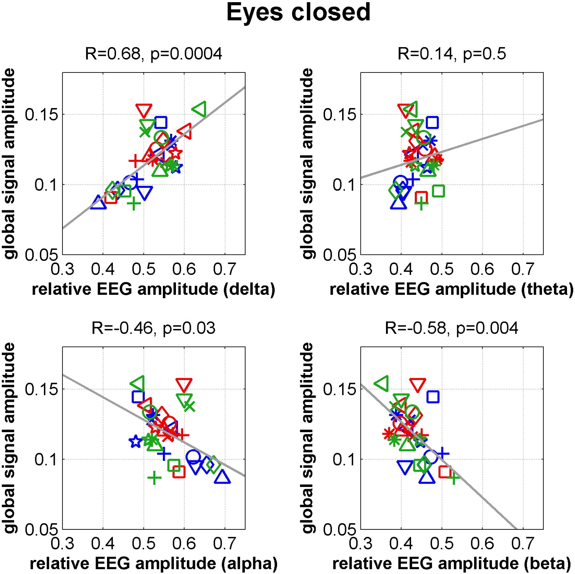
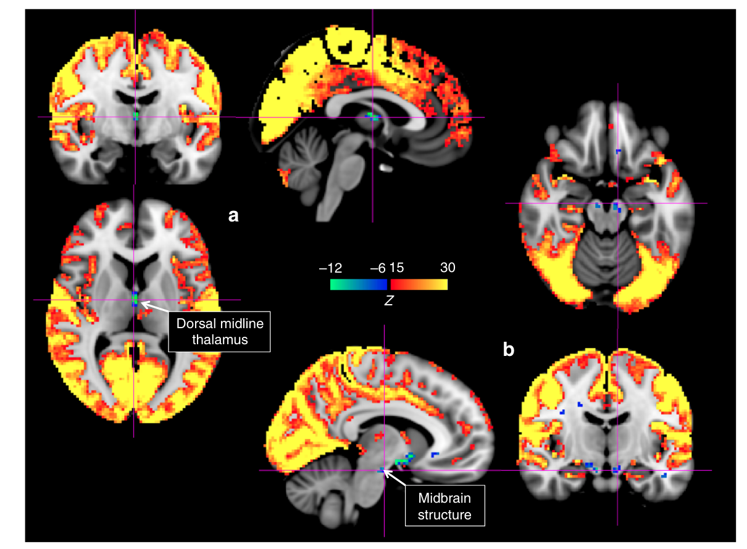
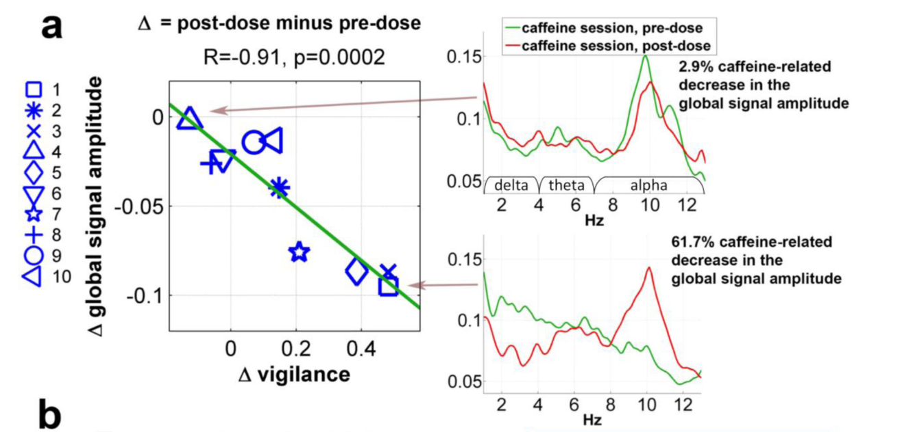
Higher Global Signal amplitude → Lower vigilance
GS amplitude is linked to low arousal
GS amplitude linked to signal decreases in subcortical structures of arousal
GS amplitude decreases with caffeine intake
Wong et al, Neuroimage 2013
Liu et al, Nat Communications 2018
Notes:
Liu 2018:momentary increases in the global signal are accompanied by signal decreases in subcortical regions with established involvement in promoting arousal and wakefulness.

Slide 11
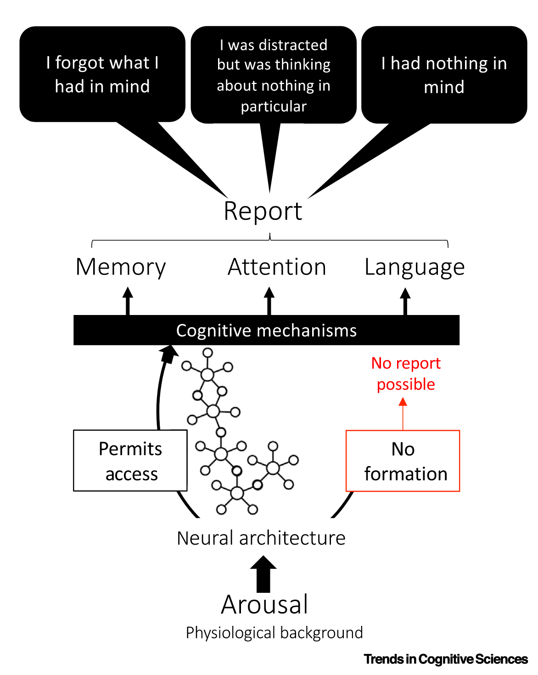
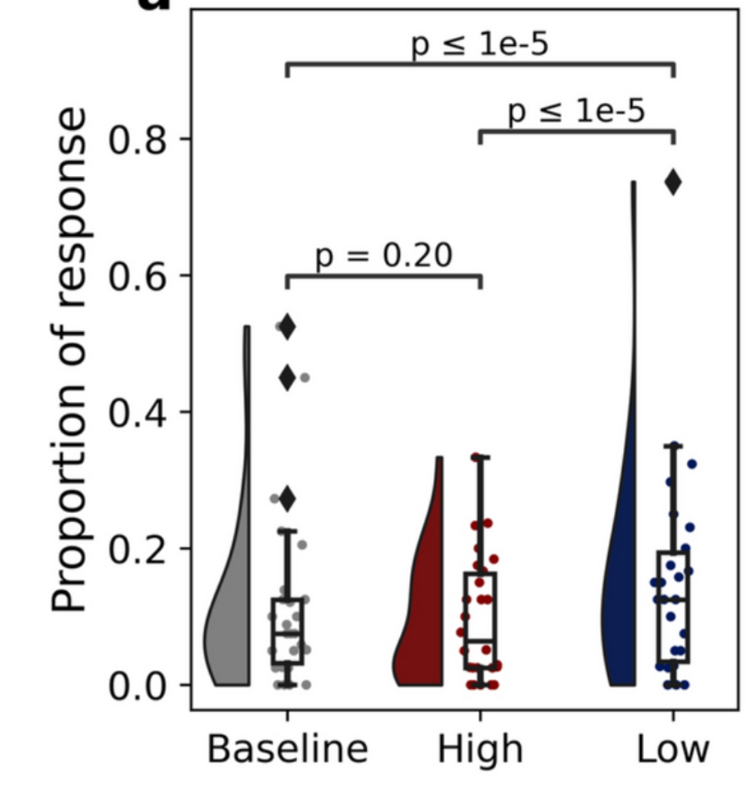
Altered arousal increases MB reports
Baseline Biking Sleep Deprivation
but MB was more frequent in
first half of post-exercise vs. second half
Boulakis, Simos, Zoi, Mortaheb, Schmidt, Raimondo, Demertzi. Sci Rep 2025
Andrillon, Lutz, Windt, Demertzi. Trends Cogn Sciences 2025
Notes:
Transition probabilities revealed that, after sleep deprivation, MW was more likely to be followed by MB and less likely to be followed by more mind-wandering reports.

Slide 12
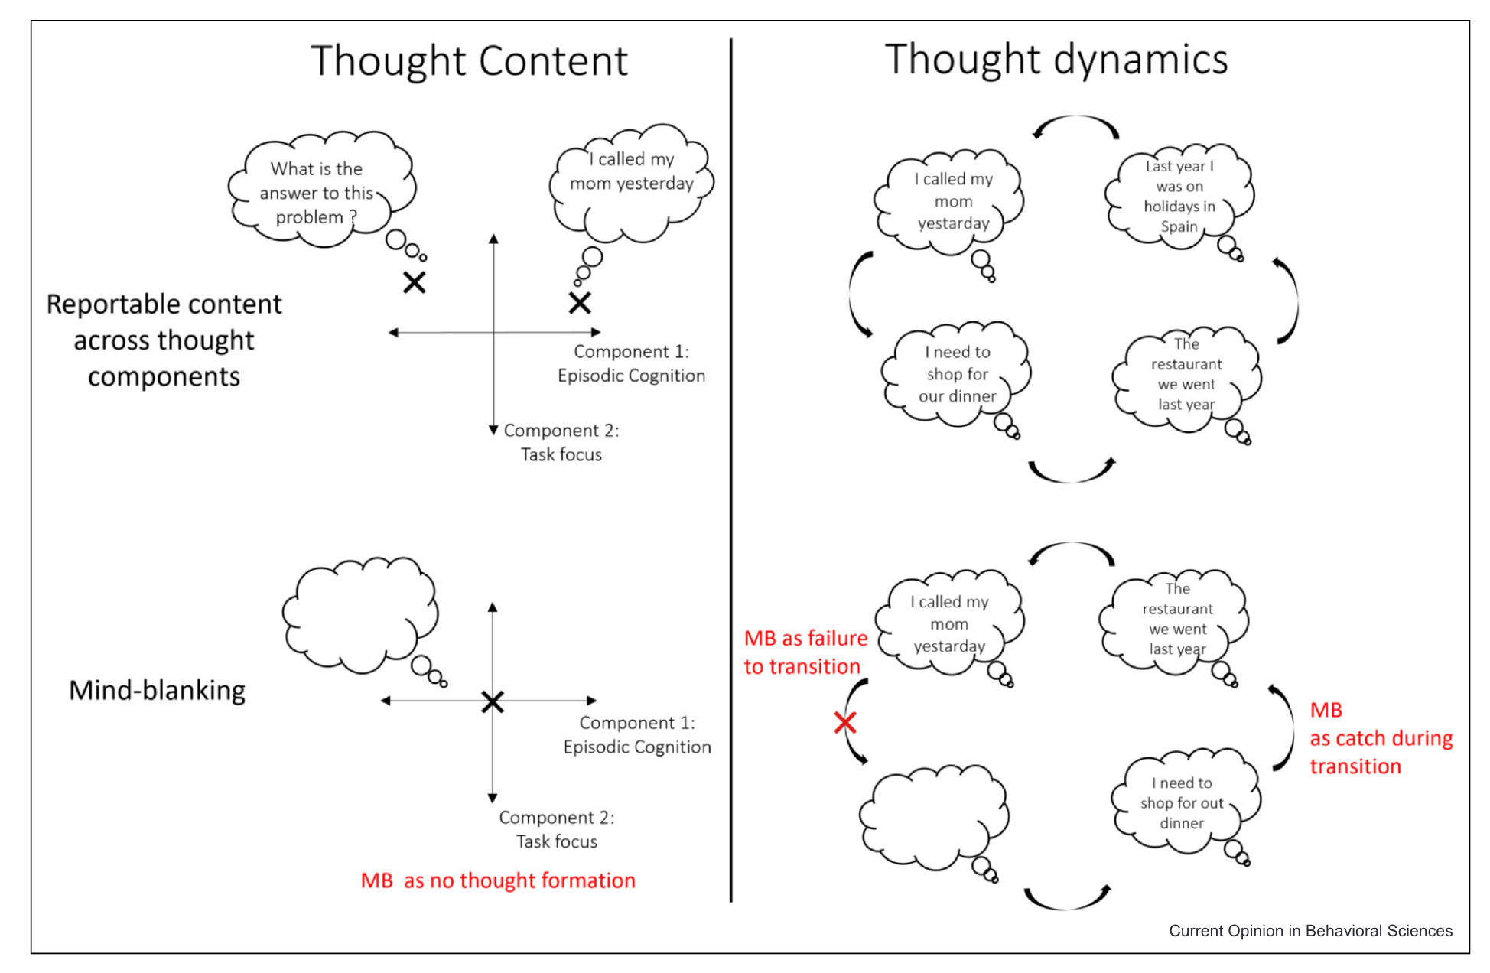
How uncertainly relates to my research
Boulakis & Demertzi. Curr Opinion Behav Sciences 2025

Slide 13
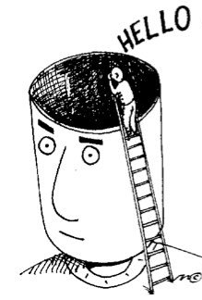
Summary
Mind Blanking reports:
happen during spontaneous thinking
are arousal-mediated
help us understand how wakefulness is sustained
Notes:
A balanced random forest classifier trained on a combination of BRAIN and BODY features 626 outperformed classifiers trained solely on BRAIN or BODY features when evaluated with balanced accuracy. Individual points 627 indicate performance on the folds of the repeated cross-validation.
b) Subset of the 10 features with the highest mean of the 628 absolute SHAP values obtained from the balanced random forest classifier.

Slide 14

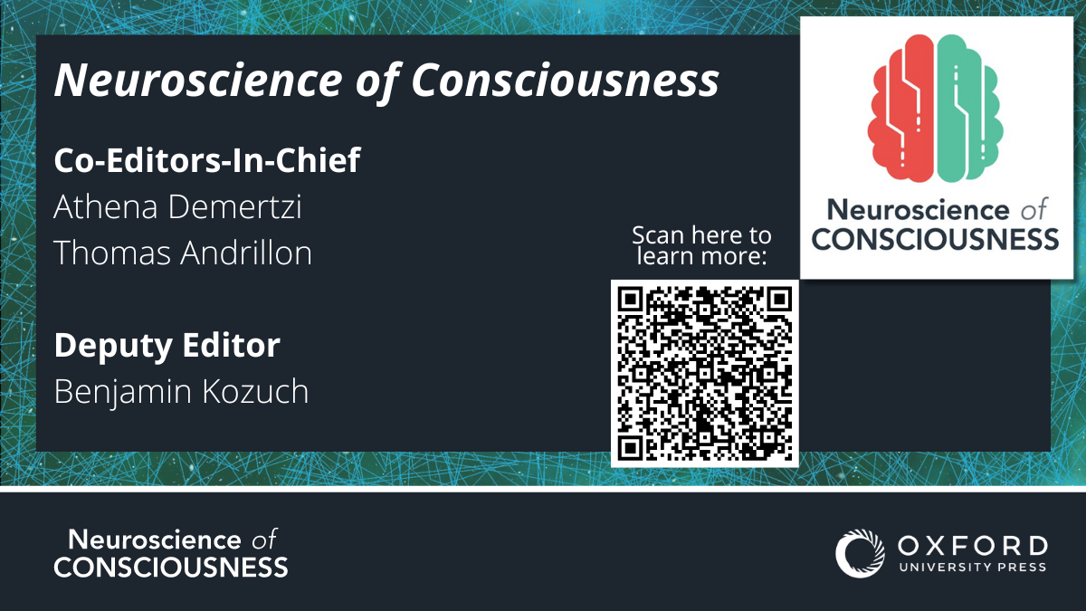
Attend!
Submit!

Slide 15





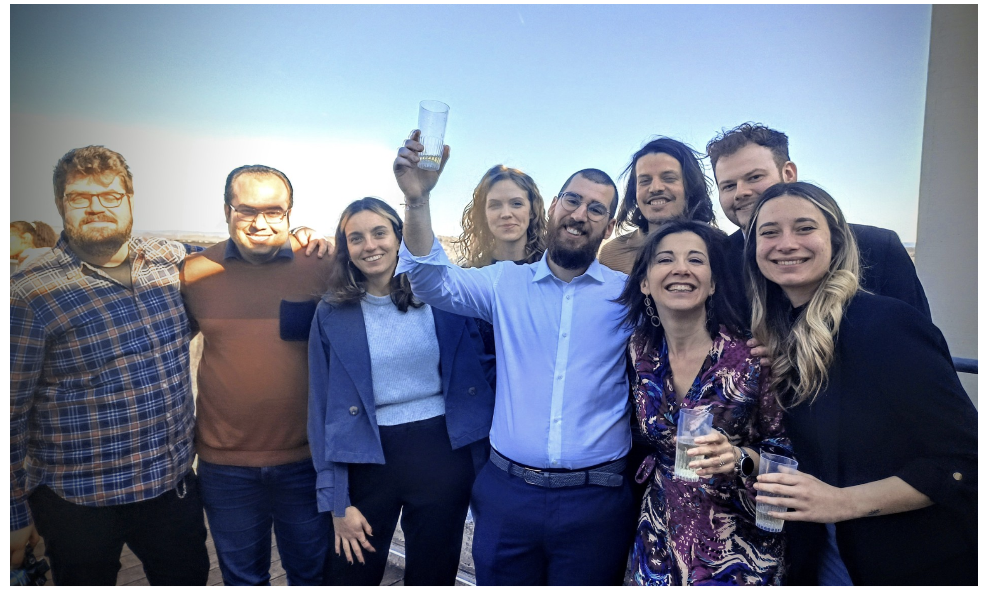

COLLABORATORS
Federico RAIMONDO (FZ Jülich)
Sepehr MORTAHEB
Mathhieu KOROMA
Christina SCHMIDT
Christine BASTIN
Christophe PHILLIPS
Gilles VANDEWALLE
Fabienne COLLETTE
CRC HUMAN IMAGING UNIT
INTERNATIONAL COLLABORATORS
Thomas ANDRILLON
Jenny WINDT
Antoine LUTZ
Aniko KUSZTOR
Kristian SANDBERG
Timo Torsen Schmidt
Marzia DE LUCIA
Andria PELENTRITOU
Christine BLUME
Jan REMAEKERS
Natasha MASON
Pablo MALLARONI
Physiology of Cognition Lab
Notes:
Conclusions: I showed how states of unconsciousness raise ethical debates, mostly about whether C . exists. I provided data which point towards the one or the other direction. In the end, it seems there is an Open dialogue in the science of about what C it is. In that respect, Consciousness is a construct of consensus and we'd better be off to define 4 quantify it as accurately as possible. This is why I think

