Slide 1


The world of energy:
problems, but always with solutions
Prof. Damien Ernst
Co-authors: Victor Dachet, Antoine Larbanois,
Samy Mokeddem, Thibaut Techy, Maurizio Vassallo

Slide 2
In the energy sector, economic and technical obstacles are often treated as if they were inevitable and impossible to overcome.
However solutions do exist.
This presentation highlights eight problems frequently raised in energy debates and shows how each of them can be addressed.
Some of the solutions presented come from research conducted by the Smart Grids Laboratory at the Montefiore Institute, University of Liège.
2

Slide 3
1st problem
Gas prices are far too high

Slide 4
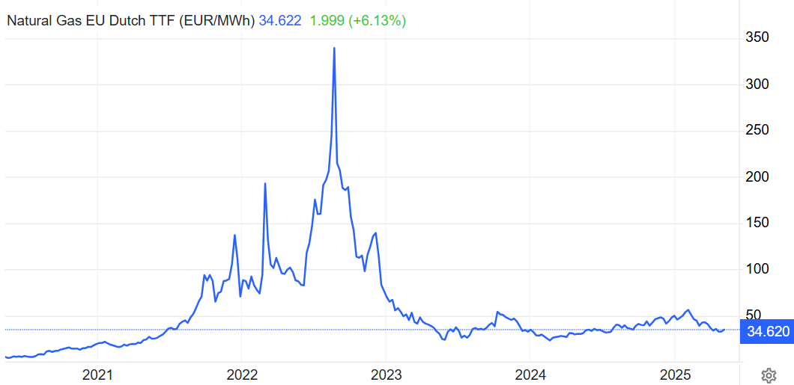
In February 2022, Russia’s invasion of Ukraine caused a sharp rise in natural gas prices on the European market, where the Dutch TTF is the benchmark price.
4

Slide 5
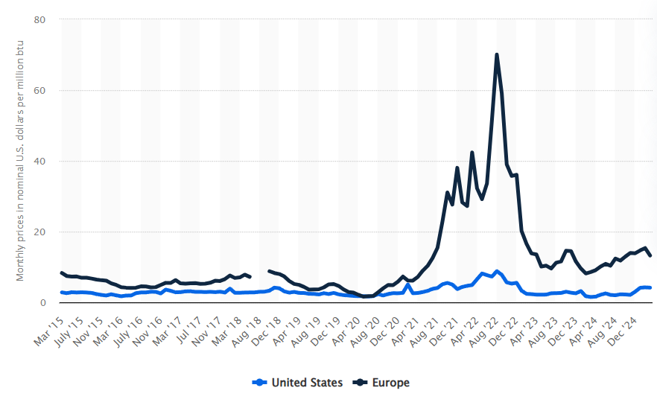
In 2025, gas is still on average three times more expensive in Europe than in the United States.*
→ Major competitive disadvantage for US companies.
→ Growing risk of gradual deindustrialization in Europe.
* The gas price shown in the figure is expressed in $/MMBtu, a unit commonly used in North American markets. One MMBtu is approximately equal to 0.293 MWh.
5

Slide 6
Will gas prices in Europe stay high forever, putting Europe’s competitiveness with the U.S. at risk?
There are very positive signs that solutions are emerging.
6

Slide 7
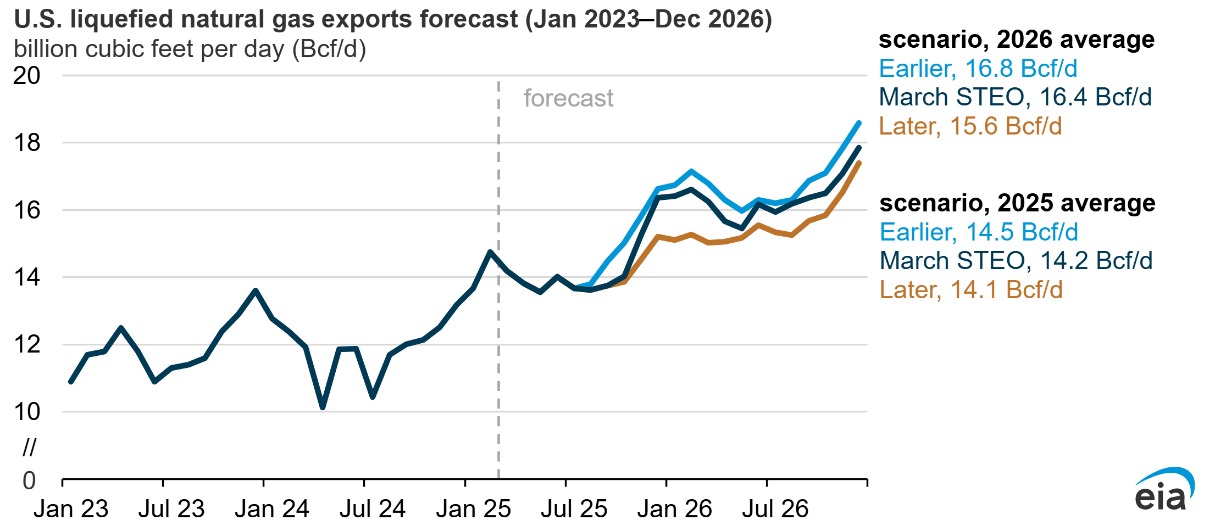
Today, Europe is the largest customer for U.S. liquefied natural gas (LNG).
In 2024, 53% of U.S. LNG exports were sent to Europe.
If Europe and the rest of the world show a desire to increase their purchase volume of North American LNG at a good price, US producers will prioritize exports.
This will lead to the development of new LNG terminals, reducing the supply available on the domestic market.
As a result, gas prices in the US are likely to rise, moving closer to European levels, and reducing the competitive gap.
1600 TWh/year early 2025 → 2000 TWh/year late 2026*
U.S. LNG export forecasts (Jan. 2023 - Dec. 2026) in billion cubic feet per day.¹
* Gas volumes in the figure are expressed in billions of cubic feet per day (bcf/d), a unit commonly used in North American markets. One billion cubic feet equals approximately 293 GWh.
¹ Eia (2025, April 23). How will start-up timing of new US LNG export facilities affect forecasts? Eurasia Review.
7

Slide 8
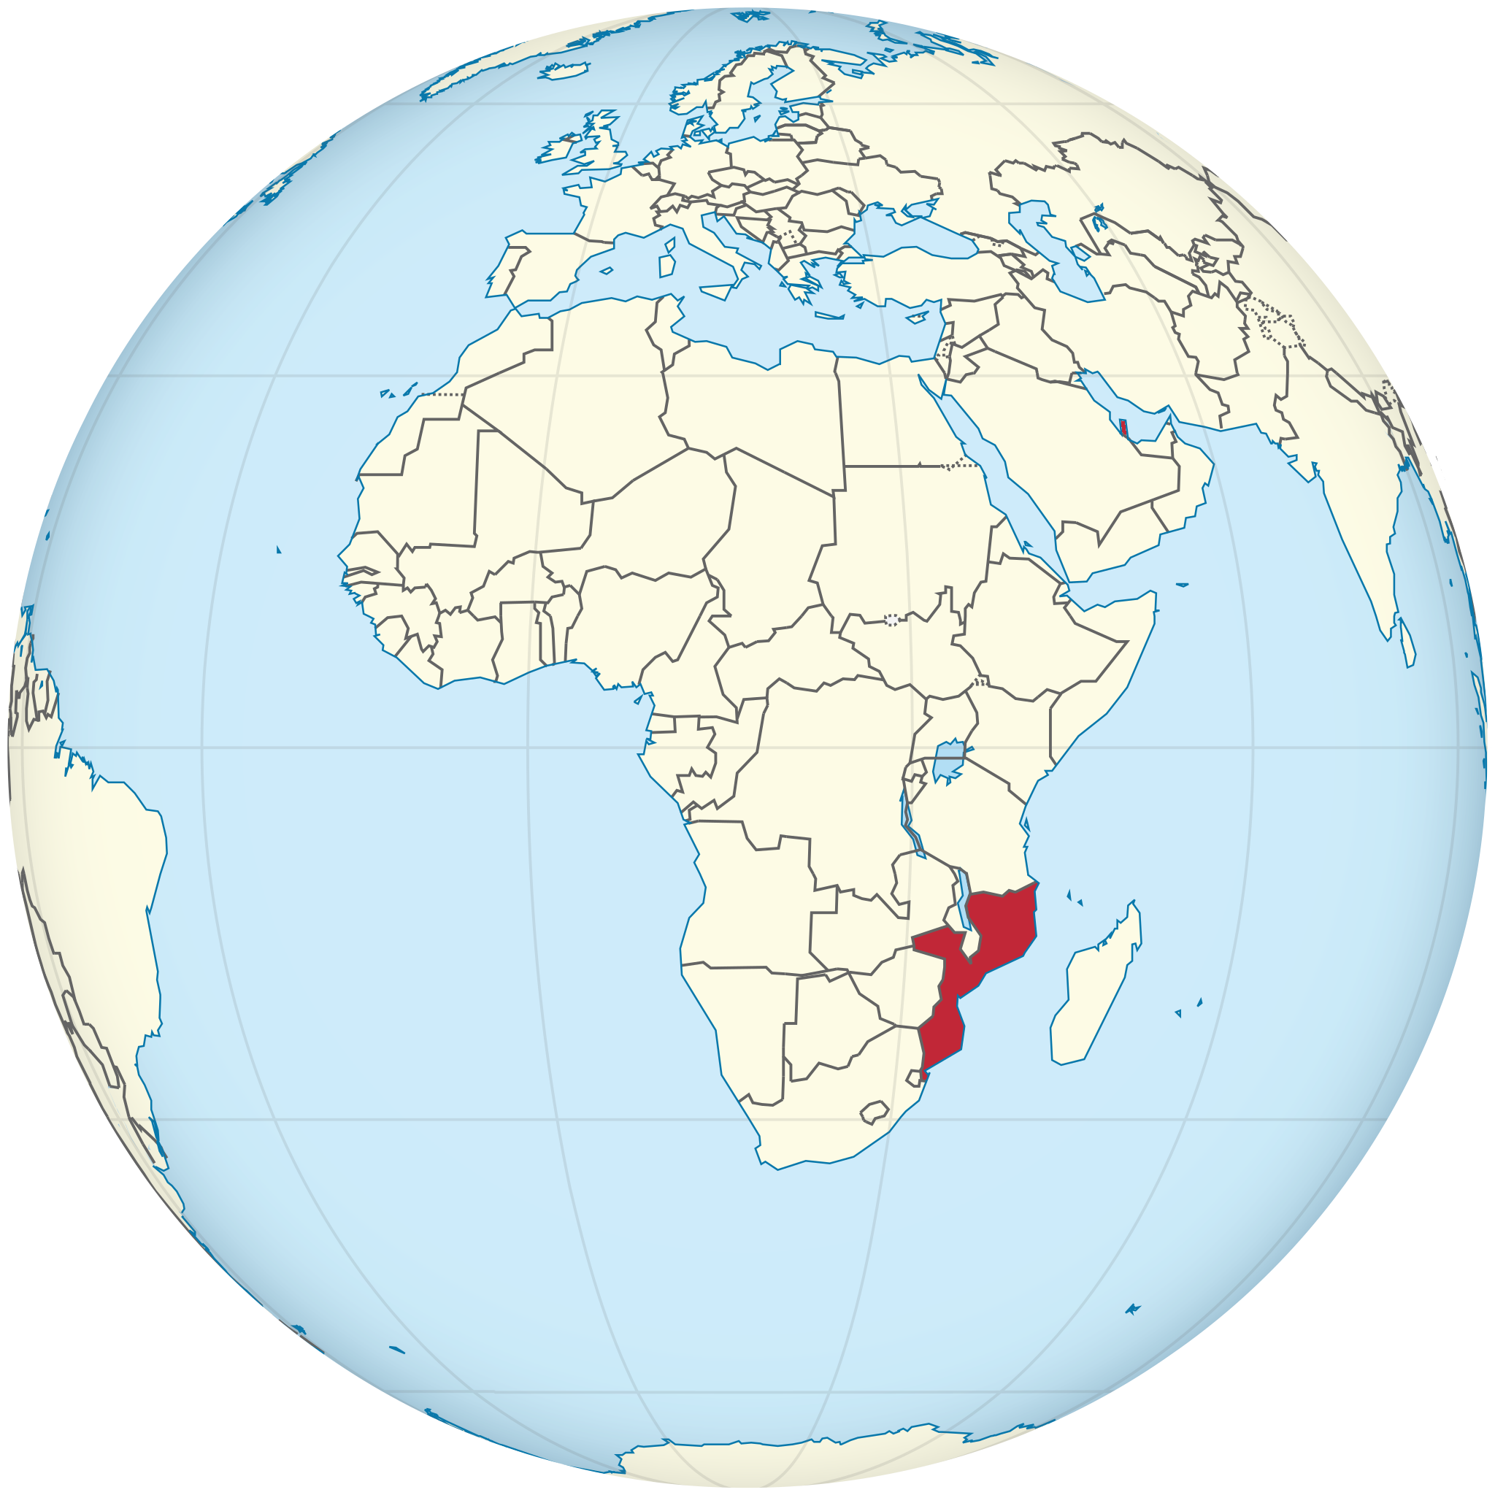
LNG export contracts are signed with new producers.
Examples of emerging export sources include:
Qatar
One of the lowest production costs in the world, as low as €1/MWh.¹
Mozambique
Strong investment by TotalEnergies, with an estimated production cost of €15/MWh.
With the rise of these new, abundant and inexpensive sources, we can even hope that the price of gas available to Europe in the future will be determined by its marginal production cost.
This is already the case for coal which is currently the only fossil fuel whose markets are not subject to manipulation.
As of May 15, 2025, the price of coal was $100 per tonne, or €12/MWh.
¹ Nikolay Kozhanov (2024, May 21) Qatar's LNG expansion plans and the issue of market oversupply. Middle East Institute.
8

Slide 9
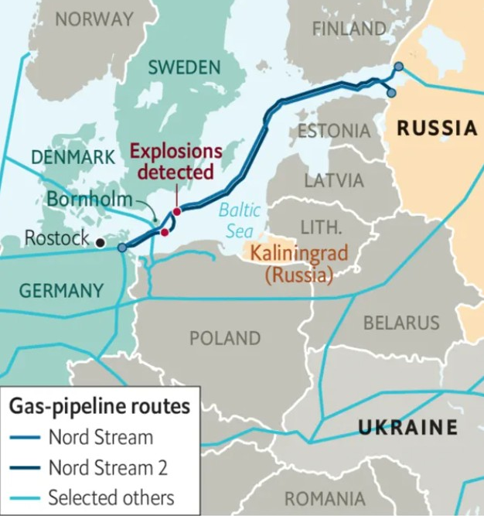
The EU could consider a partial resumption of Russian gas imports if a lasting peace agreement is reached.
Technically, three routes still allow Russian gas to be transported directly to Europe. Together they could cover a significant share of the EU's annual consumption which is around 3,500 TWh¹.
Nord Stream 2 Half of the pipeline remains operational; Capacity: 250 TWh/year.
Yamal-Europe Transit through Poland has been suspended, but the infrastructure remains intact;
Capacity: 350 TWh/year.
Brotherhood The Ukrainian grid is (almost) fully functional; Capacity: 1,100 TWh/year.
¹ R. Fernández-Blanco et al (2024, June) Natural gas consumption estimation in the European Union, Energy Reports, Volume 11.
9

Slide 10
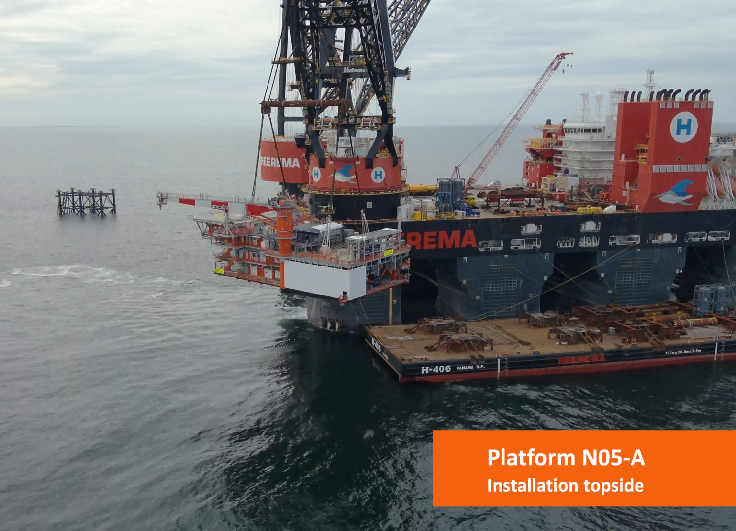
Europe boosts gas production in the North Sea.
In April 2025, the Netherlands restarted gas production in its offshore zone.
The goal is to extract up to 100 billion cubic meters of reserves. Considering that one cubic meter of gas contains 11 kWh, this corresponds to around 1,100 TWh.
That is nearly a third of the EU's average annual gas consumption (3,500 TWh/year).
Installation of the N05-A gas platform in August 2024.
Its electricity supply will be provided by offshore wind power.
10

Slide 11
2nd problem
Inverters tripping in photovoltaic systems

Slide 12
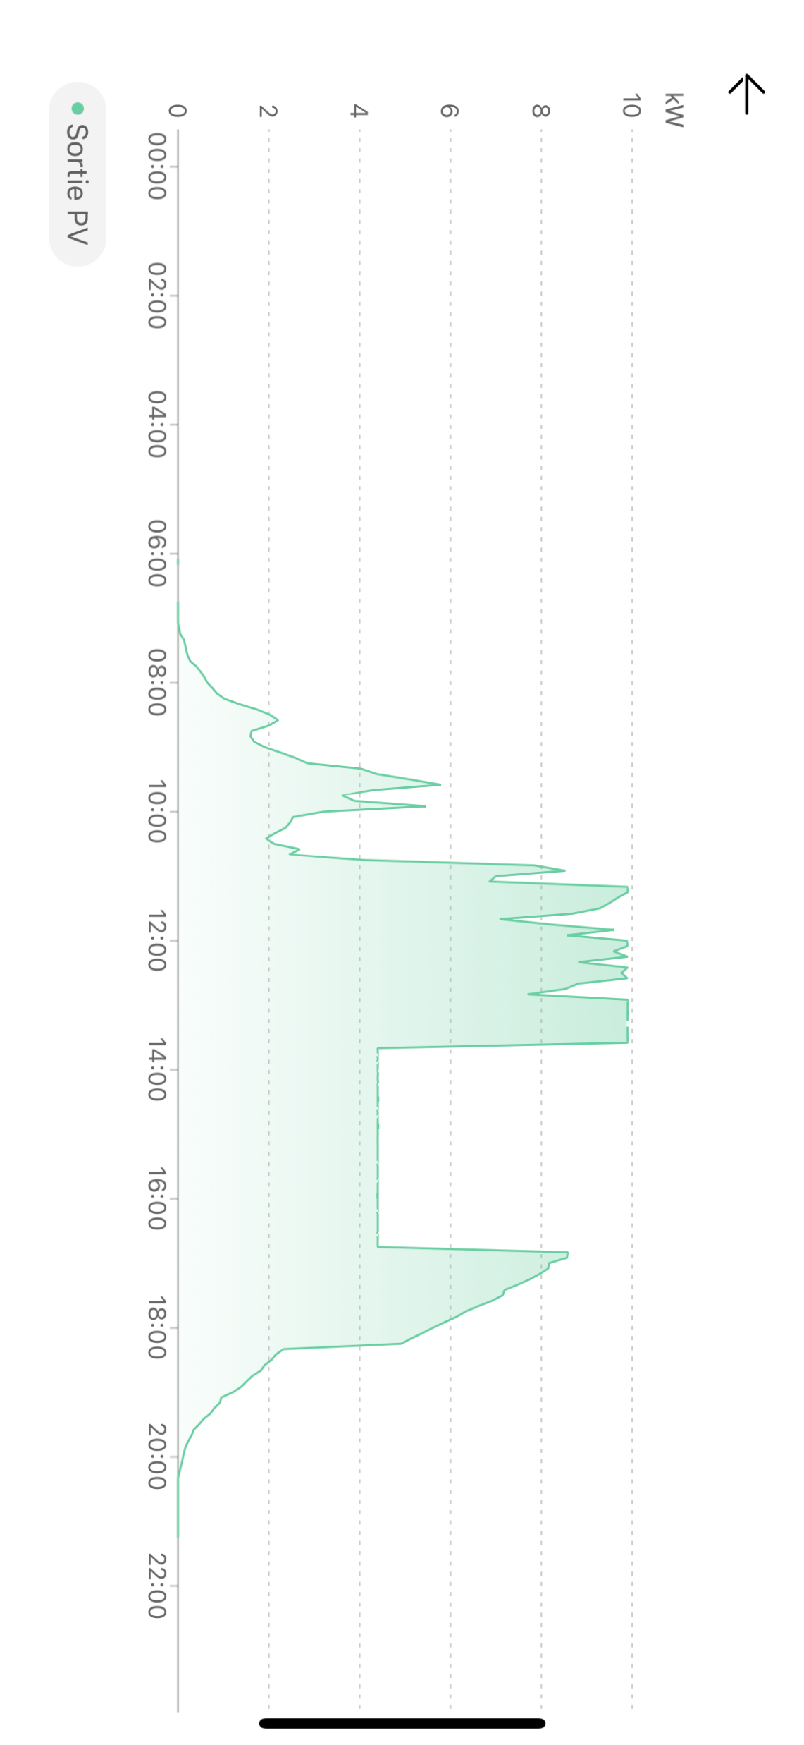
When photovoltaic (PV) production exceeds local consumption, the surplus electricity is injected into the low-voltage grid.
This leads to overvoltage.
As soon as the voltage exceeds certain thresholds, inverters automatically disconnect to protect the equipment.
If the voltage remains above 253 V (+10% relative to the nominal 230 V) for ten consecutive minutes, the inverter trips. If the overvoltage persists after this period, an additional ten-minute window is added before the inverter can reconnect.
If the voltage reaches 264 V (+15% relative to the nominal 230 V) , disconnection is immediate.
Production curve of a PV system equipped with two inverters. Shortly before 2pm, one of the inverters disconnects.
12

Slide 13
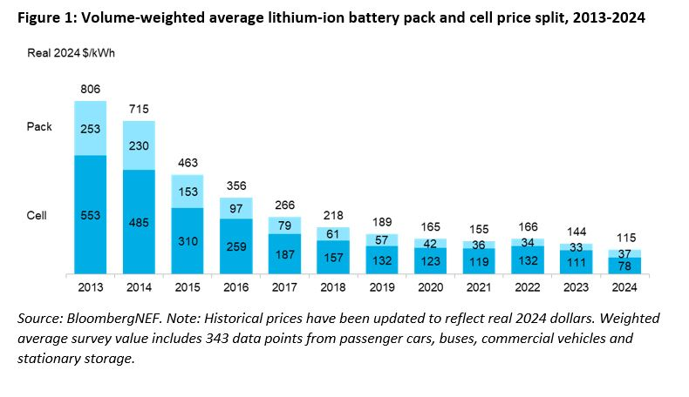
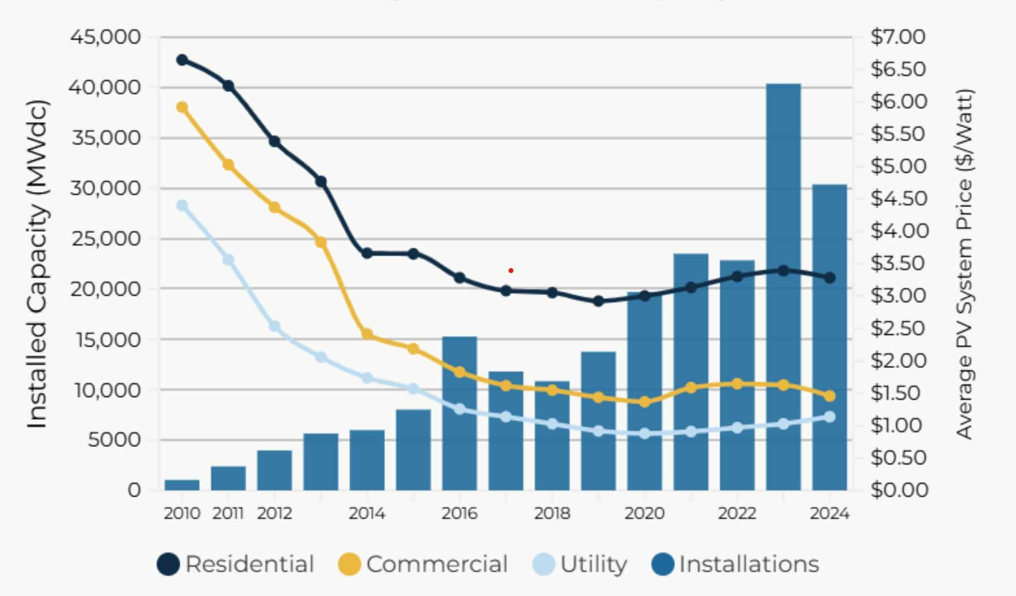
Installing a battery allows excess PV production to be absorbed locally instead of being fed into the grid, helping to mitigate power surges.
Battery costs have never been so low. Like PV panels, their prices have dropped significantly over the past decade, making this type of solution increasingly affordable.
Average price trend for lithium-ion battery packs and cells, 2013-2024.¹
Price trends and deployment growth for PV in the United States, 2010-2024.²
¹ BloombergNEF. (2024, December 10). Lithium-Ion Battery Pack Prices See Largest Drop Since 2017, Falling to $ 115 per Kilowatt-Hour.
² Native Solar (2025, May 2). What's happening with the cost of solar and battery storage in 2025?
13

Slide 14
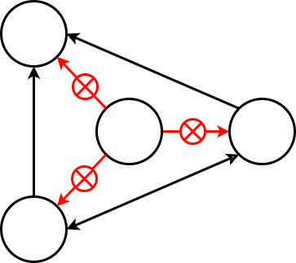





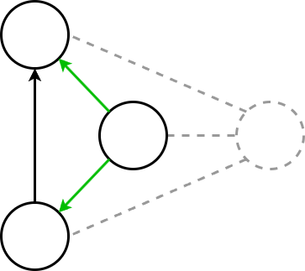
If power surges persists,
more advanced systems can switch
to islanding mode.
Voltage is
too high
Islanding refers to the ability of a site to temporarily disconnect from the grid while continuing to operate using its own PV production and storage.
The site becomes autonomous for a few minutes to several hours depending on the capacity of the battery and the PV system. It then automatically reconnects once the voltage falls back below the critical threshold.
Islanding
mode
14

Slide 15
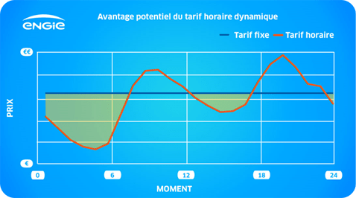
A properly sized PV system coupled with a battery can help mitigate power surges on the grid and enable islanding mode when needed.
But that is not all:
It also maximizes self-consumption, avoiding taxes and grid charges on electricity used locally;
When combined with a dynamic tariff, it creates economic opportunities by charging or discharging the battery at the most cost-effective times.
Potential Advantage of the Dynamic Hourly Tariff
Fixed tariff
Hourly tariff
Price
Moment
Engie's Dynamic tariff over a typical day.
15

Slide 16
3rd problem
The grid is saturated, and the injection is being refused

Slide 17
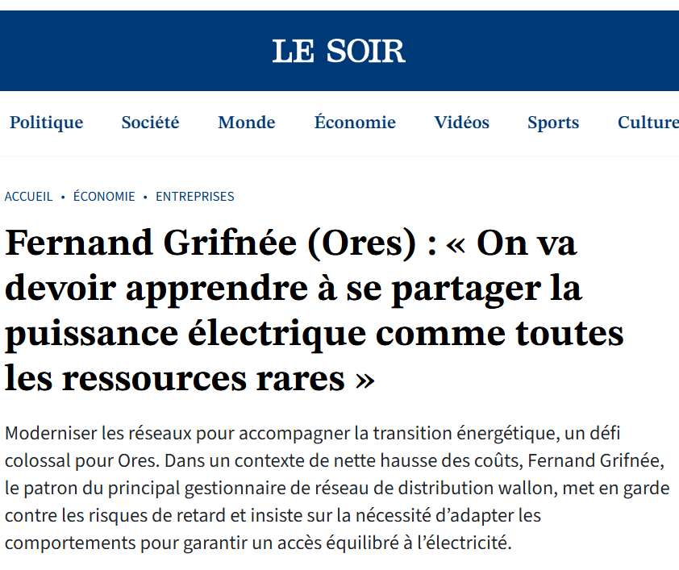

The massive integration of decentralized renewable sources like PV combined with the growing adoption of electric vehicles (EVs) is profoundly reshaping electricity flows in distribution networks.
This shift creates new technical challenges, such as power surges and local congestion. In response, the distribution network operator (DSO) may reject new connection requests for PV systems or EV charging stations.
Fernand Grifnée (ORES):
“We will have to learn to share electrical power like any other scarce resource.”
In an interview with Le Soir on March 31, 2025, the CEO of ORES, one of Belgian largest distribution network operator, acknowledged that it will not be possible to invest enough in infrastructure to fully prevent these bottlenecks.
17

Slide 18
To prevent overvoltage and congestion issues, heavy investments in cable or transformer upgrades are not always necessary.
An alternative is to make smarter use of existing capacity by allocating it intelligently among users.
A new operational network management paradigm, developed by the Smart Grids Laboratory at the Montefiore Institute, University of Liège, enables more efficient use of current infrastructure.
18

Slide 19
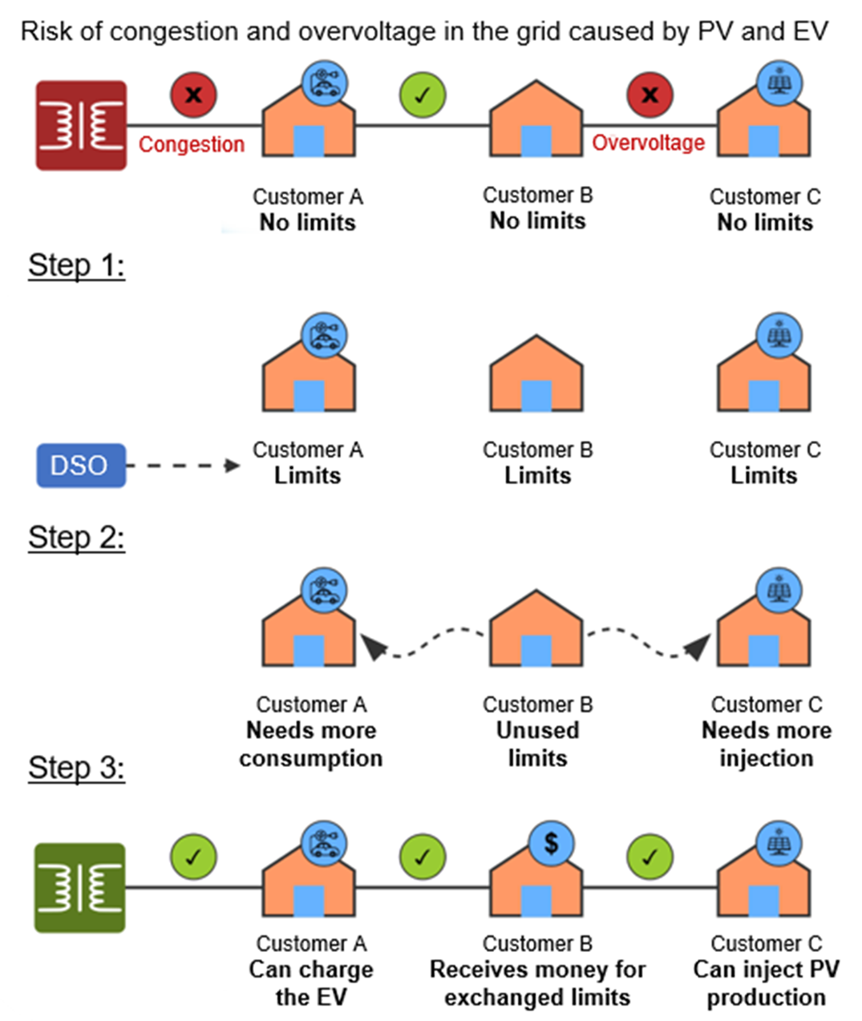
Here is the three-step solution behind the new paradigm.¹
Step 1:
The DSO assigns dynamic consumption and injection limits to each user, calculated to avoid all problems on the grid during every market period.
Step 2:
An exchange system then allows users to buy or sell part of their limits according to their needs.
Step 3:
Each transaction is monitored by the DSO to ensure that it does not cause overloads or imbalances as long as users stay within their assigned limits.
¹ Vassallo, M., Khaskheli, S., et al. (2025). A new Paradigm for Bilateral Trading of Dynamic Operating Envelopes in Electricity Distribution Networks. ORBi-University of Liège.
19

Slide 20
Concrete benefits for all.
The proposed paradigm offers several advantages for both customers and the grid:
Fewer consumption or injection refusals, thanks to better use of network capacity;
Improved valorisation of local production, helping to reduce energy losses;
Participants in the limit market receive compensation, which encourages flexibility;
The system can be deployed quickly without major investment, relying on existing infrastructure such as smart meters.
20

Slide 21
4th problem
Electrifying and/or decarbonizing all sectors is too complicated

Slide 22
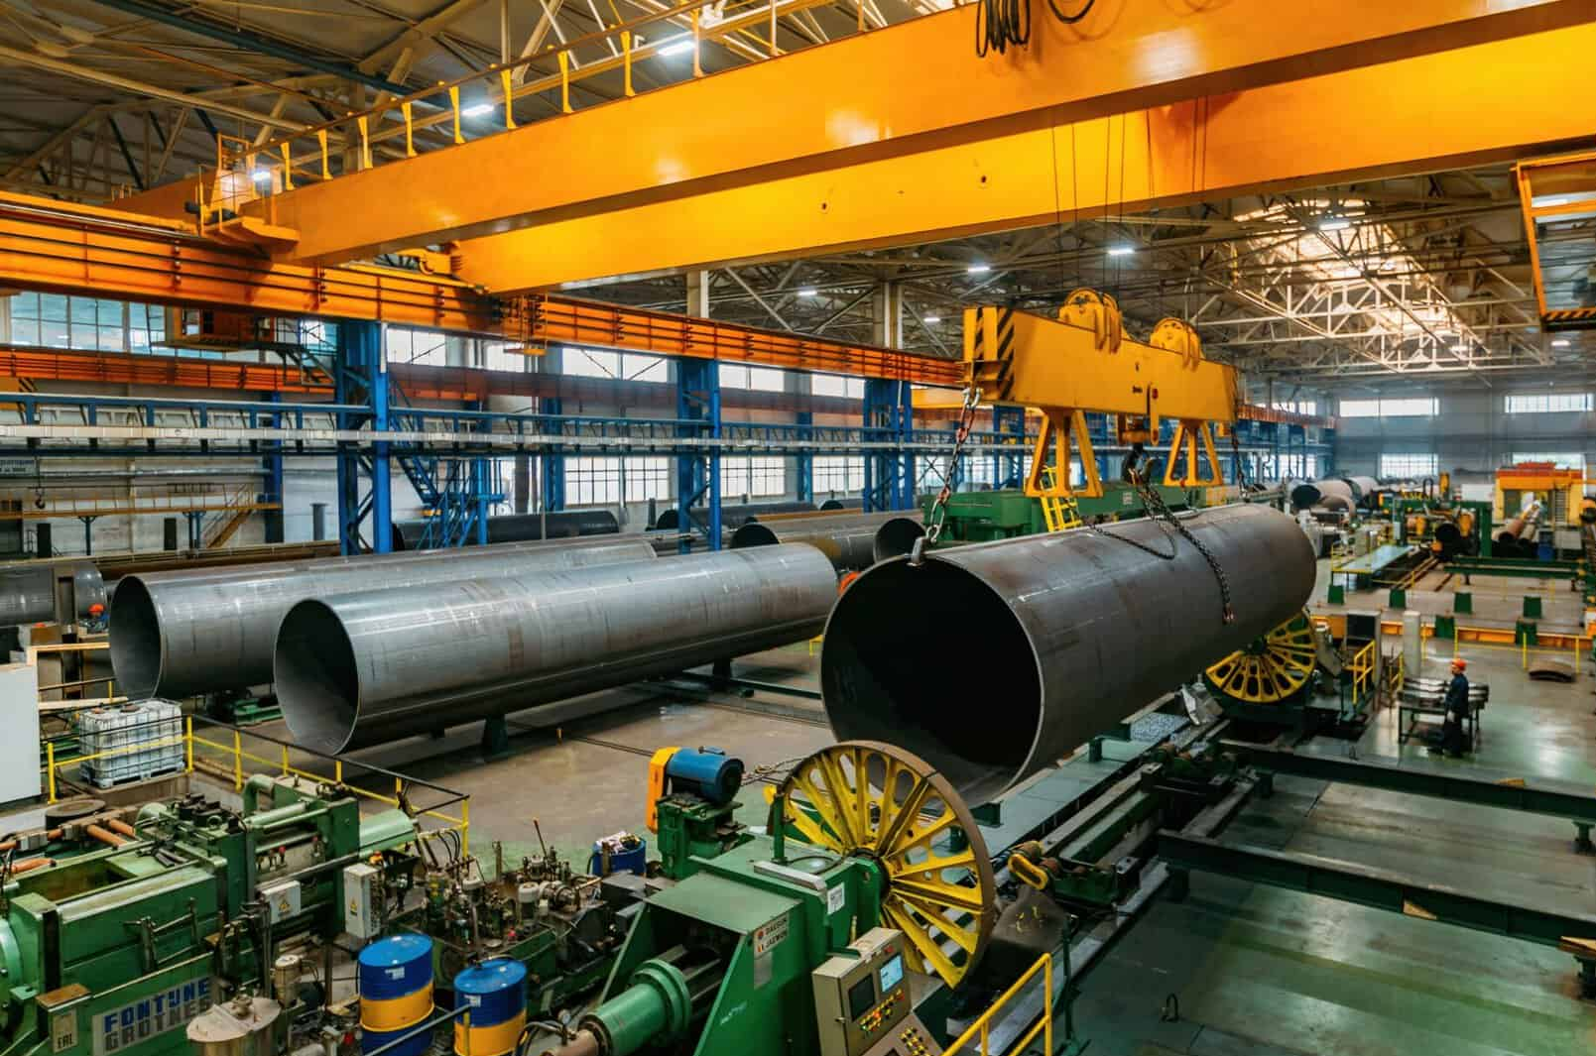

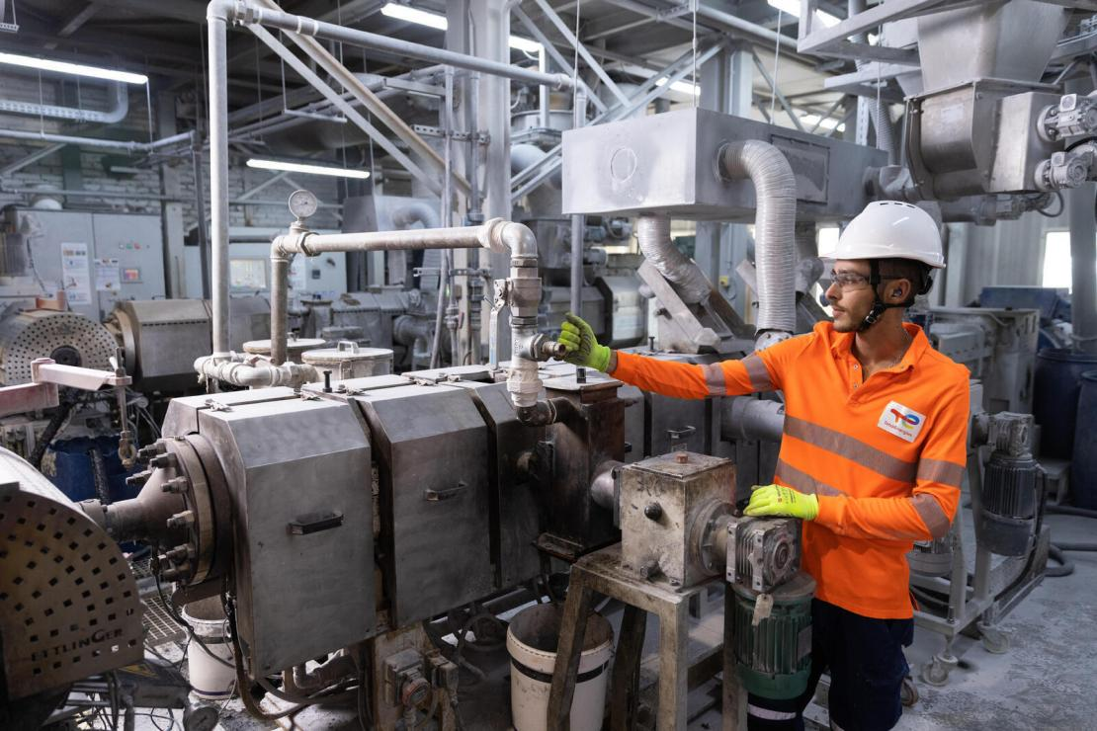

Electrification alone is not enough for all sectors:
some rely on molecules that are essential to their processes.
Heavy industry
Agriculture
Chemical industry
Air transport
Hydrogen (H₂)
→ refining
Ammonia (NH₃)
→ nitrogen fertilizers
Methanol (CH₃OH)
→ acetic acid
→ plastics
Saturated hydrocarbon
(C_{n}H_{2n+2})
→ kerosene
22

Slide 23
To decarbonize these uses, we need to turn to e-fuels.
These are synthetic fuels produced using renewable electricity.
E-fuels can be made from various base molecules:
Water (H₂O) to produce hydrogen (H₂) via electrolysis;
Nitrogen (N₂) to convert hydrogen into ammonia (NH₃);
Carbon dioxide (CO₂), captured for example from the air, to synthesize saturated hydrocarbons of the C_{n}H_{2n+2} type.
23

Slide 24
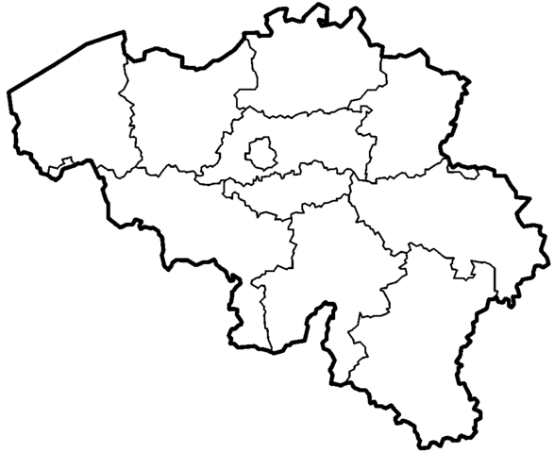
Producing e-fuels is both an economic and technological challenge. It comes with two major obstacles.
First, low-cost electricity is needed, which is not a problem in itself since solar PV is relatively cheap.
Above all, large amounts of low-carbon electricity must be available continuously. This is difficult to ensure in densely populated areas or regions with limited renewable resources.
Example: To meet Belgium’s entire national demand for kerosene by converting solar energy into e-kerosene, around 405 km² of the country would need to be covered with PV panels.*
* The methodology, along with the data and assumptions used for these calculations, is detailed in Appendix 1.
24
Notes:
There are barriers to entry for e-fuels production

Slide 25
To overcome these obstacles, e-fuels can be produced in
Remote Renewable Energy Hubs (RREHs).
An RREH is a site located far from consumption centres characterized by strong wind and solar potential as well as high land availability. Renewable energy is harvested and (frequently) converted into e-fuels at these sites before being transported to consumption centres.
Example: An RREH in the Moroccan desert captures wind and solar energy, transports it to the coast via an HVDC link, converts it into e-methane, and exports it to Europe by sea.
25
Notes:
Samy: Redo diagram without numbers

Slide 26
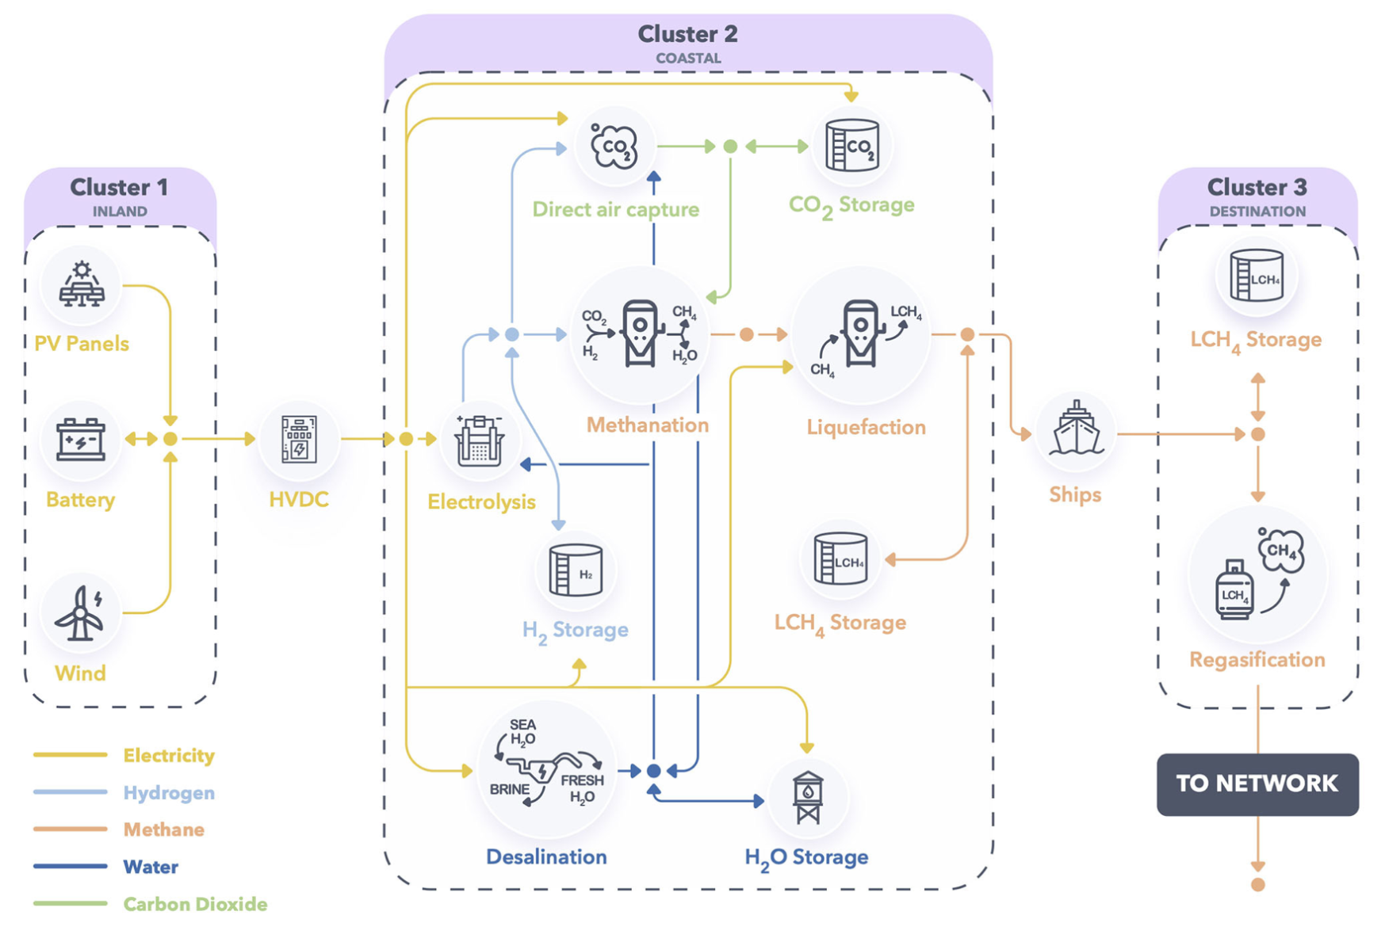
An example of an RREH technology graph for e-methane production based on direct air capture (DAC) of CO₂.
26

Slide 27
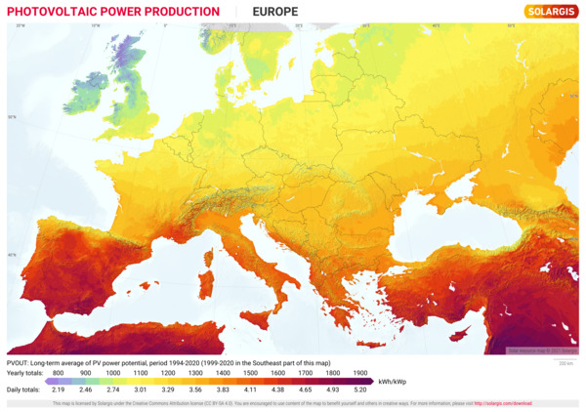
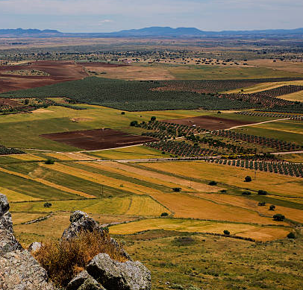
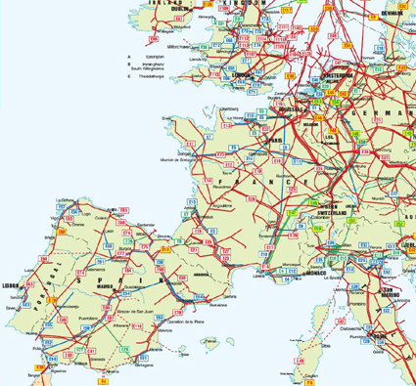

RREHs can be developed in remote areas or within Europe itself to strengthen energy security.
Example: Extremadura, Spain
High solar irradiation: 200 W/m² (compared with 110 W/m² in Belgium);
Low population density;
Direct access to the gas grid for transporting e-fuels.
27

Slide 28
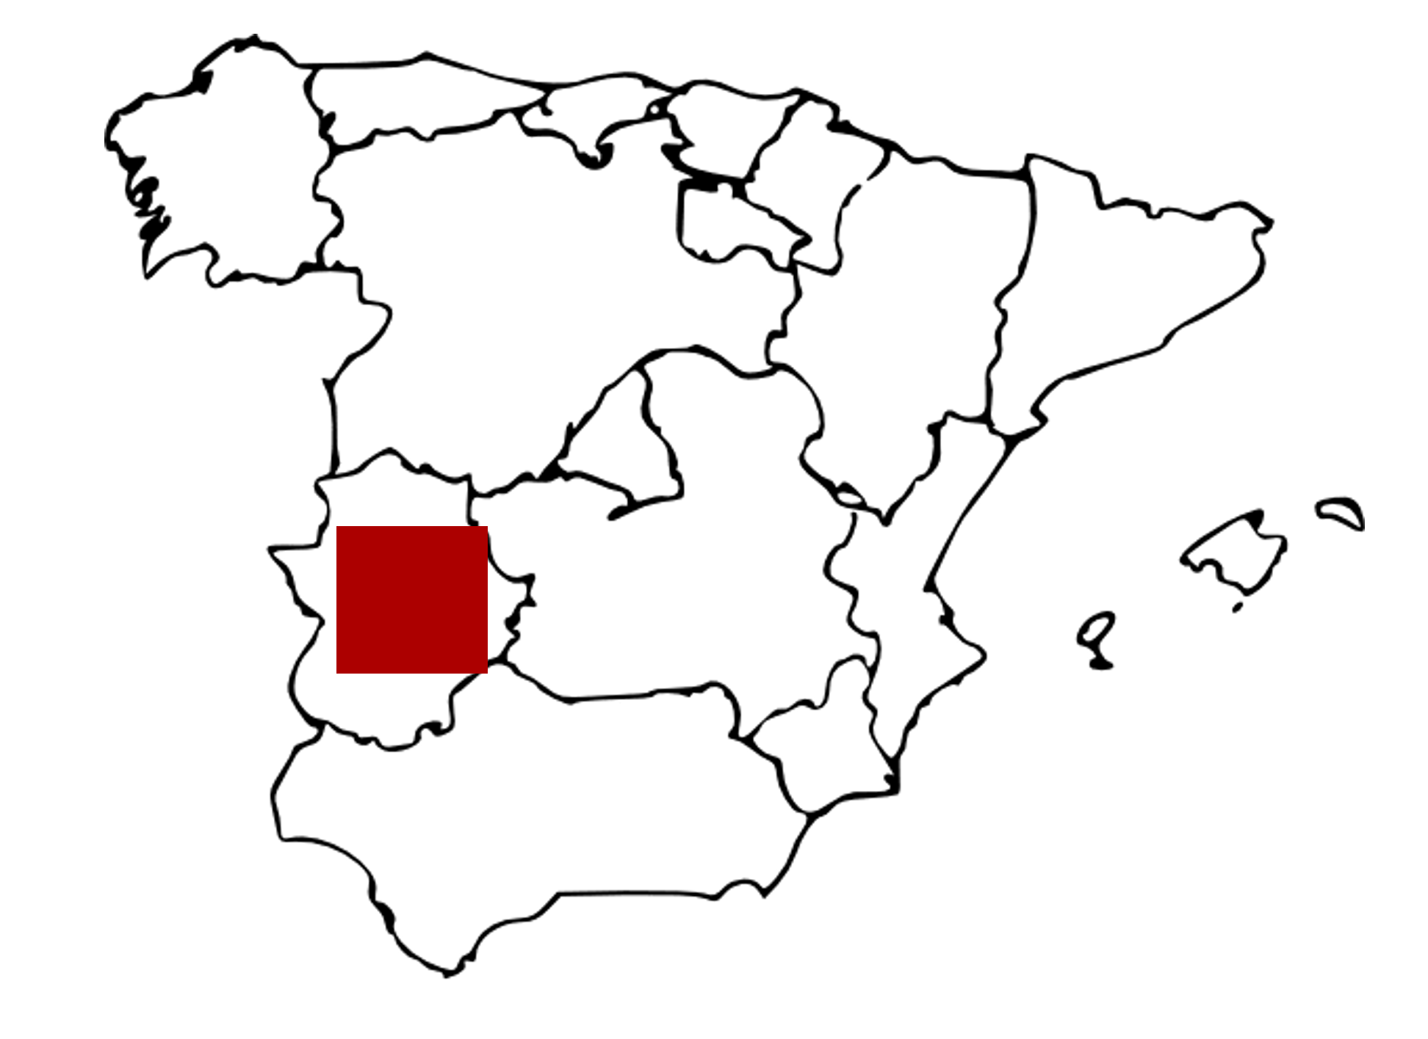
Let us do a little bit of math:
What surface area of PV panels would be needed
to cover the EU 'entire gas demand?
The EU’s average gas consumption is 3,500 TWh/year.
Around 16,000 km² of PV panels would be required to meet this demand using PV production and power-to-gas technology. This estimate assumes solar irradiance of 200 W/m², a PV load factor of 25%, and 50% losses in the conversion process.*
That is "only" 40% of the surface area of Spain's Extremadura region.
* The methodology, along with the data and assumptions used for these calculations, is detailed in Appendix 2.
28

Slide 29
5th problem
Belgian e-fuels will never be
cost-competitive with imported ones, leaving the country reliant on importing all energy-dense molecules

Slide 30
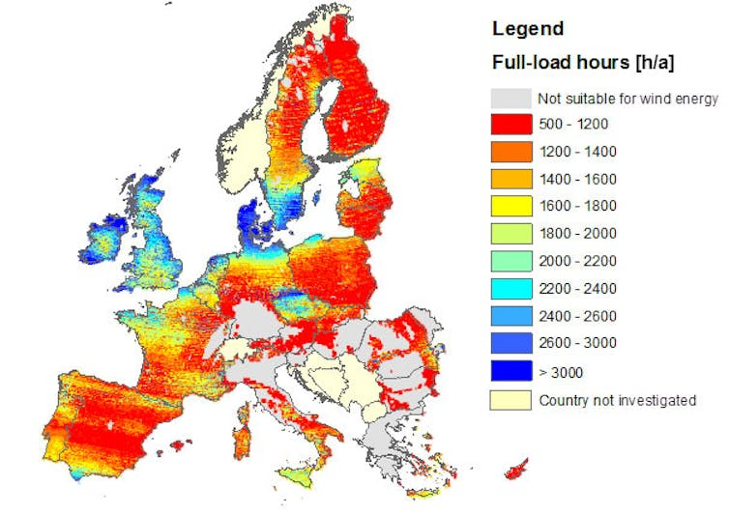
Producing e-fuels locally in a region with limited renewable potential like Belgium may seem of limited relevance
E-fuel production is highly energy-intensive. However, in Belgium, sunshine is moderate and wind regimes are generally weak especially for onshore wind power. The cost of supplying renewable energy can quickly rise under these conditions. In addition, Belgium has limited available land to capture this renewable energy.
Annual solar irradiance map
for PV potential in Europe.¹
Map of full-load hours production for wind power potential in Europe.²
¹ SolarGIS (2011) Solar Radiation Map of Europe.
² Smith, A. Z. (2015, June 22). Why onshore wind isn't as cheap as it should be in the UK. The Conversation.
30

Slide 31
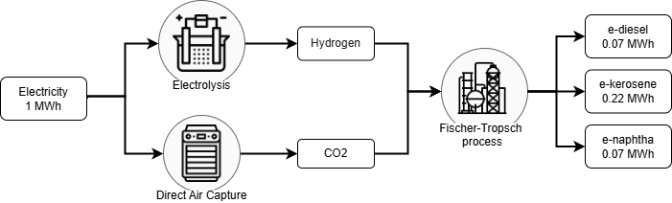
It is unrealistic to expect this basic scheme for e-fuels production to be developed in Belgium.
Production of e-diesel, e-kerosene and e-naphtha using the Fischer-Tropsch process.
However, an alternative is emerging:
integrated e-fuel production using co-products.
31

Slide 32
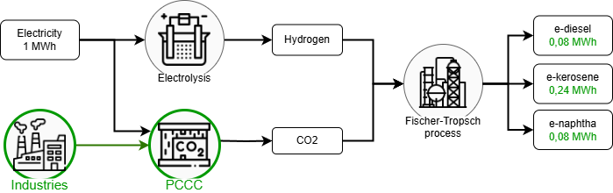
Integrated production reduces the need for energy and raw materials by reusing industrial by-products that are currently under-utilized, such as CO₂-rich gases from industries that are difficult to decarbonize.
Production of e-diesel, e-kerosene and e-naphtha using the Fischer-Tropsch process.
Equipping these industries with post-combustion carbon capture (PCCC) provides a much less energy-intensive carbon source than direct air capture (DAC), resulting in significantly higher efficiency.
32
Notes:
1) SCCP

Slide 33
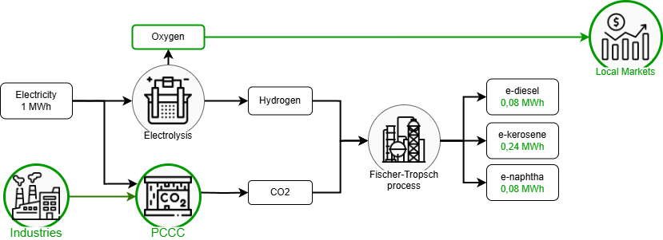
Co-products from e-fuel production can also be reused. For example, the oxygen generated during electrolysis can be sold on local markets. This helps to lower overall production costs.
Production of e-diesel, e-kerosene and e-naphtha using the Fischer-Tropsch process.
33
Notes:
Oxygen, product enhancement from my thing +.

Slide 34
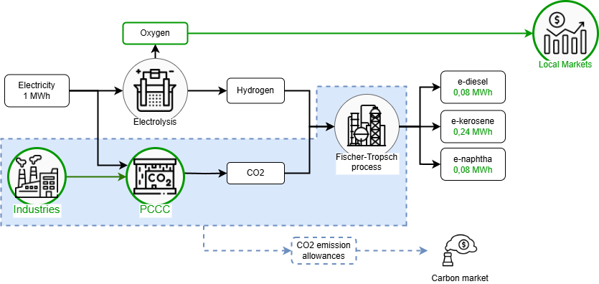
Producing carbon-free e-fuels locally can give access to CO₂ emission allowances, making the process even more economically attractive.
Production of e-diesel, e-kerosene and e-naphtha using the Fischer-Tropsch process.
34
Notes:
Oxygen, product enhancement from my thing +.

Slide 35
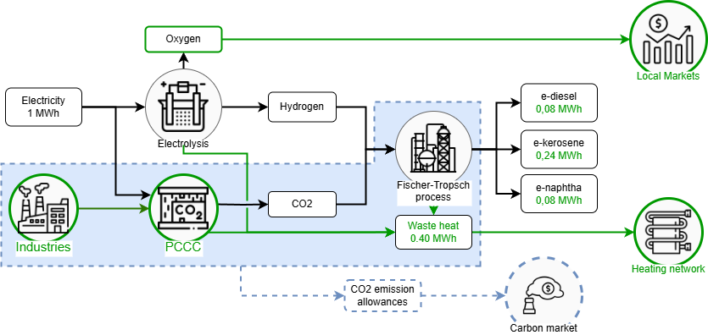
The waste heat generated during the various conversion stages can be recovered and reused in a local heating network.
Production of e-diesel, e-kerosene and e-naphtha using the Fischer-Tropsch process.
35
Notes:
ETS + mechanism

Slide 36
Initial experimental results show that integrated e-fuel production can reduce production costs by up to 40% compared with a non-integrated approach*.
Scenario | S1 | S2 | S3 | S4 | S5
Waste heat recovery | ✘ | ✘ | ✘ | ✘ | ✔
Oxygen recovery | ✘ | ✘ | ✘ | ✔ | ✔
CO₂ emission allowances | ✘ | ✘ | ✔ | ✔ | ✔
CO₂ source | DAC | PCCC | PCCC | PCCC | PCCC
Production cost (€/MWh) | 234 | 209 (-10.7%) | 191 (-18.4%) | 177 (-24.4%) | 141 (-39.7%)
* Production costs are expressed per MWh of Fischer-Tropsh mix, taking into account a selling price of heat at €40/MWh, oxygen at €40/tO₂
and CO₂ emission allowances at €80/tCO₂.
Mokeddem, S., Miftari, B., Dachet, V., et al. (In press). Distributed e-fuel hubs: Concept and case study, ORBi-University of Liège.
36

Slide 37
6th problem
A prohibitive price for the construction of an offshore grid in the North Sea

Slide 38
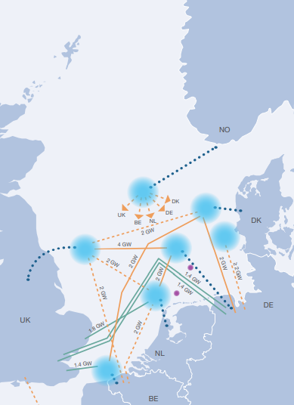
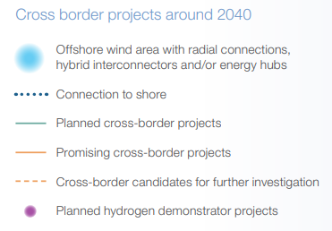
Europe is clearly committed to large-scale offshore wind development, with a target of around 400 GW. This goal requires the creation of extensive offshore grid infrastructure.
For instance, it plans to add up to 3.5 GW of offshore wind capacity in the Princess Elisabeth zone.
However, electricity infrastructure costs are now surging, a trend that was largely underestimated at the outset. In response to these rising costs, the government has started to reconsider certain projects.
38

Slide 39
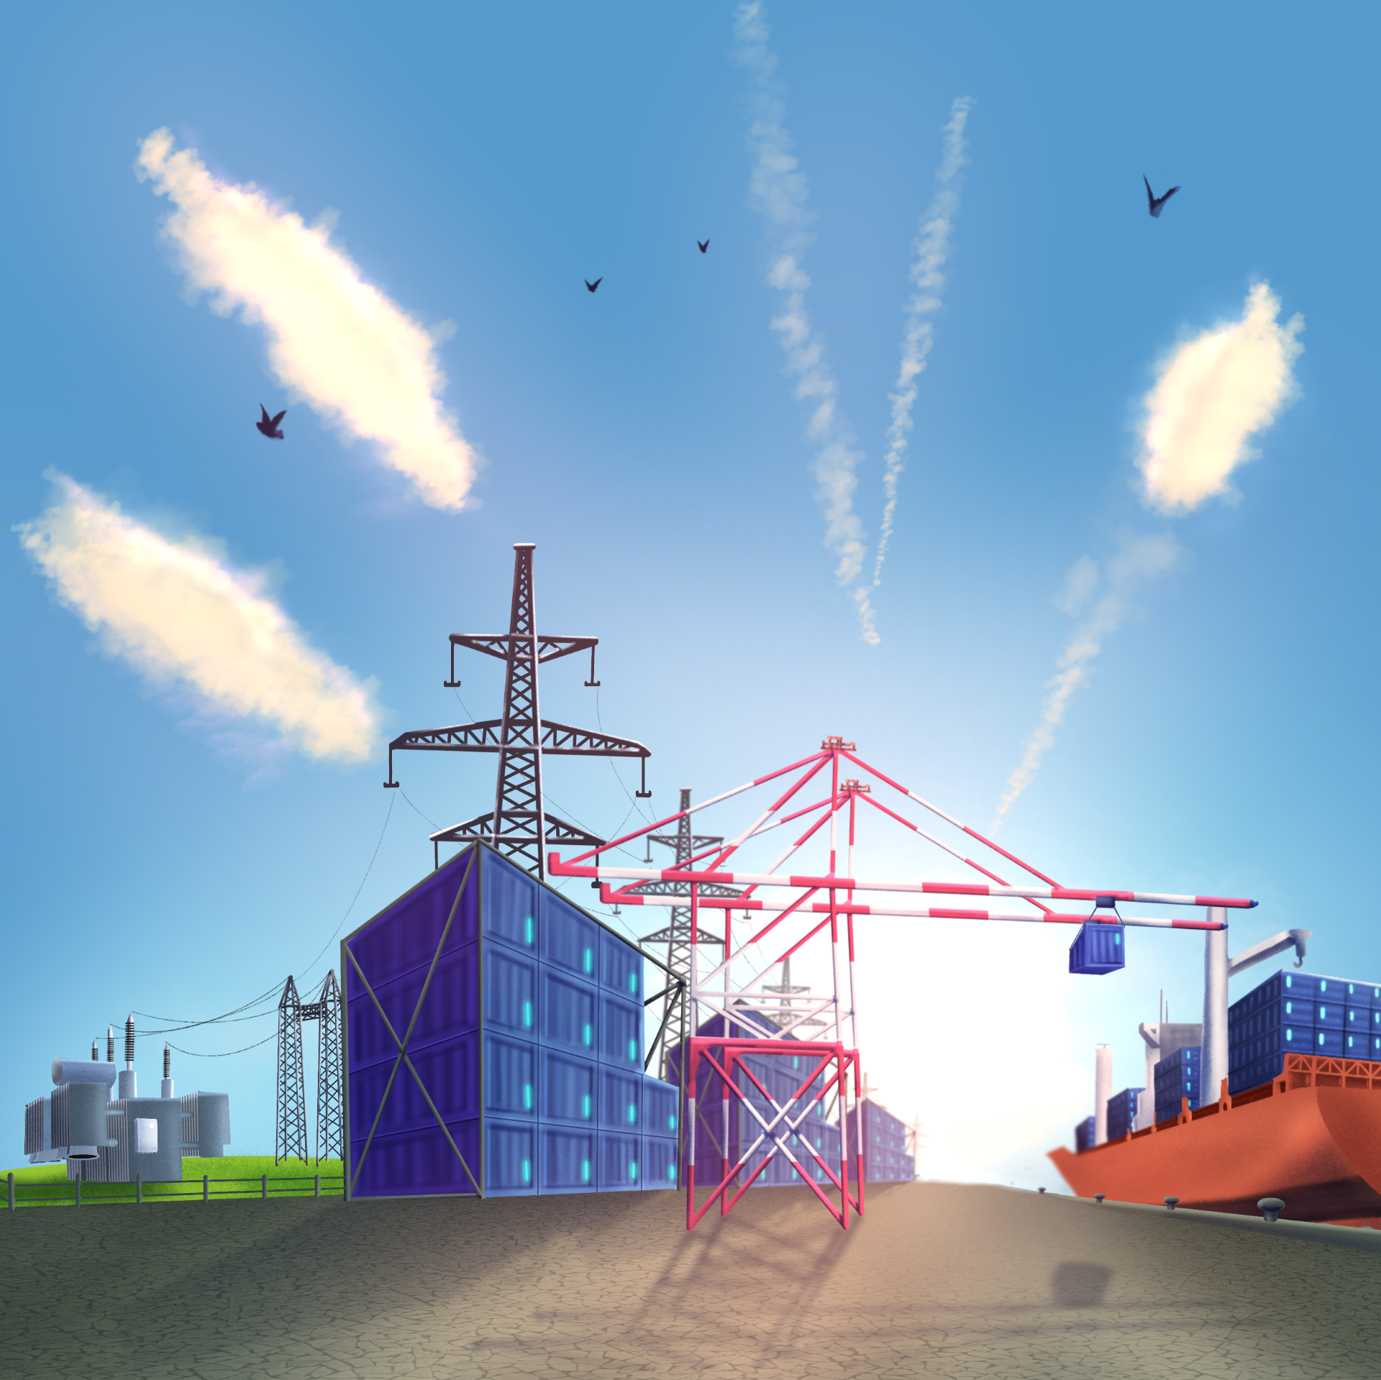
An alternative to offshore grids could be the use of battery boats.
These vessels are equipped with high-capacity batteries and can connect to a collector cable at the wind farm’s output.
Once charged, the battery boats return to shore to feed the energy back into the grid at the most opportune time.
39

Slide 40
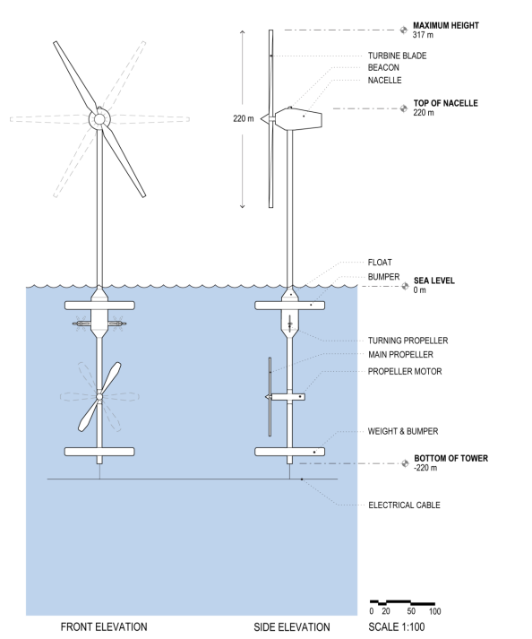
Combining battery boats with unmoored floating offshore wind turbines could unlock the full renewable potential of seas and oceans.
Conventional wind turbines can only be installed in shallow coastal waters, typically up to depths of around 60 meters.
Unmoored floating turbines are currently under study. Equipped with a propeller-based positioning system, they could be deployed much farther offshore and in significantly deeper waters.
Proposal for an unmoored floating wind turbine.¹
¹ Raisanen, J. H., Sundman, S., & Raisanen, T. (2022). Unmoored: a free-floating wind turbine invention and autonomous open-ocean wind farm concept. Journal of Physics Conference Series, 2362(1), 012032.
40

Slide 41
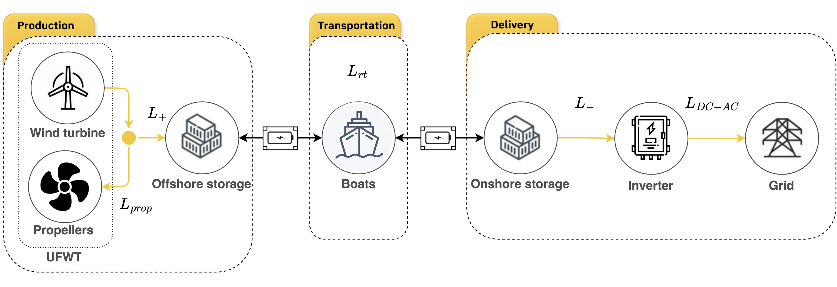

Battery boats and unmoored floating wind turbines open the way for the creation of Renewable Energy Hubs in the High Seas (REHS).
In an REHS, electricity can be generated by wind turbines held in position by propellers. The energy is then stored on battery boats, which transport it back to shore. Once docked, the electricity generated by the wind turbines and stored in the batteries is fed into the grid through an inverter.
41

Slide 42
A recent research project conducted by the Smart Grids Laboratory at the Montefiore Institute, University of Liège, aims to quantify both the load factor* and the cost of an REHS system, depending on its distance from the coast.
Distance (km) | Load Factor (%) | Cost ($/MWh)
150 | 17.4 | 160
400 | 17.3 | 204
2000 | 16.7 | 497
Estimated cost per MWh as a function of the distance to the coastal grid.¹
* The load factor represents the percentage of energy injected into the grid relative to the wind turbines' theoretical maximum output.
¹ Dachet, V., Maio, A., Counotte, P., & Ernst, D. (2025). Remote renewable energy hubs in the high seas: A battery-based fully-electric ecosystem. ORBi-University of Liège.
42

Slide 43
7th problem
New nuclear power will
always be too costly

Slide 44
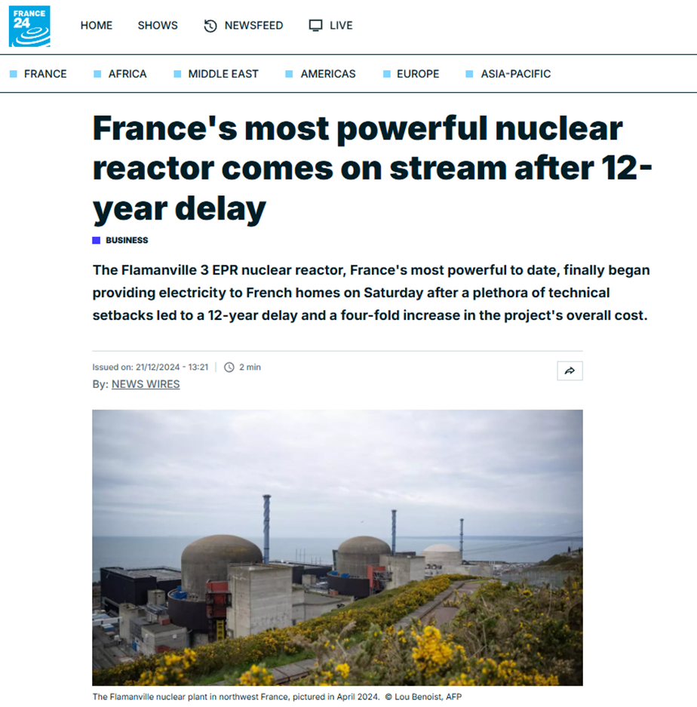
Recent projects, notably the European Pressurized Reactor (EPR), have faced major delays and cost overruns.
Some sites, such as Flamanville, are up to 12 years behind schedule with costs multiplied by a factor of six.
These setbacks have intensified criticism of the economic and industrial viability of large-scale nuclear reactors.
44

Slide 45
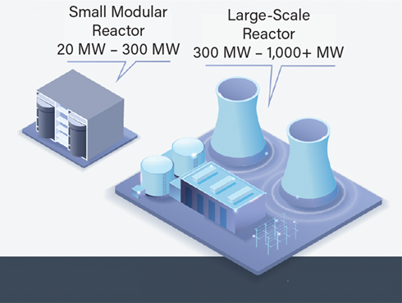
However, today a new generation of nuclear reactors known as SMRs (Small Modular Reactors) is currently under development.
An SMR is a low-power reactor (up to 300 MW electrical), designed as compact factory-prefabricated modules capable of producing both heat and electricity.
SMRs are based on a high level of standardization unlike conventional reactors which are custom-built on site. This approach could significantly reduce costs, construction times, and industrial risks.
45

Slide 46
Three additional advantages of SMRs are emerging in the market:
Some models include passive safety systems, meaning they can operate without human intervention or external power supply;
Some SMR designs aim to reduce the amount of long-lived radioactive waste and recycle previously used fuel;
Thanks to their more compact size and ability to produce high-temperature heat, SMRs can be installed near industrial sites that can recover and use large quantities of the heat produced.
46
Notes:
SMR

Slide 47
Energy systems integrating SMR-LFR (Lead-cooled Fast Reactor) with strong connections to industrial sites are being studied at the Smart Grids Laboratory of the Montefiore Institute, University of Liège.
This recovered heat can be used for various important industrial applications, such as hydrogen production, ammonia synthesis, district heating, and seawater desalination.
The objective of this research is to explore different strategies for reducing costs, particularly through the recovery of high-quality heat generated by these SMR-LFR reactors.
47
Notes:
SMR

Slide 48
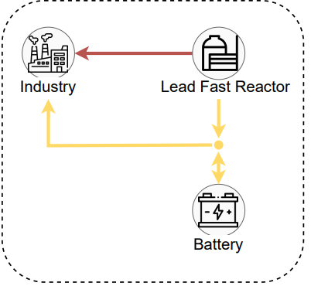
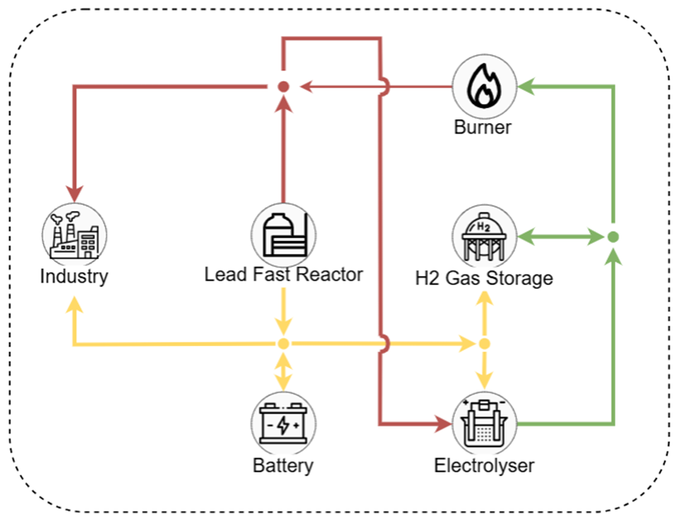
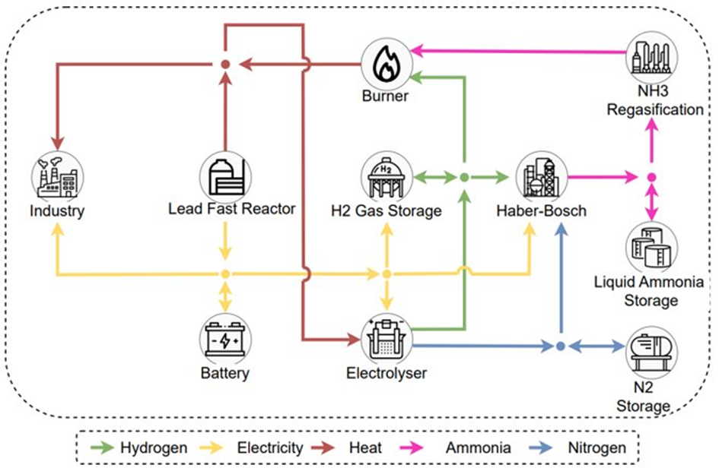
Study of different configurations for supplying electricity and heat to an off-grid industrial site.
"Battery" configuration: battery storage only
"Hydrogen" configuration: battery and hydrogen storage
"Ammonia" configuration:
battery, hydrogen and ammonia storage
SMR-LFR deployed at an industrial site without grid connection, with three possible storage configurations.
48
Notes:
SMR

Slide 49
This research aims to jointly optimize the sizing of the various components in the three configurations as well as their respective control strategies to cover all the heat and power needs of an industrial site.
In configurations that include hydrogen and/or ammonia, the system also enables these molecules to be produced, stored, and reused at the most opportune time, depending on the site’s needs.*
 | "Battery" Configuration | "Hydrogen" configuration | "Ammonia" configuration
Electricity cost (€/MWh) | 92.3 | 59.0 | 57.9
Heat cost (€/MWh) | 38.8 | 24.8 | 24.3
Table of average costs per unit of electricity and heat.
* To assess the cost of each configuration, we (i) define the total system cost, (ii) relate this cost to the quantity of useful heat, i.e. the heat consumed by the industrial site and the heat used by the turbine to generate electricity, and (iii) calculate the electricity price per MWh by dividing the cost of useful heat by the turbine’s efficiency.
49
Notes:
SMR

Slide 50
8th problem
Nuclear power depends on foreign resources

Slide 51
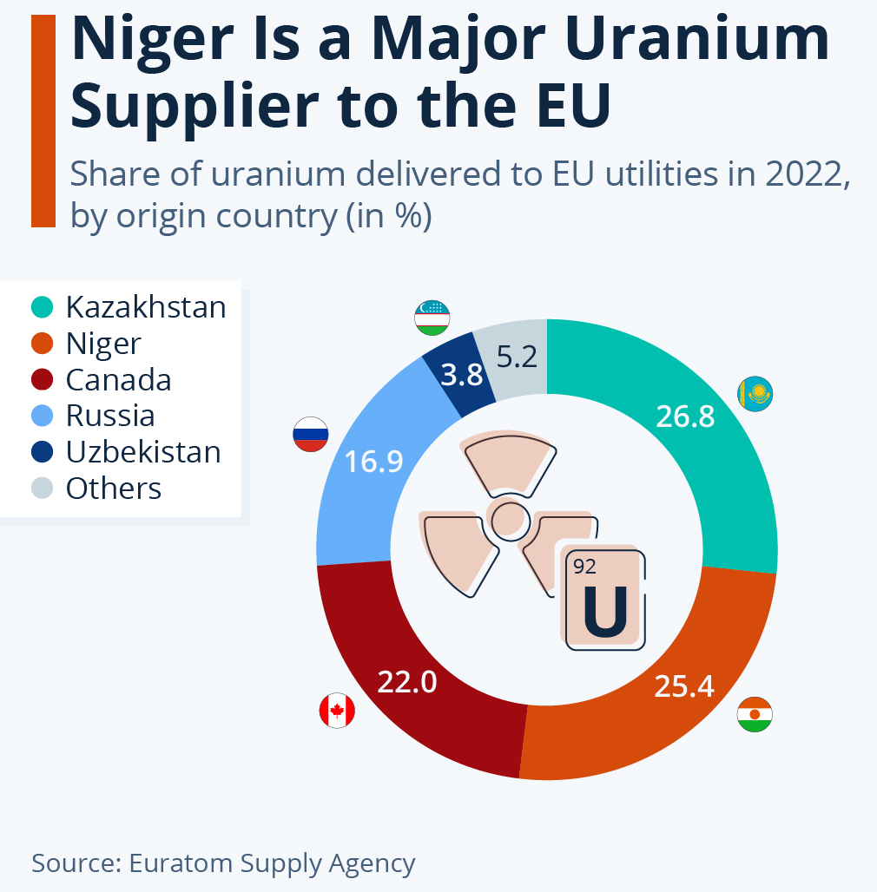
By 2022, 100% of the natural uranium consumed in the EU came from outside the Union (Niger, Kazakhstan, Russia, etc.).
This fact fuels criticism from nuclear opponents who argue:
“What is the point of producing our electricity in Belgium if we are still dependent on foreign raw materials?”
51

Slide 52
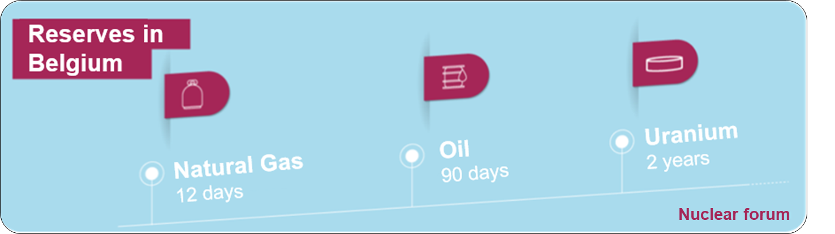
This dependence on uranium imports can be put into perspective, given its very high energy density, which makes it much easier to amass large reserves compared to fossil fuels.
Belgium, for example, holds a stock of enriched uranium sufficient to cover about two years of consumption. Achieving a similar level of reserve with gas or oil would be far more difficult, due to the massive volume of storage infrastructure that would be required.
52

Slide 53
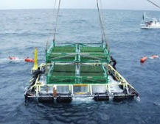
One way to reduce dependence on imported uranium could be to develop technologies capable of extracting it directly from seawater. The oceans are believed to contain around 4.5 billion tonnes of uranium, at an estimated concentration of 0.003 grams per tonne of seawater.
In a Japanese experiment carried out in the late 1990s, researchers succeeded in harvesting 1 kg of uranium in 240 days, i.e. around 1.5 kg per year, using a device with a surface area of 64 m².
In 2022, when all the reactors at the Doel and Tihange power plants were still in operation, Belgium's annual consumption of natural uranium was approximately 1000 tonnes.¹
A total surface area of 43 km² of this floating Japanese device would be required to meet the above demand using seawater extraction. This is just a small fraction of Belgium’s 3,500 km² maritime zone in the North Sea.*
Floating moored device used off the Japanese coast to extract uranium from seawater.
* The methodology, along with the data and assumptions used for these calculations, is detailed in Appendix 3.
¹ Counasse, X. (May 5, 2022). 40% of uranium used in Belgian nuclear power plants is linked to Russia. Le Soir.
53

Slide 54
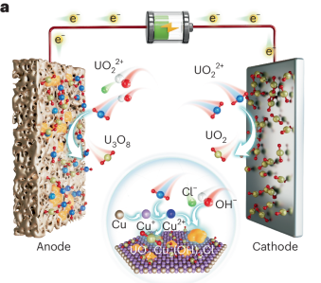
Other techniques for extracting uranium from seawater which do not rely on high specific surface area materials are currently being developed.
One innovative method uses a bipolar electrochemical cell operating at very low voltage (0.6 V) capable of capturing uranium by direct and indirect electrochemical reduction.
This technology requires neither complex membranes nor costly chemical reagents, yet achieves a capture rate of over 85%.¹
Schematic diagram of the bipolar uranium extraction process, combining indirect uranium reduction assisted by anodic electrochemistry and direct electrochemical reduction at the cathode.
¹ Wang, Y., Wen, G., Liu, Z. et al. (May 2025). Bipolar electrochemical uranium extraction from seawater with ultra-low cell voltage. Nature Sustainability.
54

Slide 55
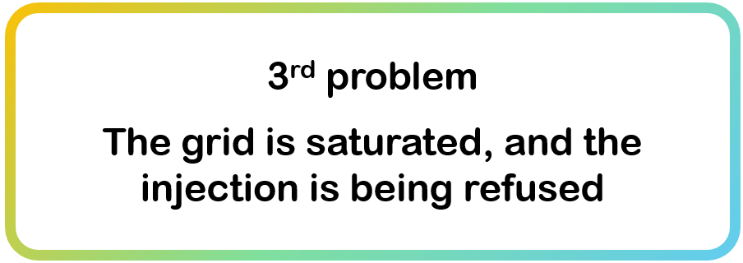
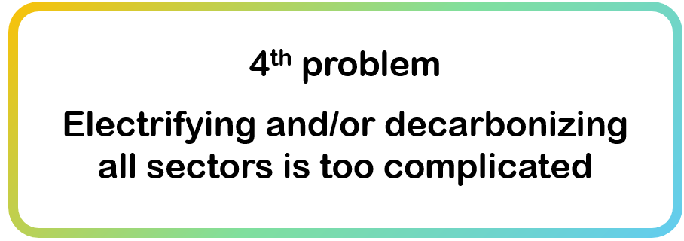
Scientific contributions from our laboratory
Vassallo, M., Khaskheli, S., Dong, L., Ha Thuc, A., Anvari-Moghaddam, A., Vergara, P., Duchesne, L., Gerard, S., & Ernst, D. (2025). A new Paradigm for Bilateral Trading of Dynamic Operating Envelopes in Electricity Distribution Networks. ORBi-University of Liège. https://orbi.uliege.be/handle/2268/331735
Dachet, V., Dubois, A., Miftari, B., Fonteneau, R., & Ernst, D. (2024, December 19). Remote renewable energy hubs: A taxonomy. Energy Reports, 13, 3112-2120. https://doi.org/10.1016/j.egyr.2025.02.040
Berger, M., Radu, D.-C., Detienne, G., Deschuyteneer, T., Richel, A., & Ernst, D. (2021). Remote Renewable Hubs for Carbon-Neutral Synthetic Fuel Production. Frontiers in Energy Research. https://orbi.uliege.be/handle/2268/250796
55

Slide 56
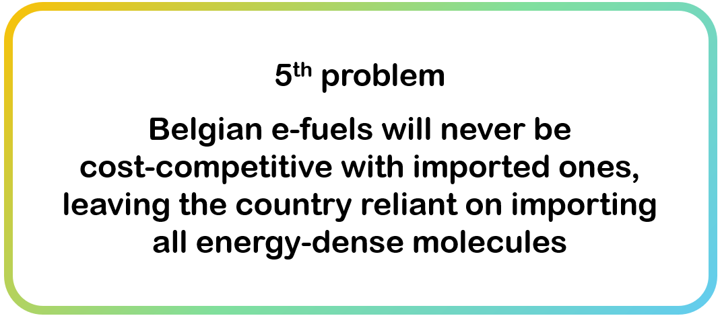


Mokeddem, S., Miftari, B., Dachet, V., Derval, G., & Ernst, D. (In press). Distributed e-fuel hubs: Concept and case study. ORBi-University of Liège. https://orbi.uliege.be/handle/2268/327044
Dauchat, L., Dachet, V., Fonteneau, R., & Ernst, D. (2024). Waste heat recovery in remote renewable energy hubs [Paper presentation]. Proceedings of ECOS 2024. https://orbi.uliege.be/handle/2268/313825
Dachet, V., Maio, A., Counotte, P., & Ernst, D. (2025). Remote renewable energy hubs in the high seas: A battery-based fully-electric ecosystem. ORBi-University of Liège. https://orbi.uliege.be/handle/2268/327232
Larbanois, A., Miftari, B., Mouchamps, A., Ayyildiz, K., Schryvers, V., Derval, G., & Ernst, D. (2025). Lead-cooled Fast Reactor SMR integration: An off grid study case based on a real-life demand. ORBi-University of Liège. https://orbi.uliege.be/handle/2268/331891
56

Slide 57





Co-authors
Victor Dachet
ULiège
PhD student
Antoine Larbanois
ULiège
PhD student
Samy Mokeddem
ULiège
PhD student
Thibaut Techy
ULiège
Energy expert
Maurizio Vassallo
ULiège
PhD student
57

Slide 58
Appendices

Slide 59

Appendix 1
What area of Belgium would need to be covered with PV panels to fully satisfy Belgium's annual kerosene demand in 2024 with e-fuels produced from solar energy?
Kerosene consumption in Belgium will amount to 2,267.2 million liters in 2024. Given that one liter of kerosene contains 10.3 kWh, this represents an annual consumption of 23.4 TWh.
We make the following assumptions:
solar irradiance: 110 W/m²;
PV panel efficiency: 25%;
overall efficiency of the conversion chain (power-to-kerosene): 24%.
The area of PV panels required to cover this annual demand of 23.4 TWh would be:
$$\frac{\text{23}\text{.}\text{4 }\text{×} \text{10}\text{12}}{\text{110 }\text{×}\text{ 0.25 }\text{×}\text{ 0.24 }\text{×}\text{ 8}\text{,}\text{760 }\text{×} \text{10}\text{6}}≈\text{405} \text{km}\text{².}$$
More information on the methodology used to perform the calculations can be found in Chapter 07 of the following course notes: https://damien-ernst.be/teaching/genv0002-1-sustainable-energy/
59

Slide 60

Appendix 2
What area of Spain's Extremadura region would need to be covered with PV panels to meet the European Union's entire gas demand of 3,500 TWh/year, by converting renewable electricity into synthetic gas?
We make the following assumptions:
average solar irradiation: 200 W/m²;
PV panel efficiency: 25%;
overall efficiency of the power-to-gas conversion chain: 50%.
The area of PV panels needed to cover the EU's gas demand would be:
$$\frac{\text{3}\text{,}\text{50}\text{0 }\text{×} \text{10}\text{12}}{\text{200 }\text{×}\text{ 0.25 }\text{×}\text{ 0.5 }\text{×}\text{ 8}\text{,}\text{760 }\text{×} \text{10}\text{6}}≈\text{1}\text{5}\text{,}\text{982} \text{km}\text{².}$$
More information on the methodology used to perform the calculations can be found in Chapter 07 of the following course notes: https://damien-ernst.be/teaching/genv0002-1-sustainable-energy/
60

Slide 61
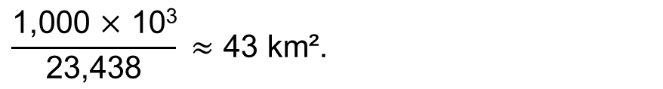
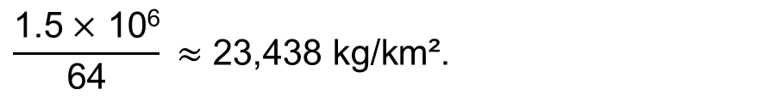
Appendix 3
What surface area in the North Sea would be needed to meet Belgium's annual natural uranium requirements, using a system similar to the one tested off the coast of Japan in the 1990s?
The Japanese experimental system was capable of extracting 1.5 kg of uranium per year from an active surface area of 64 m².
The amount of uranium that could be extracted per km² per year is:
Assuming that Belgium consumes around 1,000 tonnes of natural uranium per year, the area required to cover this demand would be:
$$\frac{\text{1.5} \text{×} \text{1}\text{0}\text{6}}{\text{64}} \text{≈}\text{ 23}\text{,}\text{438 }\text{kg}\text{/}\text{km}\text{².}$$
$$\frac{\text{1}\text{,}\text{000 }\text{×} \text{1}\text{0}\text{3}}{\text{23}\text{,}\text{438}} \text{≈}\text{ 43 }\text{km}\text{².}$$
More information on the methodology used to perform the calculations can be found in Chapter 23 of the following course notes: https://damien-ernst.be/teaching/genv0002-1-sustainable-energy/
61

