Slide 1





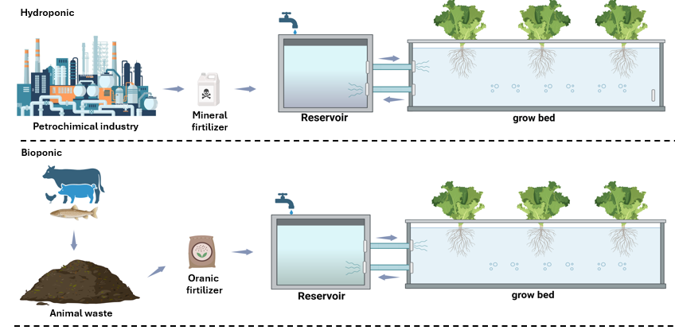

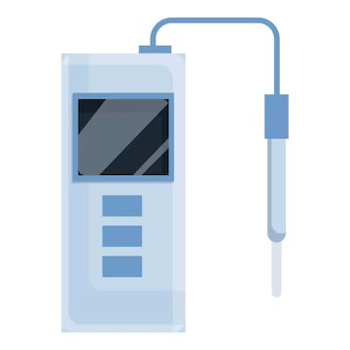
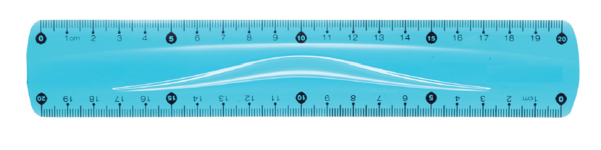





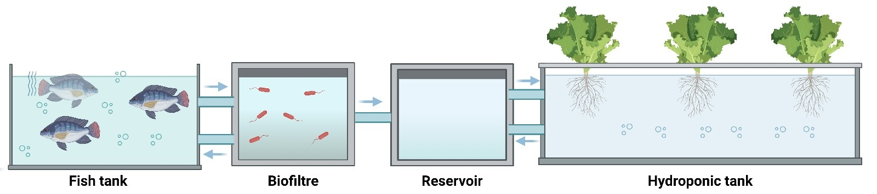
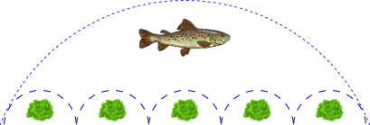

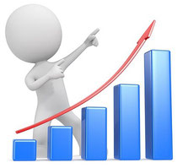
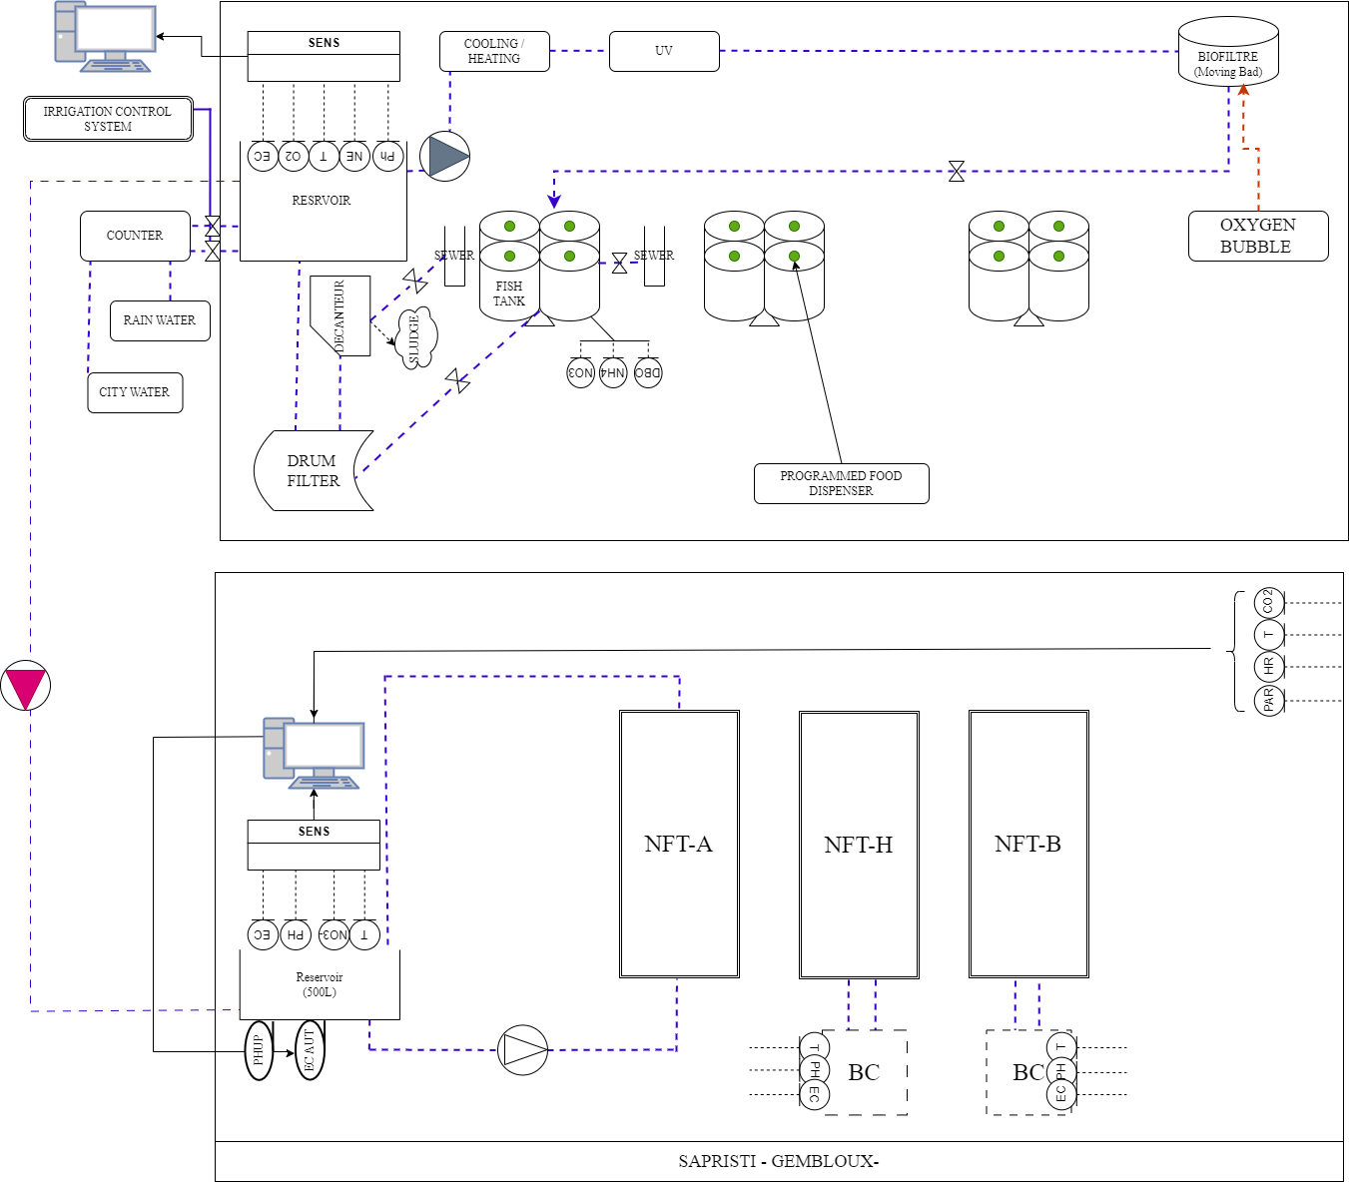
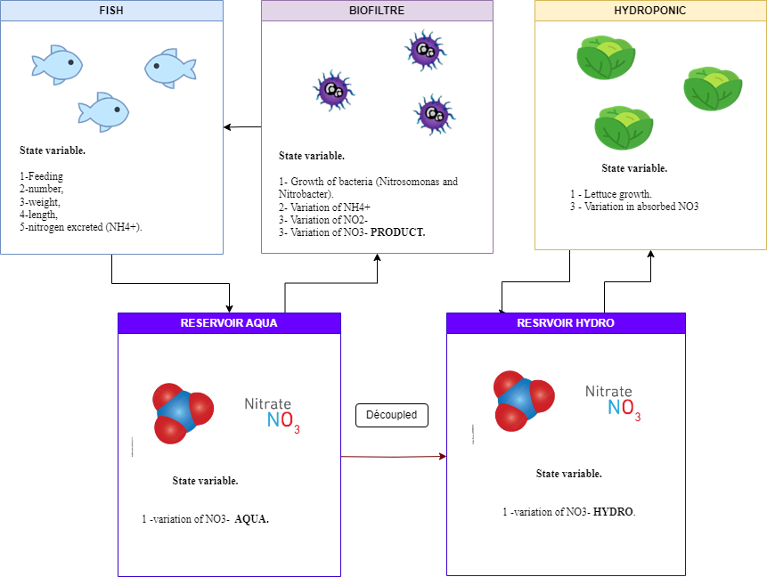
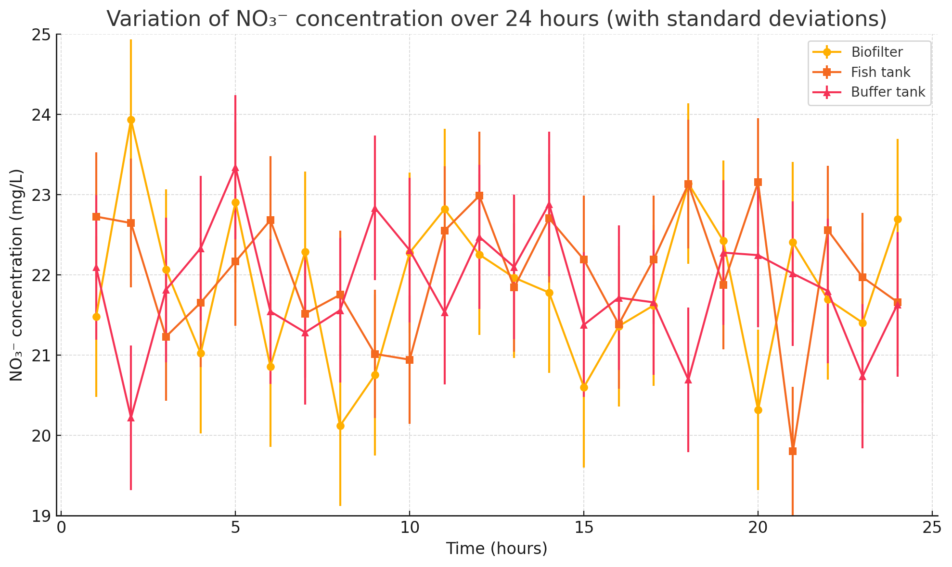
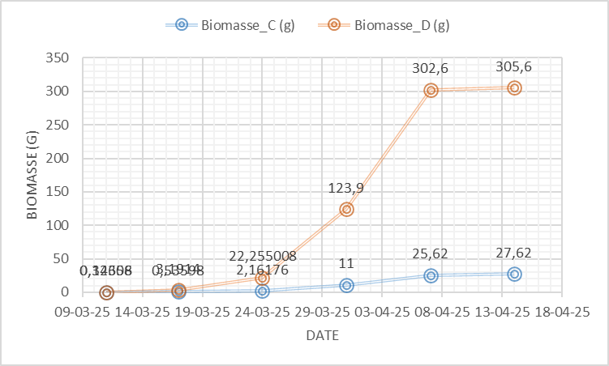
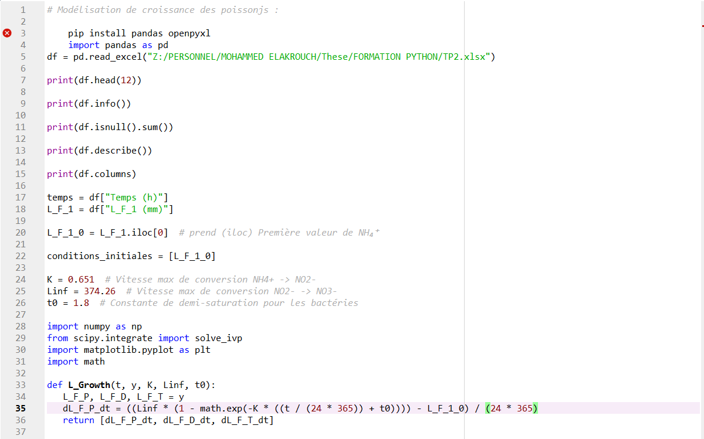
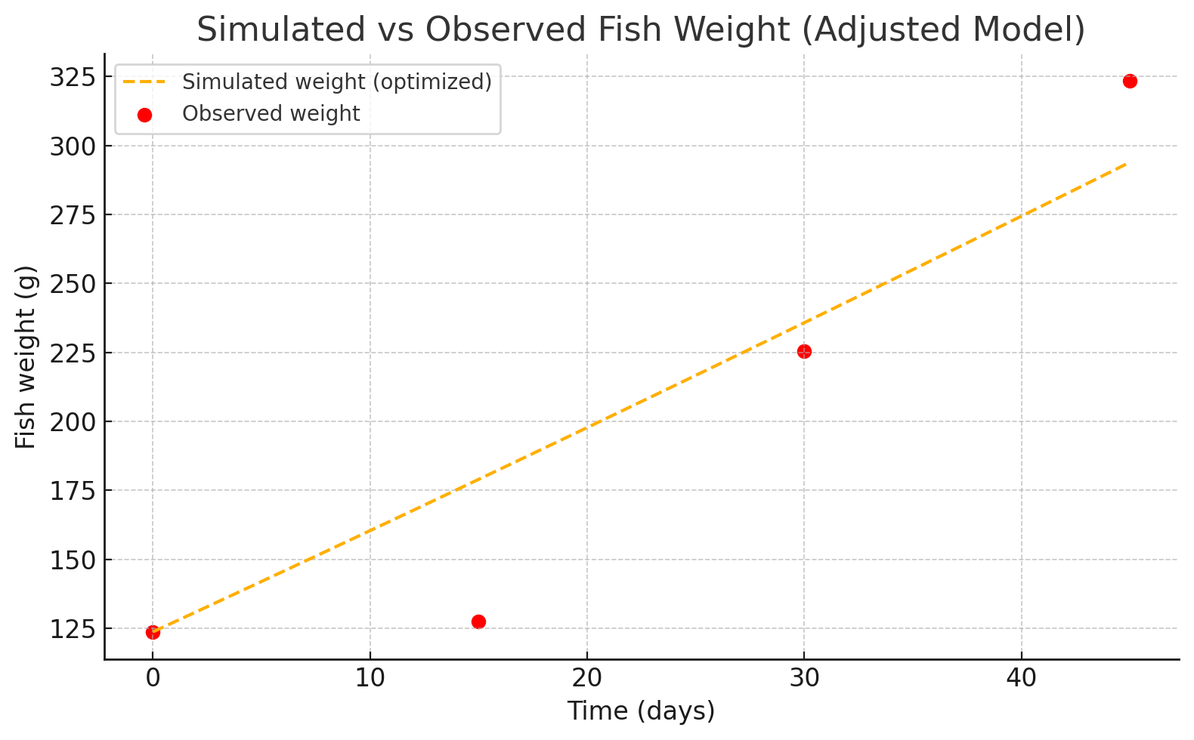
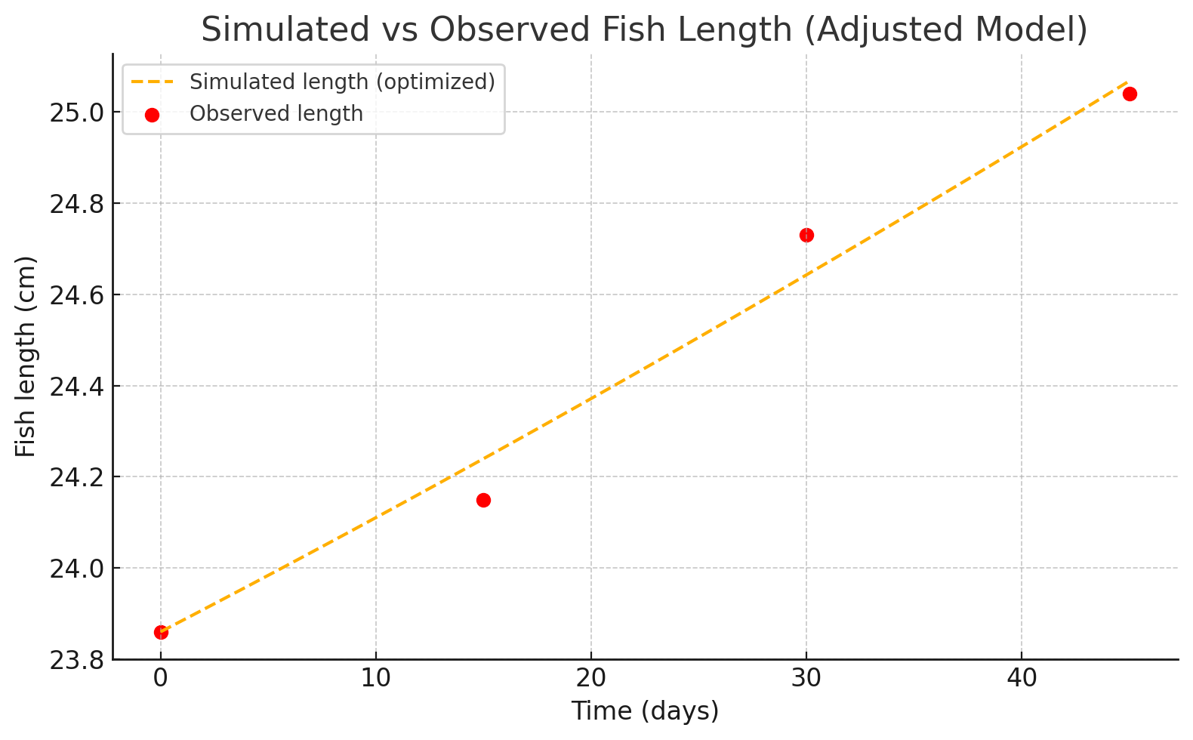
Modeling Biological and Chemical Interactions in Aquaponic Systems:
A Comparative Yield Analysis with Hydroponics and Bioponics.
Elakrouch Mohammed ¹*, Libault Arthur ¹, Rachid Ahmed ², Jijakli M. Haissam¹.
¹ Integrated and Urban Plant Pathology Unit, Agro-Bio Tech, Université de Liège, 5030 Gembloux, Belgium.
² Electrical Energy and Associated Systems Team, University of Picardie Jules Verne, Chemin du Thil, 80025 Amiens Cedex 1, Amiens, France.
Introduction
Aquaponics is an integrated, soilless cultivation system that combines recirculated aquaculture and hydroponics within a closed-loop environment (Thomas, 1994; Goudard, 2007). This system has garnered increasing attention due to its resource efficiency and its potential contribution to sustainable agriculture (Goddek et al., 2019). Within this system, biological and chemical interactions—particularly those involved in the nitrogen cycle, microbial activity, and biomass production—are critical to maintaining stability and optimizing productivity (Atique, 2023; Goddek et al., 2019).
To better understand and enhance these interactions, this research proposes a hybrid modeling approach that integrates differential equations with machine learning techniques. While mathematical models will be employed to describe the transformation of nitrogen compounds (NH₄⁺ → NO₂⁻ → NO₃⁻), machine learning algorithms will be used to estimate complex parameters such as microbial efficiency and nutrient uptake rates. In parallel, a comparative analysis will be carried out to assess the yield performance of aquaponic systems relative to hydroponic and bioponic systems. Experimental data—collected via real-time sensors and regular biomass sampling—will be utilized to calibrate and validate the models. This study aims to establish a robust framework for optimizing soilless cultivation systems and to support the advancement of efficient and sustainable agricultural technologies.
Materials & Methods
X2
This work aims to develop descriptive and predictive models for fish and plant production in aquaponics (Figure 1-C), and to compare its performance with that of other systems, notably bioponics (Figure 1-B). and hydroponics (Figure 1-A). The study is based on ten plant cultivation replicates (lettuce) per system, as well as two fish cultivation replicates (trout) (Figure 2).
Once the systems are set up, a data collection phase begins. Advanced sensors are used to monitor physico-chemical parameters such as pH, temperature (T), and electrical conductivity (EC), among others. Simultaneously, biological parameters are recorded, including fish weight and length (every two weeks) and plant biomass (every four days). After data collection, the datasets are processed using software such as Excel and Rstudio (R 3.6.0+). This step involves standardizing the data, removing outliers, and preparing the datasets for modeling. The next crucial phase is modeling, conducted in Python. Various approaches are explored, ranging from differential equations to machine learning techniques, or a combination of both through hybrid models. Finally, an analysis and simulation phase is performed to evaluate the performance of the developed models and to optimize both fish and plant production.
A
45d
Hydroponic culture cycle
X2
Sensors
manual
manual
B
Bioponic culture cycle
2: data processing :
225d
3: Modeling :
Aquaponic
C
X2
Aquaponic culture cycle
4: optimization :
Figure 1: : Overview of different soilless cultivation systems: A: hydroponics, which relies on mineral fertilizers derived from the petrochemical industry; B: bioponics, which utilizes organic fertilizers originating from animal waste (fish, chicken, fish, chicken, cow, pig ) ; and C: aquaponics, which integrates fish and plant production in an interactive system.
Figure 2: Experimental set up to study lettuce and trout production cycles in soilless farming systems (hydroponic , bioponic, aquaponic).
: Sensors
Figure 3: Soilless Cultivation System SAPRISTI – Gembloux Agro Bio-Tech. The fish tank is equipped with sensors for nitrate, ammonium, and BOD, while the buffer tank is equipped with sensors for temperature, pH, electrical conductivity (EC), dissolved oxygen, and water level. The plant section is monitored in the water (pH, EC, temperature) and in the air (CO₂, temperature, relative humidity, PAR). NFT-A: NFT growing bed for aquaponics. NFT-H: NFT growing bed for hydroponics. NFT-B: NFT growing bed for bioponics .
: water flow
Figure 4: The variables of interest in the simulation are distributed as follows: For fish: weight, length, feeding, number, and NH₄⁺ excreted. For the biofilter: concentrations of NH₄⁺, NO₂⁻, and NO₃⁻, NO₃⁻ produced, as well as the growth of nitrifying bacteria. For the loading tanks: NO₃⁻ sent, NO₃⁻ received. For plants: plant biomass and NO₃⁻ uptake by plants.
First steps and preliminary results
Figure 6 :Variation of NO₃⁻ concentration over 24 hours in aquaponic system.
Figure 7 : Biomass evolution of lettuces during a test cycle in two aquaponic systems (C: coupled, D: decoupled supplemented with mineral fertilizer). Rainbow trout was used as the fish species in both systems.
Figure 5 : Excerpt from a Python script used to model fish growth in aquaponic systeme.
Figure 8: Comparison of Simulated and Observed weight Evolution of the Fish (Rainbow trout).in decoupled aquaponic systeme
Figure 9 : Comparison of Simulated and Observed length Evolution of the Fish (Rainbow trout ) .in decoupled aquaponic systeme.
Conclusion
The objective of this study is to develop a model capable of describing the biological and chemical interactions between the different compartments of an aquaponic system. This model aims to enhance our understanding of these interactions and enable predictive optimization. To achieve this, various modeling approaches will be employed, including differential equation-based models and machine learning techniques, in order to assess the accuracy of each method. A comparative analysis will also be conducted to evaluate the performances of three systems: aquaponic, bioponic, and hydroponic.
Conclusions & prospects
Reference
Atique, F. (2023). The effect of plants on microbes, water quality, and fish performance in an aquaponic system. & Thomas, S. (1994). THIRTIETH ANNUAL MEETING 1994.
Goddek, S., Delaide, B., Mankasingh, U., Ragnarsdottir, K., Jijakli, H., & Thorarinsdottir, R. (2015). Challenges of Sustainable and Commercial Aquaponics. Sustainability, 7(4), 4199–4224.
Goudard, A. (2007). Fonctionnement des écosystèmes et invasions biologiques: Importance de la biodiversité et des interactions interspécifiques.

