Slide 1


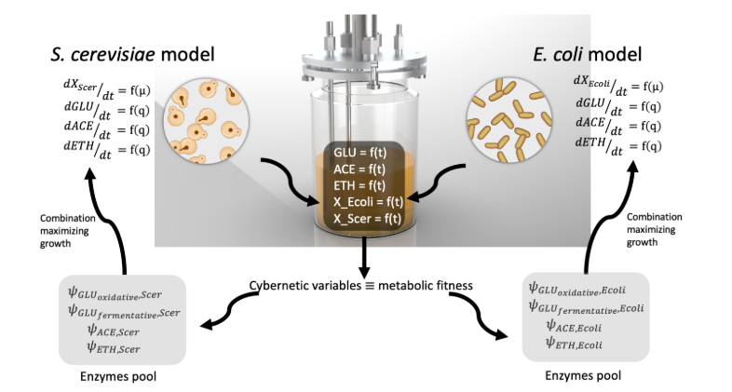
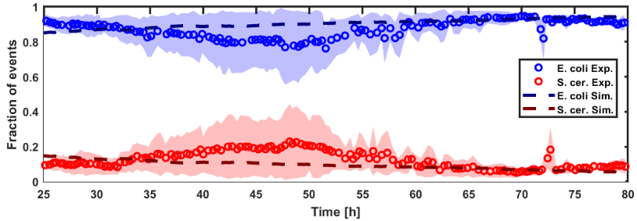
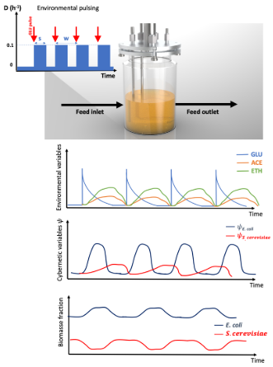
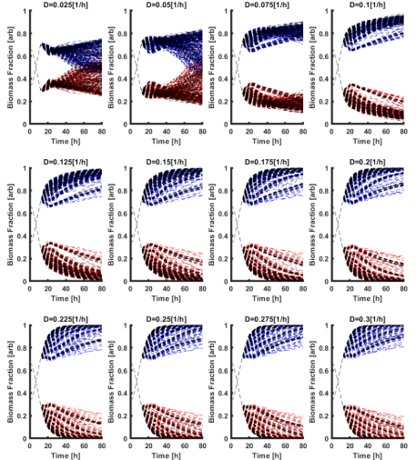
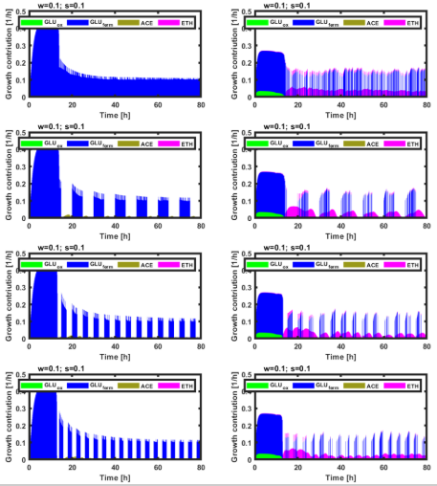
Control of microbial consortia in bioreactors
Romain Bouchat⁽¹⁾, Juan Andrés Martinez⁽¹⁾, Frank Delvigne⁽¹⁾*
¹MiPI, TERRA Teaching and Research Centre, Gembloux Agro-Bio Tech, University of Liège, Avenue de la Faculté, 2B, B-5030, Gembloux, Belgium
*Corresponding author: f.delvigne@uliege.be
Why ?
Model approaches
Currently, the use of modified strains are spread for synthetic biopathways and production of specific metabolites. However, it can lead to metabolic burden on modified cells [1].
An alternative is to set a division of labor strategy, which means the use of more than one organism. The use of some microbial populations in consortia can allow to decrease metabolic burden on cells but also to optimize the productivity [1].
The substrate affinity and its utilization are essential determinants of microbial interactions inside the consortia and can be used to have population/co-culture stability.
By considering metabolisms and growth of different microbes involved in consortia, a computational toolbox Monod-based ODE model was mathematicaly designed [2].
→ MONCKS (MONod-type Co-culture Kinetic Simulation)
The toolbox allows the models designed for each microbial species to interact with the environmental variables at each integration time step [2].
Prediction of diauxic shift which can lead to co-culture stability.
Co-cultivation of Escherichia coli and Saccharomyces cerevisae
In classic chemostat conffiguration, the model approach the results experimentaly got with a leading E. coli (blue) in comparison with S. cerevisae (red) [2],
Considering biomass of each strain and three main substrates: glucose, acetate and ethanol [2].
Based on pulse of metabolites, the model predicts a more balanced co-cultivation than chemostat [2].
Three different parameters to consider for this pulse model: Diltution rate (D), frequency of pulsing (w) and time fraction for feed pulse (s) [2].
Future directions
Apply model of control for experimentally balancing populations of E. coli and S. cerevisae with ethanol pulse.
Apply control of microbes involved in sourdough fermentation (lactobilli and yeasts) for the study of yeast stress and metabolic interactions and productions for sourdough fermentation.
Apply control of engineered strains for the production of coumaric acid from a microbial consortium.
References
1. Roell GW, Zha J, Carr RR, Koffas MA, Fong SS, Tang YJ. Engineering microbial consortia by division of labor. Microb Cell Fact [Internet]. BioMed Central; 2019;18:1–11. Available from: https://doi.org/10.1186/s12934-019-1083-3
2. Martinez JA, Delvenne M, Henrion L, Moreno F, Telek S, Dusny C, et al. Controlling microbial co-culture based on substrate pulsing can lead to stability through differential fitness advantages. bioRxiv [Internet]. 2022;2022.02.18.480836. Available from: https://www.biorxiv.org/content/10.1101/2022.02.18.480836v1%0Ahttps://www.biorxiv.org/content/10.1101/2022.02.18.480836v1.abstract%0Ahttp://biorxiv.org/content/early/2022/02/19/2022.02.18.480836.abstract

