Slide 1


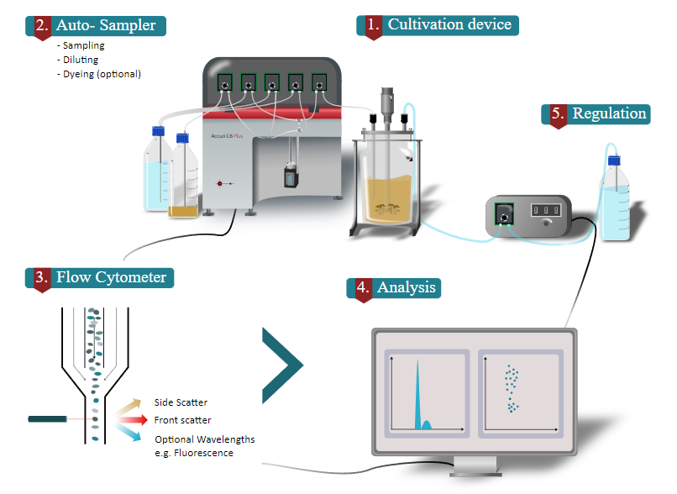

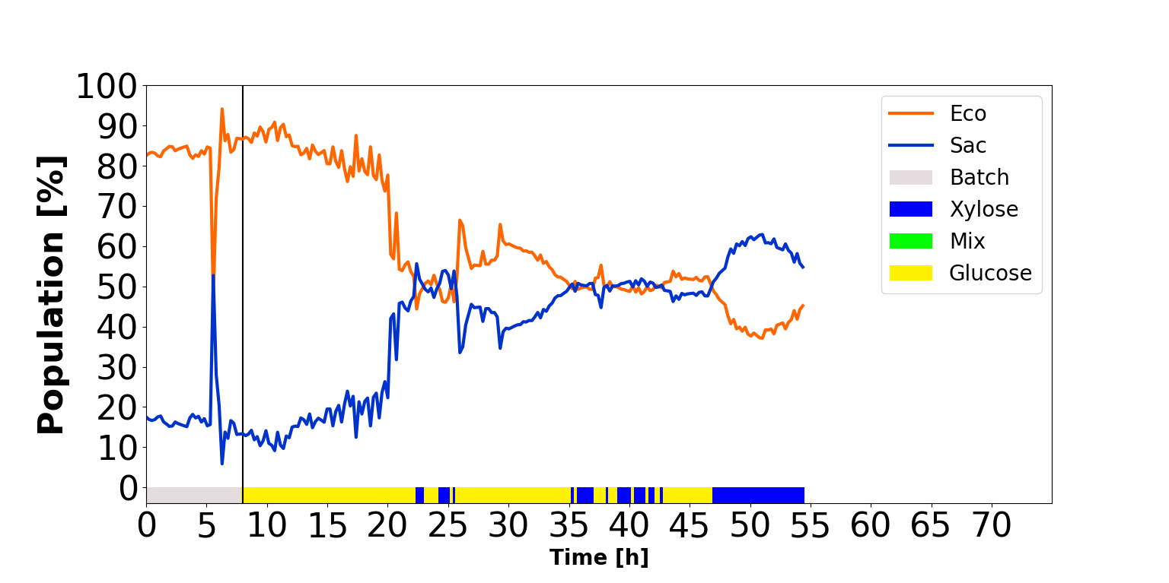
Reactive flow cytometry as an enabling technology for continuous co-cultures
Romain Bouchat⁽¹⁾, Juan Andrés Martinez⁽¹⁾, Tiphaine Gallet de Saint Aurin¹, Vincent Vandenbroucke¹ and Frank Delvigne⁽¹⁾*
¹MiPI, TERRA Teaching and Research Centre, Gembloux Agro-Bio Tech, University of Liège, Avenue de la Faculté, 2B, B-5030, Gembloux, Belgium
*Corresponding author: f.delvigne@uliege.be
We thanks the Service Public de Wallonie (SPW) (Sunup research project) and the H2020 program of the European commission (Contibio Era-Cobiotech project) for funding
Co-cultivation applications in bioindustry
Segregostat approach
Increasing interest for co-cultivation in bioindustry because the division of work allows an increase in the number of reaction steps, producing new and more complex molecule.
Issues to stabilize the co-cultivation and balance different microbial species with different fitness profiles and interactions causing issues to maintain productivity.
Differents kinds of co-cultures exist based on the level of interaction between the strains like high interactions couples such as Lactobacillus plantarum and Kazachstania bulderi for the sourdough fermentation [1] which is not the case of for Escherichia coli and Saccharomyces cerivisiae.
Segregostat is composed of a cultivation device with autosampler for online flow cytometry measuring the percentage of each population depending on a choosen gate and a machine section which allows to alter the conditions by pulses based on a control rule and cytometric data [2].
Here, pulses of C sources to reach 50/50% of each strain in couples of L. plantarum/K. bulderi and E. coli/ S. cerivisiae.
Impact of reactive flow cytometry on co-cultivation stability
Continuous co-cultivation without reactive regulation based on flow cytometry
Continuous co-cultivation with reactive regulation based on
flow cytometry or Segregostat cultivation
Co-cultivation E.coli and S.cerevisiae
Co-cultivation L.plantarum
and K.bulderi
The segregostat system allowed to balance the populations in the co-cultivation to reach dynamically 50% of each strain at the opposite of continuous co-cultivations without reactive regulation where a strain is rapidly taking the lead especially in the competitive couple E. coli/S. cerevisiae.
The pulses were glucose and xylose for the E.coli/S.cerevisiae case. For the L.plantarum/K.bulderi case, the pulses were glucose and maltose.
Proof of concept for the production of p-coumaric acid
As a proof of concept, the Segregostat was used to balance two engineered strains for the production of p-coumaric acid and improve the p-coumaric acid productivity.
Strains are E. coli WHIC pJLBaroGfbr pTrcTyrCpheACM and S. cerevisiae PTA 408. The first grows on xylose (low glucose consumption) and produces L-tyrosine from xylose [3]. The cerevisiae strain grows on glucose and is able to use L-tyrosine to produce p-coumaric acid [4].
References
1. Gobbetti, M., Corsetti, A., &#38; Rossi, J. (1994). The sourdough microflora. Interactions between lactic acid bacteria and yeasts: metabolism of carbohydrates. <i>Applied Microbiology and Biotechnology. https://doi.org/10.1007/bf01982535
2. Sassi, H., Nguyen, T. M., Telek, S., Gosset, G., Grünberger, A., & Delvigne, F. (2019). Segregostat: a novel concept to control phenotypic diversification dynamics on the example of Gram-negative bacteria. Microbial Biotechnology, 12(5), 1064–1075. https://doi.org/10.1111/1751-7915.13442
3. Martínez-Gómez, K., Flores, N., Castañeda, H. M., Martínez-Batallar, G., Hernández-Chávez, G., Ramírez, O. T., Gosset, G., Encarnación, S., & Bolivar, F. (2012). New insights into Escherichia coli metabolism: carbon scavenging, acetate metabolism and carbon recycling responses during growth on glycerol. http://www.microbialcellfactories.com/11/1/46
4. Vannelli, T., Wei Qi, W., Sweigard, J., Gatenby, A. A., & Sariaslani, F. S. (2007). Production of p-hydroxycinnamic acid from glucose in Saccharomyces cerevisiae and Escherichia coli by expression of heterologous genes from plants and fungi. Metabolic Engineering, 9(2), 142–151. https://doi.org/10.1016/j.ymben.2006.11.001

