Slide 1


Microstructural and micromechanical analysis of proximal tibia in aging rats
Laura Müller ¹, Margaux Ska ¹, Piyush Uniyal ², G. Harry van Lenthe ² and Davide Ruffoni ¹
¹ University of Liège, Belgium
² KU Leuven, Belgium
📅 11/09/2024
✉ laura.muller@uliege.be
🌐 www.biomat.uliege.be

Slide 2
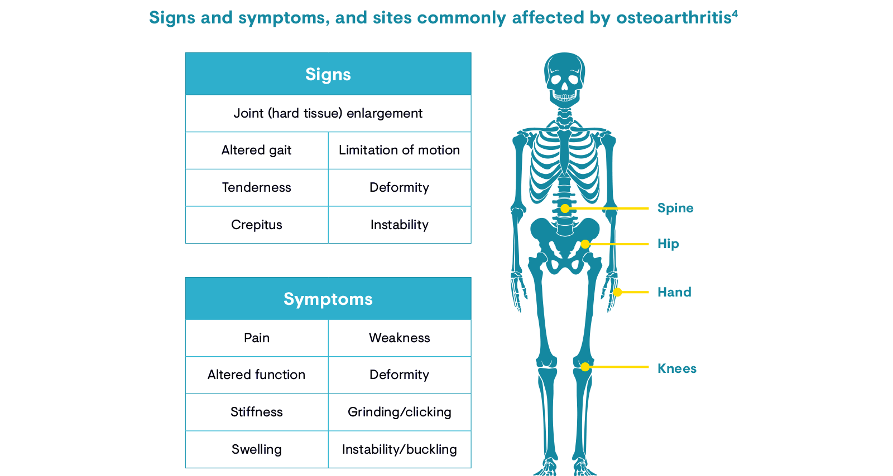
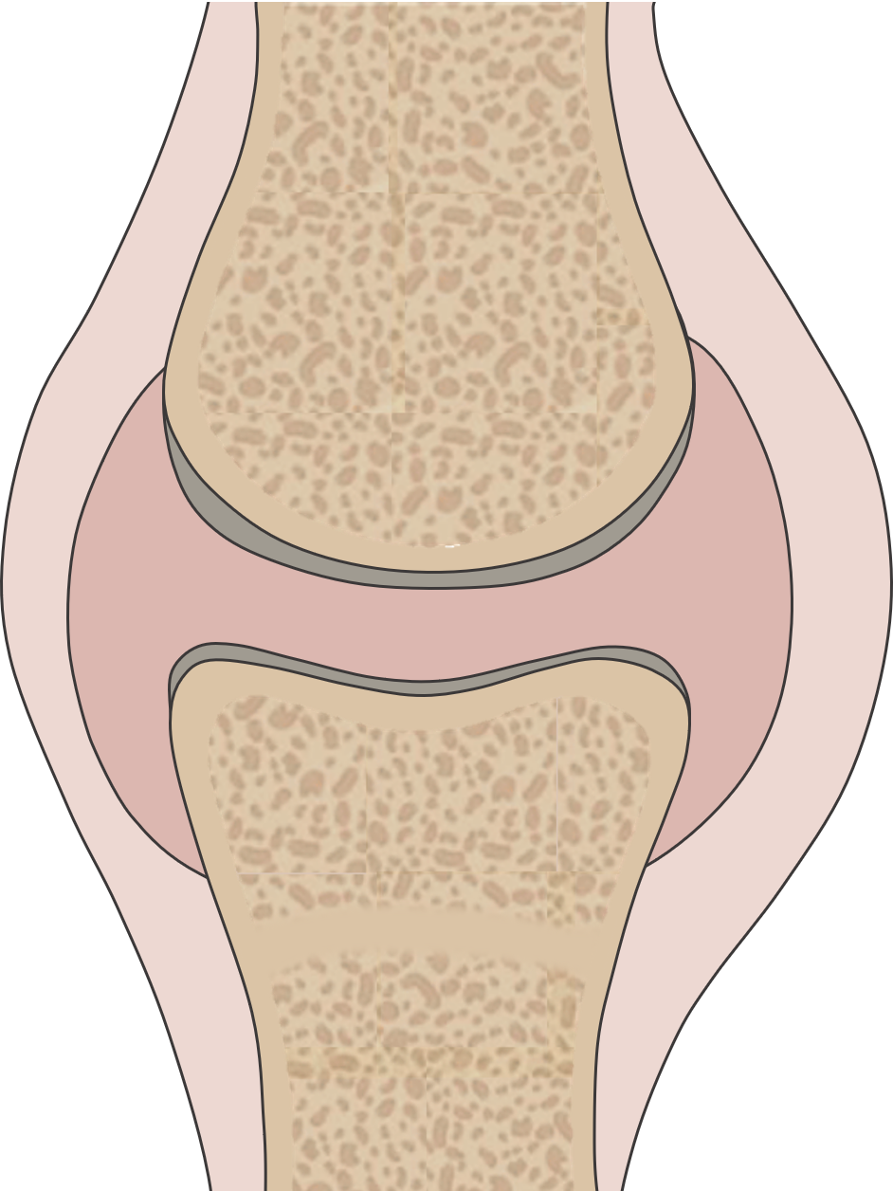
The Impact of Aging on the Proximal Tibia
How do age-related microstructural alterations impact the strain distribution in the epiphysis of the proximal rat tibia?
Femur
Epiphysis
Growth Plate
Metaphysis
Tibia
1/10
Notes:
The proximal tibia is a region of high biomechanical importance that helps to distribute forces and prevent stress concentrations.

Slide 3
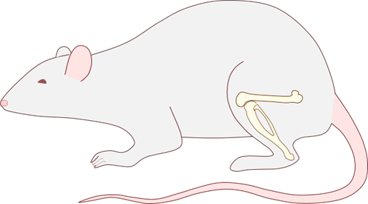
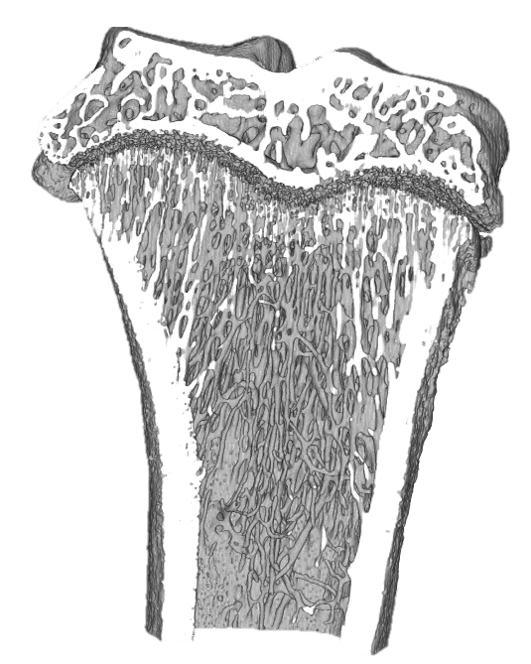
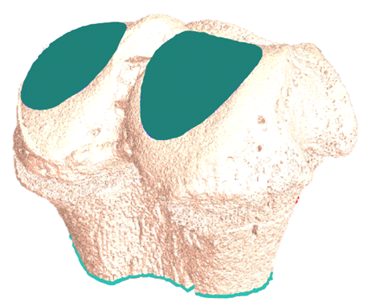
Methods
Animal model: Wistar Rats
Adult 3 months (n=6)
Old 13 months (n=6)
Microstructure
Material properties
Mechanical properties
µCT - 10 µm
Elastic modulus
Nanoindentation
1.5 µm
Strain distribution
Simulation
10 µm
3 mm
2/10

Slide 4
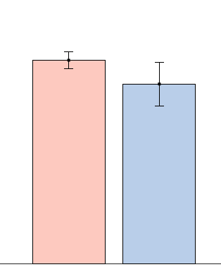
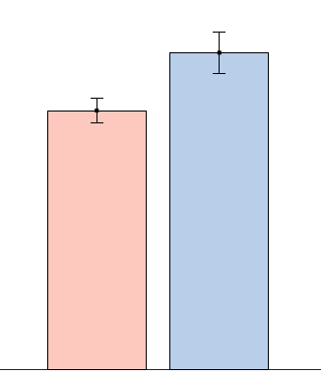
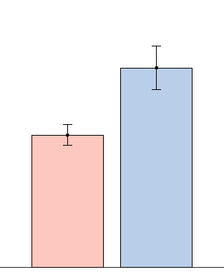
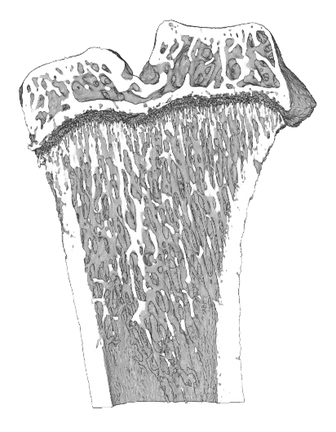
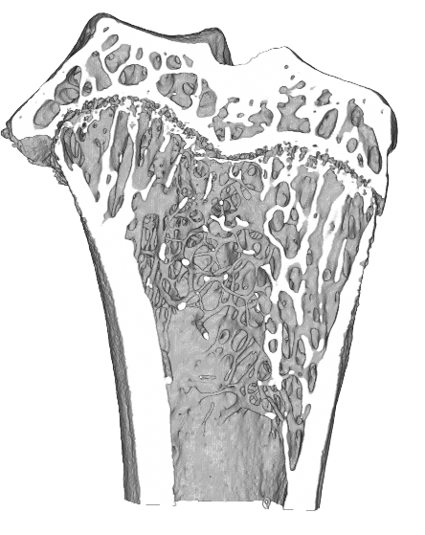
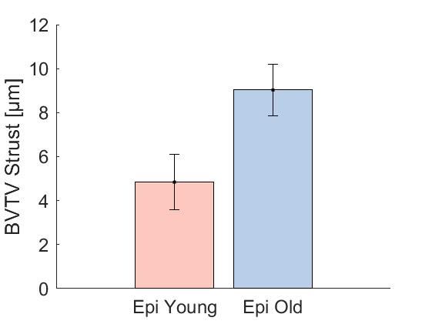
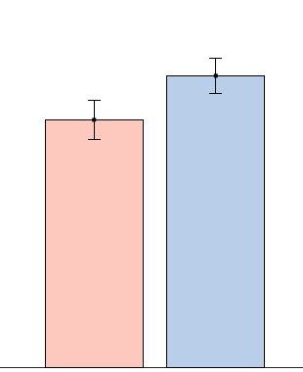
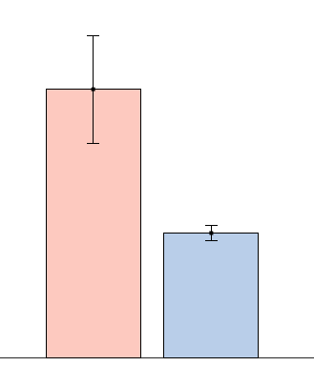
Microstructural changes with age
-12%*
+23%*
+51%*
50
150
400
40
300
30
100
Th.Sp [µm]
BV/TV [%]
Tb.Th [µm]
200
20
50
10
100
0
Young
Old
0
Young
Old
0
Young
Old
+18%*
-53%*
+86%*
400
400
10
300
300
8
Adult
Old
6
Cort.Th [µm]
200
200
GP.Th [µm]
BB/TV [%]
4
Trabecular bone
BV/TV decreases & Network becomes coarser
Same behaviour in the Metaphysis
100
100
2
0
Young
Old
0
Young
Old
0
Young
Old
3/10

Slide 5
Microstructural changes with age
-12%*
+23%*
+51%*
50
150
400
40
300
30
100
Th.Sp [µm]
BV/TV [%]
Tb.Th [µm]
200
20
50
10
100
0
Young
Old
0
Young
Old
0
Young
Old
+18%*
-53%*
+86%*
400
400
10
300
300
8
Adult
Old
6
Cort.Th [µm]
200
200
GP.Th [µm]
BB/TV [%]
4
Cortical bone
Subchondral bone plate thickness increases
100
100
2
0
Young
Old
0
Young
Old
0
Young
Old
3/10

Slide 6
Microstructural changes with age
-12%*
+23%*
+51%*
50
150
400
40
300
30
100
Th.Sp [µm]
BV/TV [%]
Tb.Th [µm]
200
20
50
10
100
0
Young
Old
0
Young
Old
0
Young
Old
+18%*
-53%*
+86%*
400
400
10
300
300
8
Adult
Old
6
Cort.Th [µm]
200
200
GP.Th [µm]
BB/TV [%]
4
Growth Plate
Thickness increases
Number of bone bridges increases
100
100
2
0
Young
Old
0
Young
Old
0
Young
Old
3/10

Slide 7
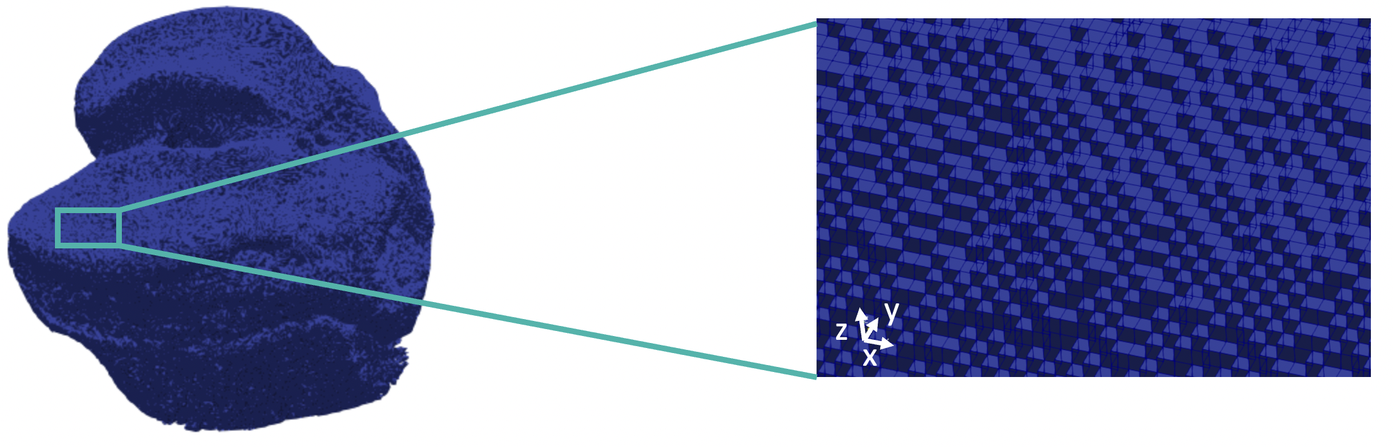
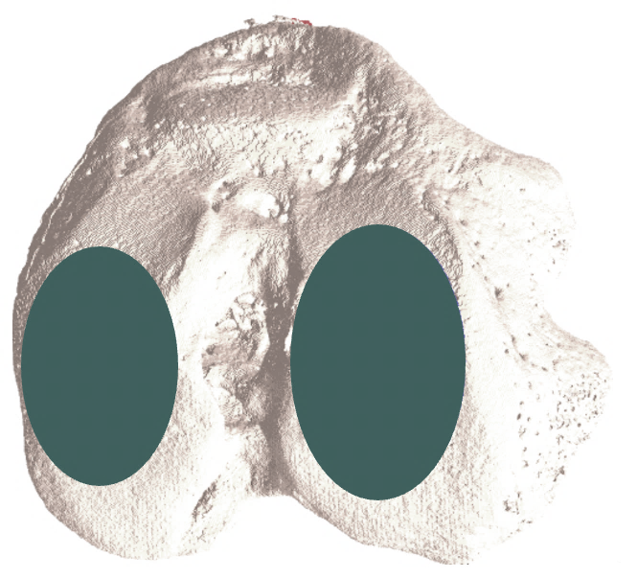
Methods: Mechanical properties
Loaded surface
Mesh
µCT-based FE models
Hexahedral elements
10 µm length
n = 6/group
F = 40N
Constrained plane
Bone Materials
Homogeneous, elastic, isotropic
Poisson ratio 0.3
Young’s modulus 25 GPa
Top view
Simulation
Parosol software
Linear elastic solution
NIC5 cluster (ULiege)
Outcomes
Effective strain
4/10

Slide 8
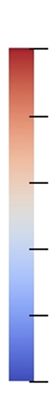
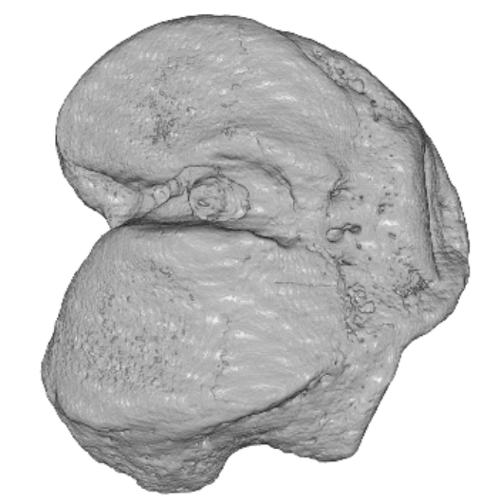
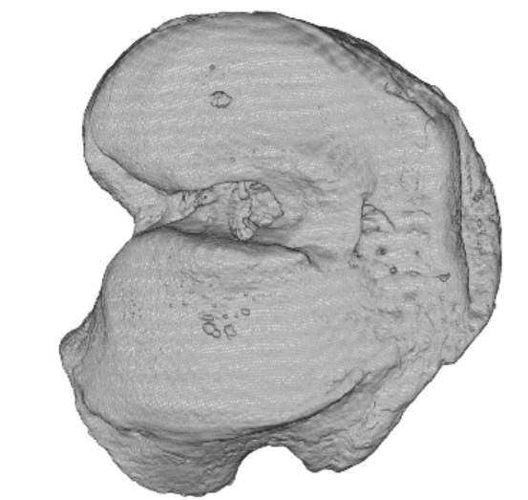
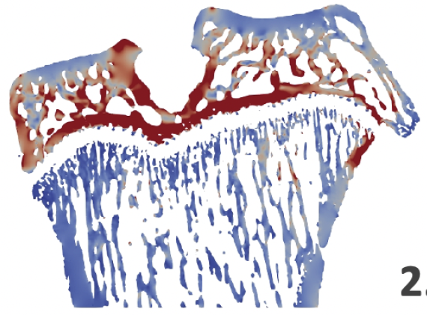
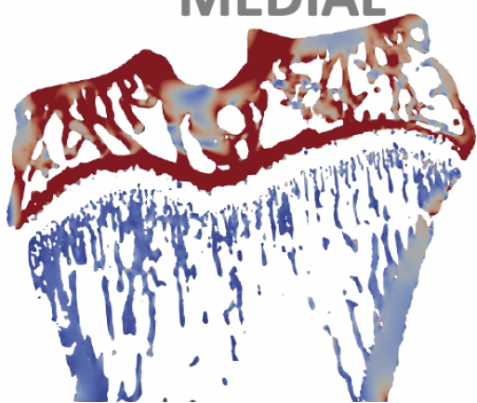
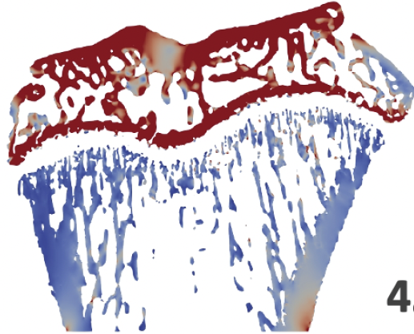
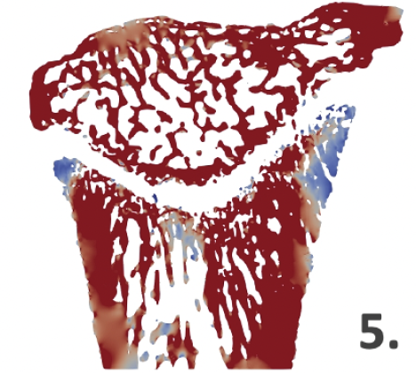
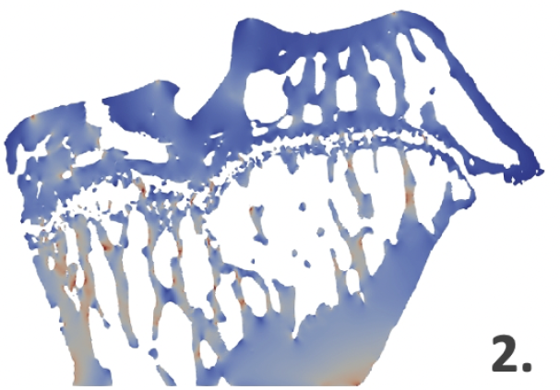
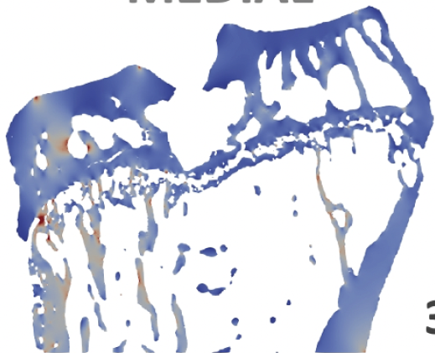
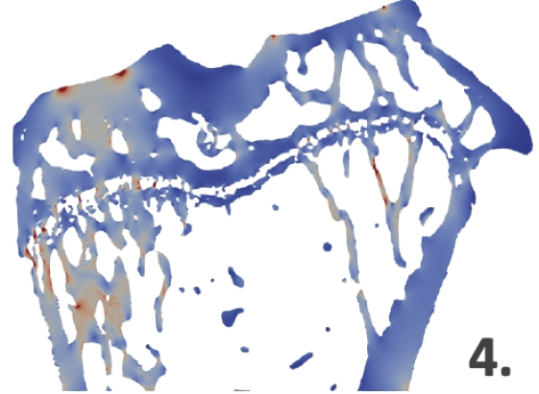
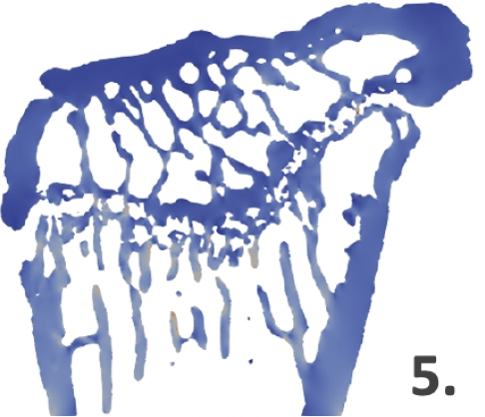
Influence of microstructure on mechanical properties
Adult tibia
Old tibia
5e-04
5e-04
4
4
3
Posterior
Anterior
Posterior
Anterior
3
Effective strain [-]
Effective strain [-]
2
2
1
1
0
0
5/10

Slide 9


Methods: Mechanical properties
Loaded surface
Mesh
µCT-based FE models
Hexahedral elements
10 µm length
n = 2 young and 1 old samples
F = 40N
Bone Materials
Homogeneous, elastic, isotropic
Poisson ratio 0.3
Young’s modulus 25 GPa
Constrained plane
Sagittal section
Growth Plate Materials
Homogeneous, elastic, isotropic
Poisson ratio 0.3
Young’s modulus 5 MPa, 50 MPa and 500 MPa
Growth Plate
Simulation
Parosol software
Linear elastic solution
NIC5 cluster (ULiege)
Outcomes
Effective strain
6/10

Slide 10

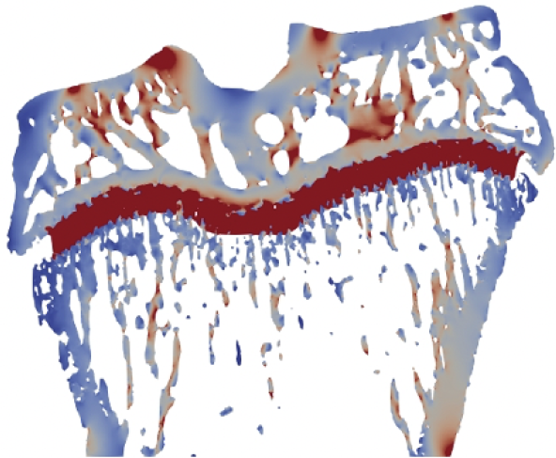
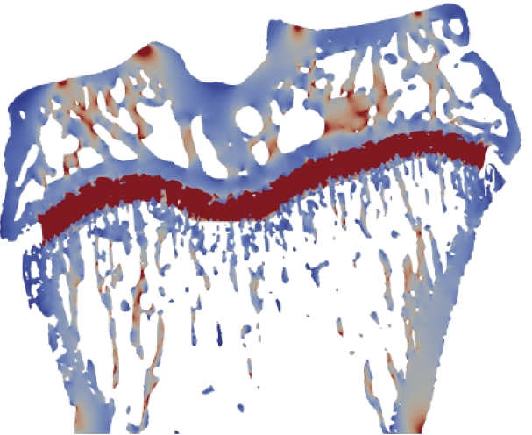
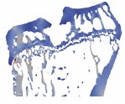
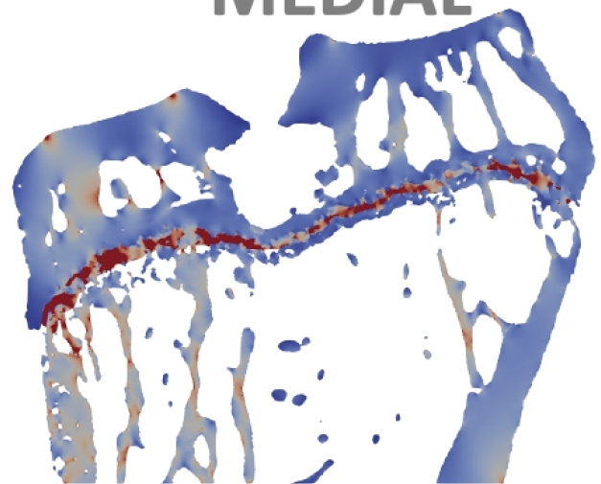
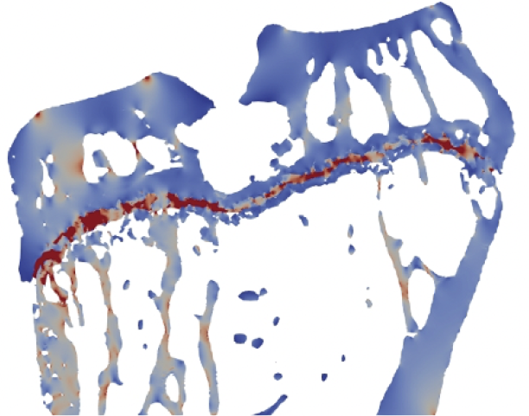
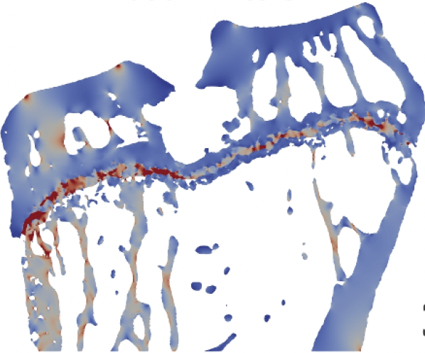
Mechanical properties: Addition of a growth plate
Adult tibia
Old tibia
5e-04
5e-04
4
4
3
3
Posterior
Anterior
Effective strain [-]
Posterior
Anterior
Effective strain [-]
2
2
1
1
0
0
0 MPa
5 MPa
50 MPa
500 MPa
0 MPa
5 MPa
50 MPa
500 MPa
7/10

Slide 11
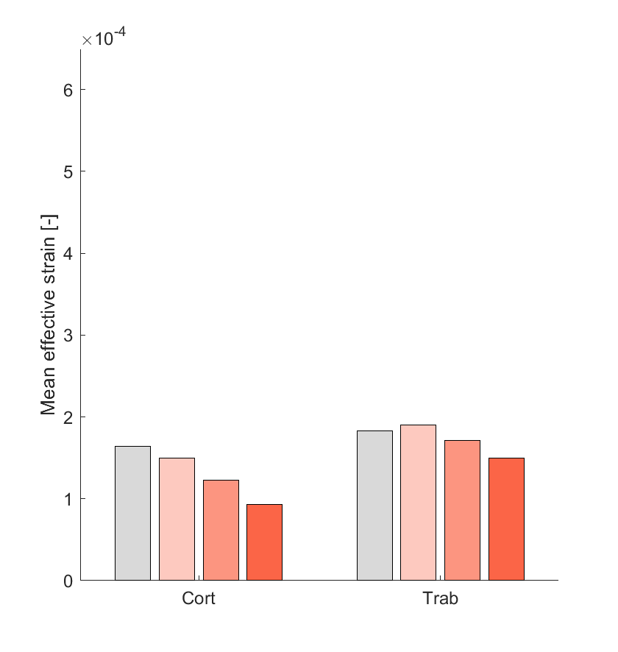
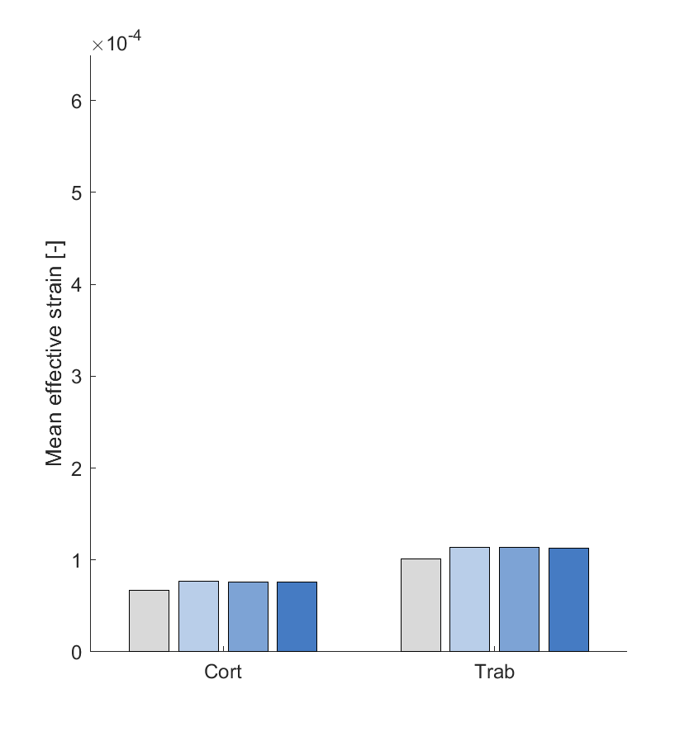
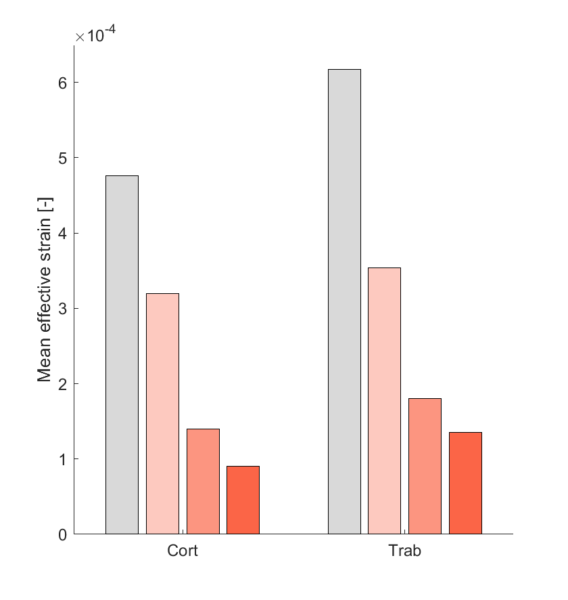
Mechanical properties: Addition of a growth plate
Adult tibia
Old tibia
With few bone bridges
With more bone bridges
6e-04
6e-04
Without growth plate
Without growth plate
5
Growth plate of 5 MPa
5
Growth plate of 5 MPa
Growth plate of 50 MPa
Growth plate of 50 MPa
4
Growth plate of 500 MPa
4
Growth plate of 500 MPa
Mean effective strain [-]
Mean effective strain [-]
3
3
2
2
1
1
0
0
Cortical
Trabecular
Cortical
Trabecular
Cortical
Trabecular
8/10

Slide 12
Influence of microstructure on mechanical properties
Adult tibia
Old tibia
With few bone bridges
With more bone bridges
6e-04
6e-04
5
5
Growth plate of 50 MPa
Growth plate of 50 MPa
4
4
Mean effective strain [-]
Mean effective strain [-]
3
3
2
2
1
1
0
0
Cortical
Trabecular
Cortical
Trabecular
Cortical
Trabecular
9/10

Slide 13
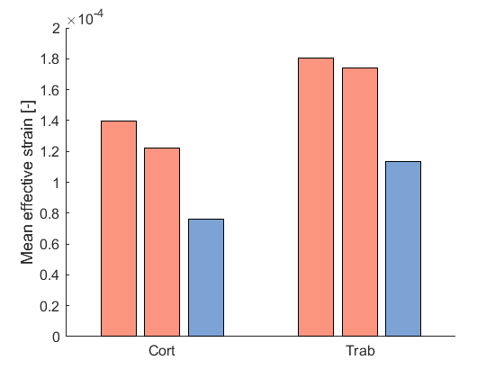
Influence of microstructure on mechanical properties
Adult tibia
Old tibia
With few bone bridges
50 MPa
With bone bridges
6e-04
2e-04
6e-04
Adult samples
Old samples
5
5
1.5
Growth plate of 50 MPa
Growth plate of 50 MPa
4
4
Mean effective strain [-]
Mean effective strain [-]
Mean effective strain [-]
3
1
3
2
2
0.5
1
1
0
0
0
Cortical
Trabecular
Cortical
Trabecular
Trabecular
Cortical
Trabecular
Cortical
9/10

Slide 14


Conclusion
Findings
Importance of the growth plate in the simulations
Young's modulus of at least 50 MPa for the growth plate
RESULTS
Future works
Increasing the number of samples to study
Refining the Young's modulus value of the growth plate
Changing the load direction
10/10

Slide 15

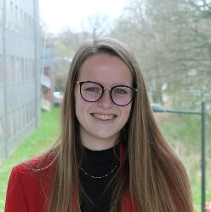


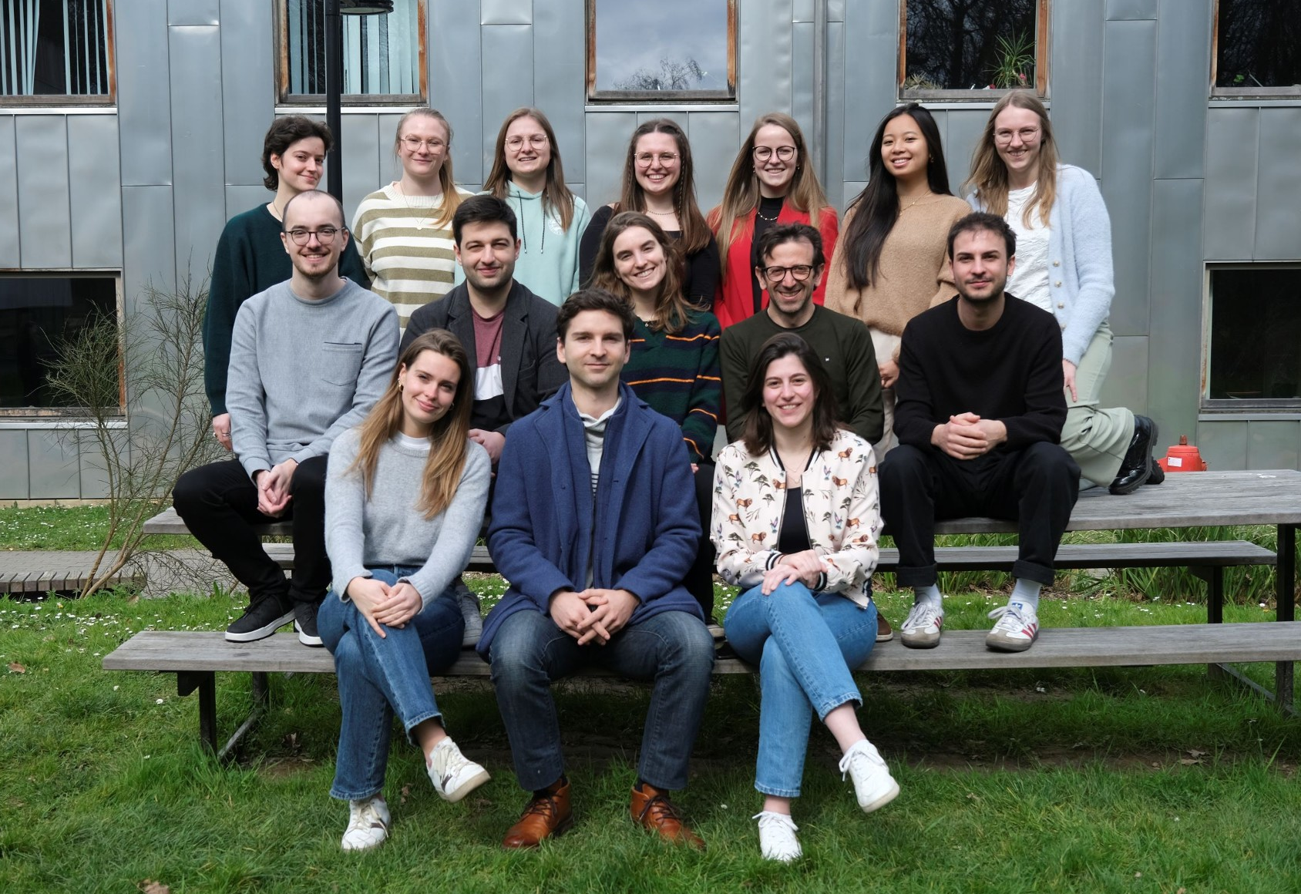






Thanks to all co-authors!
University of Liège, Belgium
University of Liège, Belgium
Margaux
SKA
Davide
RUFFONI
Pierre
DRION
Katholieke Universiteit Leuven, Belgium
Harry
van Lenthe
Piyush Uniyal
10/10

Slide 16


Thank you for your attention!
Any questions?
@Mllr_Laura
Laura Müller

Slide 17
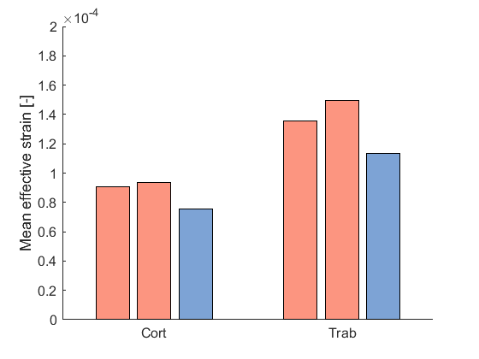
Mechanical properties: The effect of aging
50 MPa
500 MPa
2e-04
2e-04
Adult samples
Adult samples
Old samples
Old samples
1.5
1.5
Mean effective strain [-]
Mean effective strain [-]
1
1
0.5
0.5
0
0
Cortical
Trabecular
Cortical
Trabecular
9/10

Slide 18
Nanoindentation
Berkovitch tip (50 nm tip radius)
Displacement controlled trapezoidal load function
10s loading, 15s holding, 10s unloading
Penetration depth of ~150 nm
Lateral spacing of 1.5 µm

Slide 19
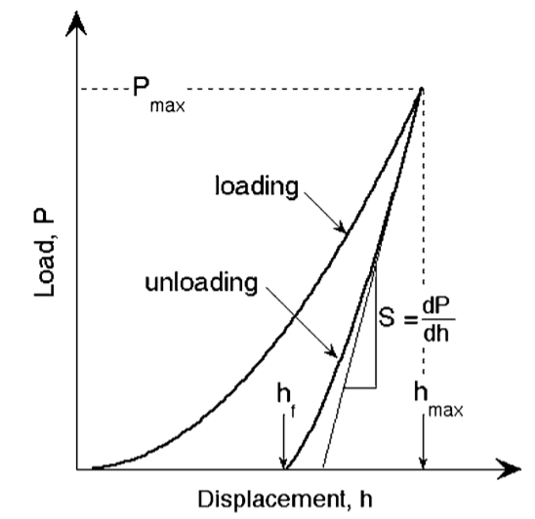
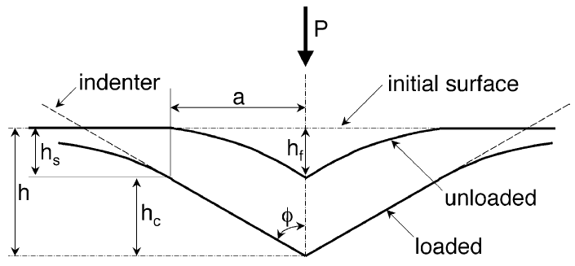

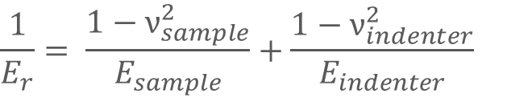


Nanoindentation
Based on Oliver Pharr model which assumes that elastic and plastic deformations during loading and only elastic displacements recovered during unloading
Berkovitch tip → β
From P-h curves: max load, max displacement and elastic unloading stiffness
From calibration in FQ (reference material): contact area →
Hardness estimation:
Elastic modulus measurements (derived from eastic contact theory):
E_{r} accounts for elastic displacement in both sample and tip
$$A=F\left(h_{c}\right)$$
$$H= \frac{P_{max}}{A}$$
$$E_{r}= \frac{1}{β}\frac{S}{2}\sqrt{\frac{π}{A(h_{c})}}$$
$$\frac{1}{E_{r}}= \frac{1−ν_{sample}^{2}}{E_{sample}}+\frac{1−ν_{indenter}^{2}}{E_{indenter}}$$

Slide 20
ParoSol simulations
MATERIAL ASSIGNMENT
BONE
Poisson’s ratio 0.3
Young’s modulus
ADULT 25.53 GPa
OLD 29.56 GPa
GROWTH PLATE
Poisson’s ratio 0.3
Young’s modulus
PHYSIOLOGICAL 5 and 50 MPa
PATHOLOGICAL 500 MPa
MESH ASSIGNMENT
10 µm length

Slide 21
Mechanical properties: Addition of a growth plate
Adult tibia
Old tibia
6e-04
Without growth plate
6e-04
Without growth plate
Growth plate of 5 MPa
Growth plate of 5 MPa
5
Growth plate of 50 MPa
5
Growth plate of 50 MPa
Growth plate of 500 MPa
Growth plate of 500 MPa
4
4
Mean effective strain [-]
Mean effective strain [-]
3
3
2
2
1
1
0
0
Cortical
Trabecular
Cortical
Trabecular
8/10

