Slide 1




Microstructural and Defects investigation of AlCrFeMnNi-based High Entropy Alloy fabricated via Laser Powder Bed Fusion
SEIDOU A. Herrim, BLONDIAU Catherine, DEDRY Olivier, TCHUINDJANG Jérôme Tchoufang and MERTENS Anne
Metallic Materials Science (MMS), Aerospace and Mechanical Engineering Dpt., University of Liège, Belgium
07/05/2025

Slide 2
Introduction
The common phases are FCC and BCC, while the IM are B2, Sigma and Laves.
BCC-based HEAs
FCC-based HEAs
High strength
Good electrical and thermal conductivity
Low thermal expansion
Better corrosion resistance
Better ductility
HEAs
CCAs
[Odetola et al. (2024)]
May have <5 elements
>35% of elements
Multiple phases, Intermetallics (IM) included
5+ elements
Single-phase solid solution
High configurational entropy
The goal of this study is to design a corrosion-resistant HEA through LPBF
International Esaform Conference 2025
07-09 May 2025 / Paestum, Italy
Notes:
This work aim to investigate the effects of the selected elements into the microstructure, and to understand the near-equilibrium mechanisms and phenomena.

Slide 3
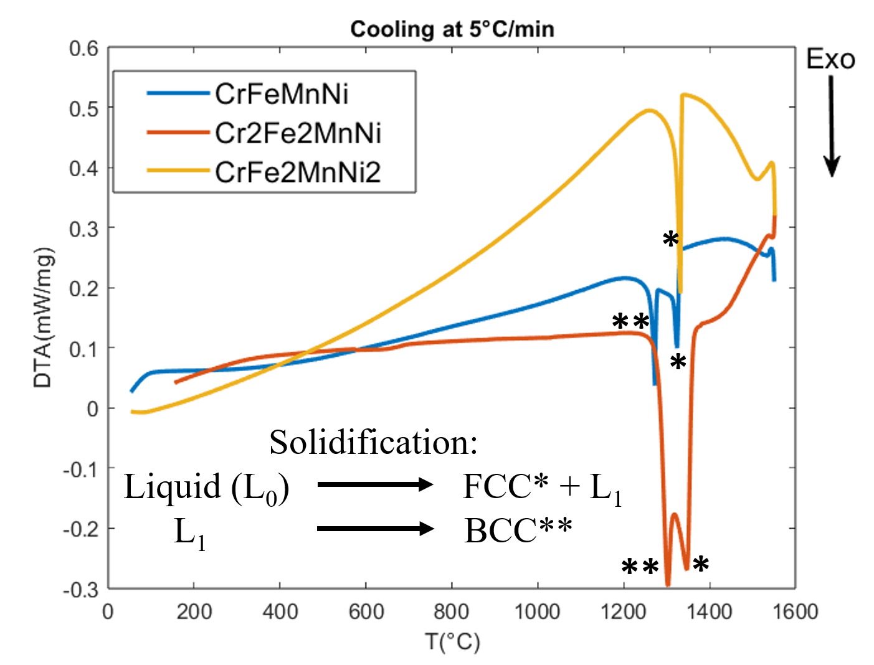
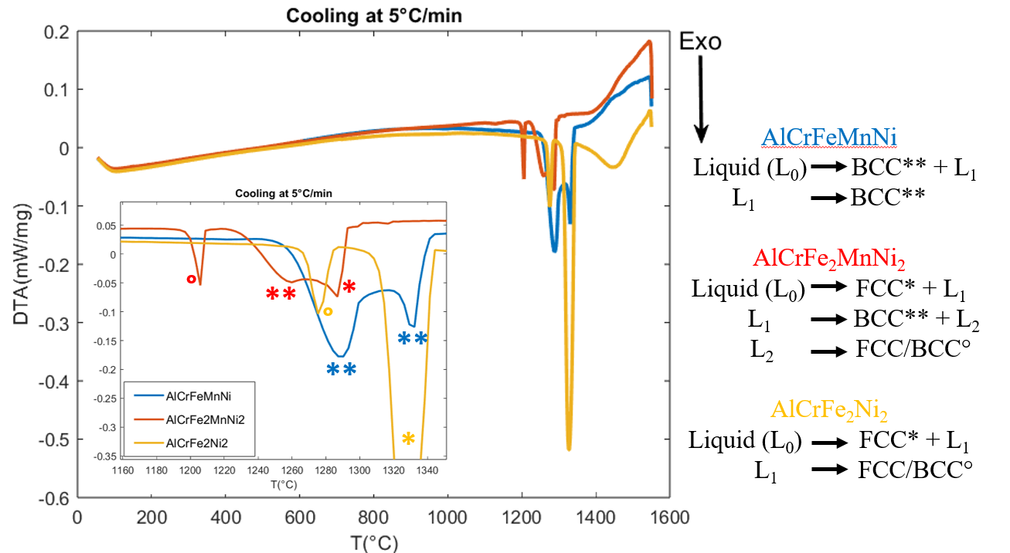
CrFeMnNi-based MEA and AlCrFeMnNi-based HEA: Solidification sequence
Differential Thermal Analysis
[Seidou et al. (2024)] Esaform2024
In AlCrFeMnNi system, FCC phase is Cr-Fe rich while BCC phase is rich in Al and Ni
Al promotes the BCC formation, followed by spinodal decomposition
International Esaform Conference 2025
07-09 May 2025 / Paestum, Italy

Slide 4
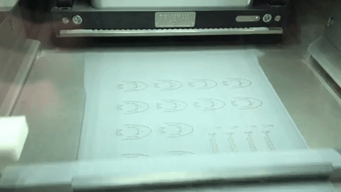
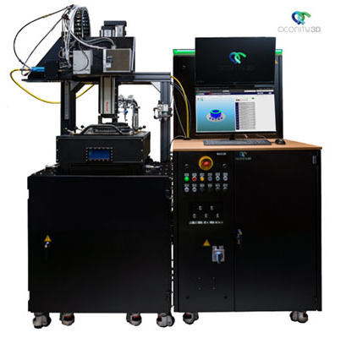
Materials and Methods
AISI 316L SS
Fe | C | Cr | Ni | Mo | Mn | Si
Bal. | 0.03 | 18 | 14 | 3 | 2 | 1
Powders obtained by Gas Atomization
Aconity MINI
Laser Powder Bed Fusion machine
LPBF process
[https://www.mmsonline.com/kc/additive_manufacturing_for_production/metal-parts]
Al_{0.2}Cr_{0.7}Fe_{1.8}MnMo_{0.1}Ni_{1.5} was printed, targeting an FCC microstructure
The powder mixture was prepared using AISI 316L SS and elemental powders
With manual mixing
International Esaform Conference 2025
07-09 May 2025 / Paestum, Italy
4

Slide 5
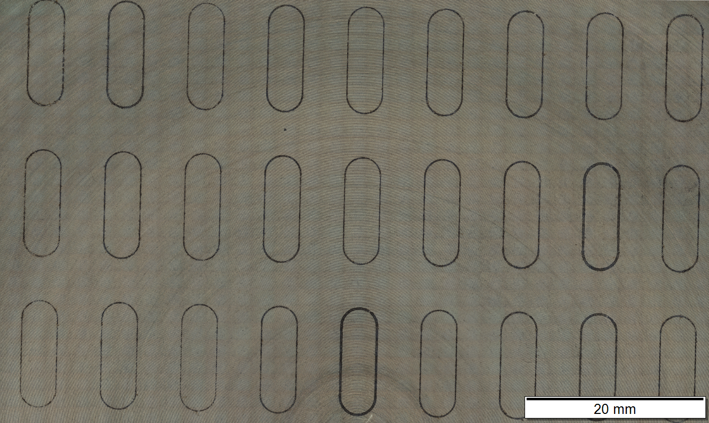
Results and discussion
Al_{0.2}Cr_{0.7}Fe_{1.8}MnMo_{0.1}Ni_{1.5}
Single tracks for parameters optimization
Parameters:
Scanning speed (mm/s): 200 to 2000
Laser power (W): 50 to 200
  -> Energy (J/mm): 0,042 to 1
53 sets of parameters were investigated to narrow the range of optimal parameters.
[Yadroitsev, I., & Smurov, I. (2010). Selective laser melting technology: From the single laser melted track stability to 3D parts of complex shape. Physics Procedia, 5, 551-560]
International Esaform Conference 2025
07-09 May 2025 / Paestum, Italy
5

Slide 6
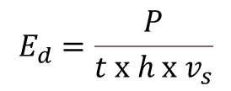
Printing parameters selected from single tracks optimization
Al_{0.2}Cr_{0.7}Fe_{1.8}MnMo_{0.1}Ni_{1.5}
Parameters:
Scan strategy: Bidirectional 90°
Remelting for better homogeneity
Pre-heating at 200°C
  To avoid cracks and delamination
Increasing Ed
Volumetric Energy Density
$$E_{d}=\frac{P}{t x h x v_{s}}$$
[J/mm³]
International Esaform Conference 2025
07-09 May 2025 / Paestum, Italy
6

Slide 7
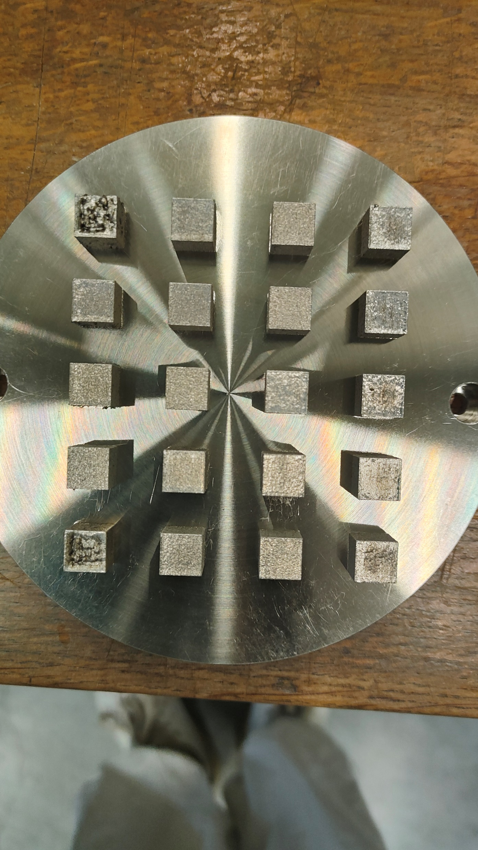

Printing parameters selected from single tracks optimization
Al_{0.2}Cr_{0.7}Fe_{1.8}MnMo_{0.1}Ni_{1.5}
.
13
14
19
15
20
BD
1
6
11
16
9
10
18
11
12
2
7
12
17
5
6
7
17
8
X
3
8
13
18
Highest Ed
Increasing Ed
4
9
14
19
1
2
16
3
4
X
5
10
15
20
Volumetric Energy Density
$$E_{d}=\frac{P}{t x h x v_{s}}$$
[J/mm³]
20 cubes 10 x 10 x 10 mm
International Esaform Conference 2025
07-09 May 2025 / Paestum, Italy
7

Slide 8
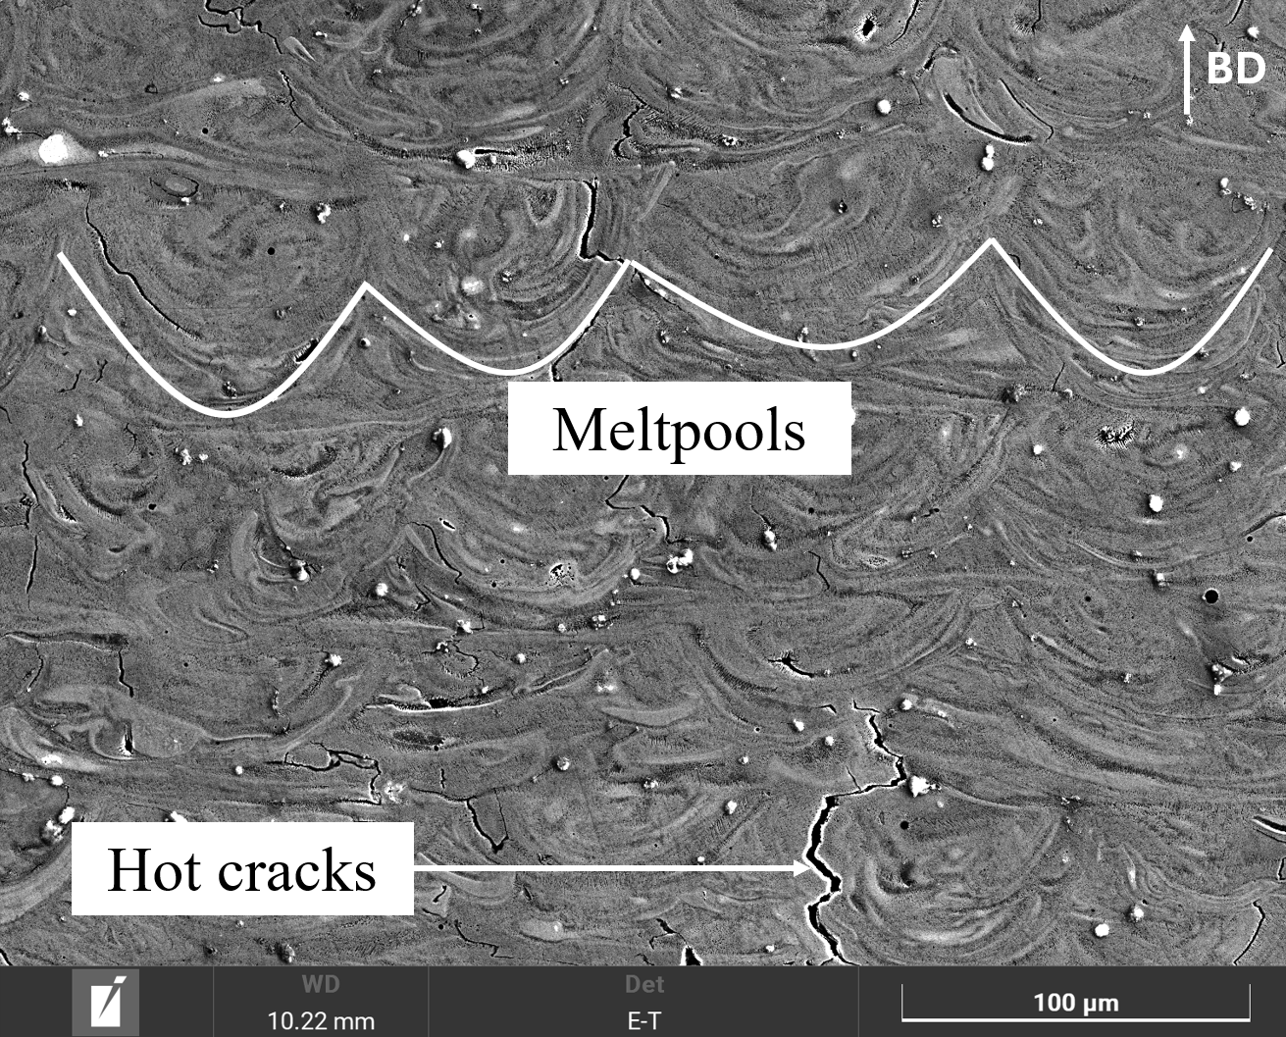
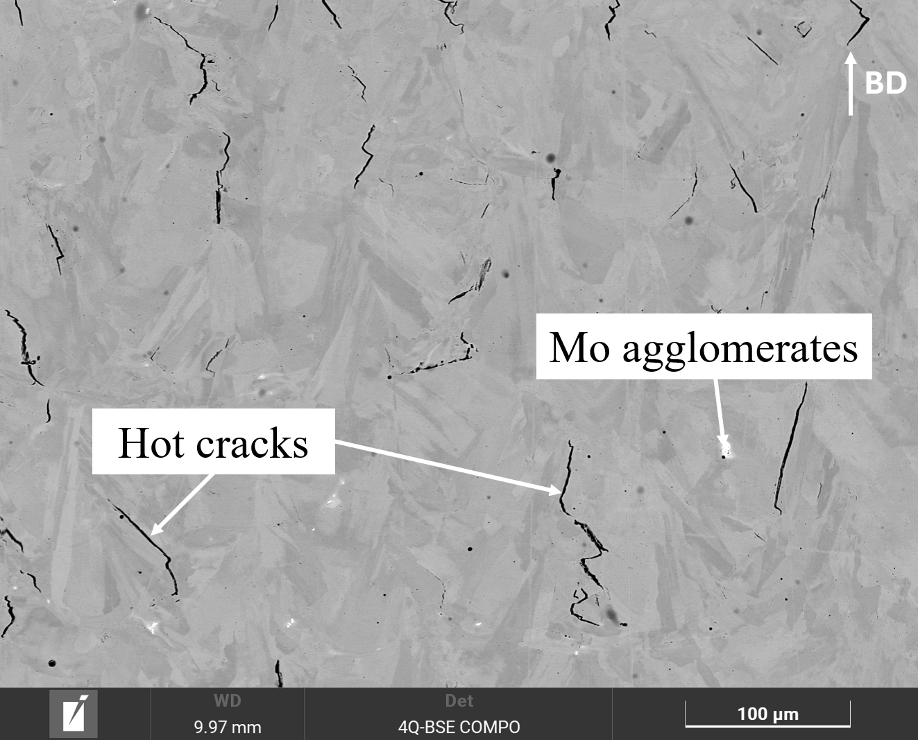
SEM micrographs revealing microstructural defects
Etched with Nital
As polished
Sample 3: P=150W, vs=800mm/s
Sample 17: P=175W, vs=800mm/s, remelting
Fluctuations within the meltpools, Mo agglomerates, and hot cracks are observed.
Hots cracks and elemental agglomerates in all the samples, including the ones with remelting.
International Esaform Conference 2025
07-09 May 2025 / Paestum, Italy
8

Slide 9
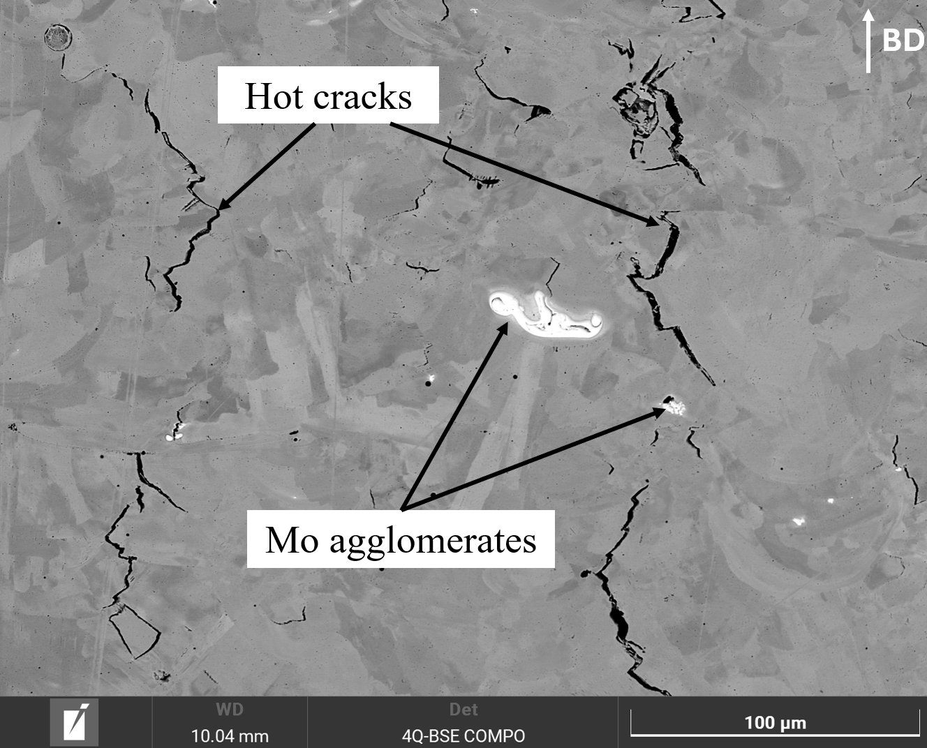
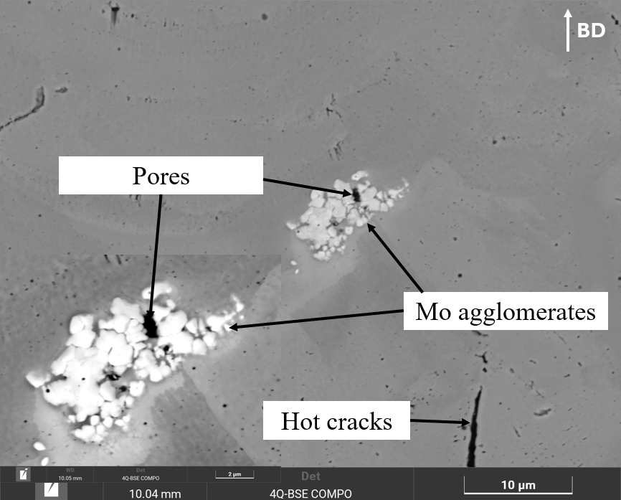
SEM micrographs revealing microstructural defects
Sample 3: P=150W, vs=800mm/s
Sample 17: P=175W, vs=800mm/s, remelting
The dissolution of refractory element (Mo) is limited, causing microstructural heterogeneity.
International Esaform Conference 2025
07-09 May 2025 / Paestum, Italy
9

Slide 10
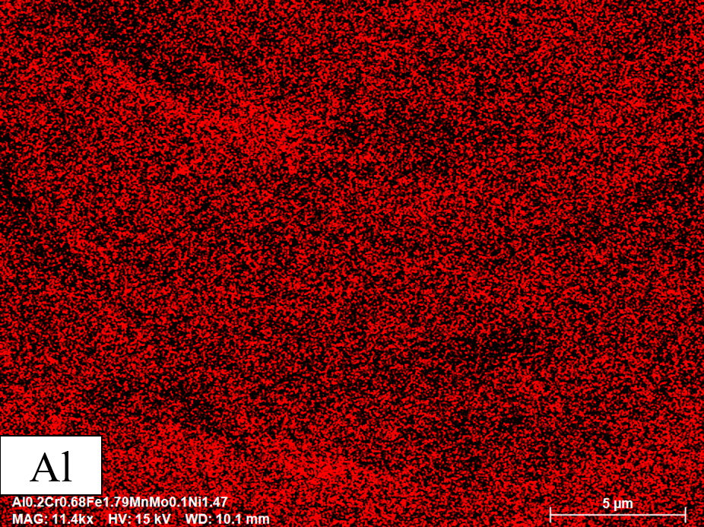
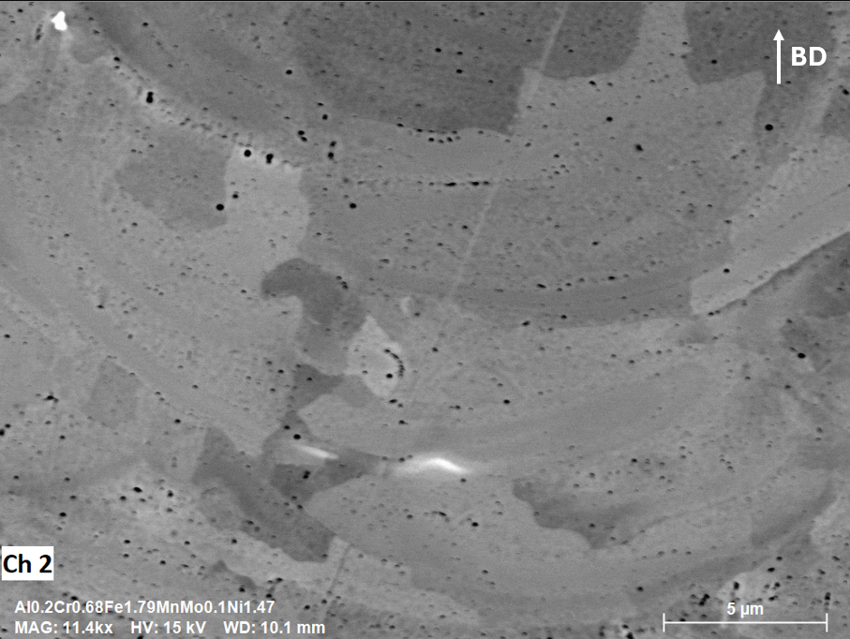
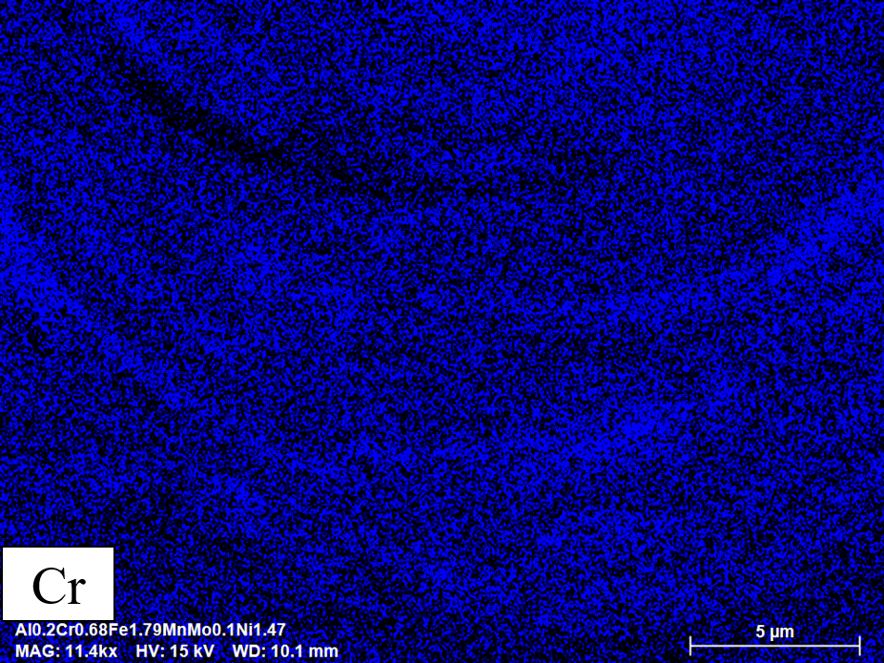
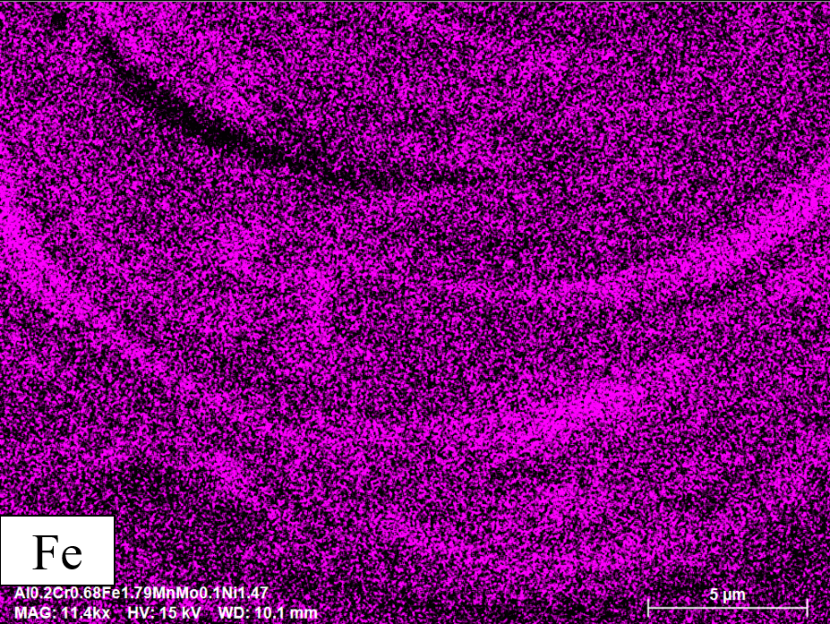
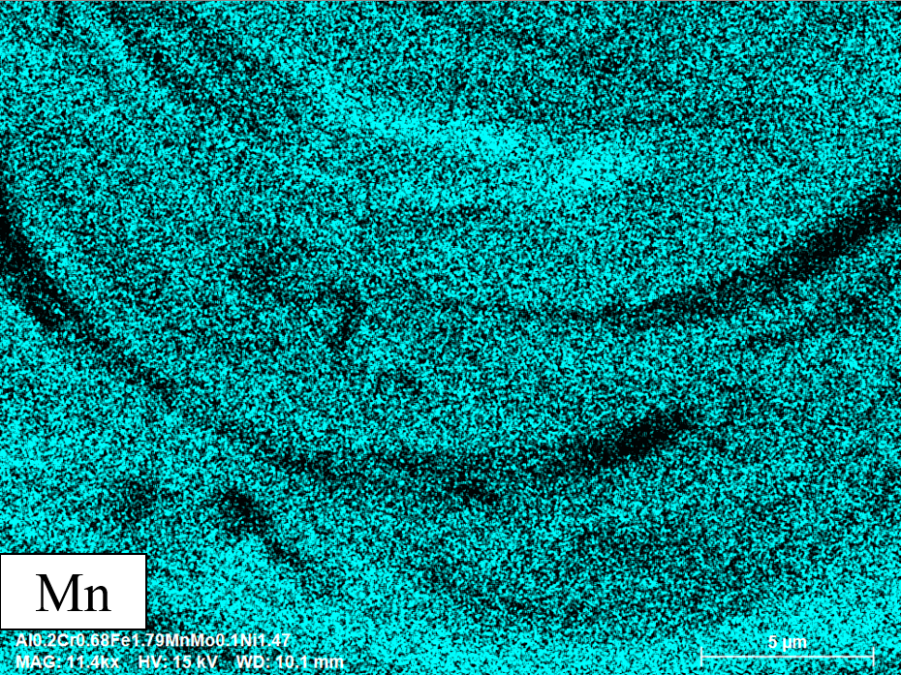
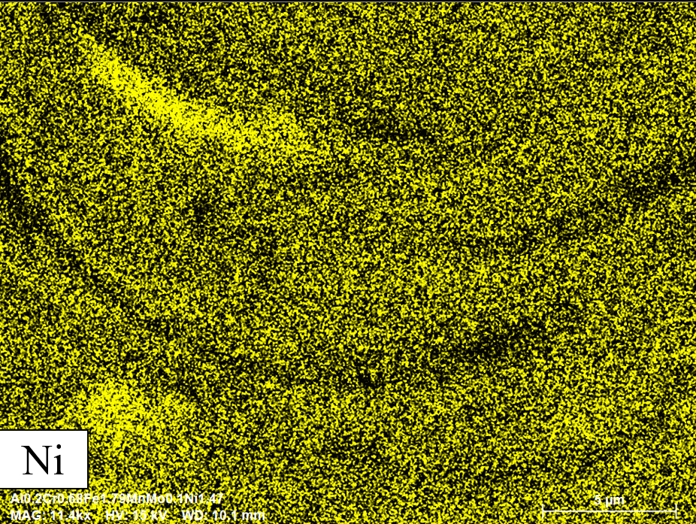
EDS elemental map showing compositional heterogeneity in the meltpool
Sample 3: P=150W, vs=800mm/s
International Esaform Conference 2025
07-09 May 2025 / Paestum, Italy
10

Slide 11
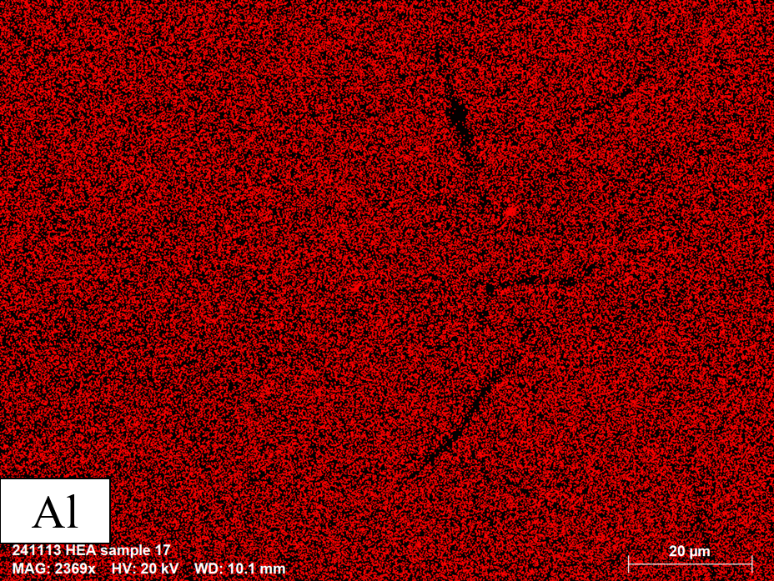
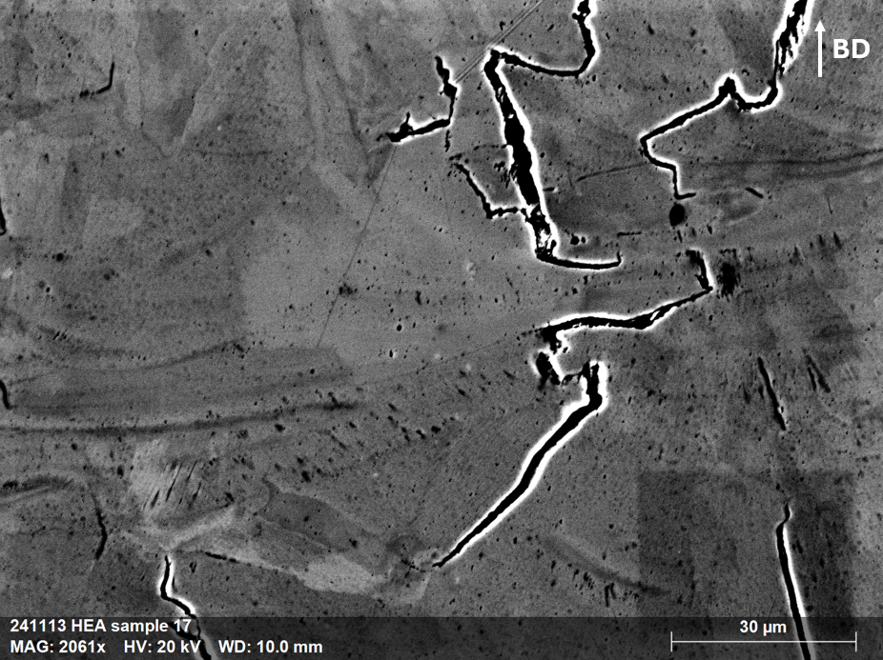
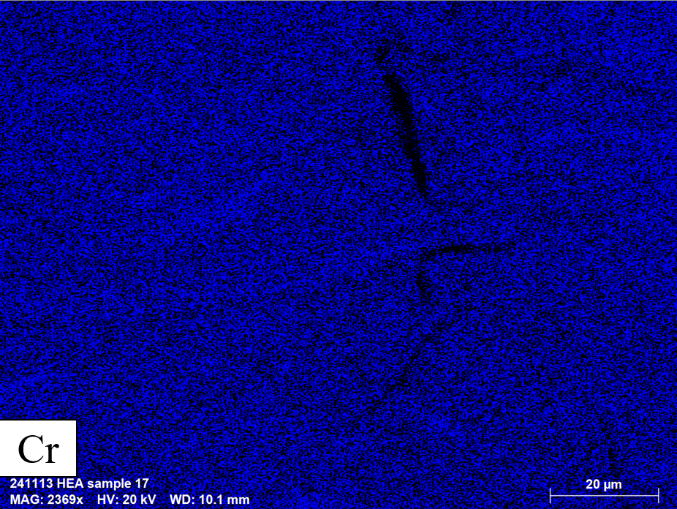
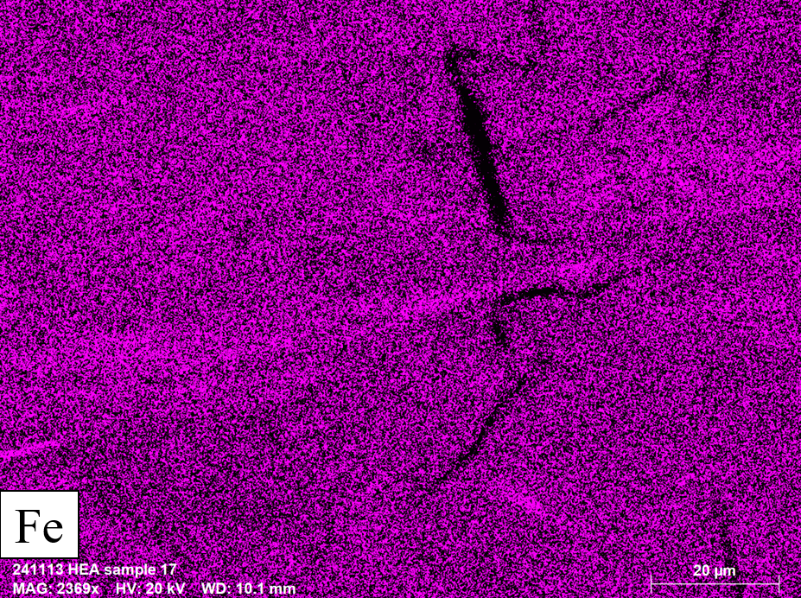
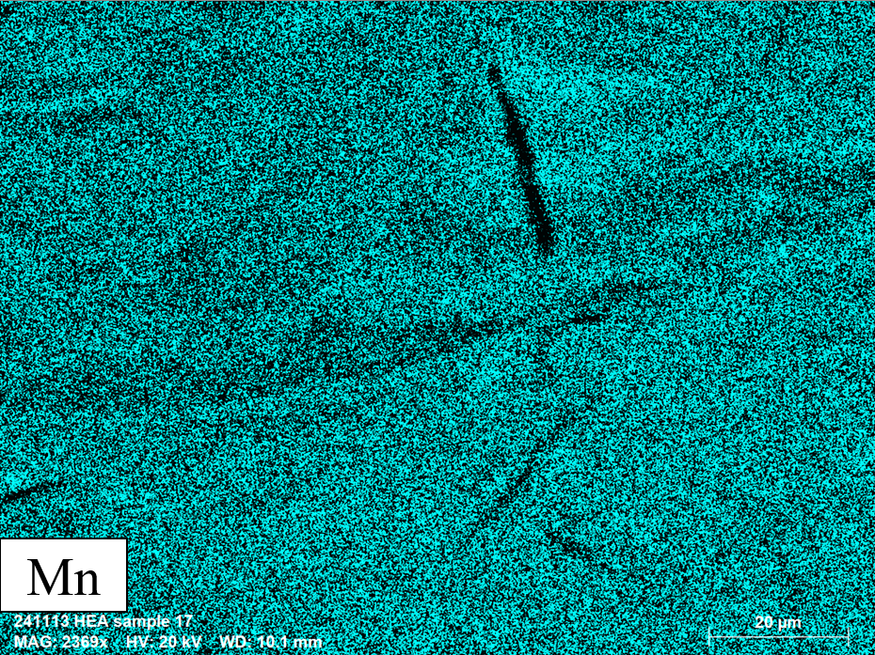
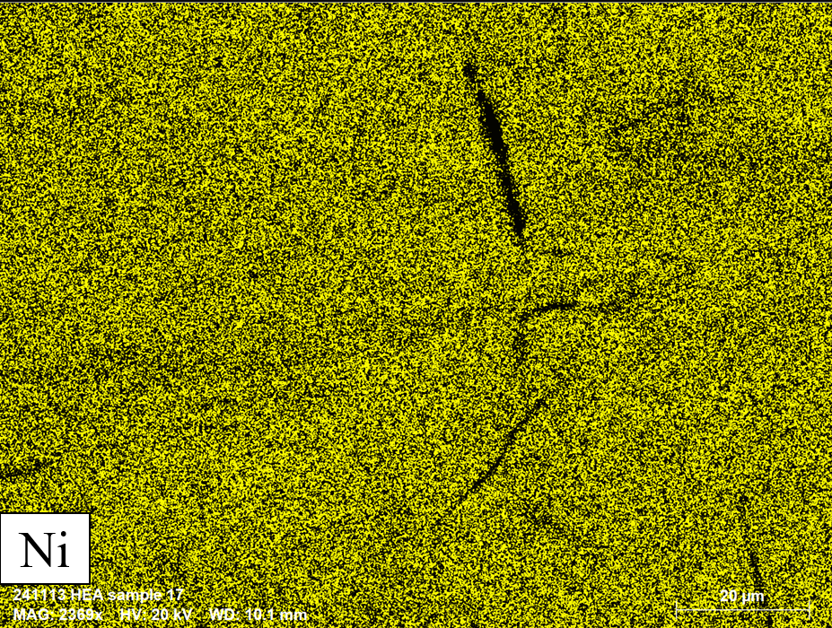
EDS elemental map showing compositional heterogeneity in the meltpool
Sample 17: P=175W, vs=800mm/s, remelting
International Esaform Conference 2025
07-09 May 2025 / Paestum, Italy
11

Slide 12
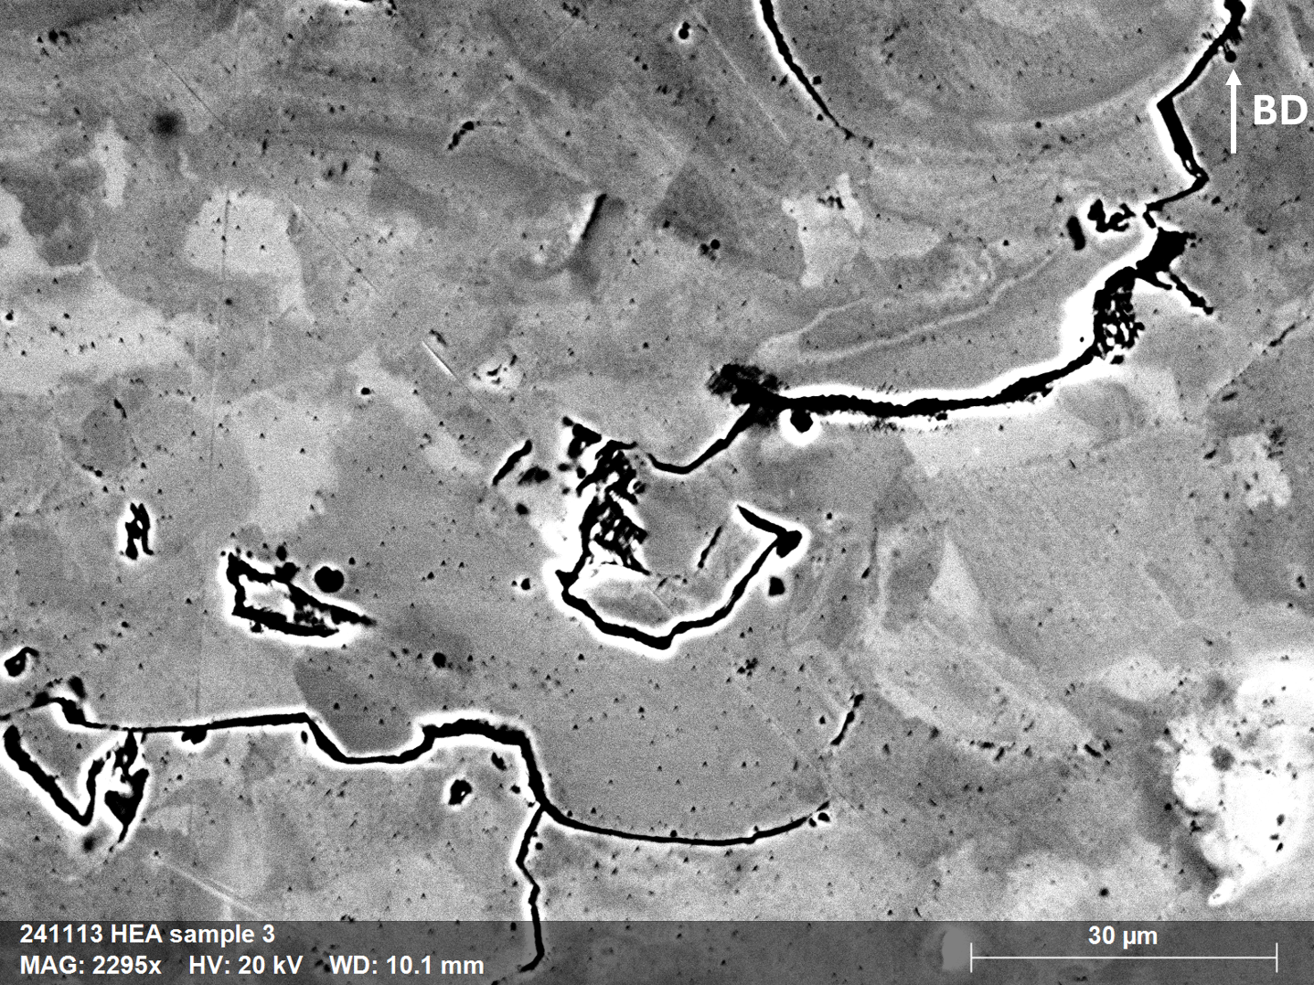
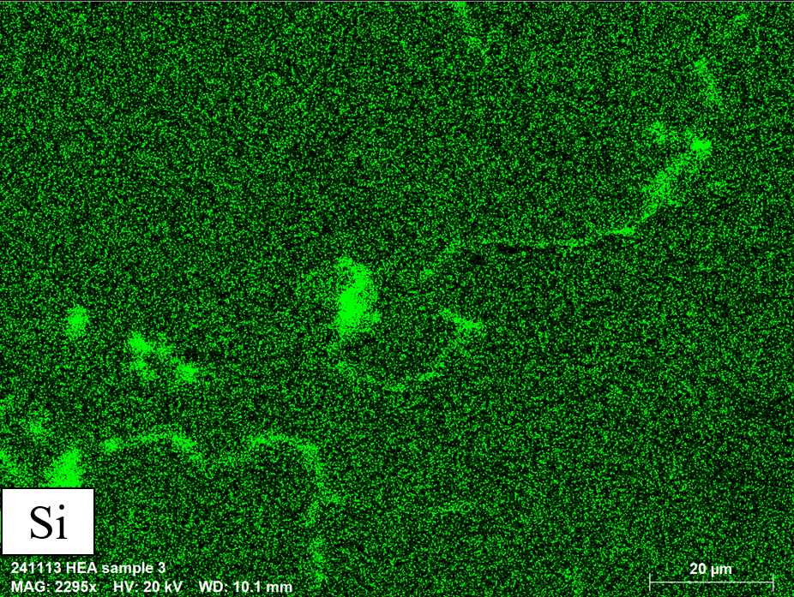
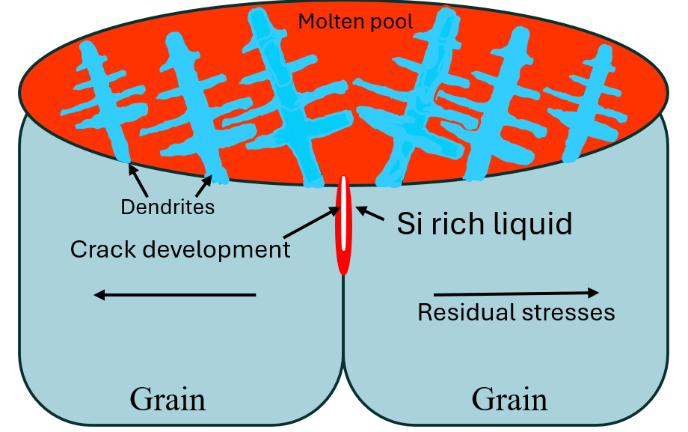
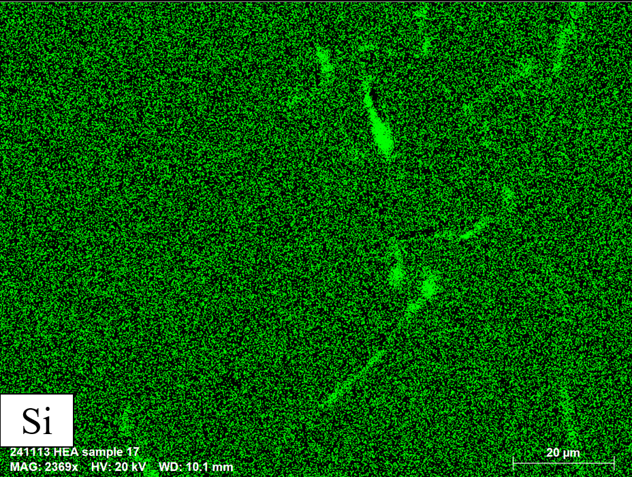
Initiation of hot cracks during solidification in LPBF
Sample 3: P=150W, vs=800mm/s
[Guo et al., Effects of elemental segregation and scanning strategy on the mechanical properties and hot cracking of a selective laser melted FeCoCrNiMn-(N, Si) high entropy alloy, J. Alloys Compd., 865 (2021) 158892]
Hot cracks can develop in the last liquid rich in Si that solidifies at high angle grain boundaries.
Sample 17: P=175W, vs=800mm/s, remelting
International Esaform Conference 2025
07-09 May 2025 / Paestum, Italy
12

Slide 13
Conclusions
Using elemental and alloy powder mixtures in LPBF allows testing multiple compositions without costly atomization.
Key challenges include partial or non-dissolution of refractory elements (Mo) and powder size effects, leading to agglomerates or comet tails in the melt pool.
Rapid cooling in LPBF causes compositional heterogeneity and elemental segregation (Si), increasing the risk of hot cracks.
Addressing these issues is crucial for HEA development: refining refractory powder size improves dissolution, while commercial pre-alloyed powders reduce reliance on elemental powders.
International Esaform Conference 2025
07-09 May 2025 / Paestum, Italy
13

Slide 14
Perspectives
Use spherical commodity powders such as 316L SS, NiCr 80:20 to reach a specific composition.
Investigate the as-built microstructure.
Use custom made pre-alloyed powders if defects such as hot cracks cannot be avoided.
Perform corrosion tests such as Electrochemical Impedance Spectrometry (EIS), Potentiodynamic polarization (PDP), Cyclic potentiodynamic polarization (CPDP).
International Esaform Conference 2025
07-09 May 2025 / Paestum, Italy
14

Slide 15
Thanks for your attention
Herrim Seidou, PhD candidate
Ahb.seidou@uliege.be
Metallic Materials Science (MMS) team
Aerospace and Mechanical Engineering Dpt.
University of Liège, Belgium
All publications of the Metallic Materials Science team are available at : https://orbi.uliege.be/

Slide 16
Sample 3: P=150W, vs=800mm/s
Sample 17: P=175W, vs=800mm/s, remelting
Average grain size = 32µm
Average grain size = 40.2 µm
LAGB
HAGB
Misorientation angle
Misorientation angle

Slide 17
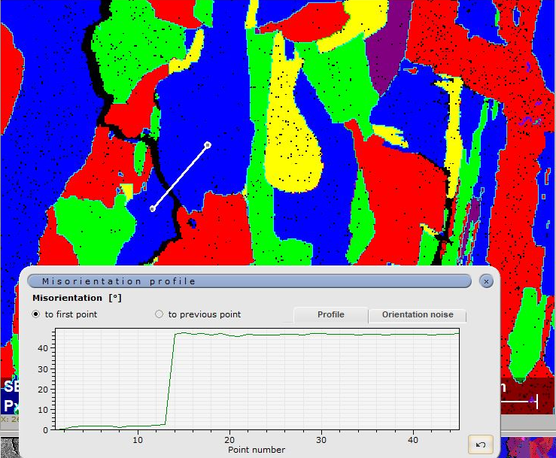
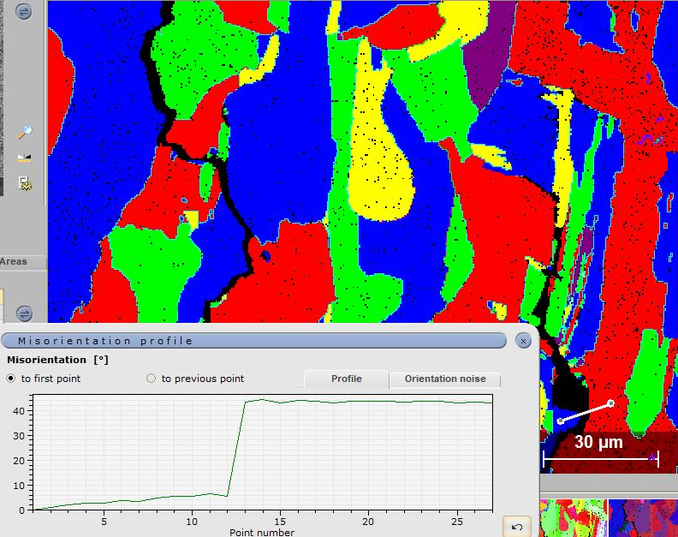
Sample 3: P=150W, vs=800mm/s
Misorientation Profiles

Slide 18
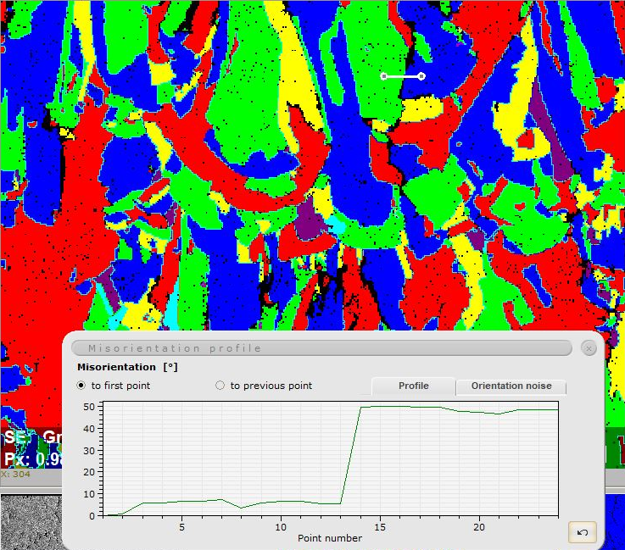
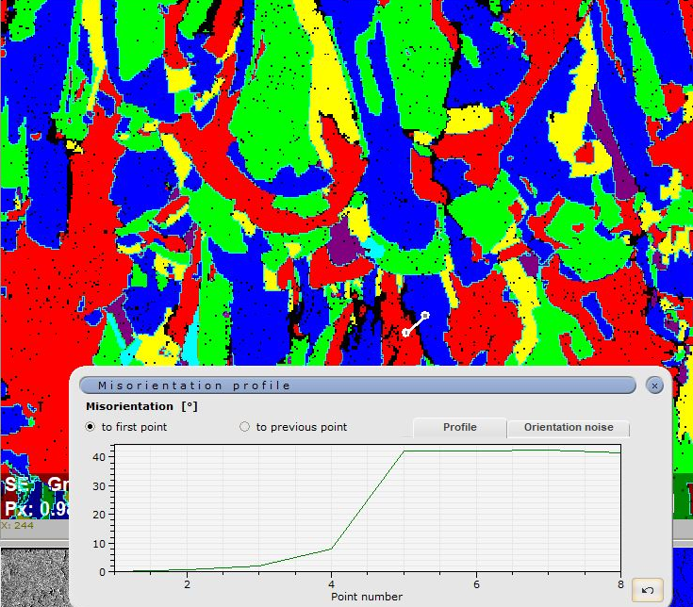
Sample 17: P=175W, vs=800mm/s, remelting
Misorientation Profiles

