Slide 1


Wildlife law enforcement strategies in FSC forest concessions in central africa
Supervision
Simon LHOEST
Doctorant: TCHAKOUDEU KEHOU STEPHANE
09 may 2025

Slide 2
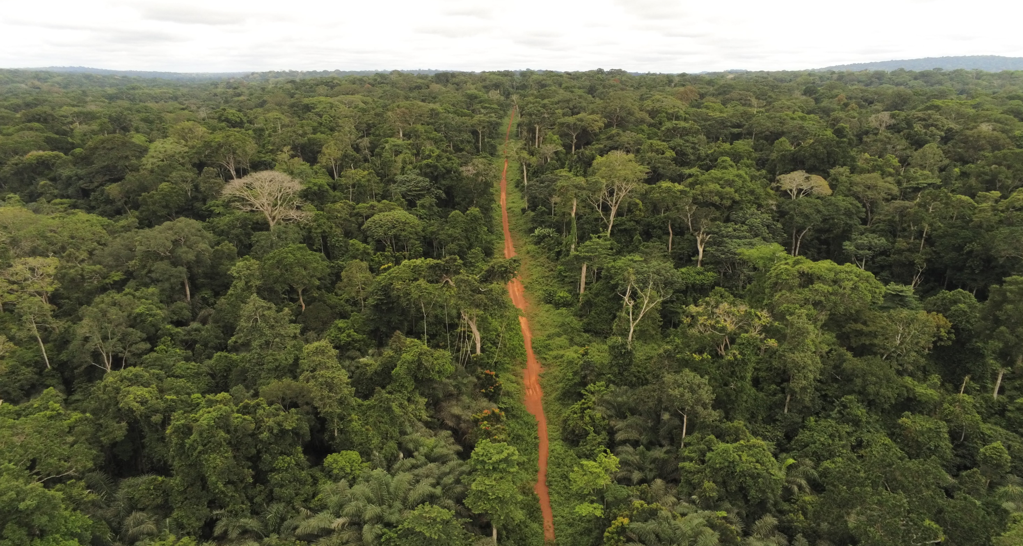
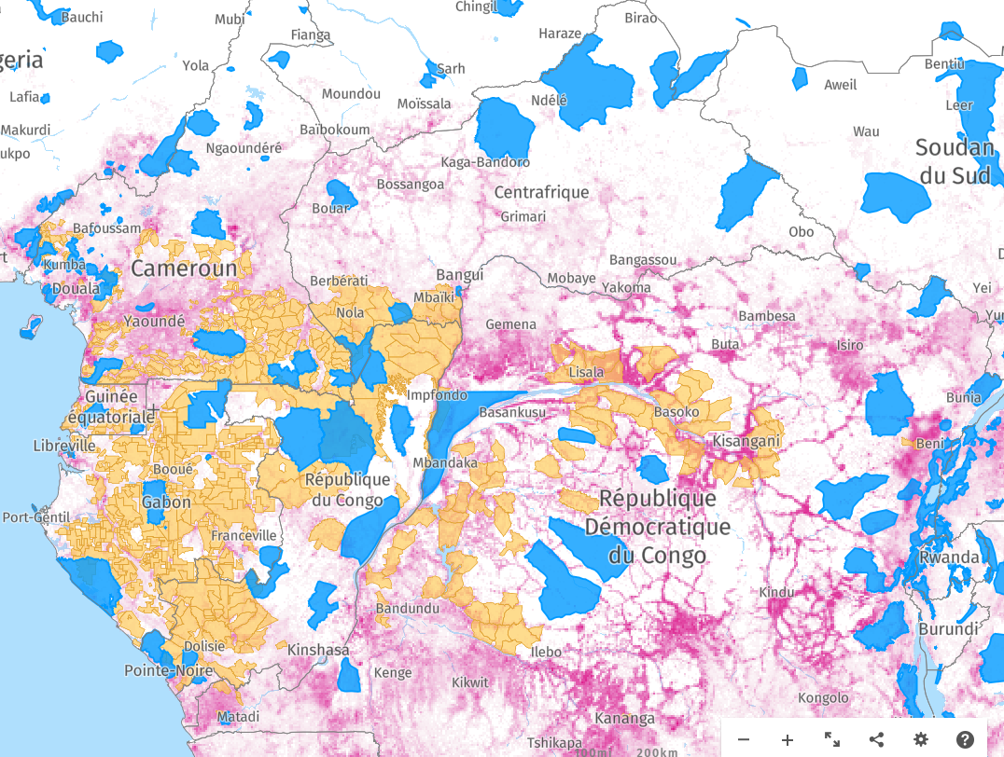
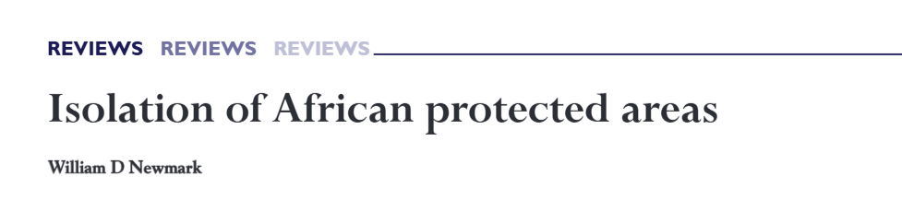
1. Introduction | 2. METHOD | 3. RESULTS AND DISCUSSIONS | 4. CONCLUSION
Protected areas too small and inadequately designed (Chape et al., 2005; Western et al. 2015).
Protected area just like islands in a sea of forest concessions
2
Notes:
establishing and managing protected areas is an effective way to protect biodiversity (Myers et al., 2000; Bruner et al., 2001; Struhsaker et al., 2005
Many protected areas are therefore too small and inadequately designed to protect all life forms, ecosystem functions, and services they were set to preserve (Chape et al., 2005; Western et al. 2015).

Slide 3
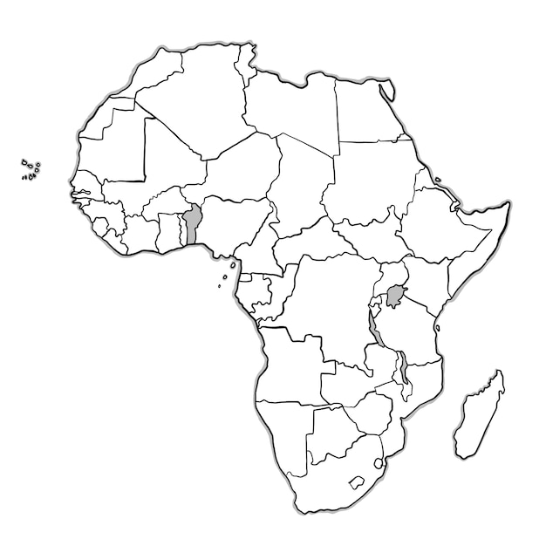


1. Introduction | 2. METHOD | 3. RESULTS AND DISCUSSIONS | 4. CONCLUSION
Effectiveness of law enforcement strategies in protected areas
Queen Elisabeth NP, Uganda.
Patrol/day
Poaching index
Buffaloes
Patrol efforts Chimpanzee
(Tai NP; Kablan et al,, 2019)
Nyungwe National Park (NNP), Rwanda.
Ranger post + ranger patrol.
Poaching.
Patrol
illegal activities
(Gonédelle et al,, 2019)
Patrol effort were associated with
subsequent reductions in snaring (Dancer et al., 2022)
illegal activities ~ patrol man-days
Kogyae Strict Nature Reserve (Afriyire et al,, 2021)
West africa
# armed patrol units poaching sighting
US$ 2,5 | US$ 72 |  | US$ 313
In Africa, (Lindsey et al., 2016) ~ 52% (law enforcement) (Mccarthy et al,, 2012)
US$ 460 |  |  |  |  |  |  |  |  | US$2,048
Effectiveness of law enforcement strategies in forest concessions?
3

Slide 4
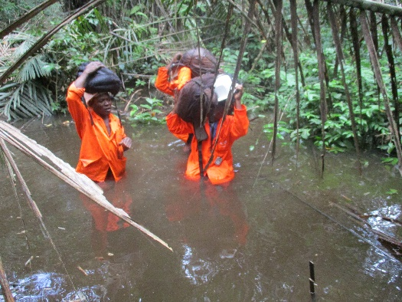
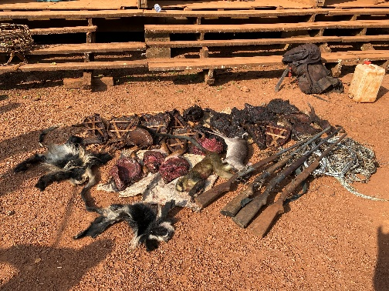
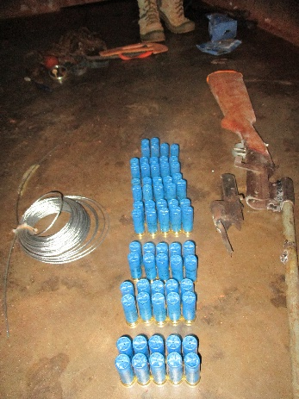

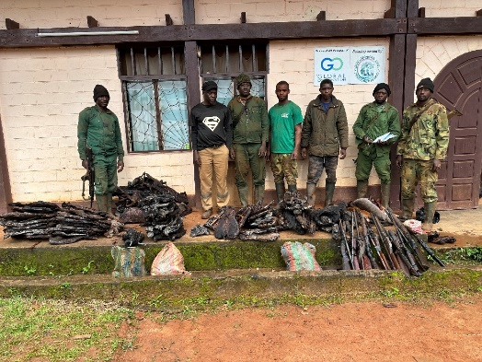
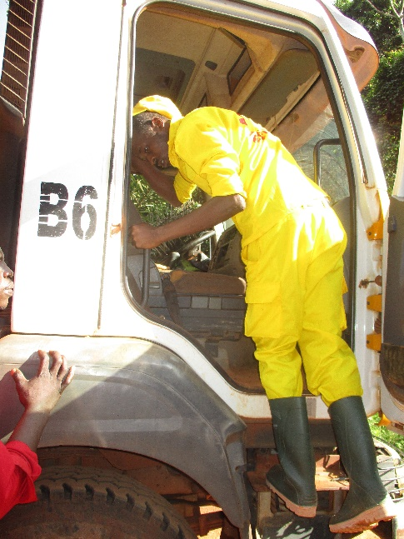
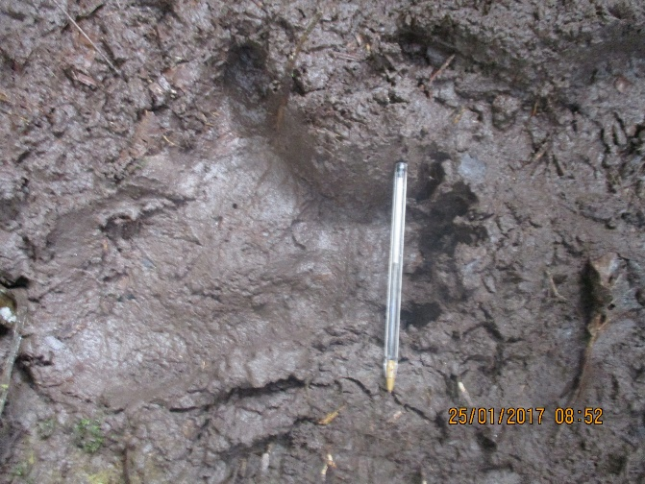
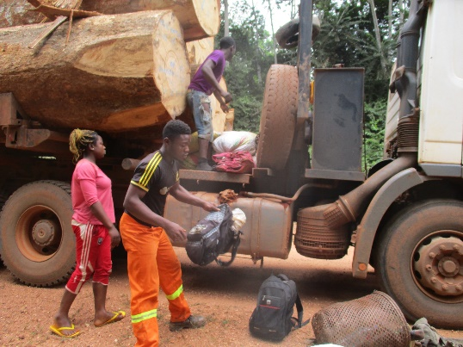
1. Introduction | 2. METHOD | 3. RESULTS AND DISCUSSIONS | 4. CONCLUSION
Specific objectives
1. Monitoring law enforcement strategies implementation in the forest concession;
2. Estimating their effect on poaching rate and on the relative abundance of important large mammal species;
3. Assessing the cost of the law enforcement strategies;
4

Slide 5











1. Introduction | 2. METHOD | 3. RESULTS AND DISCUSSIONS | 4. CONCLUSION
Law enforcement strategies in forest concessions
2. Method
To reduce poaching in the forest concession
1. Foot patrols with trained ex hunters (wildlife team of the logging company)
Road based :
SMART based :
MOU (MINFOF-logging company)
2. Joint anti-poaching motorized and foot patrols with MINFOF (sworn official ecoguards) + Gendarmes (MINDEF) + wildlife team
Preliminary work (wildlife survey, anti poaching patrols)
3. Access regulation through checkpoints at the entrances and exits of the forest concession
4. Unannounced employee camps and vehicle controls on logging roads within the forest concession.
100km
5

Slide 6

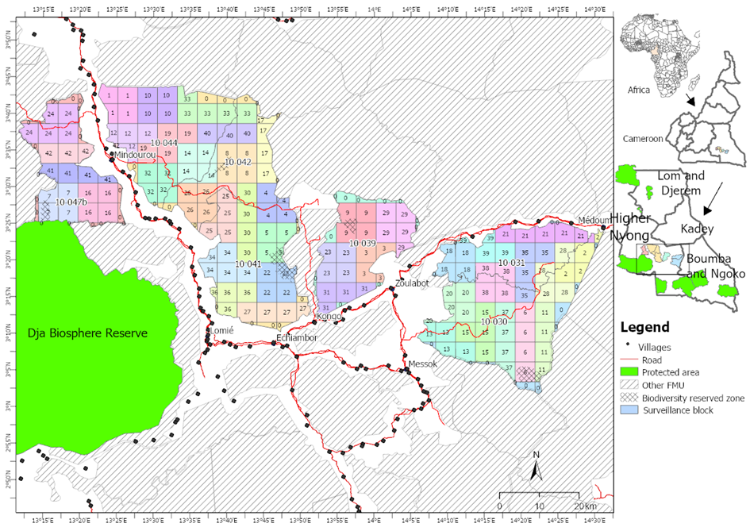
1. Introduction | 2. METHOD | 3. RESULTS AND DISCUSSIONS | 4. CONCLUSION
Law enforcement strategies in forest concessions
Sampling design
6

Slide 7
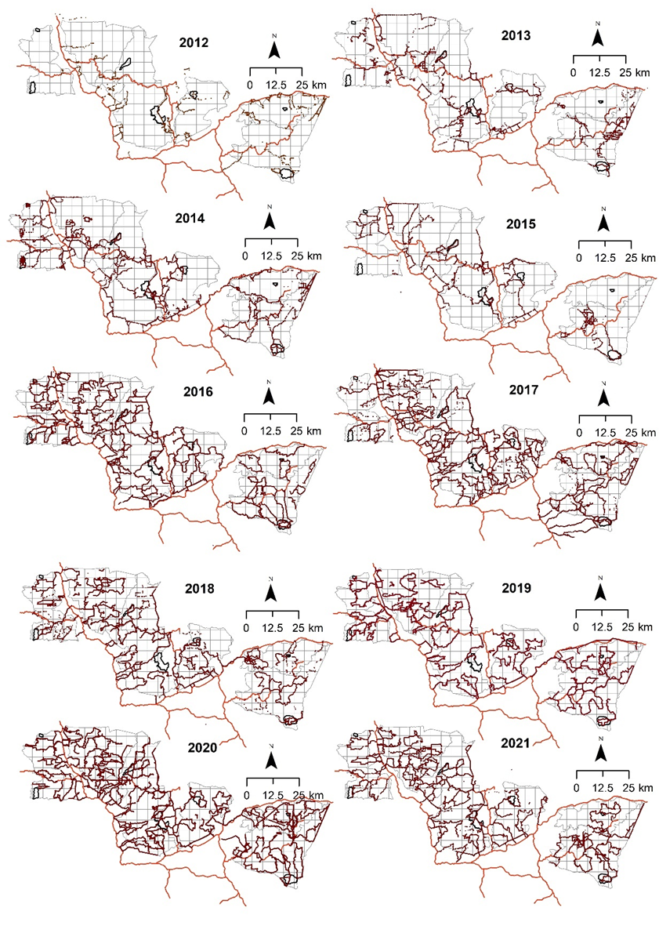

1. Introduction | 2. METHOD | 3. RESULTS AND DISCUSSIONS | 4. CONCLUSION
Law enforcement strategies in forest concessions
3.1. Implementation of anti-poaching strategies
Foot patrols with trained members of the wildlife team of the logging company
An average of 6.3 patrols per month, 4 persons per patrol and 3 days per patrol
Highest poaching signs: wire snares (47%) during SMART-based patrols
Wire snare from 2008 to 2015 (P<0,05)
Wire snare from 2016 to 2021 (P< 0.05).
Grand total of 0.8 ± 0.09 poaching observations/km²/year.
Wildlife team
Ecoguard Dja
85.6km/100km²/year
80km /100km²/year
0.001 person/km2
0.01 ecoguards/km²
Spatial coverage doubled after 2015 !
7
Notes:
194 ± 32 km for a total of 30 296 km walked (14 years).
Patrols collected on average 0.3± 0.04 shotgun cartridges/km²/year,
deactivated 0.44 ± 0.08 wire snare traps/km²/year,
encountered 0.012 ± 0.002 armed poachers/km²/year
identified 0.04 ± 0.004 active poaching camps/km²/year,

Slide 8
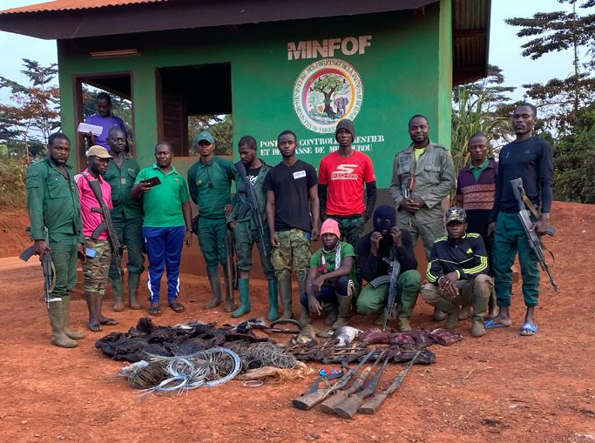
1. Introduction | 2. METHOD | 3. RESULTS AND DISCUSSIONS | 4. CONCLUSION
Law enforcement strategies in forest concessions
3.1. Implementation of anti-poaching strategies
Joint anti-poaching motorized and foot patrols with ecoguards, gendarmes and members of the wildlife team of the logging company
8

Slide 9
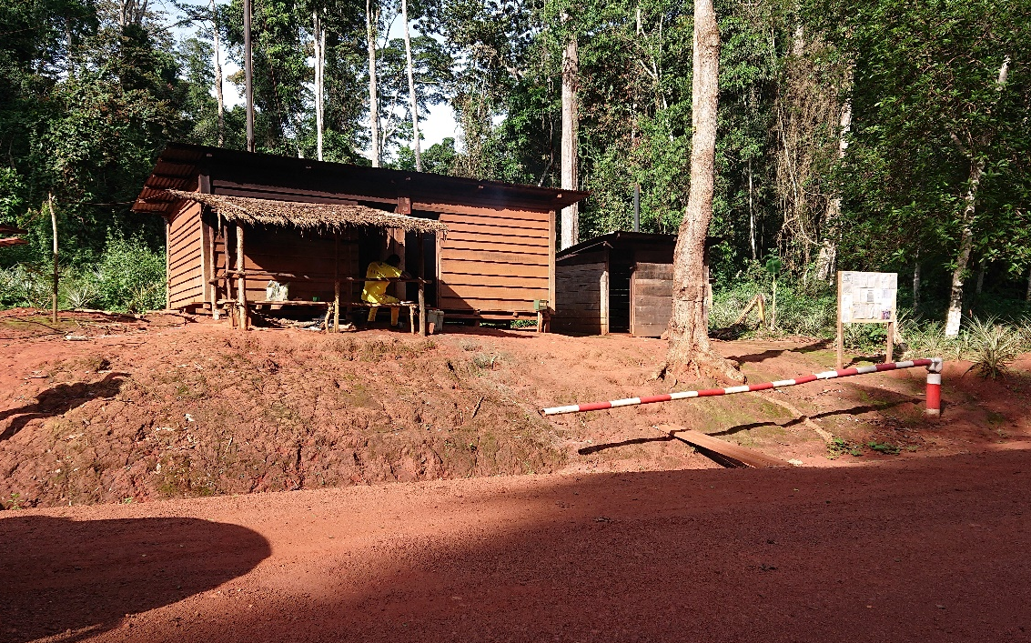
1. Introduction | 2. METHOD | 3. RESULTS AND DISCUSSIONS | 4. CONCLUSION
Law enforcement strategies in forest concessions
3.1. Implementation of anti-poaching strategies
Access regulation through checkpoints at the entrances and exits of the forest concession
24 923 ± 1 995 controls/year
Unannounced controls of employees in camps and vehicles on road network within the forest concession
6.3 ± 0.9 unannounced vehicle controls/year,
3.3 ± 1.0 infractions registered and 80% (poaching).
90% infractions (truck drivers (mostly sub contractors))
Unannounced controls (forest camps) ->3 infractions / 25 controls in 10 years (poaching)
9

Slide 10
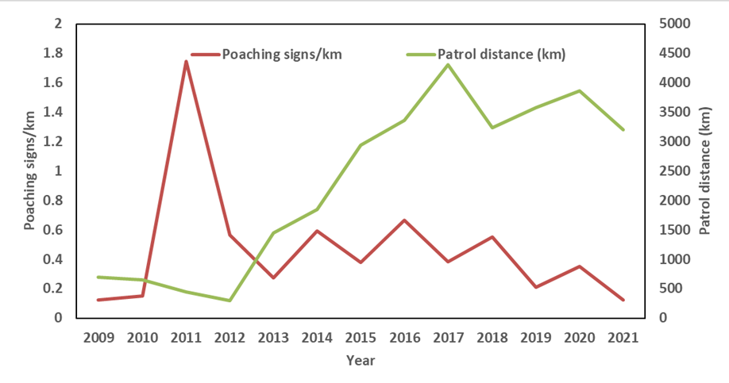
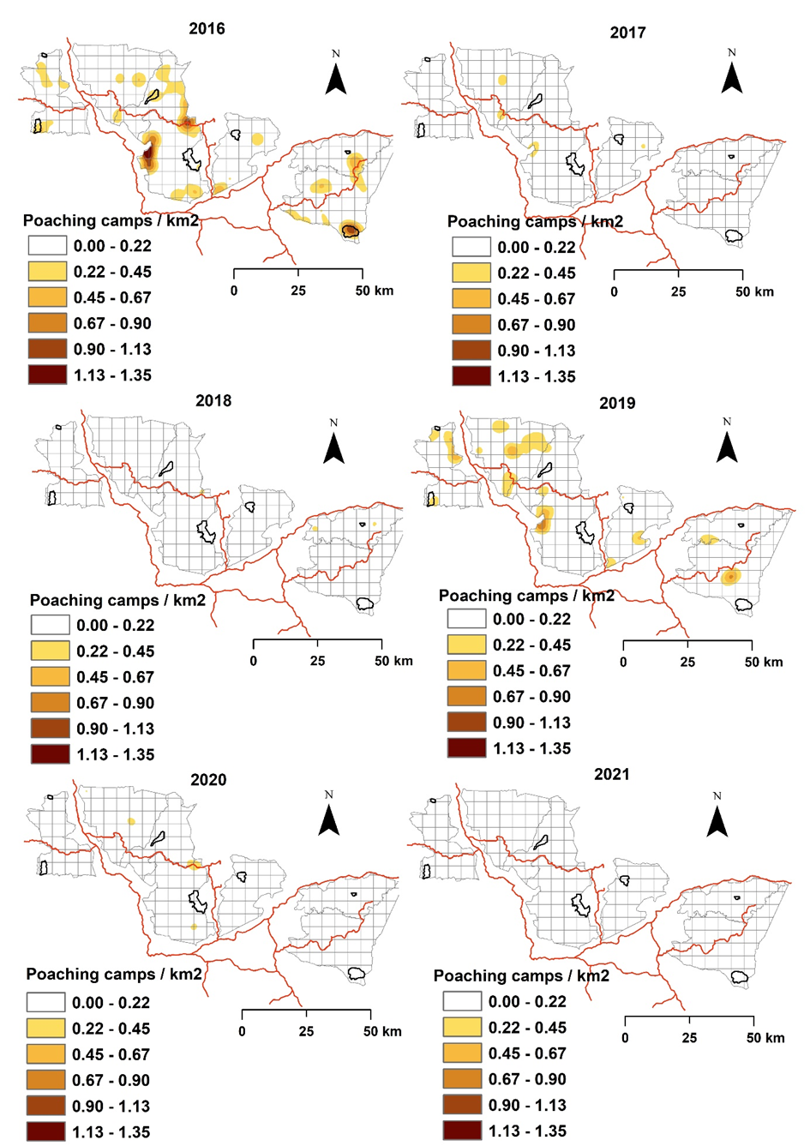
1. Introduction | 2. METHOD | 3. RESULTS AND DISCUSSIONS | 4. CONCLUSION
Law enforcement strategies in forest concessions
3.2. Monitoring effects of law enforcement strategies on poaching rate and relative abundance of mammal species
Decrease in hotspots of poaching camps
Patrol effort increased (p<0,001)
Poaching signs (wire snares/km) (p<0,5)
Patrol effort ~ Poaching signs (p<0,05)
Rise of poaching signs in 2020-2021, corresponding to the period when the COVID pandemic started.
10
Notes:
High poaching rate phase of implementation of SMART-based patrols also observed in kakum conservation area in Ghana (Wiafe, 2016).

Slide 11



1. Introduction | 2. METHOD | 3. RESULTS AND DISCUSSIONS | 4. CONCLUSION
Law enforcement strategies in forest concessions
3.2. Monitoring effects of law enforcement strategies on poaching rate and relative abundance of mammal species
Women observed ~ bushmeat harvest (r² = 0.70; +ve)
Women involved in poaching (Agu and Gore, 2020)
13 145 ± 745 kg /year (51% checkpoint near industrial site)
Truck movements ~ # armed poachers (r² = 0.50; +ve)
Poaching activities are facilitated by vehicles using logging roads especially trucks carrying logs out of the forest concession (Vanthomme et al., 2017)
Bushmeat harvested (r²=0.51);
# unannounced vehicle controls (r²=0.60);
Bushmeat harvest ~ unannounced controls (r²=0.5, -ve);
Mean annual harvest for the FMU 10.044 concession (10kg/km2/year)→underestimated (Lhoest, Vermeulen, Julve)
Unannounced controls played a critical role in the reduction of bushmeat harvest during the past 14 years
11

Slide 12
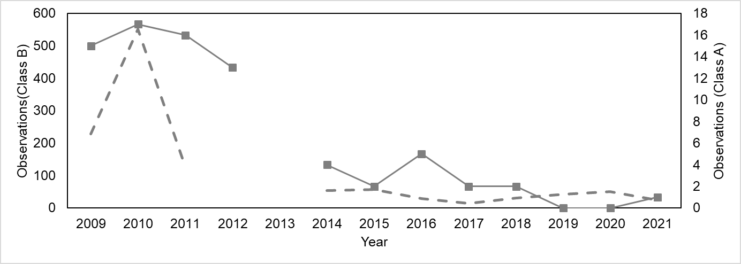
1. Introduction | 2. METHOD | 3. RESULTS AND DISCUSSIONS | 4. CONCLUSION
Law enforcement strategies in forest concessions
3.2. Monitoring effects of law enforcement strategies on poaching rate and relative abundance of mammal species
Checkpoint data
LE Patrol / wildlife survey data
3 942 direct and indirect observation signs for 27 targeted species of medium and large mammals within the forest concession during patrols (Direct and indirect will be separated);
Peter’s duiker (Cephalophus callipygus) and Bay duiker (Cephalophus dorsalis) had the most abundant observation signs;
More observations during wildlife surveys than LEM patrols
1.3 (giant pangolins) to 10.4 times (yellow backed duiker);
Observations of forest elephant, gorilla, chimpanzee and the giant pangolin did not vary significantly (p>0,05); Other species??
Decrease in carcasses observed for class A ( p<0.001) and class B (p<0.01)
12

Slide 13
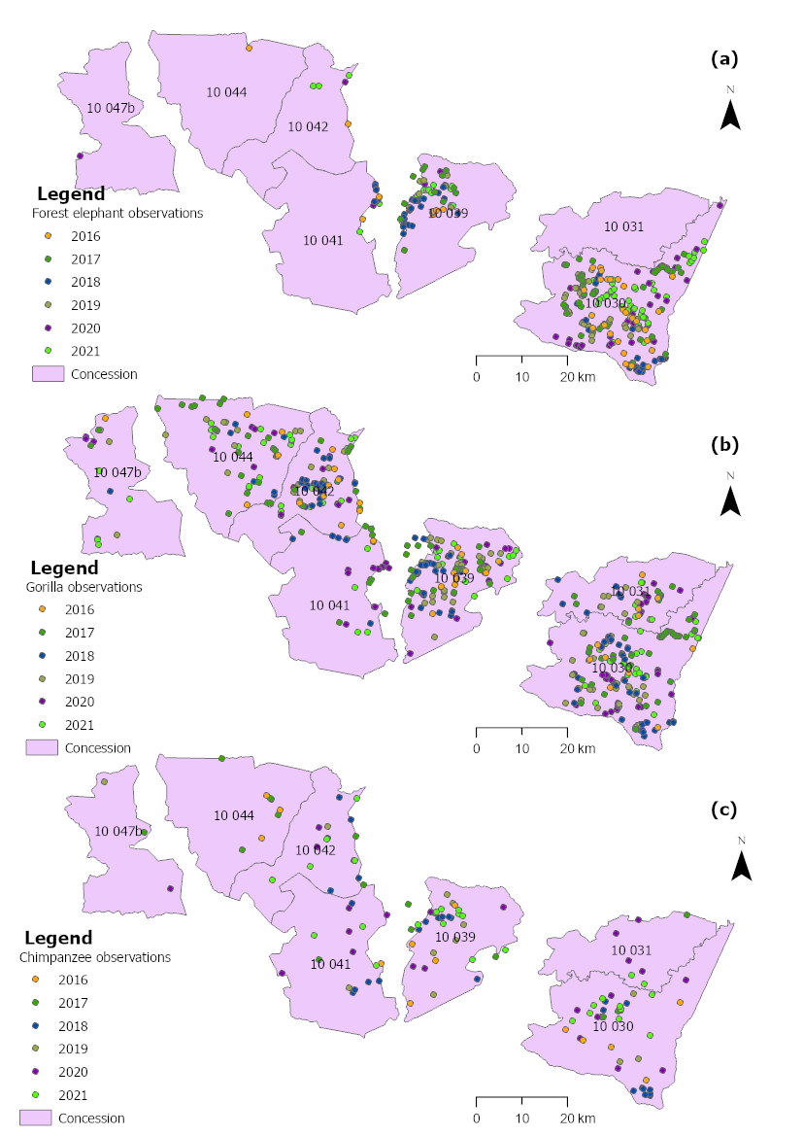
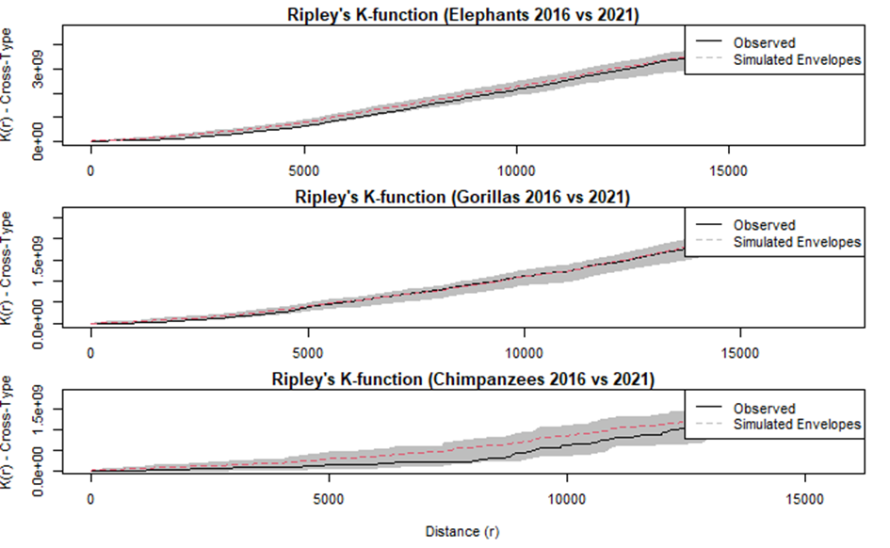
1. Introduction | 2. METHOD | 3. RESULTS AND DISCUSSIONS | 4. CONCLUSION
Law enforcement strategies in forest concessions
3.2. Monitoring effects of law enforcement strategies on poaching rate and relative abundance of mammal species
The spatial distributions of chimpanzee and forest elephant revealed no change of the spatial distribution;
Ripley’s K-function plot reveal that there was no significant spatial difference;
13

Slide 14










Introduction | 2. METHOD | 3. RESULTS AND DISCUSSIONS | 4. CONCLUSION
Law enforcement strategies in forest concessions
3.3. Costs of law enforcement strategies
Road-based patrols SMART-based patrols
41 803 ± 5231 $/year 53 441± 1124 $/year
43.7 ± 9.0 $/km
14.5 ± 0.6 $/km
5 889 ± 431 $/year
27 901 $/year
3 364 ± 568 $/year
Total cost = 84 395 ± 1 734 $/year→
1 097 131 $ mobilized for over 14 years (2008 to 2021).
23$/km²/year)
Africa’s PA --->50 $/km² < 1000 $/km² (required)(Lindsey et al, 2018).
14

Slide 15
Introduction | 2. METHOD | 3. RESULTS AND DISCUSSIONS | 4. CONCLUSION
Law enforcement strategies in forest concessions
4. Conclusion
LEM patrols are efficient in reducing poaching in logging concessions;
SMART approach improved the patrol quality but need more prosecution;
Targeted anti poaching joint patrol are efficient in reducing hotspots of poaching camps;
Access regulation prevents illegal entries;
Access regulation collect bushmeat data to inform anti poaching strategies;
Truck drivers and women plays a major role in poaching in logging concessions;
Unannounced controls reduce poaching facilitated by truck drivers on logging roads ;
23$/km²/year investment can reduce poaching in forest concessions
Nevertheless, need for more deep analysis of the effect of patrol vs poaching on specific species
15

Slide 16
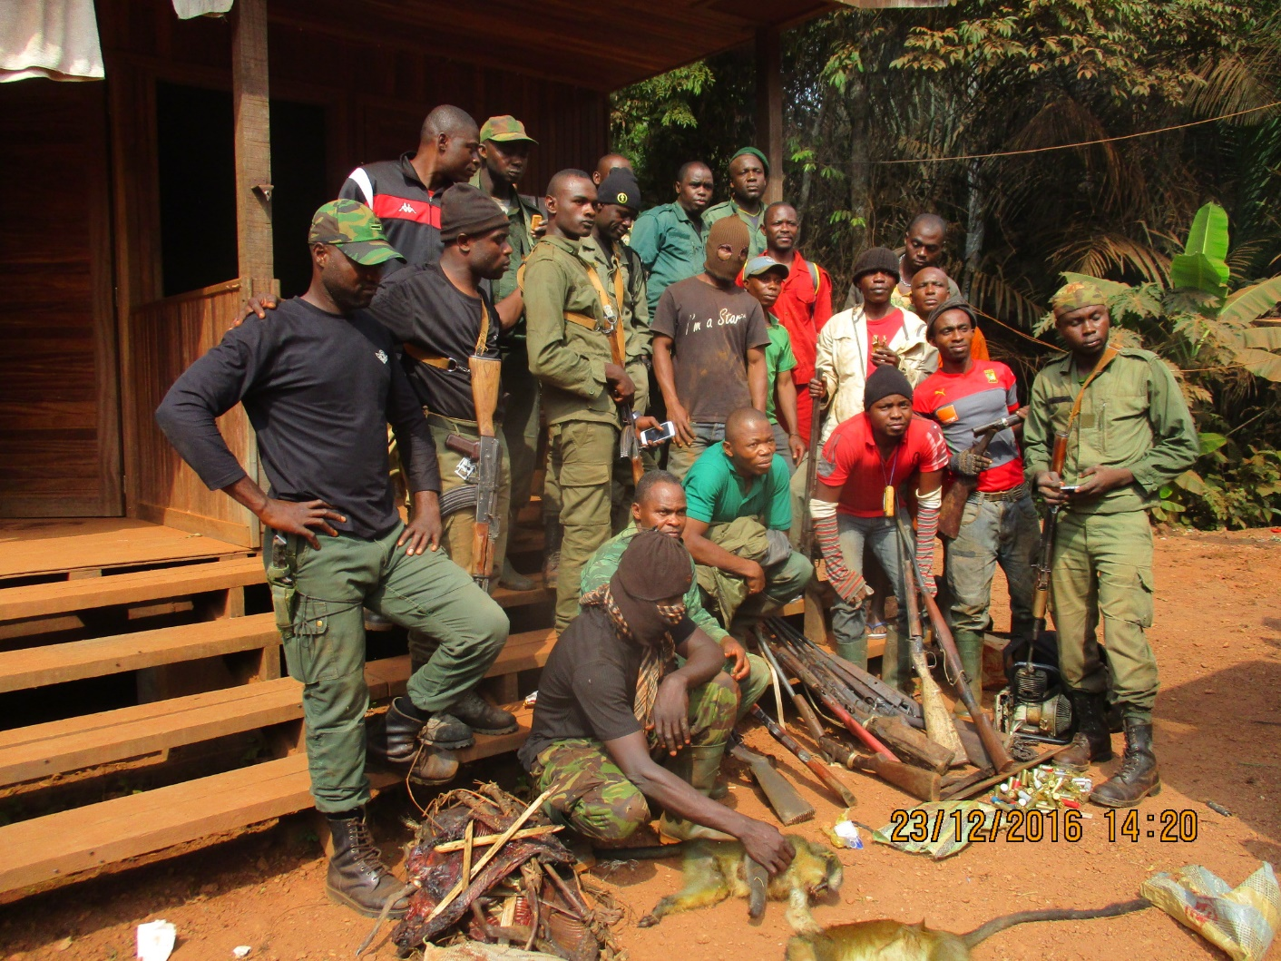

Introduction | 2. METHOD | 3. RESULTS AND DISCUSSIONS | 4. CONCLUSION
Thanks
16

