Slide 1

Complications and Recurrence After Perineal Hernia Repair by Internal Obturator Muscle Transposition in 48 Dogs
Samuel Larcheveque, DMV
Small Animal Surgery Resident
Department of Companion Animal Clinical Sciences, Faculty of Veterinary Medicine, University of Liège, Liège, Belgium
Notes:
Rajouter résident chirurgie nom du departement

Slide 2

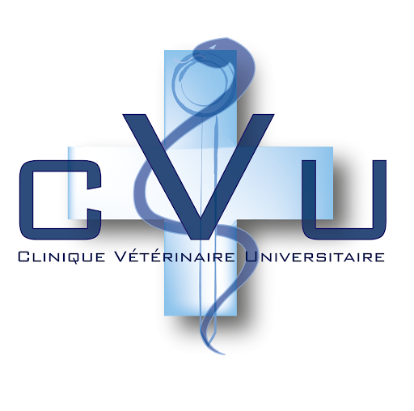

Affiliation
Authors: S. Larcheveque, R. Lotfi, S. Claeys, A. Hamaide, S. Noël
Department of Companion Animal Clinical Sciences, Faculty of Veterinary Medicine, University of Liège, Liège, Belgium
Notes:
Ajouter auteurs

Slide 3

I have no financial interest to declare

Slide 4
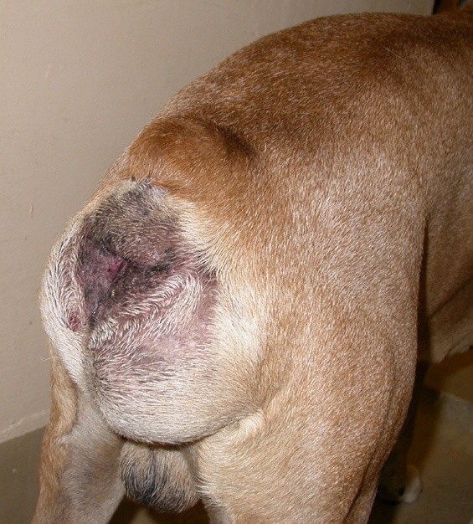
Introduction
Perineal hernias occur when the pelvic diaphragm muscles fail to support the rectal wall
Occurs mostly in intact male dogs over 5 years old
Etiology not completely understood, probably multifactorial
Hormonal influence seems to be associated with perineal hernia
Multiple surgical techniques have been described, internal obturator muscle transposition being one of the most prominent in the veterinary literature

Slide 5
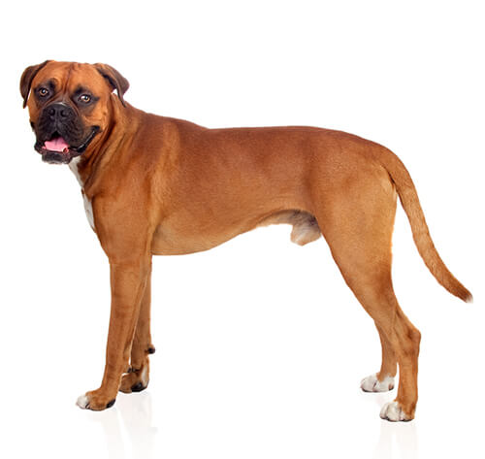
Introduction
Objective of the study:
To describe complications associated with internal obturator muscle transposition for perineal hernia repair and identify risk factors for recurrence

Slide 6
Methods
Retrospective study
Inclusion criteria: dogs that underwent a perineal repair by transposition of the internal obturator muscle in our teaching hospital between 2016 and 2023
Diagnosis performed by rectal palpation and all dogs had an abdominal and hernia ultrasound
Exclusion:
Dogs with recurrence from a surgery performed elsewhere
Dogs where the internal obturator muscle transposition could not be performed

Slide 7
Methods
Procedure
Before surgery: all dogs had lactulose and received a gastrointestinal diet between appointment and surgery
Surgery performed in sternal recumbency
Prescrotal castration performed in all intact males
Organopexy performed at the same time of the surgery if needed
Surgery performed by an ECVS diplomate or a resident in small animal surgery under direct ECVS Diplomate supervision
Postoperative treatment: cefazolin for 2 weeks, lactulose and hyperdigestible diet until recheck. Elizabethan collar for two weeks until stitches removal
Notes:
All dogs stayed in hospital for 24-48 hours with intravenous fluids, methadone (0.2 mg/kg q4h), cefazolin (20 mg/kg IV TID) and lactulose (0,3 mL/kg PO TID)

Slide 8
Methods
Data
Signalment (age, breed, neutering status)
Clinical signs
Complications (immediate, short-term, long-term)
Follow-up:
Clinical follow-up at 4-6 weeks postoperatively
Owner questionnaire for long-term

Slide 9

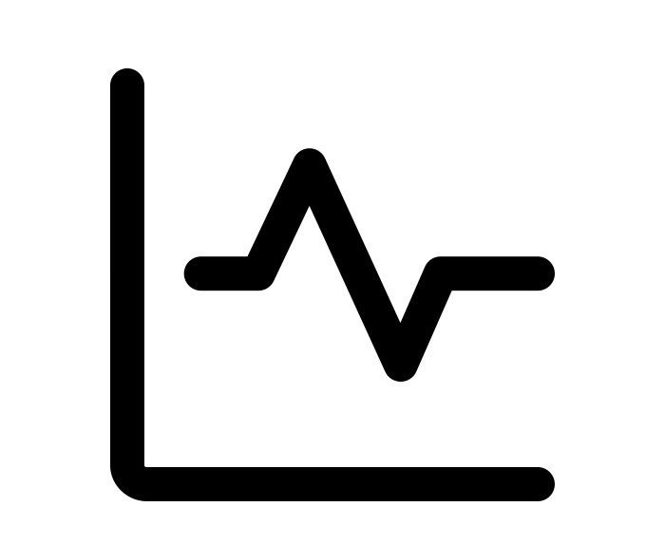
Methods
Statistical analysis
Chi-Square test performed to identify risk factors for recurrence, including testicular and prostatic pathologies, organopexy, surgeon experience, postoperative tenesmus and unilateral versus bilateral hernias.

Slide 10

Results
Cohort
48 cases included in our cohort
All dogs were male dogs with a median age of 8.7 years [6 – 13]
79% (38/48) dogs were intact male dogs,
Various breeds: Maltese 19%, cross-breed dogs 19%, Chihuahua 8%, Yorkshire terrier 8%, Boder Collie 6%, …
Notes:
6% (3/48) dogs were neutered less than a month before surgery
The remaining dogs were neutered at a previous date

Slide 11
Results
 | Number of cases | Percentage (%)
Fecal tenesmus | 33 | 69
Constipation | 11 | 23
Lethargy | 8 | 17
Pain | 8 | 17
Diarrhea | 7 | 15
Stranguria | 6 | 13
Anorexia | 5 | 10
Hematochezia | 4 | 8
Pollakiuria | 3 | 6
Vomiting | 3 | 6
Hematuria | 2 | 4
Dysorexia | 2 | 4
Hypothermia | 1 | 2
Rectal Prolapse | 1 | 2
None | 4 | 8
Clinical signs
100% dogs had a perineal mass effect
Most common sign: tenesmus in 69%
Bilateral in 63% cases
When unilateral, right hernia in 89% cases
Notes:
diarrhea faute d'orthographe
definition tenesme et constipation

Slide 12
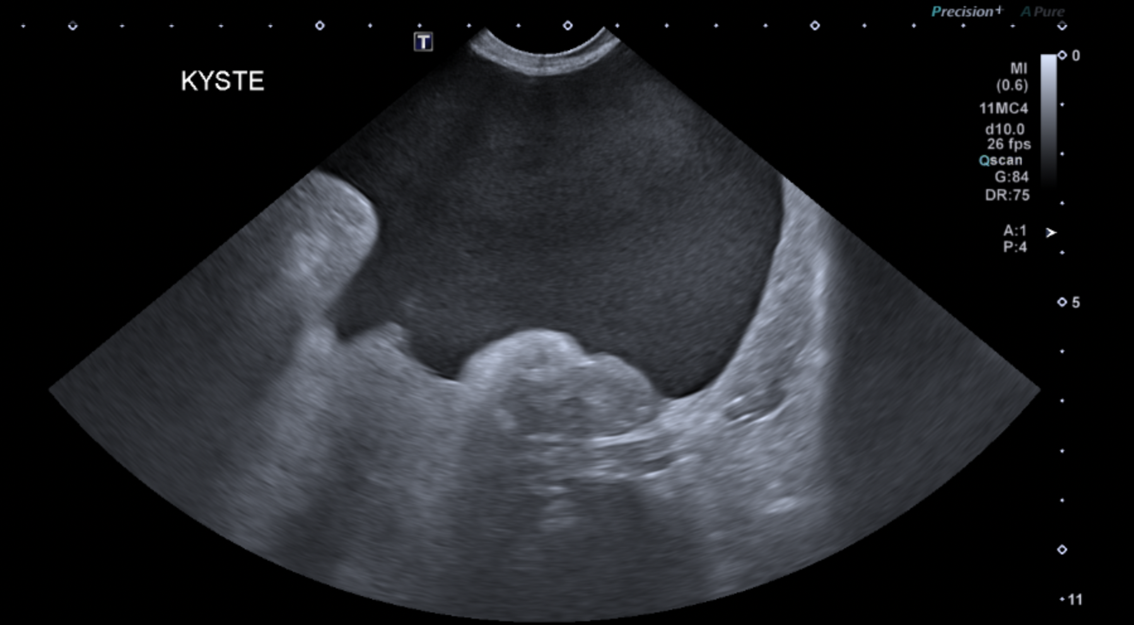
Results
Abdominal ultrasound
Prostatic finding in 83% cases ((para)-prostatic cysts mainly)
Testicular nodules in 13% cases
Hernia content: small bowels (58% cases), prostate (42%), urinary bladder (33%)
Courtesy of The Imaging Department of the CVU
Paraprostatic cyst
Notes:
prostatic finidings ?

Slide 13
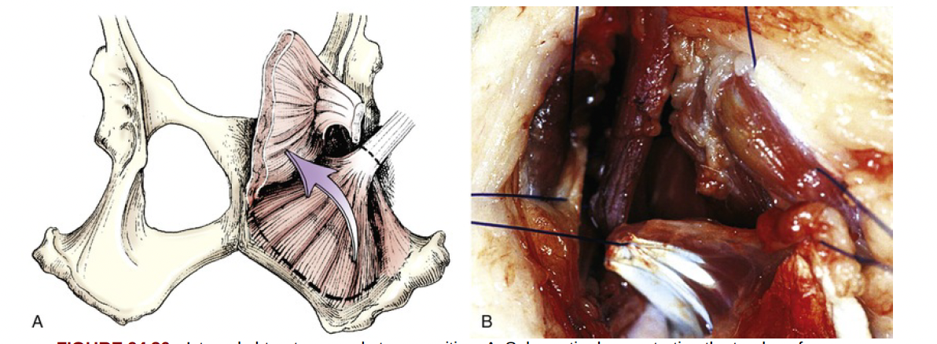
Results
Treatment
Medical treatment :
67% of dogs received lactulose preoperatively
Others were presented in an emergency setting
Surgical treatment:
89% had a neutering procedure at the time of the Internal obturator muscle transposition
92% cases had no organopexy (colopexy nor cystopexy)
1 dogs had a polypropylene mesh added to the transposition of the internal obturator muscle
All dogs had NSAIDs, lactulose and hyperdigestible diet postoperatively
From Tobias and Johnston, Veterinary Surgery in Small animals

Slide 14
Results
Complications
Immediate (48 cases)
81% had no complication
1 dog with pain and paraparesis with a thrombus
Short-term (35 cases)
Median time to follow-up 1 month
Complication rate 31%
9% had tenesmus, 9% had dysuria
Long-term (20 cases)
35% had tenesmus for a median of 318 days
Tenesmus 4%, rectal prolapse 8%, dysuria 2%
10% had dysorexia
Notes:
detailler les principales complications immediates
et detailler les complications

Slide 15
Results
Recurrence
26% dogs had a recurrence in medium to long term
In 50% cases, recurrence occurred between 3 to 4 months postoperatively
None of the tested risk factors (prostatic pathology, organopexy, tenesmus, surgery performed by a resident, bilateral pathology) were significantly associated with recurrence
Dogs with testicular pathology had a higher recurrence rate (OR 3.33)

Slide 16
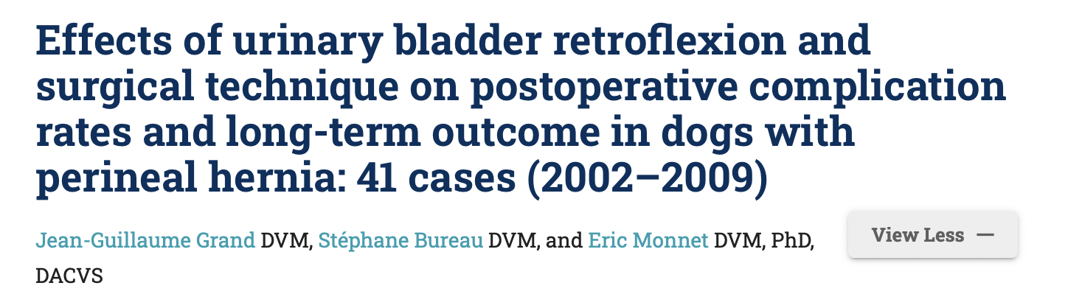
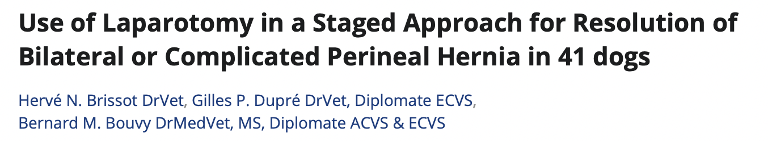
Discussion
Moderate recurrence rate
Transposition of internal obturator muscle is a successful technique for perineal hernia repair
Recurrence rate in literature between 8-33%
No systematic organopexy: debatable outcomes in literature
Notes:
First study less recurrence and less with organopexy BUT not only IOMT
Second one no difference
Moderate plutot que high
dire que ça nous fait changer approche pour améliorer les choses
laisser sous alimentation hyperdigestible à vie

Slide 17
Discussion
Surgical technique
Just one technique studied here
Traditional herniorraphy had a higher recurrence rate than internal obturator muscle transposition
Fascia lata graft non inferior
Ideally, prospective cohorts comparing surgeries

Slide 18
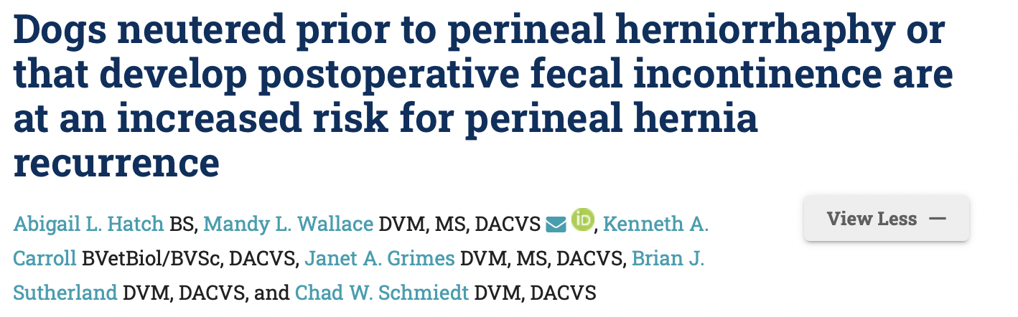
Discussion
Factors for recurrence
Surgeon experience here not a factor for recurrence
Bladder retroflexion : here no influence on recurrence
Here testicular pathology seems to have influence on recurrence → Hormonal influence on healing ?
BUT recent study
Notes:
Retrospective study : dogs neutered prior surgery + fecal incontinence higher risk of recurrence → does not support the hypothesis of our study
Also more tenesmus for dogs neutered prior in this study. Counterintuitive
point d'interrogation ?
On en avait pas beaucoup --> meriterait d,être etudié sur plus grosse cohorte de cas

Slide 19
Discussion
Other limitations
Retrospective nature of the study
Small sample of cases
Questionnaire follow-up (lack of global follow-up)

Slide 20
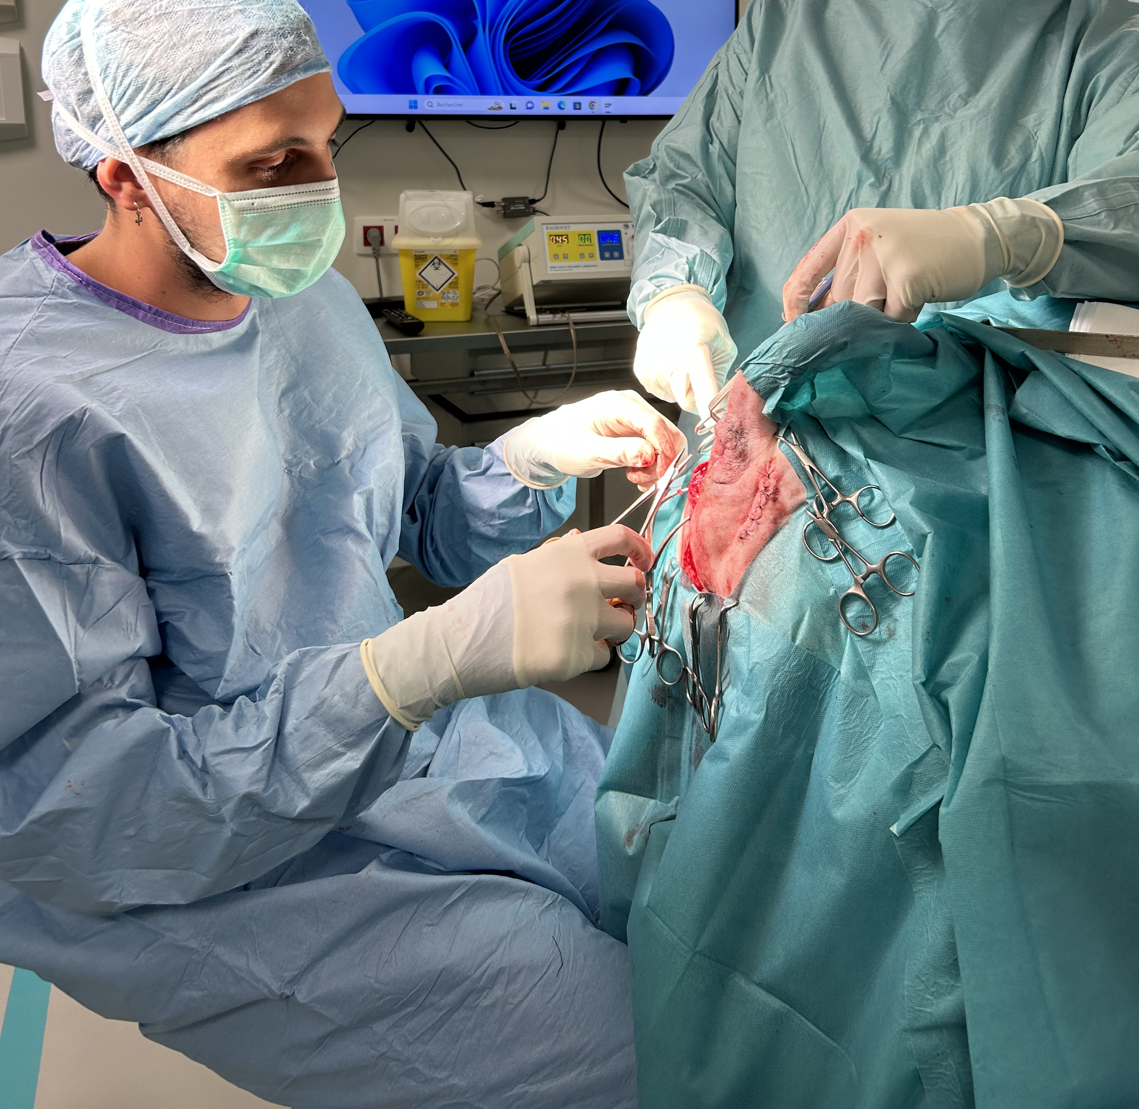
Conclusion
Internal obturator muscle transposition for perineal hernia repair is associated with a moderate rate of complications and recurrence.
Testicular pathology may increase the risk of recurrence, possibly due to hormonal factors.
Further studies are needed to confirm these findings and identify strategies to improve outcomes

Slide 21
References
Åhlberg, T.M., Salla, K., Laitinen-Vapaavuori, O.M., Mölsä, S.H., 2024. Treatment of canine perineal hernia with a fascia lata graft is noninferior to the elevation of the internal obturator muscle: a prospective randomized trial of 66 dogs. J. Am. Vet. Med. Assoc. 262, 1–9. https://doi.org/10.2460/javma.23.11.0650
Bernardé, A., Rochereau, P., Matres-Lorenzo, L., Brissot, H., 2018. Surgical findings and clinical outcome after bilateral repair of apparently unilateral perineal hernias in dogs. J. Small Anim. Pract. 59, 734–741. https://doi.org/10.1111/jsap.12920
Bilbrey, S.A., Smeak, D.D., Dehoff, W., 1990. Fixation of the Deferent Ducts for Retrodisplacement of the Urinary Bladder and Prostate in Canine Perineal Hernia. Vet. Surg. 19, 24–27. https://doi.org/10.1111/j.1532-950X.1990.tb01138.x
Brissot, H.N., Dupré, G.P., Bouvy, B.M., 2004. Use of Laparotomy in a Staged Approach for Resolution of Bilateral or Complicated Perineal Hernia in 41 dogs. Vet. Surg. 33, 412–421. https://doi.org/10.1111/j.1532-950X.2004.04060.x
Carbonell Rosselló, G., Turner, A., Macias, C., Ramírez, J.M., 2023. Combined transposition of internal obturator and superficial gluteal muscles for perineal hernia treatment in dogs: 17 cases (2017-2020). J. Small Anim. Pract. 64, 96–102. https://doi.org/10.1111/jsap.13563
Gill, S.S., Barstad, R.D., 2018. A Review of the Surgical Management of Perineal Hernias in Dogs. J. Am. Anim. Hosp. Assoc. 54, 179–187. https://doi.org/10.5326/JAAHA-MS-6490
Grand, J.-G., Bureau, S., Monnet, E., 2013. Effects of urinary bladder retroflexion and surgical technique on postoperative complication rates and long-term outcome in dogs with perineal hernia: 41 cases (2002-2009). J. Am. Vet. Med. Assoc. 243, 1442–1447. https://doi.org/10.2460/javma.243.10.1442

Slide 22
References
Hashimoto, Y., Nakagawa, T., Nishimura, R., 2023. Evaluation of semitendinosus muscle transposition for treatment of perineal hernias in 33 small-breed dogs. Can. J. Vet. Res. Rev. Can. Rech. Veterinaire 87, 282–289.
Hatch, A.L., Wallace, M.L., Carroll, K.A., Grimes, J.A., Sutherland, B.J., Schmiedt, C.W., 2025. Dogs neutered prior to perineal herniorrhaphy or that develop postoperative fecal incontinence are at an increased risk for perineal hernia recurrence. J. Am. Vet. Med. Assoc. 1, 1–6. https://doi.org/10.2460/javma.24.07.0487
Heishima, T., Asano, K., Ishigaki, K., Yoshida, O., Sakurai, N., Terai, K., Seki, M., Teshima, K., Tanaka, S., 2022. Perineal herniorrhaphy with pedunculated tunica vaginalis communis in dogs: Description of the technique and clinical case series. Front. Vet. Sci. 9, 931088. https://doi.org/10.3389/fvets.2022.931088
Orsher, R.J., 1986. Clinical and Surgical Parameters in Dogs with Perineal Hernia Analysis of Results of Internal Obturator Transposition. Vet. Surg. 15, 253–258. https://doi.org/10.1111/j.1532-950X.1986.tb00218.x
Shaughnessy, M., Monnet, E., 2015. Internal obturator muscle transposition for treatment of perineal hernia in dogs: 34 cases (1998-2012). J. Am. Vet. Med. Assoc. 246, 321–326. https://doi.org/10.2460/javma.246.3.321
Tobias, K.M., Crombie, K., 2022. Perineal hernia repair in dorsal recumbency in 23 dogs: Description of technique, complications, and outcome. Vet. Surg. VS 51, 772–780. https://doi.org/10.1111/vsu.13812

Slide 23
Affiliation

