Slide 1

Complications and Clinical Outcomes of Conventional Surgery Versus Subcutaneous Ureteral Bypass (SUB) in the Management of Feline Ureteral Urolithiasis
Samuel Larcheveque, DMV
Small Animal Surgery Resident
Department of Companion Animal Clinical Sciences, Faculty of Veterinary Medicine, University of Liège, Liège, Belgium

Slide 2



Affiliation
Authors: S. Larcheveque, C. Orban, S. Claeys, A. Hamaide, S. Noël
Department of Companion Animal Clinical Sciences, Faculty of Veterinary Medicine, University of Liège, Liège, Belgium
Notes:
Ajouter auteurs

Slide 3

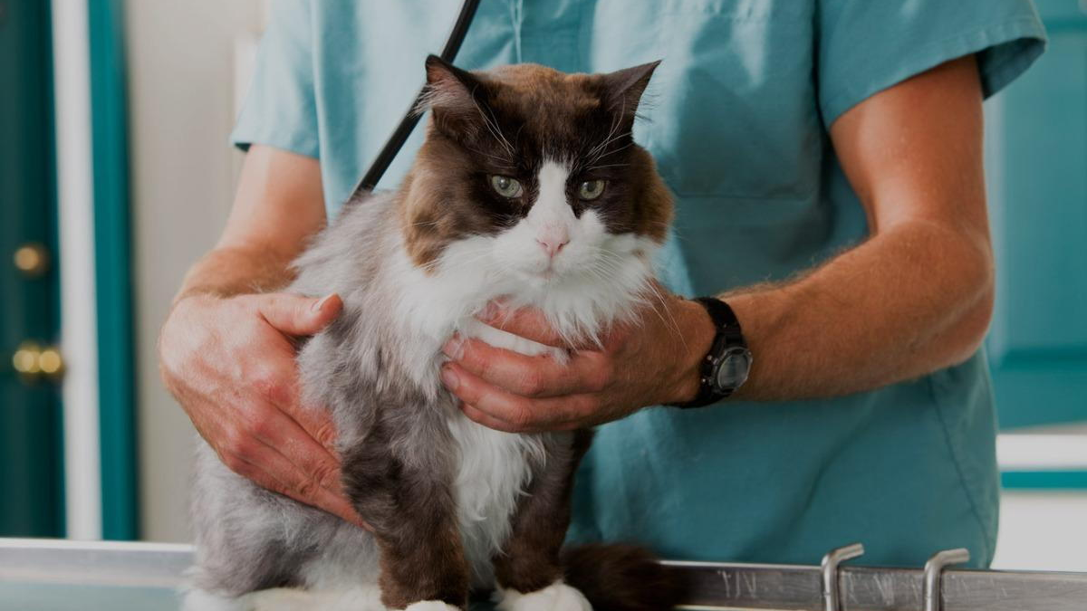
I have no financial interest to declare

Slide 4

Introduction
Benign ureteral obstruction is a well-known pathology in cats
Potentially life-threatening
Acute Kidney Injury (AKI) with azotemia
Chronic Kidney Disease (CKD) often associated
Usually secondary to uroliths (mainly calcium oxalate > 98%)
Prolonged obstruction can lead to irreversible damage

Slide 5
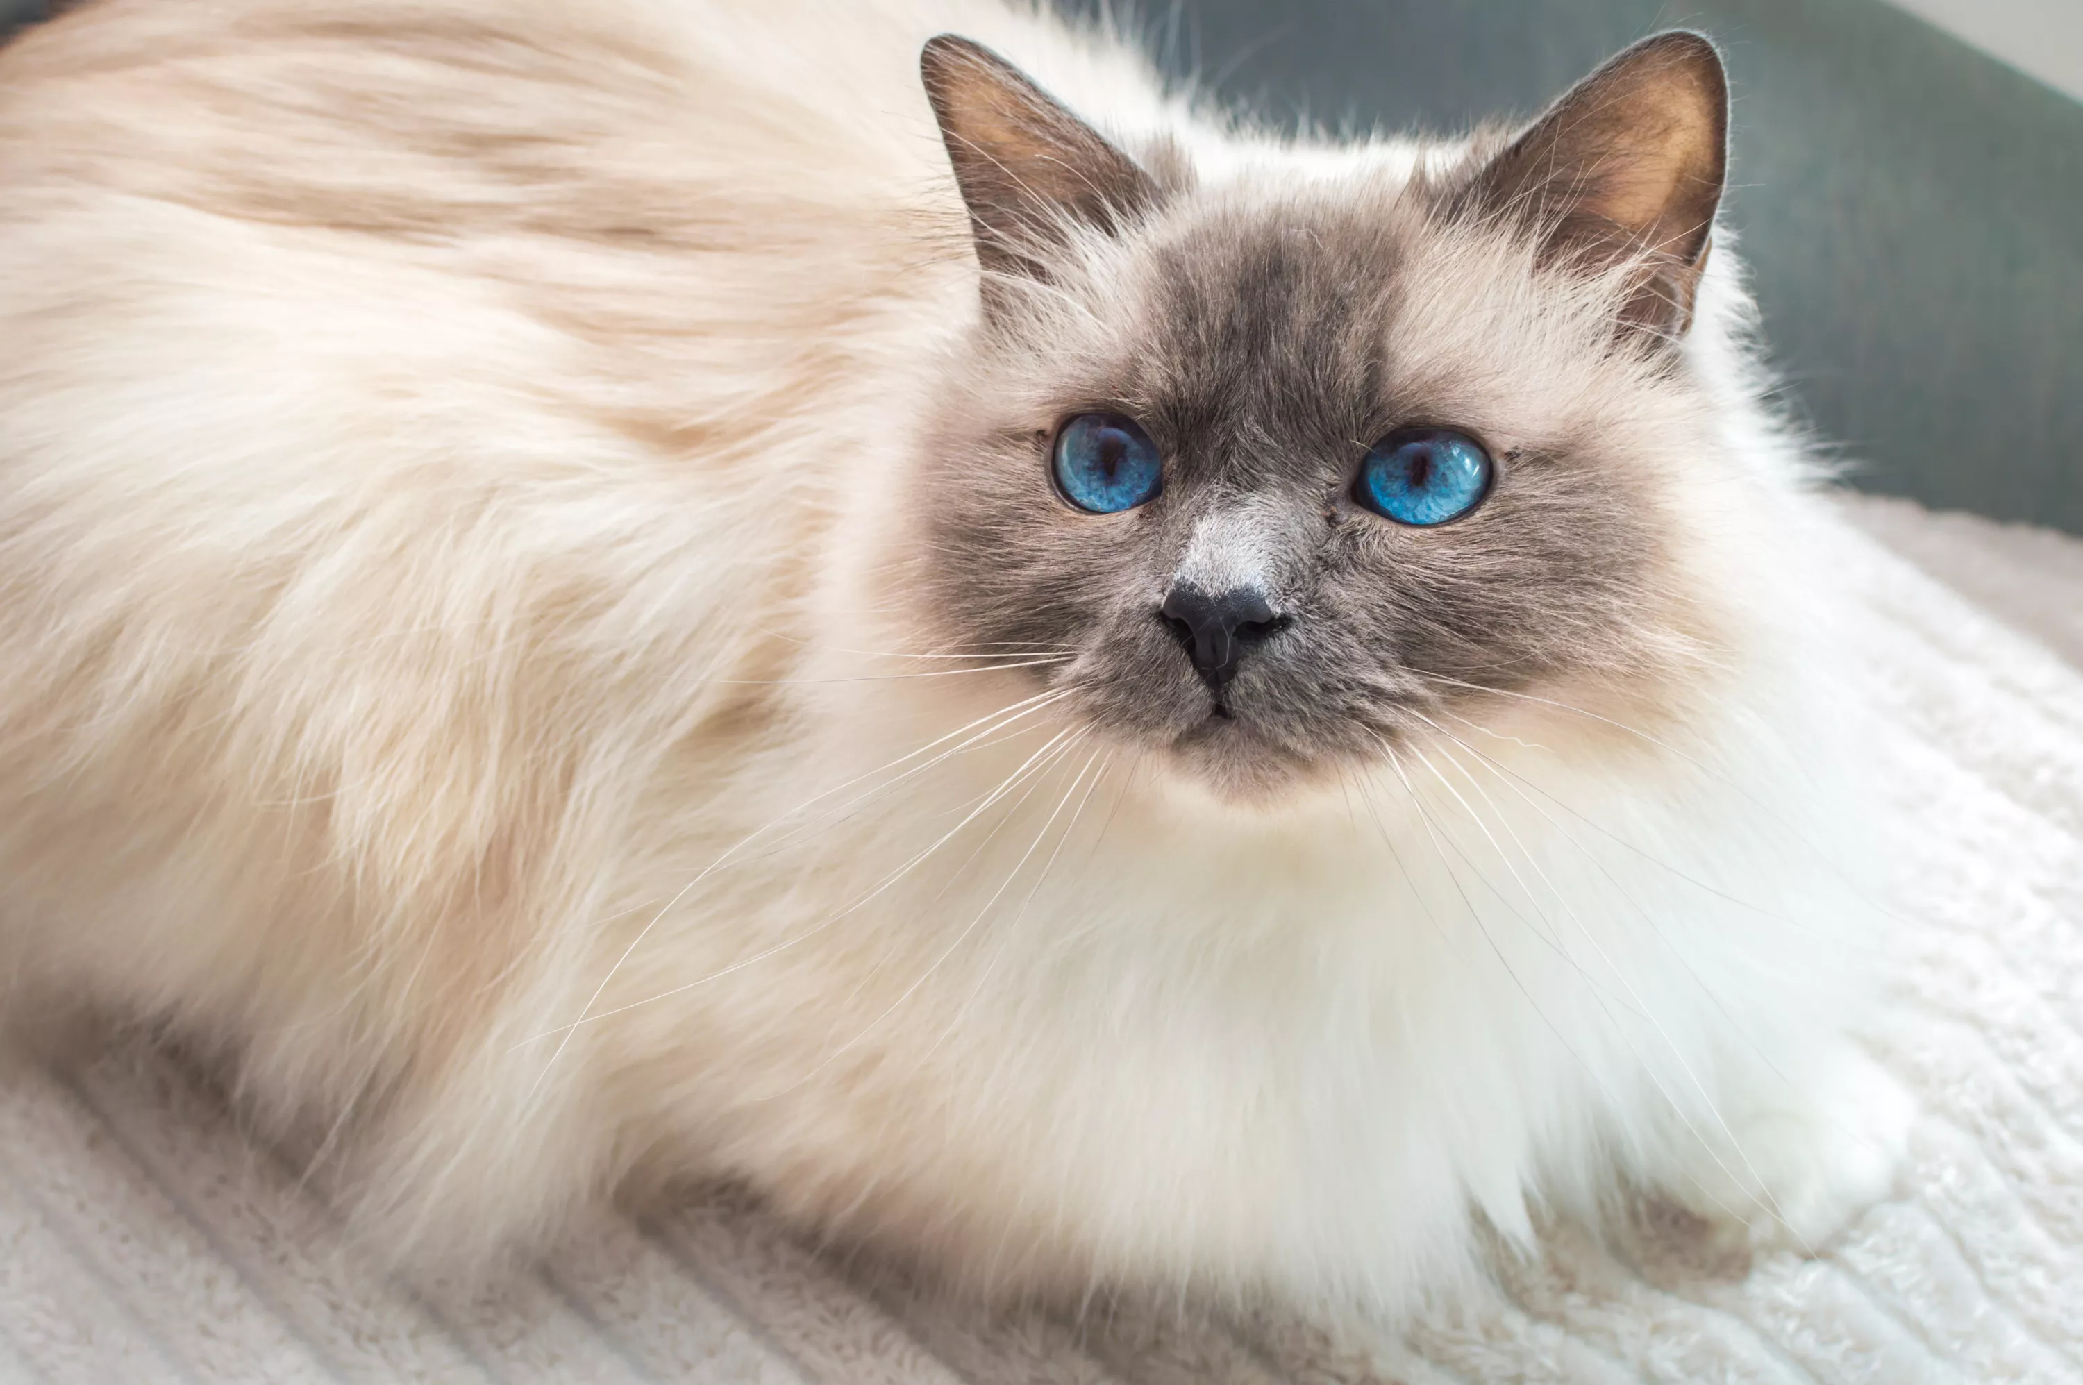
Introduction
Management
Medical management with poor to moderate success (13-30% good long-term outcomes)
Surgical management associated with better outcomes
  Conventional surgery (ureterotomy or ureteroneocystostomy)
  Subcutaneous Ureteral Bypass (SUB)
  …

Slide 6
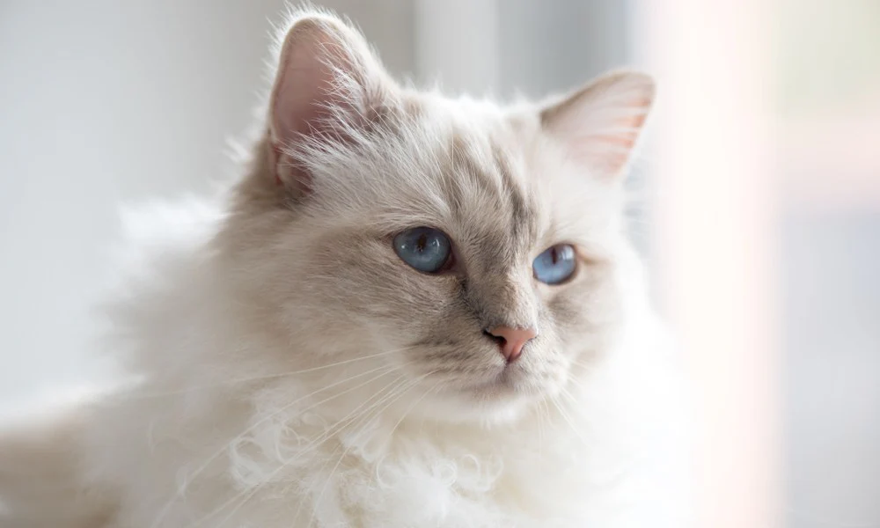
Introduction
Objective
To compare complications and outcomes between conventional surgery (ureterotomy or ureteroneocystostomy) and Subcutaneous Ureteral Bypass (SUB) in cats with ureteral obstruction due to urolithiasis

Slide 7
Methods
Retrospective study
Inclusion criteria: cats with a diagnosis of ureterolithiasis treated surgically by a conventional technique (ureterotomy or ureteroneocystostomy) or SUB placement
Diagnosis performed by abdominal ultrasound
Exclusion:
  Cats with ureterolithiasis without surgical treatment
  Ureteral obstruction without urolithiasis (malignant obstruction)

Slide 8
Methods
Data collected
Signalment
History and clinical signs
Laboratory work and urinalysis
Medical treatment before surgery
Surgical technique : cats divided in two groups (1 conventional surgery, 2 SUB)
Surgical duration
Complications (immediate, long-term)
Follow-up

Slide 9
Methods
Statistical analysis
Wilcoxon test was performed to compare pre- and post-operative values of creatinine
Chi-Square test performed to identify if the surgical procedure is associated with the presence of long-term complications

Slide 10
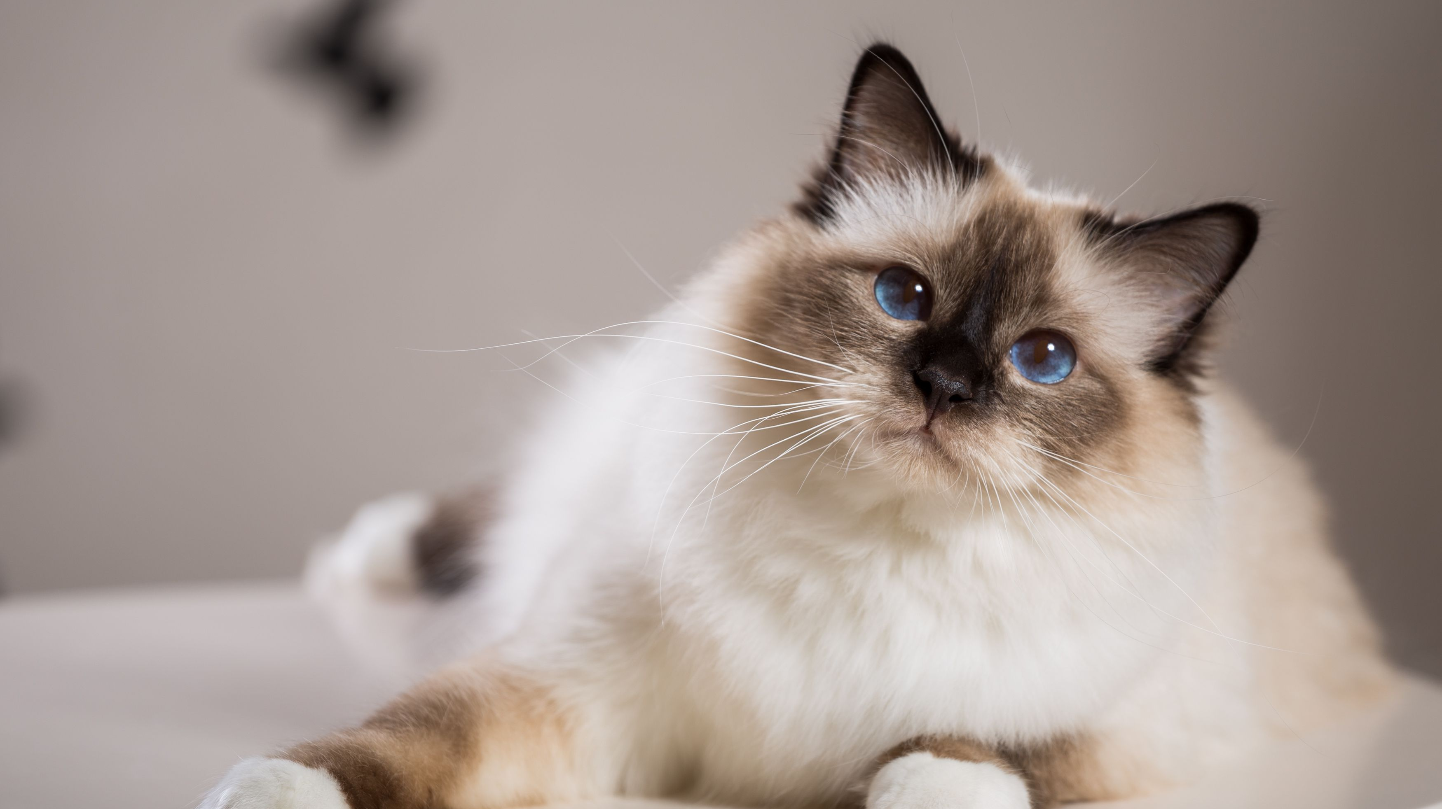
Results
Cohort
42 cats, 18 male neutered and 24 female neutered
Median age: 6 years old (0.6-13)
Median Body Weight : 3.55 kg (1.6-5.9)
Breeds: Domestique shorthair cats (22/42), Birman (5/42), European shorthair (5/42), British Shorthair (3/42), Ragdoll (2/42), Maine Coon (2/42)

Slide 11
Results
Anorexia | 81% | Abdominal pain | 31% | Dysuria | 7%
Lethargy | 69% | Dehydration | 21% | Pollakiuria | 5%
Weight loss | 52% | Polyuria-polydipsia | 17% | Haematuria | 5%
Vomiting | 43% | Stranguria | 7% | Halitosis | 5%
Clinical signs in the cohort

Slide 12
Results
Laboratory works
Azotemia (80%)
  Median Creatinine : 424.5 µmol/L (96-2303)
  Median Urea : 1.28 g/L (0.25-7.34)
Anaemia (19%)
Urinalysis
  Median USG : 1,018 (1,008-1,036)
  Positive bacterial culture in 8 cats preoperatively with E. Coli, Enteroccocus faecalis, Pateurella Multocida, Proteus Mirabilis
  2 cats had calcium oxalate cristalluria

Slide 13
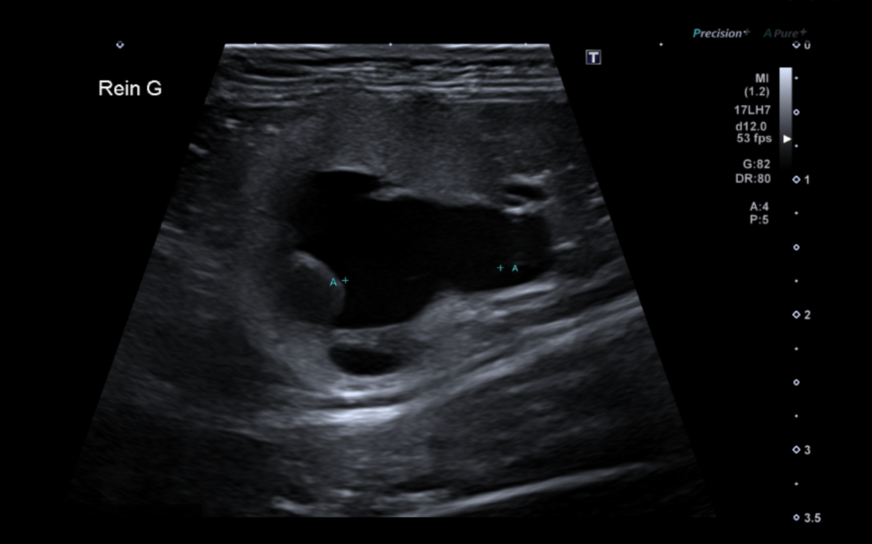
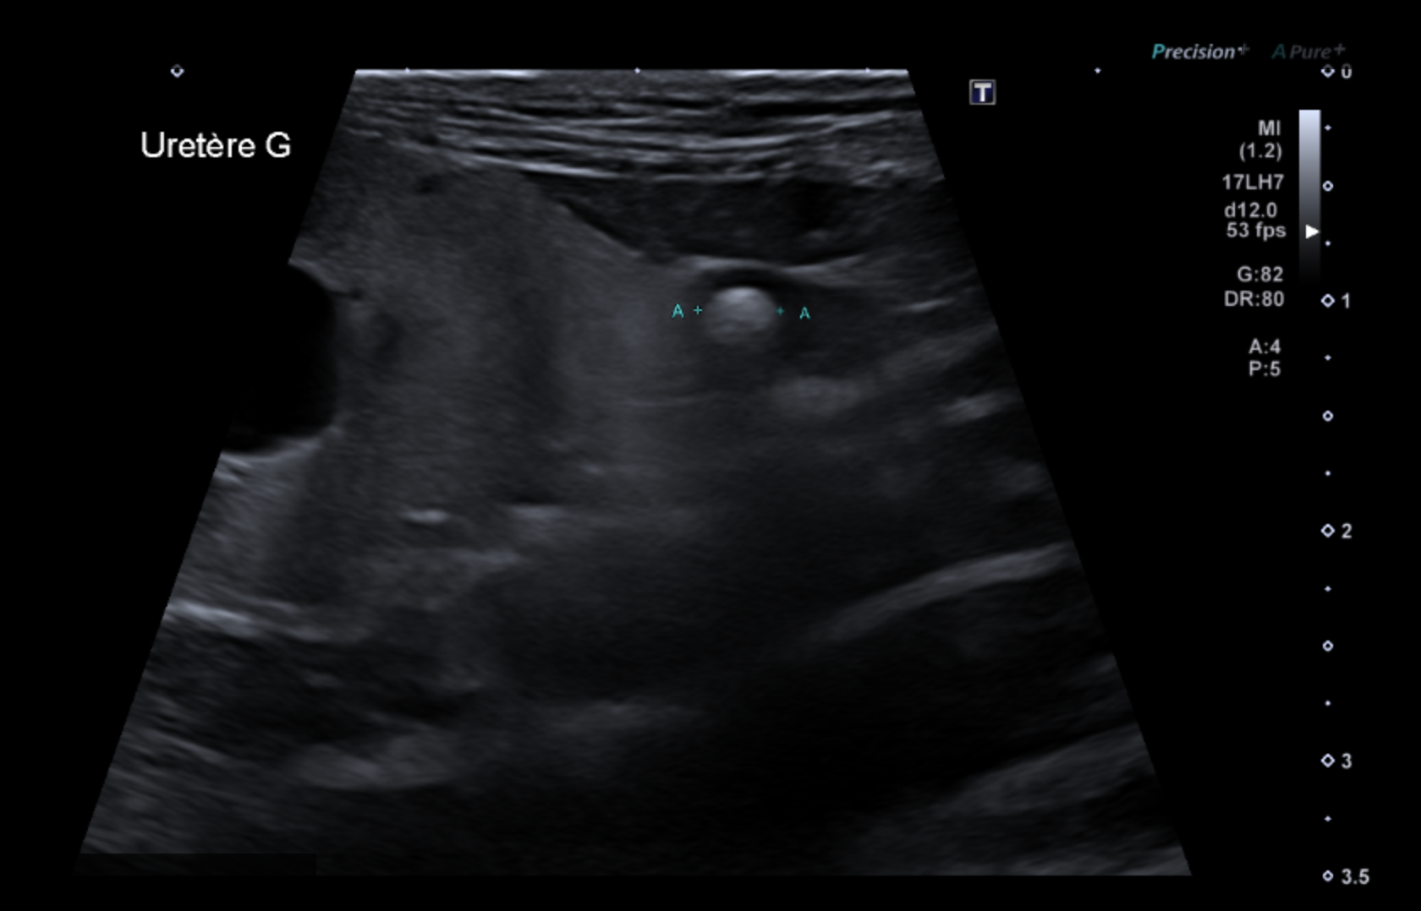
Results
Diagnostic imaging
Ultrasound and radiographs in 32 cats VS ultrasound only in 10 cats
Signs of hydronephrosis in all cases
Bilateral obstruction noted in 40% cases
69% had multiple urolithiasis
Courtesy of the Diagnostic Imaging Department of The CVU
Hydronephrosis and urolithiasis

Slide 14
Results
Preoperative medical treatment (39 cats) → «forced» diuresis
  Fluid therapy: isotonic cristalloids at a rate of 2-5 mL/kg/h
  Alpha-blockers : Tamsulosine
  Analgesia: opioids (methadone or buprenorphine)
  Diuretics: Mannitol

Slide 15
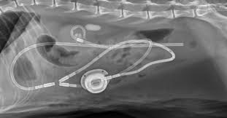
Results
Surgery
Conventional surgery: 11 cats ( 9 ureterotomies and 2 ureteroneocystostomies)
  Ureterotomy performed when the urolithiasis was proximal
  Distal obstruction for the 2 ureteroneocystostomies
SUB placement : 31 cats
No intraoperative complication
Median surgical time
  Overall: 120 minutes
  Conventional surgery: 115 minutes
  SUB placement:
    Unilateral: 115 minutes
    Bilateral : 125 minutes
    Unilateral with other procedure: 140 minutes
Postoperative radiographs of a subcutaneous ureteral bypass 3.0 (Norfolk Vet Product)

Slide 16
Results
Postoperative period
Median duration of hospitalization: 7 days (3-11)
Decrease of creatinine before discharge in 37 cases (88%)
Median creatinine at discharge : 219.3 µmol/L (88-595)
  Median decrease of 248 µmol/L→ Significant difference from preoperatively (p<0.05)
Positive bacterial culture by pyelocenthesis in 8 cats → Those cats received TetraEDTA
1 major immediate postoperative complication: uroabdomen following ureterotomy

Slide 17
Results
Conventional Surgeries
Complication rate : 54% (6/11)
Stenosis of the surgical site (4/6)
Recurrent urolithiasis (1/6)
Bacterial infection (1/6)
SUB
Complication rate: 58% (18/31)
8 cats had bacterial infection (26%)
7 cats had mineralization –related obstruction (22%) → treated with Tetra EDTA
1 cat had a migration of the cystotomy tube
1 cat had dysuria secondary to urinary bladder irritation with the pigtail catheter
Follow-up and long-term complications
Type of surgery not associated with presence of complications
Overall mortality rate 21% but no median survival time because not reached in our cohort
Notes:
Biais car moins de suivi des conventional surgeries

Slide 18
Discussion :
  Overall both are successful procedures
  Similar outcomes
    Procedures successful in decreasing the creatinine rate in a large majority of cats
  Similar complication rates for both types of procedures
    High complication rate : more than 50%
    BUT for SUBs complications easier to manage (infection, mineralization) → tetraEDTA infusions
    Major complications for conventional surgeries requiring additional procedure (stenosis and recurrence of urolithiasis)
Notes:
BIAS pour le mortality rate

Slide 19
Discussion : Ureterotomy
Complications Kyles et al., 2005 ; Roberts et al., 2011 ; Culp et al., 2016
Intraoperative : inability to remove all the uroliths (rare), blood loss requiring blood transfusion
Postoperative
Immediate: 3 to 31% of cats resulting in death in 8 to 18% of cats
Most common complication : uroabdomen in 16% of cats (just 1 cat in our study)
Long-term: persistent azotemia, persistent obstruction (2.9%), …
Less likely to have resolution of azotemia to discharge when compared to ureteral stenting in one study (Culp et al., 2016) → in our study no difference with SUB.
Notes:
For specific complications when we compare to literature
Scarce literature on ureterotomies in cats
1 study that compared with ureteral stents

Slide 20
Discussion : ureteroneocystostomy
Low postoperative complication rate
2 urines leakage in a study of 12 cats with revision surgery (Lorange and Monnet, 2020)
Few long-term complications : hematuria
In our study 1 cat had a stenosis and 1 cat had a recurrence of urolithiasis
Notes:
In our cohort we only have 2 cats with this procedure
But few complications reported in literature

Slide 21
Discussion: SUB
In the literature, Gold Standard for ureteral obstruction management in cats
High complication rate BUT improved with time and new devices
Several retrospective studies that show the success of this technique
Low Mortality rate compared to other techniques : 4-21%

Slide 22
Discussion : Limitations
Retrospective study
Small Cohort
Lack of standardization of management
Non constant follow-up

Slide 23
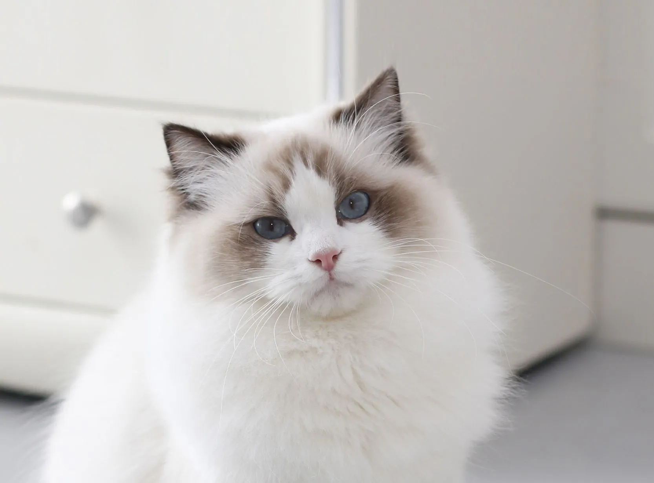
Conclusion
First retrospective study comparing conventional surgery and SUB placement for the treatment of ureteral obstruction in cats secondary to urolithiasis
Both techniques yielded long-term positive outcomes.
Conventional surgery had a high long-term complication rate, particularly stenosis requiring further surgery, but remains suitable for selected cases (single urolith).
The SUB remains the preferred treatment in most cases.

Slide 24
References
Balsa, I.M., Culp, W.T.N., Palm, C.A., Hopper, K., Hardy, B.T., Ben-Aderet, D.G., Mayhew, P.D., Drobatz, K.J., 2019. Factors associated with postobstructive diuresis following decompressive surgery with placement of ureteral stents or subcutaneous ureteral bypass systems for treatment of ureteral obstruction in cats: 37 cases (2010-2014). J. Am. Vet. Med. Assoc. 254, 944–952. https://doi.org/10.2460/javma.254.8.944
Berent, A.C., Weisse, C.W., Bagley, D.H., Lamb, K., 2018. Use of a subcutaneous ureteral bypass device for treatment of benign ureteral obstruction in cats: 174 ureters in 134 cats (2009–2015). J. Am. Vet. Med. Assoc. 253, 1309–1327. https://doi.org/10.2460/javma.253.10.1309
Boullenger, J., Lafuma, F., Baudin Trehiou, C., Blond, L., Gibert, S., Kulendra, N., 2022. Transmural migration of a subcutaneous ureteral bypass into the intestine in three cats. J. Small Anim. Pract. 63, 792–796. https://doi.org/10.1111/jsap.13502

Slide 25
References
Butty, E.M., Labato, M.A., 2021. Subcutaneous ureteral bypass device placement with intraoperative ultrasound guidance, with or without microsurgical ureterotomy, in 24 cats. J. Feline Med. Surg. 23, 1183–1191. https://doi.org/10.1177/1098612X211002014
Chik, C., Berent, A.C., Weisse, C.W., Ryder, M., 2019. Therapeutic use of tetrasodium ethylenediaminetetraacetic acid solution for treatment of subcutaneous ureteral bypass device mineralization in cats. J. Vet. Intern. Med. 33, 2124–2132. https://doi.org/10.1111/jvim.15582
Culp, W.T.N., Palm, C.A., Hsueh, C., Mayhew, P.D., Hunt, G.B., Johnson, E.G., Drobatz, K.J., 2016. Outcome in cats with benign ureteral obstructions treated by means of ureteral stenting versus ureterotomy. J. Am. Vet. Med. Assoc. 249, 1292–1300. https://doi.org/10.2460/javma.249.11.1292
Deprey, J., Baldinger, A., Livet, V., Blondel, M., Taroni, M., Lefebvre, C., Goy-Thollot, I., Moissonnier, P., Viguier, É., Pouzot-Nevoret, C., Carozzo, C., Cachon, T., 2021. Risk factors and clinical relevance of positive urine cultures in cats with subcutaneous ureteral bypass. BMC Vet. Res. 17, 199. https://doi.org/10.1186/s12917-021-02898-7
Deroy, C., Rossetti, D., Ragetly, G., Hernandez, J., Poncet, C., 2017. Comparison between double-pigtail ureteral stents and ureteral bypass devices for treatment of ureterolithiasis in cats. J. Am. Vet. Med. Assoc. 251, 429–437. https://doi.org/10.2460/javma.251.4.429

Slide 26
References
Duval, V., Dunn, M., Vachon, C., 2022. Use of tetrasodium EDTA acid for the treatment of intraluminal obstruction of subcutaneous ureteral bypass devices. J. Feline Med. Surg. 24, e330–e337. https://doi.org/10.1177/1098612X221107795
Johnston, S.A., Tobias, K.M., 2017. Veterinary Surgery: Small Animal Expert Consult - E-BOOK. Elsevier Health Sciences.
Johnston, S.K., Bennett, T., Miller, A.J., 2021. Intestinal perforation involving the Dacron cuff of nephrostomy tubes following subcutaneous ureteral bypass system implantation for ureteral obstructions in two cats. JFMS Open Rep. 7, 20551169211013296. https://doi.org/10.1177/20551169211013295
Kulendra, N.J., Borgeat, K., Syme, H., Dirrig, H., Halfacree, Z., 2021. Survival and complications in cats treated with subcutaneous ureteral bypass. J. Small Anim. Pract. 62, 4–11. https://doi.org/10.1111/jsap.13226

Slide 27
References
Kyles, A.E., Hardie, E.M., Wooden, B.G., Adin, C.A., Stone, E.A., Gregory, C.R., Mathews, K.G., Cowgill, L.D., Vaden, S., Nyland, T.G., Ling, G.V., 2005. Management and outcome of cats with ureteral calculi: 153 cases (1984–2002). J. Am. Vet. Med. Assoc. 226, 937–944. https://doi.org/10.2460/javma.2005.226.937
Livet, V., Pillard, P., Goy-Thollot, I., Maleca, D., Cabon, Q., Remy, D., Fau, D., Viguier, É., Pouzot, C., Carozzo, C., Cachon, T., 2017. Placement of subcutaneous ureteral bypasses without fluoroscopic guidance in cats with ureteral obstruction: 19 cases (2014-2016). J. Feline Med. Surg. 19, 1030–1039. https://doi.org/10.1177/1098612X16670572
Lorange, M., Monnet, E., 2020. Postoperative outcomes of 12 cats with ureteral obstruction treated with ureteroneocystostomy. Vet. Surg. 49, 1418–1427. https://doi.org/10.1111/vsu.13488

Slide 28
References
McEntee, E.P., Berent, A.C., Weisse, C., Le Roux, A., Lamb, K., 2022. Evaluation of preoperative ultrasonographic parameters to predict renal recovery in long-term survivors after treatment of feline ureteral obstructions: 2012-2019. J. Feline Med. Surg. 24, 328–336. https://doi.org/10.1177/1098612X211023645
Merindol, I., Vachon, C., Juette, T., Dunn, M., n.d. Benign ureteral obstruction in cats: Outcome with medical management. J. Vet. Intern. Med. n/a. https://doi.org/10.1111/jvim.16709
Pennington, C.E., Halfacree, Z., Colville-Hyde, C., Geddes, R.F., 2021. Factors associated with positive urine cultures in cats with subcutaneous ureteral bypass system implantation. J. Feline Med. Surg. 23, 331–336. https://doi.org/10.1177/1098612X20950312
Roberts, S.F., Aronson, L.R., Brown, D.C., 2011. Postoperative Mortality in Cats After Ureterolithotomy. Vet. Surg. 40, 438–443. https://doi.org/10.1111/j.1532-950X.2011.00836.x

Slide 29
References
Véran, E., Vachon, C., Byron, J., Howard, J., Berent, A., Weisse, C., Javard, R., Spencer, A., Gradilla, S., Palm, C., Culp, W., Cléroux, A., Dunn, M., 2022. Multicenter retrospective evaluation of transmural migration of subcutaneous ureteral bypass devices within the digestive tract in cats. J. Vet. Intern. Med. 36, 1677–1685. https://doi.org/10.1111/jvim.16511
Vrijsen, E., Devriendt, N., Mortier, F., Stock, E., Van Goethem, B., de Rooster, H., 2021. Complications and survival after subcutaneous ureteral bypass device placement in 24 cats: a retrospective study (2016-2019). J. Feline Med. Surg. 23, 759–769. https://doi.org/10.1177/1098612X20975374
Wormser, C., Clarke, D.L., Aronson, L.R., 2016. Outcomes of ureteral surgery and ureteral stenting in cats: 117 cases (2006–2014). J. Am. Vet. Med. Assoc. 248, 518–525. https://doi.org/10.2460/javma.248.5.518
Wuillemin, F., Vachon, C., Beauchamp, G., Dunn, M., 2021. Subcutaneous ureteral bypass device placement in 81 cats with benign ureteral obstruction (2013-2018). J. Vet. Intern. Med. 35, 2778–2786. https://doi.org/10.1111/jvim.16280

Slide 30
Affiliation
Notes:
Ajouter auteurs

Slide 31
Discussion: Conventional Surgeries
Advantages
Less lower urinary tract infection in the long term (Wormser et al., 2016)
Depending on the study, no clear higher reobstruction rate
Disadvantage
Requires experience of the surgeon
Cost
For ureteroneocystostomy: wider lumen and shorter length of the ureters → Fewer reobstructions than ureterotomy

Slide 32
Discussion : SUB
Authors, Date | Technique SUB placement | Number of patients (n=) | %Discharge/survival | %Postoperative complication | MST | Obstruction post operative | Reccurent Urinary tract infection
Vrijsen et al. 2021 | Ultrasound | 24 cats, 36 ureters | 19/24, 80% | 43.5% device obstruction including kink | 274 days | 8/24 [33.3%] | 5/24 [20.8%] each)
Livet et. al, 2017 | Blindly | 19 cats | 11/19, 57% | 5% kink | 77% still alive at 225 days | 1 | 21%
Berent et al 2018 | Fluoroscopically | 134 cats, 147 ureters | 94 %, | 7% leakage, blood clot occlusion 2.7%,, urethral obstruction with cystotomy or PU 2.7% | 827 | mineralization 25% (13% surgical), kinking 3%, blood clot 1%, | 33%
Butty et al, 2021 | Ultrasound guided | 24 cats , 30 ureters | 96 % | 7% kink nephrostomy tube | 1555 | 7.6% kink, 7.6% mineralization | 19%
Deroy et al 2017 | Ultrasound / Blindly | 23 cats, 30 ureters | 87 % | NR | 70% still alive at 14 months | NR | NR
Wuillemin et al 2021 | Fluoroscopically | 81 cats, 117 ureters | 94 % | 31% overall - blood clot 6%, kink 3.4%, Uroabdomen 1% | 821 | Luminal obstructions 17%, Kink in 10% (12/117) | 26%
Kulendra, 2021 | Fluoroscopically | 95 cats, 130 ureter | 89.5% | 2% obstruction by blood clot, 3% malpositioned nephrostomy catheter | 820 | unclear; 8% backed into surgery for blocked catheter (5 kink, 2 blood clot, 4 blocked) | 31%
Notes:
Rate of our complication in the range of what was described in the literature. Less reports of kinks in our cohort → might be due to the lack of follow-up

