Slide 1





From benthic functional biodiversity
to the mapping of ecosystem functions:
a case study over the Black Sea northwestern shelf
Séverine Chevalier*, Olivier Beauchard, Adrian Teaca, Tatiana Begun,
Luc Vandenbulcke, Karline Soetaert, and Marilaure Grégoire
1st May 2025
EGU Session: Global change impacts biodiversity,
from observations, and experiments to modeling
Corresponding author *: severine.chevalier@uliege.be

Slide 2
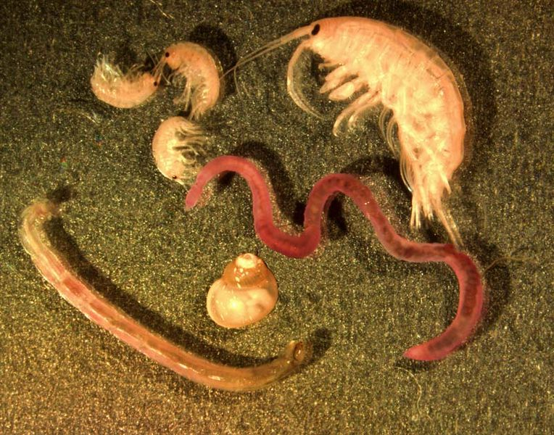
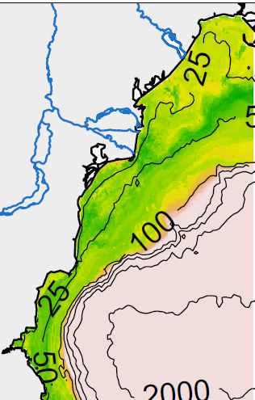
Question & Approach
Results
Conclusions & perspectives
Objective : from biodiversity to ecosystem functions ?
Field experiments
Scales of management
UPSCALING
G. Carter via NOAA/GLERL
From macrozoobenthos
Animals bigger than 0.5 mm
Living near/in/closed to the seabed
To ecosystem functions
mapping
1

Slide 3
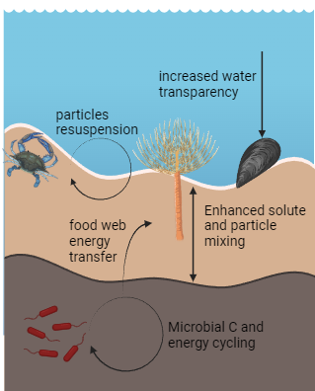


Question & Approach
Results
Conclusions & perspectives
_{Why mapping matters ?}
Pelagic
Macrobenthos play a key role in
benthic- pelagic fluxes (C, N, organic matter)
Need maps of ecosystem functions for sustainability developement
Add the role of macrobenthos into ocean models for predictions (global warming)
Benthic
*Inspired by Bianchi et al., 2021, Elem Sci Anth, made with BioRender logiciel
2

Slide 4


Question & Approach
Results
Conclusions & perspectives
How ? A functional approach of biodiversity
Traits
Ecological processes
Ecosystem functions
Burrow depth
Bioturbation
Carbon sequestration
Burrow type
Bioirrigation
Mobility
Nutrient cycling
Body mass
Biodeposition
Filtering
Benthic-pelagic coupling
Scavenging
Scavenger
Productivity
3
*Adapated from Lam-Gordillo et al., 2020, Ecological Indicators & Snelgrove et al., 2014, Trends in ecology & Evolution

Slide 5
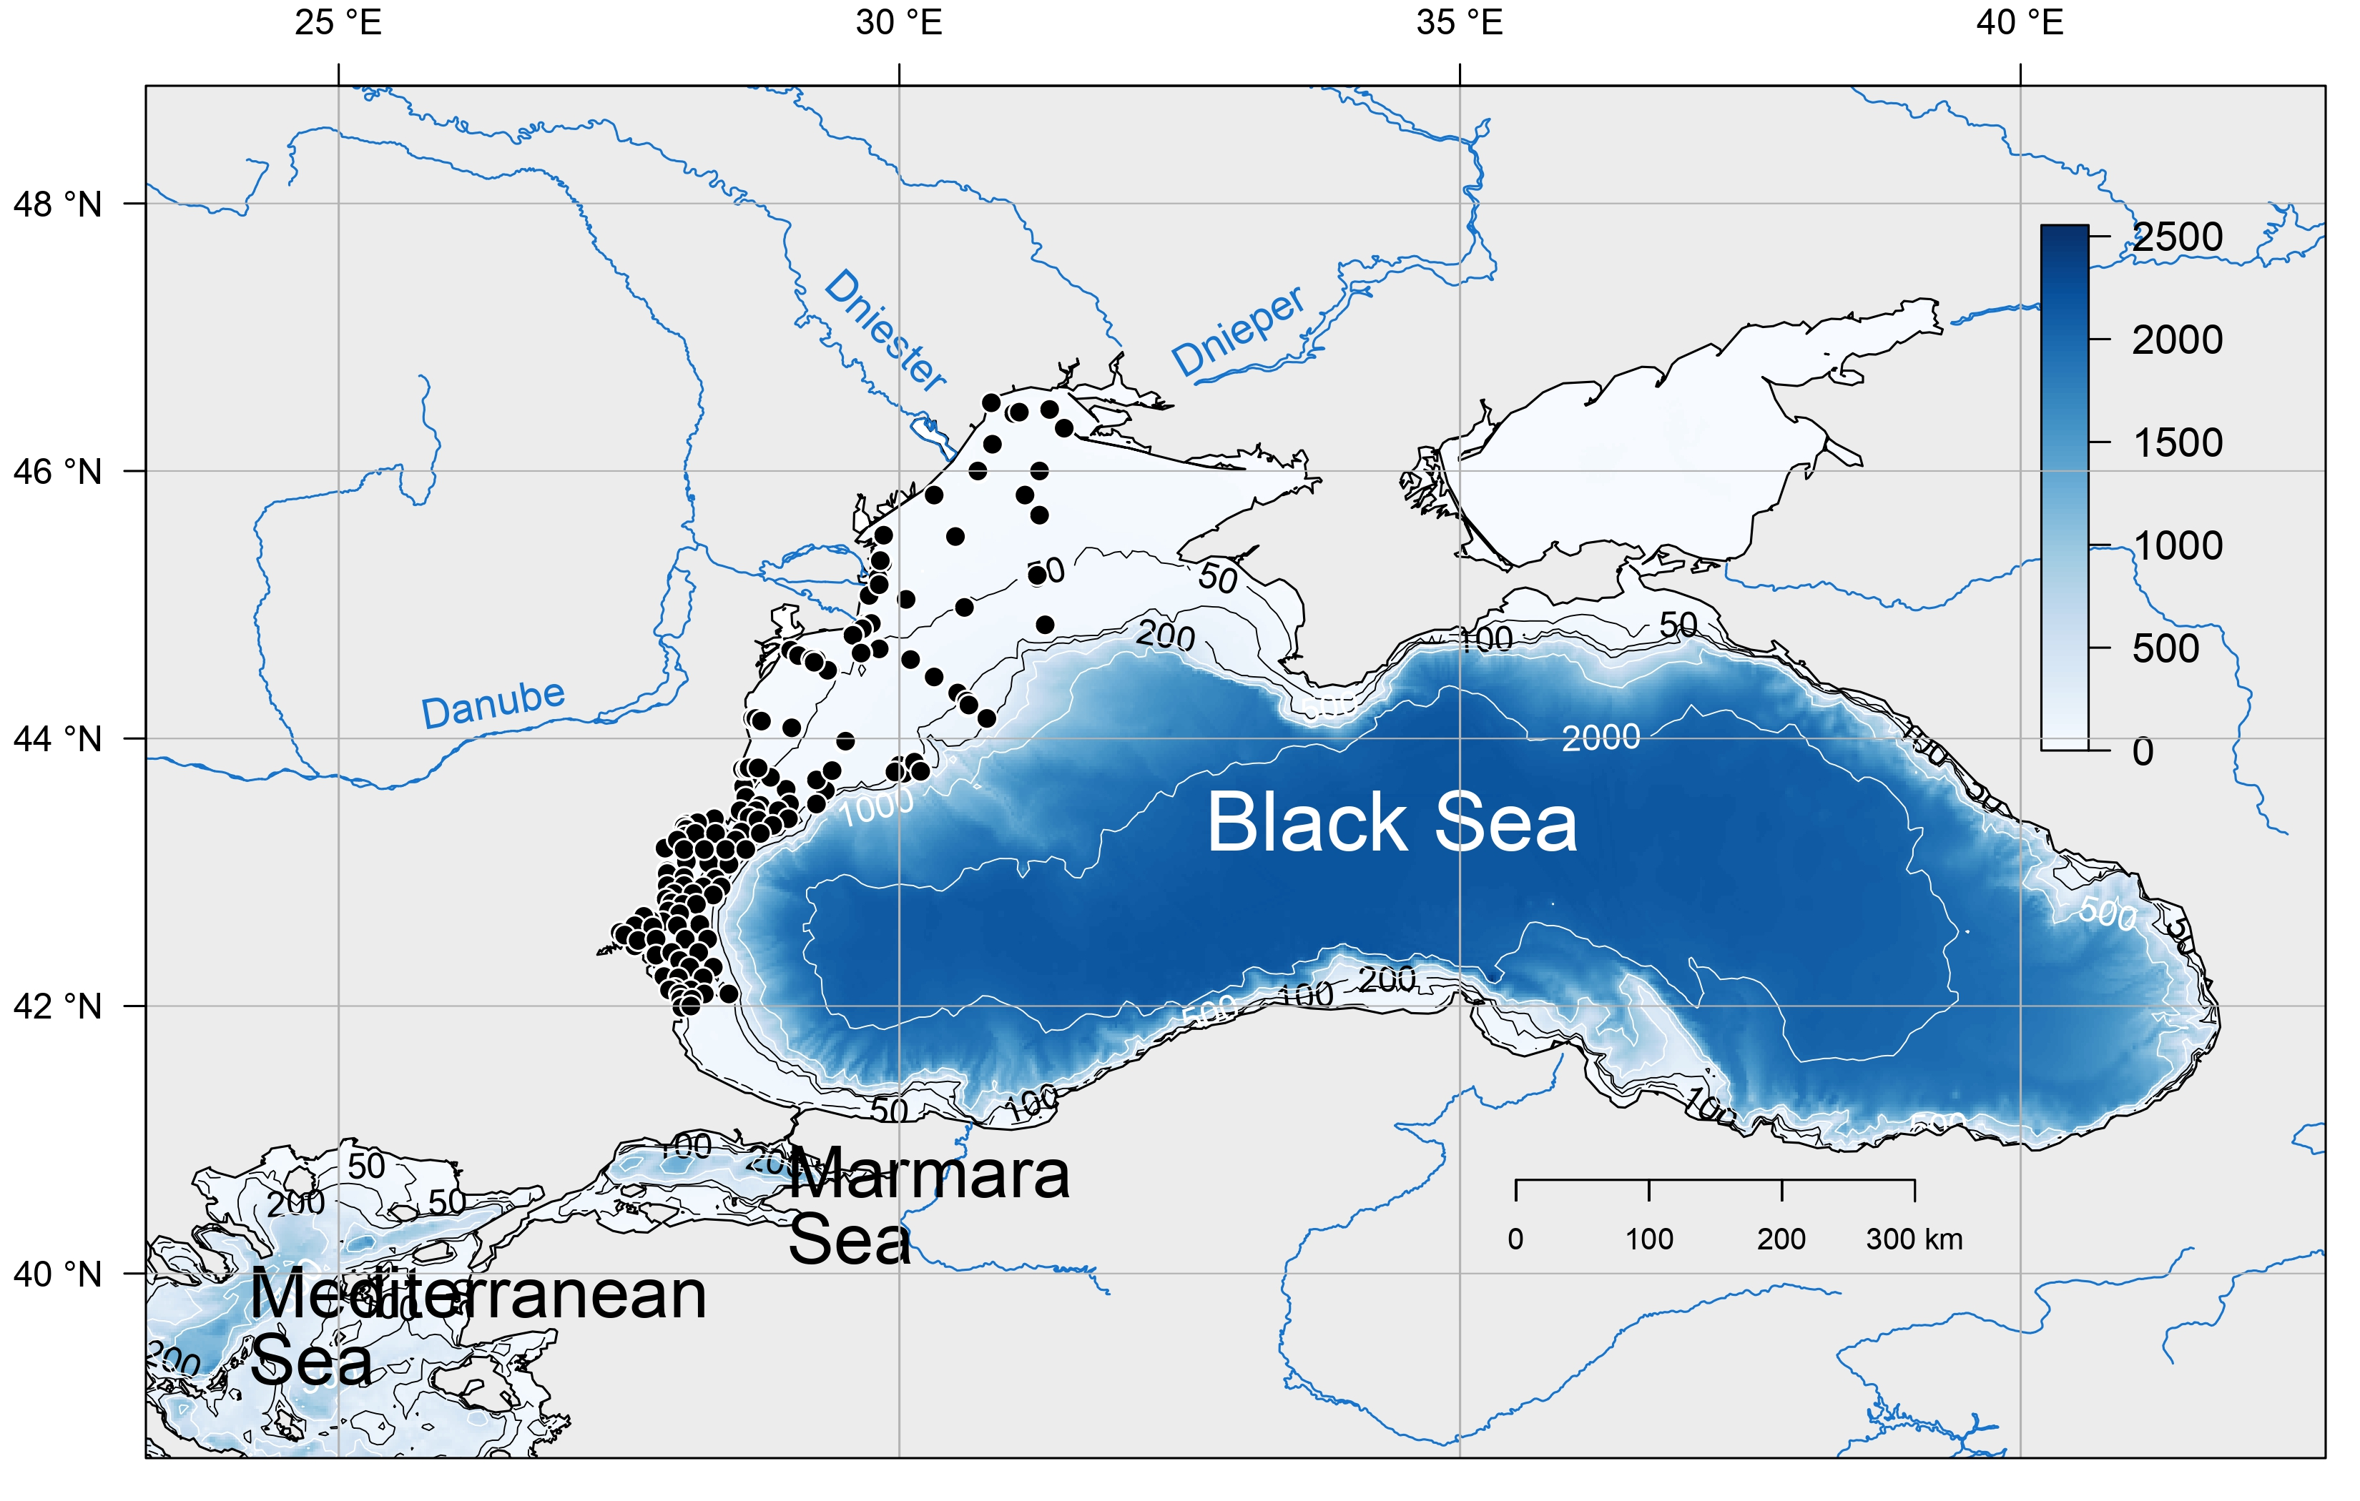

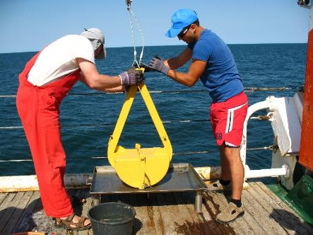

Question & Approach
Results
Conclusions & perspectives
Black Sea: A unique small ocean
210 sampling sites on the north-west shelf (2008-2017)
Grab samples: abundance and biomass per m2
No bottom oxygen
Romanian dataset: Adrian Teaca and Tatiana Begun (GeoEcomar)
Bulgarian dataset: Valentina Todorova (IO-BAS)
4

Slide 6
Question & Approach
Results
Conclusions & perspectives
Trait : Any features defined at the species level (Violle et al., 2017)
Selected traits with an impact on ecosystem functioning
Burrowing depth
[cm]
Mobility
[/]
Trait 1
Trait 2
0
no
Species 1
0-5
low
Increasing impact
5-15
mod
Species 2
> 15
high
≠ Modalities
5

Slide 7
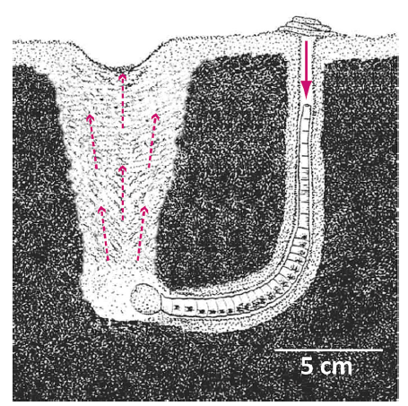
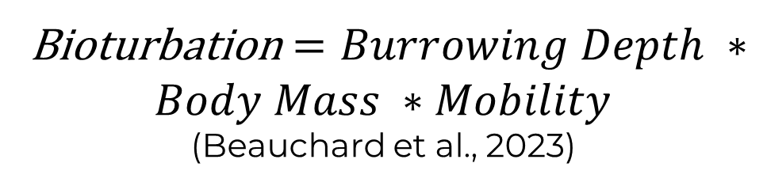
Question & Approach
Results
Conclusions & perspectives
Species level (mm-cm)
Traits
Bioturbation $=Burrowing Depth ∗Body Mass ∗Mobility$
(Beauchard et al., 2023)
Species
Combination of multiple traits weighted by their intensity
“All transport processes carried out by animals
(e.g. feeding, burrowing) that directly or indirectly affect sediment matrices”*
Ecological process
Bioturbation
Bioirrigation
Biodeposition
Scavenging,…
Species
*From Kristensen et al., 2012, Mar.Ecol Prog Ser
6

Slide 8

Question & Approach
Results
Conclusions & perspectives
Species level (mm-cm)
Community level (m- km)
Traits
Species
Abiotic data from a model reanalysis delivered by CMEMS
0 | 10
10 | 5
10 | 10
Species
Community
Abiotic
[O2], organic matter content, temperature, …
Community
Bioturbation
Bioturbation
0.8
0.2
0 + 2 = 2
8 + 1 = 9
8 + 5 = 13
Species
Community
7

Slide 9
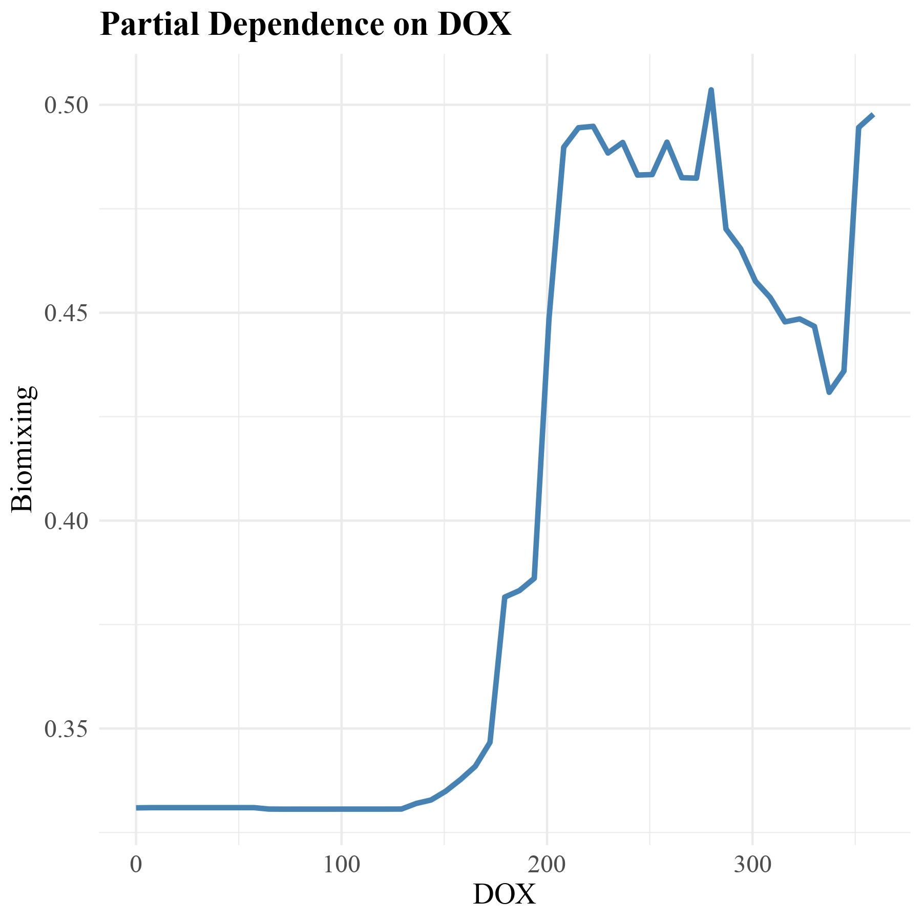
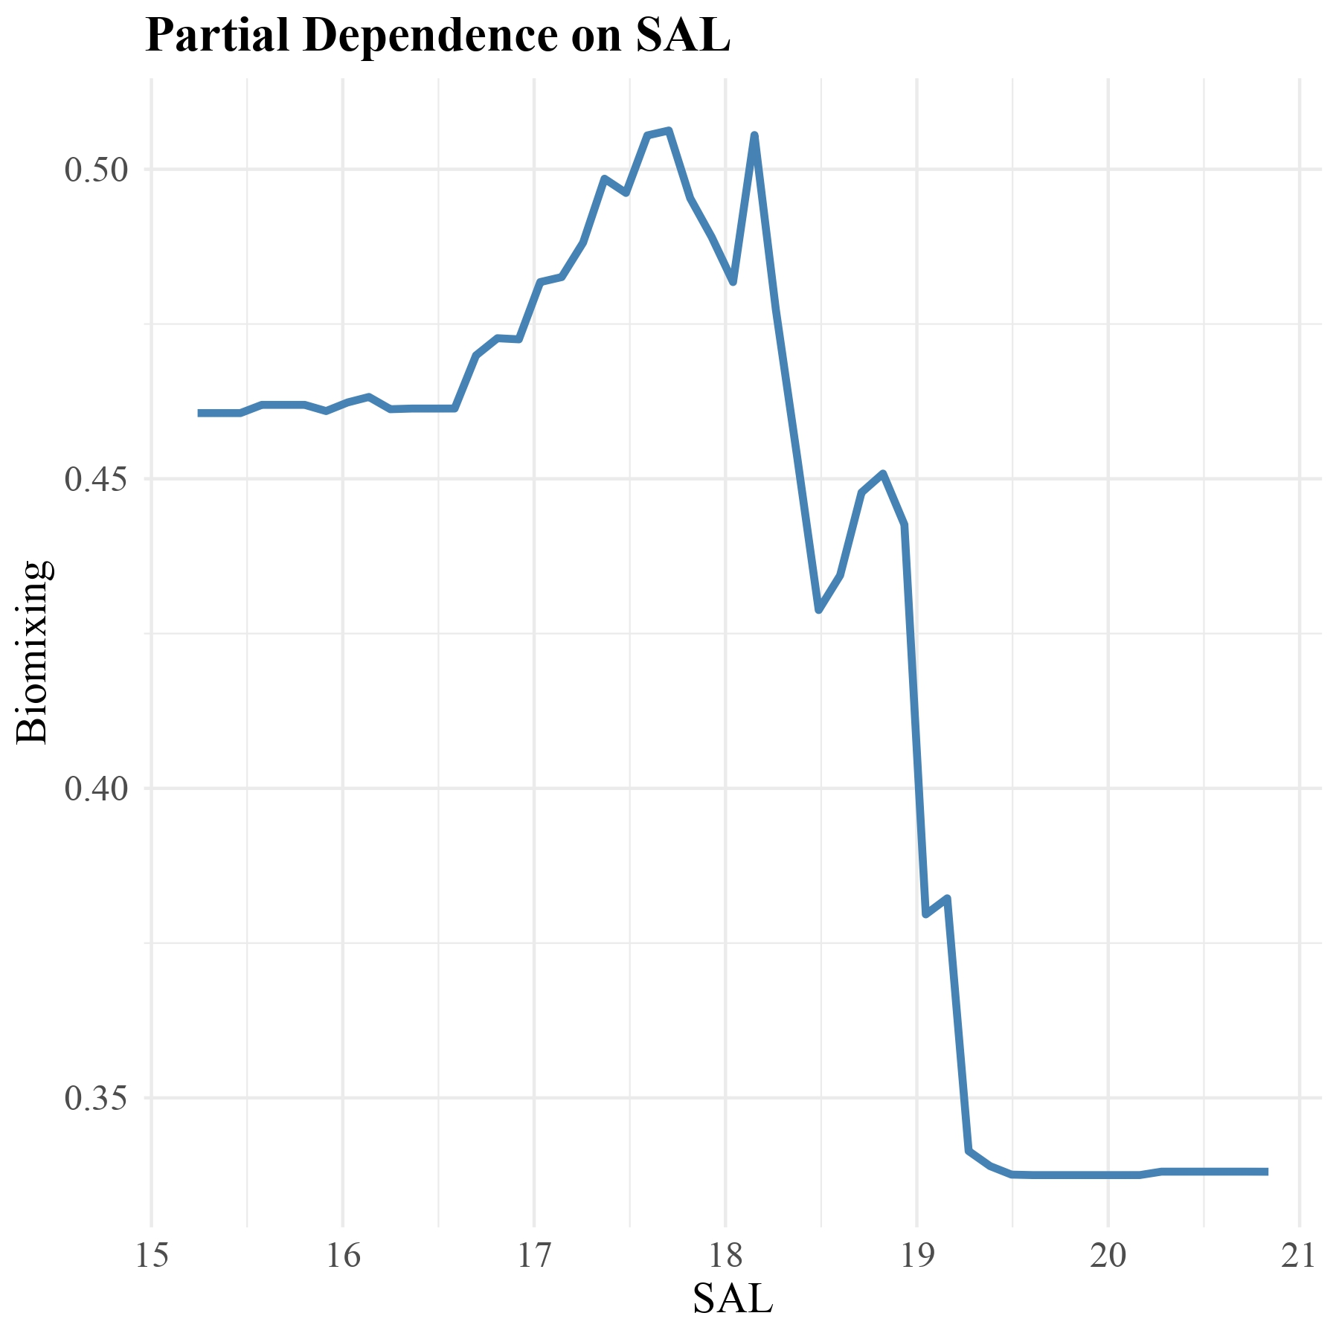

Question & Approach
Results
Conclusions & perspectives
Trait Distribution Model (TDM): 2 steps
1) Statistical modelling
Bioturbation
Partial dependence plots
Response variable
from 0 to 1
Community
Abiotic
Bioturbation
Bioturbation
Bioturbation
Abiotic
List of best predictors from multivariate analysis
(e.g. PCA, RLQ)
Bottom O2 [µmol*m^-3]
Bottom salinity [psu]
Community
Response curves
Here: Random Forest (machine learning based approach)
8

Slide 10
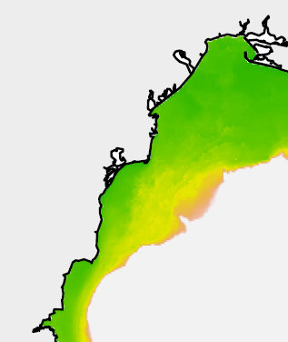
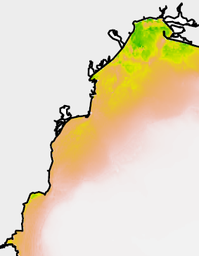
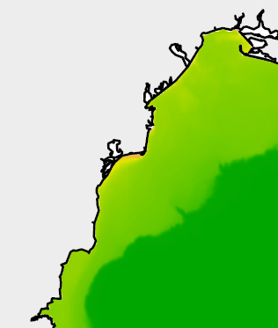
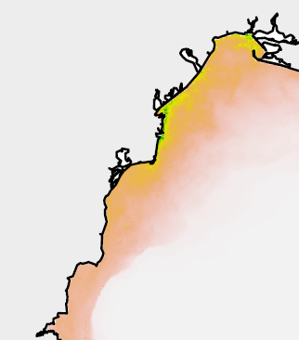
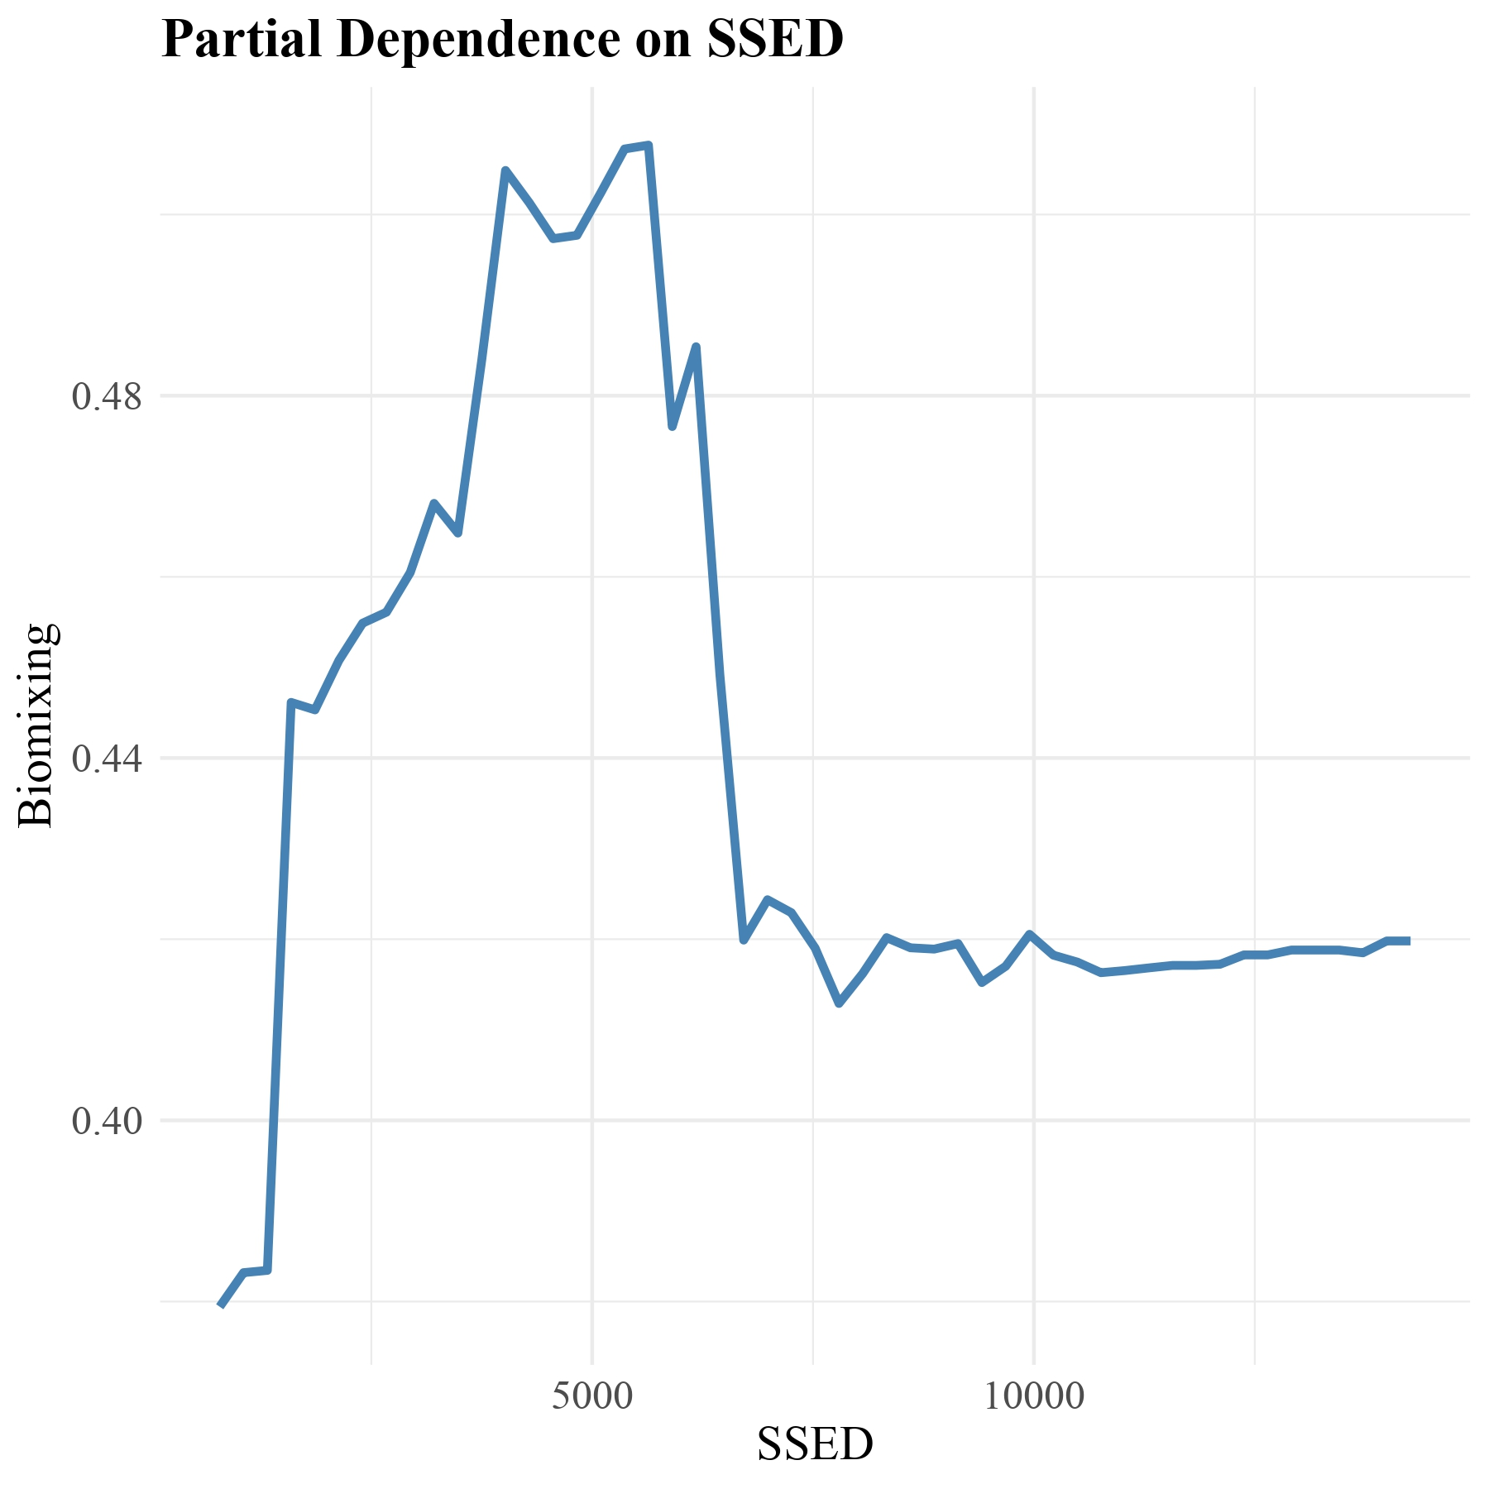

Question & Approach
Results
Conclusions & perspectives
Trait Distribution Model (TDM)
2) Spatial predictions
Climate Change ?
Slow-degraded OM stock
[O2]
Salinity
POC
Maps of abiotic data
Response curves
Predicted bioturbation
9

Slide 11
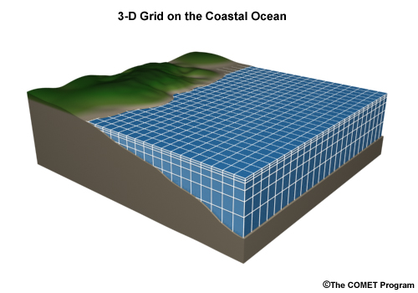
Question & Approach
Results
Conclusions & perspectives
Ecological processes
Ecosystem functions
Integration of the variability of macrofauna traits in 3D ocean model
How ? From mapping of functions and changes in model parametrization
Sediment mixing length
Diffusion coefficient
the comet program
G. Carter via NOAA/GLERL
Current ocean model
No sea life variability on the bottom
Ocean model upgraded
Macrobenthos variability
10

Slide 12
Question & Approach
Results
Conclusions & perspectives
Traits
Ecological processes
Ecosystem functions
Mapping
Modelling
Traits compilation
Species level mm-cm
Mapping of ecological processes
Community level m - km
Updated ocean model
Ecosystem level + 10 km
11

Slide 13

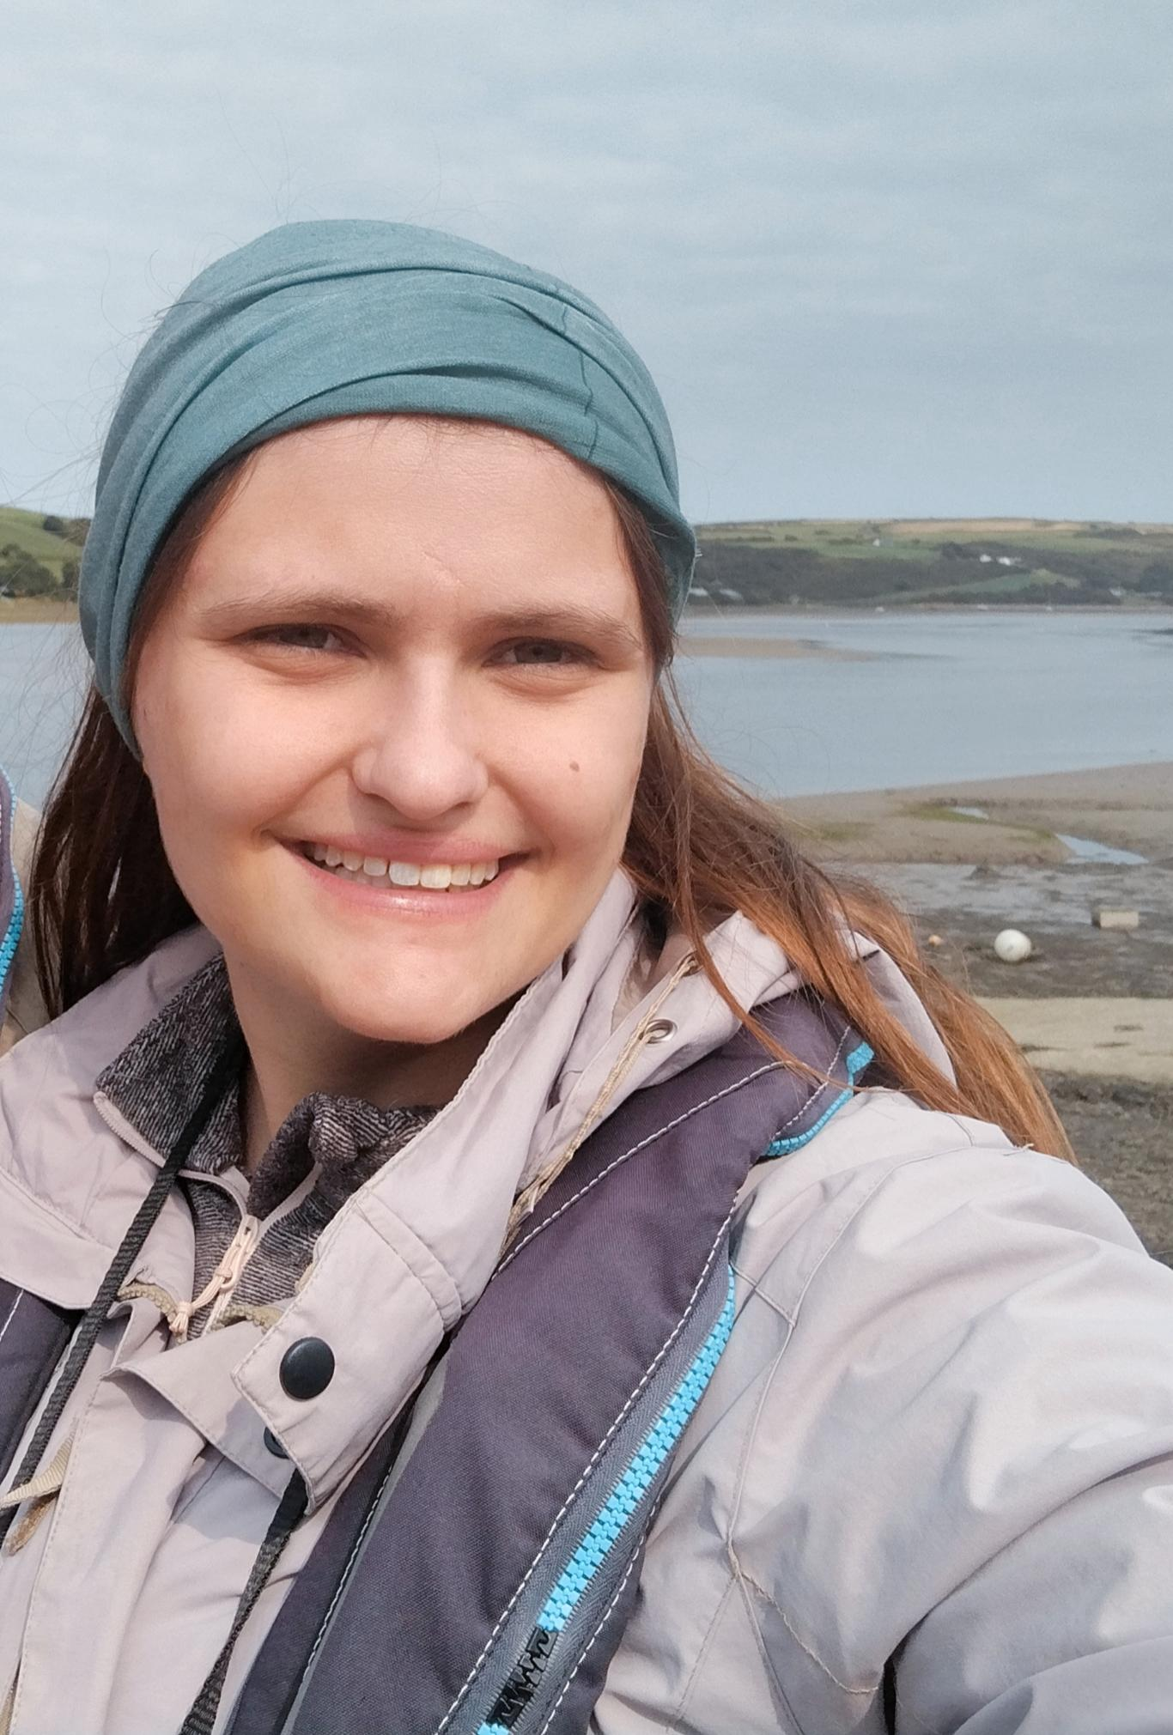






Thank you for your attention !
Abstract
https://www.mast.uliege.be
severine.chevalier@uliege.be

