Slide 1
Investigation of gammaherpesvirus-induced lymphoproliferative disorders through sequencing of the B cell receptor repertoire
Jérôme BAIWIR, Ph.D student
Promoters: Laurent GILLET & Bénédicte MACHIELS
Notes:
Hello everybody.
In my project, I am studying the lymphoproliferation induced by a gammaherpesvirus through the sequencing of the B cell receptors.

Slide 2
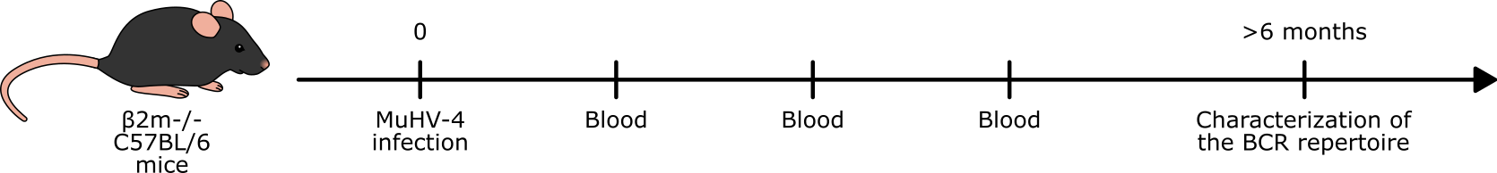
Mouse model
Investigation of gammaherpesvirus-induced lymphoproliferative disorders
through sequencing of the B cell receptor repertoire
Notes:
More specifically, I study the impact of a gammaherpesvirus on B cells in the context of immunodeficiency, in a mouse model.
Let me explain.

Slide 3

The Epstein-Barr virus
Investigation of gammaherpesvirus-induced lymphoproliferative disorders
through sequencing of the B cell receptor repertoire
Very prevalent
>90% of the adult population is infected worldwide
Latency: lifelong infection
Major reservoir: B lymphocytes
Generally asymptomatic infection
Notes:
Gammaherpesviruses are very prevalent viruses. In humans, more than 90% of the adult population is infected by the Epstein-Barr virus.
Once you are infected, you never get rid of this virus, you are infected for life. In your body, the main cell type reservoir is the B cells.
For the majority of the population, the infection is not an issue as this will not cause any symptom.

Slide 4
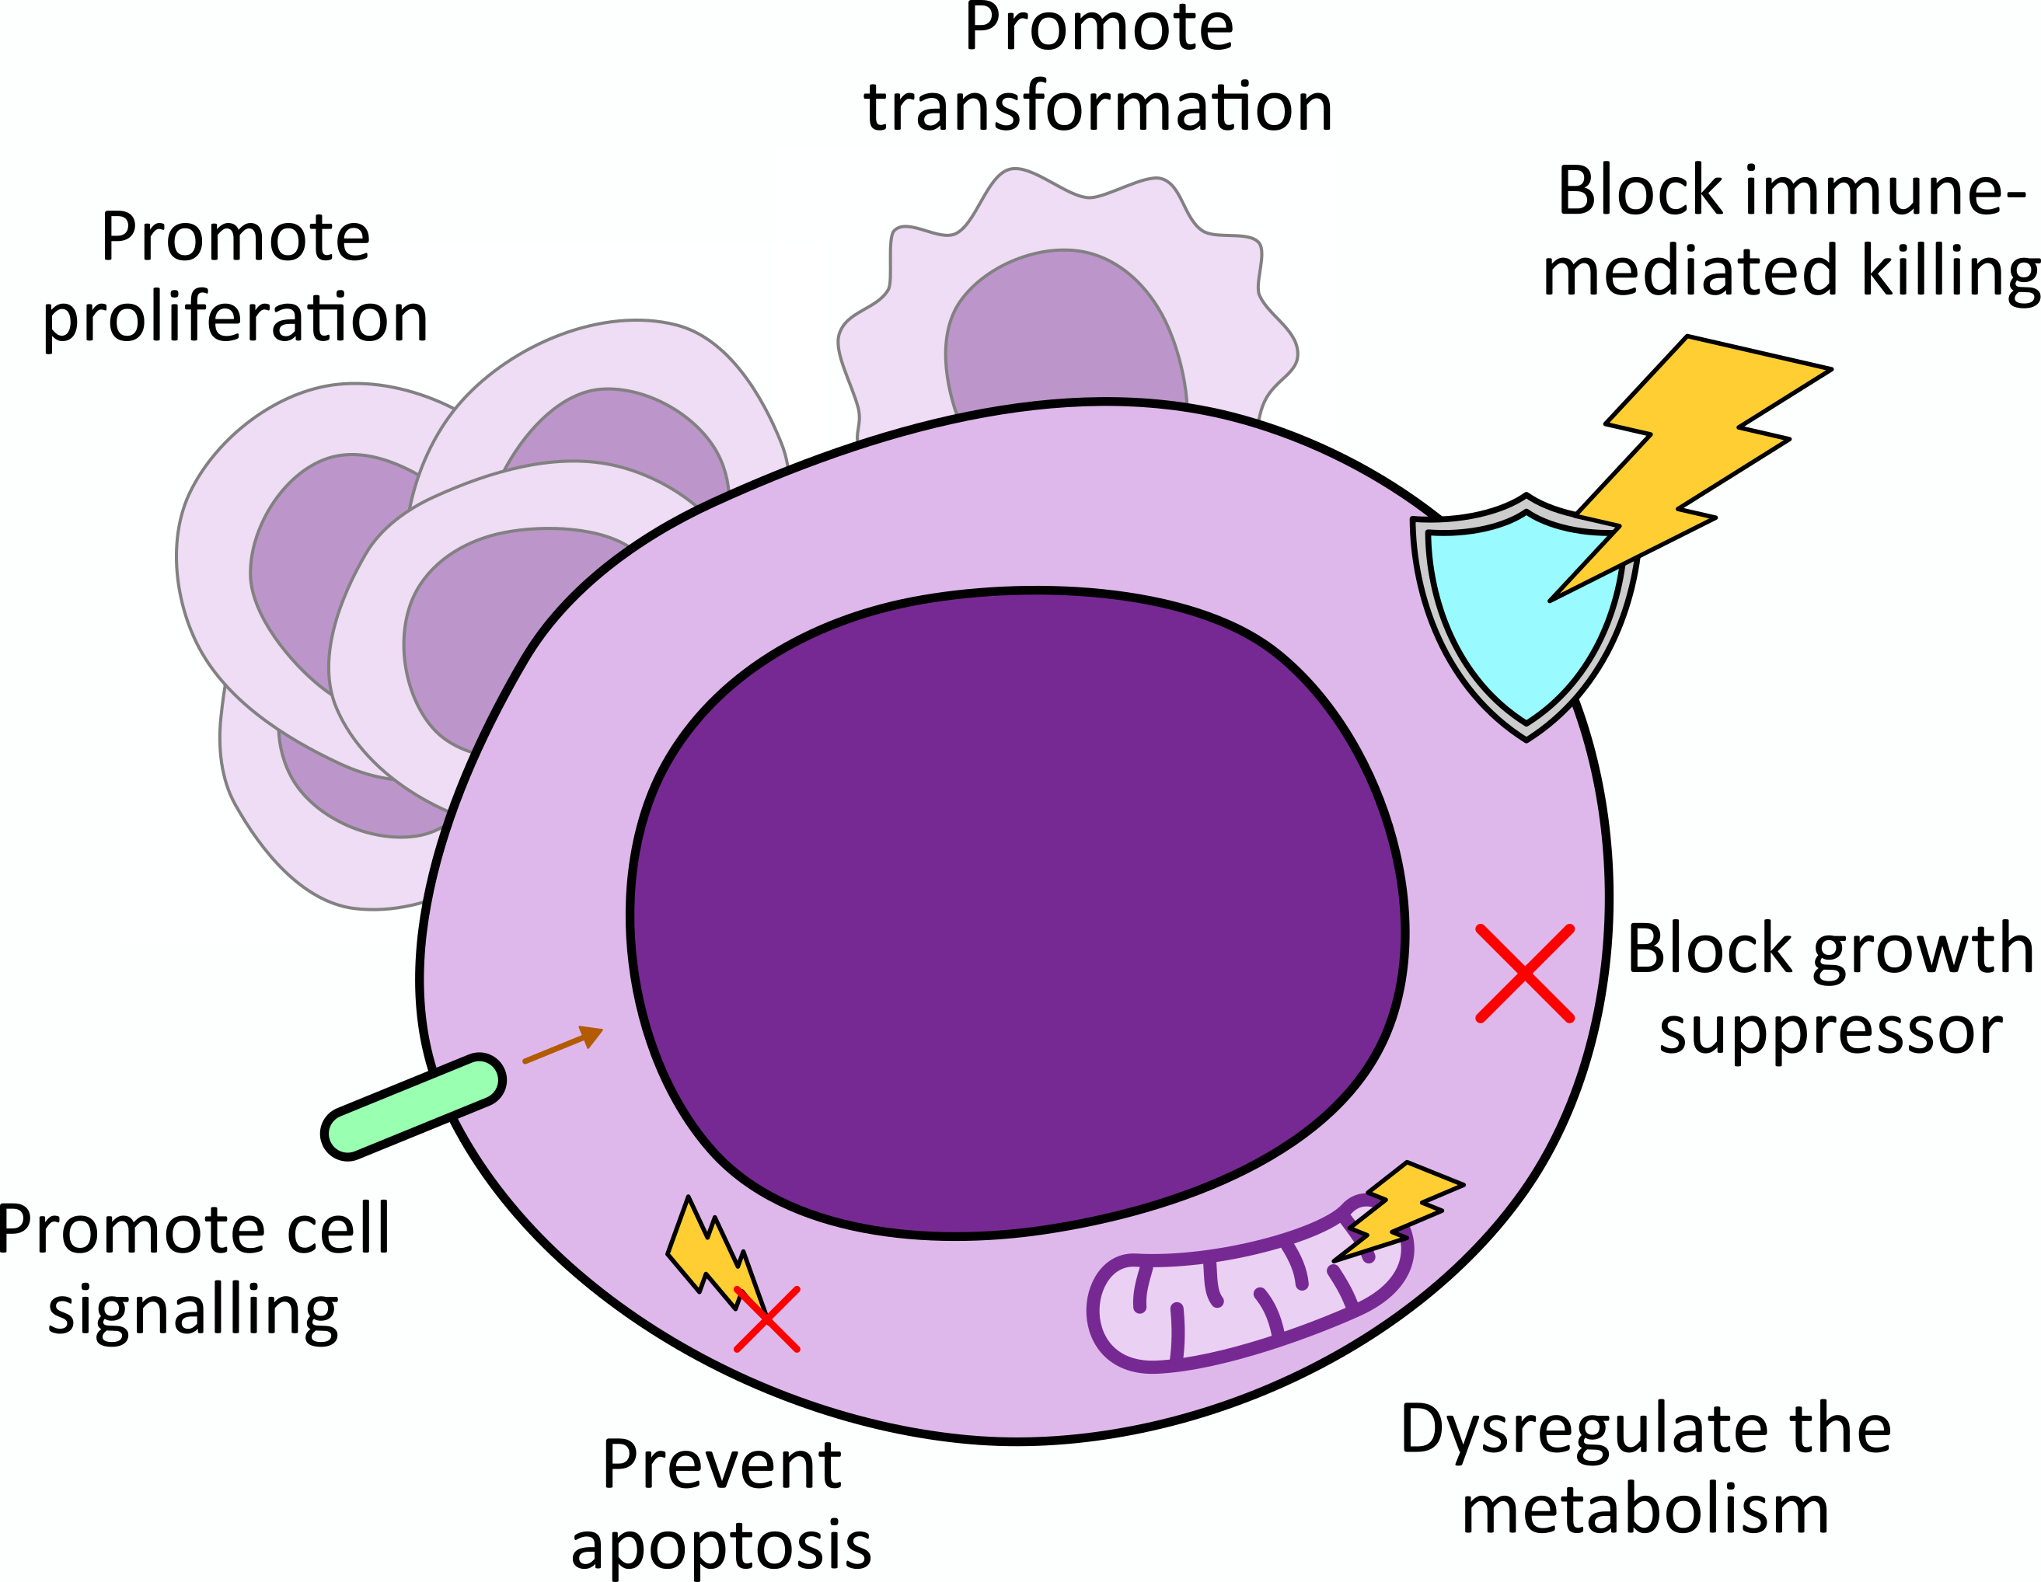
Cell cycle manipulation
Investigation of gammaherpesvirus-induced lymphoproliferative disorders
through sequencing of the B cell receptor repertoire
Immunodeficient people: γHV infection = higher risk of lymphoproliferative disorder (LPD)
Notes:
However, in immunodeficient people, the EBV infection is a major risk factor to develop a lymphoproliferative disorder.
Indeed, gammaherpesviruses are known to manipulate the cell cycle.
So people having an immune system struggling to kill cells that behave aberrantly are prone to develop a lymphoproliferative disorder.

Slide 5







Biases of infection
Investigation of gammaherpesvirus-induced lymphoproliferative disorders
through sequencing of the B cell receptor repertoire
Infection
B cells
γHV persists in some B cells
Notes:
The main reservoir of gammaherpesviruses are B cells.
And the infection is not random. The gammaherpesviruses seem to preferentially infect and persist in some B cells, as there is a bias in the BCR of infected cells.

Slide 6
The B cell receptor (BCR)
Investigation of gammaherpesvirus-induced lymphoproliferative disorders
through sequencing of the B cell receptor repertoire
Variable genes of the heavy chain
V
D
J
1
2
3
1
2
3
1
2
3
B cell maturation
2
2
1
1
3
2
3
1
3
BCR repertoire
Notes:
Long story short, the B cell receptors are antibodies at the surface of B cells that act as a receptor to activate them when they encounter a complementary antigen.
They are generated dynamically during the B cell maturation. All the BCR of an individual are called the BCR repertoire.

Slide 7
Biases of infection
Investigation of gammaherpesvirus-induced lymphoproliferative disorders
through sequencing of the B cell receptor repertoire
Infection
B cells
MECHANISM?
γHV persists in some B cells
Notes:
So the infection is not random, but the mecanism behind the preference of infection is however poorly understood.

Slide 8


Previous results: designs
Investigation of gammaherpesvirus-induced lymphoproliferative disorders
through sequencing of the B cell receptor repertoire
Infected vs non-infected mice design
Infected vs non-infected B cells design
Notes:
During my project, we compared the BCR repertoire of infected mice versus non-infected mice, and the BCR repertoire of infected B cells versus non-infected B cells in infected mice.
We could differenciate infected cells by using a virus making infected cells produce a fluorescent protein.

Slide 9


Previous results: VDJ recombination bias
Investigation of gammaherpesvirus-induced lymphoproliferative disorders
through sequencing of the B cell receptor repertoire
V1-5 D2-4 J3
Mock
vs
MuHV-4
Notes:
In those designs, we figured out that the infection induce a bias in the VDJ recombination proportions that the B cells harbour.
We can see here in blue the combinations more often found in mock mice, and in red the combinations more often found in infected mice.
Each sphere is an VDJ combination, for example, this one is the V1-5 D2-4 J3 combination.

Slide 10
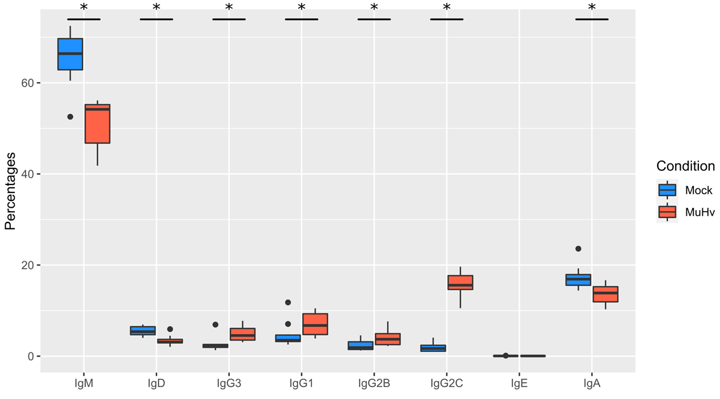
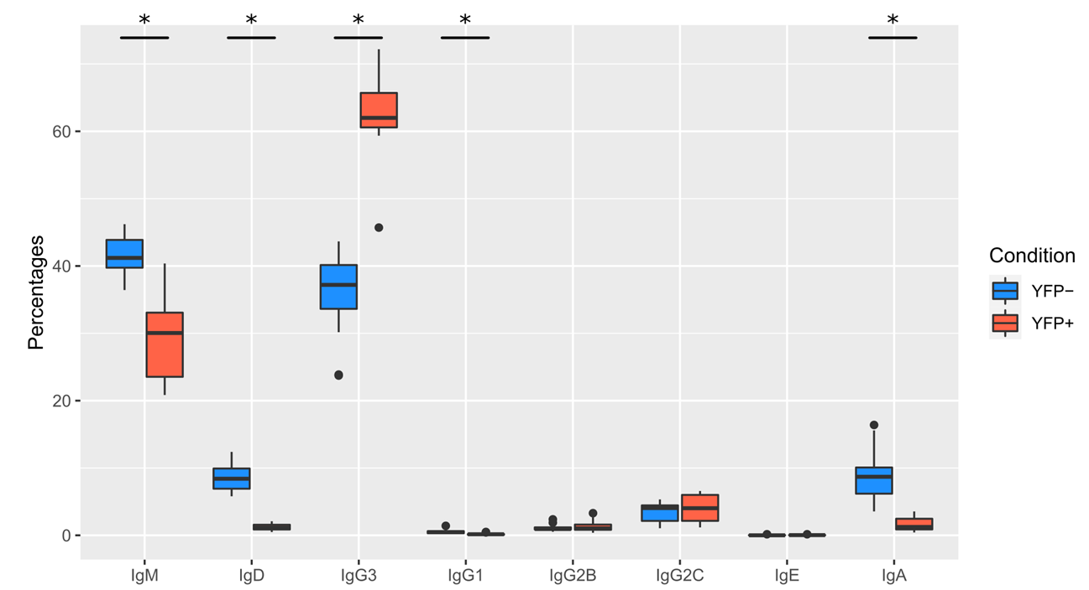

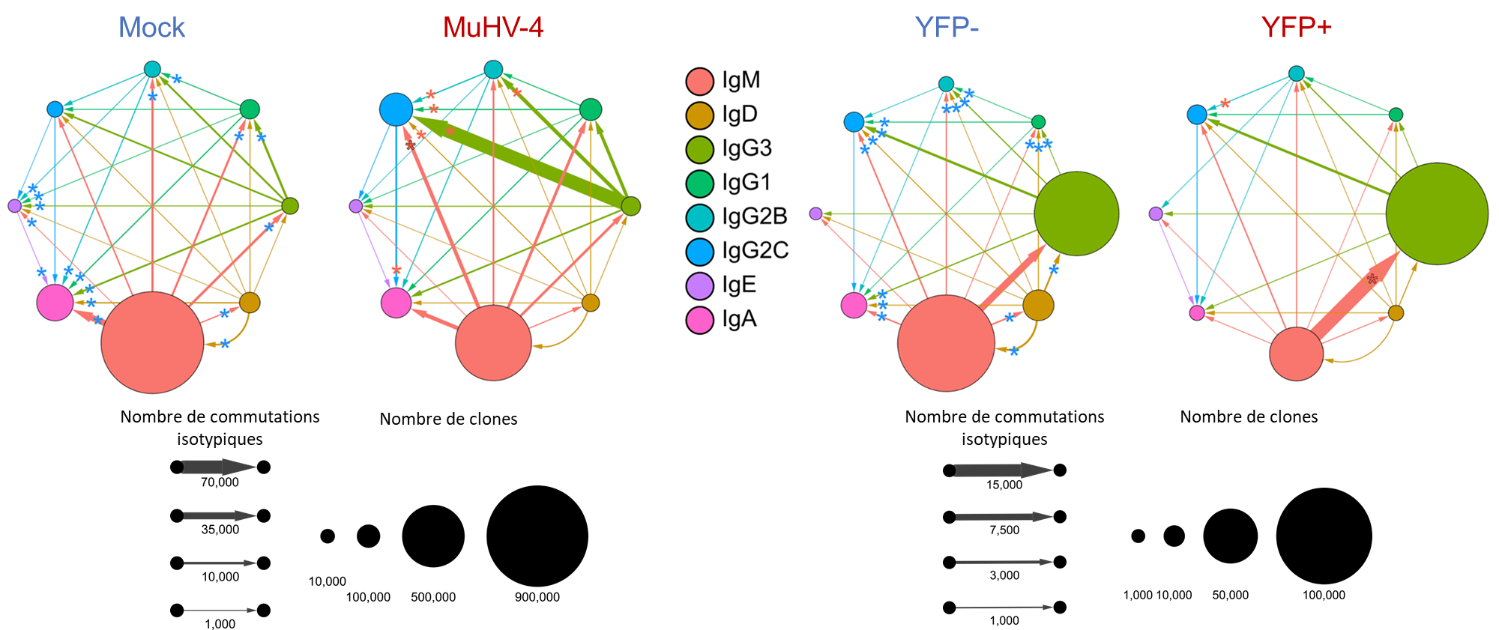
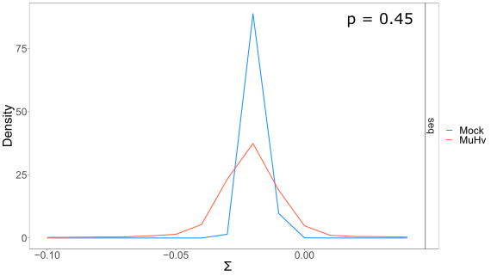
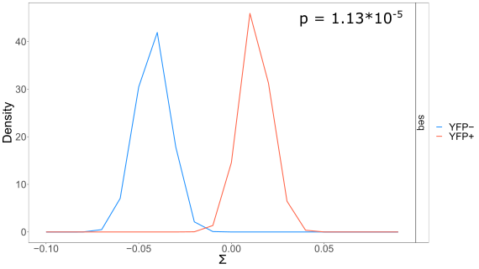
Previous results
Investigation of gammaherpesvirus-induced lymphoproliferative disorders
through sequencing of the B cell receptor repertoire
Notes:
The MuHV-4 infection also biased the isotype use of B cells, as infected mice and infected cells show differences with non-infected counterparts.
It is explained by differences in the isotype switching as we can see here.
We also could highlight differences in the expansion of the clones between infected an non-infected conditions.
Finally, we studied the somatic hypermutations and find out that we have differences between infected and non-infected B cells in infected mice, but we could not see such differences in our design for infected mice vs non-infected mice.

Slide 11

Immunodeficiency, EBV, and transplantation
Investigation of gammaherpesvirus-induced lymphoproliferative disorders
through sequencing of the B cell receptor repertoire
Transplantation
Immunodeficiency
EBV-
Immunosuppressive treatment
EBV+
Risk of LPD ↗
Risk of LPD ↗↗↗
Notes:
Earlier, I said that immunodeficient individuals have higher risk of developping lymphoproliferative disorders.
It is even worse when the person has never been infected by the EBV, needs a transplant, and the donor has been infected by the EBV. Here, the recipient needs to take an immunosuppressive treatment to avoid the engraftment rejection. It is one of the reason of the immunodefiency.
But we lack models that study such cases, and people are dying every year of that lack of data.

Slide 12
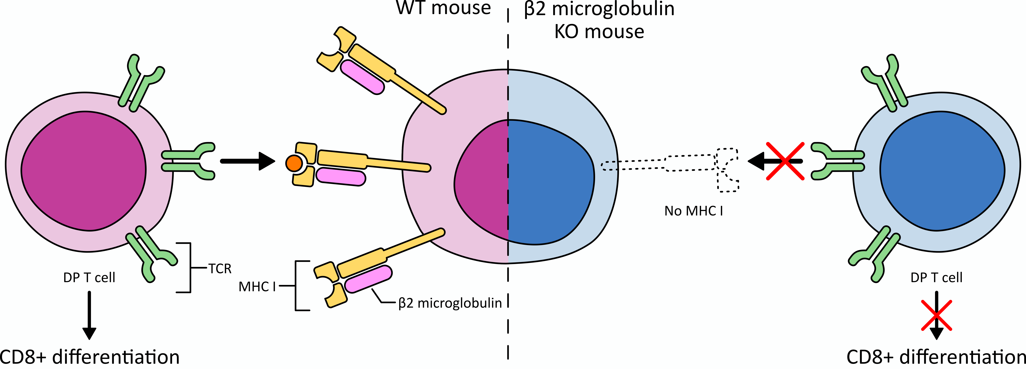
Immunodeficient mice
Investigation of gammaherpesvirus-induced lymphoproliferative disorders
through sequencing of the B cell receptor repertoire
No β2m
→ No MHCI
→ No CD8 T cells
↗ Risk of tumors
Notes:
So, now, in my project, I study the impact of the Murid HerpesVirus 4 on B cells in immunodeficient mice.
The mice I use are knock out for the beta 2 microglobulin gene, they thus do not have any MHCI on the surface of their cells.
This means that, in the thymus, the T cells in development cannot differentiate into CD8 T cell, because their TCR cannot bind to the MHCI.
And without CD8 T cells, the infection by a gammaherpesvirus cannot be controled as it should be, thus the risk of developping a lymphoproliferative disease is higher than in WT mice.

Slide 13

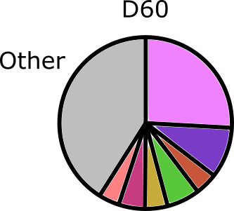

Follow-up of the lymphoproliferation
Investigation of gammaherpesvirus-induced lymphoproliferative disorders
through sequencing of the B cell receptor repertoire
?
What type of B cell?
Infected or not?
?
?
Notes:
In this experiment, I then infect those B2m KO mice with the MuHV-4 and wait for a lymphoproliferation to happen.
I will take a picture of the BCR repertoire of mice several times during the experiment by taking blood samples. And this is important, as in humans, we only have a look at the lymphoproliferative disease when the disease is already happening. Here, we will be able to have a follow up of the clones with time.
I will then try to highlight which B cells were proliferating too much, and what BCR they have and characterize them.
I hope this will give us more information on the B cells that are more prone to be an issue in such cases, like their infection status.

Slide 14
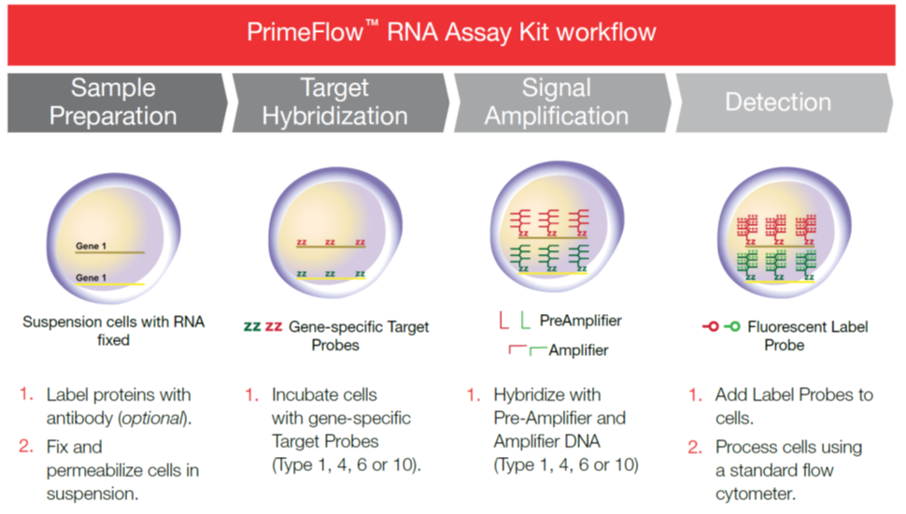
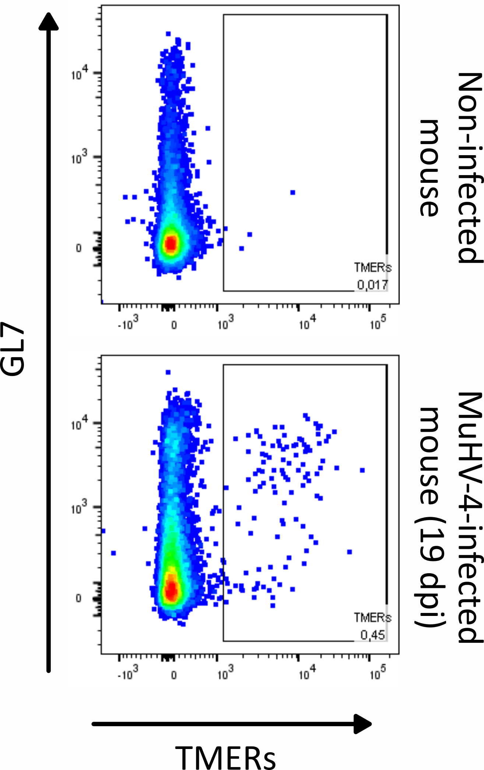
FACS sorting of infected cells
Investigation of gammaherpesvirus-induced lymphoproliferative disorders
through sequencing of the B cell receptor repertoire
Notes:
To discriminate infected from non-infected cells, I use the PrimeFlow kit that allows me to target small RNAs produced by the virus and amplify the signal before being able to detect fluorescence.
I then can sort infected cells with flow cytometry before processing the cells to sequence the BCR repertoire of those cells.
I changed from the YFP MuHV-4 because this technique is more sensitive, and can be easily used in humans too.

Slide 15
Perspectives
Investigation of gammaherpesvirus-induced lymphoproliferative disorders
through sequencing of the B cell receptor repertoire
Transplantation
Immunodeficiency
EBV-
Immunosuppressive treatment
EBV+
Transplanted people
→ PrimeFlow
→ FACS sorting
→ Characterization of the BCR repertoire
Notes:
The main perspective of this project is, after setting everything up in mice, to transpose the technique in humans.
Notably in this transplantation model.
We will work in collaboration with the CHU de Liège to get blood sample from transplanted people, some of them having a PTLD.

Slide 16
Take home messages
Investigation of gammaherpesvirus-induced lymphoproliferative disorders
through sequencing of the B cell receptor repertoire
Humans are widely infected by gammaherpesviruses
Immunodeficient people have higher risk of gammaherpesvirus-induced lymphoproliferative disorders
A gammeherpesvirus infection have a profound impact on the B cell population
The mechanisms behind those gammaherpesvirus-induced lymphoproliferative disorders are poorly understood
The B cells at the source of the lymphoproliferative disorders are yet to be characterized
Notes:
So, if you had to remember 5 things from all of this, this should be that:

Slide 17



Thank you!
Many thanks to my promoters:
Laurent GILLET
Bénédicte MACHIELS
Special thanks to:
Rémy SANDOR
Justine JAVAUX
Malyvanh PATHAMMAVONG
Sylvain LEEMANS
Lucie GILLARD (#duckmom)
& everyone in the team!
Audacious Medical Grant 2022
Notes:
This concludes my presentation, I am open to answer any question, thank you.

Slide 18
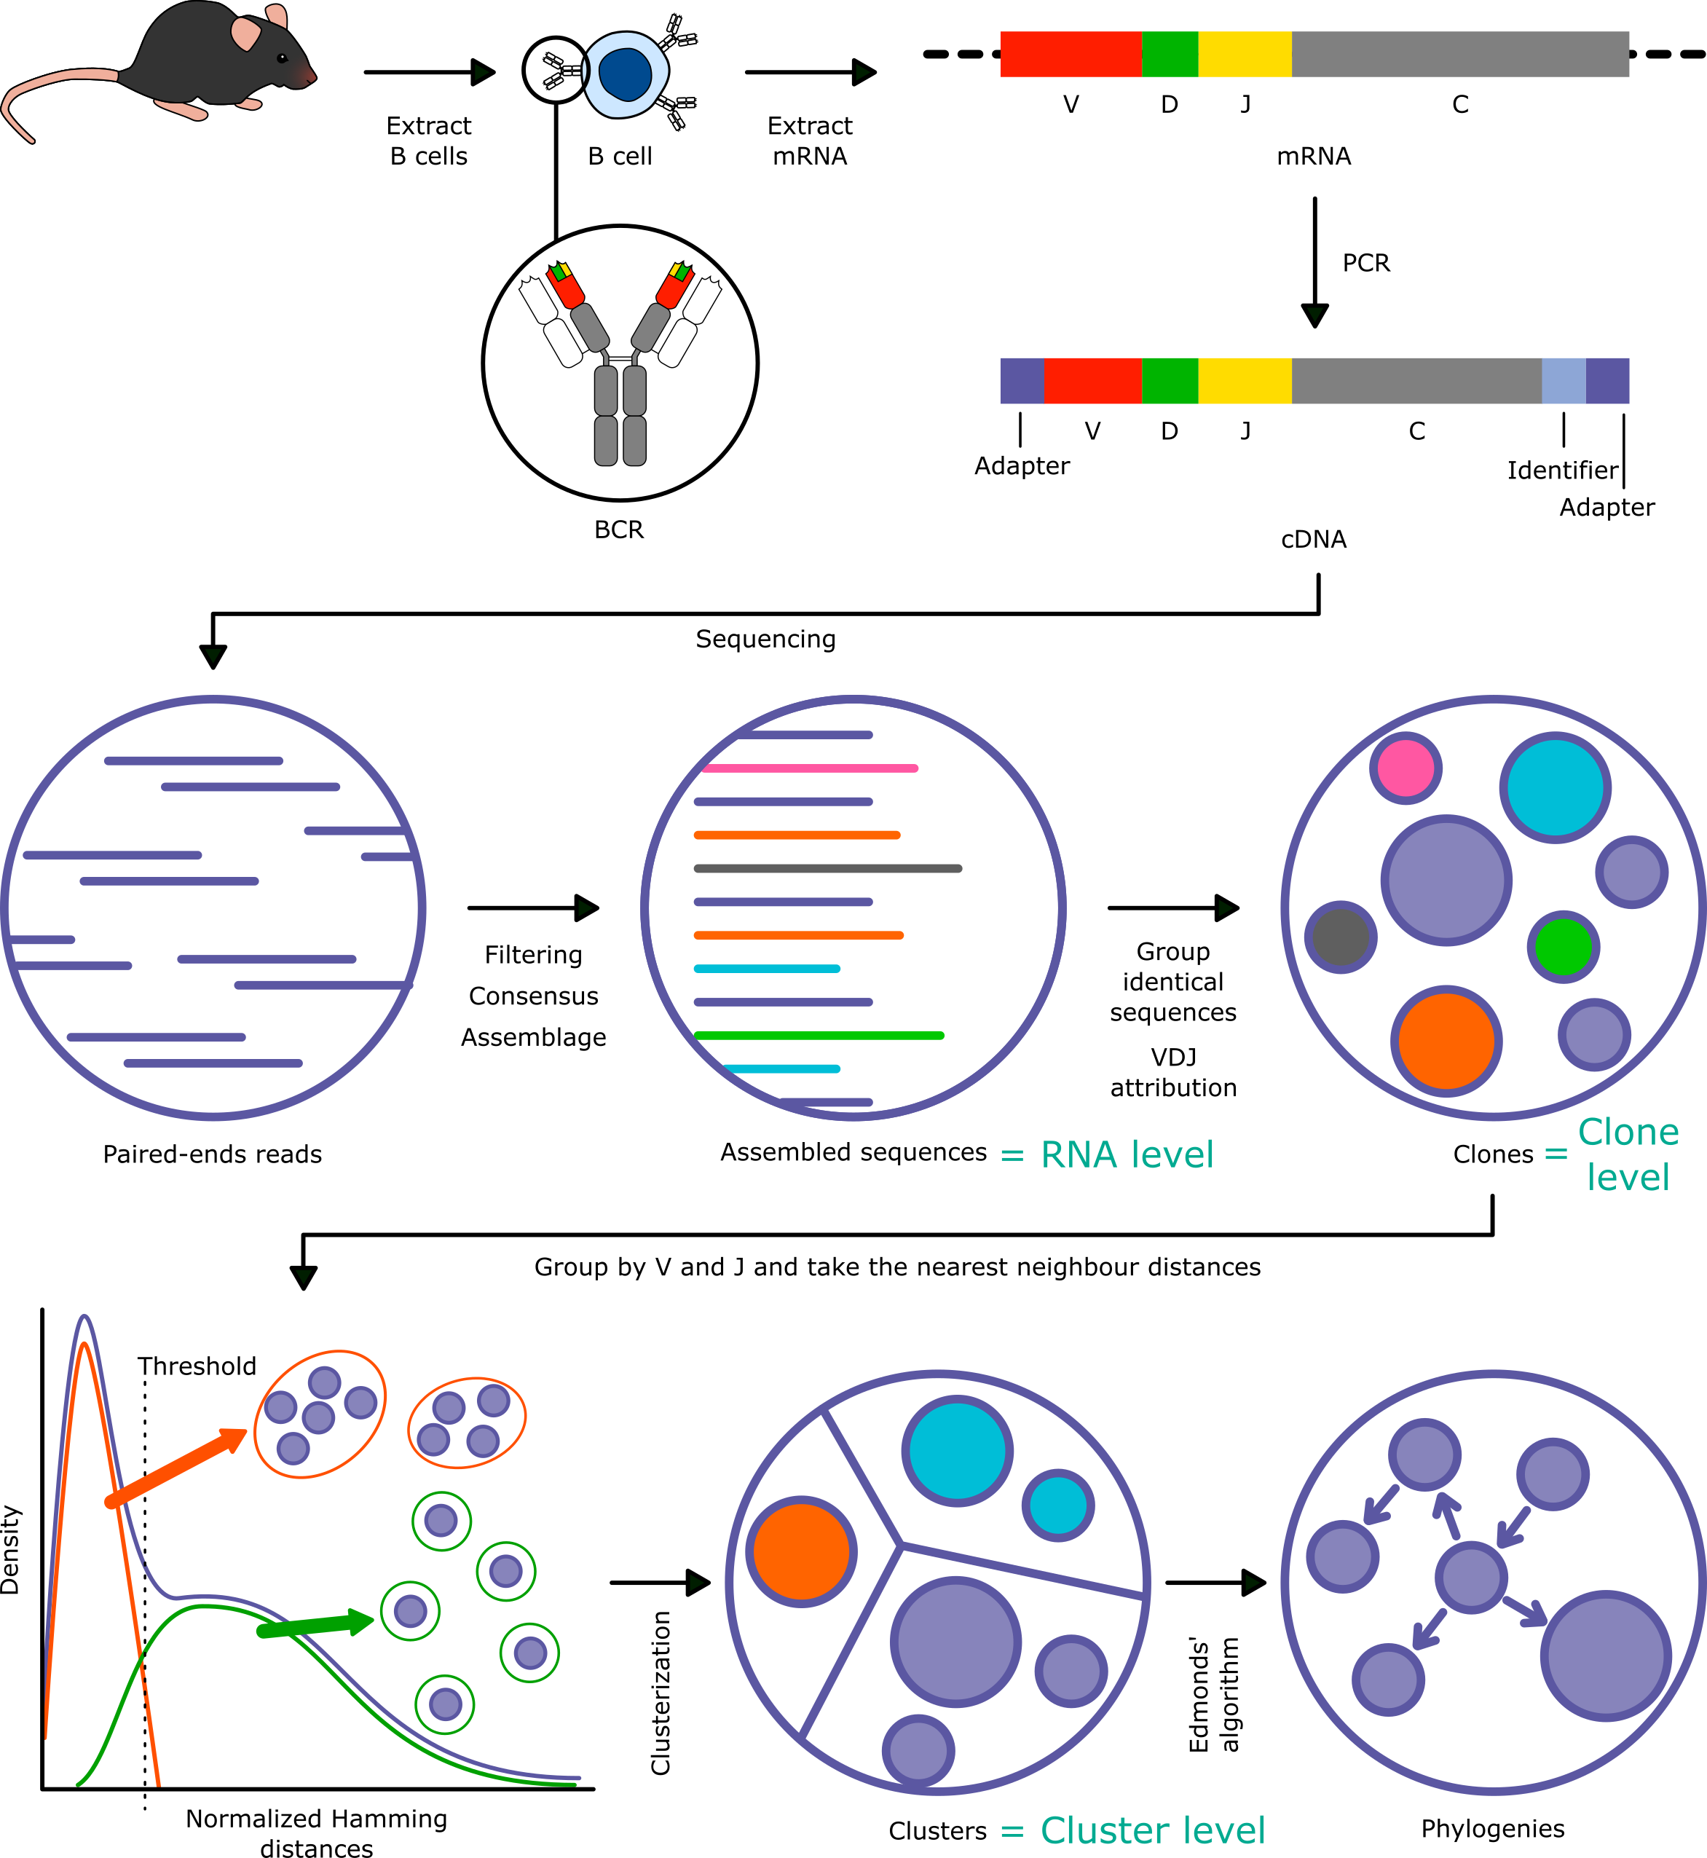
Investigation of gammaherpesvirus-induced lymphoproliferative disorders
through sequencing of the B cell receptor repertoire
Notes:
Backup

Slide 19

Investigation of gammaherpesvirus-induced lymphoproliferative disorders
through sequencing of the B cell receptor repertoire
Germinal DNA of B cells
VDJ recombination
V
D
J
C
AAA
mRNA
CDR3
Notes:
Backup

Slide 20
Investigation of gammaherpesvirus-induced lymphoproliferative disorders
through sequencing of the B cell receptor repertoire
AAA
mRNA
Notes:
Backup

Slide 21
Investigation of gammaherpesvirus-induced lymphoproliferative disorders
through sequencing of the B cell receptor repertoire
mRNA
AAA
NNNNNNNNNNNNNNN
Primer
cDNA
Identifier
Notes:
Backup

Slide 22
Investigation of gammaherpesvirus-induced lymphoproliferative disorders
through sequencing of the B cell receptor repertoire
NNNNNNNNNNNNNNN
cDNA
Notes:
Backup

Slide 23

Investigation of gammaherpesvirus-induced lymphoproliferative disorders
through sequencing of the B cell receptor repertoire
cDNA
NNNNNNNNNNNNNNN
NNNNNNNNNNNNNNN
FR3 primer
Adapter primer
CDR3
Next generation sequencing
Notes:
Backup

Slide 24
Investigation of gammaherpesvirus-induced lymphoproliferative disorders
through sequencing of the B cell receptor repertoire
Sequences arriving at sequencing:
NNNNNNNNNNNNNNN
Primer V
Sequence
Primer C
Identifier
Reads after sequencing:
Read 2 ----->
Primer V
Sequence
Sequence
Primer C
Identifier
<----- Read 1
Notes:
Backup

Slide 25
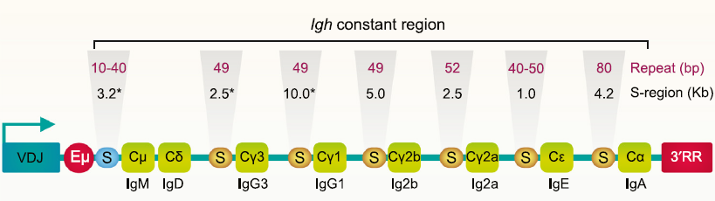
Investigation of gammaherpesvirus-induced lymphoproliferative disorders
through sequencing of the B cell receptor repertoire
Tannishtha et al., Charting a DNA Repair Roadmap for Immunoglobulin Class Switch Recombination (2021)
Notes:
Backup

Slide 26
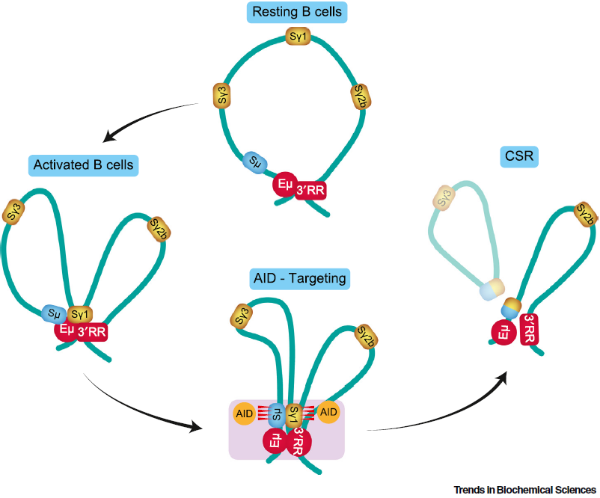
Investigation of gammaherpesvirus-induced lymphoproliferative disorders
through sequencing of the B cell receptor repertoire
Notes:
Backup

Slide 27
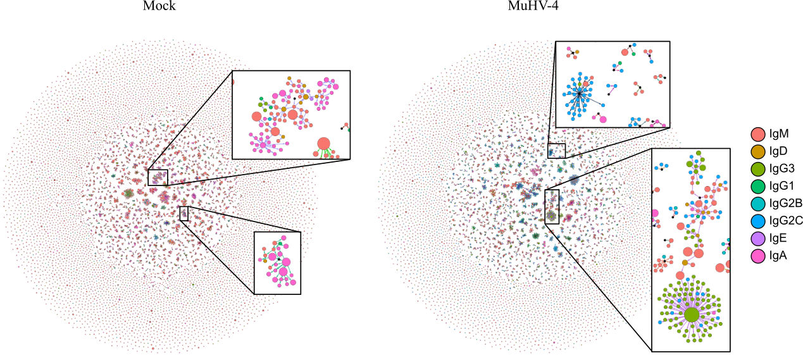
Investigation of gammaherpesvirus-induced lymphoproliferative disorders
through sequencing of the B cell receptor repertoire
Notes:
Backup

Slide 28


Investigation of gammaherpesvirus-induced lymphoproliferative disorders
through sequencing of the B cell receptor repertoire
Notes:
Backup

