Slide 1

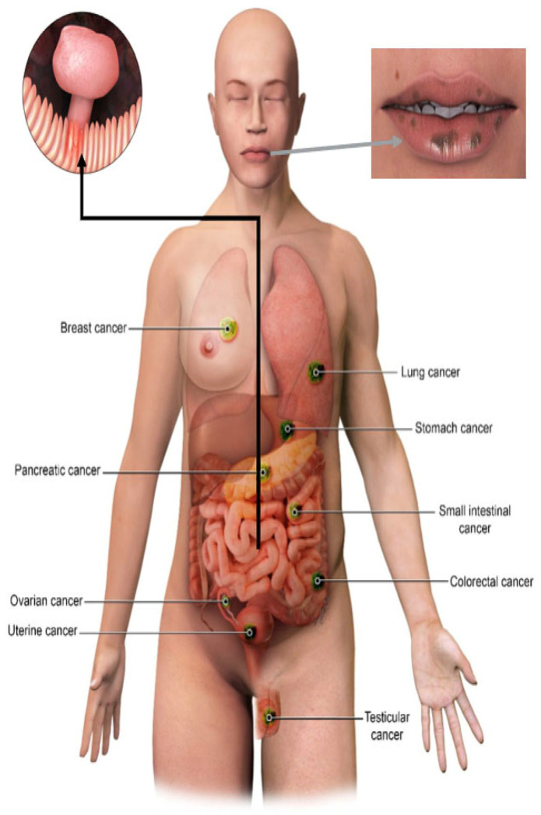
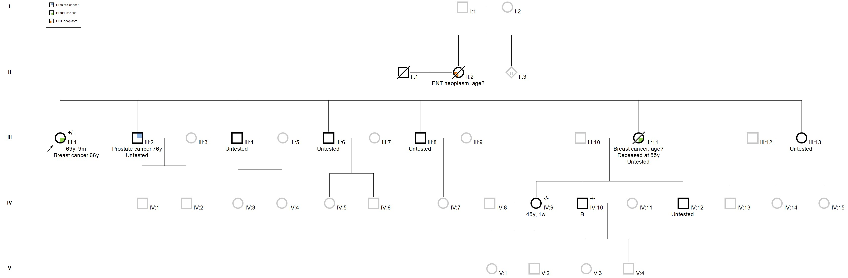
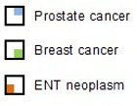
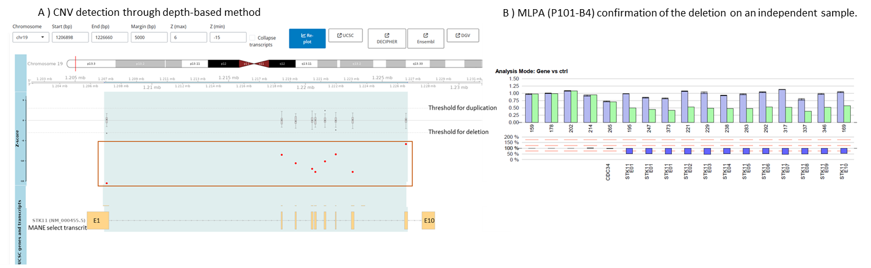
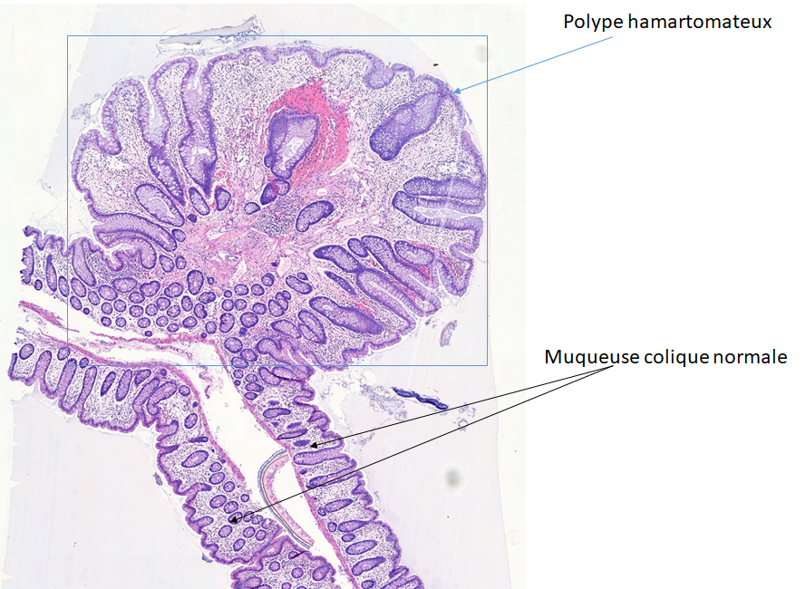
Unexpected STK11 Gene Deletion in a Breast Cancer Patient: Implications for Cancer Predisposition Panels
Sepulchre Edith*, Leroi Natacha*, Coupier Jérôme, Martin Marie, Bours Vincent
*These authors contributed equally to the work.
Centre de Génétique Humaine, CHU de Liège, University of Liège, Liège, Belgium
Corresponding author: Edith Sepulchre, MD, PhD student, e.sepulchre@chuliege.be
Peutz-Jeghers syndrome
From Klimkowski et al., Cancers (Basel), 2021.
Background and aims
STK11 encodes a serine/threonine kinase that acts as a multifunctional tumor suppressor
Heterozygous pathogenic STK11 variants cause Peutz-Jeghers syndrome
Estimated prevalence ~1-9/10⁶
STK11, CDH1 and PTEN were recently added to standard gene panels for breast and/or ovarian cancer predisposition (HBOC) screening in Belgium
This was debated due to their association with broader syndromic features
Case report
Patient: Woman with breast cancer diagnosis at 66 years-old. Medical history and clinical examination unremarkable.
Family tree:
Legend:
Genetic analysis:
      Standard HBOC panel:
        No SNV nor small indel detected in BRCA1/2, PALB2, ATM, CHEK2, TP53, BARD1, BRIP1 and MMR genes
              CNV analysis (Sequencing depth-based method, research approach):
              Complete deletion of STK11 (Peutz-Jeghers Syndrome)
Work-up for :
      Colonoscopy
      Upper digestive tract endoscopy
      Gynecologic examination
      Pancreatic MRI
Key messages
Importance of including the STK11 in gene panels for HBOC screening, even in the absence of distinctive clinical features.
Emphasizes the need for CNV analysis, not just SNV screening
Comprehensive genetic evaluation can identify significant variants, uncovering diagnoses that cannot be suspected based on clinical presentation alone.
Such diagnoses enable personalized clinical care, thereby optimizing the management of at-risk patients.
Acknowledgment
Thanks to all our colleagues from the Oncogenetic, Bioinformatic and Medical Teams, the Human Genetics Department of CHU of Liège, and to the patient and his family for their trust and support.

