Slide 1

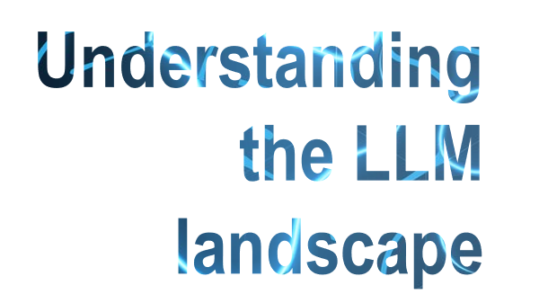


An early 2025 overview
Lize Pirenne and Prof. Damien Ernst
Image source: https://images.theconversation.com/files/154352/original/image-20170126-23840-1mo1ycx.jpg

Slide 2
Understanding the LLM landscape
Chapter 1
What is a Large Language Model?

Slide 3
What is an (autoregressive) Large Language Model?
A Large Language Model (LLM) generates a sequence (the response/ completion) that is likely to follow another one (the prompt).
This is the text the LLM should be predicting.
Prompt
Sequence to generate
This is the text the LLM should be predicting.
The autoregressive model defining the LLM iteratively gives a probability distribution over a random variable ▣ (the next token) conditioned on the whole past. Its realisation ▢ is then used for the next iteration.

Slide 4
Learning for autoregressive models
The data for learning is made of causally masked sequences where the future tokens are hidden. The resulting autoregressive model is the one that best predicts this data on average.
More formally, the learning process minimises the cross entropy between the output distribution P(▣|▢) and the correct token (a Dirac delta function distribution).
High-probability completions are seen as more desirable because they represent the data accurately.
Causal mask
This is the text the LLM should be predicting.
This is the text the LLM should be predicting.
This is the text the LLM should be predicting.
This is the text the LLM should be predicting.
This is the text the LLM should be predicting.
It looks triangular in a big matrix.

Slide 5
A deeper look into the probability of a completion
The probability of the entire completion can be computed with the chain rule:
P(▢,▢,▢|▢) = P(▢|▢) P(▢|▢,▢) P(▢|▢,▢,▢).
Prompt
Sequence to generate
This is the text the LLM should be predicting.
An autoregressive LLM gives:
P(▣|▢);
then P(▣|▢,▢);
and then P(▣|▢,▢,▢).

Slide 6
Example of autoregression (1/3)
First, we compute the distribution for the first token P(▣|▢) using the prompt ▢.
Prompt
Sequence to generate
This is the text the LLM should be predicting.

Slide 7
Example of autoregression (2/3)
After having drawn a sample ▢ from the first distribution P(▣|▢), we compute the distribution for the second token P(▣|▢,▢).
Prompt
Sequence to generate
This is the text the LLM should be predicting.

Slide 8
Example of autoregression (3/3)
Then we draw the second sample ▢ from the second distribution P(▣|▢,▢) and, finally, we compute the distribution for last token P(▣|▢,▢,▢).
Prompt
Sequence to generate
This is the text the LLM should be predicting.

Slide 9
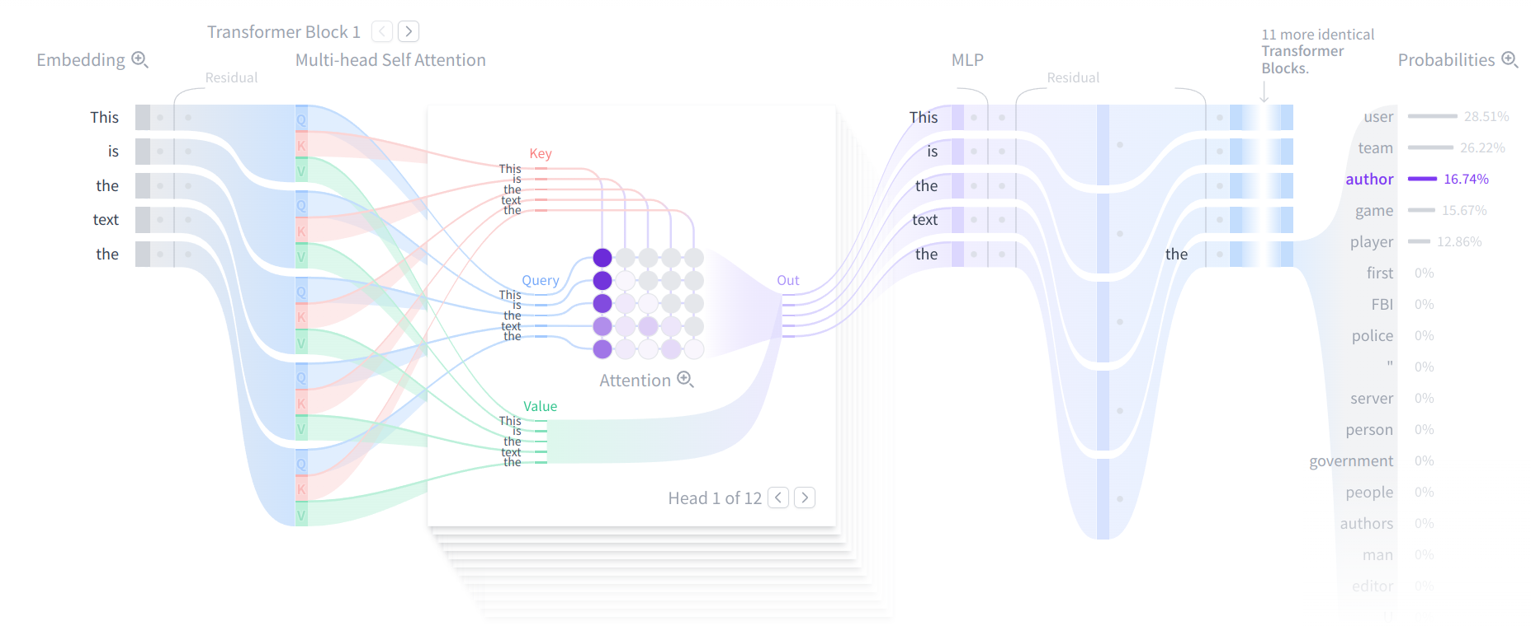
Architecture
The most common architecture used to build LLMs is called a decoder-only transformer.
Image from: https://poloclub.github.io/transformer-explainer/

Slide 10
Understanding the LLM landscape
Chapter 2
LLM as a business

Slide 11

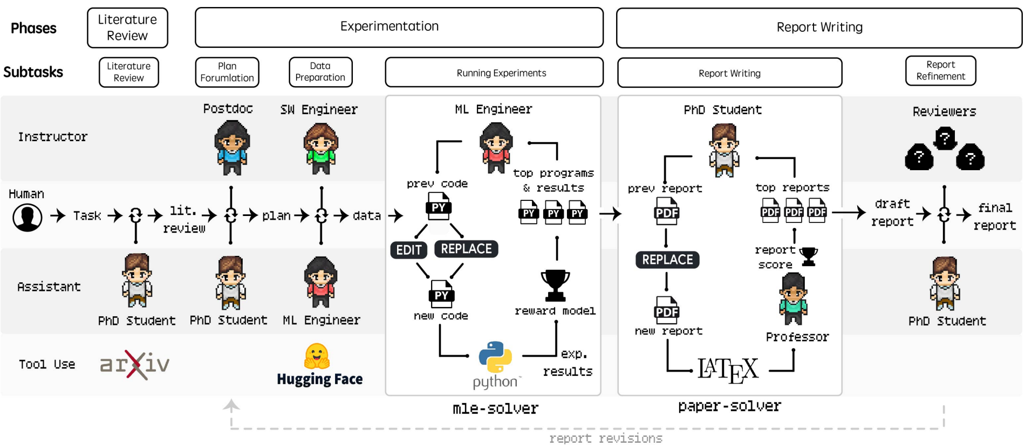

Uses of LLMs
Such a simple process allows for amazing applications, for example:
Chatbots
AI-assisted research
Content creation with AI
Images from: https://siamcomputing.com/technology/chatbots-vs-apps/ , https://arxiv.org/abs/2501.04227, https://www.bloomberg.com/news/newsletters/2023-06-16/neuro-sama-an-ai-twitch-influencer-plays-minecraft-sings-karaoke-loves-art

Slide 12
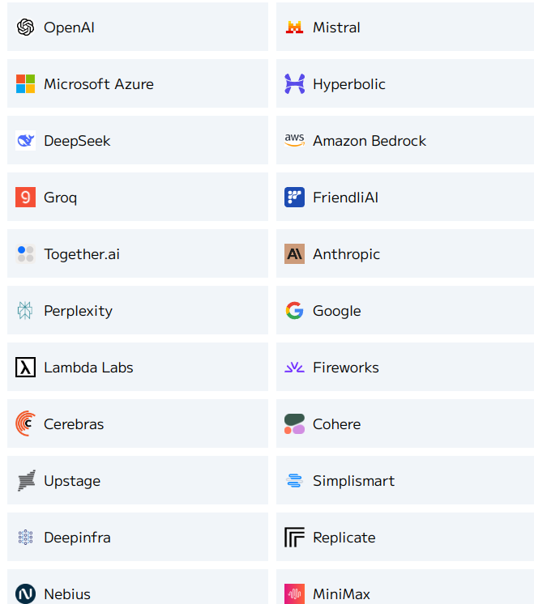
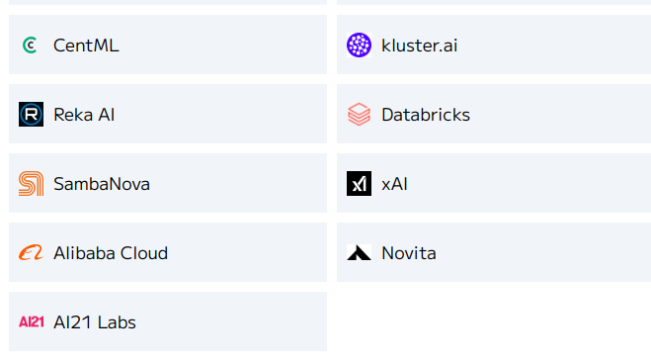
LLM provider, a new business
LLM providers are businesses that host LLMs and centralise the requests of their customers.
They often used proprietary LLMs that they have trained at huge cost but some of them also use open-source LLM models.
Those open-source models can in principle be run by anyone, but the cost of hardware is often prohibitive. Indeed, running your model locally does not allow you to amortise it over a large number of requests, as LLM providers do; they also benefit from economy of scale for building their IT infrastructure.
Image from: https://artificialanalysis.ai/leaderboards/providers

Slide 13
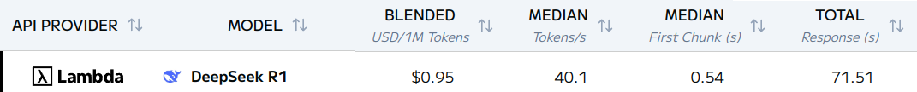
Provider prices
Prices of providers are given per (million) token.
Typical cost for a provider, here Lambda, hosting a deepseek model:
We see that we pay only $0.95 per 1 million tokens. The model produces around 40.1 tokens per second. It needs 0.54 seconds to output the first token.
Image from: https://artificialanalysis.ai/leaderboards/providers

Slide 14
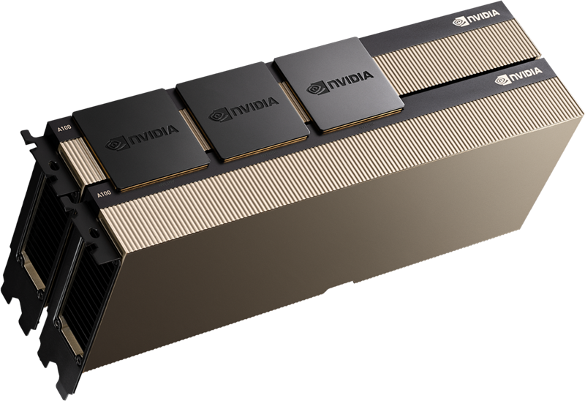
Running DeepSeek R1 locally
To run the same DeepSeek R1 model locally and produce the same number of tokens per second with the same latency, you would need 20 × A100 80GB.
This would correspond to a cost of:
20 × $17,549.95 = $333,449.05.
The DeepSeek R1 model run by Lambda could generate around 350,000 million tokens for this price.
The A100 80GB produced by NVIDIA
https://www.amazon.com/PNY-A100-80GB-Graphics-Card/dp/B0CDMFRGWZ

Slide 15
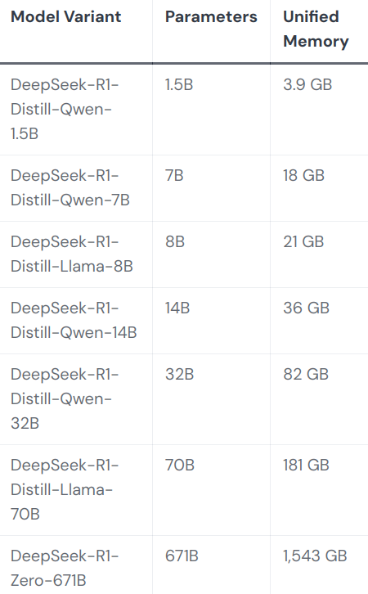

Little models for little budgets
Some people want to have their own LLM for privacy reasons (for example) without investing in expensive hardware. Smaller models, only slightly poorer performance, are suitable for them.
Some of these models can even run on your smartphone and dedicated apps have been developed for this, such as the PocketPal AI ( ))).
One phone*
One Nvidia 4090
One A100 40G
The one offered by providers
More practical info on: https://www.smartprix.com/bytes/how-to-run-deepseek-ai-locally-on-your-phone-2-methods/

Slide 16
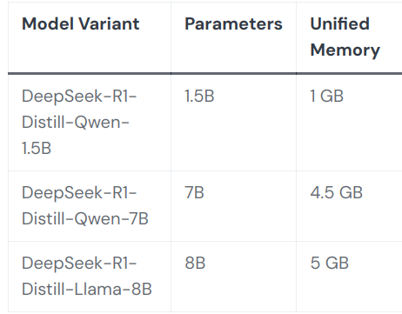
Compression techniques for making models simpler
Models can be compressed to around a fourth of their original size (almost) without modifying the output using various techniques such as “quantisation”.
This technique represents the numbers corresponding to the parameters of the model with a smaller number of bits.
Quantised:
Original:

Slide 17
Understanding the LLM landscape
Chapter 3
Growth of LLMs

Slide 18
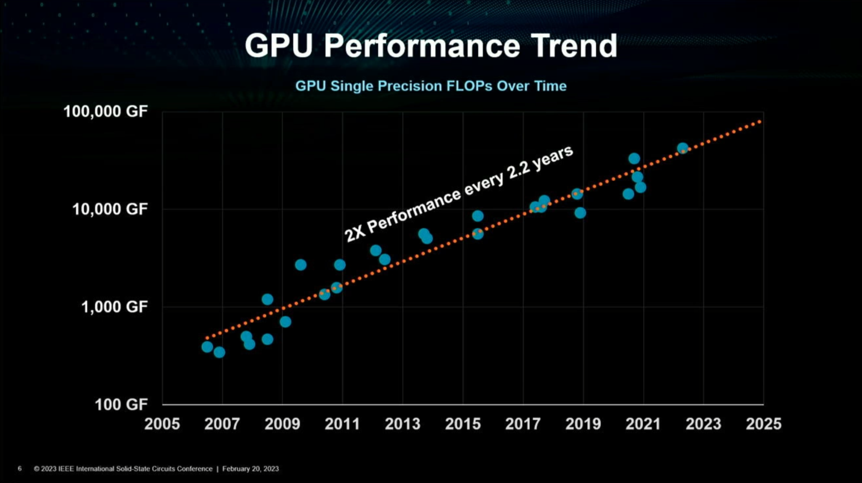
How did LLM become so good?
The excellent performances of today’s LLMs would not have been possible without the tremendous growth in the computational capabilities of GPUs.
Image from: https://wccftech.com/amd-lays-the-path-to-zettascale-computing-talks-cpu-gpu-performance-plus-efficiency-trends-next-gen-chiplet-packaging-more/

Slide 19
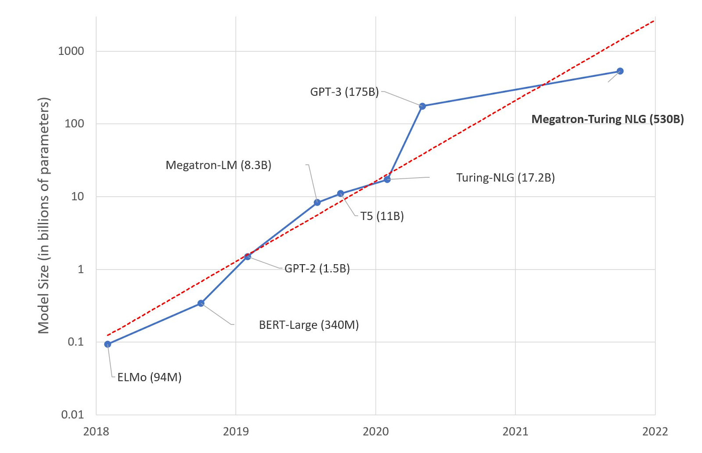
Scaling for the win
Language Models demonstrated scaling laws: “bigger is better” with no sign of stopping
The switching point in terms of performances happened with GPT-3, which is ten-times bigger and used much more data than previous models. It paid off.
Image from: https://lastweekin.ai/p/gpt-3-is-no-longer-the-only-game

Slide 20
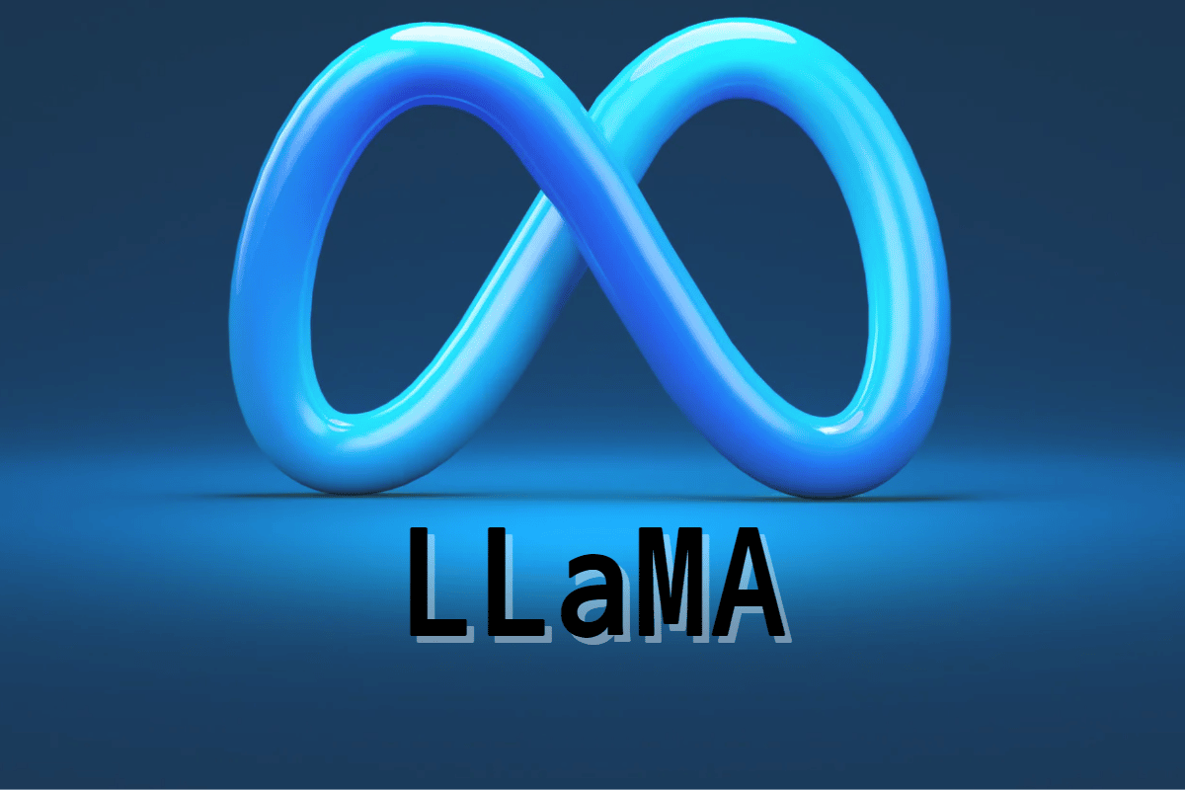
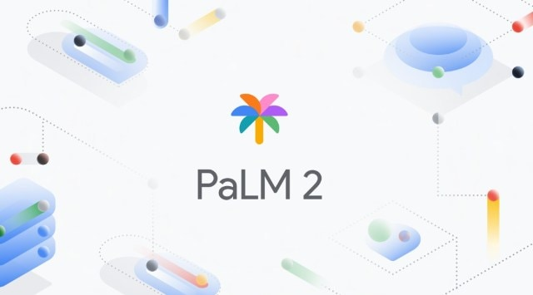

The realm of open-source models
ChatGPT is a good model, but it was closed source.
After its release, open-source models quickly caught up. Big software companies, like Meta or Google made their models available for anyone to download and run.
Examples of well-known open-source models:
LlaMa by Meta
PaLM 2 by Google
BLOOM by HuggingFace

Slide 21
Benefits of releasing open-source models
There were three incentives for big corporations to release their models as open source:
Their name would be on everyone’s lips;
The ecosystem would revolve around their standards;
Researchers could spot weak points and fix them for free.

Slide 22
Evaluating the quality of an LLM: benchmarks
Datasets made for evaluating the quality of LLMs are called benchmarks. One of the first widely used benchmarks was GMSK8.
For this benchmark, the prompt defines a Problem to be solved. For every problem, the benchmark gives the Solution scheme and the answer. The LLM is judged on its capacity to provide the Final answer.
Problem: Beth bakes 4, 2 dozen batches of cookies in a week. If these cookies are shared amongst 16 people equally, how many cookies does each person consume?
Solution scheme: Beth bakes 4 2 dozen batches of cookies for a total of 4*2 = <<4*2=8>> 8 dozen cookies. There are 12 cookies in a dozen and she makes 8 dozen cookies for a total of 12*8 = <<12*8=96>> 96 cookies.
She splits the 96 cookies equally amongst 16 people so they each eat 96/16 = <<96/16=6>> 6 cookies.
Answer: 6.
https://arxiv.org/pdf/2110.14168v1.pdf
The accuracy of the LLM is computed simply by checking that we have a complete match of the answer.

Slide 23

Stochastic parrots
A well-thought quote about LLMs being stochastic parrots:
“A system for haphazardly stitching together sequences of linguistic forms it has observed in its vast training data, according to probabilistic information about how they combine, but without any reference to meaning.”
Emily M. Bender et al.
In order to be more performant than big stochastic parrots, as GPT-3 is for example, we need something more than textual data and bigger models. On strategy is to make better use of LLM properties.
Image from: https://www.picgifs.com/graphics/parrot/graphics-parrot-365147-802609/, citation from https://dl.acm.org/doi/pdf/10.1145/3442188.3445922

Slide 24
Understanding the LLM landscape
Chapter 4
Making better use of LLMs properties

Slide 25
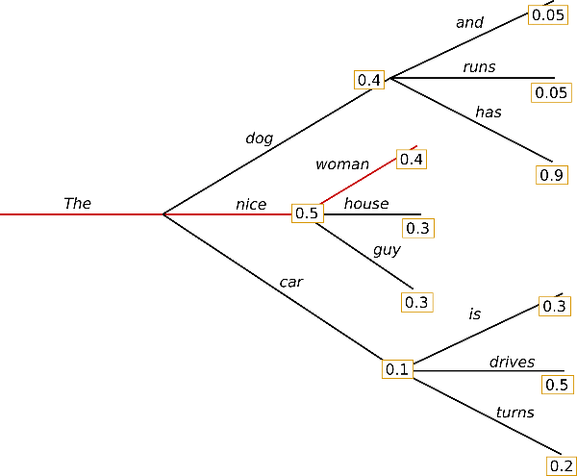
Better use 1: Searching for the best completion
The ensemble of all completions can be represented as a tree where each child of a node is possible next token with its probability. The probability of a path in the tree gives the probability of a completion.
One possible solution for making a better use of existing LLM models would be to output the path with the highest probability and not, as it is the case now, a path generated by sampling the autoregressive model.
Image from: https://huggingface.co/blog/how-to-generate

Slide 26
A computational issue
To find the maximum of the auto-regression tree, we have in principle to explore all possible nodes.
This is computationally out of reach.
Example:
Deepseek-R1 has a vocabulary size V of around 131,072 tokens. The average response length L is around 10,000 tokens.
Thus, as first approximation the number of paths in the tree is 131,072^{10,000}.
V
L

Slide 27
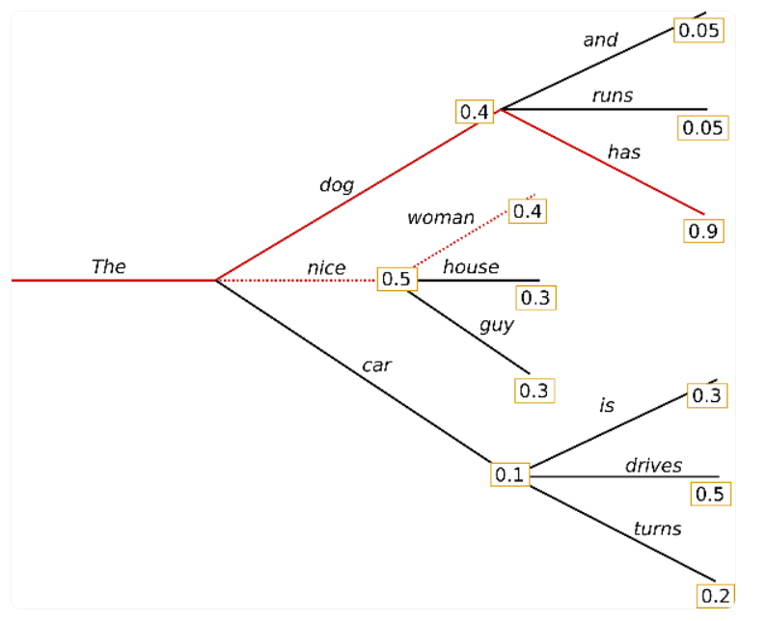
Exploring the tree efficiently
Many scientists have developed algorithms for efficiently exploring this tree in order to rapidly identify a high-probability path.
One of the most common strategies is to grow only a limited number of paths by favouring branches having a high probability.
In this example, only the red-coloured paths are explored.

Slide 28
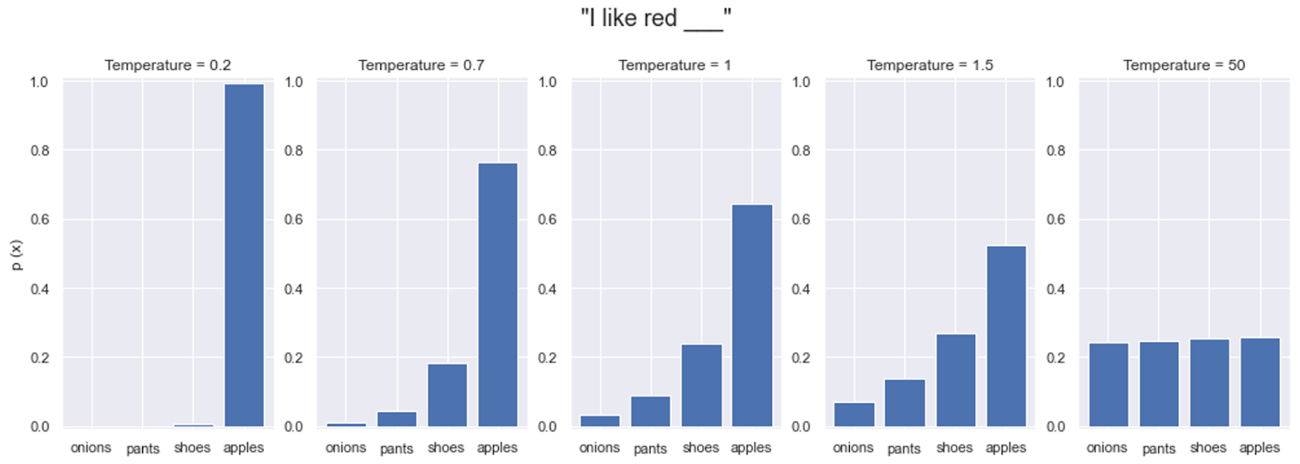
Better use 2: Fostering creativity with temperature
Some use-cases require creativity, as is the case when writing an original book. In such cases, we may want to diverge from the original data distribution. This can be done by changing the temperature parameter that tweaks the distribution defined by the LLM towards a more uniform one.
Image from: https://www.hopsworks.ai/dictionary/llm-temperature

Slide 29
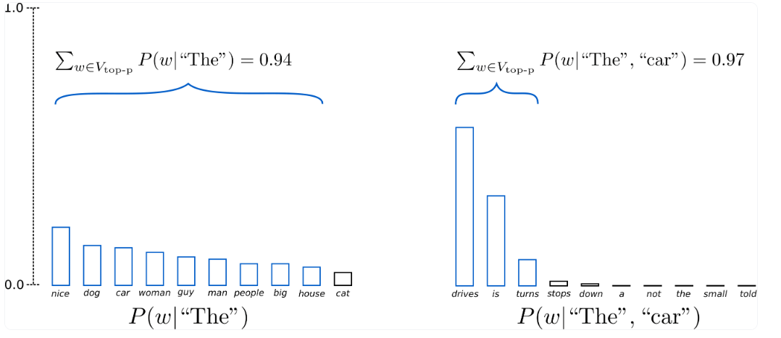
Better use 3: Limiting unlikely samples with nucleus sampling
We may want creativity, but we also want to stay in the realm of possible completions. Many tokens have overestimated probabilities (especially with high temperature). We can choose to only include those who contribute the most (top-k sampling), or up to a certain total percentage. This is called nucleus sampling.
Image from: https://huggingface.co/blog/how-to-generate

Slide 30
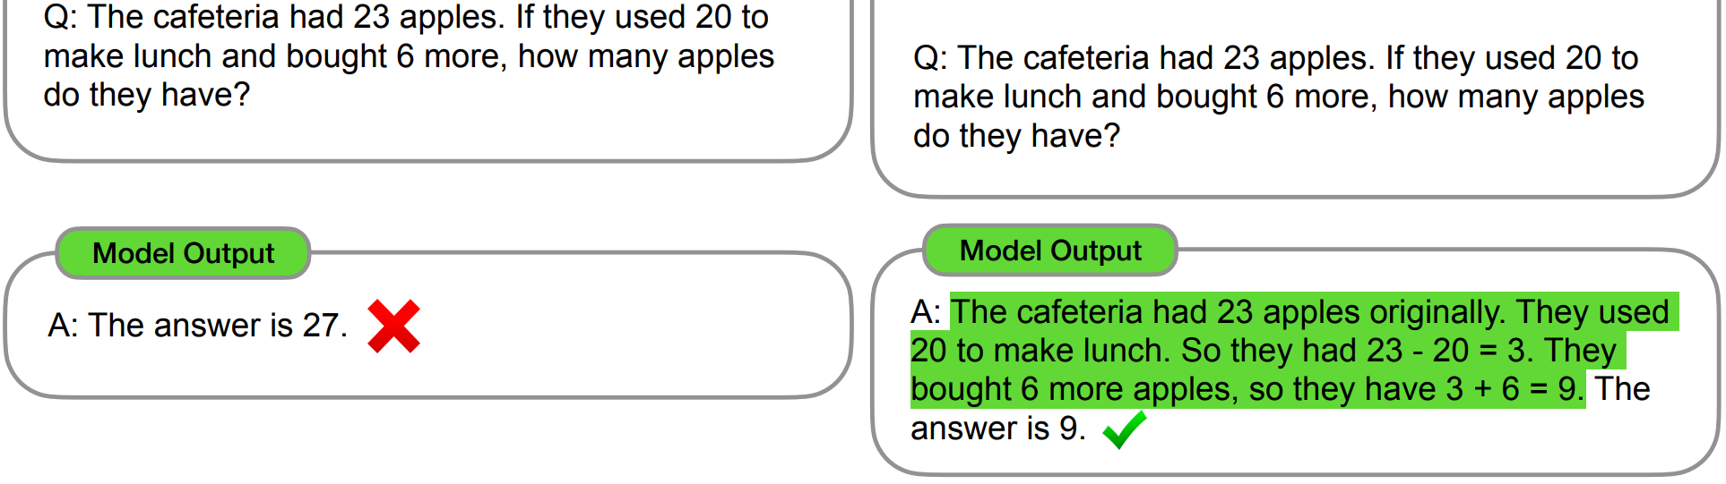
Better use 4: Prompting better with Chain-of-Thoughts
On the right two outputs of LLM on a question of the GSMK8 benchmark. The first is asked with a straightforward prompt but the question does not give a correct answer.
Adding a simple line “Let us think step by step” to the beginning of the LLM’s completion gives the correct answer.
The LLM can perform better if asked to come with the reasoning steps leading to the answer, that is to develop a Chain-of-Thoughts.
Let’s think step by step.
Image from: https://arxiv.org/abs/2201.11903

Slide 31
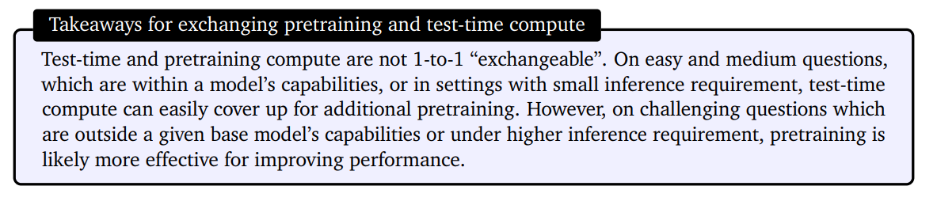
Test-time compute
The methods developed in this chapter are grouped under the name test-time compute since they leverage computation time after the training* is over.
Test-time computing is favoured with smaller models as it can be seen as an approach to offset the loss of performances associated with model size reduction.
Choosing the right trade-off between training and test-time compute depends also on the usage. But notice that all compute is not equivalent.
Quote from: https://arxiv.org/abs/2408.03314
*The entire training phase is usually done in three phases: pretraining, fine tuning and reinforcement learning.

Slide 32
Understanding the LLM landscape
Chapter 5
Emulating intelligence

Slide 33
Road to intelligence: diversified inputs
To start building intelligence, we want models to have a more accurate view of how concepts relate to each other. Let us take the following example:
“An apple falls under the effect of gravity.”
The object “apple” can be influenced by the force “gravity” creating the result of “falling”. There are clearly a lot of concepts hidden behind this sentence.
Would it not be easier for a machine to understand them if it had access to a video of the apple falling and not only the text? This suggests that as a first step on the road to intelligence to have LLMs that can process multiple modalities.

Slide 34
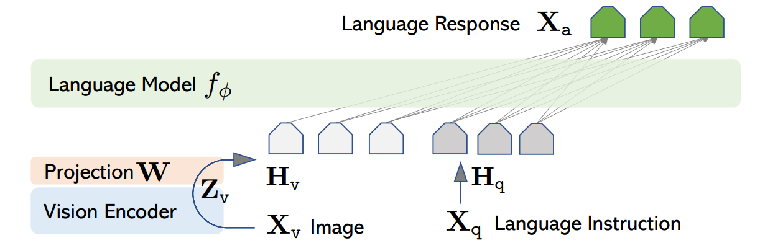
Adding senses to LLMs: multimodality
We now see LLMs appearing that can understand many modalities.
The strategy used to achieve this is quite simple: a mapping of all the different inputs into the same space, the one whose elements are further processed by the LLM. This can be done efficiently by training a little module that will translate (project) the different inputs into this space.
The image is taken from: https://arxiv.org/abs/2304.08485

Slide 35
Computational challenges related to multimodal LLMs
Multimodal LLMs (MLLMs) process very large inputs made among others of audio-visual signals, and this requires much more hardware capabilities.
The research community has had to address these computational challenges. It proposed two main improvements:
Multi Layer Attention: Reusing the same blocks for different layers of the language model f_{ɸ} → ~98.2% more efficient (56.9 × compression factor);
Flash attention: Reordering the matrix multiplications to take advantage of hardware infrastructure.
More information on MultiLayer Attention (MLA) in the video: https://www.youtube.com/watch?v=0VLAoVGf_74 , the numbers are taken from https://arxiv.org/abs/2405.04434

Slide 36
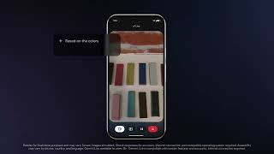
An example of multimodality in action

Slide 37
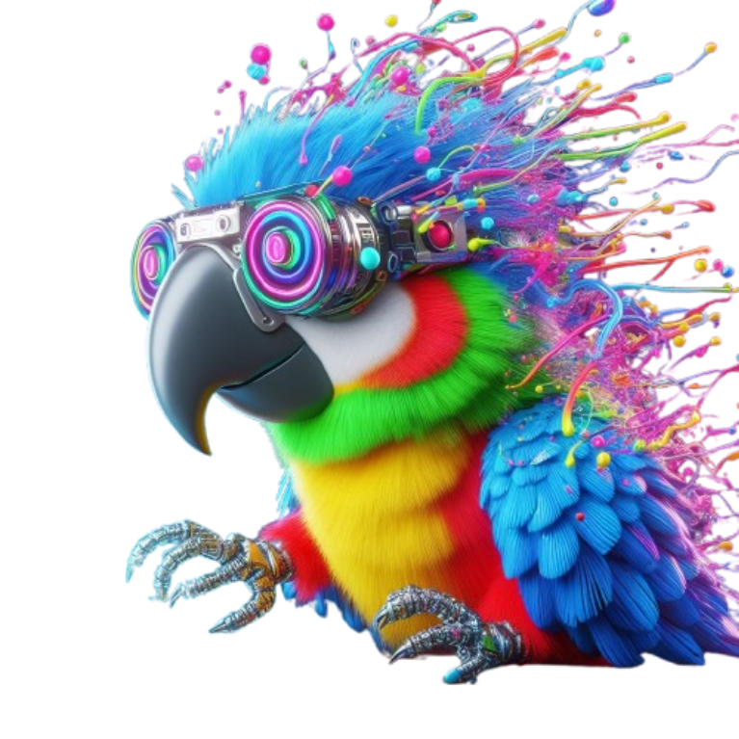
Are big multimodal models intelligent?
The goal of MLLMs is still the same as regular LLMs: Best prediction of what should follow a prompt given all input data in the multimodal prompt and its prior beliefs from its training.
MLLMs are still stochastic parrots, but their generations are a lot easier due to the enormous conditioning provided by the prompt.
Multimodality is good, but it is not sufficient to have general intelligence.
Image generated by Bing Image Creator using the prompt "A colorful futuristic parrot who is looking at a computer screen and getting dizzy"

Slide 38
Road to intelligence: adaptation
Humans are masters of adaptation. We want to give that capacity to LLMs too.
Let us define a setting in which an LLM would learn from an evaluation of its performances through a numerical score/reward:
An LLM gives an answer to a prompt;
A human or computer software quantifies the quality of this answer by giving a numerical score/reward to it;
The LLM modifies its behaviour such that it would get better rewards next time.
Question:
How can the LLM indeed modify its behaviour in such a setting?
https://link.springer.com/chapter/10.1007/978-1-4842-9807-7_4

Slide 39
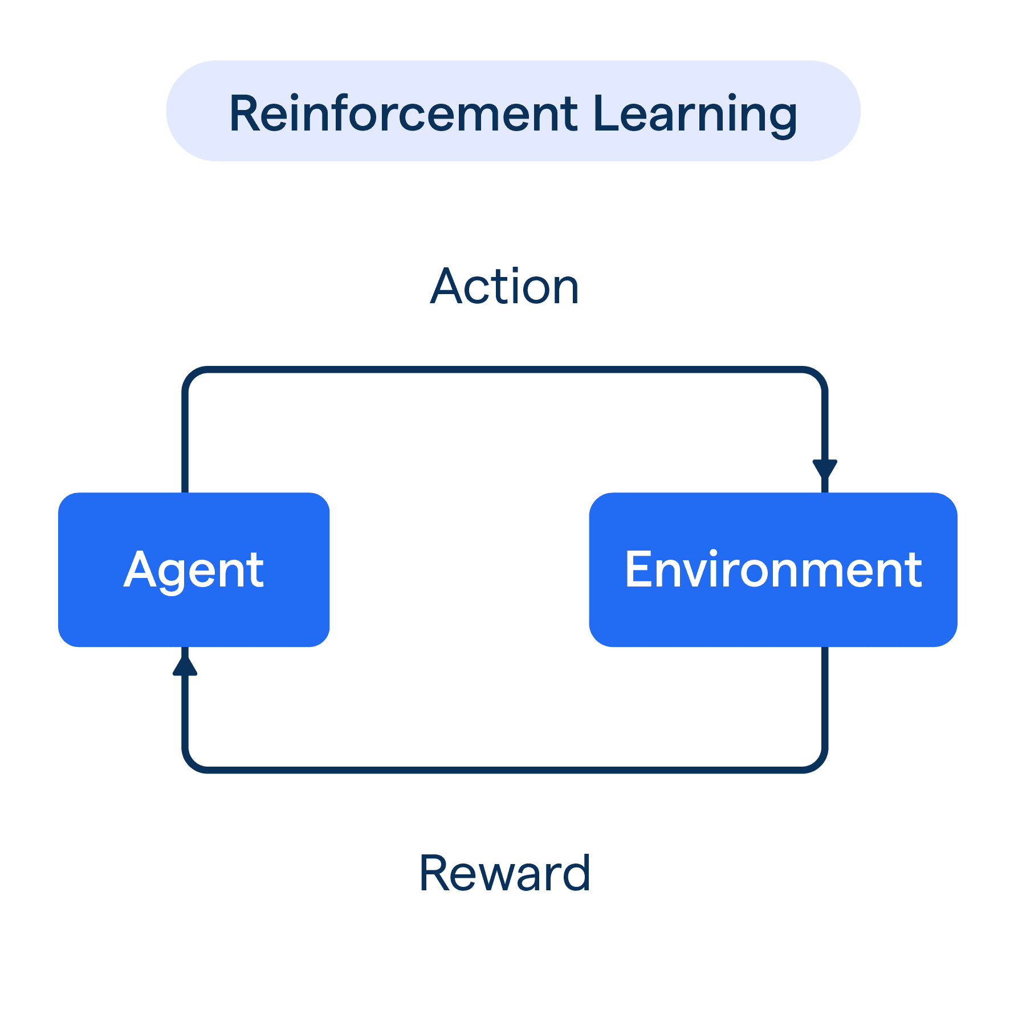
Reinforcement learning algorithms for adaptation
Reinforcement Learning (RL) is a subfield of Artificial Intelligence focusing on the design of algorithms for making an agent learn from its environment through a numerical reward signals that scores its behaviour.
In a typical RL setting, an agent applies an action to its environment and in return gets a reward and observations of the environment.
In our case, the LLM is the agent’s policy generating the token. The observation signals are the tokens. The environment can be a conversation*, a coding space… and the rewards score the behaviour of the LLM.
*When humans are giving the feedback, it is called RLHF (RL from Human Feedback).
Figure taken from: https://botpenguin.com/glossary/reinforcement-learning

Slide 40
Are models using intelligent human feedback?
Not necessarily. They can still be seen as parrots that have learnt to please humans instead of copying them. Indeed, they have been training with the goal of producing a high-probability completion, though the highest probability sentence reflects human preferences.
Additionally, a common phenomenon happening when training with reward models is reward hacking: The model finds a strategy to maximise the rewards in training and this strategy does not necessarily generalise to problems not seen during training*.
This highlights a shortcoming in intelligence of LLMs trained in a RL setting.
*We note that one way to mitigate reward hacking is to force models to stay close to the original one by adding a KL divergence term.

Slide 41
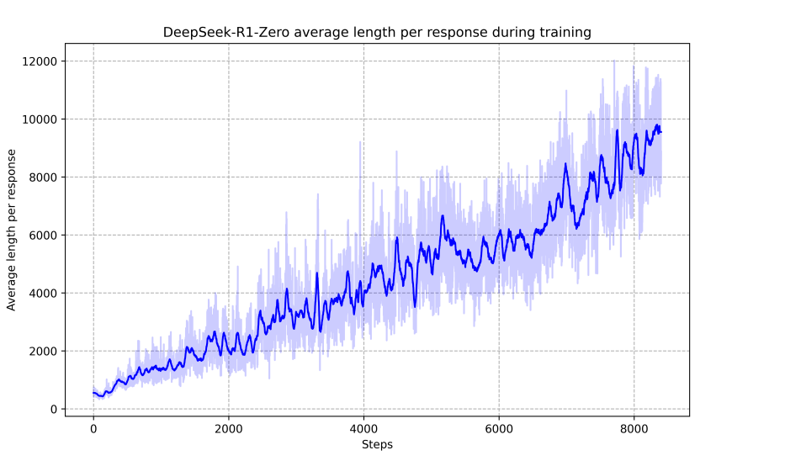
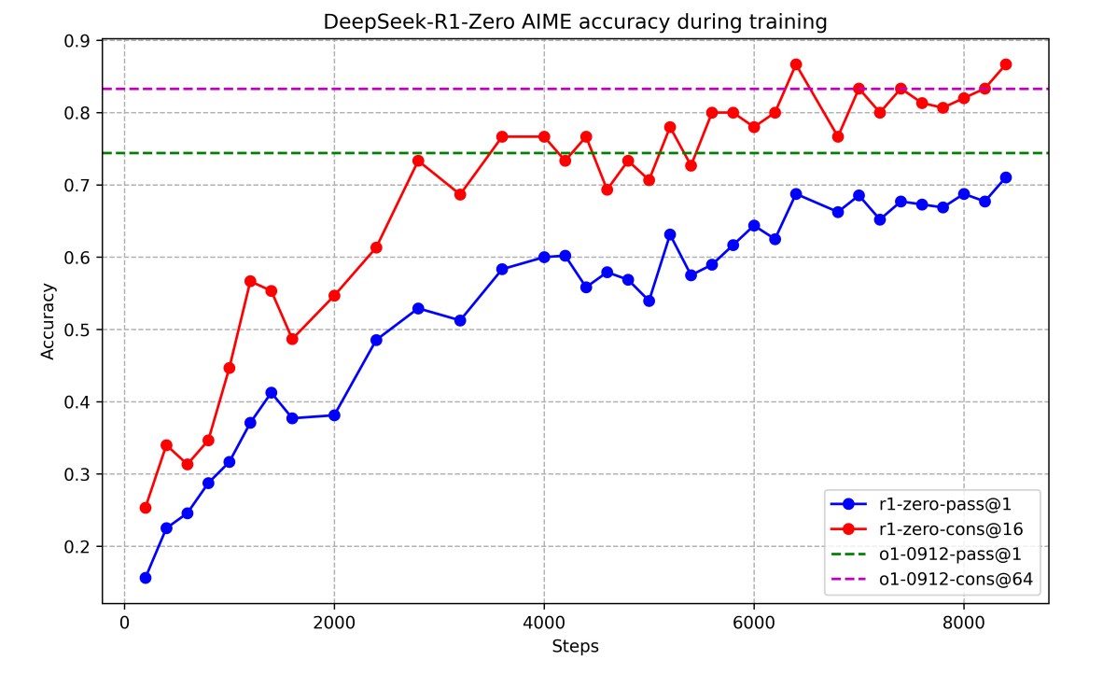
Addressing this shortcoming using rewards with “Chain-of-thought” flavour
By just adding to the rewards terms that scores not only the final answer, but also the presence of reasoning leading to the answer, better performances can be achieved.
In the first image, we see that the reasoning length increases with training when using such rewards. In the second image, we see two metrics for evaluating the quality of the answer growing with the RL training time.
Images from: https://arxiv.org/abs/2501.12948

Slide 42
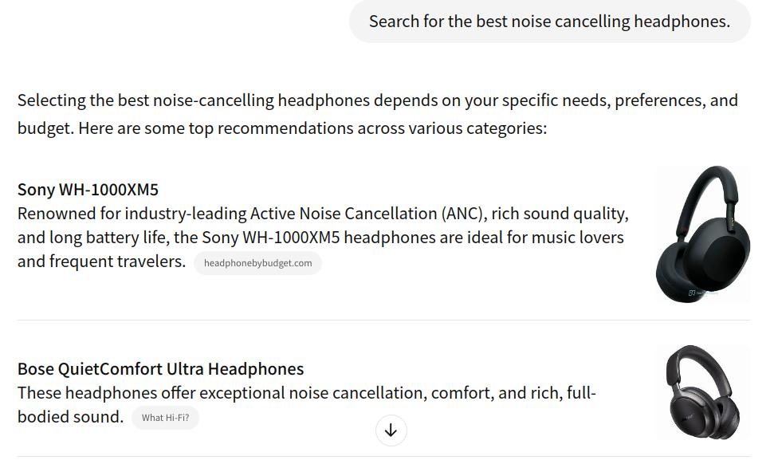
Road to intelligence: LLMs interacting with tools
An LLM can use external tools when appropriate. This can greatly empower them! The call to external tools is simply done by generating the right text for APIs.
An example of an LLM using tools to better answer a question.
This is done in several steps:
Select “Google Search” as first tool to use;
Make an API call to this tool;
Summarise the information gained;
Select the “Format answer” tool to display images in a nice way.
Chat history https://chatgpt.com/share/67eea174-4584-8013-9440-3cf2c78e9b74

Slide 43
Understanding the LLM landscape
Chapter 6
Finding the rationale
(My research)

Slide 44
Explaining LLM answers in Question Answering (QA)
In closed-context QA, there is often a requirement to find the elements of the context that were used to produce the answer. These elements are collectively called the rationale. This is particularly desirable for having trust in the answer of the LLMs and sourcing the information used.
My research focuses on developing techniques to find rationales.
Layer 5, Head 4
### Question: What is Sauvignon blanc?
### Context: Sauvignon blanc is a green-skinned grape variety that originates from the city of Bordeaux in France. The grape most likely gets its name from the French words sauvage ("wild") and blanc ("white") due to its early origins as an indigenous grape in South West France. It is possibly a descendant of Savagnin. Sauvignon blanc is planted in many of the world's wine regions, producing a crisp, dry, and refreshing white varietal wine. The grape is also a component of the famous dessert wines from Sauternes and Barsac. Sauvignon blanc is widely cultivated in France, Chile, Romania, Canada, Australia, New Zealand, South Africa, Bulgaria, the states of Oregon, Washington, and California in the US. Some New World Sauvignon blancs, particularly from California, may also be called "Fumé Blanc", a marketing term coined by Robert Mondavi in reference to Pouilly-Fumé.
[...]
### Answer: strongSauvignon blanc is a green-skinned grape variety that originates from the city of Bordeaux in France. The grape most likely gets its name from the French words sauvage ("wild") and blanc ("white") due to its early origins as an indigenous grape in South West France.strong
One example is on the right, the rationale found by one of the technique I have used is the text whose background is coloured in black.
https://orbi.uliege.be/handle/2268/322654

Slide 45
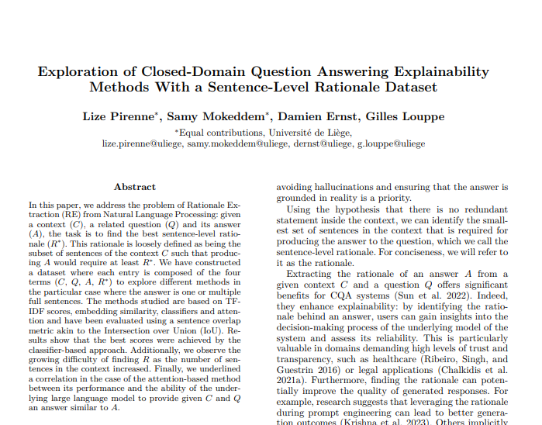
More on this strategy I have used
Fine tune the model on a QA dataset;
Identify heads that have a tendency to spot the rationale;
Improve this inherent ability of the head with RL using the attention/rationale overlap as a metric;
Access the paper:
https://hdl.handle.net/2268/322654

