Slide 1
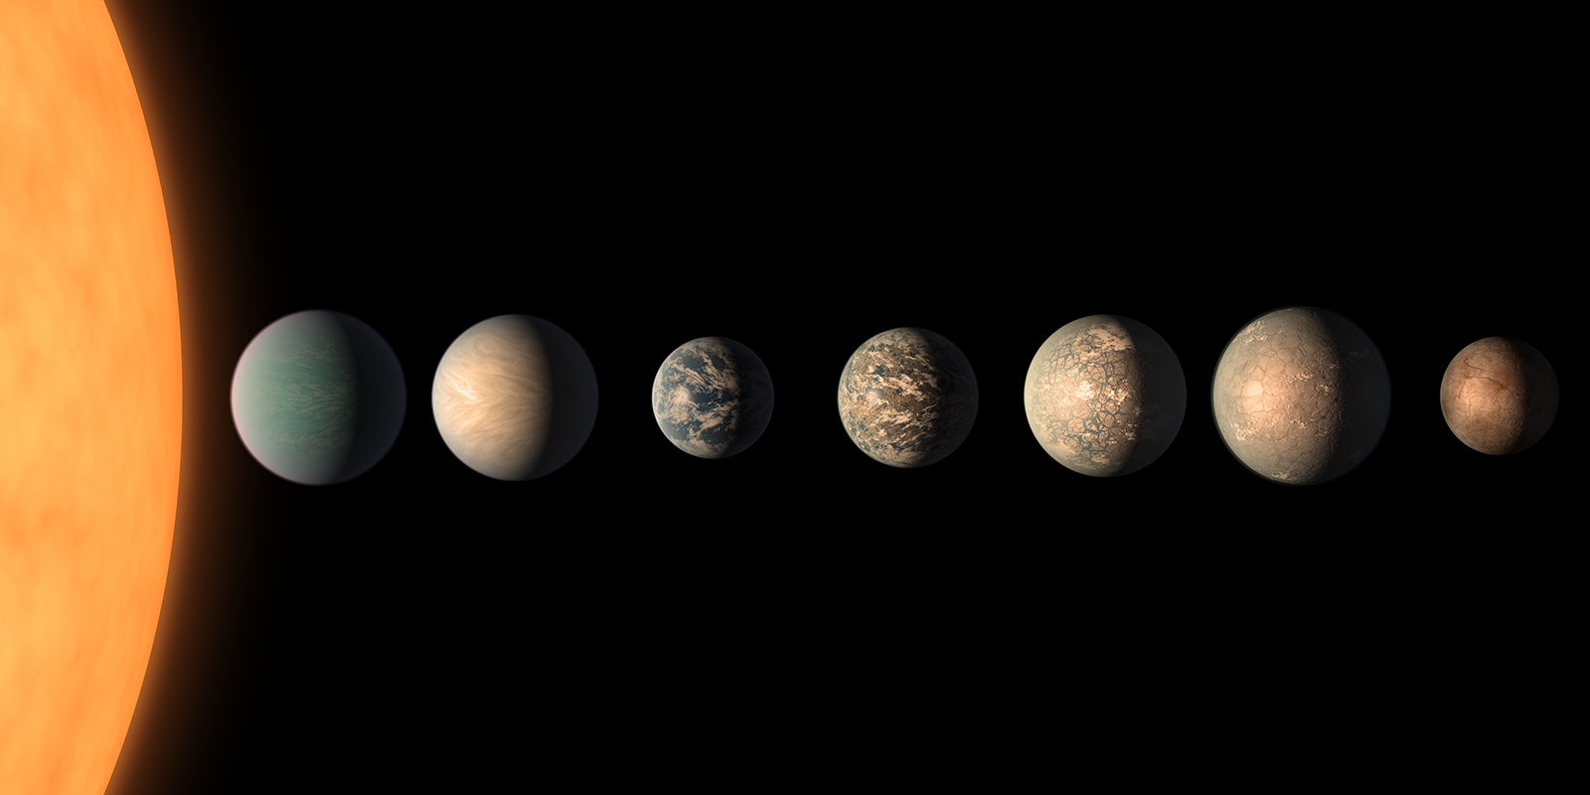



The limits of photosynthesis in the infra-red
PORTAL Project
Tom Feller
Pierre Cardol
Emmanuelle Javaux
Yannick Lara

Slide 2
Phototrophy On Rocky HabiTAble PLanets
TRAPPIST - 1 system
Goal of the project :
Discover habitability conditions
Reproduce conditions inside a biodome
Study the acclimation of microorganisms

Slide 3


Slide 5
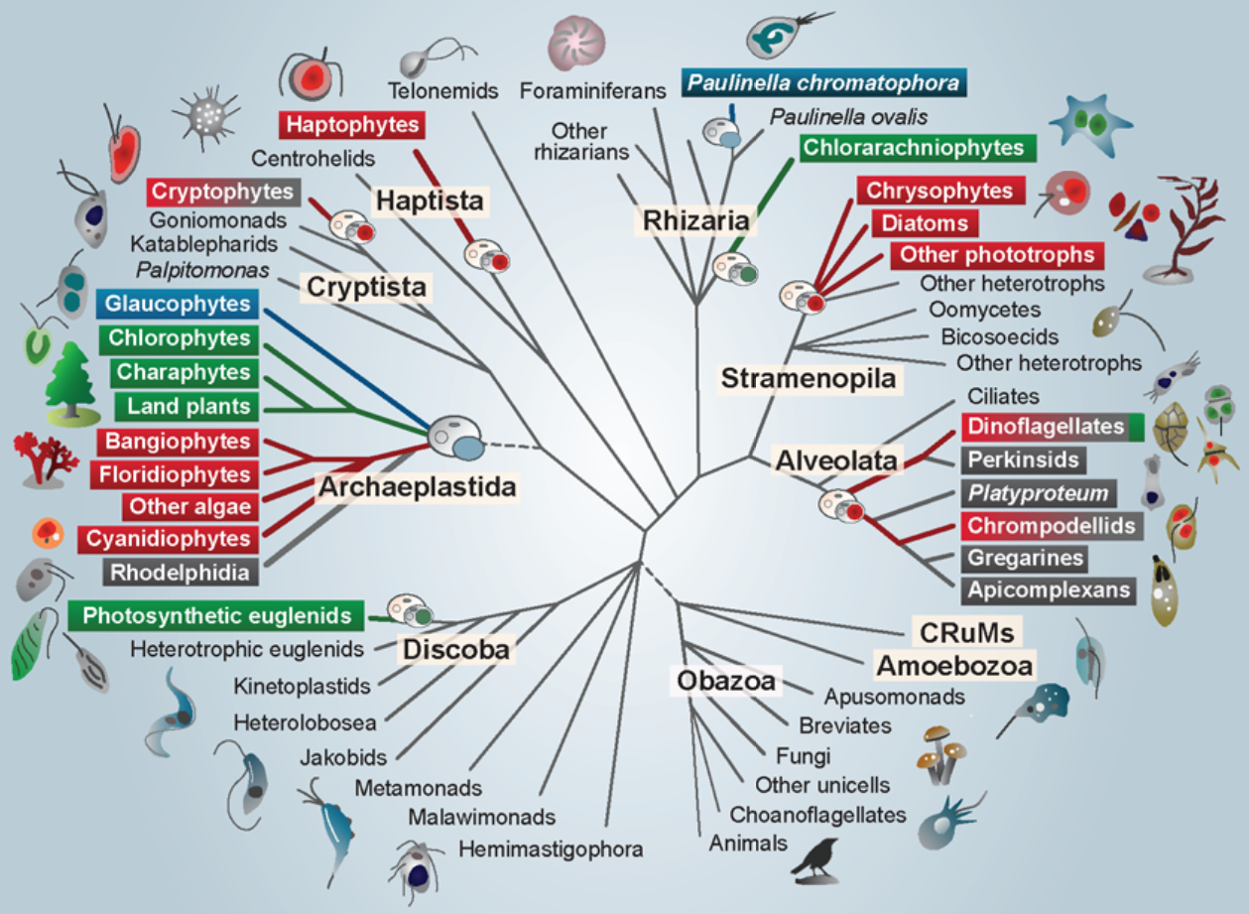
Selection

Slide 6
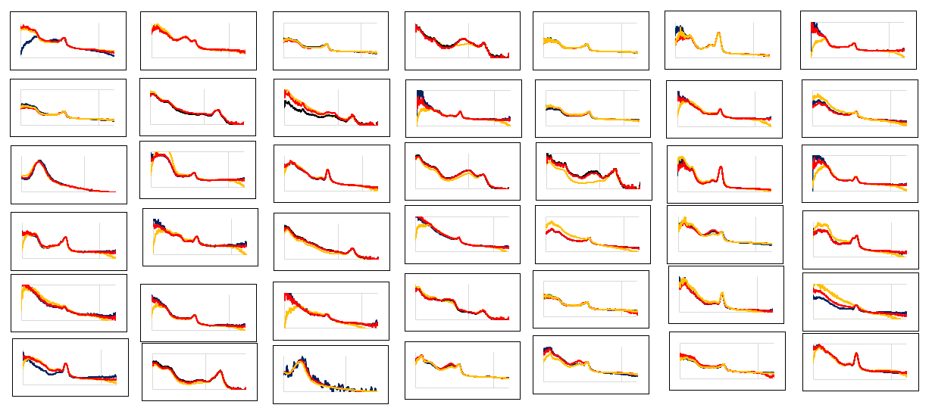
Screening

Slide 7
Interesting candidates

Slide 8
Interesting candidates

Slide 9
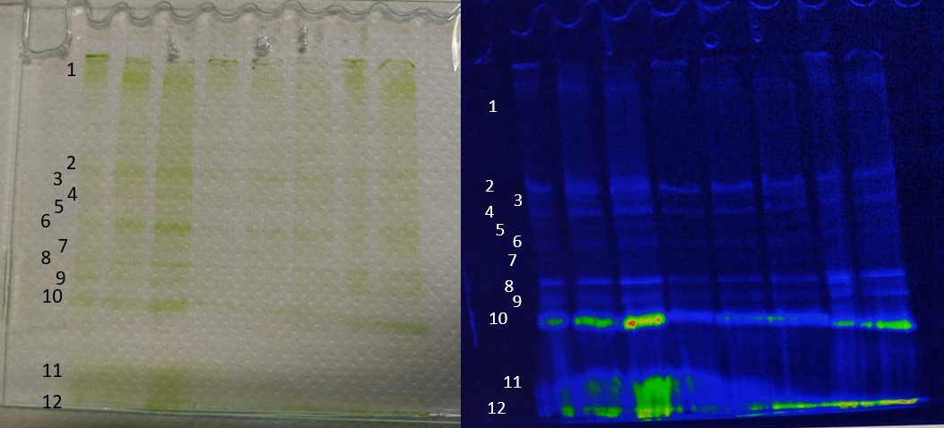
Complexes separation by Native-Page
Band 2 : PSII
Band 6/7 : PSI
Band 8/9 : PSII core
Band 10 : LHC E
Band 11 : Trimeric LHC II
Band 12 : Monomeric LHC II / Free chlorophyll

Slide 10

Absorbance of separated complexes

Slide 11
R.T. Fluorescence of separated complexes
685 nm
695 nm

Slide 12
77k Fluorescence of separated complexes
PS II
PS I
682 nm
722 nm

Slide 13
77k Fluorescence of separated complexes
LHCE
PS II
PS I
682 nm
714 nm
722 nm

Slide 14
Induction curve of PSII from Euglena gracilis

Slide 15
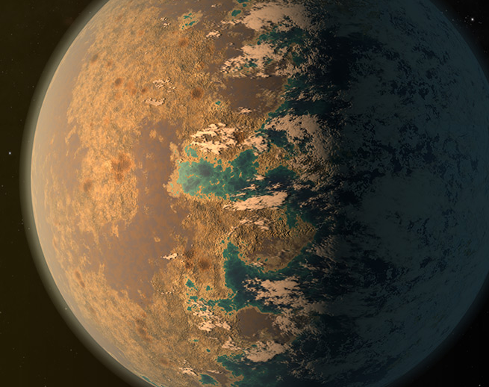









Acknowledgment :
Pierre Cardol
Emmanuelle Javaux
Yannick Lara
Michaël Gillon
Tim Van Hoolst
Veronique Dehant

Slide 16
Induction curve of PSII from Euglena gracilis

Slide 17
Induction curve of PSII from Chlamydomonas reinhardtii

Slide 18
Interesting candidate
Relative Fluorescence

Slide 19
Induction curve of PSII from Chlamydomonas reinhardtii

Slide 20
Induction curve of PSII from Euglena gracilis

Slide 21
Induction curve of PSII from Euglena gracilis

Slide 22
Induction curve of PSII from Euglena gracilis

