Slide 1
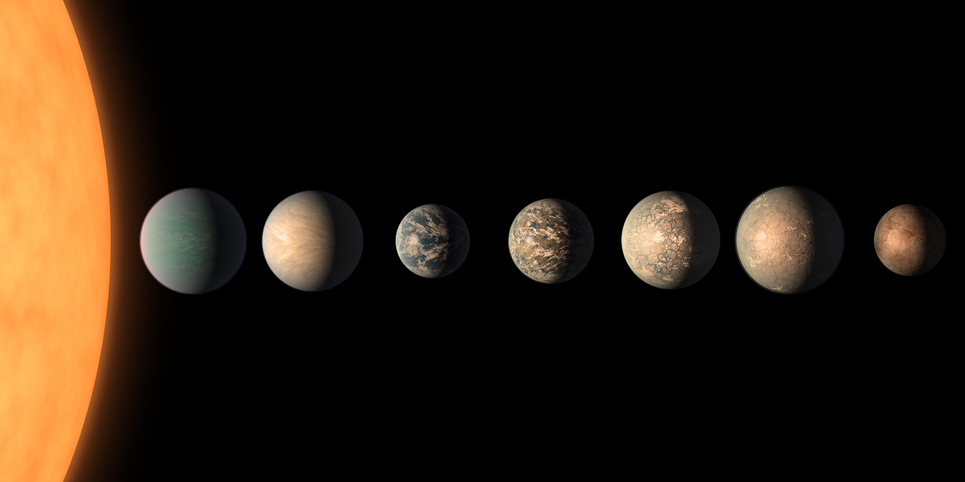



WP6:
The limits of photosynthesis in the infra-red
PORTAL Meeting 16 June 2022
Tom Feller
Pierre Cardol
Emmanuelle Javaux
Yannick Lara

Slide 2
PORTAL : PhOtorophy on Rocky habiTAble pLanets
Habitability & Phototrophy (possibility and signatures) of rocky exoplanets around VLM stars
HABITABILITY of TRAPPIST-1 planets
WP1: The photon & proton émission of the star
WP2: Transmission spectroscopy of the planets with JWTS
WP3: Build-up of TRAPPIST-1 planet atmospheres
WP4: Atmospheric modeling and retrieval
WP5: (Sub)-surface habitability and irradiation of the planets
PHOTOTROPHY
WP6 : Limits of phototrophy
Infra-red acclimatated/adapted phototrophyc life on modern Earth
WP7 : Signatures and evolution of Phototrophic life on the early Earth
WP10: managment
WP11: data
WP12: valorization
WP8: TRAPPIST Biodome
Infra-red acclimatated/adapted phototrophyc life under TRAPPIST Star UV-IR and atmospheric conditions
WP9: Phototrophic life on rocky habitable planets around very-low-mass stars (from all WP)

Slide 3
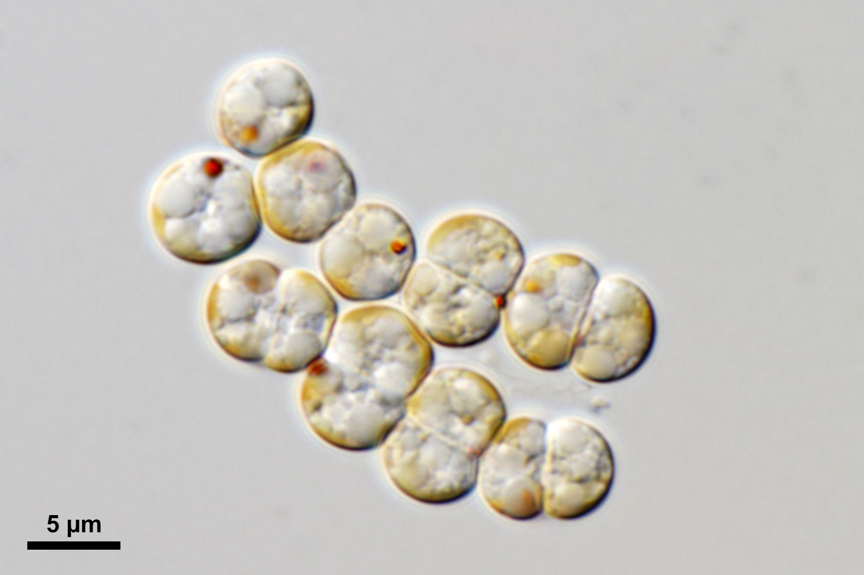
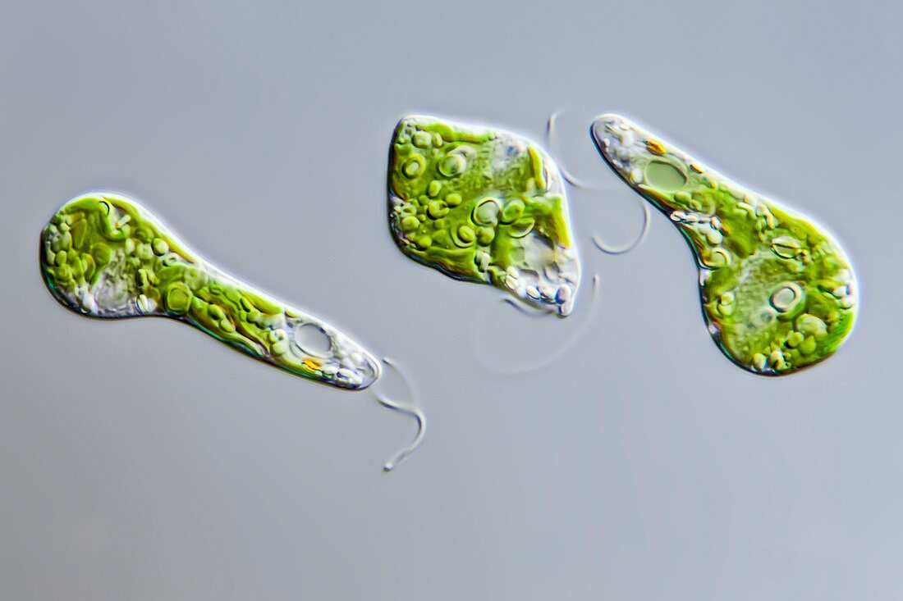
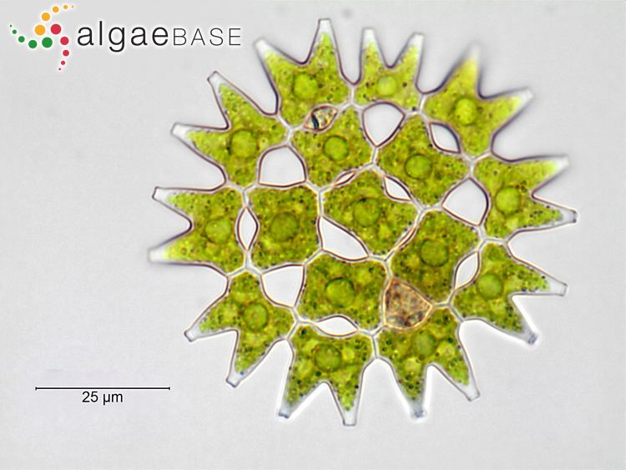
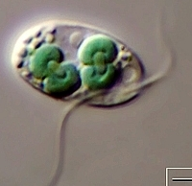
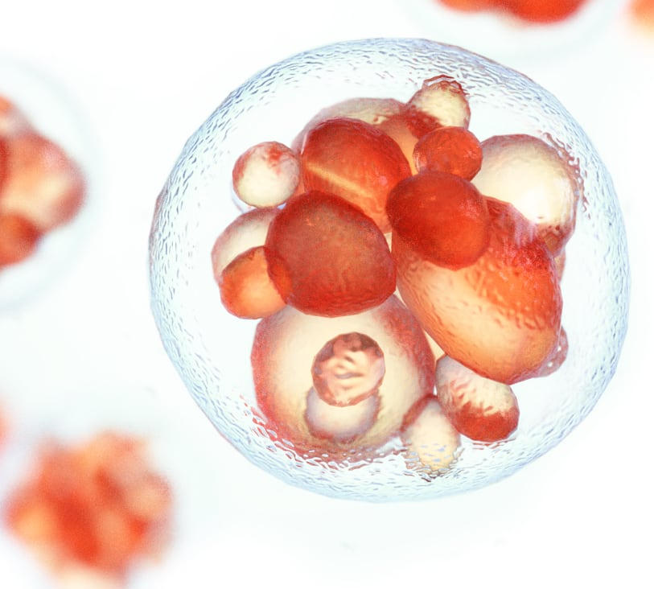
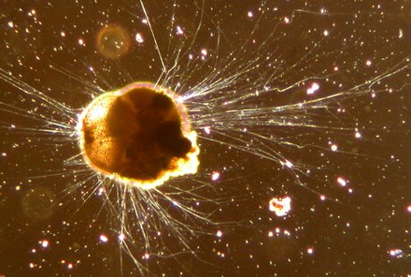
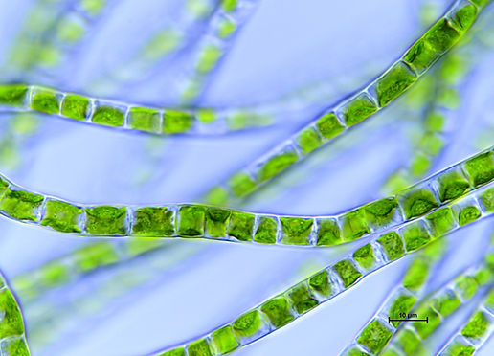
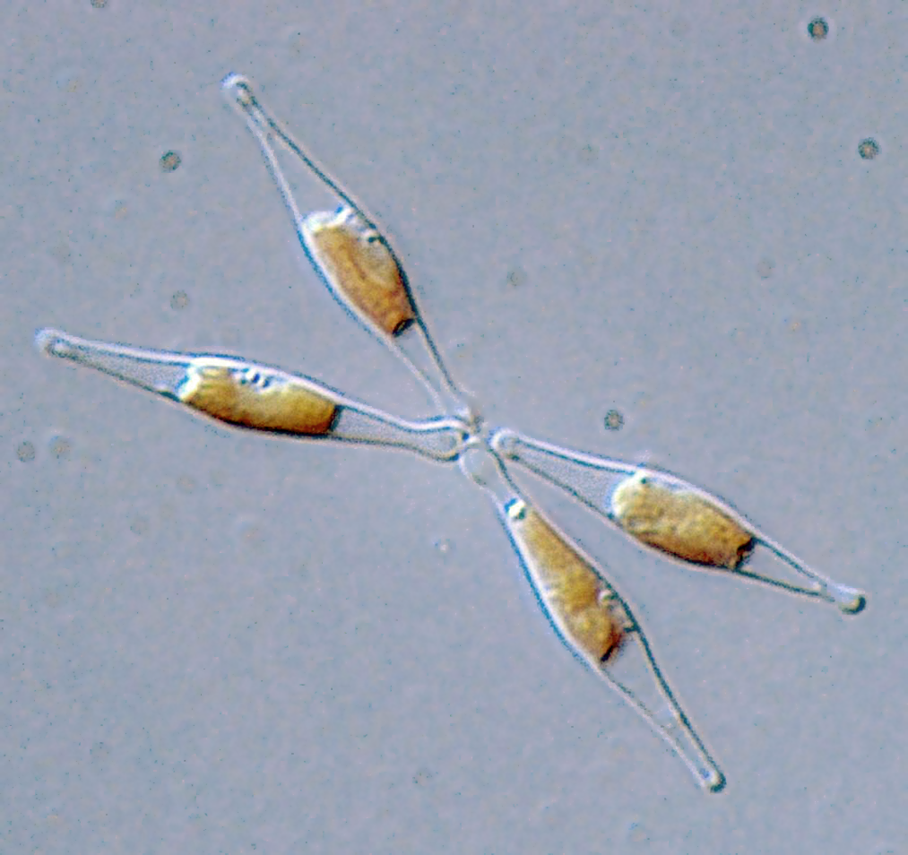
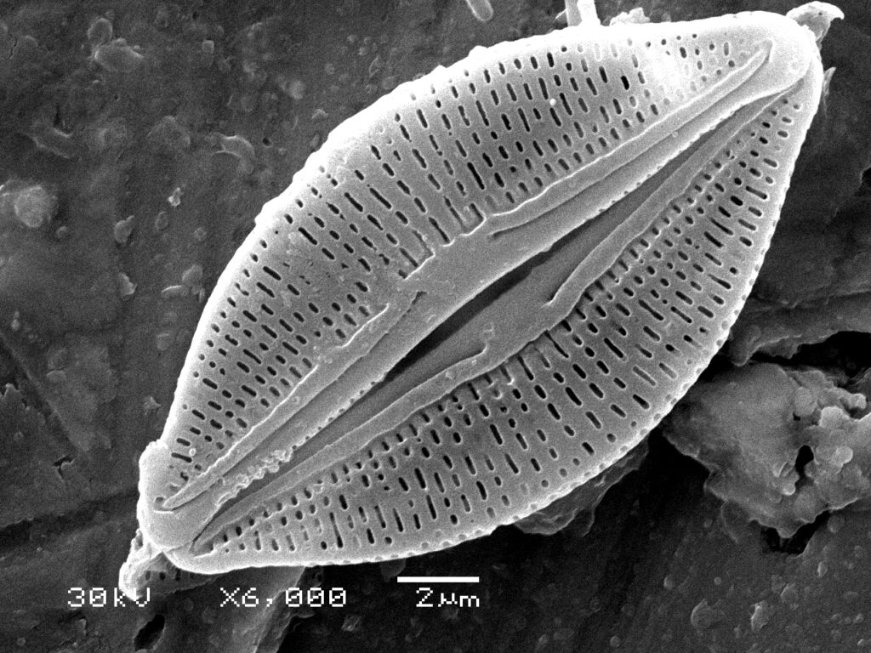
Morphologic/Physiologic diversity of microalgae
Chromera Velia
Euglena gracilis
Pediastrum
Porphyridium
Cyanophora
Cryptista
klebsormidium
phaeodactylum
Diatoms

Slide 4
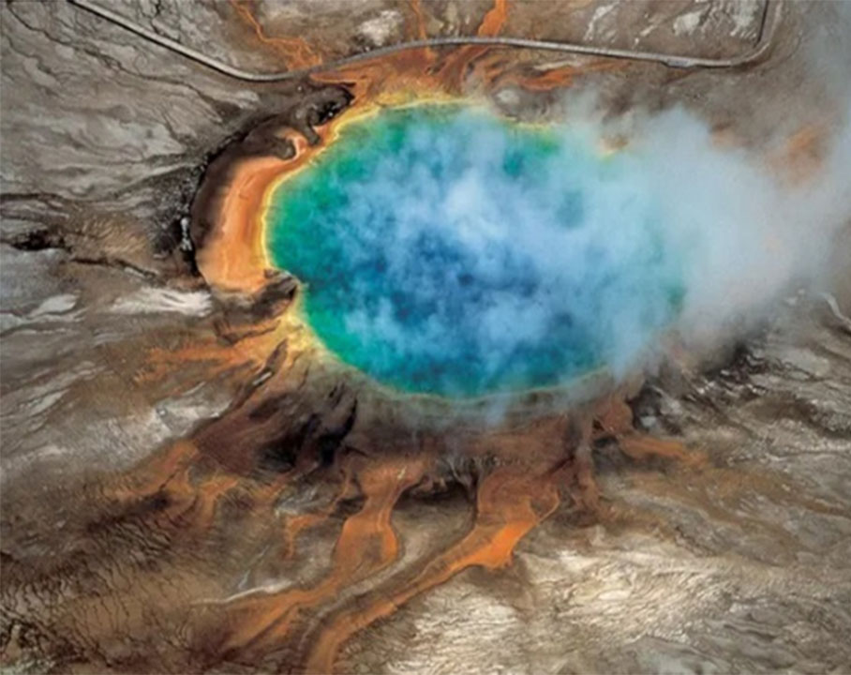
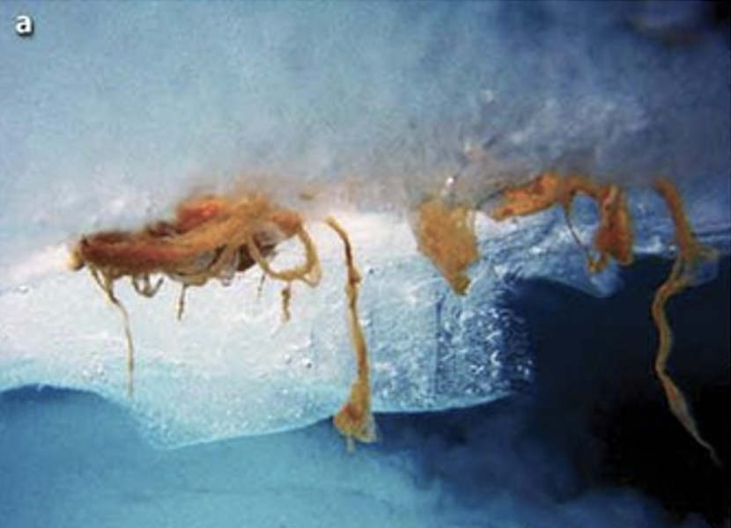
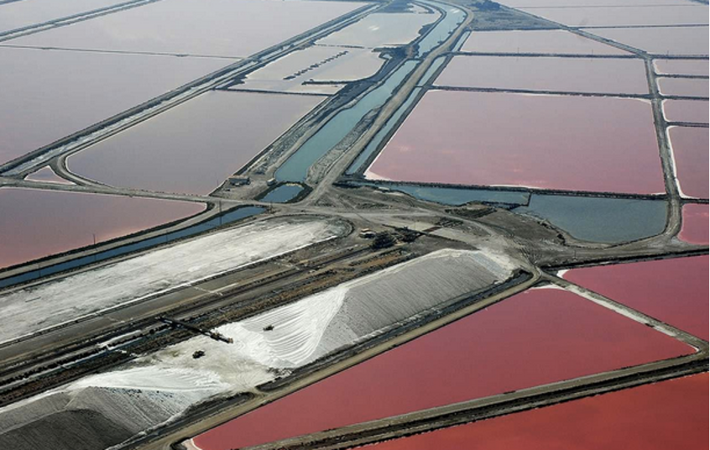
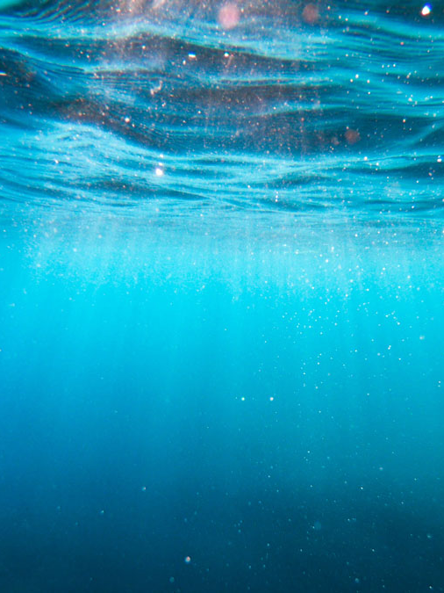
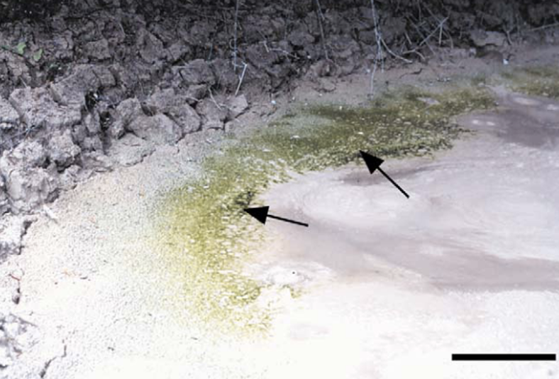
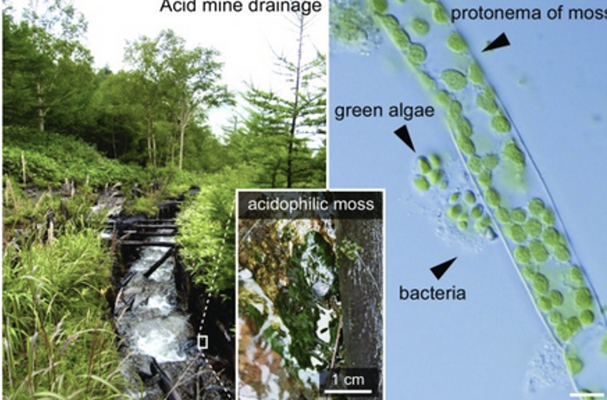
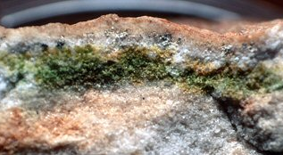
Extreme environments
Hot acid spring
Icy environment
High salt environment
Deep ocean
Acid environment
Heavy metal polluted environment
Endolithic environment

Slide 5
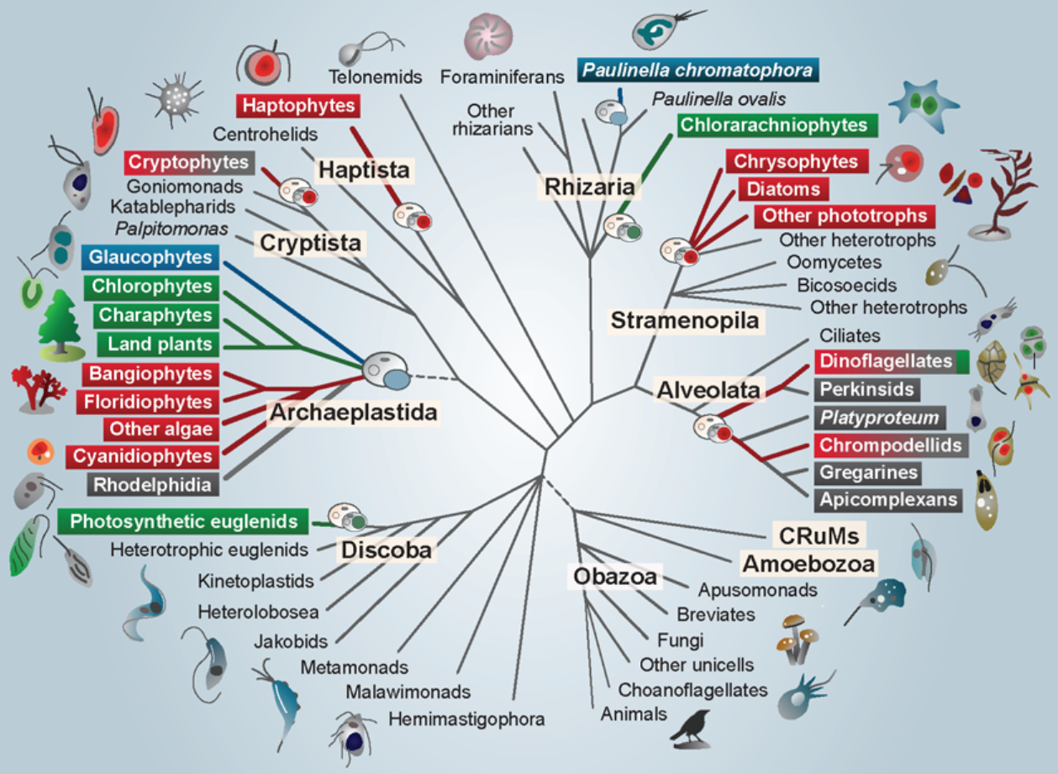
Genomic diversity due to evolution
60 Algae from
7 Phylla
14 Orders

Slide 6
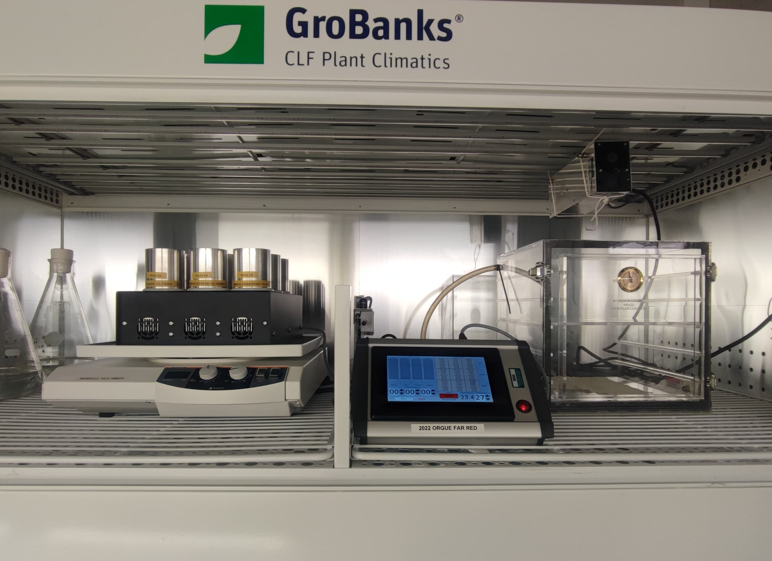
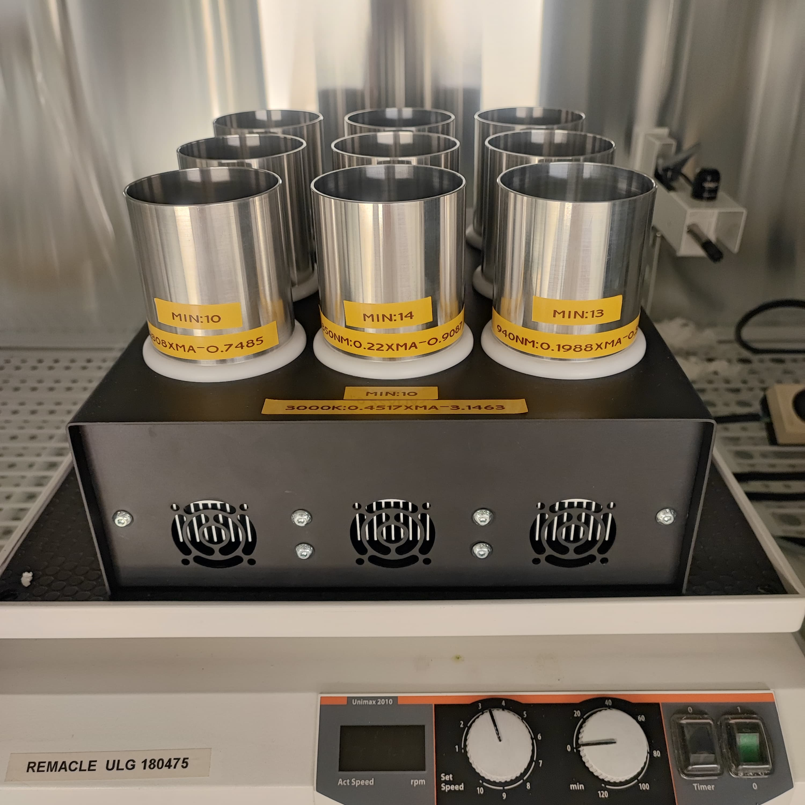
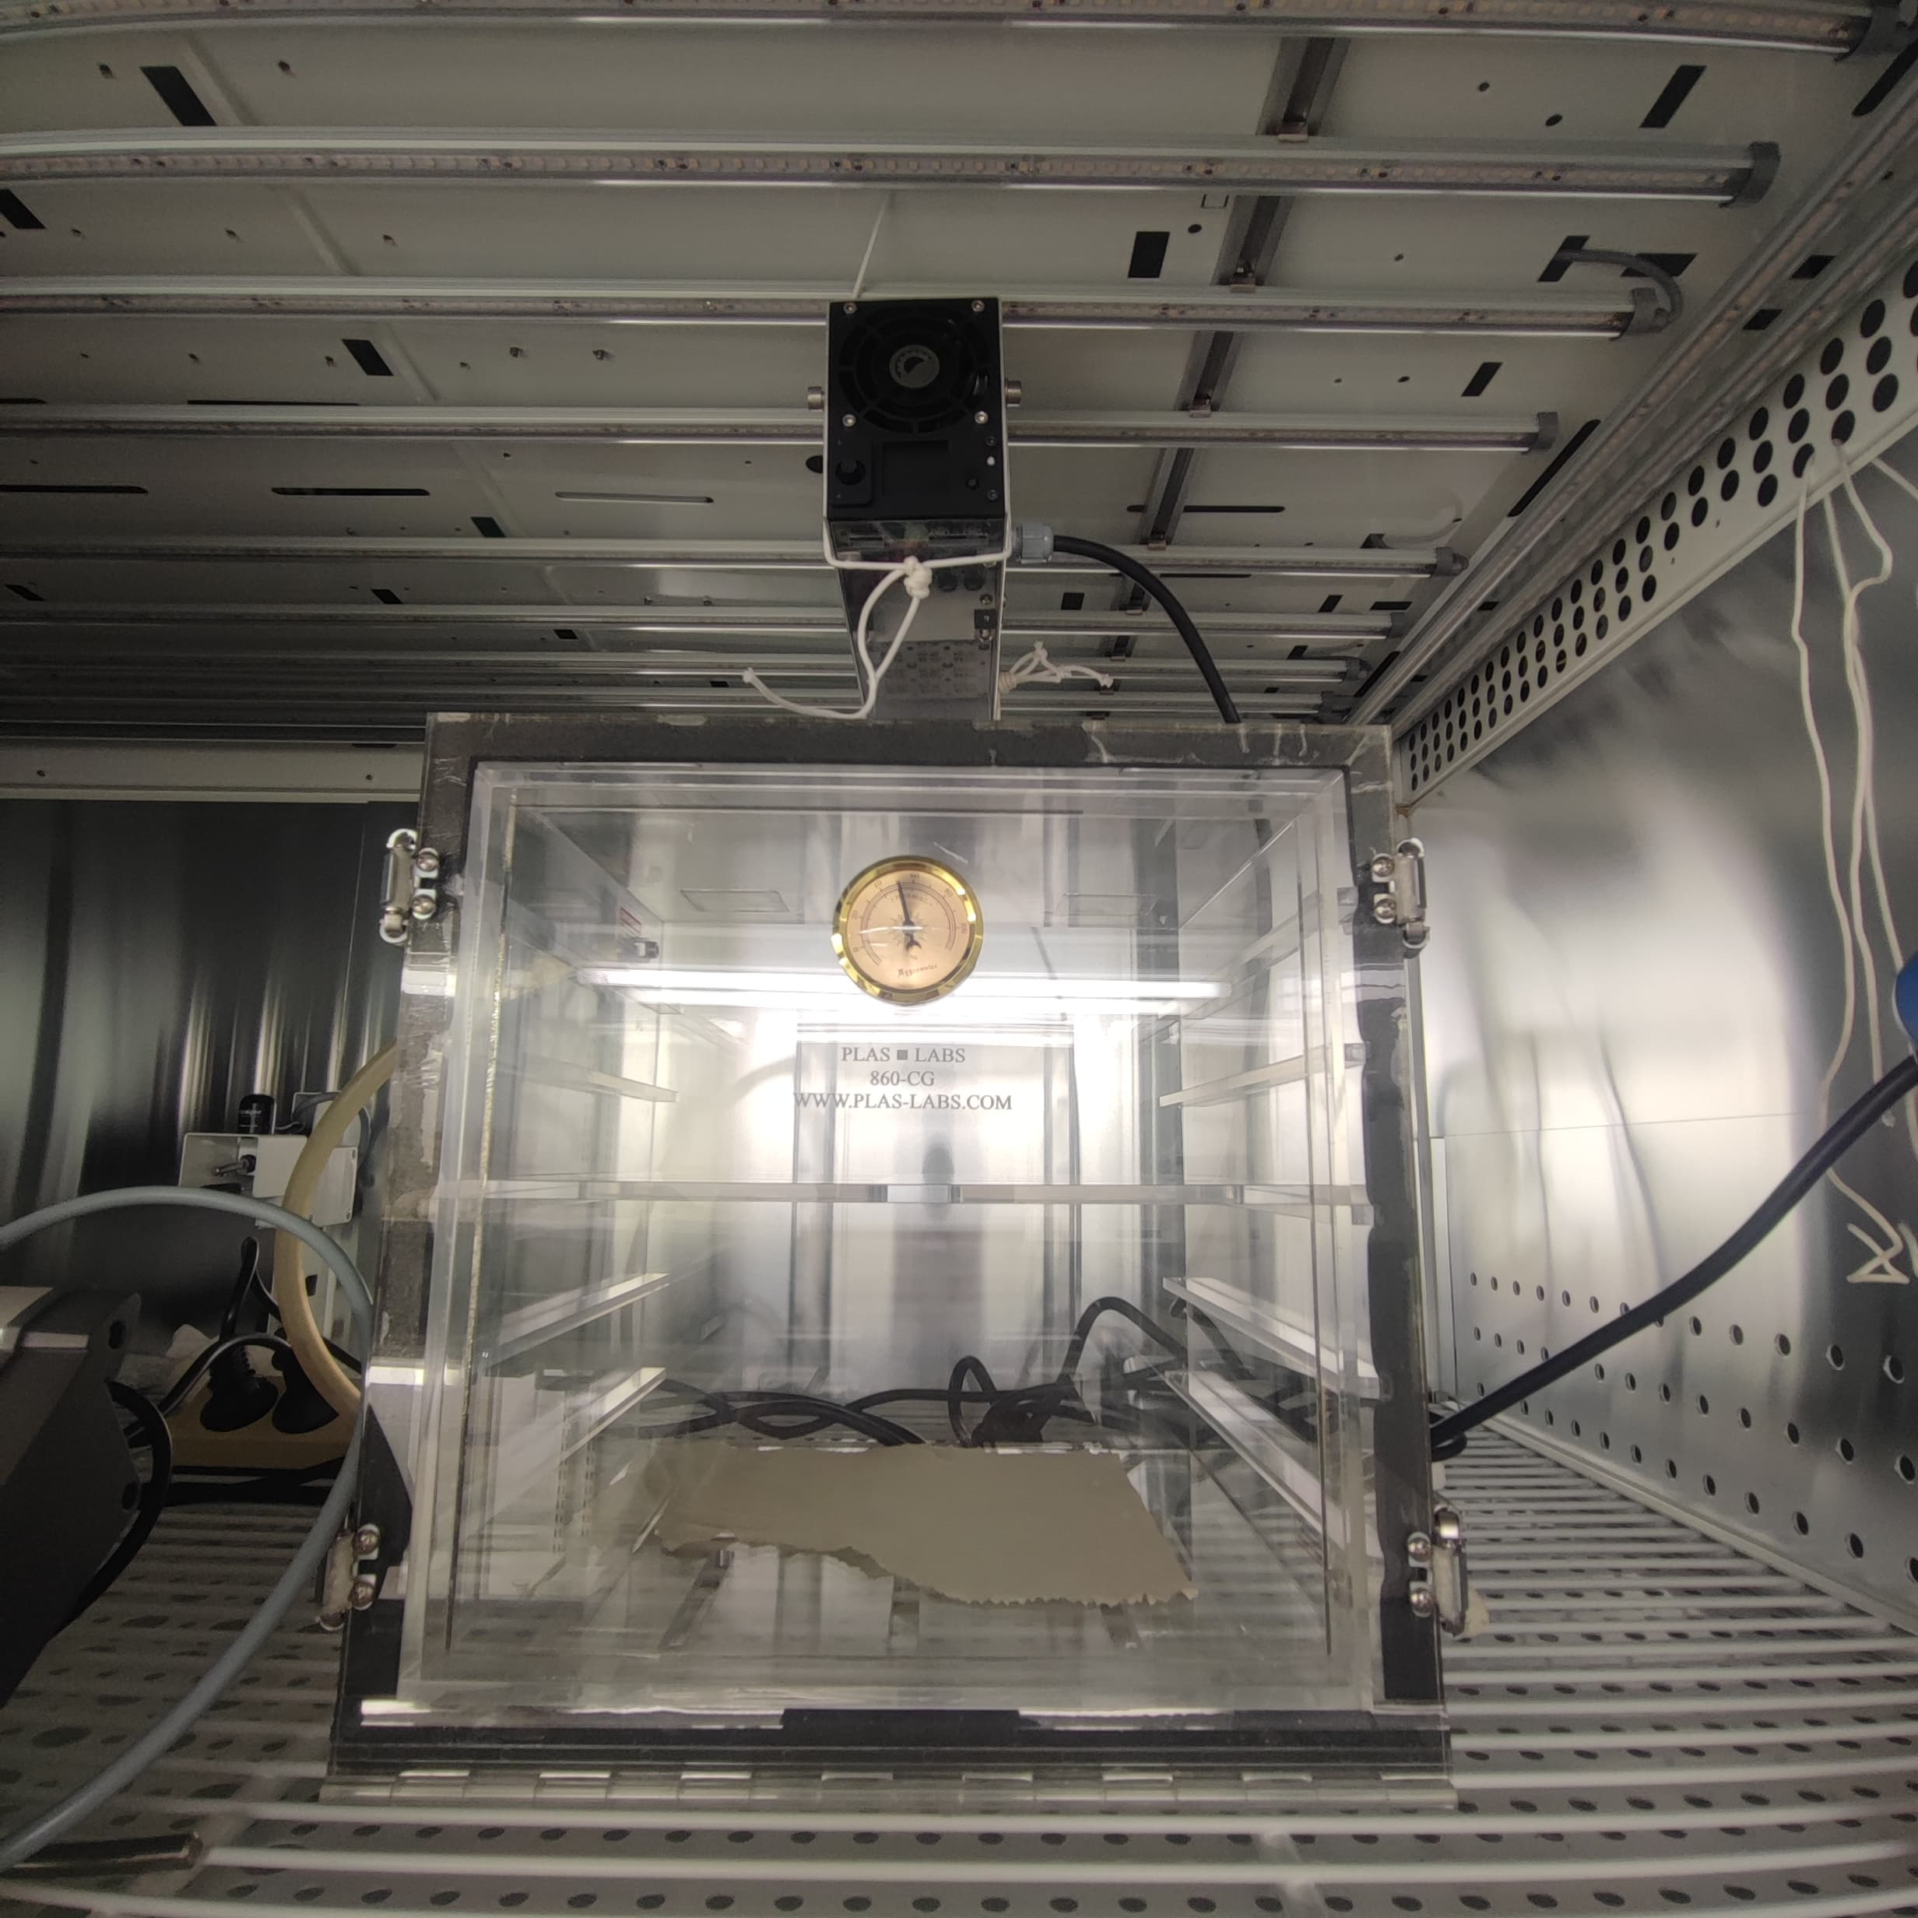
Equipment
Multi cultivator
Far-Red / Infra-Red Light
Controlled temperature
Controlled agitation
Grobanks
Withe light
Controlled temperature
Hermetic box
Far-Red/Infra-Red Light
Gas control

Slide 7

Equipment
Grobanks / Multi cultivator /Hermetic box
Withe Far-Red/ Infra-Red Light
Controlled temperature
Controlled gas
Controlled agitation

Slide 8
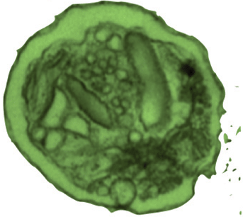
Interesting candidates

Slide 9
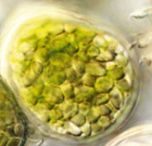
Interesting candidates

Slide 10
Absorbance spectrum of E.gracilis

Slide 11
Absorbance spectrum of E. gracilis under different wavelenghts
Dark
LL
ML
HL

Slide 12
Absorbance spectrum of E. gracilis with Temperature

Slide 13
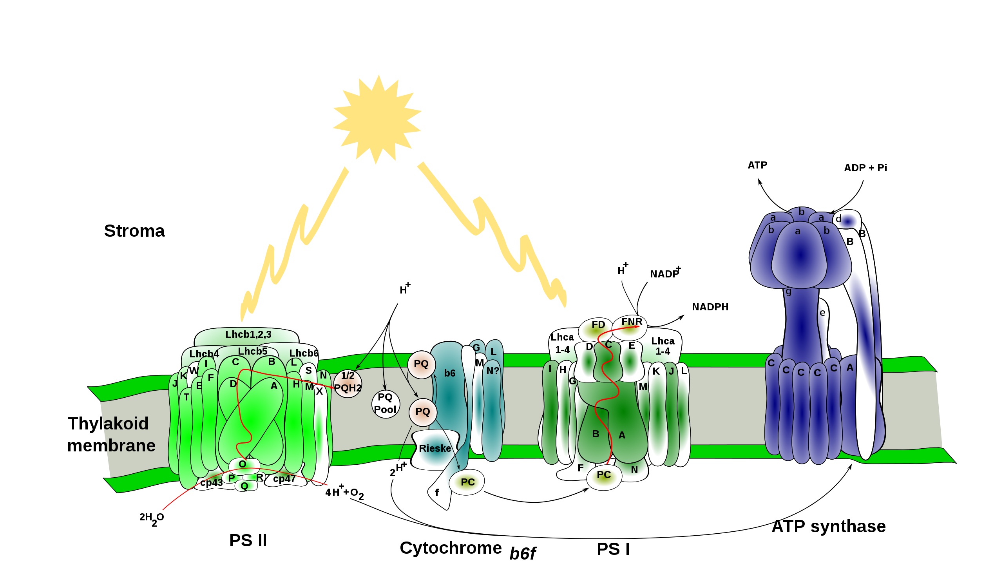
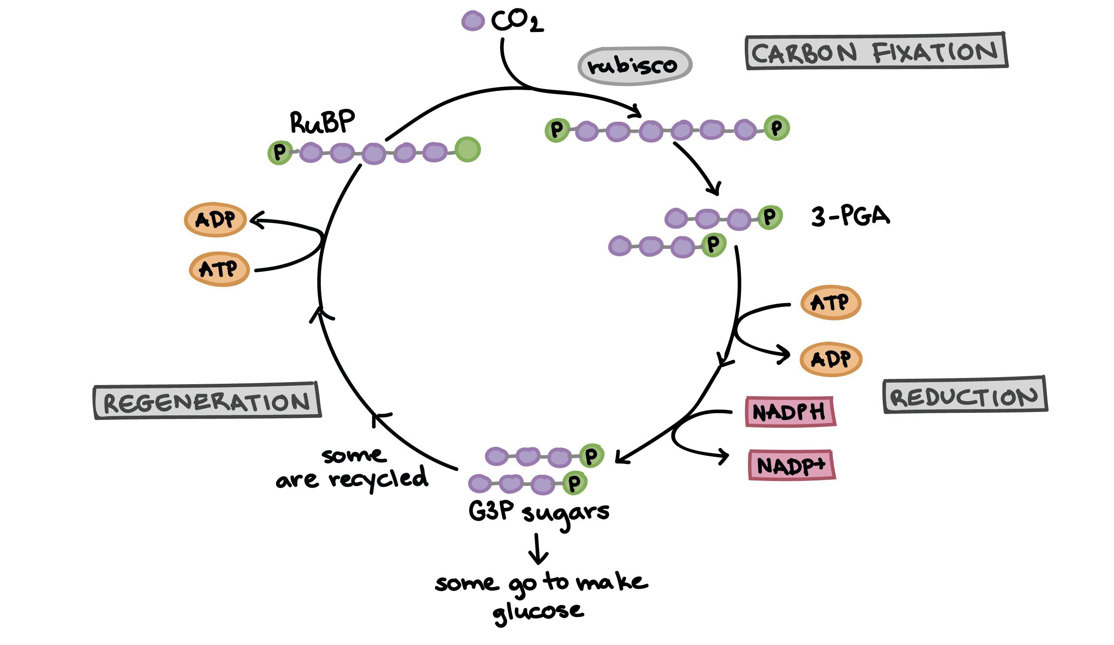
Photosynthetic chain

Slide 14
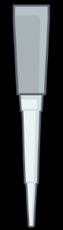
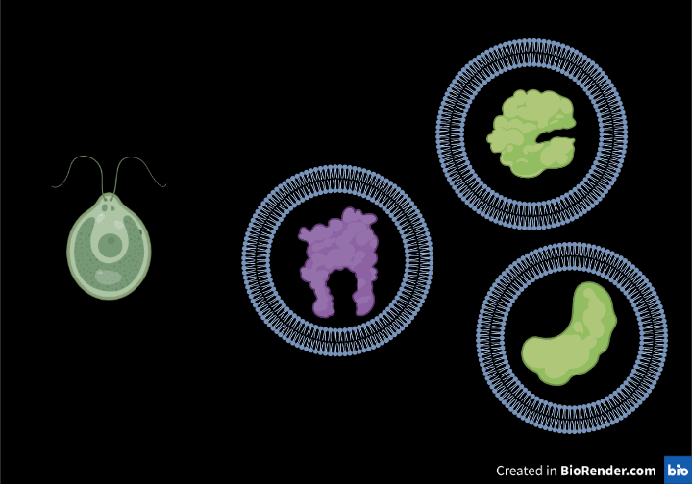
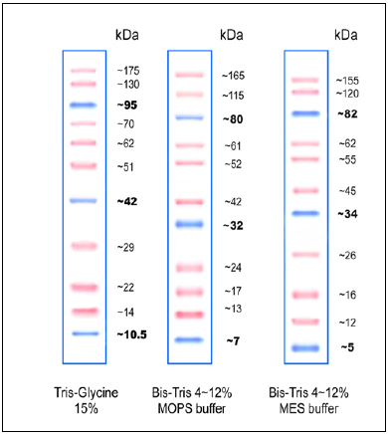
Complexes separation by Native-Page
Algae cells
Broken cells
Isolated complexes
N-PAGE
4%
-
Sonicator
α-DDM
+
12%

Slide 15
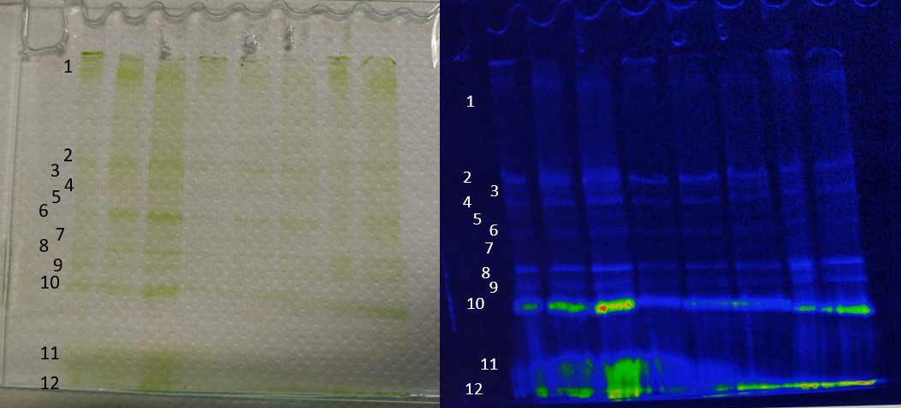
Complexes separation by Native-Page
Band 2 : PSII
Band 6/7 : PSI
Band 8/9 : PSII core
Band 10 : LHC E
Band 11 : Trimeric LHC II
Band 12 : Monomeric LHC II / Free chlorophyll
1
MDa
100 kDa

Slide 16

Absorbance of separated complexes
PSII
LHCE

Slide 17
Fluorescence of separated complexes
R.T. Fluorescence
77K Fluorescence
PS II
LHCE
685 nm
695 nm
682 nm
714 nm

Slide 18
Photosynthetic chain & DCMU
DCMU

Slide 19
Induction curve of PSII from Euglena gracilis

Slide 20
Perspective for next year
Confirm interesting candidates
  Absorbance / Fluo / HPLC
  Publication of the Diversity of Eukaryote adaptation to far red light ?
Photosynthetic research at ≠ wavelength
  rETR + Oxygen evolution
  PSII / PSI
  NPQ
  ECS / Cyclic electron flow
miRNA Knok down mutant on Euglena gracilis

Slide 21
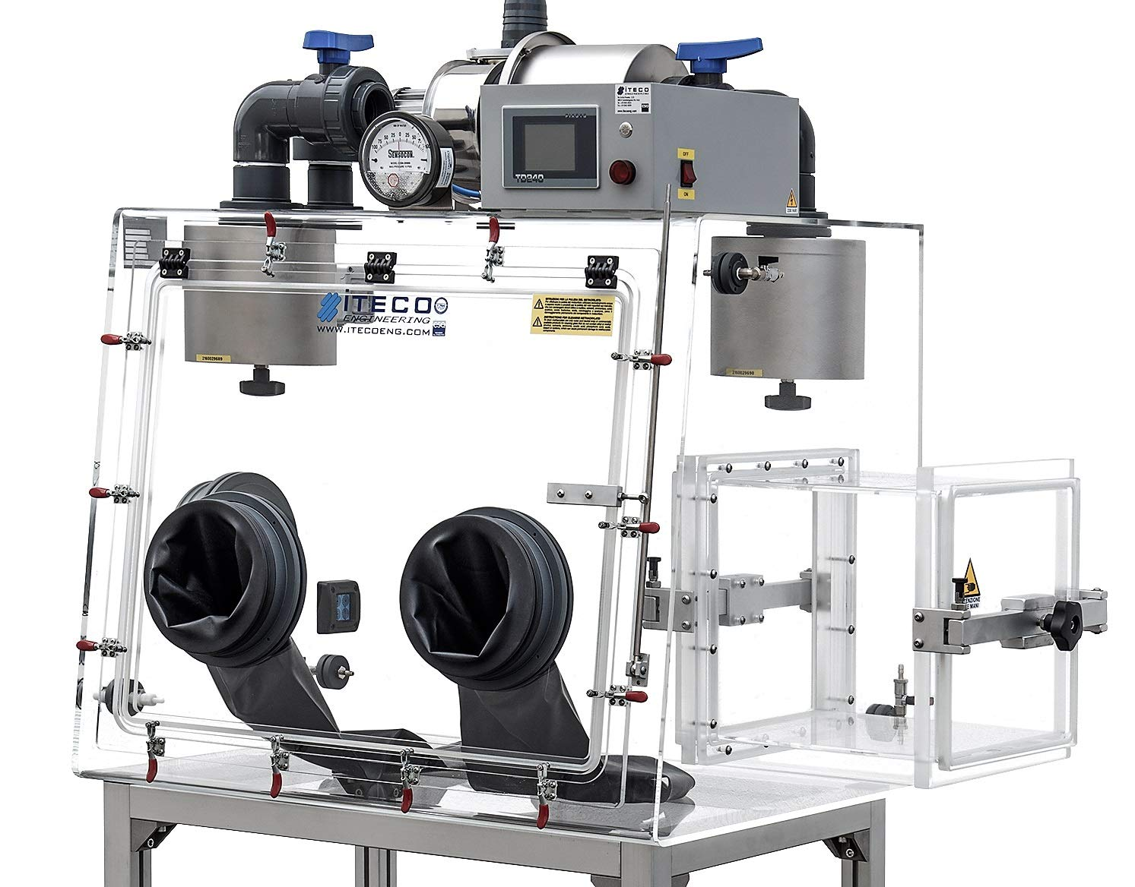
Biodome
Grow bank + hermetic box
Controlled temperature
Extern light control
Multiple gas injection
Glove box
Extern /intern Light control
Multiple gas injection
Independent door

Slide 22
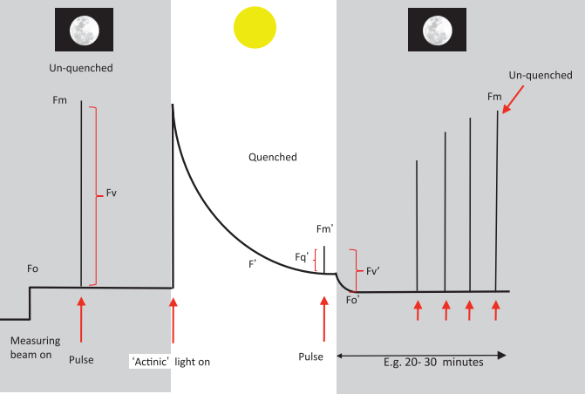
Perspective : interesting candidates
Variable wavelength :
  Recording : FO, Fm, F0’,Fm’,Fv, Fs
    → Fv/Fm (maximum quantum yield of primary photochemistry)
    → Fv’/Fm’ (maximum efficiency of PSII)
    → ϕPSII (operating efficiency of PSII) : [(FM’- FS)/FM’]
    → NPQ (Non photochemical quenching) : [(FMFM’)/FM’]
    → qp (photochemical quenching) : [(FM’- FS)/FM’- FO’]
    → rETR (relative electron transfer) : ϕPSII x Light intentity
  Oxydation of PSI-PSII at different wavelength
  Oxygen evolution at different wavelength
    Coupled with rETR with speedzen of JTS
  ECS (protons transfer from the stroma to the lumen)
    Cyclic electron flow around PSI

Slide 23
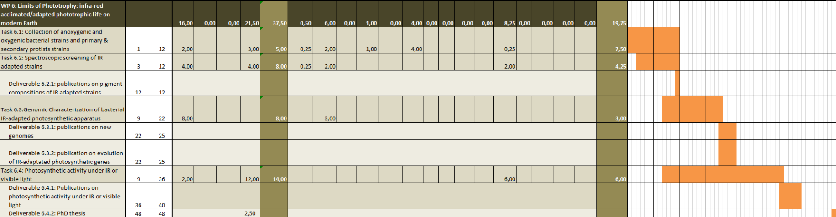
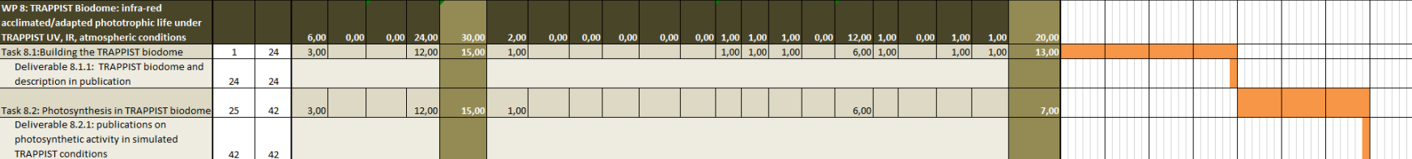

Slide 24
77k Fluorescence of separated complexes
LHCE
PS II
PS I
682 nm
714 nm
722 nm

Slide 25
Induction curve of PSII from Euglena gracilis

Slide 26
Induction curve of PSII from Euglena gracilis

Slide 27
Induction curve of PSII

Slide 28
Induction curve of PSII

