Slide 1



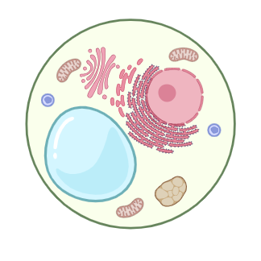
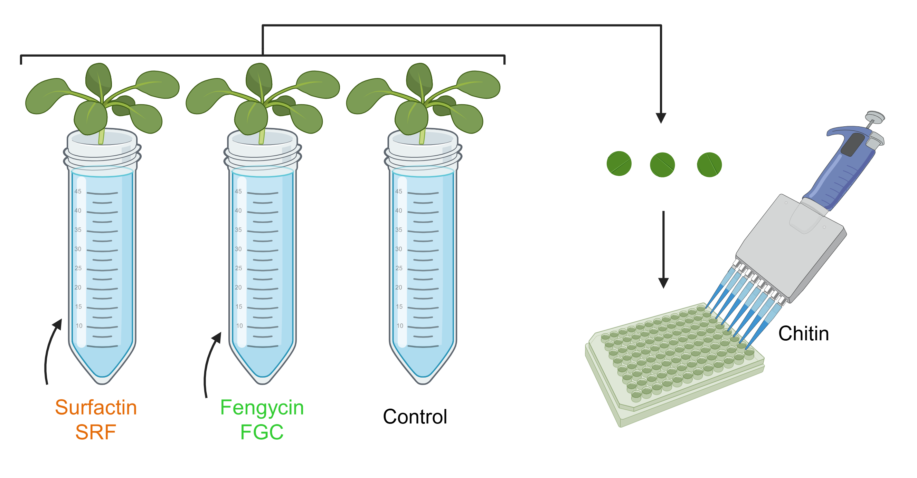
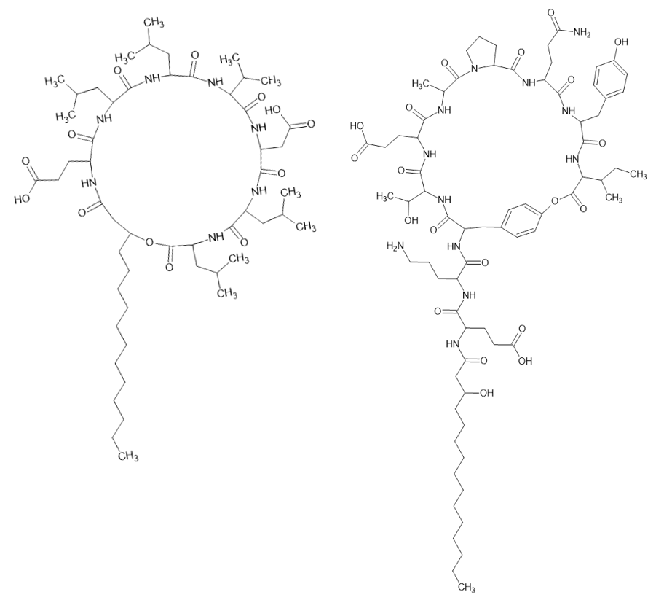
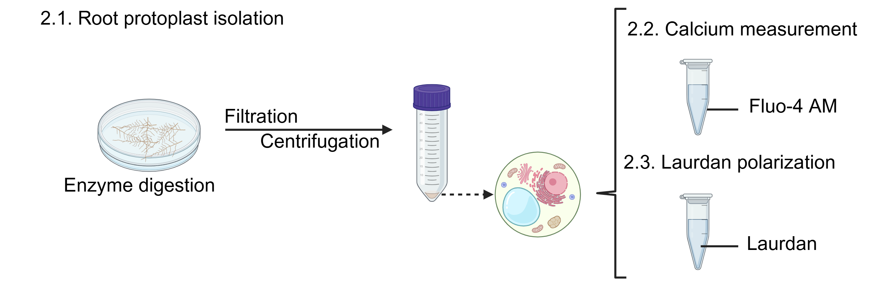
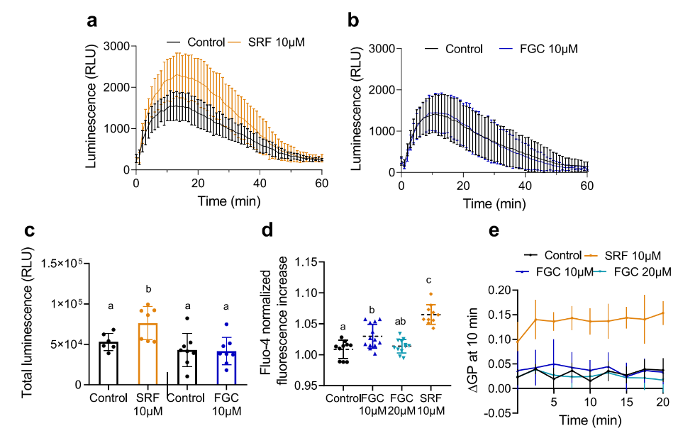
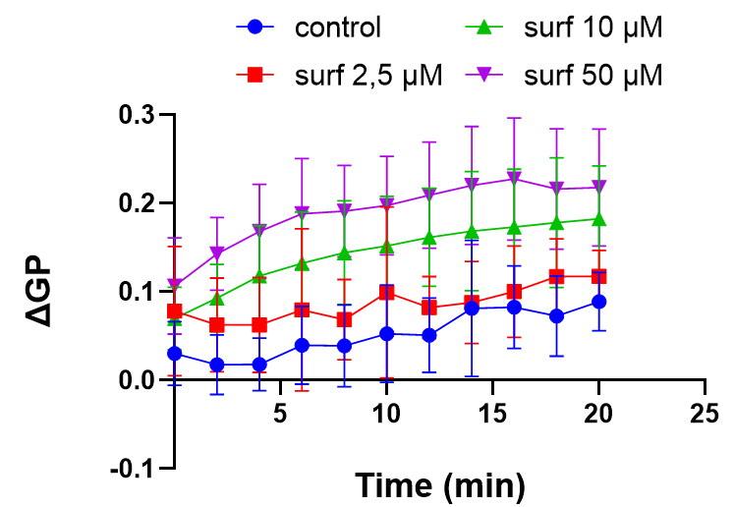
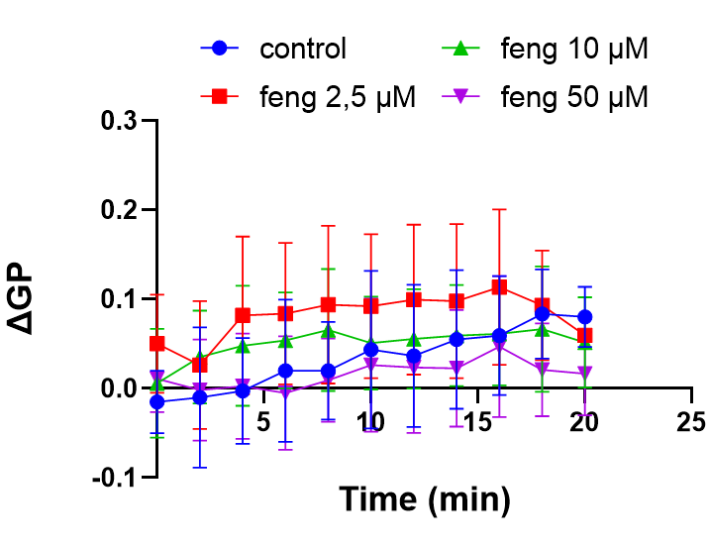
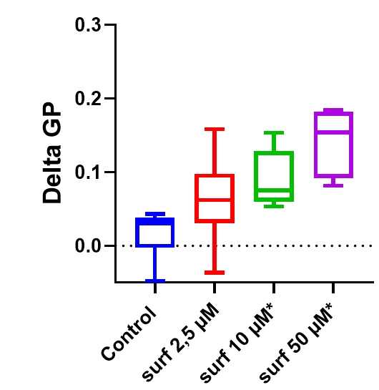
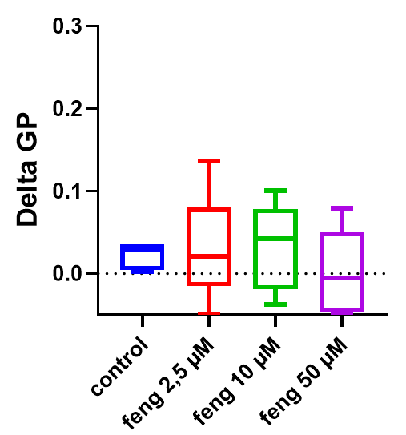
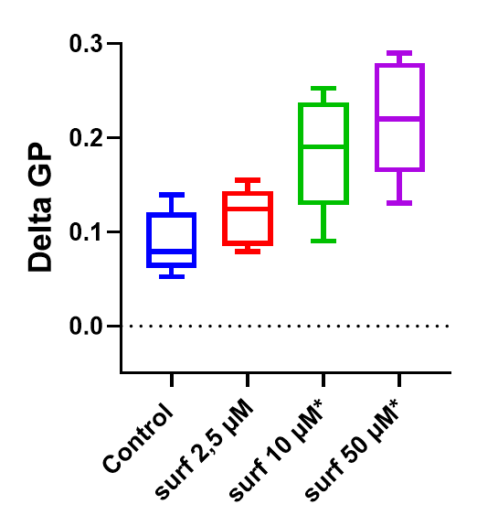
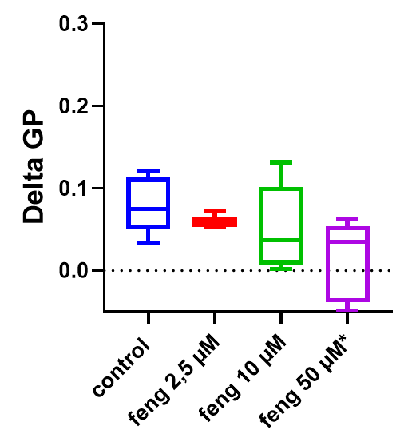

Mechanism of perception of cyclic lipopeptides from soil bacilli by the monocotyledon plasma membrane in relation with their plant defense eliciting activity
Anaïs Claeys¹⁻², Guillaume Gilliard³, Florence Blaise¹,
Marie-Laure Fauconnier², Magali Deleu¹
Université of Liege, Gembloux Agro-Bio Tech, Belgium,
¹ Laboratory of Molecular Biophysics at Interfaces
² Laboratory of Chemistry of Natural Molecules,
³ Università degli Studi di Milano – Department of Medical Biotechnology and Translational Medicine
E-mail: anais.claeys@uliege.be
There is a gap in knowledge on the eliciting activity of Bacillus CLPs on monocots. This study aims to investigate how Bacillus CLPs interact with the PM of wheat, a monocot of agronomic interest, by identifying the activity and studying the impact of CLPs on PM mechanics and organization.
Do SRF and FGC have distinct effects on immune stimulation and plasma membrane mechanics in wheat cells?
Elicitors are compounds capable of stimulating the natural defenses of plants.
They represent a promising alternative to conventional chemical pesticides by limiting pathogen invasion in a context of sustainable agriculture.
1. Systemic immune activation assays (SIA)
Surfactin
SRF
Fengycin
FGC
Cyclic lipopeptides (CLPs) secreted by soil beneficial bacilli, are promising candidates for stimulating natural plant defenses. Due to their amphiphilic nature, CLPs interact directly with the lipids of the plasma membrane (PM) of plant cells, leading to dynamic changes in the lipid organization.
Since PM lipid composition varies between plant species, CLPs do not have the same impact on all plants. Their differential effectiveness between monocots and dicots could be linked to distinct interaction mechanisms, influenced by both CLP structure and PM lipid composition and organization.
2. Root protoplast
Effect of FGC and SRF on dicot plant cell immune stimulation and plasma membrane mechanics
Effect of FGC and SRF on monocot plant cell immune stimulation and plasma membrane mechanics
a
b
Kinetics of ROSapo production measured with luminescence assay following treatment with 250 µg/mL chitin in leaf disk of Arabidopsis pre-treated at the root level with 10 µM SRF (a) or 10 µM FGC (b)
Total ROSapo production (c)
Change of laurdan generalized polarization (ΔGP) measured in wheat root protoplasts after control treatment or treatment with 2.5, 10, 50 µM SRF (a) and 2.5, 10, 50 µM FGC (b)
c
*
*
d
ns
ns
Arabidopsis plants pre-treated at the root level with 10 μM SRF show an increased ROSapo production in response to chitin treatment, unlike those pre-treated with 10 μM FGC, which respond similarly to the control.
ns
ns
e
ns
*
*
f
ns
*
ns
[Ca²⁺cyto] elevation detected with Fluo-4 in root protoplasts of Arabidopsis Col-0 after treatment with 10 µM SRF, 10 µM FGC or 20 µM FGC (d)
Change of laurdan generalized polarization (ΔGP) measured in Arabidopsis root protoplasts after control treatment or treatment with 10 µM SRF, 10 µM FGC or 20 µM FGC (e)
Treatment with 10 μM SRF induced a significant [Ca²⁺cyto] increase while FGC treatment showed significantly lower [Ca²⁺cyto] responses
No effect on PM lipid packing was observed for FGC contrary to SRF that increased lipid compaction
Change of laurdan generalized polarization (ΔGP) measured after 2 minutes (c-d) and 20 minutes (e-f) in wheat root protoplasts caused by treatment with 2.5, 10, 50 µM SRF (c-e) and 2.5, 10, 50 µM FGC (d-f)
The correlation between the effect of CLPs on fluidity of protoplast PM, their ability to induce a [Ca²⁺cyto] responses and their SIA suggests that SRF can trigger immunity in Arabidopsis by interacting with the PM, whereas FGC cannot.
The effect of CLPs on protoplast PM fluidity shows that the PM stiffens immediately after treatment with SRF, while FGC decreases rigidity, potentially causing protoplast damage or destruction at 50 µM FGC and leading to solubilization.
What we now know
CLPs can interact with PM lipids in dicots and monocots
SRF activates systemic immunity, notably by increasing PM rigidity in Arabidopsis and wheat
FGC destabilizes wheat PM and has minimal effect on Arabidopsis
What we would like to further know
To investigate putative early immune events triggered by CLPs in monocots
Analysis of cytosolic and apoplastic ROS production
Analysis of Ca²⁺ influx
Evaluation of SIA
Acknowledgements:
M.D. thanks the F.R.S.-F.N.R.S. (National Funds for Scientific Research, Belgium)
for her position as Senior Research Associate. The authors thank also the financial support via the project LIPOIL, PDR LIPOWHEAT (T.0081.24), FRIA DOMSURF (FC36421).
XXIII GEM Meeting: Diving into the Secrets of Cellular Membranes
April 1-4, 2025, Nausicaá, Boulogne-sur-Mer, France

