Slide 1




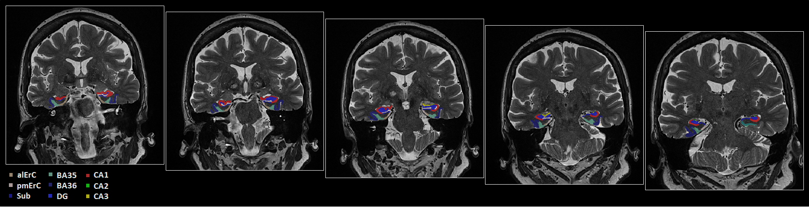
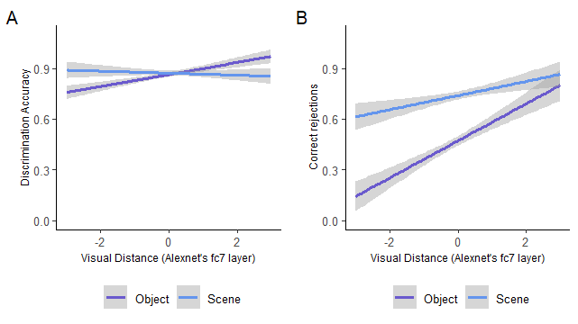

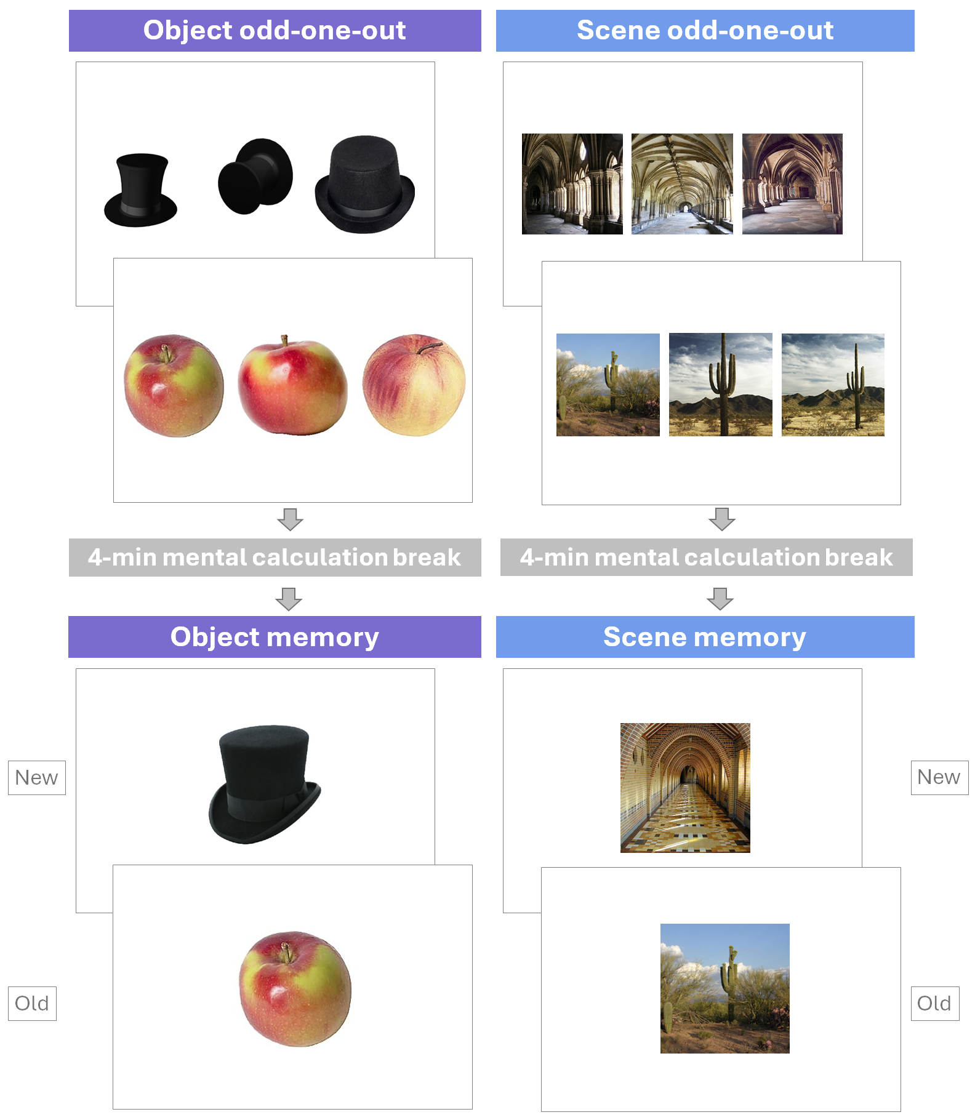

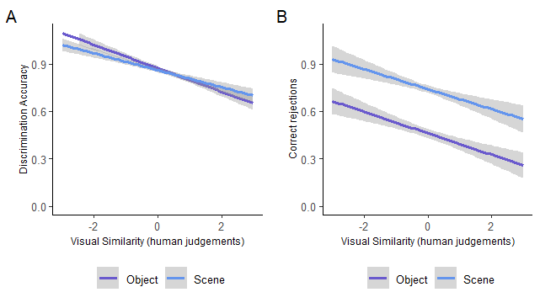




Transentorhinal cortex integrity predicts object fine-grained perceptual and mnemonic discrimination
Emma Delhaye^{a,b}, Gabriel Besson^{c}, Mohamed Ali Bahri^{b}, & Christine Bastin^{b}
ª CICPSI, Faculty of Psychology, University of Lisbon, Portugal; ^{b} GIGA-CRC Human Imaging, University of Liège, Belgium; ^{c} CINEICC, University of Coimbra, Portugal
Emma.Delhaye@psicologia.ulisboa.pt
Introduction
Results
Discussion
The transentorhinal cortex (tErC) is one of the first regions affected by Alzheimer’s disease, often showing changes before clinical symptoms appear.
Its role in cognition is not clear yet.
This study tested the hypothesis that tErC supports fine-grained representations of unique individual objects, sensitively to the granularity of the demanded discrimination, influencing both perceptual and mnemonic functions, so that its alteration should be associated with an alteration of fine-grained entity representations.
Results of the automated and manual segmentations of the MTL subregions
The structural integrity of the pmErC is specifically related to the sensitivity to visual similarity for scenes, but not for objects
The structural integrity of the tErC is specifically related to the sensitivity to visual similarity for objects, but not for scenes.
This relationship depends on how visual similarity is measured
  in perceptual discrimination : only using CNN visual similarity measures
  in mnemonic discrimination : only using subjective similarity ratings
  different measures of similarity (objective or subjective ratings) are representative of the demands on the discriminative processes engaged in the tErC depending on the nature of the task, mnemonic or perceptual
Discrimination sensitivity to object visual similarity may serve as a specific marker of tErC structural integrity
Impact of visual distance on perceptual and mnemonic discrimination
Visual distance computed using Alexnet’s fc7
Methods
Odd-one-out
Memory
Participants : 51 nominally healthy older adults
Materials and procedure: 4 behavioural tasks
Participants demographics
 | Mean (SD)
Male/Female | 20/31
Age | 69.49 (3.65) [65-83]
Education | 14.59 (3.44) [6-24]
MoCA (/30) | 27.75 (1.83) [22-30]
ECoG | 56.42 (11.40) [39-86]
3T Siemens Prisma scanner
high-resolution T2-weighted structural MRI covering the median temporal lobe (MTL) perpendicular to the long axis of the hippocampus.
MTL automatic segmentation using the ASHS toolbox (Yushkevich et al., 2015)
Manual segmentation of the entorhinal cortex into its antero-lateral and postero-medial parts
bilateral TErC (F(2,47) = 6.31 ; p < .01 ; R² = .21)
left pmErC (F(1,49) = 4.35 ; p = .042 ; R² = .08)
n.a
left pmErC (F(1,48) = 8.73 ; p < .01 ; R² = .15)
Visual similarity computed using human ratings
All trials characterized in terms of visual similarity using:
Alexnet
Human subjective ratings
Odd-one-out
Memory
« Which one is different from the other two? »
48 trials / condition
This work was funded by the FRS-FNRS, the SAO/Fondation Recherche Alzheimer, the Léon Frédéricq Foundation, and by the Portuguese national funding agency, FCT – Fundação para a Ciência e a Tecnologia, I.P, through the Research Center for Psychological Science of the Faculty of Psychology, University of Lisbon (UID/04527: Centro de Investigação em Ciência Psicológica).
« Did you see this item previously? »
96 trials / condition
48 old & 48 new
n.a.
right TErC & BA36 (F(2,44) = 4.91 ; p = .012 ; R² = .18)
n.a.

